Slide 1
SPS-BGI Mechanical Design Discussion ML-MME 3
INDEX
Cooling Sealing O-ring
Cooling Coupling
Feedthrough Design
RF Contacts
Parallelism Tolerances
HV Requirements
Vacuum x ML Discussion
Requests

Slide 2
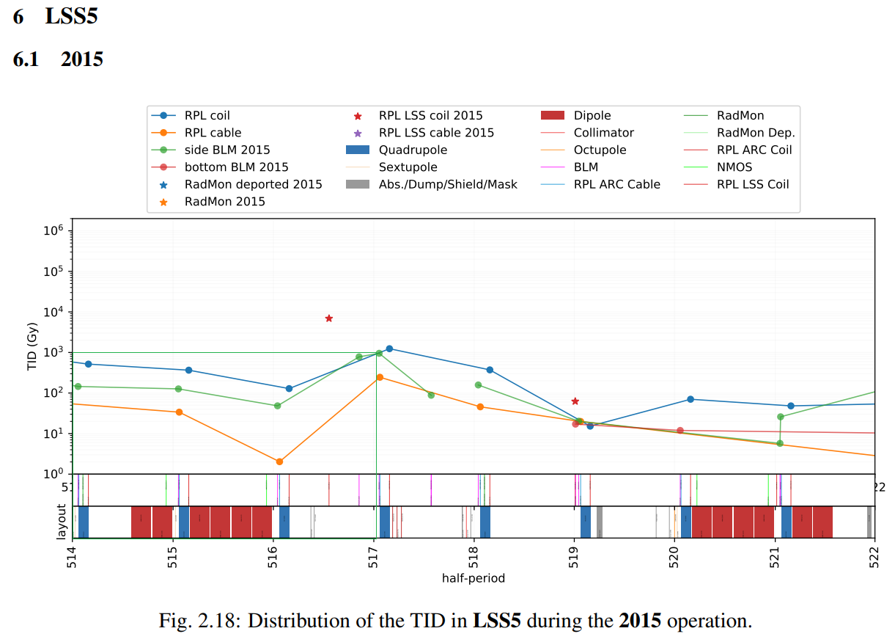
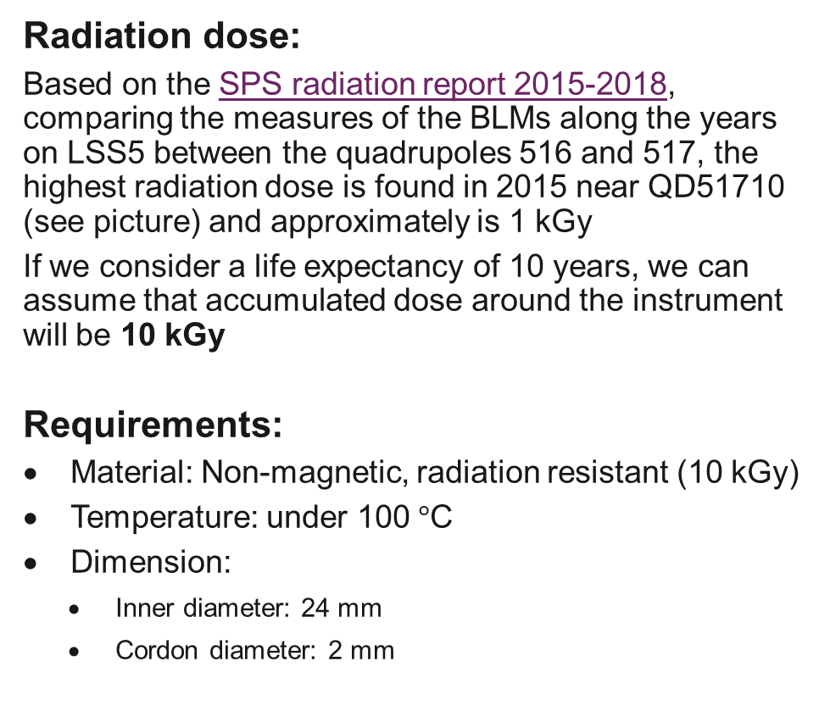
Cooling Sealing O-ring
Radiation dose:
Based on the SPS radiation report 2015-2018, comparing the measures of the BLMs along the years on LSS5 between the quadrupoles 516 and 517, the highest radiation dose is found in 2015 near QD51710 (see picture) and approximately is 1 kGy
If we consider a life expectancy of 10 years, we can assume that accumulated dose around the instrument will be 10 kGy
Requirements:
Material: Non-magnetic, radiation resistant (10 kGy)
Temperature: under 100 $°$C
Dimension:
Inner diameter: 24 mm
Cordon diameter: 2 mm
Source: SPS radiation report 2015-2018

Slide 3
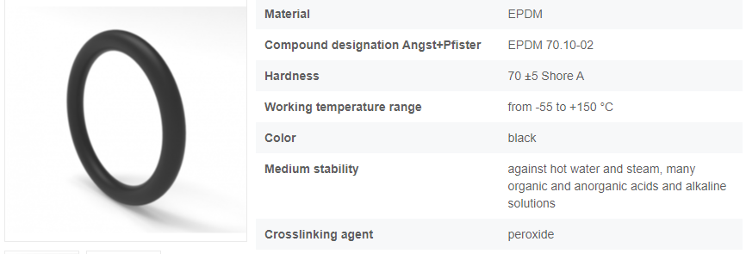
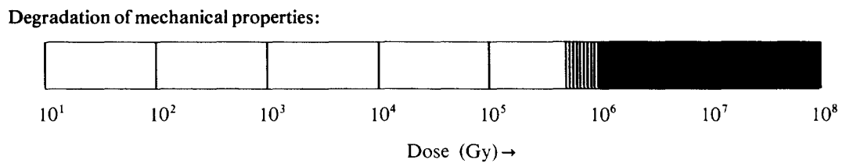
Cooling Sealing O-ring
Contact:
Angst+Pfister, Switzerland: https://www.apsoparts.com/en-CH/11400601-hitecr-o-ring-epdm-70-10-02.html
Source: COMPILATION OF RADIATION DAMAGE TEST DATA – Part III: Materials used around high-energy accelerators

Slide 4
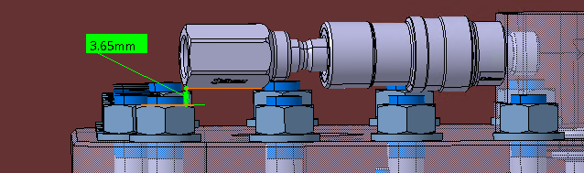
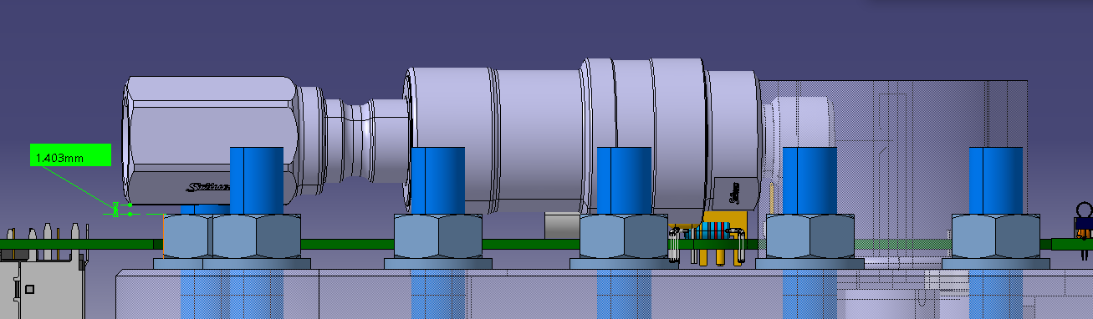


Cooling Coupling MCB Staubli
ST number: ST1639839 / ST1639836
Bore diameter: 3 mm / 5 mm
Maximum pressure: 100 bar / 70 bar
Temperature range: - 20 ºC to + 150 ºC
Materials: SS + EPDM (seal)
Parts:
BSP male thread socket: MCB03.1150/IC / MCB05.1151/IC
BSP female thread plug: MCB03.7100/IC / MCB05.7101/IC
MCB03: $d_{min}=3.650 mm$
MCB05: $d_{min}=1.403 mm$

Slide 5
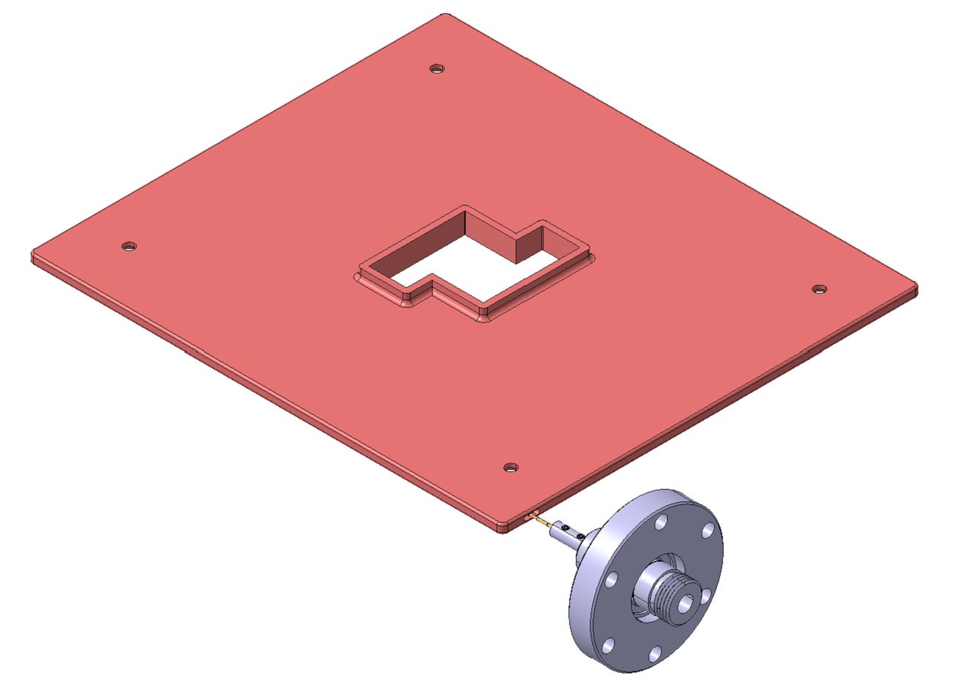
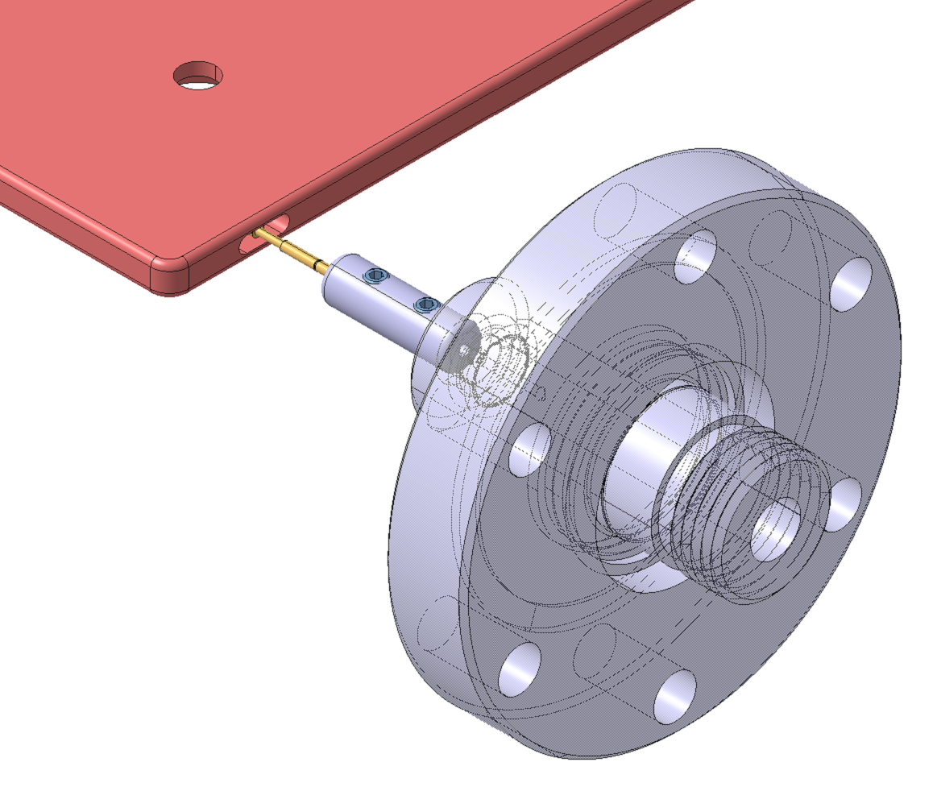
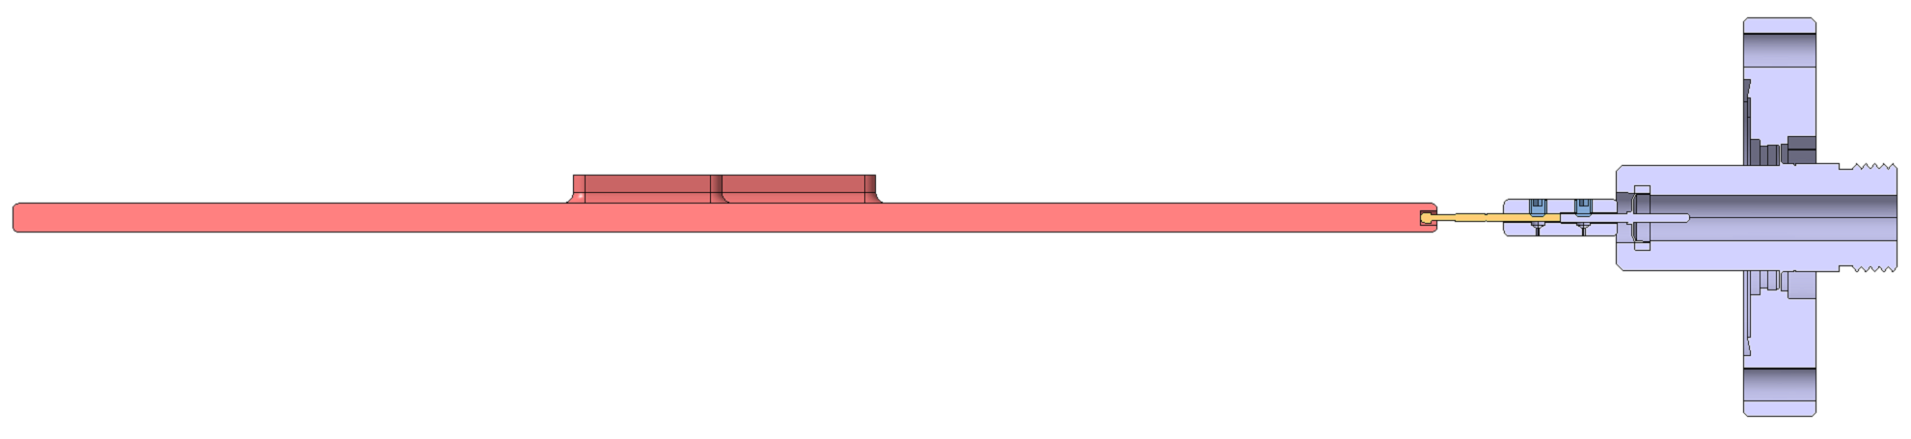
Feedthrough Design
Top electrode
ST number: ST1641972
Considerations:
The top electrode has been modified and a elliptical pocket has been created
The spring probe was incorporated in the model as a stp file directly provided by the manufacturer (https://www.harwin.com/products/P25-4023/). Three head variants have been ordered (spherical radius, serrated and star) and will be electrically tested. A vacuum acceptance test is ongoing
The connector spring probe - feedthrough pin has been designed by ML and will be produced at CERN. Therefore, a drawing needs to be produced
Spring probe
Connector
Feedthrough pin

Slide 6
Feedthrough Design
Top electrode
Is the pocket in the top electrode necessary? Wouldn’t it be enough if the spring probe touches the top electrode from the outside? The pocket is created to guide the spring probe and ensure a good electrical contact in a defined volume
At the moment there is only a point contact between the spring probe and the top electrode, is that good for the electrical contact and the high voltage? Yes, because even if we have a big voltage, the current is on the order of microamps.
The distance between the connector and the feedthrough is 1.3mm at the moment, is it ok? On one side, the triple junction where the sparks are created appears when we have in contact a conductor surface, an insulator surface and vacuum. In this case, Alumel (feedthrough’s pin material) and SS/ Cu are conductors, so no risk is foreseen. On the other side, the potential difference is zero in the assembly, so no gap is needed
Spring probe
Connector
Feedthrough pin

Slide 7
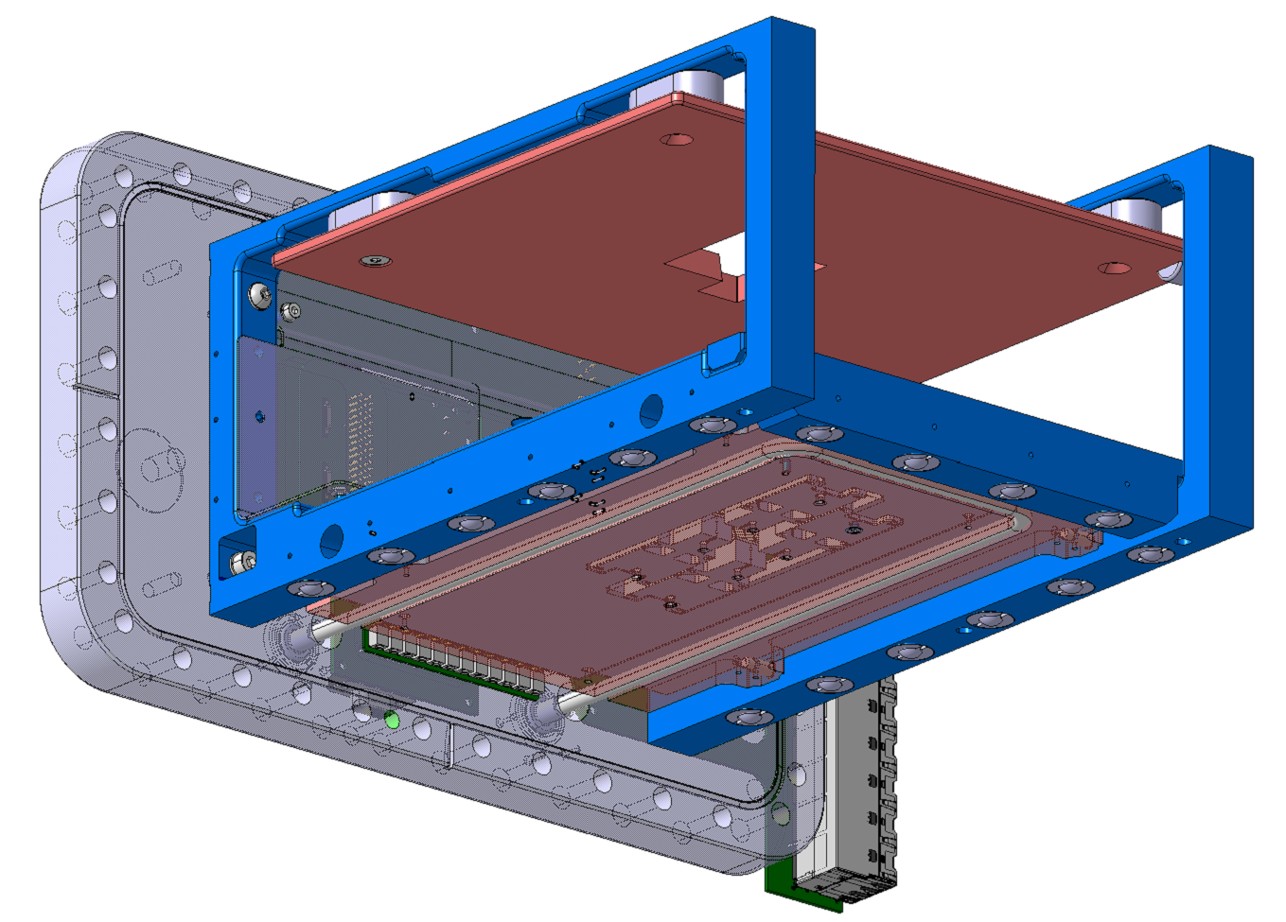
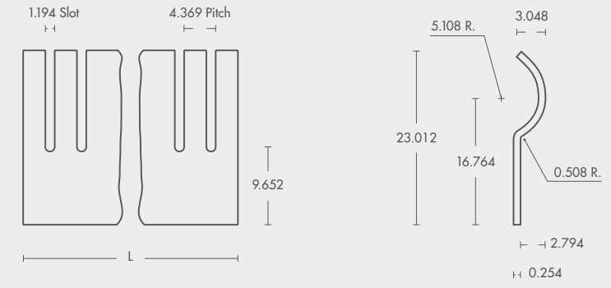
RF Contact Fingerstock – Requirements / Contact
Requirements:
Material: Non-magnetic and radiation resistant (10 kGy)
2 mm < Height < 4 mm
Contact:
EURO Technologies, Italy: https://www.euro-technologies.eu/en/product/fingerstock-contact-strips/
Cu-Be
Fingerstock

Slide 8
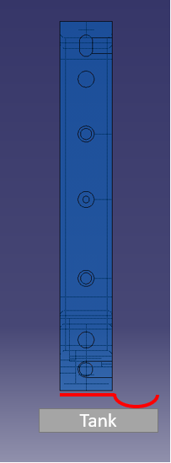
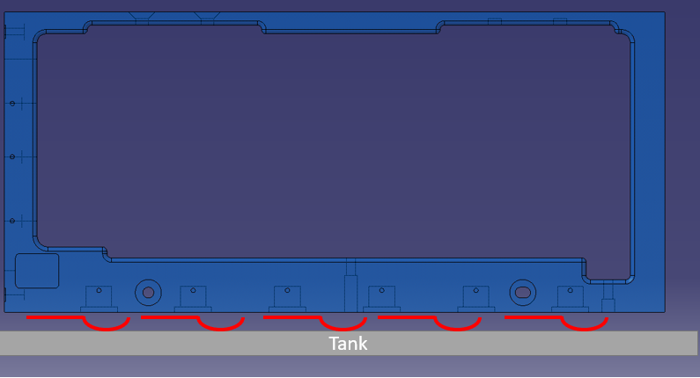
RF Contact Fingerstock – Positioning
Positioning 1 | Positioning 2
Easier to install (only hole drilling and screwing is needed) | Easier to assemble (smoothly sliding)
Slot: 1.194 mm | Slot: 11.656 mm

Slide 9
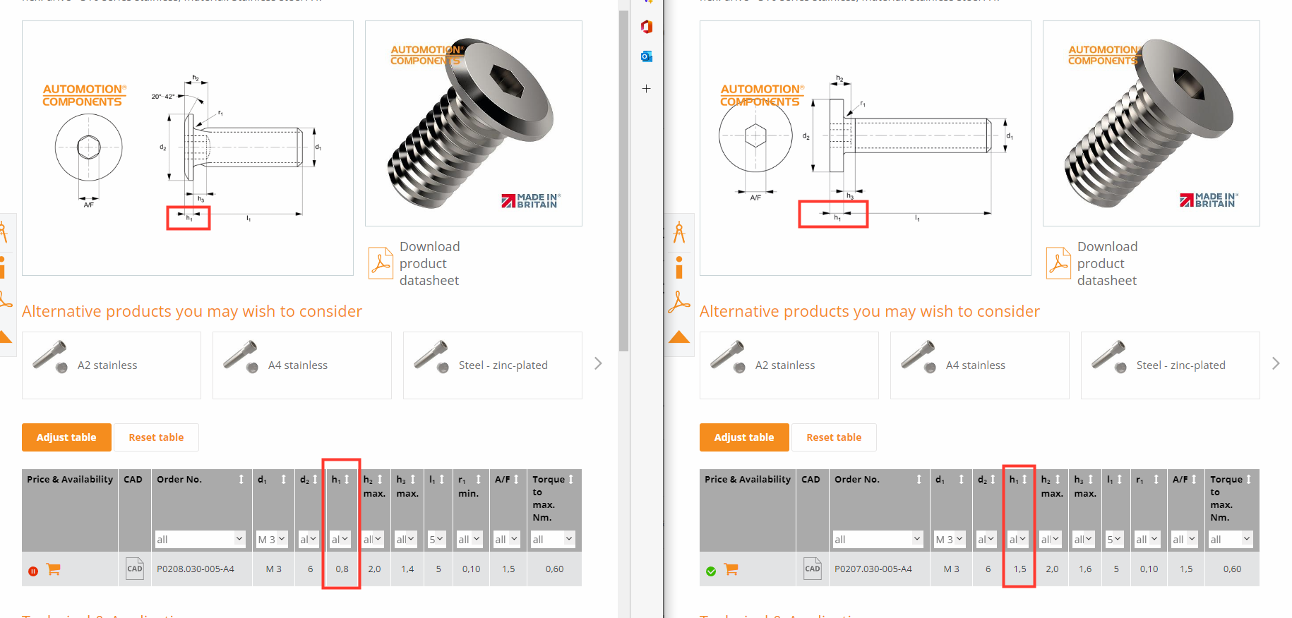
RF Contact Fingerstock – Fixation Low Head Cap Screws
Option 1 - P0207.A4 | Option 2 – P0208.A4
h = 0.8 mm | h = 1.5 mm

Slide 10
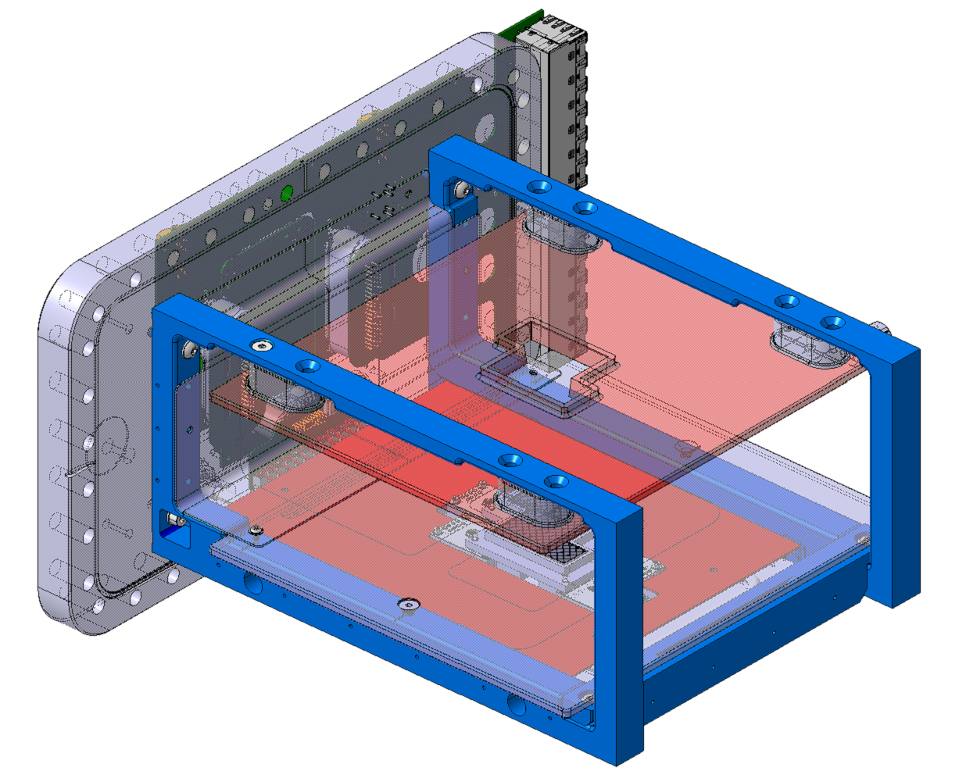
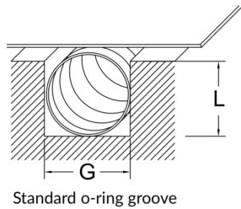
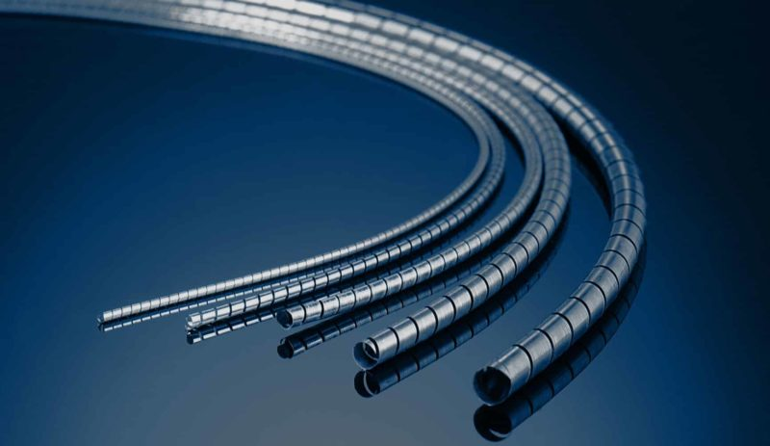
RF Contact Spira Shield
Spira shield Groove: bottom electrode
Spira shield Groove: support arms
Requirements:
Material: Non-magnetic and radiation resistant (10 kGy)
Groove Dimension: L <= 2 mm and G <= 4 mm
Contacts:
SPIRA, California (USA): https://www.spira-emi.com/product/spira-shield/
E-SONG EMC, Seoul (Korea): https://esongemc.com/eng/page/product/m04/Spiral_Spring_Gasket.php
M3
Is it possible to re-use the holes for the disassembly?
Spira shield Groove: bottom electrode
M5

Slide 11
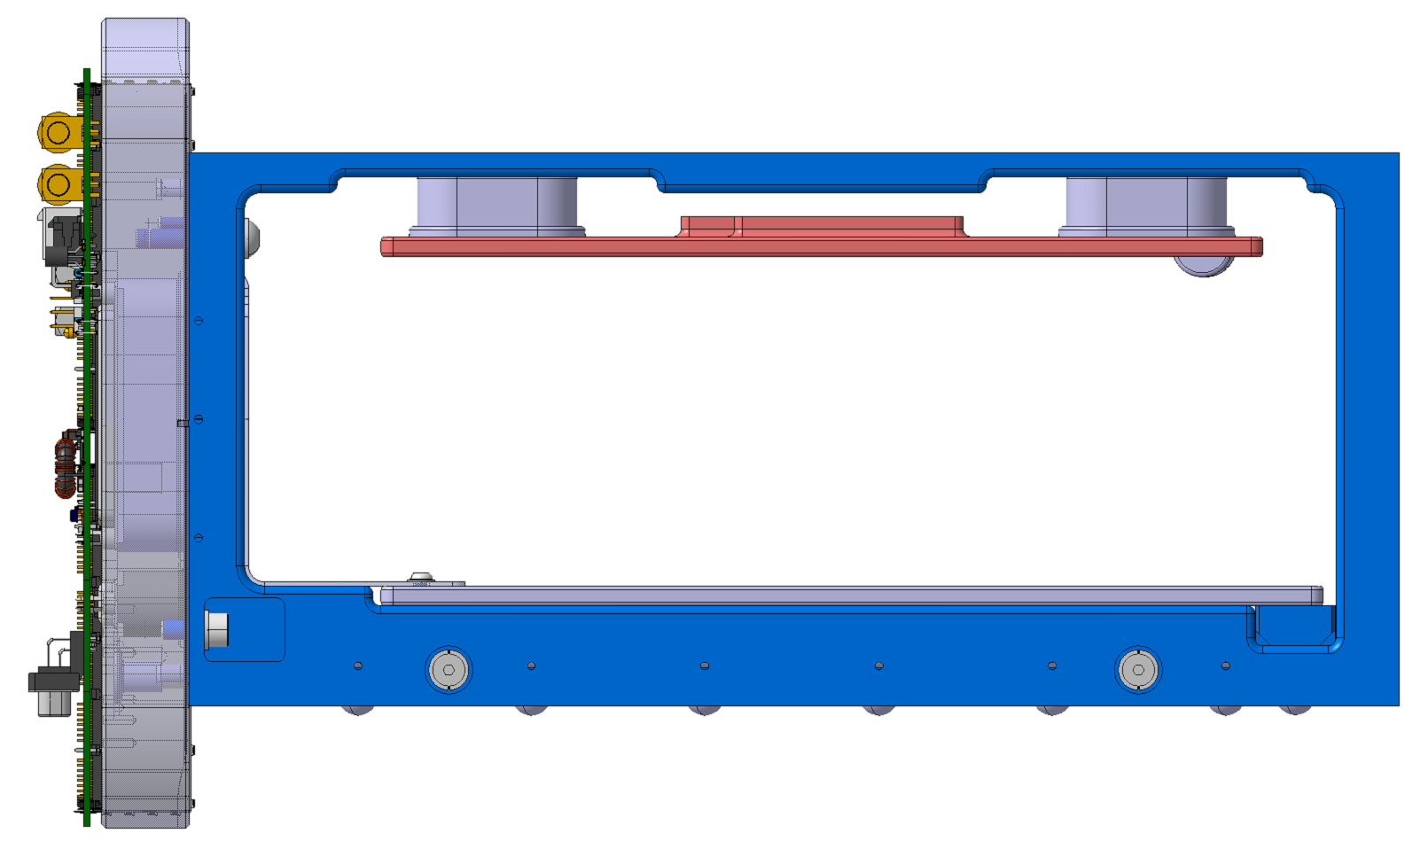
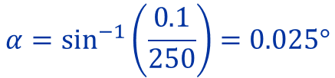
Parallelism Tolerances
250 mm
0.1 mm
$$α=\sin^{−1}\left(\frac{0.1}{250}\right)=0.025°$$

Slide 12
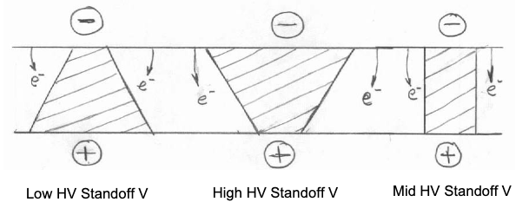
HV Requirements ”Rules of Thumb” from the NASA HV workshop
HV (-30 kV)
Conductor surface
Insulator surface
p.d.
General
GND
Conductor surface
Minimise surface irregularities → polished 316L SS
Radius corners and edges generously
Min. vacuum gap = 3 kV/mm → 10 mm
Min. distance within insulator material = 4 kV/mm → 7.5 mm
Radius corners and edges that are close to the conductor surfaces at HV
Material with high dielectric strength, low (relative) permittivity and good thermal conductivity: Al2O3, MACOR, AlN
Middle shape would give a better Standoff Voltage
Min. distance along insulator surface = 1 kV/mm → 30 mm

Slide 13
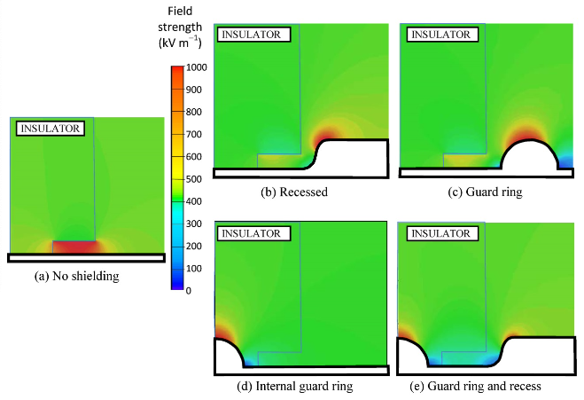
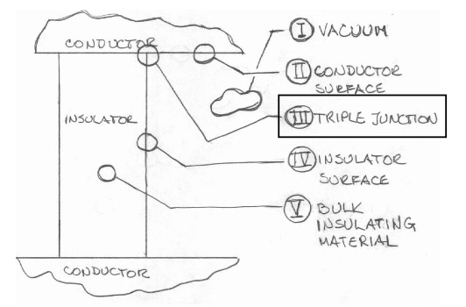
HV Requirements Triple Junctions
Definition: where a conductor, insulator and vacuum come together
Ignition points for discharges are essential to control!
Mitigations shown in the attached picture, which all work by reducing the electric field at the triple point junction

Slide 14
Vacuum x ML Discussion
Friday 25th of November Conclusions:
A sector valve to do fast interventions is not needed, since the sector is destined to beam instrumentation
UHV CF are preferred
For the gas injection, the instrument should be moved upstream
A meeting is foreseen to discuss about the injection constraints and equipment

Slide 15
Requests
Special roughness for the pocket created to install the 90º adaptor
Support arms thickness of 19 mm
Rounded radii of the ion trap
Rounded cap screws near HV parts
Change the aperture from 82 mm to 84 mm
Update the 3D model

