Slide 1
SPS-BGI mechanical design
INDEX
Detector assembly
Bottom electrode
Ceramic cover
Cooling block
Rectangular flange
Expected feedback

Slide 2
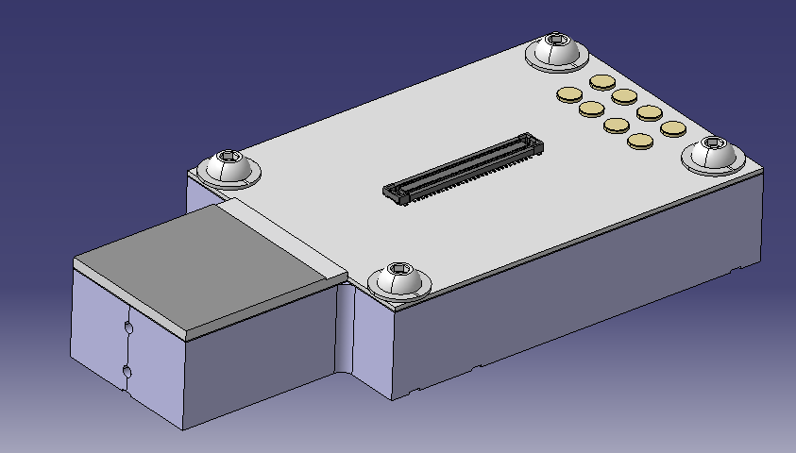
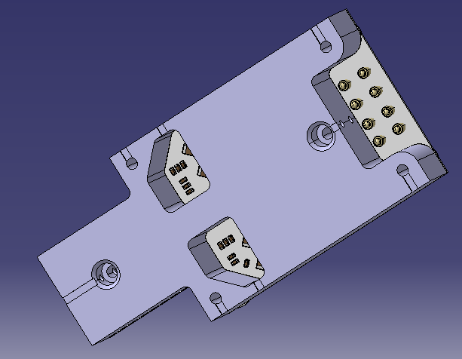
Parts and assembly Assembly detector
3D Model | Functionality | Material
ST1570691 | Integrates the TPX3, and power and data electronics | Module base: Alu EN AW-6082 (T6)

Slide 3
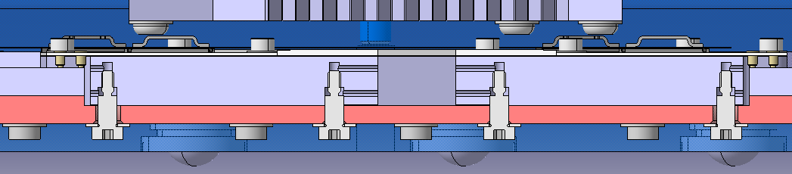
Parts and assembly Assembly detector
3D Model | Functionality | Material
ST1570691 | Integrates the TPX3, and power and data electronics | Module base: Alu EN AW-6082 (T6)

Slide 4
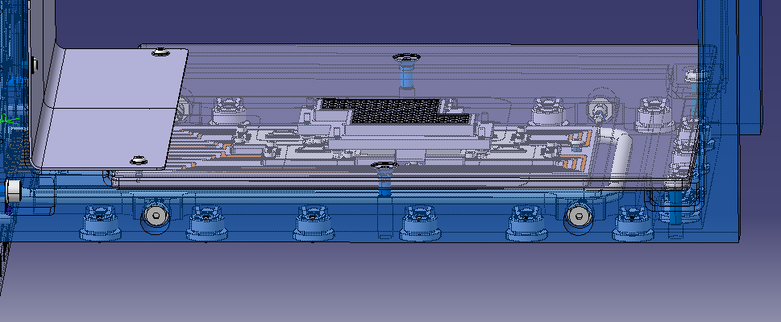
Parts and assembly Bottom electrode
3D Model | Functionality | Material
ST1571600 | Connected to GND, is in charge of creating the electric field. Its opening also allows electrons detection | St. Steel EN 1.4429 EDMS 790774 Sheet

Slide 5
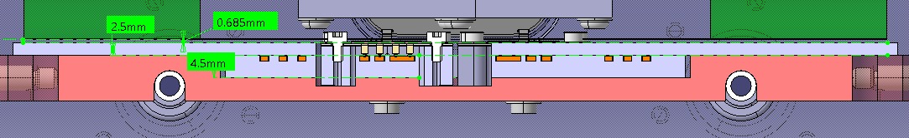
Parts and assembly Ceramic cover
3D Model | Functionality | Material
ST1584545 | Power cabling electrical insulation | Ceramic Al2O3 96%
Ceramic cover made thicker 1mm -> 2.5mm
Tolerance chain between Cooling block, ceramic cover and Ceramic guide

Slide 6
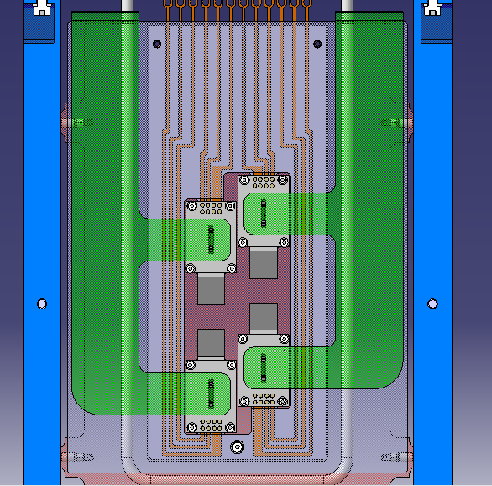
Parts and assembly Ceramic cover
3D Model | Functionality | Material
ST1584545 | Power cabling electrical insulation | Ceramic Al2O3 96%
Number of screws reduced to 3

Slide 7
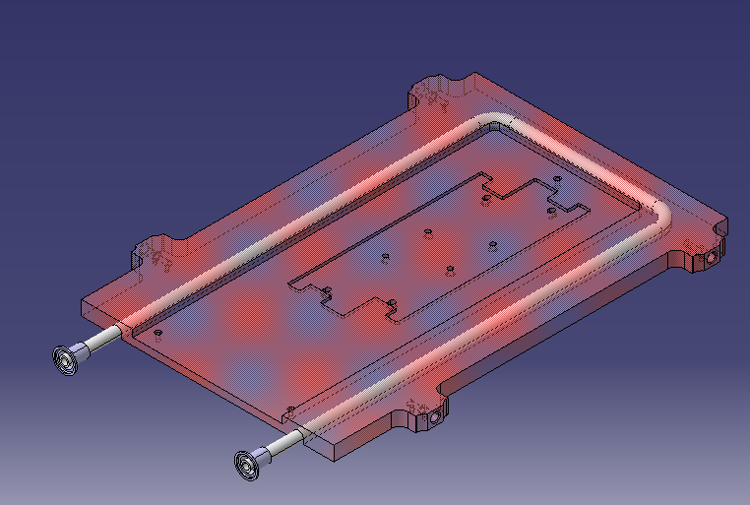
Parts and assembly Cooling base plate
3D Model | Functionality | Material
ST1571284 | Positioning of the cooling pipe, the detector modules and the ceramic guide | Cu OFE C10100 (HO2)
Assembly process?
If the plate is machined first and then the pipe welded, will if affect the plate reference surfaces?
Or first weld the pipe and Intermediate parts and then make a final machining?

Slide 8
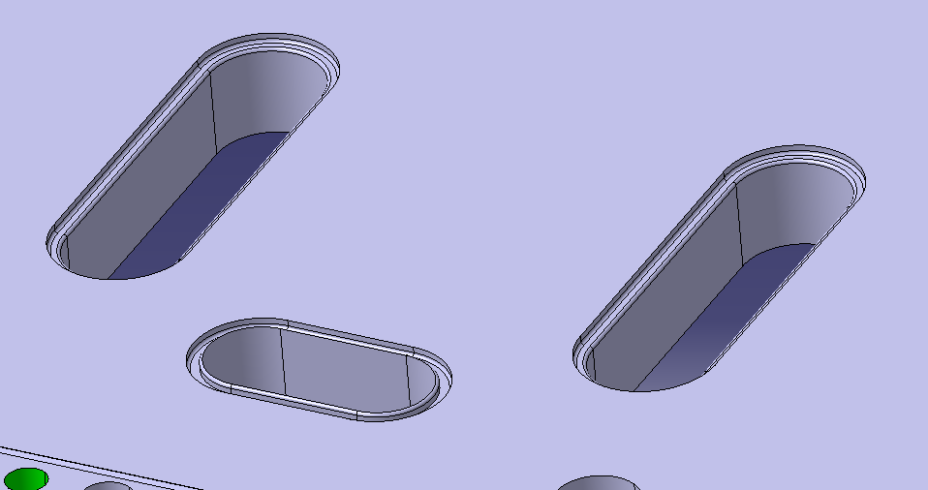
Parts and assembly Rectangular flange assembly
3D Model | Functionality | Material
ST1588145 | Insures vacuum and contains cooling, power and data connectors | St. Steel EN 1.4429 EDMS 790775 Blank and EDMS 790773 Round Bar
Welding faces?
When will the handles and electronic boards be installed?
Blind model with drw done

Slide 9
Feedback expected
Square nest
Feedthrough and Top electrode
RF contacts

