Slide 1
SPS-BGI Mechanical Design Discussion ML-MME 3_answers
INDEX
Feedthrough Design
RF Contacts
Parallelism Tolerances
Requests

Slide 2
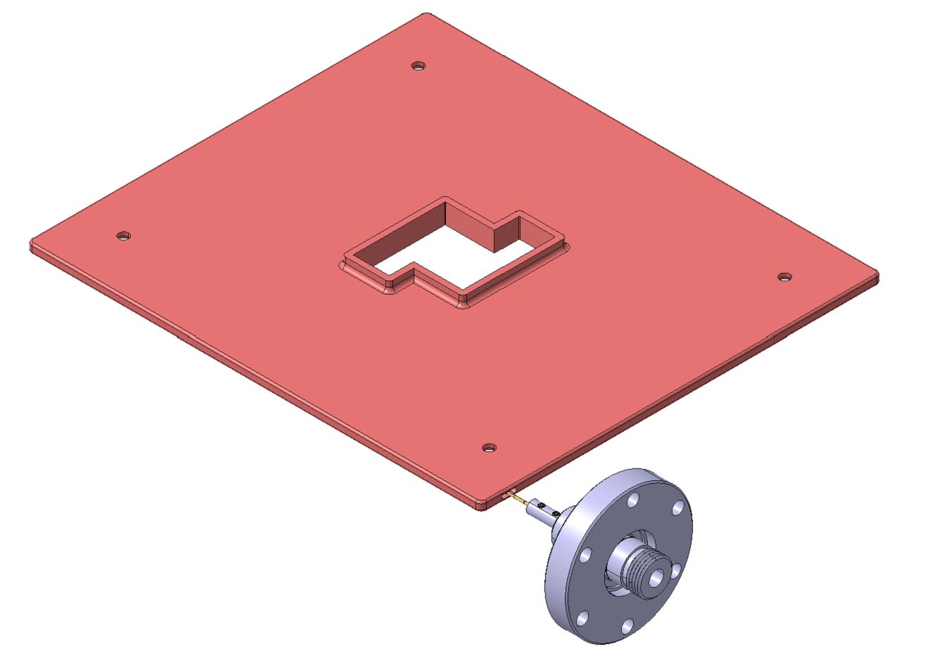
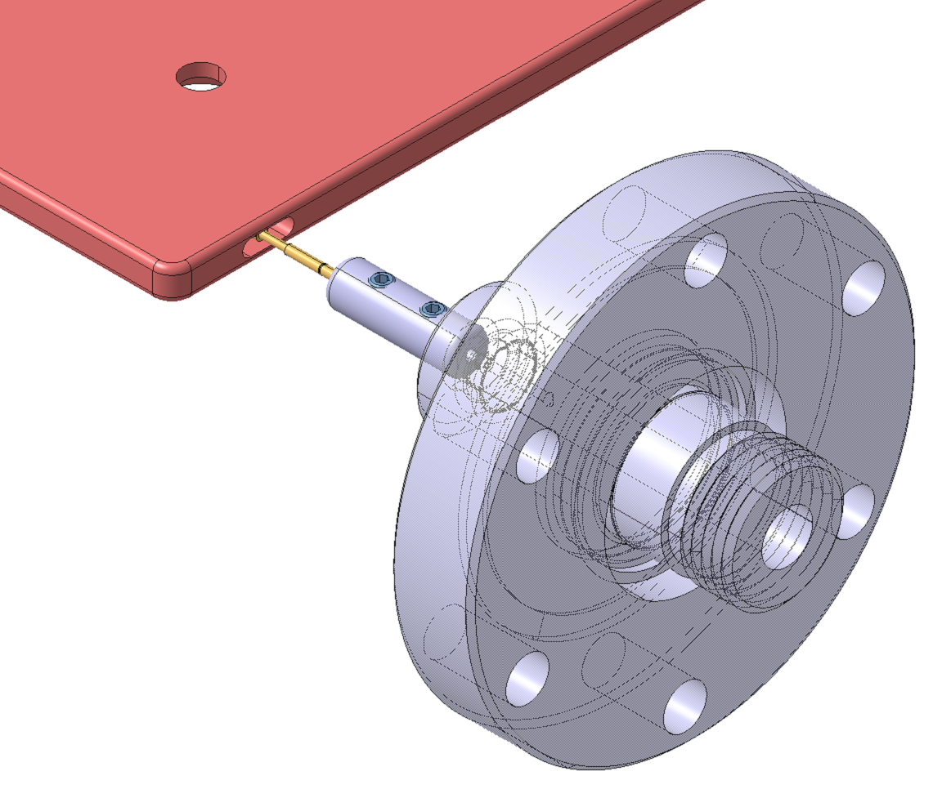
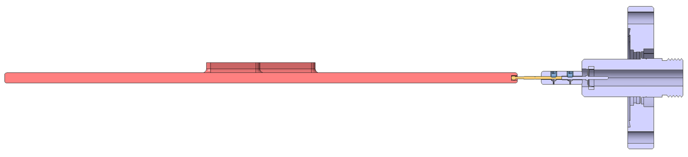
Feedthrough Design
Top electrode
ST number: ST1641972
Considerations:
The top electrode has been modified and a elliptical pocket has been created. To ensure a proper insertion of the spring probe a chamfer of 0.5 mm has been created
The spring probe was incorporated in the model as a stp file directly provided by the manufacturer (https://www.harwin.com/products/P25-4023/). Three head variants have been ordered (spherical radius, serrated and star) and will be electrically tested. A vacuum acceptance test is ongoing
The connector spring probe - feedthrough pin has been designed by ML and will be produced at CERN. Therefore, a drawing needs to be produced
Spring probe
Connector
Feedthrough pin

Slide 3
Feedthrough Design
Top electrode
Is the pocket in the top electrode necessary? Wouldn’t it be enough if the spring probe touches the top electrode from the outside? The pocket is created to guide the spring probe and ensure a good electrical contact in a defined volume
Will we need golden coating for the top electrode? No, it is not necessary
At the moment there is only a point contact between the spring probe and the top electrode, is that good for the electrical contact and the high voltage? Yes, because even if we have a big voltage, the current is on the order of microamps
The distance between the connector and the feedthrough is 1.3mm at the moment, is it ok? Yes, it is ok since the connector is at -30 kV and the feedthrough insulator has no potential
Spring probe
Connector
Feedthrough pin

Slide 4
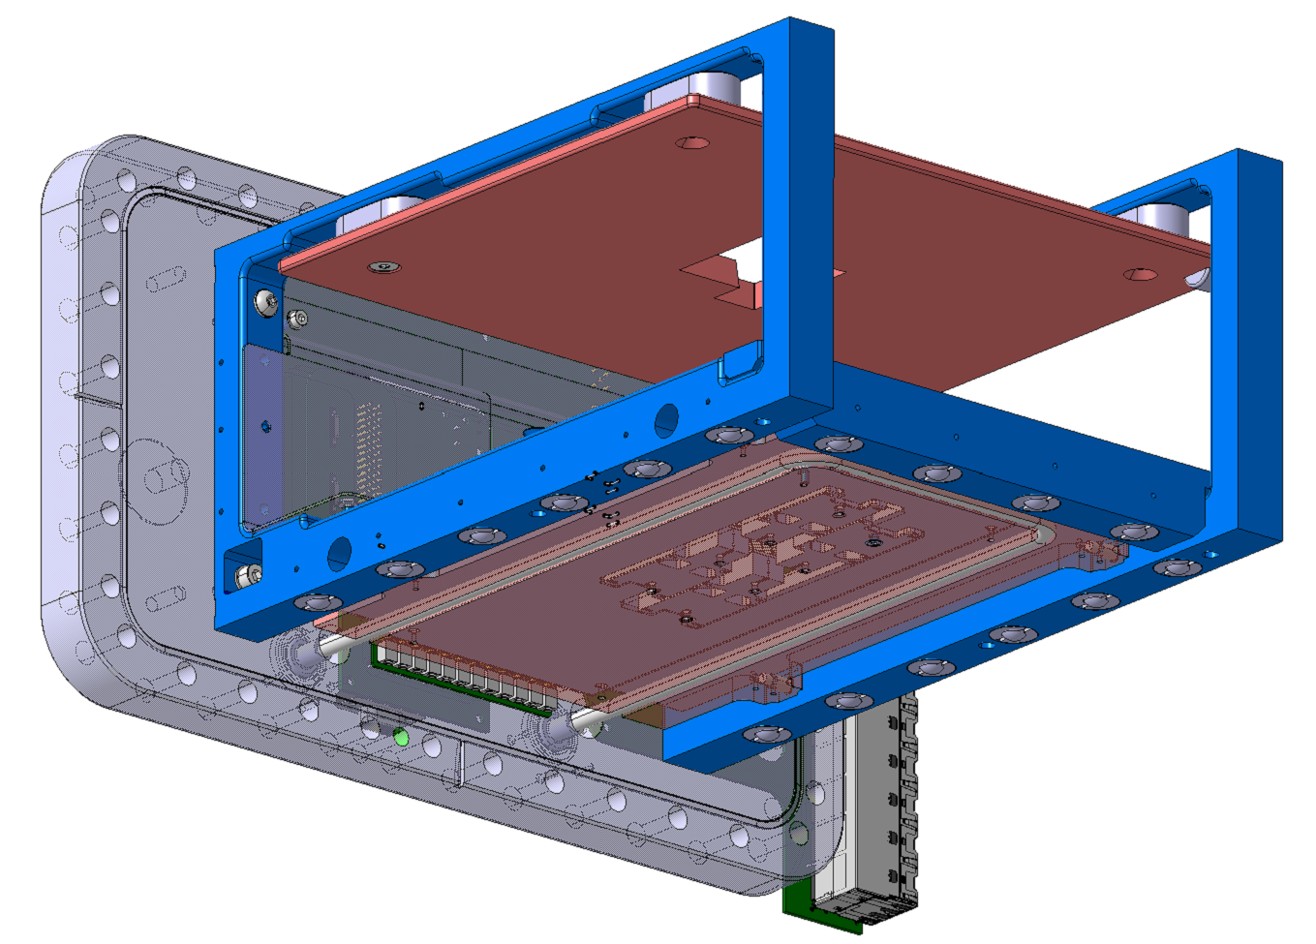
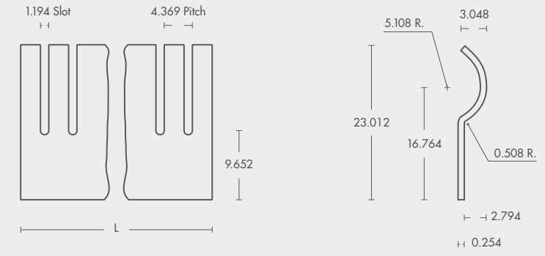
RF Contact Fingerstock – Requirements / Contact
Requirements:
Material: Non-magnetic and radiation resistant (10 kGy)
2 mm < Height < 4 mm
Contact:
EURO Technologies, Italy: https://www.euro-technologies.eu/en/product/fingerstock-contact-strips/
Cu-Be
Fingerstock

Slide 5
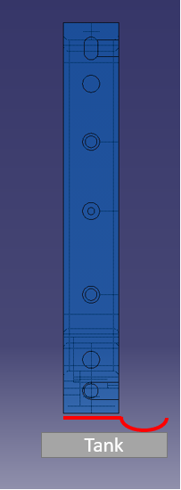
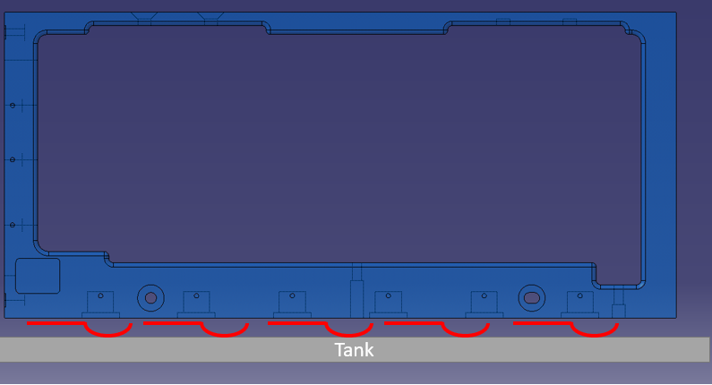
RF Contact Fingerstock – Positioning
Positioning 1 | Positioning 2
Easier to install (only hole drilling and screwing is needed) | Easier to assemble (smoothly sliding)
Slot: 1.194 mm | Slot: 11.656 mm
Two low head cap screws
Overlap of 1mm

Slide 6
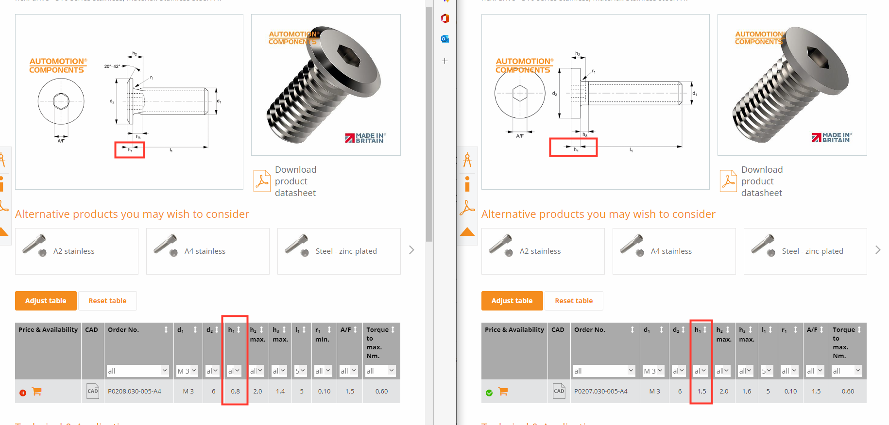
RF Contact Fingerstock – Fixation Low Head Cap Screws
Option 1 - P0207.A4 | Option 2 – P0208.A4
h = 0.8 mm | h = 1.5 mm

Slide 7
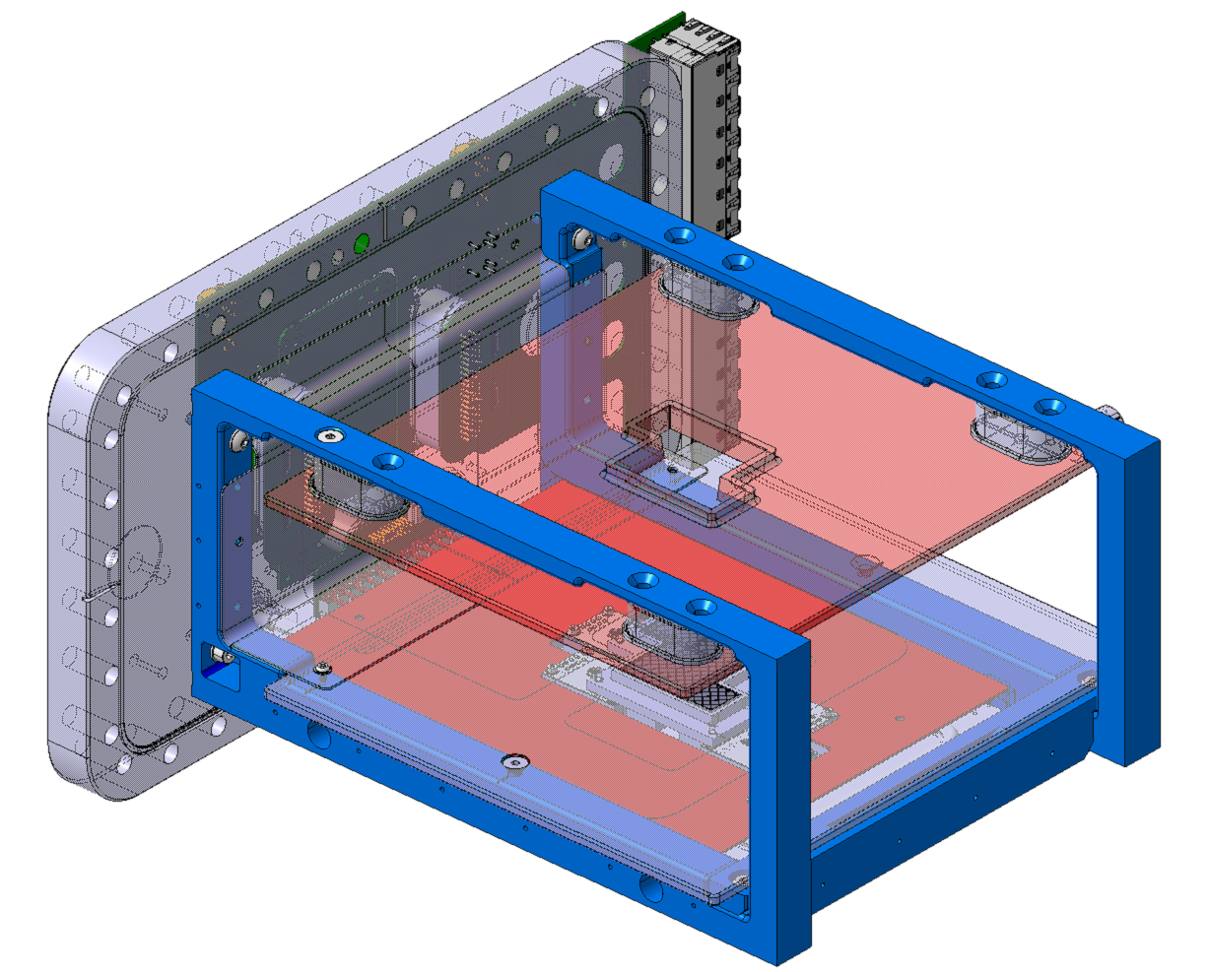
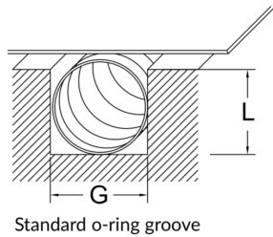
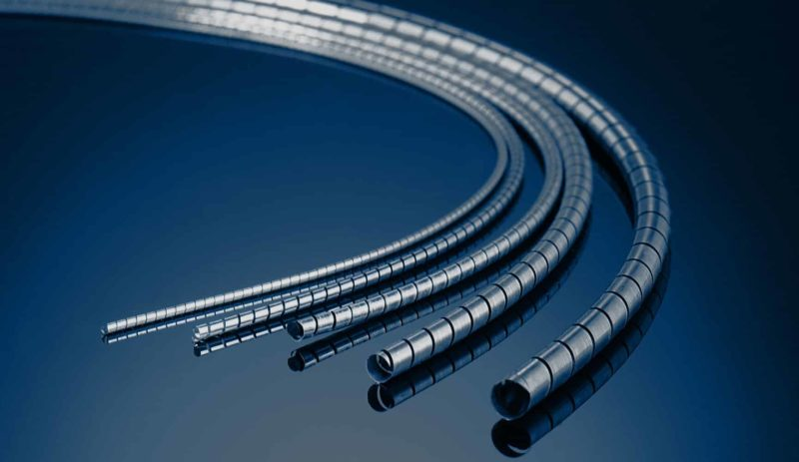
RF Contact Spira Shield
Spira shield Groove: bottom electrode
Spira shield Groove: flange
Spira shield Groove: support arms
Requirements:
Material: Non-magnetic and radiation resistant (10 kGy)
Groove Dimension: L <= 2 mm and G <= 4 mm
Contacts:
SPIRA, California (USA): https://www.spira-emi.com/product/spira-shield/
E-SONG EMC, Seoul (Korea): https://esongemc.com/eng/page/product/m04/Spiral_Spring_Gasket.php
M3
Is it possible to re-use the holes for the disassembly?
Spira shield Groove: bottom electrode
M5

Slide 8
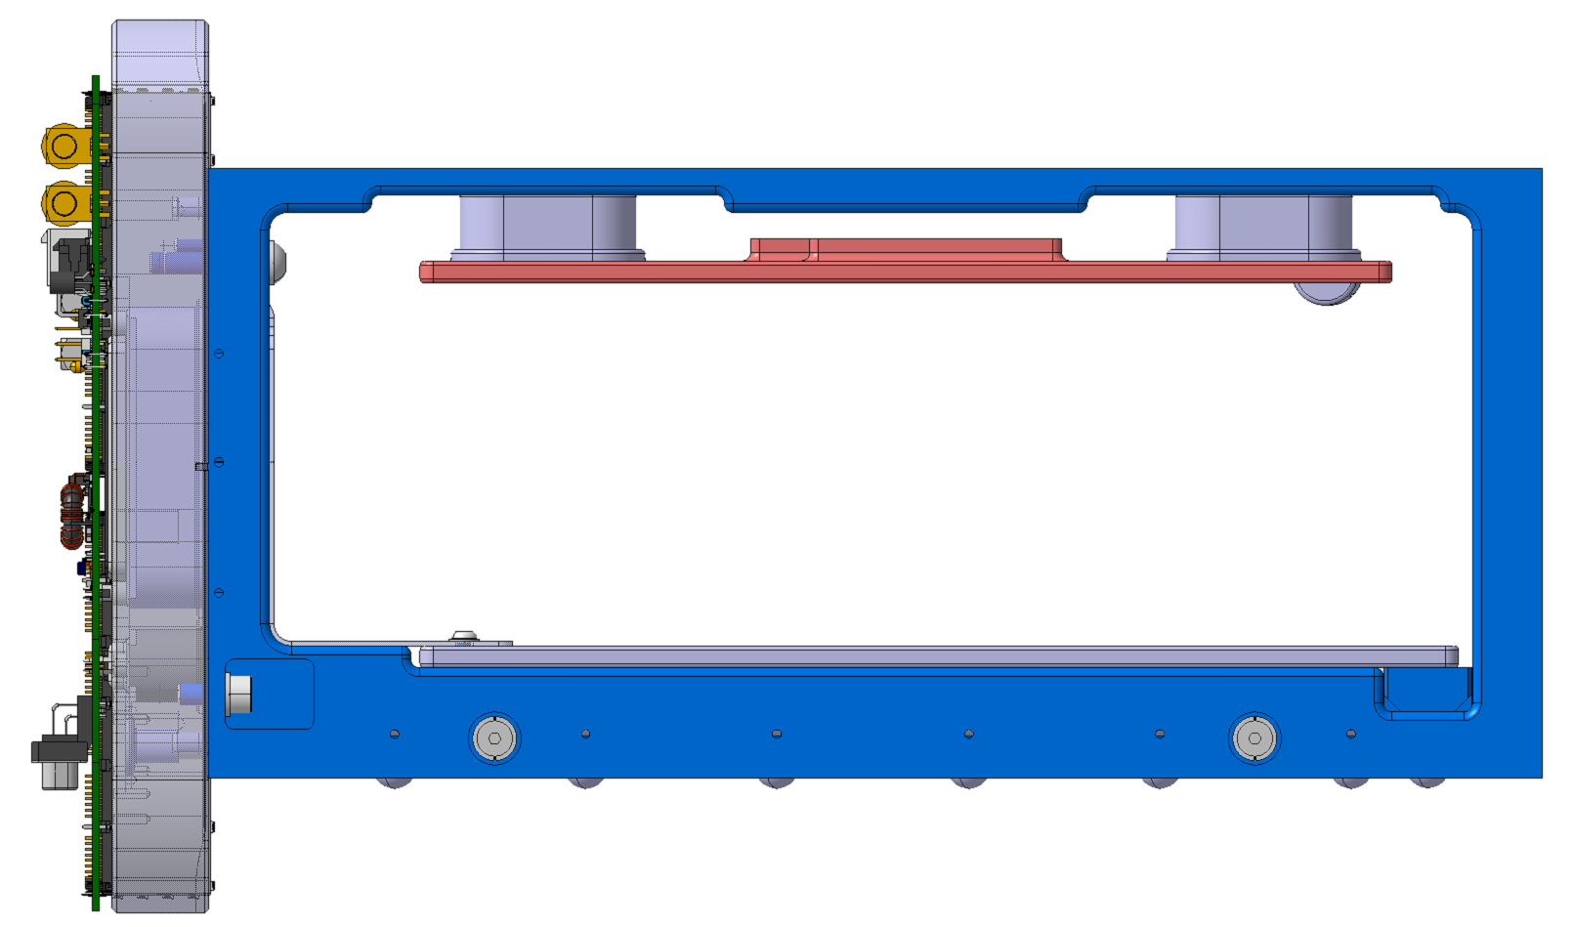

Parallelism Tolerances
250 mm
0.1 mm – 0.2 mm
Shims will be used for the final adjustment
25-30 ceramic insulators will be manufactured in case it’s needed some adjustment
$$α=\sin^{−1}\left(\frac{0.1}{250}\right)=0.025°−0.05°$$

Slide 9
Requests
Special roughness for the pocket created to install the 90º adaptor
Support arms thickness of 19 mm
Rounded radii of the ion trap
Rounded cap screws near HV parts
Change the aperture from 82 mm to 84 mm
Update the 3D model
Create the drawing for the power cabling

