Slide 1
Quick report on CHIMERA 2022 run
Kacper Bilko and Ruben Garcia Alia on behalf of the entire CHIMERA team!
Core test team during 5-day 2022 CHIMERA run: E. Johnson, K. Bilko, N. Emriskova, A. Waets, A. Coronetti
Many thanks to the PS/LIER/LINIAC3 operation, RP, CHARM and IRRAD teams for the support!
01/12/2022

Slide 2
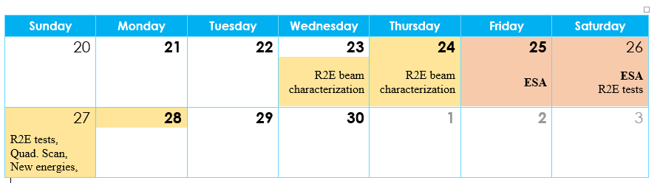
CHIMERA high-level objectives and schedule
To provide high-energy (>100 MeV/u) heavy-ion beams for radiation effects testing of electronics, for accelerator and space applications, and with the support of the European Space Agency (ESA) and European Commission,
More specifically, in the 2022 run:
  From an accelerator perspective: to provide variable energy and intensity, in a controlled manner,
  From a beam instrumentation/radiation monitor perspective: to accurately measure the beam energy/LET and flux at the Device Under Test (DUT) location,
2022 experimental schedule:
  Several parallel MDs since ion setup in PS, with the beam propagated until the F61 East Area dump
  Two dedicated Wednesday MDs with the beam propagated down to T8,
  5-day run from 23/28-11, including external users from ESA (2 days),
    23-24.11 – Beam Characterization by R2E,
    25-26.11 – External user tests (ESA),
    27-28.11 – R2E tests and MD activities (e.g. quad scan)

Slide 3
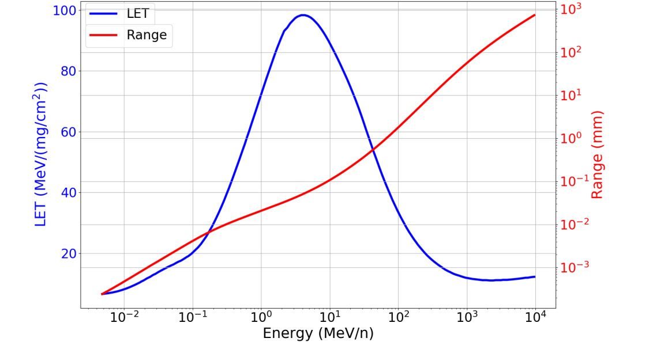
East Area ions for radiation effects testing
Key concept: by varying the lead beam energy, a reasonably broad LET range can be explored, with relatively large penetration capacity in matter (which is an important asset for modern microelectronics components and boards)
Desired heavy-ion beam properties:
Few energies to provide different beams with the LET variation,
Long spill, with the relatively uniform time profile (no peaks),
Large beam at the DUT (FWHM of few cm),

Slide 4
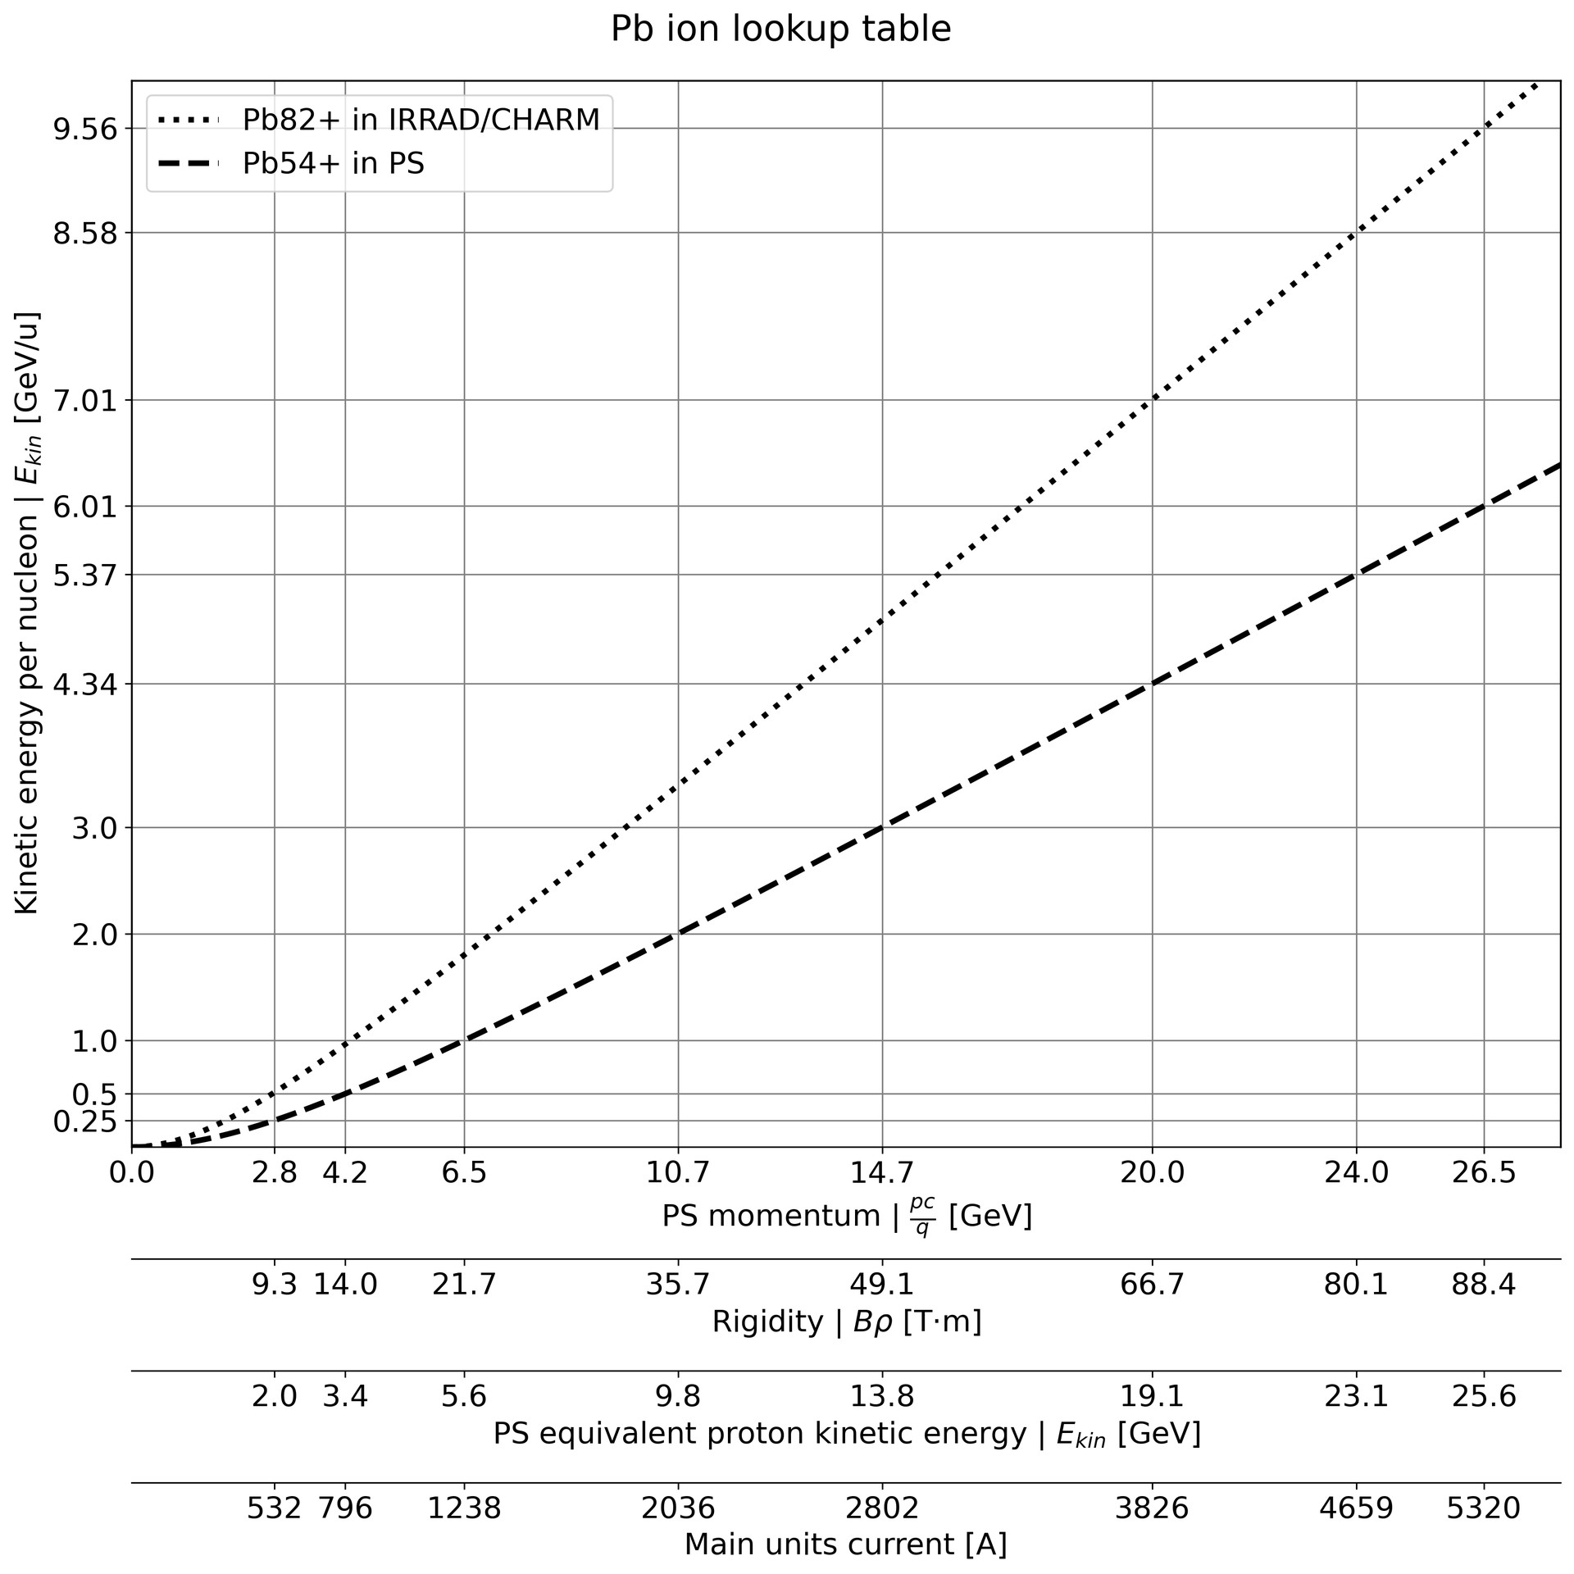
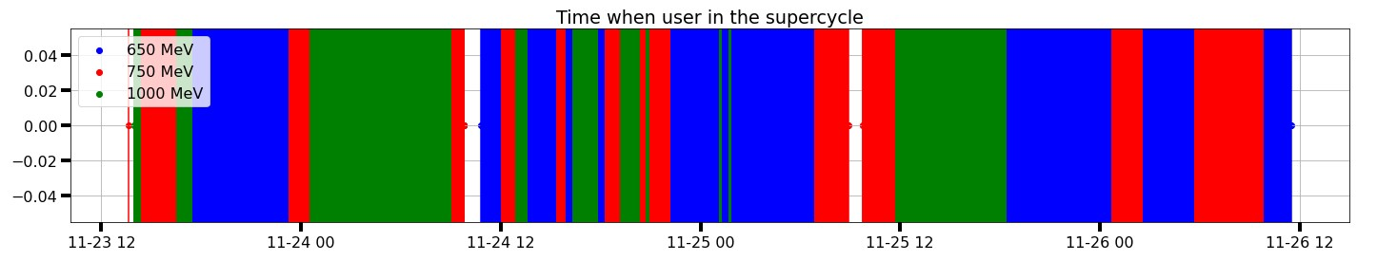
Heavy-ion beam: energy variation
Three PS energies selected for CHIMERA 2022 run, with the main objective of yielding a relatively large LET range (~13-25 MeVcm²/mg) at the device-under-test location
Significant energy degradation along the line, mainly due to the long (several 10s of meters) sections in air, as demonstrated via a dedicated FLUKA simulations,
Extracted PS energies: 1000MeV/u, 750MeV/u, 650MeV/u,

Slide 5
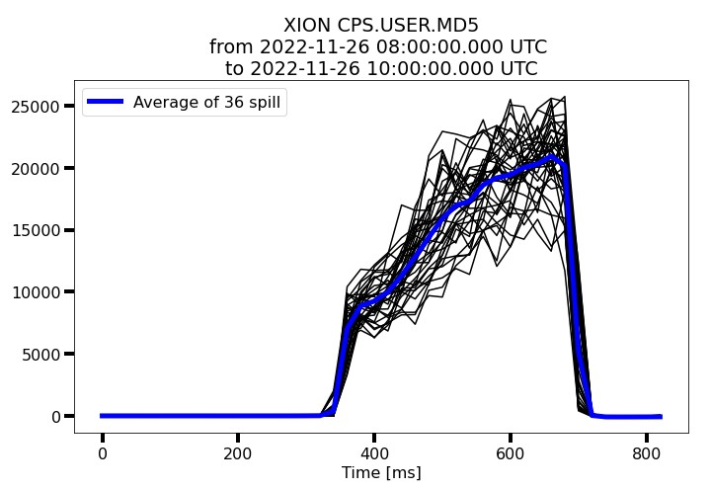
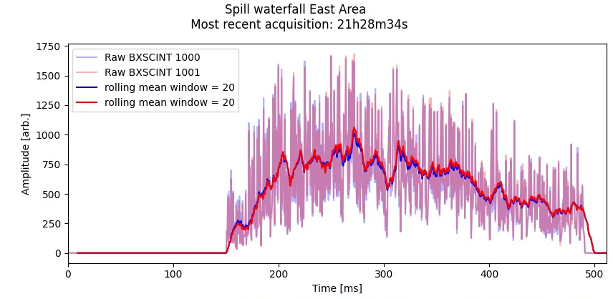
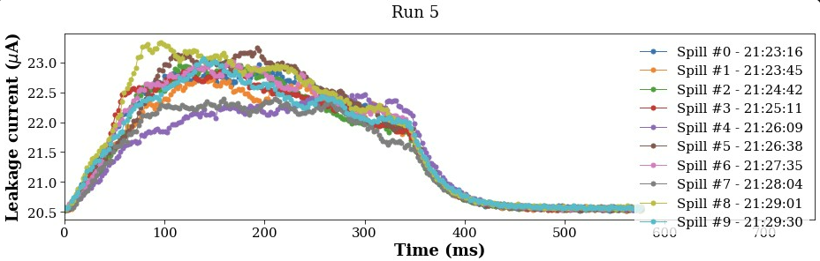
Heavy-ion beam: spill time profile
Measured with a variety of instruments
Overall, the spill time structure is long and uniform enough for radiation effects testing
130 kHz (7.7ms) structure observed, coming from the TFB plates (extraction pulsing every three turns because of tune of machine and resonant frequency of TFB)

Slide 6
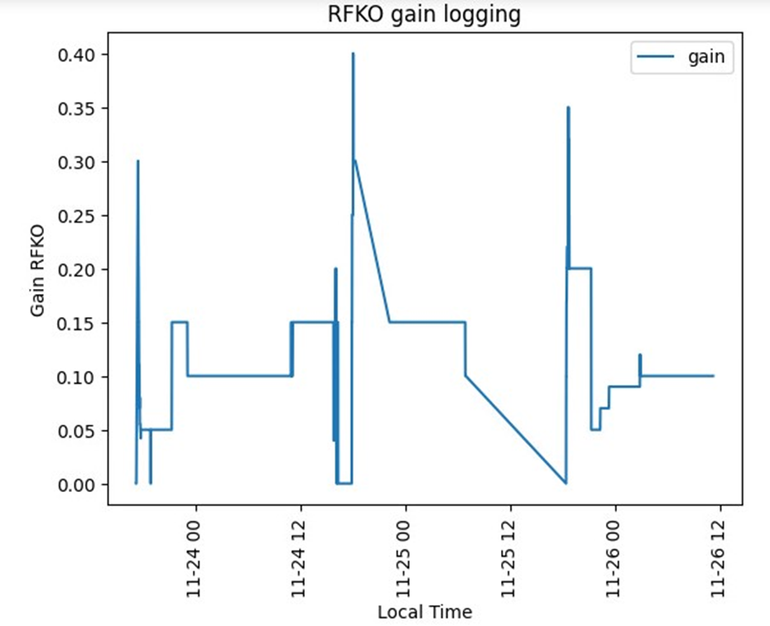
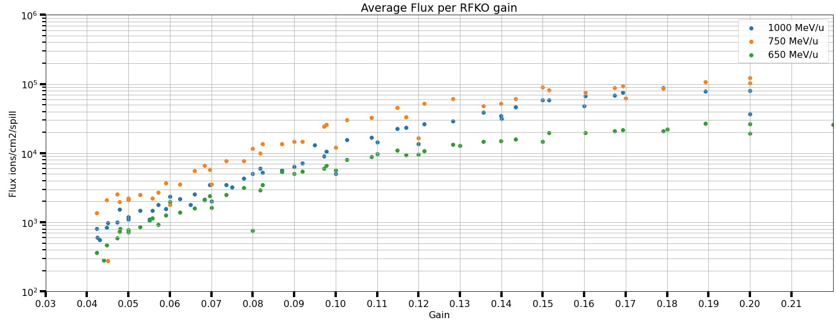
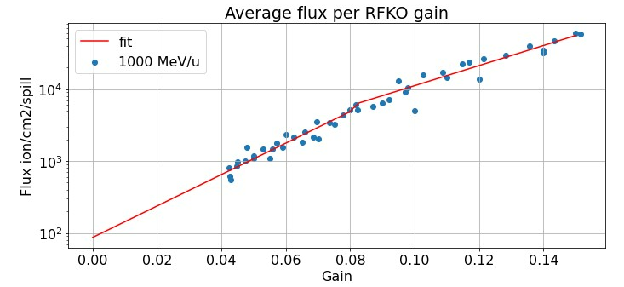
Heavy-ion beam: intensity control via the gain of RFKO
Radio Frequency Knockout (RFKO),
Well behaved and reproducible relationship between gain and intensity/flux
Through this technique, the beam flux could be easily selected within a range of almost two orders of magnitude,

Slide 7
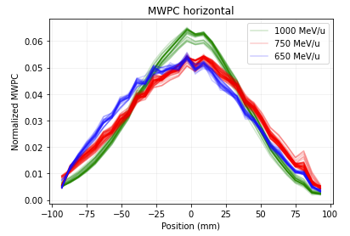
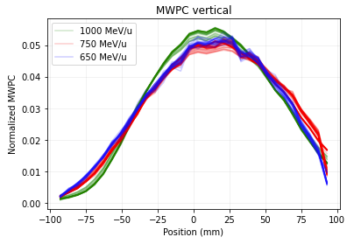
Heavy-ion beam: spatial profile at testing location
Based on the Multi-Wire Proportional Chamber (MWPC),
Operated mostly at high voltage (1.8 kV) to increase the sensitivity, as opposed to the nominal 0.1 kV,
Adequately covering intensity range used in the tests,
Relatively large beam: FWHM ~10 cm,
Profile seems independent of beam intensity,
To be analyzed:
  Stability of beam profile throughout different runs,
Possible option for the future: further de-focus the beam and apply rectangular collimation in the center, for homogeneous, rectangular beam

Slide 8
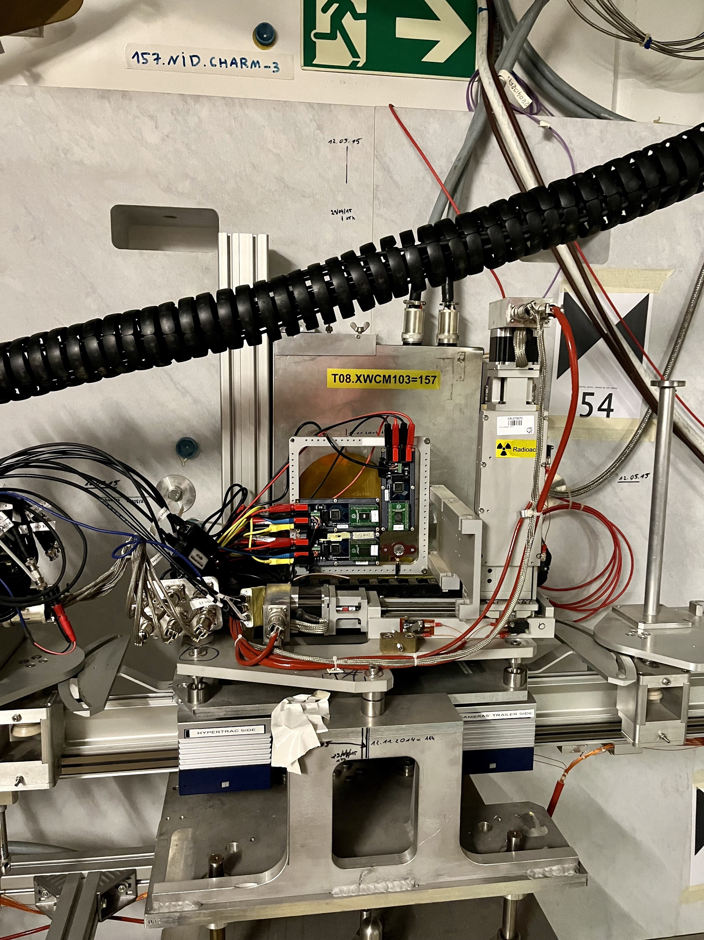
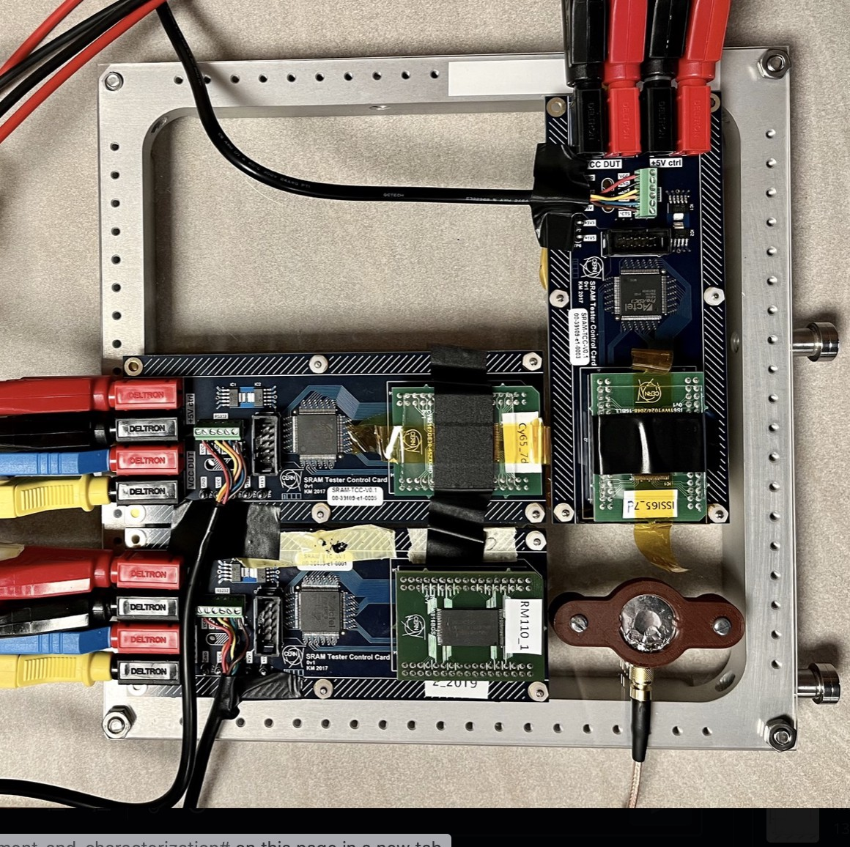
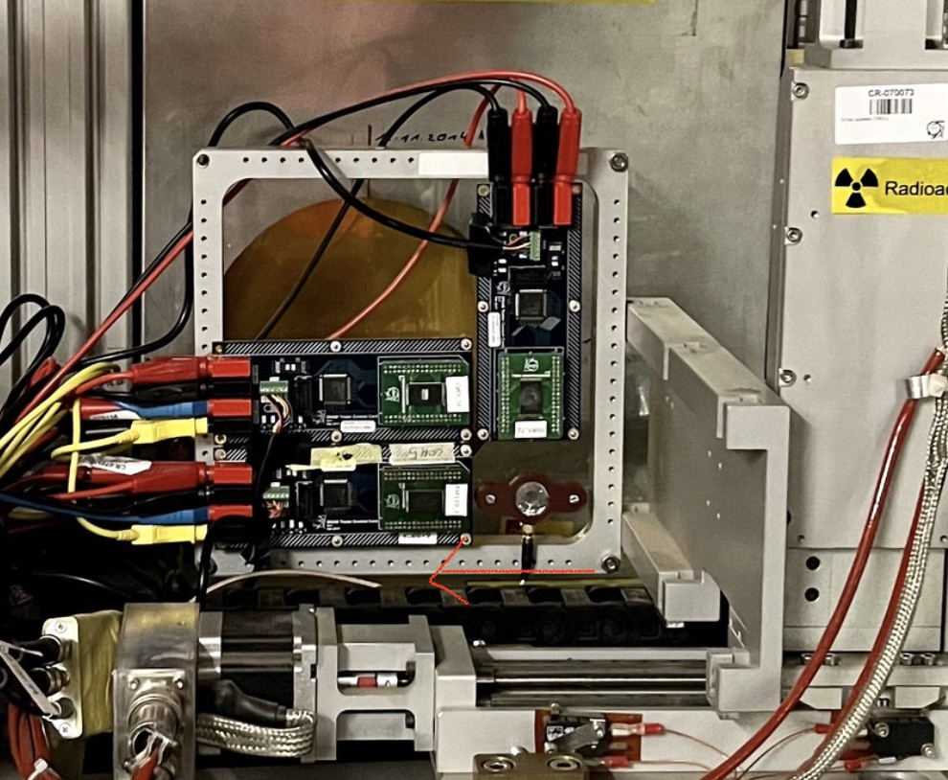
R2E Beam Characterization: Si diode and SRAMs

Slide 9
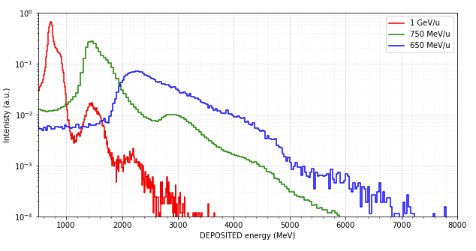
Diode as beam diagnostics: event-by-event energy deposition,
The diode provides an extremely powerful beam diagnostics tool, as it counts ion by ion, and provide the additional information of the energy deposited by each ion (in 300um of silicon)
The measured energy deposition spectra can be benchmarked against FLUKA simulations to retrieve beam energy and the corresponding LET,
Counts ion by ion, therefore can be exploited for the intensity monitoring,

Slide 10
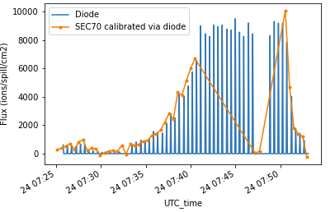
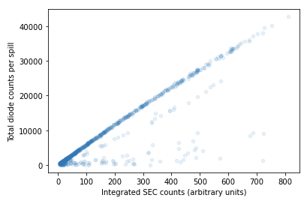
Diode as beam diagnostics: flux monitor
As the diode measures deposition events from single ions, one can use it as a flux monitor, simply by taking the counts corresponding to the primary beam, and dividing by its sensitive surface
For a given beam shape, the flux at the center of the beam should be proportional to its intensity. Therefore, one can use the diode to obtain a conversion factor between intensity (e.g. as measured by SEC70) and flux,
This was applied during the online analysis (dashboard) and, when benchmarked against the SRAM memories,
Counts by the
Si detector
Good linearity
SEC70 normalized counts

Slide 11
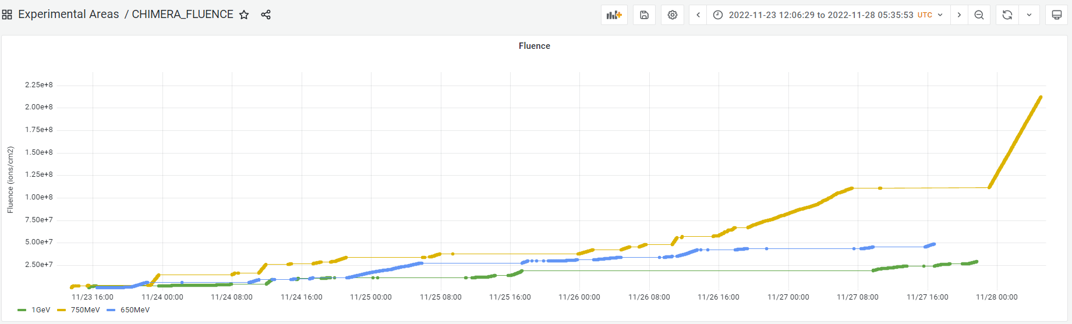
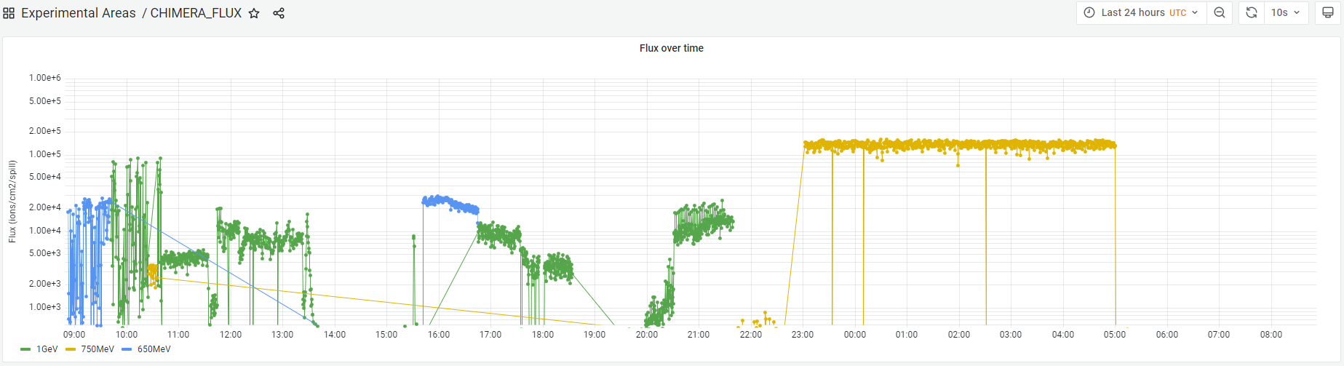
Beam instrumentation: flux estimate based on SEC70 and diode
Link
Online dashboard with the implemented R2E Beam Characterization
– very useful and necessary for the users, as their test relied on “real time” flux measurements
Link
Flux at the DUT as measured by SEC70,
calibrated with the Si diode

Slide 12
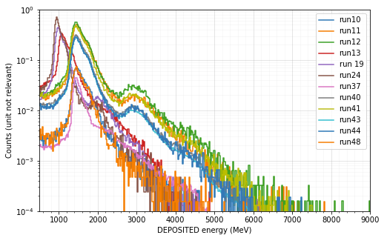
Open point: mysterious energy change (preliminary!)
Over the CHIMERA run, as measured by the Si diode, the energy at the DUT (in CHARM) varied,
This was observed for all three primary beam energies (1GeV/u, 750MeV/u, 650MeV/u),
For each of the primary beam energy (PS), 2 beam energies at DUT were observed,
Investigations are ongoing…
Maybe additional material budget being put in and out of the line?
750 MeV/u
Position of the peak
(deposited energy)

Slide 13
Conclusions
Very successful test campaign – a lot of data collected, waiting to be analyzed in detail
  Data analysis and reporting will be as important as test preparation and execution,
No blocking issues with the PS (e.g. frequent POPS trips) and with the relevant Beam Instrumentation (SECs, XIONs, MWPC),
Delivered heavy-ion beam:
  Extracted beams of 3 primary energies: 1GeV/u, 750MeV/u, 650MeV/u,
  Long spills (~400 ms), with the relatively constant intensity over spills (neglecting 130kHz structure),
  Thanks to the intensity control via RFKO, seems that spill time and spatial profiles were independent of the intensity itself (not the case with the other tested slow extraction techniques),
  Very good spatial profile: at the test location (CHARM) beam had approximately 10 cm FWHM,
  Open point: What may have changed the energy of the beam throughout the different runs?
    Additional material budget being put in and out of the line?

Slide 15
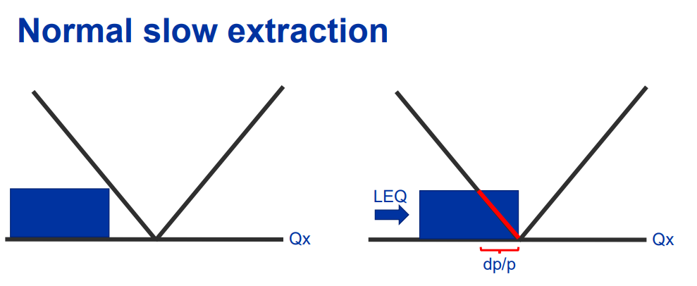
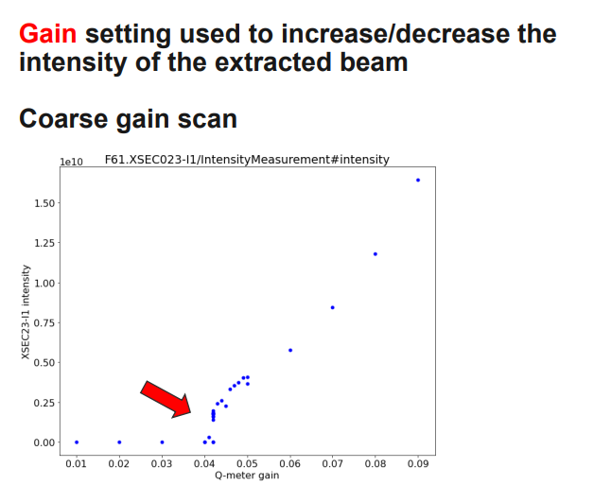
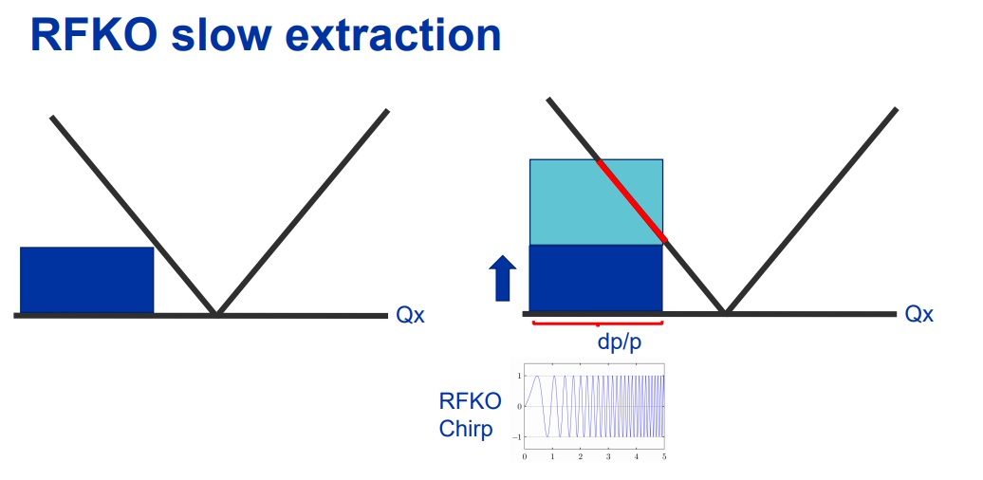
Intensity knob: gain of RFKO
Slow extraction intensity control through Radio Frequency-Knockout (RFKO)

