Slide 1
Outlook to 2023
2022 Injectors Availabilities
2023 Schedules
Eva Barbara Holzer
SPS and PS Physics Coordinator
PS and SPS User Meeting
December 1st, 2022

Slide 2
2022 Injectors Availabilities
Facility | Destination | Achieved 2022 Total [%] | Period
LINAC4 | - | 97.1 | 28.03.2022 – 21.11.2022
PSB | PS | 95.5 | 28.03.2022 – 21.11.2022
 | ISOLDE | 95.5
PS | SPS | 89.6 | 28.03.2022 – 21.11.2022
 | nTOF | 90.0
 | AD | 90.6
 | East Area | 91.6
SPS | LHC | 89.9 | 25.04.2022 – 21.11.2022
 | North Area | 73.2
 | AWAKE | 92.3
 | HiRadMat | 93.6

Slide 3
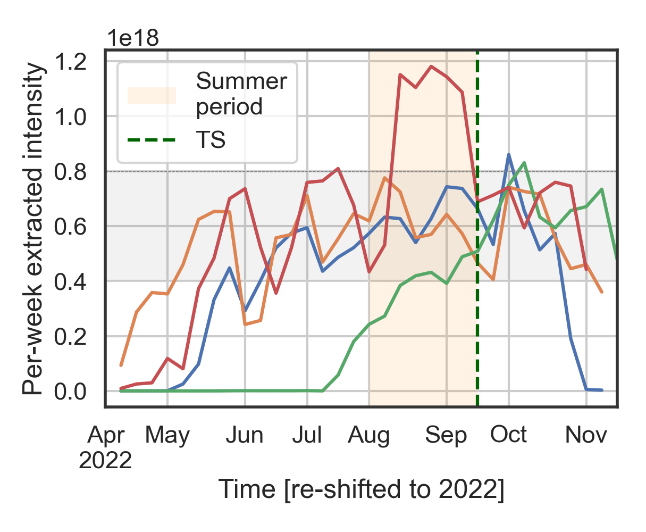
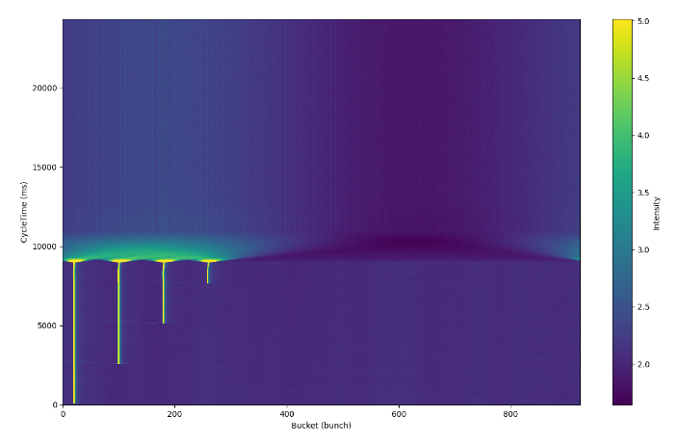
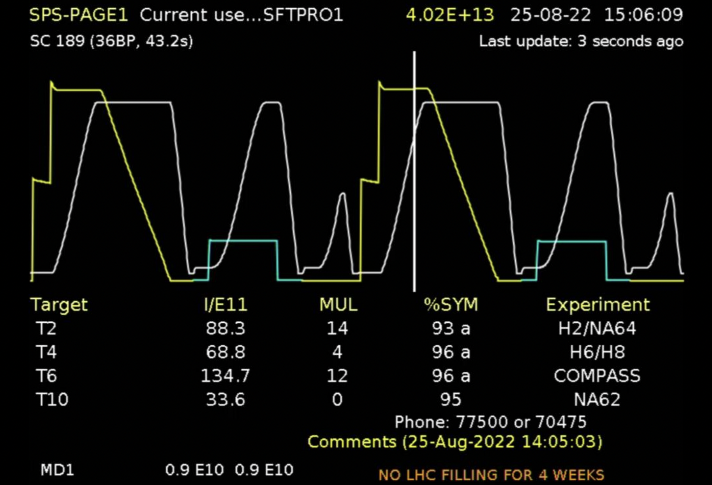

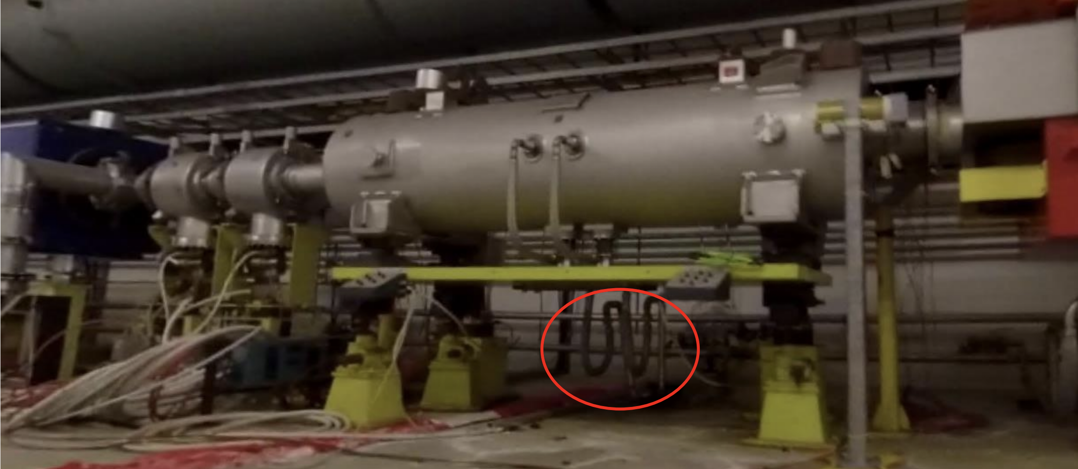
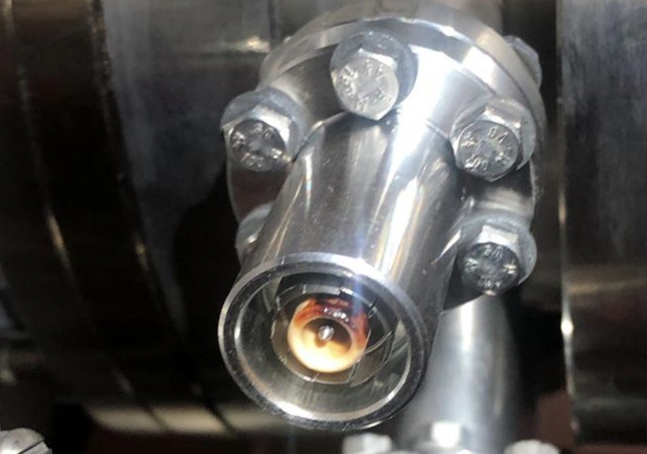
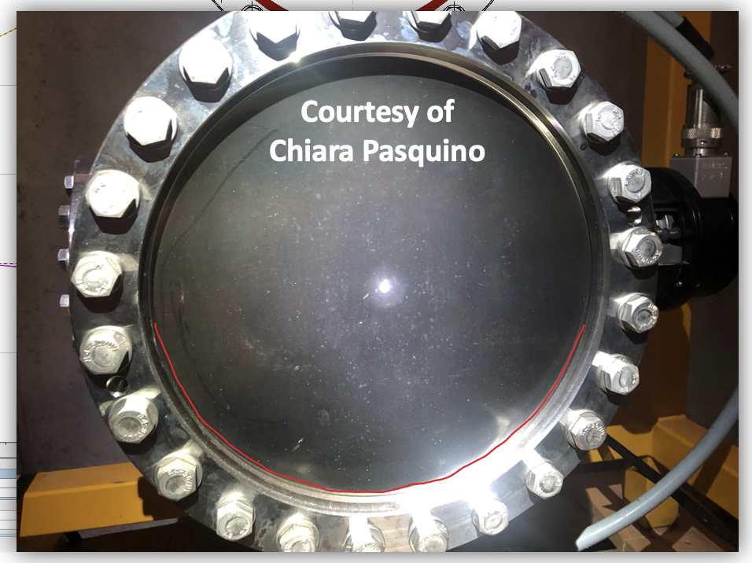

Timeline & Milestones (mainly SPS)
Start physics
HiRadMat SMAUG
record intensities
Ion commissioning
with new system
HOT summer
record extraction rates
April
May
June
July
August
September
October
November
December
TCSC
ZS
TBIU
POPS

Slide 4
Towards an Injector Schedule for 2023
2023 physics period shortened (SPS by 6 weeks)
  YETS extended by 4 weeks and moved forwards by 6 weeks to cover most expensive period for electrical cost
  2024 restart will be 2 weeks earlier than in 2023
  2023 SPS FT proton program 74% of 2022
  Roughly 80% for the other PS and SPS users
YETS user activities to be included in the 2023 injector schedule
  In EHN1: GIF++, MADMAX
  ISOLDE and AD winter physics
  AWAKE, CLEAR
Updated injector schedule to be presented at the IEFC 2nd December 2022 for endorsement
To be presented to the Research Board on 7th December 2022 for approval
There is a small chance, that the physics beam time can start one week earlier for PS and/or SPS → beam time for the first users may move by +/- 1-2 weeks on a short notice

Slide 5
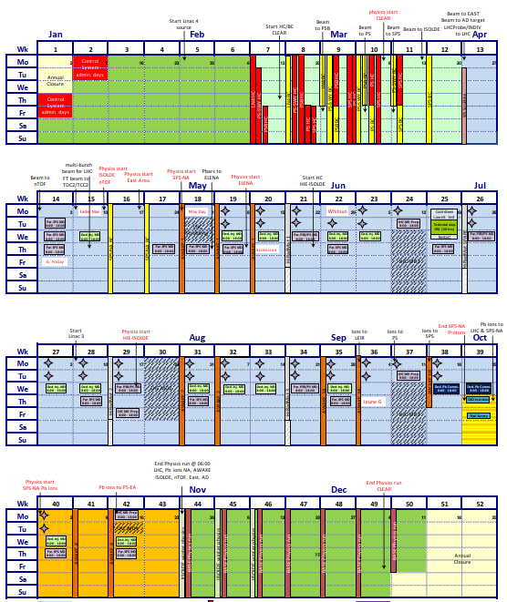
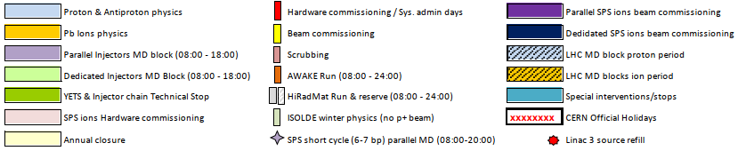
Draft Injector Schedule 2023 – last Details being worked on
To be presented to IEFC on Friday
To the Research Board next week for approval
AWAKE: 9.5 weeks; HiRadMat: 3 weeks + 1 spare week
EDMS 2785499: https://edms.cern.ch/document/2785499/latest
ASM link (from within CERN)
Small chance of starting PS EA and/or SPS NA one week earlier
 | ISOLDE | nTOF | AD/ELENA | PS EA FT | SPS NA FT
p (p-) start | April 10 | April 10 | May 11 | April 17 | May 1
p (p-) end | October 30 | October 30 | October 30 | October 30 | September 28
Pb ion start |  |  |  | October 16 | October 2
Pb ion end |  |  |  | October 30 | October 30
weeks | 29 (35 in 2022) | 28 (35 in 2022) | 24.4 p- (32.5 in 2022) | 28 p (35 in 2022) | 21.5 p (29 in 2022) 4 Pb
Notes:
High number of parallel activities in the SPS in 2022 (LHC start-up, MDs, ion commissioning)

Slide 6
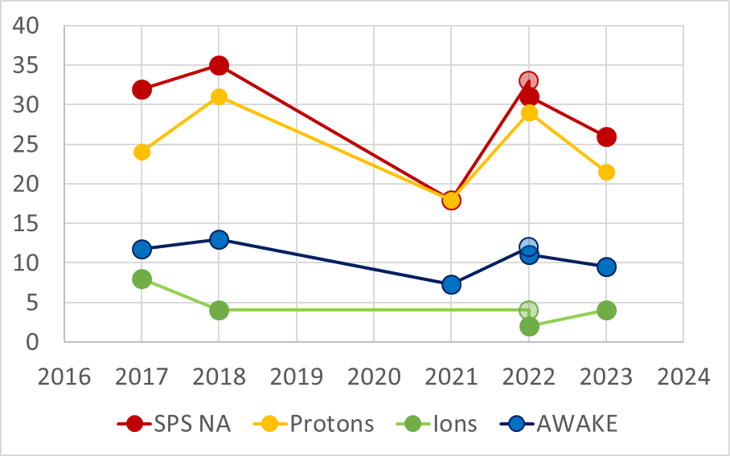
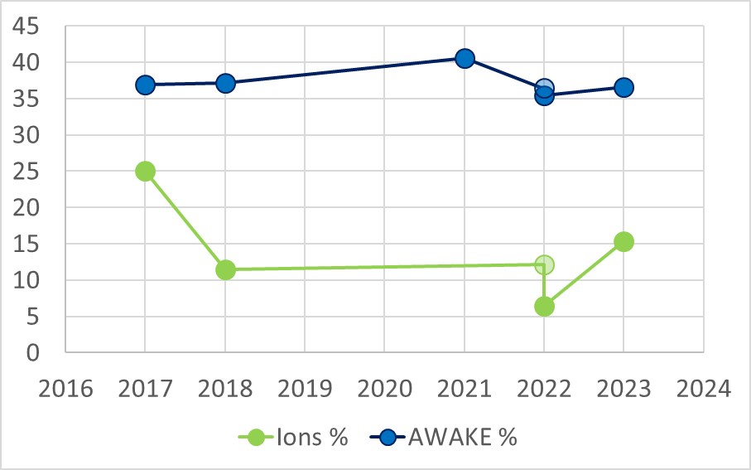
SPS Physics and FT Test Beams 2017 – 2023
2023 will be a short year for all users
SPS H2/H4 beam lines → high energy,
high purity electron beam users
  The period requested by NA61, NA63 and
  NA64e, which mostly excludes electron
  beam users extends over approximately
  16 weeks + any request from the Neutrino
  Platform (out of 21 weeks of p physics)
  → prioritization required
 | SPS NA weeks | Proton weeks | Ion weeks | Ions % | AWAKE weeks | AWAKE %
2017 | 32 | 24 | 8 | 25 | 11.8 | 37
2018 | 35 | 31 | 4 | 11 | 13 | 37
2021 | 18 | 18 |  |  | 7.3 | 41
2022 original | 33 | 29 | 4 | 12 | 12 | 36
2022 reduced | 31 | 29 | 2 | 6 | 11 | 35
2023 | 26 | 21 | 4 | 15 | 9.5 | 37
weeks
percent

Slide 7
Towards a User Schedule for 2023
Imminent: Call for 2023 PS/SPS proton and ion fixed target beam time requests
Deadline for submission will be beginning of January 2023
7.2.2023 SPSC: Present draft user schedule
  Afterwards: Distribute the draft schedule to the users
8.3.2022 LHCC: Present review of requests and draft user schedule
Typically: First official version 1.0 of the user schedule a few weeks before the start of physics (about mid March)

Slide 8

Transnational Access: Financial support for users coming to CERN for beam tests (per diem only, no travel cost) for beam times in 2023 to 2025
Developing a data-base driven software tool for User's request submission, scheduling, statistics, reporting
→ presented today at the last PS and SPS user meeting of 2022

Slide 9
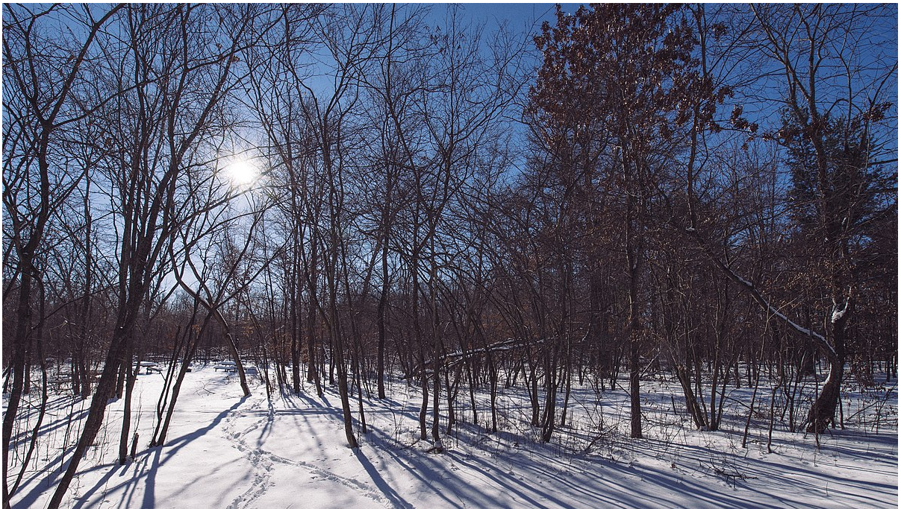
https://commons.wikimedia.org/wiki/File:Animal_tracks_in_the_snow_-_Winter_at_Wild_River_State_Park,_Minnesota_(24966185907).jpg https://creativecommons.org/licenses/by-sa/2.0/deed.en

Slide 10
Thank you for fruitful collaboration and mutual support!
It has again been a very successful and pleasant year thanks to all of you!
https://commons.wikimedia.org/wiki/File:Animal_tracks_in_the_snow_-_Winter_at_Wild_River_State_Park,_Minnesota_(24966185907).jpg https://creativecommons.org/licenses/by-sa/2.0/deed.en

Slide 11
END

Slide 12
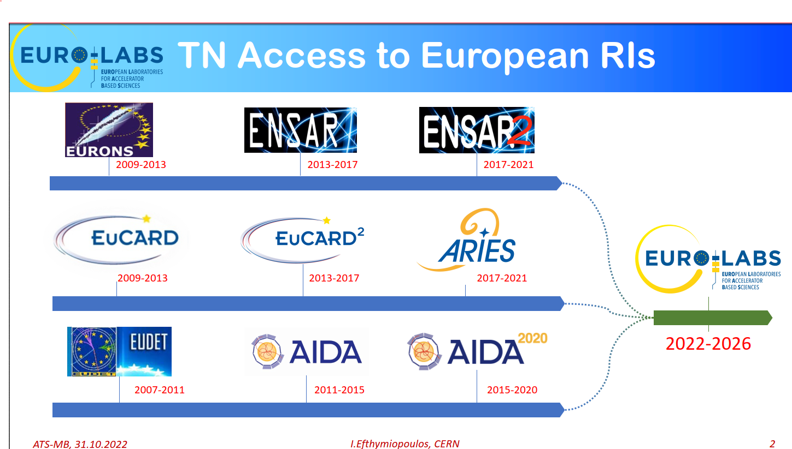

Slide 13
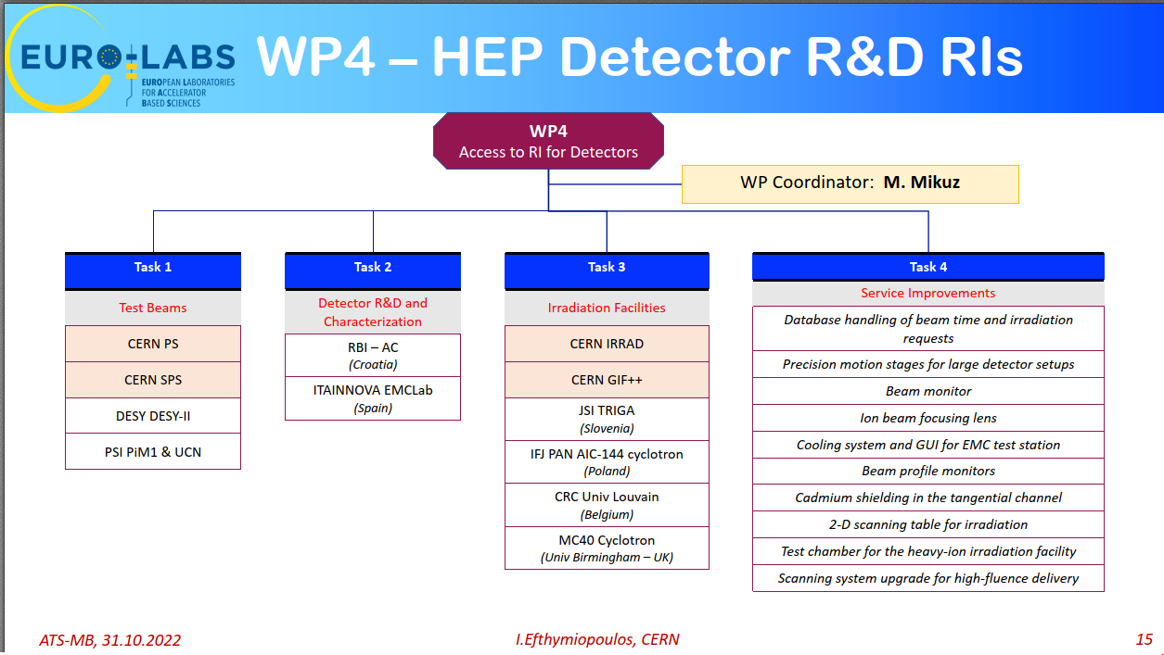

Slide 14
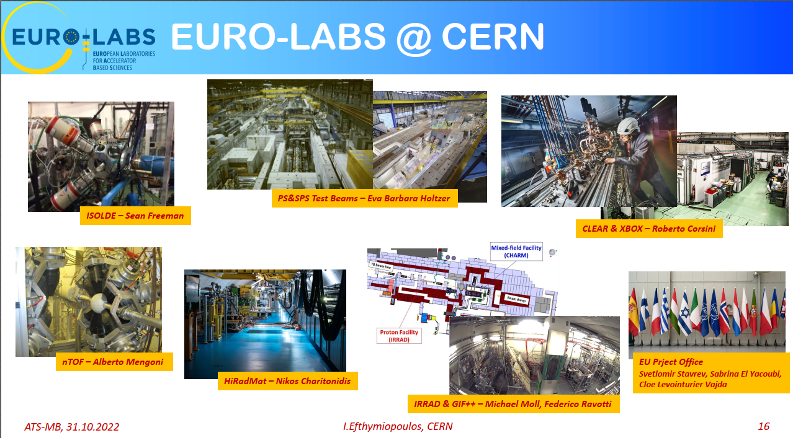

Slide 15
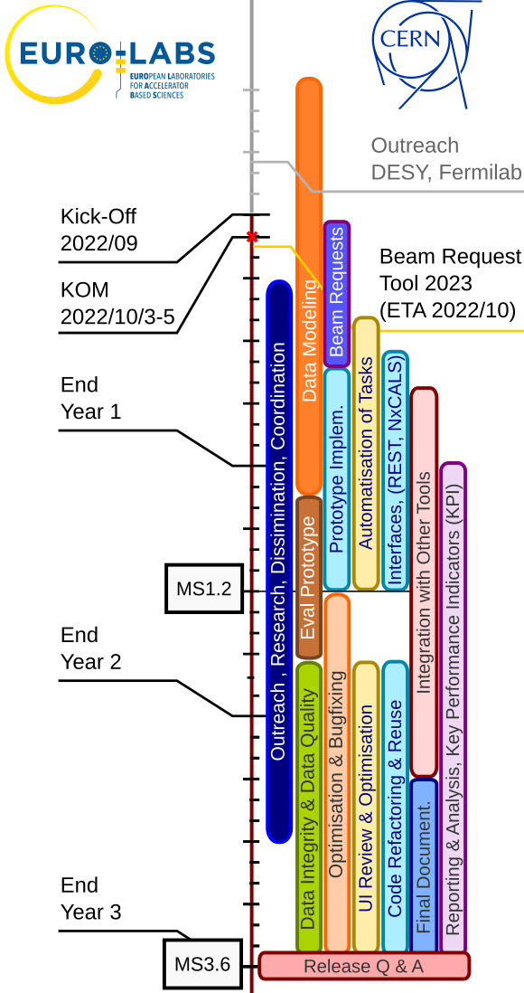
4.4.1. Development Of A User Schedule Management Tool
  Developing a data-base driven software tool for users' beam request submission, scheduling, statistics, reporting, etc.
  Model and store the data in a unified way (➔ data model)
  Accessible for analysis and data inspection to both humans and computer scripts / programs
  Provides a streamlined view towards our users to file and manage their requirements and constraints
  Serves as a foundation for the scalable development of tools for solving current and future problems

Slide 16




4.4.1. Development Of A User Schedule Management Tool
Current Status
  As a starting point, a new tool for collecting PS and SPS user requests for the 2023 period:
  Based upon the same software stack as the IRRAD Sample manager and the RADNEXT project (django, openshift), allowing closer collaboration and eventual code sharing
  The tool will already include improvements over the previously used solutions (Drupal webforms, MS Office documents + Sharepoint)
  Data accessible via REST API for easy consumption and processing of the data with simple scripts and programs
  Written with extensibility in mind – should serve as the foundation for future developments and improvements

