Slide 1
Update on noise studies in the LHC
S. Kostoglou, G. Sterbini, H. Bartosik, Y. Papaphilippou,
J. H Emonds-Alt, D. Ribiollet, M. Soderen
210th WP2, 13/12/2022

Slide 2
Overview
A recap on observations in Run 2 & UPS noise measurements in SM18
ADTObsBox spectrum analysis in NXCALS
Observations in 2022
MD results

Slide 3
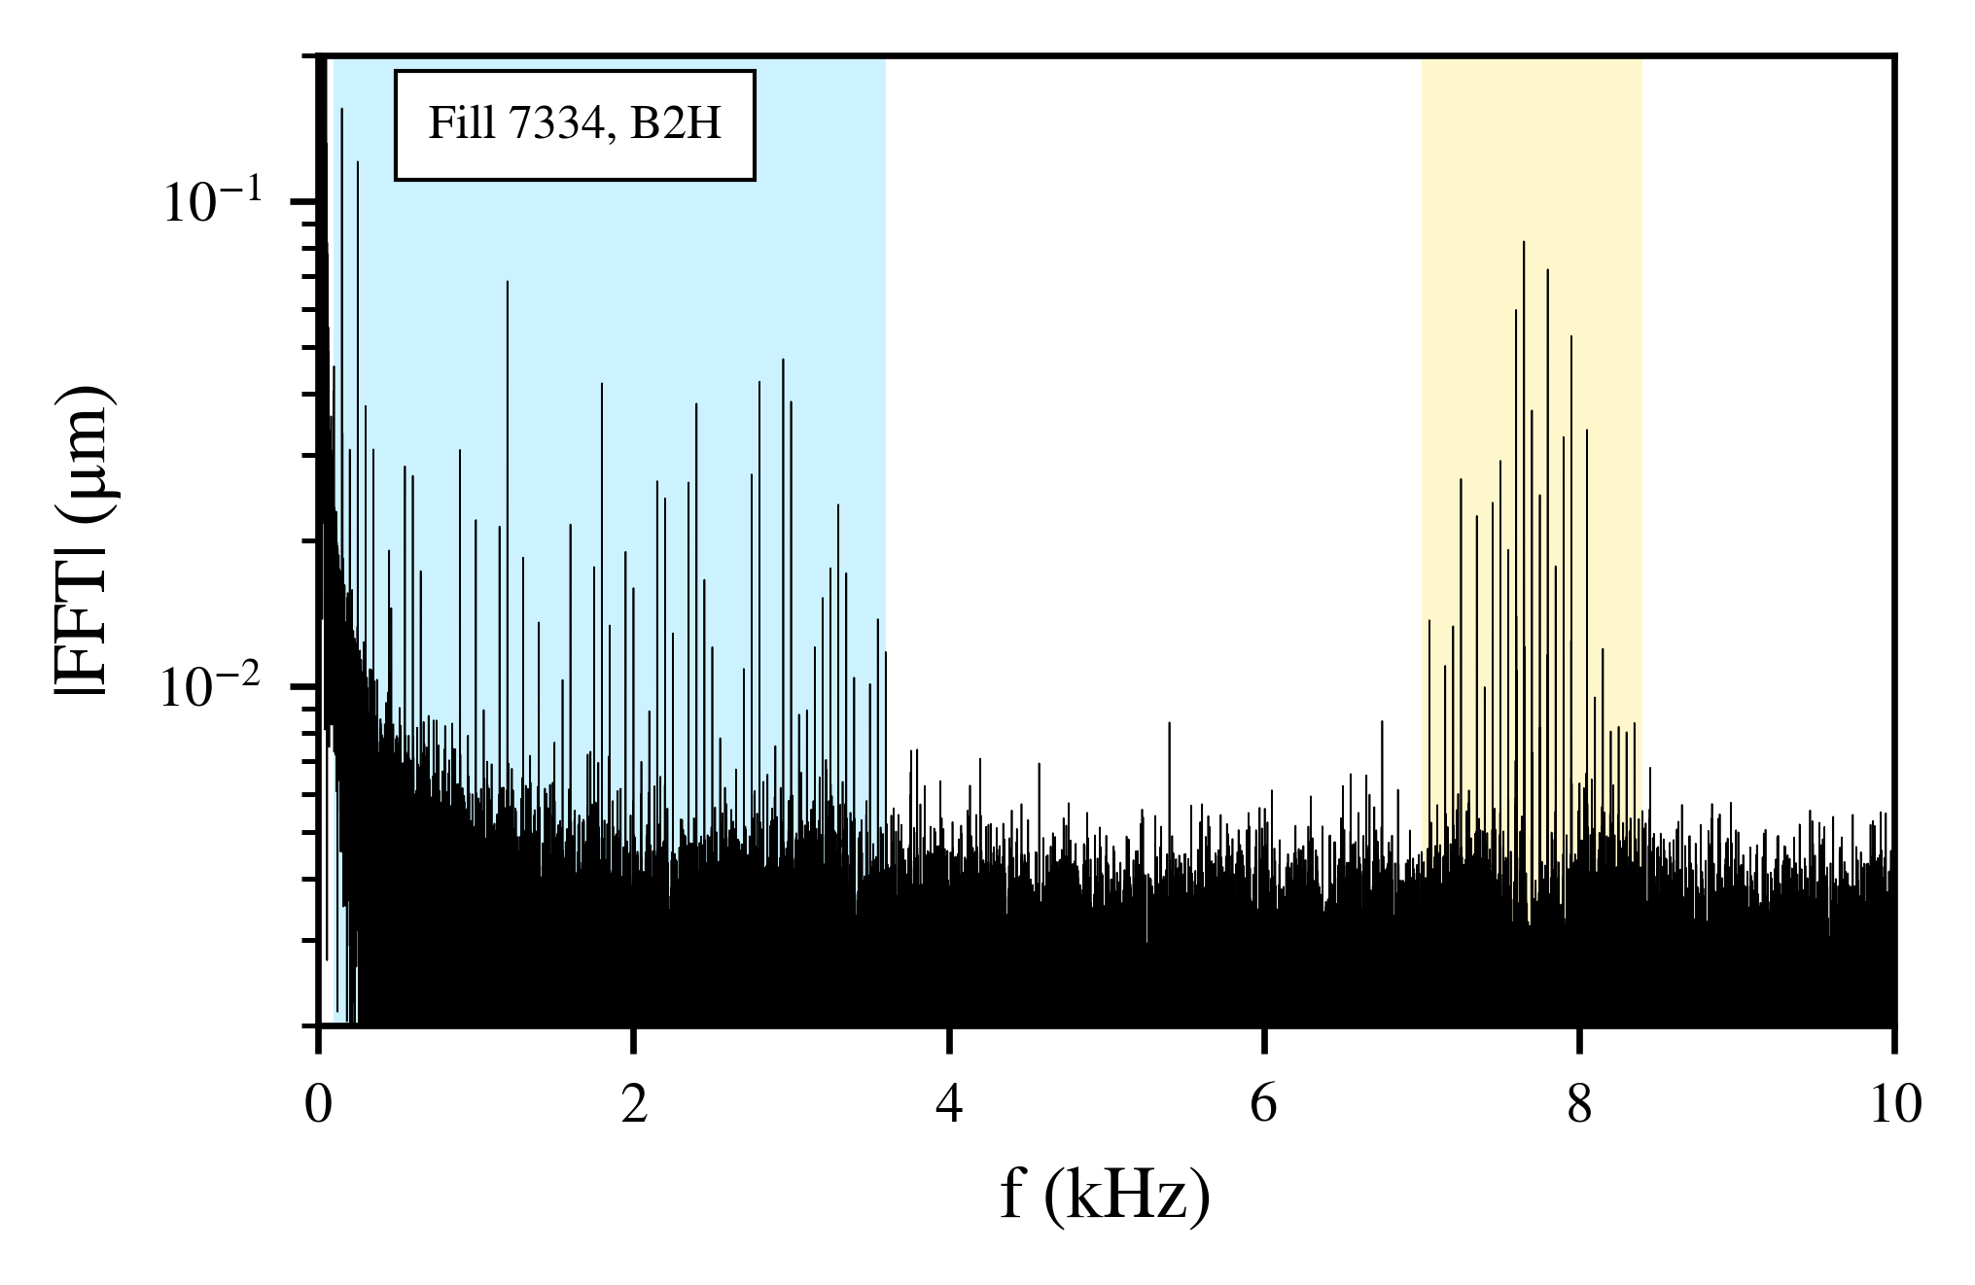
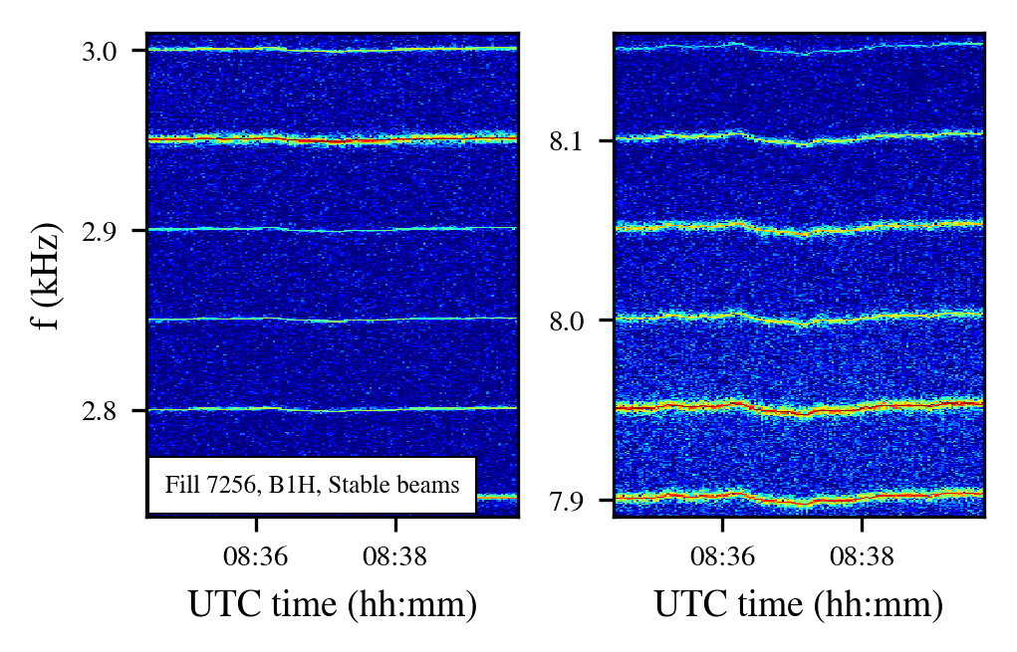
Observations in Run 2
Trying to understand the source of
..with this specific signature

Slide 4
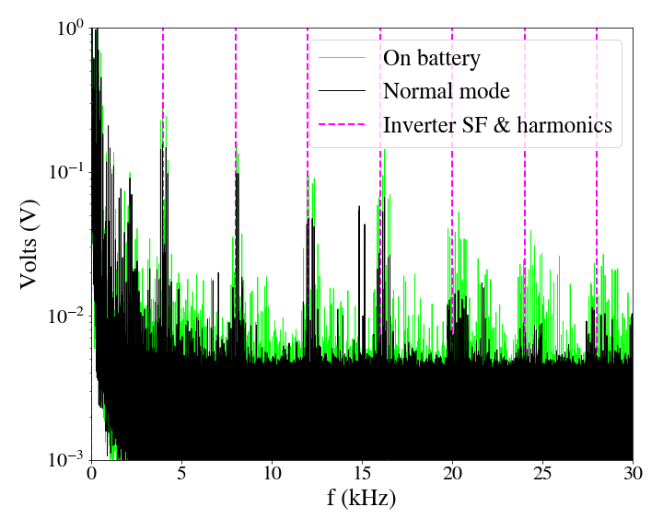
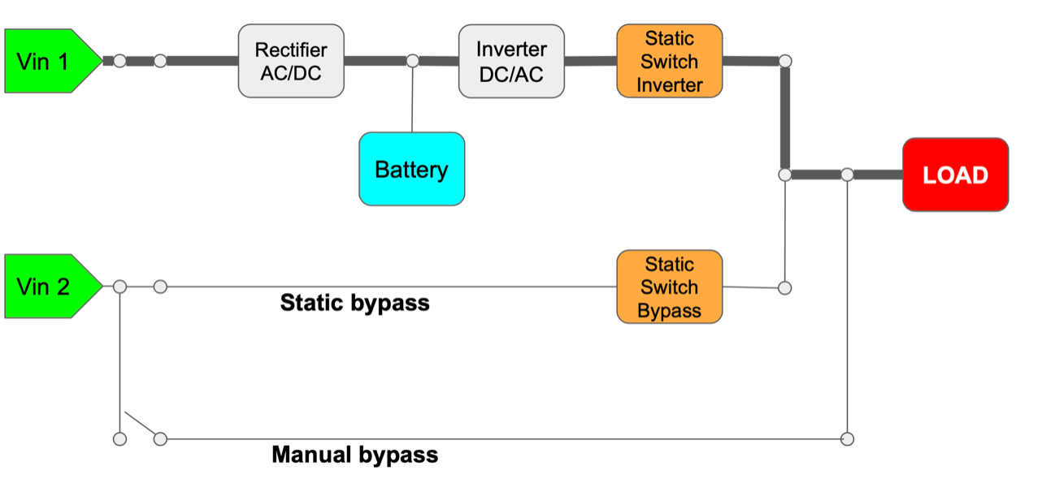
UPS voltage measurements
Measurements of spare UPS in SM18 thanks to EN/EL: UPS output voltage spectrum very similar to transverse LHC beam spectrum in terms of ripple→ good candidate to study
Different modes of UPS operation:
Nominal
On battery
Static & manual bypass
UPS noise spectrum
UPS modes of operation
Link for UPS noise measurements in SM18

Slide 5
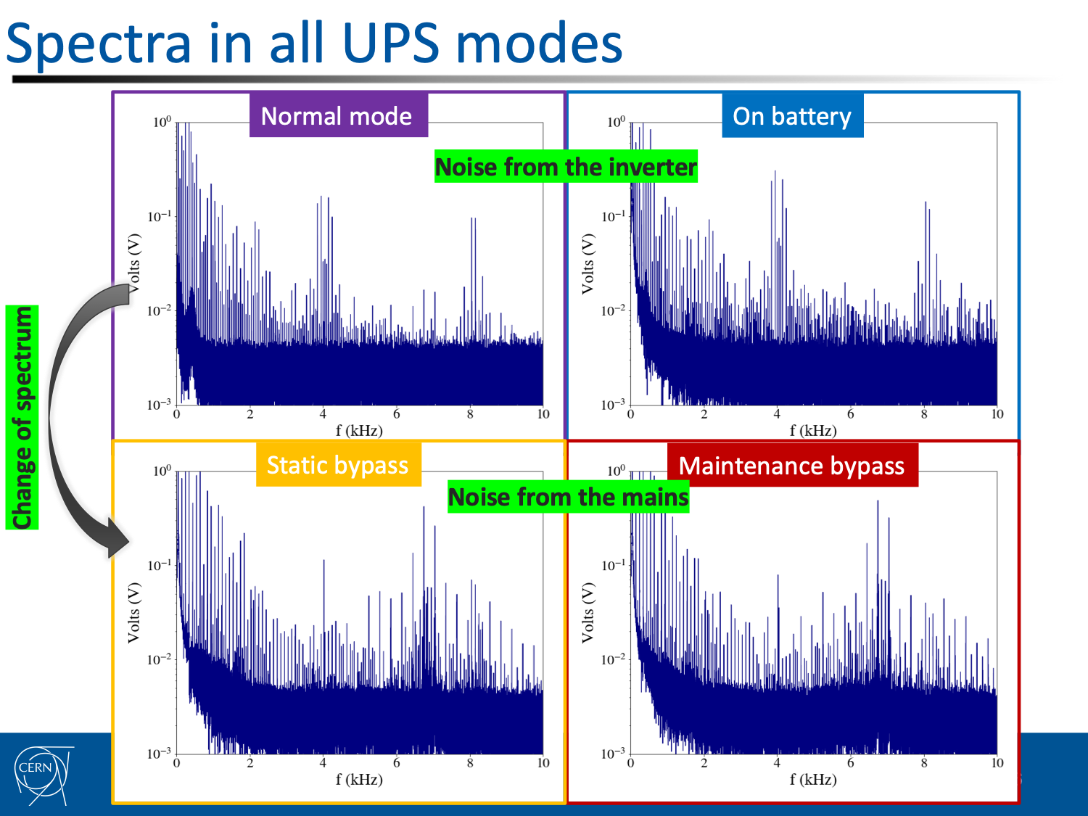
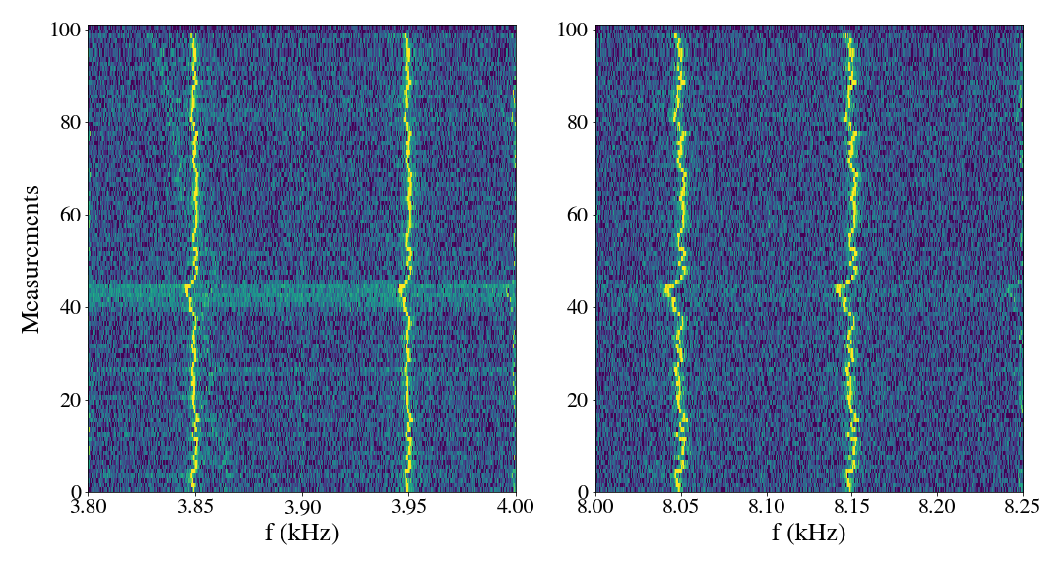
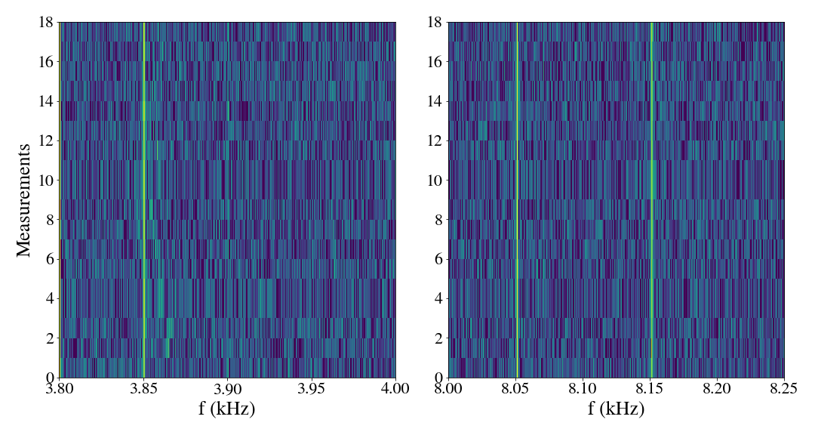
UPS voltage measurements
Changing mode of UPS operation → different UPS output voltage spectrum → Can these changes be detected on the beam spectrum as well?
Bypass: Change of UPS spectrum (change of harmonics’ amplitude), not so easy to detect.
On battery: Clear change of UPS spectrum (loss of synchronization with mains), can be easily detected.
Nominal to battery mode

Slide 6
What is new in Run 3?
Circular ADTObsBox buffer:
  In 2018, analysed data from sparse ADTObsBox measurements based on instability trigger.
  In 2022, continuous measurements for every fill: for the first time, systematic fill-by-fill analysis is possible in a high frequency range. Following evolution of the lines will allow collecting observations & identify the source.
First step, analysis performed in HTCondor due to huge amount of data:
  A few hours needed to analyse 1 fill (even when subsampled to 1 minute).
  Time-consuming & tedious analysis needed for every fill in 2022.

Slide 7
What is new in Run 3?
Online spectrum analysis published in NXCALS from M. Soderen:
  High-frequency range spectrum published for both beams & planes every 1 minute (can go down as low as 15 seconds during MDs).
  Available from 29/09/2022.
  Frequency range up to ~11 kHz.
  Spectra can be downloaded and plotted for 1 fill in a few minutes.
  Allows for the first time to have a systematic fill-by-fill analysis.
  Note: Not calibrated in amplitude.
  Variables in nxcals: ObsBox2Spectrum.LHC.ADT.REAL.B1H.Q7:acquisitionCorrected:acquisition ObsBox2Spectrum.LHC.ADT.REAL.B1V.Q7:acquisitionCorrected:acquisition ObsBox2Spectrum.LHC.ADT.REAL.B2H.Q7:acquisitionCorrected:acquisition ObsBox2Spectrum.LHC.ADT.REAL.B2V.Q7:acquisitionCorrected:acquisition

Slide 8
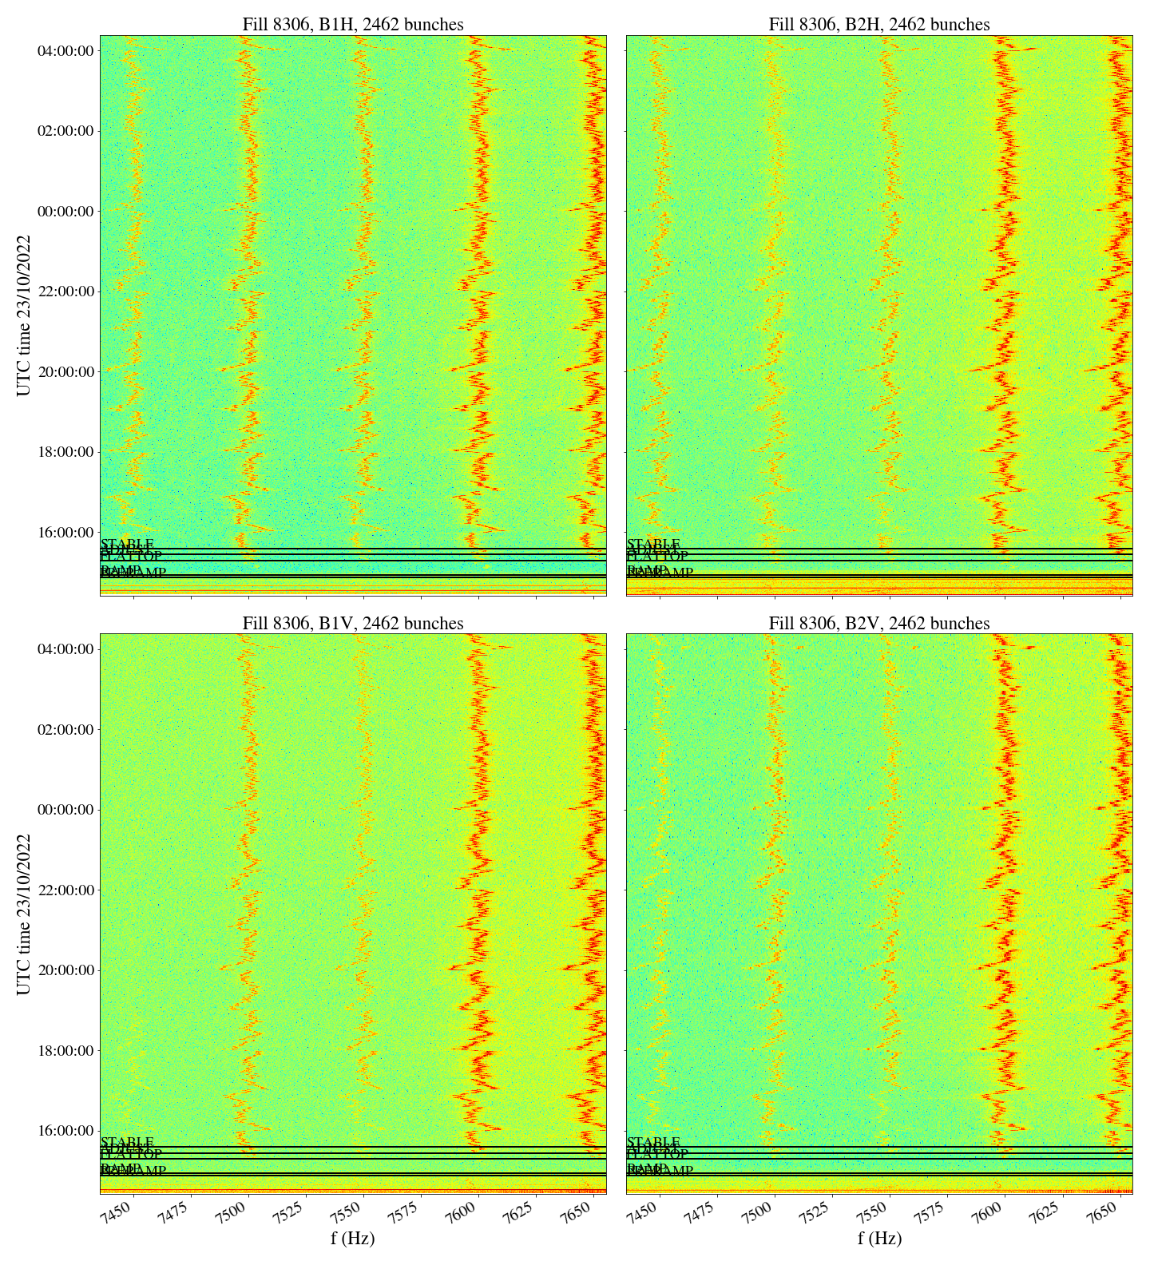
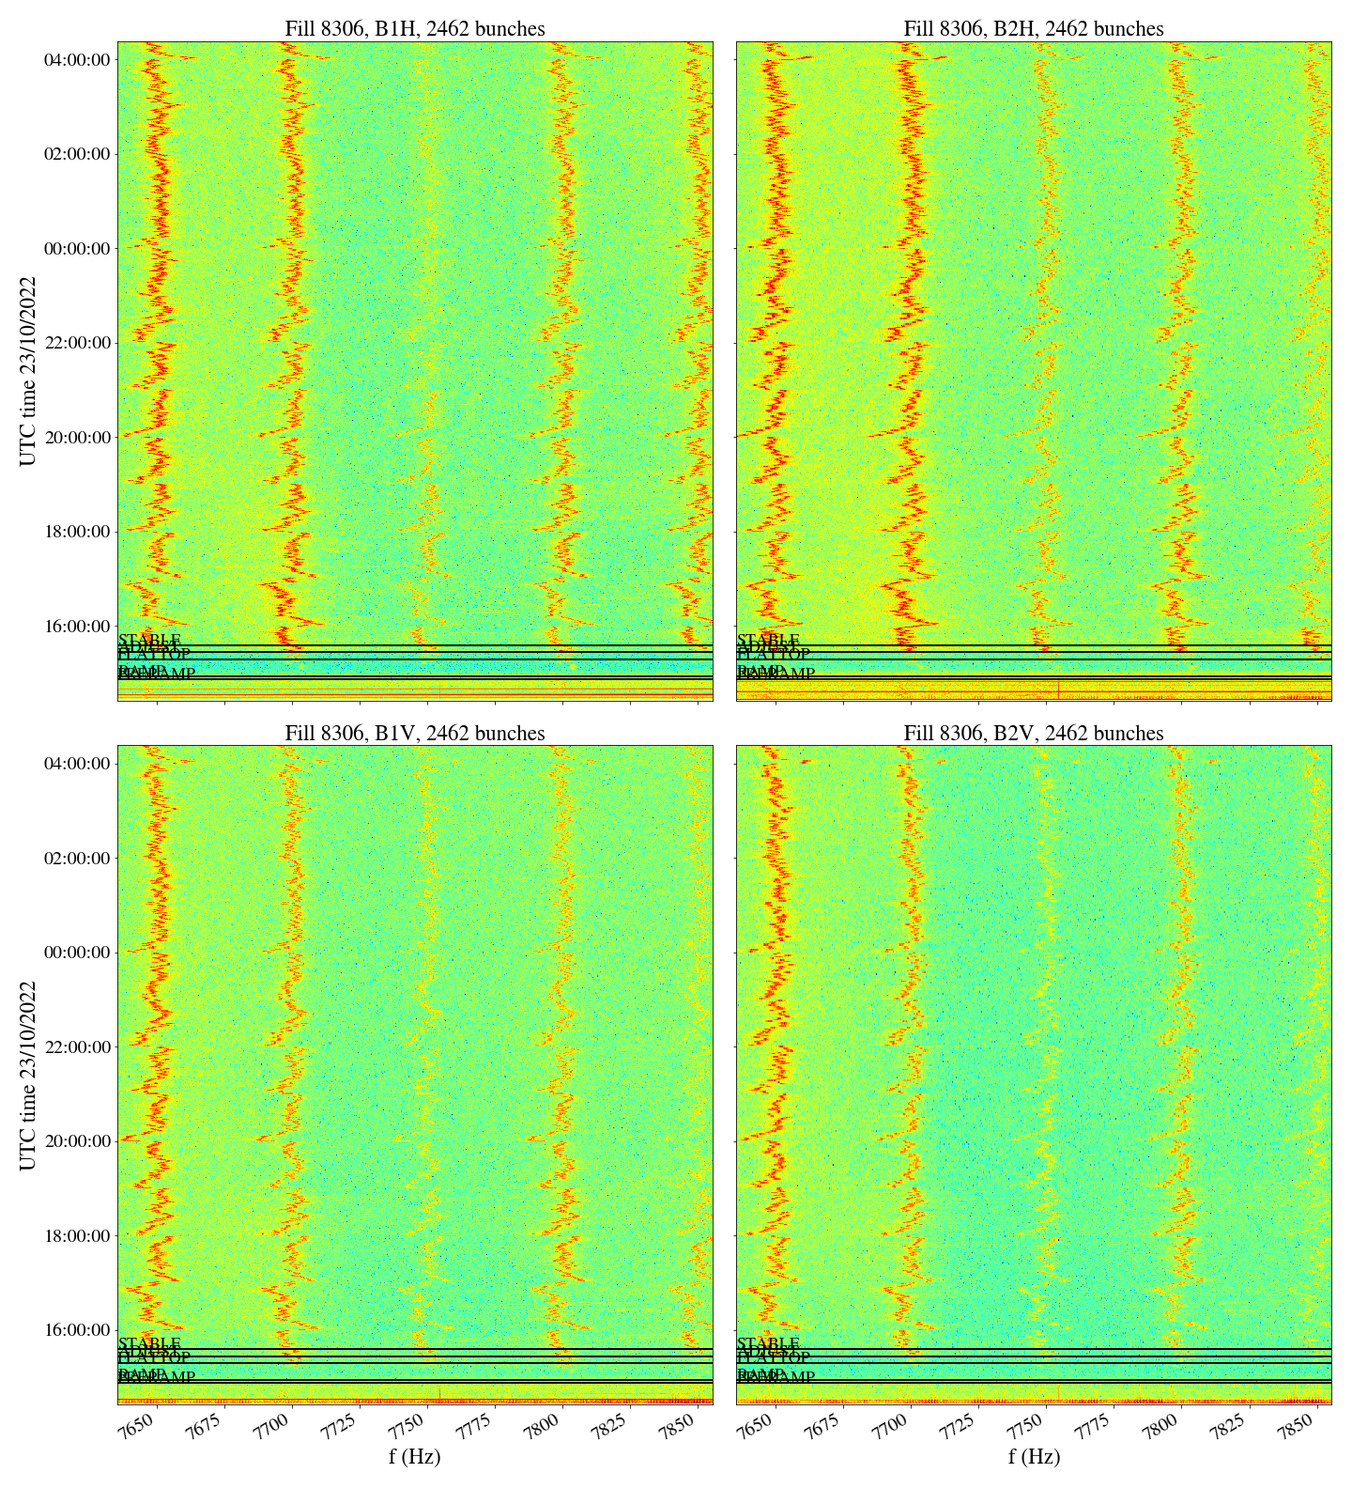
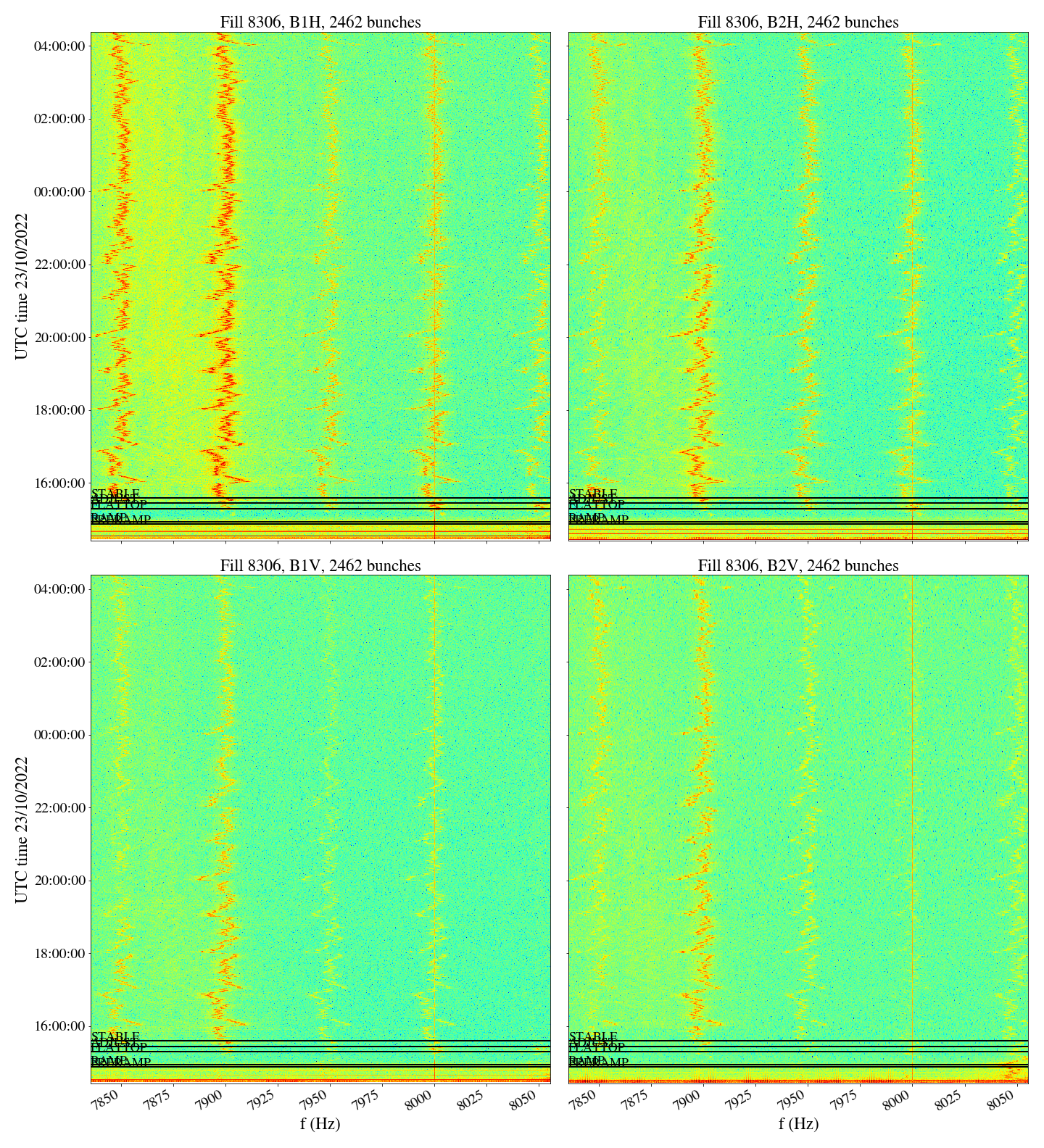
Observations in Run 3
Analyzed every fill of 2022 run:
  Spectrum is reproducible in every fill of 2022: 8 kHz cluster is clearly visible for all beams & planes.
  No change detected in a specific fill that could indicate correlation with a specific source.
B1H
B2H
B1V
B2V
7.45-7.65 kHz
7.65-7.85 kHz
7.85-8.05 kHz

Slide 9
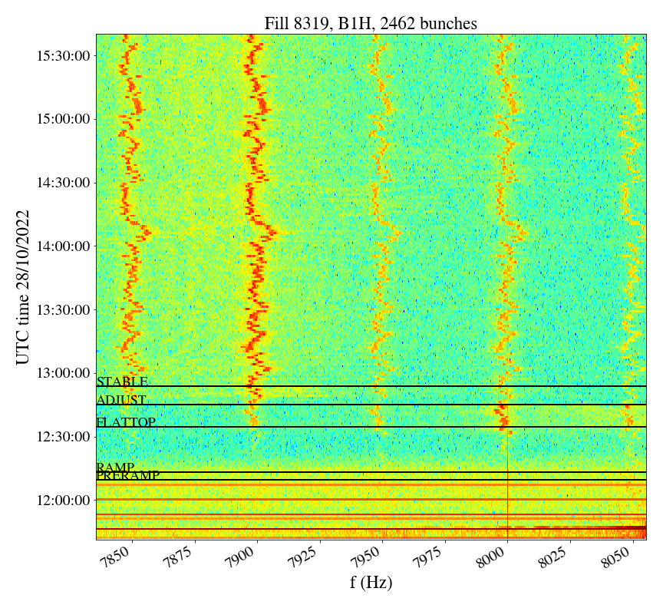
Observations in Run 3
  Contrary to low-f cluster, 8 kHz cluster is enhanced at the end of the ramp/ start of flattop: this was not clear in Run 2 due to limited ADTObsBox measurements.

Slide 10
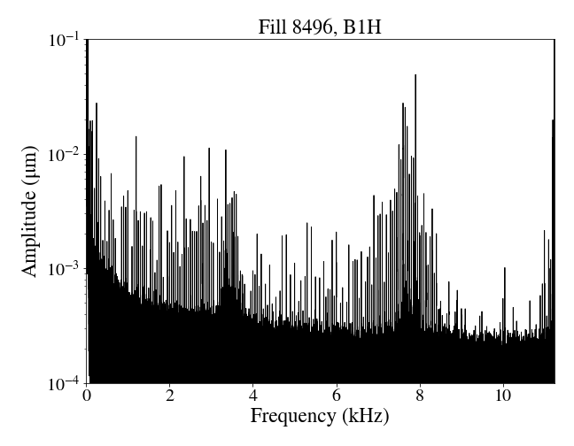
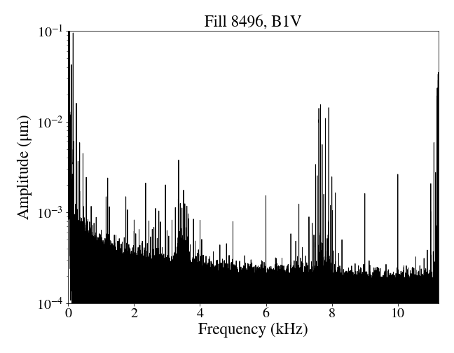
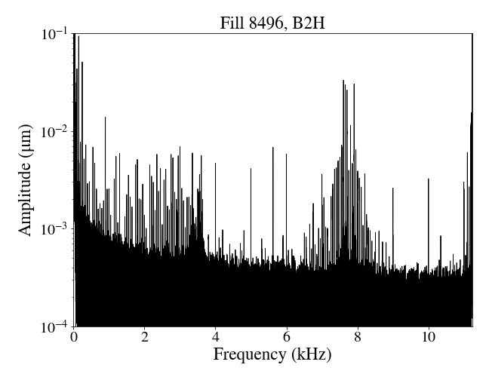
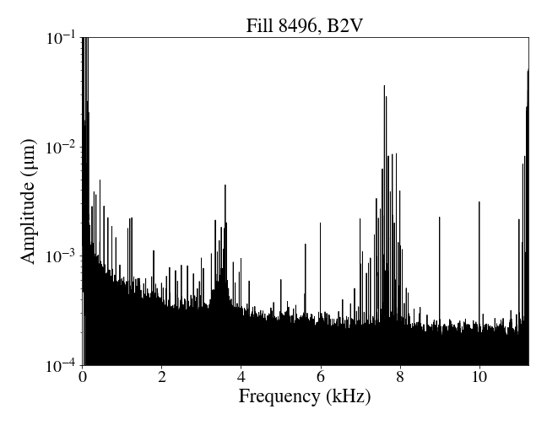
Observations in Run 3
B1H
B1V
Calibrated spectrum for fill 8496, 2390 bunches, Stable beams: similar to what was considered for Run 2.
B2H
B2V
Steps for calibration:
https://codimd.web.cern.ch/s/V1pL7RIBp

Slide 11
MD overview
2 MDs (July & November)
First MD:
  at injection, with 6 pilots and then 4 nominals
  UPS modifications from EN/EL:
    First, EZS1/45X and EZS11/45X (in cascade) in UX45 (access needed) switched from “nominal” configuration to “manual bypass” and then back to “nominal”. Not possible to switch to “battery mode” without remote control.
      UPS connected to (H. Timko): ADT, racks for klystrons, LLRF crates for cavity control and longitudinal diagnostics in UX45.
    Then, EBS11/4R in SR4 (no access needed) switched from “nominal” configuration to “battery”, “static bypass”, “manual bypass” and back to “nominal”.
      UPS connected to (H. Timko): ADT, LHC beam control (RF frequency generation, beam phase loop, synchronisation etc.), longitudinal diagnostics in SR4 (APWL, beam spectra, longitudinal ObsBox)

Slide 12
MD overview
Conclusions from 1st MD:
  8 kHz cluster not observed at injection with a few bunches.
  No impact from UX45 UPSs.
  Impact observed from UPS in SR4: loss of mains’ synchronization for some low-order harmonics on the beam when UPS switched to battery mode. Observed only on B1 and not in B2 (e.g. 550, 750, 1150, 1950, 2950, 3150 Hz).

Slide 13
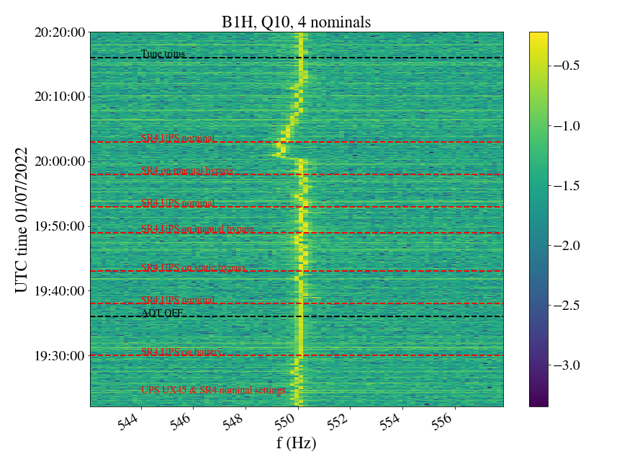
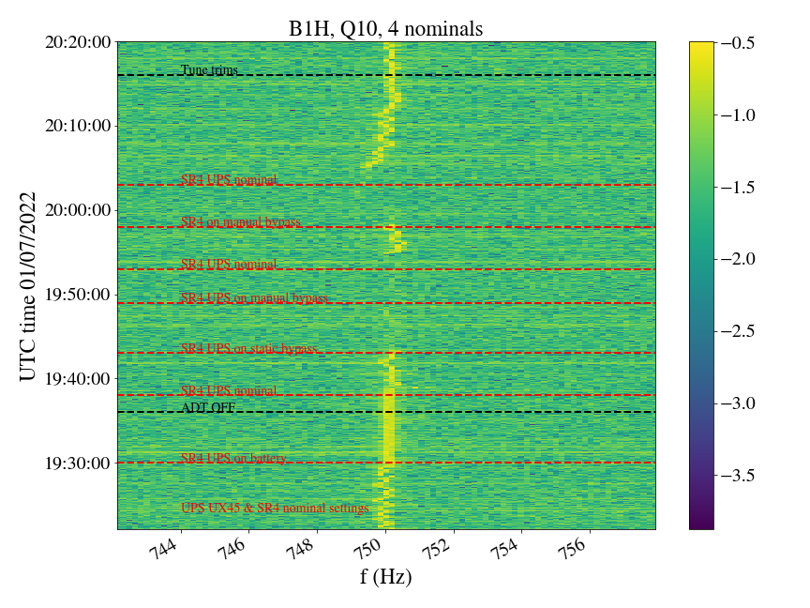
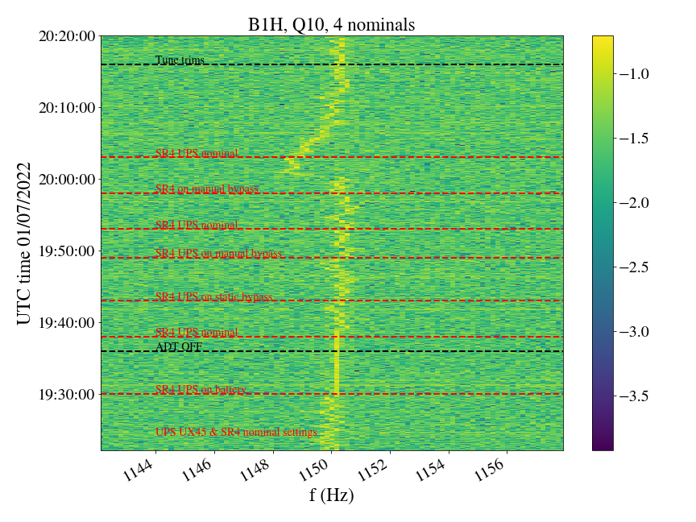
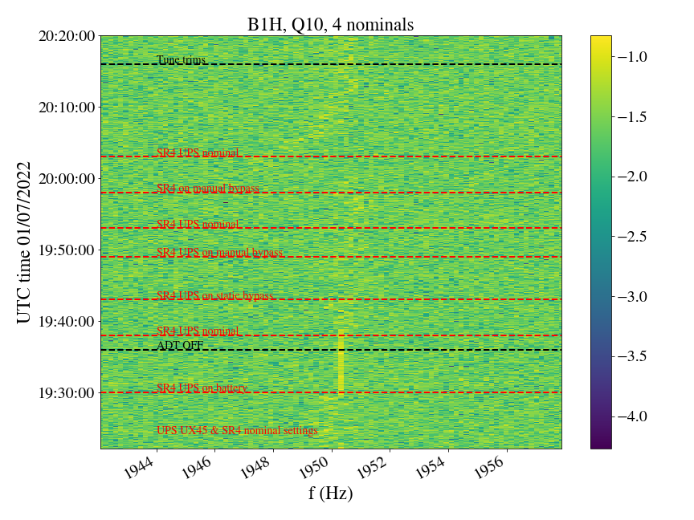
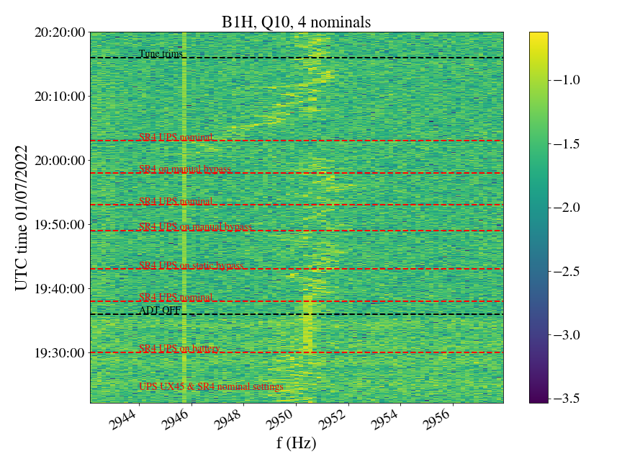
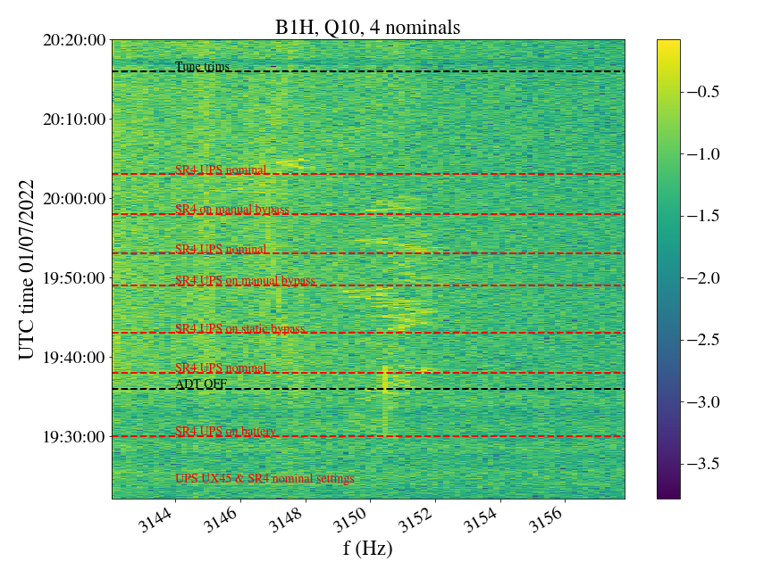
ADTObsBox spectra in MD, UPS in SR4 tests

Slide 14
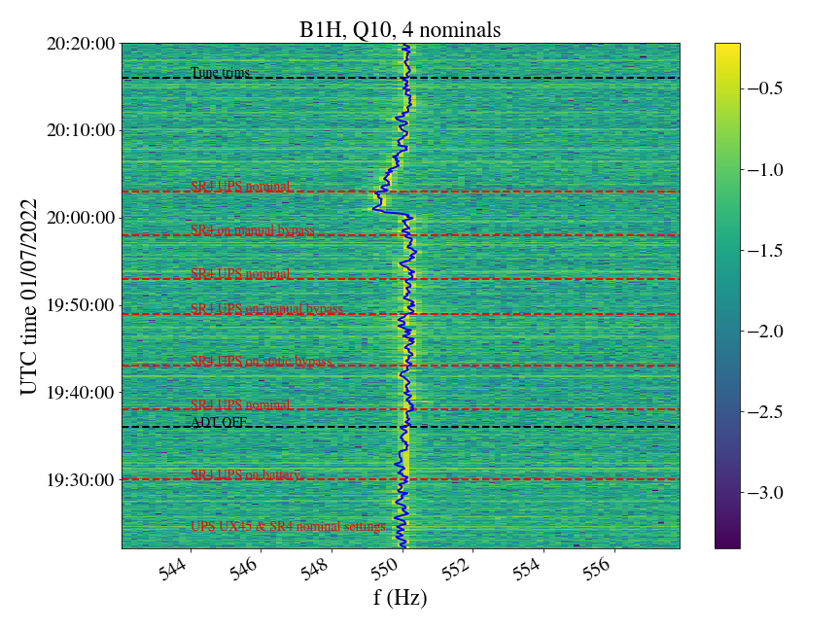
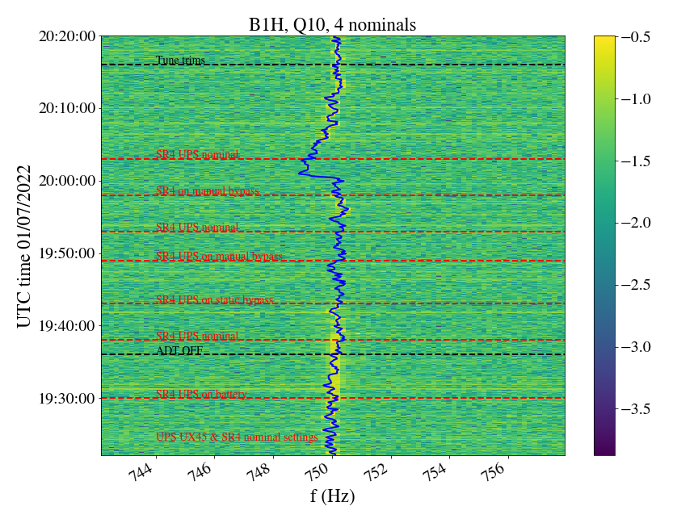
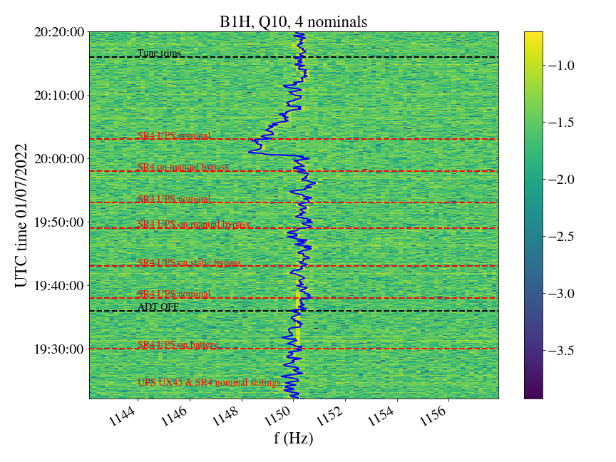
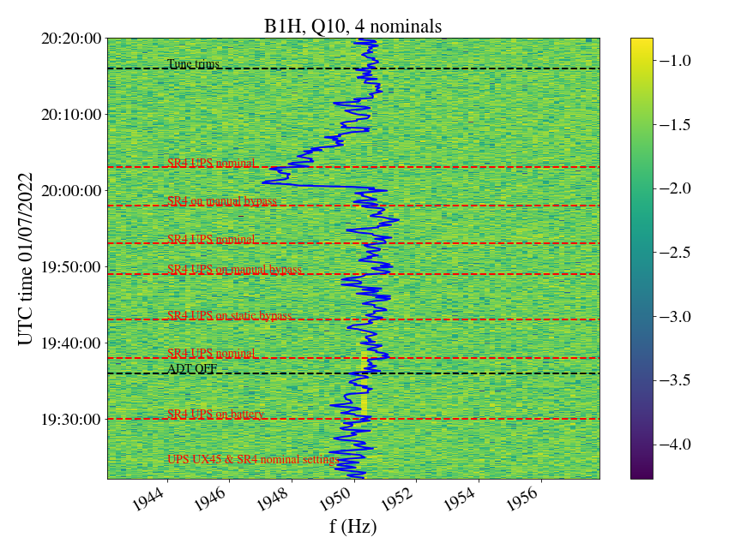
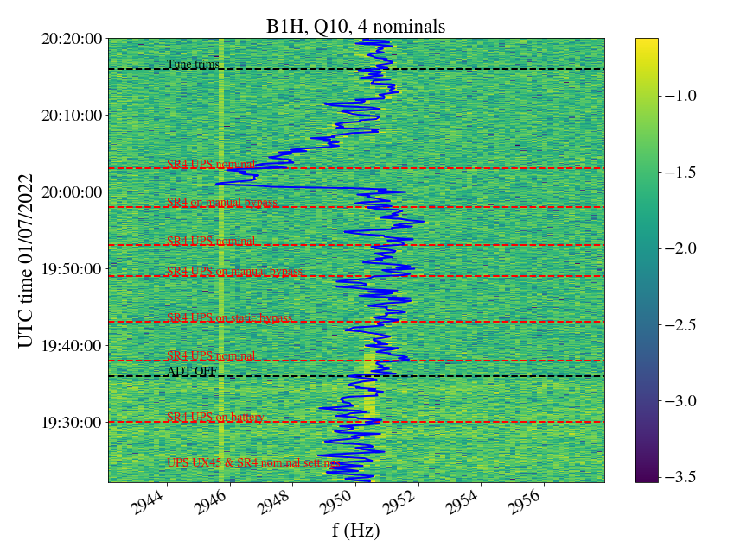
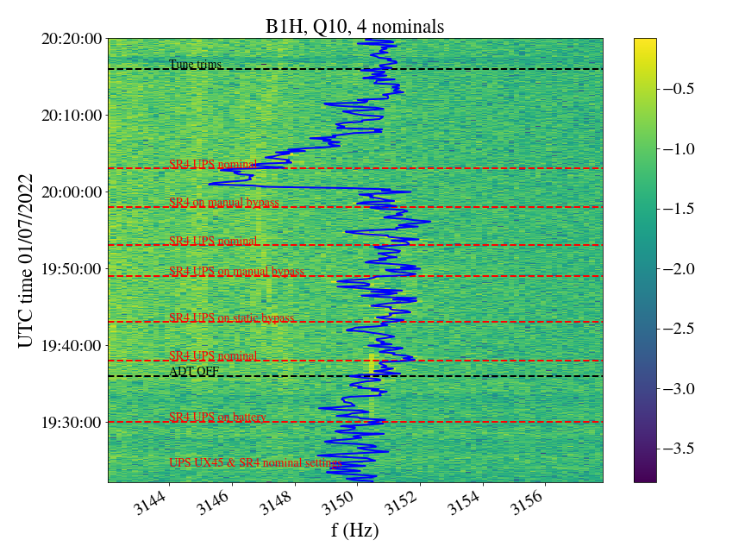
ADTObsBox spectra in MD, UPS in SR4 tests
Data from Réseau de Transport d'Électricité

Slide 15
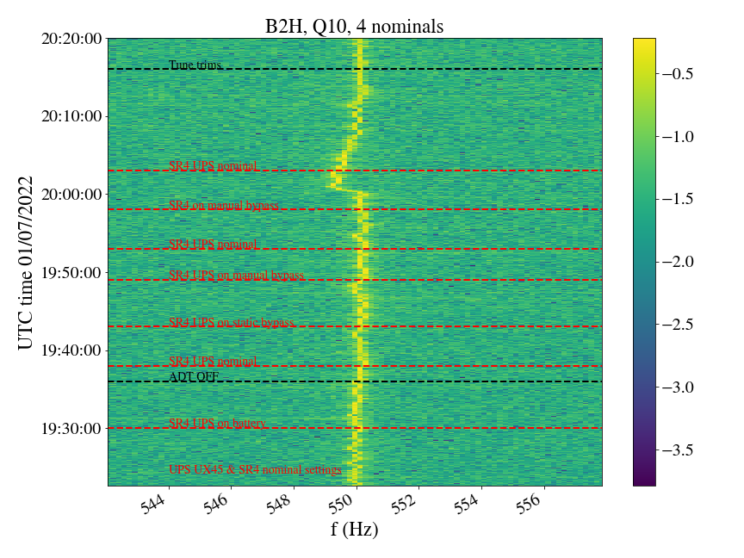
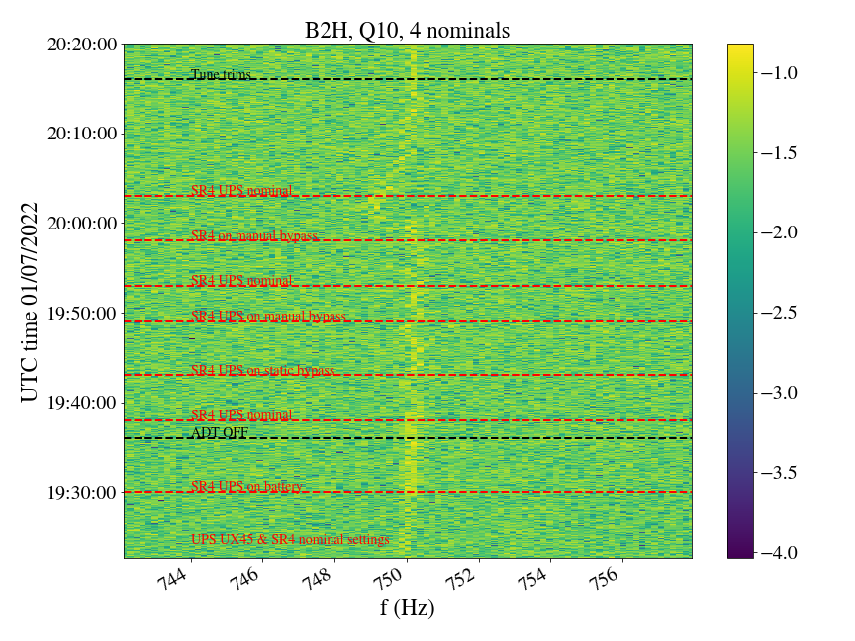
B1
B2

Slide 16
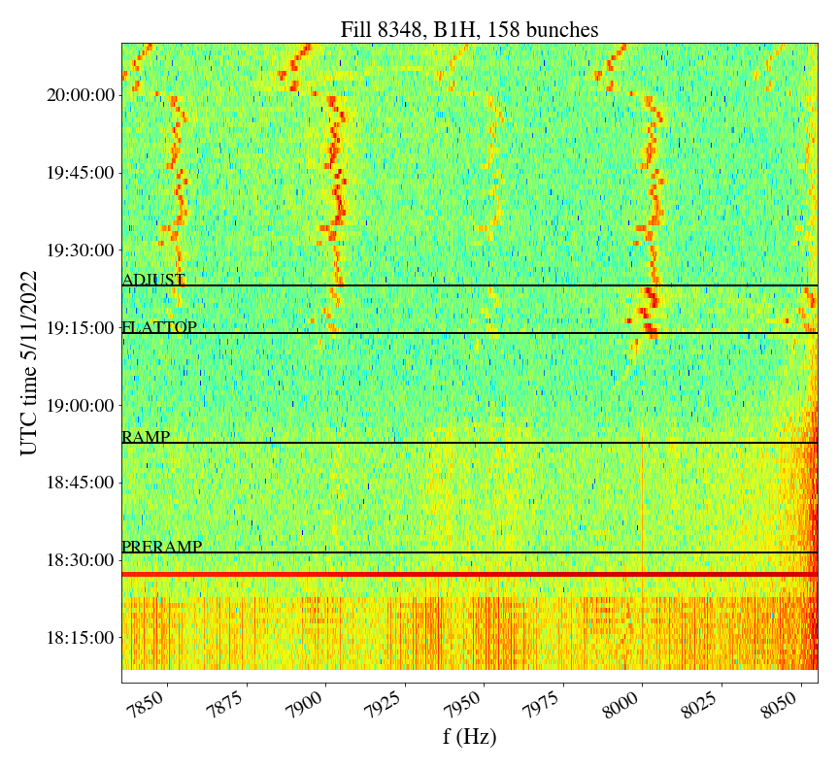
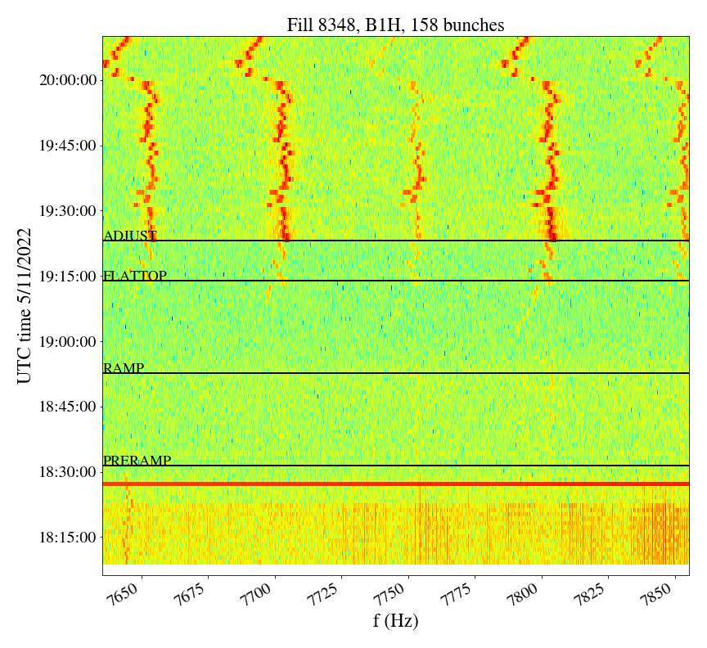
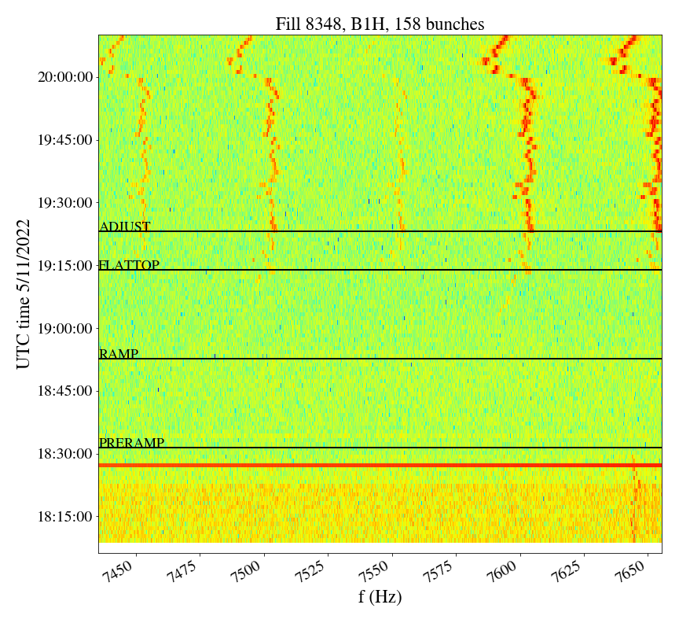
MD overview
Second MD:
  At top energy so that the 8 kHz cluster is clearly visible.
  With 3 trains of 48 bunches to have a symmetrical filling scheme.
  UPS in SR4 switched twice to battery mode and back to nominal operation
B1

Slide 17
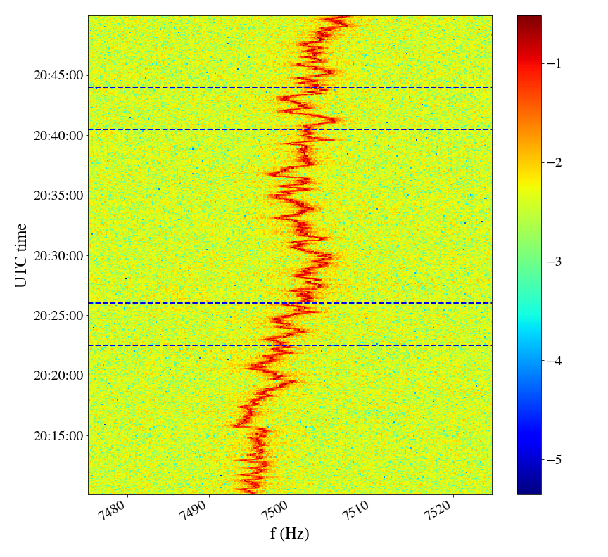
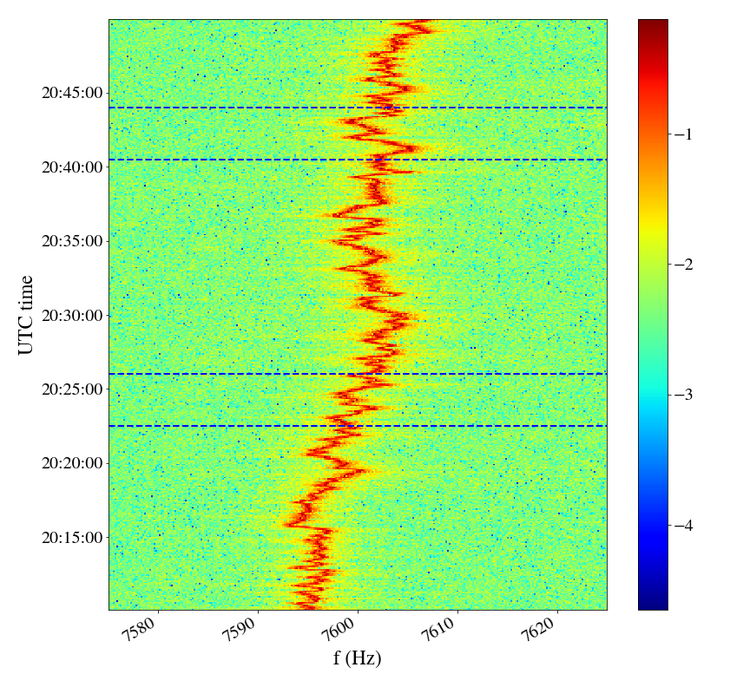
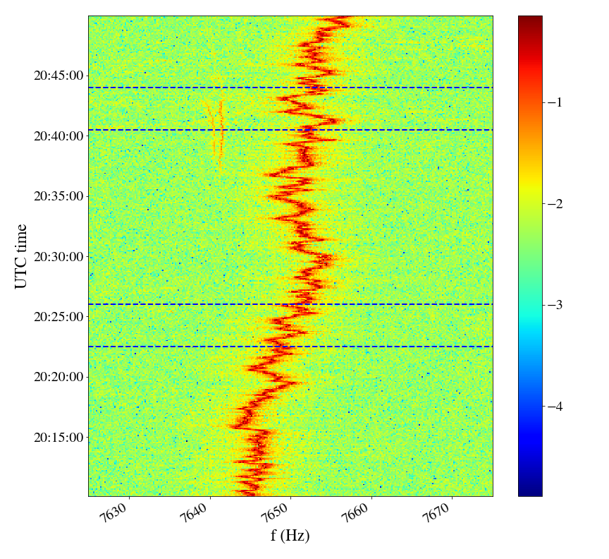
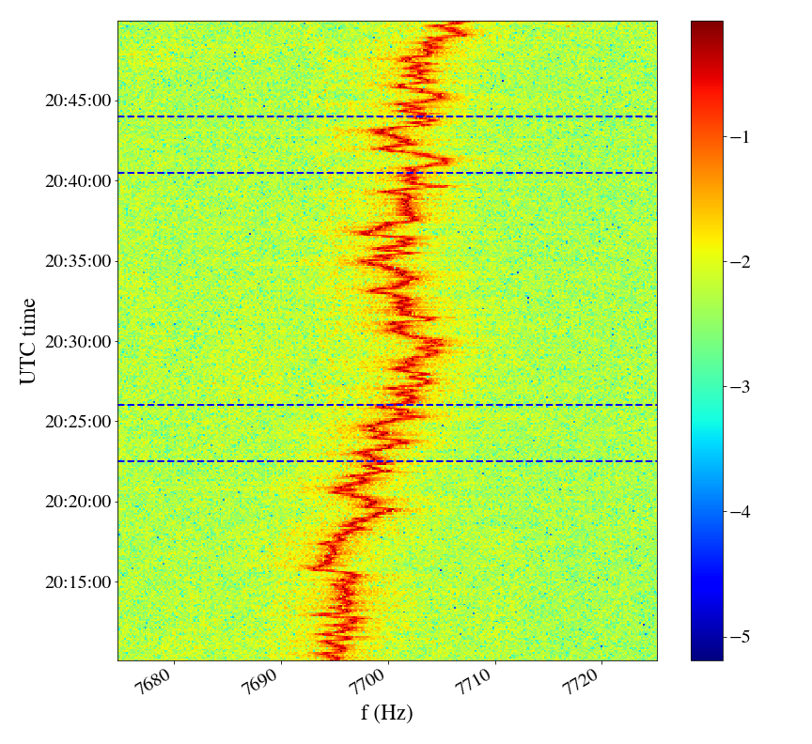
MD overview
No loss of synchronization during tests

Slide 18
Conclusions
Spectrum analysis in high-frequency range available in NXCALS thanks to M. Soderen:
  Allowed for the first time to perform a systematic fill-by-fill analysis of the transverse beam spectrum in the 2022 Run.
  Very promising tool for noise (& other?) studies.
Evolution of 8 kHz cluster is reproducible in all 2022 fills:
  8 kHz cluster is enhanced at the end of the ramp:
    What changes at this point in the fill & leads to amplitude increase?
    Could this be related to the “extra blowup” that we see during ramp?
  Did not observe any “atypical” behavior that could pinpoint to the source.

Slide 19
Conclusions
MD results: Investigated impact of some UPSs thanks to J. Emonds & D. Ribiollet
  At injection with 4-6 bunches:
    8 kHz cluster could not be observed and studied and injection with a few bunches.
    No impact from UX45 UPSs but impact on some low-order harmonics from UPS in SR4 when switched to battery mode→ focused on this UPS for next MD.
  At flat top with 3x48 bunches:
    8 kHz cluster clearly visible after end of ramp.
    No impact on the 8 kHz cluster when SR4 UPS switched to “battery” mode.

Slide 20
Conclusions
Next steps are unclear:
  Only tested a few UPSs.
  Not having the possibility of remote UPS operation adds complexity:
    Changing to “battery” mode (clearest signature to detect) not possible without remote control for UPSs that require access.
    Changing to other modes of operation (more difficult to detect on beam spectrum) when access is needed: too much MD time to test at top energy.
  Other sources?

