Slide 1
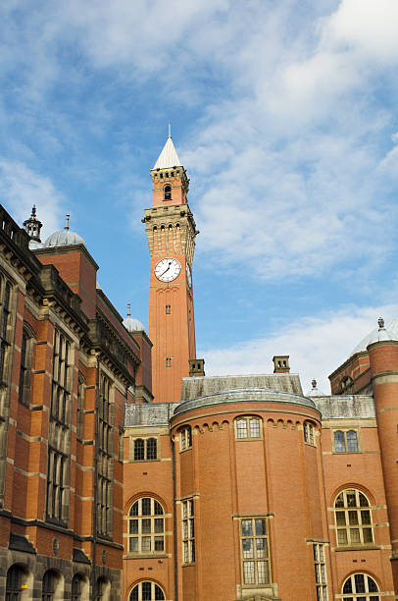
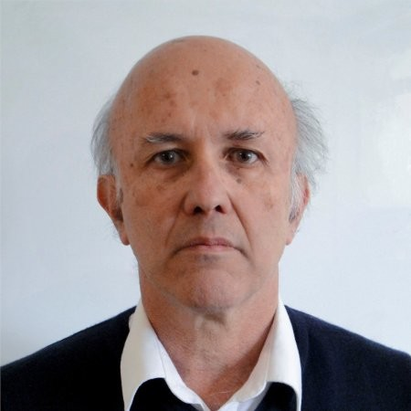
Higher Twists & Hyperons
Tribute to Orlando Villalobos Baillie, Birmingham University
Using materials from:
F. Antinori
M. Benayoun
D. Evans
J.B. Kinson
E. Quercigh
…
Karel Šafařík, Czech Technical University (ČVUT), Prague
This contribution is supported by the project Centre of Advanced Applied Sciences with the number: CZ.02.1.01/0.0/0.0/16-019/0000778 Project Centre of Advanced Applied Sciences is co-financed by European Union

Slide 2
Overview of the talk
Introduction – Heavy-Ion Physics in ČSFR
ALICE experiment – history
Hardware contribution
Computing
Physics analyses
Future development

Slide 3
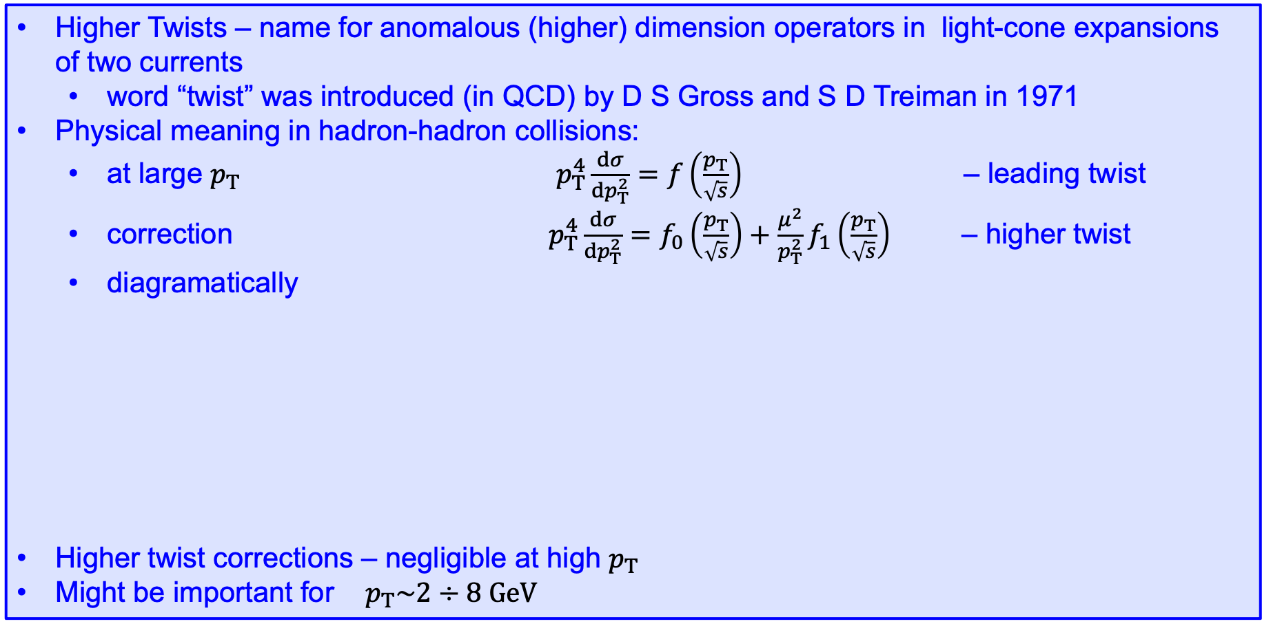
Higher Twists (Power corrections)
Higher Twists – name for anomalous (higher) dimension operators in light-cone expansions of two currents
  word “twist” was introduced (in QCD) by D S Gross and S D Treiman in 1971
Physical meaning in hadron-hadron collisions:
  at large $p_{T}$ $p_{T}^{4}\frac{dσ}{dp_{T}^{2}}=f\left(\frac{p_{T}}{\sqrt{s}}\right)$ – leading twist
  correction $p_{T}^{4}\frac{dσ}{dp_{T}^{2}}=f_{0}\left(\frac{p_{T}}{\sqrt{s}}\right)+\frac{μ^{2}}{p_{T}^{2}}f_{1}\left(\frac{p_{T}}{\sqrt{s}}\right)$ – higher twist
  diagramatically
Higher twist corrections – negligible at high $p_{T}$
Might be important for $p_{T}\sim 2÷8 GeV$
leading twist
higher twist
p₁
p₃
p₁
meson
p₂
p₄
p₂
p₃

Slide 4
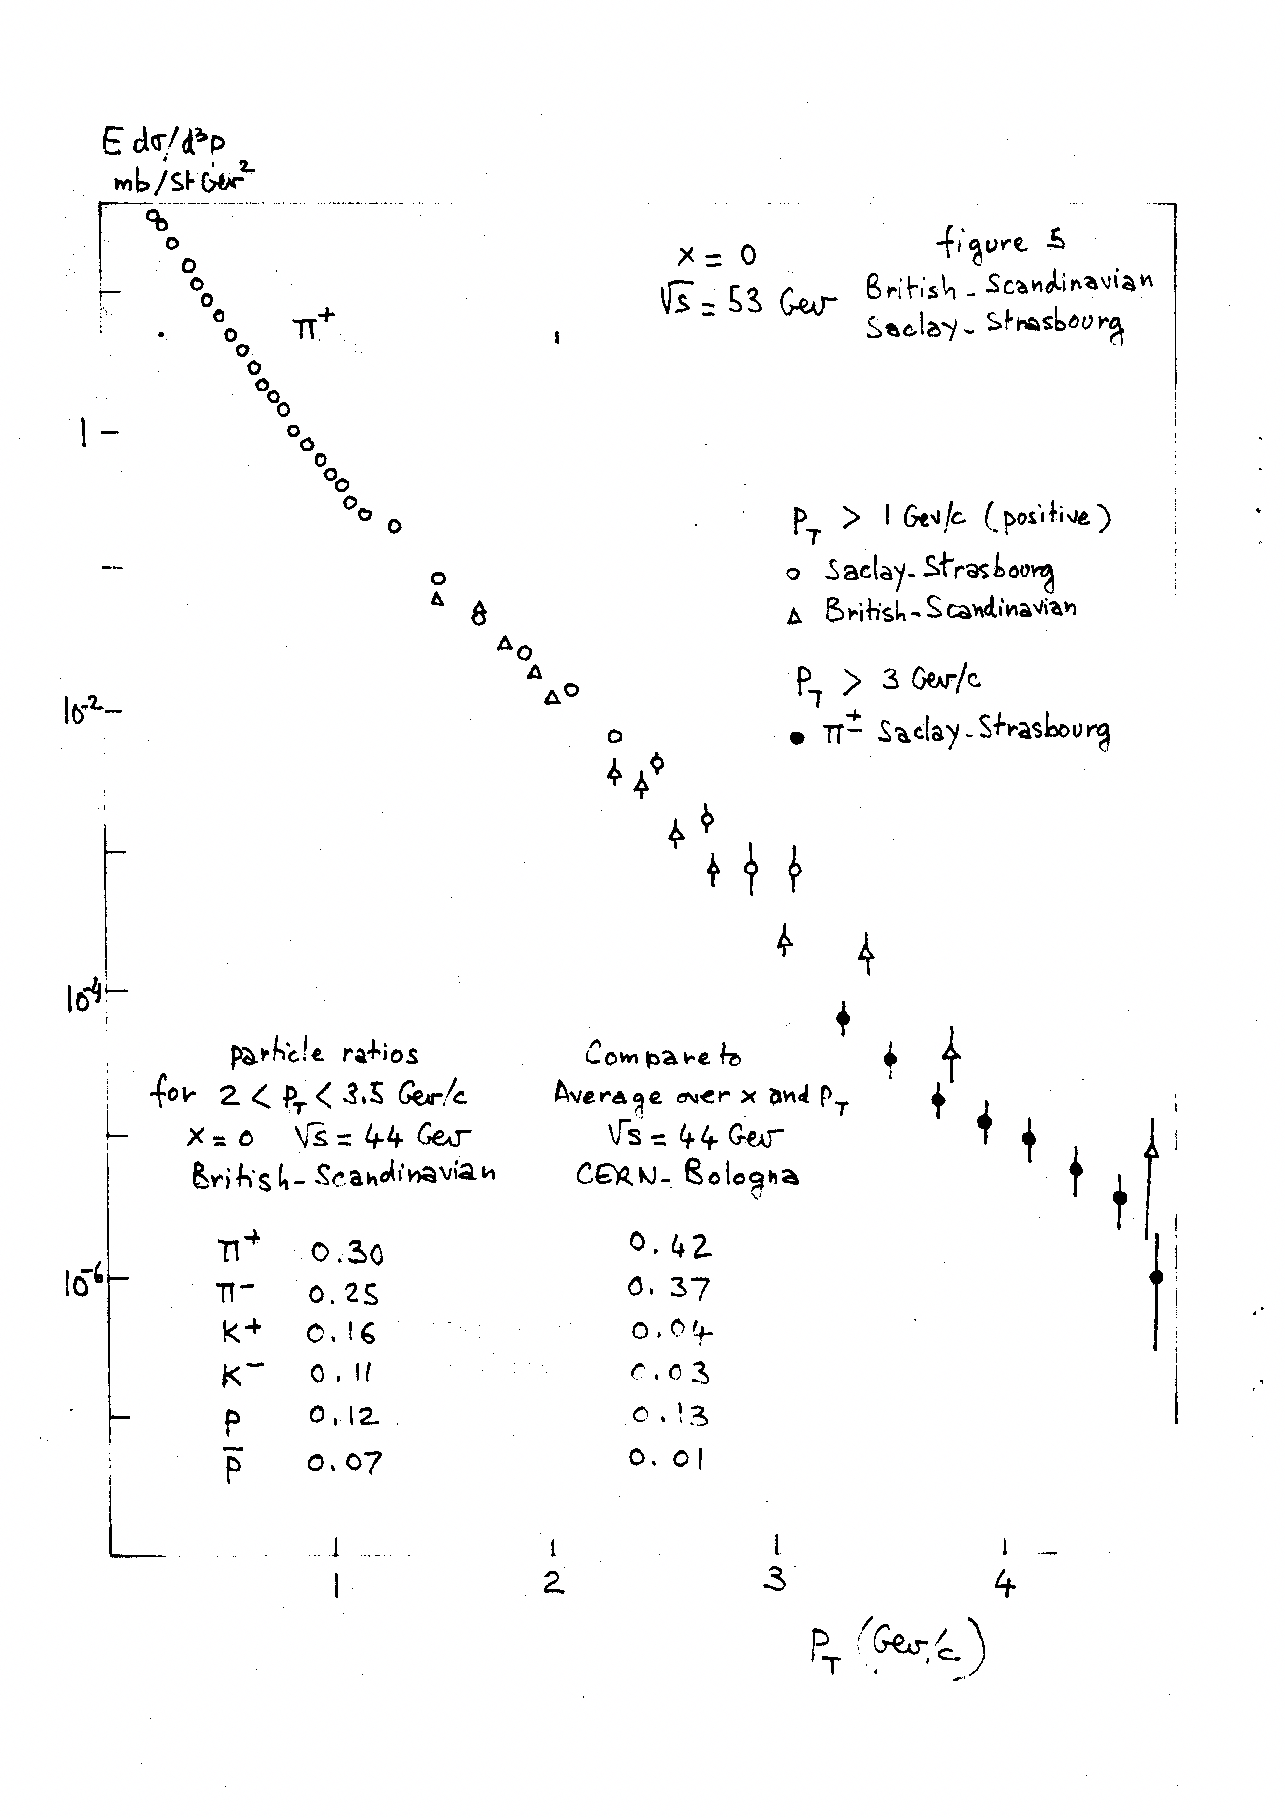
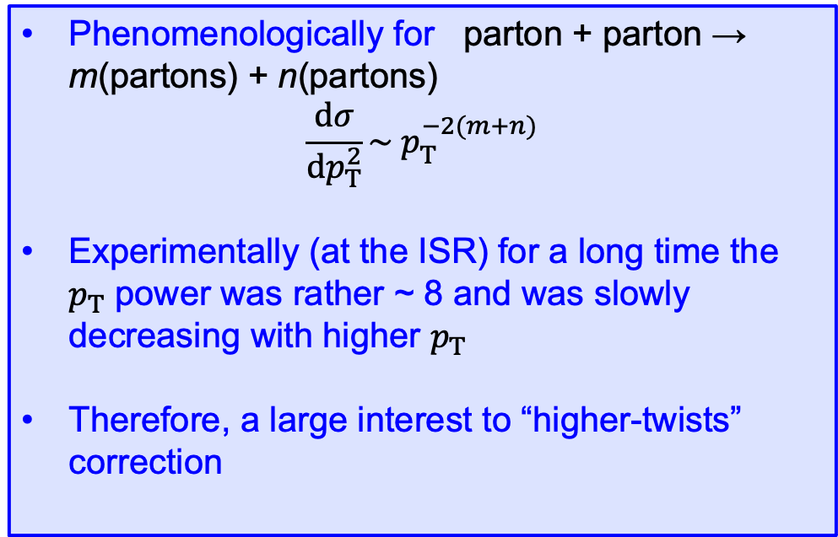
Higher Twists (Power corrections)
Phenomenologically for parton + parton → m(partons) + n(partons)
$$\frac{dσ}{dp_{T}^{2}}\sim p_{T}^{−2(m+n)}$$
Experimentally (at the ISR) for a long time the $p_{T}$ power was rather ~ 8 and was slowly decreasing with higher $p_{T}$
Therefore, a large interest to “higher-twists” correction
M.Jacobs Fields Quanta: 3 (1974)

Slide 5
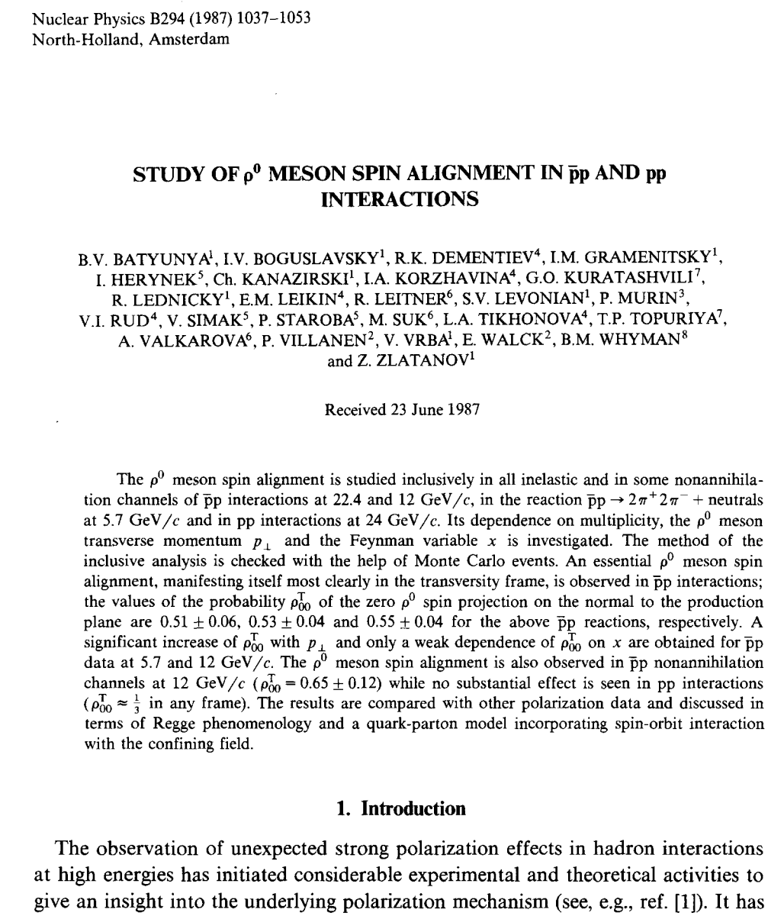
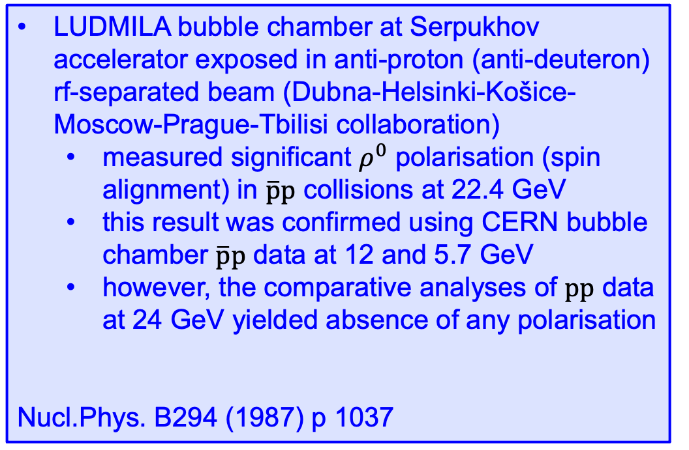
On the other side of “the wall”
LUDMILA bubble chamber at Serpukhov accelerator exposed in anti-proton (anti-deuteron) rf-separated beam (Dubna-Helsinki-Košice-Moscow-Prague-Tbilisi collaboration)
  measured significant $ρ^{0}$ polarisation (spin alignment) in $\overline{p}p$ collisions at 22.4 GeV
  this result was confirmed using CERN bubble chamber $\overline{p}p$ data at 12 and 5.7 GeV
  however, the comparative analyses of $pp$ data at 24 GeV yielded absence of any polarisation
Nucl.Phys. B294 (1987) p 1037

Slide 6
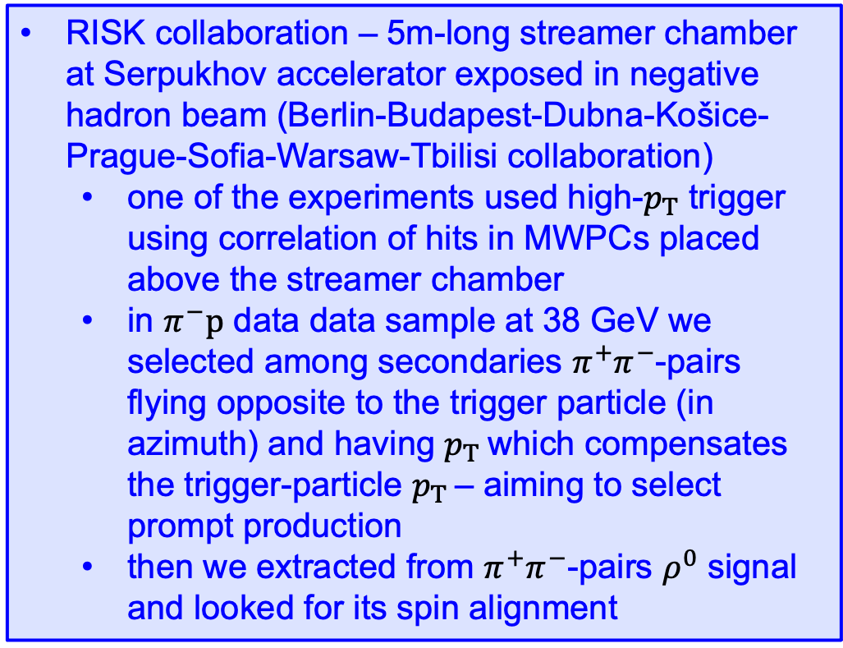
RISK experiment
RISK collaboration – 5m-long streamer chamber at Serpukhov accelerator exposed in negative hadron beam (Berlin-Budapest-Dubna-Košice-Prague-Sofia-Warsaw-Tbilisi collaboration)
  one of the experiments used high-$p_{T}$ trigger using correlation of hits in MWPCs placed above the streamer chamber
  in $π^{−}p$ data data sample at 38 GeV we selected among secondaries $π^{+}π^{−}$-pairs flying opposite to the trigger particle (in azimuth) and having $p_{T}$which compensates the trigger-particle $p_{T}$– aiming to select prompt production
  then we extracted from $π^{+}π^{−}$-pairs $ρ^{0}$ signal and looked for its spin alignment

Slide 7

$ρ^{0}$ polarisation
RISK collaboration: Z.Part.Phys. C 49 (1991) p 245

Slide 8
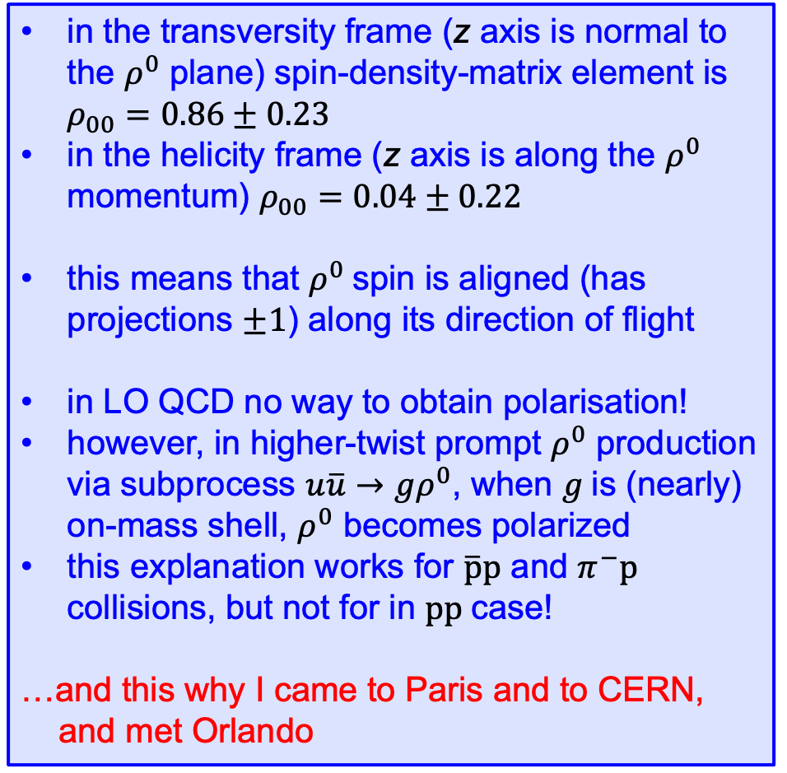
$ρ^{0}$ polarisation
in the transversity frame (z axis is normal to the $ρ^{0}$ plane) spin-density-matrix element is $ρ_{00}=0.86±0.23$
in the helicity frame (z axis is along the $ρ^{0}$ momentum) $ρ_{00}=0.04±0.22$
this means that $ρ^{0}$spin is aligned (has projections $±1$) along its direction of flight
in LO QCD no way to obtain polarisation!
however, in higher-twist prompt $ρ^{0}$ production via subprocess $u\overline{u}→gρ^{0}$, when $g$is (nearly) on-mass shell, $ρ^{0}$ becomes polarized
this explanation works for $\overline{p}p$ and $π^{−}p$ collisions, but not for in $pp$case!
…and this why I came to Paris and to CERN,
and met Orlando

Slide 9
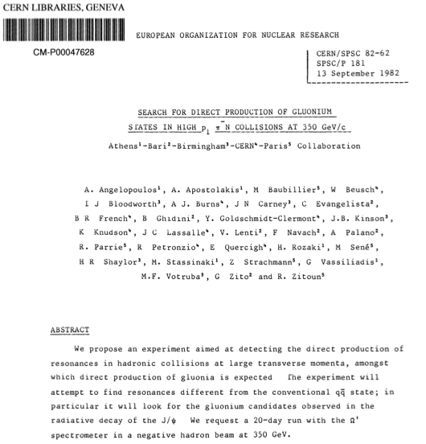
… back to CERN
In 1982 E Quercigh with collaborators submitted to SPSC proposal P181, became WA77

Slide 10
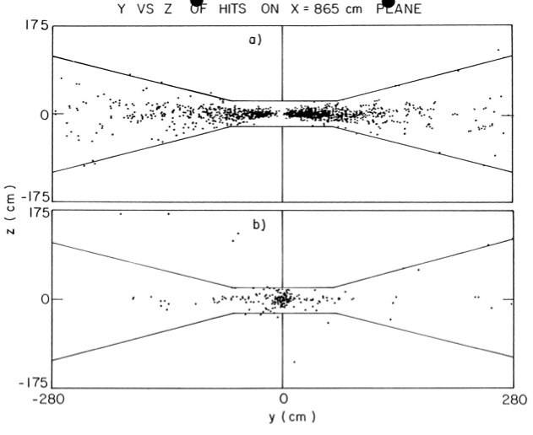
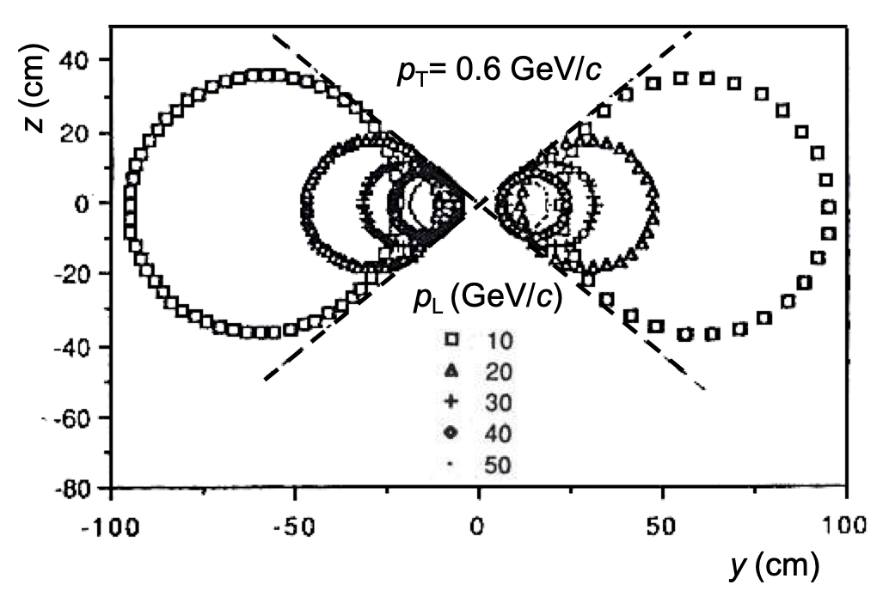

Trigger with “butterfly”
To suppress low-$p_{T}$particles in the trigger, use the butterfly shaped trigger detectors. This idea became later very fruitful.
$p_{T}<0.6$ GeV
hadrons
γ conversions

Slide 11
“Butterflied” Detectors
Scintillator hodoscopes HZ1 and HZ2
MWPCs MY1/2 and MY3/4 (two sensitive planes each)
  cathode made of 12 μm mylar foil with graphite paint divided into 3 insulated regions
  to make a region unsensitive the cathode high voltage was lowered by ~ 20%
  planes MY1(2) and MY3(4) were sensitive only in upper(lower) region
HZ2
W Beusch et al. NIM A249 (1986) 391

Slide 12

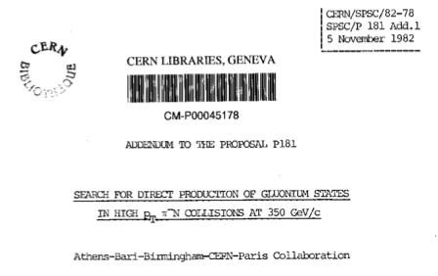
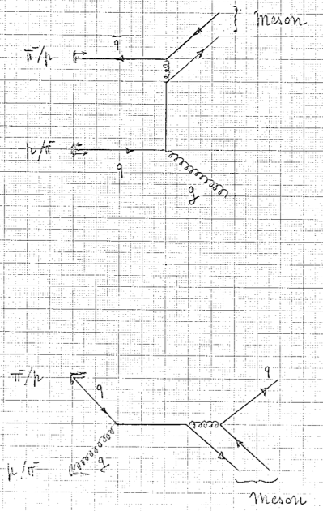
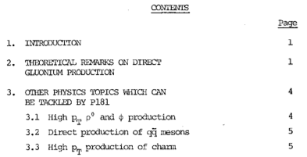
Prompt meson production – addendum
WA77 became higher-twists experiment

Slide 13
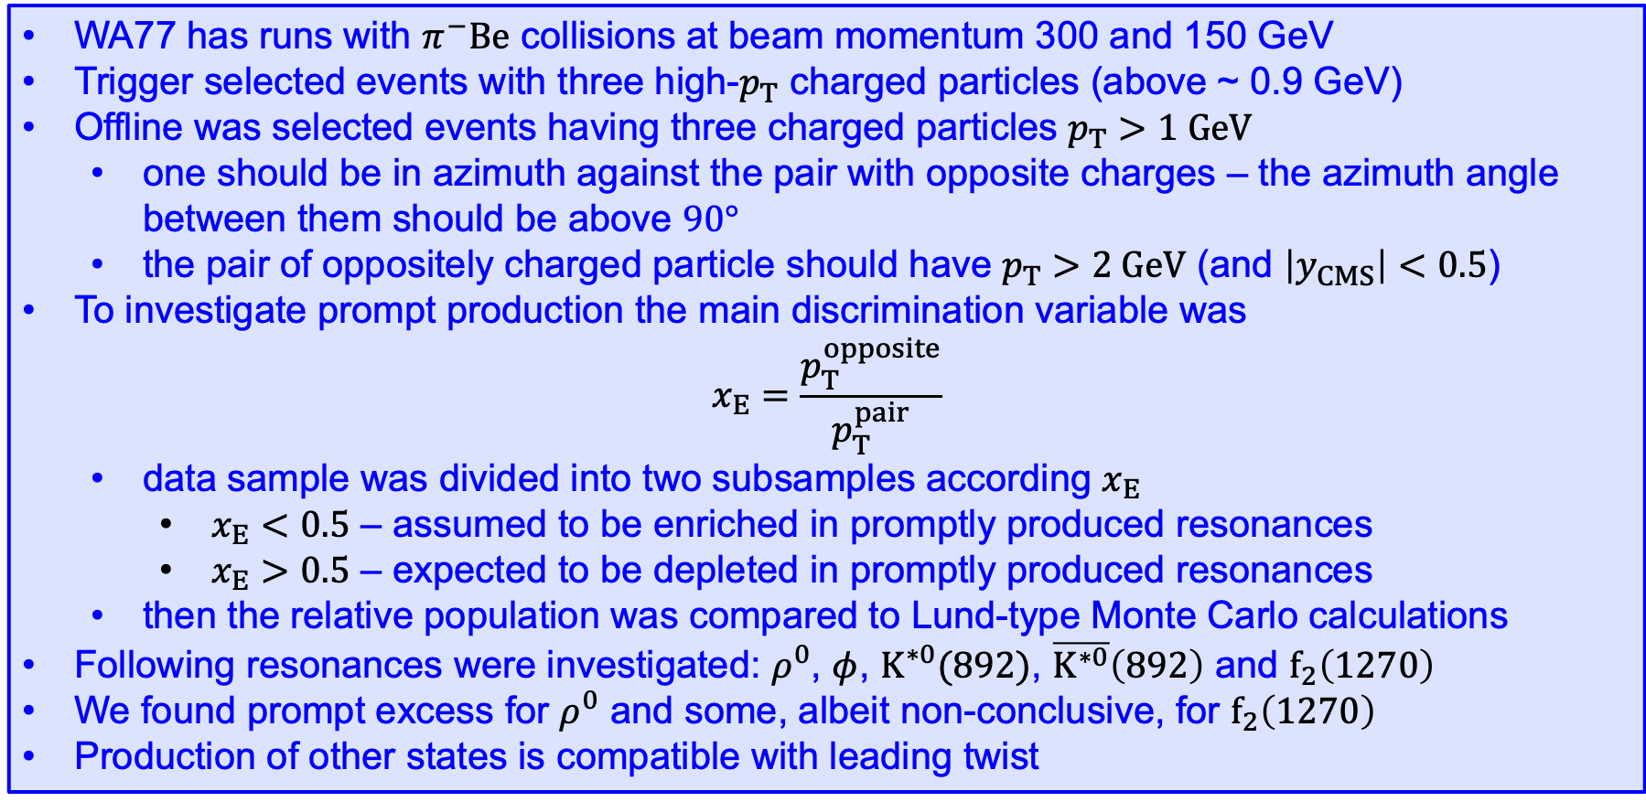
Search for Higher Twists
WA77 has runs with $π^{−}Be$ collisions at beam momentum 300 and 150 GeV
Trigger selected events with three high-$p_{T}$ charged particles (above ~ 0.9 GeV)
Offline was selected events having three charged particles $p_{T}>1 GeV$
  one should be in azimuth against the pair with opposite charges – the azimuth angle between them should be above $90°$
  the pair of oppositely charged particle should have $p_{T}>2 GeV$ (and $\left|y_{CMS}\right|<0.5$)
To investigate prompt production the main discrimination variable was
$$x_{E}=\frac{p_{T}^{opposite}}{p_{T}^{pair}}$$
  data sample was divided into two subsamples according $x_{E}$
    $x_{E}<0.5$ – assumed to be enriched in promptly produced resonances
    $x_{E}>0.5$ – expected to be depleted in promptly produced resonances
  then the relative population was compared to Lund-type Monte Carlo calculations
Following resonances were investigated: $ρ^{0}$, $φ$, $K^{∗0}(892)$, $\overline{K^{∗0}}\left(892\right)$ and $f_{2}\left(1270\right)$
We found prompt excess for $ρ^{0}$ and some, albeit non-conclusive, for $f_{2}\left(1270\right)$
Production of other states is compatible with leading twist
WA77 collaboration, Z.Phys. C 95 (1995) 235

Slide 14
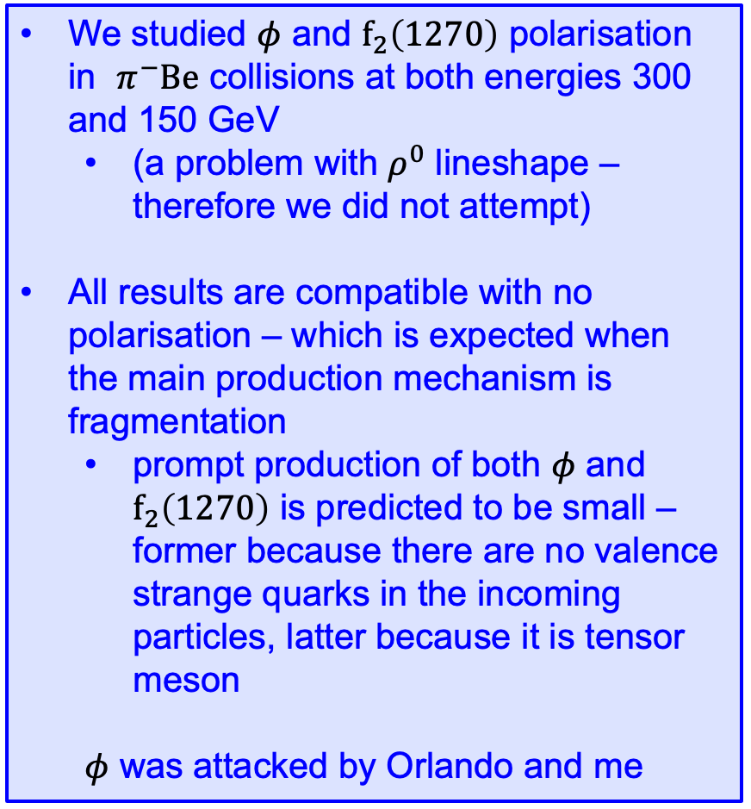
WA77 polarisation measurement
We studied $φ$ and $f_{2}\left(1270\right)$ polarisation in $π^{−}Be$ collisions at both energies 300 and 150 GeV
  (a problem with $ρ^{0}$ lineshape – therefore we did not attempt)
All results are compatible with no polarisation – which is expected when the main production mechanism is fragmentation
  prompt production of both $φ$ and $f_{2}\left(1270\right)$ is predicted to be small – former because there are no valence strange quarks in the incoming particles, latter because it is tensor meson
  $φ$ was attacked by Orlando and me
WA77 collaboration, Z.Phys. C 64 (1994) 15

Slide 15
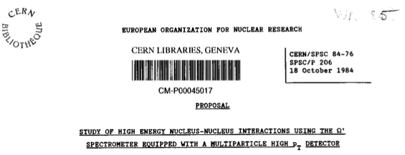
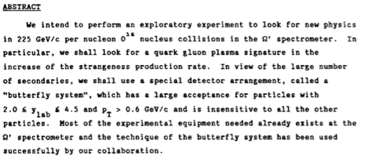
Moving to Heavy Ions
In 1984 E Quercigh with collaborators submitted to SPSC proposal P206 for O¹⁶ run at Ω

Slide 16
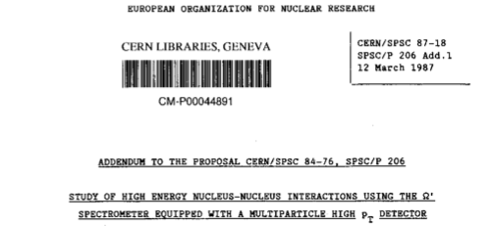
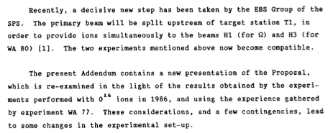
WA85 S–W experiment
Proposal P206 was originally refused due to incompatibility with WA80 experiment that was later resolved and P206 was approved in 1987 as WA85, however, for S³² beam

Slide 17
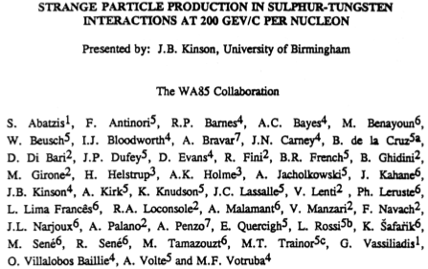
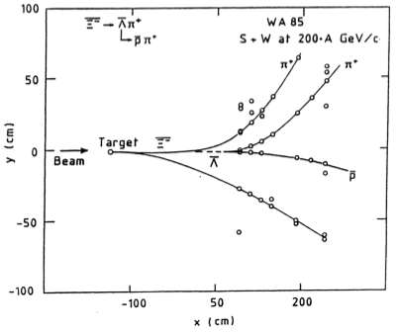

WA85 success story
WA85 experiment was extremely successful, the yields and spectres of $Λ$, $Ξ^{−}$ and even $Ω^{−}$ hyperons were measured (see Federico’s talk) – significant Birmingham participation
clean event with $Ξ^{−}$ candidate thanks to butterflied MWPCs
J B Kinson presentation at QM’91 in Gatlinburg

Slide 18
WA85 later lead by Bham
WA85 web page: http://www.ep.ph.bham.ac.uk/exp/WA85/

Slide 19
Strangeness review
Orlando and me (together with S Margetis) were asked to write a review for Ann. Rev. Part. Sci.
Thus we spent many days and nights at CERN (cafeteria) discussing and writing
Indispensable role of Orlando in English!
First ALICE simulations were shown there

Slide 20
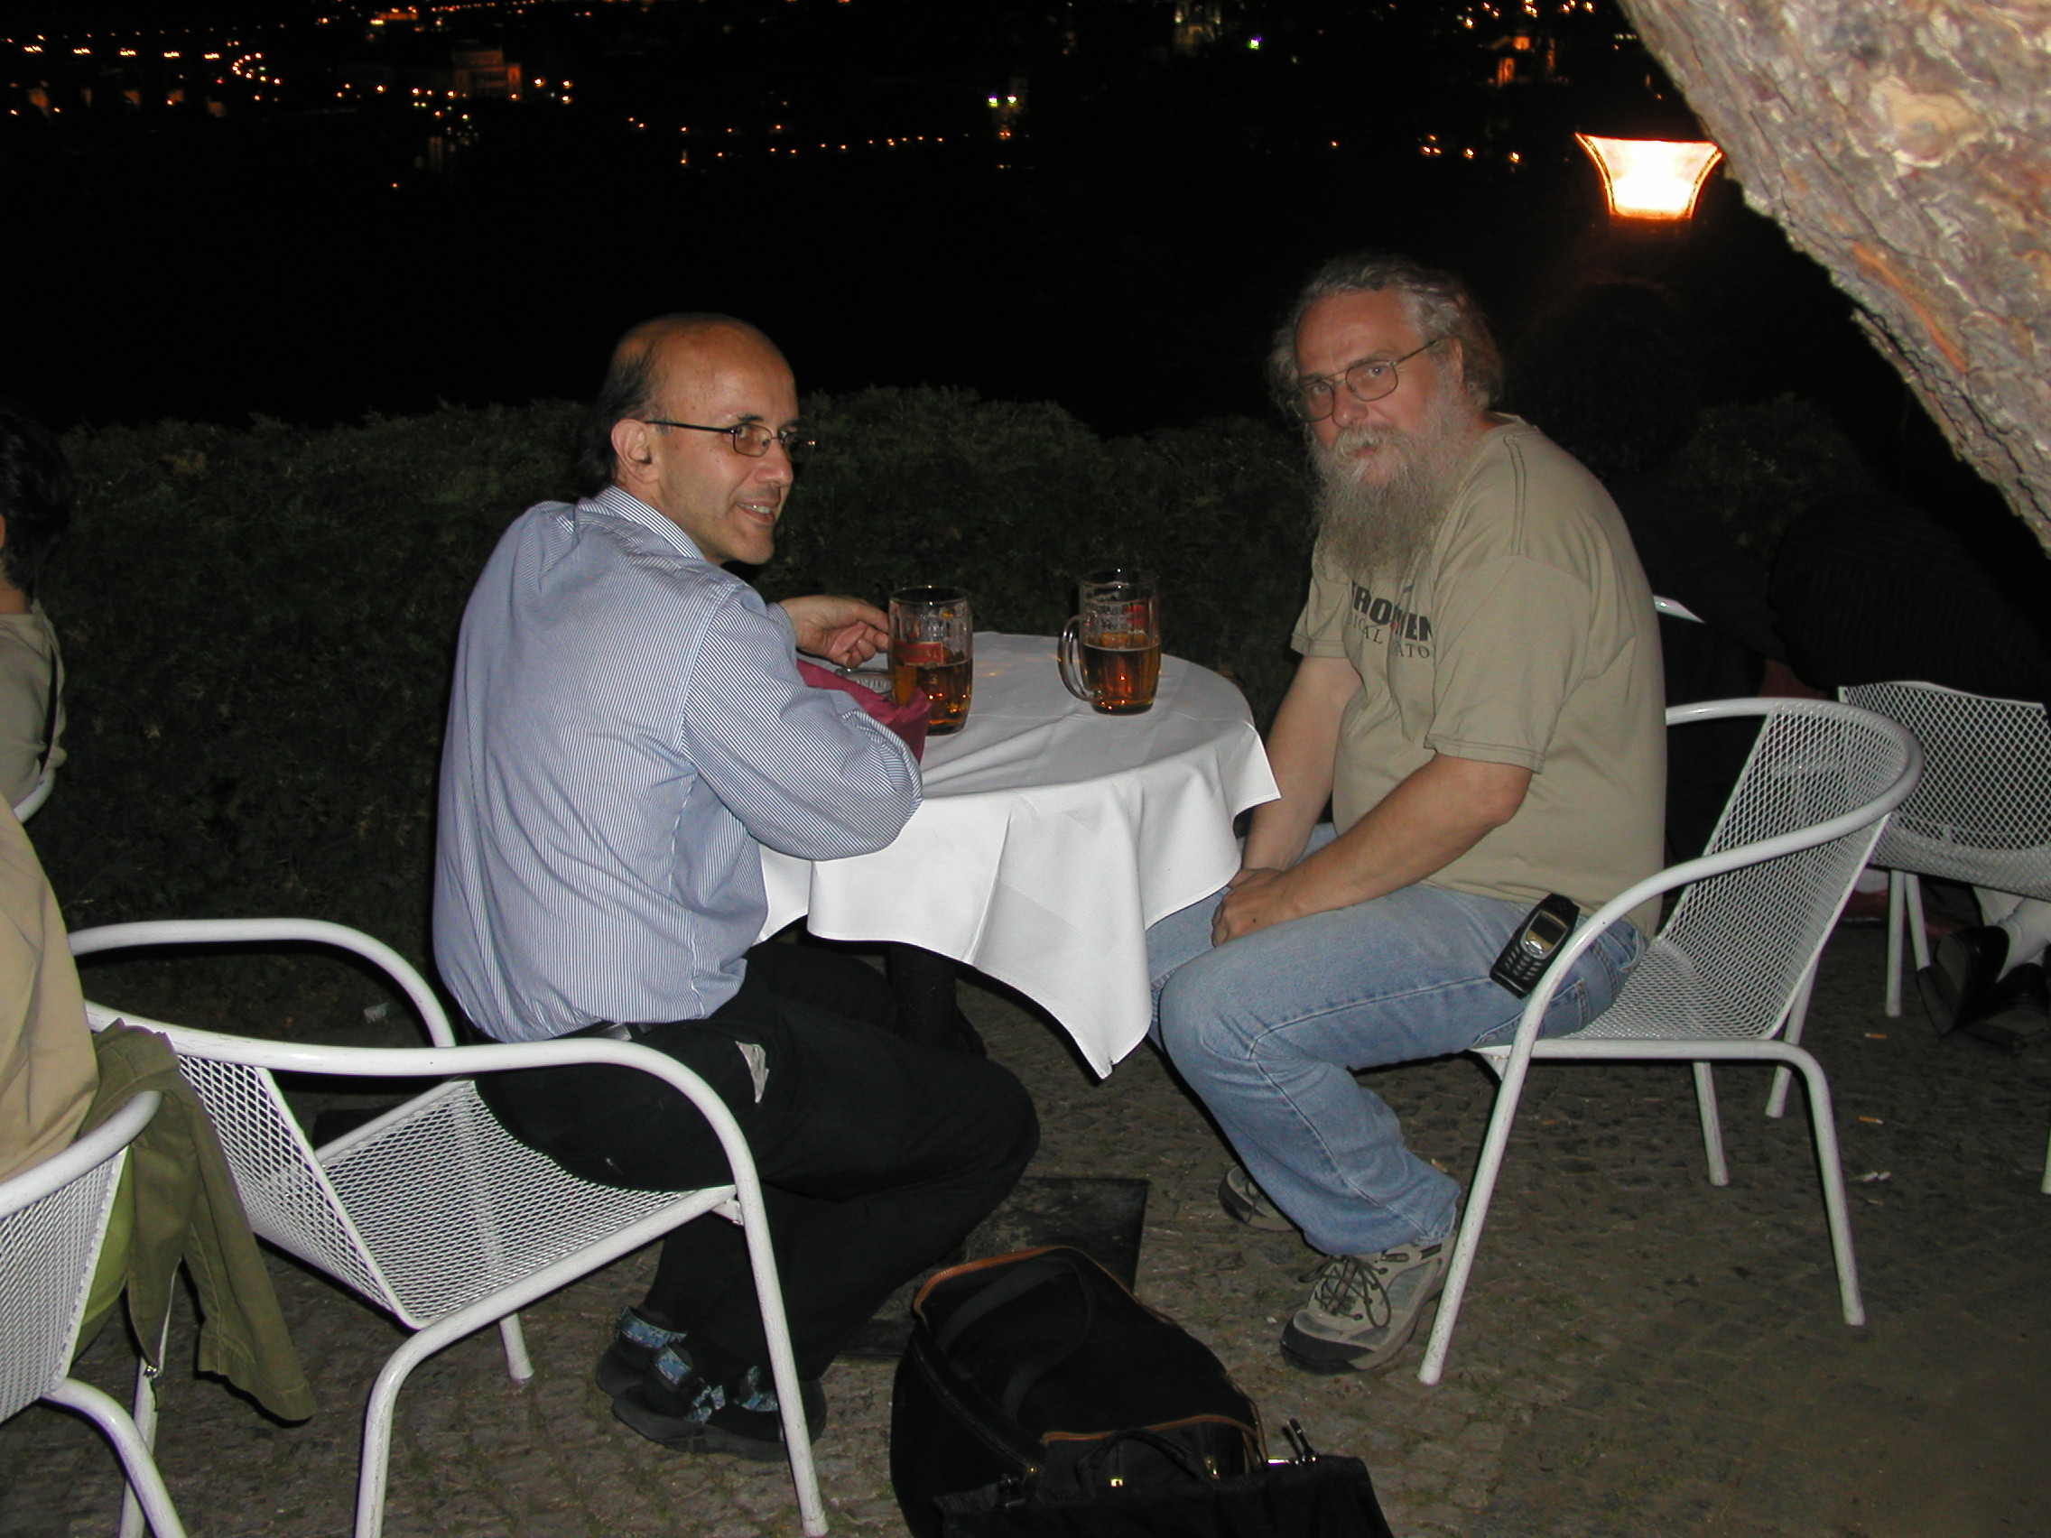
…and we spent long time at…

Slide 21
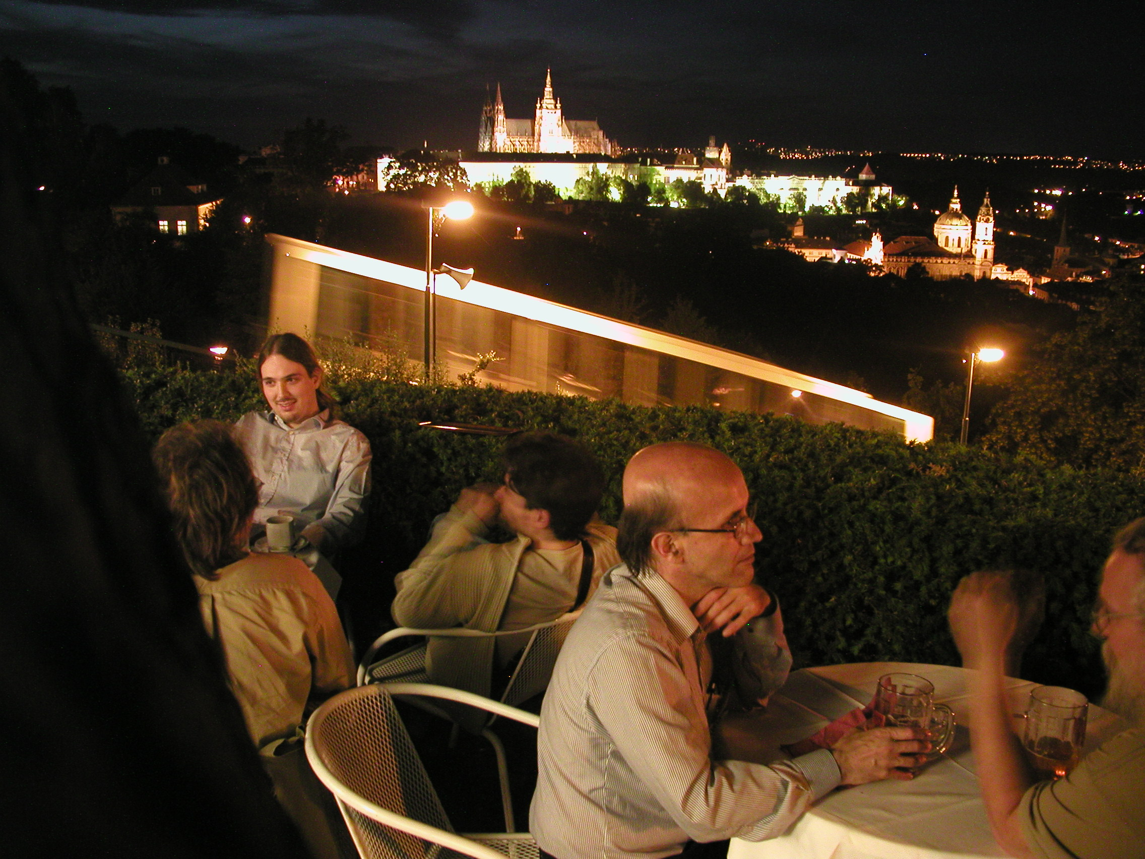
…in Prague…

Slide 22
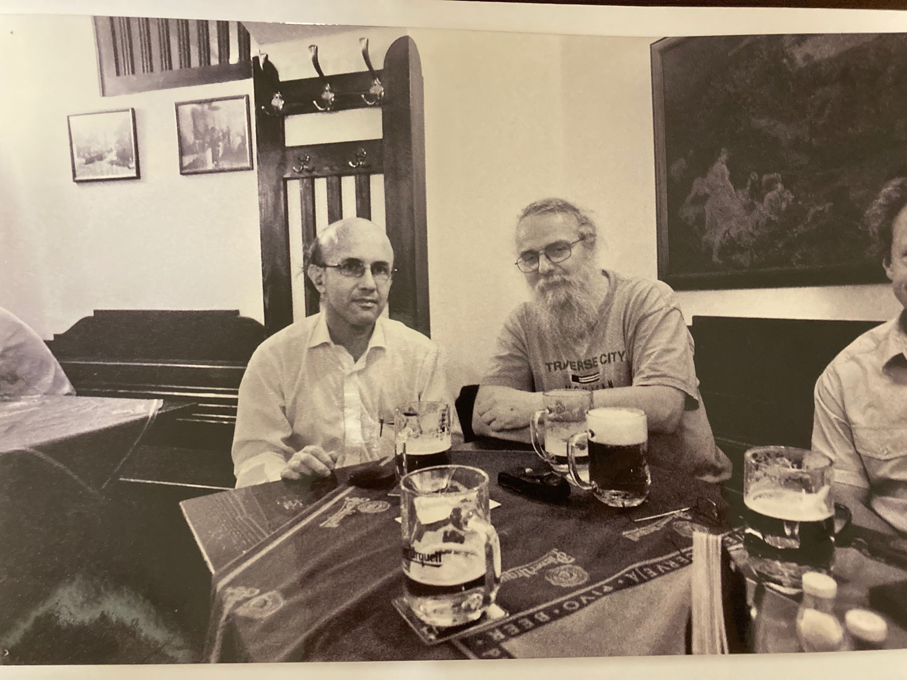
…in Prague underground…

Slide 23
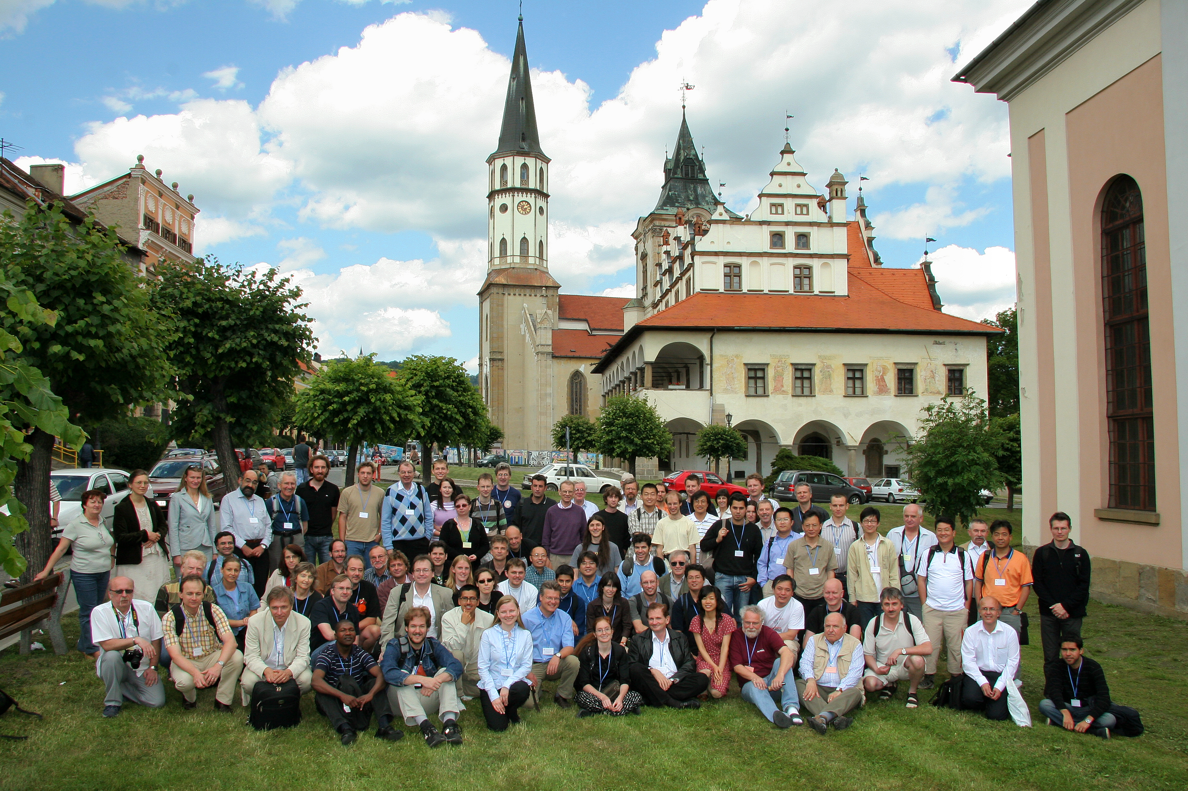
At SQM’s – Levoča 2007

Slide 24
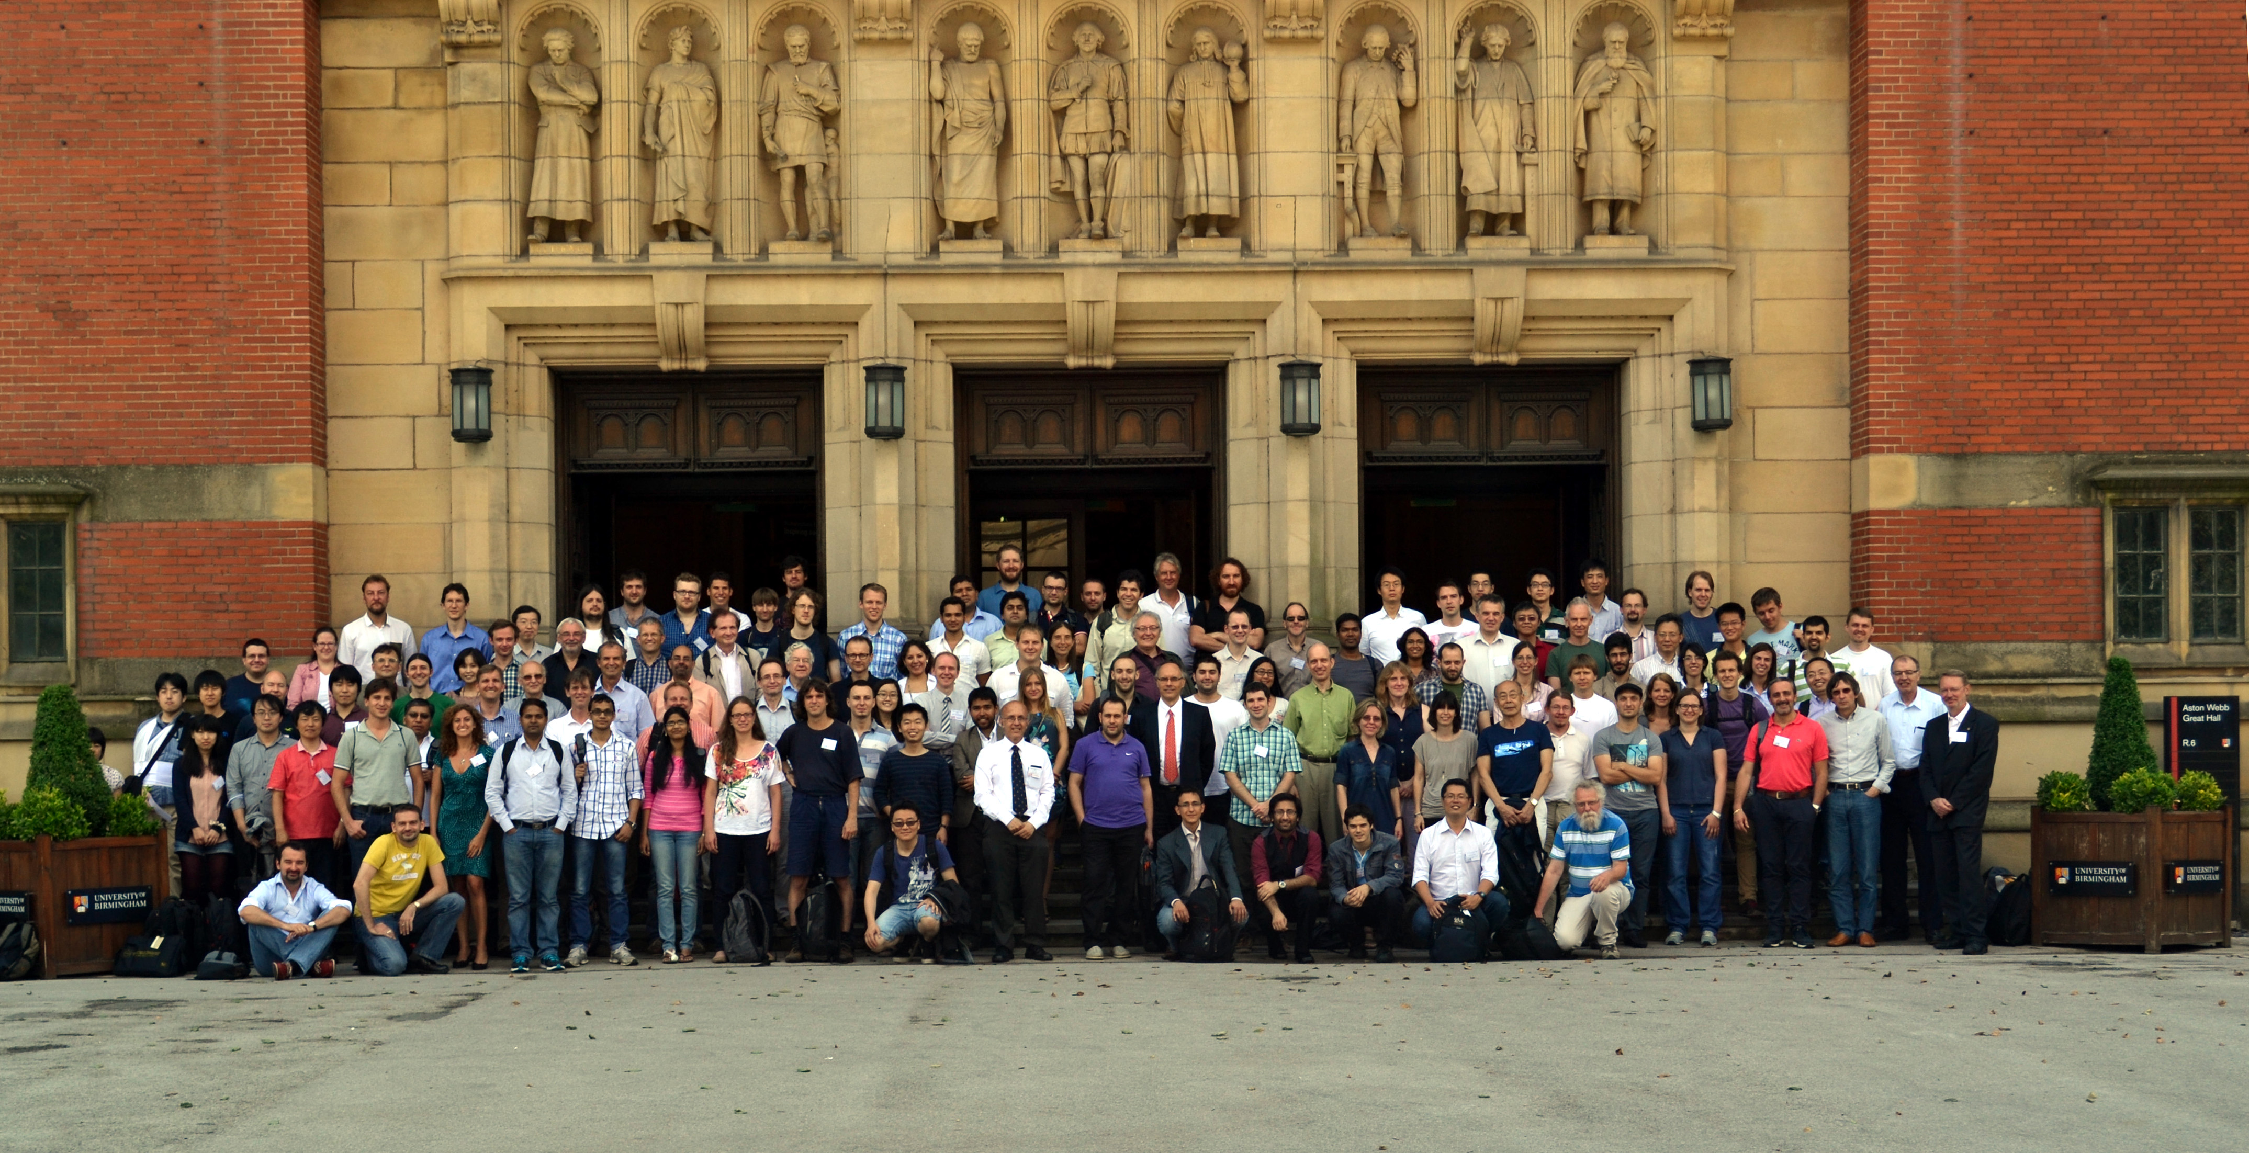
SQM Birmingham 2013

Slide 25
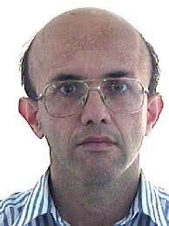
Thanks Orlando, stay like this!

