Slide 1

MIXED-VACUUM MECHANICAL CONCEPTS
MICHAEL BOOTH
Michael.booth@physics.ox.ac.uk

Slide 2
Contents
Main Presentation
Evaluation of the Mixed-vacuum approach.
Maintenance Tube: The “linchpin concept” that ties it together.
Thin-foil Shield
  Tension tests, conclusions & possible next steps
Wire/Fibre Shield
  Proposed layout, feasibility & prototyping option
Open/Closed Position Mechanics
  Concept mechanism, linkage & setup requirements
Extra Slides
Wakefield Suppressor design thoughts
Note:
2

Slide 3
Evaluation of the Mixed-Vacuum Approach
“Mixed-Vacuum” refers to the elimination of the electronics boxes, combining CERN Primary and VeLo Secondary vacuum volumes
Advantages
Enables ultra-thin foil geometries without ΔP considerations.
Lower impedance contribution in open and closed VeLo positions.
Modules closer to beam (~1mm).
Connection to beam path monitoring may allow fine-adjustment of modules and minimising the beam clearance.
Disadvantages
UHV compatibility of mechanisms and electronics.
Complex remotely actuated maintenance system.
Additional ‘dead’ chamber upstream of the VeLo, on the order of 2m length.
  Opportunity for detector development
3

Slide 4
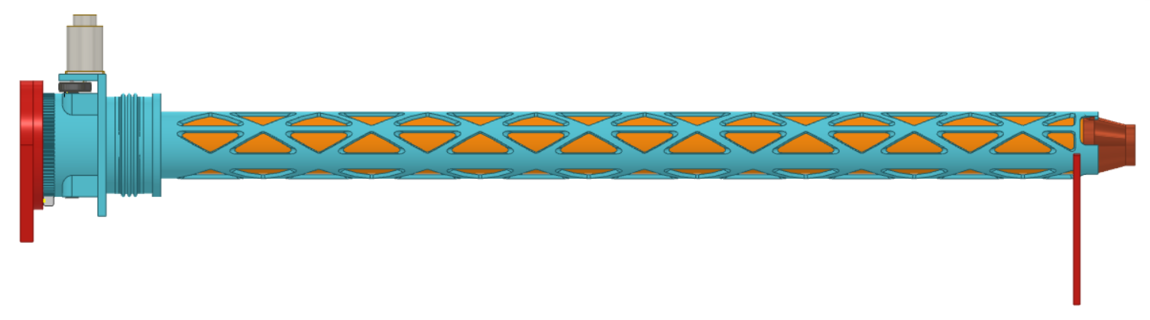
Maintenance Tube – The “linchpin concept”
Higher radiation load to the modules requires more frequent maintenance. Mixed-Vacuum complicates this, as we can’t afford to contaminate the primary vacuum with un-baked surfaces.
To minimise bakeout and cleaning, the “Maintenance Tube” aims to separate the VELO Chamber from the primary vacuum during maintenance stops.
Outer View
Downstream
Beampipe
US-Seal
Rack&Pinion
Outer Tube
Seal Tube
Claw Restraint
Upstream mechanism
Rail Support
4

Slide 5
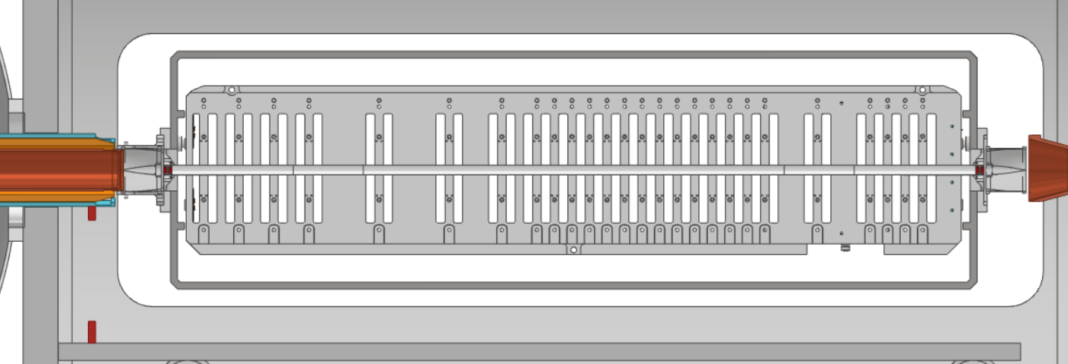
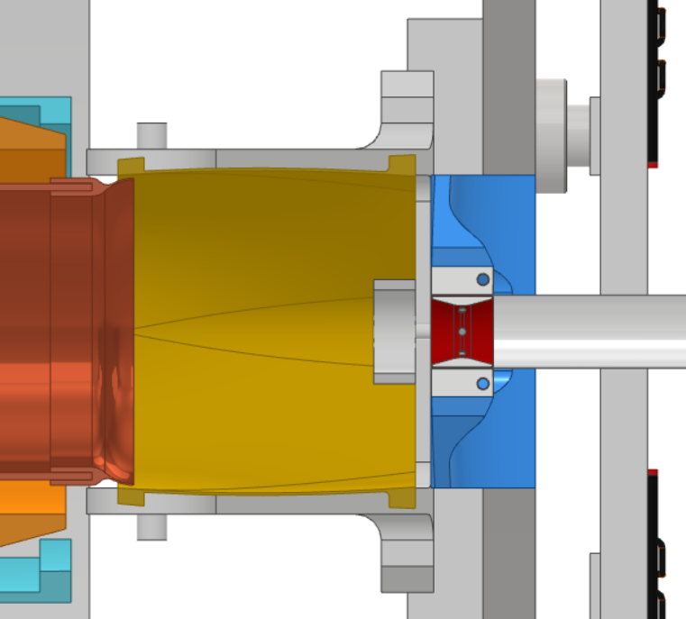
Maintenance Tube – Operation
STAGE 0: Begin Maintenance Operation.
Side View
“Fixed” Beampipe
Electronics Box Placeholder
“Fixed” Beampipe
RF Spring Collar
Ultra-thin Foil Tension Mechanics
Placeholder WFS
“Normal Operation”
5

Slide 6
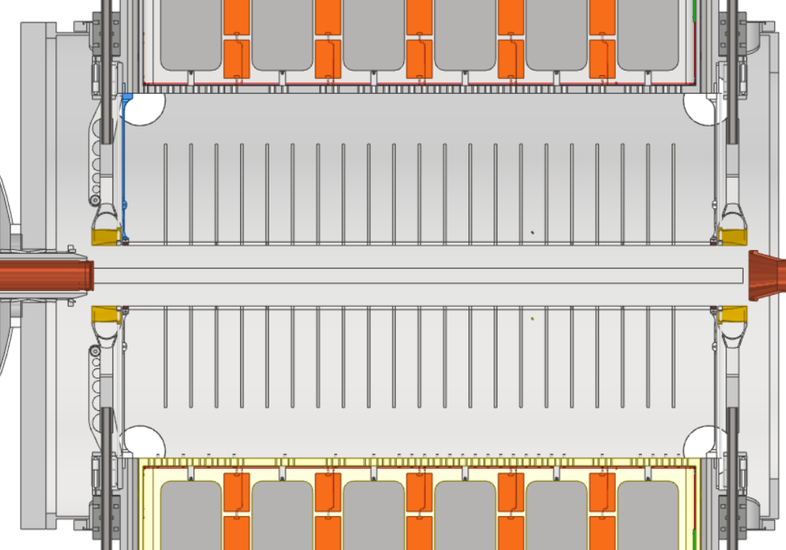
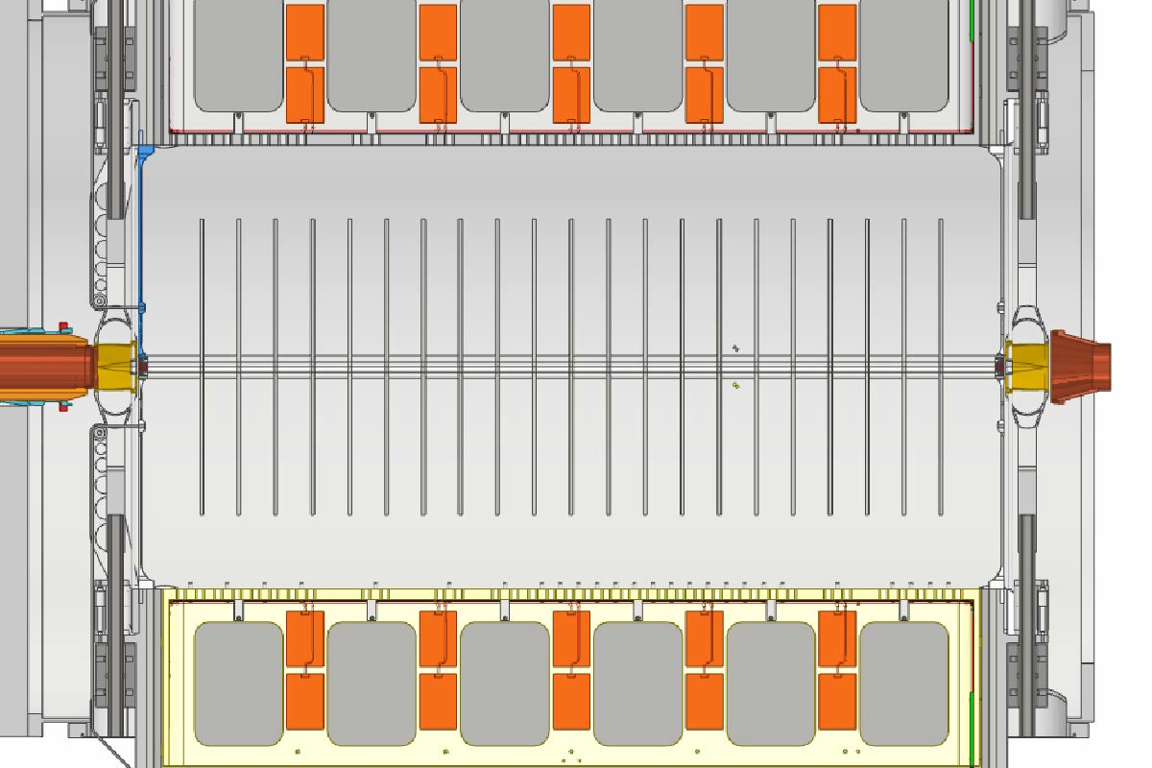
Maintenance Tube – Operation
STAGE 1: Retract modules and RF shielding
Top View
Note: Movement of modules is 60 mm on each side
6

Slide 7
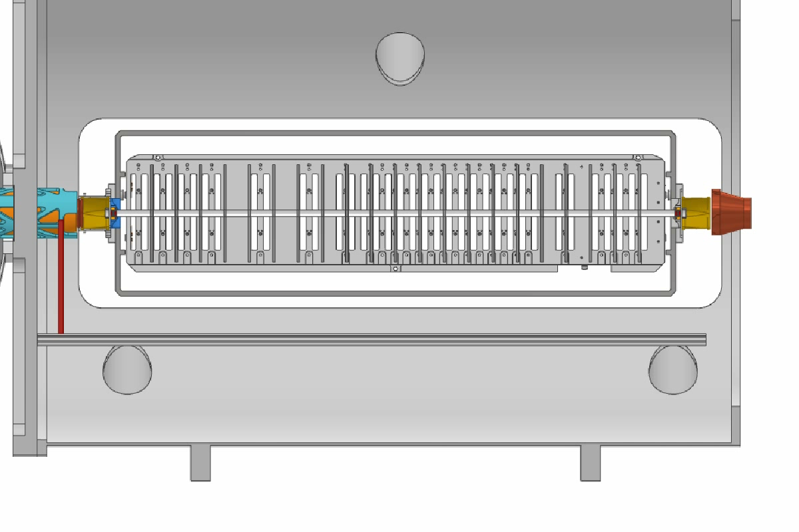
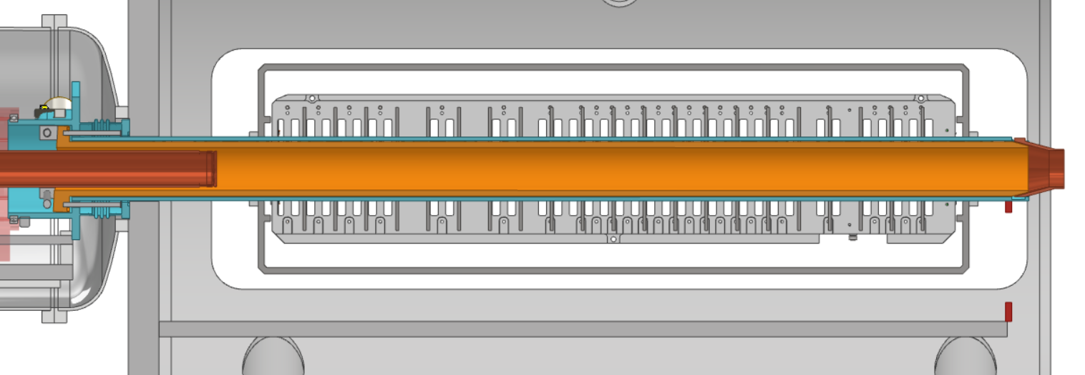

Maintenance Tube – Operation
STAGE 2: Seal Tube Assembly moved on rails, supported in both upstream and main VeLo chambers.
Side View
7

Slide 8
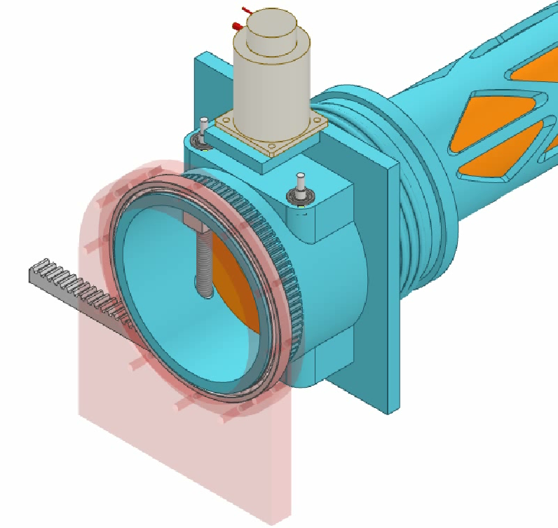
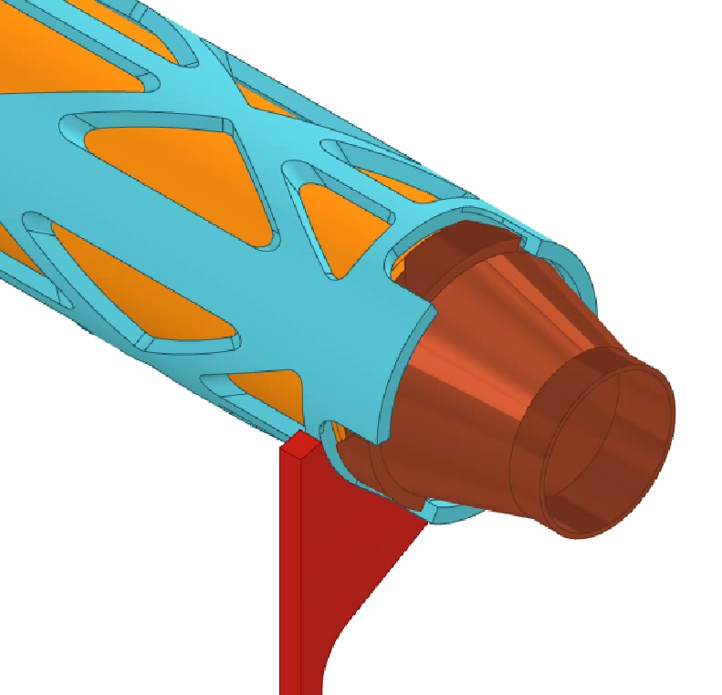
Maintenance Tube – Operation
STAGE 3: Seal-Tube assembly is rotated by 60 degrees to engage the claw restraint on the downstream beampipe. This serves to balance the compression loads on the vacuum seals
Upstream View
Downstream View
8

Slide 9
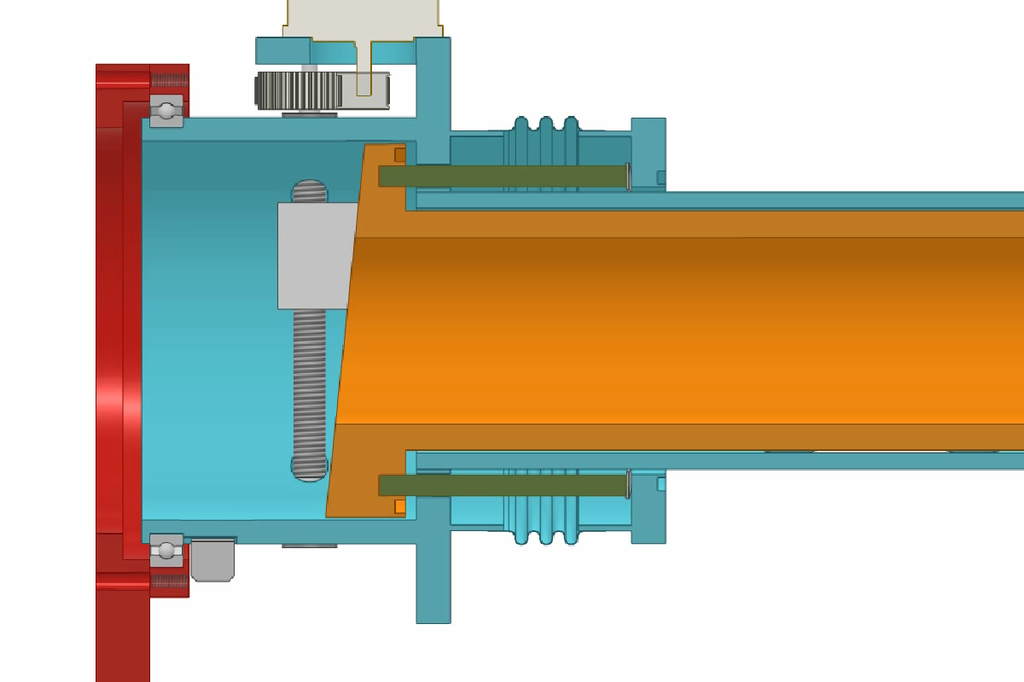
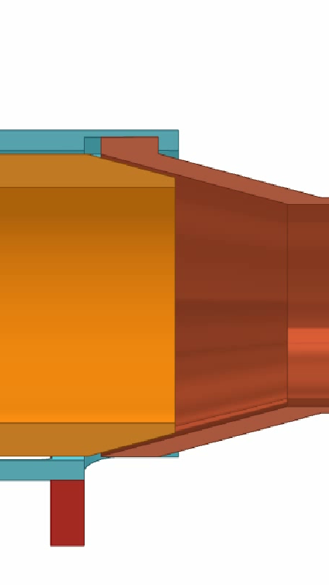
Maintenance Tube – Operation
STAGE 4: Dual-cam & follower engages with the seal tube, applying compressive force from the outer tube onto the seal-tube.
Upstream Chamber
VELO Chamber
Downstream View
Upstream View
Note wave-spring for additional compliance
9

Slide 10
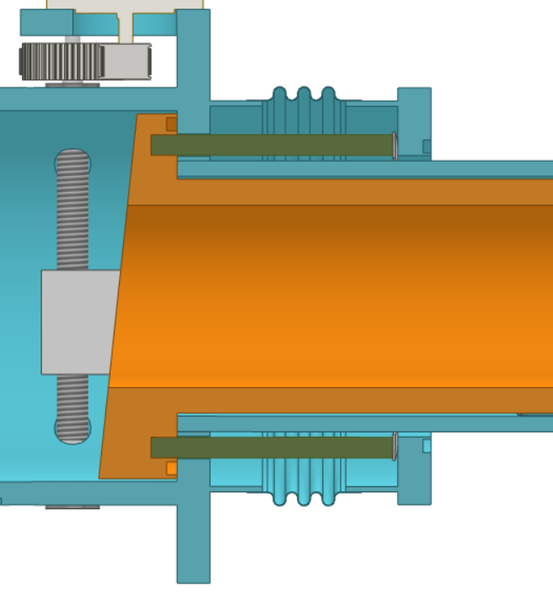
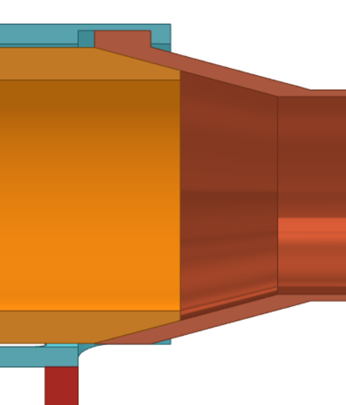
Maintenance Tube – Some Additional Considerations
Mechanism UHV Compatability
Downstream dual-seal with interstitial pumping? What over-pressure is the Neon back-fill run at? Any chance of beampipe contamination during maintenance?
  i.e. Pressure control sequence to be considered
Actuation is concept-only. Compression load for 4 UHV, rad-resistant seals will be high
Spring compression force-balance to be considered.
Replacement schedule of the re-used seals? Full LHCb bakeout.
Initial conversations have implied possibility of re-used Helicoflex seals, but dual-seals with interstitial pumping may be necessary.
Possible interstitial pumping with gun-drilled bore in thick-wall of seal-tube.
Adding more complexity to upstream mechanics, a sprung interface could be placed here to ensure all 3 interfaces can reach full compression.
10

Slide 11
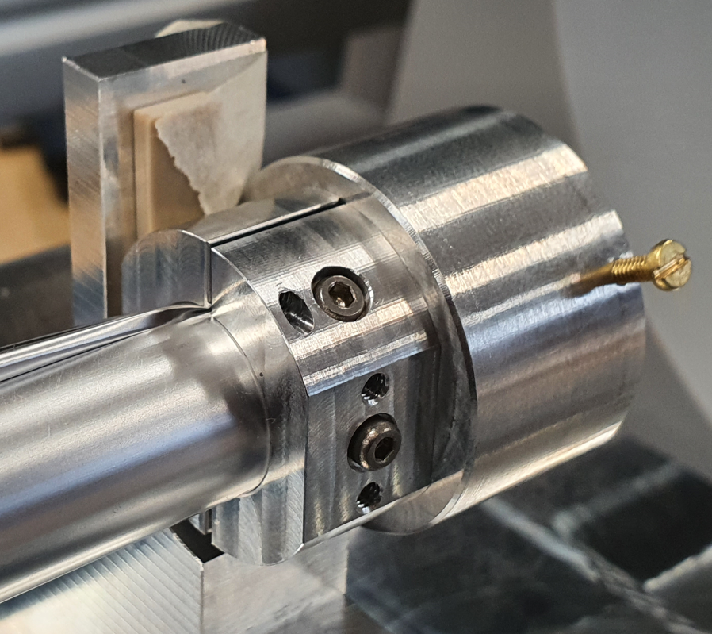
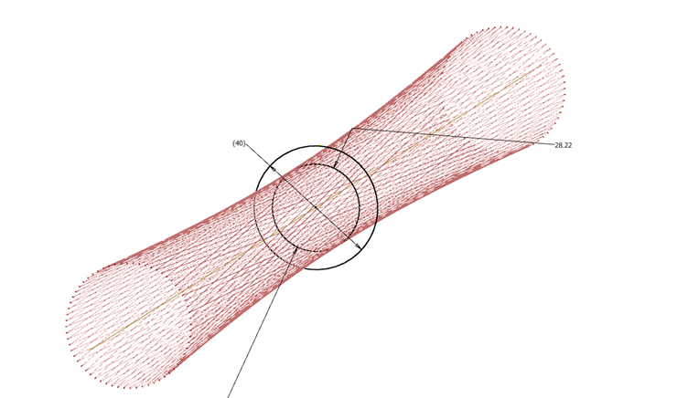
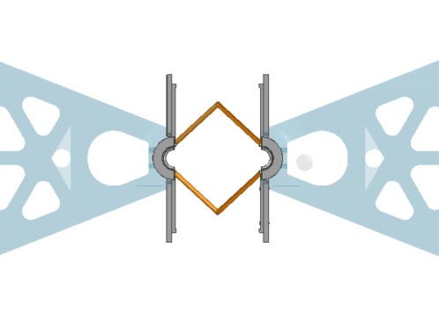
What does the seal-tube enable?
Thin-foil Shield
  Tension tests, conclusions & possible next steps
Wire/Fibre Shield
  Proposed layout, feasibility & prototyping option
Open/Closed Position Mechanics
  Concept mechanism, linkage & setup requirements
11

Slide 12
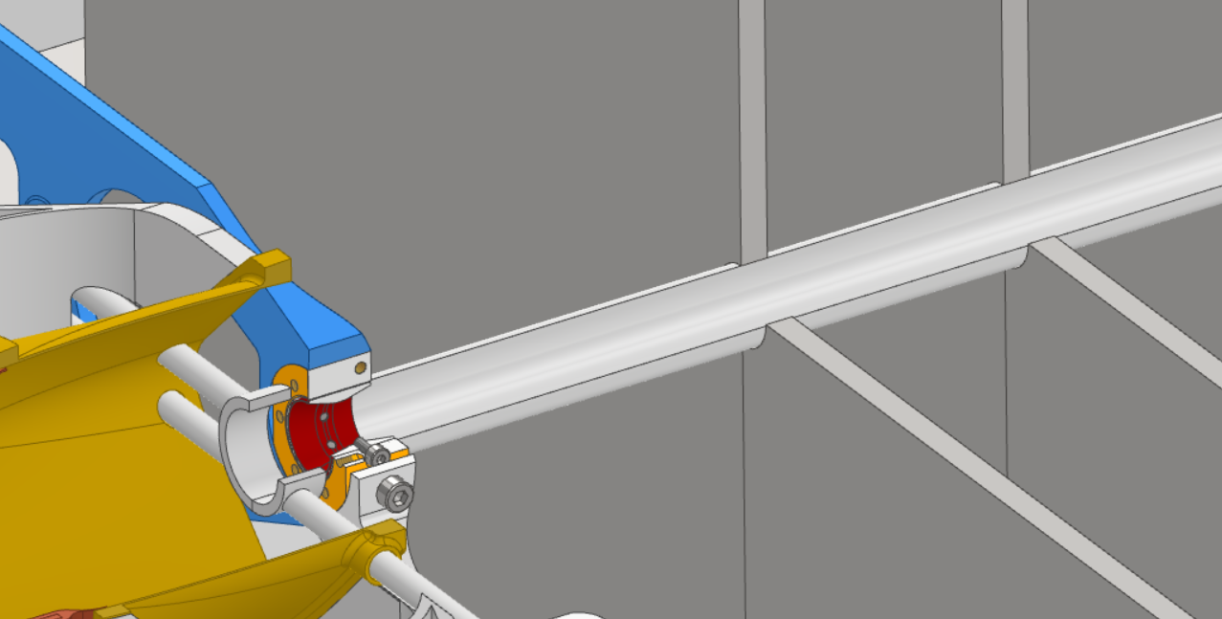
Thin-Foil Shield - Updates
Previously had investigated a foil of 7 mm radius, 20 micron thickness.
Question was asked on the minimum foil radius achievable with an ultra-thin foil: With “conventional” clamping, as prototyped, this would be 5 mm with a minimum clearance-to-beamline of 3 mm at the collar ‘throats’. With composite laminate techniques, this radius may be reduced further.
Recap: Foil held under tension across full length of VELO, split into two halves to allow open/closed positioning.
Note: WFS not shown in closed position
12

Slide 13
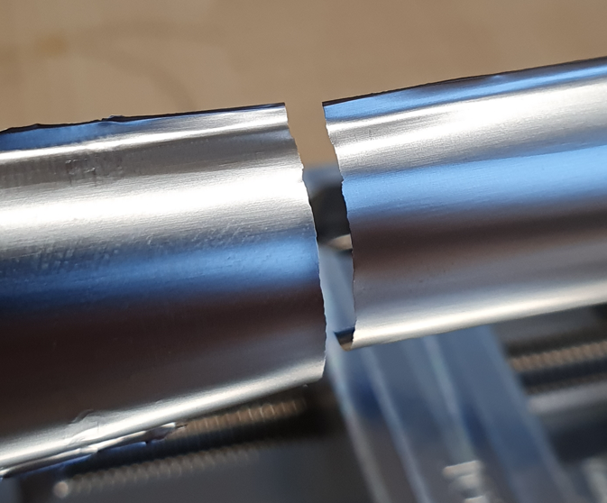
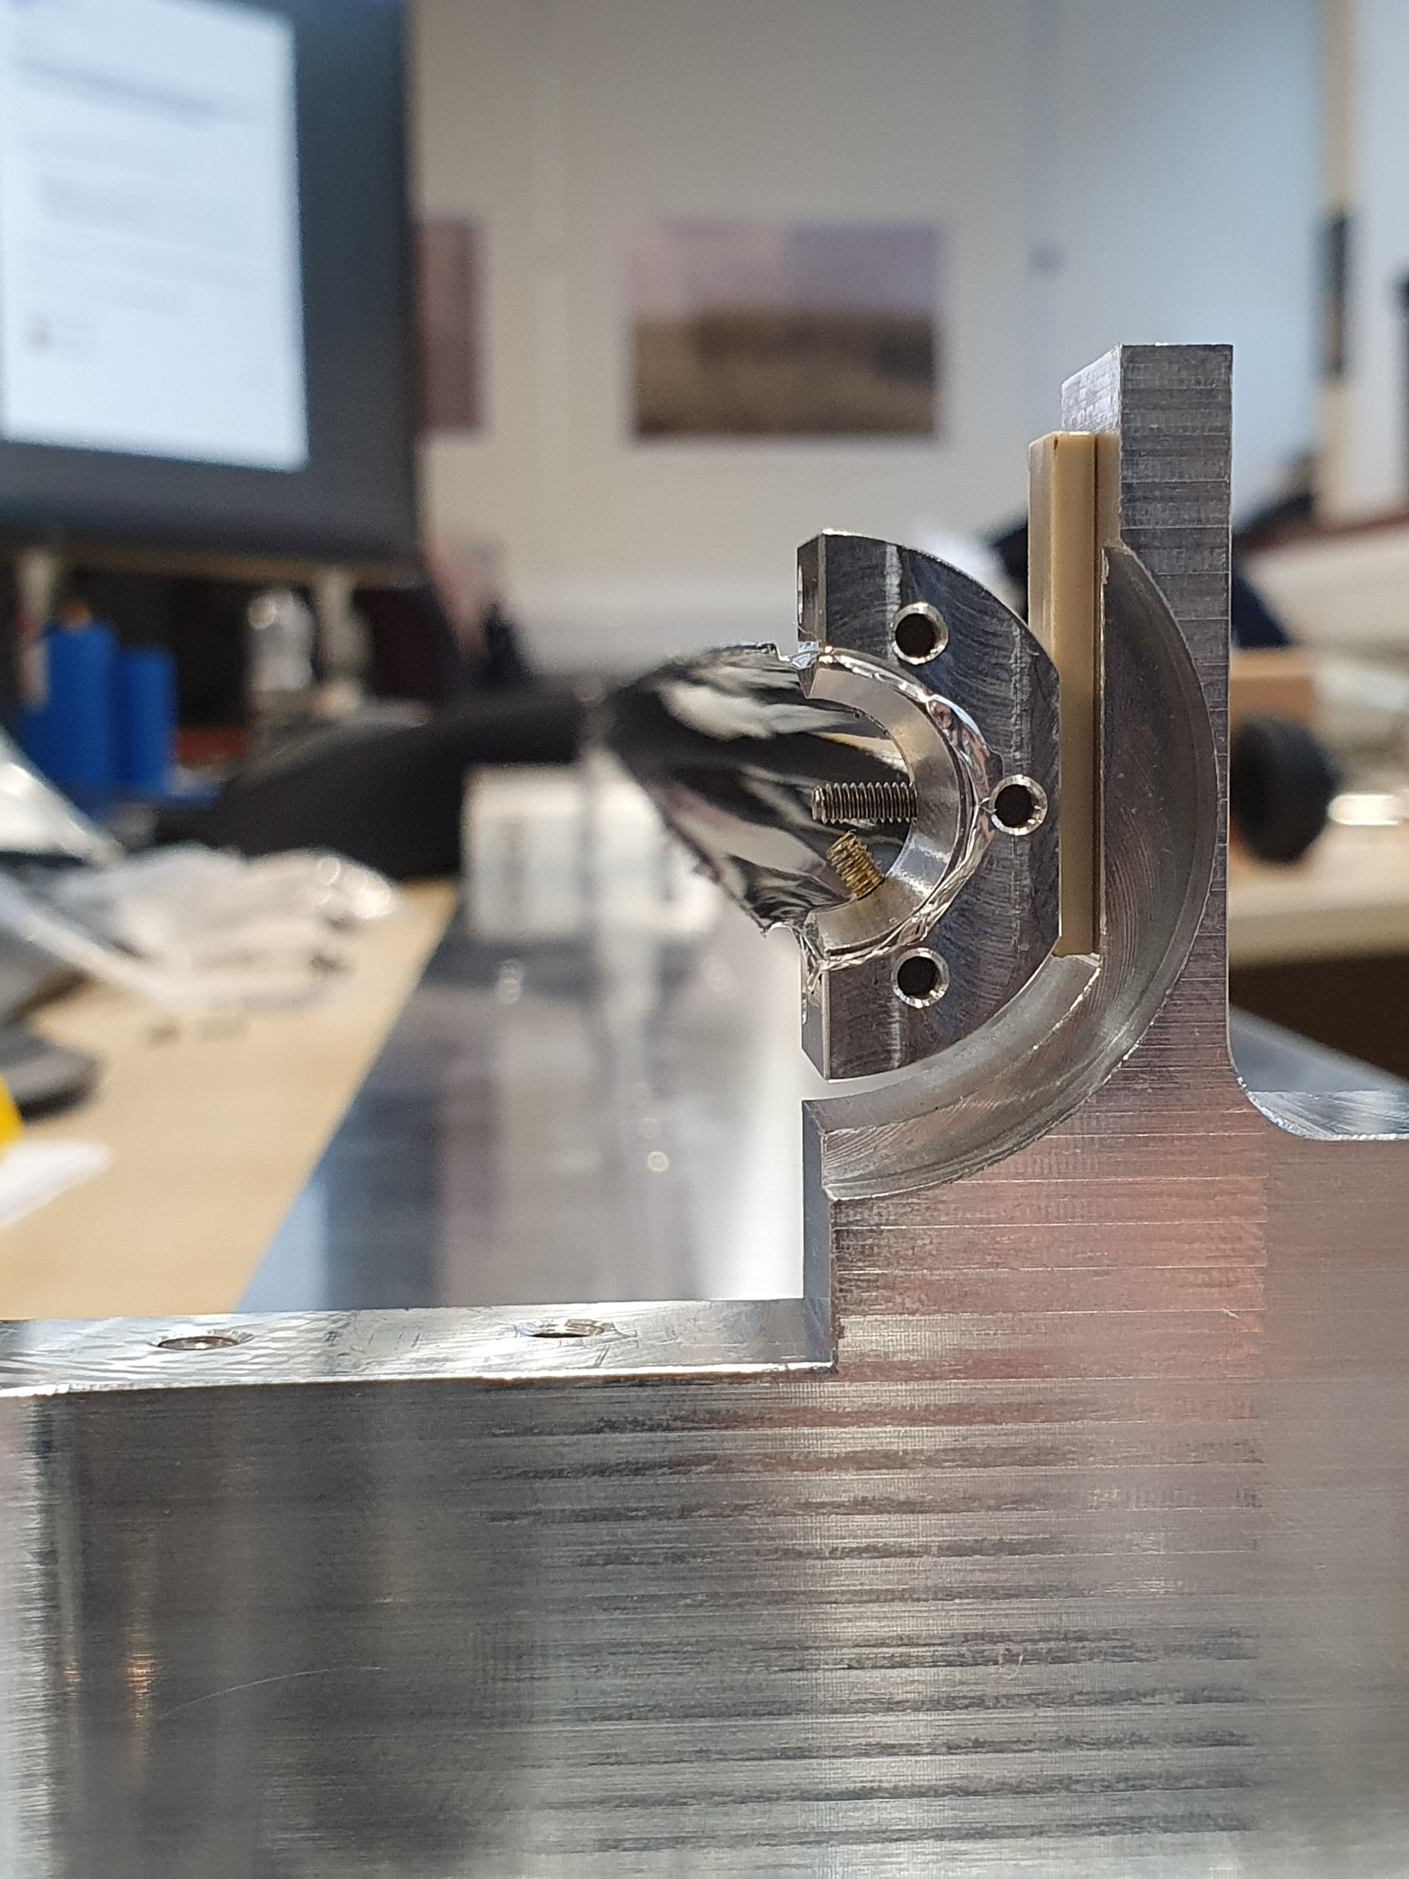
Thin-Foil Shield - Prototyping
Assembly and tensioning rig created to test the following:
  Shape stability along length of foil
  Elastic/plastic/failure extension limits
  Bakeout performance, 200C (activation of potential NEG)
  Loss of tension with impedance heating
Instrumentation
end-collar
Breaking far from
clamped region
Developed shape maintained
in first ~100 mm from collar
Single
foil
13

Slide 14
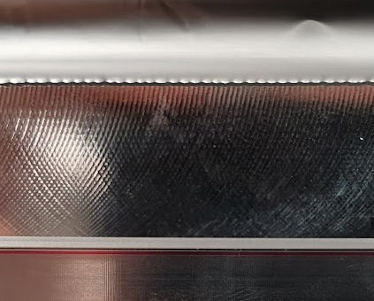
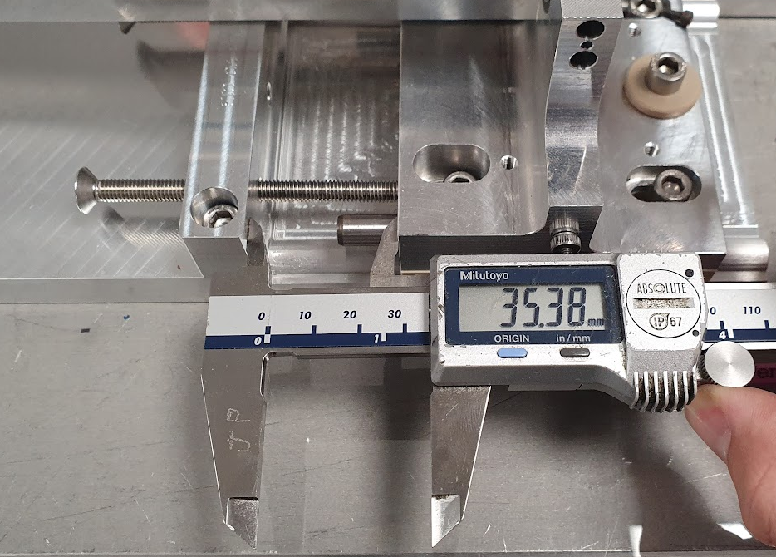
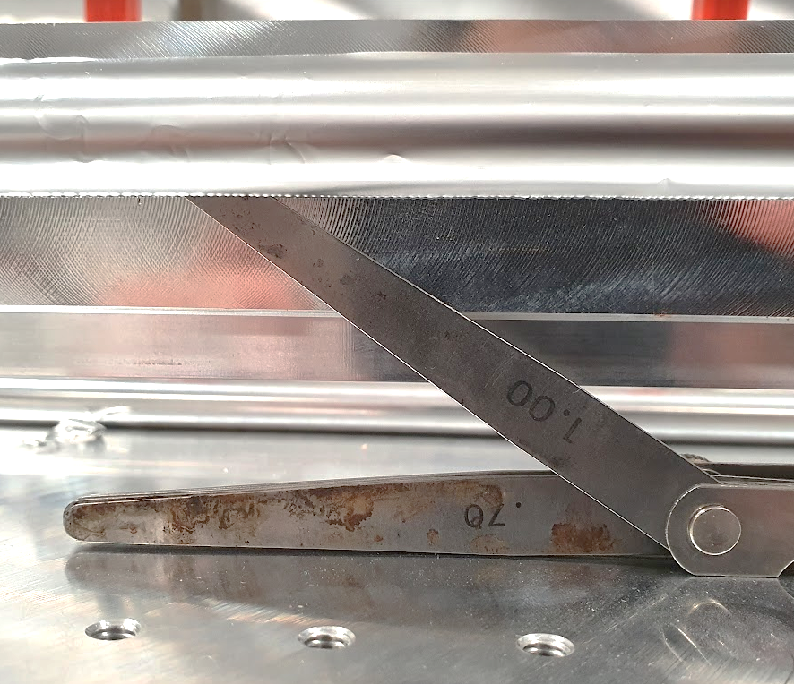
RESULTS: 1st Aug 2022
Extension Test Results
Gap = 2 x distance between foil and straight edge. Subtract 0.15 mm for bar flatness error, and 0.1 mm for bar offset.
Heat Treatment
Stress-relieving heat treatment involving a 2 hour dwell at 120C, with a slow cooldown helped relieve the internal stresses and resulted in better shape holding.
Gap, mm |  | dZ, mm | Gauge, mm | Gap, mm
Front | Back
35.38 | 35.4 | 0 | 1 | 1.5
36.26 | 36.49 | 0.98 | 0.95 | 1.4
36.81 | 36.89 | 1.46 | 0.95 | 1.4
37.31 | 37.28 | 1.91 | 0.95 | 1.4
37.76 | 37.74 | 2.36 | 0.9 | 1.3
38.23 | 38.36 | 2.91 | 0.9 | 1.3
38.7 | 39 | 3.46 | 0.9 | 1.3
39.3 | 39.42 | 3.97 | 0.85 | 1.2
39.91 | 39.77 | 4.45 | 0.85 | 1.2
40.31 | 40.68 | 5.11 | 0.8 | 1.1
42.28 | 42.33 | 6.92 | 0.8 | 1.1
Hard limit on extension reached.
Gap cannot be pulled away with current collar design.
Is 1.3-1.4 mm acceptable?
Can we improve the tooling design?
FOIL
½ Gap
Elastic Plastic Deformation Risk of break
Straight Edge/Bar
14

Slide 15
Thin-Foil Shield – Next Steps
Composite laminate collars could be designed, similar to those tested by Adam.
  Would allow for reduced clearance to beamline.
Collars mounted off the modules could come into contact with the shield at regular intervals to ensure the shape is held and ensure electrical contact between the shields.
  Similar to concepts where the shield is mounted directly to the collars, but allows individual module maintenance.
“3D” foil geometries to be considered, with local thickness variations to encourage cylindrical shape-holding.
RF leak through ‘soft’ contact of foil halves to be investigated
15

Slide 16
VELO Upgrade II
CNT Fibre Concept
Michael Booth
Michael.booth@physics.ox.ac.uk
16

Slide 17
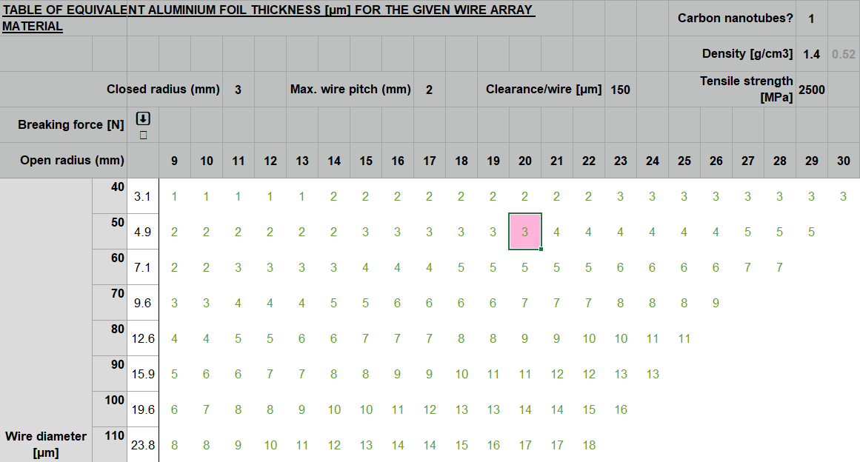
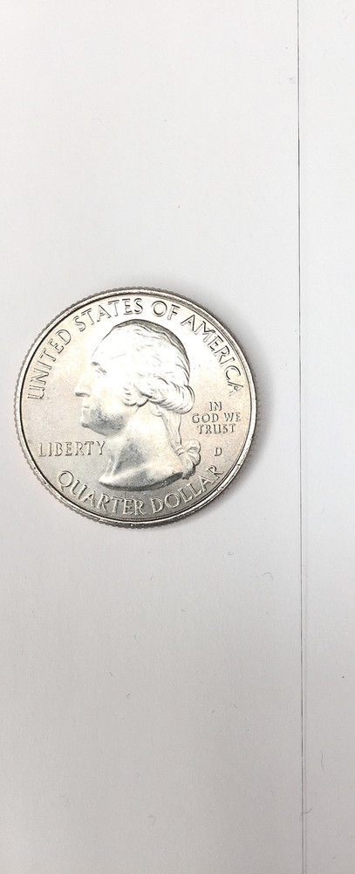
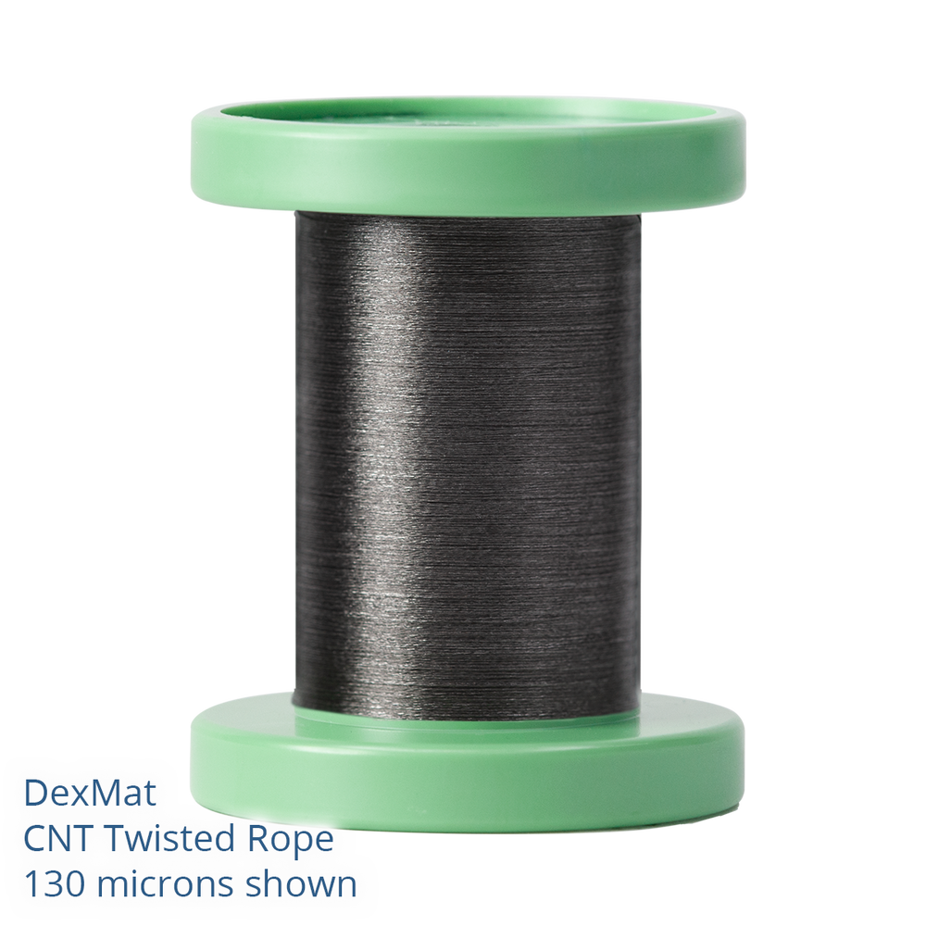
Motivation
50 micron CNT fibre available from https://store.dexmat.com/galvorn-cnt-hs-fiber-50-microns/#product-details
CNT = Carbon Nanotube
Much lower radiation length compared to aluminium foil
Greater breaking force for the wire, (50 micron has a breaking load of ~ 5 N)
A single-layer mesh of 50 micron CNT fibre has equivalent al. foil thickness of 3 microns
17

Slide 18
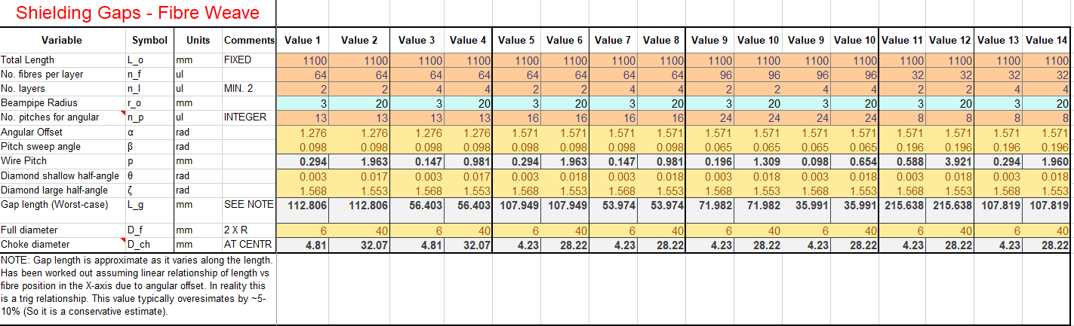


Update
Discussion with Malcolm suggested that there is a large safety factor on the maximum gap value of 15 mm.
Prepared a design spreadsheet that will tell us the maximum gap length with different initial parameters, based off Malcolm’s initial spreadsheet.
$$L_{g}=\left[\frac{\left(\frac{rsin\left(β\right)}{\sin\left(\frac{180−β}{2}\right)}\right)\sin\left(90−θ\right)}{\sin\left(\frac{\tan^{−1}\left(\frac{rcos\left(90−α\right)}{L_{o}}\right)}{2}\right)}\right]$$
Pitch
$$L_{g}=\frac{p}{tanθ}$$
Where $θ=f\left(α,r,L_{o}\right)=\tan^{−1}\left(\frac{r_{o}\cos\left(180−α\right)}{L_{o}}\right)$
*Gives a conservative, but representative, value
θ
Gap
18

Slide 19
Update
Discussion with Malcolm suggested that there is a large safety factor on the maximum gap value of 15 mm.
Prepared a design spreadsheet that will tell us the maximum gap length with different initial parameters, based off Malcolm’s initial spreadsheet.
19

Slide 20
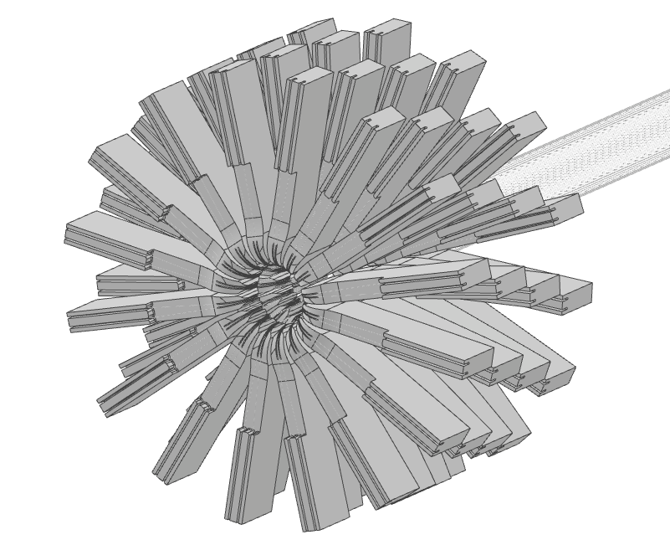
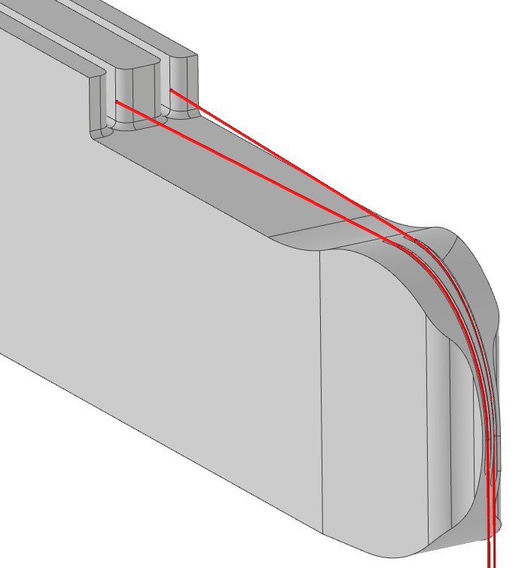
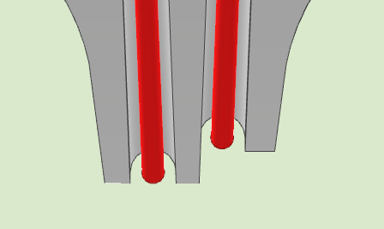
Tension Mechanics & Routing
To route the fibre tensioning away from the already busy upstream and downstream ends, they need to bend around a corner. No pulley exists to do this, so a low-friction ceramic former with (TBC) laser cut, 100 micron grooves would be required.
To make this machinable, a 2-layer, 64 fibre (128 total) approach would need to be split into 4 layers of routing mechanics.
These routing fins will need to move in and out, to allow for an adjustable shield radius.
Tension mechanics would need long constant-force springs to allow for error and thermal expansion.
Also, between 3 and 20 mm radius, each fibre extends by approx. 5%, which will need to be accounted for in a larger range of motion on one or both sides.
Laser micromachining ref: https://www.lasermicromachining.com/materials/ceramics/alumina-3d-milling/
  Better surface quality, typically used in biomedical science
Micromilling ref: https://www.sciencedirect.com/science/article/pii/S0924013611001774
  Poor surface quality = increased wear
20

Slide 21
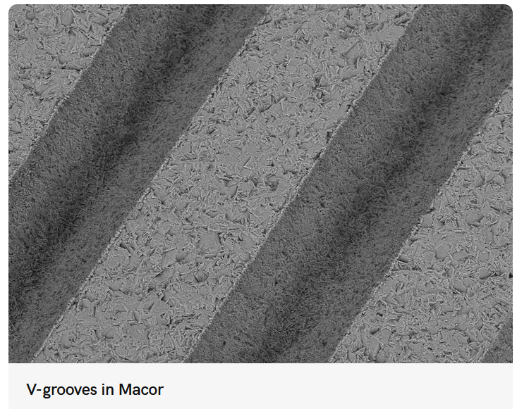
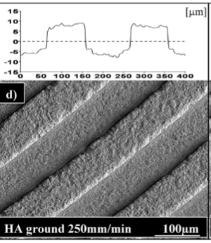
Tension Mechanics & Routing
Considerations
(X)UHV:
  Full tension mechanics would need to be pulled out of the way, off to one side, to allow the maintenance tube concept to work.
    Fix: Gate valves before/after VELO?
  Carbon wear, mechanism debris in UHV
Cost:
  Accelerated lifetime testing of the ceramic/carbon interface to build confidence
  Vacuum compatability of CNT fibre (probably ok)
  Machining methods typically used in the biomedical field = £££ (No feel for how much)
Tension system
  Heritage work already done for us on the WEAVE system, but our range of motion is larger.
Laser micromachining ref: https://www.lasermicromachining.com/materials/ceramics/alumina-3d-milling/
  Better surface quality, typically used in biomedical science
Micromilling/grinding ref: https://www.sciencedirect.com/science/article/pii/S0924013611001774
  Poor surface quality = increased wear
21

Slide 22
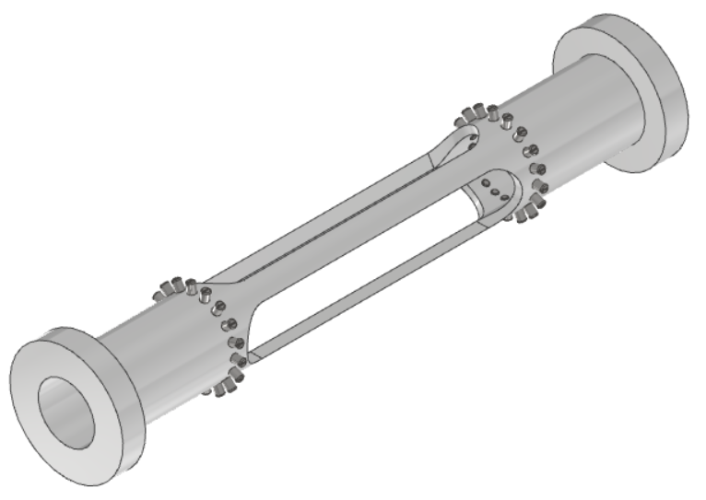
Wire Approach - Conclusions
The physics benefits are great, recalling that a 0.05 mm CNT fibre mesh allows an “apparent” foil thickness of 0.003 mm.
  Shielding performance must be confirmed (prototype below)
  Gap length
From an engineering perspective, this is an extremely difficult requirement. The fibre density and chosen radius would necessitate some degree of frictional sliding of a CNT fibre over micro-machined features.
  Any debris, or ultimate failure of a single fibre will impact beam and UHV performance.
  Wear can be reduced by having larger detector length changes between open and closed positions.
  Bespoke mechanics may allow micro-pulleys with constant-force springs to mitigate sliding contact.
Proposed concept would allow several different fibre geometries to be tested.
Large up-front expense on CNT fibre, so could be initially trialled with fine aluminium wire (e.g. as used in wirebonding applications)
22

Slide 23
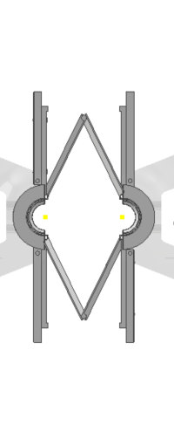
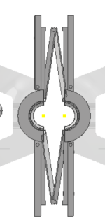

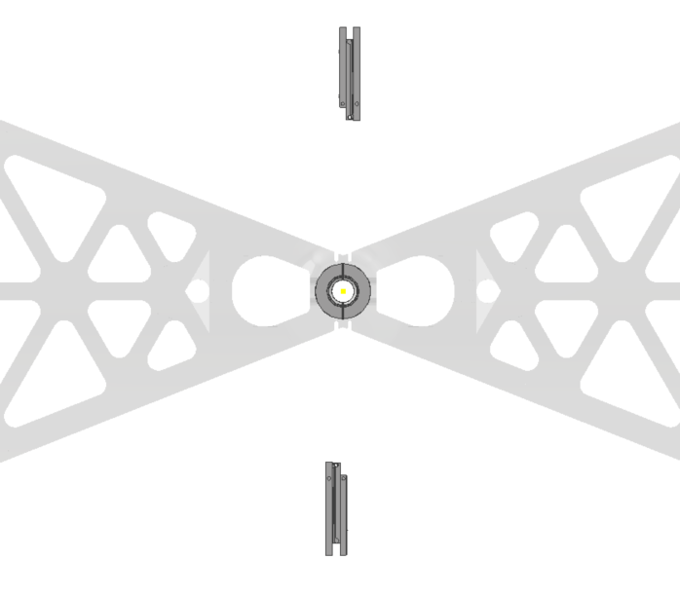
Open/Closed Position Mechanics
Two different bunch diameters go through the VELO. Current design uses:
  R_{closed} = 7 mm
  R_{open} = 25 mm
Having a fully cylindrical volume for the open position is not critical.
Reducing impedance contribution for the VELO is a great benefit we can gain.
a)
b)
c)
d)
e)
(a): Open Position. (b), (c): Closing. (d): Closed position achieved. Removal of ‘diamond’.
(e) detector box moves on a limited ~3 mm travel to bring detectors into overlap positon.
23
23

Slide 24
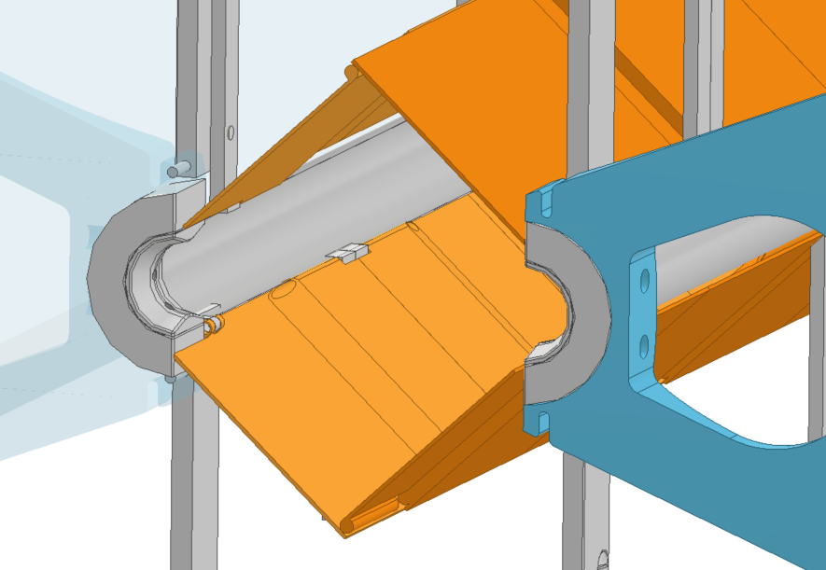
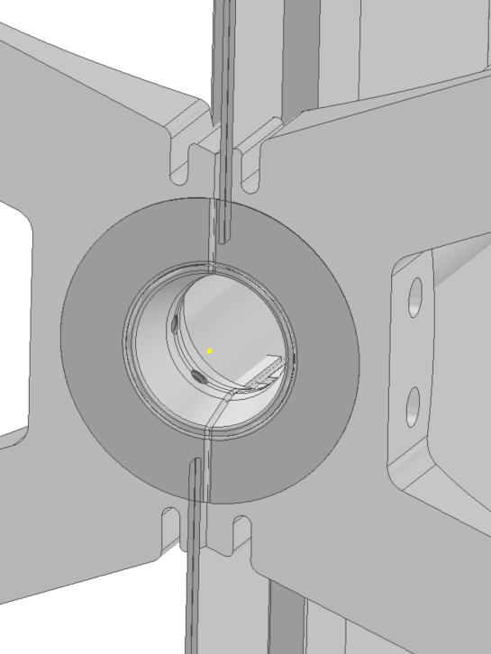
3. Open/Closed Position Mechanics
Currently quite a bit of ‘floating’ design, but no showstoppers foreseen. A system like this will take a long time to characterise and optimise to ensure reliable free-running.
Attachment points onto the tensioning arms remove the need for lateral adjustment of the edges of the ‘diamond’.
Note: Old slides with CAD error present.
Representation only.
24

Slide 25
Questions/Discussion
Extra Slides – WFS Concepts
Main Presentation
Evaluation of the Mixed-vacuum approach.
Maintenance Tube: The “linchpin concept” that ties it together.
Thin-foil Shield
  Tension tests, conclusions & possible next steps
Wire/Fibre Shield
  Proposed layout, feasibility & prototyping option
Open/Closed Position Mechanics
  Concept mechanism, linkage & setup requirements
25

Slide 26
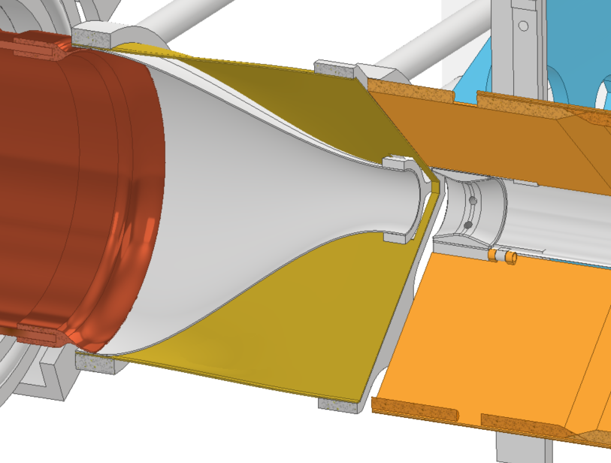
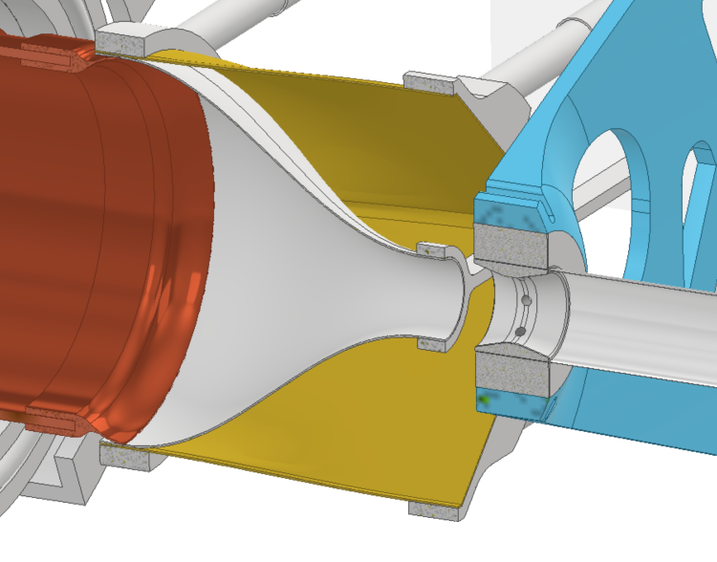
Wake-field Suppressor Design Concepts
Complex & critical component.
Shown below is a concept for a double-layer WFS to cover both open and closed positions.
The outer layer stays fixed in place during operation. The foil-end of the ‘closed’ position layer would move, similar to the current WFS design.
Call for input – are there any design & analysis documents for the WFS I can refer to?
RF spring connection to beampipe
Open position
Closed position.
26

Slide 27
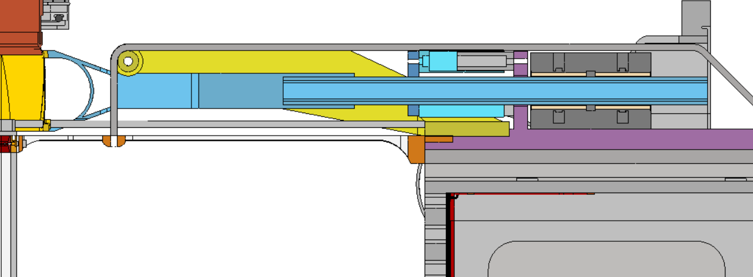
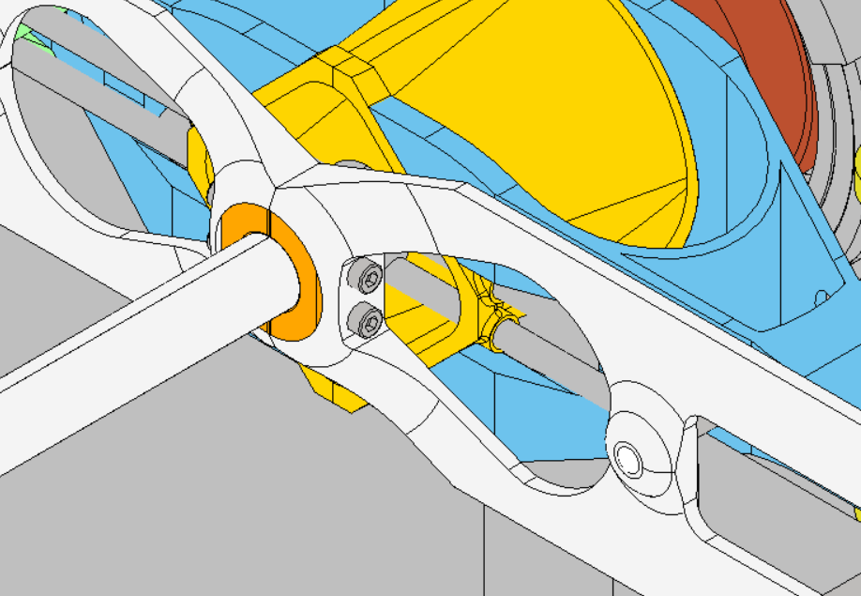
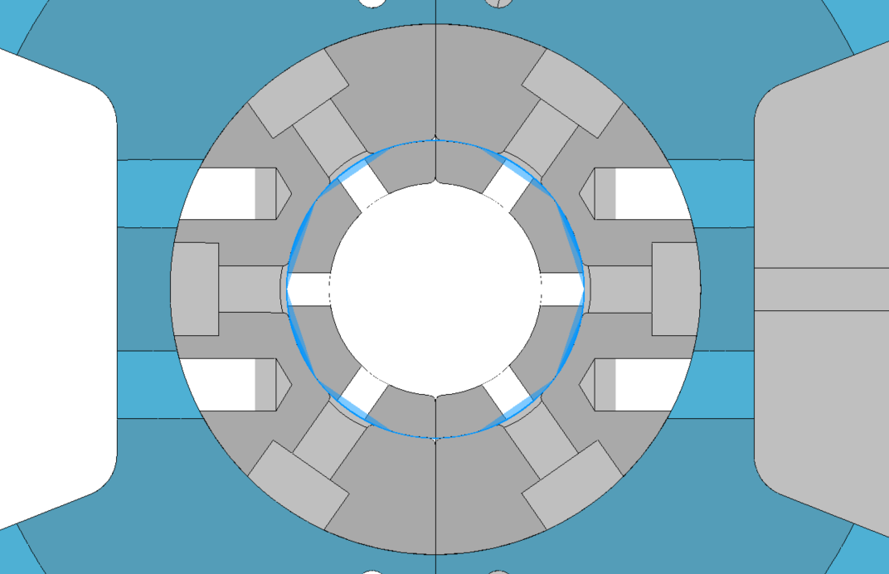
Extra Slides: Upstream Tension Mechanics
LHC Beamline
Wake-field Suppressor
Steel Wire Pulley
To Tensioner
WFS Support, on sprung rail
All foil mechanics mounted off old electronics box
Tension here
27

