Slide 1
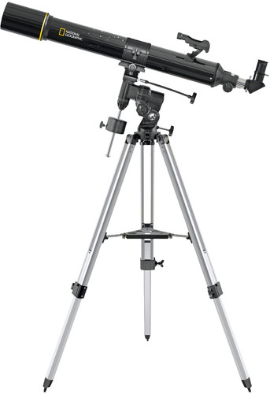
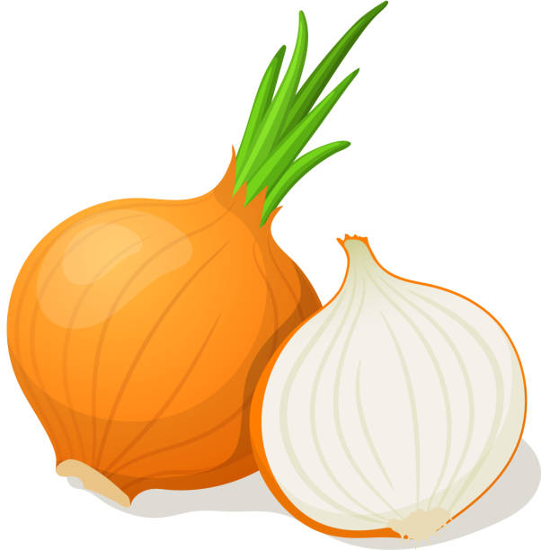
VUII
What is better than a telescope? .. an onion?

Slide 2

Disclaimer
Nikhef currently has no budget for VUII
  I work 1 day a week on LHCb.
    This includes current velo support(U1)
    Student support
    Design on VUII
    So development is slow, but here are my incoherent thoughs
So here is the same story
NEWS FLASH – NOTHING HAPPEND

Slide 3
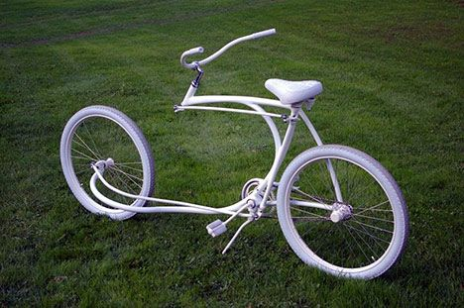
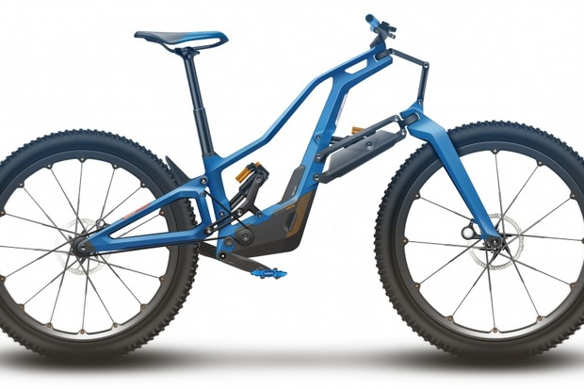
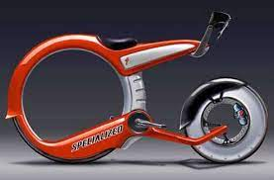
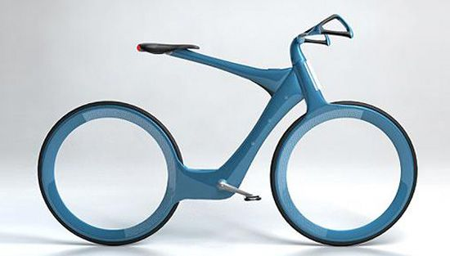
Future of the velo?

Slide 4
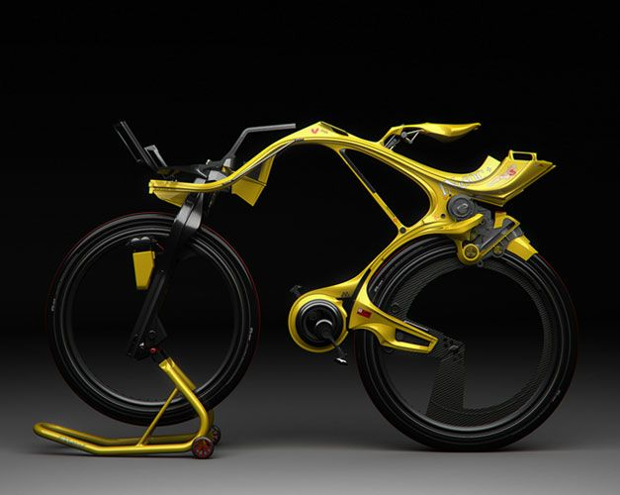
Or maybe this?

Slide 5
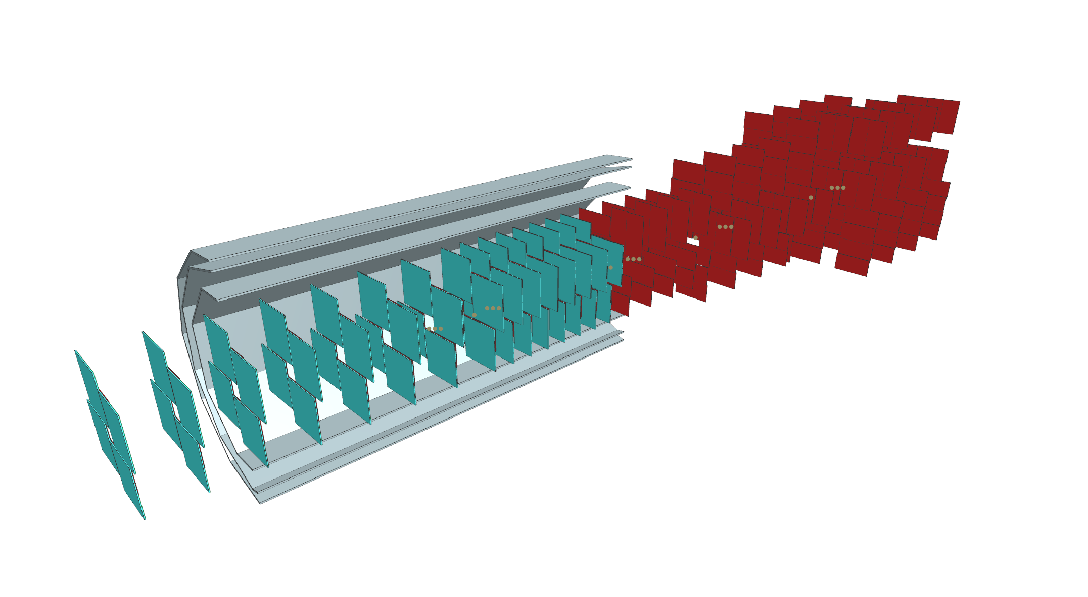
Barrel with expanding size
Maybe not the best use of silicon.

Slide 6
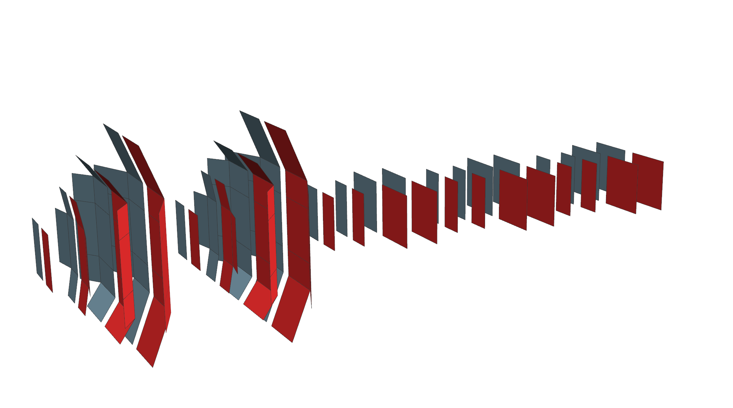

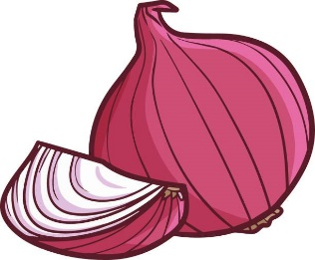
The nion
So good it makes you cry!
Increases the acceptance.
Curved shape should gives better Z resolution.
Optimezed used of silicon

Slide 7
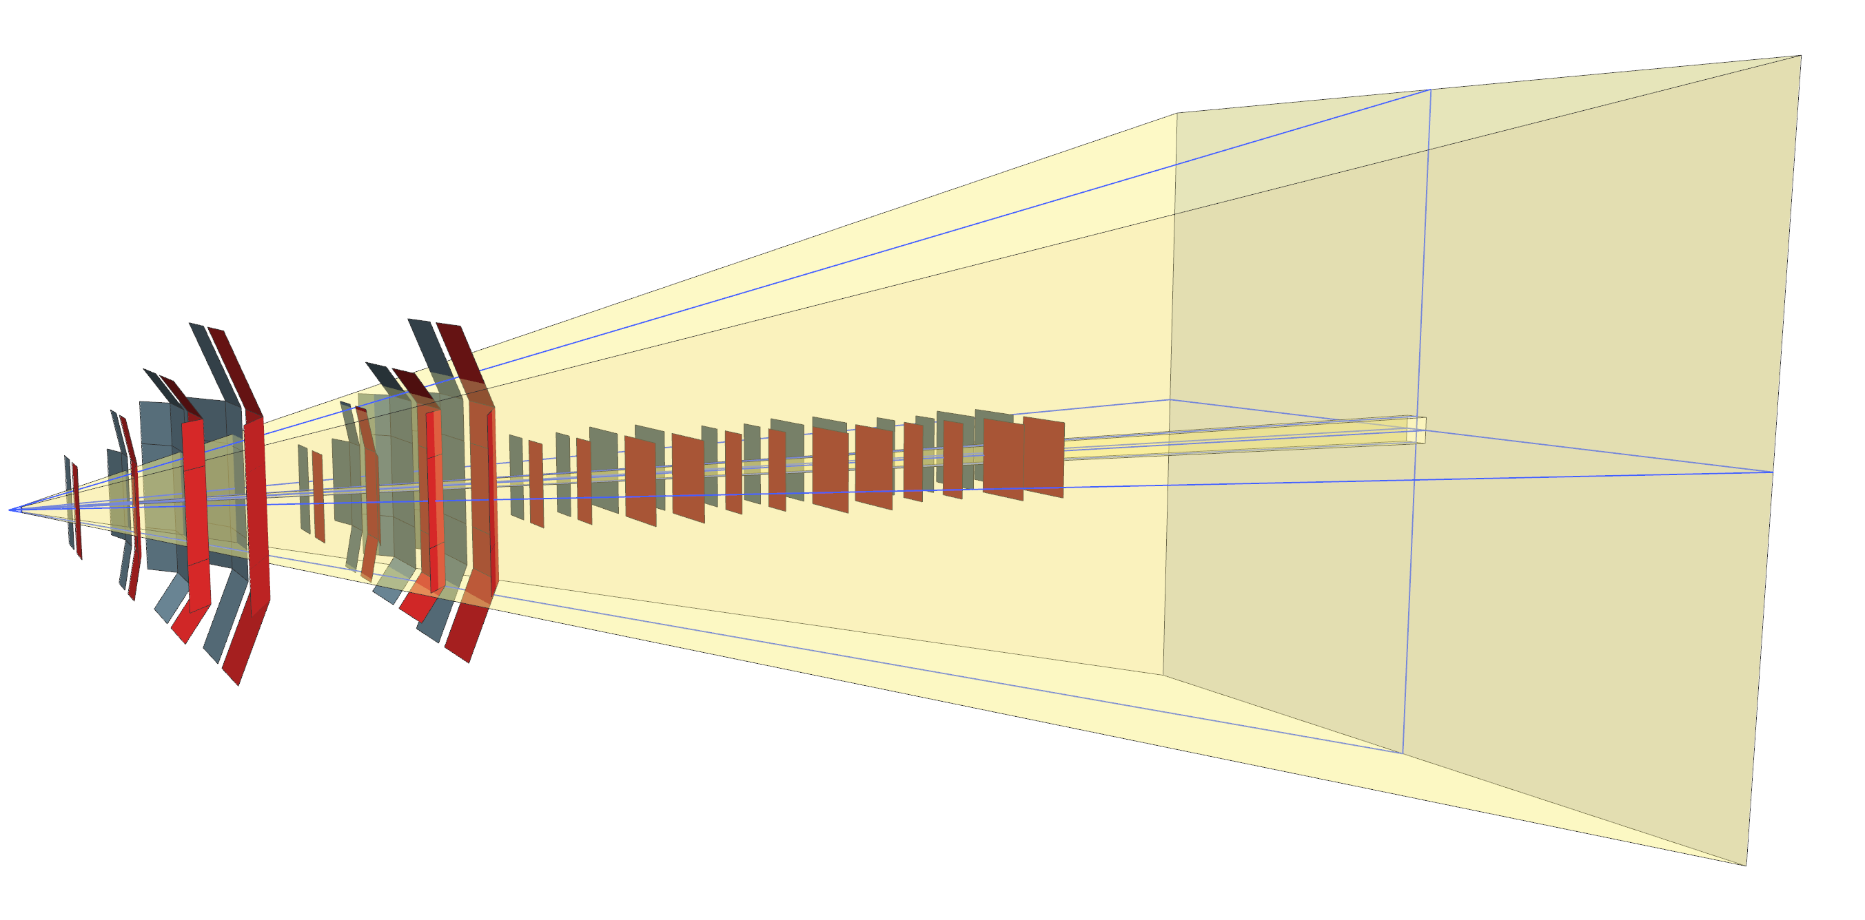
Increases the acceptance
In yellow is the old acceptance

Slide 8
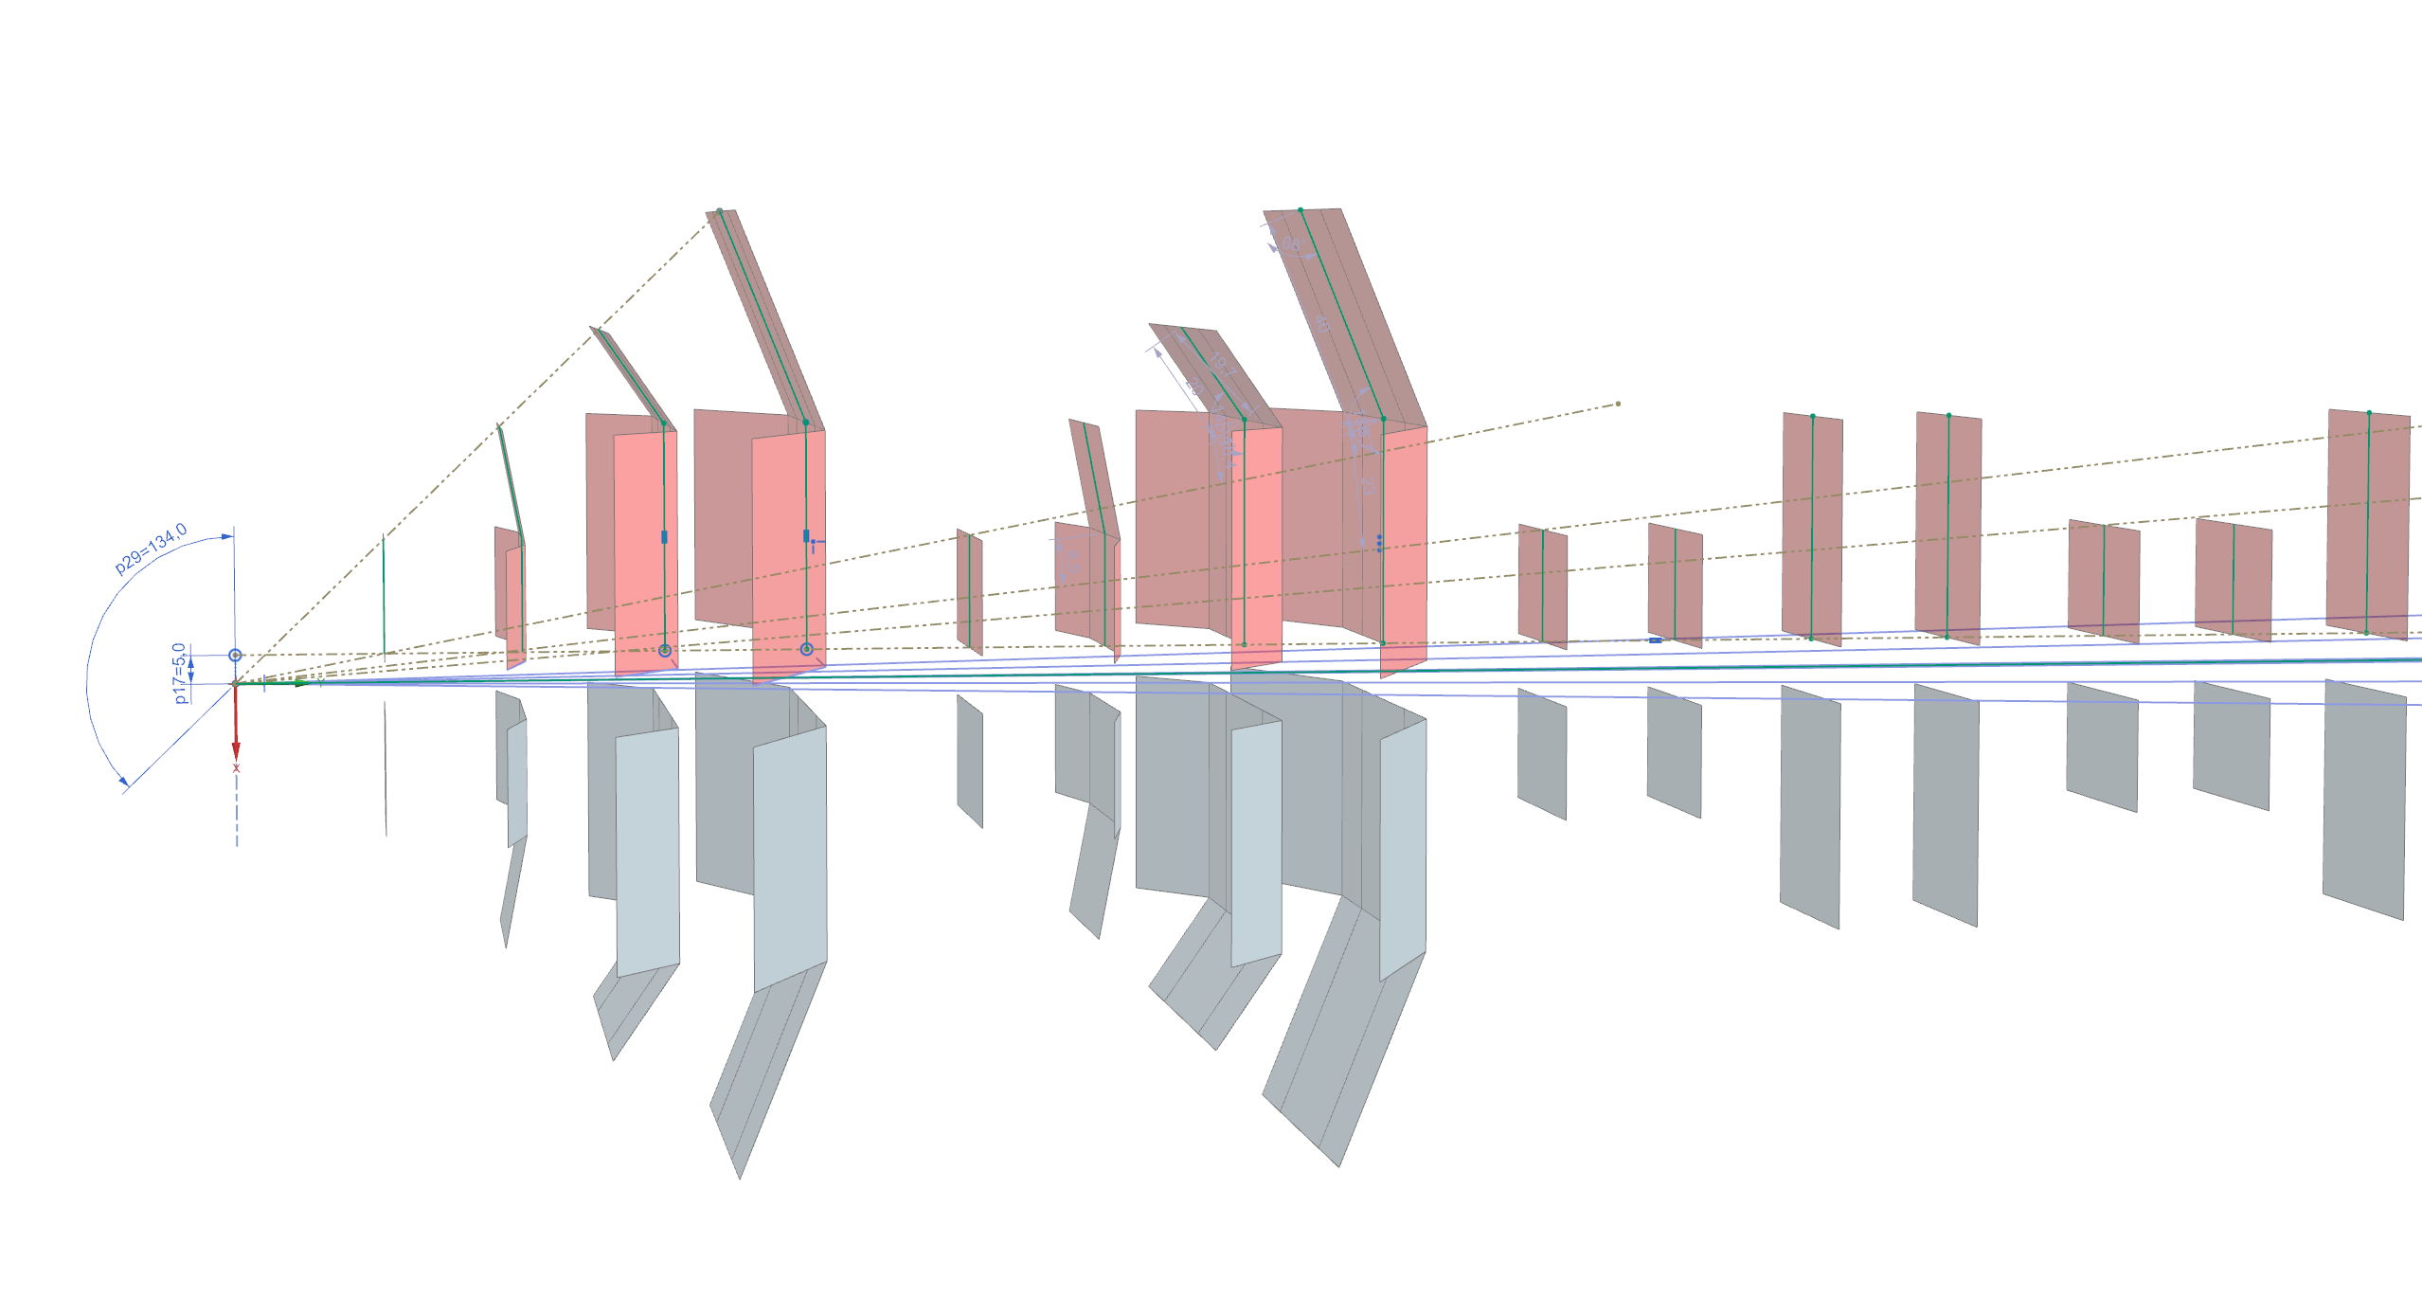
Each track has minimal 4 hits

Slide 9
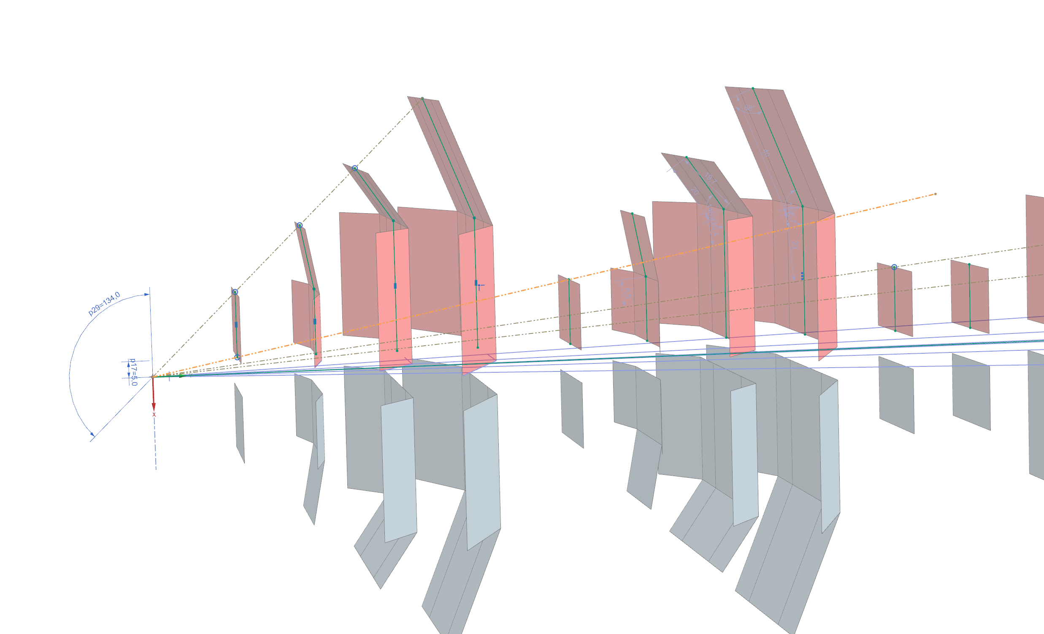

Slide 10
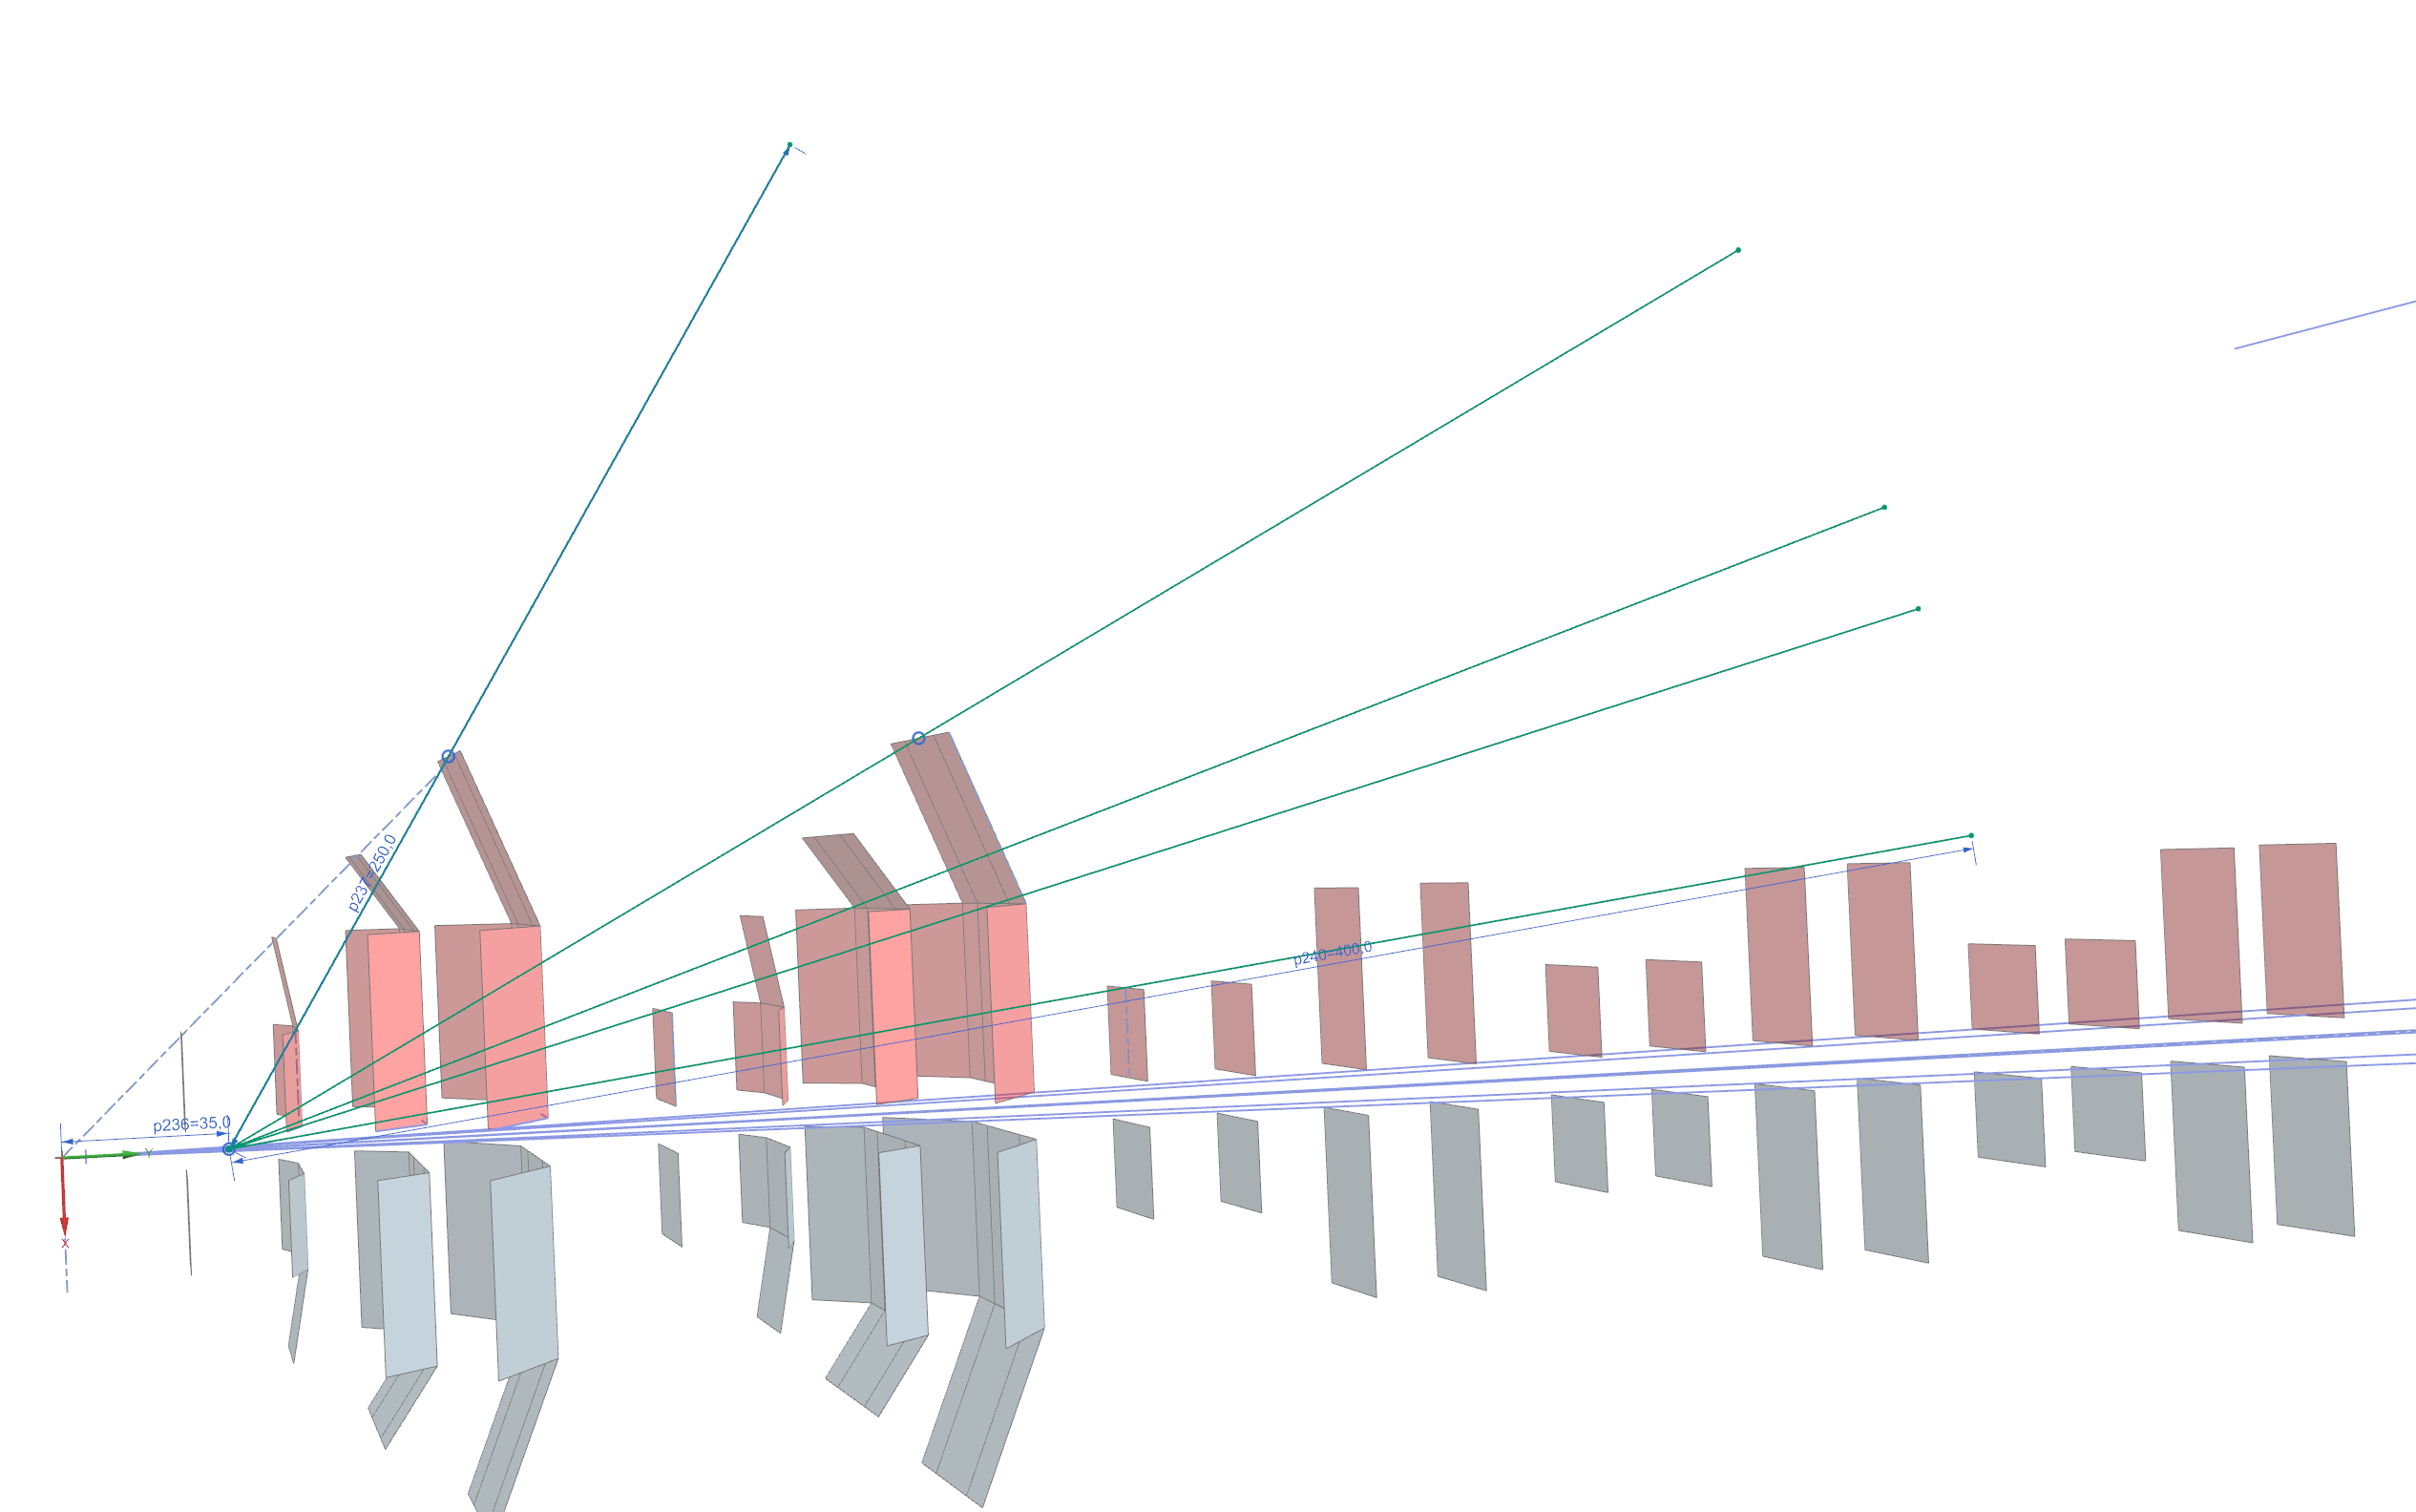
IP strecht of +/-35 mm, gives even bigger acceptance, but some tracks have only 3 hits.

Slide 11
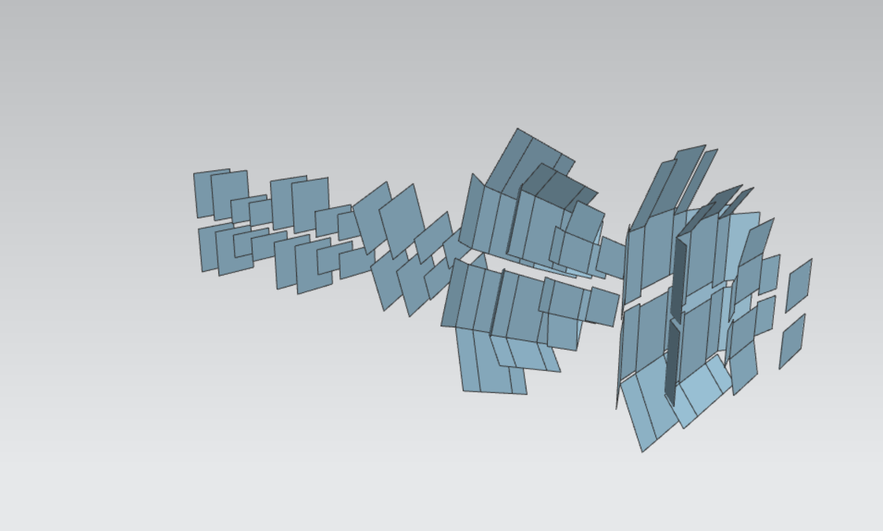

Slide 12
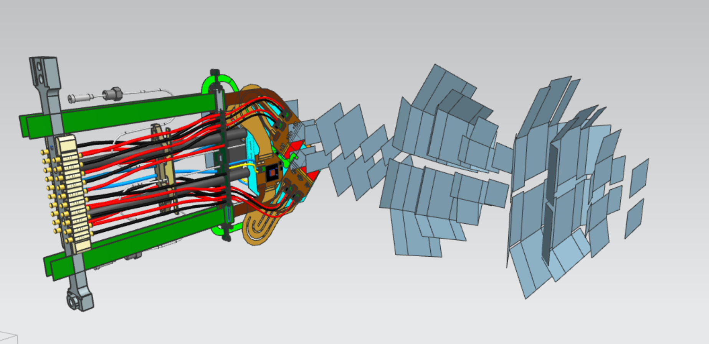

Slide 13
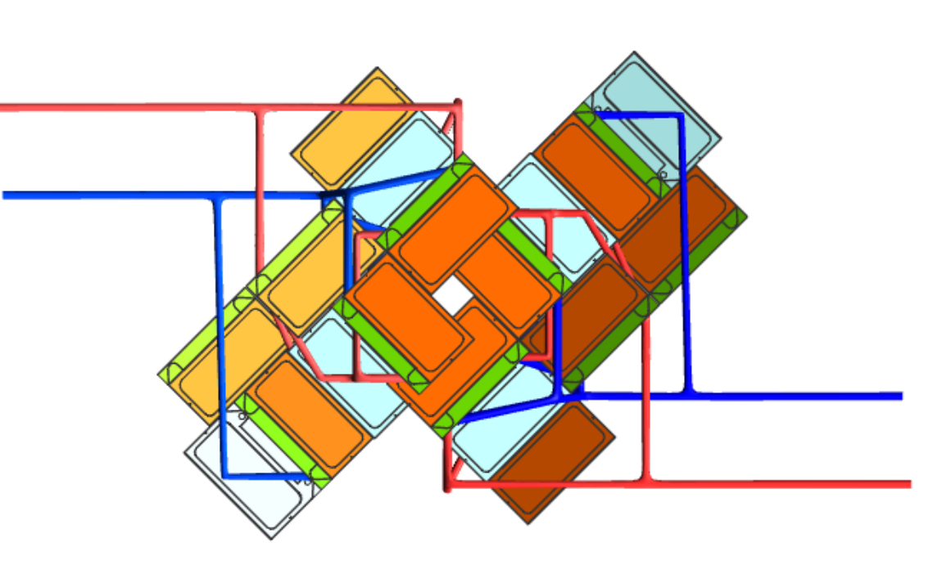

Slide 14
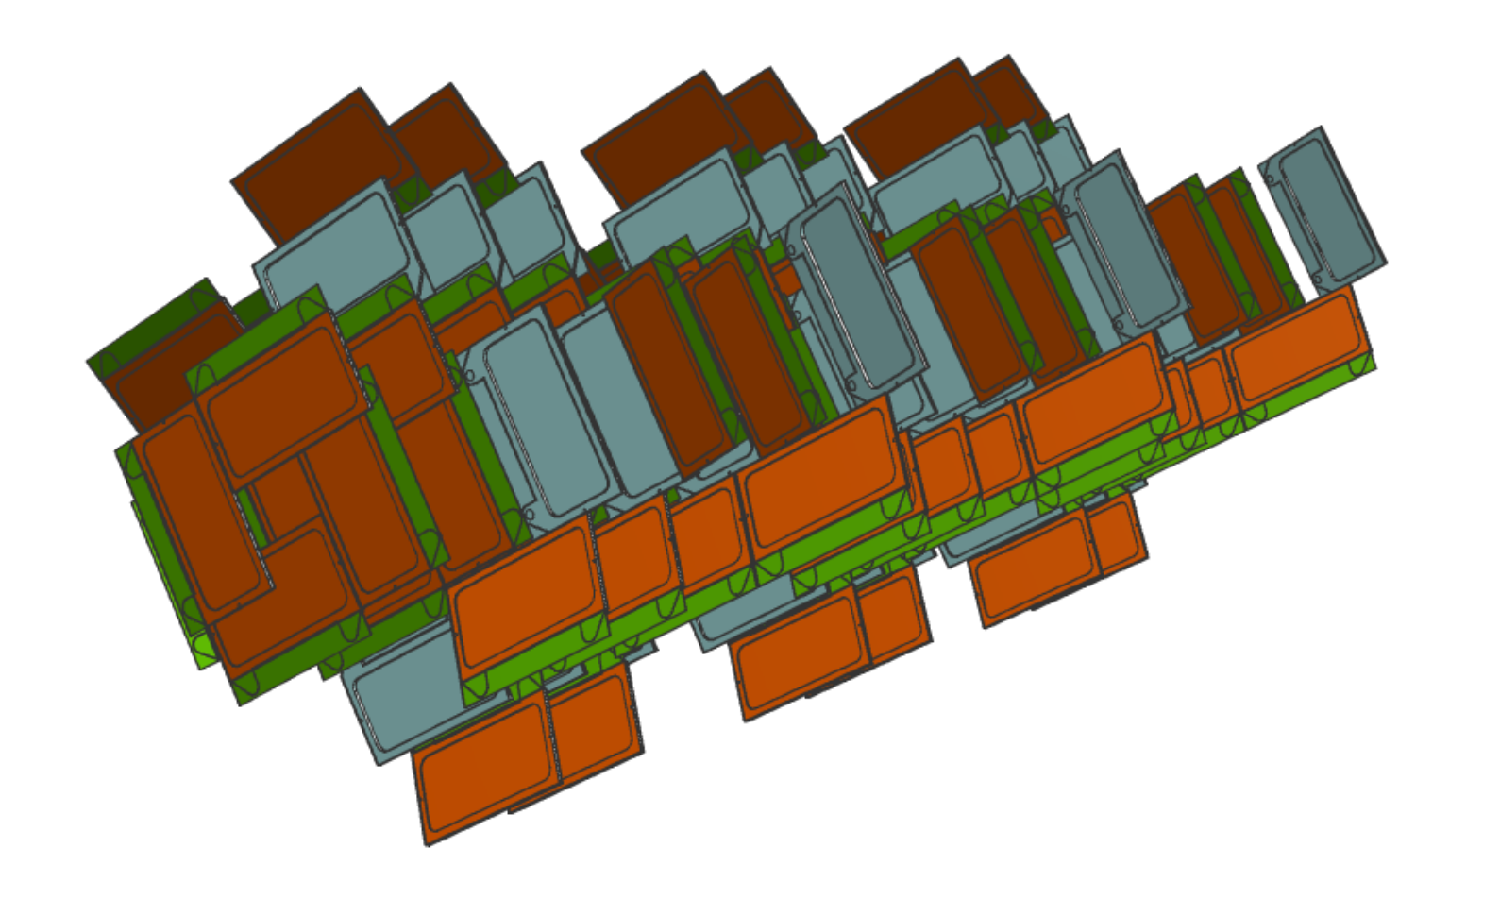

Slide 15
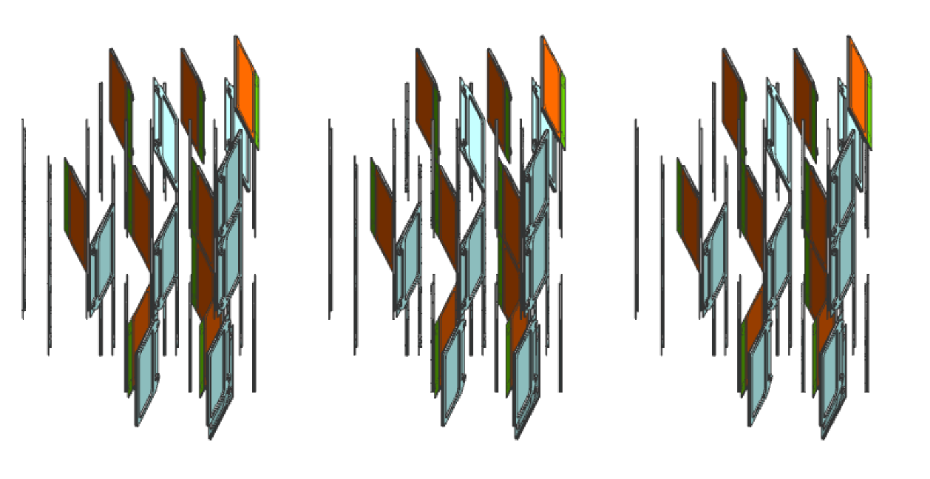

Slide 16
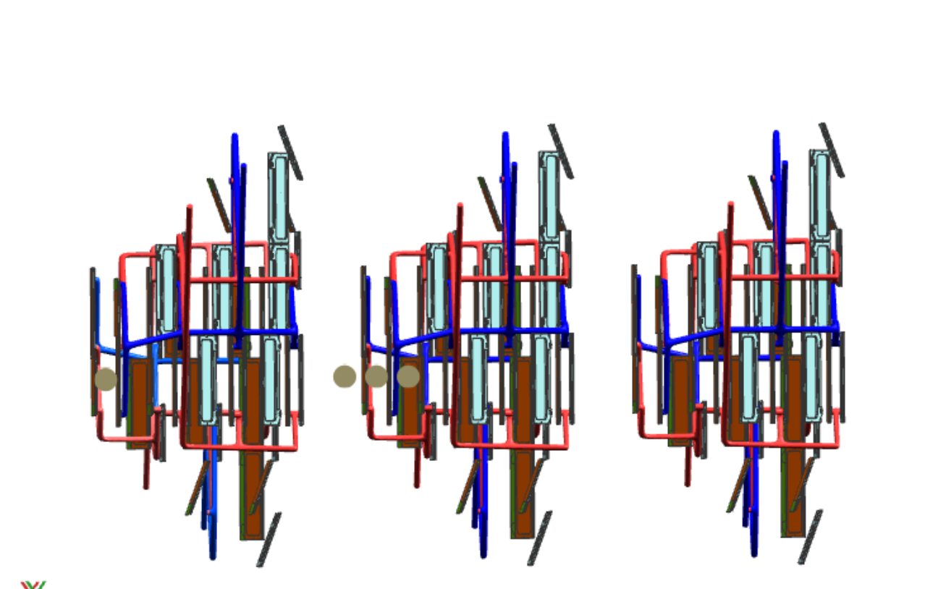
Some numbers
Onion
23 modules, 46 ASICs
332,1 shown length.
Upgrade I
52 modules , 624 ASICs
1026,4, 624

Slide 17

by
The nion
So good it makes you cry!

