Slide 1
Detector cooling R&D with multi-micro-channels: lessons learned & reminder on different options
D. Hellenschmidt, P. Petagna, M. Angeletti
VELO Upgrade II Workshop, Science Park, Amsterdam, Feb 6 – 8 2023

Slide 2
Overview: Detector cooling R&D with multi-micro-channel cold plates
1 Lessons learned (CERN EP-DT)
Manufacturing technique Material Fluid Lessons learned on
MEMS techniques: etching & bonding Si + glass CO₂ connectors
fluidic testing & design
3D-printing ceramic, metal water manufacturing limitations
2 Short reminder on different manufacturing options (CERN EP-DT & collaborating institutes)

Slide 3
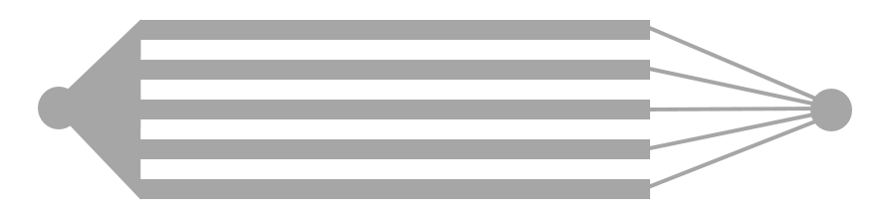

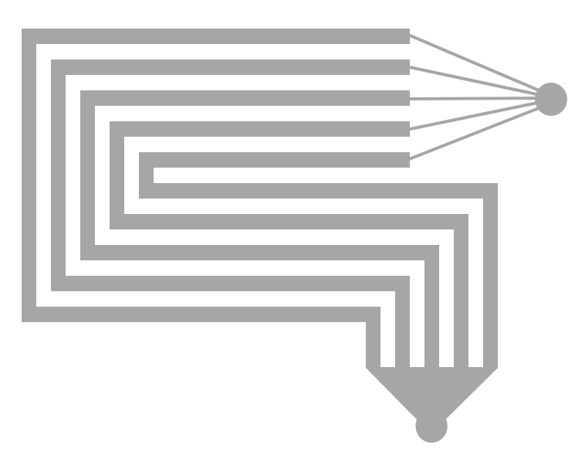
Multi-micro-channel cold plates produced with MEMS techniques: etching & bonding
Generic channel layout for boiling flows
micro-channels etched into
Si substrate
Si-substrate bonded to
Real case: Si-wafer
R&D version for flow visualisation:
glass wafer
main channels
restrictions
outlet
inlet
outlet
plenum
FLOW
Si substrate
various meandering layouts possible

Slide 4
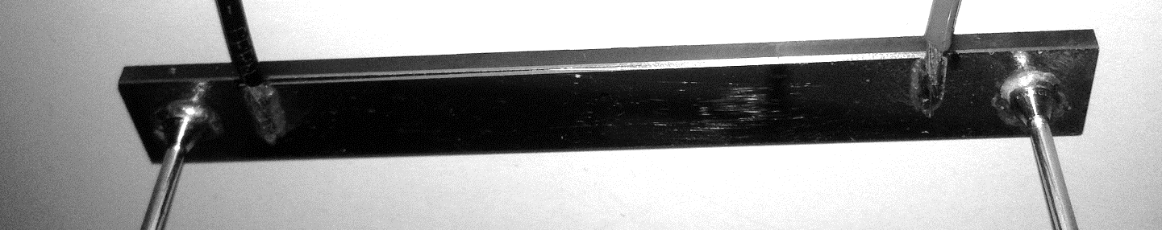
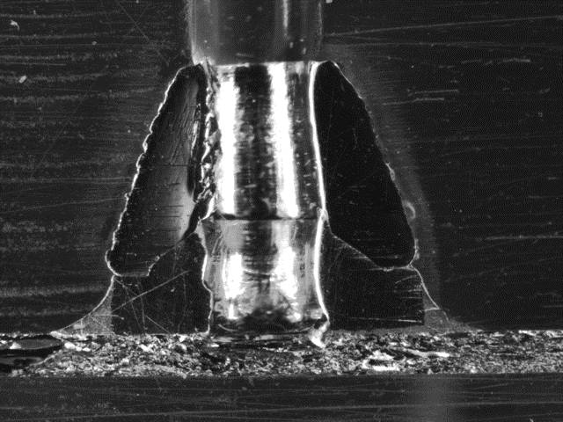
Multi-micro-channel cold plates produced with MEMS techniques: etching & bonding
Generic channel layout for boiling flows
Example: Resulting R&D device
Si-substrate bonded to
Real case: Si-wafer
R&D version for flow visualisation:
glass wafer
main channels
restrictions
outlet
inlet
outlet
plenum
FLOW
Si substrate
B-B
glass
Si substrate
dummy heater
Standard 1/16” tubing
B-B: hydraulic inter-connection: soldered variant
To CO₂ cooling plant
From CO₂ cooling plant

Slide 5
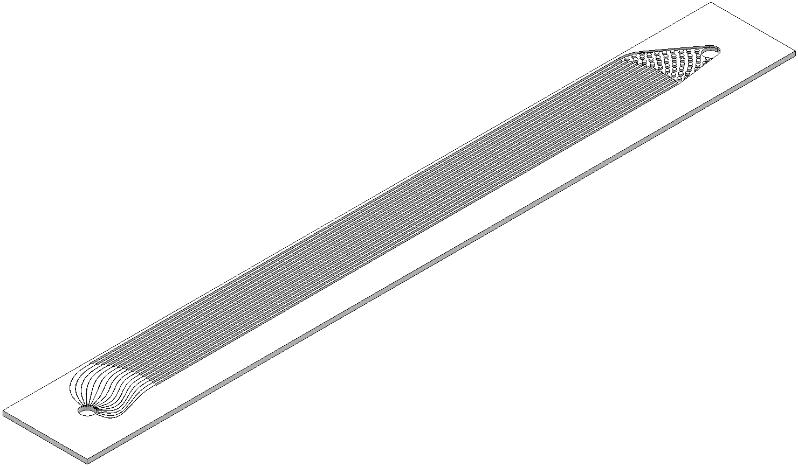
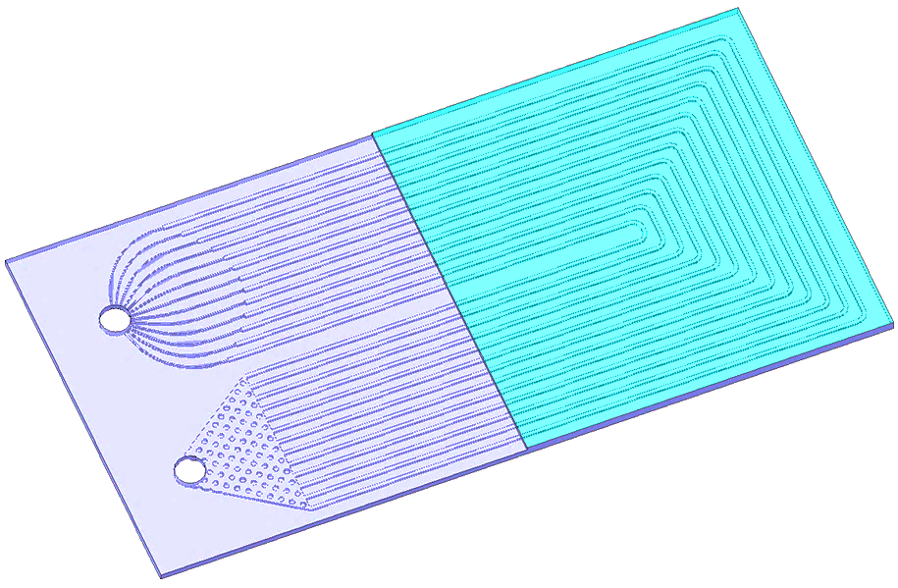
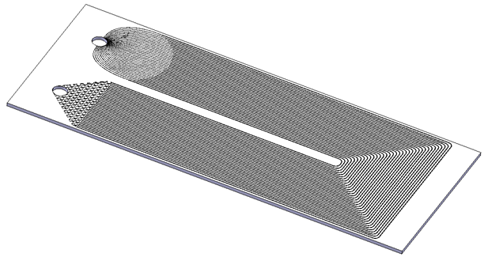
Multi-micro-channel cold plates produced with MEMS techniques: etching & bonding
Generic channel layout for boiling flows
Actual channel layouts for boiling flows (1st generation R&D)
Si-substrate bonded to
Real case: Si-wafer
R&D version for flow visualisation:
glass wafer
main channels
restrictions
outlet
inlet
outlet
plenum
FLOW
Si substrate
ATLAS
overall dimension 45 x 20 mm
year: ∼ 2012
intended for: ATLAS FEI4
institutes involved: CERN, University of Manchester, CSEM, EPFL Cmi
FRAME4
overall dimension: 85 x 10 mm
year: ∼ 2012
intended for: NA62 GTK
institutes involved: CERN, CSEM, EPFL Cmi
REFLECS
overall dimensions: 20 x 40 mm, 20 x 80 mm,
20 x 100 mm
year: ∼ 2014
intended for: generic 20 x 20 mm chips
institutes involved: CERN, FBK, LPNHE

Slide 6
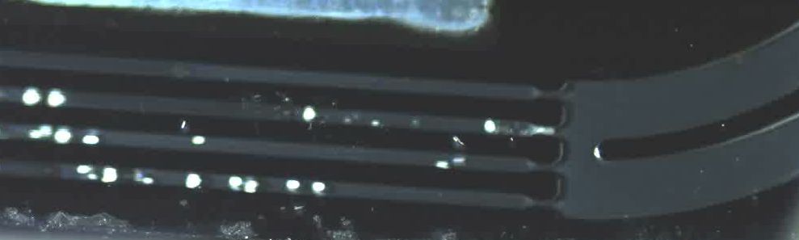
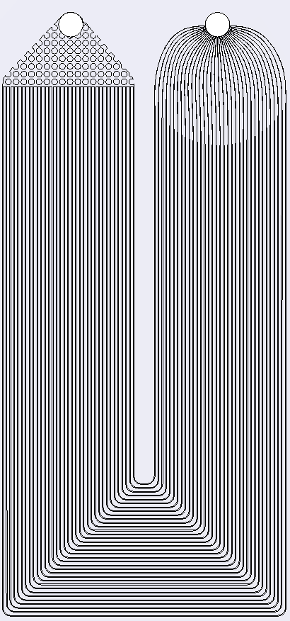
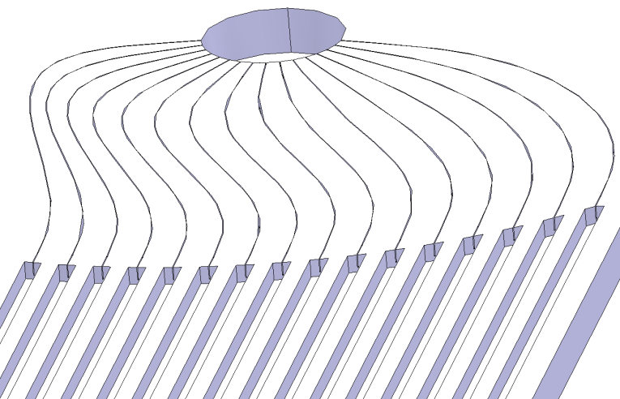
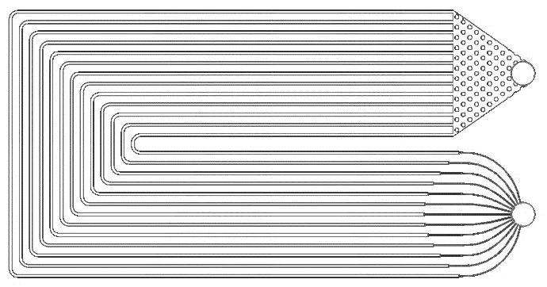
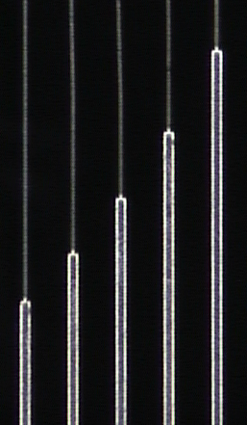
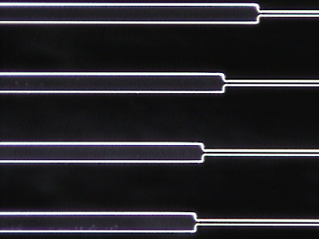
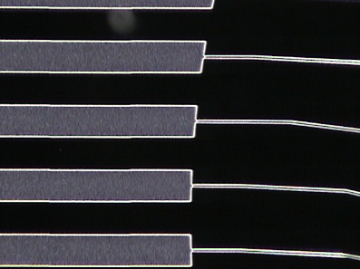
Detailed channel design for boiling flows
Appropriate inlet restrictions/capillaries:
Crucial requirement: for a correct functionality without flow instabilities during two-phase flow and flow boiling which otherwise would induce severe pressure fluctuations and local hot spots
2) Preferred side effect: Fluid-dynamic backward-facing step can trigger boiling onset due to recirculation areas causing low pressure zones in the near-wall region
↔ At this stage a complete analytical fluid dynamical evaluation was omitted and the technological manufacturing aspects were prioritised
↔ inappropriate restriction design allowing back flow and flow oscillations (video)
►
Nominal flow direction
ATLAS
No. channels 35
W_{restriction} 10 μm
H_{restriction} 190 μm
W_{main} _{channel} 50 μm
H_{main} _{channel} 190 μm
REFLECS
No. channels 13
W_{restriction} 60 μm
H_{restriction} 120 μm
W_{main} _{channel} 20 μm
H_{main} _{channel} 120 μm
FRAME4
No. channels 16
W_{restriction} 20 μm
H_{restriction} 200 μm
W_{main} _{channel} 200 μm
H_{main} _{channel} 200 μm
(documented version!)

Slide 7
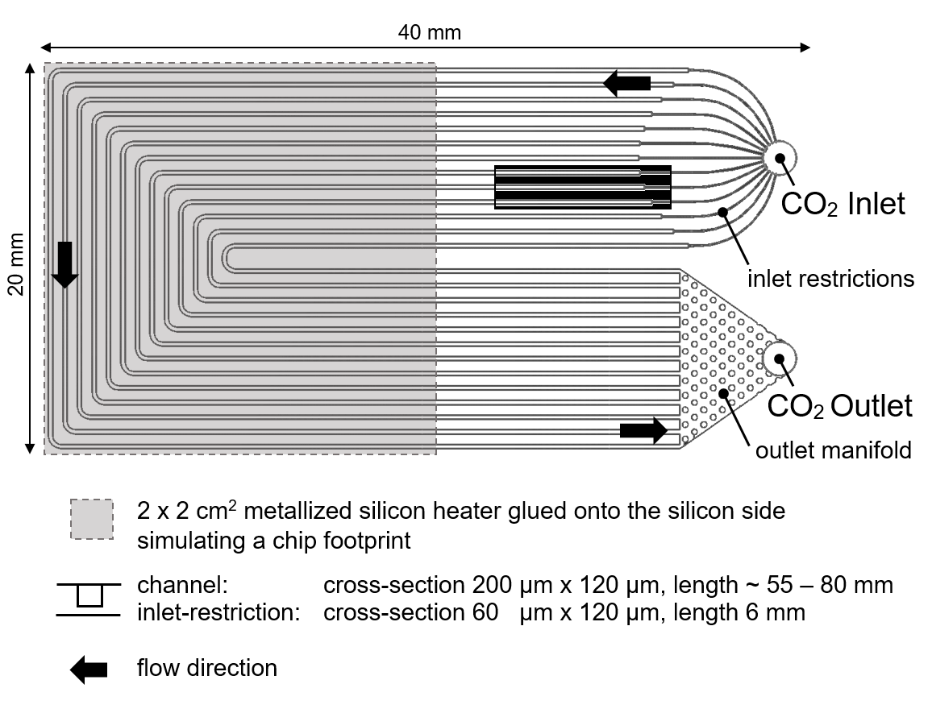
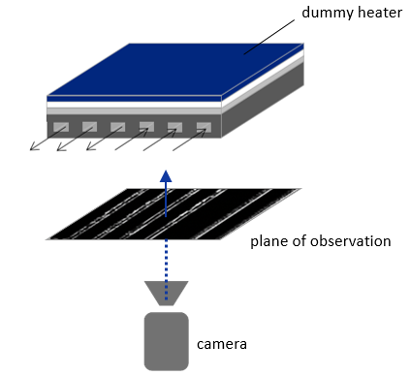
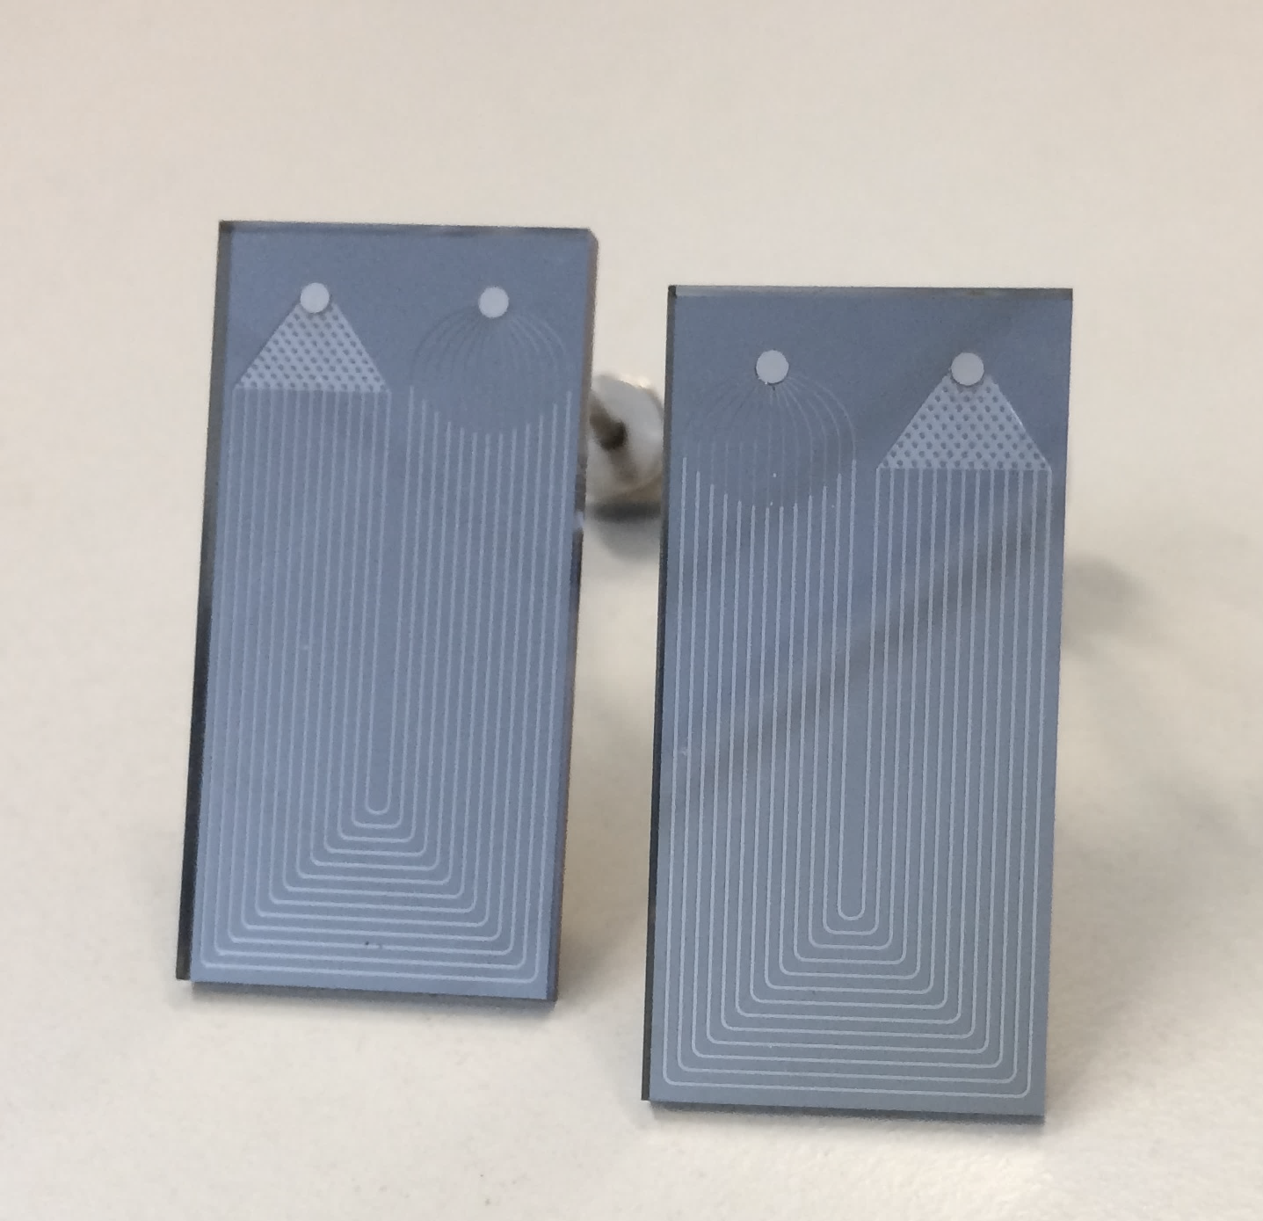
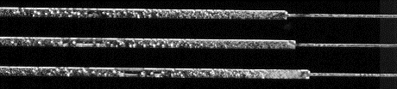
Initial R&D approach:
Step 1: Flow visualisation with high-speed camera
Step 2: Image analysis
Step 3: Publish awesome paper with many bubbly images ☺
Renewed R&D approach:
Step 1: Take step 1 from above and see what's next …
Step 2: Discard the “steps” approach since we literally had to go steps backwards in time
In detail:
Some (!) of the odyssey so far & results presented and discussed at the
Forum on Tracking Detector Mechanics 2022
https://indico.cern.ch/event/853861/contributions/4841288/
Today’s focus:
2 types of channel contamination
Channel contamination at inlet due to soldered connectors
Possibility of erosion damage inside Silicon multi-micro-channels
RECORDING & TESTING
►
DEVICE ANALYSIS
VIDEO
ANALYSIS
IMAGE ANALYSIS
ANALYTICAL APPROACH

Slide 8
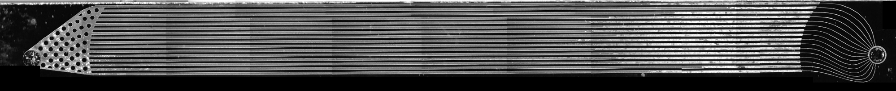
Device analysis: how it all started
After fluidic testing obvioius contamination of the channels was found
FRAME4

Slide 9
Device analysis: how it all started
After fluidic testing obvioius contamination of the channels was found
many optical microscope images through the glass ↔ truly look inside the channels
OPTICAL MICROSCOPE
FRAME4

Slide 10
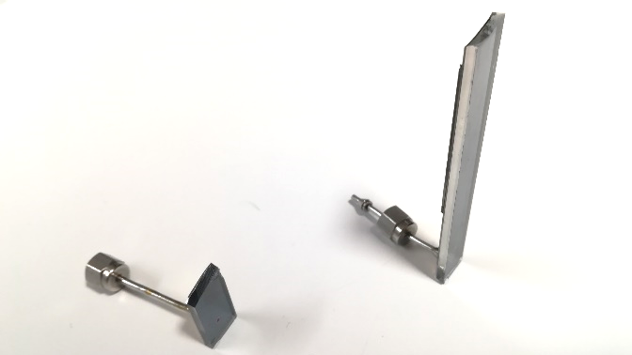
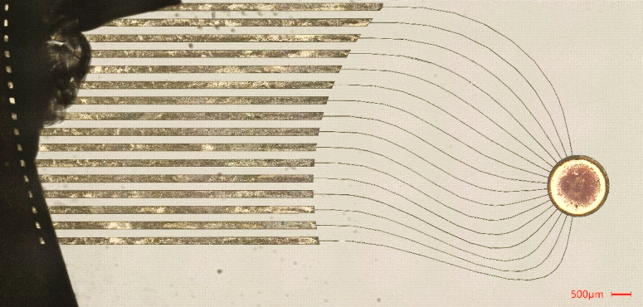
Device analysis: how it all started
After fluidic testing obvioius contamination of the channels was found
many optical microscope images through the glass ↔ truly look inside the channels
with MME department at CERN we cut/broke the channels close to the inlet
OPTICAL MICROSCOPE
CUT
CUT DEVICE
FRAME4
CUT
CUT

Slide 11
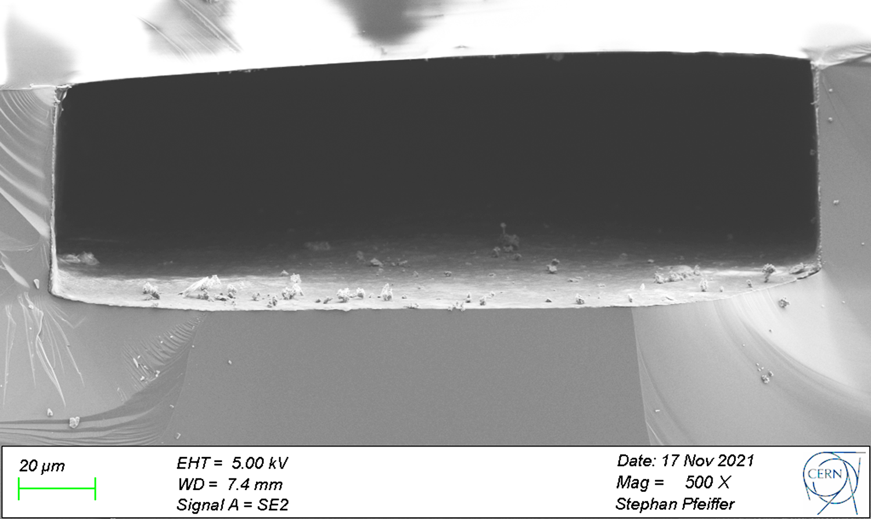
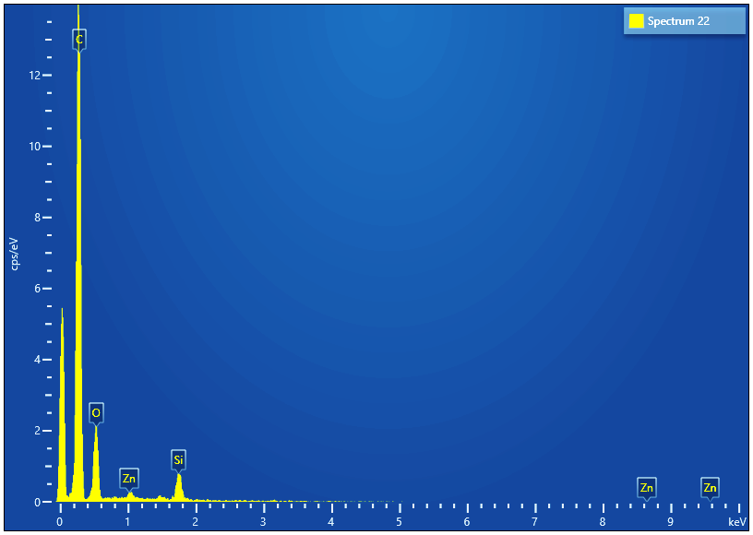
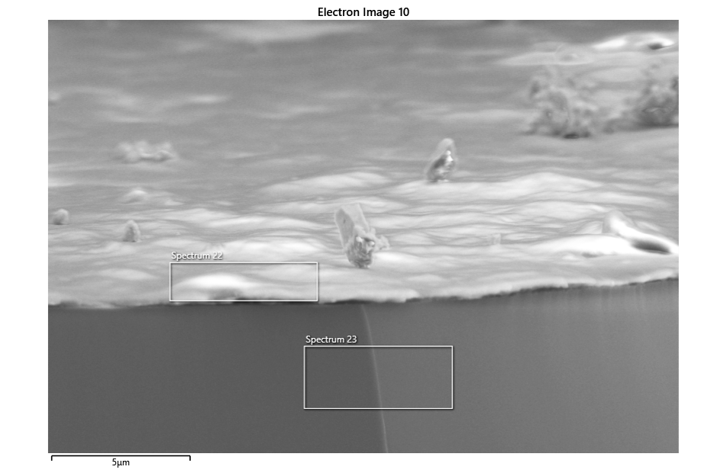
Device analysis: how it all started
After fluidic testing obvioius contamination of the channels was found
many optical microscope images through the glass ↔ truly look inside the channels
with MME department at CERN we cut/broke the channels close to the inlet
SEM images and spectral analysis of exposed channel cross-section
  thin film:
  → Zn and C signatures
  → SiO₂
  = solder flux + glass dust
  (ZnCl₂ + paraffin/petrolatum C_{n}H_{2n+2}) + SiO₂
OPTICAL MICROSCOPE
CUT DEVICE
FRAME4
CUT
SEM
thin film

Slide 12
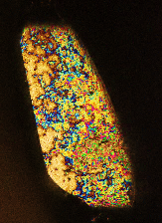
Device analysis: how it all started
After fluidic testing obvioius contamination of the channels was found
many optical microscope images through the glass ↔ truly look inside the channels
with MME department at CERN we cut/broke the channels close to the inlet
SEM images and spectral analysis of exposed channel cross-section
  thin film:
  → Zn and C signatures
  → SiO₂
  = solder flux + glass dust
  (ZnCl₂ + paraffin/petrolatum C_{n}H_{2n+2}) + SiO₂
  Further evidence:
  multi-colour reflection effect of petroleum and its derivatives
OPTICAL MICROSCOPE
CUT DEVICE
FRAME4
CUT
SEM
top view onto open channel section
thin film

Slide 13
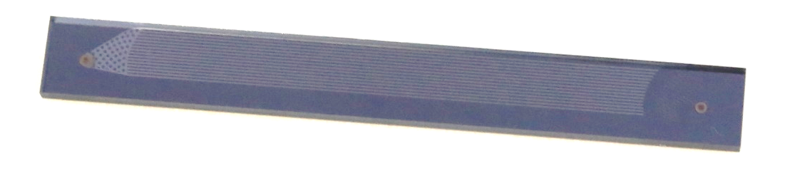
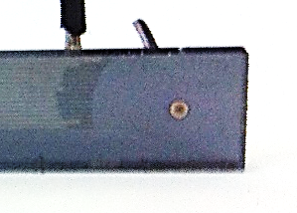
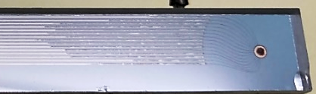
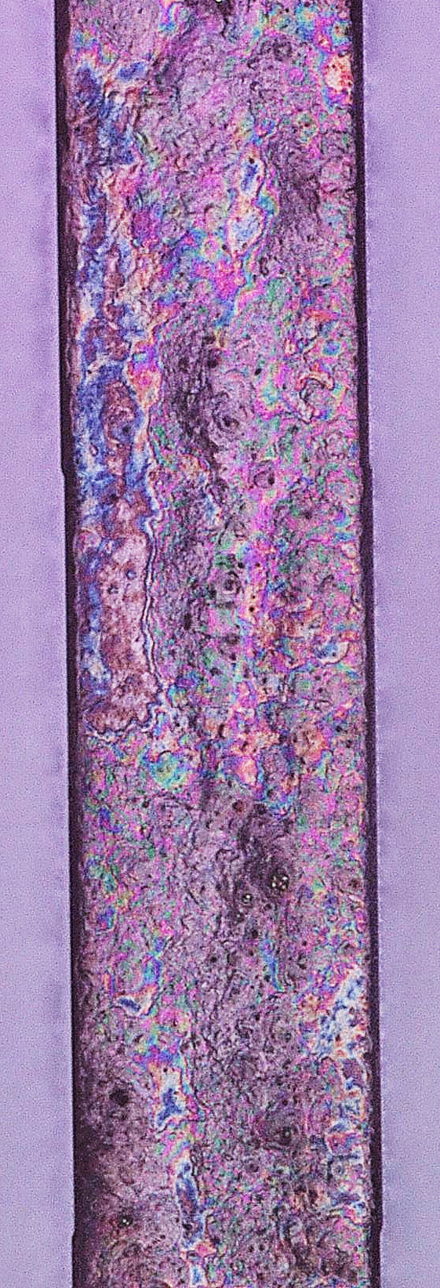
Channel contamination at inlet due to soldered connectors
Extreme capillary forces drew the soldering flux into the inlet capillaries
Furthest inwards for the shortest inlet capillary giving rise to the parabola shaped pattern
Less at outlet due to absence of capillaries
Flux did propagate further into channels during fluidic testing
layer found on Si and glass side
thickness estimated to ~ 1 μm (on Si side)
2012
FRAME4 in 2012: unsoldered
FRAME4 in 2012: soldered
FRAME4 in 2021: soldered & tested multiple times (from 2012 to 2016)
2021
= 1st type of contamination:
caused prior to testing
Schlieren-like due to interaction with flow
transparent (Paraffin = transparent)

Slide 14
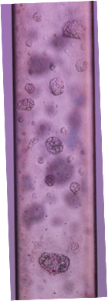
Channel contamination at inlet due to soldered connectors
Extreme capillary forces drew the soldering flux into the inlet capillaries
Furthest inwards for the shortest inlet capillary giving rise to the parabola shaped pattern
Less at outlet due to absence of capillaries
Flux did propagate further into channels during fluidic testing
layer found on Si and glass side
thickness estimated to ~ 1 μm (on Si side)
2012
FRAME4 in 2012: unsoldered
FRAME4 in 2012: soldered
FRAME4 in 2021: soldered & tested multiple times (from 2012 to 2016)
2021
= 1st type of contamination:
caused prior to testing
Schlieren-like due to interaction with flow
transparent (Paraffin = transparent)
2nd type of contamination:
caused during testing
Point-like
Non-transparent

Slide 15
Device analysis: how it continued
Due to microscopic point-like structures another cut did not make sense
non-destructive approach: Keyence Profilometer

Slide 16
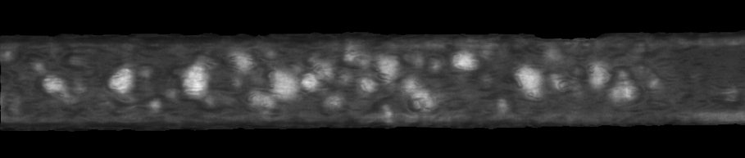
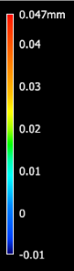

Device analysis: how it continued
Due to microscopic point-like structures another cut did not make sense
non-destructive approach: Keyence Profilometer
Device analysis confirms local, crater-like erosion damage (removal of material)
200 μm
PROFILOMETER
Erosion on Silicon side confirmed as “blue indentations (-)”

Slide 17
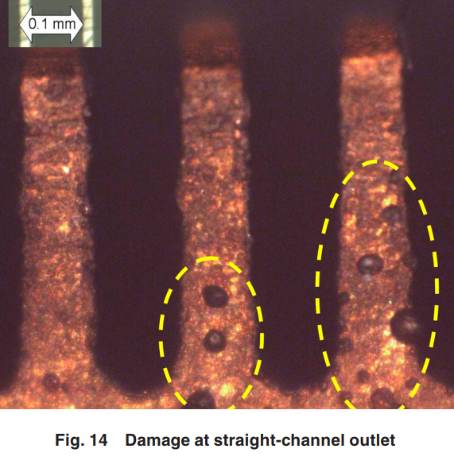
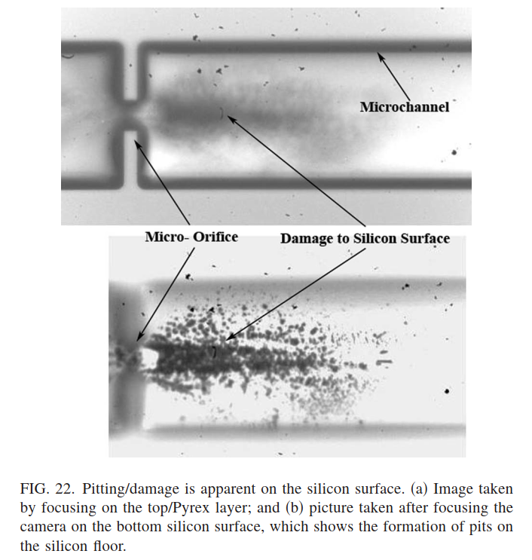
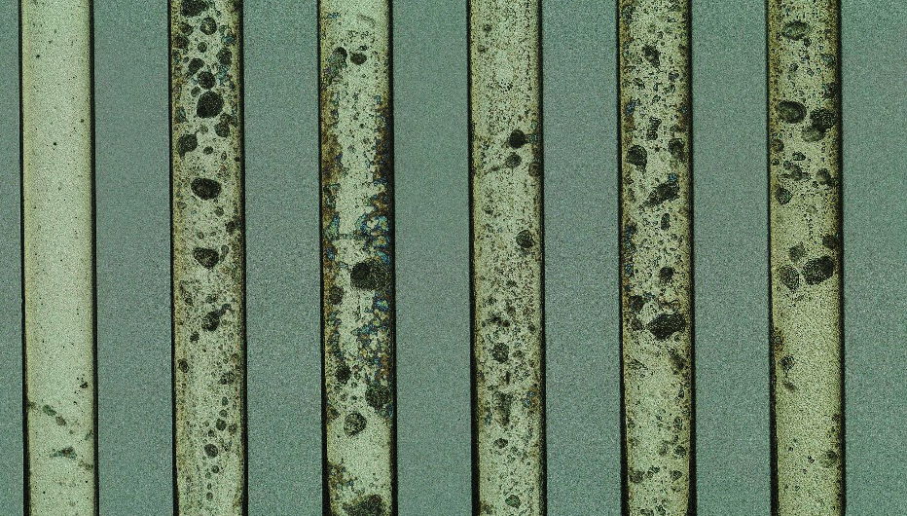
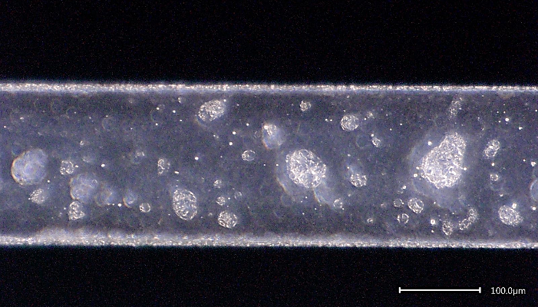
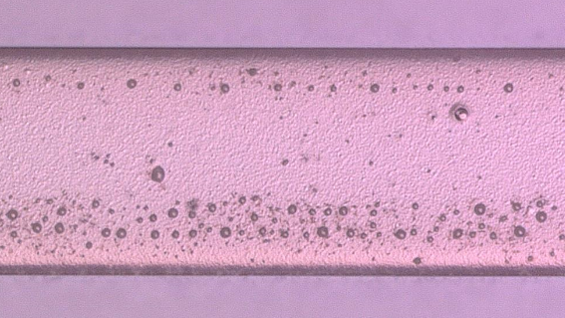
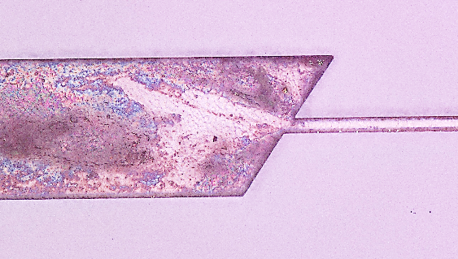
Device analysis: how it continued
Due to microscopic point-like structures another cut did not make sense
non-destructive approach: Keyence Profilometer
Device analysis confirms local, crater-like erosion damage (removal of material)
Erosion patterns similar to findings from literature concerning pitting damage inside micro-channels
200 μm
PROFILOMETER
Erosion on Silicon side confirmed as “blue indentations (-)”
[1]
OPTICAL MICROSCOPE
[2]
Damaged channels: our case literature

Slide 18
Device analysis: how it continued
Due to microscopic point-like structures another cut did not make sense
non-destructive approach: Keyence Profilometer
Device analysis confirms local, crater-like erosion damage (removal of material)
Erosion patterns similar to findings from literature concerning pitting damage inside micro-channels
Further evidence: glass dust mentioned before was created by erosion and accumulated in the paraffin layer
200 μm
PROFILOMETER
Erosion on Silicon side confirmed as “blue indentations (-)”
[1]
OPTICAL MICROSCOPE
[2]
Damaged channels: our case literature

Slide 19
Device analysis: how it continued
Due to microscopic point-like structures another cut did not make sense
non-destructive approach: Keyence Profilometer
Device analysis confirms local, crater-like erosion damage (removal of material)
Erosion patterns similar to findings from literature concerning pitting damage inside micro-channels
Further evidence: glass dust mentioned before was created by erosion and accumulated in the paraffin layer
  → Formulation of Hypothesis:
  Damage may be caused by cavitation
200 μm
PROFILOMETER
Erosion on Silicon side confirmed as “blue indentations (-)”
[1]
OPTICAL MICROSCOPE
[2]
Damaged channels: our case literature

Slide 20

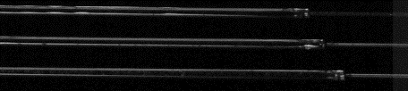
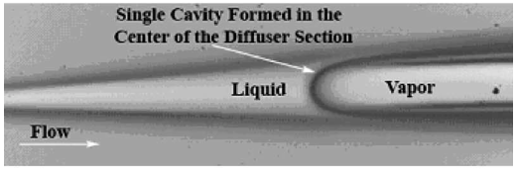
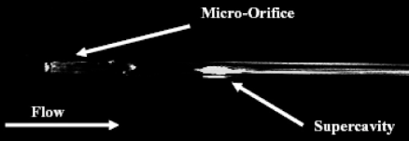
→ Validation of Hypothesis: Damage may be caused by cavitation
Video analysis
Flow pattern “analysis” by eye and comparison to literature
Visual results from high speed camera recordings exhibit similarities to cavitating flow patterns from literature
Image analysis
Further image analysis confirms for example bubble collapse which can famously induce damage:
line profile after expansion (A-B) = evolution of pixel grayscale value in time
A
B
0 s
B
A
time
►
[3]
[4]
►
e.g. cavitating flows form so-called single stationary super-cavity
e.g.
discontinued bubble clouds
indicate bubble collapse
0.073 s

Slide 21
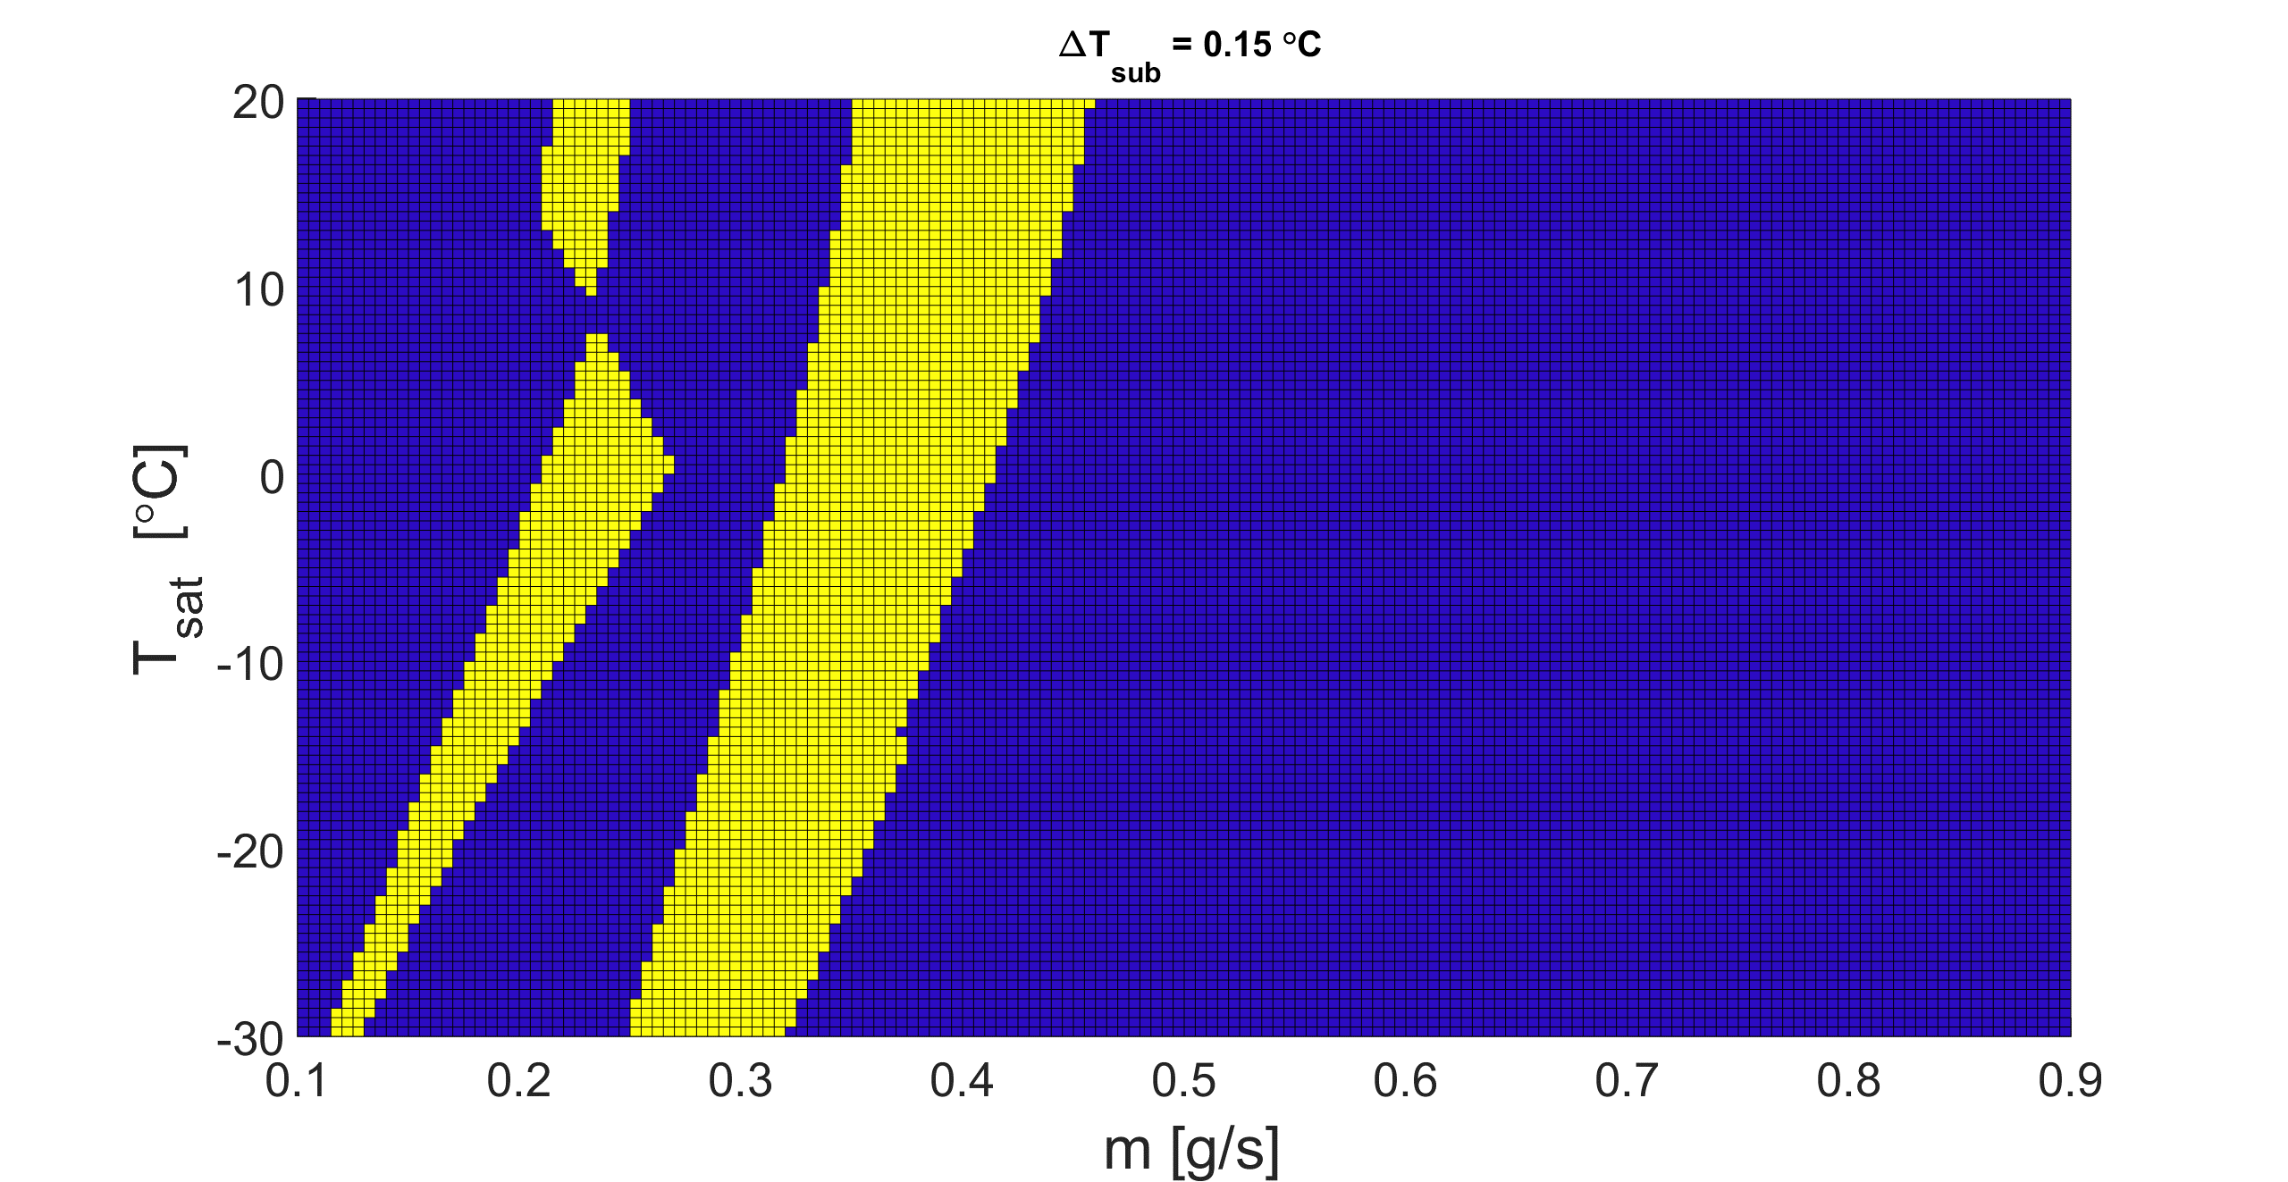
Analytical approach
Cavitation may be triggered by combination of inlet geometry and flow parameters, which were chosen rather randomly so far for the actual experiments [within reason]
in order to avoid destructive flow parameters/ cavitating flow regime: Proposal of a parametrical map based on standard duct flow formulations
in function of total flow rate and T_{sat}, fixed sub-cooling level, fixed geometry (↔ map differs for different devices)
Example with fixed geometry: REFLECS device, 0.15°C sub-cooling
Possibility of reverse-tuning the map by changing the geometrical inputs
  → Such map may be used as guidance for designers and experimentalists, designing and investigating future multi-micro-channel cold plate layouts, tuning the geometry and the flow parameters for a safe and efficient operation
1
2
simplified map with legend
1
safe flow parameters
2
possibly dangerous flow parameters due to cavitation !!!

Slide 22
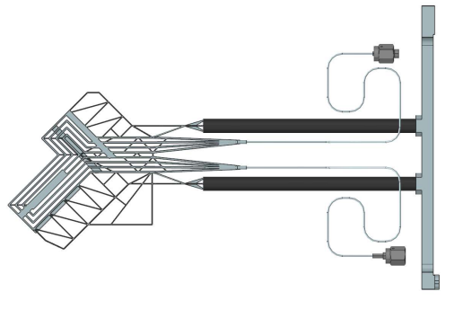

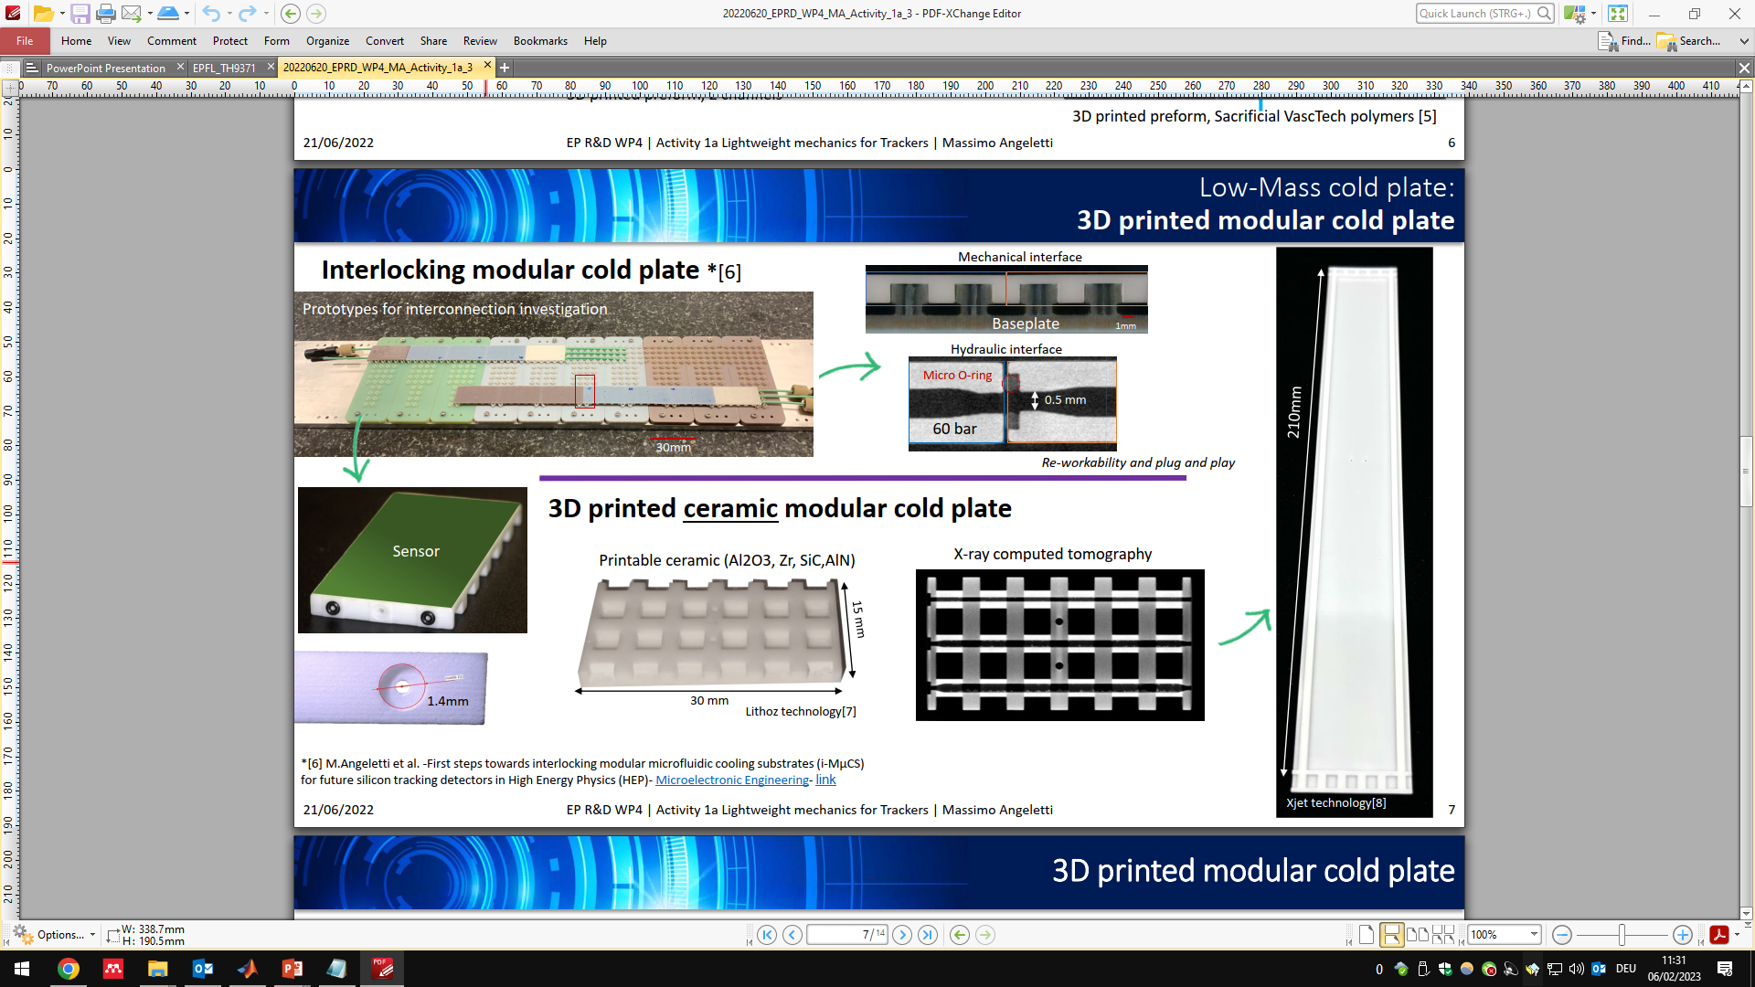

Multi-micro-channel cold plates produced with 3D-printing techniques
Initial idea: the technology should be harvested to achieve more complex channel layouts
two relatively mature designs in the detector cooling community:
  LHCb Velo upgrade proposal: complex multi-micro-channel cooling substrate in titanium grade 2
  EP R&D proposal: basic, interlocking (LEGO-like) modular multi-micro-channel cooling substrate in ceramic
However many technological boundaries have to be
implemented into the design process making it difficult
to achieve more complex channel layouts
  Porosity
  Planarity
  Shrinkage
  min. ID
  ID geometry
  Powder removal
  Channel roughness (also its evolution over time)
→ how to make it work for the “LEGO”- concept and for much more information:
M. Angeletti, PhD thesis massimo.angeletti@cern.ch

Slide 23
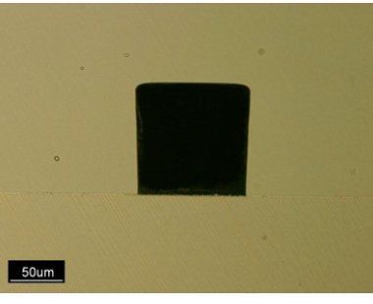
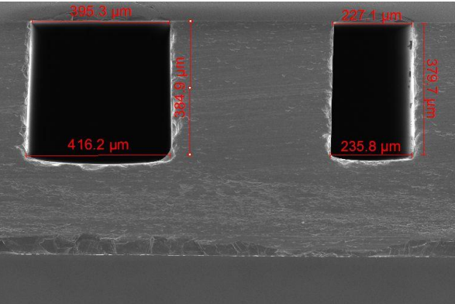
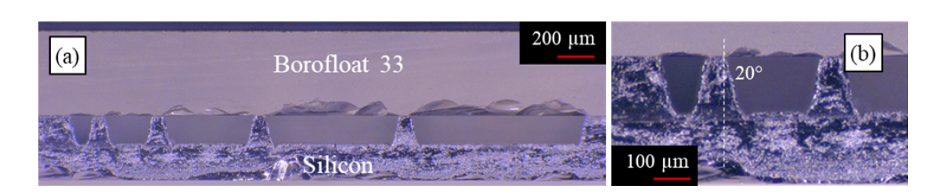
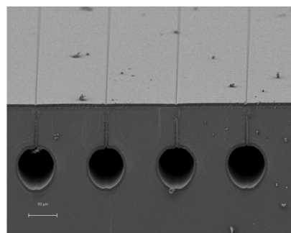
Short reminder on different manufacturing options (CERN EP-DT & collaborating institutes)
Motivation
cost reduction (↔ state of the art Si-Si cold plates €€€)
reliability (↔ state of the art 3D-printed cold plates)
material reduction (↔ thickness of reliable & cheap conventionally machined cold plates >>> detector cooling requirements)
Research already initiated at CERN EP-DT & collaborating institutes
Manufacturing procedure
trenches in planar Si wafer fusion of two planar wafers
  - Etching (DRIE, WET) - bonding (direct, anodic)
  - Laser engraving with fs-Laser (M. Angeletti, PhD thesis)
                - eutectic bonding under investigation
  at IFIC/HLL (M. Vos, IFIC Valencia)
  - thermo-compression (T. Frei, PhD thesis)
buried micro-channels
  Combination of DRIE + XeF₂ etching filling of trenches with e.g. PECVD, Parylene
(A. Mapelli, R. Callegari: another link )
eutectic bonding
thermo-
compression
buried
micro-channels

Slide 24
Summary & Conclusion
Multi-micro-channel cold plates produced with MEMS techniques: etching & bonding
Soldering flux used during connectorizing the cold plate did pollute the channels prior to testing
→ on R&D level with focus on the fluidic behaviour of the cold plate itself a glued connector will be used henceforth
Erosion damage was found inside micro-channels
Cavitation phenomena were hypothesized and confirmed
→ A parametrical map was proposed to avoid the damaging flow regime
Publish awesome paper with many bubbly images ☺
But still so much more to discover at those small scales
Multi-micro-channel cold plates produced with 3D-printing techniques
Necessary to find and push the limits of this technology for the needs of the detector cooling community
Short reminder on different manufacturing options
Use the links provided and names given as first pointer to the mentioned technologies

Slide 25
Thank you for your attention!
…“I would rather have questions that can’t be answered, than answers that can’t be questioned.”
— Richard P. Feynman.

Slide 26
Quick-References
[1] https://doi.org/10.1115/1.4024388
[2] https://doi.org/10.1063/1.2132289
[3] https://doi.org/10.1109/JMEMS.2005.851800
[4] https://doi.org/10.1063/1.1827602

