Slide 1
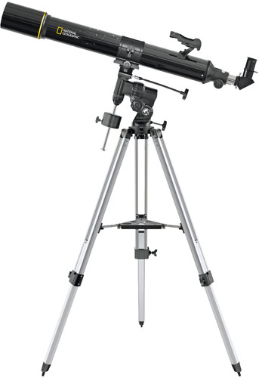
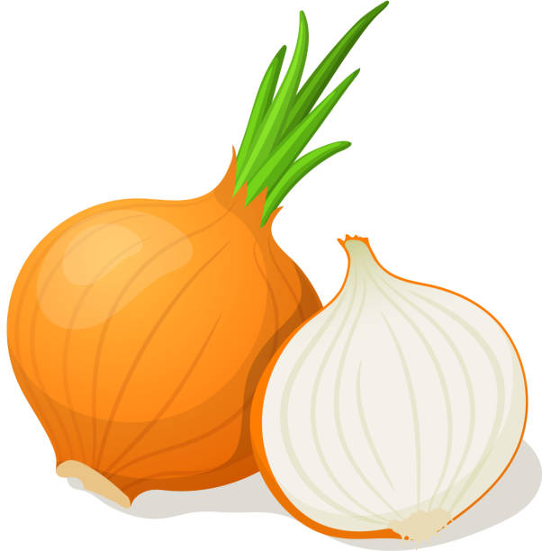
VUII
What is better than a telescope? .. an onion?

Slide 2

Disclaimer
Nikhef currently has no budget for VUII
  I work 1 day a week on LHCb.
    This includes current velo support(U1)
    Student support
    Design on VUII
    So development is slow, but here are my incoherent thoughs
So here is the same story
NEWS FLASH – NOTHING HAPPEND

Slide 3
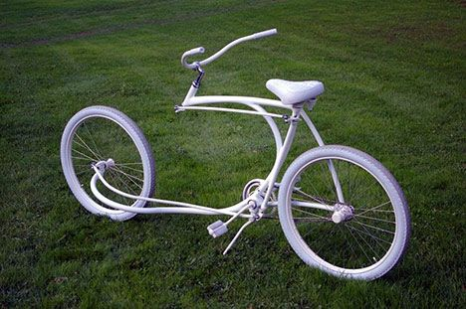
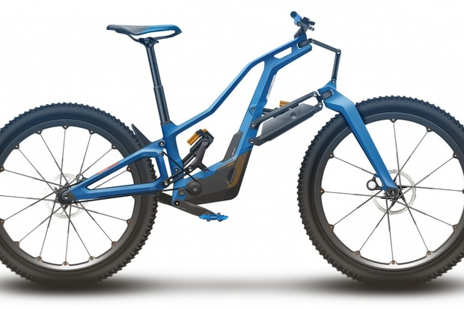
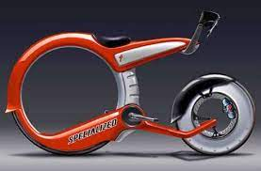
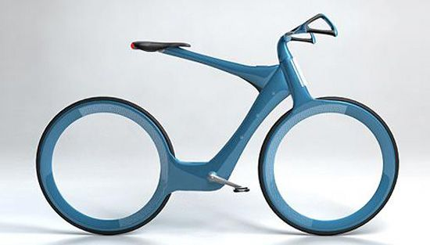
Future of the velo?

Slide 4
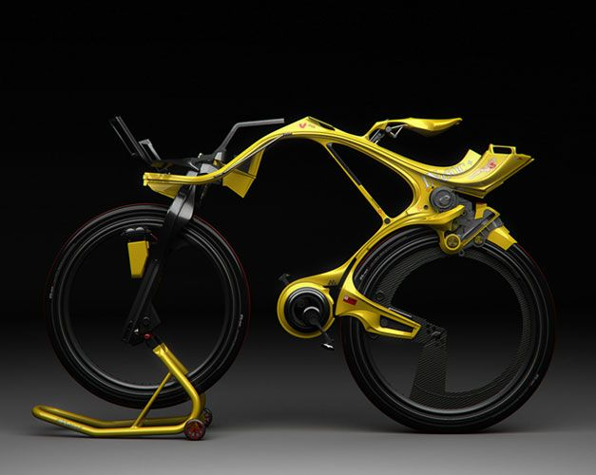
Or maybe this?

Slide 5
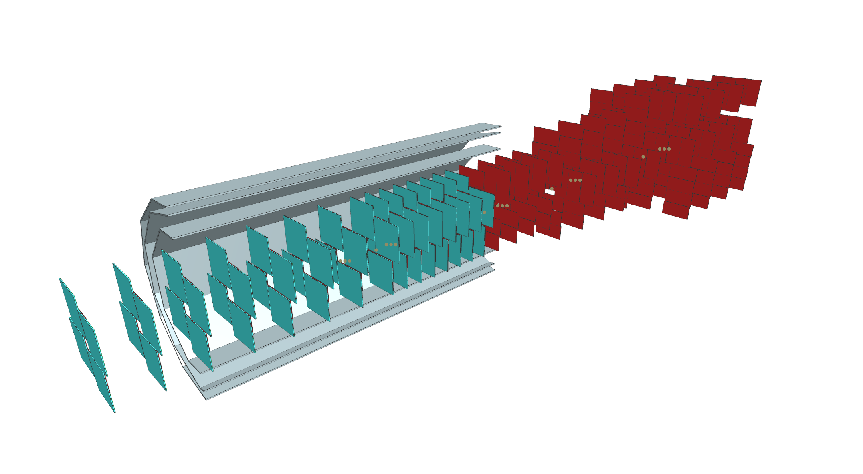
Barrel with expanding size
Maybe not the best use of silicon.

Slide 6
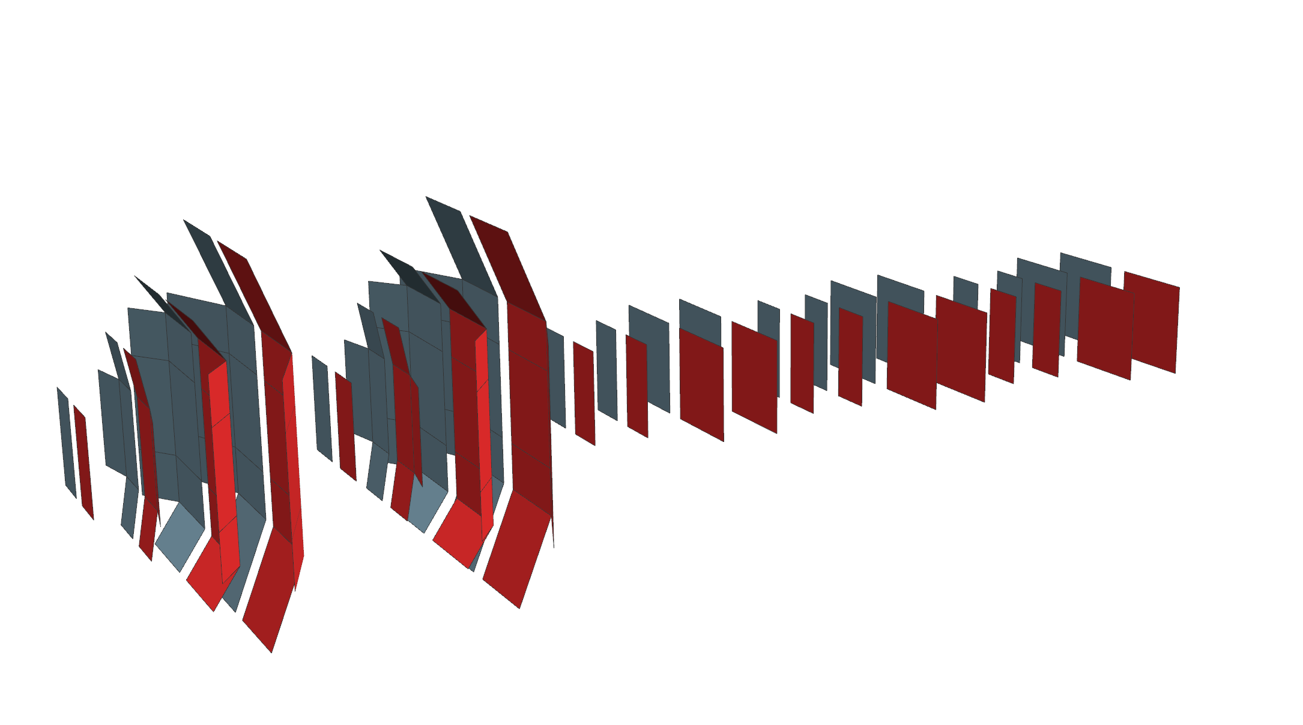

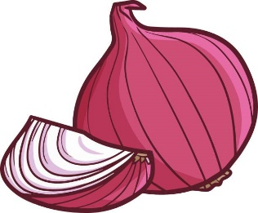
The nion
So good it makes you cry!
Increases the acceptance.
Curved shape should gives better Z resolution.
Optimezed used of silicon

Slide 7
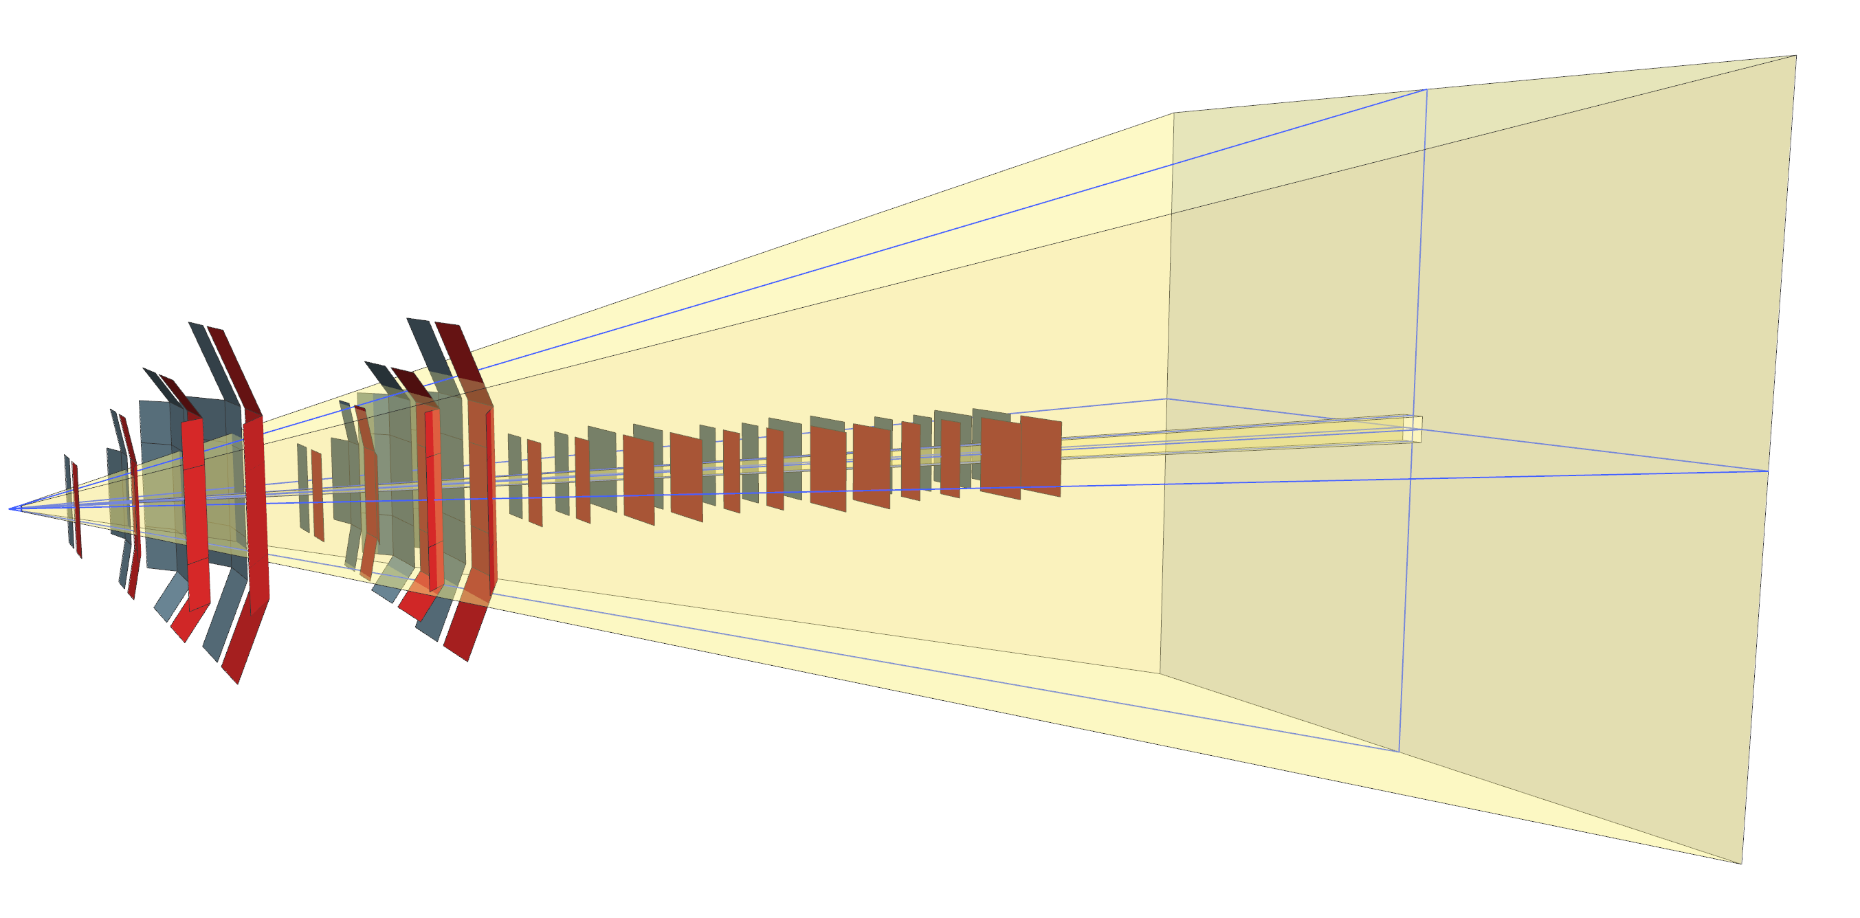
Increases the acceptance
In yellow is the old acceptance

Slide 8
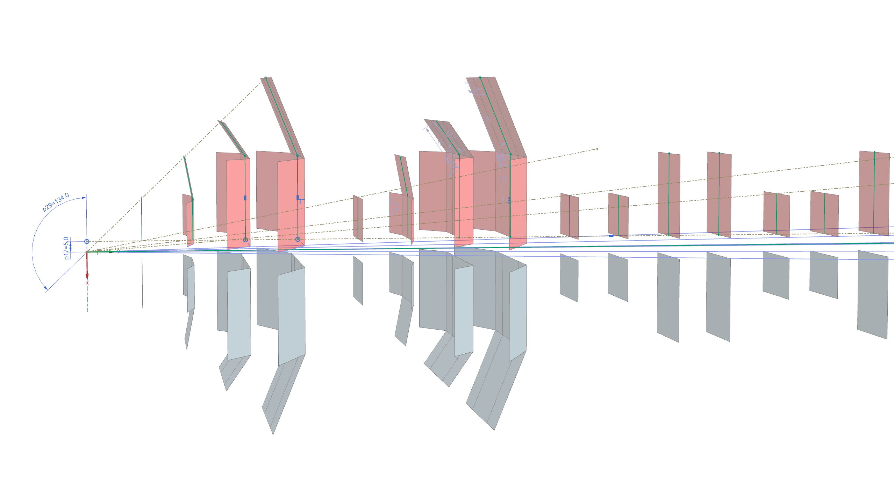
Each track has minimal 4 hits

Slide 9
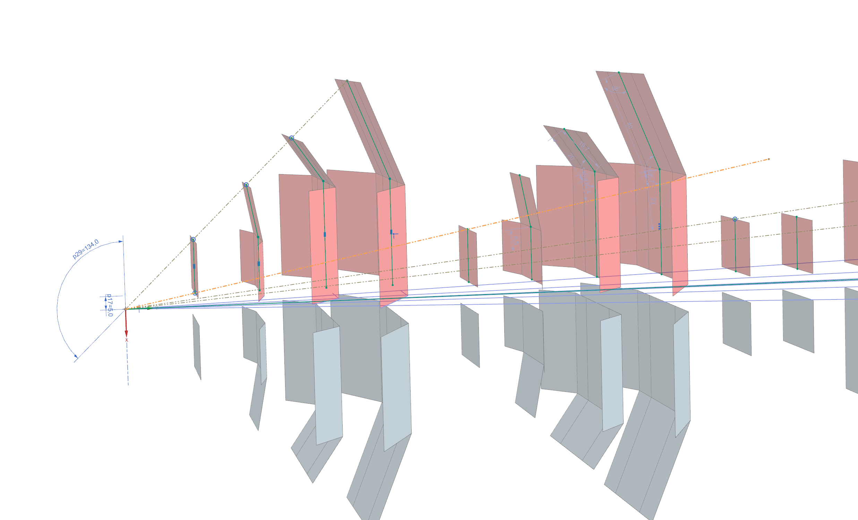

Slide 10
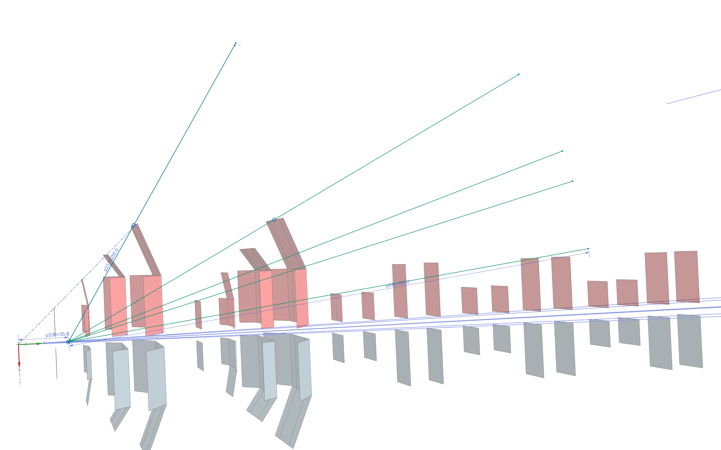
IP strecht of +/-35 mm, gives even bigger acceptance, but some tracks have only 3 hits.

Slide 11
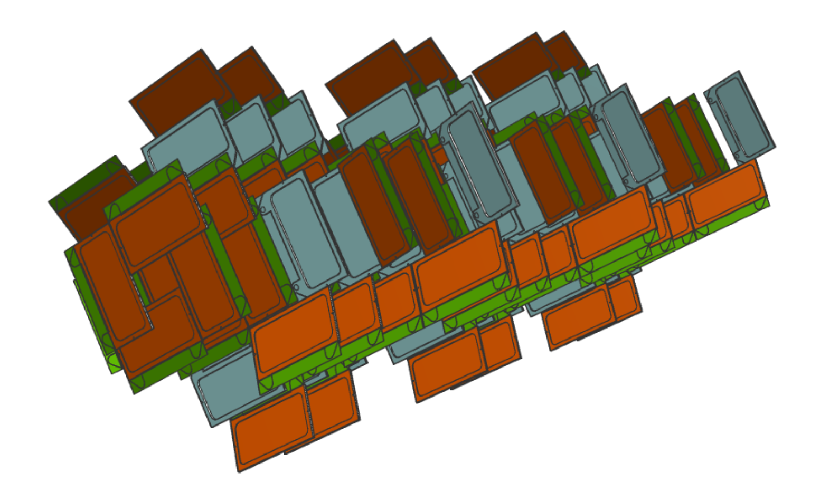

Slide 12
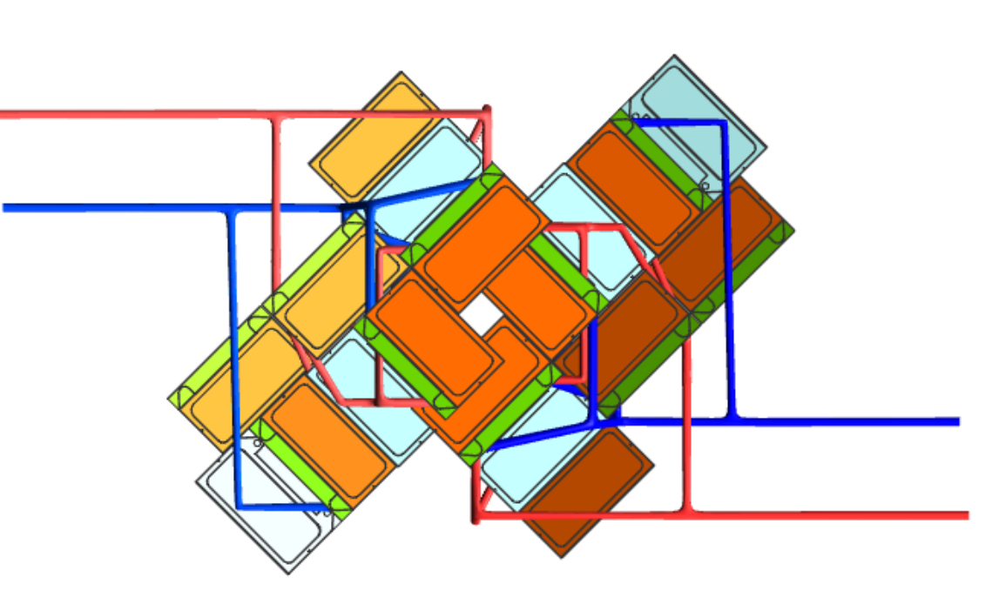

Slide 13
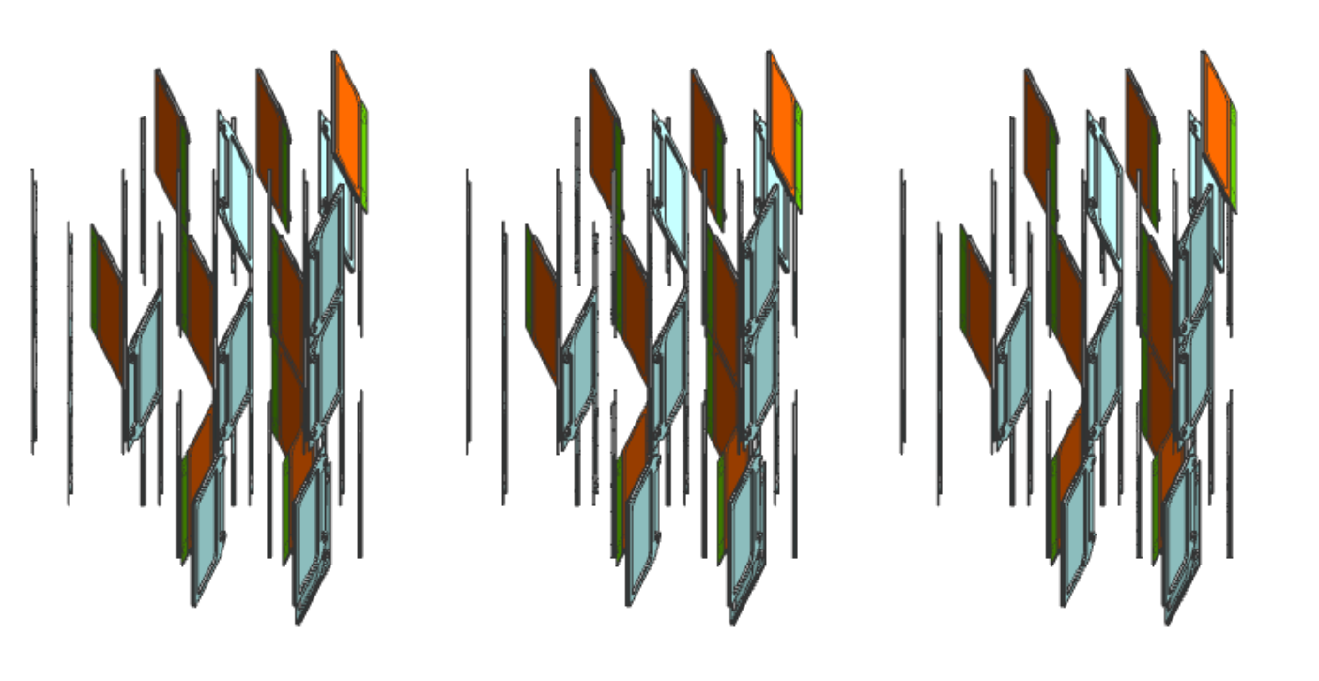

Slide 14
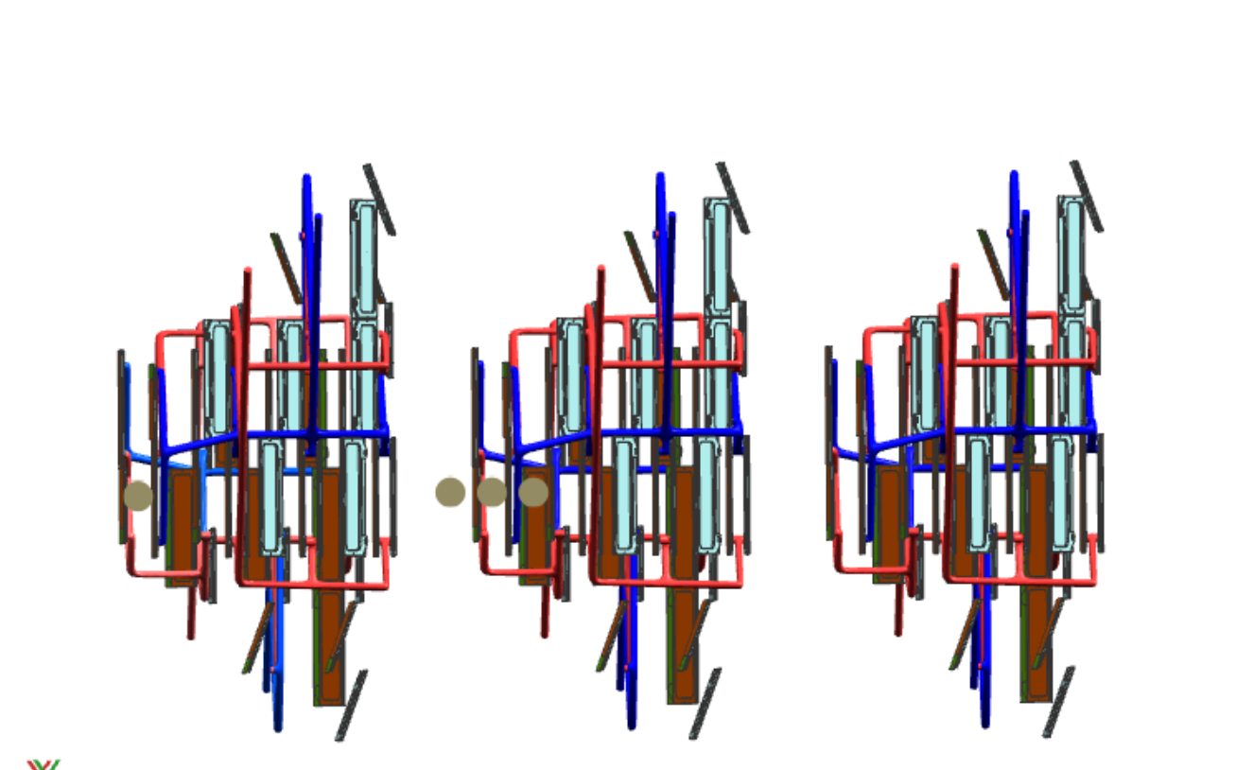
Some numbers
Onion
23 modules, 46 ASICs
332,1 shown length.
Upgrade I
52 modules , 624 ASICs
1026,4, 624

Slide 15
Multi functional support:
- 3d printed aluminium
- Hollow tubes, for cooling supply
- Low voltage supply.
- If more stiffness is required glassfiber-epoxy can be added
A single set of modules:
- Design can change depending on location inside dectector
Modules can be replaced
1 set of LV/cooling connection
3d printed support gives option to create extreme layouts, like the onion shape

Slide 16
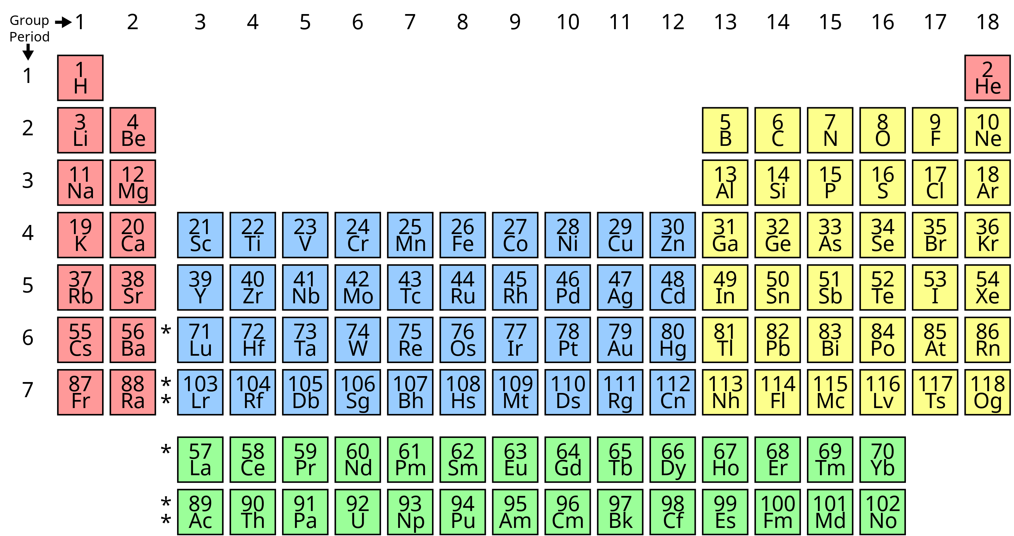


Slide 17
Some materials
boron carbide - tank armor, bulletproof vests
Boron nitride - 2.1 g/cm³
Atomically thin boron nitride is one of the strongest electrically insulating materials. Monolayer boron nitride has an average Young's modulus of 0.865TPa and fracture strength of 70.5GPa, and in contrast to graphene, whose strength decreases dramatically with increased thickness, few-layer boron nitride sheets have a strength similar to that of monolayer boron nitride
And a lot more

Slide 18
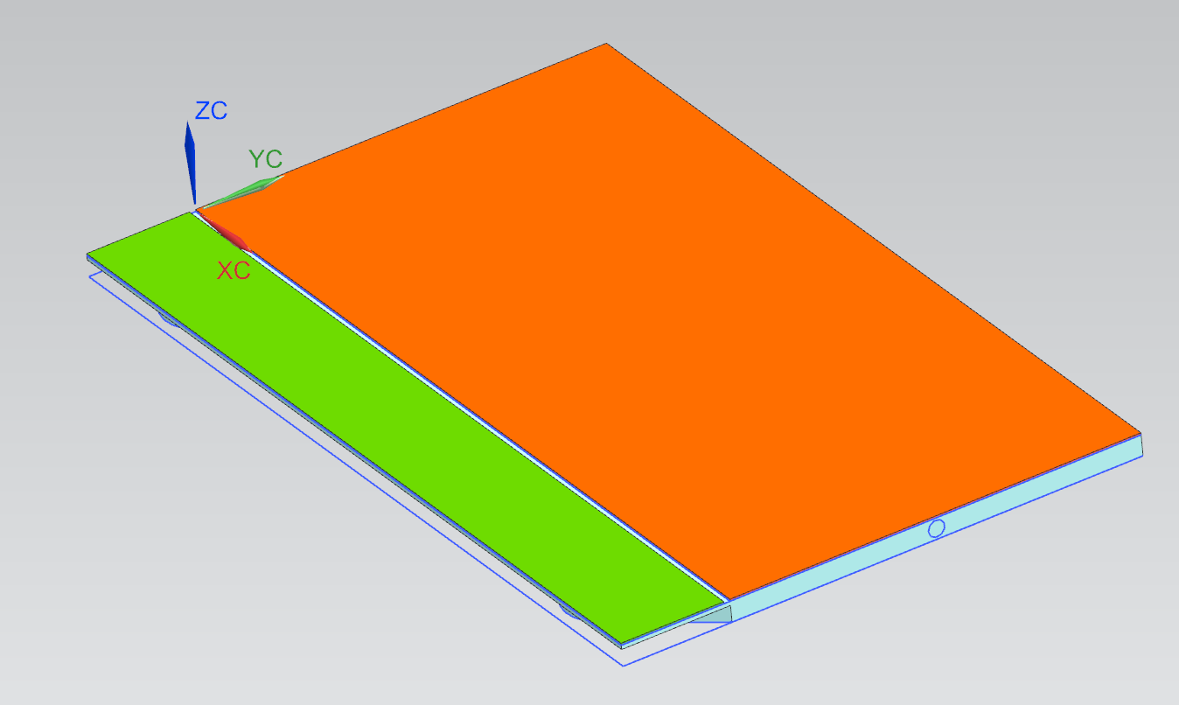
Research is ongoing on fluid connection
Micro connectors
Soldering
etc
Inlet
Cooling substrate:
0,2mm wall thickness
Light weight ceramic
Total thickness 1mm
Outlet
Some selected values:
Sensor size 20x40mm
Smal section for connectors and components
Soldered sensor to cooling

Slide 19
Plans
Micro fluid connector developments (Jan 23)
LV as mechanical support (cooling) (feb 23)
Soldering ASIC to cooling (mar 23)
Use all to build a Timepix4 prototyp module.

Slide 20
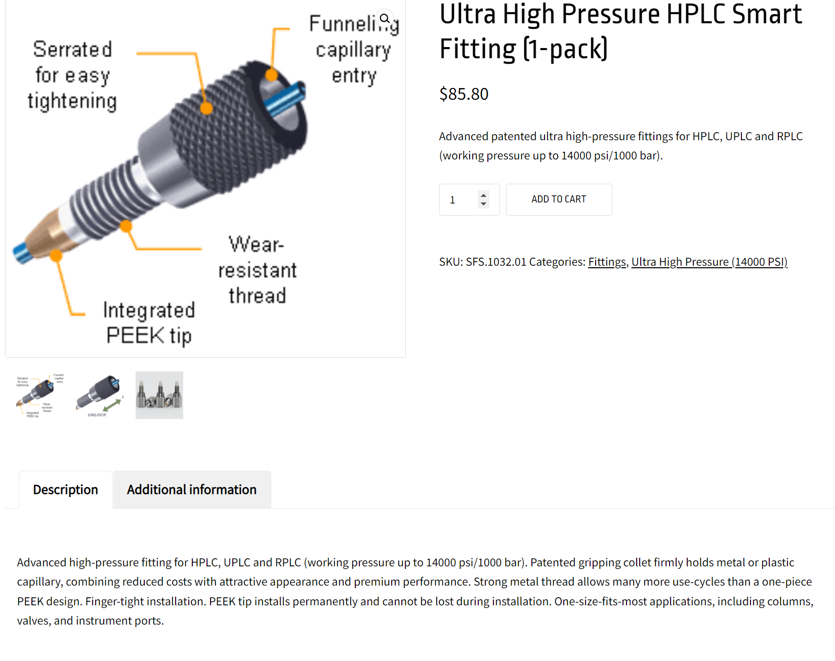
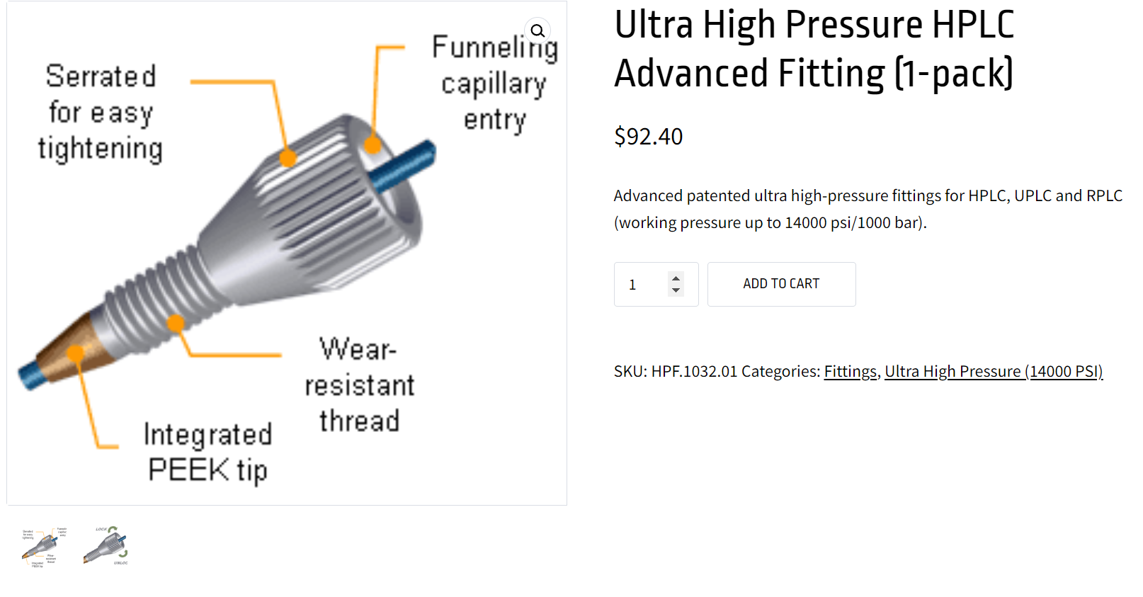
Micro connectors.
Some commercial ideas that can be adopted to be used for us

Slide 21
Cooling support
3d printed aluminium
3d printed SiC
Contact ongoing with companies.
BeO (internal review on possibly using this)
Notes:
https://bist.lc/shop/fittings/ultra-high-pressure-14000-psi/ultra-high-pressure-hplc-advanced-fitting-1-pack/

