Slide 2

CERN Vacuum acceptance tests for particle accelerator equipment: An Overview
Giuseppe Bregliozzi
TE-VSC-BVO
VELO Upgrade II Workshop
Amsterdam, 6 – 8 Feb 2023

Slide 3
Outline
Why vacuum acceptance tests?
Acceptance tests procedures:
  Unbaked system
    Example of polymeric component
  Baked system
Conclusions & Advices
Additional slides: Some special needs and examples:
  Beam induced effects: ESD & PSD cases
  New sintered materials
  Glues vs. NEG

Slide 4
Why Vacuum Acceptance Tests?
One of the main mandates of the CERN Vacuum Surfaces Coatings group is to provide the beam operation with a required vacuum level on all the accelerator complex.
To achieve that mandate, acceptance tests are needed to assess the compatibility of all pieces of equipment to be installed in the beam vacuum system of the accelerator complex:
    Leak tightness.
    Detection of contamination.
    Measurement of outgassing rate and its time variation.
    Measurement of virtual leaks (in leakage).

Slide 5
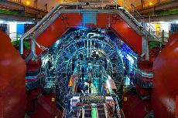
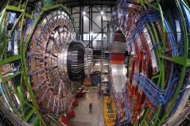
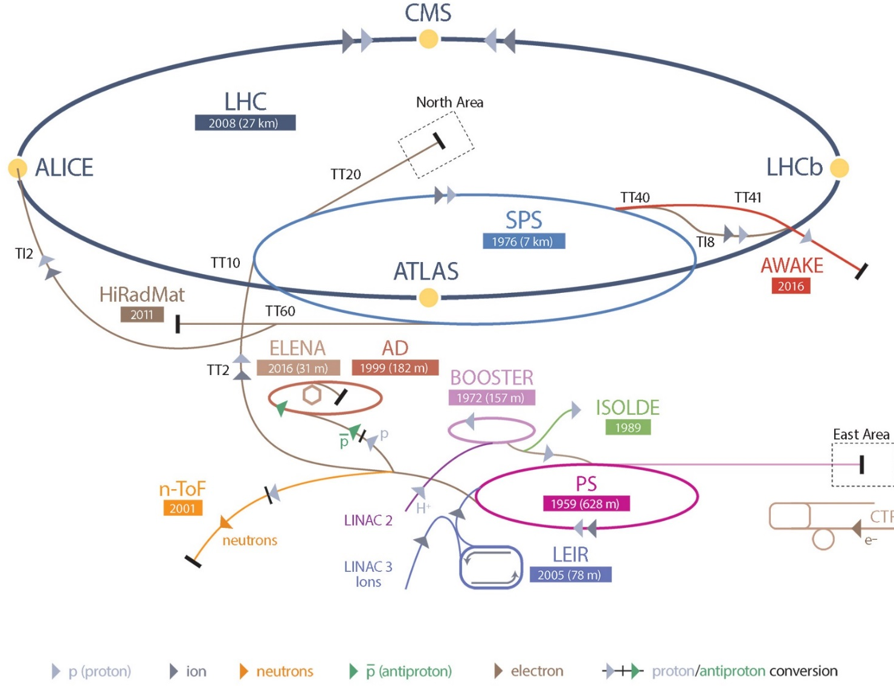
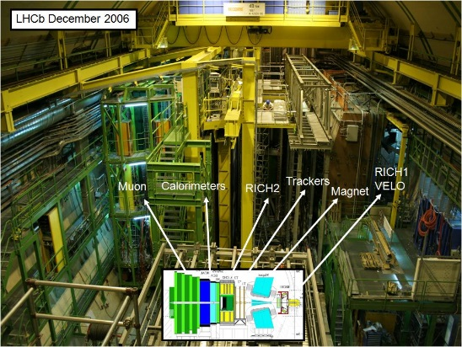
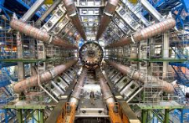
CERN accelerators chain
2 X 7 TeV
450 GeV
26 GeV
ALICE
CMS
450 GeV
LHCb
1-1.4 GeV
50 MeV
ATLAS

Slide 6
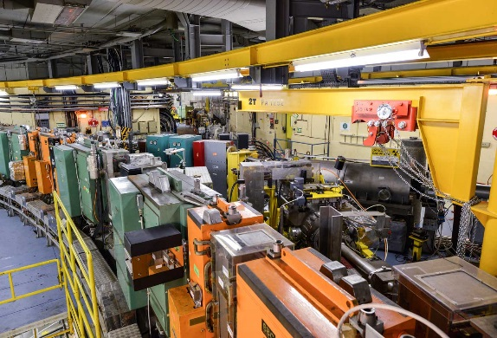
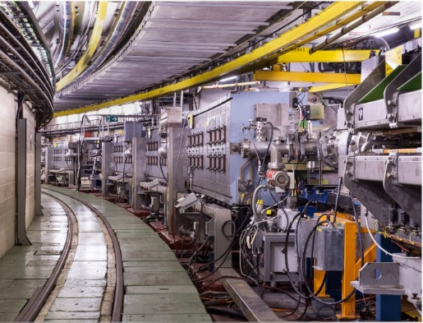
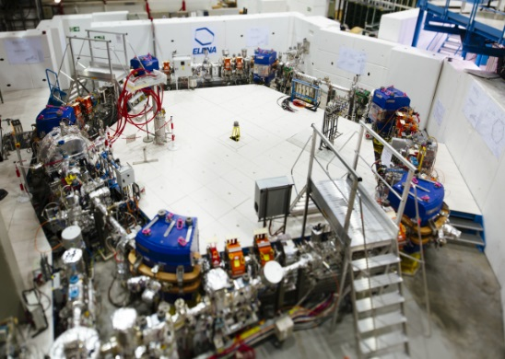
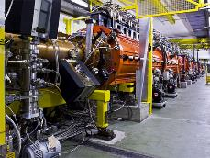
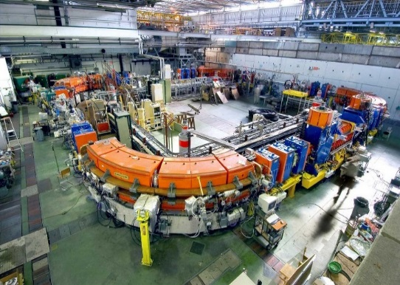
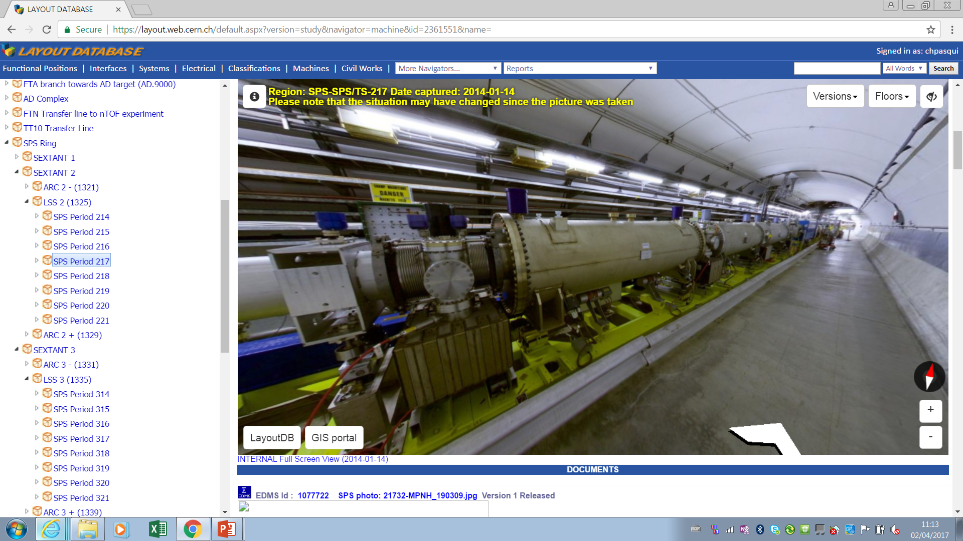
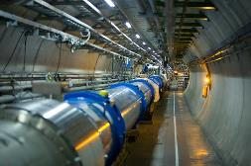
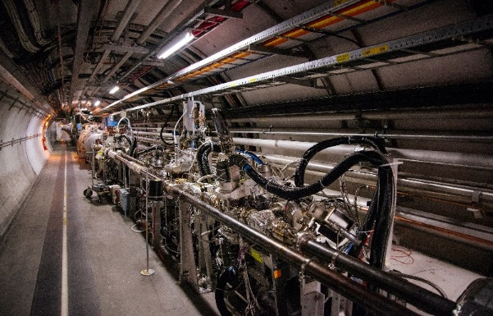
CERN accelerators chain: vacuum systems and requirements
PSB
<5*10⁻⁸ mbar*
PS
<2*10⁻⁸ mbar*
LEIR
<10⁻¹² mbar
Linac2
<2*10⁻⁶ mbar*
ELENA ring<4*10⁻¹² mbar
SPS LSS <10⁻⁷ mbar*
LHC Arcs
<10⁻⁸ mbar
LHC straight sections <10⁻¹⁰ mbar
UNBAKED SYSTEMS (SEPTA..):
TMP, ION PUMPS;
SUBLIMATORS;
CRYO SYSTEMS:
CRYOPUMPING;
BAKED SYSTEMS:
ION PUMPS;
Non Evaporable Getter (TiZrV) coating

Slide 7
How to define the acceptance criteria?
admissible outgassing rate
DRIVEN BY Beam-gas scattering: Beam losses and beam lifetime
  Estimation of average pumping speed to define a total admissible outgassing rate;
  Determine admissible molecules density;
DRIVEN BY Beam downtime: Allowed time to restart the machine in case of components exchange.
DRIVEN BY Equipment requirement: Maximum allowed pressure/molecules density to run devices like kickers or RF cavities.
No Contamination
Anomalous presence of hydrocarbons, most probably due to error in design and/or lack of appropriate cleaning (error in cleaning procedure or post-cleaning pollution); inappropriate choice of materials (polymers, glues, lubricants …);
Higher than expected CO and CO₂ outgassing indicating the presence of carbonised elements;
Any chemical element or compound usually not present in the residual gas phase, for example, F and Cl (issue with etching and cleaning), K and Na (manipulation), P and S (issue with electrolytic treatments).

Slide 8
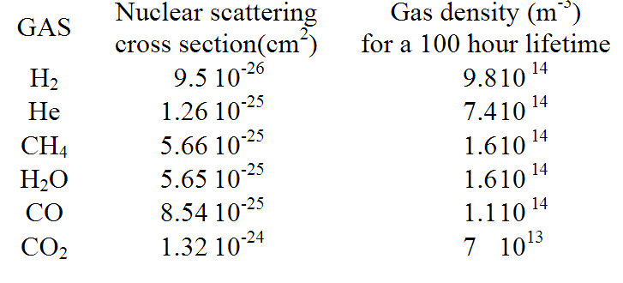
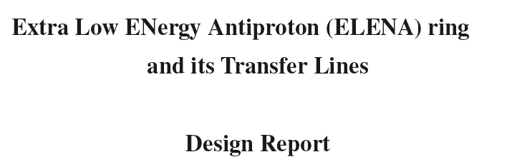

Some examples: Baked system
LHC
Area | Equivalent Hydrogen gas density | Effective pumping speed (indicative)
Arcs | ≤10 ⁺¹⁵ H₂ m⁻³ | ≥100 l.s⁻¹
Experiments | ≤10 ⁺¹³ H₂ m⁻³
ELENA
Area | Pressure requirements | Effective pumping speed (indicative)
Ring | ≤4 x10⁻¹² mbar | Depend upon position (NEG sticking probability)
Transfer lines | ≤10⁻¹⁰ mbar
ELENA ACCEPTANCE THRESHOLDS
Ensures the limitation of momentum and emittance blow up induced by the interaction of 100 keV antiprotons with a beam population of 10⁷. No specification on gas composition
LHC ACCEPTANCE THRESHOLDS
Ensure 100 h of circulating beams before intensity degradation due to residual gas interactions occurs and minimise the background for the experiments.
Courtesy: C.Pasquino – OLAV - V
LHC Design Report
CERN-2004-003
4 June 2004
Dynamic effects included!
In both examples, the pressure requirements are driven by beam requirements.

Slide 9
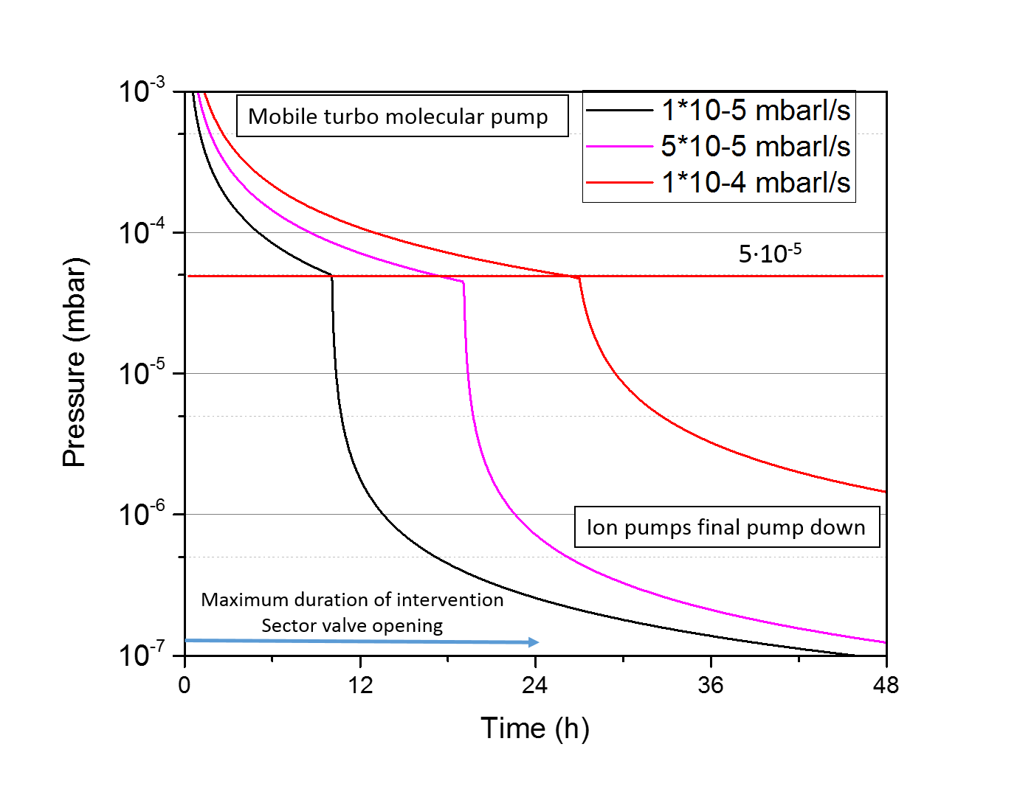
Some examples: Unbaked system
SPS ARCs PUMPDOWN
Accelerator | Area | Operational pressure requirement (24h pumping) [mbar] | Average effective pumping speed (indicative) [l s⁻¹] | Outgassing rate limit at 24 h [mbar.l.s⁻¹]
PS complex | LINACS AND TRANSFER LINES CLOSE TO PSB AND PS | ≤2.10⁻⁶ | 100 | 5∙10^{-5 (*)}
 | PSB AND TRANSFER LINES CLOSE TO THE PS RING | ≤5.10⁻⁸ | 100 | 5.10^{-6 (*)}
 | PS ring | ≤2.10⁻⁸ | 70 | 1.5.10^{-6 (*)}
SPS | Arcs | ≤10⁻⁶ | 10 | 10⁻⁵
 | LSS (kickers, septa, RF cavities) | ≤10⁻⁷ | 100 | 10^{-5 (*)}
 | TI2&TI8: From SPS to TED | ≤10⁻⁵ | 1-2 | 2.10⁻⁵
 | TI2&TI8: From TED to LHC | ≤5.10⁻⁷ | 5 | 2.5.10⁻⁶
Courtesy: C.Pasquino – OLAV - V
ACCEPTANCE THRESHOLDS
LHC injectors:
  Ensure beam operation after 24h pump down;
  Ensure proper functioning of High Voltage and RF devices;
  Ensure ion operation at low energy (e.g. LEIR, PS);
In this case, the acceptance thresholds are beam downtime and equipment driven.

Slide 10
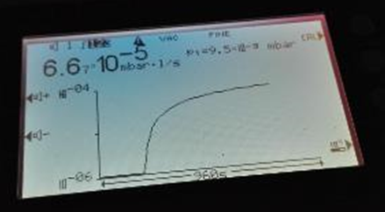
Acceptance Criteria
VACUUM
COMPONENT
CONTAMINATION
OUTGASSING RATE
VIRTUAL LEAKS
LEAK TIGHTNESS
Courtesy: C. Pasquino – OLAV -V

Slide 11
Unbaked: Vacuum validation steps
Measurement and verification of vacuum performance
    Functionality
    Leak tightness (First: high background)
    Outgassing rate after 24h of pump down
    Residual Gas Analysis
    Leak tightness (Final)

Slide 12
Unbaked: Acceptance Thresholds Overview
He leak rate:
    Q_{AIR}< 10⁻¹⁰ mbar∙l/s
Outgassing rate after 24h of pump down:
    Q_{Out} < Depends on the machine
Gas composition: H₂O is the dominant peak
All the masses between 18 et 44 are at least 100 lower of the intensity of peak 18 (2 order of magnitude lower) except for masses 28 et 44
All the masses from 44 to 100 are at least 1000 lower of the intensity of peak 18 (3 order of magnitude lower) except for mass 44
Atomic mass units from 18 to 44
Atomic mass units from 44 to 100 (Indication of organic contamination)

Slide 13
Acceptance tests for unbaked components
Courtesy: C. Pasquino – OLAV -V
KEY FACTORS:
The chosen materials (polymers, sintered materials, high vapour pressures materials);
The thermal treatments (pre-baked in air or under vacuum (cladded cables));
The mechanical design: trapped volumes, leak tightness.
Pump down curve: outgassing rate value at 24h in N₂ equivalent to be compared with the acceptance criteria for each specific accelerator and transfer line.

Slide 14
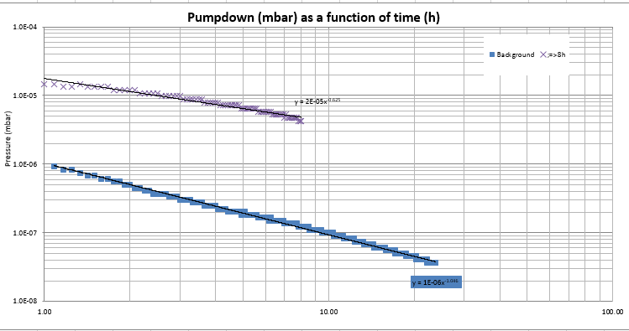
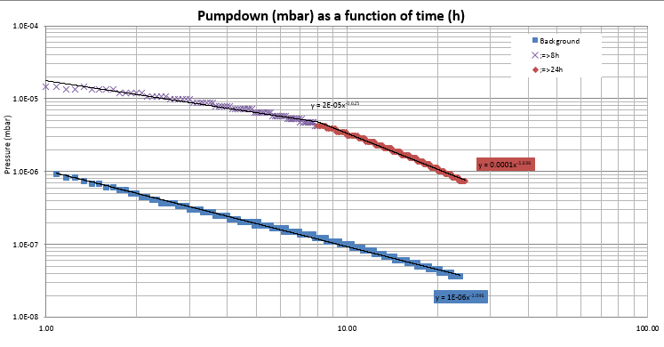
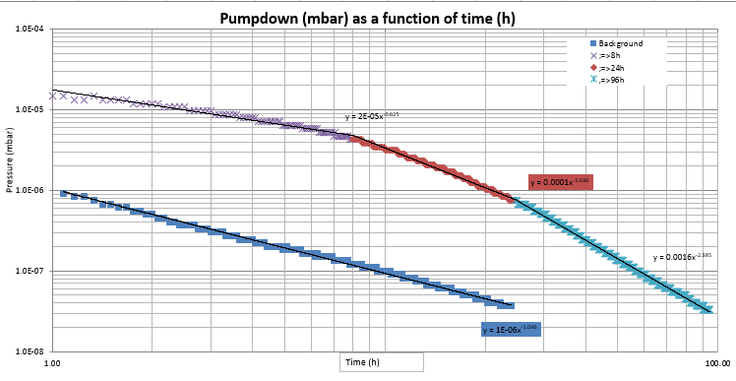




Is it 24h of pump down enough?
24h represent a good compromise that allows performing test within 1 week of time: installation, first leak detection, air venting overnight and final test. However…………..
In presence of polymeric materials, the thickness has an important role on their outgassing rate behaviour and should be addressed in advance
$$q_{H_{2}O}∝\frac{1}{√t}$$
Exponential decay
$$q_{H_{2}O}∝\frac{1}{t}$$
Example of insulated cable with polyimide film of 0.2mm thickness

Slide 15
Polymers in vacuum technology
Polymers are sometimes the only option as seal/insulator
PEEK, Kapton and Vespel -> Limited bakeout temperature
Guarantee a certain beam lifetime or certain operation conditions
Outgassing limit (maximum pressure to be reached in 24 hours) is defined for each machine AND the residual gas analysis free of contaminants
Acceptance test prior to installation:
- Pumpdown will define the outgassing rate and variation in time
- Leak detection
- Outgassing @ 24h
- RGA scan
VELO Upgrade II Workshop - Amsterdam, 6 – 8 Feb 2023 – G.Bregliozzi

Slide 16
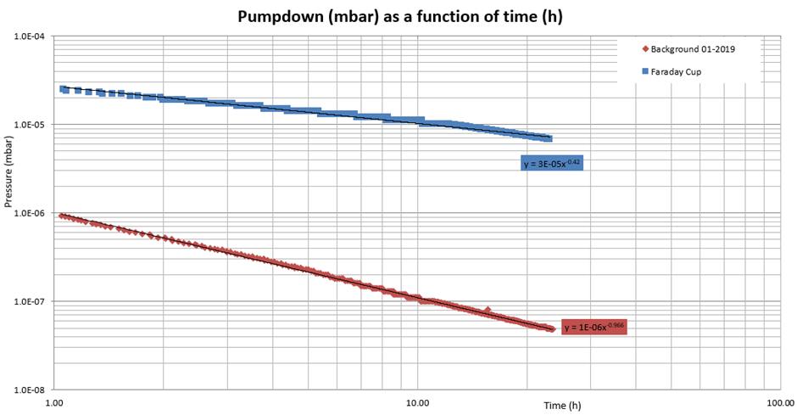
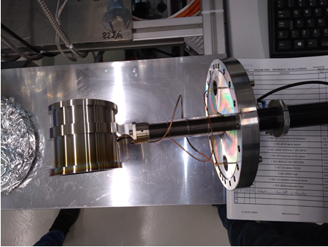
Polymers in vacuum technology
LINAC 4 Faraday Cup
Vespel & Kapton wires
Pumpdown LINAC4 Faraday Cup
VELO Upgrade II Workshop - Amsterdam, 6 – 8 Feb 2023 – G.Bregliozzi

Slide 17
Outgassing of water
Metallic surface vs Polymer
Outgassing
Molecules which have previously
been adsorbed (venting),that
desorb again
Molecules diffusing through the bulk
material, entering the surface and
desorbing from it
VELO Upgrade II Workshop - Amsterdam, 6 – 8 Feb 2023 – G.Bregliozzi

Slide 18

Outgassing of water
Metallic surface vs Polymer
Outgassing
$$\frac{1}{t}$$
Molecules which have previously
been adsorbed (venting),that
desorb again
Molecules diffusing through the bulk
material, entering the surface and
desorbing from it
Ivo Wevers
VELO Upgrade II Workshop - Amsterdam, 6 – 8 Feb 2023 – G.Bregliozzi

Slide 19

Outgassing of water
Metallic surface vs Polymer
Outgassing
$$\frac{1}{t}$$
$$\frac{1}{\sqrt{t}}$$
Molecules which have previously
been adsorbed (venting),that
desorb again
Molecules diffusing through the bulk
material, entering the surface and
desorbing from it
VELO Upgrade II Workshop - Amsterdam, 6 – 8 Feb 2023 – G.Bregliozzi

Slide 20

Outgassing of water
Metallic surface vs Polymer
Outgassing
$$\frac{1}{t}$$
$$\frac{1}{\sqrt{t}}$$
Molecules which have previously
been adsorbed (venting),that
desorb again
Molecules diffusing through the bulk
material, entering the surface and
desorbing from it
$$e^{−t}$$
VELO Upgrade II Workshop - Amsterdam, 6 – 8 Feb 2023 – G.Bregliozzi

Slide 21
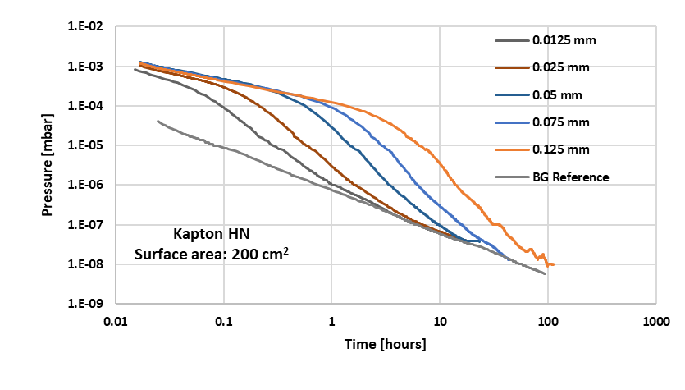

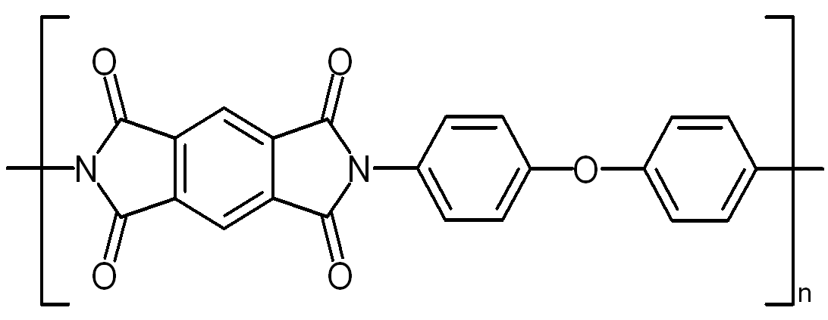
Some example: Kapton
Kapton HN
Polyimide - Melting temperature: none
Expected water content: 0.96%
Samples: square sheets side 100 mm
Thicknesses: 0.0125-0.125 mm
VELO Upgrade II Workshop - Amsterdam, 6 – 8 Feb 2023 – G.Bregliozzi

Slide 22
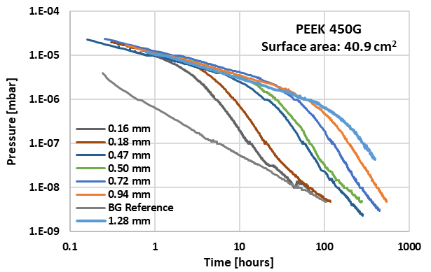
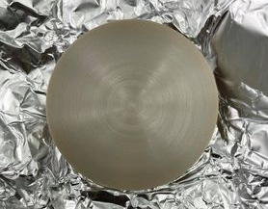
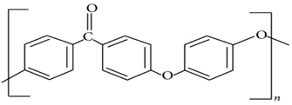
Some example: PEEK
PEEK 450G
PolyEther-Ether Ketone
Semi-crystalline thermoplastic
Melting temperature: 343°C
Expected water content: ca. 0.25%
Samples shape: disks ∅ 51 mm
Thicknesses: 0.16-1.28 mm
VELO Upgrade II Workshop - Amsterdam, 6 – 8 Feb 2023 – G.Bregliozzi

Slide 23
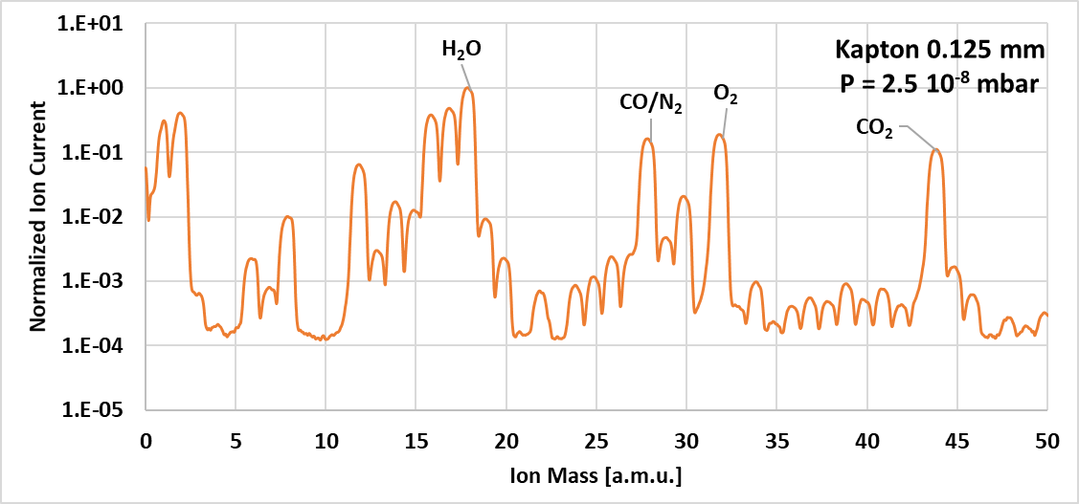
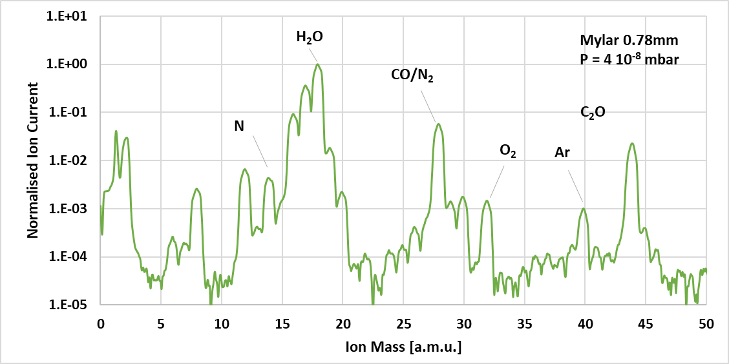
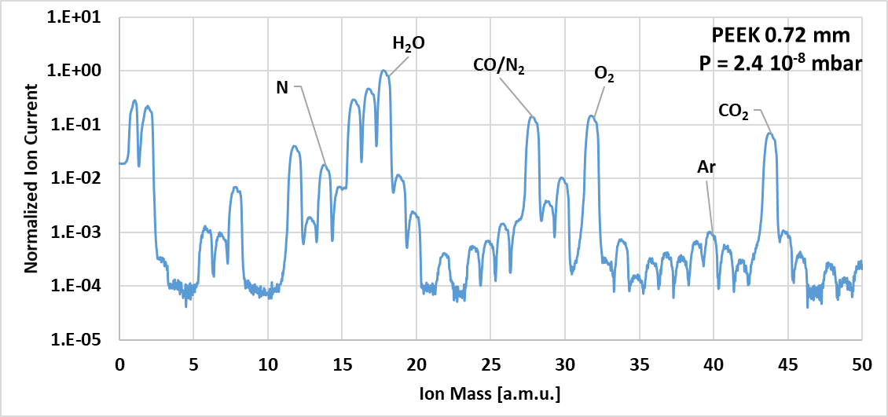
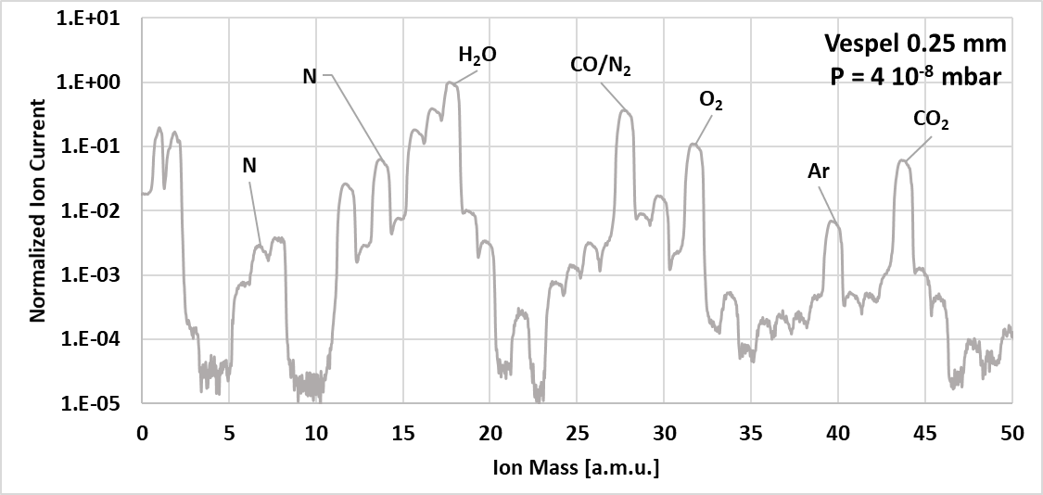
Residual gas analysis
Some examples
Kapton
Mylar
PEEK
Vespel
VELO Upgrade II Workshop - Amsterdam, 6 – 8 Feb 2023 – G.Bregliozzi

Slide 24
Outgassing measurements of PEEK, Kapton and Vespel samples
Kapton
Mylar
WATER
PEEK
Vespel
VELO Upgrade II Workshop - Amsterdam, 6 – 8 Feb 2023 – G.Bregliozzi

Slide 25
Outgassing measurements of PEEK, Kapton and Vespel samples
Kapton
Mylar
AIR
PEEK
Vespel
VELO Upgrade II Workshop - Amsterdam, 6 – 8 Feb 2023 – G.Bregliozzi

Slide 26
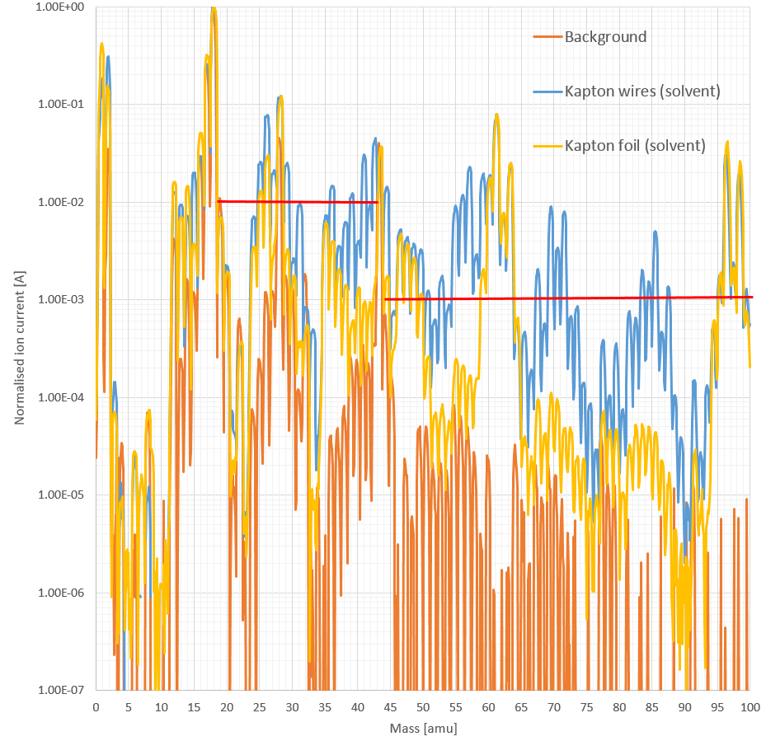
Cleaning methods of polymers

Slide 27
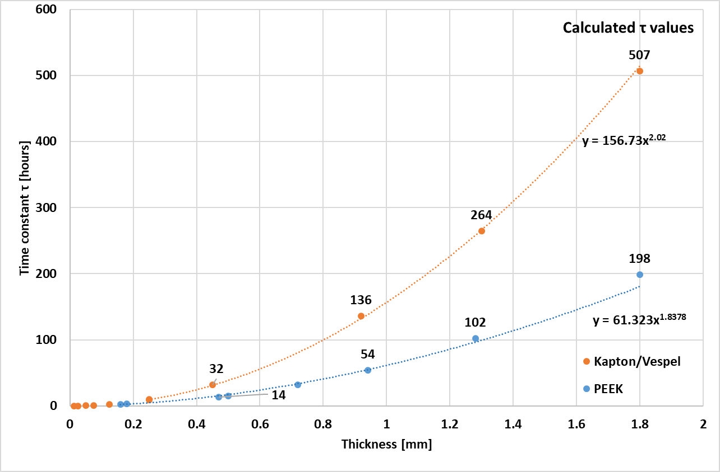
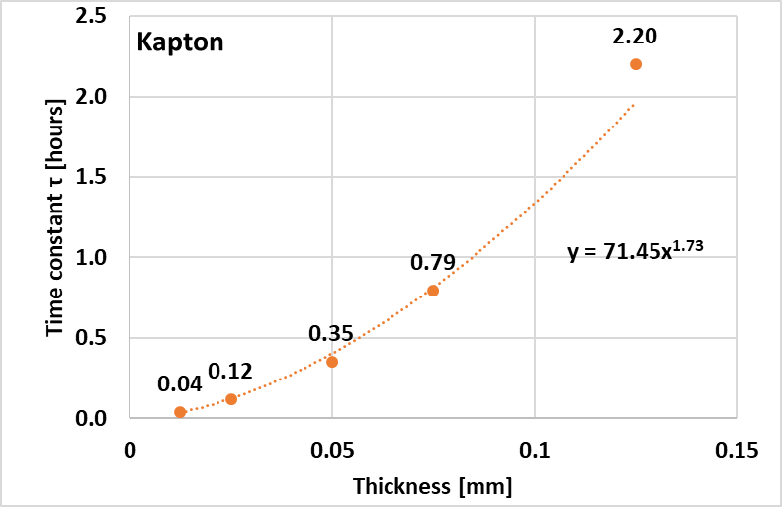
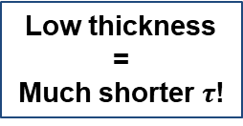
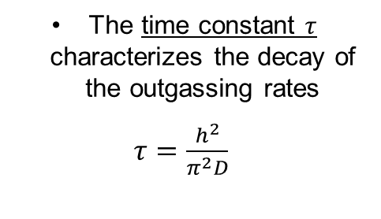
Estimate of diffusion coefficient, moisture content and decay time
The time constant $τ$ characterizes the decay of the outgassing rates
$τ=\frac{h^{2}}{π^{2}D}$.
Low thickness
=
Much shorter $τ$!
It depends on thickness and diffusion coefficient
The thickness has the greatest impact and can change pumping times by hundreds of hours
VELO Upgrade II Workshop - Amsterdam, 6 – 8 Feb 2023 – G.Bregliozzi

Slide 28
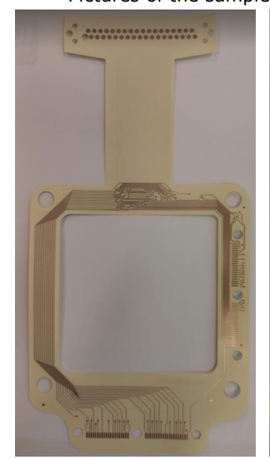
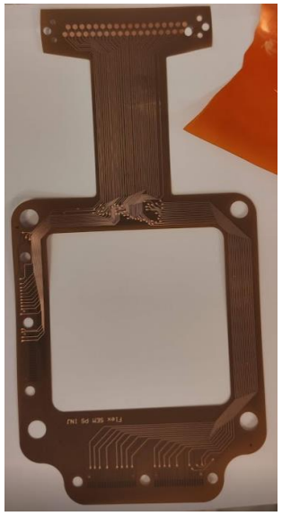
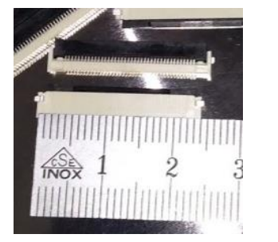
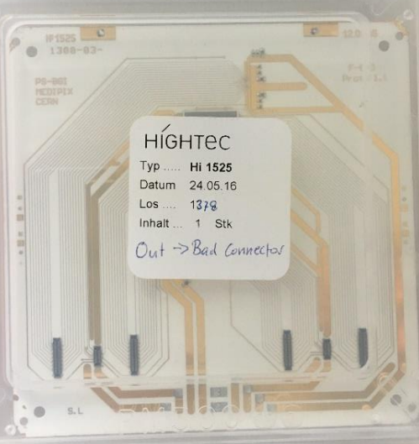
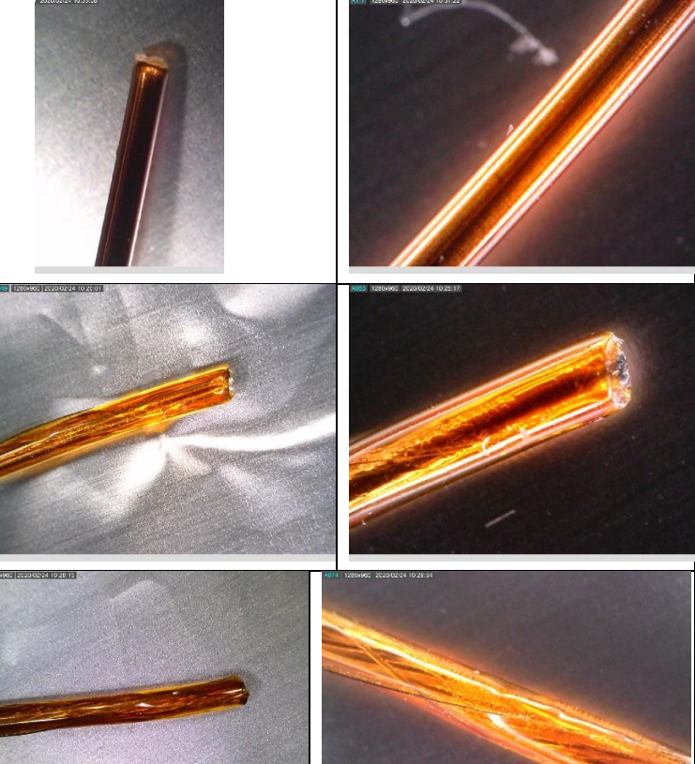
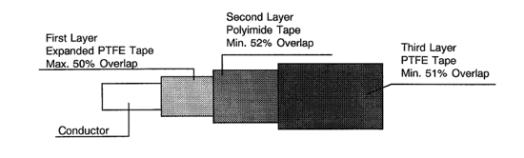
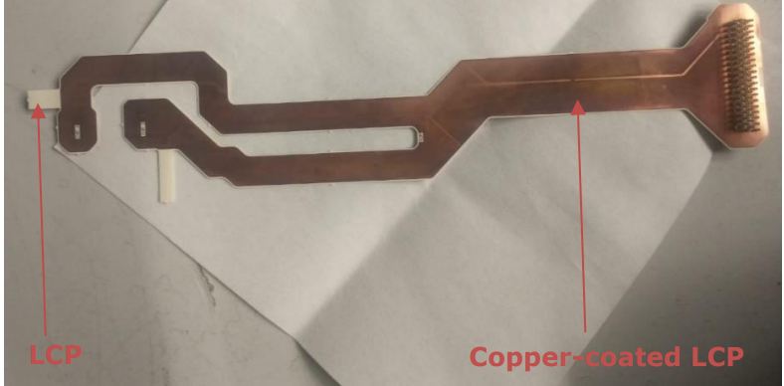
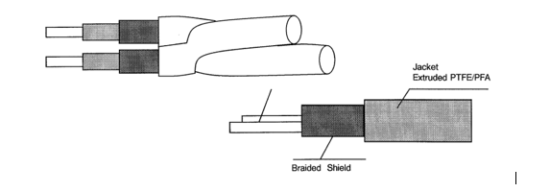
Ongoing studies: Vacuum compatibility
Kapton board
LCP Connector
Pixel detector for BGI
LCP
LISA Pathfinders Cables
Kapton cables
LCP

Slide 29
Acceptance tests for unbaked components
x 100
x 10³
KEY FACTOR
Detect the presence of hydrocarbons, CO, CO₂, P, S, F, Cl or any unusual peak.
POSSIBLE SOURCES?
NONCONFORMITY IN THE DESIGN (lubricants under vacuum, glues…);
NONCONFORMITY IN THE CLEANING PROCEDURES;
NON-CONFORMITIES IN THE HANDLING PROCEDURES;
Courtesy: C. Pasquino – OLAV - V
Residual Gas Analysis: after few hours of filament conditioning, the amplitude of the peaks is compared to the water content in the system. The component is considered accepted if the ratio between the water peak and the peaks up to mass 44 is higher than 100 and if the same ratio is higher then 1000 for peaks above mass 44.
He leak rate:
    Q_{AIR}< 10⁻¹⁰ mbar∙l/s

Slide 30
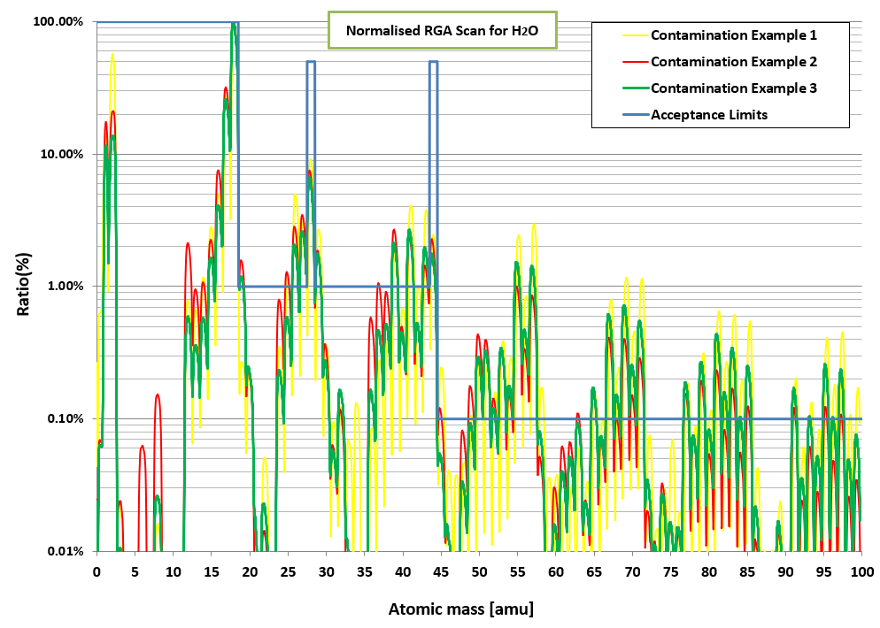
Example of detected contaminants

Slide 31
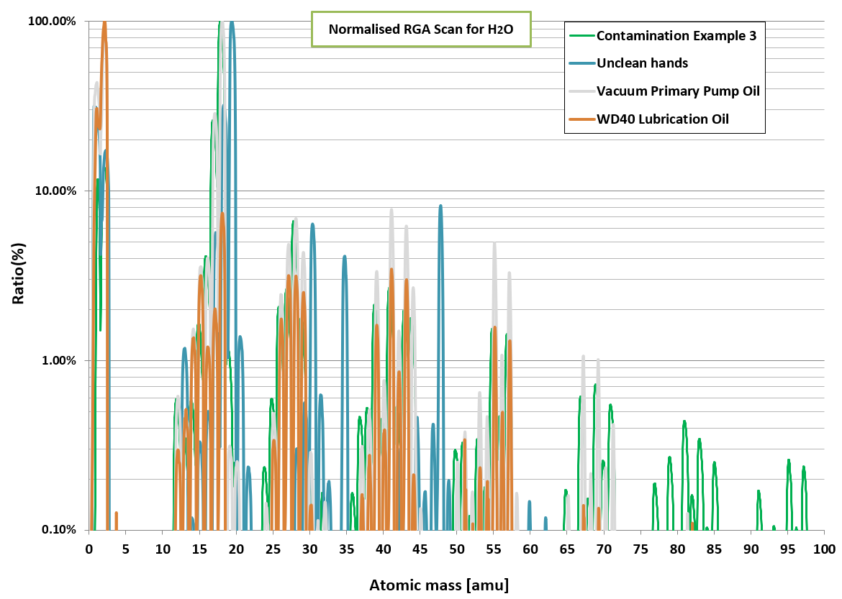
Example of contaminants
Cross checking the roots cause

Slide 32
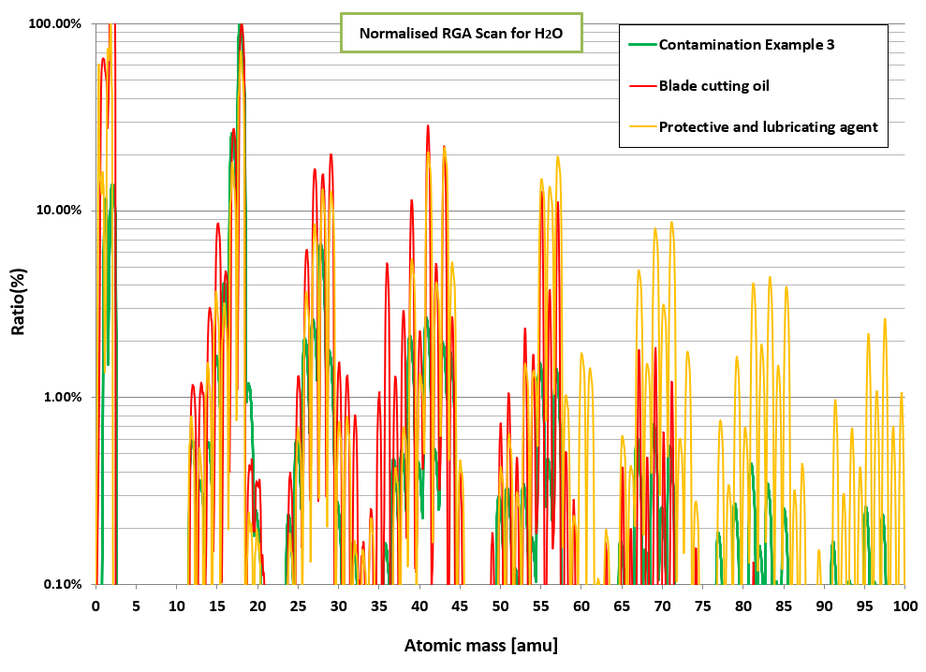
Example of contaminants
Cross checking the roots cause

Slide 33
Baked: Vacuum validation steps
Measurement and verification of vacuum performance
    Functionality
    Leak tightness
    Outgassing rate
    Residual Gas Analysis
    Leak tightness
    Functionality
Before bake out cycle
After bake out cycle

Slide 34
Baked: Acceptance Thresholds Overview
LHC Case
He leak rate:
    Q_{AIR}< 10⁻¹⁰ mbar∙l/s
Internal leak rate:
        Q_{AIR}< 5∙10⁻⁹ mbar∙l/s
Outgassing rate:
    Q_{Out} < 1∙10⁻⁷ mbar∙l/s
Gas composition: H₂ is the dominant peak
Atomic mass units from 18 to 44 (Possible impact on NEG performance)
Different acceptance thresholds are selected as a function of the gas.
Atomic mass units from 44 to 100 (Indication of organic contamination)
Acceptance criterion: RGA signals for all masses higher than 44 are at least 10000 times lower than the signal of peak H₂ (mass 2).

Slide 35
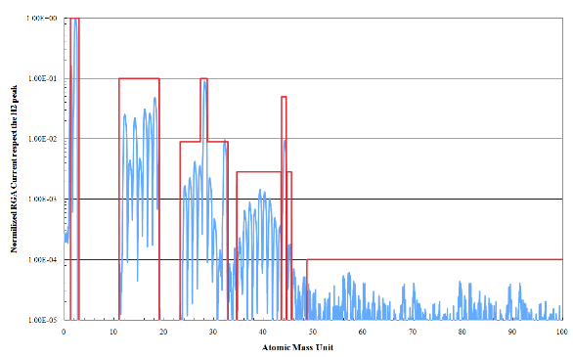
Baked: Acceptance Thresholds Overview
LHC Case
    Maximum total outgassing ≤1∙10⁻⁷ mbar∙l/s
    RGA Scan normalized to H₂
H₂
CH₄
CO
CO₂
Affect the saturation level of NEG coating

Slide 36

Conclusion & Advices
We need to clearly analyze and define which is your driving parameter and then set the acceptance criteria;
We should define gas density more than general pressure;
We could be flexible on the total outgassing, but we can not accept any form of contaminations;
We should be part as much as possible to the design phase to eliminates problems and nonconformities at the source.
Thank you for your attention

Slide 37
Additional Slides:
Some special needs and examples

Slide 38
What about beam induced pressure increase?
How to deal with it?
An example in case of electron and photon flux

Slide 39


Beam induced pressure increase
ATALS Interaction point
Courtesy: C.Y.Vallgreen

Slide 40


SYNchrotron RADiation: SynRad
IP
IT
ATLAS:
Dipoles & Quadrupoles
2808b , 6.5 TeV, Flat Top
D1
D2
Q4
1 Wm⁻²
Q5
D2
10⁻⁻³ Wm⁻²
Q4
Q6
10⁻⁻⁵ Wm⁻²
Courtesy: C.Y.Vallgreen
Q5
10⁻⁷ Wm⁻²
Q7
Q6
MB
Definition of distributed photon flux
MB
Q7
MB
100× zoom in radial direction
MB
Arc

Slide 41


Material characterization: η_{ph}
Courtesy: M.Ady et Al. IPAC15

Slide 42





Definition of the SEY Threshold & Electron Flux
Electron flux distribution
Allow to determine the impact of the electron flux on the beam pipe surface
Without Field:
High SEY treshold
Dipole Field:
Concentrated electron flux
Quadrupole Field:
Trapping effect, area dependent on magnetic field
SEY Threshold
Allow the definition of the minimum acceptable SEY for each materials
Courtesy: C.Y.Vallgreen
Example of LHC Beam Screen

Slide 43
Material characterization
SEY vs Primary energy:
The SEY scan allow determining the secondary electron evolution function of primary energy;
Accumulating electron dose bombardment it reduces the SEY and allow to create the ‘conditioning’ curve;
Courtesy: R.Salemme & M.Taborelli
Conditioning Curve:
Allow determining and the SEY evolution and study its impact function of the simulated SEY threshold and electron flux.

Slide 44

Material characterization: η_{el}
Courtesy: V.Baglin

Slide 45

Synchrotron Radiation & Electron Cloud
Dynamic Pressure Profile: VAcuum Stability COde (VASCO)
ATLAS Long Straight Section
Synchrotron Radiation
Electron Cloud
Courtesy: C. Y. Vallgreen
Dynamic pressure profile

