Slide 1




LGAD R&D program in the UK
Glasgow: Dima Maneuski, Richard Bates, David Friday, Lojius Lombigit, Rory McFeely, Neil Moffat, Ryuji Moriya, Paul Soler
Manchester: Oscar Augusto de Aguiar Francisco, Alex Oh, Francisca Munoz Sanchez, Enoch Ejopu, Michael Perry, Graham Miller, Patrick Parkinson, Nawal Al Amairi, Marco Gersabeck, Peter Svihra (now CERN)
Edinburgh: Mark Williams
Birmingham: Naomi Cooke, Dan Thompson, Niladri Sahoo, Ioannis Kopsalis, Nigel Watson, Marcus Madurai

Slide 2
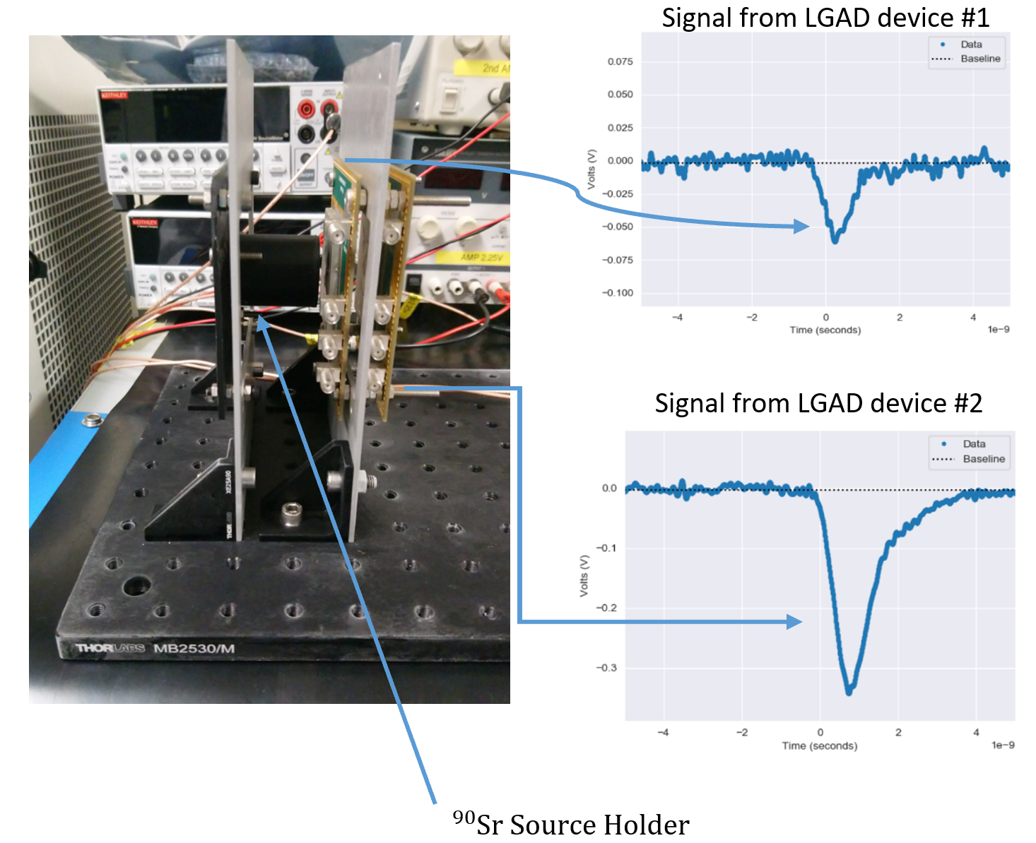
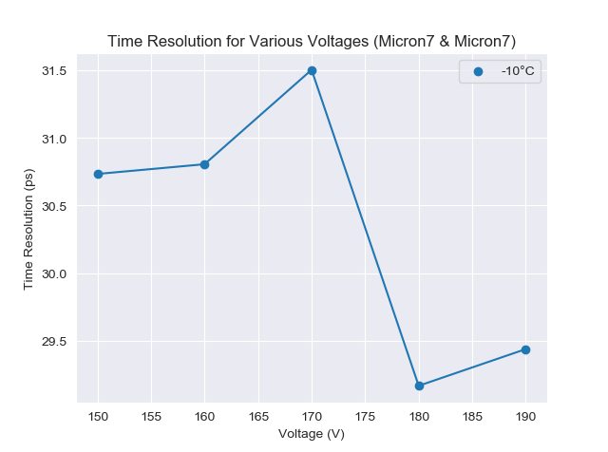
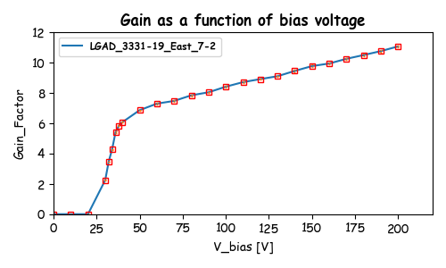
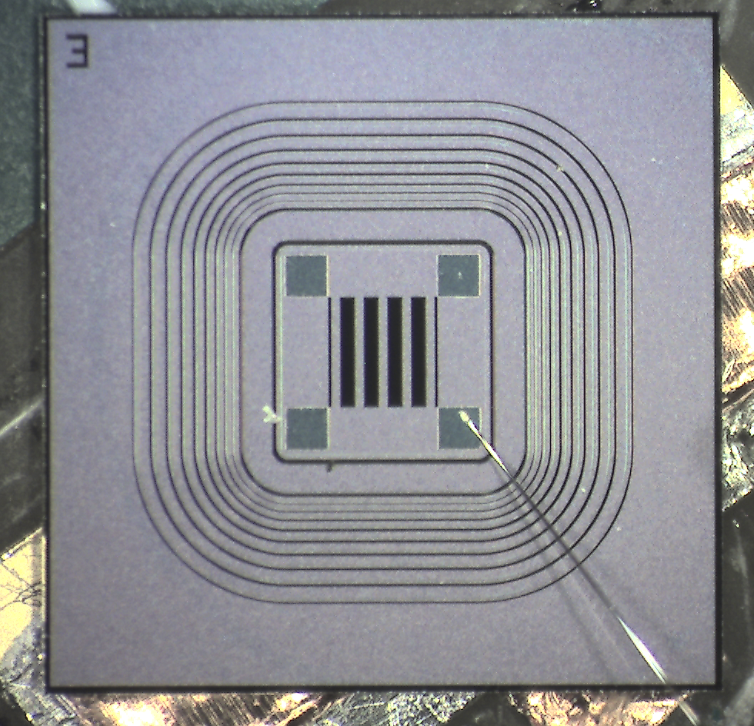

LGAD timing measurements
Components:
${}_{ }^{90}{Sr}$ source holder
SCIPP PCB with integrated 2GHz bandwidth pre-amp
DAQ: Fast Oscilloscope
Timing resolution of 30ps
  1x1mm pads
  50um thick

Slide 3
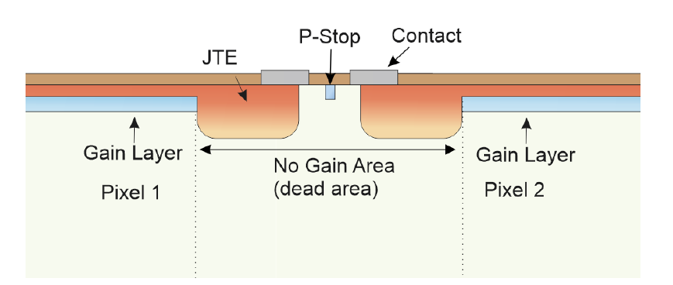
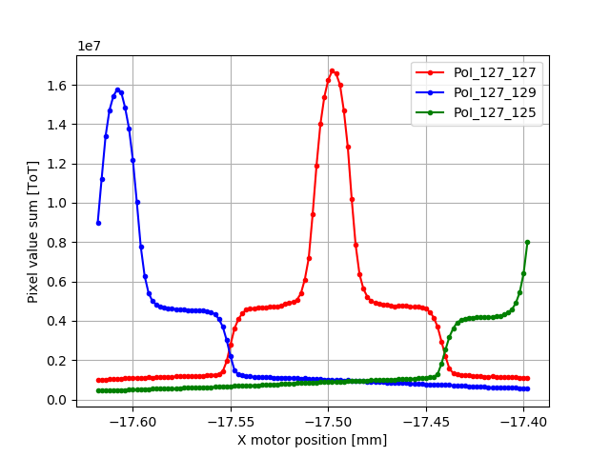

Small pixels – fill factor
10µm JTE
  55 µm² pixel – 0% FF
  110 µm² pixel – 11% FF
$$Fill Factor =\frac{Gain Area}{Total Area}$$
Geometric fill factor
  No gain between multiplication contacts
110x110 μm² pixels with 10 μm JTE
Effective fill factor
  Deep JTE implants distort E-field at edge
  Charge collected on JTE and not multiplied
  Gain area is at the pixel centre
1.7
350V, Gain: 3.4‬, FF 5%
Diamond Light source beam test
15 keV X-rays
  1.7 μm FWHM spot size
Scanned device through beam
Mapped response as function of position and bias
0.5

Slide 4
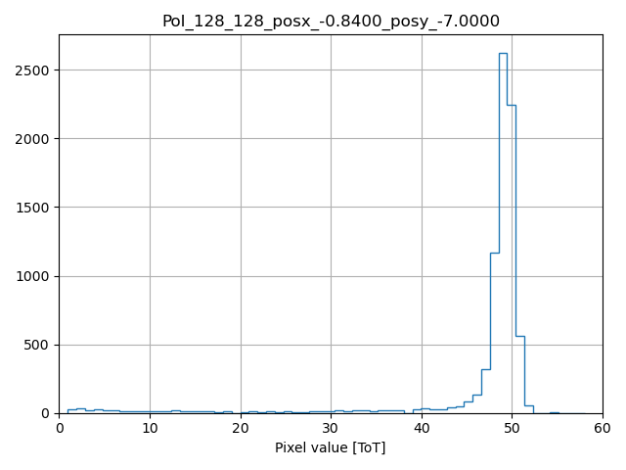
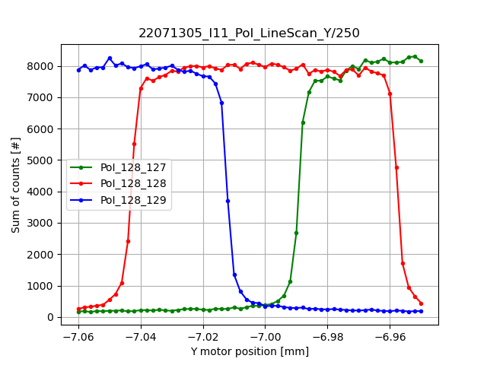
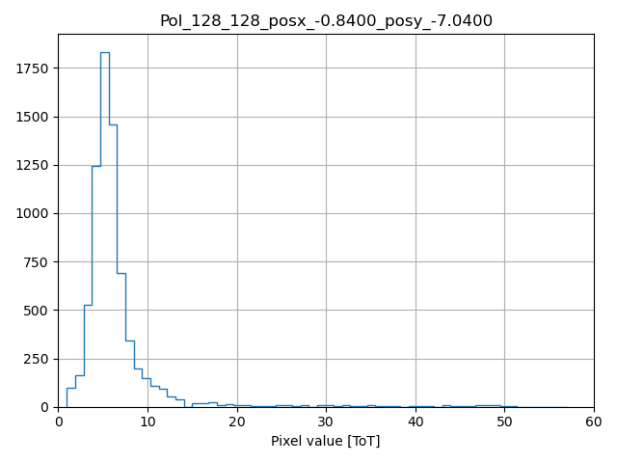
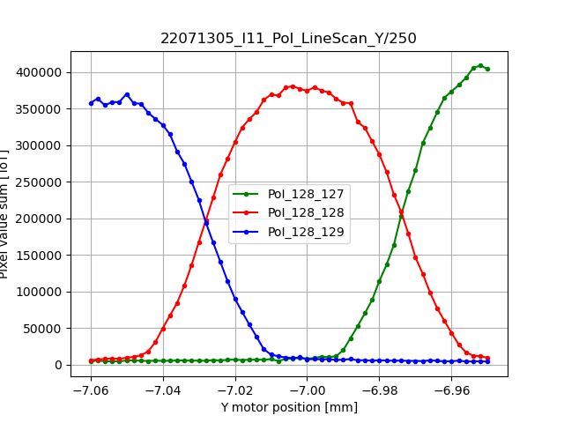
iLGAD: 55 um pixel
250V
Line scan (gain pixel)
Threshold at ~0.1 of amplified X-ray peak
Step function pixel response
Convoluted with finite beam size
Full 15 keV peak observed in the middle (with gain)
Wider “effective” pixel due to higher signal / threshold ratio (compared to PIN device)
Uniform gain achieved
Counts
∑ Counts
55 um
10
ToT
50
ToT
∑ ToT
55 um
10
ToT
50

Slide 5
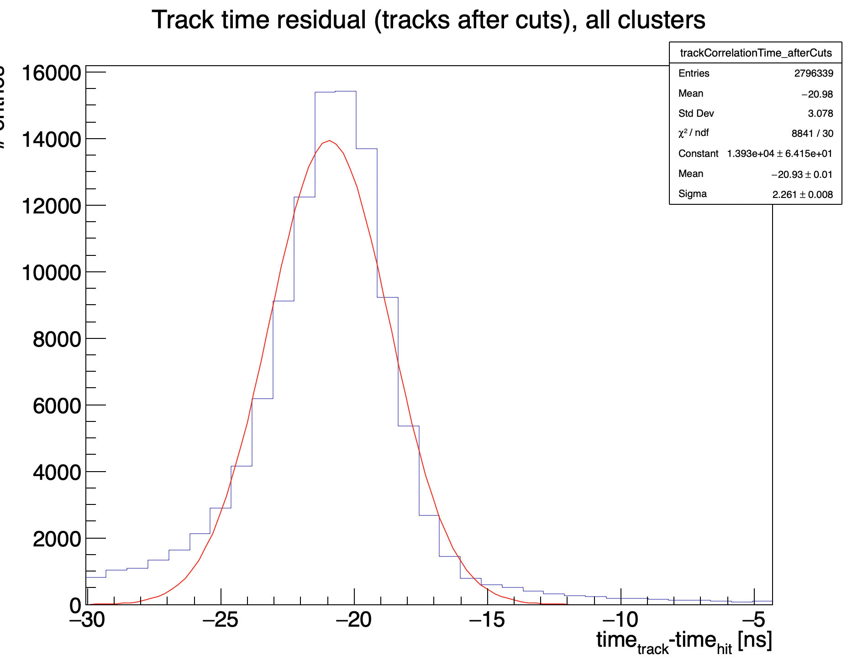
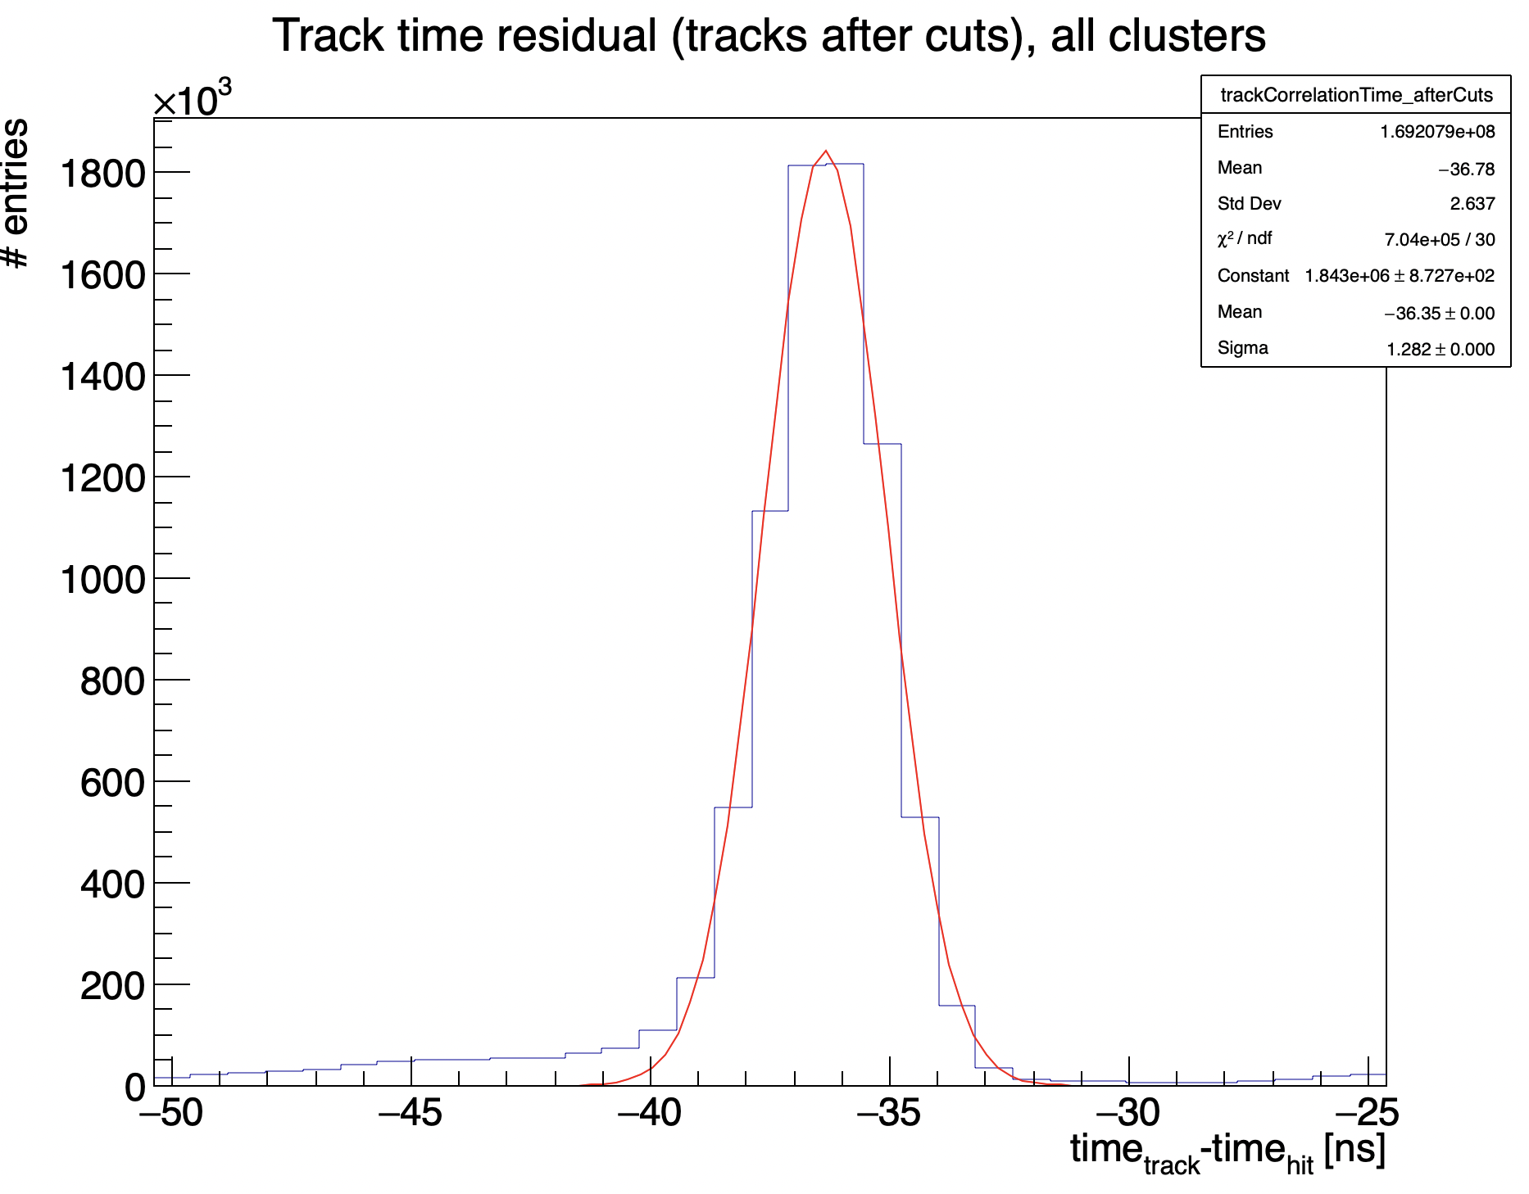
TimePix3 assemblies: Timing resolution
SPS (120 GeV Pions) test beam timing resolution comparison
Timewalk plot – time resolution between telescope timing (3 scintillators) and cluster
Use SPIDR TDC, Not timewalk corrected
2.26 ns
1.28 ns
Standard p-in-n
iLGAD, 300V
Results from Peter Svihra

Slide 6
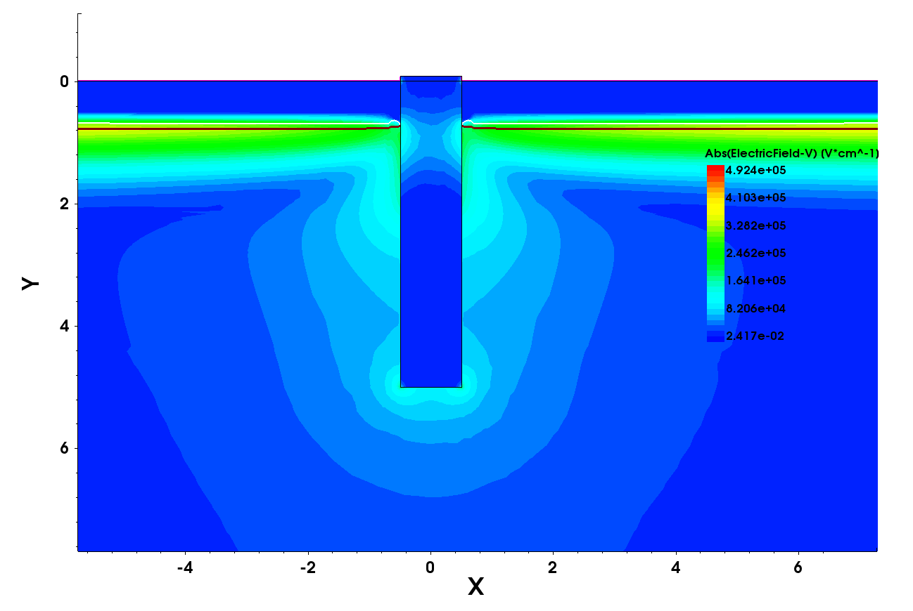
Trench isolated LGAD
Pixel isolation with a trench
  Simulated range of pixel isolations with saturated oxide charge
  Single trench provides good pixel isolation when there is no gap between trench and multiplication implant
Wafers in production
12 FZ 200um thick
6 EPI 50um thick
Range of multiplication implant dose
4 wafers etched with trenches
    Ready ~ 1 month
Contain Diodes and TimePix3 sensors
E –field V/cm
5.0E5
4.0E5
3.0E5
2.5E5
1.5E5
0.8E5
2.0E2
μm
μm

Slide 7
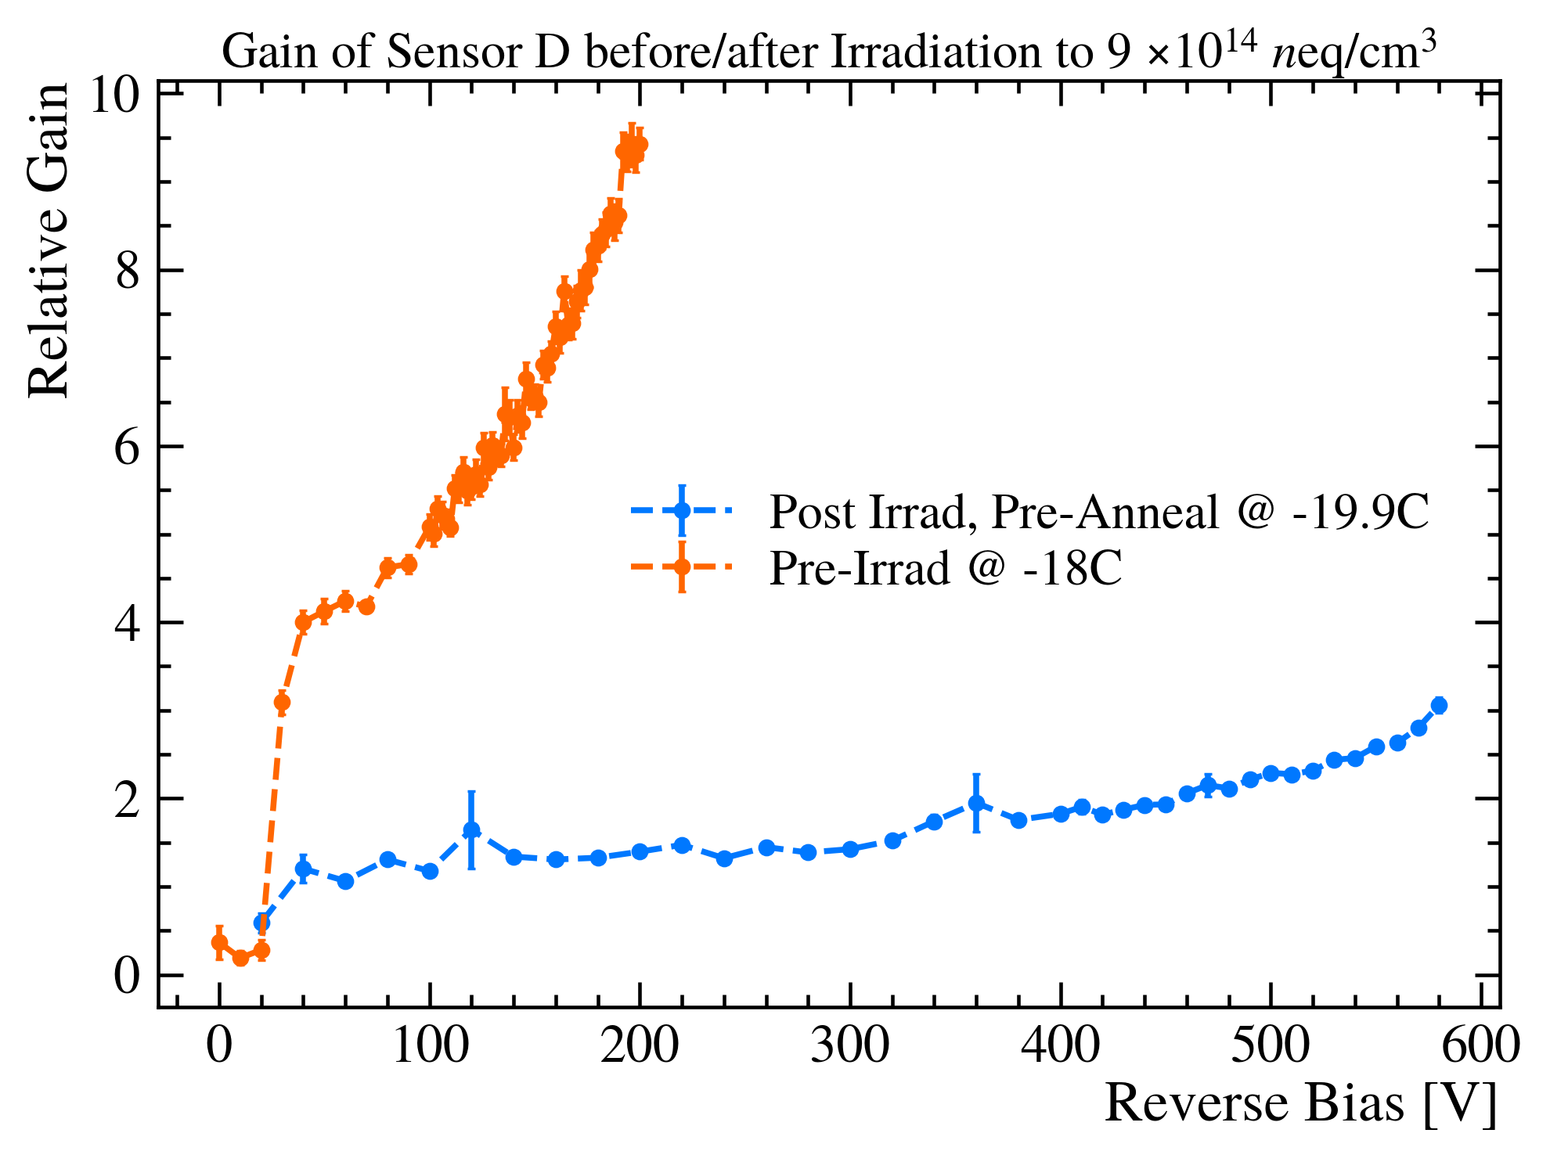
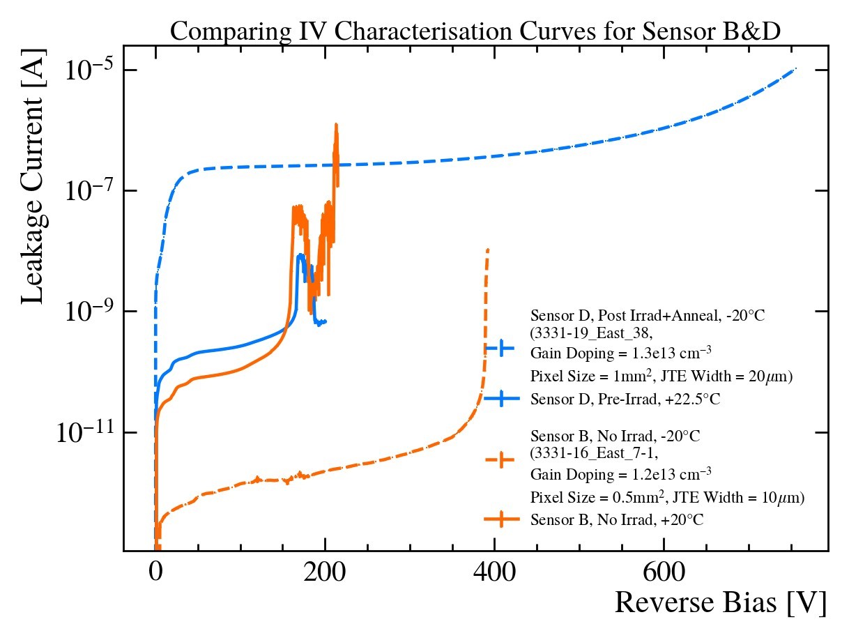
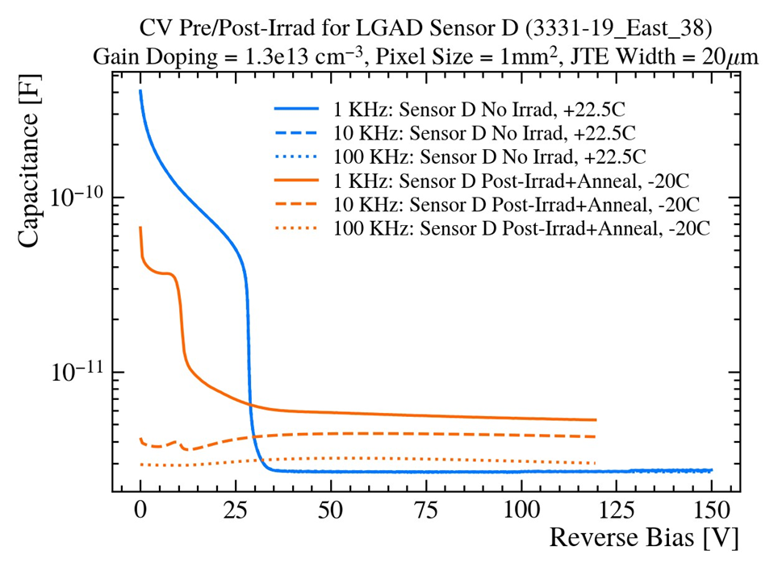
Post-Irradiation
Irradiated at B’ham cyclotron
9e14 neq/cm² , ~40 MeV protons
IV
U1 Velo expectation, Post irradiation: “Leakage currents of around 200 µA/cm² are expected at −25 ◦C” after 8e15 neq/cm²
For 0.5 mm² sensor -> 0.5 µA
CV
Significant reduction in V_{GD} & V_{FD} post irradiation
Gain from IR TCT
Reduction in gain from 4 to 8 to 2 to 3 @ -20C
Investigating Carbon doping & deeper Boron implants

Slide 8
Backup

Slide 9
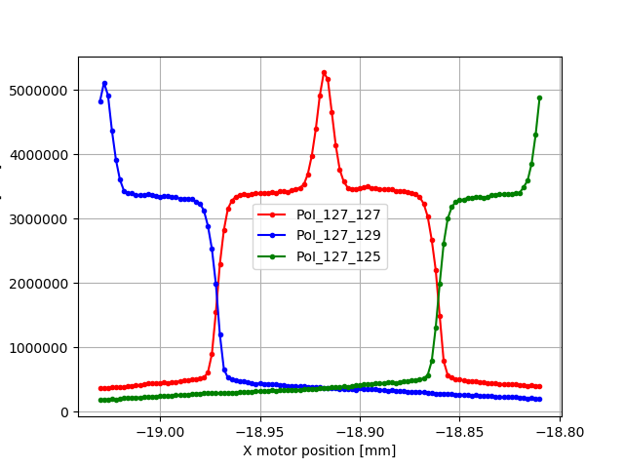
Measurement at Diamond light source
200 μm thick LGAD TimePix modules
55x55 μm² pixels with 5 μm JTE,
110x110 μm² pixels with 10 μm JTE
110x110 μm² pixels with 20 μm JTE.
15 keV X-rays
  1.7 μm FWHM spot size
Scanned device through beam
Mapped response as function of position and bias
55x55 μm² pixels with 5 μm JTE: No Gain observed
110x110 μm² pixels with 10 μm JTE
110x110 μm² pixels with 20 μm JTE
1.7
5.2
3.3
0.5
350V, Gain: 3.4‬, FF 5%
450V, Gain: 1.6, FF 1% ‬

Slide 10
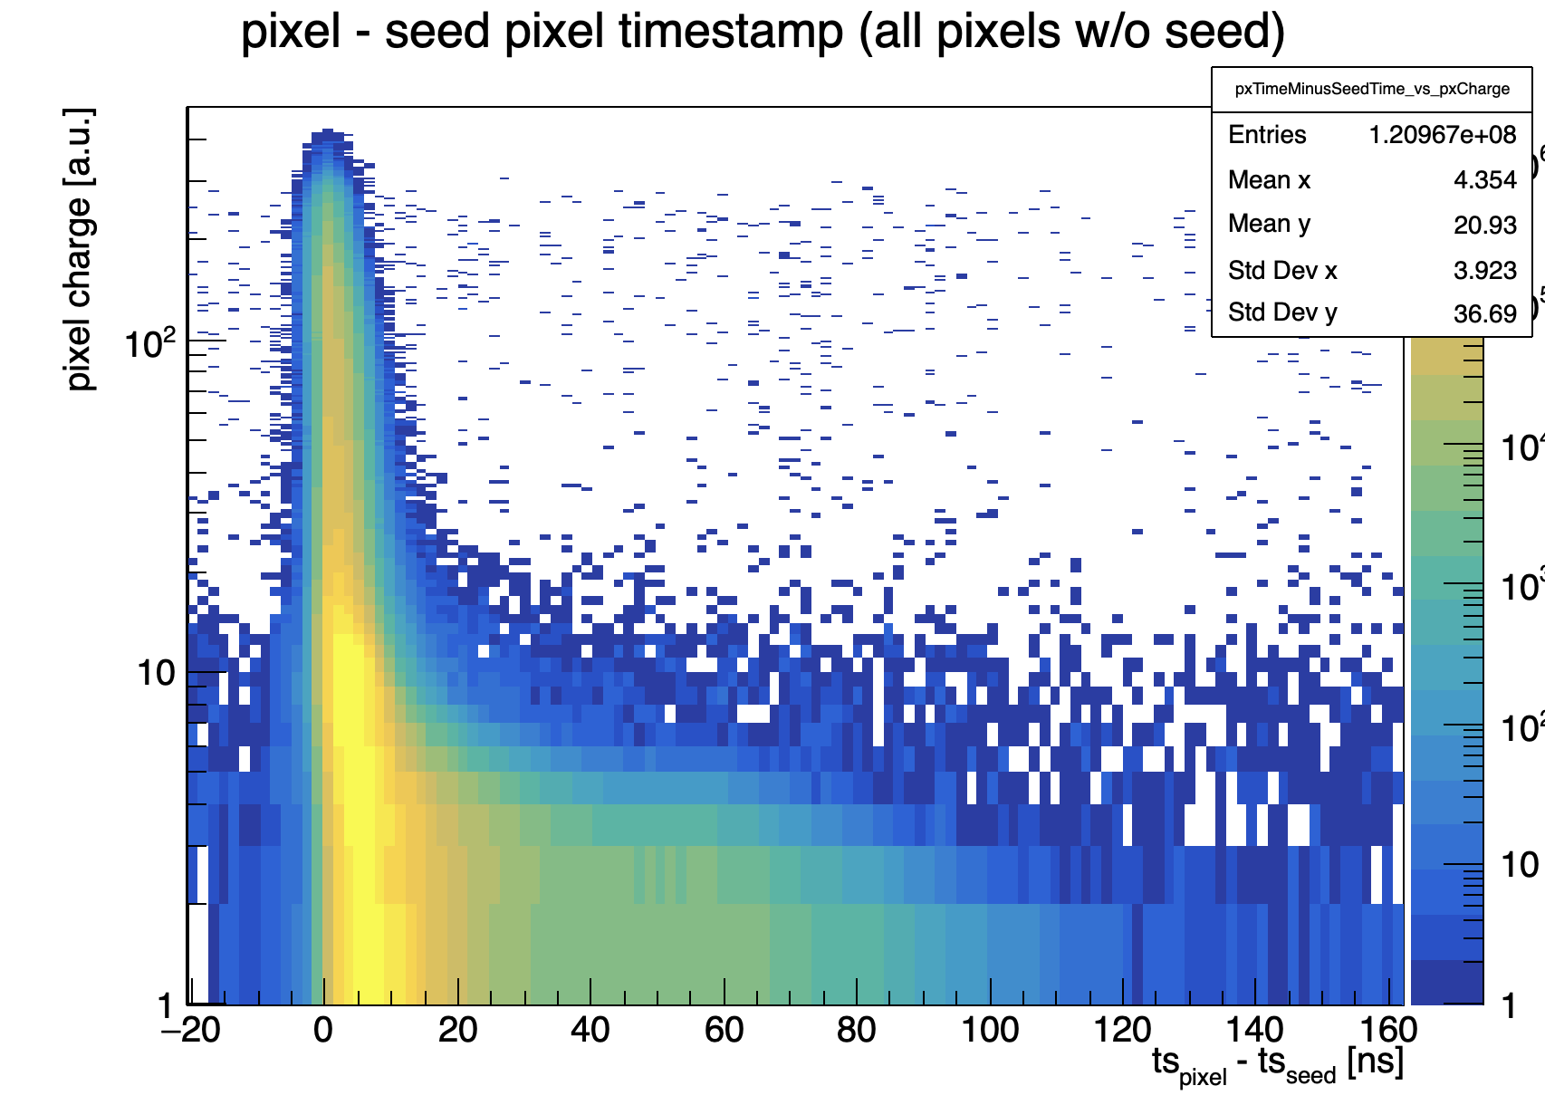
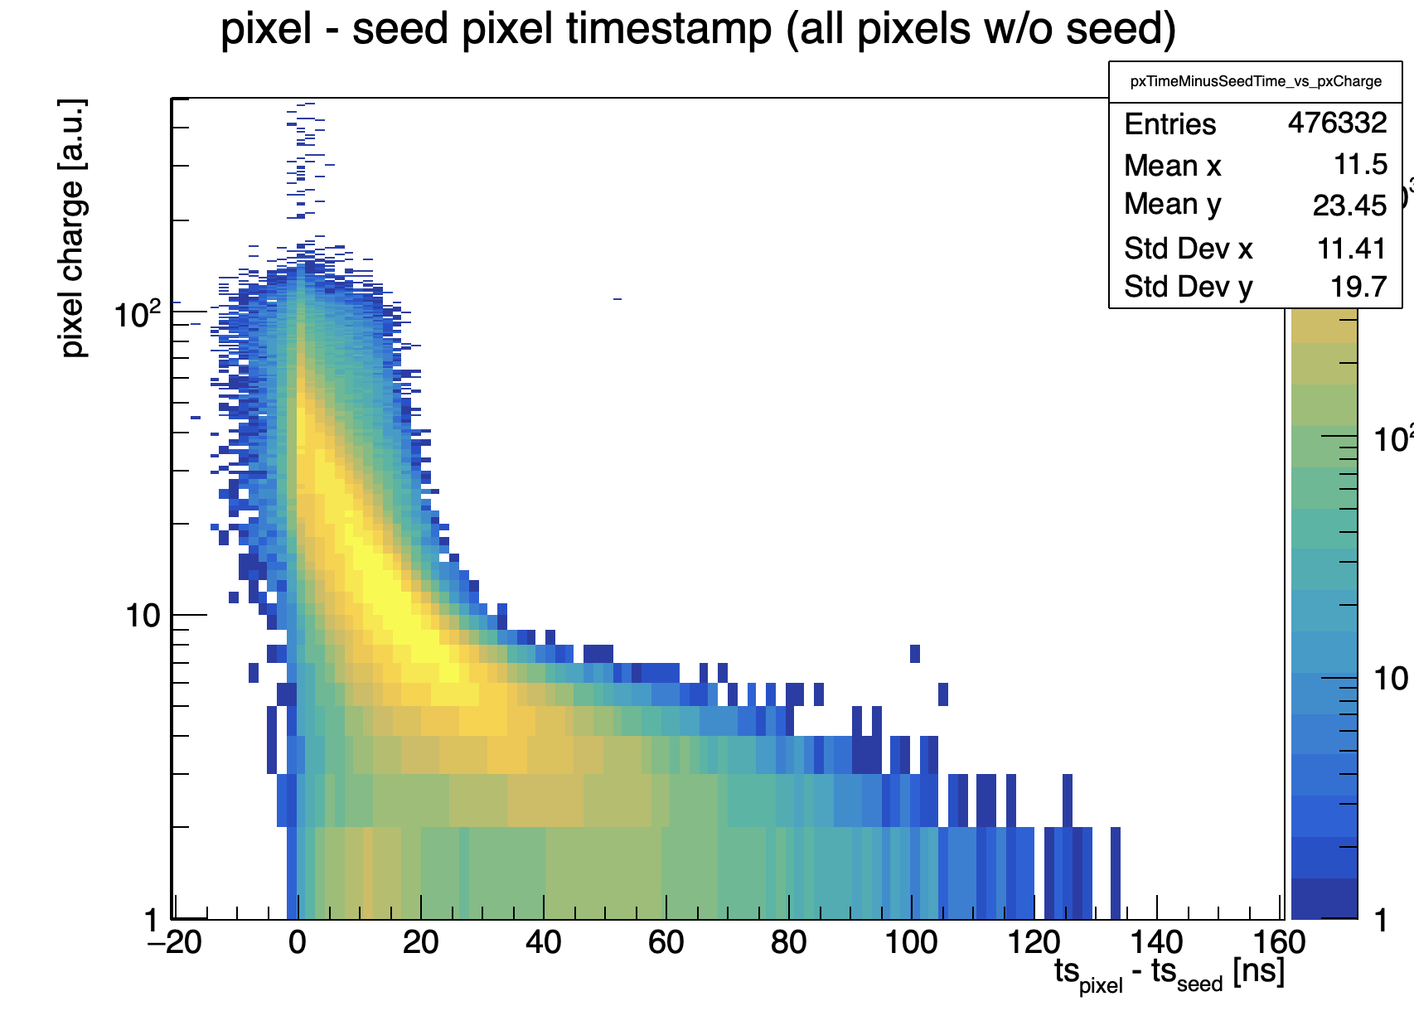
TimePix3 assemblies: Timing resolution
SPS (120 GeV Pions) test beam timing resolution comparison
Timewalk plot
iLGAD, 300V
standard p-in-n
~8 ns
~60 ns
Results from Peter Svihra

Slide 11
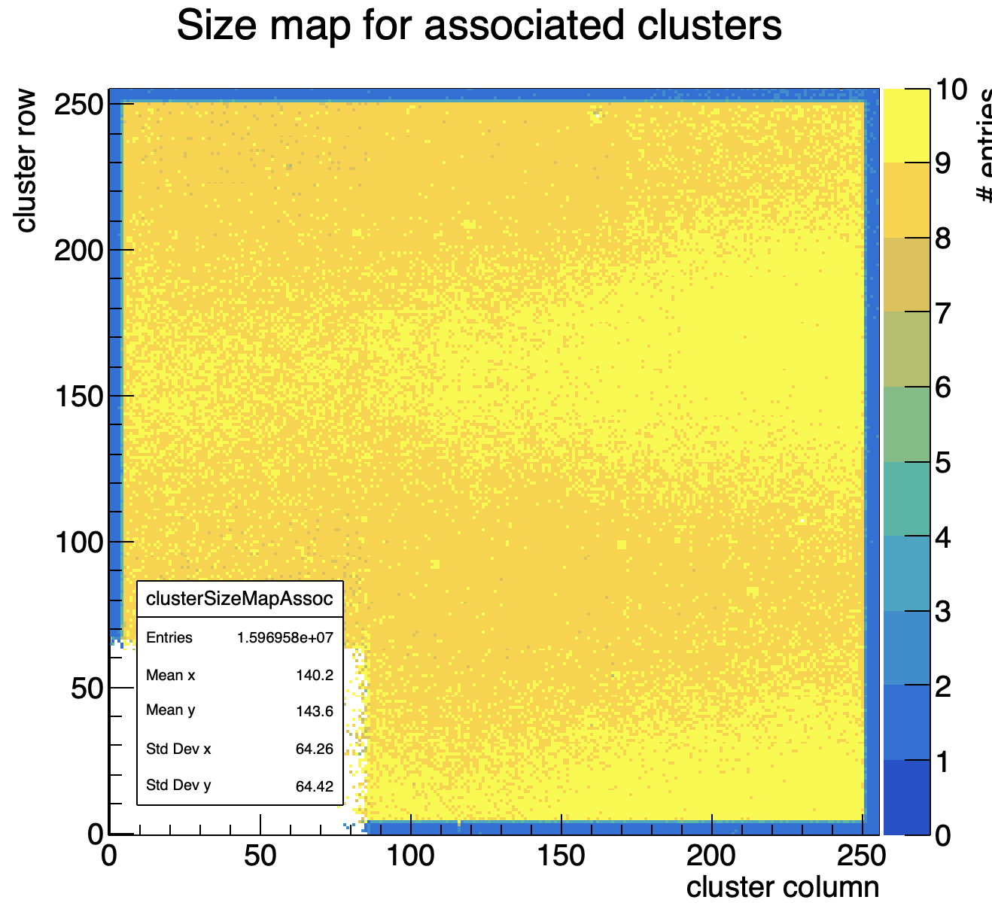
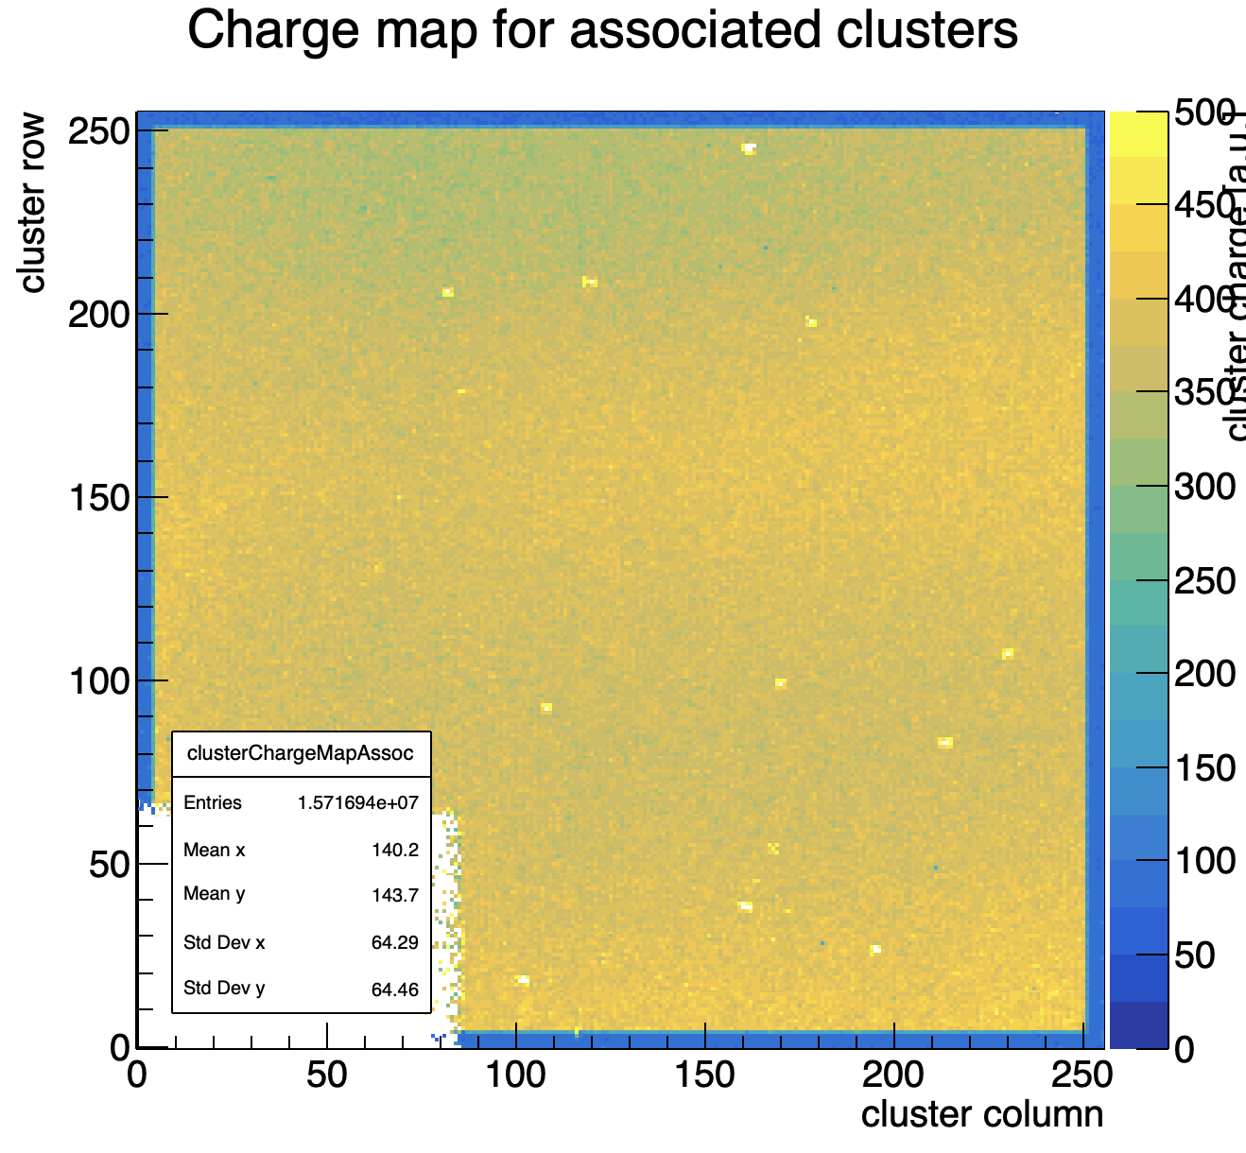
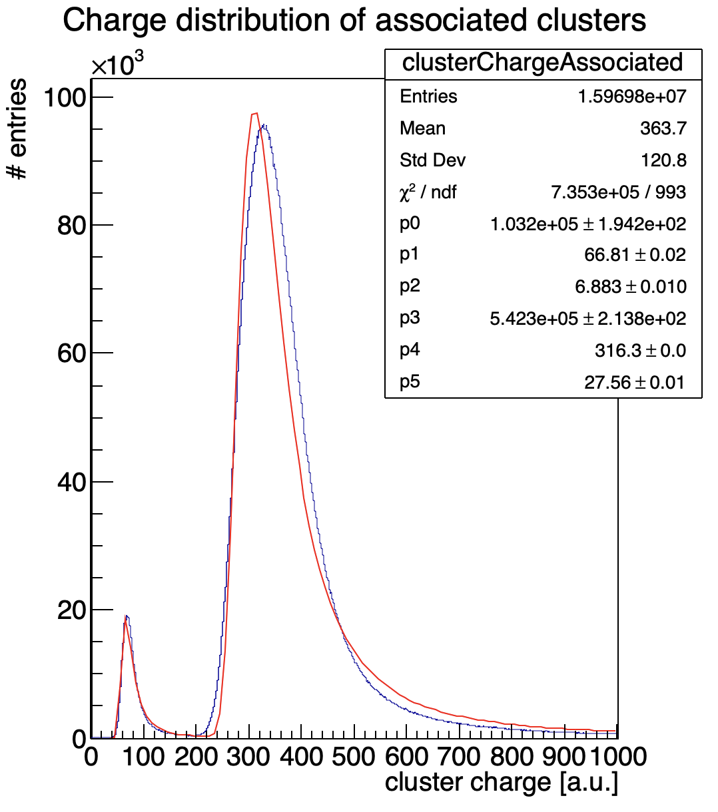
TimePix3 assemblies: Matrix gain uniformity
SPS (120 GeV Pions) test beam gain uniformity map
Gain about 4.75 at 300V
ToT not corrected!
Fresh results from Peter Svihra

Slide 12
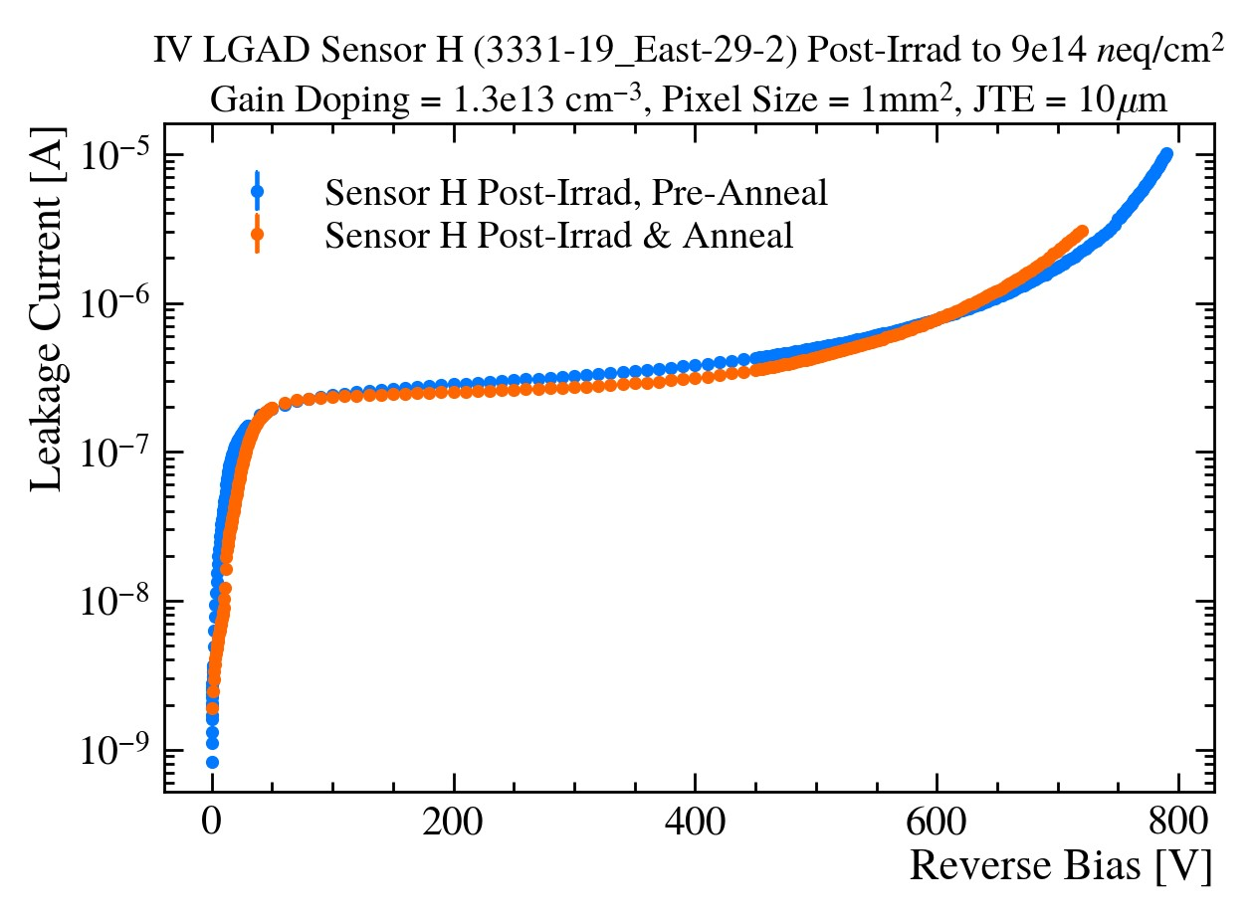
Post-Irrad IV
No cold IV measurements performed for Sensor D so warm included with Sensor B warm/cold for comparison.
Annealing did little to reduce leakage current.
U1 Velo Limits, Post irradiation: “Leakage currents of around 200 µA/cm² are expected at −25 ◦C”
For 0.5 mm² sensor -> 0.5 µA
Therefore aren’t pushing IV’s beyond 10 µA
  Power supply limits at 900V
  TCT Set-up’s amplifiers not suitable to greater than ~1-3 µA

Slide 13
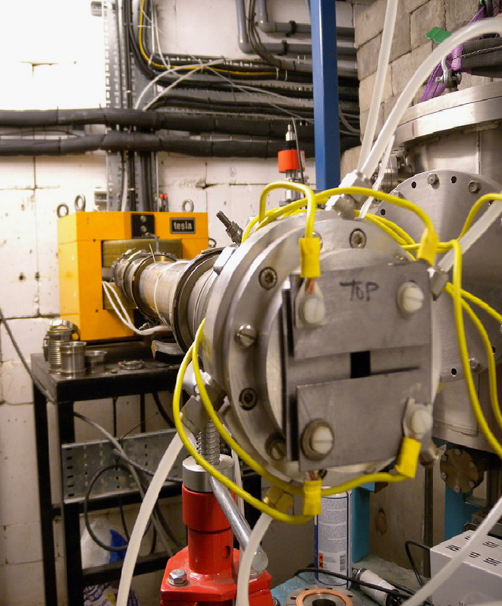
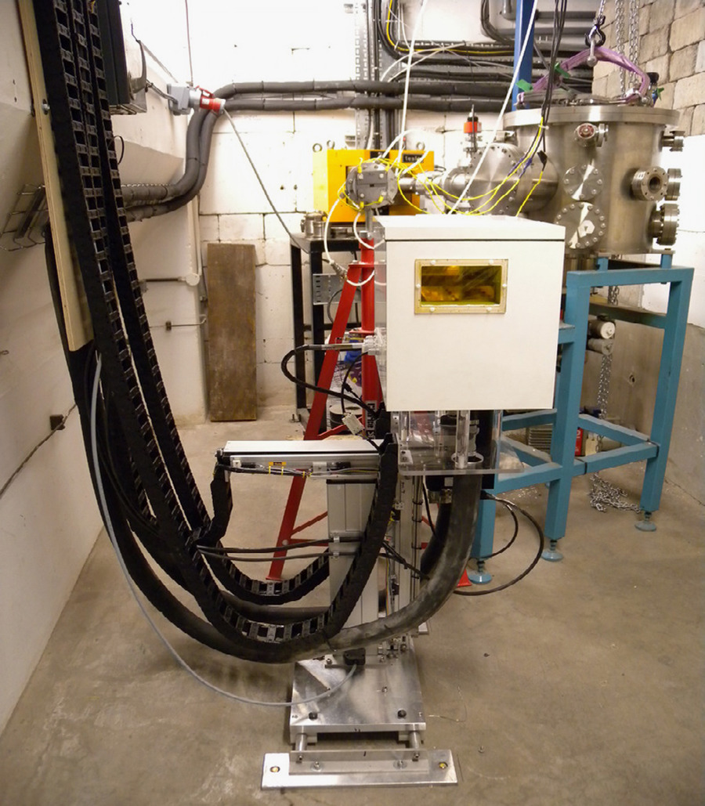
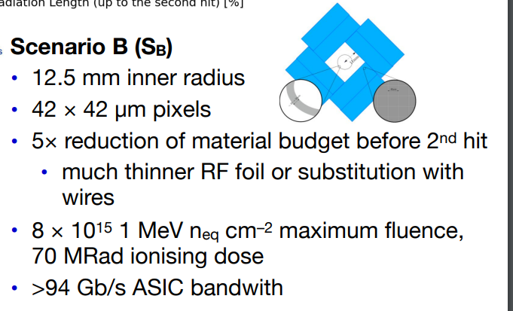
Birmingham Irradiation Facility
In-house cyclotron.
Regularly used for ATLAS ItK
4 Sensors irradiated to 9e14 neq/cm²
  U2 FTDR States minimum 0.8-1e16 for Velo Scenario B
Two sensors currently tested (D, H), other two left until absolute confidence in techniques and sensor handling.
Annealing Process:
  Perform 1 measurement pre-annealing (choose between IV/CV and Gain Measurement)
  Anneal in oven @ 60ºC for 80 minutes

