Slide 1
Challenges with fast timing on large pixel matrices
  Xavier Llopart
  8th February 2023

Slide 2
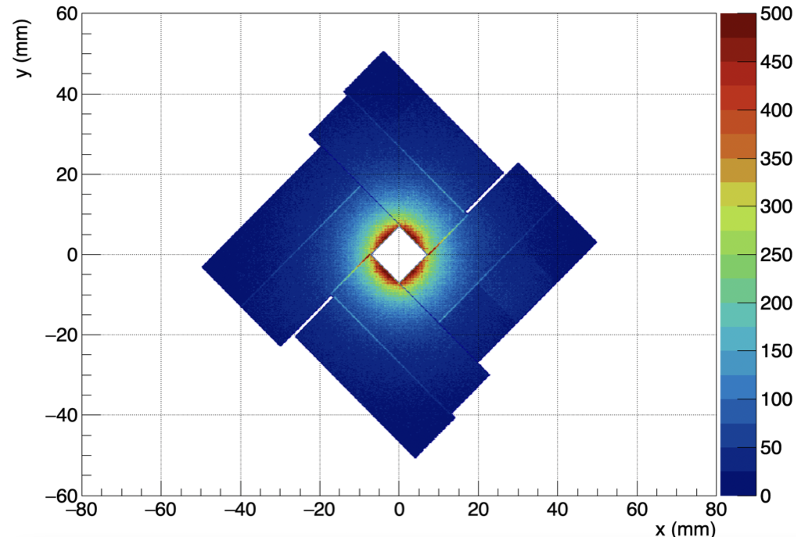
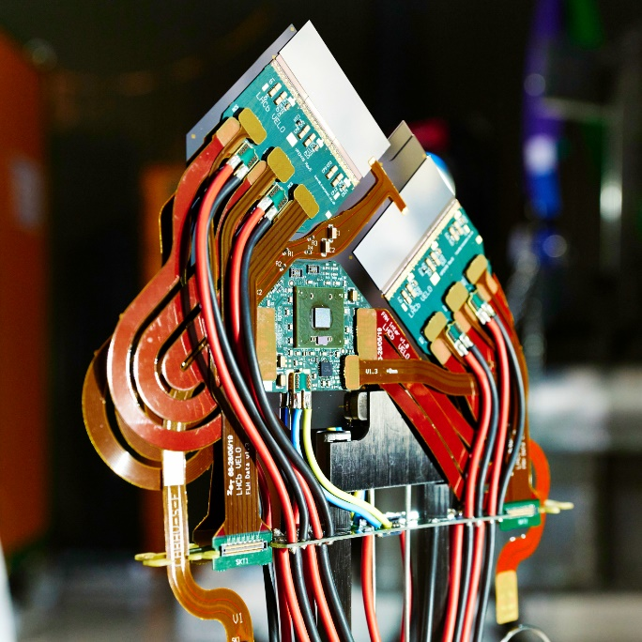
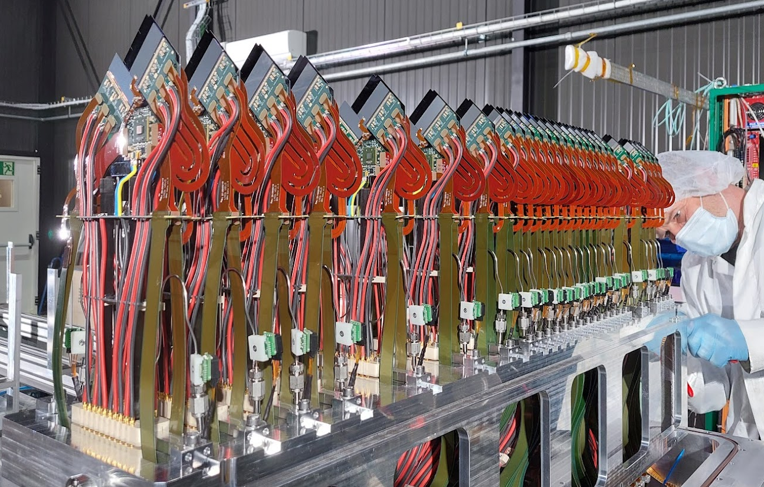
Velopix (2016)
Technology |  | TSMC 130nm – 8 metal
Pixel Size |  | 55 x 55 µm
Pixel arrangement |  | 256 x 256 (2x4 superpixels)
Sensitive area |  | 1.98 cm²
Data driven (Tracking) | Mode | Binnary (hitmap) + TOA
 | Event Packet | 30-bit
 | Max rate | 5x10⁶ hits/mm²/s
 | Max Pix rate | ~50 KHz/pixel
TOT energy resolution |  | < 1Kev
Time resolution |  | 25ns
Readout bandwidth |  | 4x @5.12 Gbps
Minimum threshold |  | <500 e⁻
Cluster occupancy of whole velo when fully closed (22/10/2022)
March 2022

Slide 3
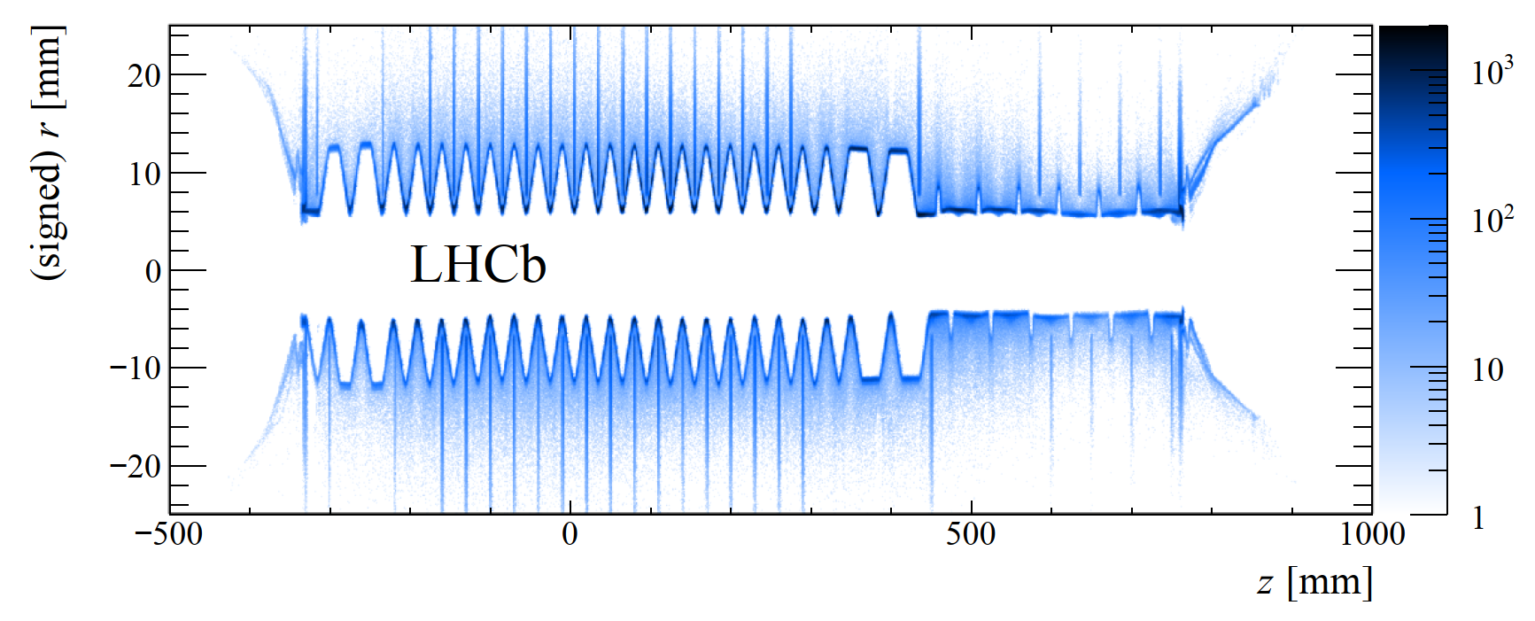
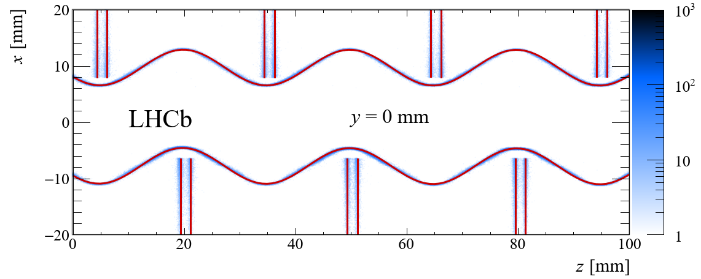
Mapping the material in the LHCb vertex locator using secondary hadronic interactions
https://doi.org/10.1088/1748-0221/13/06/P06008

Slide 4
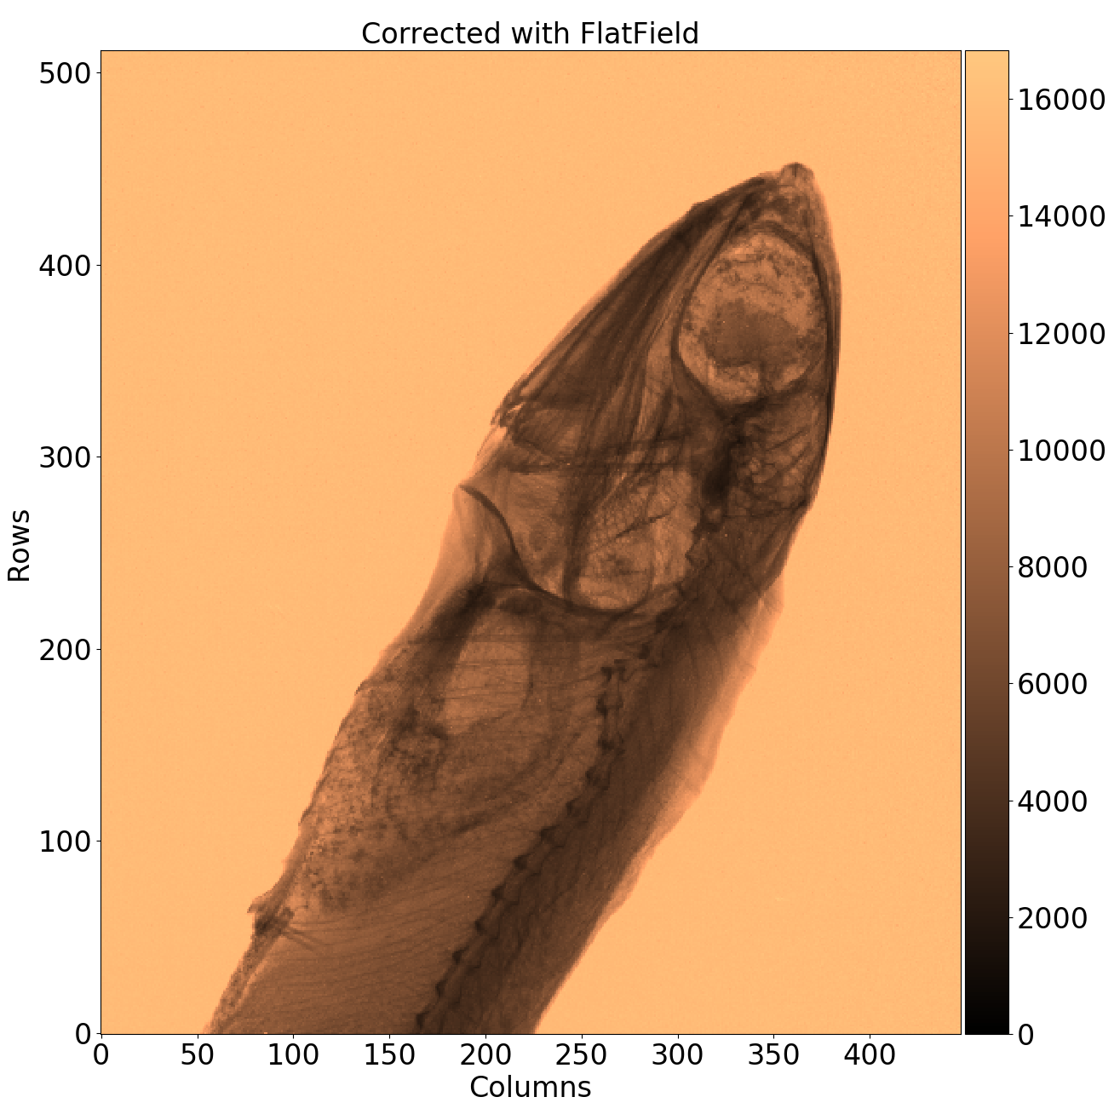
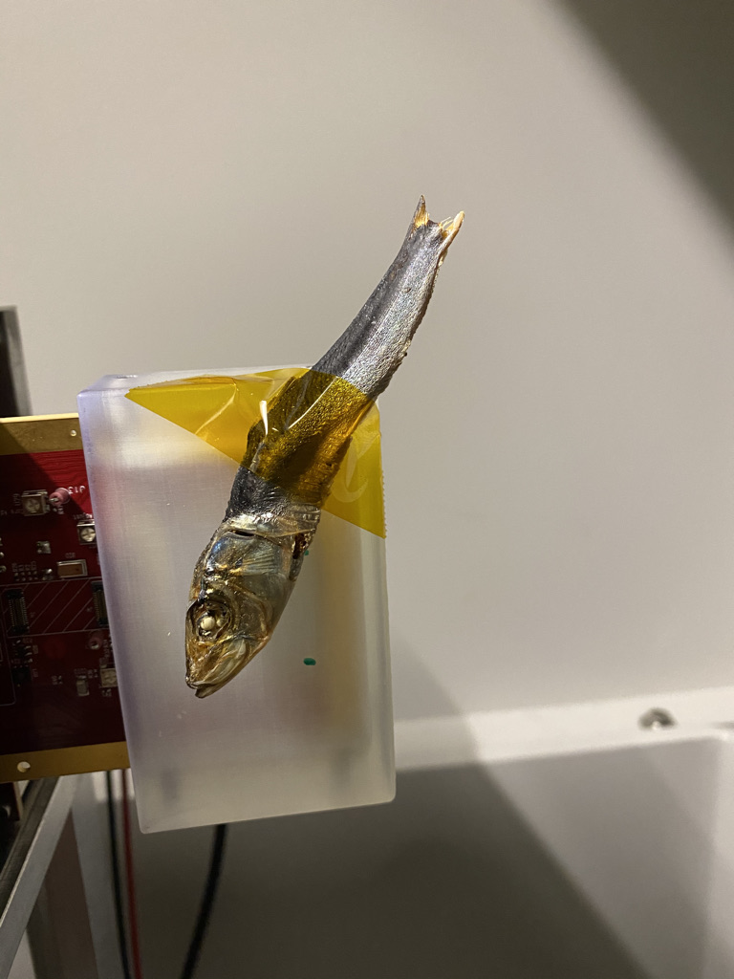
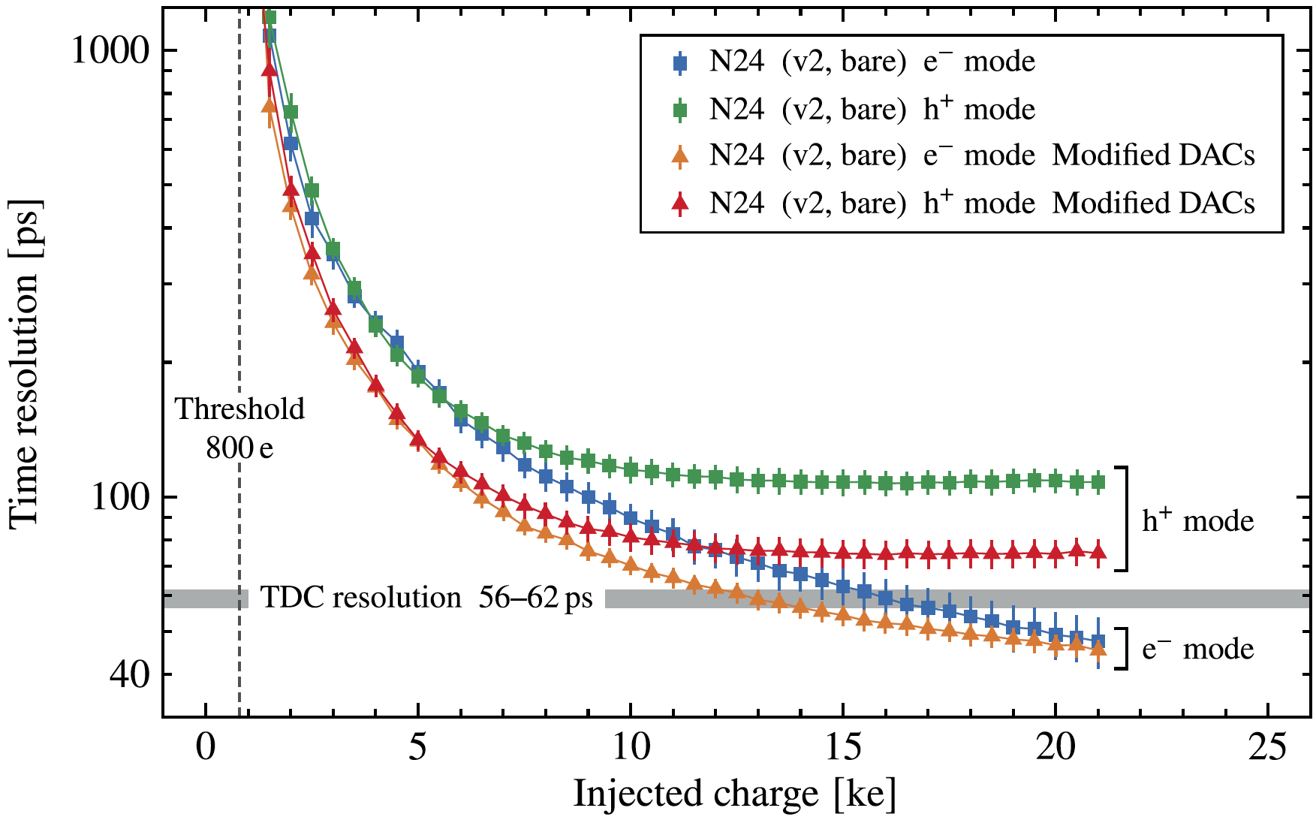
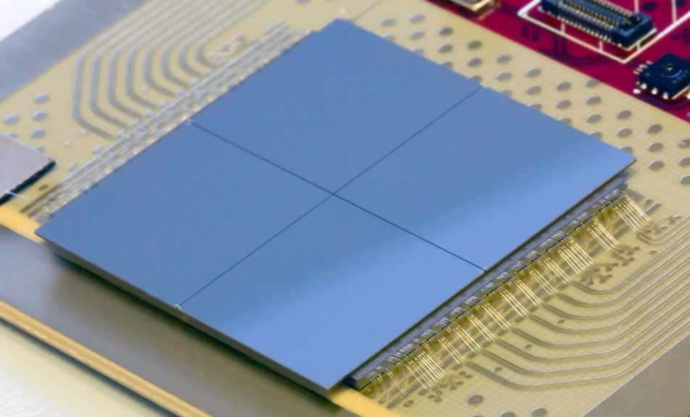
Timepix4 (2019)
https://indico.cern.ch/event/1121147
X. Llopart et al 2022 JINST 17 C01044
Technology |  |  | 65nm – 10 metal
Pixel Size |  |  | 55 x 55 µm
Pixel arrangement |  |  | 4-side buttable 512 x 448
Sensitive area |  |  | 6.94 cm²
Readout Modes | Data driven (Tracking) | Mode | TOT and TOA
 |  | Event Packet | 64-bit
 |  | Max rate | 3.58x10⁶ hits/mm²/s
 |  | Max Pix rate | 10.8 KHz/pixel
 | Frame based (Imaging) | Mode | CRW: PC (8 or 16-bit)
 |  | Frame | Not-zero-suppressed
 |  | Max count rate | ~5 x 10⁹ hits/mm²/s
TOT energy resolution |  |  | < 1Kev
Time resolution |  |  | 195ps bin → ~60ps_{rms}
Readout bandwidth |  |  | 16x @10.24 Gbps
Minimum threshold |  |  | <500 e⁻
K. Heijhoff (Nikhef)
Analog Power @400mW/cm²
Timepix4v0 with 4x300 µm (256x256) edgeless Si sensor (August 2020)

Slide 5
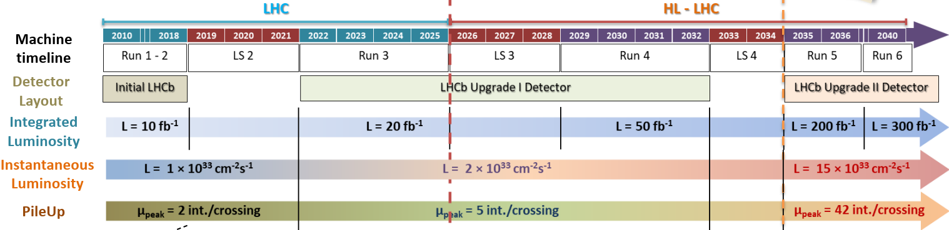
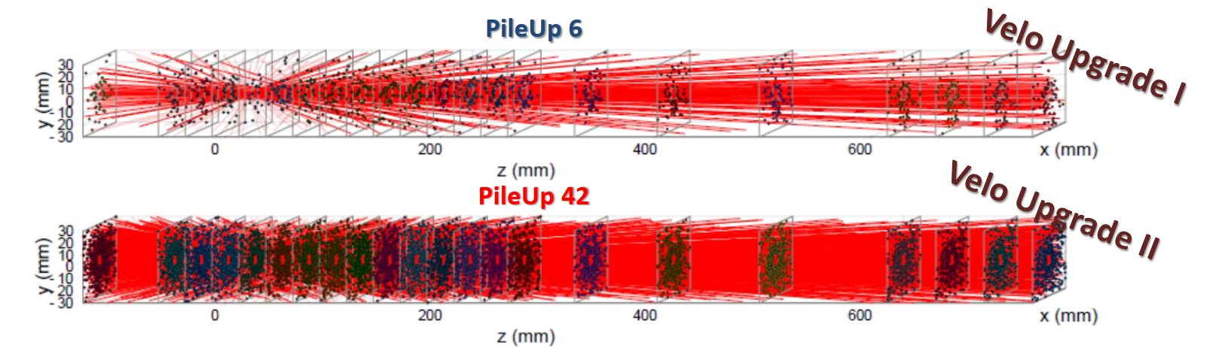
Towards HL-LHC in LHCb
If track time information <20ps_{rms} Primary Vertices can be reconstructed !!
https://indico.cern.ch/event/1140707/contributions/5067786/attachments/2536255/4365084/Gkougkousis_VERTEX22.pdf

Slide 6
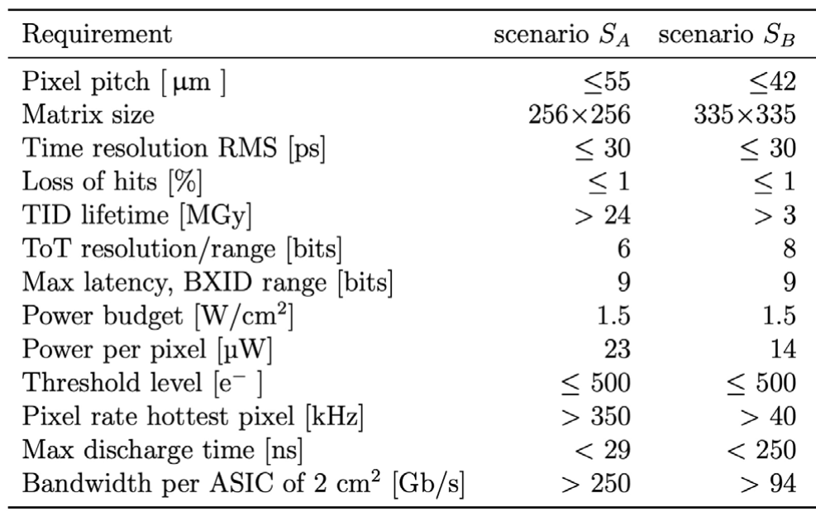
Initial LHCb requirements for Velopix2
Priority
Challenging!
doable

Slide 7
Velopix2 demo chip → PicoPix
TSMC HPC+ 28nm → Provides great level of integration at the Pixel level
  Large choice of standard cell libraries included characterized at 0.8V, 0.9V and 1V
  Radiation tolerance is better than in 65nm and 130nm
  Make use of different Macro blocks being developed in the section (Serializer, DACs, ADC, IO Pads, DC-DC,…)
  TSMC 28nm is a 90% linear shrinkage process from 32nm technology
Designed as a “real” small scale prototype of the large Velopix2 to avoid to get false expectations on final design:
  Analog FE
  Local VCO
  Pixel data clustering
  Pixel readout
  SEE robust architecture
  Clock distribution using dDLL approach (as in Timepix4)
  High-speed links
  On-chip Bandgap and biasing DACs
  UVM Functional verification
Chip should be ready to be bump bonded to different sensor types:
  ACF Anisotropic Conductive Film
Slow Control protocol can be simplified → reused from Medipix4/Timepix4?
Required ASIC for future sensor developments

Slide 8
Project manpower/Status
Direct manpower:
  CERN:
    V.Sriskaran: Analog FE + analog periphery (100%)
    X.Llopart: Project management & digital designer (50%)
    S. Esposito: Functional verification and architecture debugging (50%)
  NIKHEF:
    V.Gromov: On-pixel PLL
    C.Akgun: Sigma-delta
    A.Vitkovskiy (from summer 2023) → PCS (Physical Coding Sublayer)
  IGFAE:
    A. Fernandez: DAQ studies
  More CERN manpower (another full time digital designer) will be available by the end of the year:
    Delayed due to CHIPS support to other projects
Indirect manpower:
  Many IP blocks in TSMC 28nm being designed in the CERN R&D (Serializer, SLVS drivers/receivers, PADs…)
Current submission plans Q2/2024

Slide 9
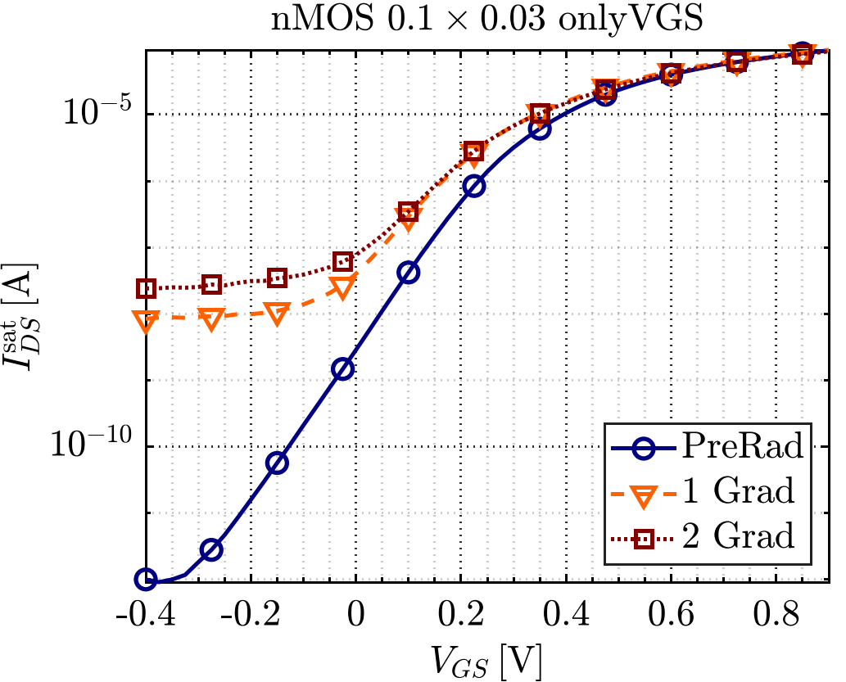
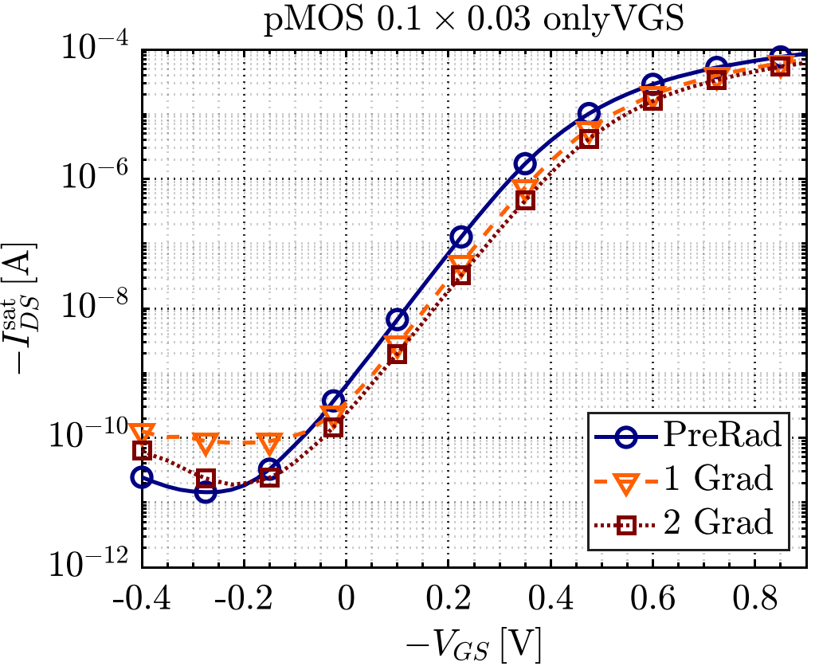
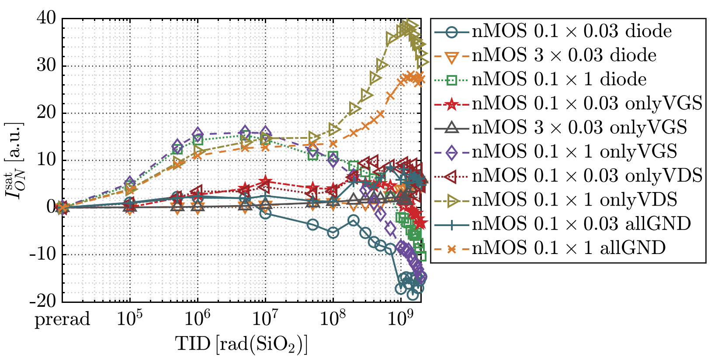
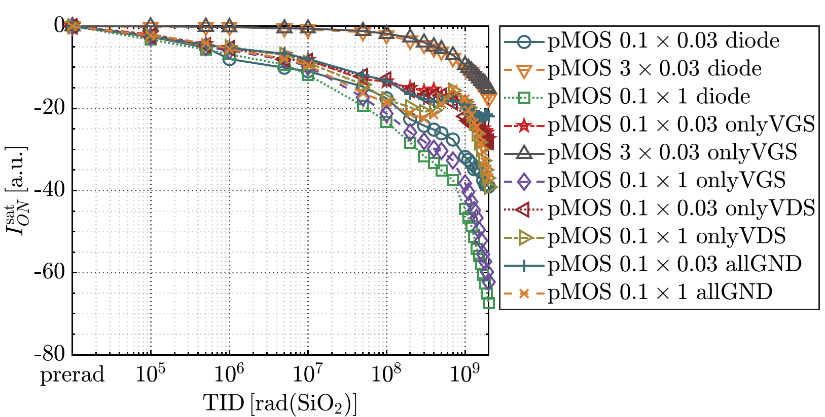
Radiation hardness of TSMC HPC+ 28nm
G.Borghello
Increase of parasitic leakage in NMOS → NO ELTs
W
Decrease of ION in PMOS

Slide 10
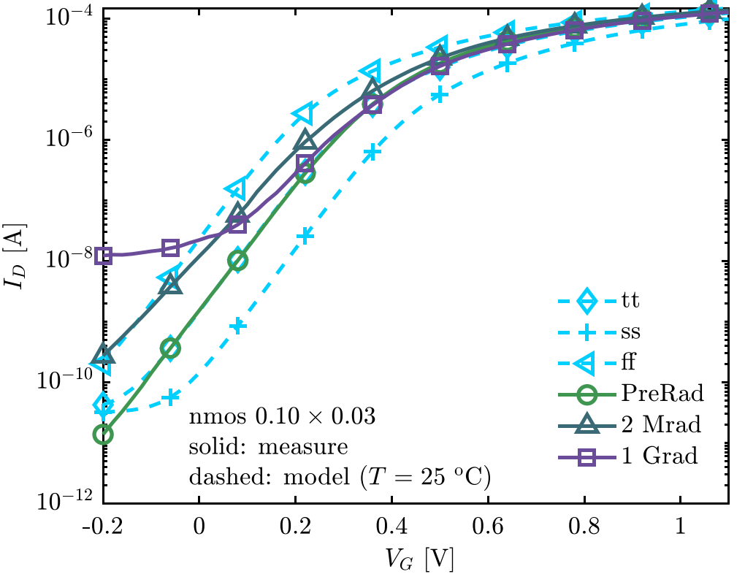
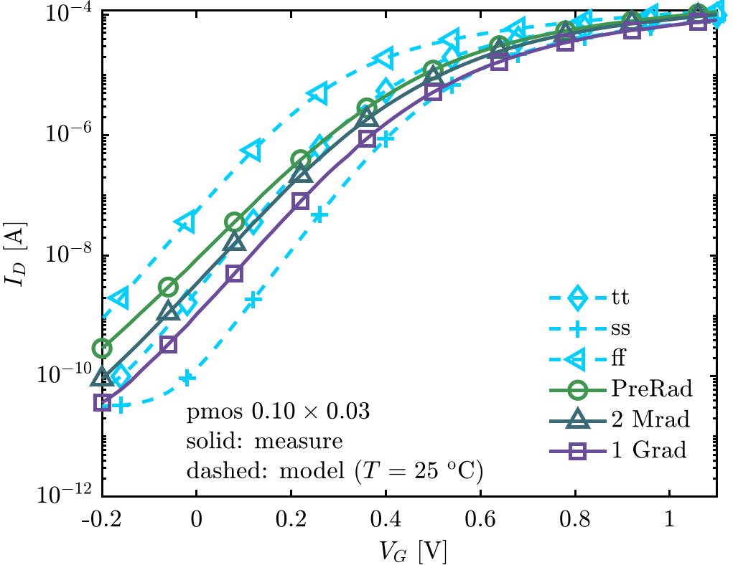
Radiation vs corner models
G.Borghello
Corner model simulations contain measured radiation shifts:
  NMOS: not true for VGS<~100mV
  PMOS: fits rather well

Slide 11
Summary of 28nm Radiation effects
G.Borghello
Caused by charge trapped in the oxides
In 28nm, the source of TID-induced degradation are the STI oxides
  leakage current increase only in nMOS
  larger degradation in narrow channel devices (RINCE)
  larger degradation in long channel devices
In general → wider (W) transistors behave better under radiation
Available corner models covers expected shifts → We can ~simulate rad effects
Other important effect: temperature, bias, dose-rate, variability…
  Temperature: lower is better
  Dose-rate: being evaulated
larger in pMOS

Slide 12
PicoPix ASIC
3.456 mm
Pixel Matrix
64x64 54µm
Scenario A
2.88 mm
Pixel Matrix
64x64 45µm
Pixel Size
Drawn | Si
50 | 45
51 | 45.9
52 | 46.8
53 | 47.7
54 | 48.6
55 | 49.5
56 | 50.4
57 | 51.3
58 | 52.2
59 | 53.1
60 | 54
61.111… | 55
Scenario B
3.456 mm
2.88 mm
Periphery
Periphery
1 mm
1 mm
~120 K$
~75 K$
Price for 100 chips and all options
Design time comparable to a full-scale design if targeting a “real” Velopix2 prototype
  Might be spaced limited in the periphery…
Bump-bonding with diced ASICs

Slide 13

Time resolution in tracking detectors: VELO2 case
Target resolution of <20ps_{rms} track time is required to distinguish PV
Single plane resolution of <50ps_{rms} → σ²_{sensor} (40ps_{rms}) + σ²_{ASIC}
σ²_{ASIC} (30ps_{rms})→ σ²_{analogFE} + σ²_{conversion} + σ²_{clock}
σ²_{conversion} → $\frac{{TDC}_{bin}}{\sqrt{12}}$ → TDC_{bin} = 40ps → 11.5 ps_{rms}
σ²_{clock} → Reference clock at pixel level < 10 ps_{rms}
σ²_{analogFE} → <25ps_{rms}

Slide 14
Analog FE
What are the achievable limits?
Proposed scheme

Slide 15
Beyond Timepix4 → sub-25ps time resolution?
Slide from CERN Detector Seminar 11th February 2022
Sensor technologies: thin planar, LGAD, 3D, CMOS …
  Radiation hardness, input capacitance, …
  Not further discussed here…
Front-end: There is a limit on time resolution that are achievable for small pixels with limited power
TDC: Distribution of reference clock with <20ps skew for large pixel arrays:
  N. Egidos et al., "20-ps Resolution Clock Distribution Network for a Fast-Timing Single-Photon Detector," in IEEE Transactions on Nuclear Science, vol. 68, no. 4, pp. 434-446, April 2021, doi: 10.1109/TNS.2021.3057581.
Timepix4
60 ps_{rms} @ Qin=10 ke- and 0.5W/cm²
20 ps_{rms} @ Qin=10 ke- and 1.5W/cm²
R.Ballabriga, The Timepix4 analog front-end design: Lessons learnt on fundamental limits to noise and time resolution in highly segmented hybrid pixel detectors https://doi.org/10.1016/j.nima.2022.167489

Slide 16
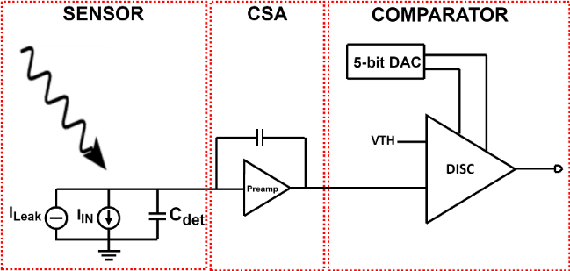
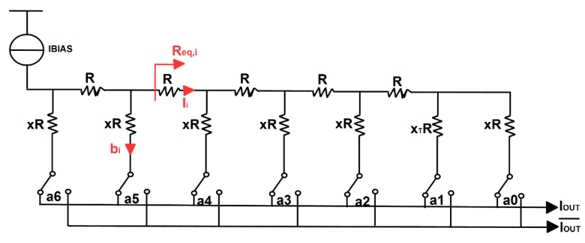
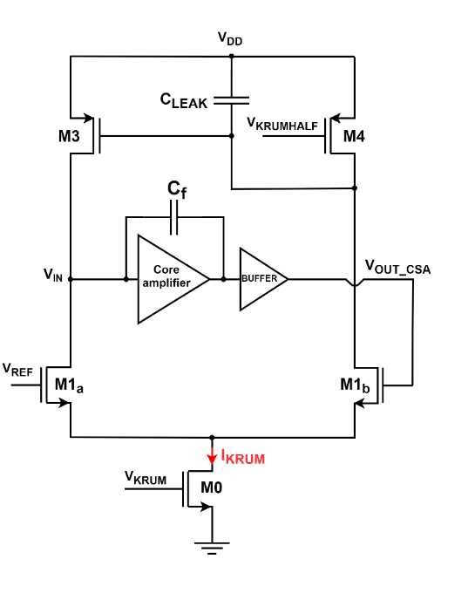
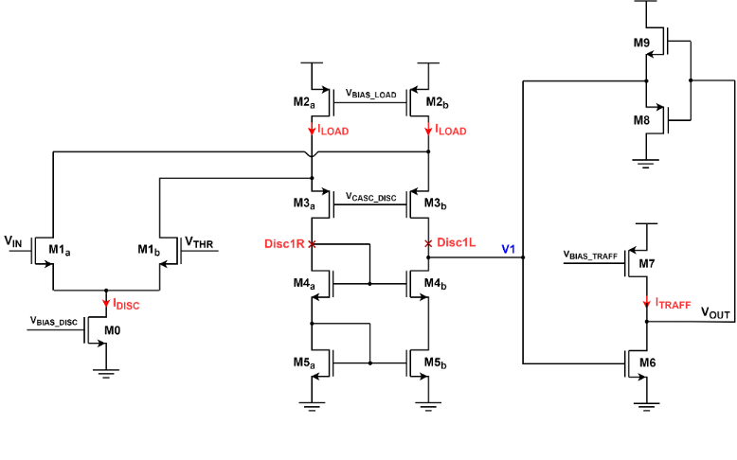
Analog front-end pixel for PicoPix
V. Sriskaran
Conventional tuning DACs use binary structure:
  Consumes large silicon area → sub-binary radix DAC
Study of four different topologies by S. Emiliani:
Current comparator provides the best performances in jitter and matching.

Slide 17
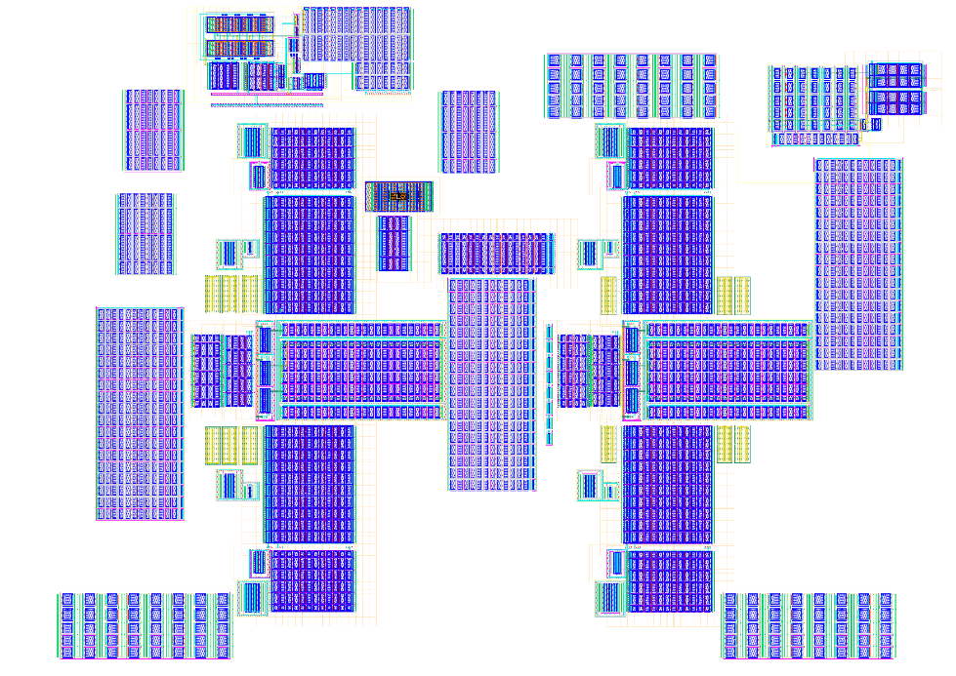
Status Analog FE island
V. Sriskaran
Schematic well defined:
  4 analog channels group
  7-bit sub-binary radix Threshold DAC per pixel (28-bit/island)
  4-bit Testbit + 4-bit Maskbit:
Initial full custom layout steps indicate that the analog island should fit in a drawn 50x50 µm → 45x45 µm (Si)
Analog
50 µm (drawn)

Slide 18
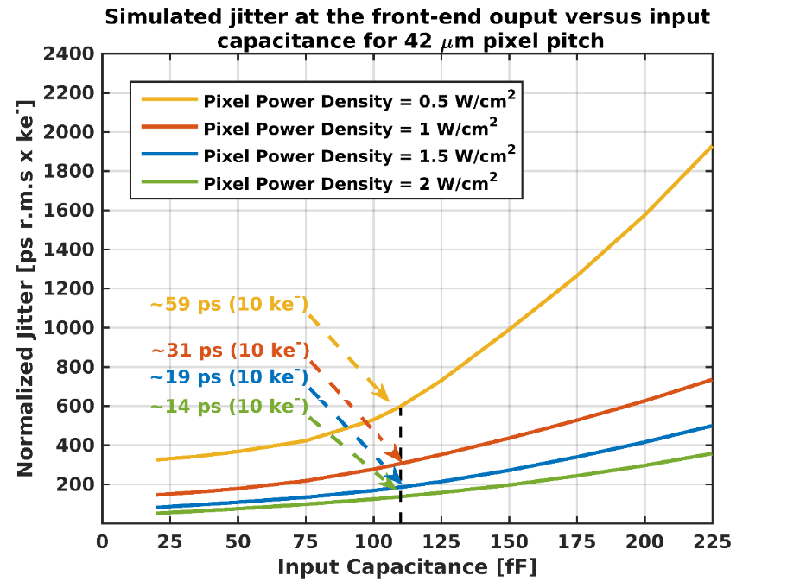
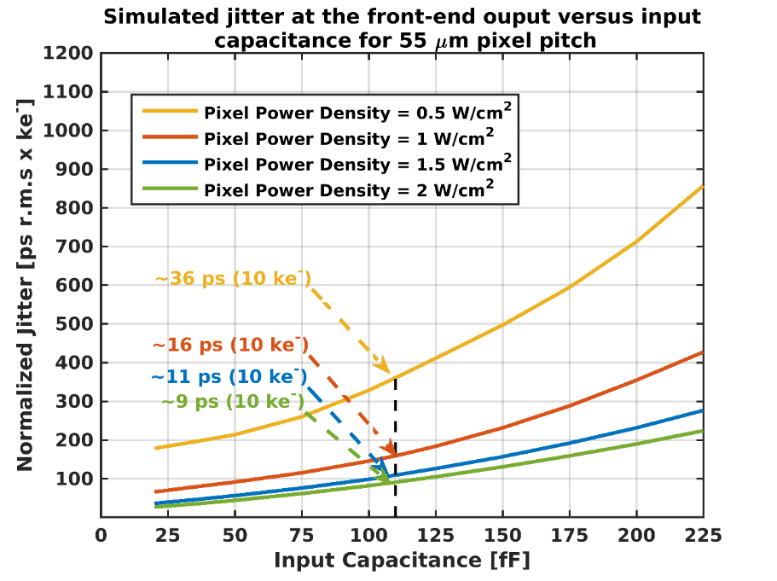
Simulated jitter at front-end output versus input capacitance
V. Sriskaran
37.8 µm (Si)
49.5 µm (Si)
Simulation using schematic view!!
NB: 110 fF is the total pixel capacitance obtained with 3D-trench sensor.
DOI: 10.1088/1748-0221/15/09/P09029
Why not using more power per pixel to enhance the timing performances ?

Slide 19
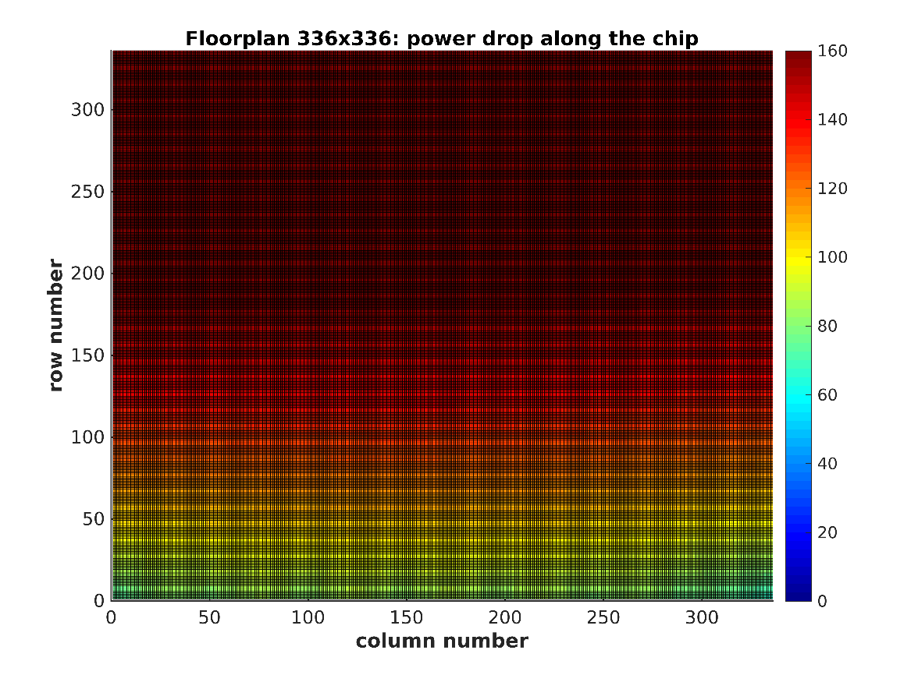
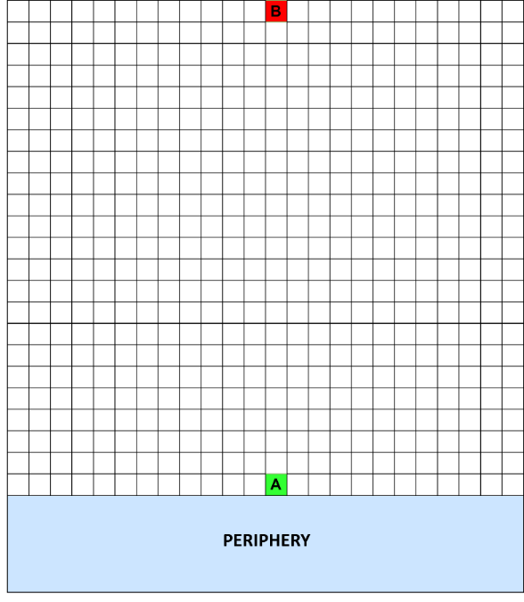
Power drop in a 336 x 336 array of 42 µm pixels
(33 µA per analog pixel)
37.8 µm (Si)
 | Pixel A | Pixel B
V_{GND} [mV] | 45 | 90
V_{GND_KRUM} [mV] | 45 | 61
Peaking time [ns] | 1.71 | 2.27
I_{DS}(M_{INPUT}) [µA] | 17.3 | 11.9
σ_{TOA} (ps r.m.s) | 12 | 24
I_{KRUM} [nA] | 98 | 69
ToT [ns] | 42 | 68
→ The power drop along the pixel must be minimized to avoid top-down effect!
→ Systematic I_{KRUM} mismatch: ToT mismatch and gain mismatch!
V. Sriskaran

Slide 20
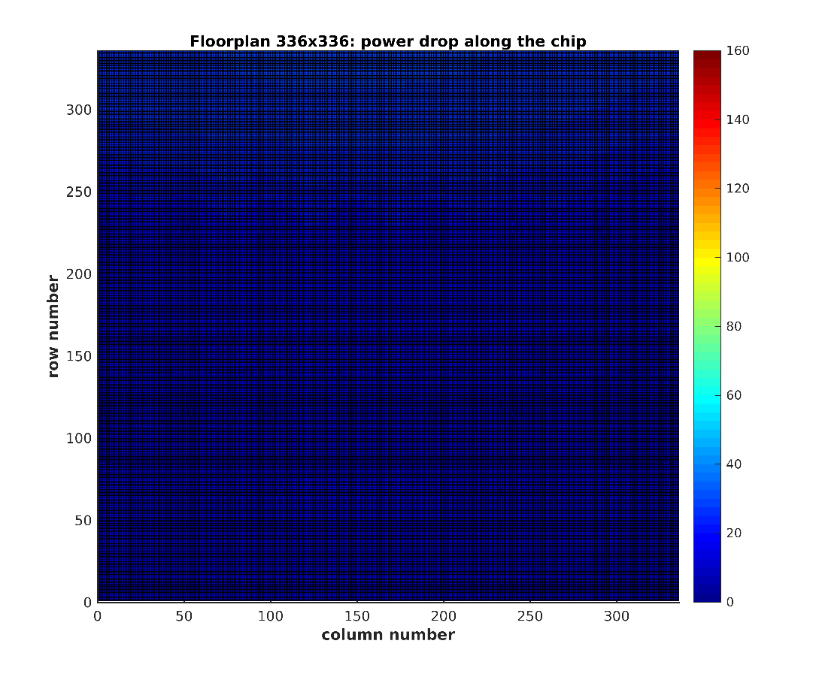
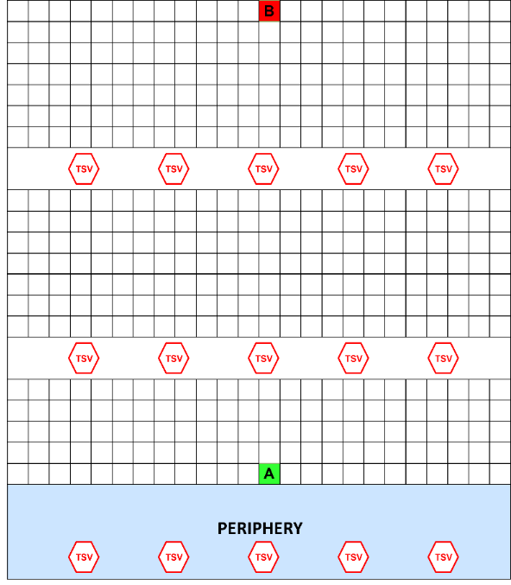
Power drop in a 336 x 336 array of 42 µm pixels
(33 µA per analog pixel)
37.8 µm (Si)
 | Pixel A | Pixel B
V_{GND} [mV] | 8 | 14
V_{GND_KRUM} [mV] | 8 | 14
Peaking time [ns] | 2.06 | 2.1
I_{DS}(M_{INPUT}) [µA] | 17.3 | 16.5
σ_{TOA} (ps r.m.s) | 9 | 11.5
I_{KRUM} [nA] | 98 | 82.6
ToT [ns] | 42 | 49
Advantages of using TSVs:
  Improved Analog & digital power distribution → Better uniformity in pixel performances
  Improved readout bandwidth
  Minimized top-down radiation mismatch
Disadvantages:
  Post-processing required → Cost, risk,…
  Added material in the substrate
  Complex assembly due to different thermal requirements (Bump-bonding, BGA,…)

Slide 21
On-time measurements <30ps_{rms}
Distribution of the Clock Reference
On-Pixel TDC

Slide 22
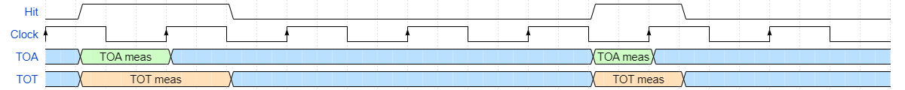
Time and Energy Measurement
Time of arrival (TOA):
  Fine TOA → measure from the rising edge of Hit to first Clock edge
  Coarse TOA → Sample a BxID transmitted across the matrix
Time over threshold (TOT):
  Measure the discriminator ON duration → Equivalent energy measurement
Reference clock distribution is critical:
Pixel to pixel skew (static) can be corrected (calibrated)
Clock jitter (dynamic) cannot be corrected
On-Pixel Time-to-Digital Converter (TDC):
40ps bin → 25GHz clock bin
Low area, low power TDC
Energy measurement:
Required to correct the FE timewalk
High energy measurement resolution is required

Slide 23
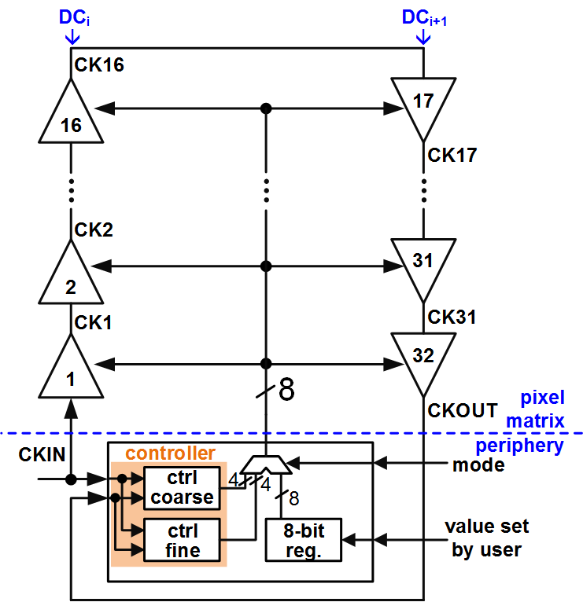
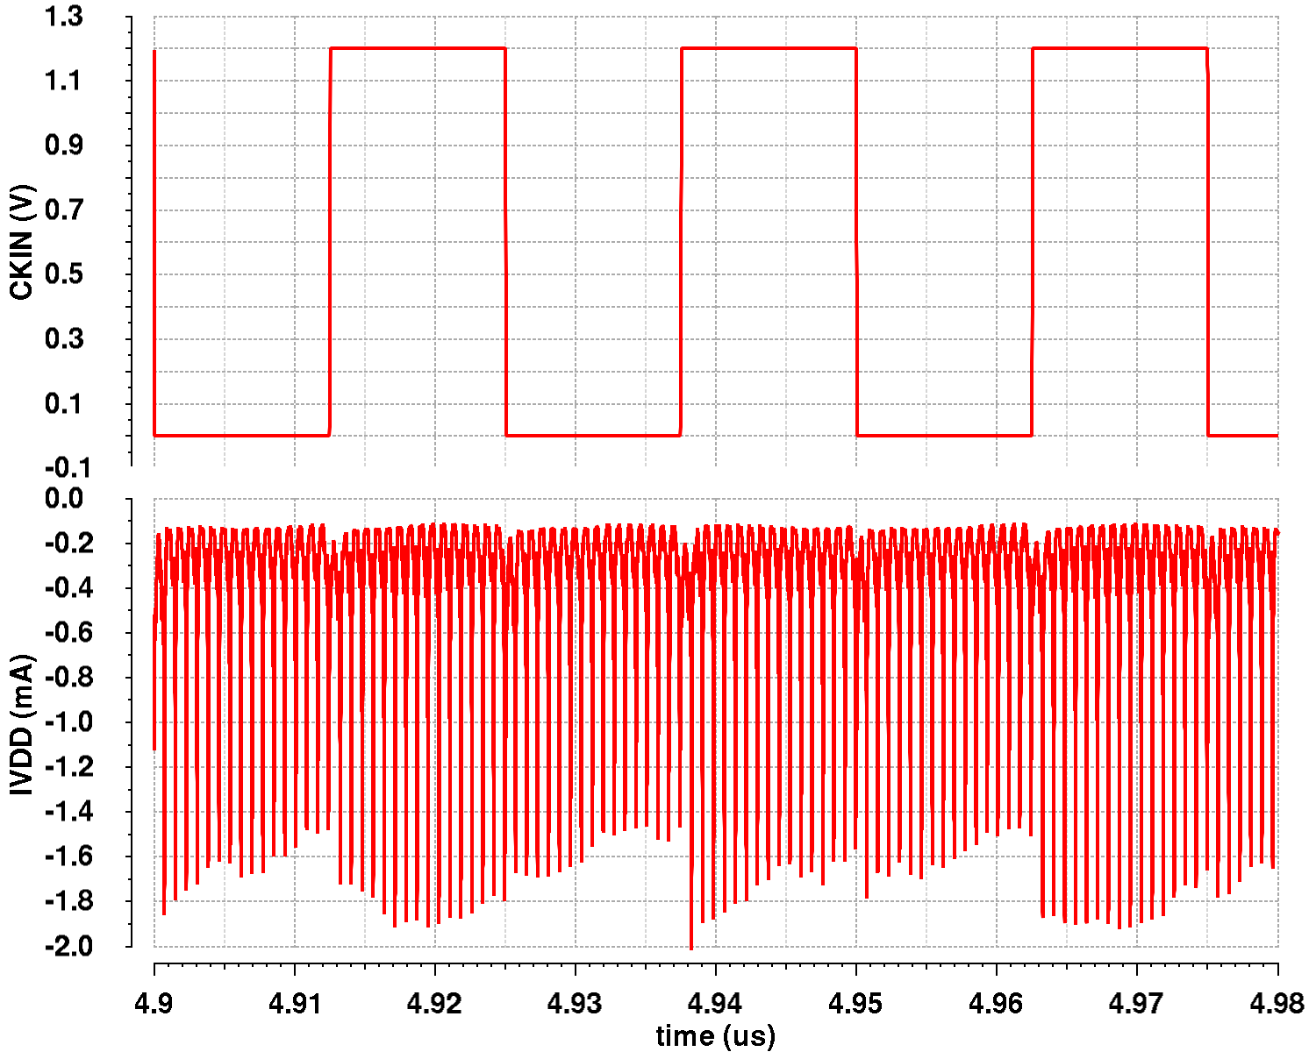
Full digital double column DLL
[448 dDLL: 224 Top Matrix and 224 Bottom Matrix]
iWoRID 2018
X. Llopart et al 2019 JINST 14 C01024
ADB
in
coarse
delay
section
fine
delay
section
ByPass
out
buffer
15
15
1
ctrl_coarse
ctrl_fine
bypass
Measured in Timepix4v2
Timepix4 ~23 mW/cm² @40MHz clock with <100ps skew
Timepix3 ~100mW/cm² @40MHz clock with ~1.2ns skew
Dynamic digital power consumption is distributed across the clock period

Slide 24
Full digital double column DLL for PicoPix
Main idea: Instead of a distributing the same control code (8-bits) for all DLL stages → tune each stage individually:
  In Timepix4 32 stations @ LSB=4-5ps → ± 128-160 ps resolution
  In Picopix @ LSB=4-5ps → ± 4-5 ps resolution
Serial protocol to communicate with the dDLL column stations:
  Broadcast command to speed-up DLL lock (as in Timepix4)
  Non-Broadcast command for fine tuning
  Bypass dDLL stations
  Delay equalization for top-down delay mismatch

Slide 25
Column clock DLL Calibration
Column clock DLL used to distribute clock across pixel matrix with a known phase
Principal working mechanism of a DLL is that all the cells in the delay line are identical, but:
  Our columns are long (might be few cm) and we will suffer from PVT + radiation non-uniformities → Need to measure and calibrate
How to measure delay line mismatches:
  In Timepix4 we could bypass 1 delay cell at a time an relock → measure bad behavior in DLL
  @lock we store the digital locking value
  Stations with more delay when bypassed show a higher locking value
In PicoPix… we do the same:
  But since the locking precision is higher we can compensate the on-pixel clock phase errors better

Slide 26
PicoPix example in RTL
20ns clock period
Top – down mismatch of ~90ps total added
Input clock 10ps rms jitter + 0.5ps jitter in each delay line station
Uncorrected:
Max-Min=381.95ps
Stdev=142.8ps
Corrected:
Max-Min=22.16ps
Stdev=7.5ps

Slide 27
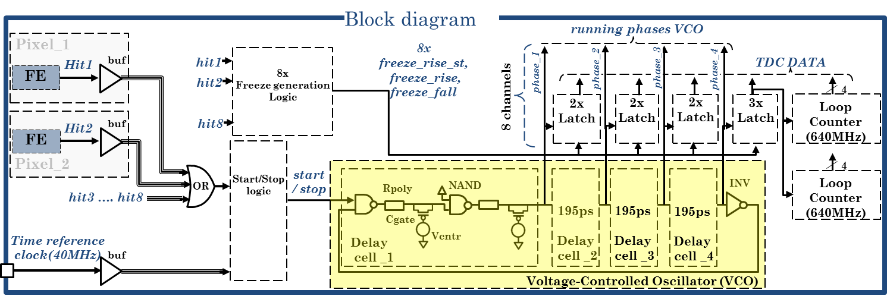
How can we extend the Timepix4 TDC to meet PicoPix requirements?
VCO Oscillation pattern
Timepix4 uses a VCO with 1 peripheral PLL that generates a Vcontrol distributed to all pixels:
  In Timepix4 1 LSB is 195ps
  1 TDC every 2x4 pixels → power/area reduction
PicoPix VCO @1.28GHz with 10 phases 78.125ps bins → 22.5 ps_{rms} (!?)
How to deal with systematic effects (Column supply drops, TID, mismatch…)?
stage | Phase[0] | Phase[1] | Phase[2] | Phase[3]
0 | 1 | 1 | 1 | 1
1 | 1 | 1 | 1 | 0
2 | 1 | 1 | 0 | 0
3 | 1 | 0 | 0 | 0
4 | 0 | 0 | 0 | 0
5 | 0 | 0 | 0 | 0
6 | 0 | 0 | 0 | 1
7 | 0 | 0 | 1 | 1

Slide 28
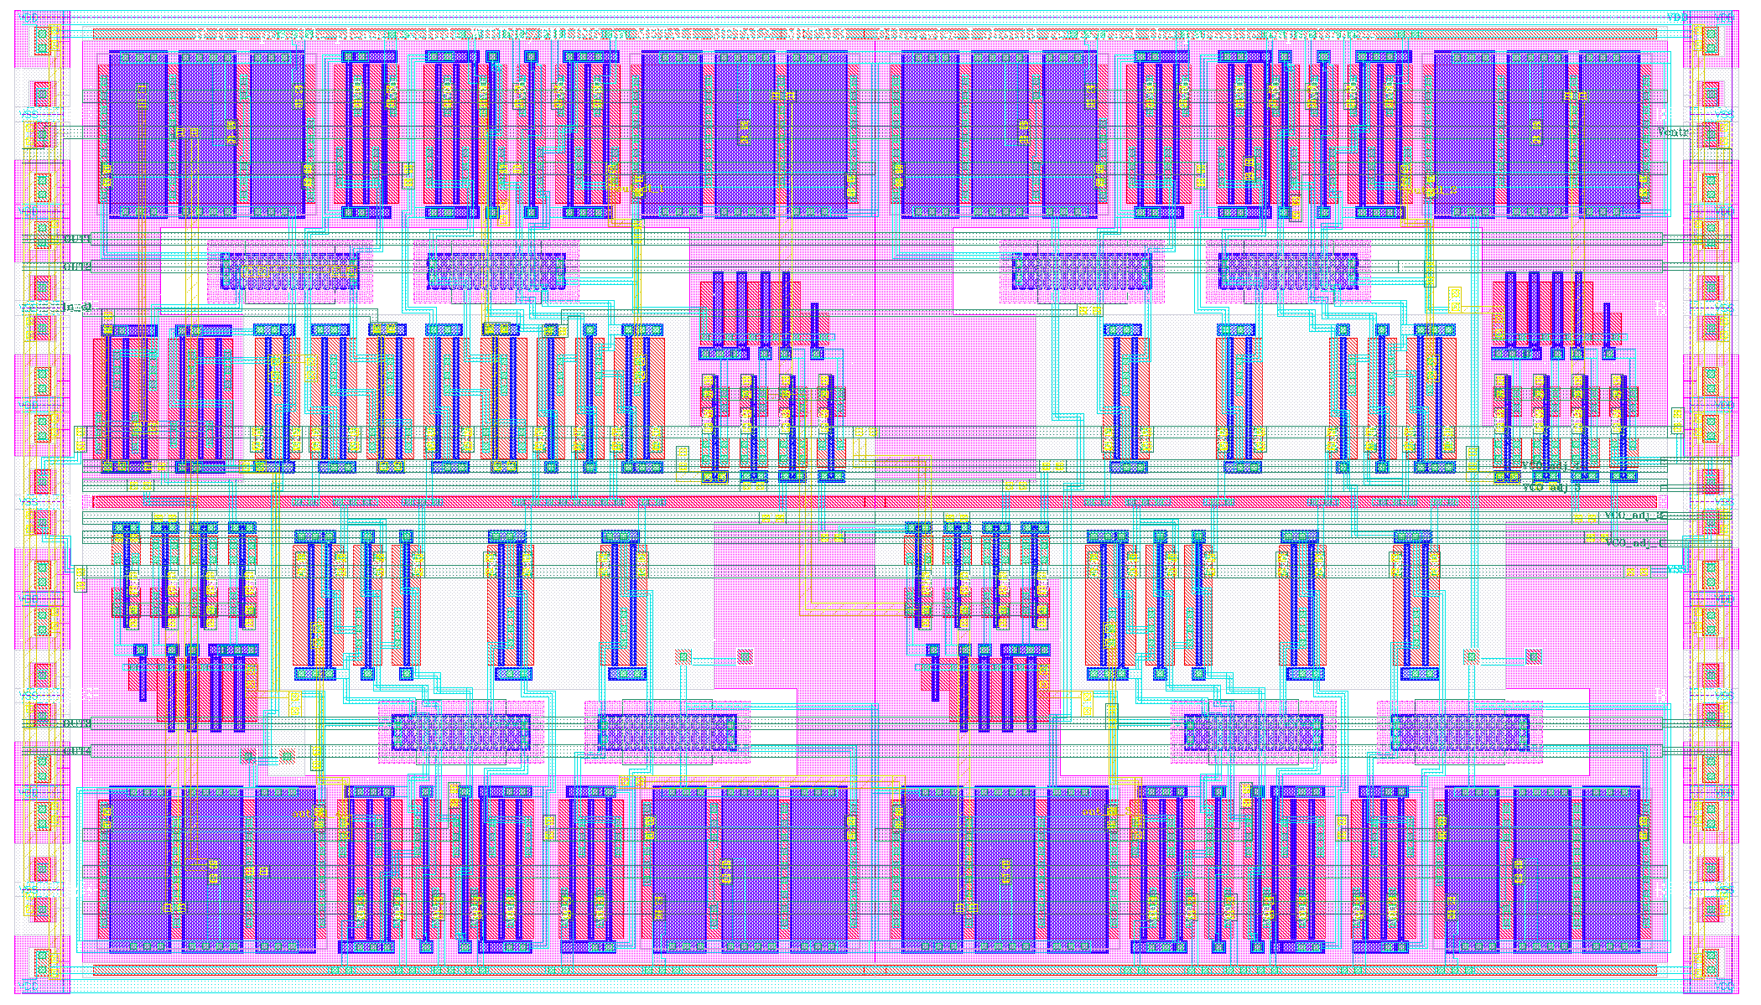
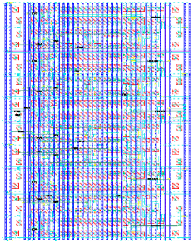
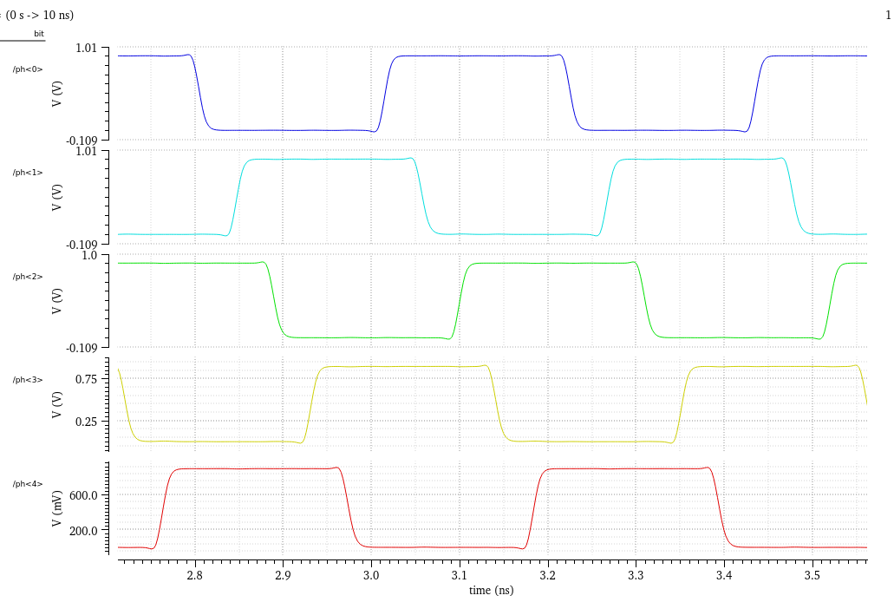
Free running On-pixel DCO
Timepix4 VCO (65nm)
Explored the idea of the on-pixel free-running DCO with event-by-event calibration:
  With 3 bits oscillation control
  Using 7T cells with extracted parasitic
Advantages:
  No control voltage distributed along the column
  Systematic effects can be suppressed
  Faster oscillation times and lower dynamic power → better time resolution
Disadvantages:
  Requires DCO calibration measurement → data bandwitdth!
PicoPix DCO (28nm)
0
1
2
3
4
5
6
7
8
9
 | freq | Phases | Phase mismatch [max-min] | LSB | Area | power
Timepix4 VCO | 640 MHz | 8 | ~25% | 195ps | ~350µm² | ~500µW
PicoPix DCO | 2-3 GHz | 10 | < 5% | 50-33ps | ~38µm² | ~150µW

Slide 29
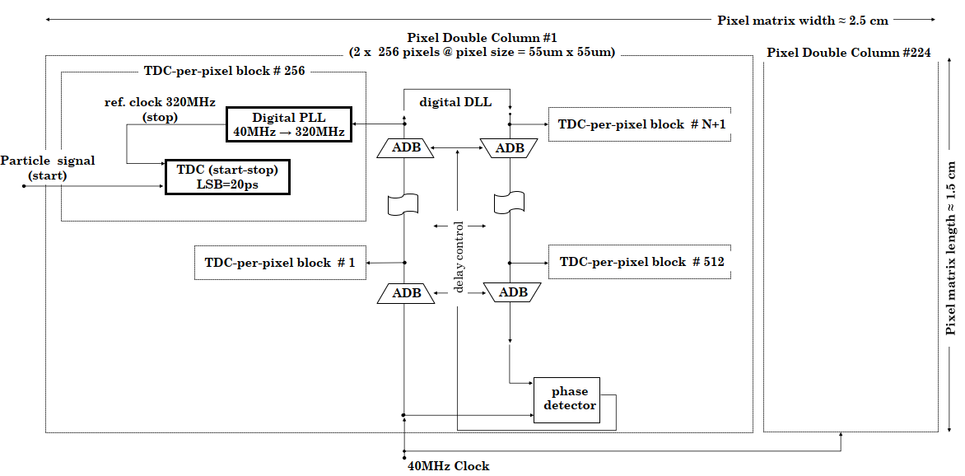
Region Digital PLL
V.Gromov
Design of a low power, low area digital PLL:
  Reference clock cleaning
  Clock multiplication 40 → 320 MHz
  < 10ps p-p jitter
Challenge to cope with dynamic supply (VDD/GND)
  Digital power analysis is essential to understand the limits of the circuit

Slide 30
Pixel to output data readout
On-pixel data reduction
Large readout bandwidth

Slide 31
On pixel event processing → Data reduction
Most events are clusters of 1-4 pixels
  Readout only the largest event in a cluster → Best time (TOA) and energy (TOT) resolution
Cluster events in X and Y in a single data output packets:
  1 data packet per cluster
  Master (M) pixel found using arbitration circuitry as in Medipix4
  TOA and TOT only on Master (M) pixel
  Hitmap of pixels around Master (M)
Advanced on-pixel data filtering possible:
  Accept events only in certain TOT range
  Accept events only in certain TOA range
  Accept events only for certain hitmap range
M
M
Fundamental to filter undesired data at pixel level !!!

Slide 32
Pixel Matrix organization: PicoPix SuperPixel
1 Analog island:
  4 FE + 4 Disc
  Threshold (5-bit) and TOT (3-bit) calibration
1 TDC:
  Discriminator inputs are OR-ed → Only 1 TDC measurement per SuperPixel
  In Timepix4 each pixel has an independent measurement → “Simpler” block for PicoPix
Arbitration:
  Finds the pixel with larger charge → Winner
  From Medipix4
  Works across SuperPixels in all directions
Hitmap:
  Finds pixel with a HIT around the Winner
  Works across SuperPixels in all directions
Packet Formatter:
  Might add local filtering: TOT, size of hitmap,…
FIFO:
  Stores data temporarily
SuperPixel
Analog
TDC
Arbitration
Hitmap
Packet Formatter
FIFO

Slide 33
PixeMatrix organization:
SuperPixelRegion and Full Columns
Contains 2xN SuperPixels:
  N is a parameter in the RTL code
  N=4 → 32 pixels
  N=8 → 64 pixels
1 dDLL station node
Pixel readout architecture
Pixel and SuperPixel configuration
Should be the macro block for array formation
M SuperPixelRegions form a full pixel column:
  M is a parameter in the RTL code
  M=16, N=4 → 512 pixels
SuperPixel
SuperPixel
SuperPixelGroup
SuperPixel
SuperPixel
dDLL + dPLL
SuperPixel
SuperPixel
SuperPixel
SuperPixel

Slide 34
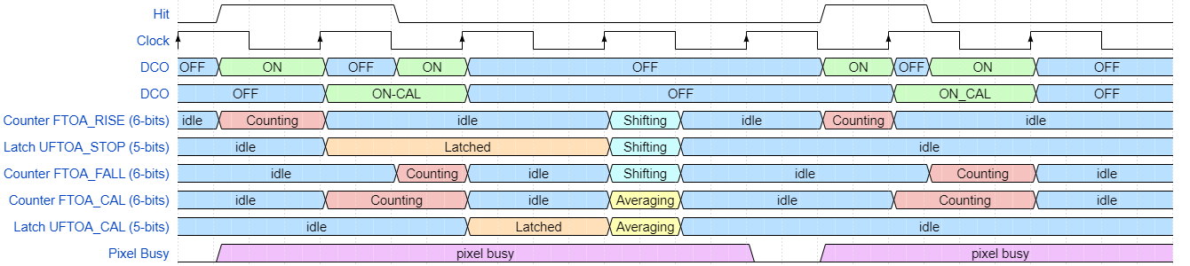
Event-by-event VCO calibration
Ref clock @40MHz:
  FTOA 6-bits → Max VCO freq before overflow 2.52 GHz
  Calibration could be done after event (ON-CAL):
    To measure the VCO frequency: FTOA_CAL(6) + UFTOA_STOP(5) + UFTOA_CAL(5) = 16-bits
  Pixel (cluster) busy for 3-4 clock cycles → 100ns @40MHz (50ns @80MHz)

Slide 35
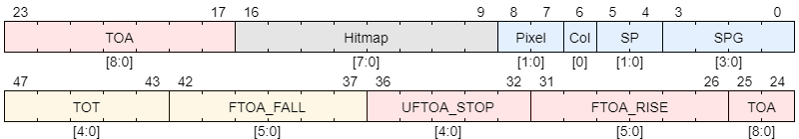
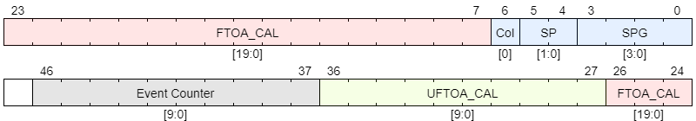
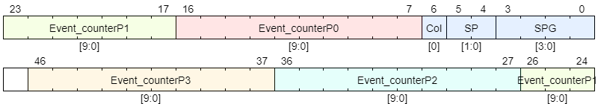
Types of pixel packets
512 pixels/DC
Event packet:
1 packet/event
Address+hitmap+TOA+TOT
DCO Calibration packet:
Cumulative calibration data → improved DCO measured frequency
To be sent every N events or by DAQ request
Event counter packet:
Used for threshold equalization, counting…

Slide 36
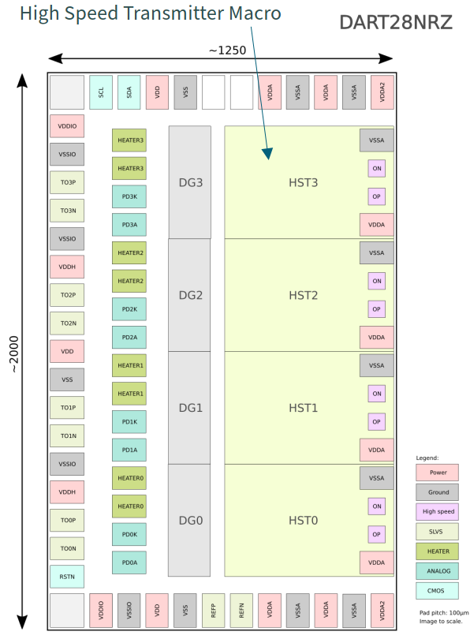
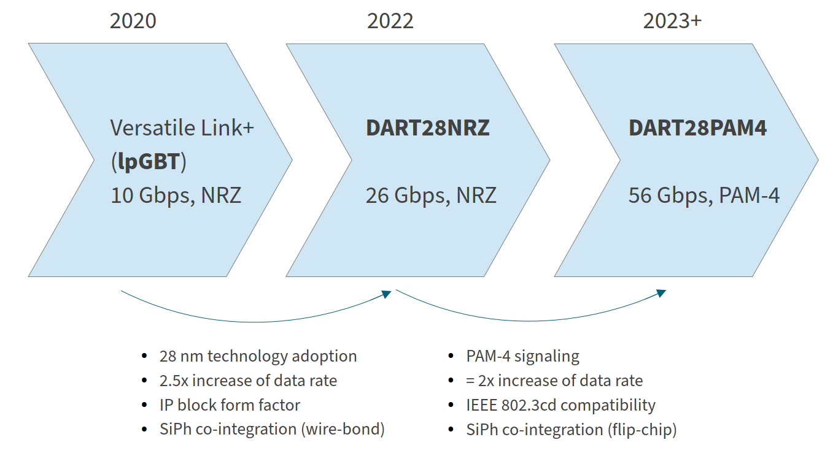
High Speed Links in 28nm
S.Bieregel (CERN-ESE-ME)
https://indico.cern.ch/event/1138500/
WP6 ASIC Roadmap
Planned submission in Q1/2023
Demonstrate:
  Electrical: correct operation of high-speed transmitter
  Optical: SiPh integration, end-to-end optical link
  Dual Channel WDM*:2 NRZ links on one fiber
*Wavelength Division Multiplexing

Slide 37
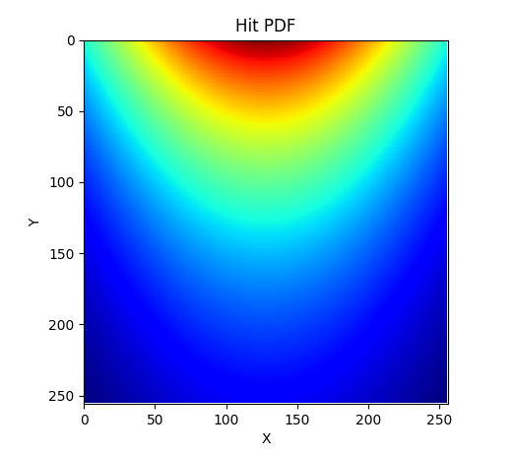
Architectural Exploration
Architectural Choices will be evaluated through simulations
  Arbitration scheme
  Datapath architecture
  Hit filtering
Simulation parameters
  Hit Location PDF
    Or Montecarlo data
  Hit Energy PDF
    Or Montecarlo data
  Fifo sizes and connections
  Matrix size
  On-pixel hit arbitration scheme
  On-pixel hit filtering functions
Configurations
Results
Hit Probability Density Function
Random Packet Generator
Address and ToT distribution
Arbitration
Filtered data size
Parameters
Matrix datapath model
Buffers saturation
Periphery datapath model
Buffers saturation
Data Throughput

Slide 38
Simulations

Slide 39
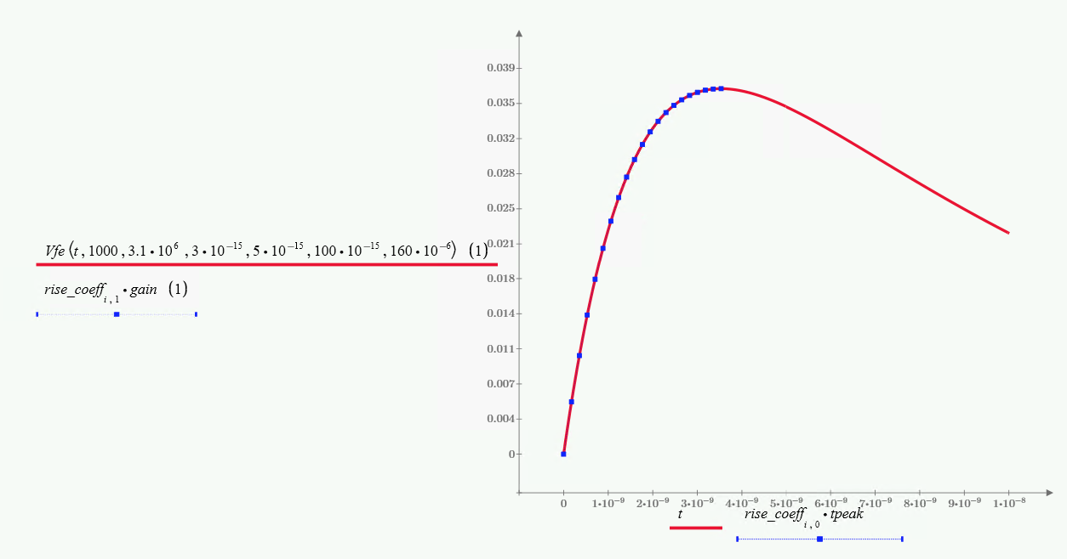
Digital simulation environment
Full Column → M=16 SuperPixelRegions and N=4 SuperPixels
  128 TDCs
  Full dDLL + EOC controller
Noise sources modelled:
  ClkDLL jitter as random gaussian
  VCO jitter as random gaussian
  FE ENC as random Gaussian
Modified FE pixel model represent more realistically the rise-time slope → critical to extract correct timing
  Model includes analog pile-up
  Fall time is a constant slope

Slide 40
Event simulation
Simulation:
  Events: 1000
  Qin: uniform distributed [1Ke- to 10Ke-]
  Basic charge sharing sensor model
  Clk jitter =10ps_{rms}
  DCO jitter =1ps_{rms}
  Winner takes it all enabled → Master
  DCO calibration by running average
Measure in cluster events with larger Qin (TOT)
TW correction using TOT
Filtering events with lower Qin (TOT)

Slide 41


Timewalk correction
From the measured TOT (ns) → Qin
  Typical fit for the front-end (Krumenacher ) we need 4 parameters (Atot, Btot, Ctot and Ttot):
From Qin → TOA (ns):
  Fit need 3 parameters (Ctoa, Ttoa and Dtoa):
For the level of TOA precision required we will need a pixel-by-pixel calibration:
  On-pixel correction for Atot could be added but will increase pixel area…
c
$$Tot\left(ns\right)=QinAtot+Btot−\frac{Ctot}{Qin−Ttot}$$
c
$$Toa\left(ns\right)=\frac{Ctoa}{Qin−Ttoa}+Dtoa$$

Slide 42
How to get the <30ps_{rms} timing ?
<30ps_{rms}

Slide 43
Other building pieces…

Slide 44
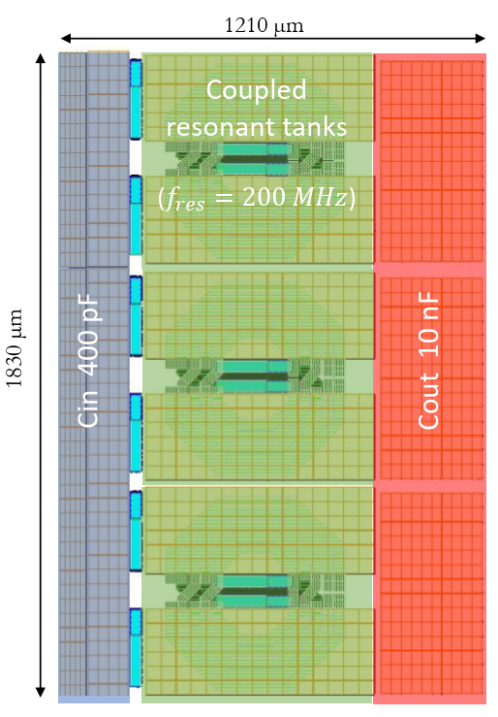
On chip DC-DC Converter?
G. Ripamonti (CERN-ESE-ME)
https://indico.cern.ch/event/1138502/
WP 5.2
A proposal for a 5V, 250mA fully-integrated DC-DC converter in 28nm CMOS: 5V to 0.9V converter
Great simplification of the module
Target TID 1Grad
Expected output ripple <3mV
Output current limits the power consumption but can be done if internal power is split by blocks of columns

Slide 45
Other macro blocks ….
 | Designer | Institute
Periphery
R2R Buffer | Markus (WP 5.1) | CERN
DAC (8-bit) | Markus (WP 5.1) | CERN
DAC(12-bit) Sig-Delta | Can | NIKHEF
DAC(12-bit) Pseudo | Viros/Markus | CERN
BandGap | Bergamo origin to be modified by Viros | CERN
AEOC | Viros | CERN
Monitoring ADC | Tobias (WP 5.1) | CERN
On-Pixel CC-PLL | Vladimir | NIKHEF
Periphery PLL | dPLL or from Serializer | NIKHEF/CERN
PADs
SLVS Tx/Rx | WP 5.1 | CERN
Serializer | WP 6 | CERN
DC/DC | WP 5.2 | CERN

Slide 46
Feasibility of a <30ps_{rms} large hybrid pixel (~50 µm) ASIC
Sensor with no/very low charge sharing is required (3D) otherwise many events will not be “on-time” → Massive TOT filtering on-pixel required
Analog FE requires power → What is the minimum acceptable pixel column height? Can TSVs be used?
If events 1-4 pixel clusters → no external re-clustering required
  Try to order all packets by TOA at the periphery → to be studied…
On-pixel calibration and post-processing is required:
  On pixel: Threshold equalization (5-7 bits), event filtering,…
  On pixel region: dDLL clock reference
  External: dDLL clock reference, TOT timewalk correction
Studying many novel ideas: On-region dPLL + LDO, DACs, DC-DC on chip, serializers,…
Massive use of modern ASIC design techniques are essential →Aim towards a first time good Si:
  Digital-on-top methodology
  Functional verification
  Dynamic power analysis (Voltus)

Slide 47
Summary and Project Status
PicoPix is intended to be a “realistic” demonstrator chip for a possible future upgrade of the LHCb Velo project (LS4)
  Main requirement is to target a time resolution < 30ps_{rms}
  Other very challenging requirements (pixel size, radiation hardness, power, bandwidth,…)
Status → “exploration phase” of the specs limitations for a large 30ps_{rms} target ASIC:
  Front-end limits and optimization
  On-pixel TDC
  dDLL reference clock distribution
  On-pixel clock-cleaning PLL (Nikhef) + local LDO
  1st full column RTL exists
  Architecture readout simulations to start soon
Project organization:
  Bi-weekly design meetings have been organized
  Design team: CERN, Nikhef and IGFAE
Expected submission Q2/2024

Slide 48
SPARE

Slide 49
TOA resolution for a 10Ke- input [THR@1Ke-]
Running Average 16
Event-by-Event

Slide 50
TOA resolution for a 10Ke- input [THR@1Ke-] with charge sharing
257 filtered events → TOA improved 5 psrms

