Slide 1
Cable List for
De-cabling and Re-cabling HL-LHC
G. Georgiev
EDMS 2806309
09 December 2022

Slide 2
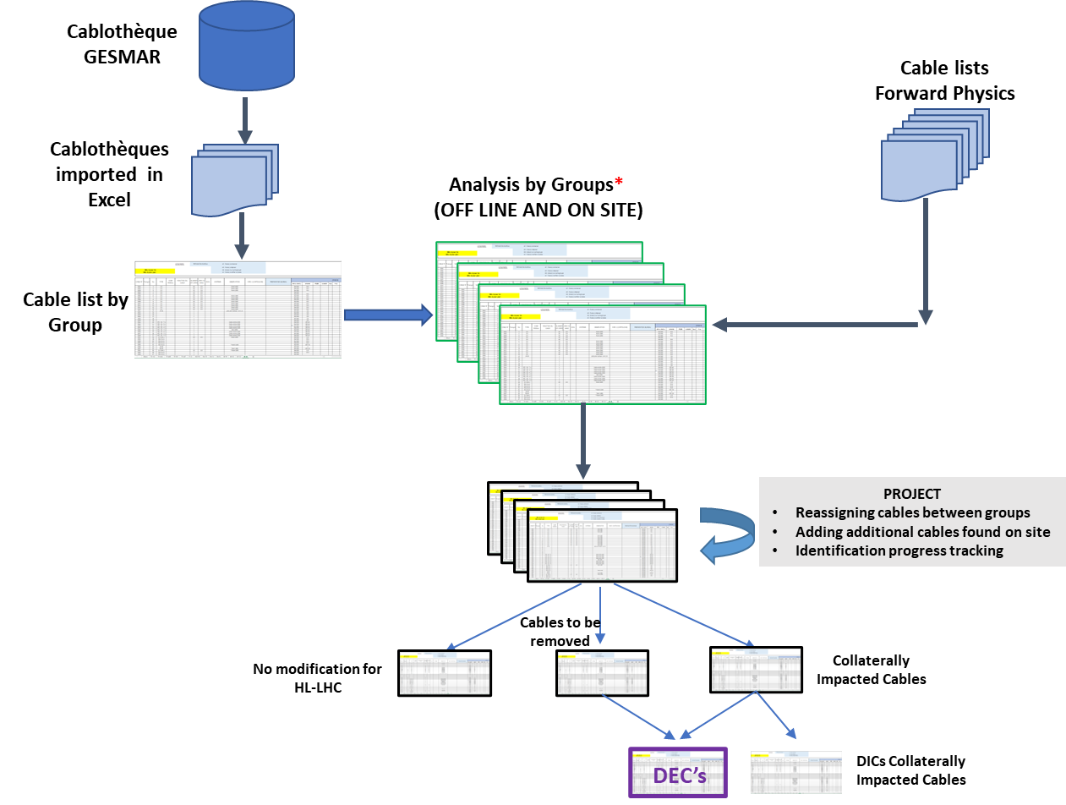
General Process Remainder
SharePoint details in
Miguel Baeza presentation
Today we are here
*This is the second iteration of the exercise performed in 2020
(EDMS 2378603 – Miguel Mendes document).

Slide 3
Cable list 1/3
General categories Slide 4
Slide 5
Classification
Extraction from GESMAR
…..
To confirm now
Exercise June 2021, including collaterally impacted and unused cables (EDMS 2607291). Cable list extracted in 2018, P1L and P5 complete.
Exercise performed in 2020, only collaterally impacted cables (EDMS 2378603 – Miguel’s document)

Slide 4
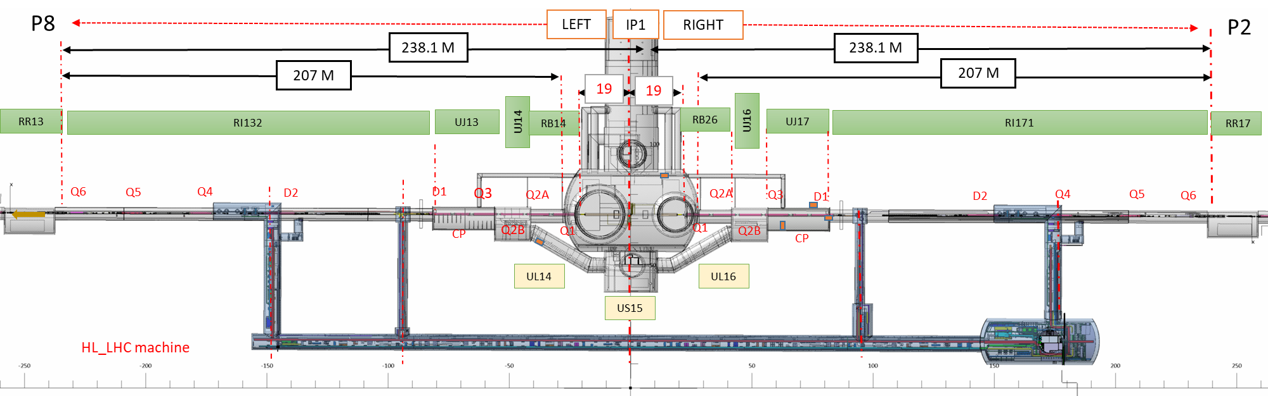
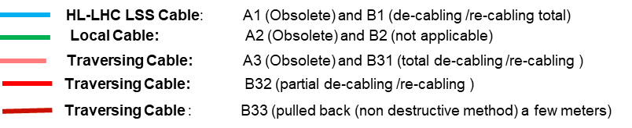
Cable list 2/3
General categories and Strategy
Example P1L. The same categories for P1L, P5L and P5R
De-cabling limit
…..
General categories to fill in the list:
Category A (Obsolete Cable)
Category B (Collaterally Impacted Cables)
N/A (not expected)

Slide 5
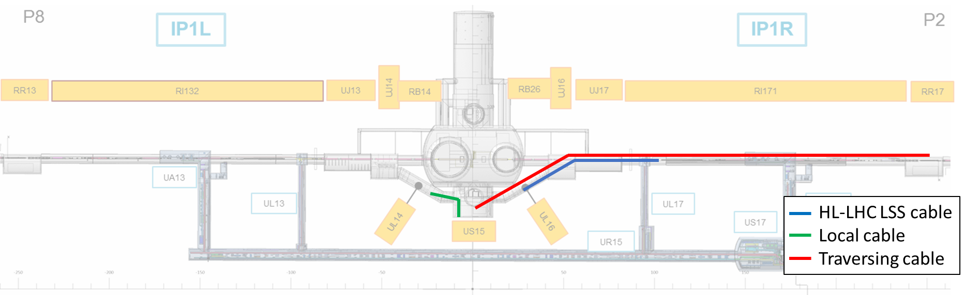
Cable list 3/3
Location 1: HL-LHC LSS cables
Geographical Location
Location 4: Beginning and end of cable
in UPS14, UPS14 is not in LSS1
Location 2: Local Cables
Location 3: Traversing cables
Location 21: One cable end in US15, UL14 or UL16, the second going to the surface (denoted by the cross)
Geographical Location is to help users to identify quickly where the cable goes.

Slide 6
Different studies among the years
To be analyzed
Collaterally impacted and unused cables analyzed
Only collaterally impacted cables analyzed
Geographical Location 21 & 4: P1 217, P5 272 cables

Slide 7
BACKUP SLIDES

Slide 8
Definitions from EDMS 2378603
HL-LHC LSS cables: these are cables for which at least one of the extremities falls within the area impacted by HL-LHC project (IP centre to the IP side of the RR alcove), and are routed in tunnel cable trays
Local cables: local cables are defined as cables that connect equipment either in the same gallery, or between two galleries, but without passing in the LHC tunnel.
Traversing cables: these are cables whose extremities are outside of the area impacted by HL-LHC upgrade (as defined in HL-LHC LSS cables), put whose path passes in the areas impacted by the upgrade.
Category A (Obsolete Cable): These are cables that, because of the HL-LHC upgrade do not have any function for Run 4.
  Action: During LS3, remove definitively this cables.
  Category by Locations: A1, A2, A3
Category B (Collaterally Impacted Cables) : These are cables belonging to systems not upgraded/replaced by HL-LHC project, but that must be removed and put back before Run 4 because their function is required in that frame.
  Action: During LS3, remove fully or partially, then reinstall them.
  Category by Locations: B1, B2 (not applicable), B3

Slide 9
Guidelines summary
The Layout of the cable sheets is a GESMAR extraction with four columns to the left of it under the name of "Classification;
The "EDMS 2378603" column is the result of the exercise taken in 2020;
This document uses the same notation for collaterally impacted cables as noted in EDMS 2378603;
The "Exercise June 2021" Column adds the collaterally impacted and undused cables notations found in Georgi GEORGIEV’s
presentation on 24/10/2022, EDMS 2607291;
The "Exercise Dec 2022" Column is where the user is demanded to put his/her de-cabling and re-cabling demands
using the notation (A & B) from EDMS 2378603;
The "Geographical Location" Column depicts the beginning and end location of the cable as noted in EDMS 2378603 where:
  1 = HL-LHC LSS cables;
  2 = Local Cables;
  21 = Local Cables going to surface(Specific to this document, not in 2378603);
  3 = Traversing cables;
  4= Not in impacted LSS but part of cables that are(Specific to this document, not in 2378603);

