Slide 1


Status update on SWELL programme
FCCee R&D and Technology meeting
F. Peauger and M. Therasse
on behalf of the FCC&SRF R/D team
19-01-2023

Slide 2
Contents
Introduction
  Slotted RF cavity concept and past experience - Franck
SWELL (Slotted Waveguide ELLiptical) SRF cavity for FCC
  600 MHz 2-cell highly damped cavity design for FCCee - Franck
  1.3 GHz cavity demonstrator with status update - Mathieu
  Summary and perspectives

Slide 3
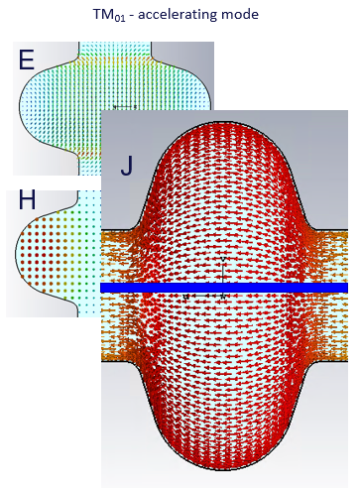
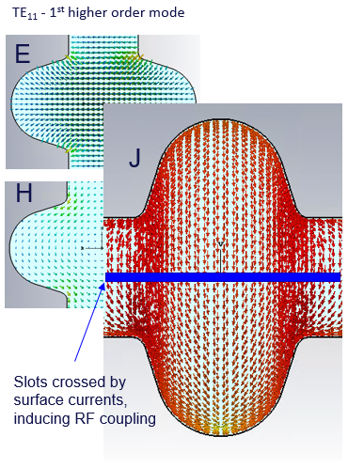
Split cavity concept and advantages
In elliptical cavities for the fundamental mode RF current lines are running longitudinally along the surface (parallel to the beam trajectory)
It is possible to divide the RF volume into sectors or to add longitudinal slots without perturbing the field pattern of the accelerating mode
→ “open” RF structure: surface preparation and control are easier
→ can propagates and damp higher order modes

Slide 4
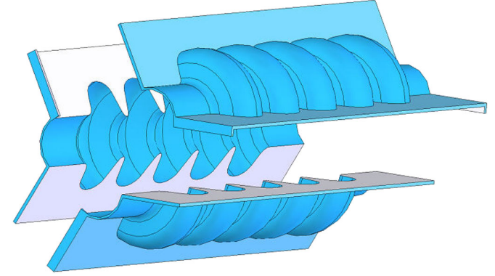
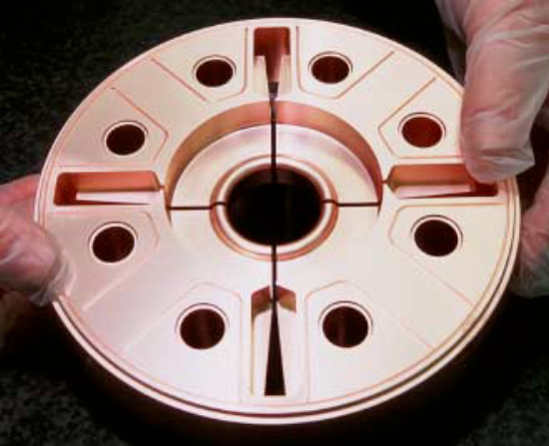
Past experience
CLIC RF structures
SRF bulk niobium split cavities
Slotted Irises Constant Aperture (SICA) 3 GHz accelerating structure used in CTF3 for a beam current of 3.5 A
Designed for high current Energy Recovery Linac (ERL) applications
E. Jensen, ‘CTF3 drive beam accelerating structures’, Proceedings of LINAC2002, Gyeongju, Korea.
Z. Liu et al., Novel superconducting rf structure for ampere-class beam current for multi-GeV energy recovery linacs, PRSTAB 13, 012001 (2010)

Slide 5
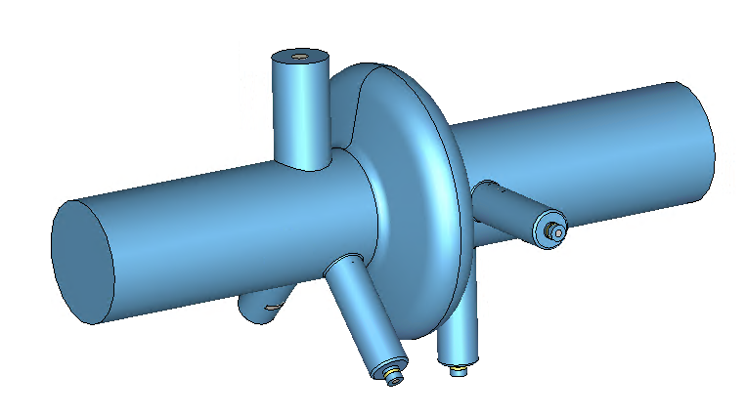
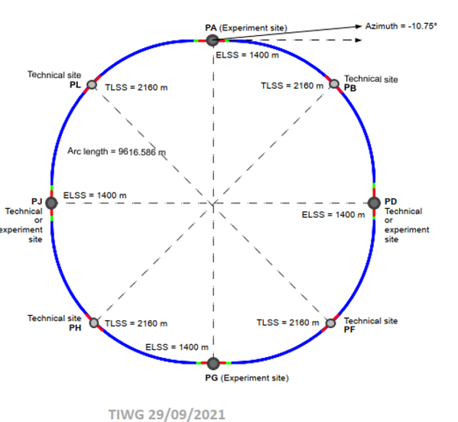
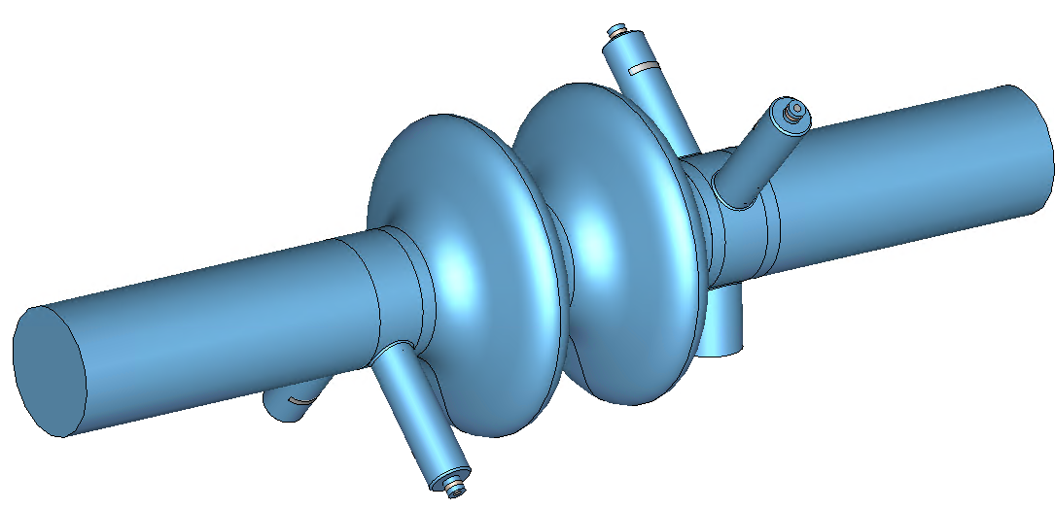
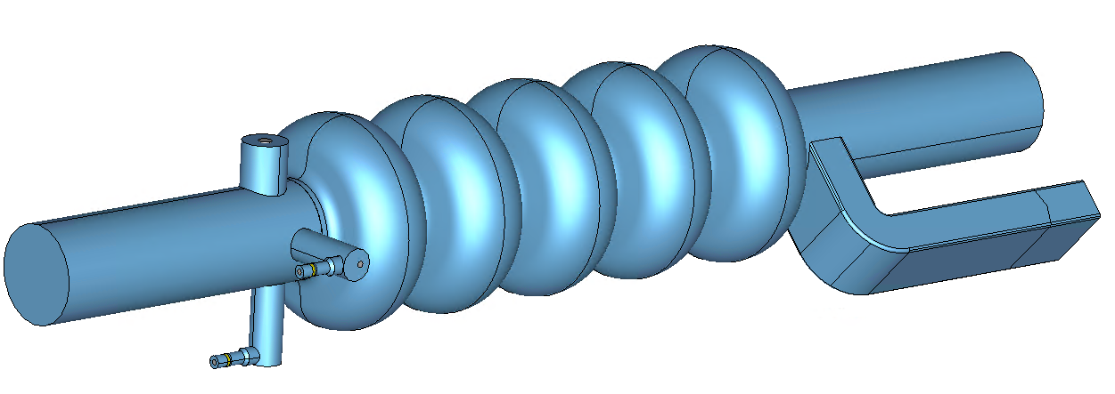
RF system for FCCee – baseline scenario
  Designed to provide 100 MW of RF power in CW to compensate losses by synchrotron radiation
  Three SRF cavity types under study equipped mainly with standard coaxial hook-type HOM couplers
  400 MHz 1-cell Nb/Cu for Z
 | Energy (GeV) | Current (mA) | RF voltage (GV)
Z | 45.6 | 1280 | 0.120
W | 80 | 135 | 1
H | 120 | 26.7 | 2.08
ttb | 182.5 | 5 | 11.67
  400 MHz 2-cell Nb/Cu for W&H
  4 interaction points
  RF systems located in PL for Z, W, H and PH for ttb
  800 MHz 5-cell bulk Nb for ttb

Slide 6
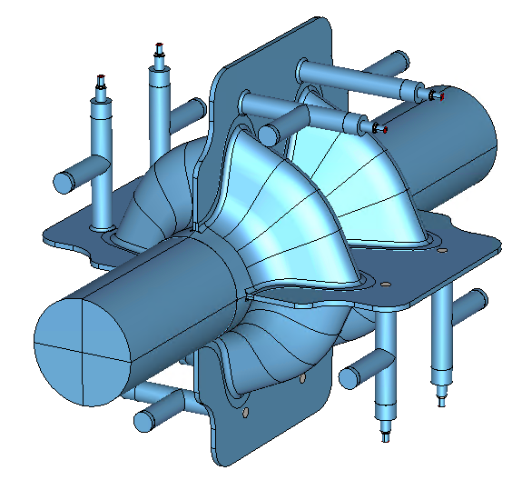
The SWELL superconducting cavity concept
HOM coaxial extractors (x8)
A good alternative candidate to have a single cavity type for Z, W and H of FCCee
  Proposed in Dec. 2020 * to improve the cavity performances, to optimize the installation scenario of the RF system and to reduce its overall cost
  Can run at high gradient and high current at the same time
  Equipped with four slotted waveguides, coupled to two coaxial RF lines to extract transverse higher order modes
  Operates at 600 MHz as an intermediate frequency (compromise between cavity size and impedance)
Slotted waveguides (x4)
Accelerating cells and beam pipes (x2)
* I. Syratchev, F. Peauger, I. Karpov, O. Brunner, “A Super-conducting Slotted Waveguide Elliptical Cavity for FCC-ee”, Zenodo. https://doi.org/10.5281/zenodo.5031953
SWELL: Slotted Waveguide ELLiptical cavity

Slide 7
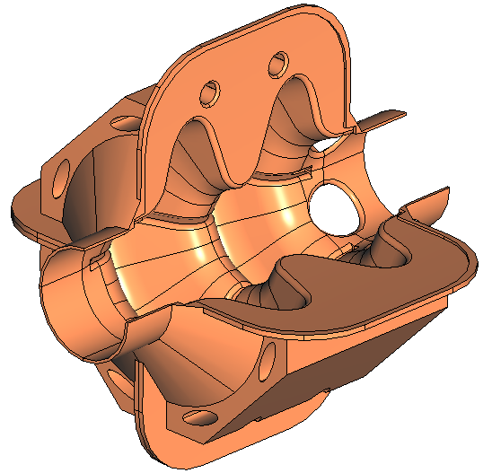
The SWELL cavity manufacturing technology
Slotted waveguide (x4)
HOM extractors (x8)
  Many beautifull advantages:
  Made of four independent quadrants in copper, precisely machined and clamped together
  Open structures, very favourable for surface preparation Niobium coating
  “seamless” by its nature: no assembly joints on high electromagnetic field regions
  Very stiff RF structure, robust against RF detunings due to Lorentz forces and microphonics
  Cryogenic cooling by drilled channels, which limits the volume of liquid helium
  Separation of the beam vacuum from the cryomodule insulation vacuum is a challenge
Copper quadrants with Nb thin films
Cooling circuits

Slide 8
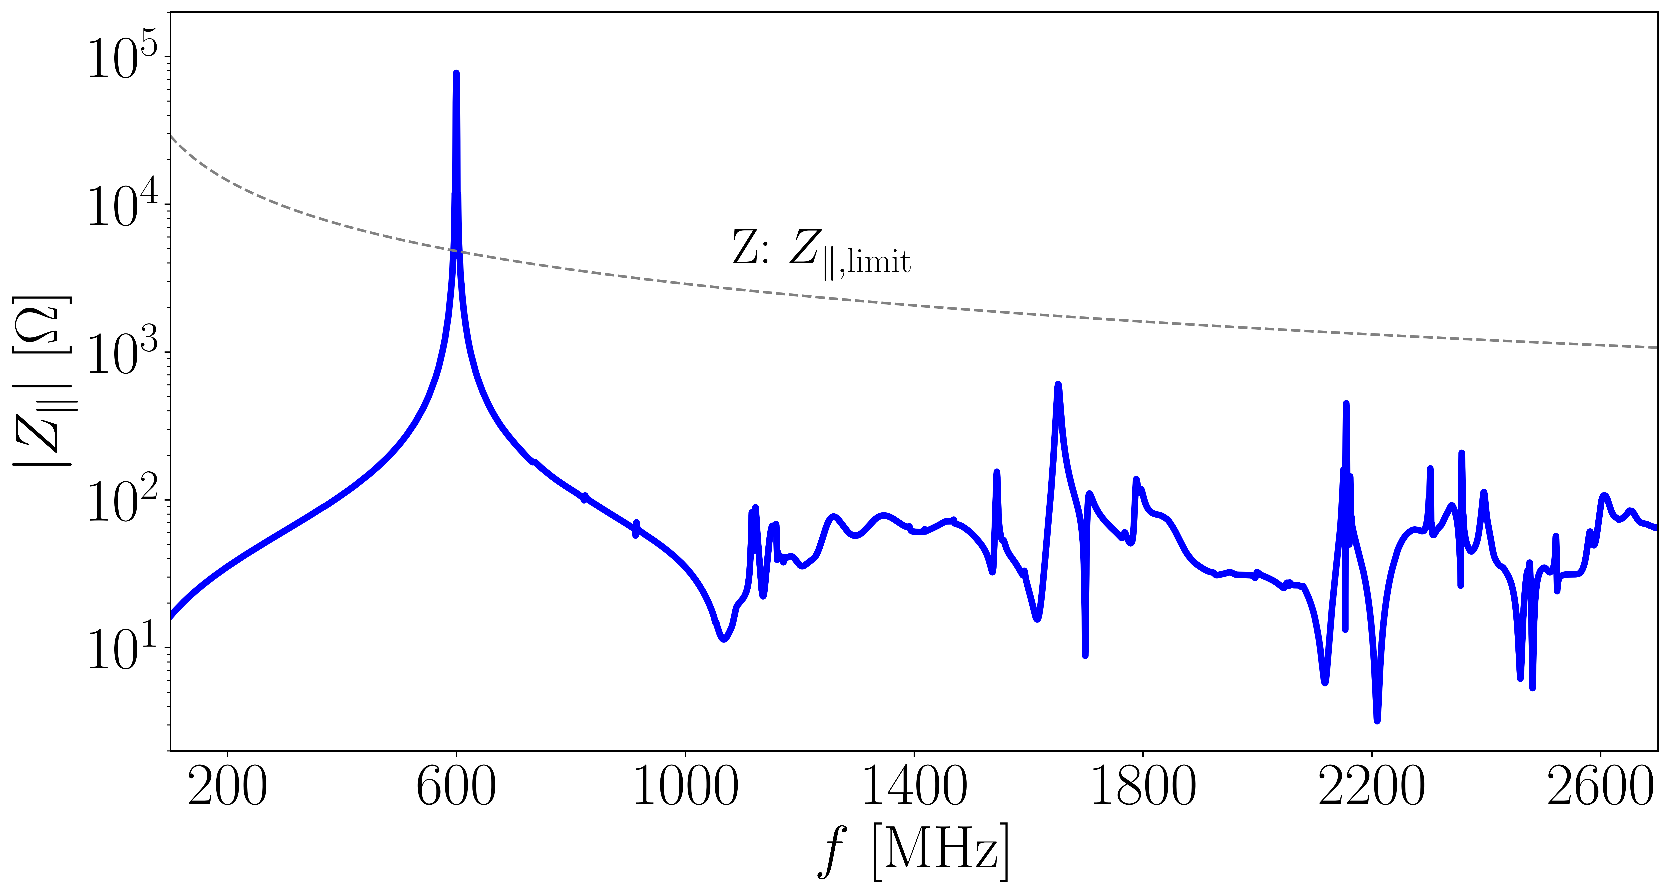
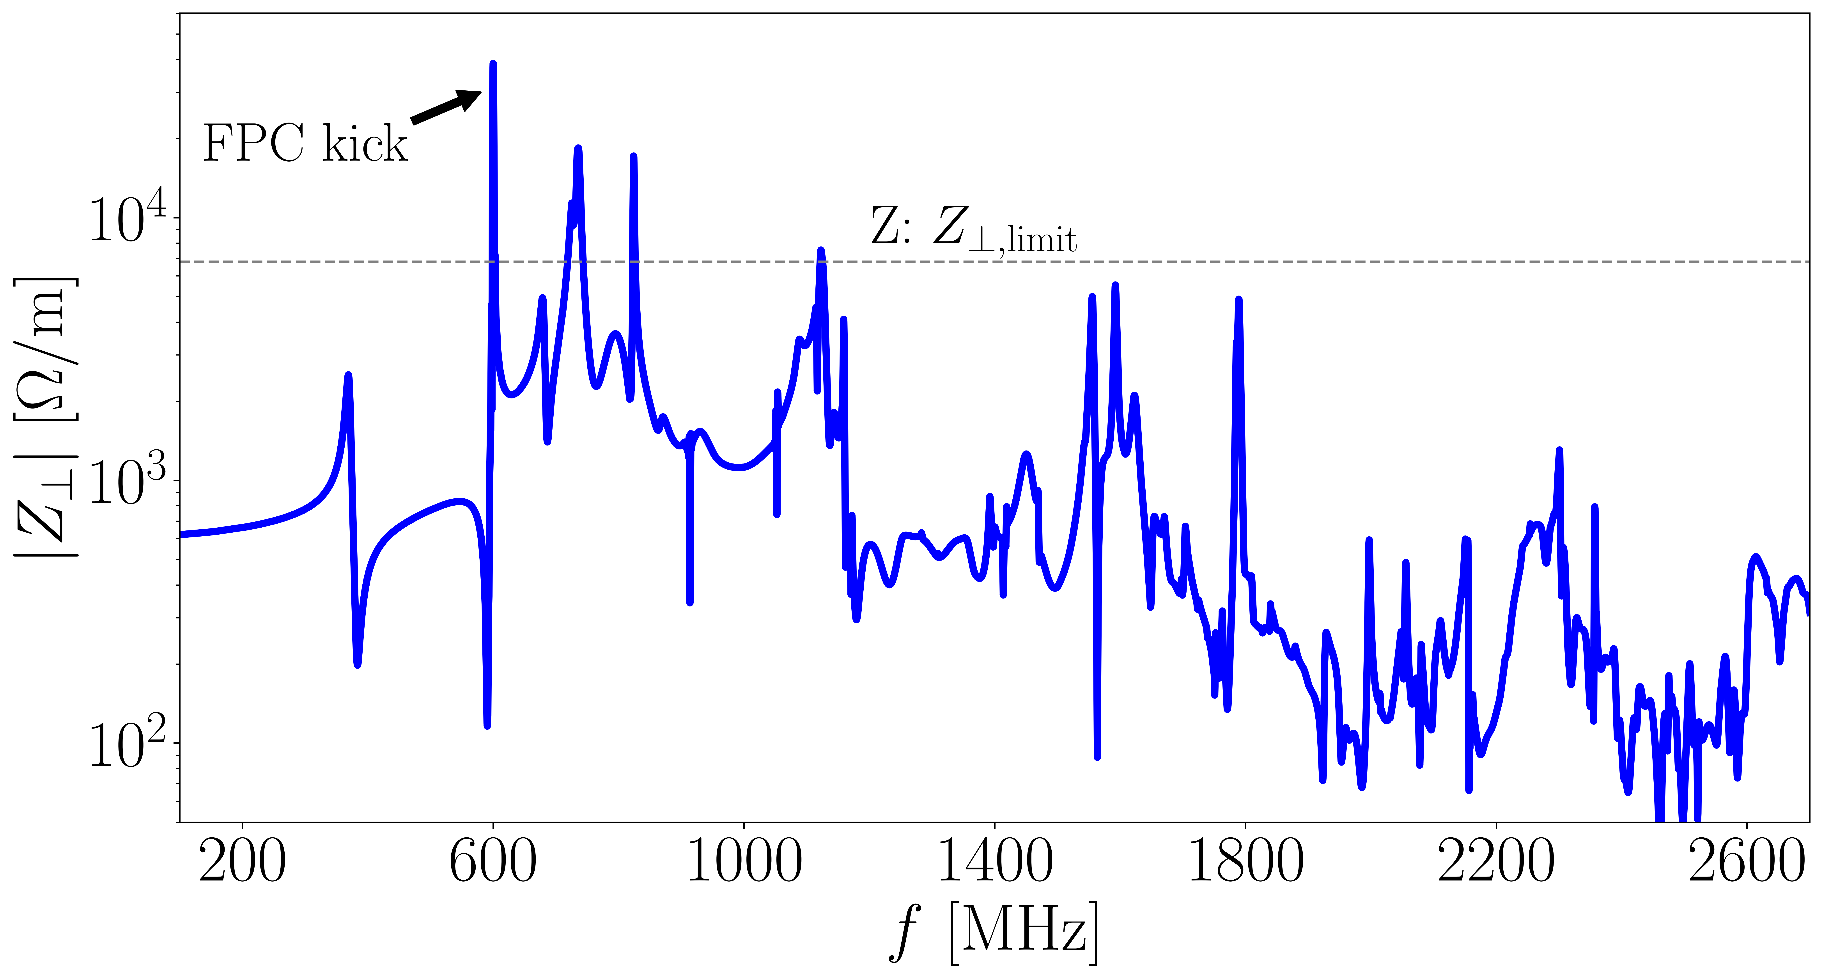

Impedance and HOM damping
Longitudinal coupled bunch instabilities due to the FM will be mitigated by direct RF feedback, as performed in the LHC
Three transverse modes remain above the stability threshold:
  Spike at the FM frequency is due to coupler and plunger asymmetry and can be compensated by alternating their orientation along the accelerator
  For the two other modes at 748 and 830 MHz a bunch-by-bunch feedback system with a damping time of about 100 turns
$$Q_{ext}\sim 180 max$$
S. Gorgi Zadeh
I. Karpov, “Beam-cavity interaction studies for the FCC-ee – RF frequency considerations”, presented at the FCC Week 2022, Paris, France, May 2022

Slide 9
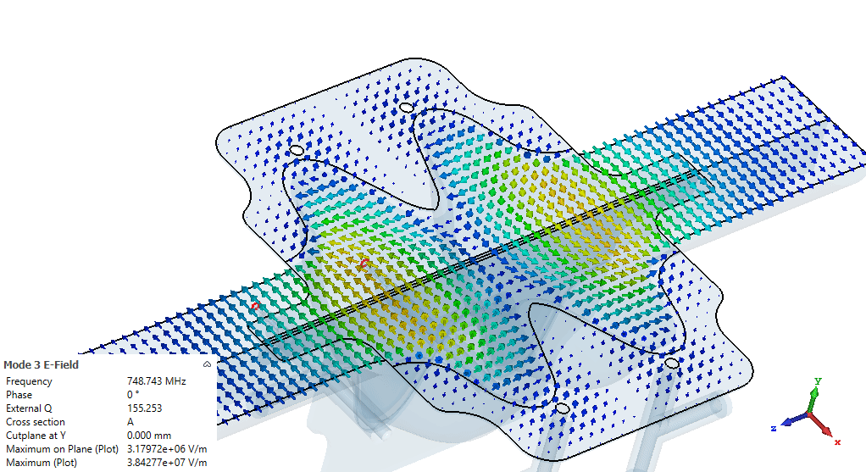
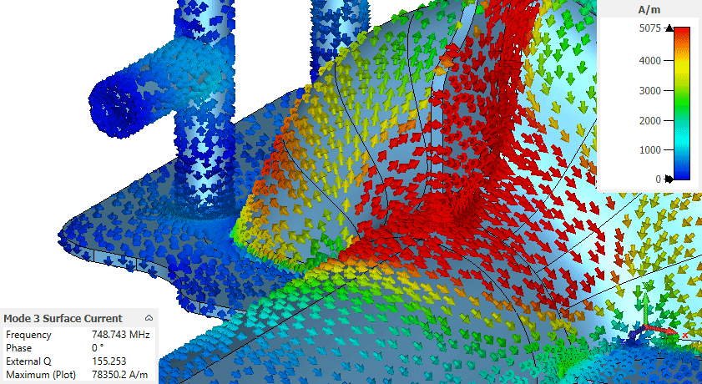
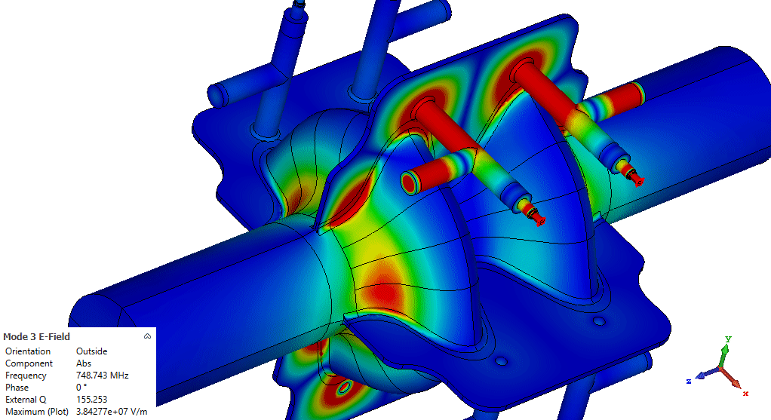
Example of HOM damping mechanism
E field
TE mode - F = 748 MHz
Qext factor is reduced to 155
Surface current
E field

Slide 10
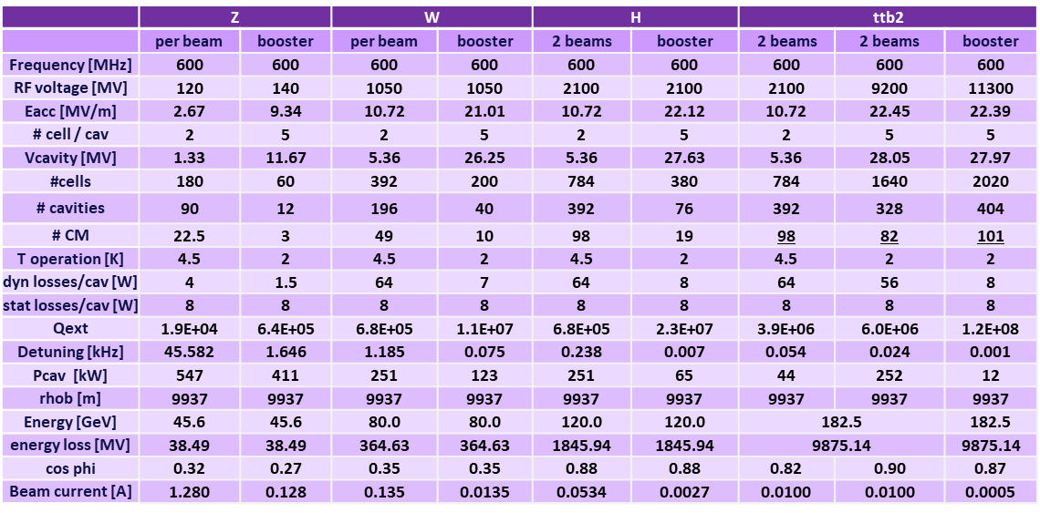
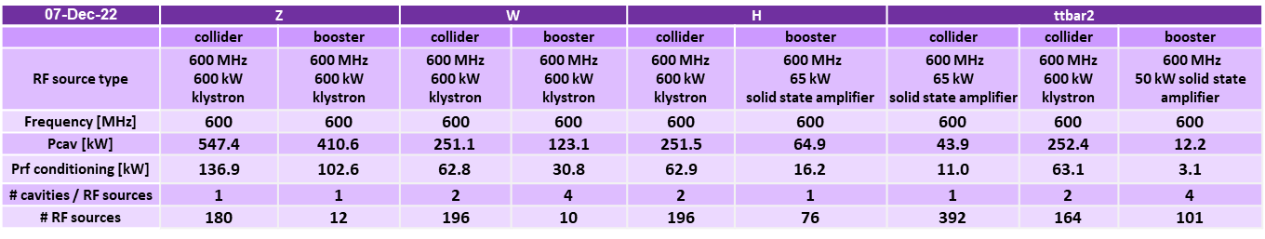
FCCee at 600 MHz (alternative option)
with SWELL 2-cell and ELLIPTICAL 5-cell
SWELL for Z, W and H with staged installation scenario (no cavity removal after Z)
5-cell cavity for ttb and booster: scaled from the 800 MHz version, same gradient and Q0 kept
281 cryomodules, 1125 cavities
-> reduction by ~ 16 % compared to the 400/800 MHz baseline
600 kW high efficiency klystron + solid state amplifiers to be developed

Slide 11
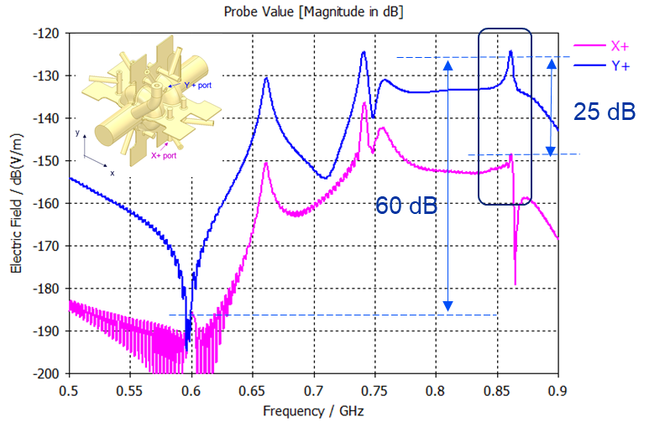
Wakefield monitor for beam positionning
Wakefield simulation with beam offset of 5 mm toward X+
Fourier transform of the voltage signal collected on two HOM extractors (X+ and Y+
The TE11 ‘π’ mode at 861 MHz has a good sensitivity to beam offset
Note the excellent rejection of fundamental mode at 600 MHz
SWELL cavity can play the role of a BPM (for free) with very good resolution

Slide 12
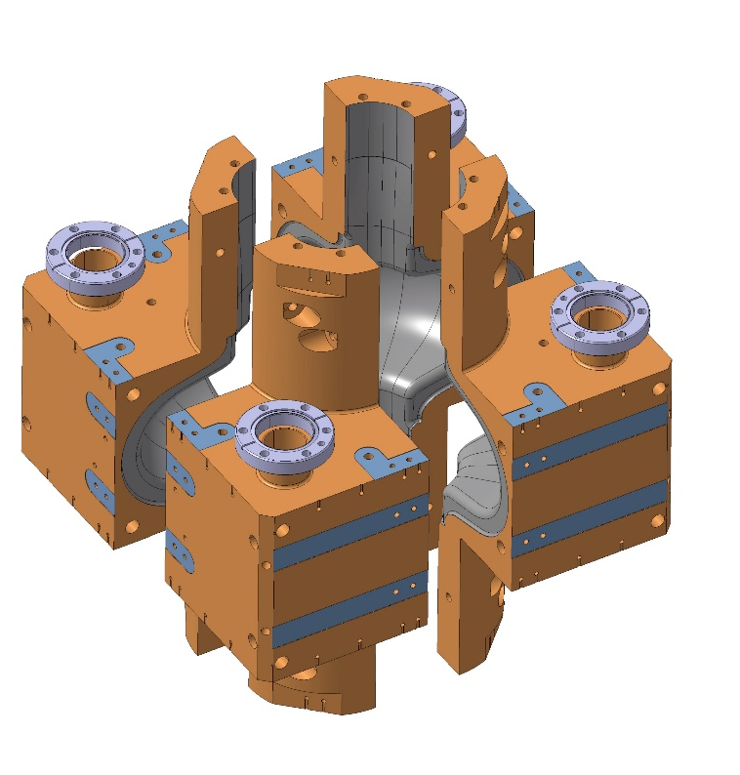
SWELL feasibility demonstration at 1.3 GHz
SWELL version of the TESLA 1.3 GHz single cell SRF cavity
Simplified geometry (closed slots) in order to evaluate the maximum accelerating gradient achievable with this technology
Objectives @ 4.5 K
→ E_{acc} > 15 to 18 MV/m
→ Q_{o} > 3.10⁸ (50 W of RF losses)
M. Timmins

Slide 13
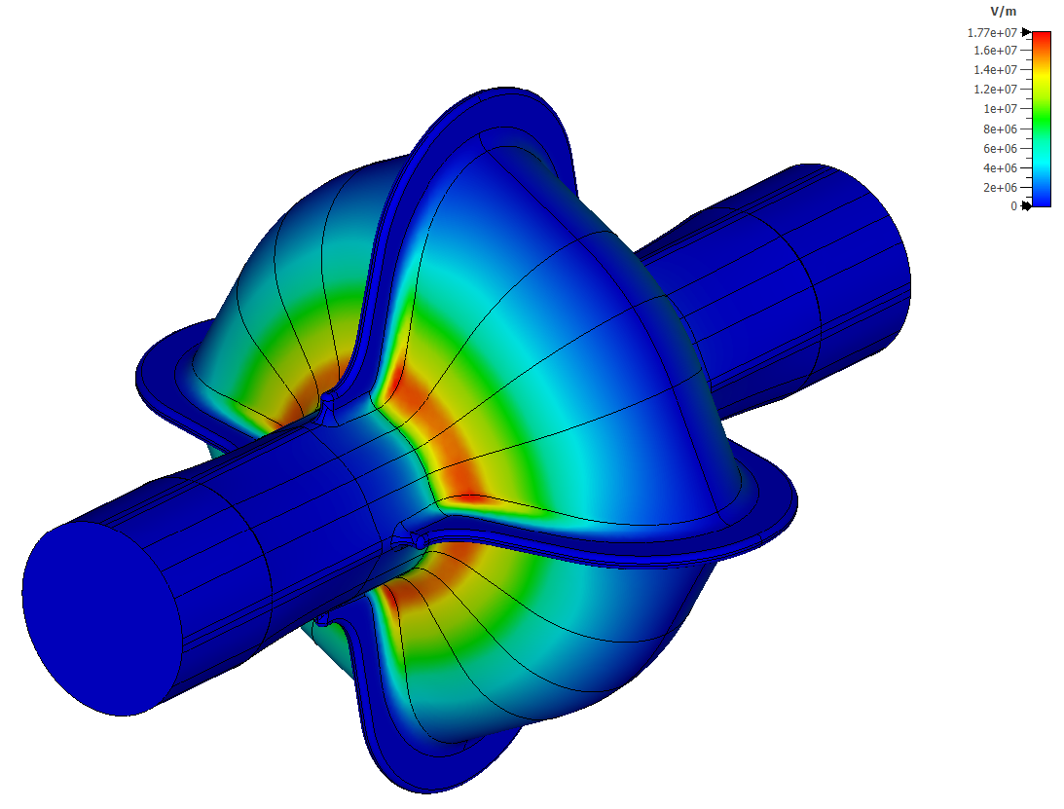
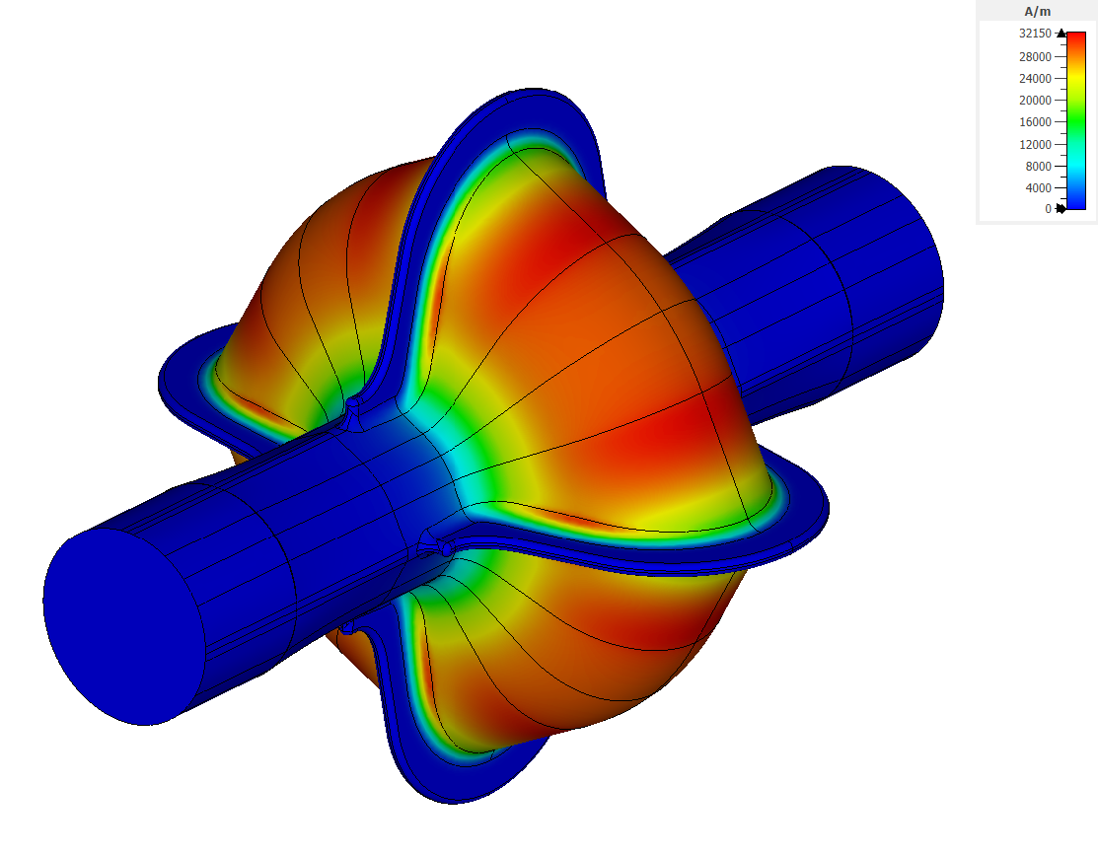
SWELL 1.3 GHz cavity RF design
E field
H field
Parameters | Values
F (GHz) | 1.3
R/Q linac (Ω) | 122.9
Lacc (mm) | 115.3
Epk/Eacc | 2.01
Bpk/Eacc (mT/(MV/m)) | 4.61
G (Ω) | 265.56
for 1 Joule stored energy
I. Syratchev
F. Peauger

Slide 14
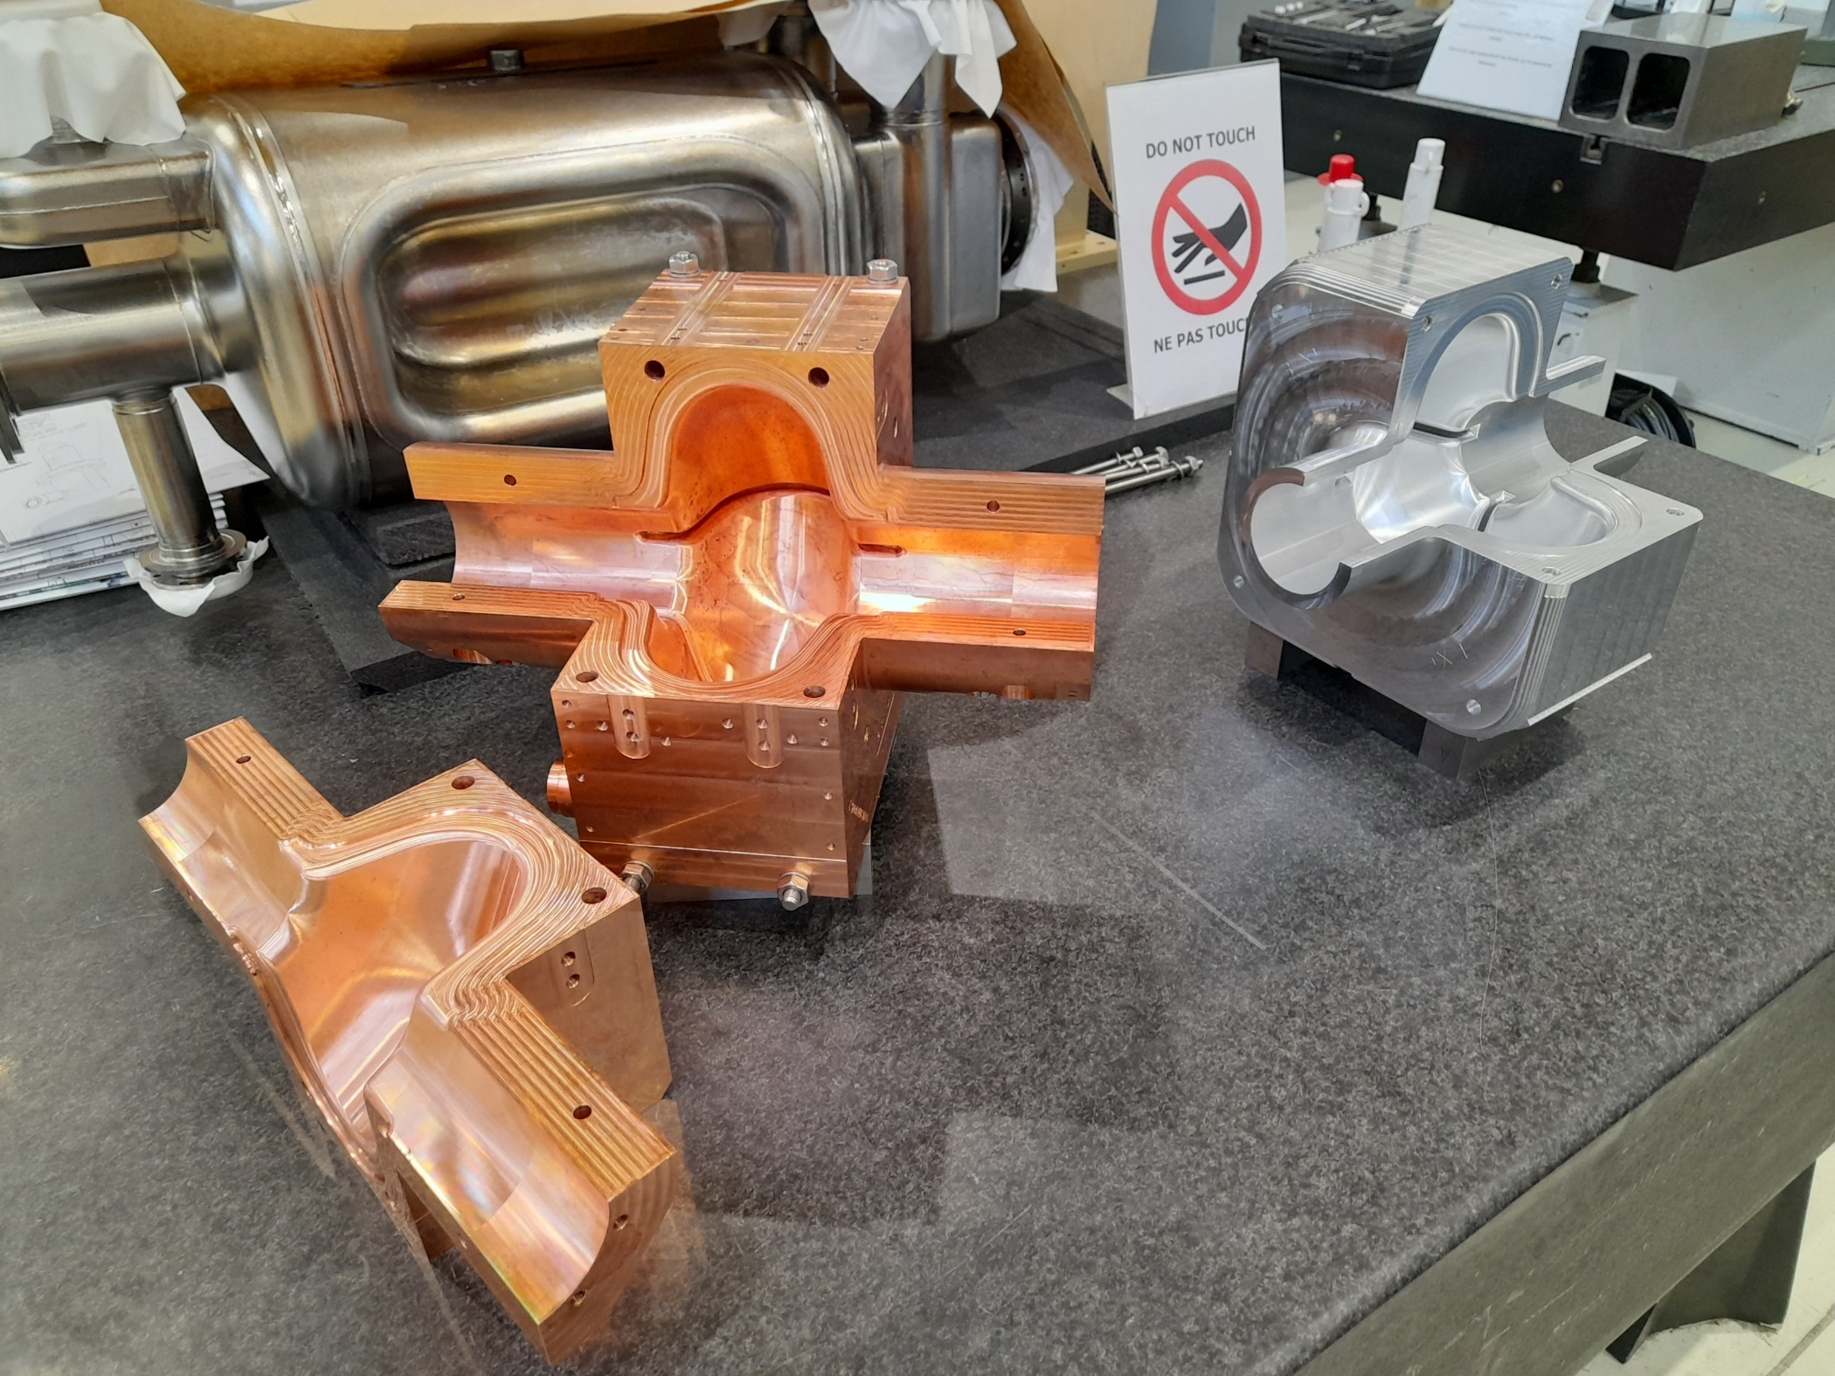
Precise machining in the CERN workshop
M. Garlasche
-
Picture courtesy Romain Ninet and Karol Scibor - CERN

Slide 15
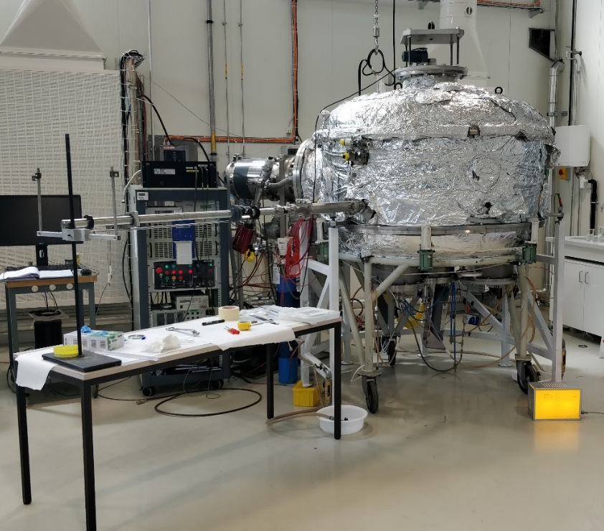
SWELL 1.3 GHz cavity surface preparation
Electropolishing
  By immersion with an optimized cathode shape
  Masks on contact surface between quadrants
Niobium coating
  Bi-polar HiPIMS* sputtering to obtain a dense film
  Using of an existing chamber at CERN (photo)
  First coating successfully performed on a flat sample
  → Rs = 5 nΩ @ 400 MHz, 2 K, 30 mT
Clean room assembly
  Ultra-pure water rinsing at low pressure
  Mechanical alignement and assembly in ISO5 clean room
G. Rosaz
* High power impulse magnetron sputtering

Slide 16
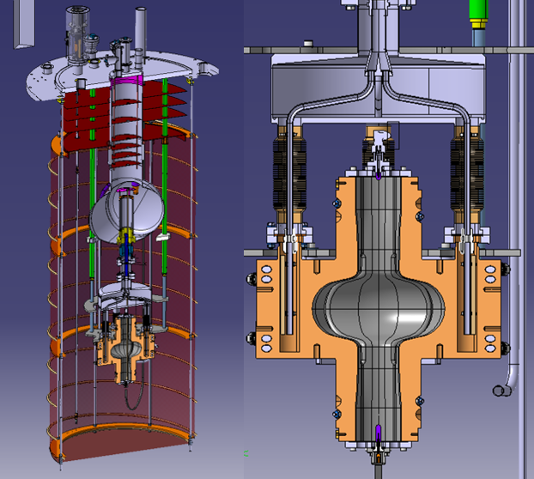
RF testing at low temperature
Test at CERN in SM18 in V5 cryostat
  Common vacuum system - the cavity vacuum is the same as the insulation vacuum, 10⁻⁹ mbar achievable (legacy of HIE-ISOLDE superconducting linac project)
  Particle free environment (local clean room around the cryostat insert)
  RF measurement setup upgraded from 100 MHz to 1.3 GHz
  Earth magnetic flux compensation possible
  4.5 K and 2 K operation with new cryogenic distribution system to cooldown the 4 quadrants in a uniform way
M. Therasse, T. Koettig

Slide 17
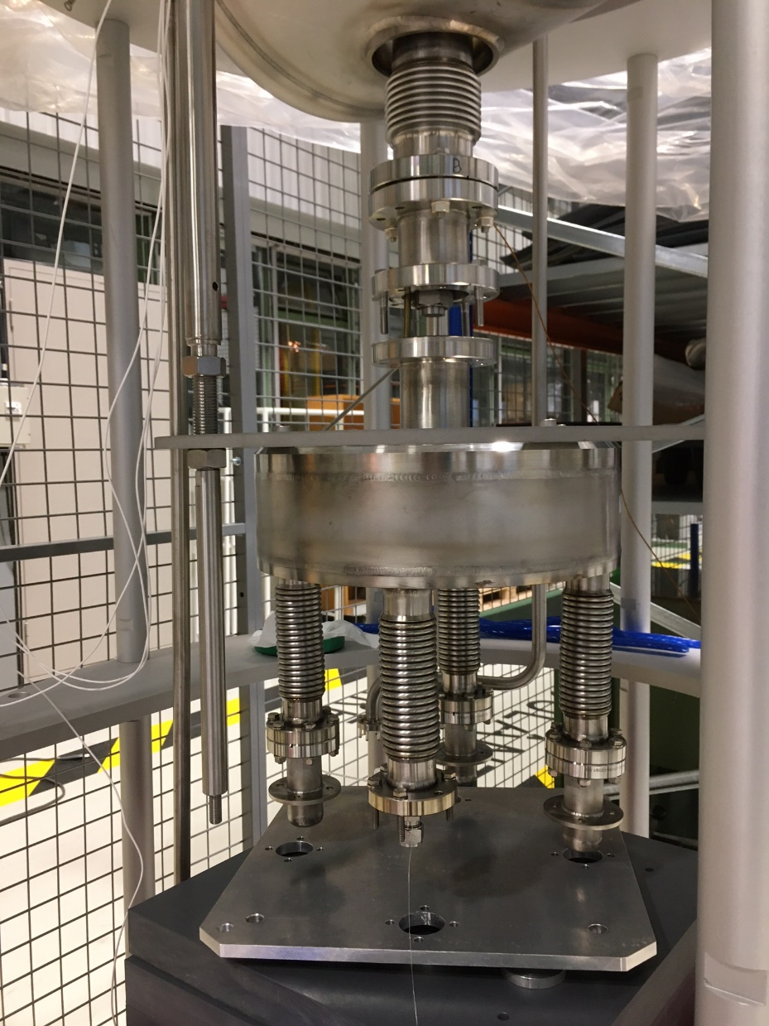
Status and next steps (1/3)
V5 insert preparation
  toolings and blank assembly done
  Gas return line modification and leak detection / pressure test done and ok
  Instrumentation (TT, LT) ok
  He tank and equipment installation for the insert commissioning ongoing
  Cleaning of the insert and support + V5 insert test area not done
  HIE-ISOLDE insert removing from cryostat and storage not done
Installation of the insert in January for commissioning
Depend on ressources and Crab cavity tests

Slide 18
Status and next steps (2/3)
Cavity assembly
  Cavity toolings, handling tools and cleaned screws ok
  Tooling for blank assembly not done
Cavity nibium coating
  toolings: parts received but not checked yet
  Tooling cleaning and blanck assembly not done
Cavity Blank assembly and tooling testing in 252 and SM18 : February/March
Coating process start: being defined this week

Slide 19
Status and next steps (3/3)
RF equipment test stand
  Cryo process implementation (with TE/CRG) done
  Cryo process commisioning (with TE/CRG) planned with insert commissioning
  PLC control upgrade (with RF/CS) hardware done, software: not done
  New RF power meters, spectrum analyzer and 1.3 GHz RF amplifier received, to be installed
  RF measurement system
    analog (labview) on going
    digital not done
    RF line check and calibration not done
Goal: be ready for the cavity test in mid-2023

Slide 20
Summary
New innovative SRF cavity concept proposed for FCCee with great potential to reduce the cost of the RF system
Detailed RF design study of a 2-cell 600 MHz SWELL cavity with a strong HOM damping features finalized, compatible to operate at the Z, W and H working energies
Depending beam dynamic studies, it will be possible to scale the cavity geometry to another RF frequency, typically between 500 MHz to 650 MHz
A "TESLA like" SWELL cavity is being developed in parallel to demonstrate experimentally the feasibility of the concept. A first unit has been machined with great success and is ready for surface preparation and niobium coating. First RF tests at cryogenic temperature are foreseen in mid-2023.

Slide 21
Perspectives
Mechanical study of SWELL 2-cell cavity including the design of a test horizontal cryostat integrating all RF couplers and RF tuning systems
Possible collaborations on the SWELL development program:
  IN2P3-LPSC (France) – multipacting studies with experimental validation – collaboration already started
  E. ZANON
  Jefferson Laboratory
  …
Other Ampere-class high energy accelerator projects like EIC (USA) or CEPC (China) could find an interest in looking into the SWELL cavity options
Thank you for attention

Slide 23
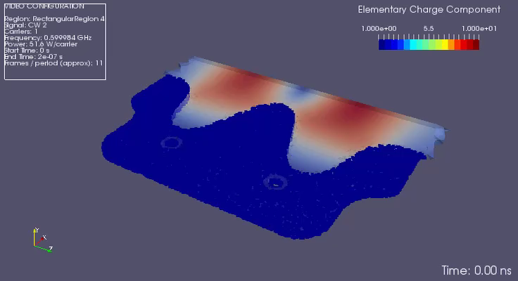
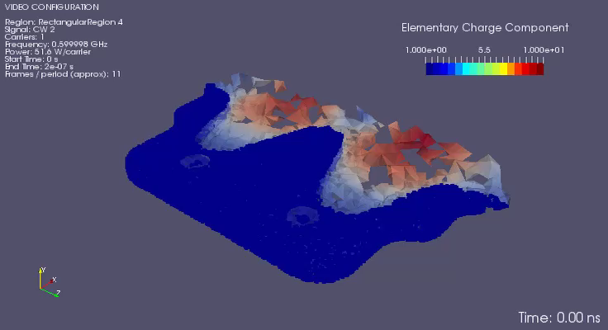
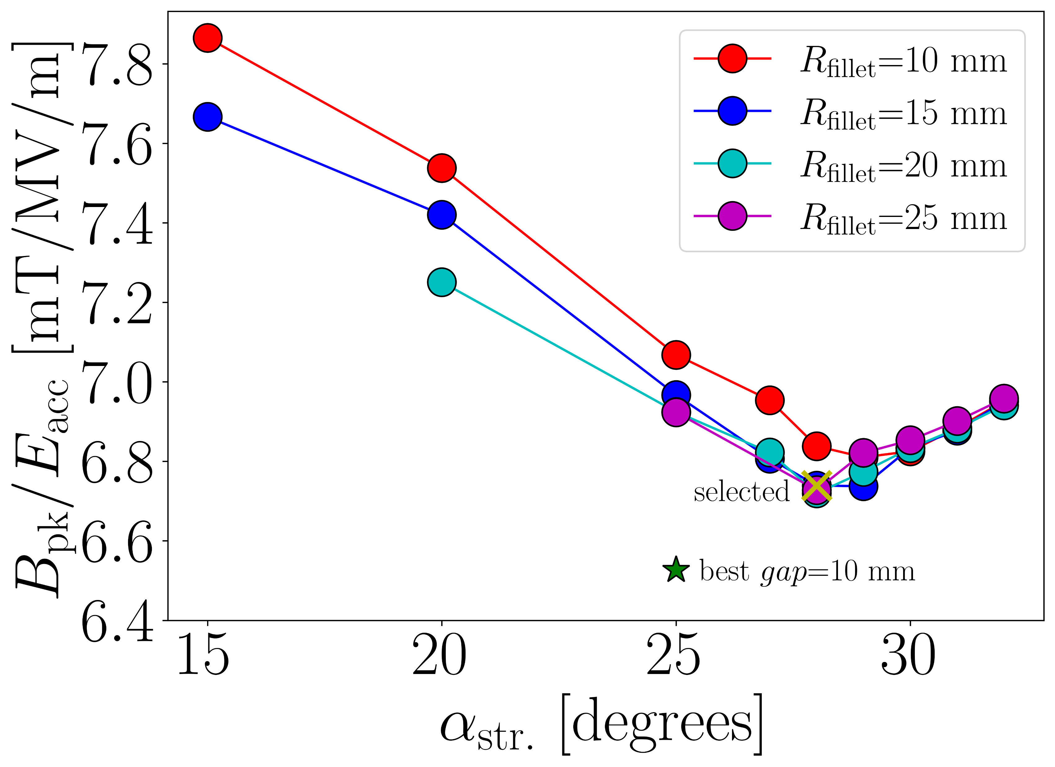
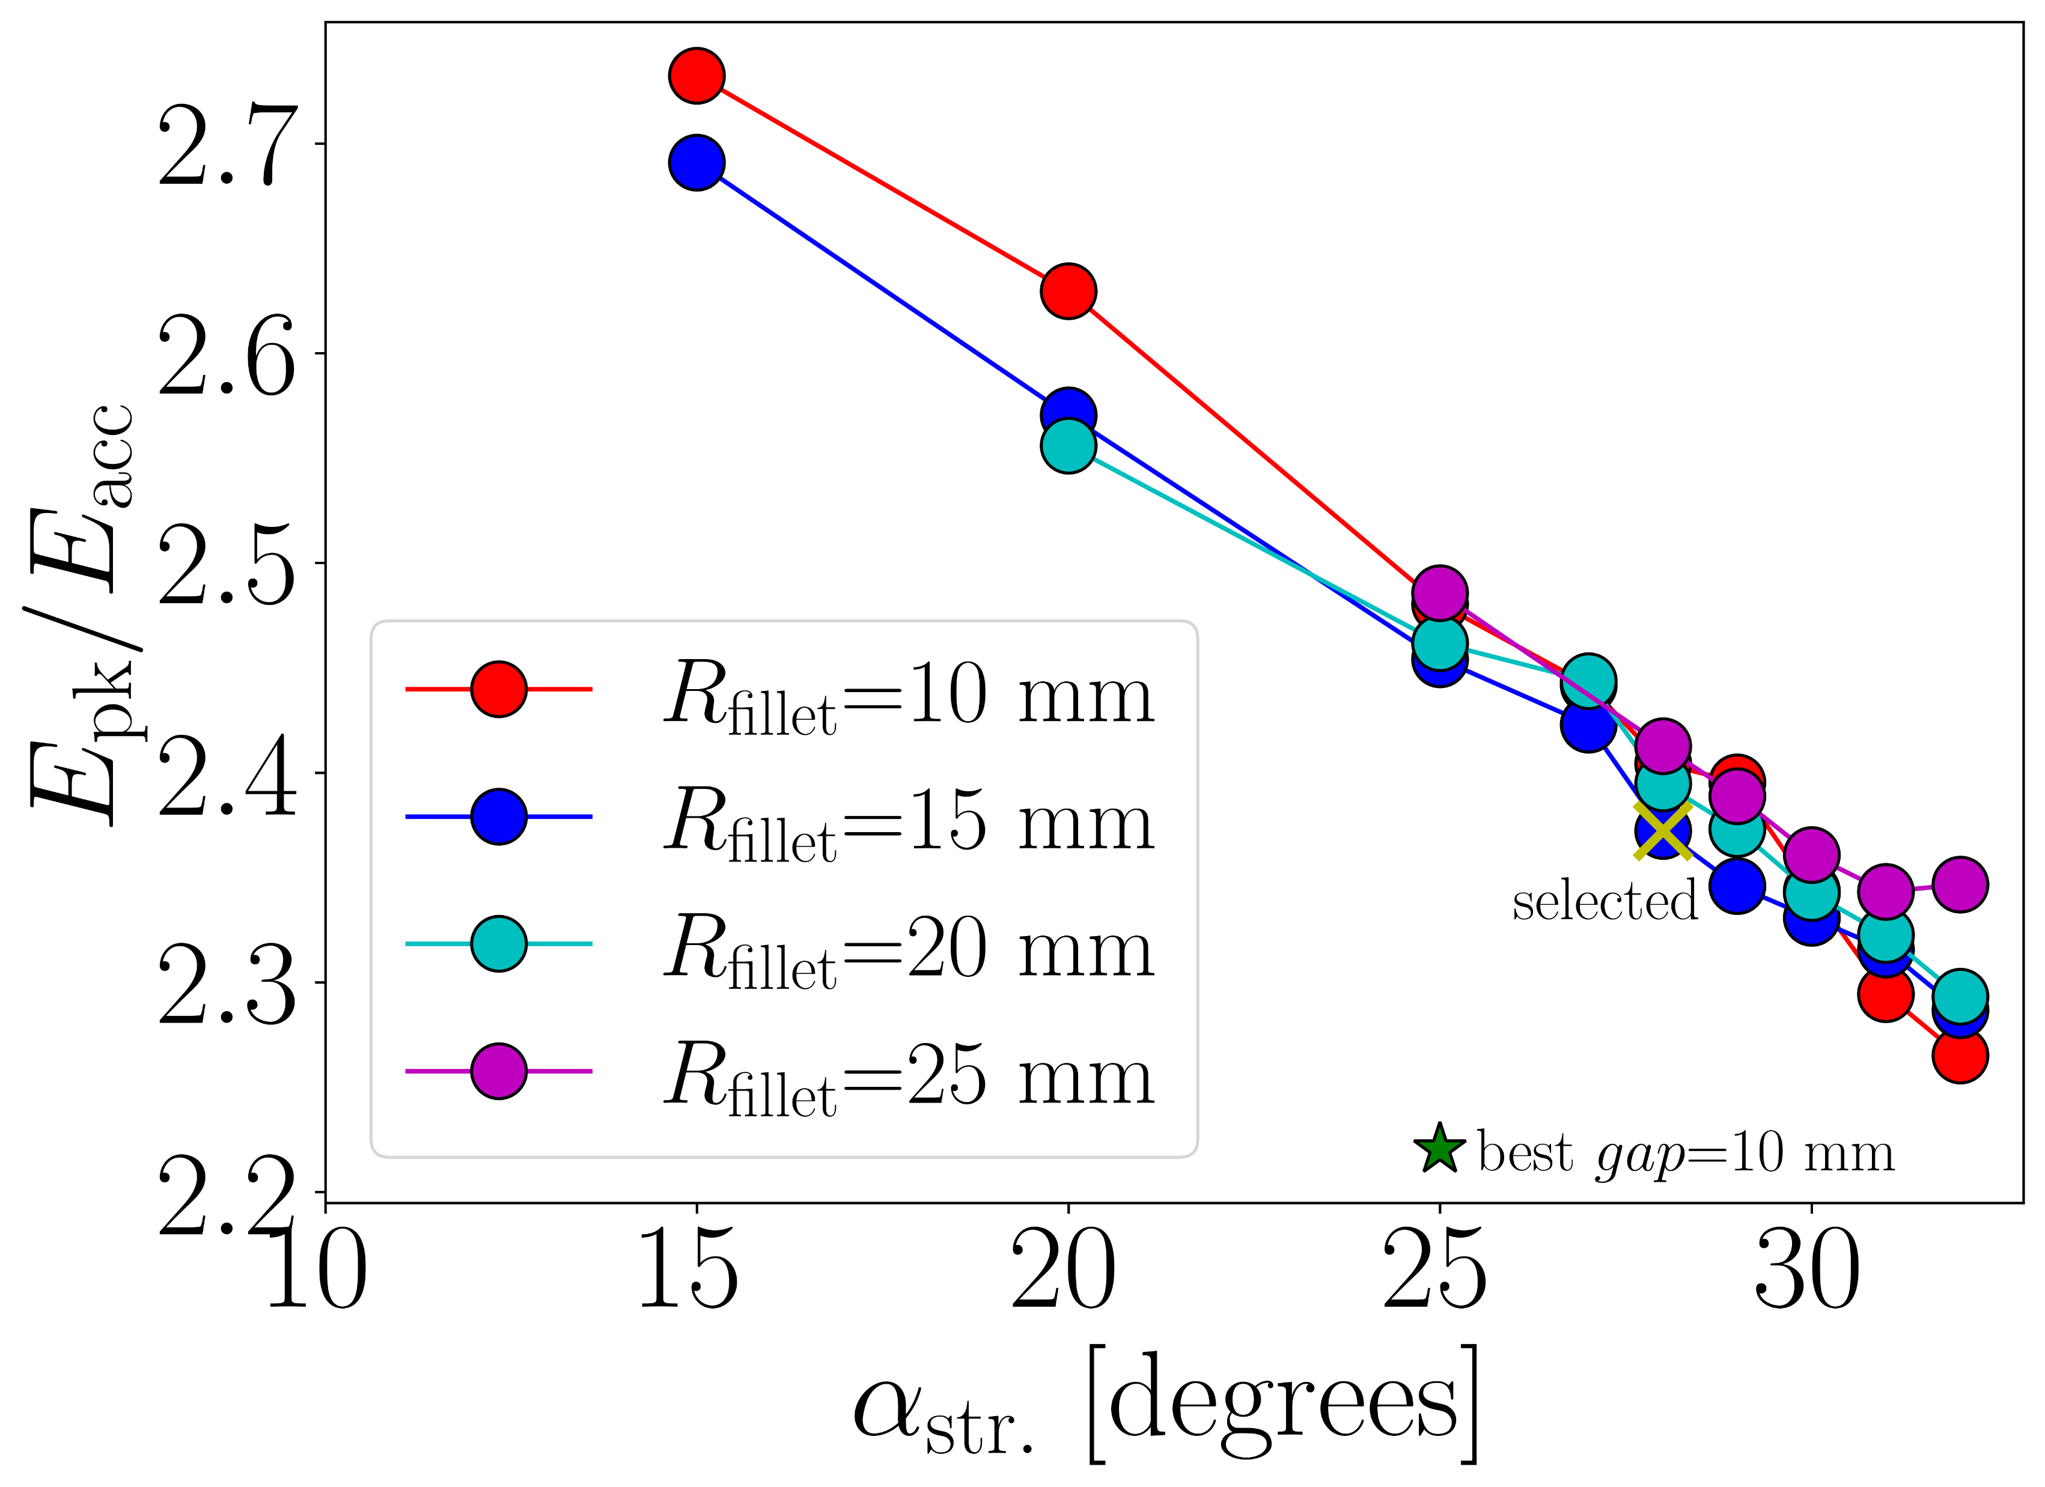
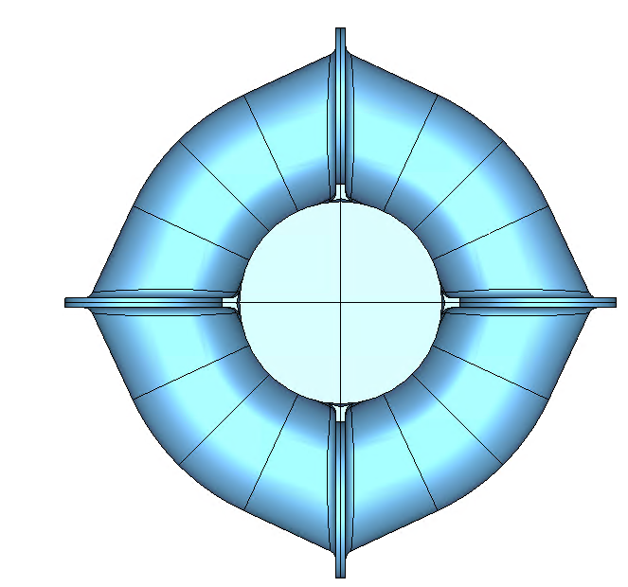




RF surface fields minimization
RF shape optimization strategy presented at IPAC22 in June:
S. Gorgi Zadeh et al., “Optimization of a 600 MHz two-cell slotted waveguide elliptical cavity for FCC-ee”, Proceedings of the 2022 IPAC Conference, Bangkok, Thailand.
Slot gap has been increased from 10 to 20 mm to push multipacting barriers above Eacc = 20 MV/m
Re-optimized shape is for α_{str}=28° and R_{fillet} = 15 mm
Slot gap = 10 mm, $E_{acc}$=16 MV/m
Slot gap = 20 mm, $E_{acc}$=16 MV/m
$$α_{str}$$
S. Gorgi Zadeh
$$R_{fillet}$$

Slide 24
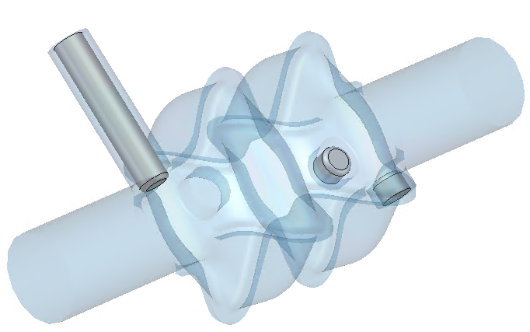
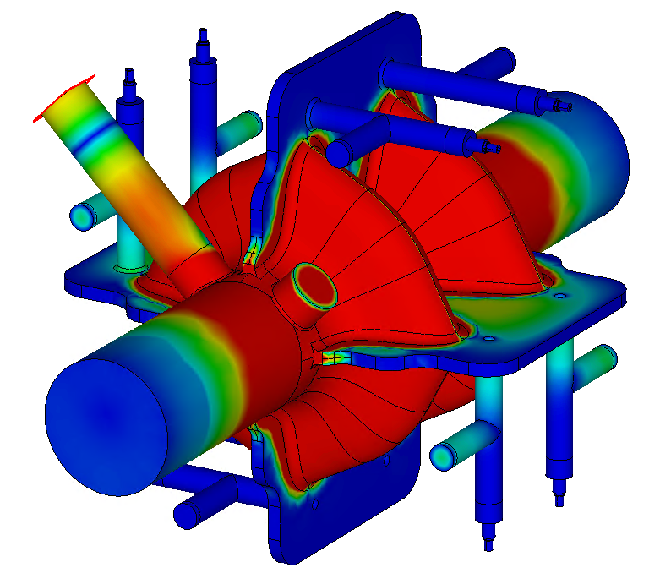

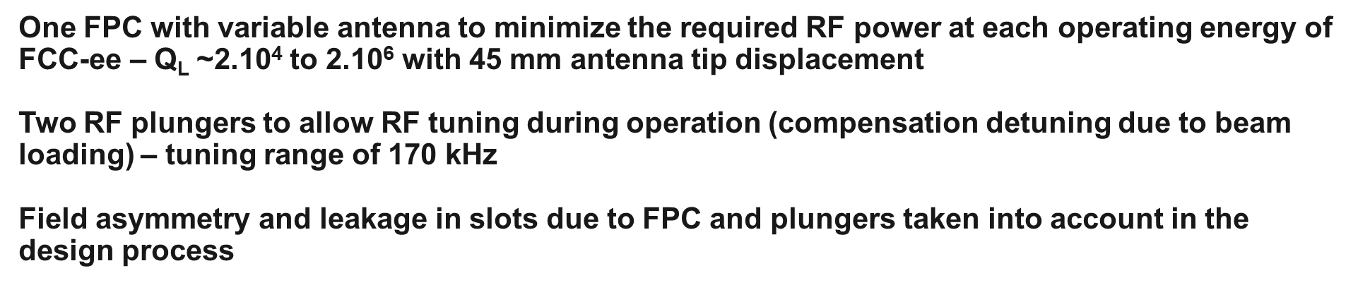
RF coupling and tuning of fundamental mode
One FPC with variable antenna to minimize the required RF power at each operating energy of FCC-ee – Q_{L} ~2.10⁴ to 2.10⁶ with 45 mm antenna tip displacement
Two RF plungers to allow RF tuning during operation (compensation detuning due to beam loading) – tuning range of 170 kHz
Field asymmetry and leakage in slots due to FPC and plungers taken into account in the design process
FPC antenna
E field
S. Gorgi Zadeh
RF plungers (x2)
half-wavelength notch filter

