Slide 1
HTS Coating for the FCC-hh Beamscreen Status report
Sergio Calatroni on behalf of the Collaborators
19.1.2023

Slide 2
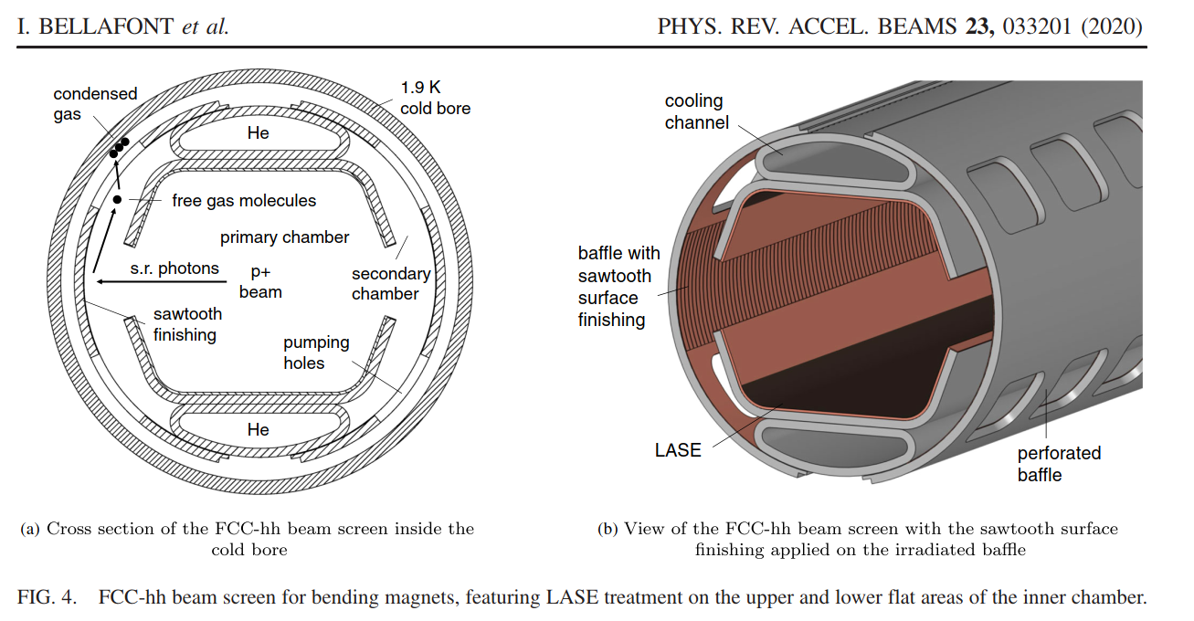
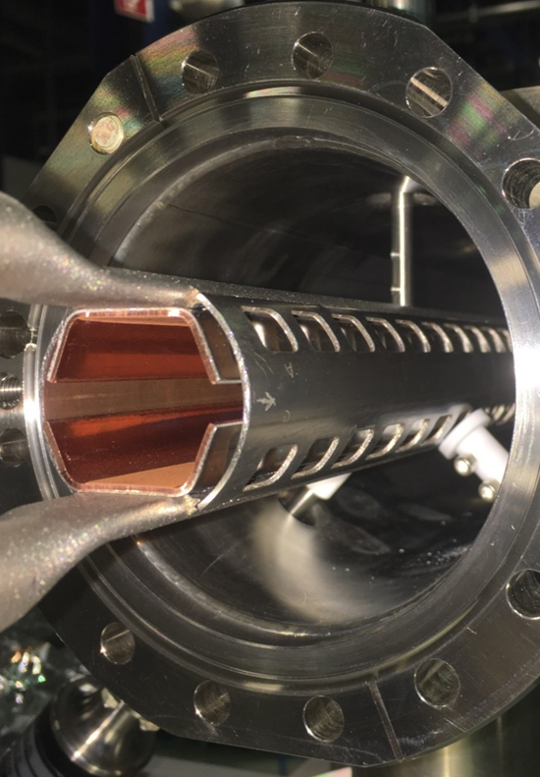
Need for a beam screen in a p-p collider
Synchrotron radiation load:
~30 W/m/beam (@16 T) (LHC < 0.2 W/m)
~5 MW total in arcs + Image currents, + electron cloud, + …
The synchrotron radiation cannot be dumped on the cold bore at 1.9 K: considering cryo efficiency, this would require almost 5 GW of electrical power
In the LHC, the beam screen is held in the 4÷20 K interval

Slide 3
Power consumption, vacuum and impedance
3000
From:
Ph. Lebrun
L. Tavian
V. Baglin
T_{cold mass} = 1.9 K (Nb₃Sn magnets)
2500
T_{cold mass} = 4.5 K (HTS magnets)
2000
300 MW
1500
Total power to refrigerator [W/m per beam]
200 MW
1000
100 MW
500
0
0
50
100
150
200
Multi-bunch instability growth time: 25 turns 9 turns (ΔQ=0.5)
Beam-screen temperature T_{bs} [K]

Slide 4
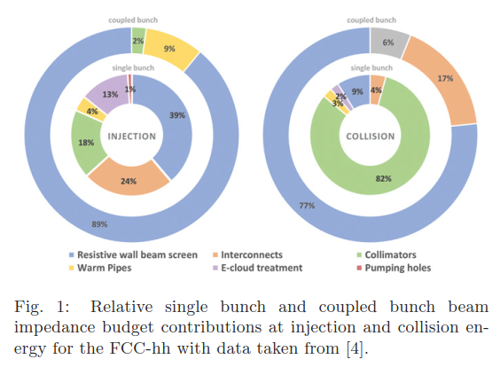
Impedance breakdown
Injection energy
Collision energy
P. Krkotic et al., EPL, 140 (2022) 64001
doi: 10.1209/0295-5075/acaac3

Slide 5
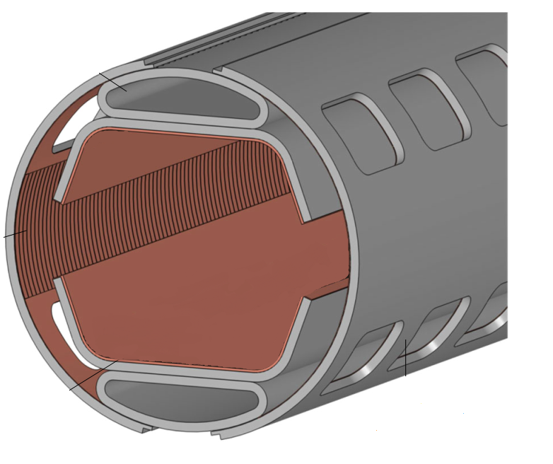

Surface impedance: the key
$$\left|Δω\right|$$
τ Risetime of beam instabilities
Z_{T} Transverse impedance (property of the beam)
R_{S} Surface resistance (property of the surface)
τ: instabilities rise-time
Δω: betatron tune-shift
I_{b}: bunch current
M: number of bunches
E: beam energy
L: bunch length
R: accelerator radius
c: speed of light
b: vacuum chamber radius
f: wakefields frequency
ρ: electrical resistivity
The lower the resistivity ρ, the higher the time τ it takes for developing beam instabilities

Slide 6
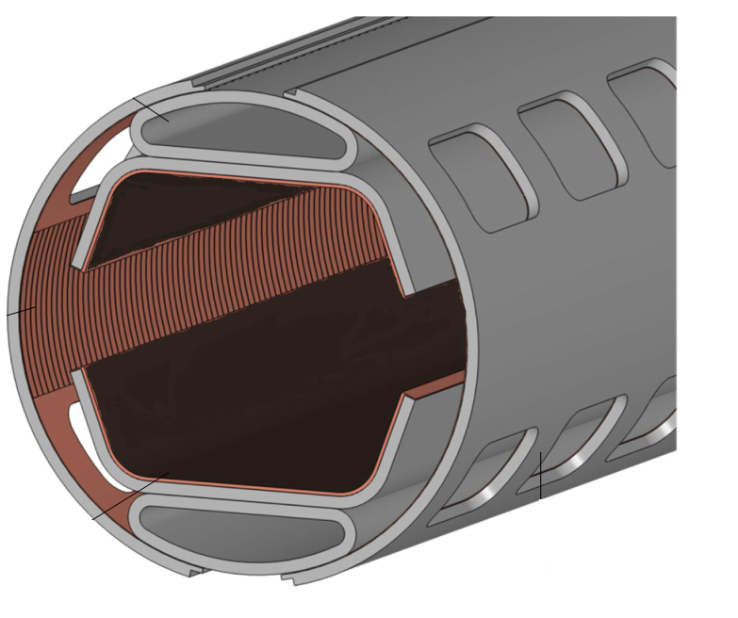
Surface impedance: the key
$$\left|Δω\right|$$
τ Risetime of beam instabilities
Z_{T} Transverse impedance (property of the beam)
R_{S} Surface resistance (property of the surface)
τ: instabilities rise-time
Δω: betatron tune-shift
I_{b}: bunch current
M: number of bunches
E: beam energy
L: bunch length
R: accelerator radius
c: speed of light
b: vacuum chamber radius
f: wakefields frequency
ρ: electrical resistivity
What could be better than copper at 50 K?
High-Temperature Superconductors (HTS)

Slide 7
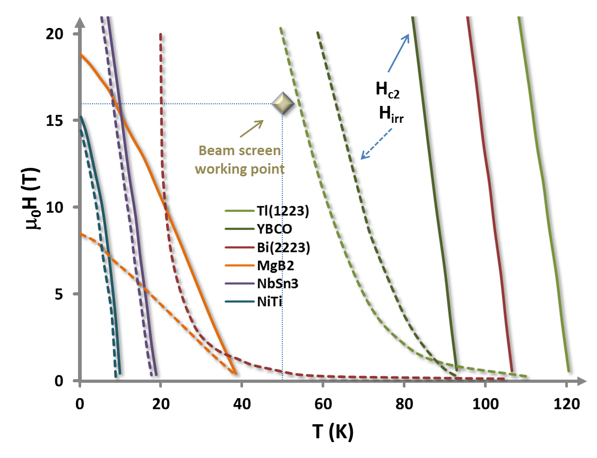
Choice of HTS for the FCC-hh beam screen
Nature 414, 368-377 (15 November 2001)
High-Tc superconducting materials for electric power applications
David Larbalestier, Alex Gurevich, D. Matthew Feldmann & Anatoly Polyanskii
Superconductor Science and Technology, Volume 11, Number 8
Synthesis and properties of fluorine-doped Tl(1223): bulk materials and Ag-sheathed tapes
E Bellingeri, R E Gladyshevskii, F Marti, M Dhallé and R Flükiger
Requirements:
HTS must operate at 50 K and 16 T
Critical field (FCC-hh dipoles):
Hc₂ , H_{irr} >> 16T
Critical current (1μm thickness):
J_{c} > 25 kA/cm² (2.5x10⁸ A/m²)
Surface resistance:
R_{s} better than for copper

Slide 8
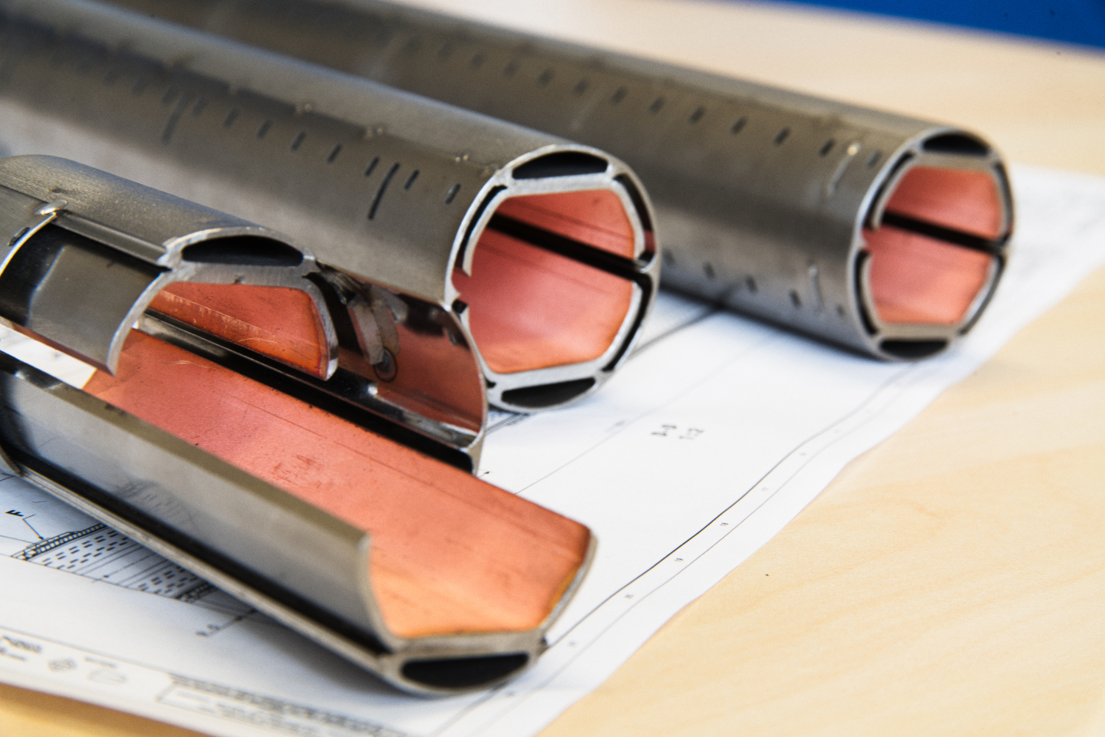









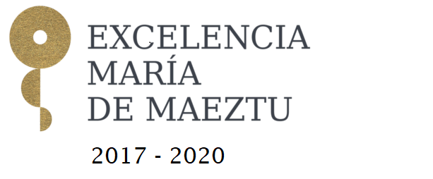


How to make it in practice ?
Manufacture the screen using REBCO tapes soldered to the screen
Coat the inside of the screen
with Tl-1223 films

Slide 9
Challenges
Use HTS inside the FCC-hh beam screen with:
Up to 16 T of magnetic field
Surface currents up to 1 A (Jc > 2.5x10⁸ A/m²)
Operating temperature 40-60 K
Surface resistance ( at frequency < 1 GHz) better than copper
Guaranteeing compatibility with the accelerator environment:
Low outgassing
Low Secondary Electron Yield
Robustness to synchrotron radiation
Negligible impact on magnetic field profile
Reduced lifecycle impact

Slide 10
(Oversimplified) Timeline
2015
First ideas of using HTS for beam-impedance mitigation (first ideas from Lucio Rossi) and first evaluation of potential performance
First public discussions of these ideas (EUCAS Lyon)
2016
Start of the formal collaborations within the FCC-hh study
CNR-SPIN & TU-Wien: Tl-based HTS
ALBA – ICMAB – IFAE and UPC (Barcelona): Coated Conductors
2020
Many results beyond expectation!
Agreement to start the next phase of the collaboration

Slide 11
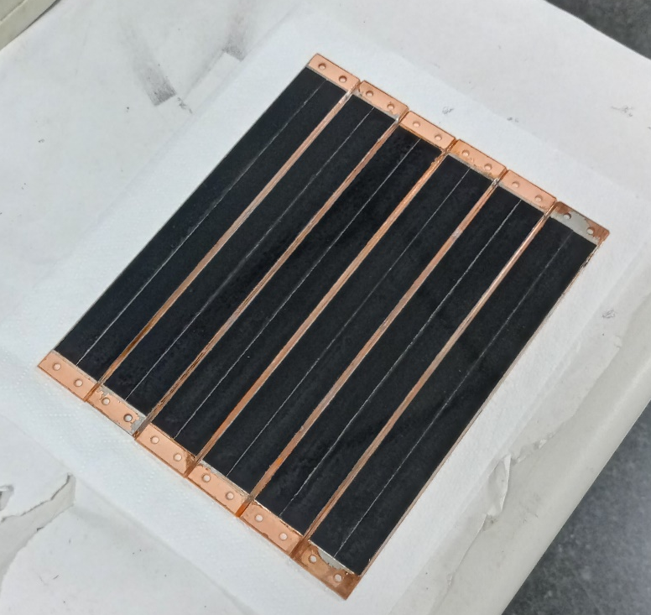






REBCO Coated Conductors are commercially available
with different widths in Km length
Ag ~ 2 μm
REBCO HTS ~ 1 – 3 μm
Cu ~ 20 μm
Buffers ~ 0.2 – 1 μm
Metallic Substrate ~ 30 – 100 μm
T_{c} ≈ 91 K
H_{c2} (4.2K) > 100 T
H_{irr} (4.2K) > 60 T
Joffre Gutierrez

Slide 12
REBCO CCs have lower R_{s} than Cu in a broad H,T region
T = 50 K, ν = 8 GHz
REBCO
T. Puig et al, Supercond. Sci. Technol. 32 (2019)
A. Romanov, et al. Scientific reports 10 (2020)

Slide 13
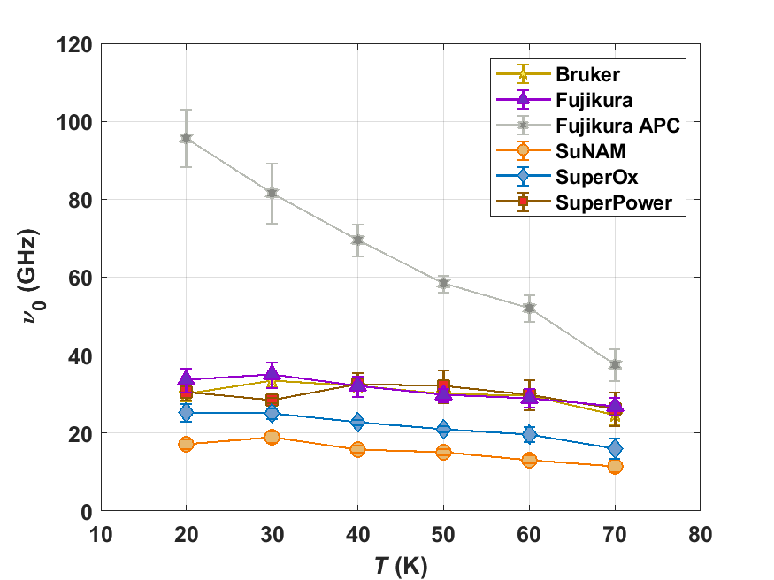
Gittleman-Rosenblum model predictions based on our Z_{s} experimental data
A. Romanov, et al. Scientific reports 10 (2020)
Estimation of depinning frequency ω_{p}
Gittleman-Rosenblum model prediction of Z_{s}
REBCO X_{s}
Cu R_{s}
T = 50 K, ν = 1 GHz
REBCO R_{s}
ω_{p}
REBCO CCs have high depinning frequencies
Enables operation up to high frequencies
The G-R model predicts a much larger benefit from REBCO at lower operating frequencies

Slide 14
Initial study shows that CCs have a weak dependence with the RF power
FCC-hh
T = 50 K, ν = 8 GHz
P. Krkotic, et al. Supercond. Sci. Technol. 35 (2022)
Opens the possibility for high-power applications:
Future high-energy or high-power linacs (SLAC collaboration), Muon collider

Slide 15
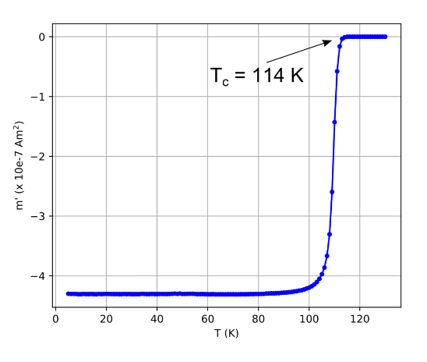
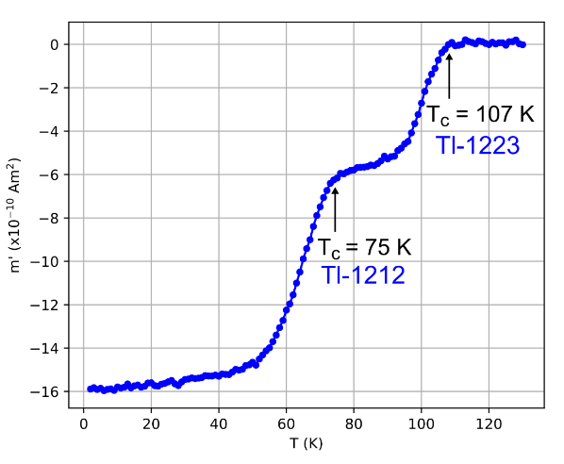
Tl-1223, critical temperature and surface resistance
bulk sample (mixing and reacting the precursors)
“Good” phase 1223 is often mixed with 1212 phase
Alessandro Leveratto

Slide 16
Goals for the new collaboration round (2021-2023)
Move from small-size samples to a proof-of-concept device (for Coated Conductors)
Demonstrate a scaled-up coating implementation (for Tl-HTS)
Continue and further develop the work on material characterization (transport, microstructure, RF, synchrotron radiation) fostering exchanges between the consortia.
Invest into lower frequency RF characterization and do not rely only on extrapolations
Ensuring full compatibility with the FCC-hh:
Guarantee magnetic field quality while keeping good impedance, through striations of HTS. Simulations and experimental validation
Assessment of correct operational temperature for a-C coating. A possible increase may result in extra power savings
Do not forget intrinsic non-linearities of HTS, and their potential effect on the beam

Slide 17
Annual Collaboration meeting, Rome 11.11.2022 https://indico.cern.ch/event/1170520/
Few highlights
Effect on magnetic field quality
Lowe(er) frequency measurements
Synchrotron radiation studies
Multifrequency measurements

Slide 21
Joan O’Callaghan

Slide 22
Montse Pont

Slide 23
Montse Pont

Slide 26
Follow-up from Rome plenary meeting 11.11.2022
Characterization at ~1 GHz is a fundamental need, still to be fully demonstrated
Parallel-plate resonator being commissioned at UPC, for samples
We need impedance testing of proof-of-concept device
Demonstrate the appropriate frequency scaling laws, and assess creep
Keep an eye on imaginary part
Increasing operating temperature would be very relevant for the FCC-hh
From 50 K to 70 K (also motivated by carbon coating) allows large energy savings
Challenging for REBCO (flux creep…)
Tl-HTS is extremely challenging, temperature increase could be also an opportunity.
Experimental validation of magnetic field profile in striated beam screen
Critical issue for accelerator, and may open up new beam screen designs (and active compensation of multipoles)
PSD to be assessed in collaboration with KEK
Thanks to Massimo and Roberto for helping pushing this forward

Slide 27
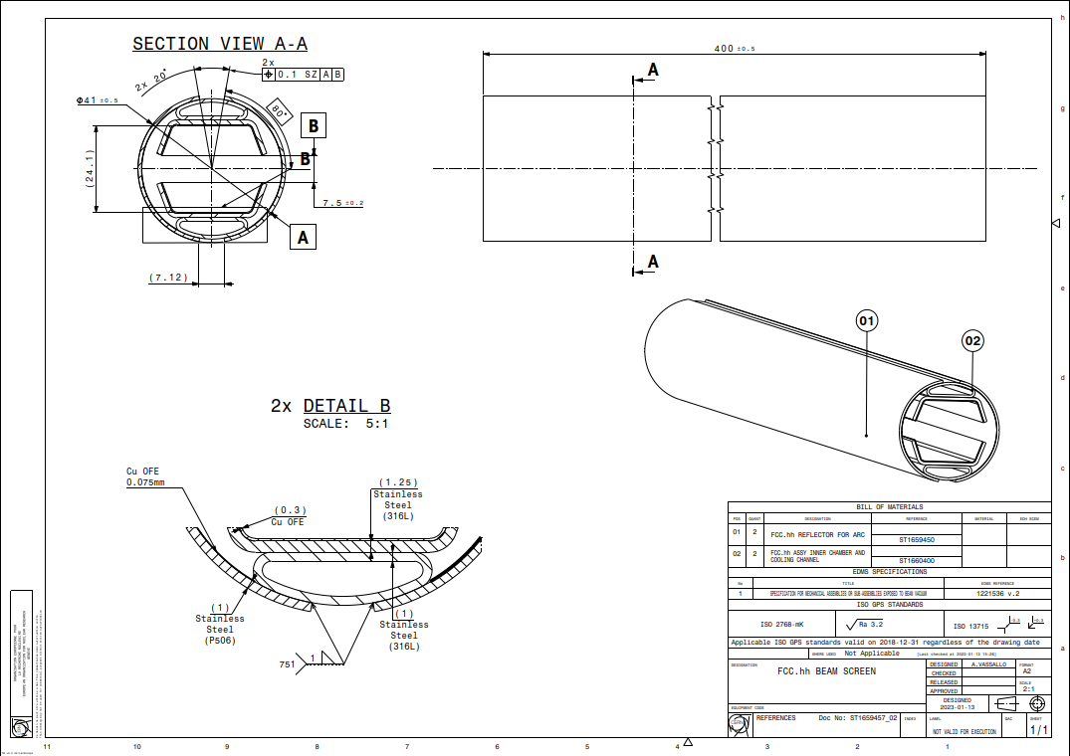
Drawing of proof-of-concept beam screen
Christian Duclos

Slide 28
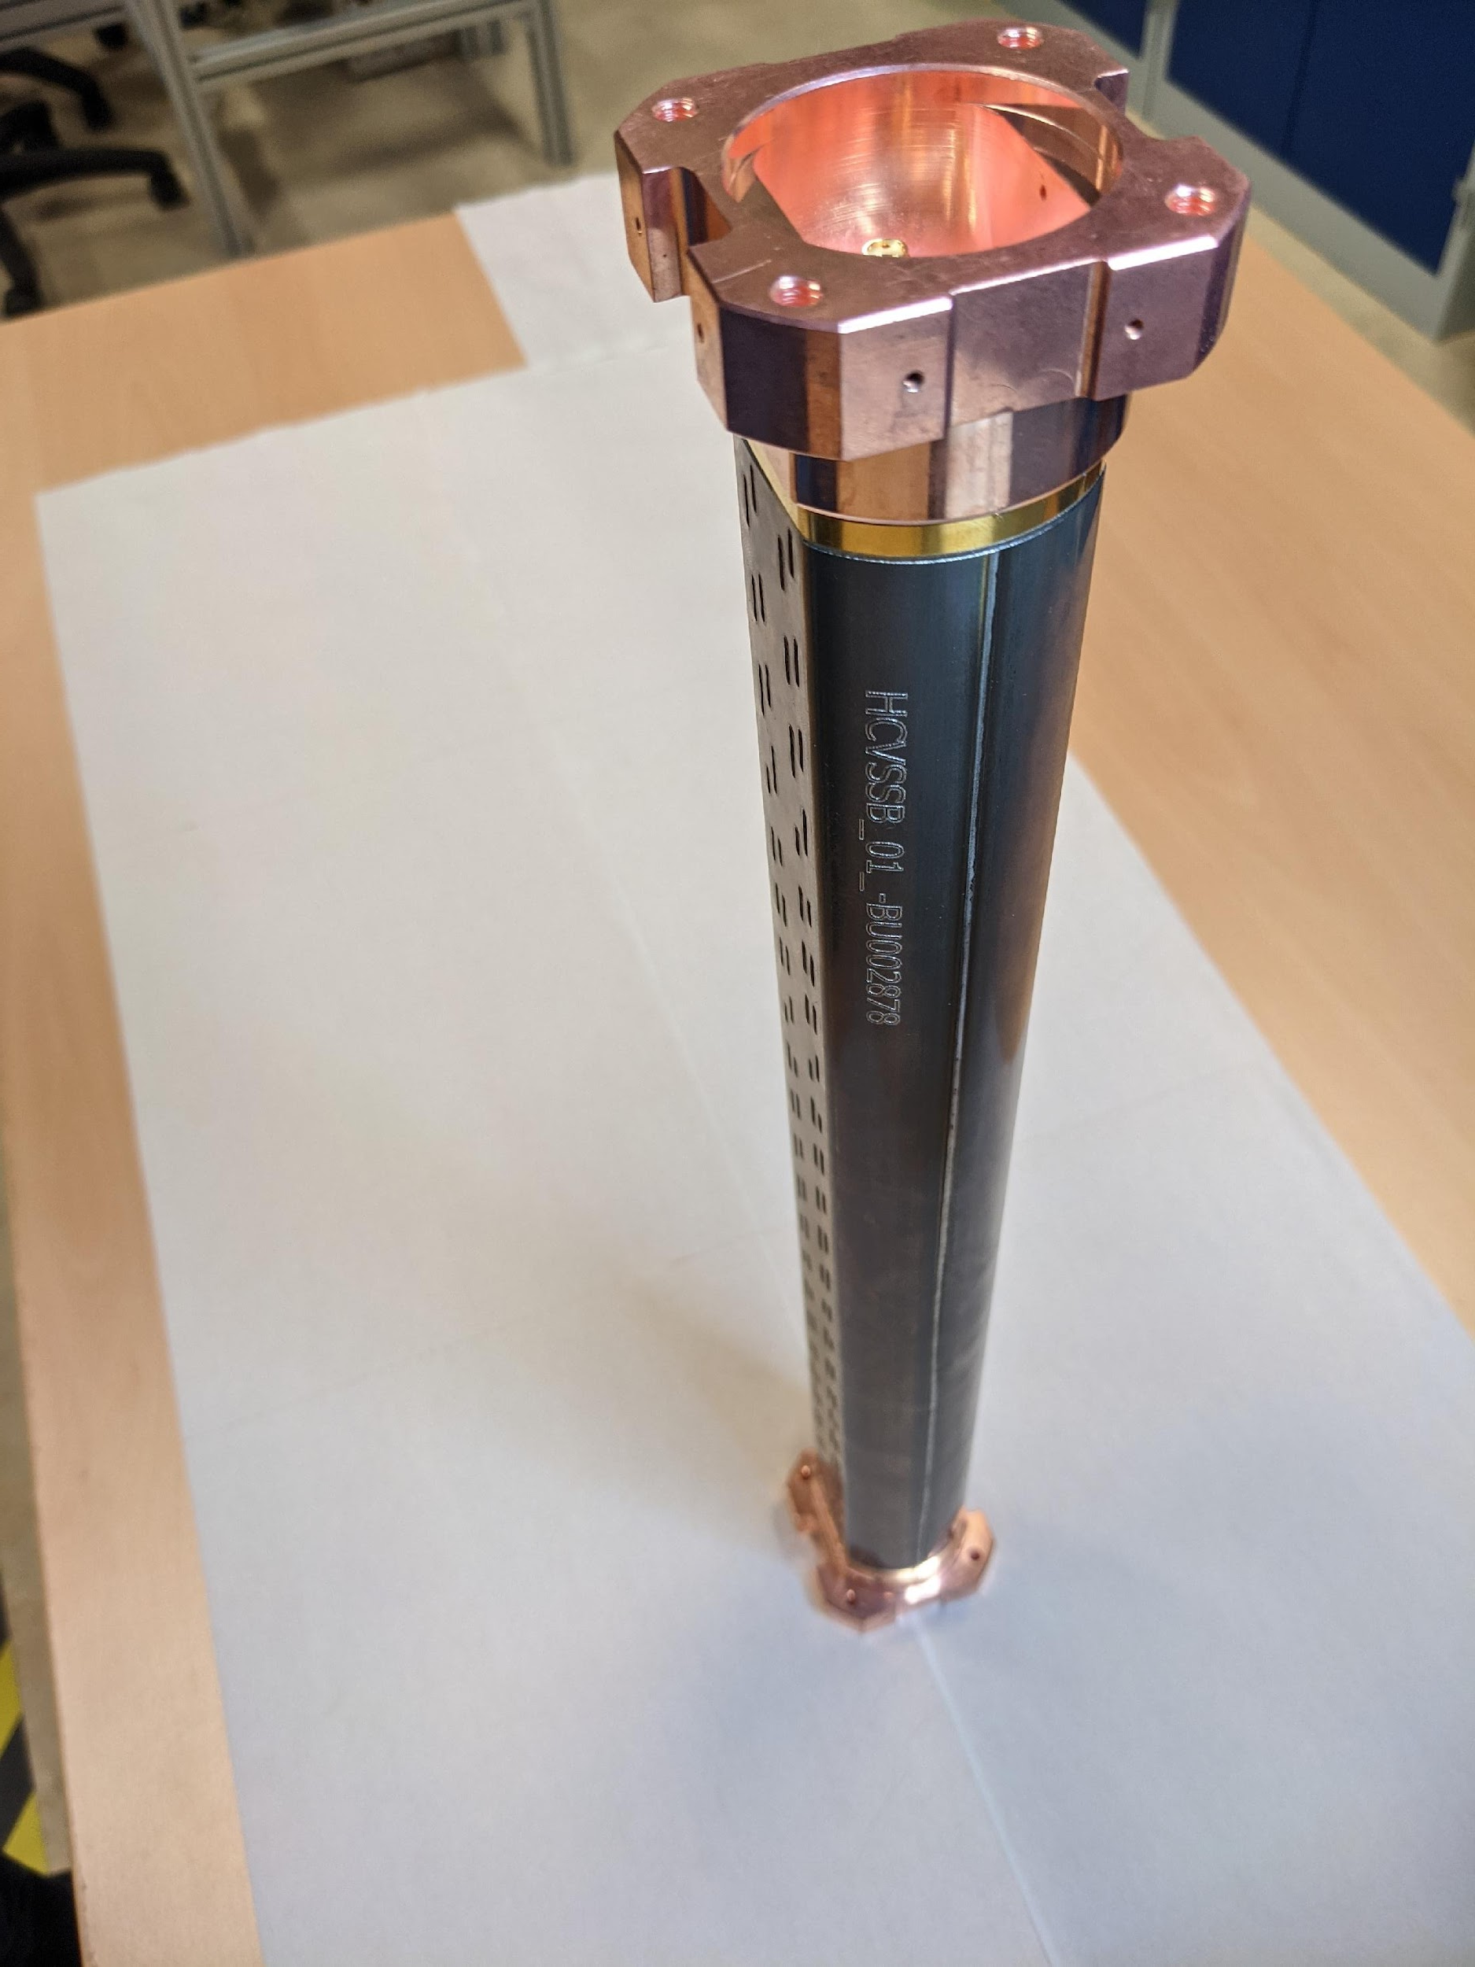
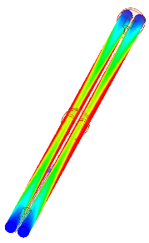
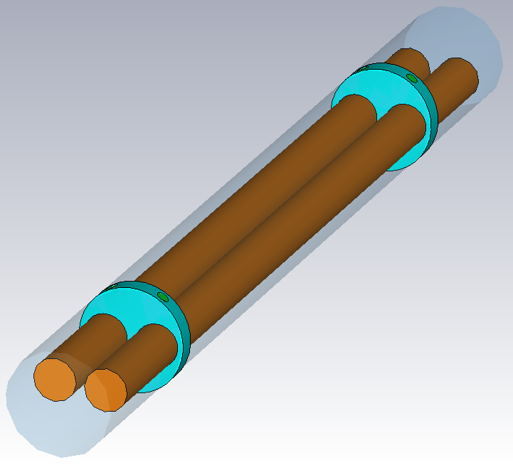
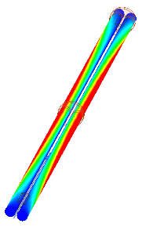
Measurement of surface resistance of beam screen “Two-rods” system
Resonator with 2 fundamental modes (at same frequency)
Measurement of Q-factor of both modes makes it possible to “subtract the contribution” of the inner rods from the resistive losses
Developed, ready and tested for HL-LHC beam screens (carbon coating, LESS)
Even mode
Odd mode
Kristof Brunner

Slide 29
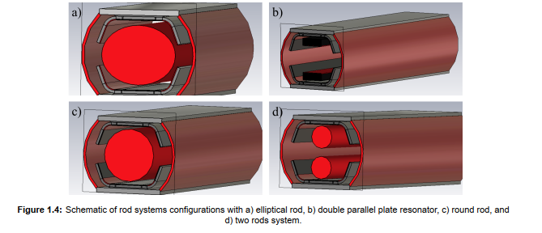
Possible configurations for FCC-hh beam screen
Nikki Tagdulang

Slide 30
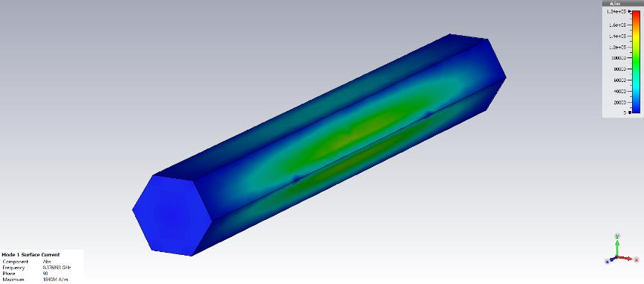
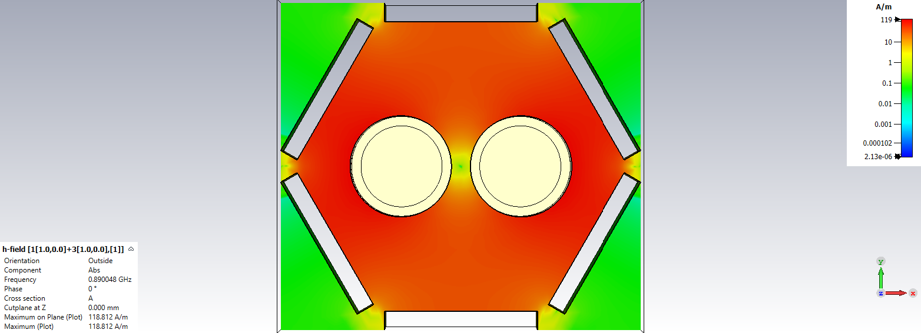
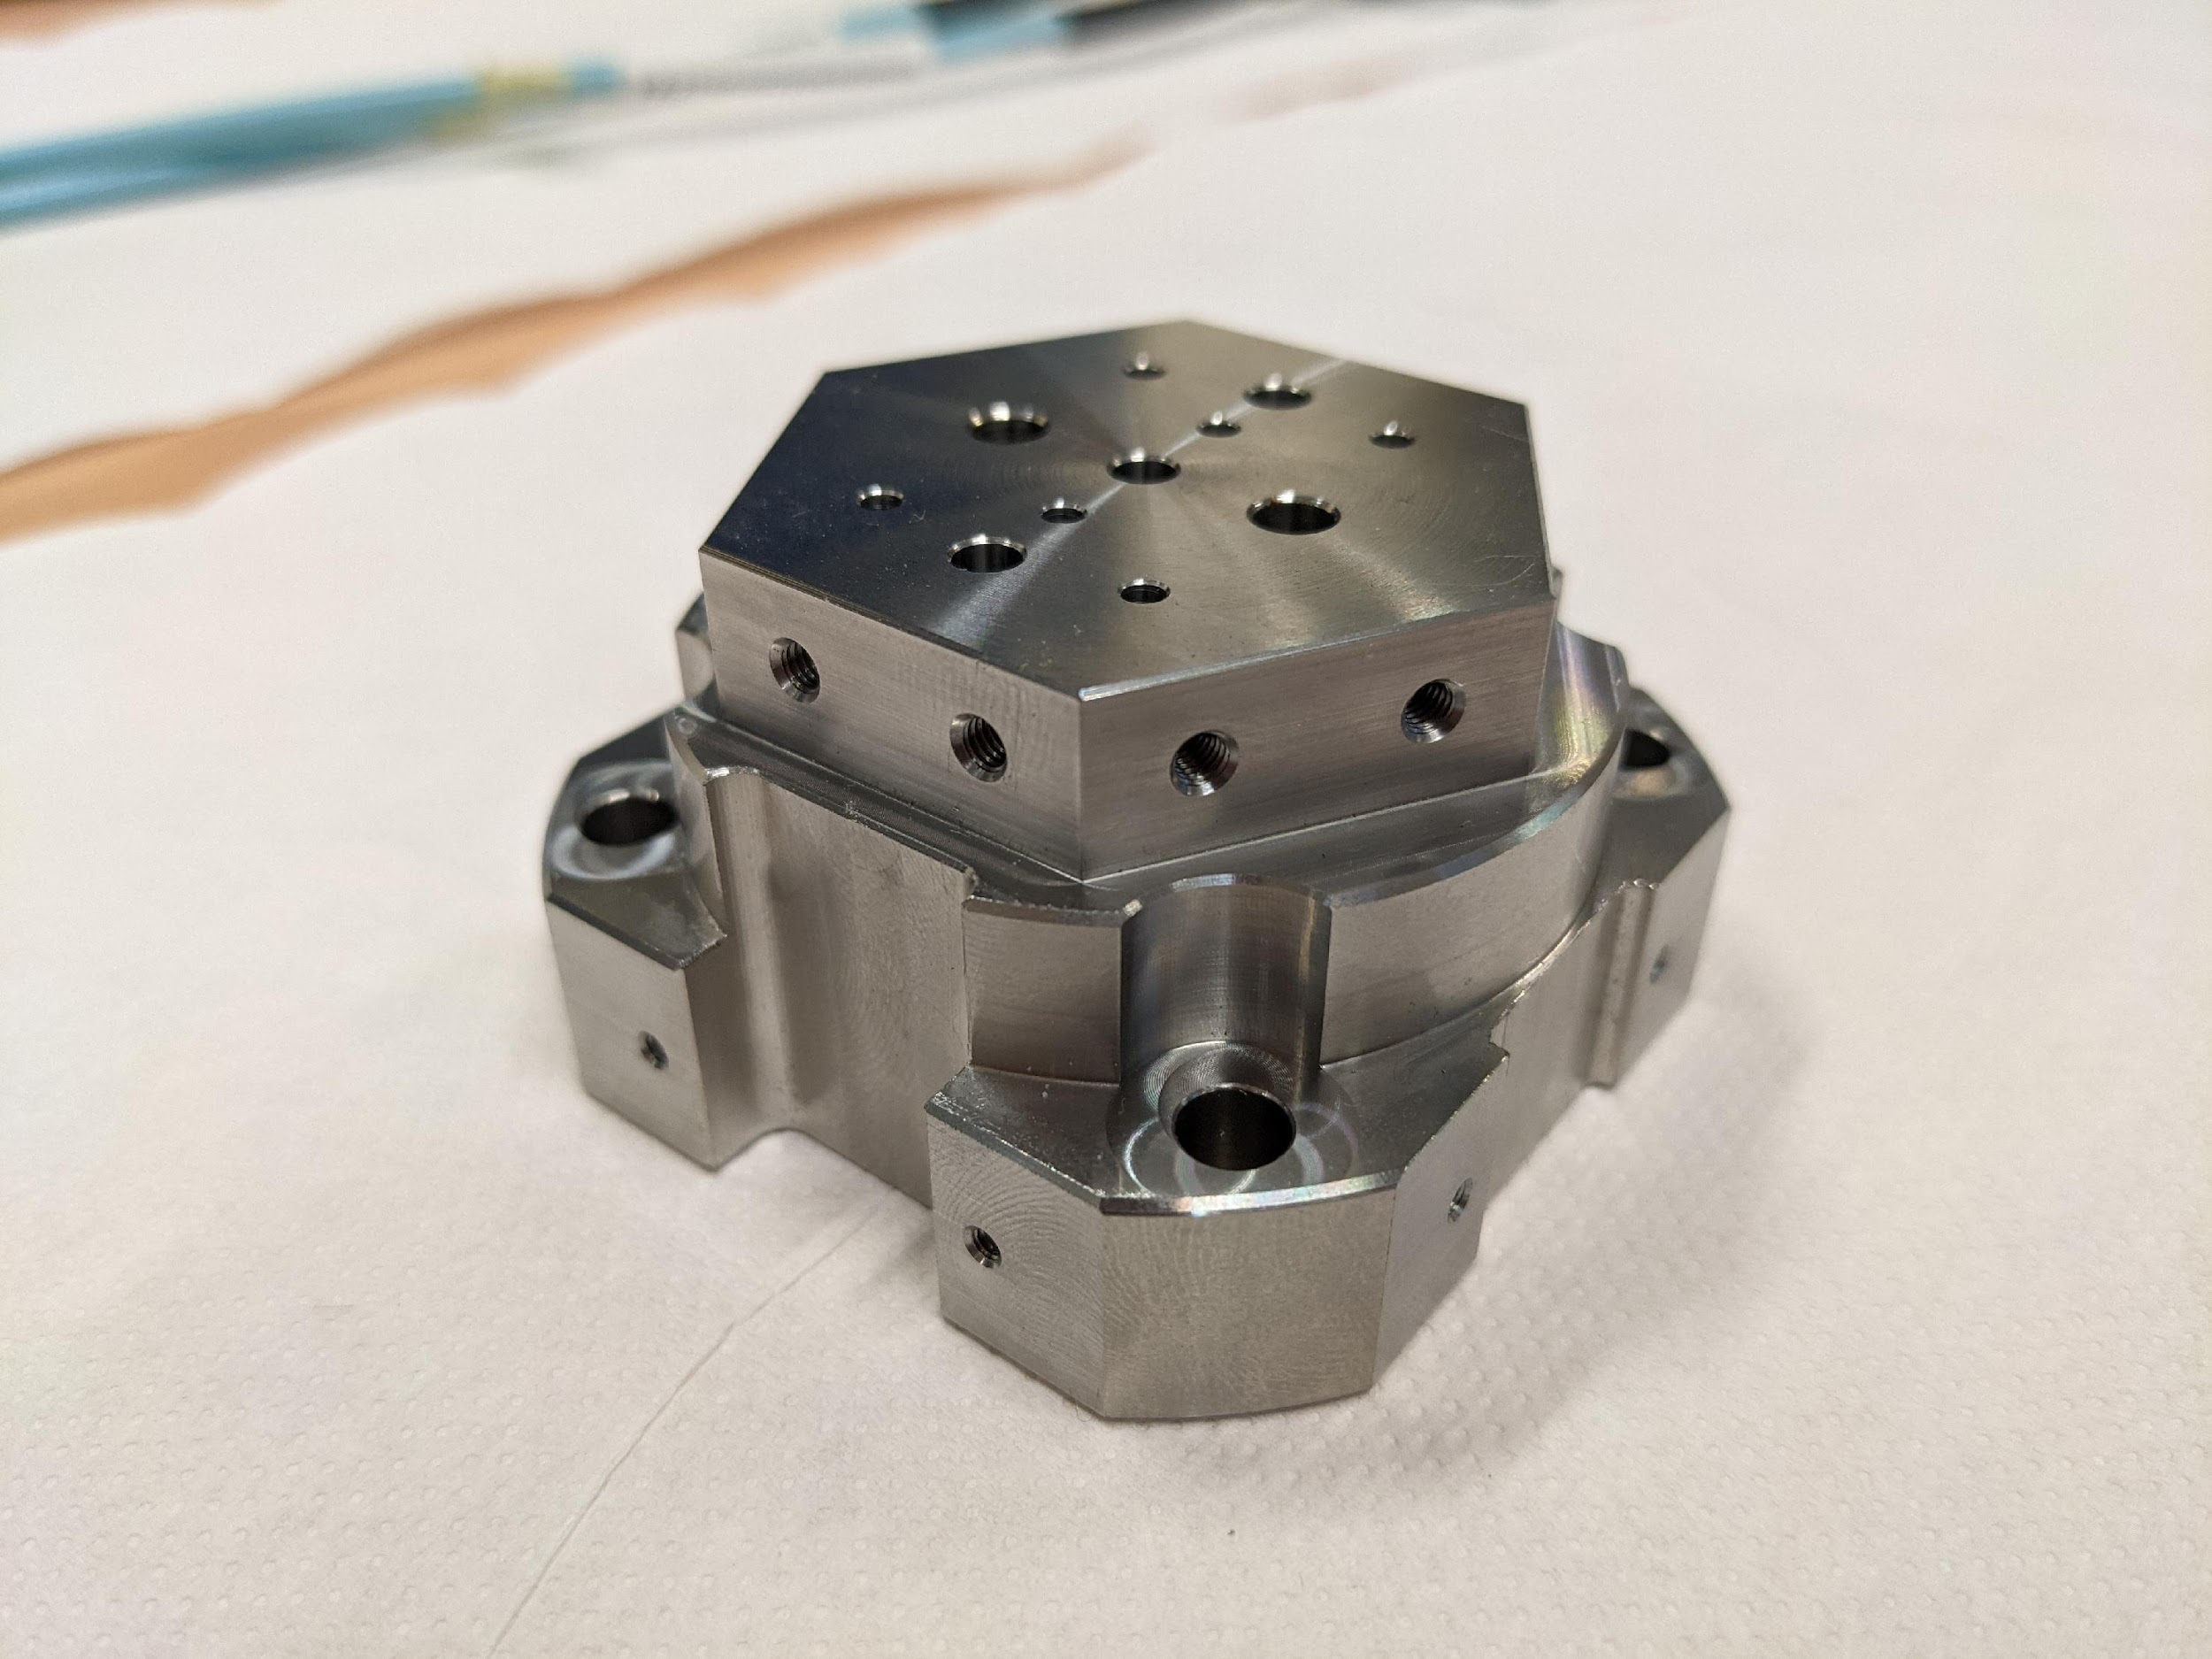
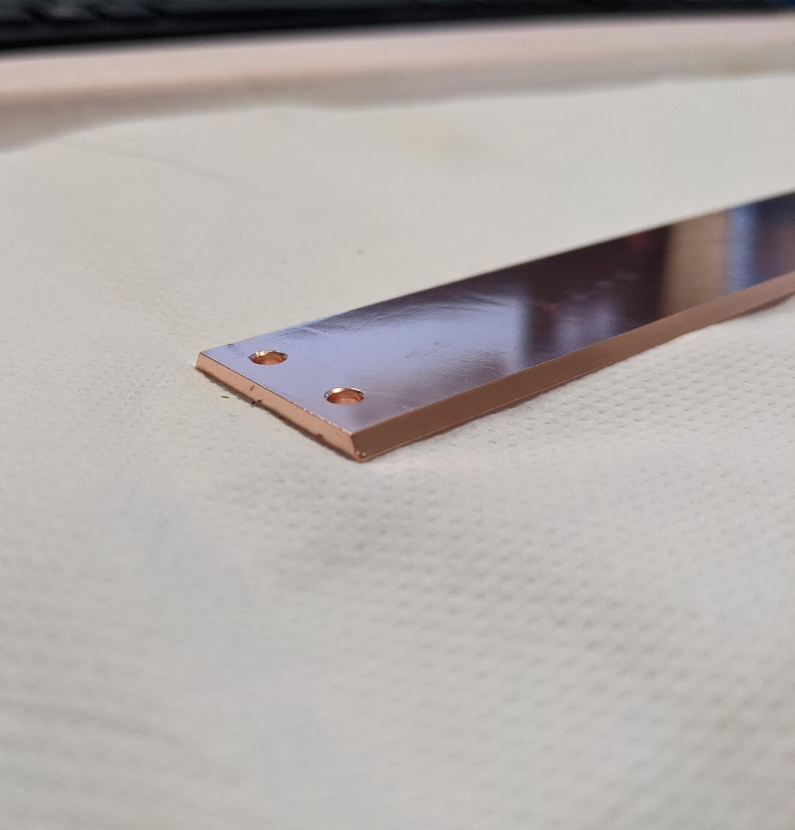

HTS tape hexagonal “beam screen”

Slide 31
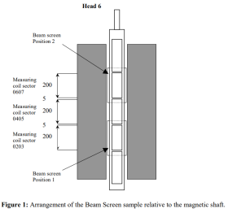
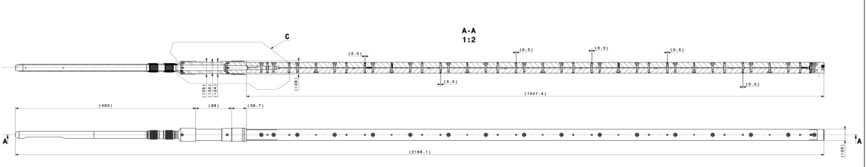
Measurement of magnetic field quality
• Test in the 11 T model @ SM18
• Feather in Fresca2 rotating coil magnetic measurement
• Integration study needed
• Possibility to move up (or down) the beam screen to be investigated
The measurement precision for the multipoles is ~0.1 unit
Carlo Petrone

Slide 32
Collaborators
CCs Consortium (12/2020-11/2023) (Kickoff meeting 1/2021)
IFAE KE4944
ALBA KE4945
UPC KE4946
CSIC-ICMAB KE4947
Tl-HTS Consortium (3/2021-2/2024) (Kickoff meeting 4/2021)
SPIN KE5072
TU-Vienna KE5073
Roma Tre KE5084

Slide 33
Budget situation
 | 2021 | 2022 | 2023 | 2024 | Totals (kEUR) | Paid (kEUR) | Open (kEUR)
CERN (this activity only, bc 11346 FCC 3.4.6 vacuum sys.) | 40 kCHF | 40 kCHF | 40 kCHF | 20 kCHF | 140 kCHF
KE4944 - HTS CC tapes (IFAE) | 60 | 50 | 50 |  | 160 | 110 | 50
KE4945 - HTS CC tapes (ALBA) | 50 | 100 | 30 |  | 180 | 150 | 30
KE4946 - HTS CC tapes (UPC) | 25 | 35 | 20 |  | 80 | 60 | 20
KE4947 - HTS CC tapes (CSIC-ICMAB) | 60 | 80 | 40 |  | 180 | 140 | 40
KE5072 - Thallium cuprate performances (CNR-SPIN) | 100 |  |  | 74 | 174 | 100 | 74
KE5073 - Thallium Based HTS coating (TUWIEN) | 60 | 60 |  | 60 | 180 | 60 | 120
KE5084 - Thallium and REBCO coated cond (UNIROMA3) | 50 | 30 |  | 11 | 91 | 50 | 41

Slide 34
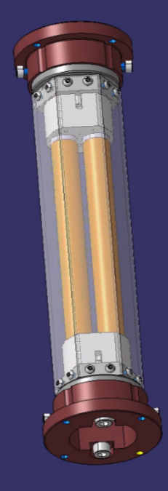
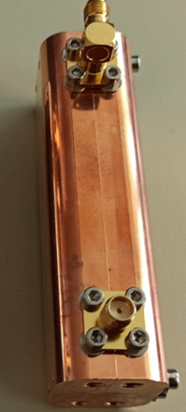
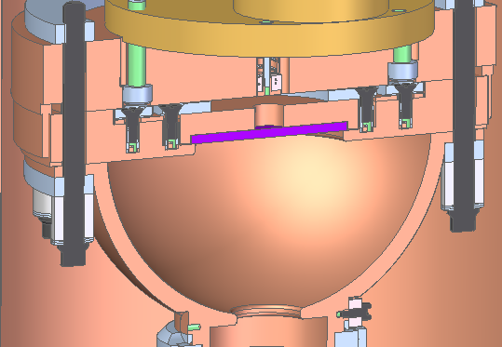
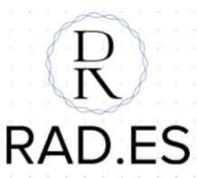

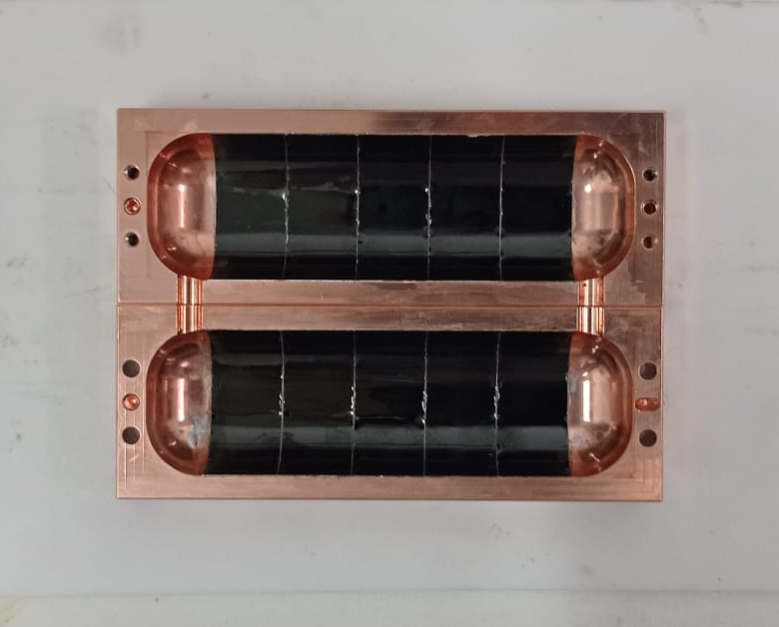
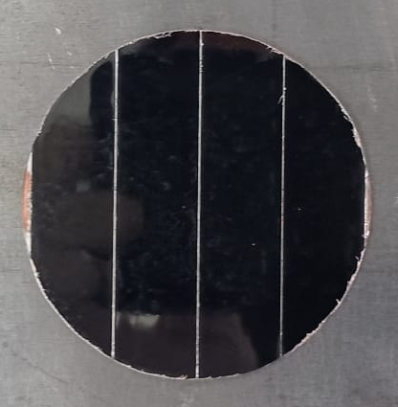
Multi-shape low impedance coatings for high energy physics applications
Two rod system for impedance measurements
RF haloscope cavity for axion detection
Mushroom cavity for high accelerating gradients

