Slide 1
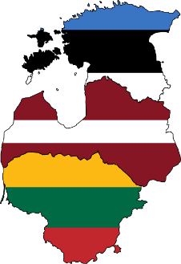
Advanced Particle
Therapy Center for the Baltic States
CERN Baltic Group
Prof. Toms Torims, Convener of the
Advanced Particle Therapy Center
in the Baltic States Working Group

Slide 2

What is CERN Baltic Group and how it works ?
Medus kūka 🇱🇻
Medaus pyragas 🇱🇹
Meekook 🇪🇪
Photo: Shutterstock
Honey Cake
Notes:
Who are the Partners?
How CBG opperates?

Slide 3

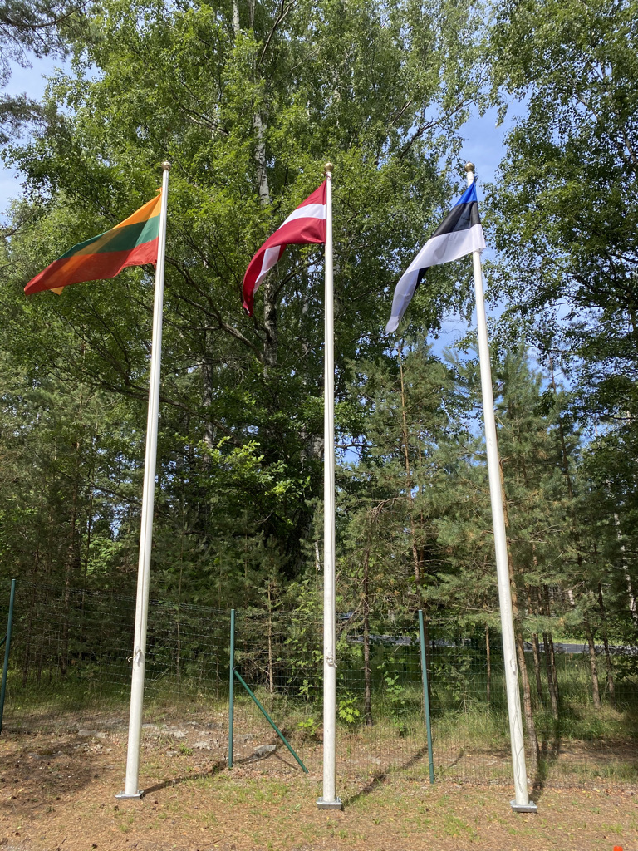

Science Diplomacy vis-à-vis CERN
Baltic style
Common system of values
One voice
Reliable and open
Many challenges = numerous opportunities
Notes:
Who are the Partners?
How CBG opperates?

Slide 4
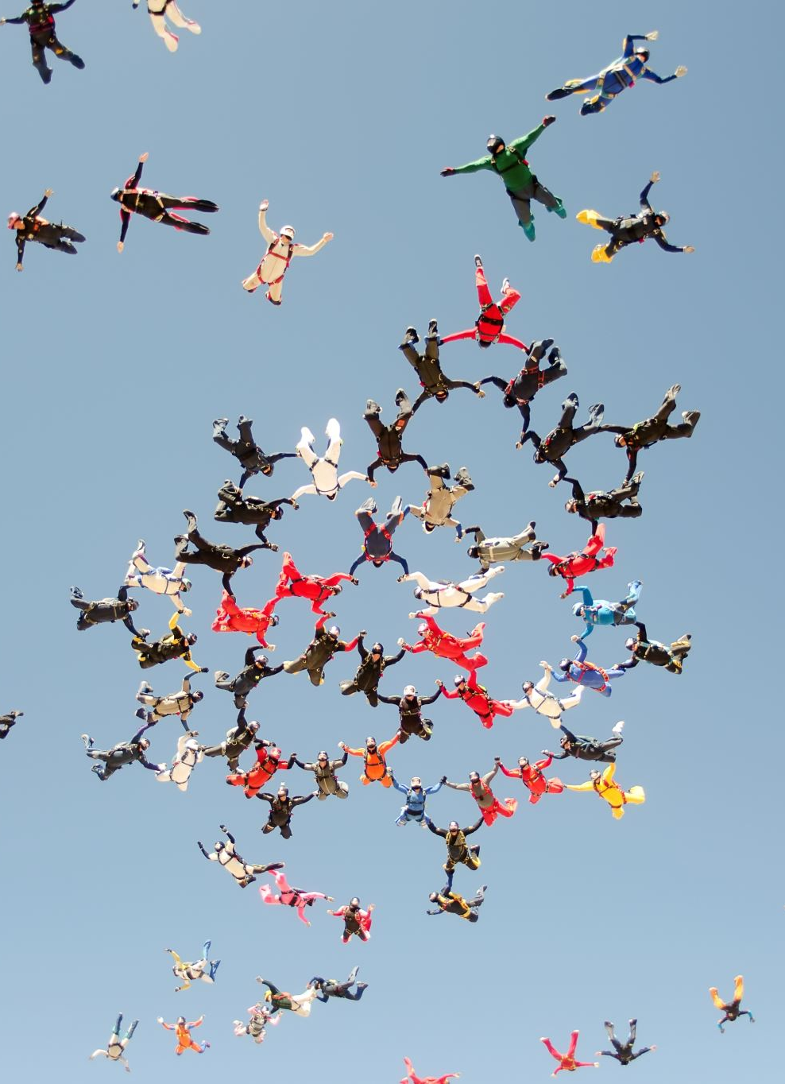
CBG objectives
Coordination of the Baltic research institutions activities towards CERN and related Collaborations/Experiments
Strengthening and development of Baltic High Energy Physics Community
Development of the Baltic international multidisciplinary masters/doctoral level study programme in High Energy Physics and Accelerator Technologies
The main principles:
transparency, honesty, sharing and collaboration

Slide 5
Regional dimension
Cooperation
In action
Exchange
Strong
Attractive
Trustful partners
Riga Technical University 🇱🇻
University of Tartu 🇪🇪
Vilnius University 🇱🇹
University of Latvia 🇱🇻
National Institute of Chemical Physics and Biophysics 🇪🇪
Kaunas University of Technology 🇱🇹
Riga Stradinš University 🇱🇻
Tallinn University of Technology 🇪🇪
Vytautas Magnus University 🇱🇹
Lithuanian Energy Institute 🇱🇹
Daugavpils University 🇱🇻
Lithuanian University of Health Sciences 🇱🇹
Ventspils University of Applied Sciences 🇱🇻
Notes:
Who are the Partners?
How CBG opperates?

Slide 6
How it works?
CERN Baltic Group
Bottom-up initiatives
Clear responsibilities
Different levels
Different stakeholders
Photo: Shutterstock
Notes:
Who are the Partners?
How CBG opperates?

Slide 7
How it works?
General Meeting
Coordination Team & Secretariat
Study Program Group
Scientific and Technology Working Group Activities
General Meetings: Riga, Geneva, Tallinn, Vilnius, Kaunas
Regular work of the Coordination Team and Technical Coordination Meetings
Sub Group Activities and meetings
Industry engagement
∑ 60+ joint events
Well documented
Well coordinated
and strong together
- involving
- engaging
- recognising
- exchanging
- learning
- building
- community
- visibility
- goal
- connecting
- developing
- motivating
https://indico.cern.ch/category/10023/

Slide 8
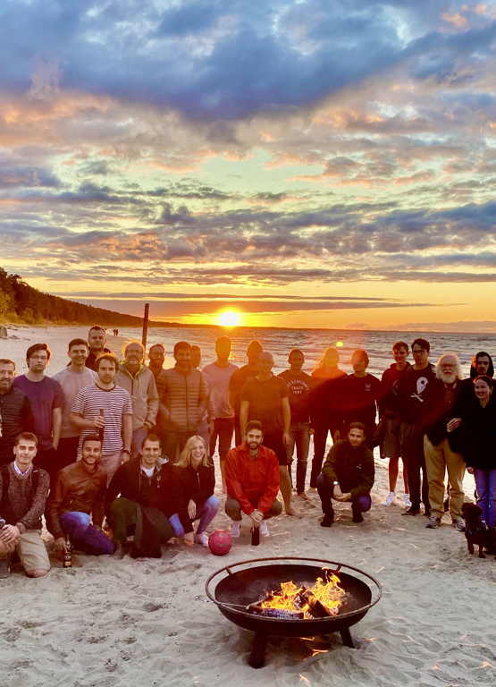
Success of CBG
Collaboration with Baltic Assembly
Joint/coordinated position vis-à-vis CERN
Strong and united position at CERN Council
Stakeholder engagement
Major regional events and conferences
Joint study programme
Flagship project Advanced Particle
Therapy Center for the Baltic States

Slide 9
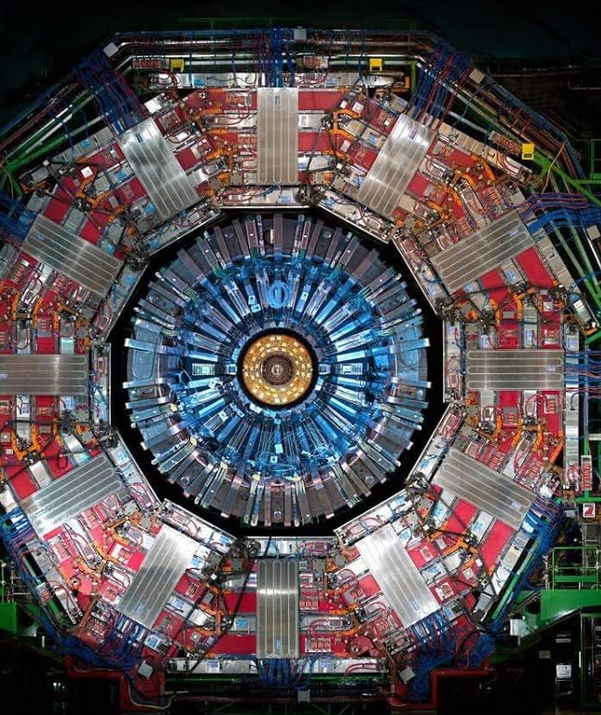
In the spirit of CERN
Knowledge
Transparent
Honest
United
Successful
Regional grasp

Slide 10

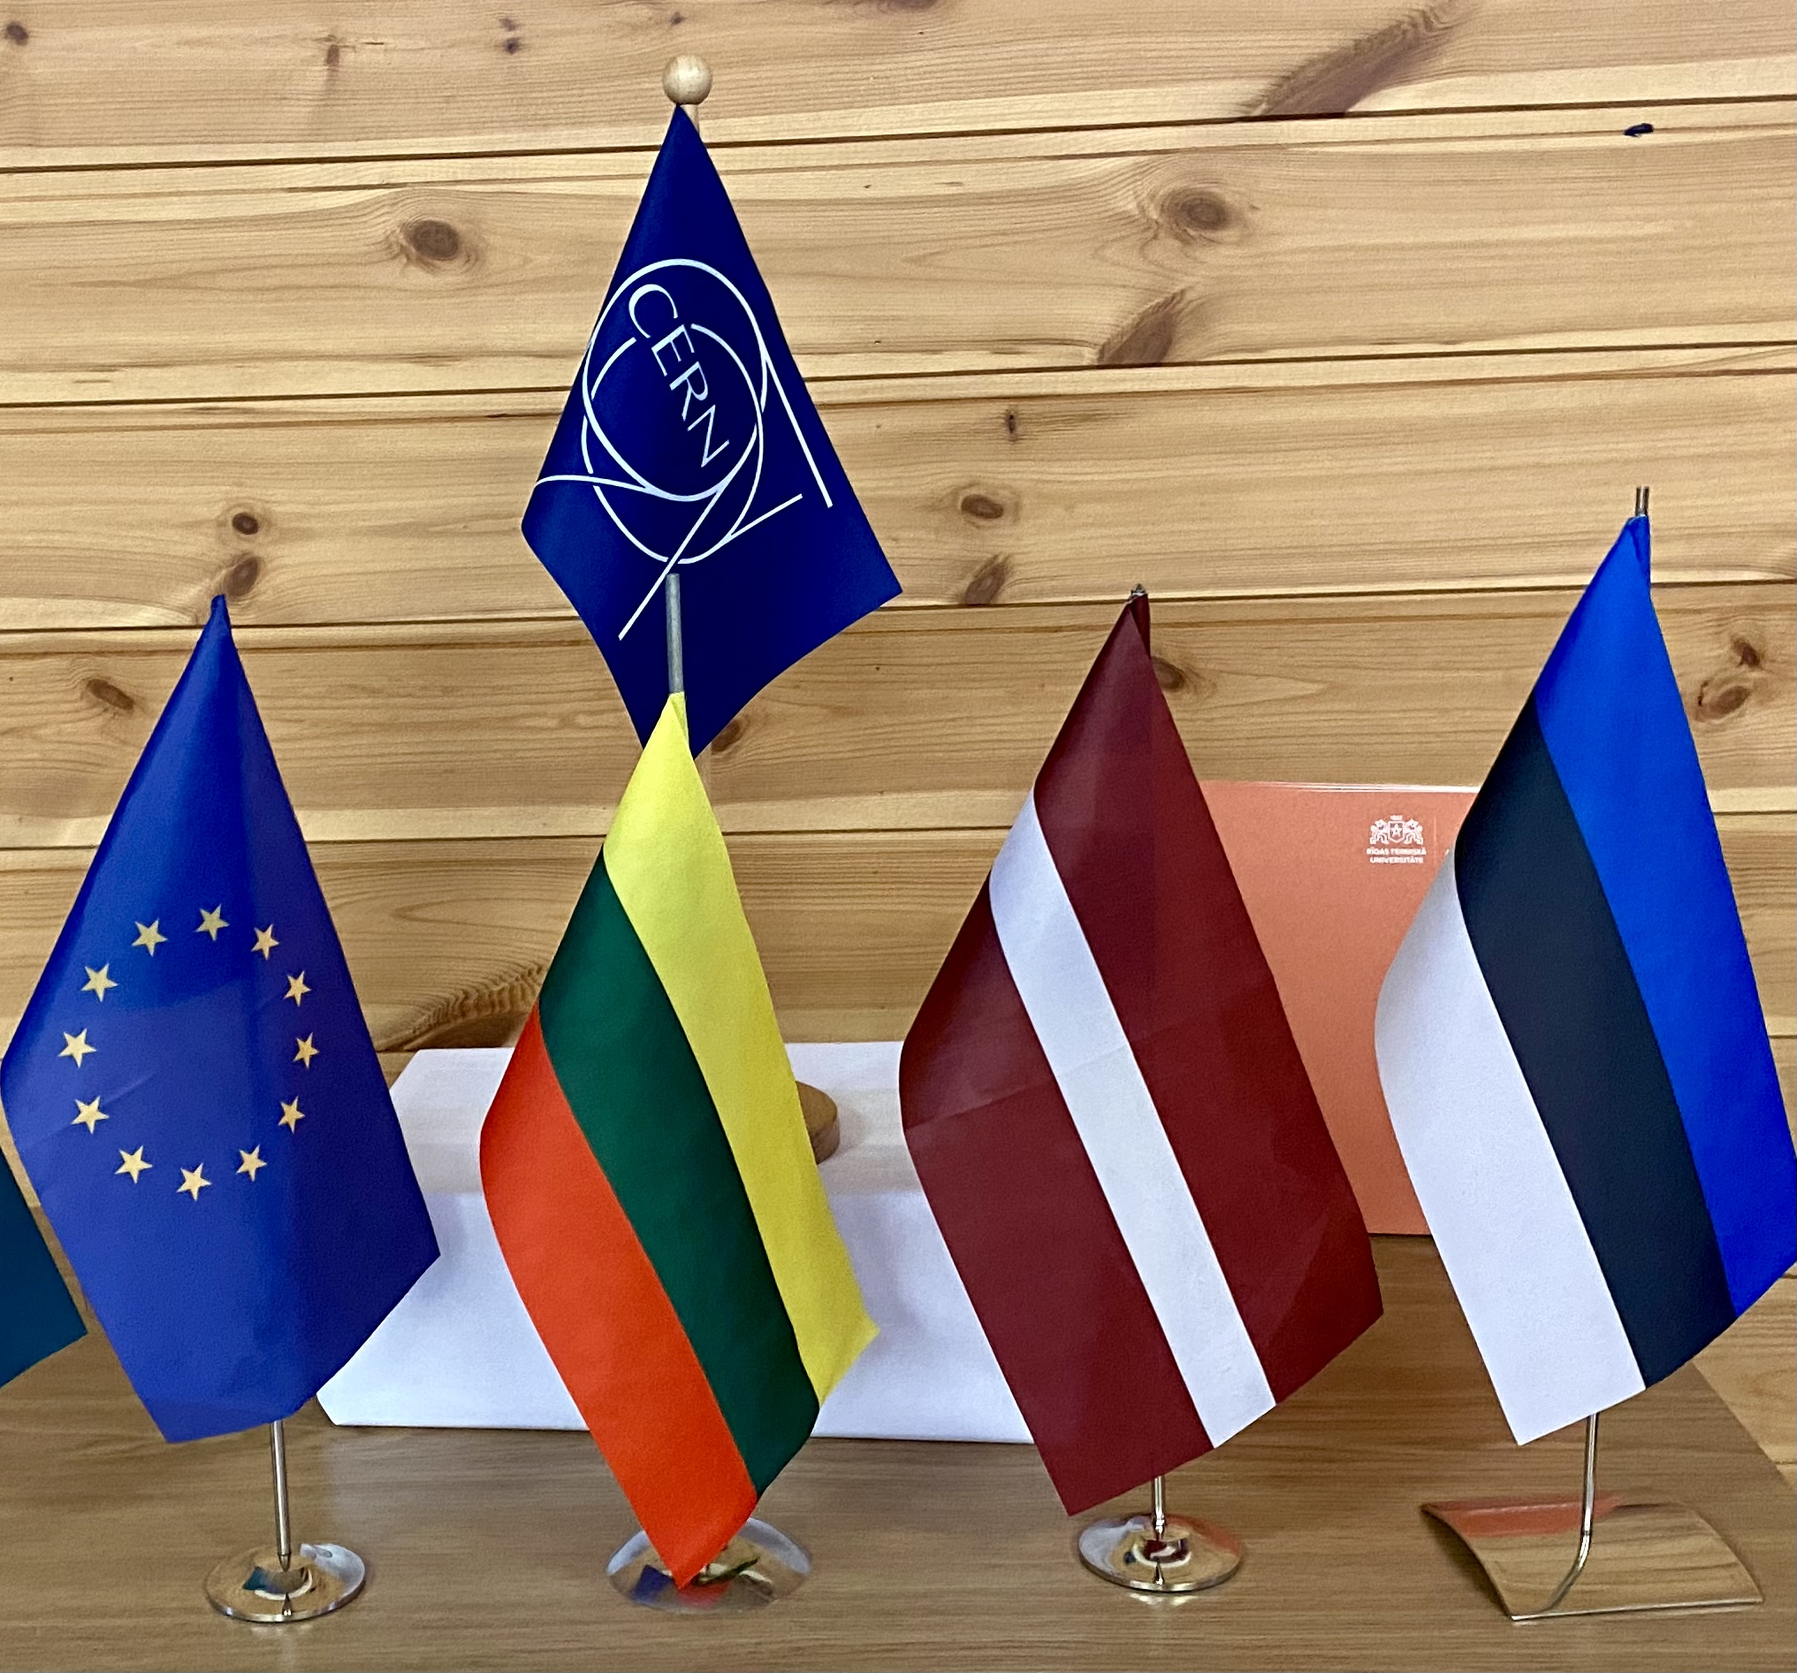



Science Diplomacy
Baltic style
CERN Baltic Group
We are strong together
Trust in science
Experience to be sheared

Slide 11
Advanced Particle
Therapy Center for the Baltic States

Slide 12
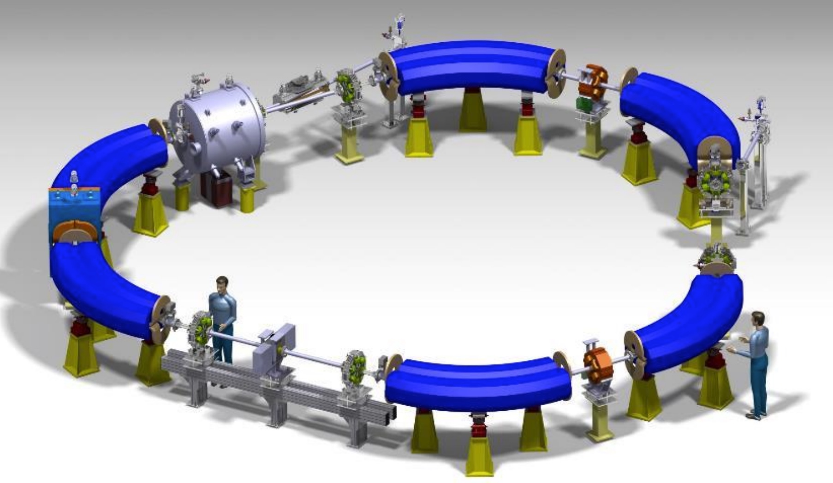
Advanced Technology developed at CERN
Experience
Expertise
Novel
Practical
EU priorities
Medical community
Supported

Slide 13
Flagship project for 3B
Advanced Cancer Therapy Center
Advanced concept
Regional Center
Advanced technology
Advanced medically
Advanced scientifically
Advancing collaboration between 3B
Advancing collaboration with CERN
Advancing multidisciplinary
Advancing STEM
Advancing quality of life in the 3B
Center of hope for the patients
Center of the technological development
Center to prevent brain-drain
Center of hope and education for young scientists, doctors, researchers, technical specialist
Center to push for the excellence
Own high-tech lab = regional research infrastructure
Center of gravity for the cooperation with CERN

Slide 14
Mandate
On April 12th 2022 within CERN Baltic Group 9th general meeting at CERN
the Advanced Particle Therapy Center in Baltic States Working Group
has been established

Slide 15
Partnership with CERN
Center would be done following NIMMS main idea – using the developed technologies within NIMMS collaboration in order to create a unique treatment center
Project has been already started in a framwork of working in close collaboration with NIMMS and CERN together in delivering the facility
The proposed project would be one of the leading in Baltic States porfolio of collaborations with CERN

Slide 16
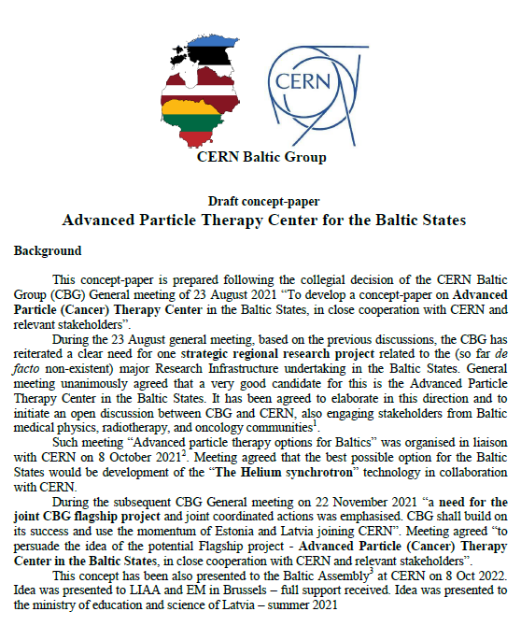
Current status of the project
A dedicated concept paper has been developed

Slide 17
Current status of the project
Presented
21st meeting of the TIARA Collaboration Council (March 29th, 2022)
Internally within CERN NIMMS collaboration, with approval of collaboration
Stakeholder support gained in the Baltic States
Baltic scientific community: 9th CERN Baltic Group General Meeting and 2nd CERN Baltic conference
Baltic political stakeholders:
Meeting of the Health, Welfare and Family Committee of the Baltic Assembly
Baltic Assembly letters adressed to prime ministers of Baltic States
Baltic States ambassadors within EU COREPER I
Investment and innovations agencies within the Baltic States

Slide 18
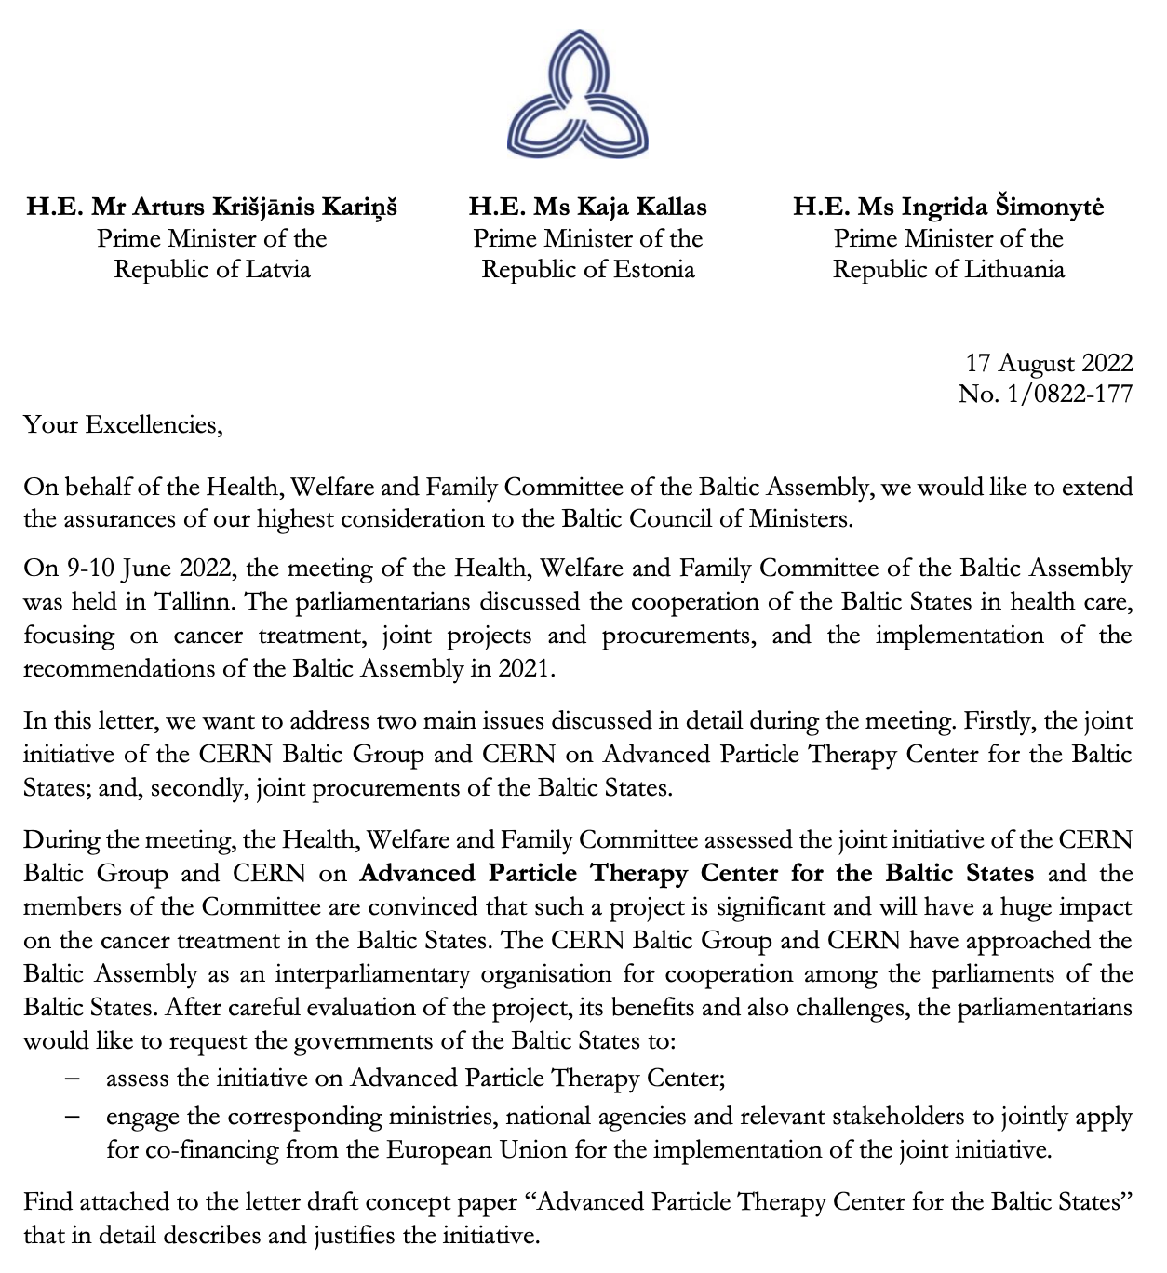
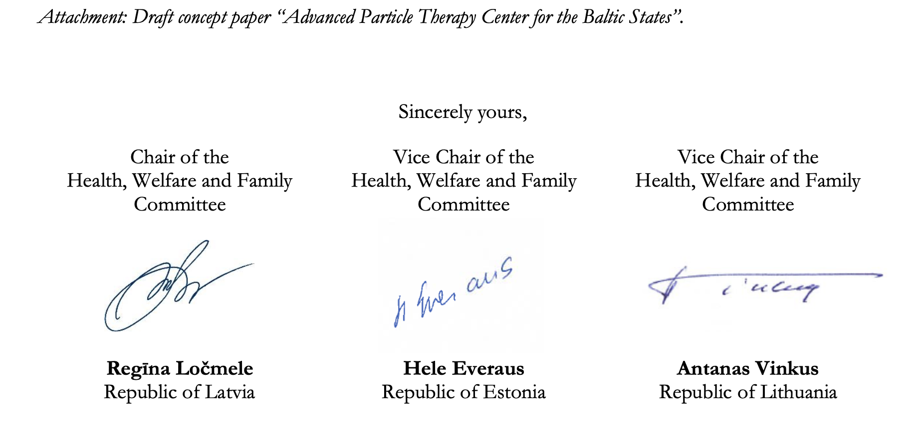
Strong support of the policy makers

Slide 19
Project financing

Slide 20
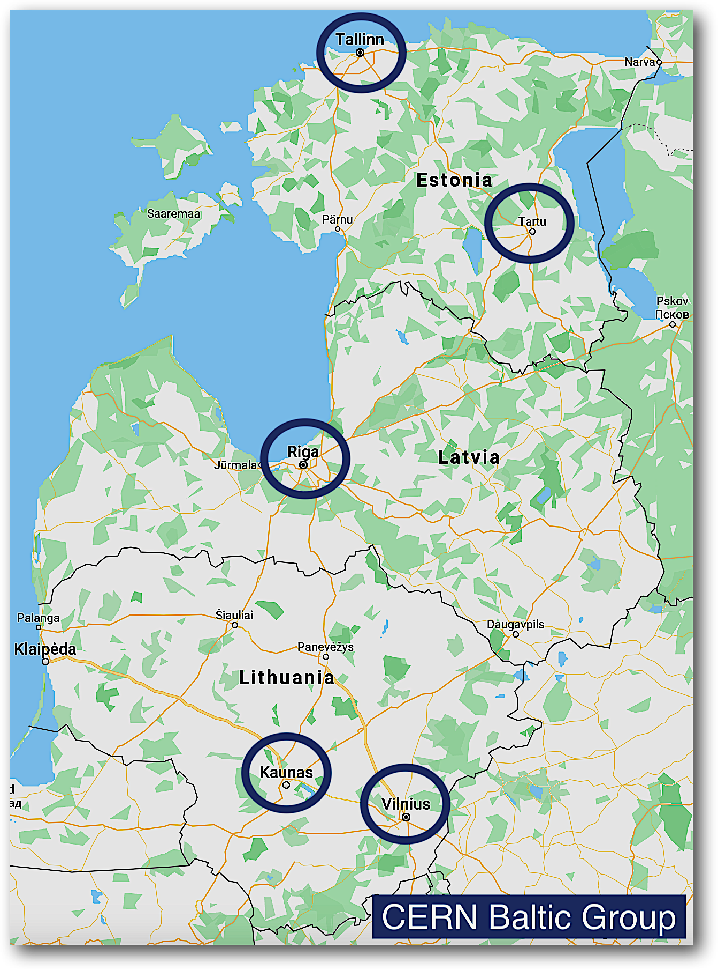
Site selection criteria
Clear and undivided support to the project from the national medical community at large (oncologists, radiologists, etc)
Strong and continuous political support: from the parliament, government, relevant ministries, and governmental agencies
Sustained Stakeholder engagement and participation in the project
The main site shall be integral part of the major oncology hospital. Physical proximity and access to the existing infrastructure is critical
Proximity to the international airport – max 50 km distance
Accessibility and servicing patients from all Baltic countries and beyond – accessible from the RailBaltica, its inter connections and major roads
Direct hosting facilities for the patients and their families
EC support for the chosen site

Slide 21
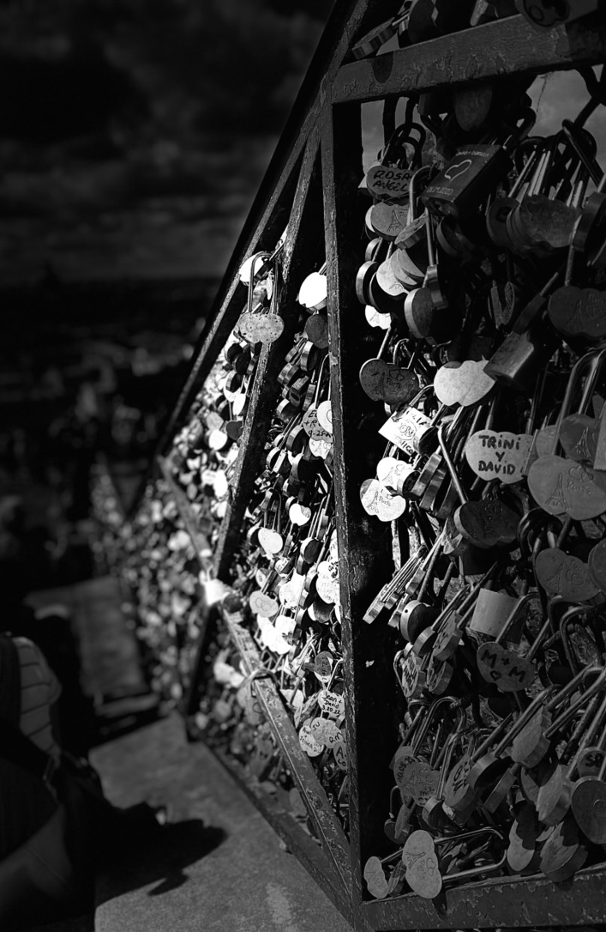
Take away
Visionary and long-term goals
Exciting and uniting
Flagship project for Baltics
Supported by CERN
Preventing brain-drain
Commercially viable
Goes hand in hand with development strategies of the Baltic States and overall EU priorities
Opportunity not to be missed…
Notes:
Your support is neede!

