Slide 1
Advanced Particle Therapy center for the Baltic States
Prof. Toms Torims
Chairman of CBG «Advanced Particle Therapy center for the Baltic States» working group

Slide 2
Advanced Particle Therapy center for the Baltic States
Research institution
Clinical facility
Infrastructure for industry involvement and future innovations
Particle
therapy
Nuclear
medicine

Slide 3
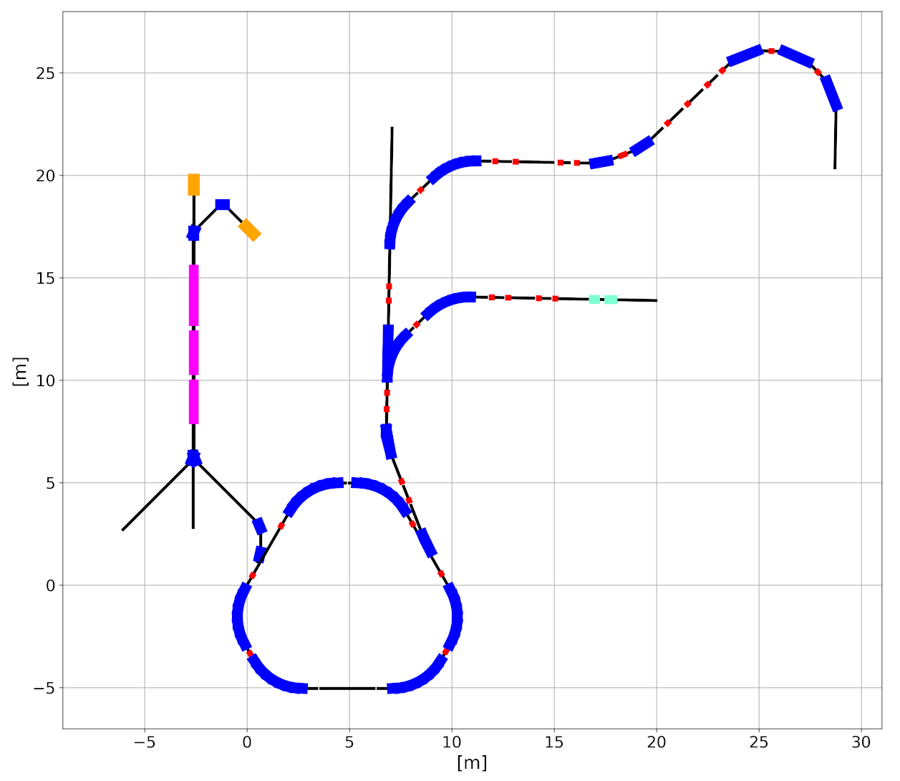
Overview
Helium synchrotron technology developed by CERN NIMMS collaboration
Unifying: clinically established proton therapy, research and clinical future on helium ion therapy, parallel LINAC based radioisotope production
Dedicated beamline for research – pre-clinical, medical physics, material science , nuclear physics etc.
Future perspective of innovations for the needs of particle therapy community
More – dedicated presentations in events
Design by Mariusz Sapinski, Elena Benedetto and Maurizio Vretenar

Slide 4
Current progress report

Slide 5
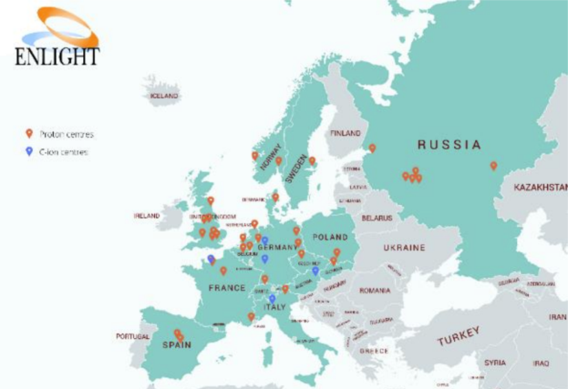
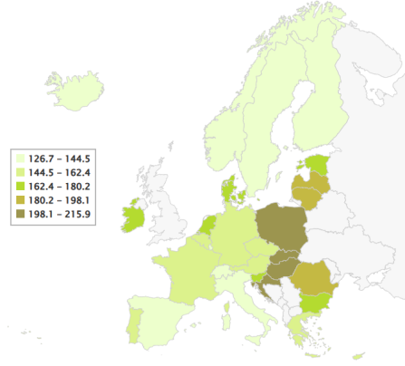
Initial steps
CERN Baltic Group discussions with CERN NIMMS collaboration on particle therapy facility options in the Baltic States
https://indico.cern.ch/event/1071872/
Particle therapy centre geography in Europe, ENLIGHT 2020
Cancer mortality rate in Europe per 100000 inhabitants,
data of 2020
End of 2021

Slide 6
Initial steps
Helium synchrotron – developing technology proving to be most cost-effective, sufficiently ambitious and minimum risk for our region
CERN NIMMS establishes helium synchrotron working group with participants from CERN Baltic Group
End of 2021
February 2022

Slide 7
Initial steps
9th CERN Baltic Group General Meeting
«Advanced Particle Therapy center for the Baltic States» working group is established within CERN Baltic Group
Chairman: Proffesor Toms Torims (RTU)
Deputy chair: Dr. Diana Adlienė (KTU)
https://indico.cern.ch/event/1138329/
End of 2021
February 2022
April 12th 2022

Slide 8
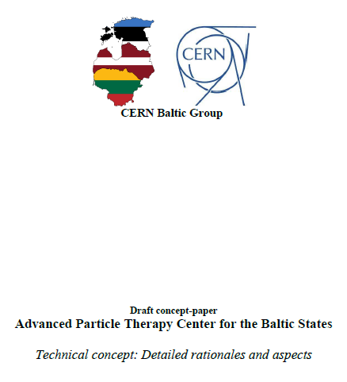
Concept paper development
A dedicated draft concept paper has been developed for the proposed facility
Outlines: relevant clinical aspects and rationales, proposed research directions, technical aspects etc.
End of 2021
February 2022
March – April 2022

Slide 9
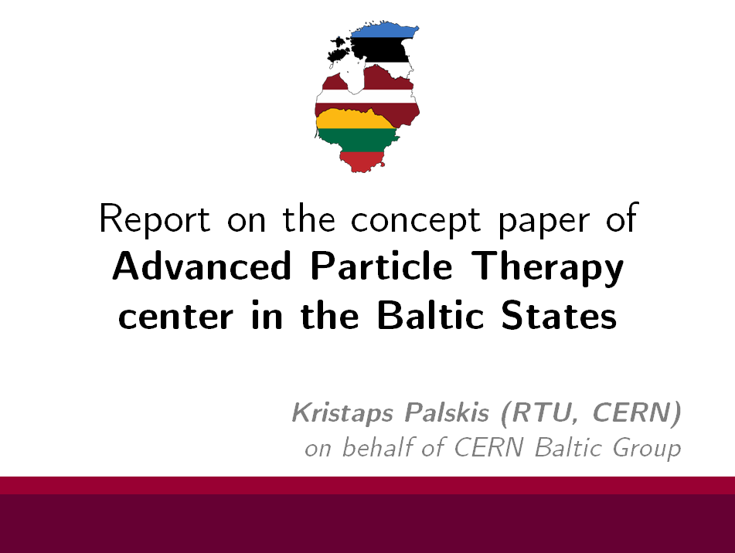
Concept presentation:
Scientific communities
21st meeting of the TIARA Collaboration Council
https://indico.cern.ch/event/1137672/ (March 29th , 2022)
Internally – NIMMS collaboration «Joint NIMMS-SEEIIST Meeting #82 https://indico.cern.ch/event/1176297/ (July 1st, 2022)
March – April 2022
Spring, summer 2022

Slide 10
Concept presentation:
Political stakeholders
Initial meeting: Baltic Assembly and CERN Baltic Group meeting https://indico.cern.ch/event/1117311/ (February 7th , 2022)
Baltic Assembly meeting of Health, Welfare and Family Committee (June 9th and 10th, 2022, Tallinn)
Also presented to:
  Baltic States ambassadors within EU COREPER I
  Investment and innovations agencies within the Baltic States
March – April 2022
Spring, summer 2022

Slide 11
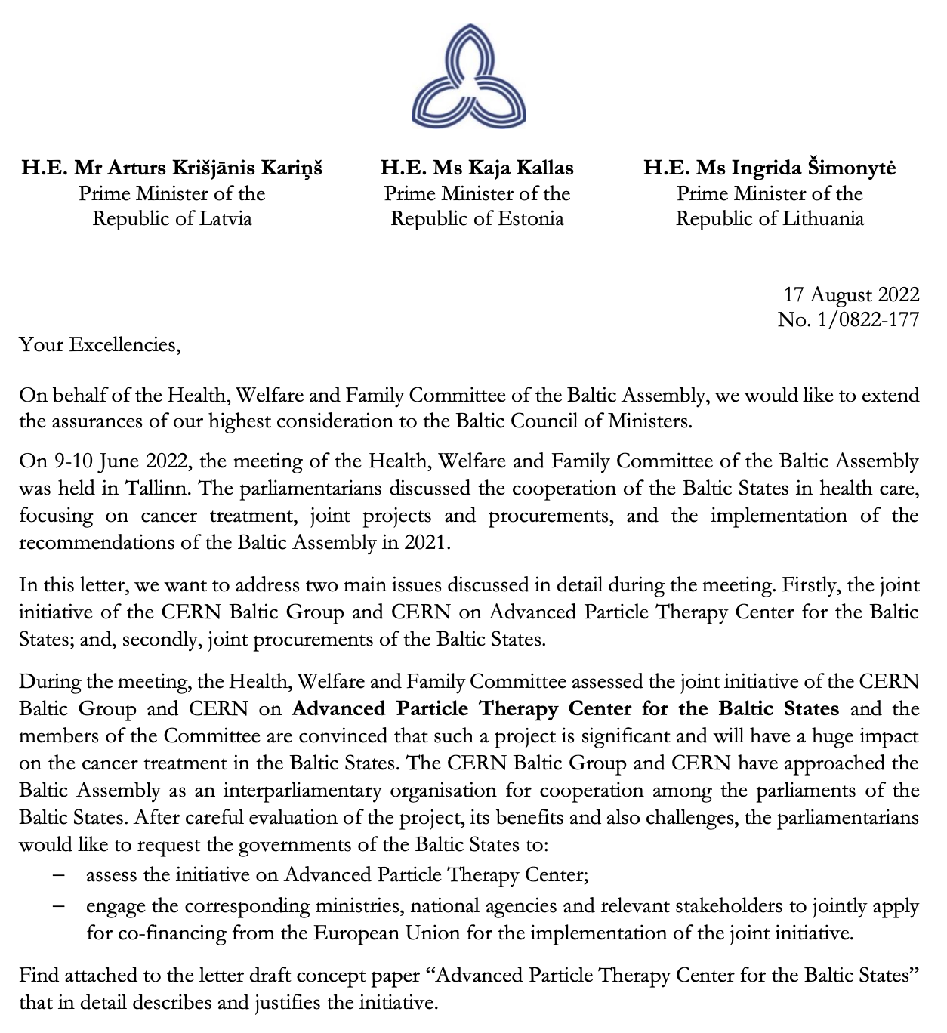
Concept presentation:
Political stakeholders
August 2022
Following Health, Welfare and Family Committee, Baltic Assembly adresses letters to the 3 Baltic State Prime ministers
March – April 2022
Spring, summer 2022

Slide 12
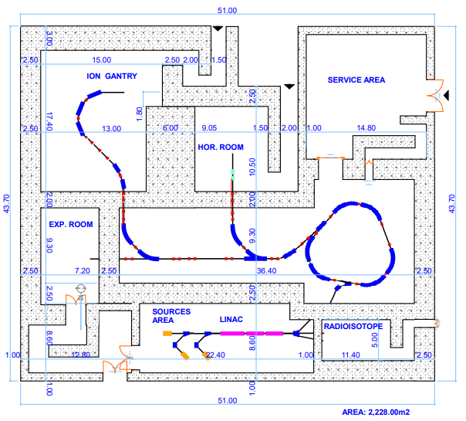
Facility initial plan
October 2022

Slide 13
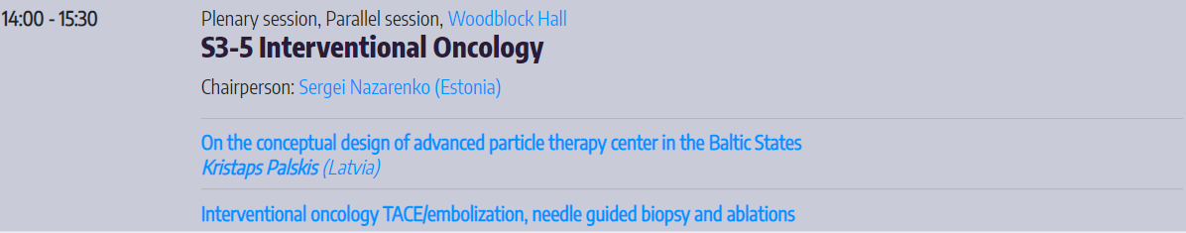
Concept presentation:
Initial steps in medical community
Presentation at 8th Baltic Radiology Congress
https://www.conference-expert.eu/en/bcr2022 (October 7th - 8th, 2022)
Also – at 2nd CERN Baltic conference
https://indico.cern.ch/event/1147717/ (July 10th – 12th, 2022)
March – April 2022
Spring, summer 2022
October 2022

Slide 14
Addressing Baltic medical communities
CBG «Advanced Particle Therapy center for the Baltic States» working group identified the crucial need to organize bilateral meetings with communities of radiologists, radiation oncologists, medical physicists, research institutions and political stakeholders
Main goals of the meetings:
  Informing community on technical aspects and latest developments of the project
  Understand position of the above-mention
  Identify relevant representatives for the further worked stakeholders
October 2022
November 2022

Slide 15
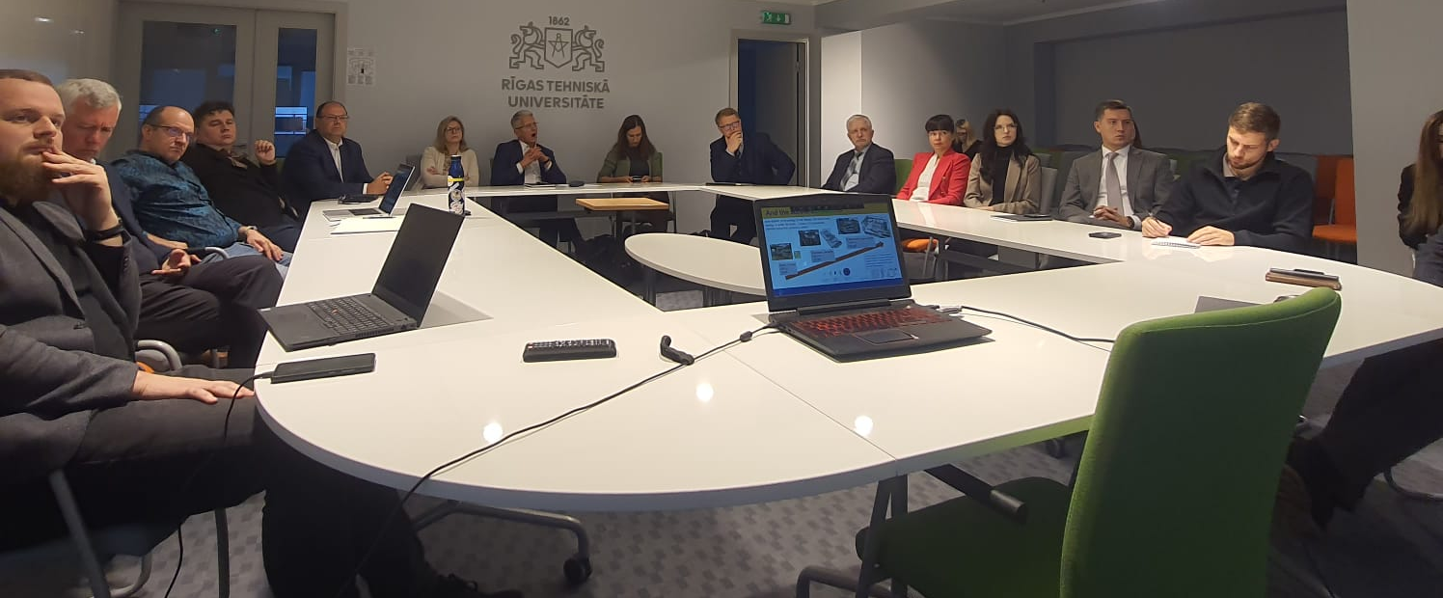
Addressing Baltic medical communities
Discussion in Riga, Latvia
18th of October, 2022
https://indico.cern.ch/event/1201786/
October 2022
November 2022

Slide 16
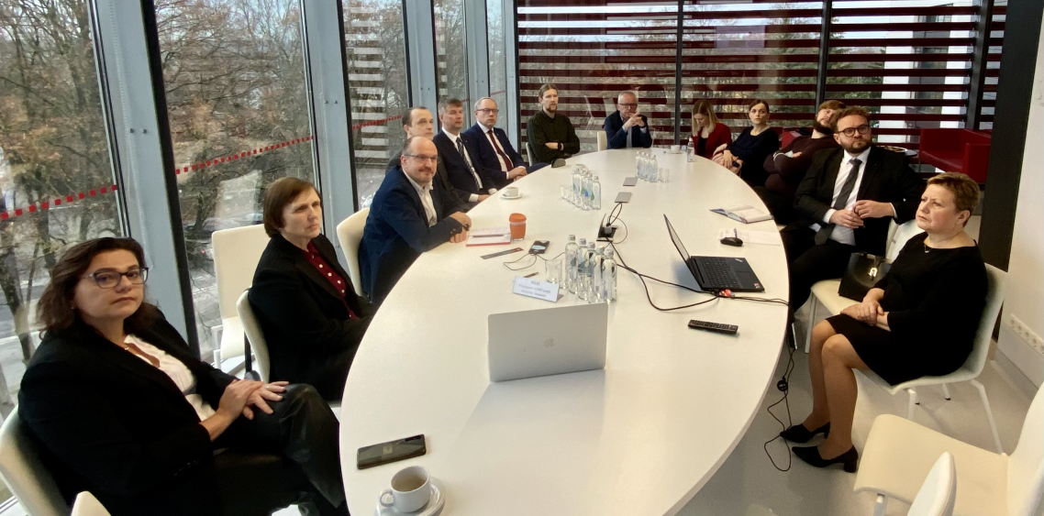
Addressing Baltic medical communities
Discussion in Kaunas, Lithuania
16th of November, 2022
https://indico.cern.ch/event/1216261/
October 2022
November 2022

Slide 17
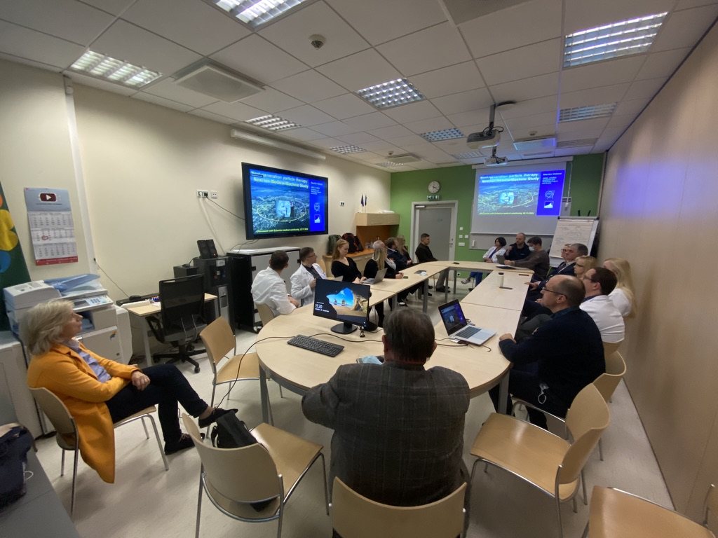
Addressing Baltic medical communities
Discussion in Tallinn, Estonia
22 November, 2022
https://indico.cern.ch/event/1221170/
October 2022
November 2022

Slide 18
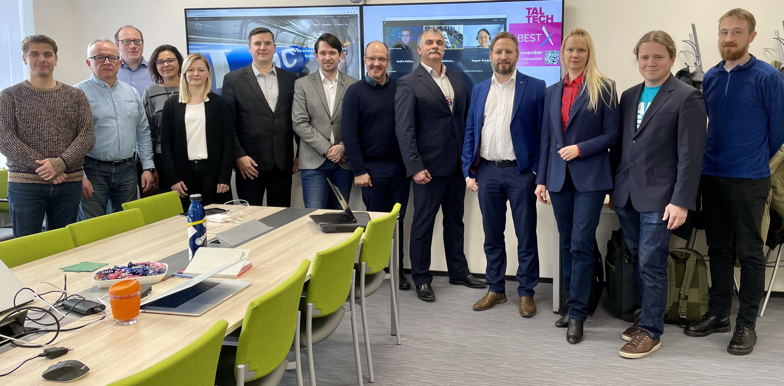
CERN Baltic Group
General Meeting
Tallinn, Estonia
21-22 November, 2022
https://indico.cern.ch/event/1215747/
October 2022
November 2022

Slide 19
Current key take-aways
There is high stakeholder interest, but further clinical aspect investigations must be done
Clinical indications for particle therapy, clinical trial results of proton therapy
Baltic States cancer statistics and localization profile
Patient selection and funding models in other European ion therapy centers
Experience exchange visits neccessary, future learning opportunity identification . . .
October 2022
November 2022
End of 2022

Slide 20
Future steps
Educational visit to one of the European particle therapy centers
To understand the workflow and clinical gains of particle therapy, educational visit to be done to one of European particle therapy centers in the first quarter of 2023 (possibly – CNAO or HIT)
A clinical team of 2 specialists (radiation oncologist + medical physicist) from each country to work on clinical case that could not be treated with conventional therapy in the Baltic States
End of 2022
Going into 2023

Slide 21
Future steps
IPAC 2023 contribution
A report on helium synchrotron design advancements are to be presented in International Particle Accelerator Conference 2023
A case study is proposed to be included in the contribution, indicating the cancer profile and statistics in the Baltic States and applicability of helium therapy for the future
End of 2022
Going into 2023

Slide 22
Future steps
A possible clinical seminar on particle therapy gains
A dedicated clinical specialist giving overview of particle therapy gains over conventional radiation therapy from one of the European particle therapy centers
Possibly, two seminars should be done – on particle therapy and on novel radioisotope usage in nuclear medicine
End of 2022
Going into 2023

Slide 23
Future steps
Joint Baltic stakeholder workshop on Advanced Particle Therapy center in the Baltic States
CERN, Geneva in first quarter of 2023
Based on the identified concerns in medical community discussion meetings – workshop adressing and discussing potential development
Clear involved medical community and association consensus to be reached for the future of the project
End of 2022
Going into 2023

Slide 24
Agenda for the workshop
What is the current technology readiness level of the technology proposed?
What will be the costs and benefits at the regional scale?
What would be the estimated clinical efficiency, taking into account statistics
and prognosis of the number of eligible oncological cases in the Baltic region?
What are the alternative treatment methods in the region?
What are the main project-associated risks and how they will be addressed and
managed?

Slide 25
Agenda for the workshop
What will be the role of the CBG partner universities?
What will be the potential of the local industry involvement?
What further clinical trials are needed at the current and future stages of
proton and helium ion therapy clinical use?
What is the link between this initiative and “EU Mission: Cancer”?

Slide 26
Identified team members
Torims Toms Riga Technical University/CERN
Paļskis Kristaps Riga Technical University/CERN
Adliene Diana Lithuanian Association of Medical Physicists and Engineers/KTU
Korobeinikova Erika Lithuanian University of Health Sciences
Juozaitytė Elona Lithuanian University of Health Sciences
Radziņa Maija Latvian Society of Radiology
Š̌orubalko Arturs Latvian Therapeutic Oncology Association
Kalniņa Marika Baltic Nuclear Medicine Association
Gershkevitsh Eduard Estonian Society for Biomedical Engineering and Medical Physics
... other experts?

Slide 27
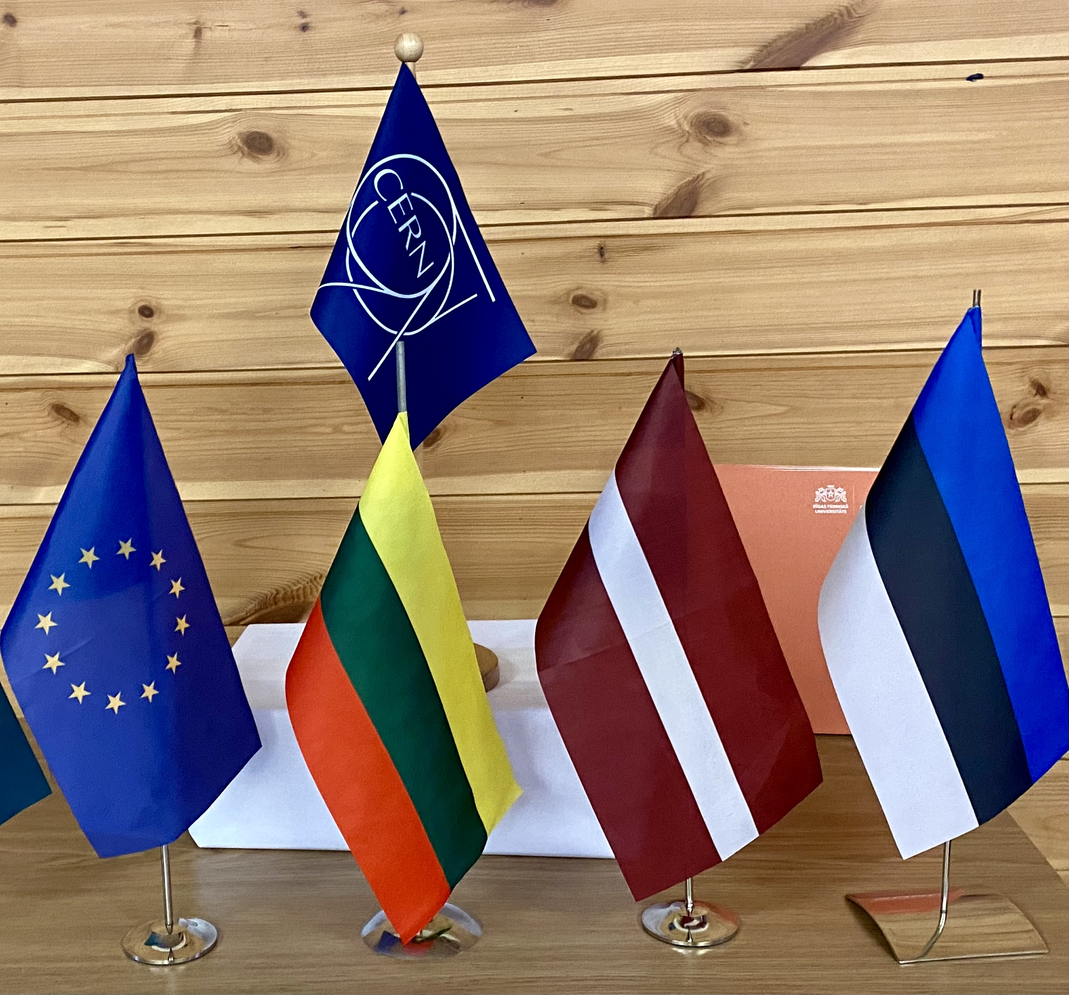
CERN Baltic Group
We are strong together

