Slide 1

Warm skew quad installation: preliminary analysis
G. Bregliozzi, J.P. Corso, P. Fessia, S. Maridor, M. Martino, E. Page, H. Thiesen, P. Thonet, Y. Thurel
IT task force 17/02/2023

Slide 2
Outline
Data on the proposed magnet
PC characteristics and possible availability
Vacuum lay-out proposals
Integration on the beam line, preliminary analysis

Slide 3
Magnet P. Thonet

Slide 4
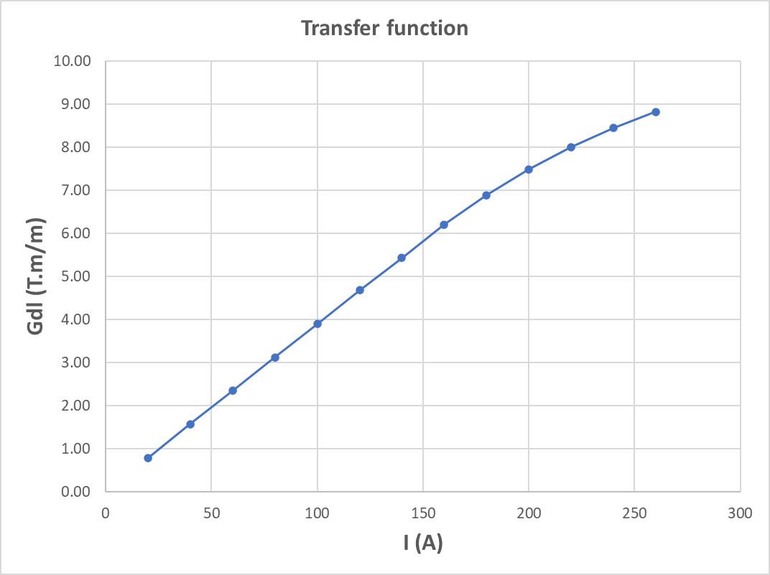
Preliminary tests on SPLQS__NWP-00000028 magnet
Some preliminary tests and measurements were done on the SPLQS__NWP-00000028 skew quadrupole:
The magnet was tested up to 260 A but P. Thonet would recommend to not go over 240 A to limit the D T to 30°C. For such current we would have the following operation values:
- D P demineralized water: 12 bar
Water flow: 6 l/min
I: 240 A
- D T: 30°C
During the test we measured the pole field at 150 far from the extremity with a Hall probe to evaluate the saturation. The measured values are listed in the following table:

Slide 5
Test results and future actions
The magnet could electrically work up to 240 A with 12 bar D P.
• LSS1L : Sector 81, D P available 10,7 bar ;
• LSS1R : Sector 21, D P available 11,9 bar ;
• LSS5L : Sector 45, D P available 13,1 bar ;
• LSS5R : Sector 56, D P available 11,0 bar.
Less then desired but should be enough to keep the magnet temperature below 50 C for the selected current
If the magnet is powered with more than 180 A, P. Thonet would recommend to install an interlock on water flow (Eletta) to not take the risk to overheat the coil in case of water supply failure .
From first and approximative magnetic measurements the quadrupole starts to saturate between 160 A and 180 A (quadrupole center).
All these values (field integral and transfer function) shall be confirmed by a proper magnetic measurement campaign (from mid of February).
The magnet has been certified in the workshop at the moment and also renewed according to the present standards. He will be sent next week to magnetic measurement that should confirm the preliminary data shown in the previous slide
Next point to be verified available water D P in the installation location
Agreed working proposal
Circuit current rating 180 A for integrated gradient of 6.9 T/m*m

Slide 6
Power converters M. Martino, H, Thiesen, Y. Thurel

Slide 7
Power Converter proposal
Identified PC candidate providing
1 Quadrant
200A-60 V PC [recommended up to 190A continuous operation]
100 ppm stability of 200 A
Time constant ≤0.4 s
Volume 1 PC=1 rack
Requested 2 A/s, possible with this PC choice up to 5A/s
Possible to regulate around 2 A i.e. 1% of the nominal
Space probably available near present installed triplet PC [UL14, UL16, UL557, USC55]
Cable section to be evaluated (probably around 100 mm²).
Cost of the long lead time components (only long lead ones) for 1 PC only : 15 kCHF
Delivery time of the above components 6-7 months from the date of the order
Next points to be checked the WIC/PIC connection, the detail of the space for the racks (both power and control), the cable path to confirm cable lengths, hence sections (cable request needed 9 months before installation), the IT network infrastructure (Ethernet socket,…)

Slide 8
Vacuum lay-out preliminary analysis G. Bregliozzi, E. Page

Slide 9
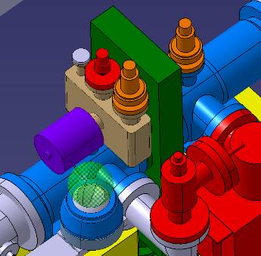
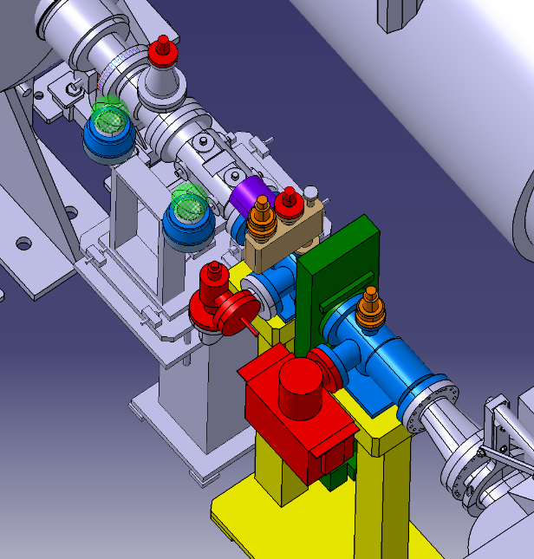
Current situation in 4R1
2 modules with bellow
2 penning gauges (1 on each side of the sector valve)
1 ion pump (CH4 pumping)
2 NEG cartridge (H2 pumping)
1 sector valve
1 support
v
1 pressure relief valve
TE-VSC needs minimum equipment for pressure indication, pumping, safety and control interlocks

Slide 10
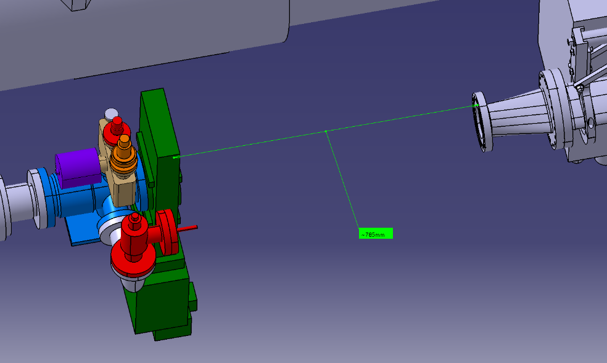
Solution C
1 module with bellow
2 penning gauges (1 located after the first MBXW)
1 valve for rough pumping
1 NEG cartridge
1 ion pump located after the first MBXW
1 sector valve (new type)
Corrector on Room Temperature side
1 pressure relief valve
785mm enough for the corrector + vacuum chamber?
1 potential issue: quite rigid assembly

Slide 11
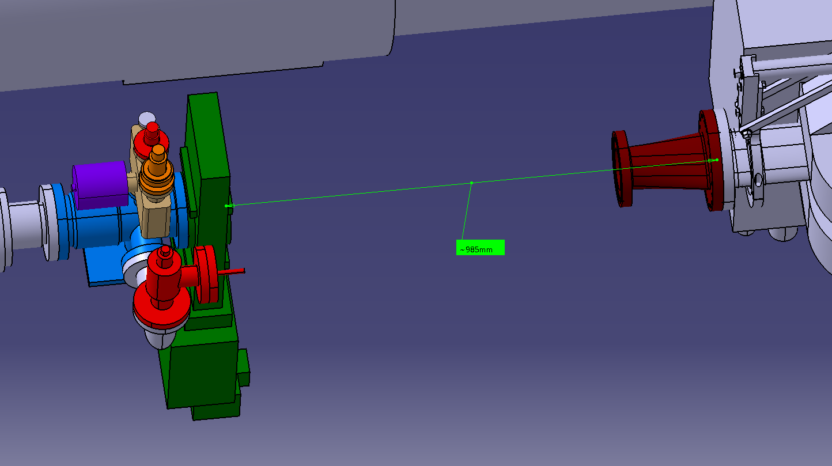
Solution D
1 module with bellow
2 penning gauges (1 located after the first MBXW)
1 valve for rough pumping
1 NEG cartridge
1 ion pump located after the first MBXW
1 sector valve (new type)
Corrector on Room Temperature side
Transition inside the corrector chamber
1 pressure relief valve
965 mm for the corrector + vacuum chamber (20 mm margin for the bellow)
1 potential issue: quite rigid assembly

Slide 12
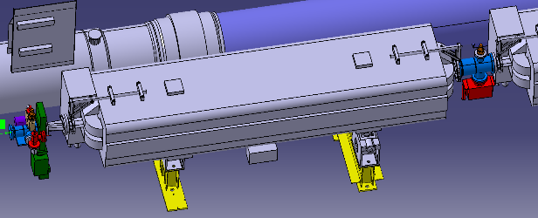
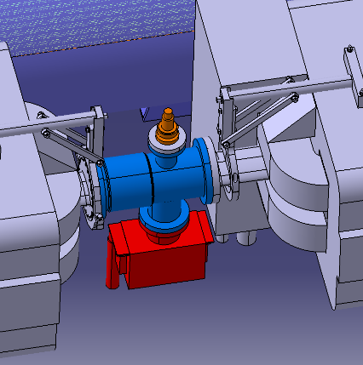
Solution B and D
1 new module
1 penning
1 new ion pump

Slide 13
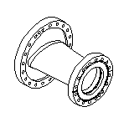

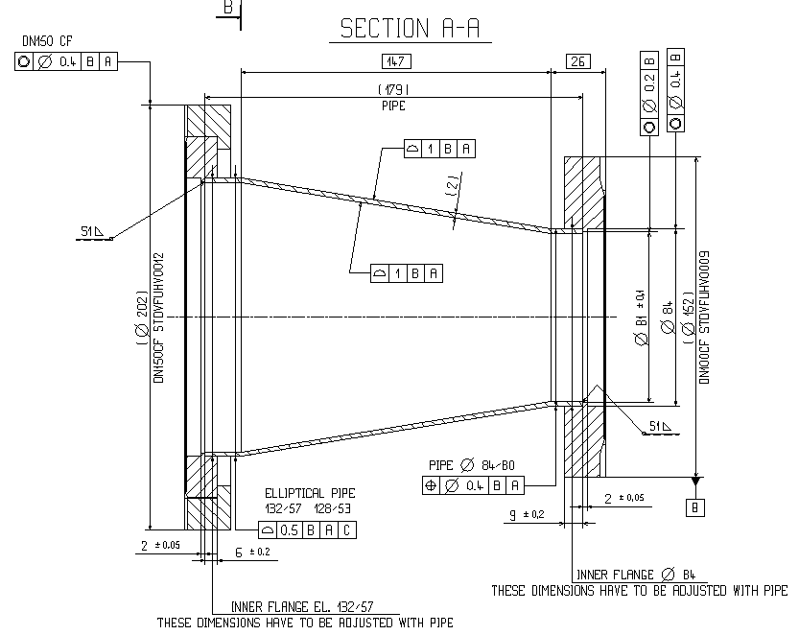
Transition part VCTNC – Could its length be reduced?
Current Length L=200 mm
L can be decreased to 120 mm for keeping the maximum angle of 15° imposed by impedance

Slide 14
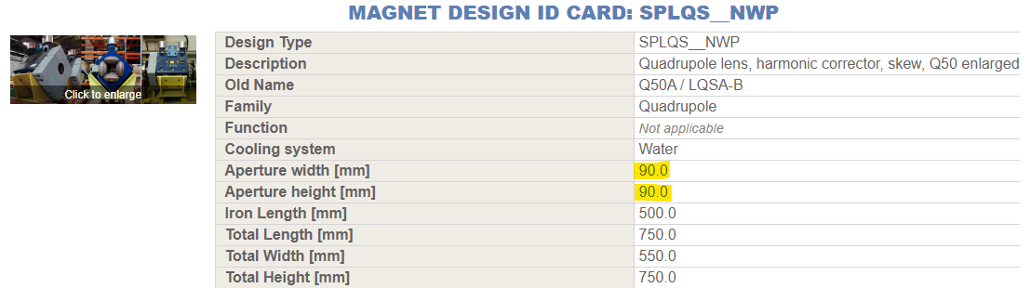
Aperture check
The transition chamber could be inner diameter 80 to Elliptical 128/53 mm

Slide 15
Important remarks
The BPM removal and the displacement of beam vacuum sector valve will require the triplet warm up
The magnet will be probably equipped with a carbon coated chamber to avoid bake out, dealing with possible issue of chamber/coil proximity

Slide 16
Skew quadrupole integration and installation preliminary considerations J-P. Corso, P. Fessia, S. Maridor
Transport analysis for installation just started
C. Bertone M. Perez Obredo

Slide 17
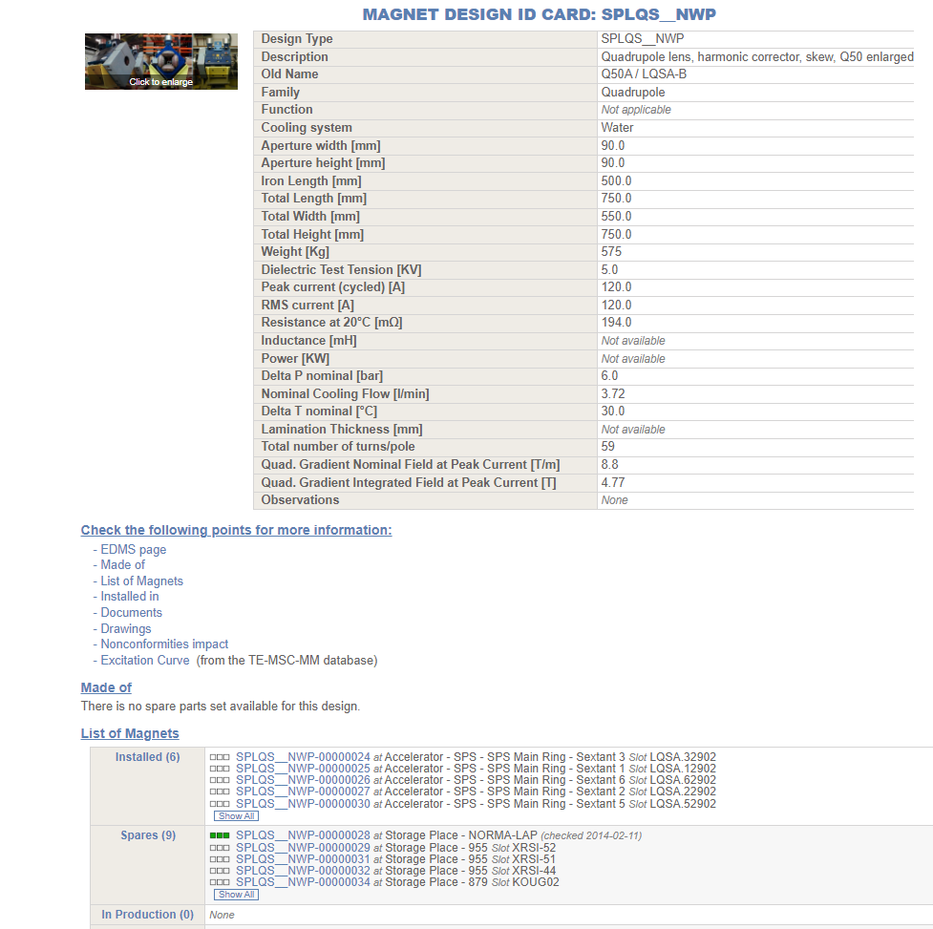
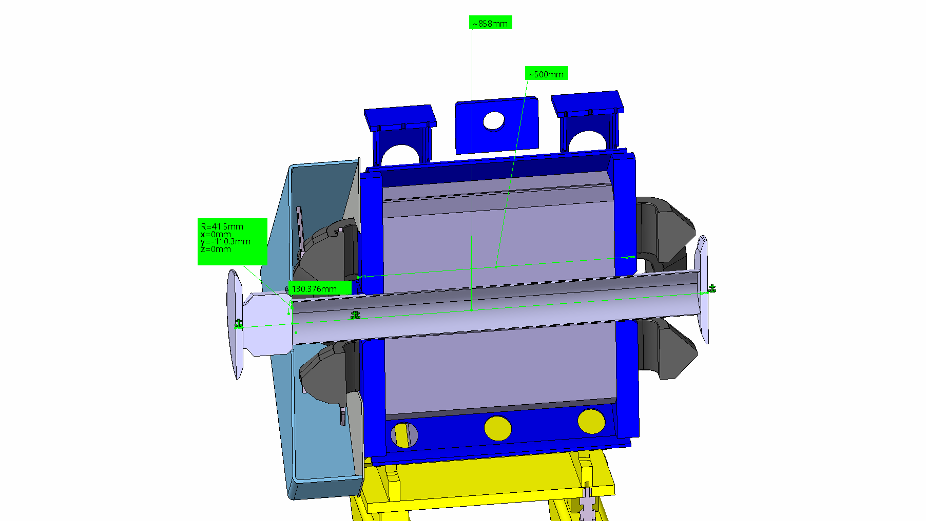
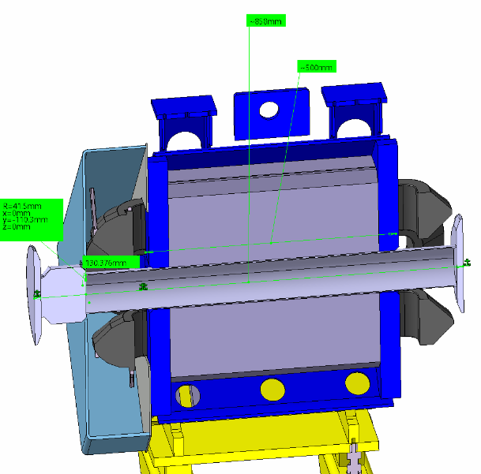

Slide 18
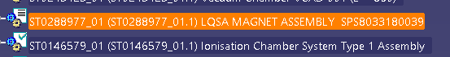
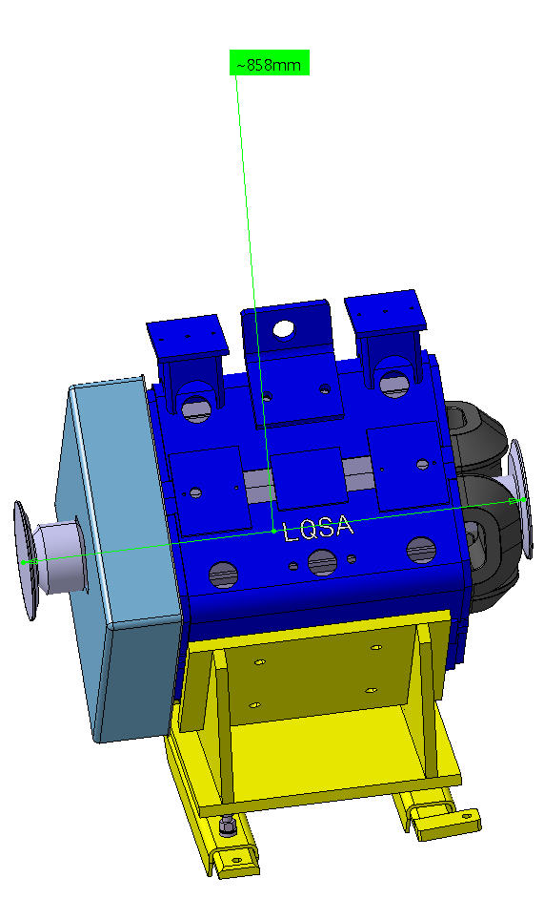


Slide 19
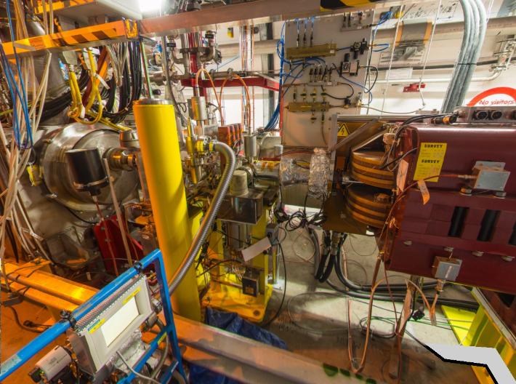
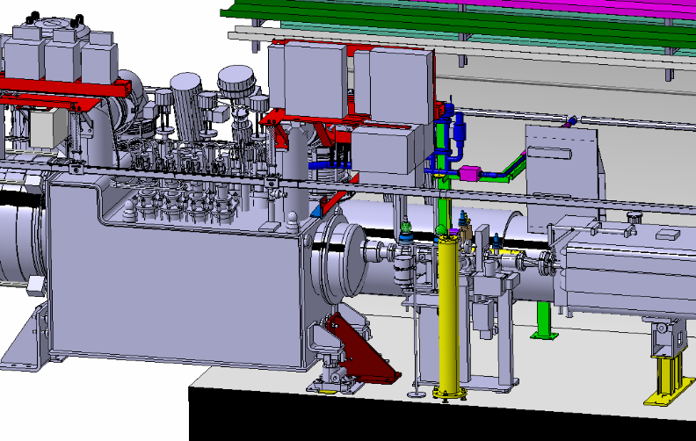
Issues common to the 4 IP sides
Wire positioning system: it could be necessary to remove it for installation.
See BE-GM slide later
No loss of reference
No showstopper, but taking time
ALARA analysis needed

Slide 20
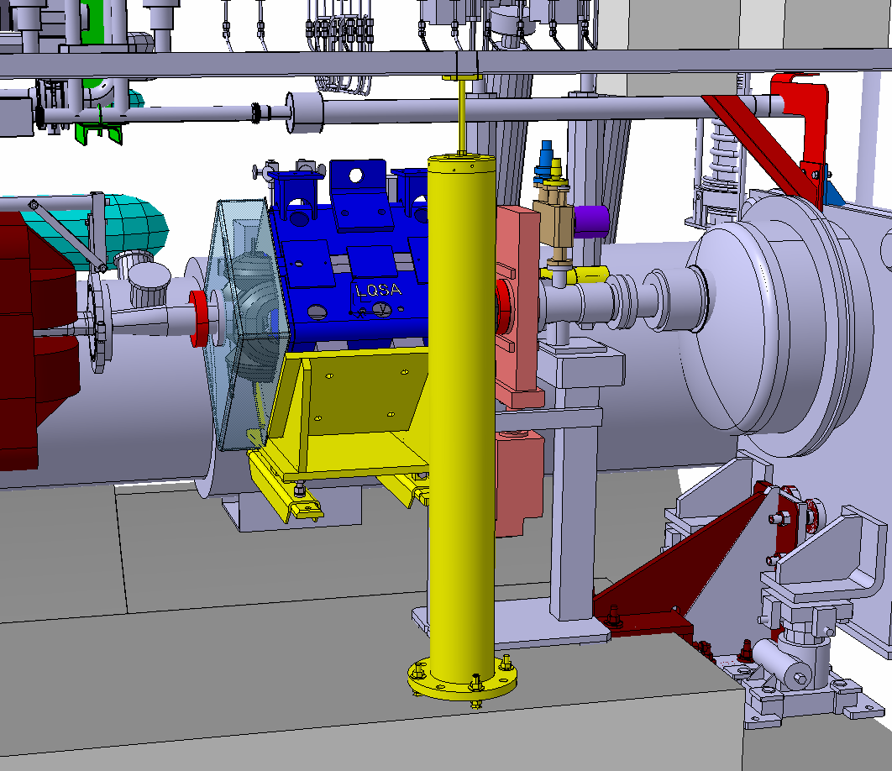
P5 L

Slide 21
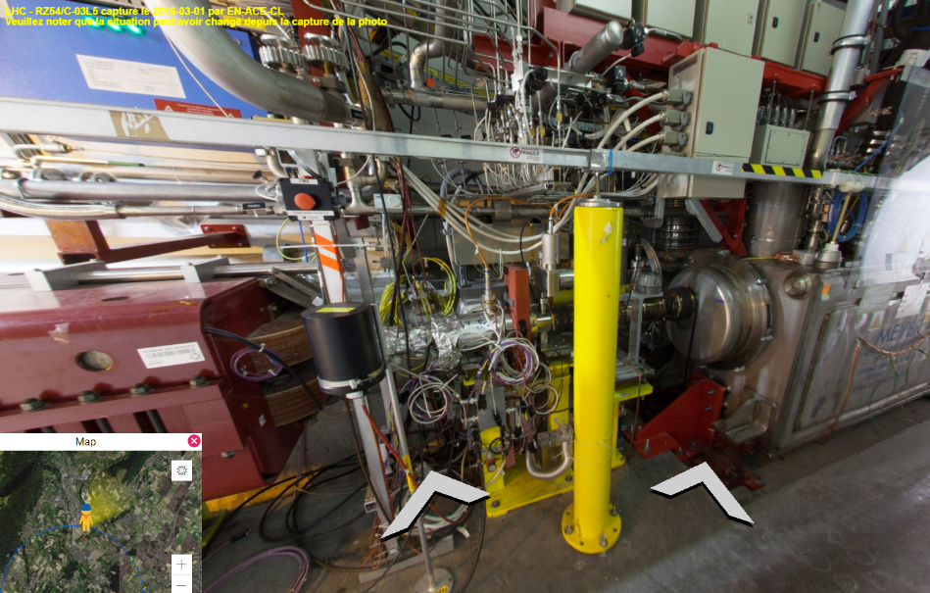
Issues common to the 4 IP sides
RP PIM to be removed
BLM to be moved
Cabling is quite massive
Needs to be verified on the field with experts

Slide 22
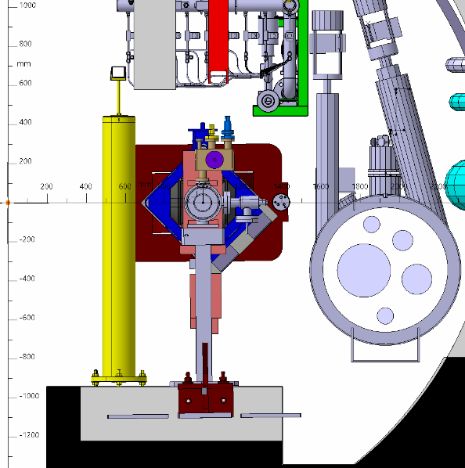
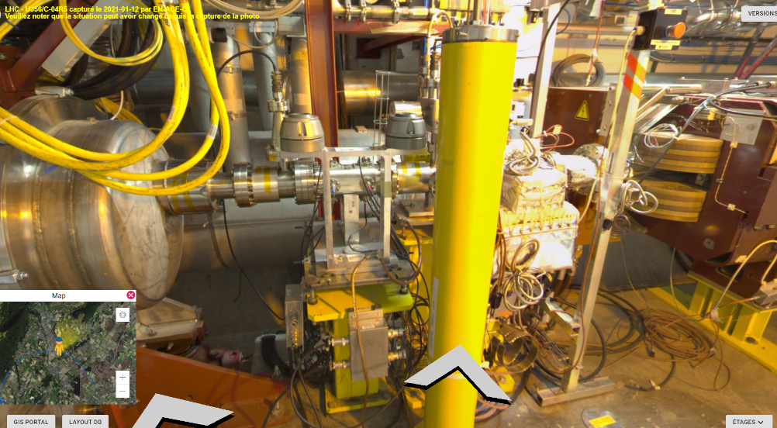

Issues common to the 4 IP sides
DFBX Ancillaries and their support structure
The structure are slightly different from IP to IP.
Need to check if they can be an issue for handling in height for the de-installation and installation
Modifications are very probably needed in 5R and 1L. It s required to find solution to keep elements in place while changing the system

Slide 23
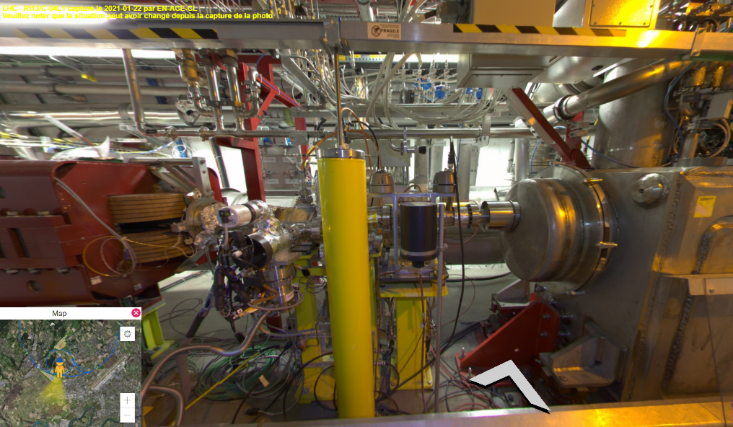
Issues common to the 4 IP sides
Vacuum supports
According to local specificities special vacuum supports could be needed

Slide 24
Survey implications A. Herty

Slide 25
BE-GM-HPA
Installation of a warm skew quadrupole would have major impact
time for activities per IP side approx. 1 (1.5) week for a survey team
extensive exposure to radiation of BE-GM-HPA personnel due to recalibration of WPS
Any installation type not requiring to dismount the wire (wire protection stays in place) would be the preferred solution for BE-GM
note
This analysis only takes into account the part for BE-GM-HPA and the impact to the alignment monitoring system. All alignment actions for the installation of this component (BE-GM-ASG) are not taken into account.
Warmup process
validation of alignment system (0.5/1 [d/person])
follow up during warmup / venting process (1.0/1)
Dismounting (0.5/2)
a) dismount wire, wire protection and yellow pillar removal
b) secure wire protection, yellow pillar removal, check measurement system integrity
Installation (1.0/2)
installation yellow pillar, wire protection and wire
recalibration of WPS sensors due to new reference wire (2.0/2, Q1-D1)
validation of alignment system (0.5/1)
Consequences / impacting factors
no radial measurements and link left-cavern-right for the time of intervention (wire dismounting to wire installation)
recalibration of WPS sensors mandatory in case wire dismounted (=exchanged)
bakeout ?
Remarks: displacement of the 1st MBXW could be very complicate as it is support of one of the main BE-GM reference
FTE (d per IP side)
3.5 engineer (+2.0)
1.5 technician (+2.0)
Andreas Herty on behalf of BE-GM-HPA · 16.02.2023

