Slide 1

The Status, Challenges and Opportunities of Medical Physics in Africa
Chris Trauernicht
Head of Division: Medical Physics – Tygerberg Hospital
Associate Professor – Stellenbosch University
South Africa
cjt@sun.ac.za

Slide 2
Contents
My background
What is Medical Physics?
Medical Physics in South Africa
  Background, Education and Training Requirements, Current Status
Medical Physics in Africa
  Current Status, Challenges, Opportunities
FAMPO

Slide 3
My background:
BSc – Physics and Applied Maths (UCT) – 1995-7
BSc (Hons) – Theoretical Physics (UCT) – 1998
I completed my clinical training in October 2005
Worked at iThemba LABS for two years
Then spent 9 years at Groote Schuur Hospital
At Tygerberg Hospital since Feb 2017
No conflict of interest to declare

Slide 4
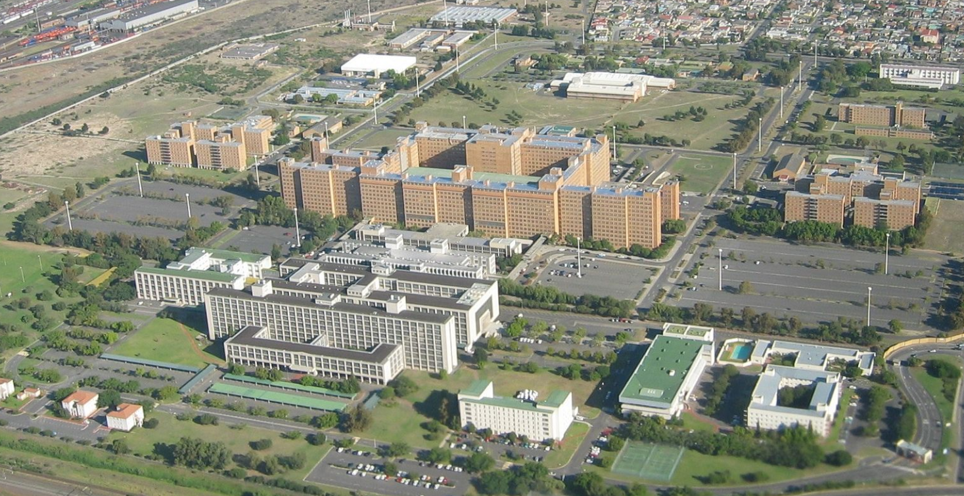
Tygerberg Hospital
Tertiary hospital in Cape Town, opened in 1976
1386 beds

Slide 5
What is Medical Physics?
Medical physics is an applied branch of physics involving the application of physics concepts and methods to the diagnosis and treatment of human disease.
It integrates core knowledge in traditional physics disciplines with specific domain knowledge, including
- the science of healthcare delivery
- effects of exposure to ionizing and non-ionizing radiation
- optimization of imaging and therapeutic procedures
- image science and image analysis
- data analysis and statistics
- quality assurance and improvement
- …

Slide 6
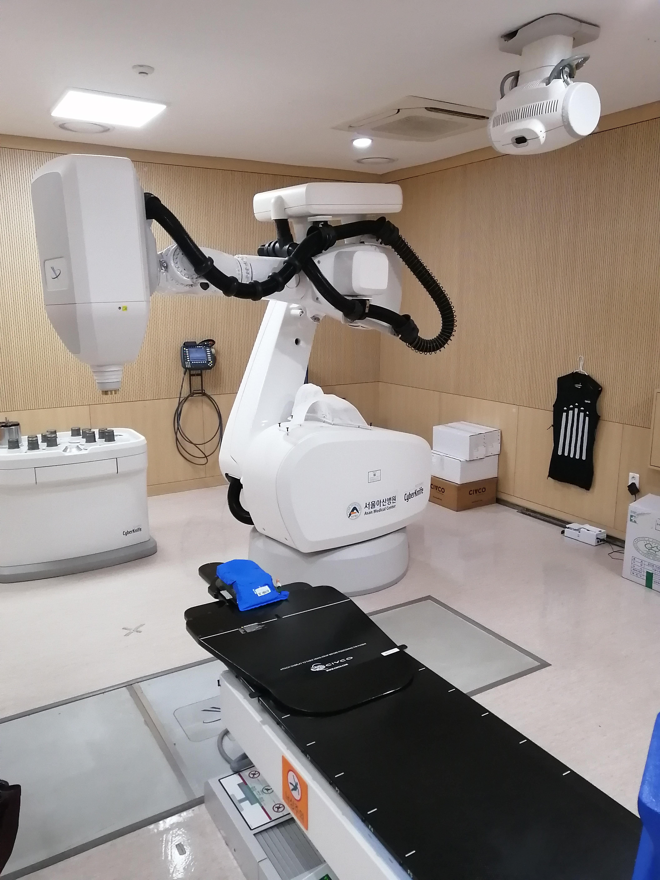
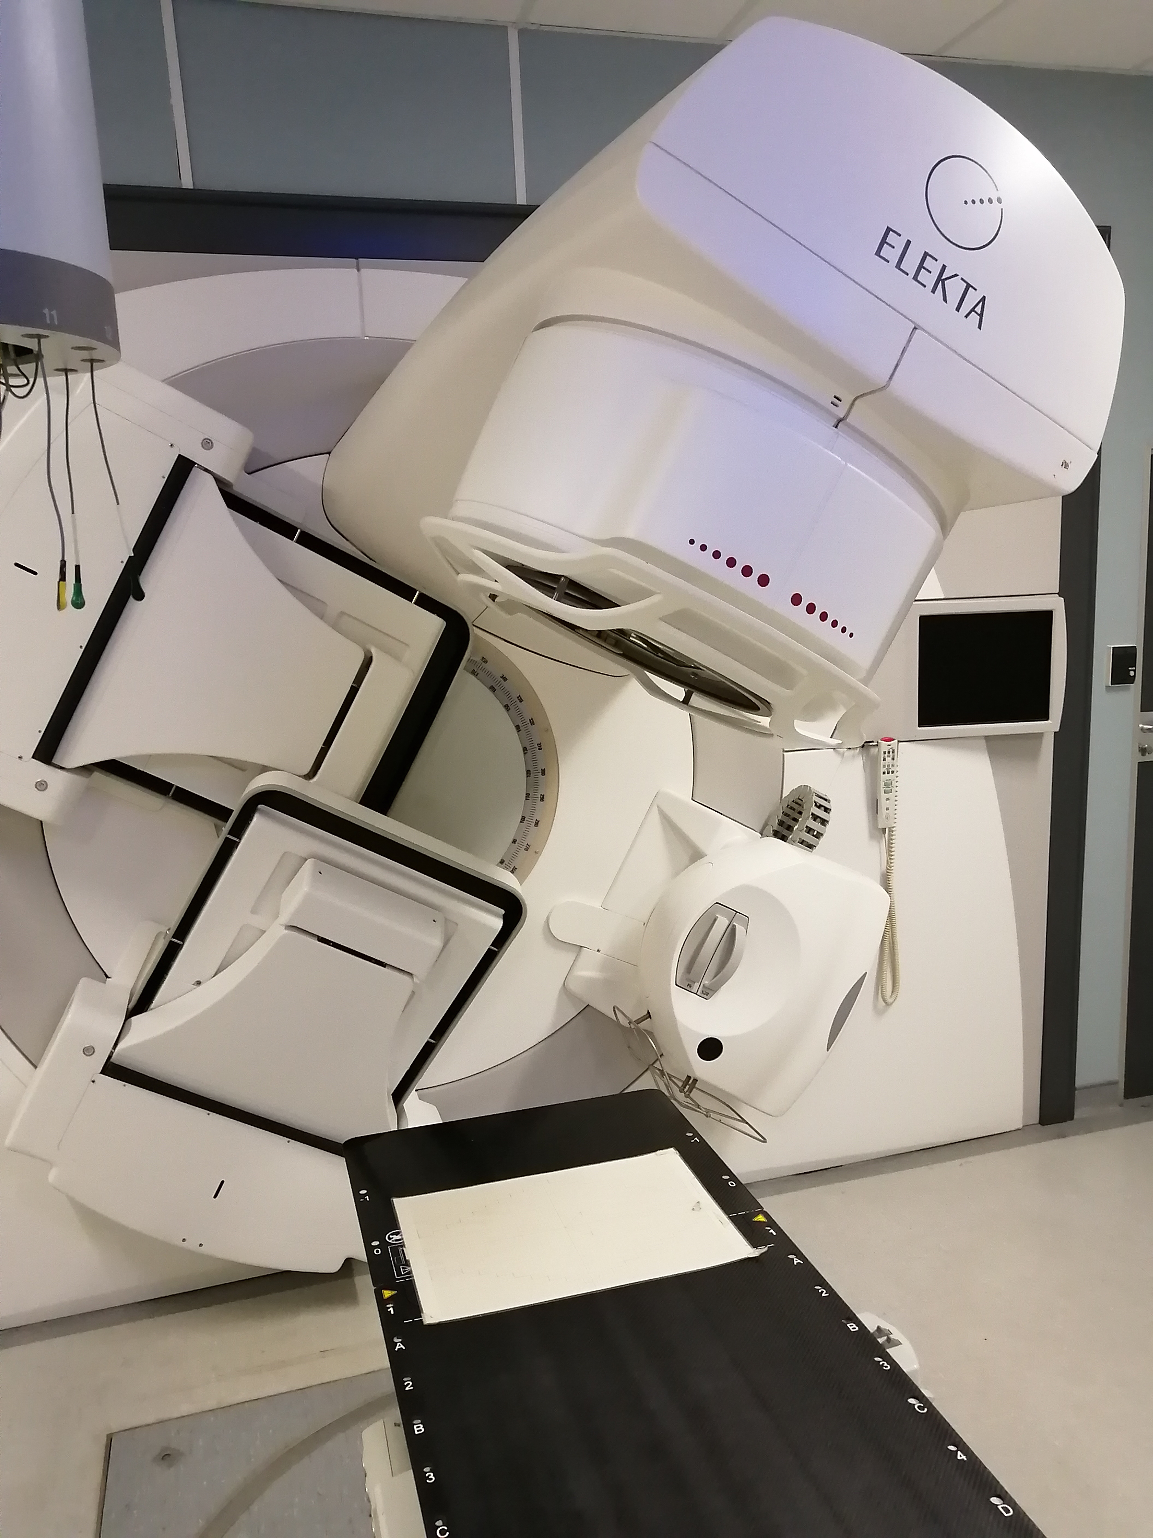
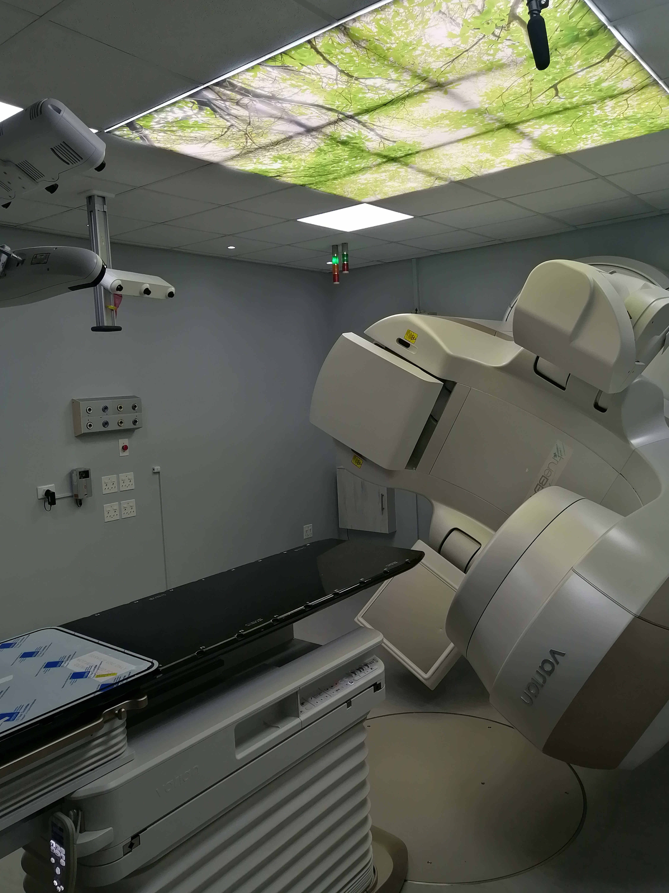
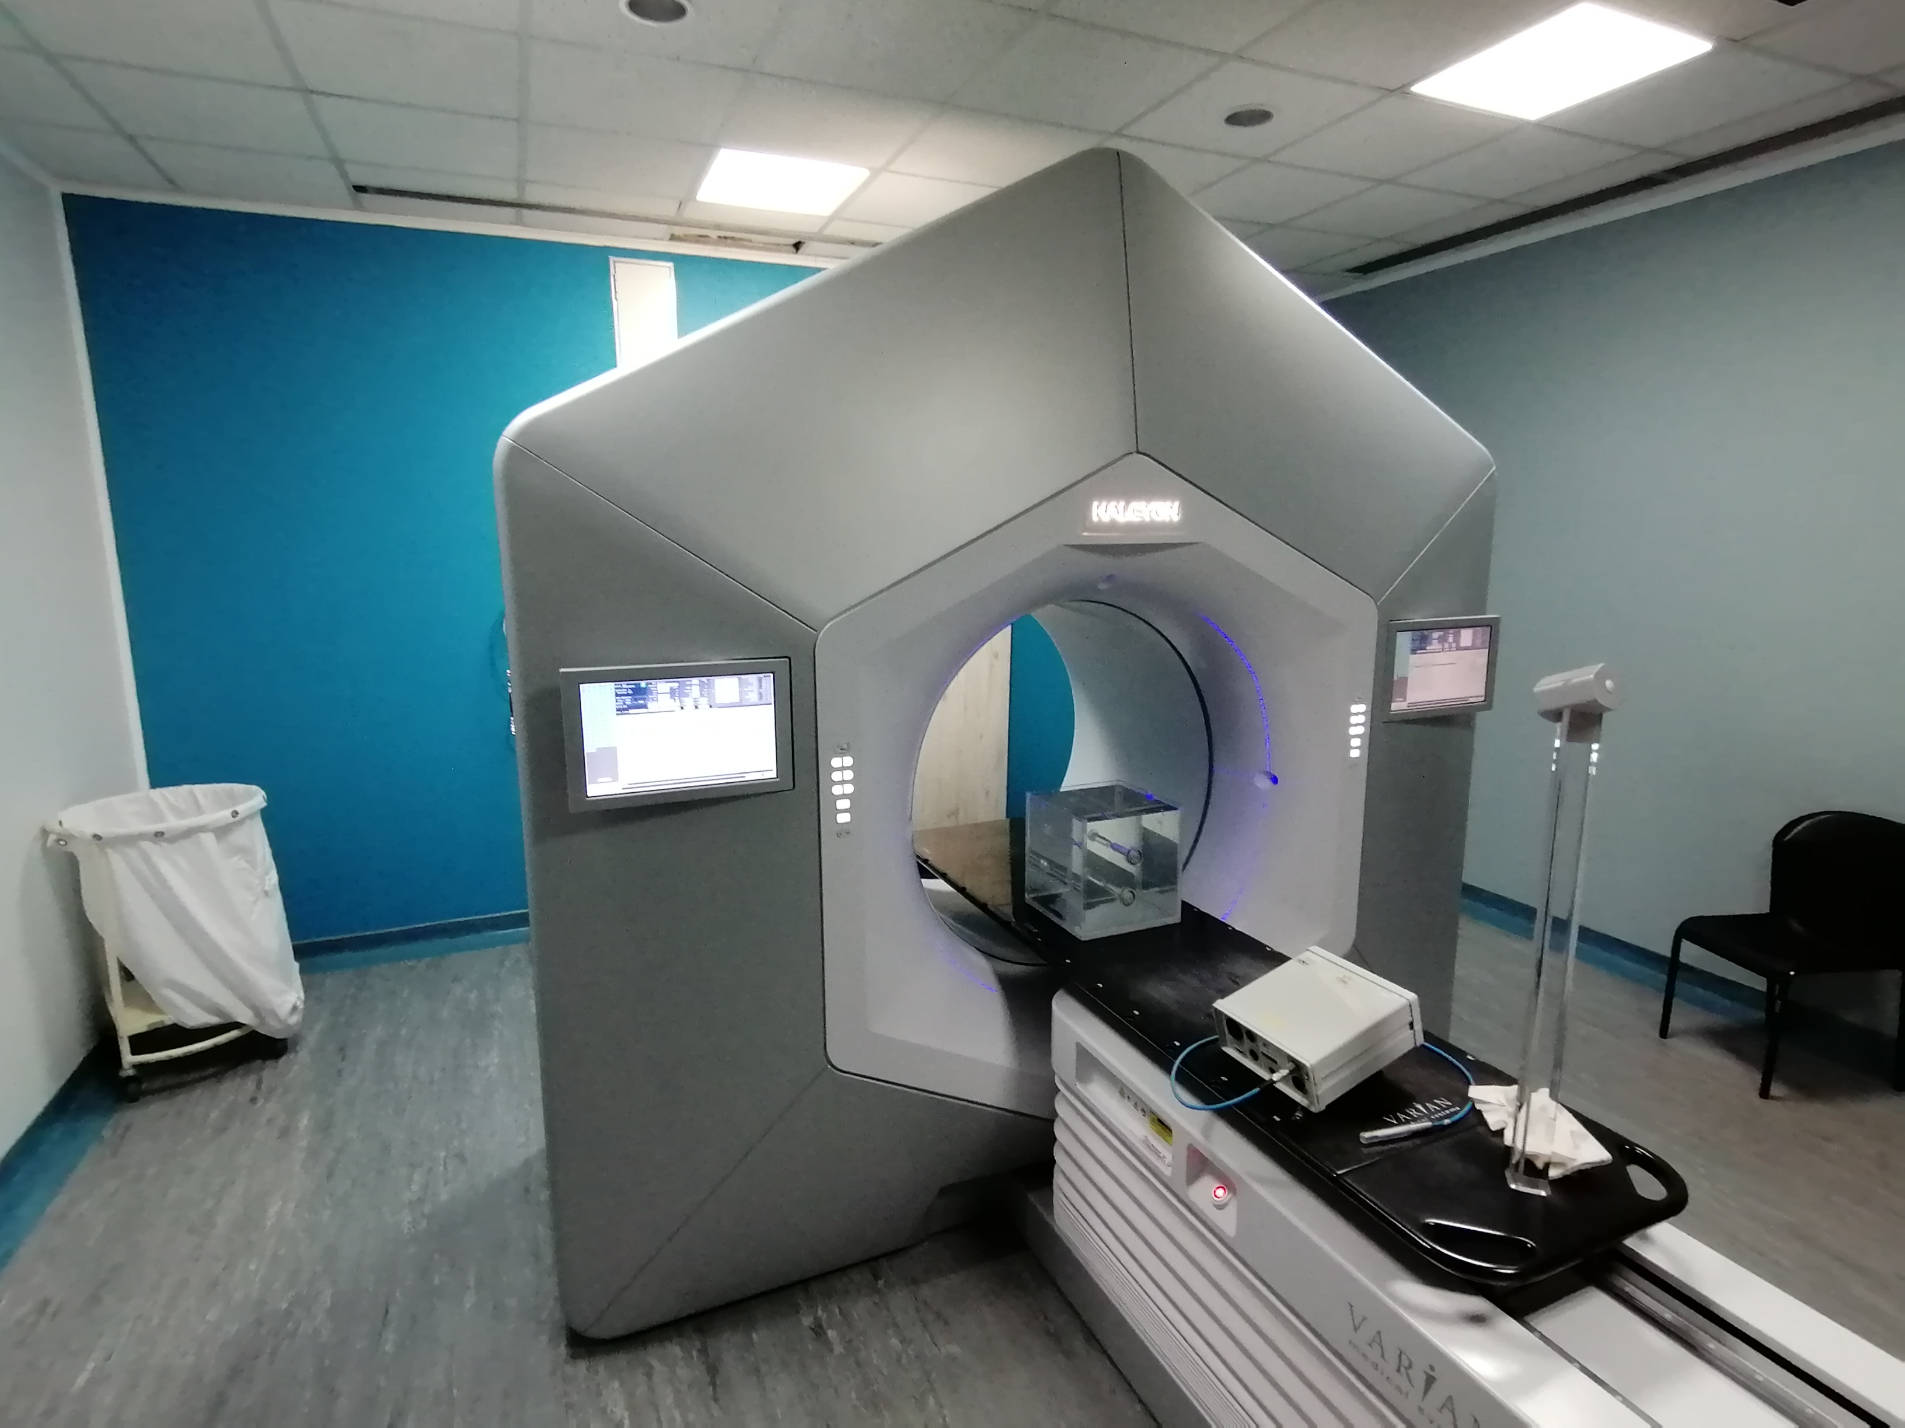
Clinical service delivery
Mainly in radiotherapy, nuclear medicine, diagnostic and interventional radiology, and the radiation protection aspects of these

Slide 7
Research and Development
- asking questions around the biological effects of radiation
- patient dose calculations
- new techniques
- use of AI and machine learning …

Slide 8
Education

Slide 9
Administrative component
Regulatory component
Accreditation component

Slide 10


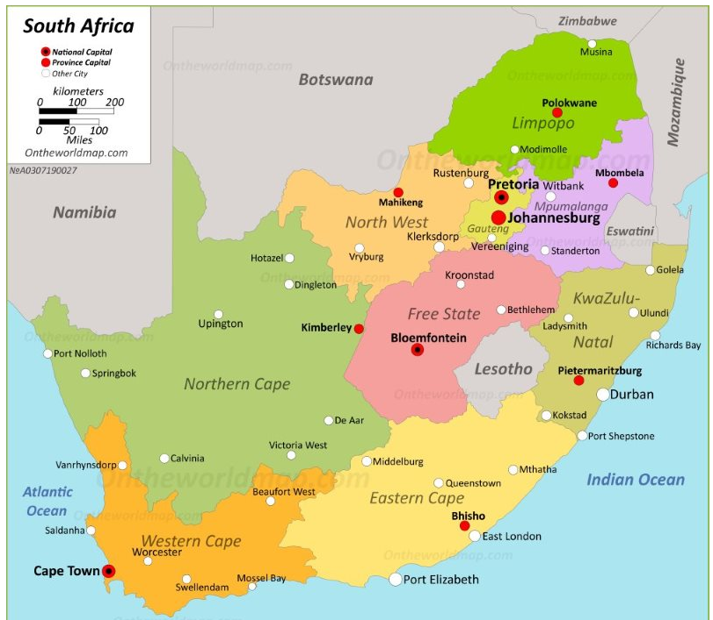



Medical Physics in South Africa
1.22 M km² (471.000 sq miles)
~58 M people
9 provinces, 11 official languages
Classified as Upper Middle Income Country

Slide 11
Large inequality
2015: 71% of net wealth held by 10% richest of the population
60% of the poorest hold 7% of net wealth
About a quarter of the population lives on <1.25 USD /day
~17% of SA population has access to private healthcare, but private sector accounts for about half of all SA healthcare expenditure and employs 70% of healthcare specialists

Slide 12
2015 study on licensed imaging equipment
Only three provinces have the full spectrum of imaging modalities
General radiography: 34.8 units / million
Fluoroscopy: 6.6 / million
Mammo: 4.96 / million
CT: 5.0 / million
Discrepancy 11-fold between best and least-resourced province
Discrepancy 13-fold between private and public sectors.
MRI: 2.9 / million (46-fold discrepancy btw private and public sectors)

Slide 13
Background
From 1940’s: Groote Schuur Hospital (Cape Town) started using radium sources, later also gold and tantalum, still have a well-established I-125 LDR (ophthalmic) brachytherapy programme
Late 1940’s: first orthovoltage units installed, first radionuclides imported
1958 or 1962: First Co-60 unit installed
1968: First linac in the southern hemisphere installed in Bloemfontein (12 MeV)

Slide 14
Imaging
First use of X-rays apparently during the Boer war (1899-1902)
Allan Cormack
Nuclear Medicine: ~1960 or so – Thyroid uptake, Vit B-12 absorption using Co-60, P-32, Cr-51 and Fe-59 blood studies
First rectilinear scanner in ~1964 in Port Elizabeth
First gamma camera installed in Bloemfontein in 1960’s

Slide 15
Regulation of Medical Physics
As soon as the Atomic Energy Corporation became aware of the use of radiation in medicine, they started publishing regulations
Hazardous substances act (1973) provides regulations for X-ray devices and radioactive substances
Various regulations published
Scope of medical physics profession published under Government Notice R310 in 1988
Health Profession Act of 1974: all medical physicists must be registered by a professional board – HPCSA
Currently: Regulator undergoing structural changes, severely understaffed

Slide 16
Education of Medical Physicists
MP education seems to have started in the 1950’s, because regulations from the Atomic Energy Board required “hospital physicists” to be registered from 1956
→ SA one of the first countries to regulate the profession
Minimum requirement: BSc(Hons) in Medical Physics with a 2-year internship at an accredited training institution

Slide 17
Academic Training
Six universities offer academic training (two of them re-established the programmes last year only), Bloemfontein starts the medical physics at undergraduate level already.

Slide 18
Clinical Training
Training programmes accredited by the HPCSA every five years
Seven institutions offer clinical training
  12 months in Radiotherapy
  6 months in Nuclear Medicine
  6 months in Diagnostic Radiology
PoE, assessments, exit exam with external moderator
Medical Physicist (Independent Practice) – not possible to register in one field only

Slide 19
Continuous Education
30 CPD / CEU points required per year for ongoing registration with HPCSA, including ethics points

Slide 20
Medical Physicists in SA (2019)
46 MPs appointed at the teaching hospitals
Only two universities have academic appointments of MPs
28 interns undergoing training

Slide 21
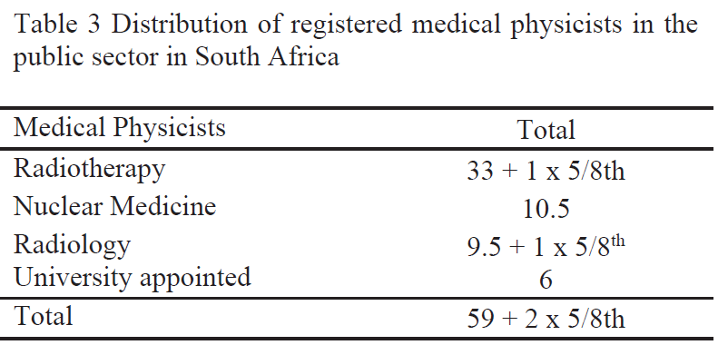
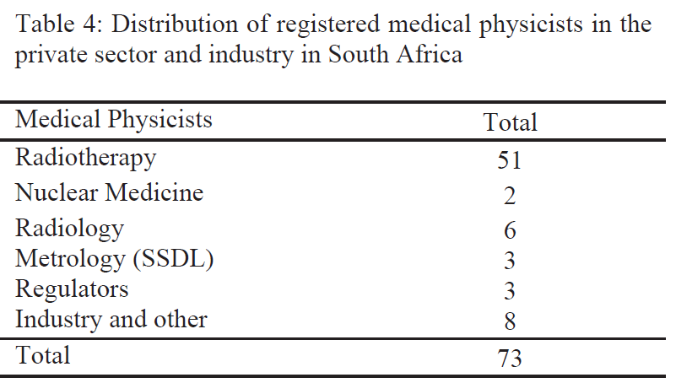
Medical Physicists in SA (2019)

Slide 22
SAAPMB
2 Feb 1960: the SA Association of Medical Physicists is founded by 8 medical physicists
Now: South African Association of Physicists in Medicine and Biology
Three societies:
SAMPS
SARPS
SARS
Membership: 119 full members, 71 associate/student/institutional/ retired/honorary members

Slide 23
Status in SA
There are some worrying signs (vacant posts not filled, severe problems at the regulator)
There are a lot of young and enthusiastic medical physicists who are keen to take medical physics forward.

Slide 24
Africa

Slide 25
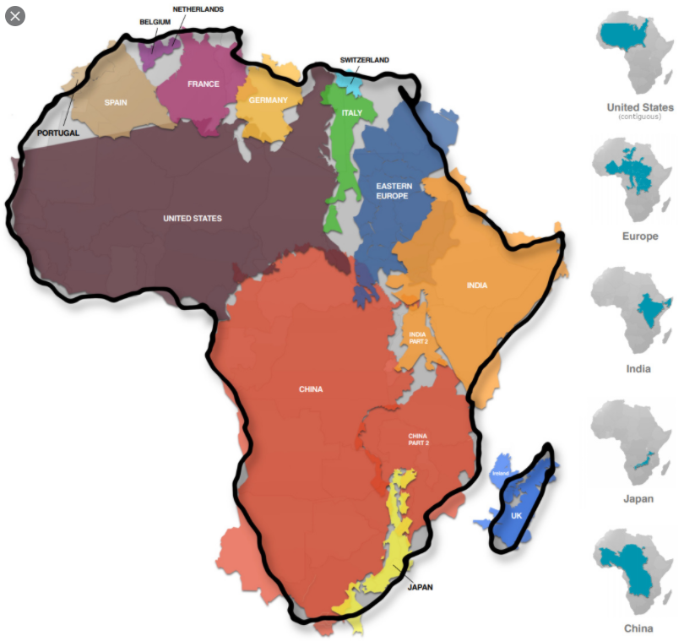

Slide 26
Africa
54 countries
Population of 1.285 billion
Size of over 30 million square kilometres
Estimated 1500 – 2000 languages

Slide 27
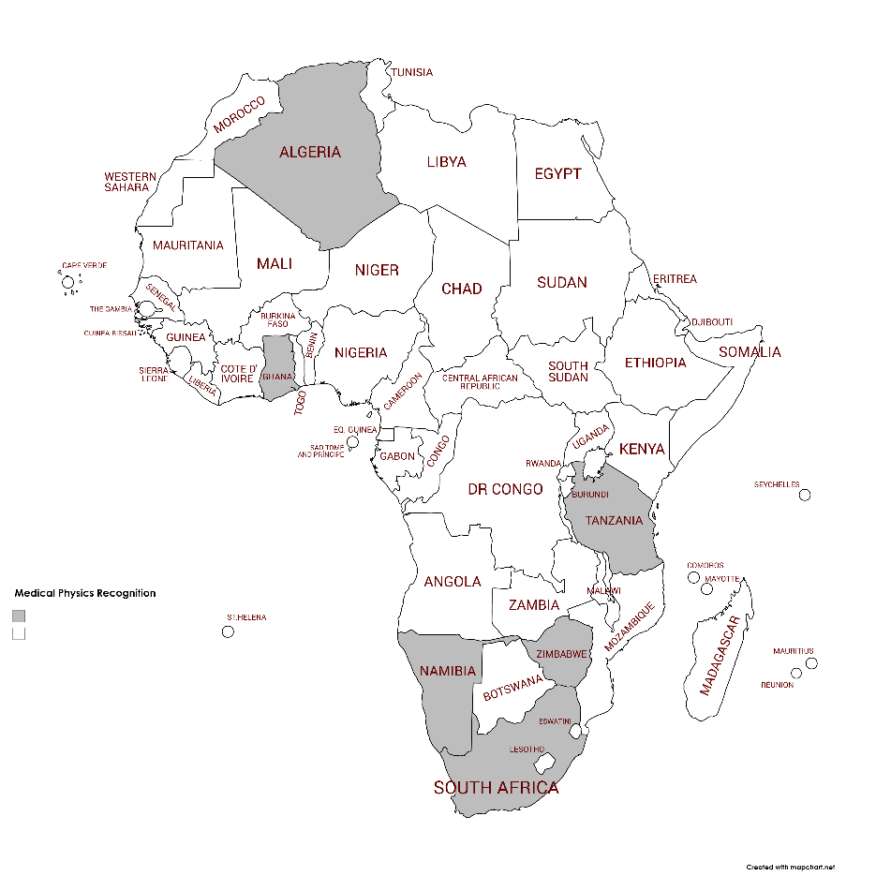
Only six countries have a legislative recognition of medical physicists

Slide 28
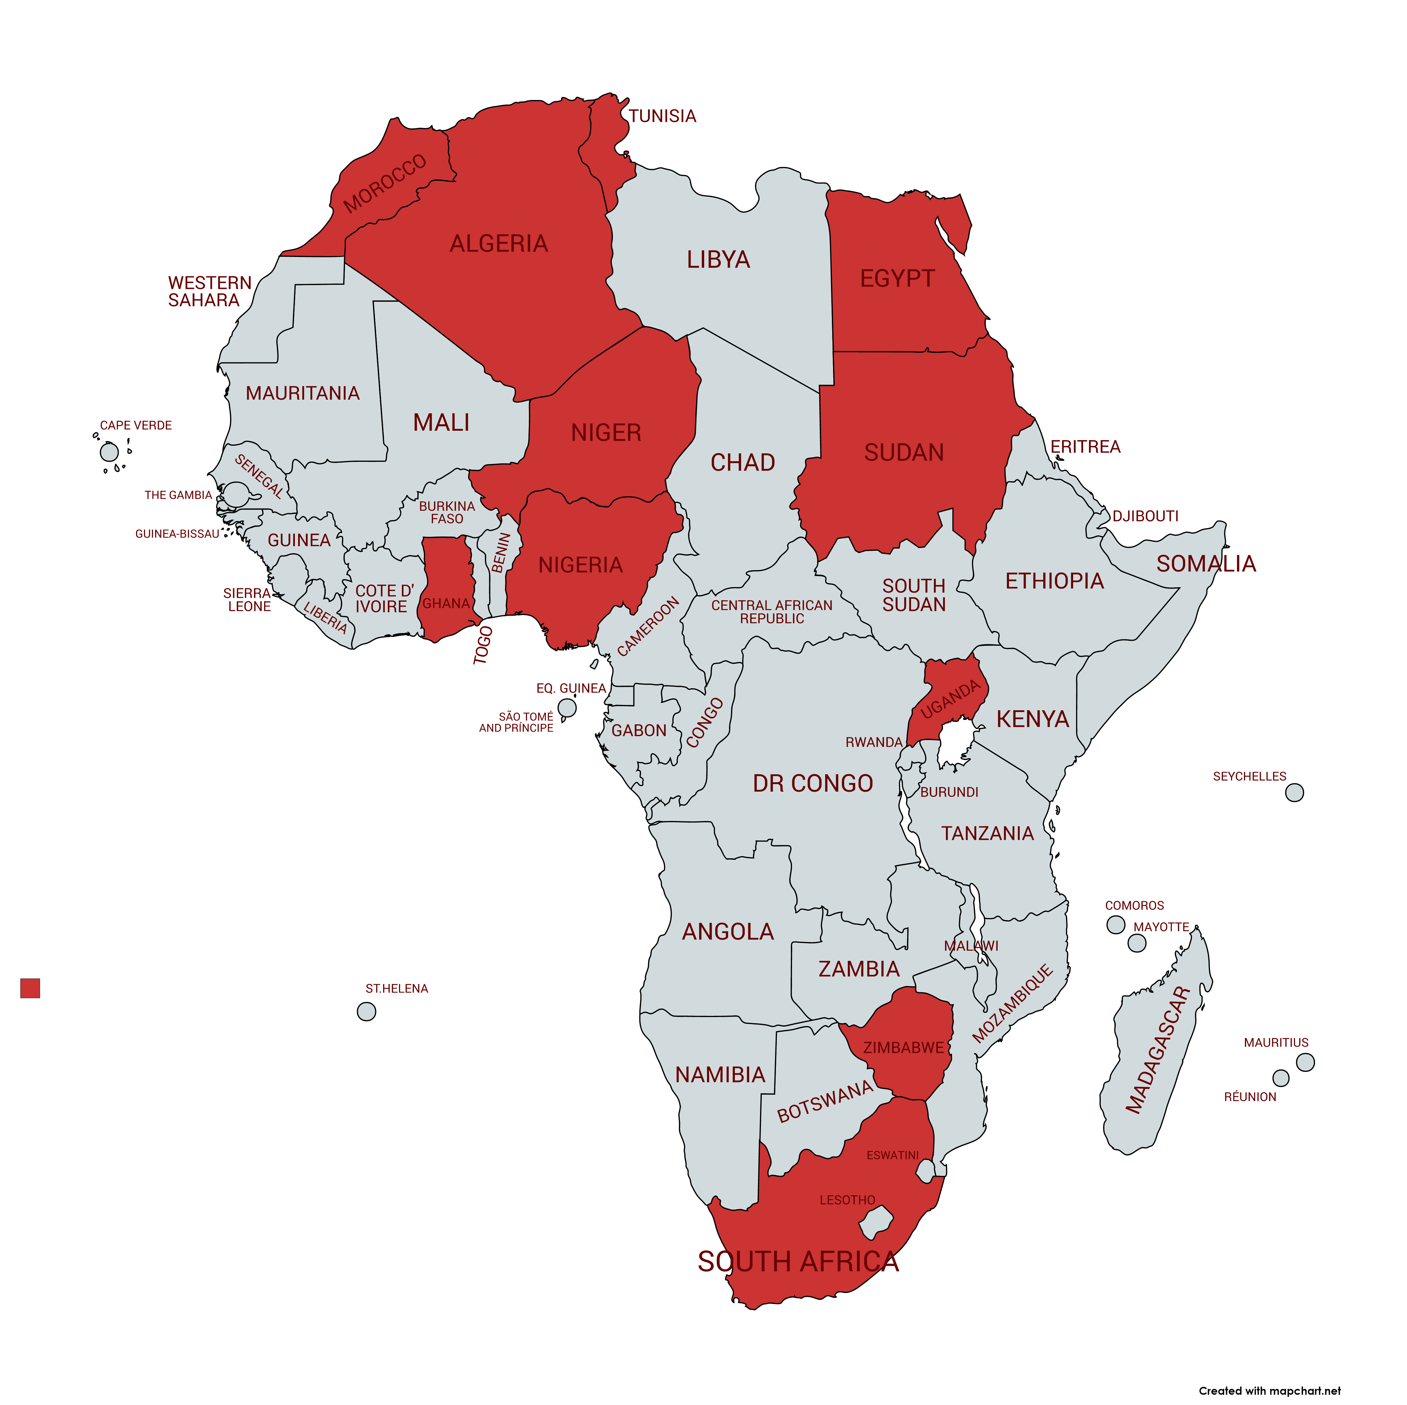
Only 12 countries have a national medical physics society
South Africa – 1960
Nigeria – 1986
Algeria - 1994
Morocco – 1996
Egypt – 1998
Sudan – 1999
Ghana – 2011
Tunisia – 2011
Niger – 2017
Uganda – 2019
Zimbabwe – 2020
Kenya - 2023

Slide 29
The Role of a National Society
Speaks as the collective voice for the profession
Protects the boundaries of the speciality
Engages with public and private stakeholders
Sets or raises standard
Arranges workshops / conferences / CPD events
Can liaise with the Health Professions Council
Can add valuable input into regulations
Improved networking with peers and other professionals
Disseminate information and job openings

Slide 30
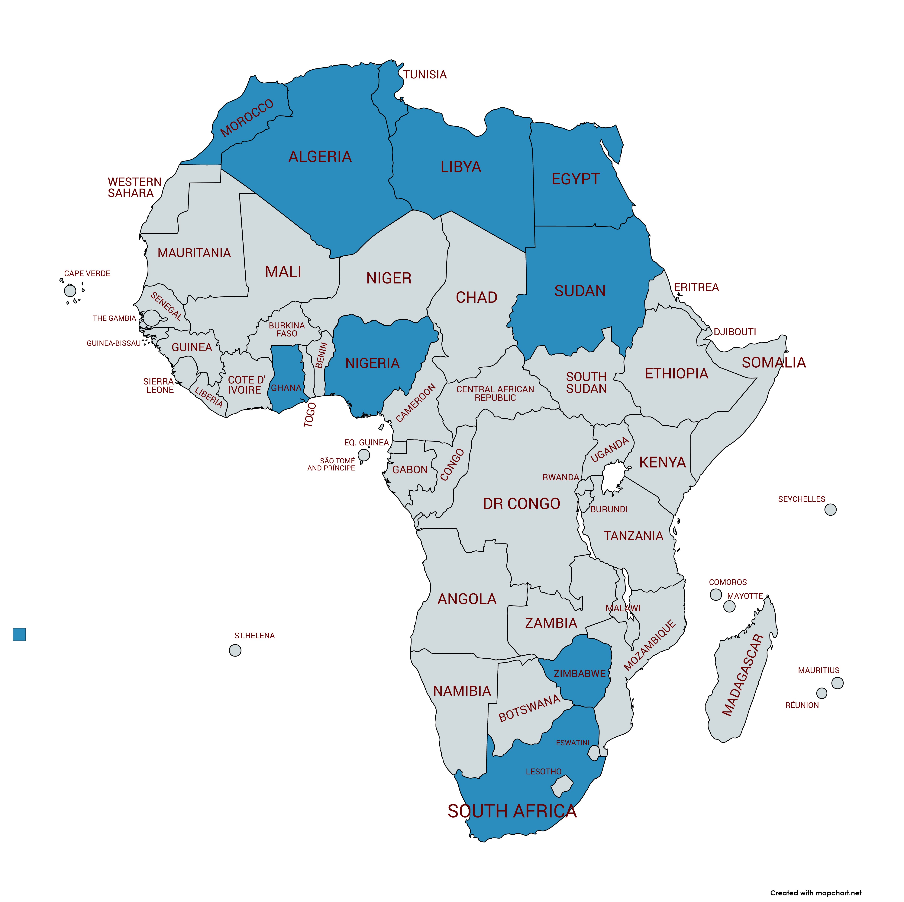
Only 10 countries offer academic training
Algeria
Egypt
Ghana
Libya
Morocco
Nigeria
South Africa
Sudan
Tunisia
Zimbabwe

Slide 31
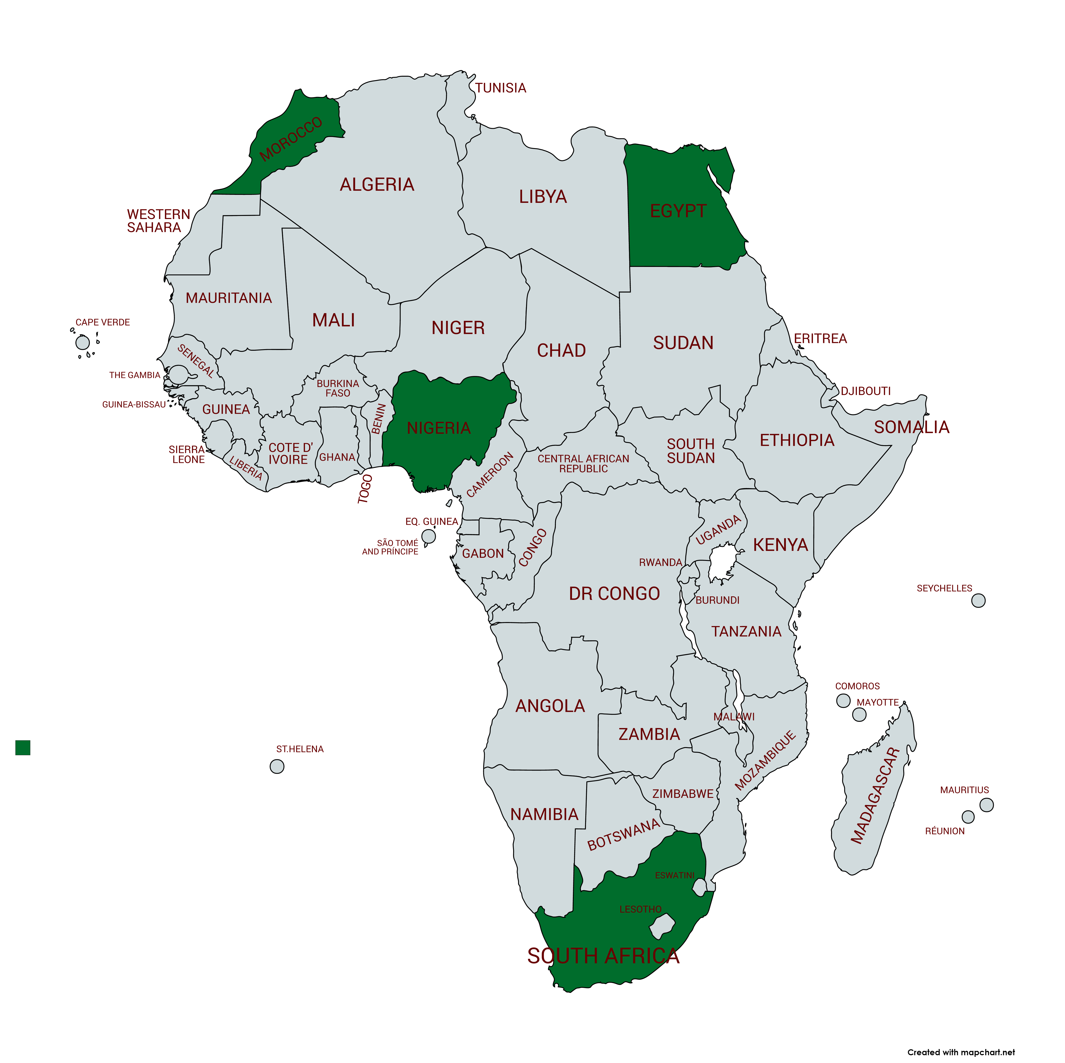
Only seven (?) countries offer clinical training
?Nigeria – dormant since 2012
?Algeria – much improved
Egypt
Ghana?
Morocco
South Africa
Zimbabwe – incorporated into MSc
Tunisia

Slide 32
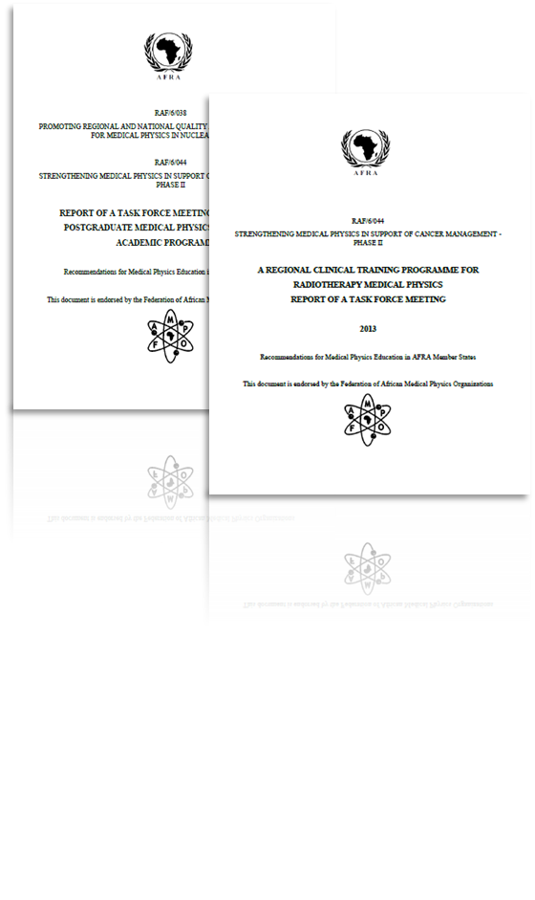
MP Training Programme

Slide 34
Descriptions of:
Core modules and recommended modules for academic training
Including syllabus for core modules
Clinical Training

Slide 35
Infrastructure required
Clinical training under supervision of a clinically qualified MP
Max ratio of student : trainer = 2 : 1
Internet access essential
Essential reading list / references
List of essential equipment and facilities
List of competencies to be achieved
The curriculum exists, implementation is non-uniform.

Slide 36
Actual numbers
2010 – around 350 medical physicists
2018 – around 700 medical physicists
2020 - 1041

Slide 37
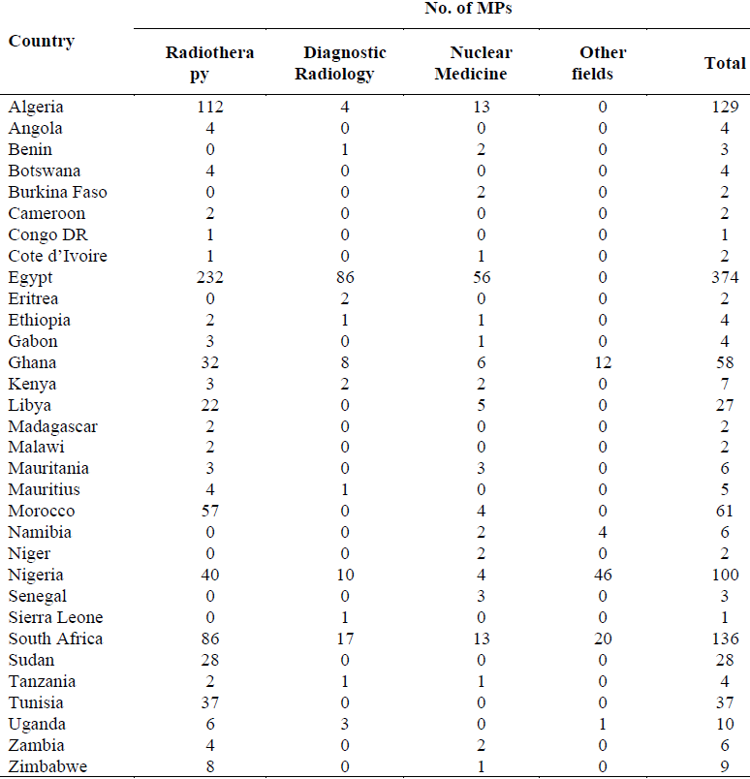
Total: 1041
Of these: 137 in DR, 124 in NM
Remove the 639 MPs from Egypt,
Algeria and SA (200M population)
~500 MPs for 1.1B

Slide 39
Why the increase?
Algeria: National Cancer Plan
South Africa: 127 → 136: private sector mainly
Zimbabwe: MSc programme: 4 intakes of 10 students each, no posts yet
Ghana: stable, hoping to place a physicist in each of the 216 local districts
Morocco: Regulations requiring MP published in 2014
Egypt: who knows?

Slide 40
Opportunities
1 in 4 men and 1 in 5 women worldwide develop cancer during their lifetime
1 in 8 men and 1 in 11 women worldwide die from cancer

Slide 41
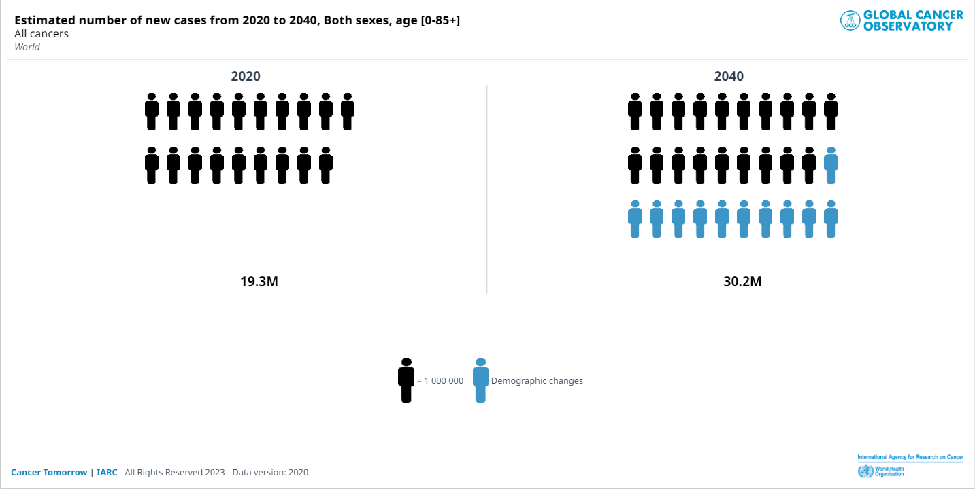

Slide 42
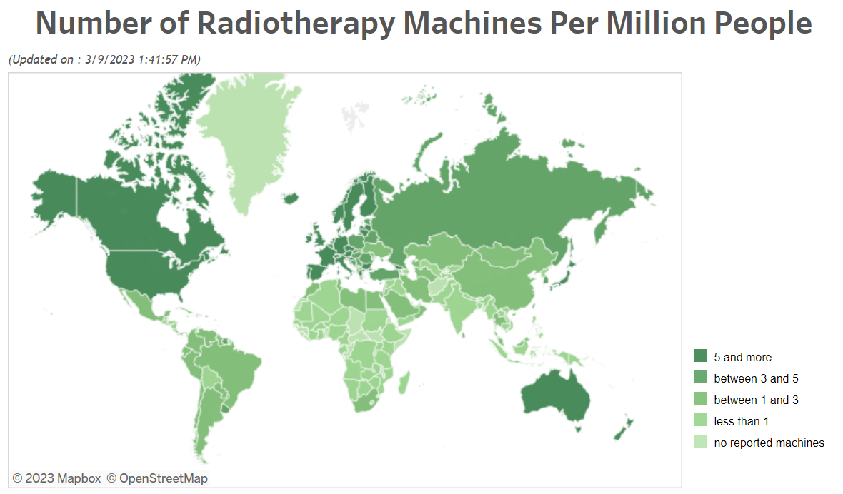
Radiotherapy Resources
(all data from DIRAC database: https://dirac.iaea.org/)
54

Slide 43
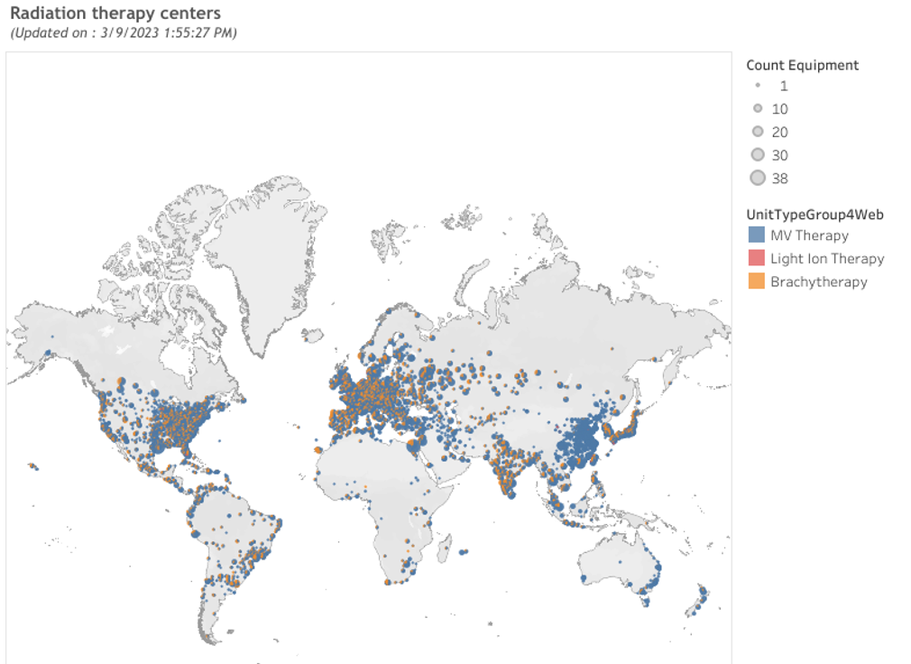

Slide 44
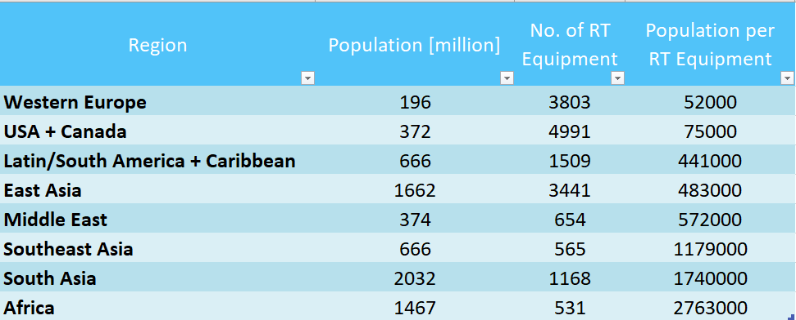

Slide 45
The Medical Physics Gap
Lancet Oncology (2015)
  Projection: by 2035 in LMICs for radiotherapy we need 22.000 MPs
  Call for Action: by 2025 in LMICs: 6.000 MPs to be trained
  THIS IS JUST AROUND THE CORNER

Slide 46
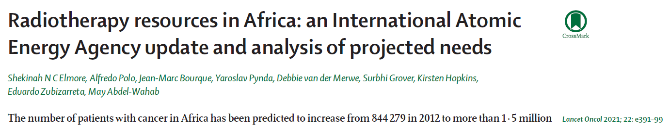
“As of March 2020, 28 of 54 countries had access to external beam radiotherapy. 21 had brachytherapy capacity, and no country had a capacity that matched the estimated treatment need.”
“Urgent, novel initiatives in financing and human capacity building are needed…”

Slide 47
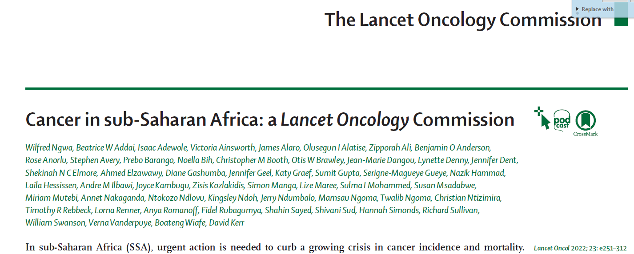
“In the next 15 years, Africa is estimated to require at least 5000 additional megavoltage radiotherapy machines to ensure equity in cancer care”

Slide 48
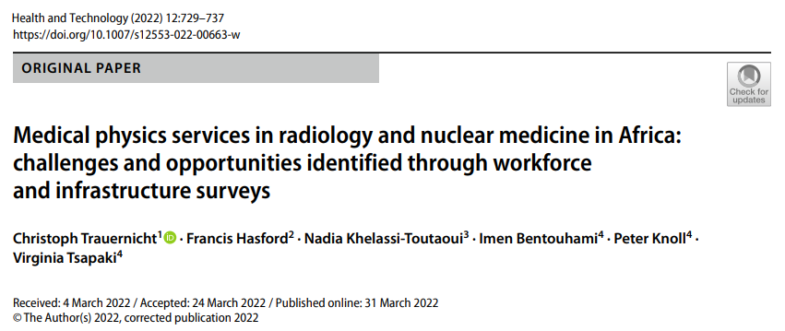
Imaging
“Data analysis indicated that the number of radiology and nuclear medicine CQMPs is largely inadequate, at least by a factor of 20 in almost all countries in the region.”

Slide 49
FAMPO
Member of IOMP since 2010
Established to:
Promote the profession and practice of medical physics
Promote the training of medical physicists
Promote appropriate use of technology
.
.
.

Slide 50
Thank you!
Chris Trauernicht - cjt@sun.ac.za

