Slide 1





Cultivating the
skills ecosystem of the future

Slide 2
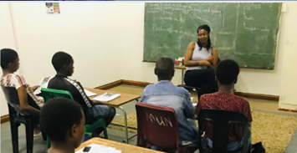
Skills Ecosystem
Feeding the skills pipeline
Recruiting from other companies
Employing new graduates
Not a solution to skills shortage
Cultivating the pipeline
School level
Identify skills
Nurture skills
**

Slide 3
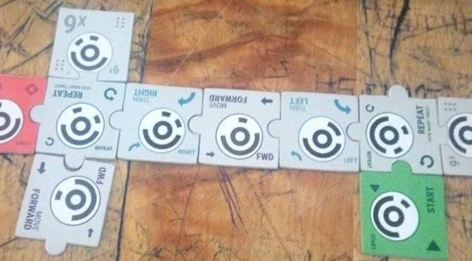
TANKS Mobile App
No computers
No electricity
No internet
Low budget
Easy entry for teachers
Fun
Quality
**

Slide 4
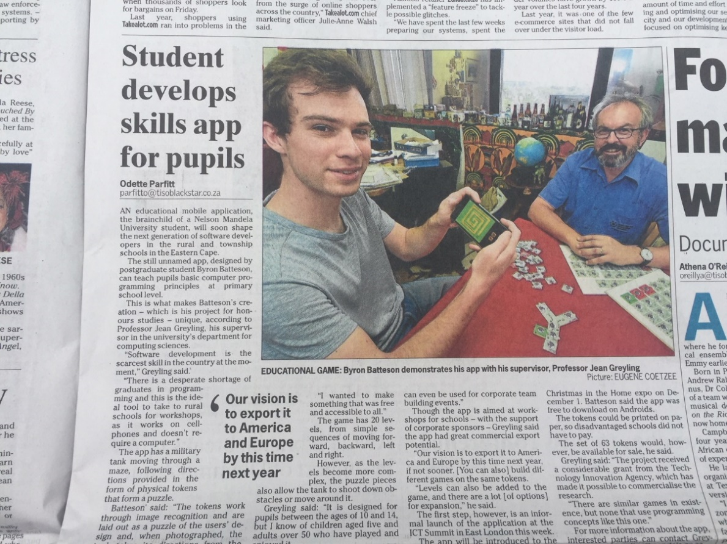

TANKS Mobile App
**

Slide 5
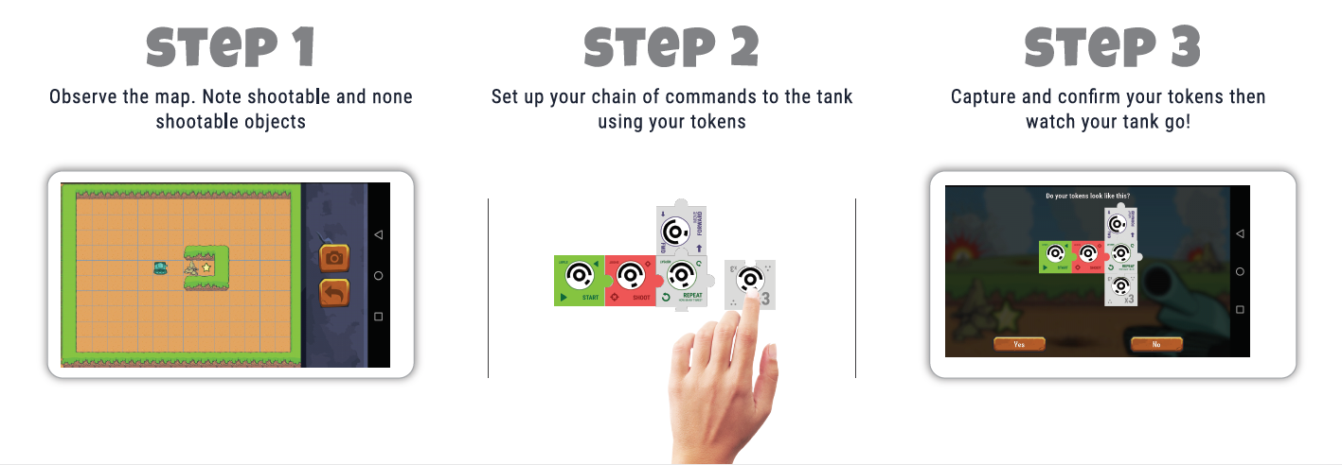
TANKS Mobile App
**

Slide 6
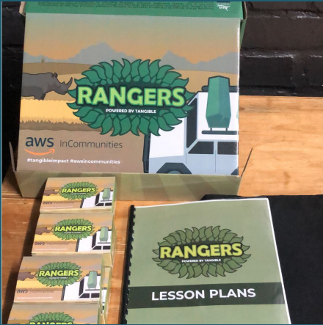
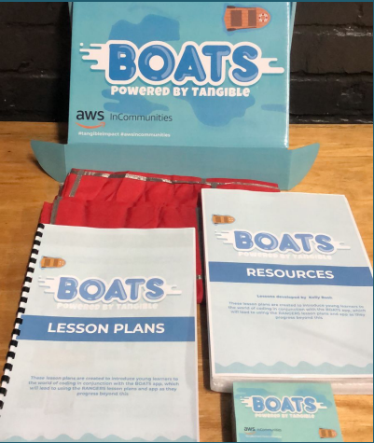
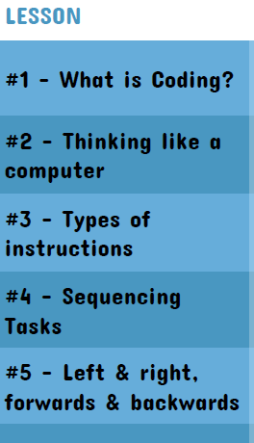
Supporting Tools
**

Slide 7
**
Why at a Physics
Conference?

Slide 8
**
It’s not about coding

Slide 9
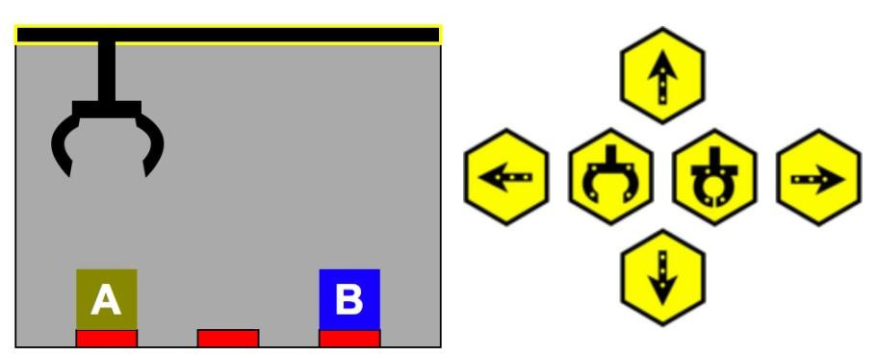
**

Slide 10
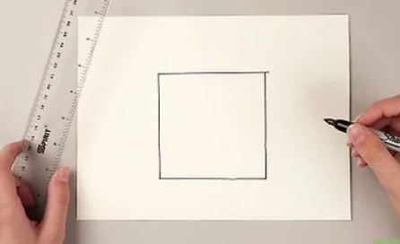
Computational Thinking
Abstraction
Decomposition
Pattern Recognition
Algorithm
**

Slide 11
Abstraction
Decomposition
Pattern Recognition
Algorithm
**

Slide 12
Abstraction
Decomposition
Pattern Recognition
Algorithm
**

Slide 13
Abstraction
Decomposition
Pattern Recognition
Algorithm
**
3cm
3cm
3cm
3cm

Slide 14
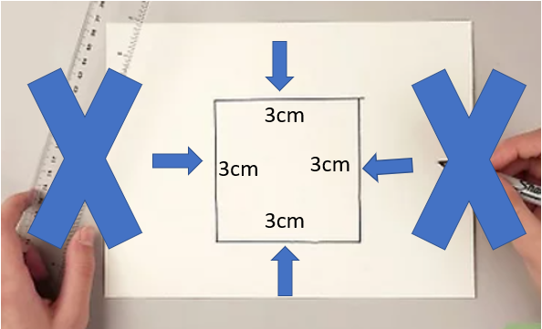
Abstraction
Decomposition
Pattern Recognition
Algorithm
**
Forward 3cm
Turn Right
Forward 3cm
Turn Right
Forward 3cm
Turn Right
Forward 3cm
Turn Right

Slide 15

RANGERS Coding

Slide 16
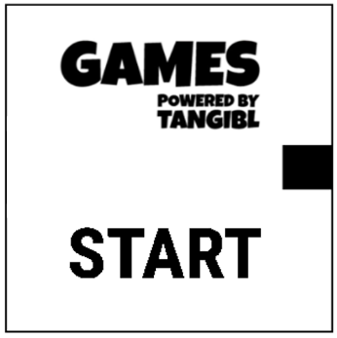
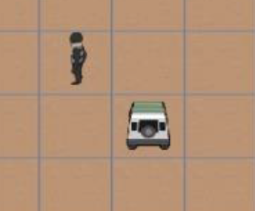


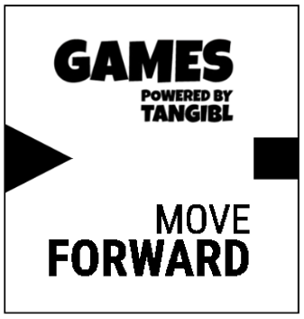
RANGERS Coding

Slide 17
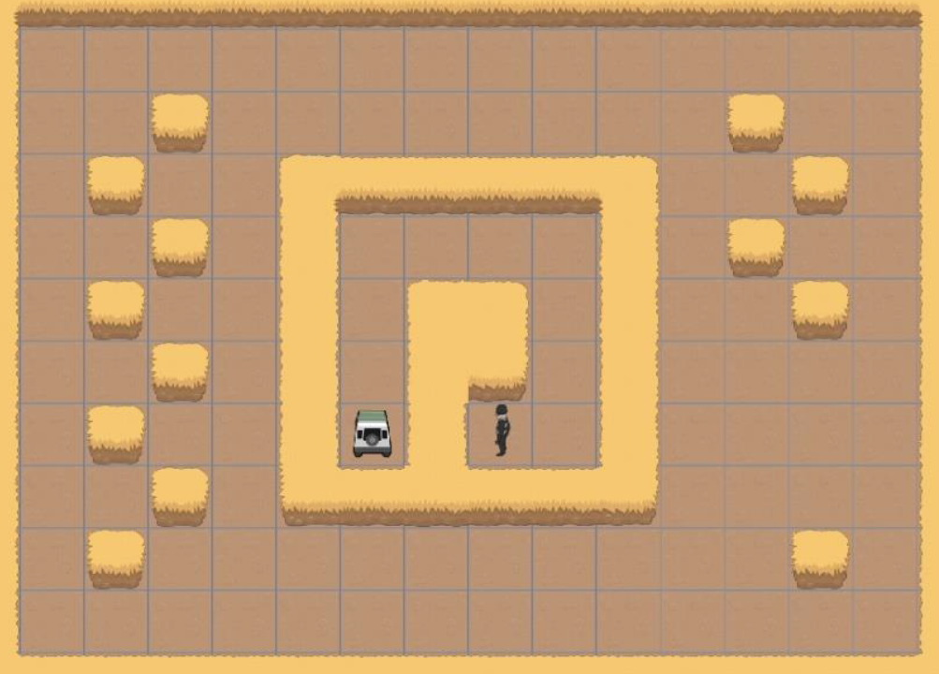
RANGERS Coding

Slide 18
RANGERS Coding
Abstraction

Slide 19
RANGERS Coding

Slide 20
RANGERS Coding

Slide 21
RANGERS Coding
Decomposition

Slide 22
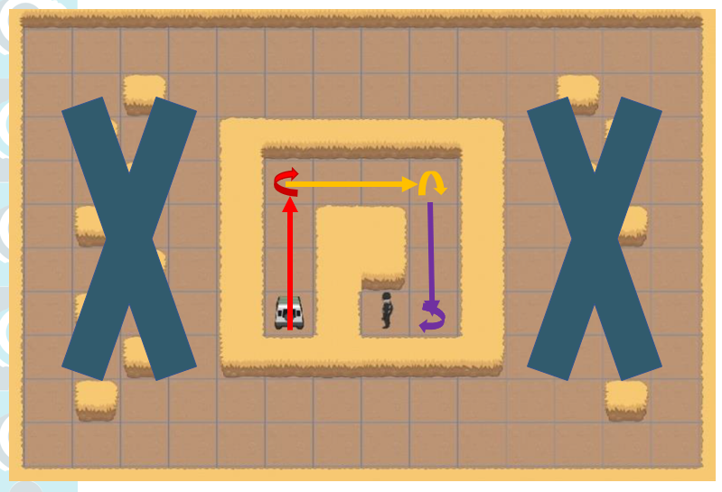


Pattern Recognition
3

Slide 23
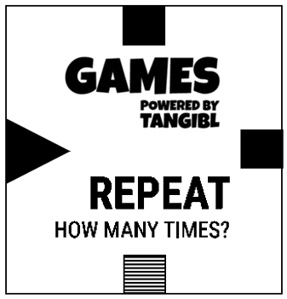

Algorithm

Slide 25
Pattern Recognition

Slide 26
Algorithm

Slide 27
Algorithm

Slide 28
Abstraction
Decomposition
Pattern Recognition
Algorithm
**
Forward 3cm
Turn Right
Forward 3cm
Turn Right
Forward 3cm
Turn Right
Forward 3cm
Turn Right

Slide 29
Abstraction
Decomposition
Pattern Recognition
Algorithm
**
Forward 3cm
Turn Right
Forward 3cm
Turn Right
Forward 3cm
Turn Right
Forward 3cm
Turn Right
Repeat x3
Forward 3cm
Turn Right
End

Slide 30
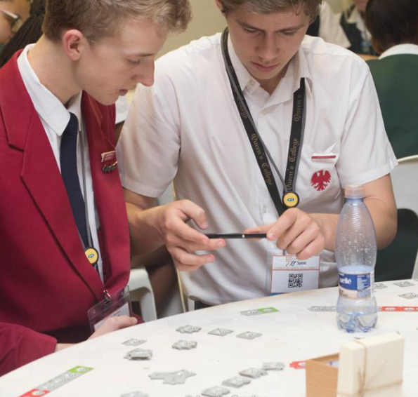
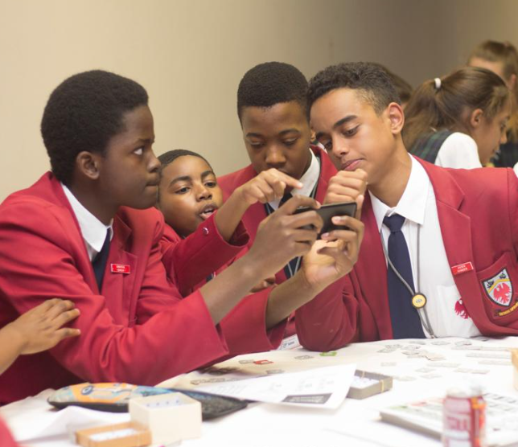
Group work

Slide 31
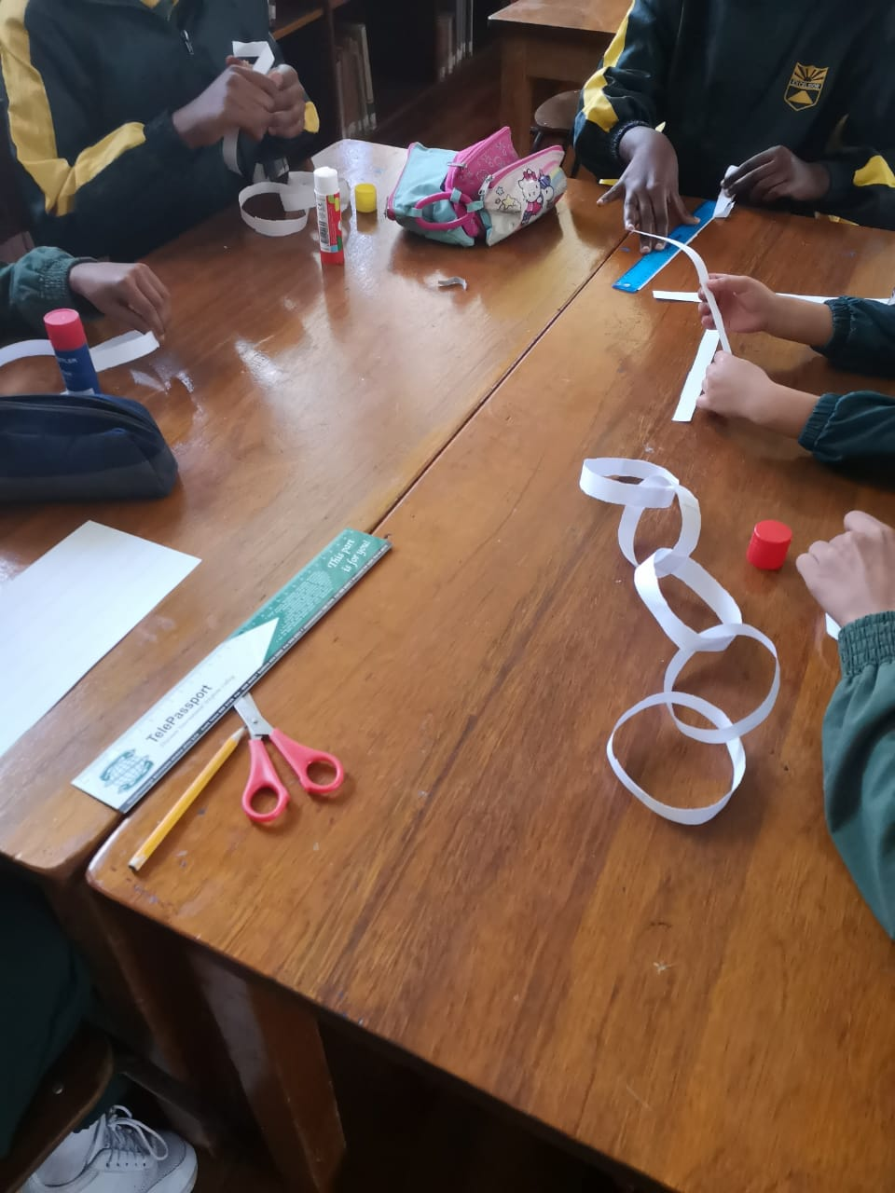
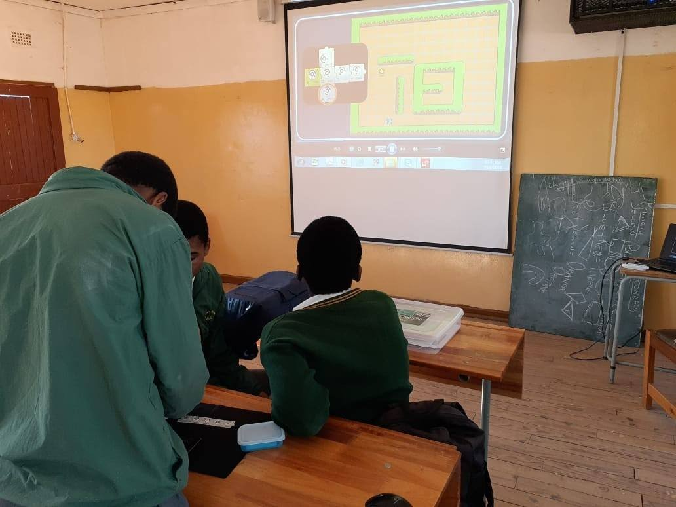
Coding (Problem Solving) Clubs

Slide 32
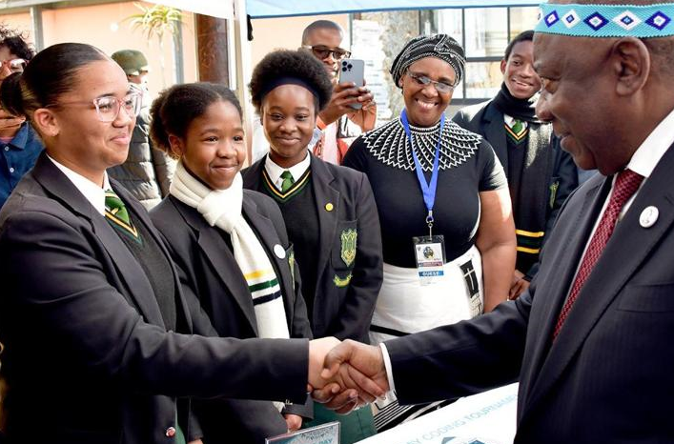
Impact since 2017
Reached 100 000+ learners
Trained nearly 30 000 teachers
Helped to change the narrative
Various national and global accolades
**

Slide 33
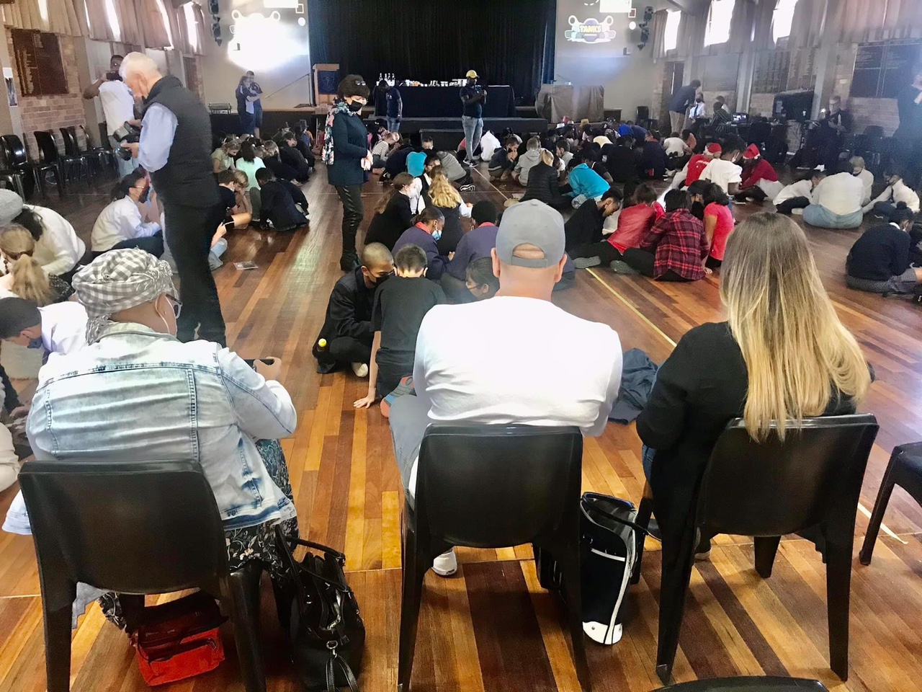
Tournaments
Mandela Day
16 000 learners
500 schools and libraries

Slide 34
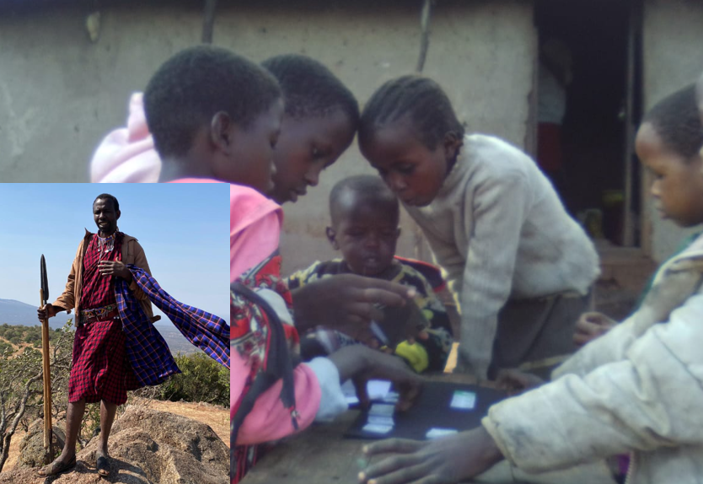
Africa

Slide 35
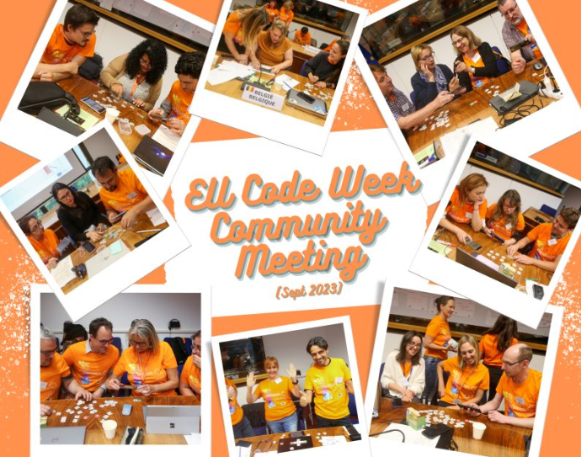

Slide 36
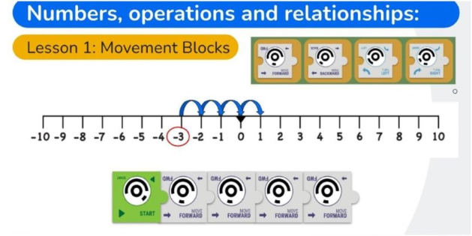
Maths and Coding

Slide 37
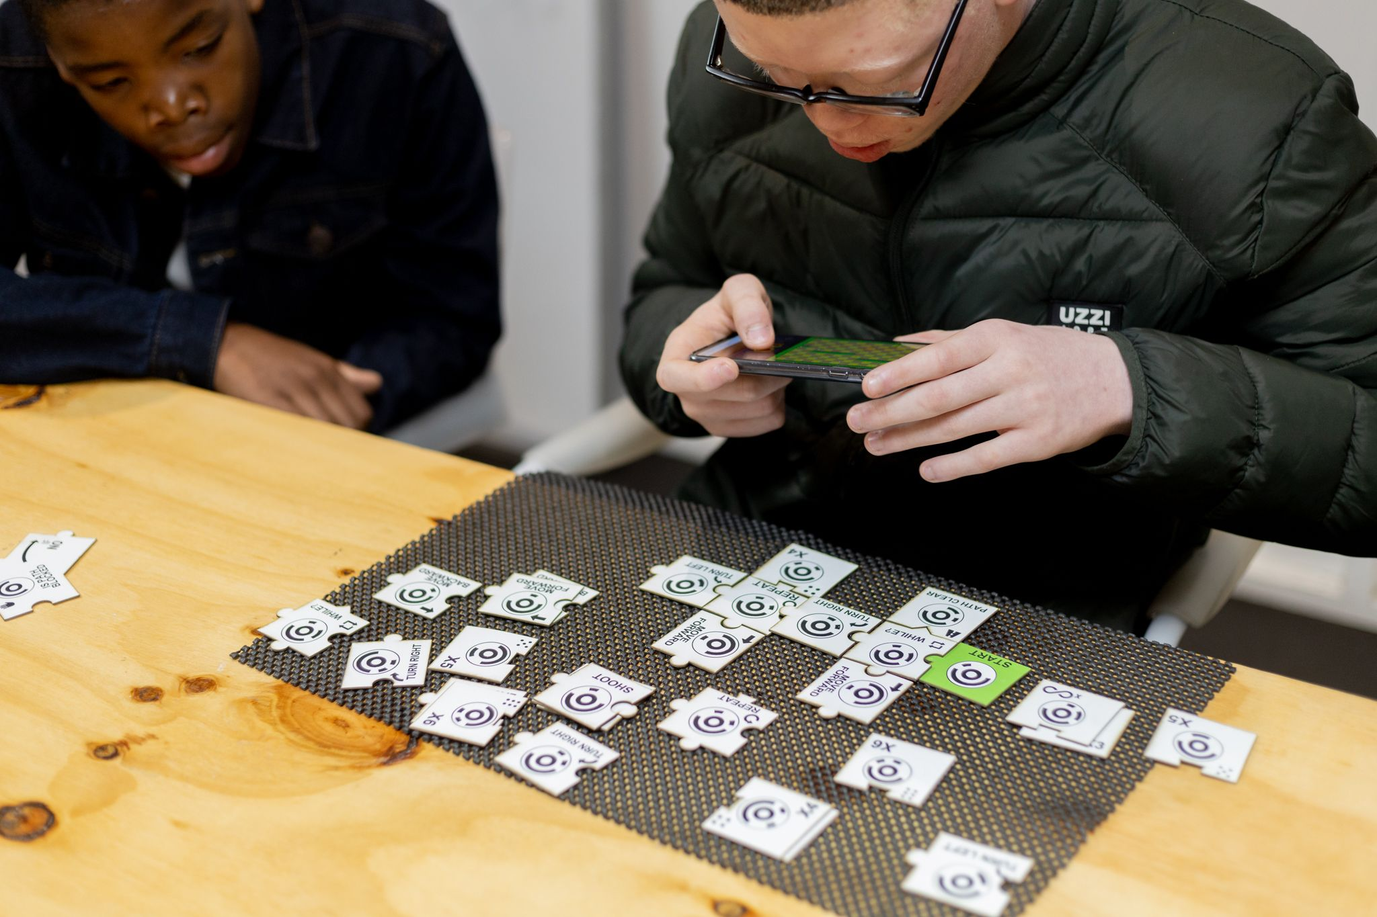
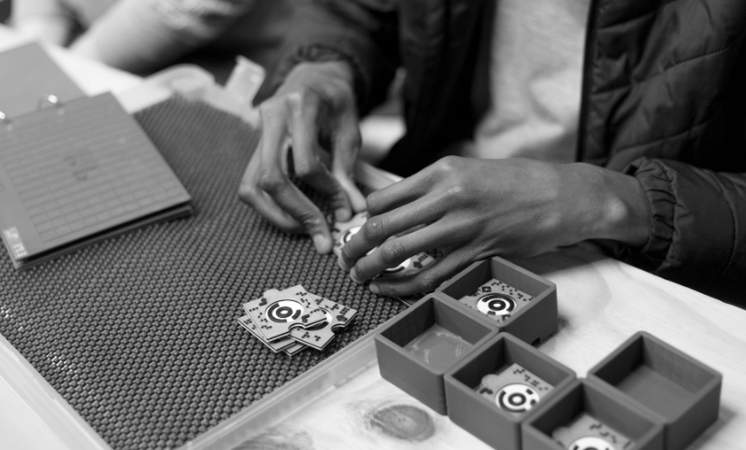
Visually Impaired

Slide 38
Cultivating the PHYSICS
skills ecosystem of the future

Slide 39
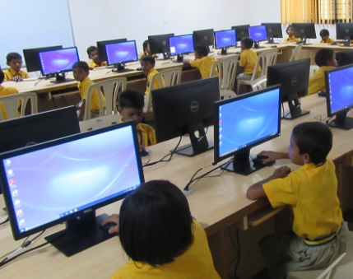
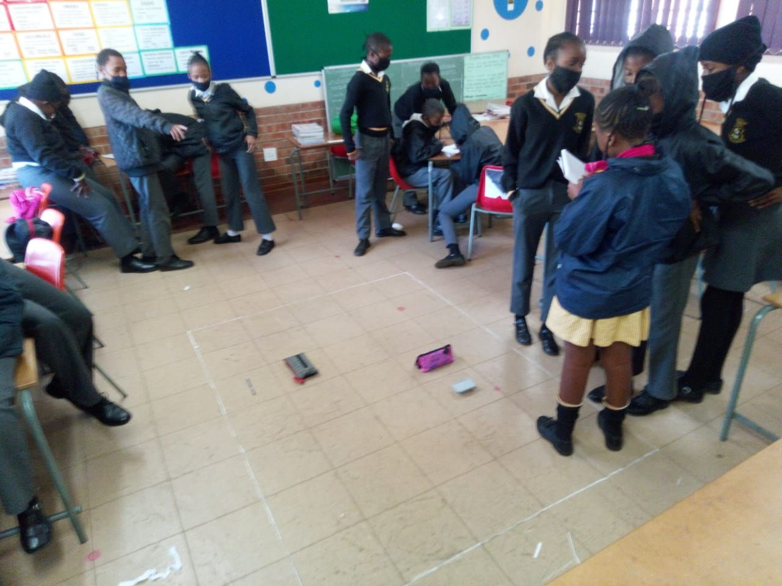
It is not about coding!

Slide 40
Your fraternity also need learners that can solve problems.

Slide 41
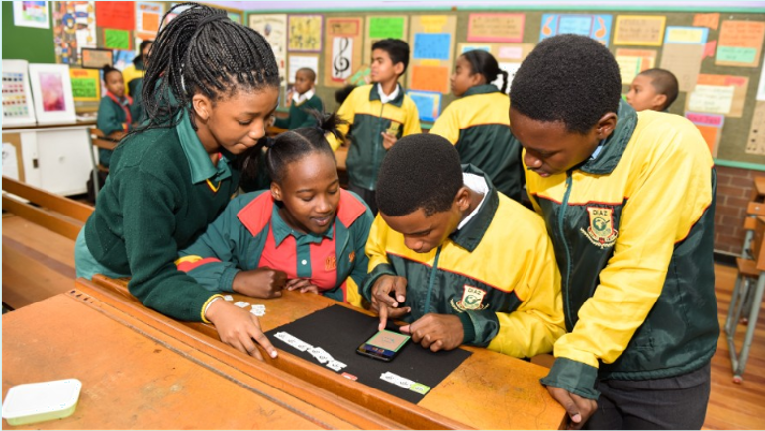
Enhance those skills
while having fun

Slide 42
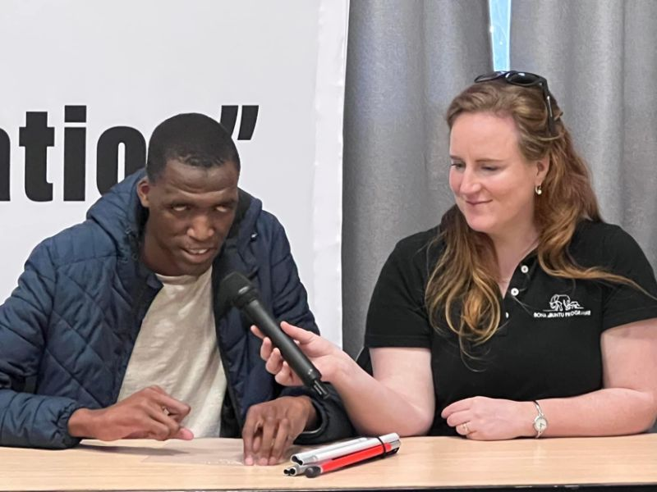
“The more I play, the better my thinking becomes.”

Slide 43

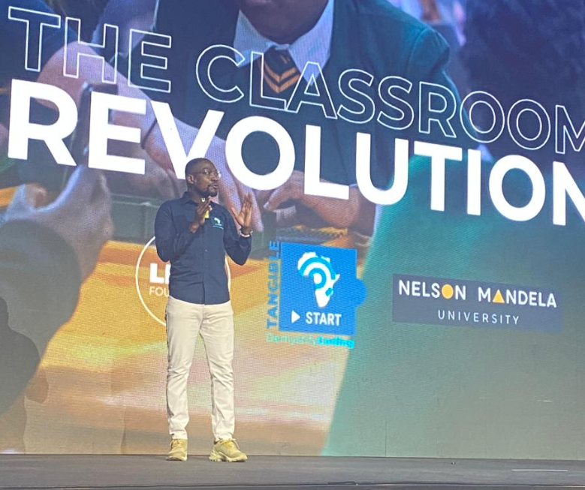


Tangible Africa“
Jean Greyling“
0835544183“

