Slide 1
HPC in South `Africa: Efforts in support of Physics
Dr Happy Sithole
28 September 2023
Email: hsithole@csir.co.za

Slide 2
Common services between any two entities of NICIS
Intersection of the three entities most crucial, as defines the success of overall NICIS.
Development of cross-cutting skills internally and within the community
SANReN
DIRISA
Transferring large data
CHPC
Fast/Secure systems
HPDA
Mainly Large Scale Science projects:
SKA, CERN, 4IR, SADC C.I. Framework, Climate Change (e.g. IPCC)

Slide 3
Strategic Objectives
SO3
Position South Africa to take part in, host and lead large scale global research and science projects (e.g. SKA and CERN experiments).
SO4
Provide thought leadership to South Africa’s evolving cyberinfrastructure strategy and activities, and facilitate the uptake of advanced cyberinfrastructure.
SO5
Foster the development of human capacity in cyberinfrastructure and its application, and contribute to the transformation of this sector.
SO2
SO1
Sustain a world class and relevant national integrated cyberinfrastructure system for Science and Technology
Enable and promote eScience in South Africa.

Slide 4

Open (FAIR) Data & Open Science
Federated locally and globally (“One-stop-shop” catalogue)
Certified as Trusted Repository
Linked to funder systems
Suite of services for RDM and data intensive analytics
DIRISA cloud portal
Archival data & staging: VM access
1 PFLOPS
Compute
iRODS
2 PB
4 PB
Storage Virtualisation Server
40 PB
8 PB
0.5 PB
Fast Parallel FS
Services & staging between DIRISA and CHPC storage systems
Active data: near real time interactive access
Software defined storage hierarchy
Small, fast
Big, slow

Slide 5
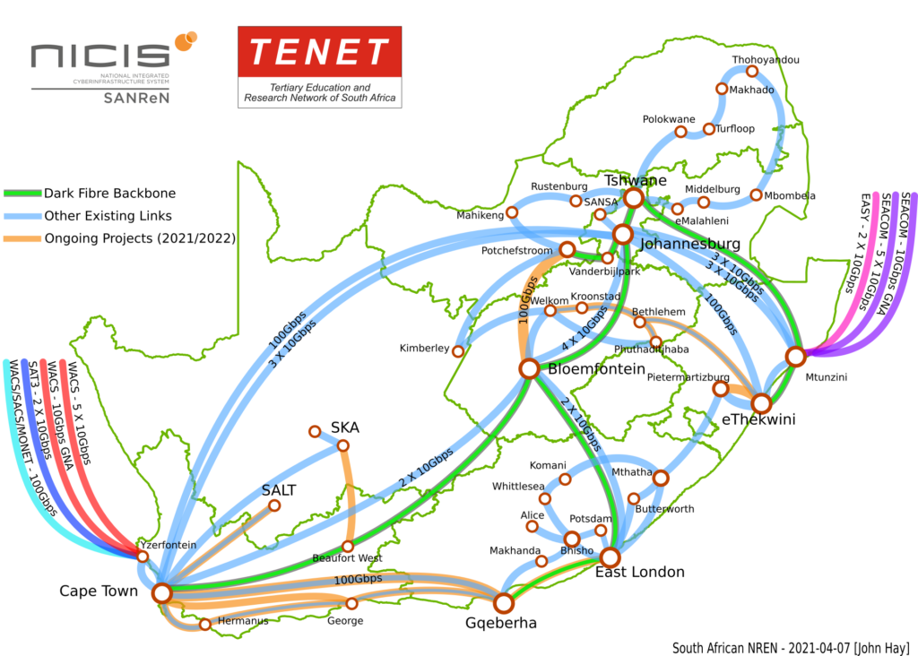
Network Infrastructure

Slide 6
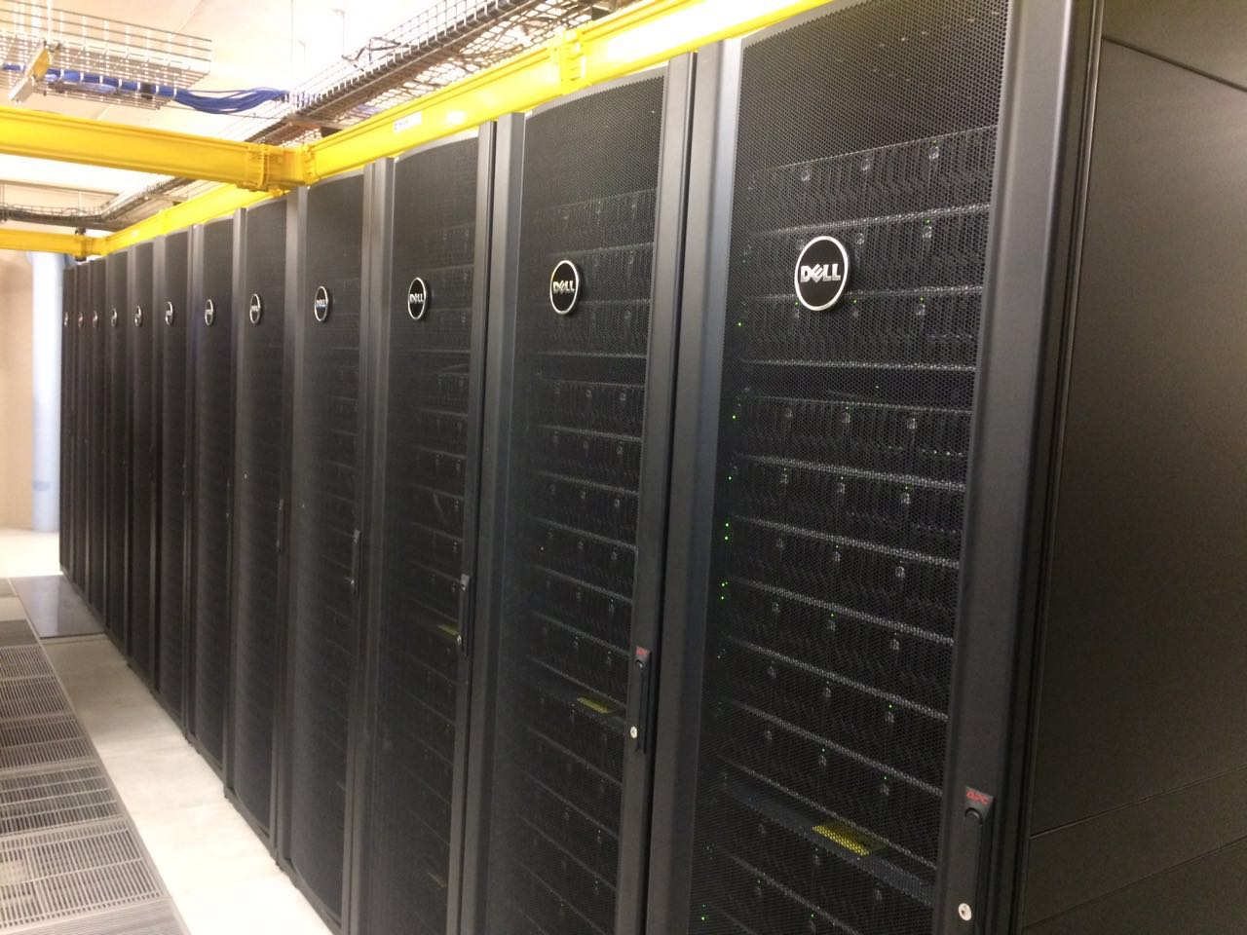
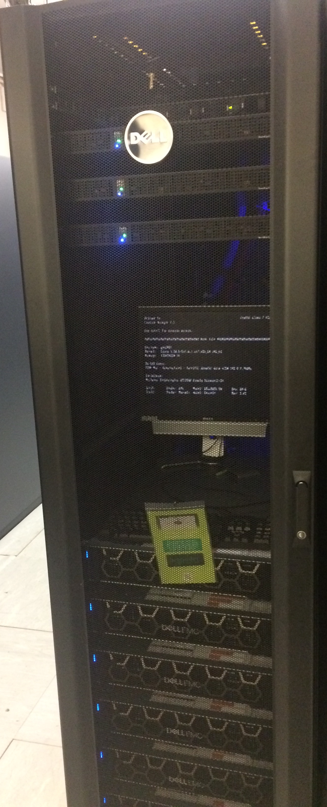
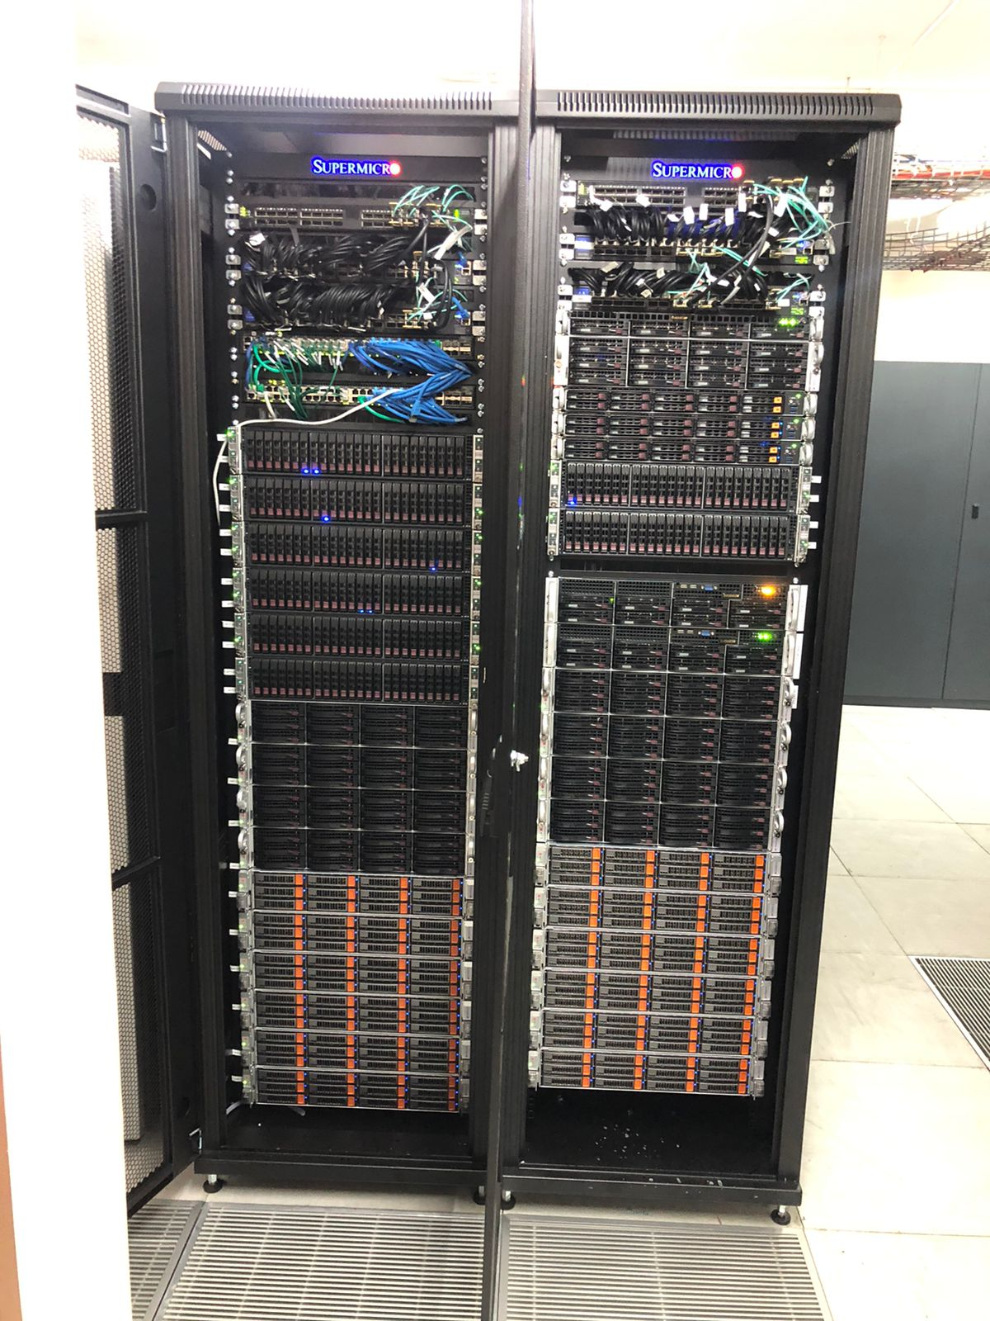
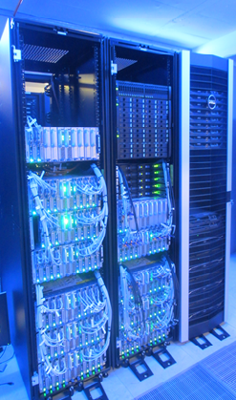
NICIS Platforms
GPU Cluster with 9 Nodes each with 4 NVIDIA – V100 processors.
Mainly used for Machine Learning, Artificial Intelligence and Materials Science applications.
Lengau = “Cheetah”
Installed 2015 with 1.6 PFLOP performance
1 345 Nodes of INTEL processors
Rear-door water cooling system
7 Petabytes of Lustre storage
Close to 100% utilisation
OpenStack Cloud named SEBOWA
52 Nodes with INTEL processors
Installed in March 2020
Used for many applications including COVID-19 Data Services
CERN Tier-2 Grid facility
Supports ALICE and ATLAS experiments

Slide 7
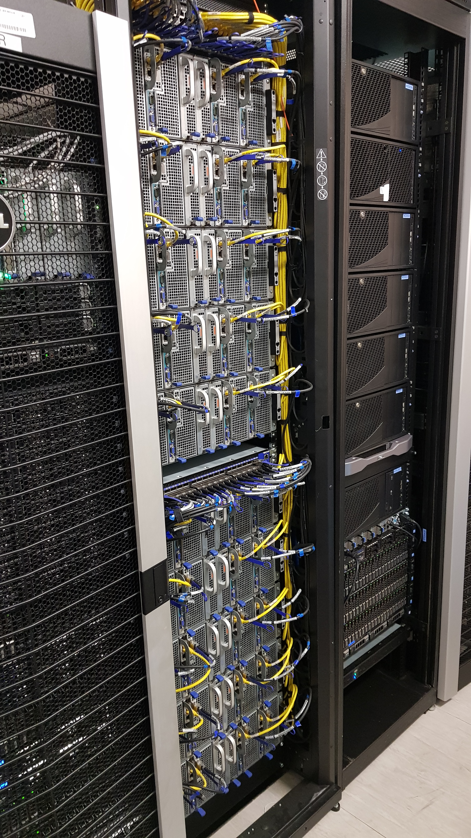
Research in Technology
Evaluate technology for HPC and cloud
Investigate and develop technology to improve HPC systems
Provide a consulting service for HPC and cloud technology
Collaborate with users with special applications to drive efficiency
Operate experimental systems

Slide 8
User Categories
2016/17 – 2021/22

Slide 9
CHPC User Categories Total Hours Used
Past 6 Years
2016/17 – 2021/22
 | Hours (Million)
SA Academic | 791
SA Public Inst | 103
African Partners | 86
SA Industry | 11
Total Hours: 992 Million
# Hours Used (Million)

Slide 10
CHPC User Categories

Slide 11
CHPC Use: SA Universities
2016/17 – 2021/22
University | Programmes
UCT | 52
RU | 21
UL | 4
UP | 53
Wits | 24
UKZN | 38
NWU | 20
UNISA | 9
SU | 44
UJ | 12
UFS | 4
UWC | 12
NMU | 8
UV | 6
DUT | 2
MUT | 4
UFH | 1
TUT | 5
SMU | 1
CPUT | 2
VUT | 1
Total Active*
Programmes:
323

Slide 12
CHPC Domain Areas: Total Active* Programmes
Past 6 Years
2016/17 – 2021/22
Domain | Programmes
Mat Sci | 57
Chem | 101
Health | 33
Earth | 26
CFD | 66
Bioinf | 68
Physics | 12
Astro | 22
Comp Sci | 18
Maths | 16
Other | 15
Elec Eng | 12
Env Sci | 11
# Active Programmes
Total Active* Programmes: 458
*Active refers to at least 1000 compute hours used over the relevant period.

Slide 13
CHPC Domain Areas
2016/17 – 2021/22
Domain | Hours (Million)
Mat Sci | 295
Chem | 212
Health | 125
Earth | 99
CFD | 69
Bioinf | 68
Physics | 31
Astro | 29
Comp Sci | 26
Maths | 20
Other | 10
Elec Eng | 6
Env Sci | 2
Total Hours: 791 Million

Slide 14
Gender: Principal Investigators and Users
Past 6 Years
2016/17 – 2021/22
Principal Investigators:
Users:
Total PIs: 457
Total Users: 1728

Slide 15
Demographics: Principal Investigators and Users
Past 6 Years
2016/17 – 2021/22
Principal Investigators:
Users:
Total PIs: 457
Total Users: 1728

Slide 16
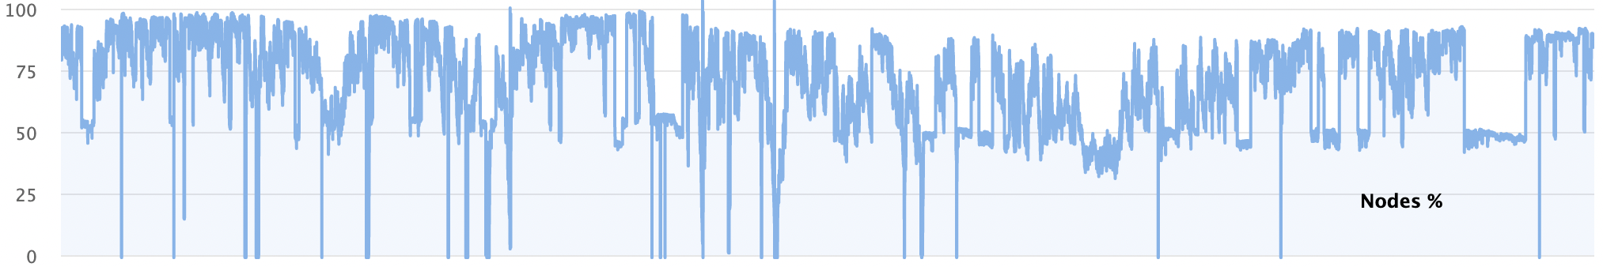
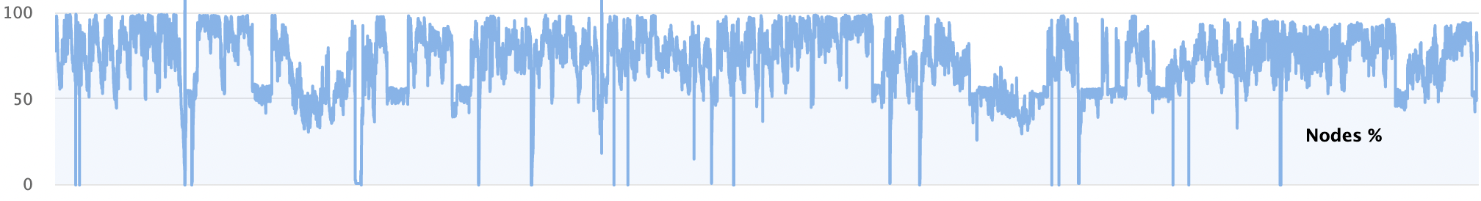

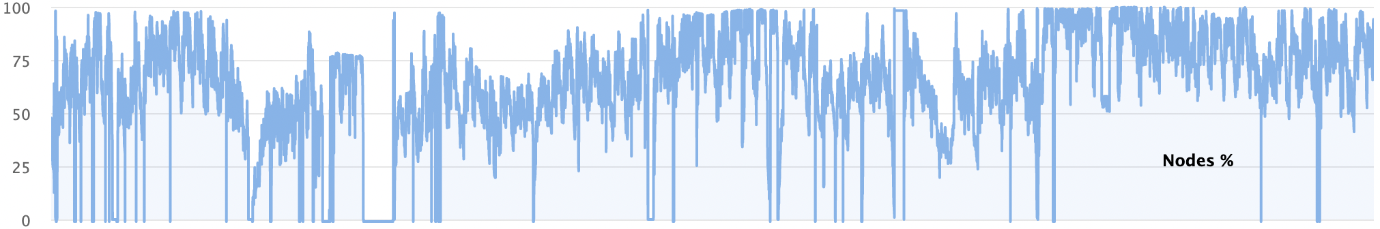
CHPC Lengau Cluster Utilisation: 2016-2022
Aug 2020
Aug 2022
Aug 2018
Aug 2020
Aug 2016
Aug 2018

Slide 17
CHPC User Research Outputs: 2007-2022
Total Publication* Count Per Calendar Year
Total Number of Publications*: 2309
Until Aug 2022…
*Publications = Journal Article, Book, Thesis (PhD, Master’s, Hons), etc.

Slide 18
CHPC User Research Outputs: 2007-2022
Total Publication* Count Per Domain Area
Total Number of Publications*: 2309
*Publications = Journal Article, Book, Thesis (PhD, Master’s, Hons), etc.

Slide 19
CHPC User Research Outputs: 2007-2022
Total Publication* Count Per Institution
Total Number of Publications*: 2309
*Publications = Journal Article, Book, Thesis (PhD, Master’s, Hons), etc.

Slide 20
CHPC User Research Outputs: 2007-2022
Total Publication* Count Per Type
Total Number of Publications*: 2309
*Publications = Journal Article, Book, Thesis (PhD, Master’s, Hons), etc.

Slide 21
Website: www.nicis.ac.za

