Slide 1

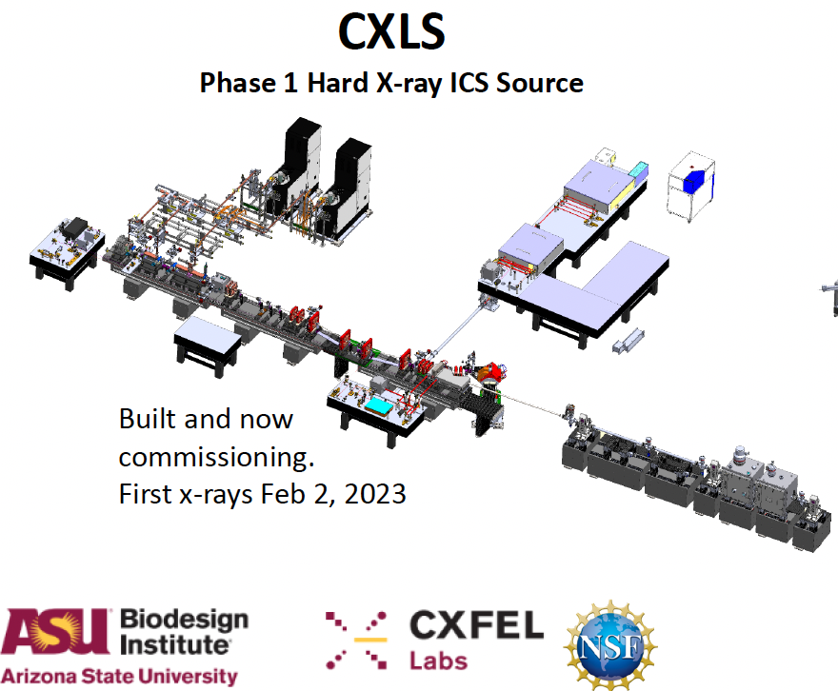

Slide 2
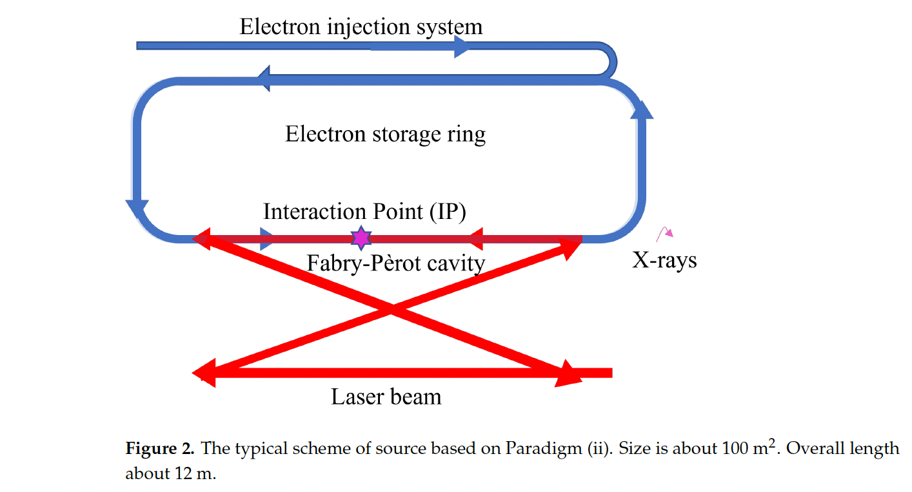

Slide 3
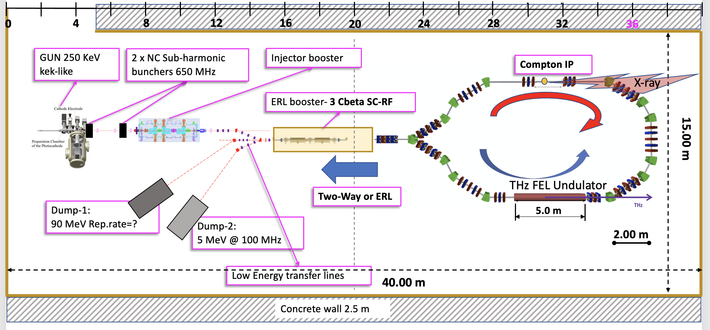
BriXSinO

Slide 4
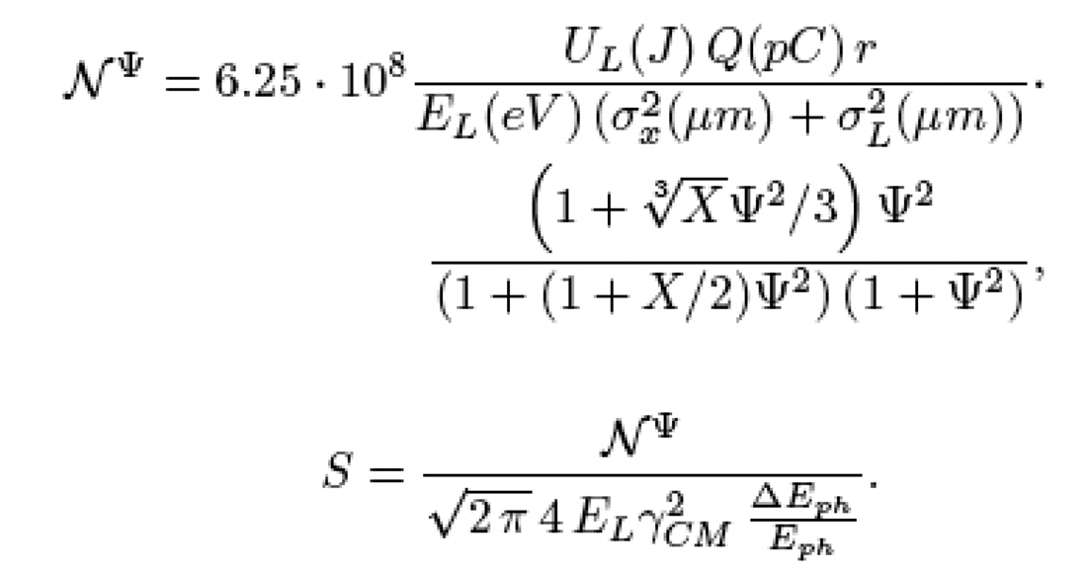


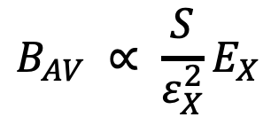
# photons within normalized
acceptance angle Ψ = γ.θ_{acc}
Spectral Density S
relevant to X-ray imaging
and nuclear photonics
$$S∝\frac{\left\langle I_{e}\right\rangle U_{las}}{ε_{n}^{2}E_{x}}$$
Serafini-Petrillo criterion
Average Brilliance
relevant to microscopy/
spectroscopy
$$B_{AV} ∝ \frac{S}{ε_{X}^{2}}E_{X}$$
$$ε_{X} ∝ σ_{x}θ_{acc}$$

Slide 5
SP criterion: quality factor Q_{S} = <I_{e}> U_{L} / ε_{n}²
ThomX Nph (s⁻¹) = 10¹² (10% bdw) S at 30 keV (s⁻¹eV⁻¹) = 3*10⁸
max 80 keV QS = 3.2 (16 mA * 20 mJoule / 10 mm.mrad)
MuCLS Nph (s⁻¹) = 10¹¹ (10% bdw) S at 30 keV (s⁻¹eV⁻¹) = 3*10⁷
max 40 keV QS = 0.3 (10 mA * 3 mJoule / 10 mm.mrad)
STAR Nph (s⁻¹) = 5*10¹⁰ (10% bdw) S at 30keV (s⁻¹eV⁻¹) = 1.5*10⁷
max 350 keV QS = 0.16 (100 nA * 1 Joule / 0.8 mm.mrad)
STARmb Nph (s⁻¹) = 5*10¹¹ (10% bdw) S at 30 keV (s⁻¹eV⁻¹) = 1.5*10⁸
QS = 1.6 (1 microA * 1 Joule / 0.8 mm.mrad)
CXLS Nph (s⁻¹) = 4*10¹⁰ (10% bdw) S at 30keV (s⁻¹eV⁻¹) = 1.3*10⁷
max 20 keV QS = 0.13 (25 nanoA * 200 mJoule / 0.2 mm.mrad)
BriXSinO Nph (s⁻¹) =2*10¹² (10% bdw) S at 30 keV (s⁻¹eV⁻¹) = 6*10⁸
max 40 keV QS = 6.4 (5 mA * 2 mJoule / 1.25 mm.mrad)

Slide 6
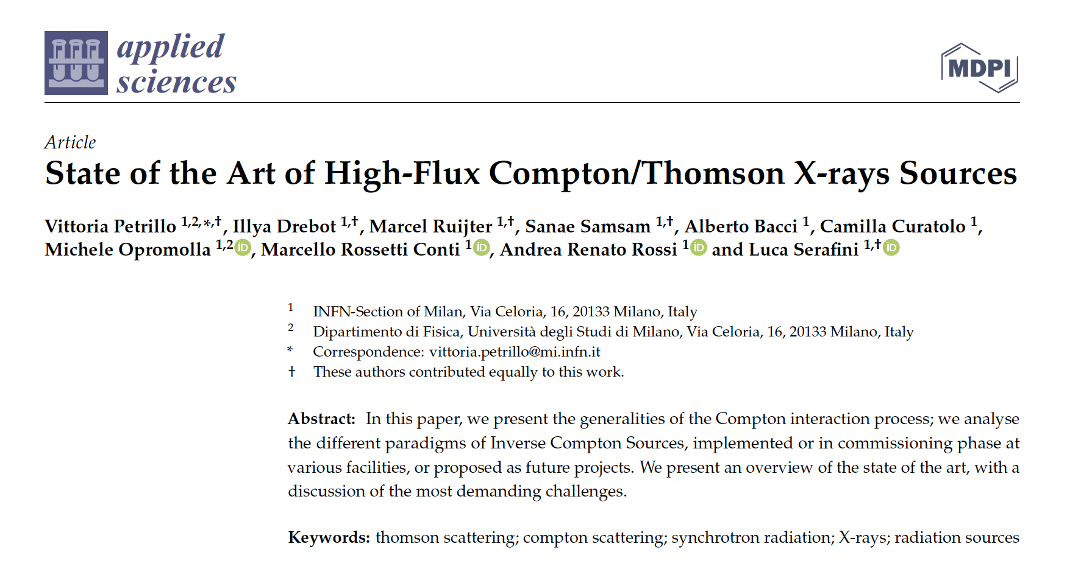

Slide 7
Additional Slides

Slide 8
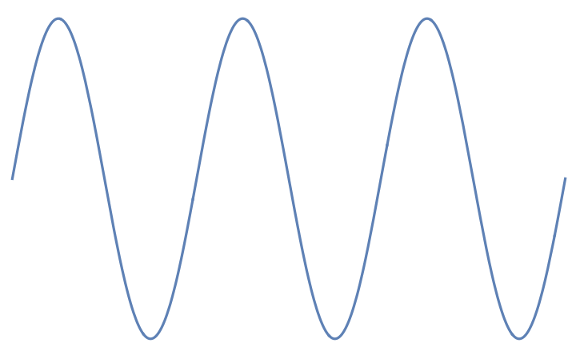
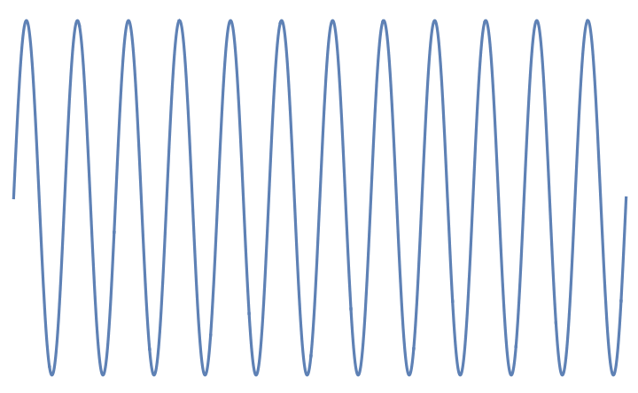
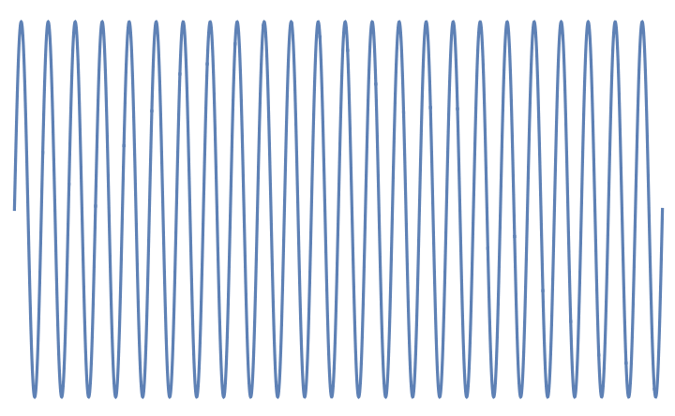


incident electron
E_{e} = γmc²
incident photon E_{ph}
Lab Reference Frame
Kinematics of
Inverse Compton Scattering
a Cartoon
incident photon E*_{ph} = 2γ E_{ph}
Electron rest frame
E*_{e} = mc²
scattered photon at
θ=1/γ E’_{ph} =E’₀ /2
if E*_{ph} << mc² the photon is scattered
back elastically with same energy E*_{ph}
(zero recoil, Thomson limit)
scattered photon at θ
E’_{ph} =E’₀ (1-γ ²θ²)
Lab Reference Frame
after Scattering
θ=1/γ
θ
scattered electron
E’_{e} = γmc² + E_{ph} – E’_{ph}
energy of scattered photon at θ=0 E’₀ = 2γ E*_{ph} = 4γ² E_{ph}

Slide 9
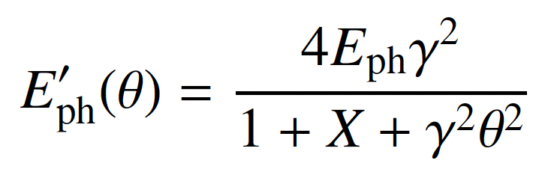
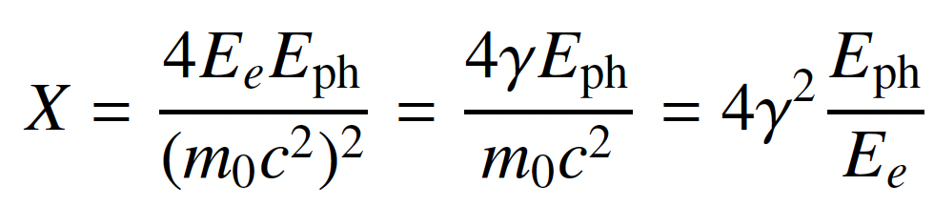
E’_{ph} - energy of scattered photon at θ
red shift at θ≠0
θ
scattered electron
E’_{e} = γmc² + E_{ph} – E’_{ph}
All I.C.S. X/γ ray Sources work at X<1 and A » 1
STAR (350 keV) X_{STAR} < 2.6.10⁻³ A_{STAR} > 10⁴
ELI-NP (20 MeV) X_{ELI-NP} < 0.026 A_{ELI-NP} > 2.4.10⁵
X = recoil parameter – twice the energy of the photon seen
by the electron in its own reference frame normalized to mc²

Slide 10
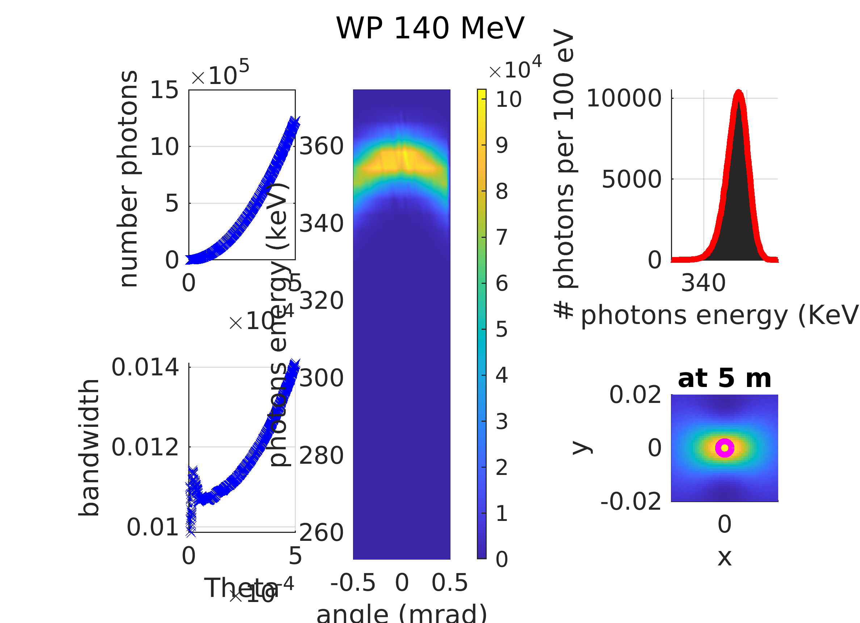

Slide 11
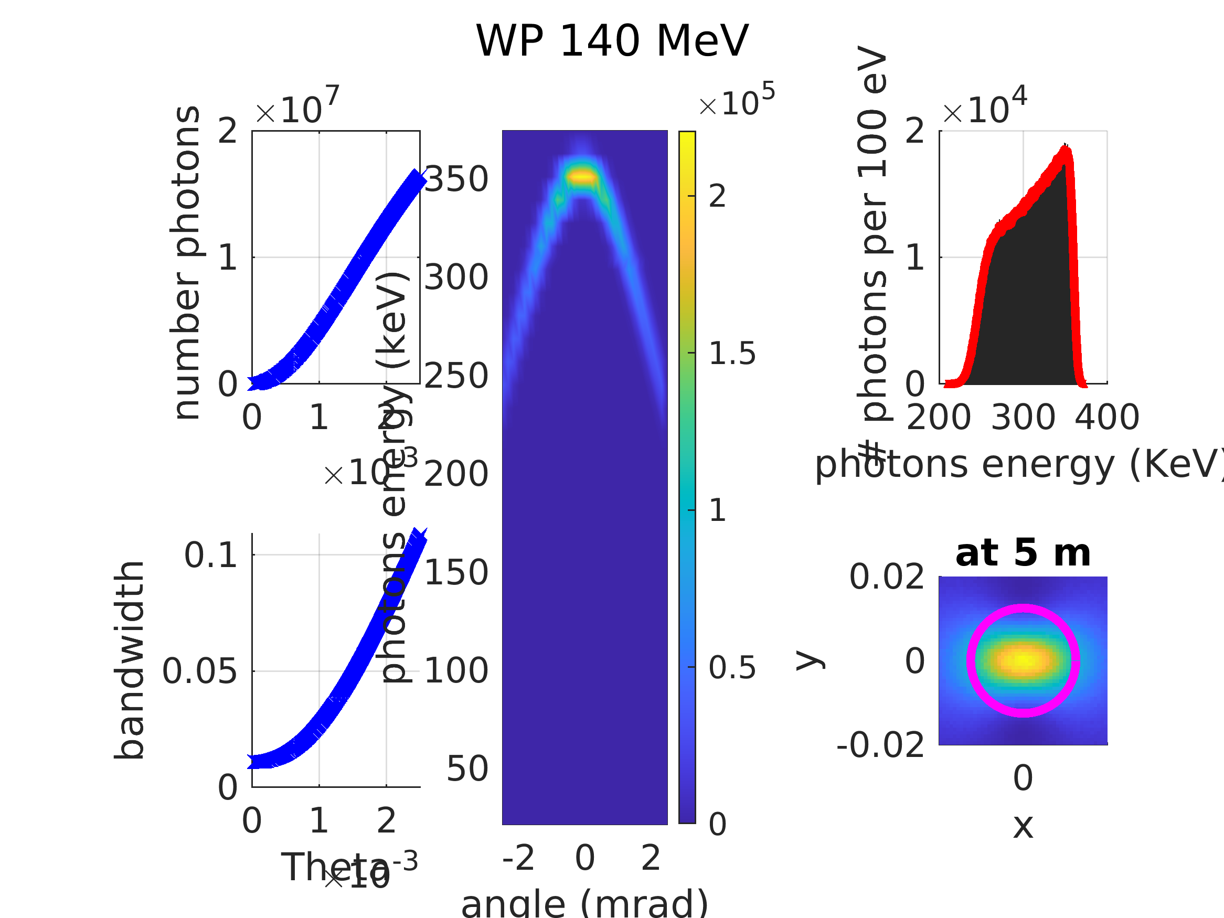

Slide 12
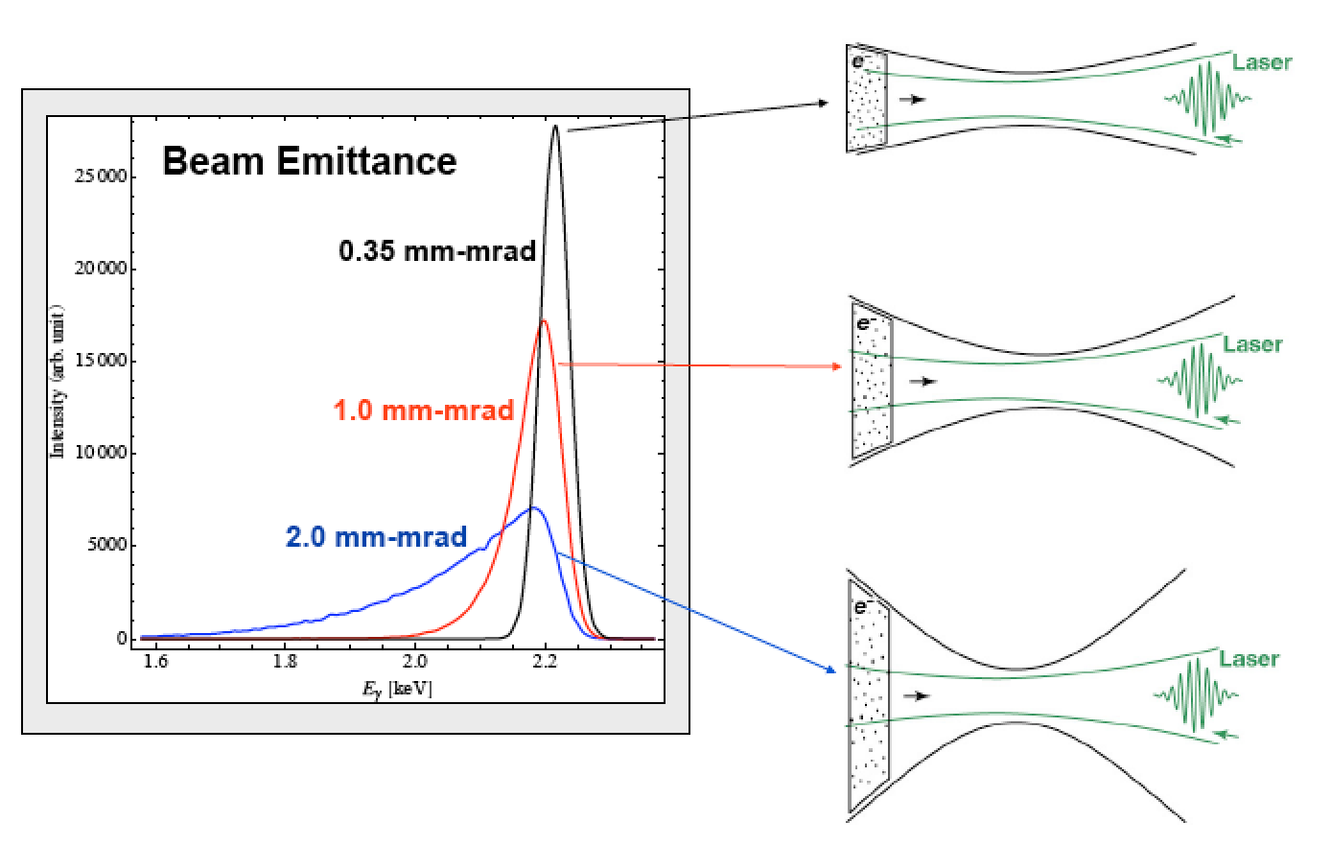
Courtesy C. Barty - LLNL

Slide 13
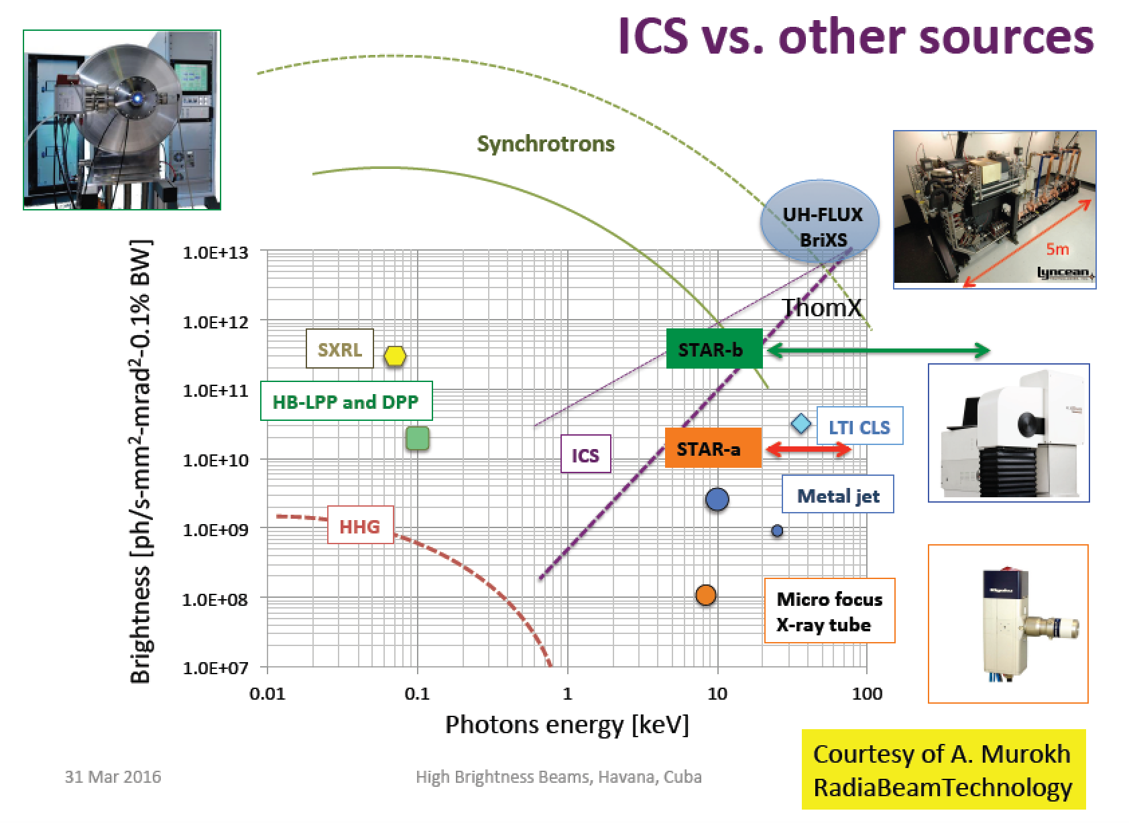

Rivaling with Synchr. Light Sources for energies above 50 keV
$$B_{av}=\frac{N_{ph}f}{ε_{x}^{2}\frac{ΔE_{X}}{E_{X}}}$$

Slide 14
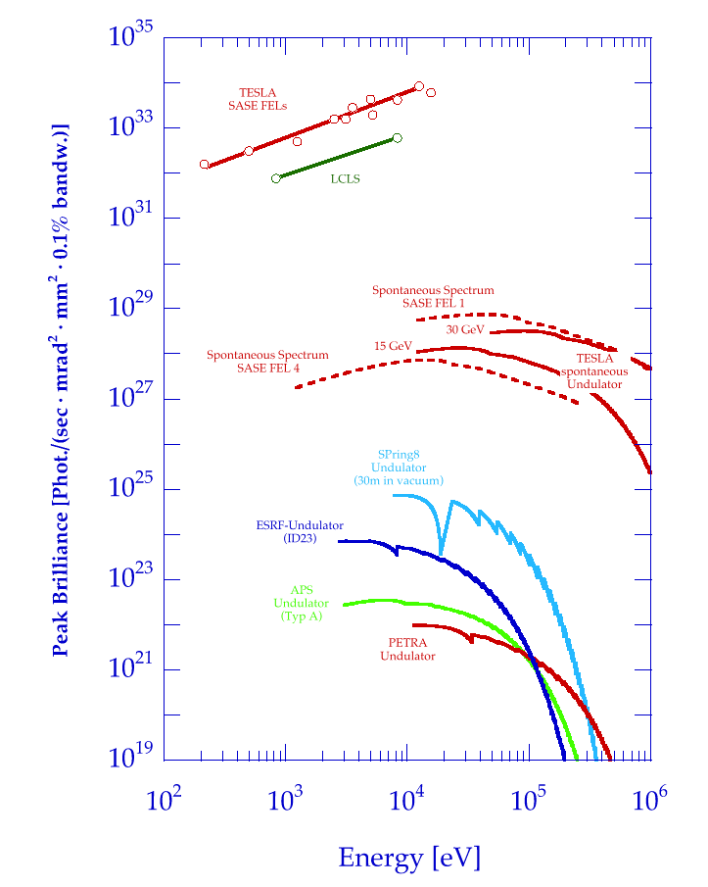
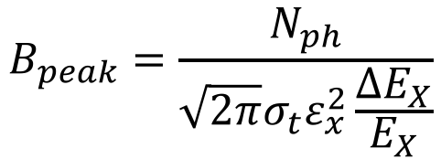
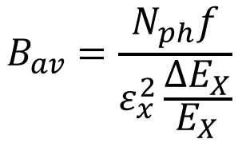
Brilliance of Lasers and X-ray sources
ELI
12.4
1.24
0.124
λ (nm)
BELLA
FLASH
$$B_{peak}=\frac{N_{ph}}{{\sqrt{2π}σ_{t}ε}_{x}^{2}\frac{ΔE_{X}}{E_{X}}}$$
Thomson/Compton Sources
$$B_{av}=\frac{N_{ph}f}{ε_{x}^{2}\frac{ΔE_{X}}{E_{X}}}$$

Slide 15
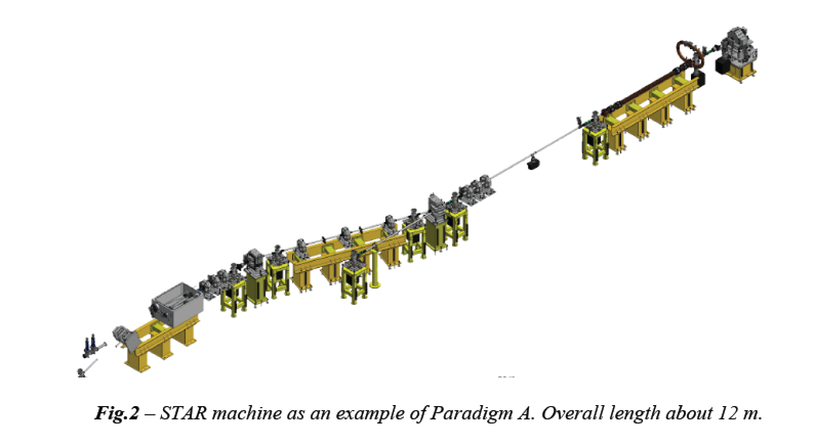
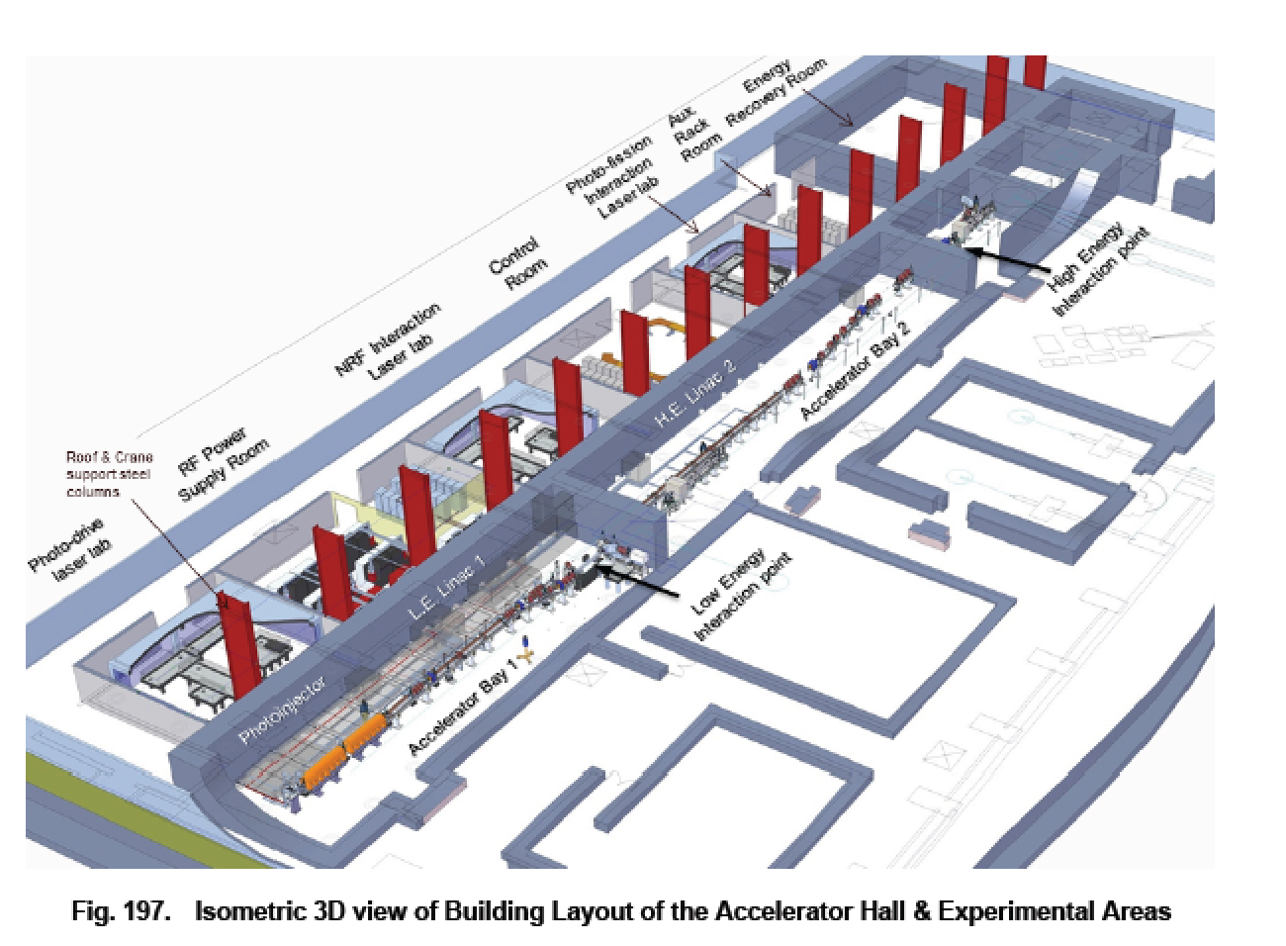
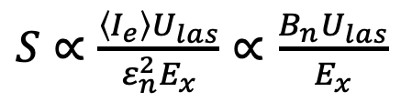
STAR was designed adopting a common paradigm with ELI-NP-GBS: both are e-γ linear collider based on 100 Hz amplified J-class lasers interacting with high brightness RF photo-injector. The design strategy applies Petrillo-Serafini criterion for maximum spectral density.
strong focusing of high brightness
(peak & average) to maximize Luminosity
According to Petrillo-Serafini criterion
$S∝\frac{\left\langle I_{e}\right\rangle U_{las}}{ε_{n}^{2}E_{x}}∝$ $\frac{B_{n}U_{las}}{E_{x}}$
true for all
collisional radiation
Spectral Density S (# photons per sec per eV bdw) relevant to X-ray imaging
(Brilliance is relevant to microscopy/spectroscopy)
250-750 MeV e⁻
1-19.5 MeV γ
30-150 MeV e⁻
20-350 keV X

Slide 16
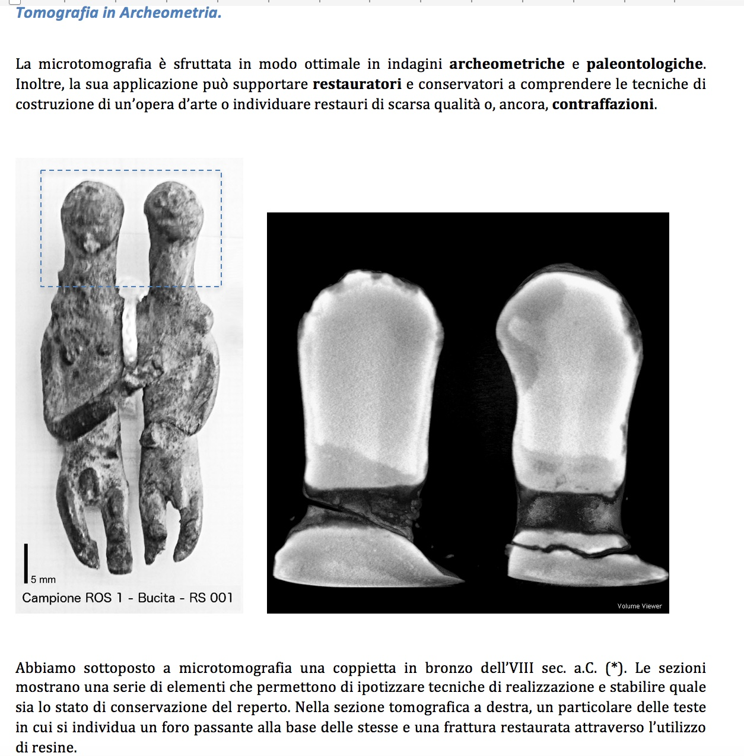
Courtesy R. Agostino

Slide 17
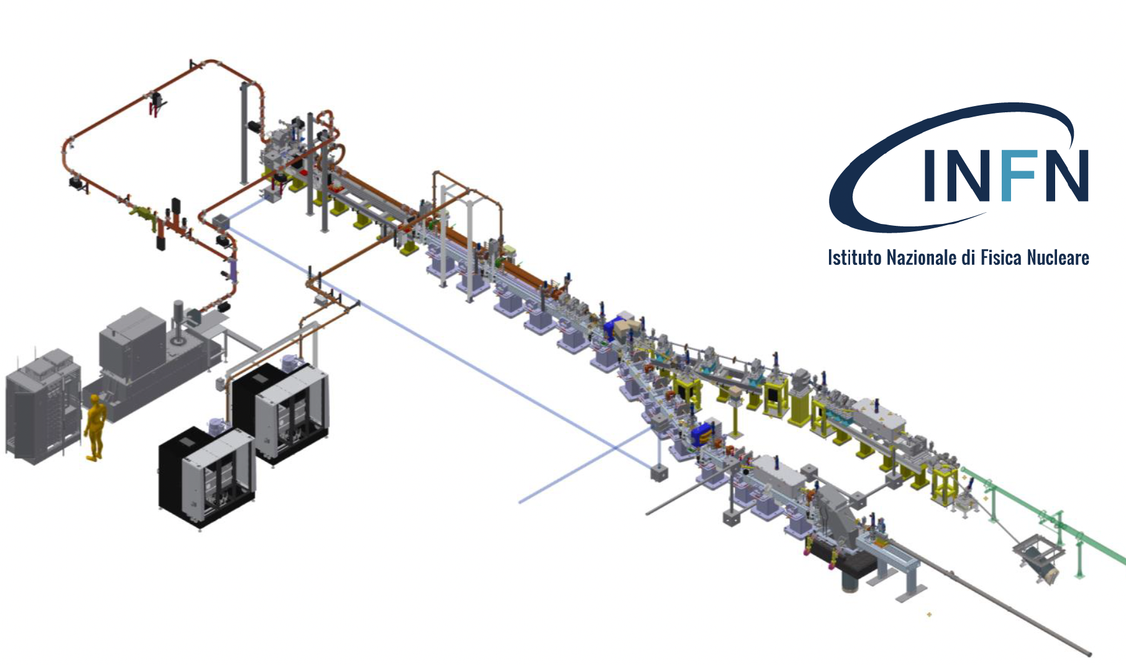
N_{ph} (s⁻¹) = 5.10¹⁰ (10% bdw) S @ 30keV (s⁻¹eV⁻¹)= 1.5.10⁷
STAR-multi-bunch N_{ph} (s⁻¹) = 5.10¹¹ (10% bdw)
S @ 30 keV (s⁻¹eV⁻¹)= 1.5.10⁸
cmp. spectral density S of a X-ray tube S ≈ 100-300 !!

Slide 18
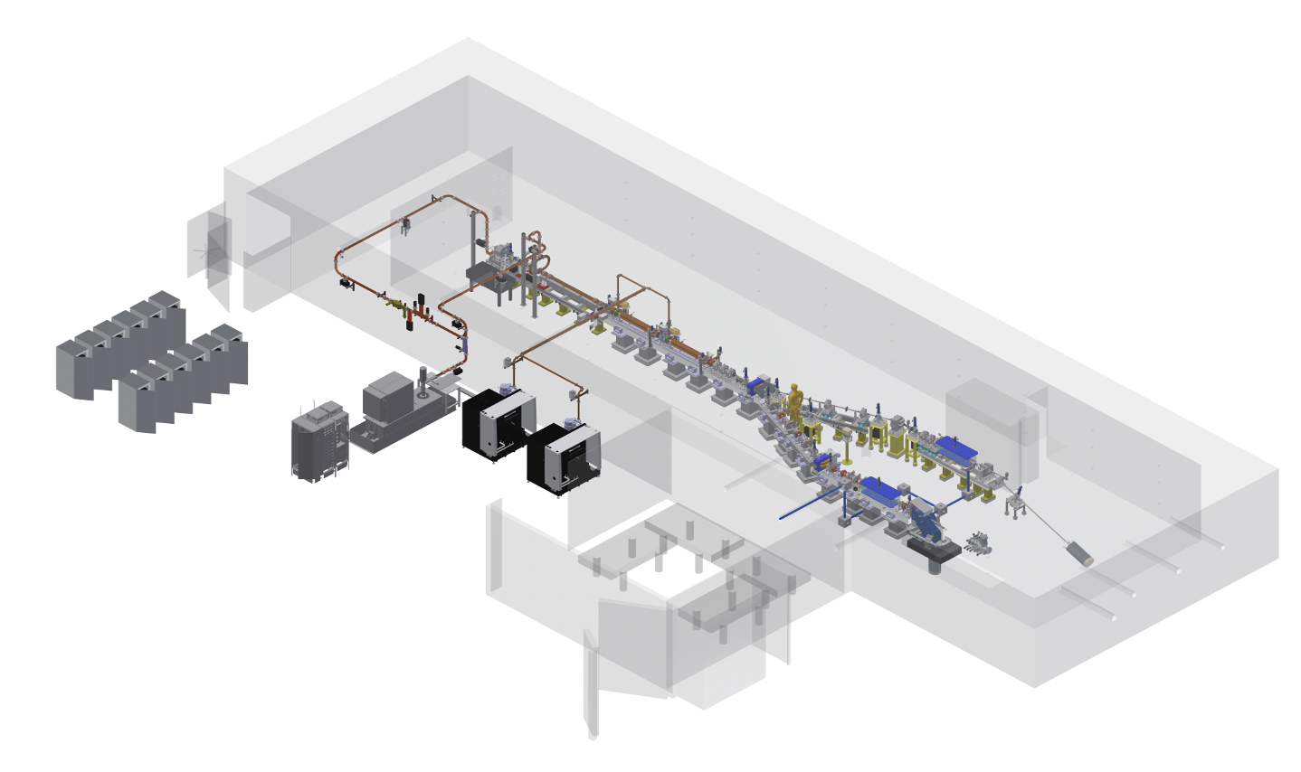
150 MeV High Brightness Electron Linac + Laser 12 M€
Bunker/building + ancillary equipm. 4 M€
2 X-ray beam lines for micro-tomography 3 M€
20 m
35 m
10 m
photon beam lines

Slide 19
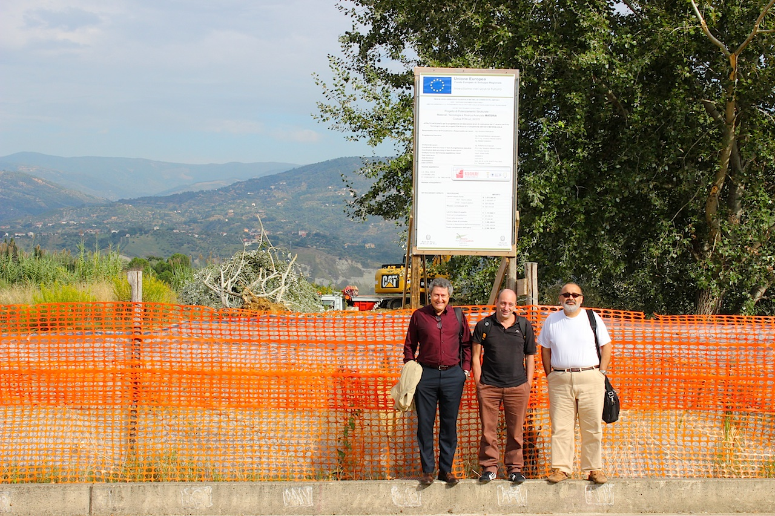
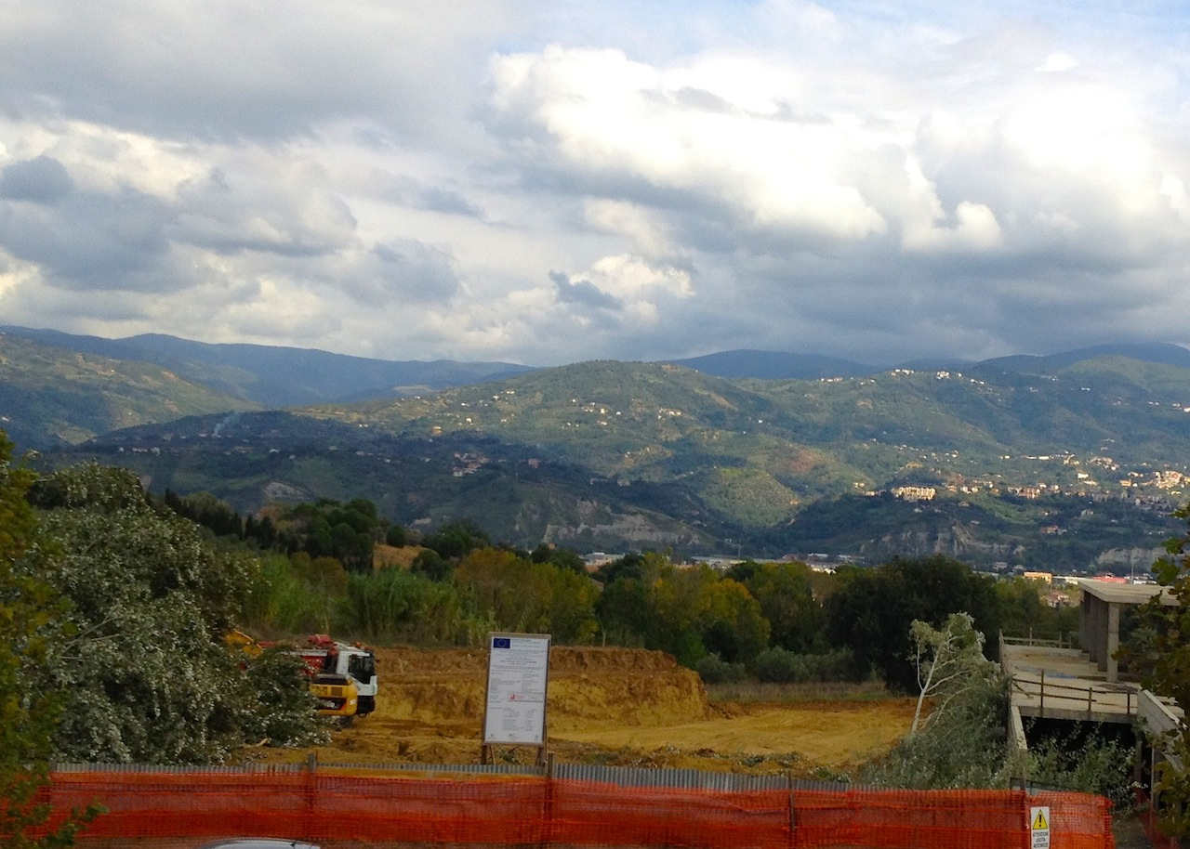
Schematic Budget for a
170 keV X-ray ICS to be built from scratch
100 MeV Linac+Laser (170 keV) - 9 M€
Bunker/building + ancillary equipm. 4 M€
2 X-ray beam lines (fully equipped) 3 M€
TOTAL 16 M€
Injector for AfLS (100 MeV Linac) 5-6 MeV
Bunker/building + ancill. equipment used also for AfLS
Cost specific to ICS (9-5) + 3 = 7 M€

Slide 21

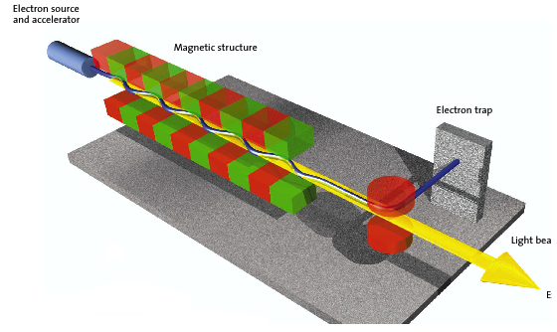
The Classical E.M. view (Maxwell eq.): Thomson Sources as synchrotron radiation sources with electro-magnetic undulator
FEL’s and Thomson/Compton Sources common mechanism:
collision between a relativistic electron and a (pseudo)electromagnetic wave
3 km
cm und. period λ_{u}
1-25 GeV
electrons
100-0.5 Å
photons
20-150 MeV electrons
0.8 μm laser λ
20-500 keV
photons
20 m

Slide 22
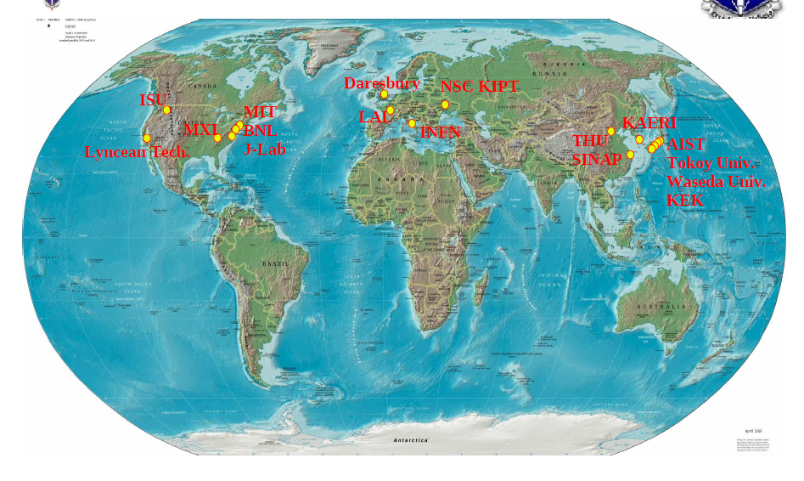
CALA
ELI-NP
HigS
STAR
ICS are the most effective “photon accelerators” (boost twice than FELs)
“4γ² boost effect”
Courtesy A. Variola

Slide 23
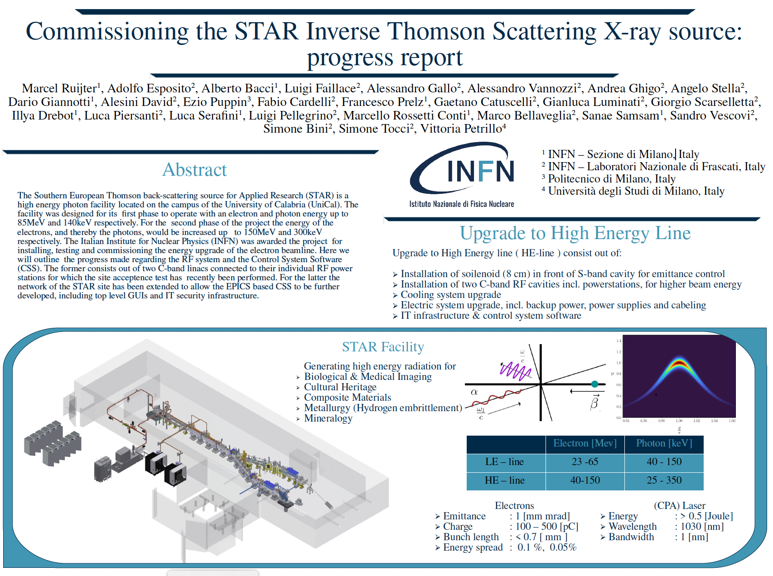

Slide 24
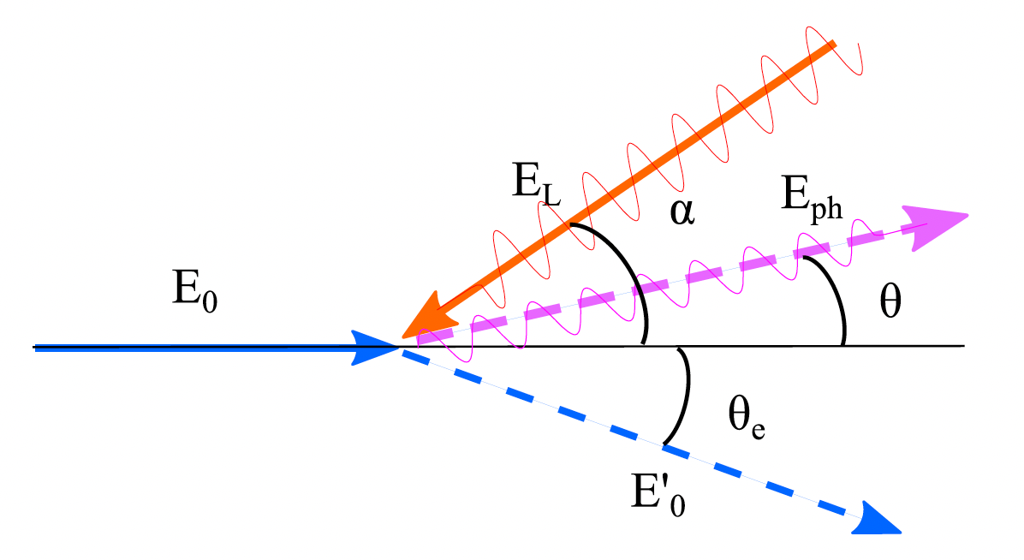
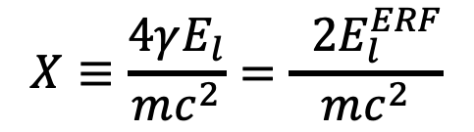

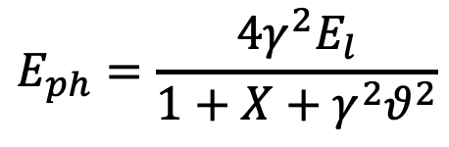
The γ²θ² issue/disease
All radiation originated by a Lorentz Boost associated to relativistic emitting particles (electrons, heavy ions) is intrinsically poli-chromatic because of γθ correlation (energy boost of scattered photons depends on scattering angle, at θ=1/γ photon energy is 50% of max photon energy at θ =0 ) of single electron spectrum (on top of inhomogeneous effects)
True for all kinds of Undulatory and Collisional radiation (bremsstrahlung, wiggler/betatron, synchrotron, RRS, ICS), while resonant or amplified radiation (undulators, FELs), that are diffraction limited thanks to their beam quality, are not (or only partially) affected
$$E_{ph}=\frac{4γ^{2}E_{l}}{1+X+γ^{2}θ^{2}}$$
$$E_{0}=γmc^{2}$$
$$X≡\frac{4γE_{l}}{mc^{2}}=\frac{ 2E_{l}^{ERF}}{mc^{2}}$$

Slide 25
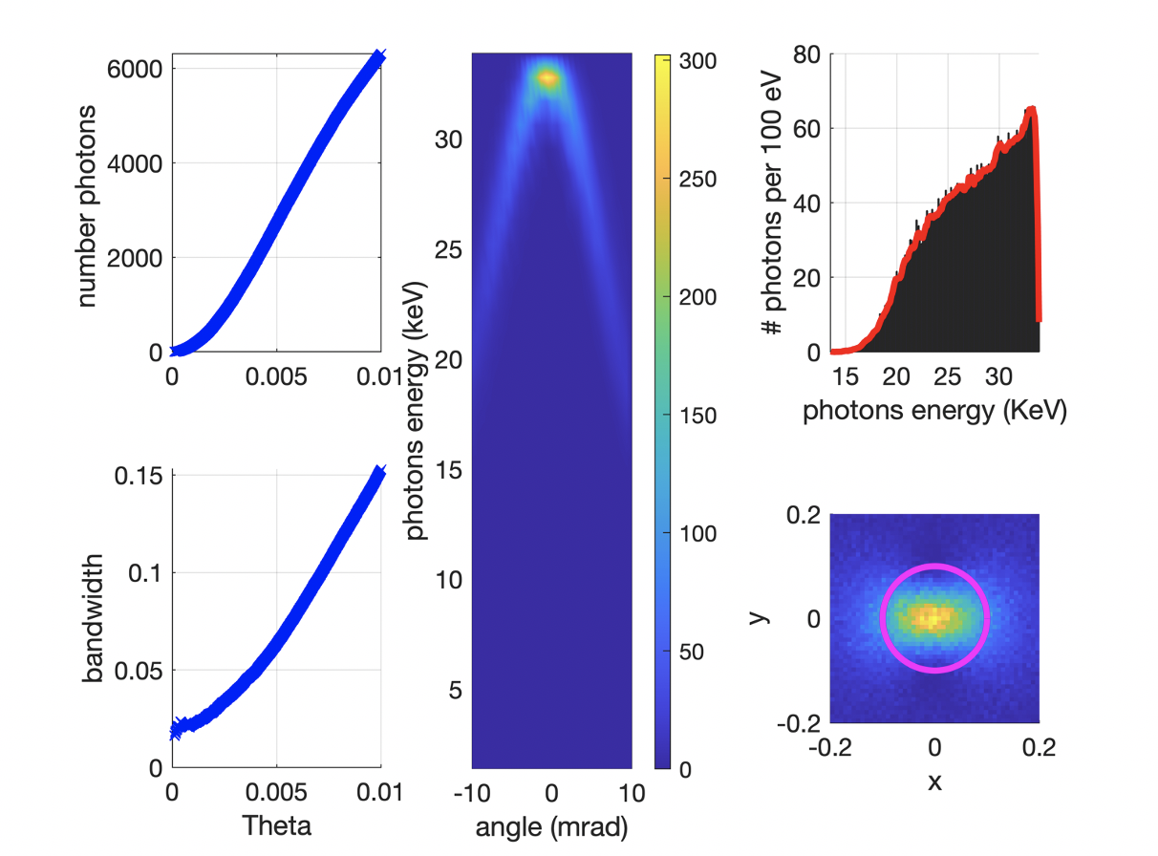
BriXSinO’s ICS source – Illya Drebot with CAIN –
ICS Moustache
BriXSinO T.D.R. @ www.marix.eu

Slide 26
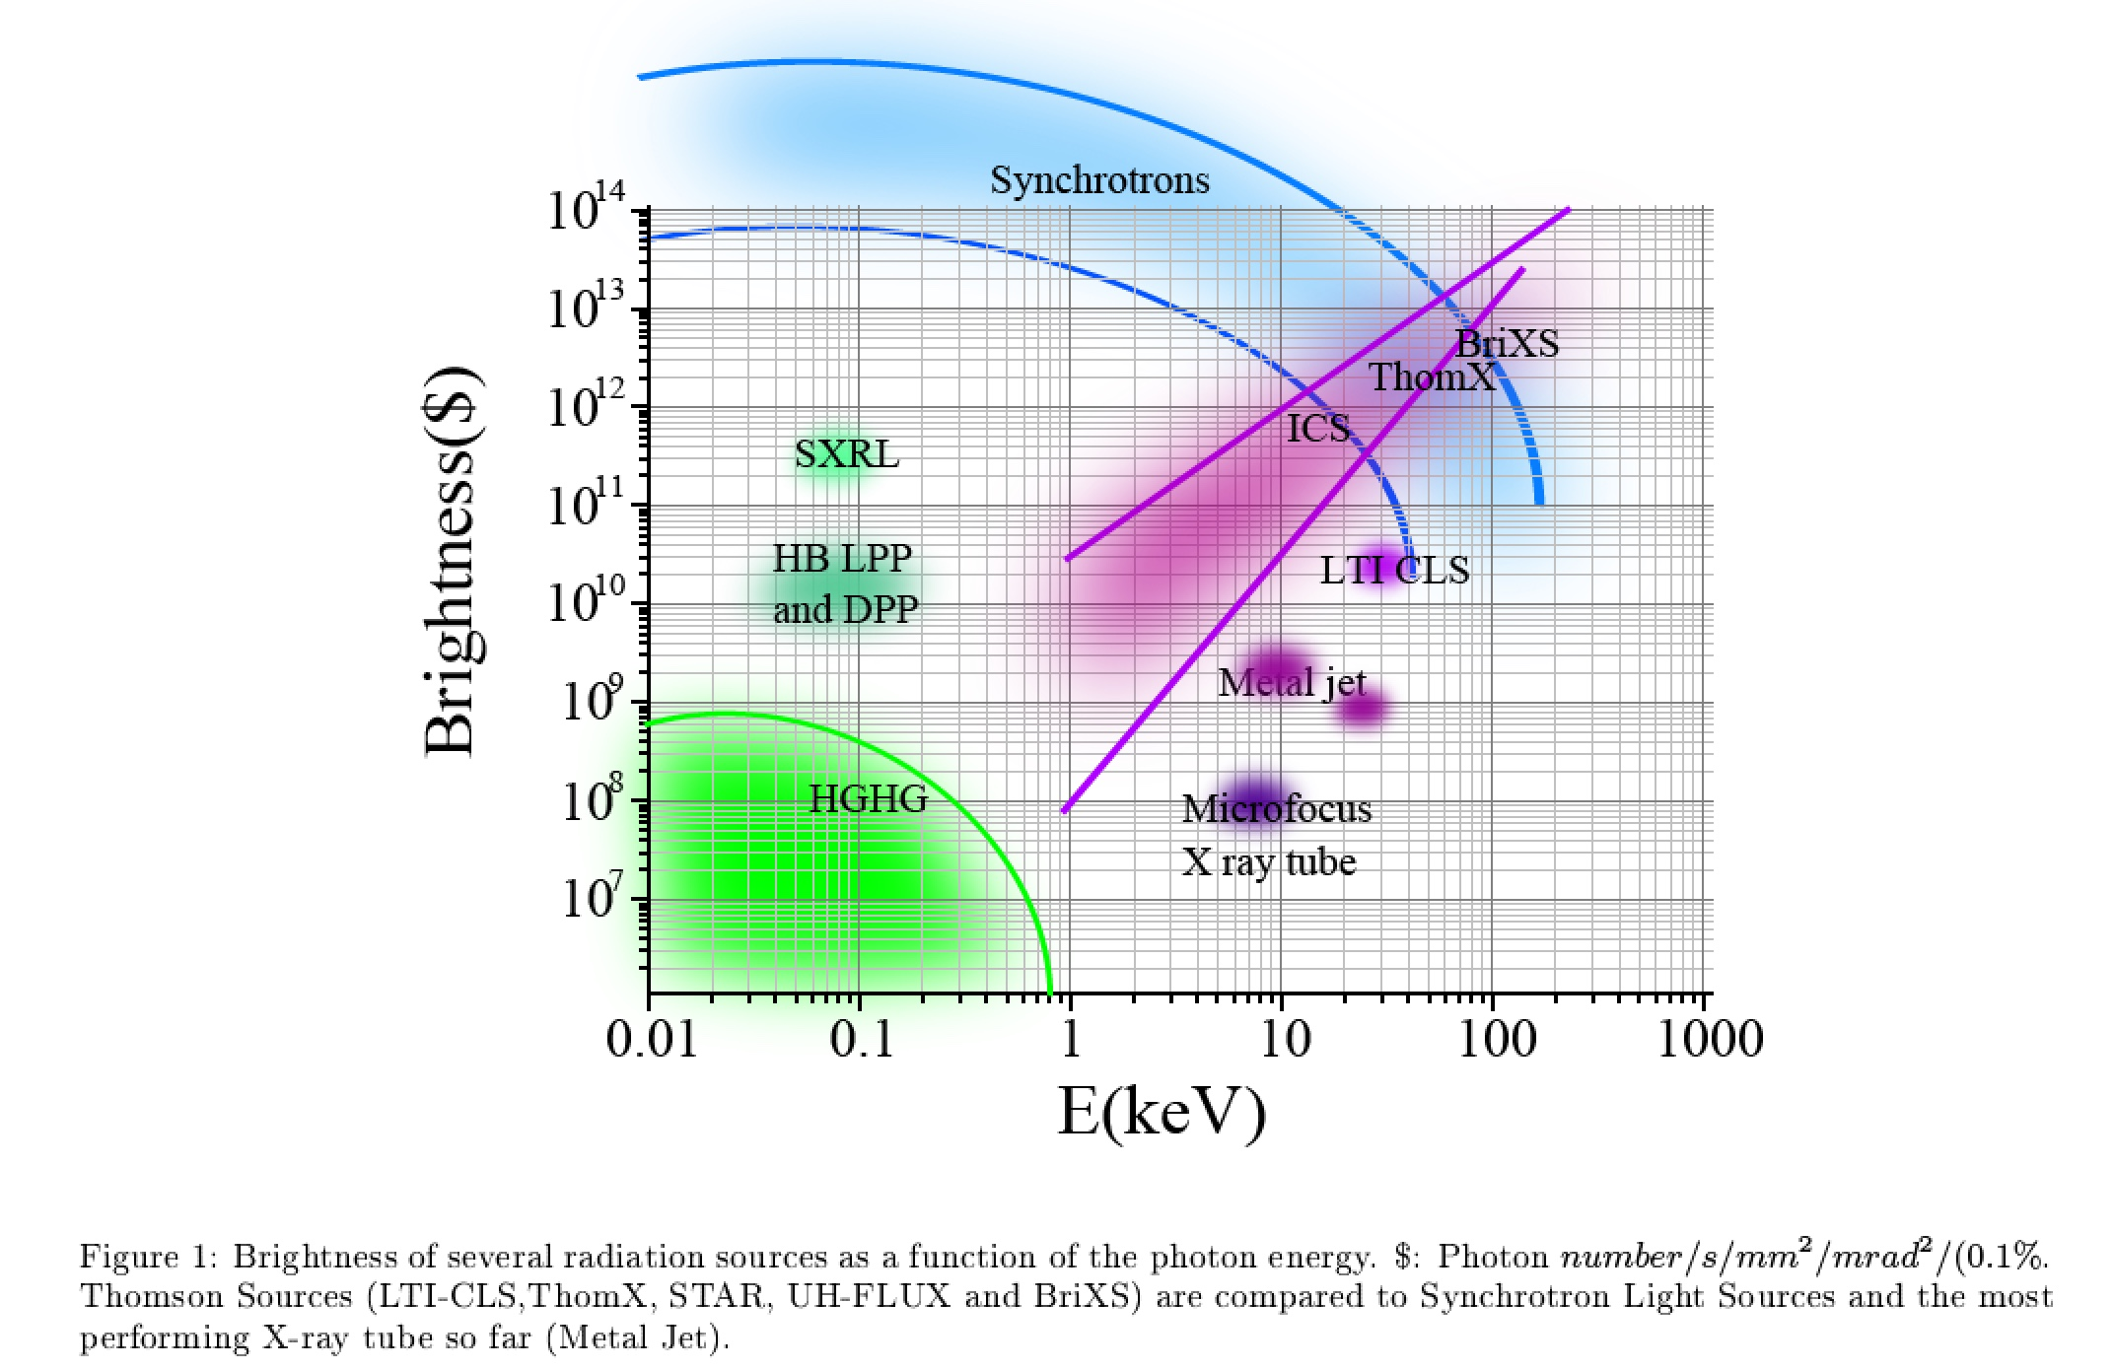
Inverse Compton Sources rivaling/overcoming
Synchrotron Light Sources at photon energies above 80-100 keV
ELI-NP-GBS
STAR
I.C.S.

