Slide 1
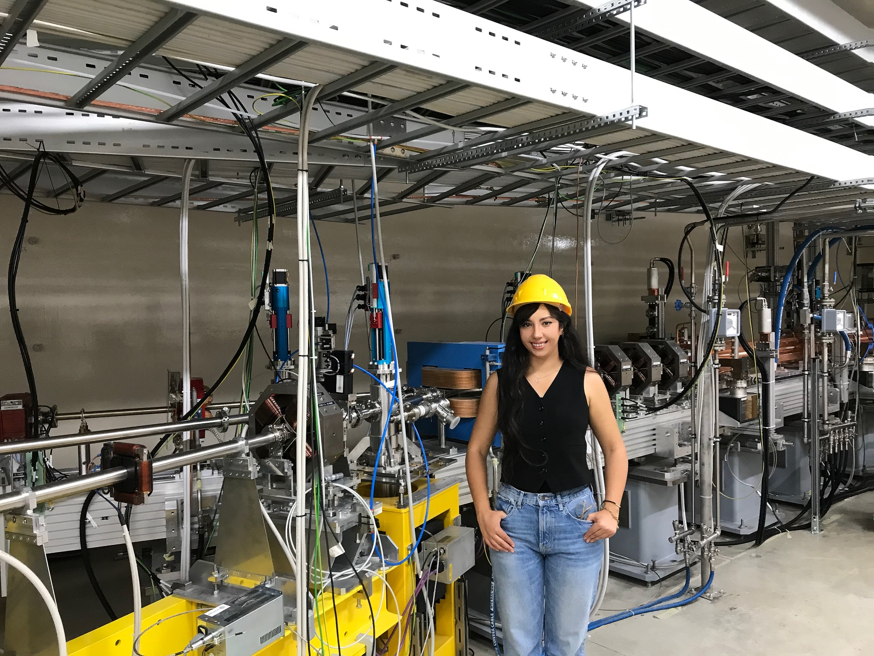


ASK an ASP
(Alumni)
From ASP to Illuminating Africa's Future in Light Sources
"We must inspire and motivate more women to pursue advanced studies in the fields of physics and science. I am committed to actively engaging in these efforts upon returning home."
Dr. Sanae SAMSAM

Slide 2


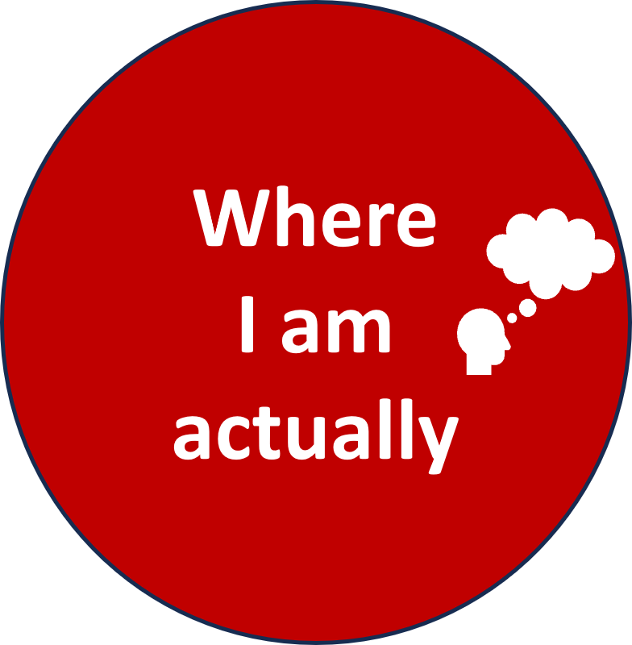


Slide 3
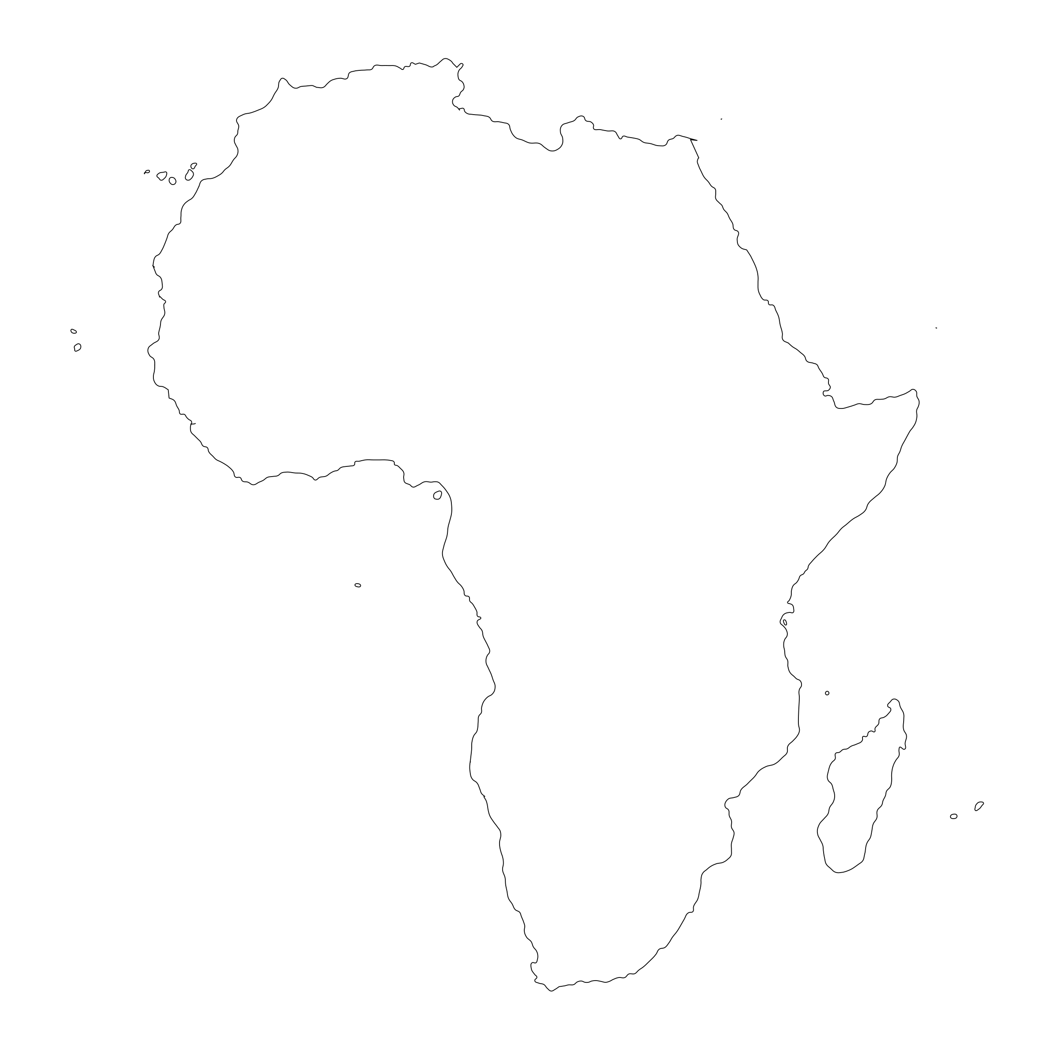


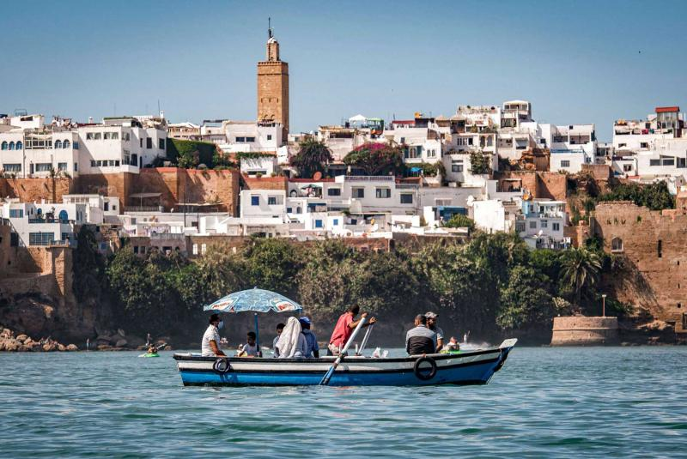
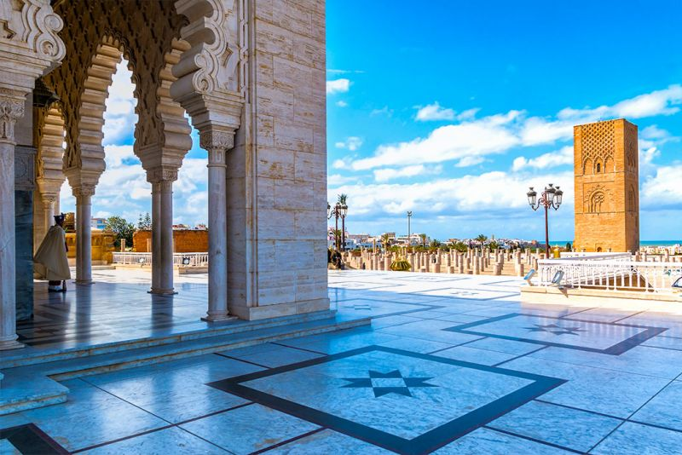
Origines
Salé, Morocco
Kingdom of Morocco
Arabic, Amazigh, French, Spanish & English.
Rabat, Morocco
Established: 788
Population: 37,840,044

Slide 4


Education
University of Mohamed V
Rabat, Morocco
M.Sc in Quantum Physics: Applications to information theory
B.SC in Medical Physics
B.Sc in Mechanical Energy
Master
Sciences
http://www.um5.ac.ma/um5/
Bachelor
Sciences
Specialized Bachelor
Sciences

Slide 5
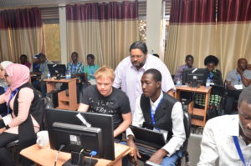
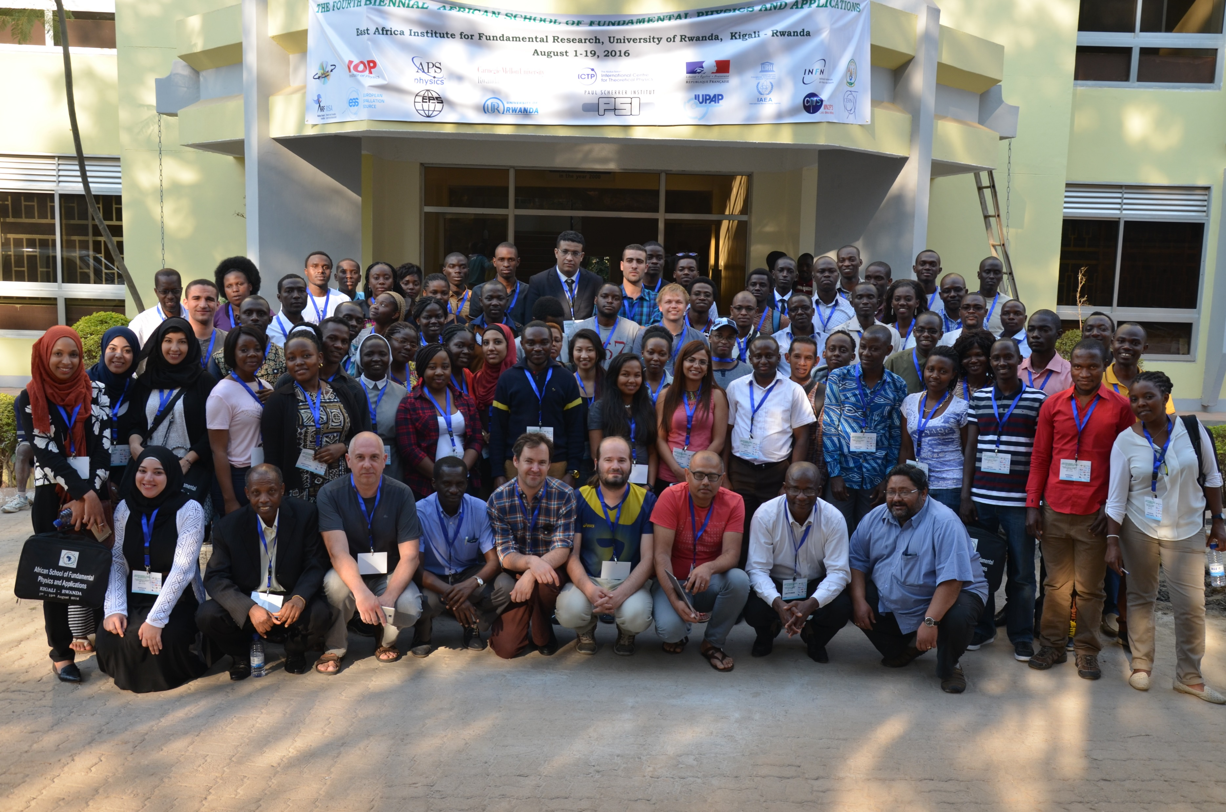
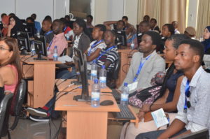
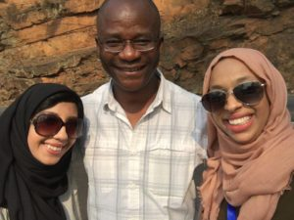
ASP School Edition
ASP
Experience
ASP 2016, Kigali, Rwanda

Slide 6
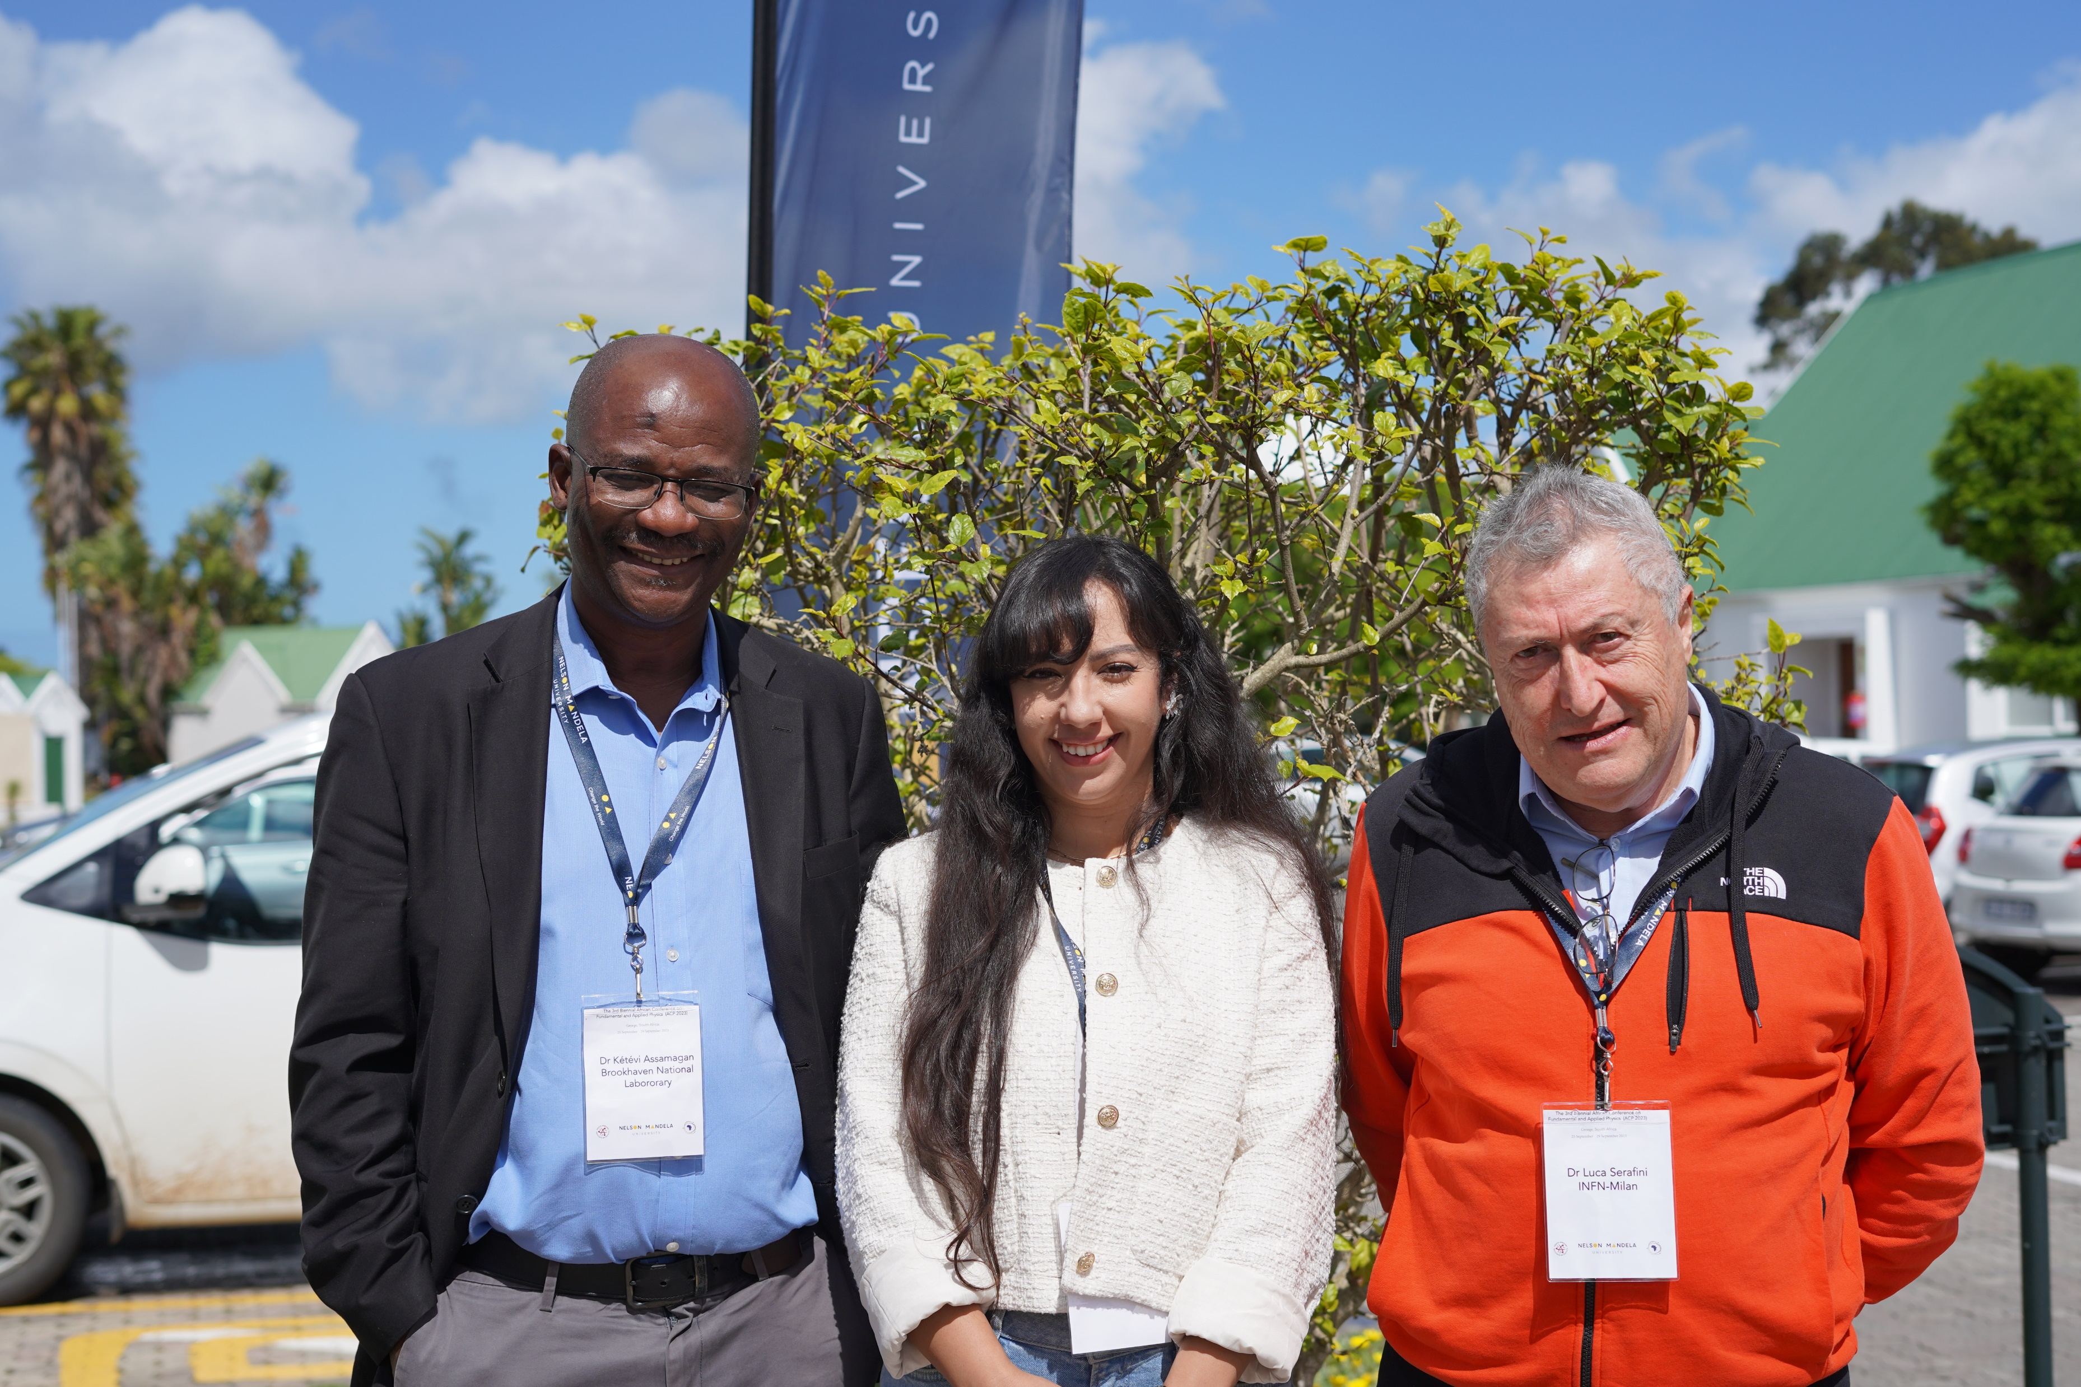


Dr. Luca Serafini
INFN
The Mentorship Program
Dr. Kétévi Assamagan
BNL
https://www.africanschoolofphysics.org/mentoring-and-coaching-program/

Slide 7
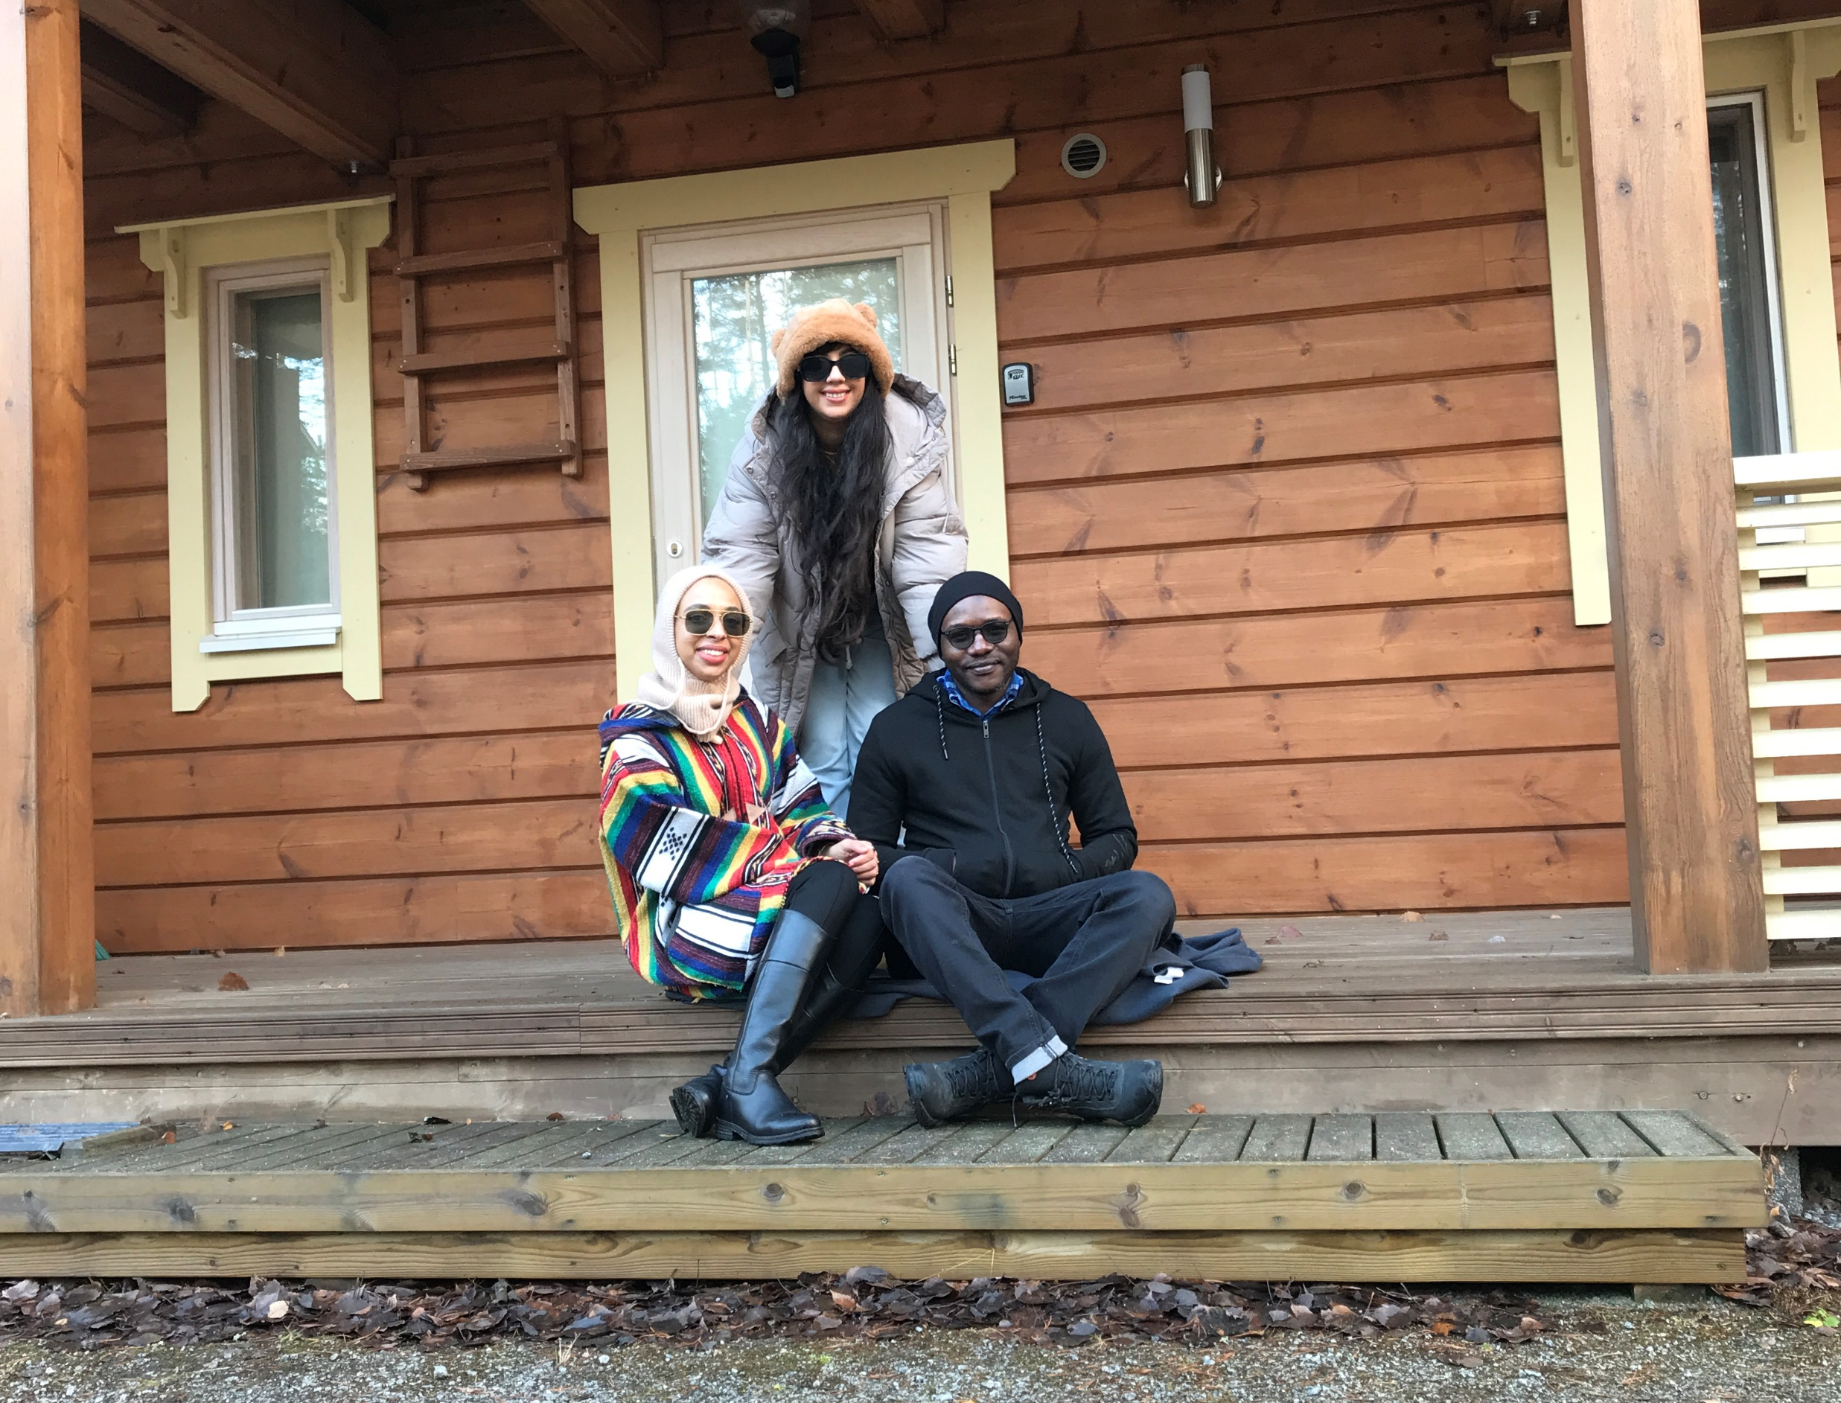
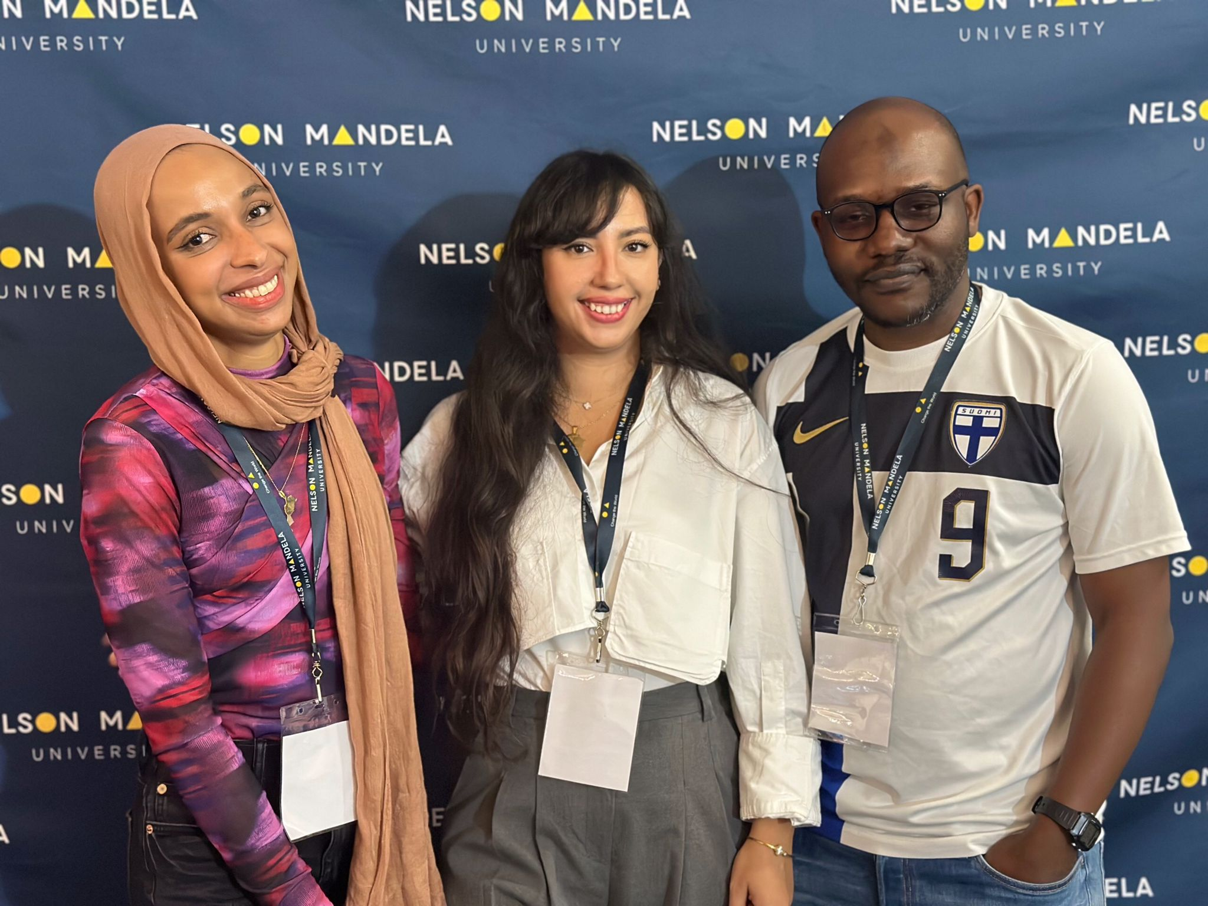

ASP 2016 Folks
November 2022, Finland
September 2023, South Africa

Slide 8
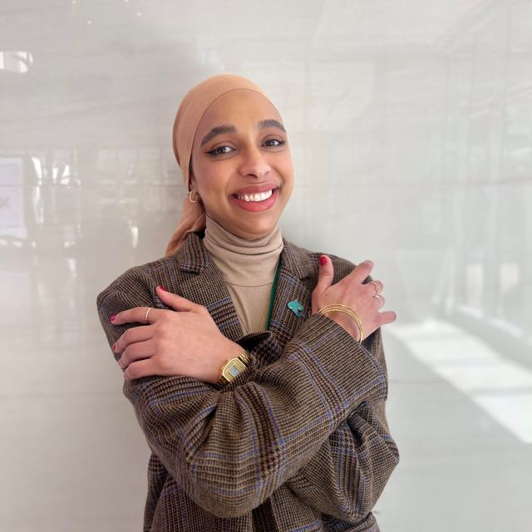
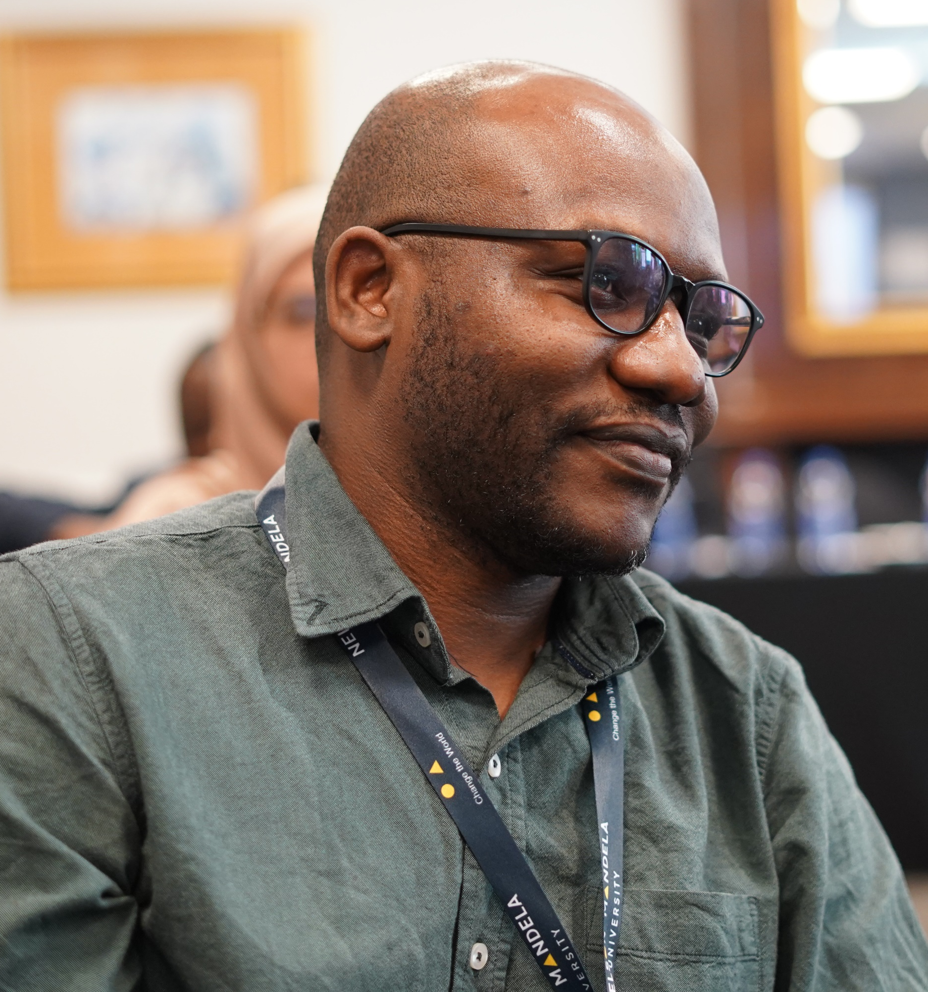
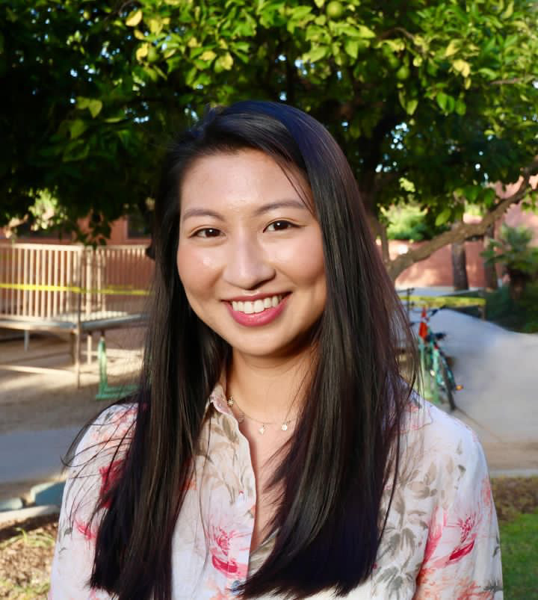
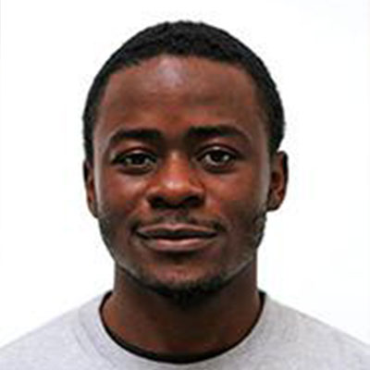
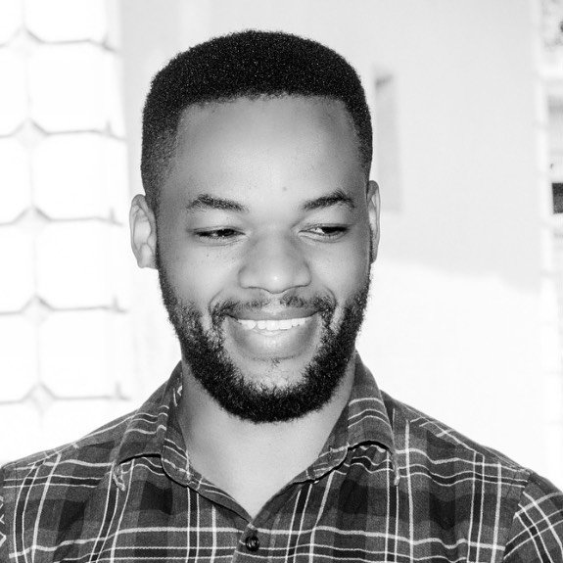
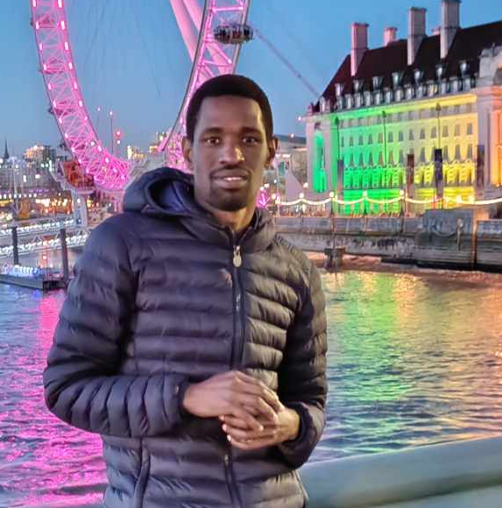
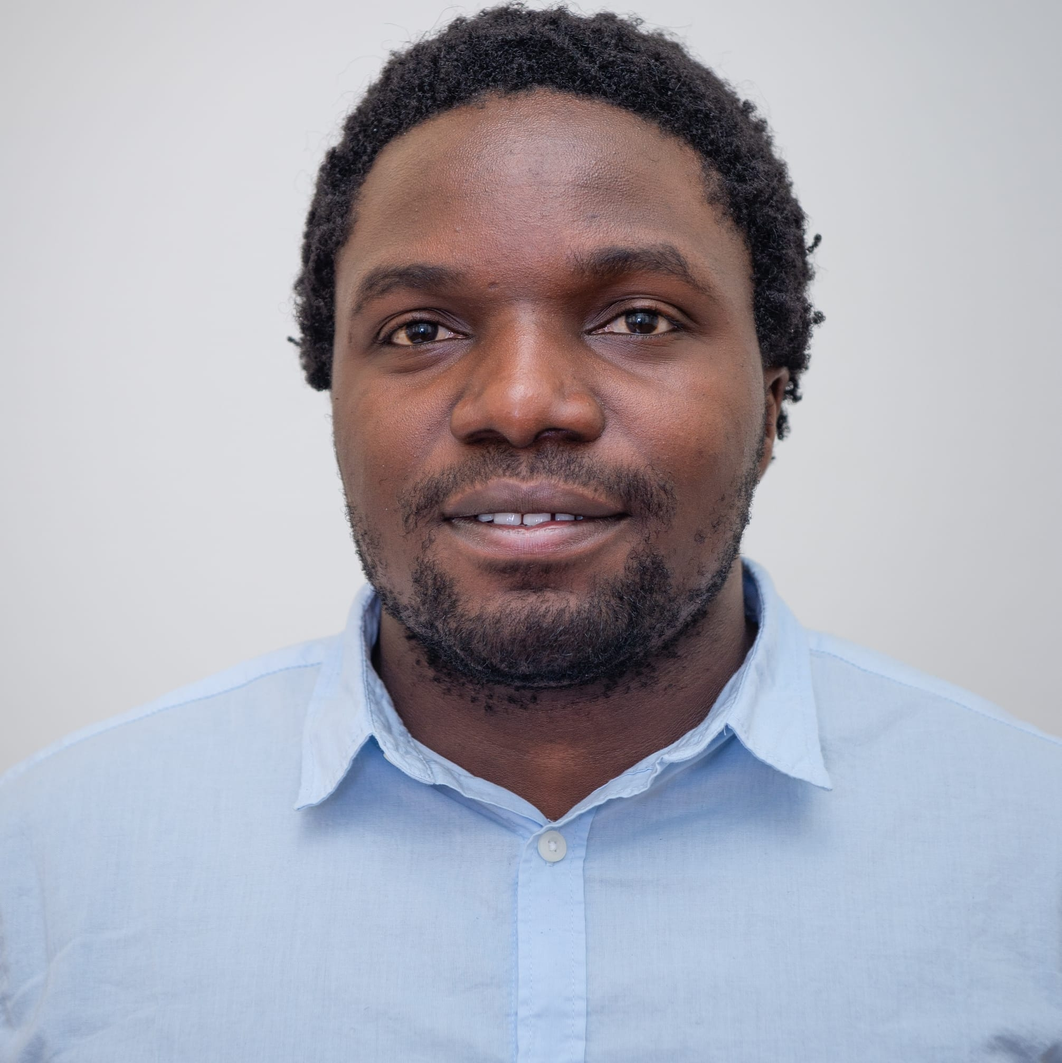
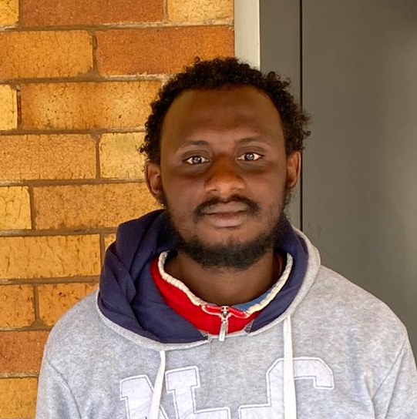
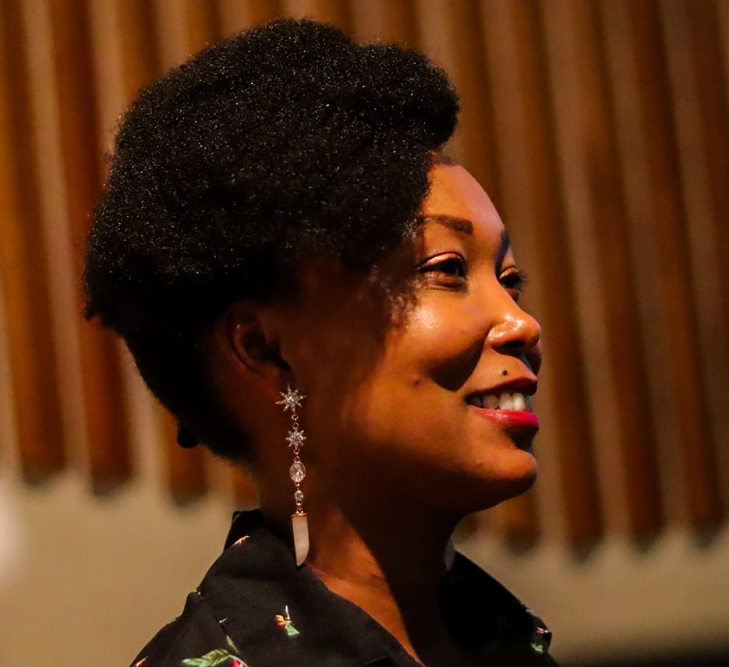
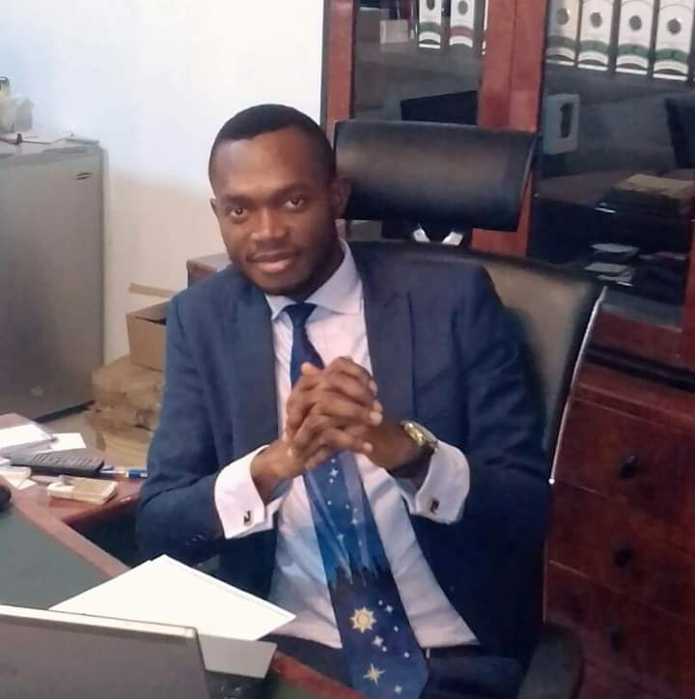
ASP 2016 Folks
Mounia Laassiri
Post Doc
University of Helsinki
George Zimba
Post Doc
FRIB, MSU
Jessica Li
PhD in Astrophysics
University of Arizona
Davis Welakuh
Post Doc
New York University
Kamanzi
Oncology Medical Physicist, Rwanda
Enoch Ejopu
PhD in Particle Physics
University of Manchester
Eric Samikwa
PhD in Computer Sc
University of Bern
Abulgaffar Abdulrazzak
Post Doc
LAAS CNRS, Toulouse
Ann Njeri
Research Assistant
NCL, UK
Uche Ogbonnaya
MOBSOL Technologies
Abuja, Nigeria

Slide 9




Ph.D Accelerator Physics
Post Doc
Optimization and simulations of X-ray Compton radiation spectra in the linear and non-linear regime.
High energy line measurements of STAR Project in Calabria, Italy.
Simulations of HOM effects on BD in SC cavities for BriXSinO projects in Milan, Italy.
https://star.unical.it/
https://indico.cern.ch/event/1229551/sessions/505466/#20230925
Where
I am
actually

Slide 10




References
ASP Mentorship Program
https://www.africanschoolofphysics.org/mentoring-and-coaching-program/
MAEICI Scholarship:
https://www.esteri.it/en/opportunita/borse-di-studio/per-cittadini-stranieri/borsestudio_stranieri/
Training and Research in Italian Laboratories (TRIL)
https://www.ictp.it/opportunity/training-and-research-italian-laboratories-tril
PhD in Accelerator scholarship at LA SAPIENZA University.
https://phd.uniroma1.it/web/ACCELERATOR-PHYSICS_nD3504_EN.aspx

Slide 11
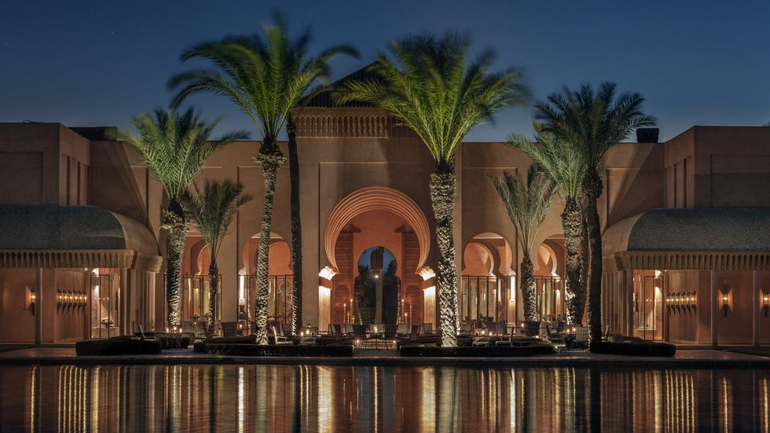
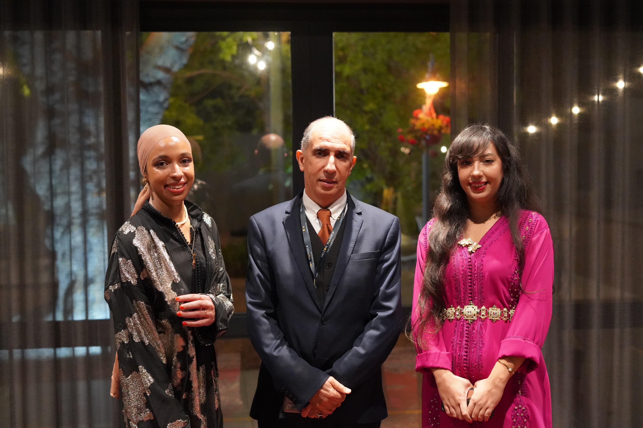
See you next year in ASP24, Marrakech, Morocco

Slide 12
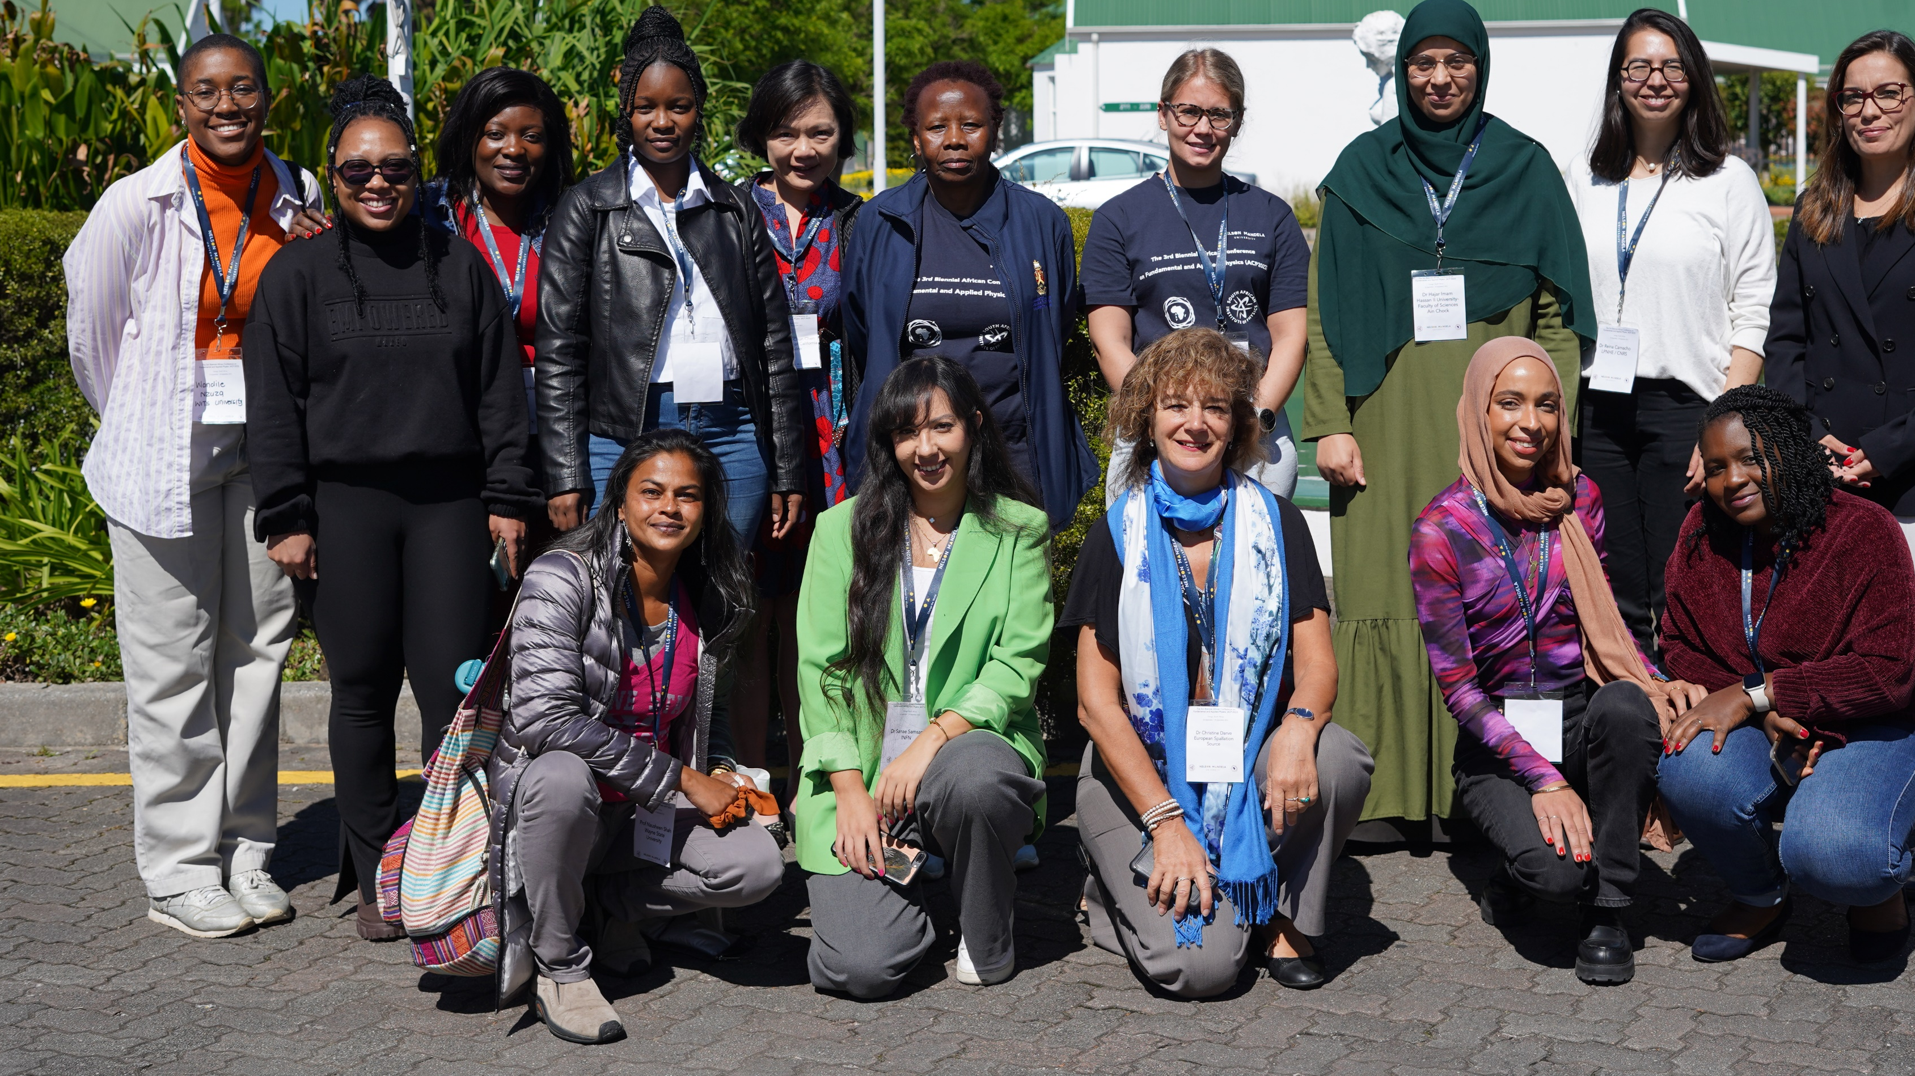
Thank you
I believe that the future of physics in Africa is bright, and it's our collective responsibility to ensure that this light continues to shine. Let us seize this conference as an opportunity not only to exchange groundbreaking ideas but also to nurture the seeds of curiosity and ambition in the hearts of our young scientists, with a special focus on encouraging women to pursue careers in physics.

