Slide 1
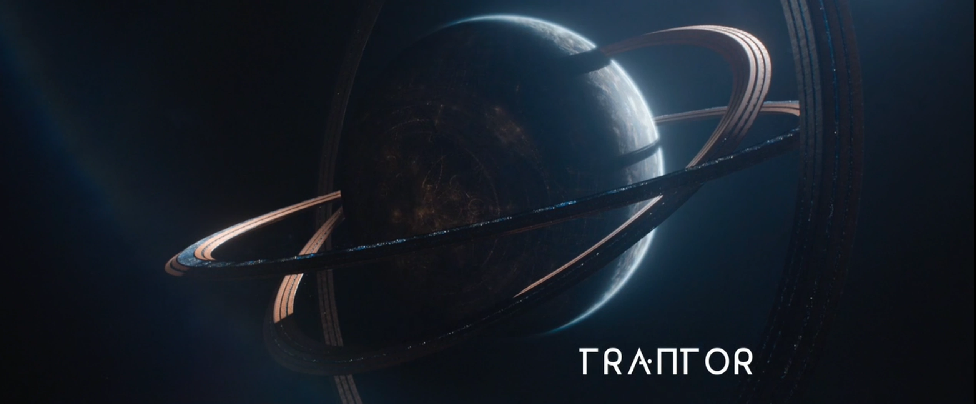

High energy physics: The edge of possibility
Xola Mapekula
16 September 2023
University of Johannesburg

Slide 2
Brief introduction about myself
Background in mechanical engineering
  I know this is strange but please let me explain
Did my masters in high energy physics
  This is where my imagination started runningwild

Slide 3
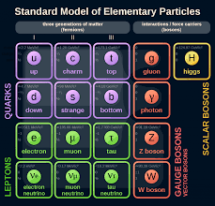
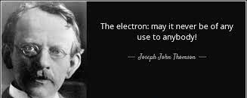
Why I carried on with High Energy physics

Slide 4
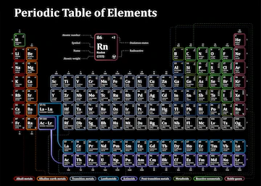
What if there was a periodic table for dark matter

Slide 5
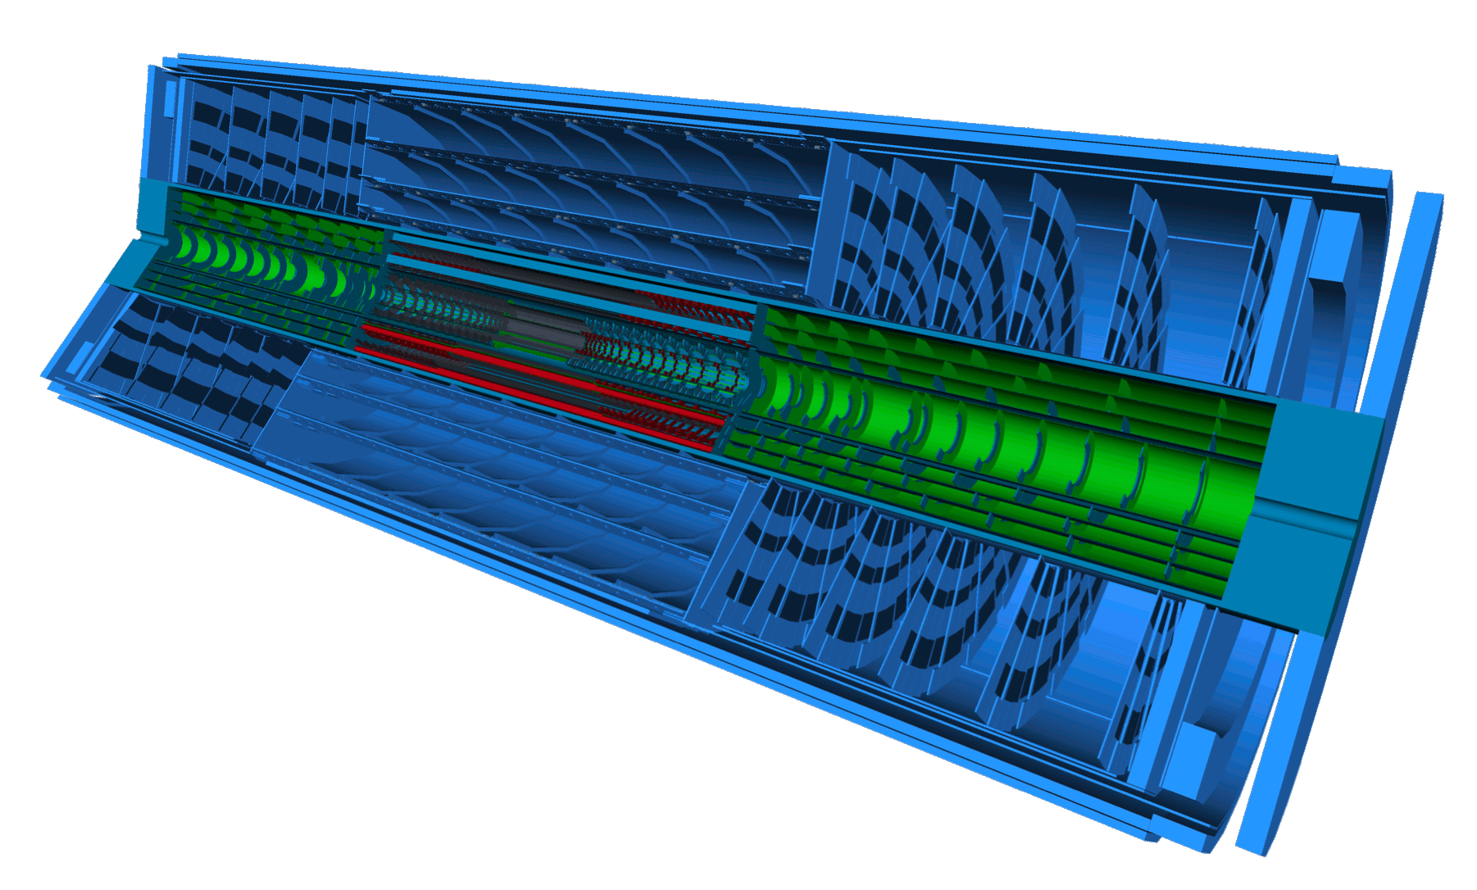
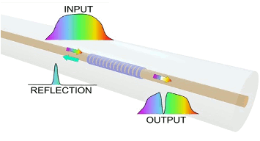
Still get to do engineering work
Sensitive region
Currently working on developing fiber optic sensors
Impact sensitive parts of the detector which include sensors that monitor environment
Sensors close to collision point are exposed to the most radiation
Need solution for sensors that are resistant to radiation damage
Possible solution has been studied for radiation hard sensors that monitor temperature and humidity inside the detector

Slide 6
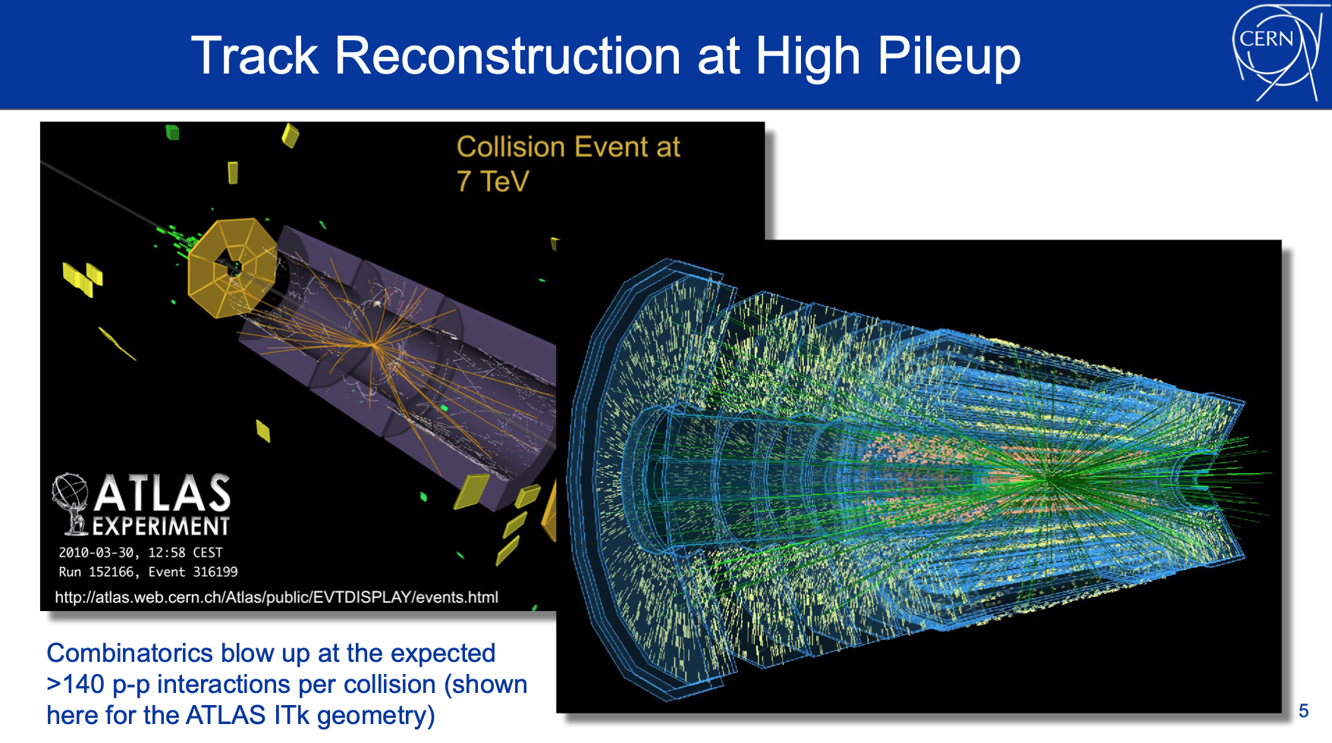


l
l
l
l

Slide 7
Brief introduction about myself
Will dedicate my academic life to the study of dark matter
Also use my expertise as an engineer to use technology developed at High energy physics collaborations to solve societal problems
Hope to see the day where we can use dark can be used to solve energy problem

Slide 8
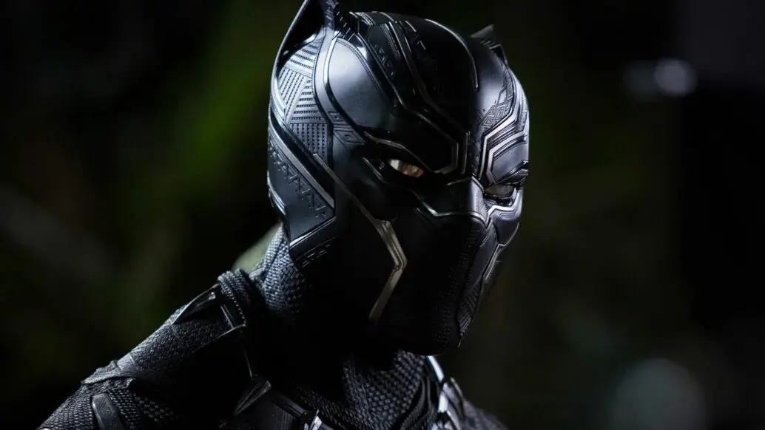
Thank you

