Slide 1


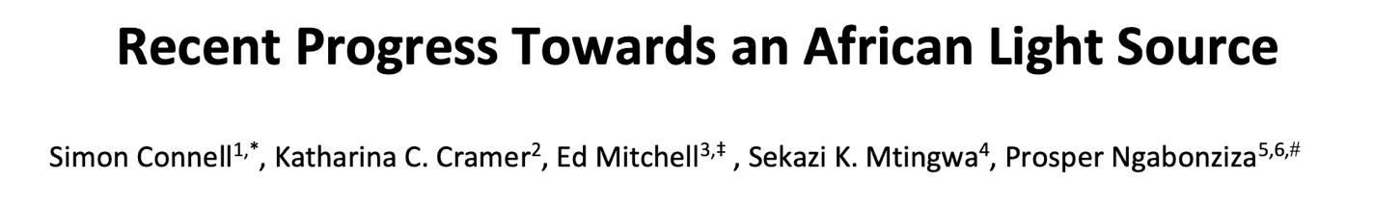

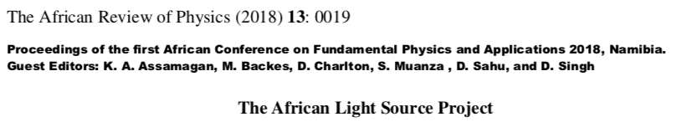
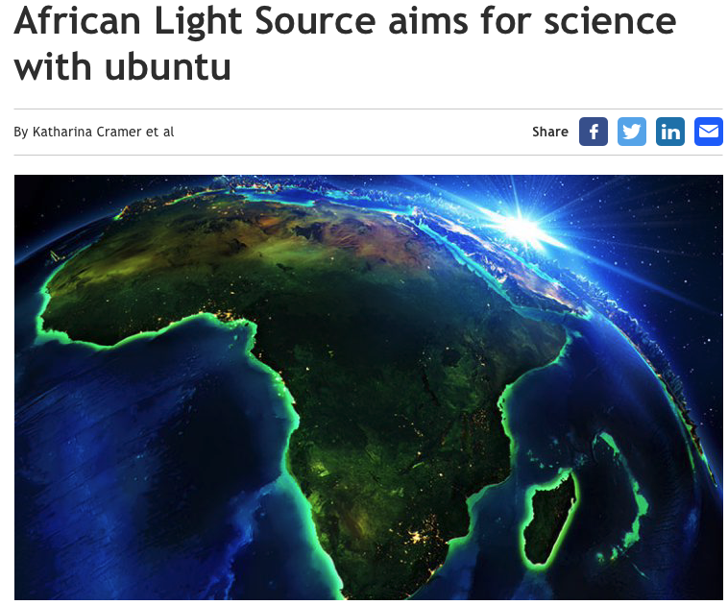


AfLS Website https://www.africanlightsource.org
Johannesburg – Soccer World Cup 2010
Debating the Societal Impact of Big Science in the 21st Century
To appear soon …..
https://www.worldscientific.com/doi/abs/10.1142/S0217732318300033
http://lamp.ictp.it/index.php/aphysrev/article/view/1610/586

Slide 2
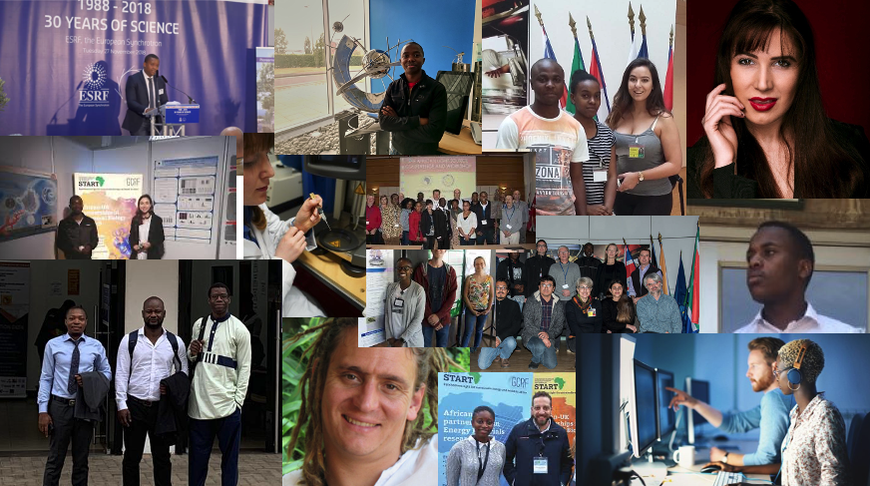




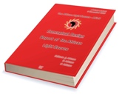

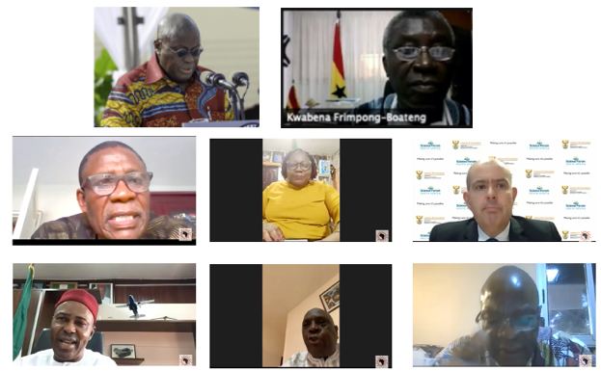

Roadmap : AfLS Conference 2015
    http://events.saip.org.za/conferenceDisplay.py/getPic?picId=66&confId=61
Bottom Up
Human Capacity: scientists, engineers, technicians
African scientists access existing LSs
African relationships with existing LSs.
Involvement of industry
Community for the African light source Users
Conferences, Workshops, Outreach, Media
Top Down
Strategic approach to African Governments and (Pan) African orgs.
Conceptual Design Report (CDR)
Inter-African co-operation on Regional feeder infrastructure
African multinational beamlines at existing LSs
Regional / Pan African membership of existing LSs
Technical Design Report (TDR)
Ready soon !!!!
MoU
AUC-ESTI
can help
politically
LoS

Slide 3
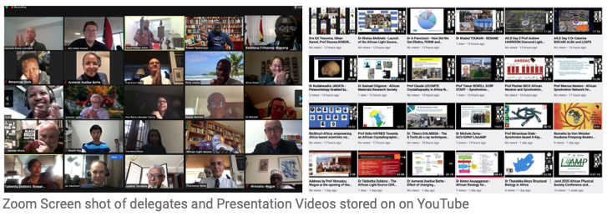
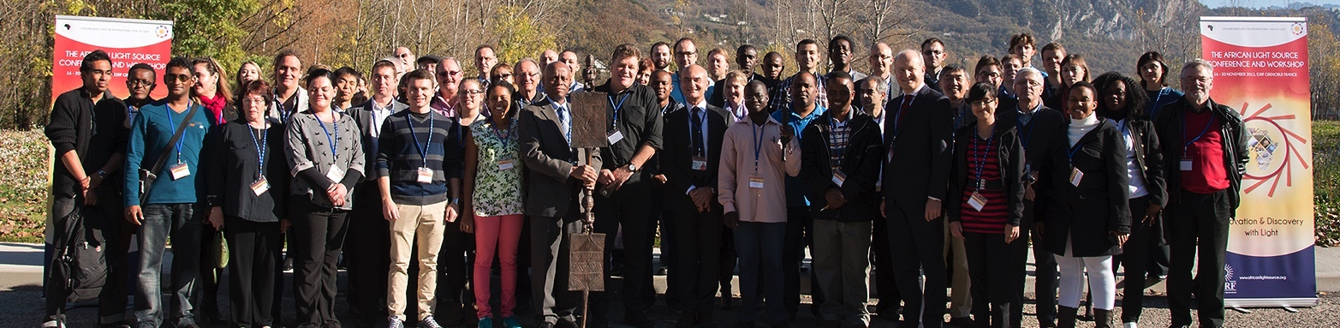
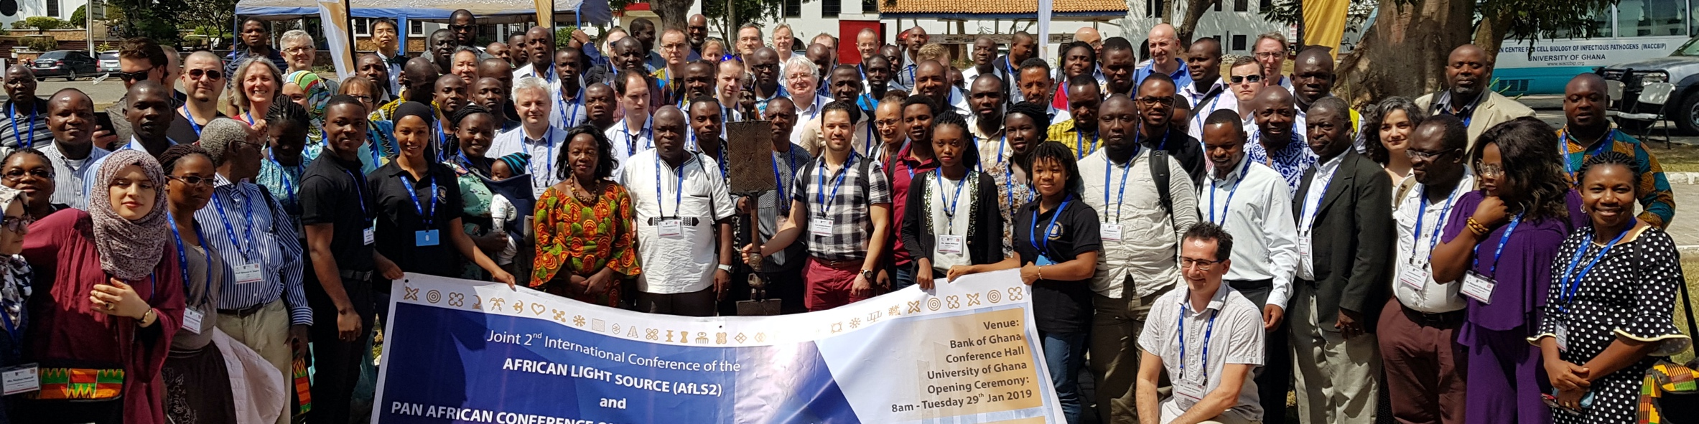
Conferences
2015, 2019, 2020,
2021, 2022,
2023
2021
Now 5 African Governments involved
Many co-conveners
Prof bodies
Academies
2021
>500 registrations
2022
~1000 registrations
  AfLS1 2015
  https://events.saip.org.za/event/61/
  AfLS 2019
  https://events.saip.org.za/event/145/
  AfLS 2020
  https://events.saip.org.za/event/211/
  AfLS3 2021
  https://events.saip.org.za/e/AFLS3
  AfLS4 2022
  https://events.saip.org.za/e/AfLS2022

Slide 4
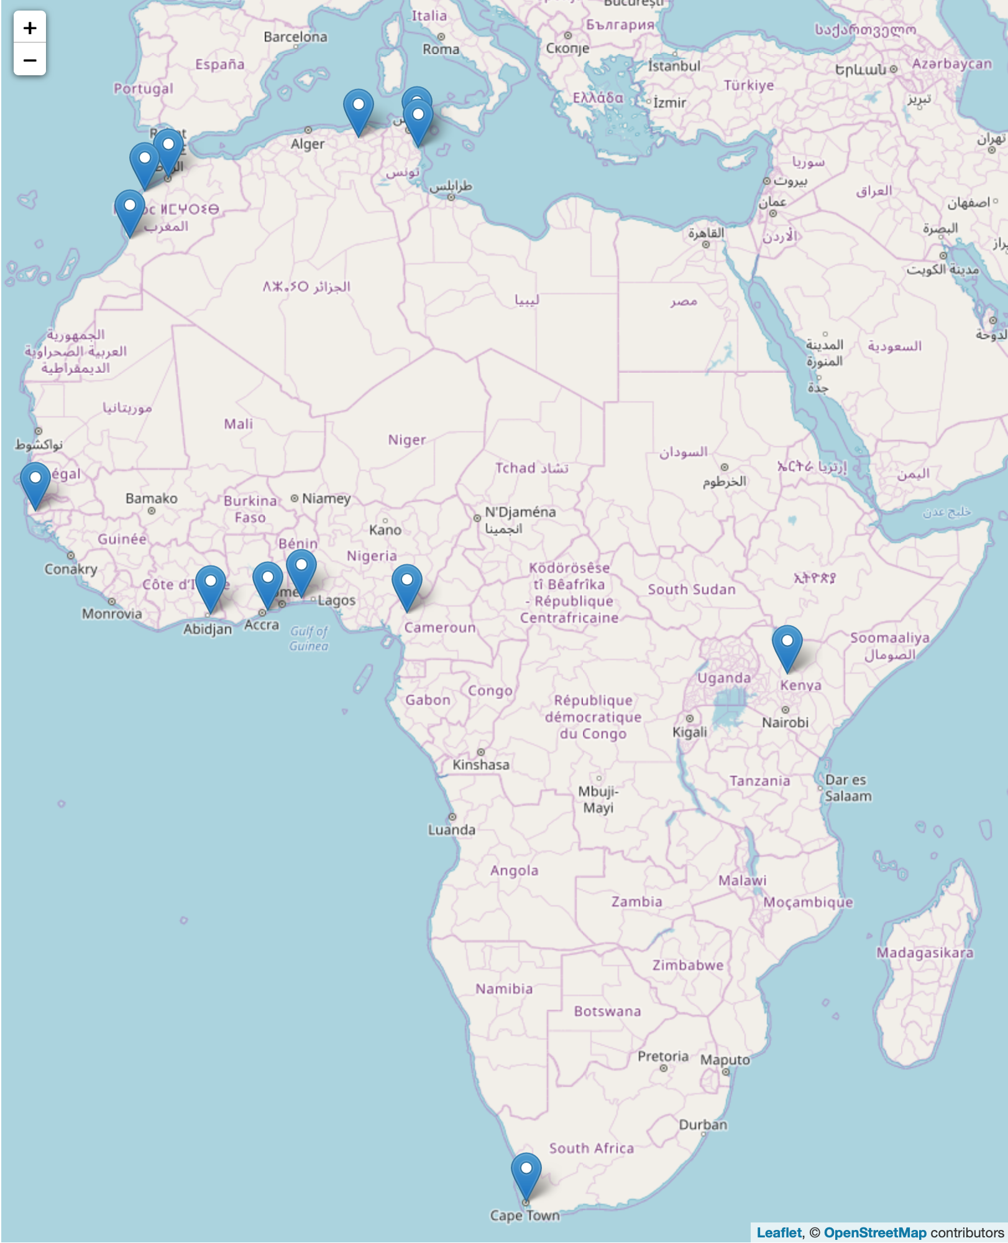
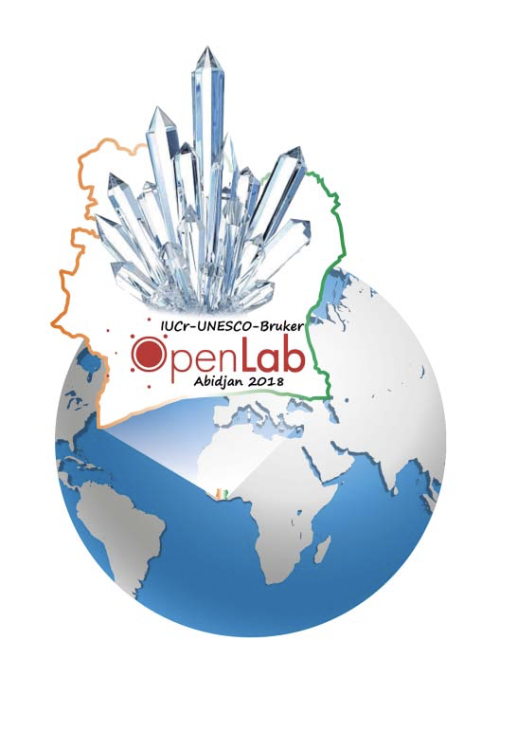
Feeder Facilities
South Africa
  Aaron Klug Centre, UCT, link,
  U Witwatersrand, U Free State,
  U Stellenbosch, iThemba
Benin, X-TechLab, Benin, link
Ghana, U Ghana, link
Côte d'Ivoire, LaCPM, Universite Felix
Houphouet Boigny, Abidjan, link
Senegal, Ziguinchor, link
Cameroon, Dschang, link
Kenya, Kenyatta University, link
Tunisia
  Monastir, link, Nabuel, Tunisia, link
Algeria, Constantine 1, link
Morocco
  U Rabat,, link, El Jadida, Morocco, link ,
  Agidir, Morocco, link
Significant facilities
IUCr OpenLab venues with facilities

Slide 5
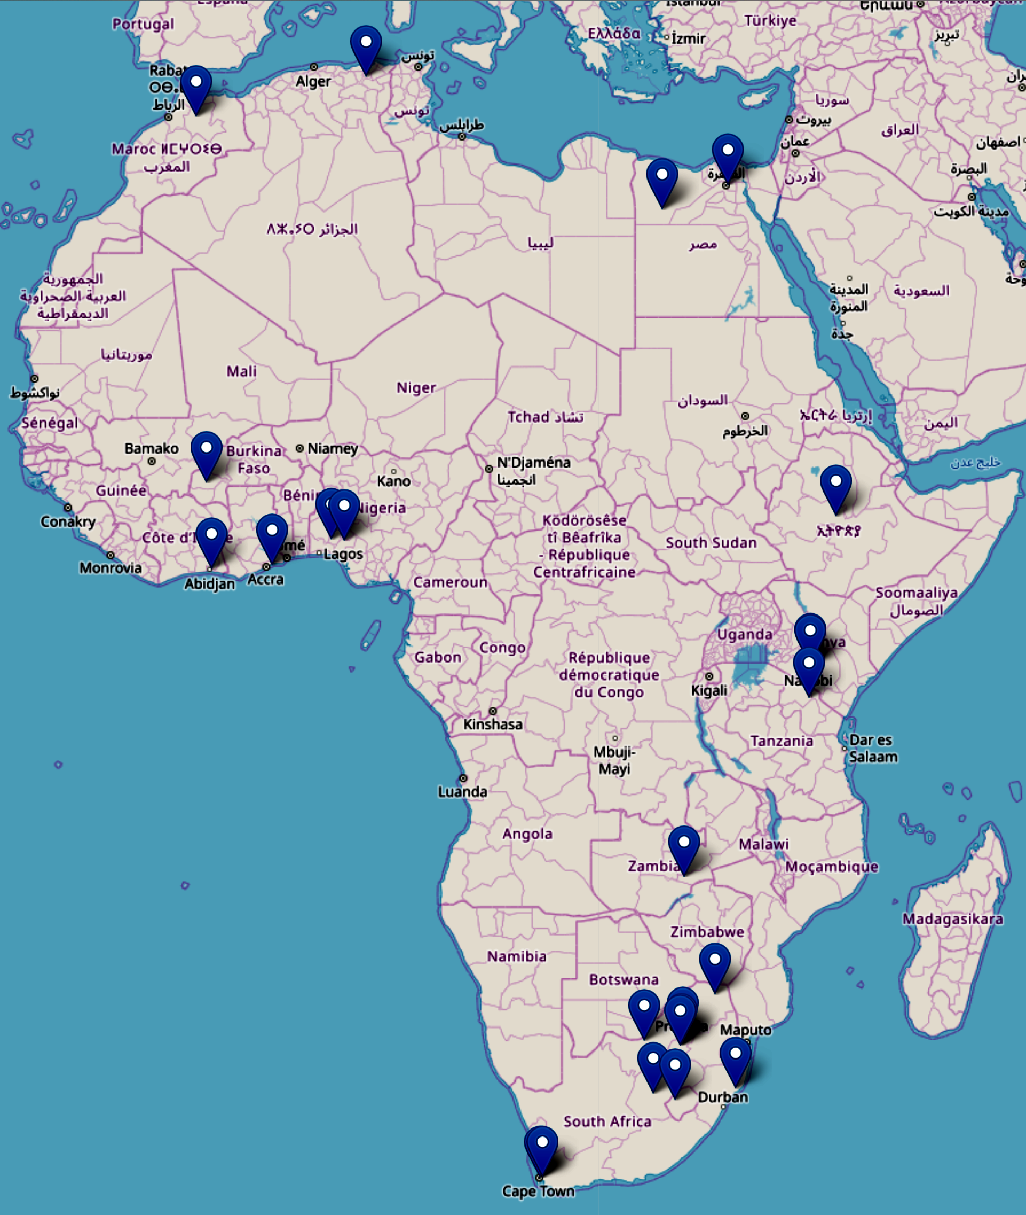
Bottom Up
Bio-Science Capacity in Africa
Ghana
University of Ghana
Zambia
The University of Zambia
Algeria
Ecole Nationale Polytechnique de Constantine
Nigeria
Federal University of Technology, Akure
University Ile-Ife
Burkina Faso
Institute of Research in Health Sciences, Burkina Faso
Morocco
University Sidi Mohamed Ben Abdellah
Ivory Coast
Universite Felix Houphouet Boigny
Egypt
Helwan University, Ain Shams University
Lesotho
National University of Lesotho
Ethiopia
Addis Ababa University

Slide 6
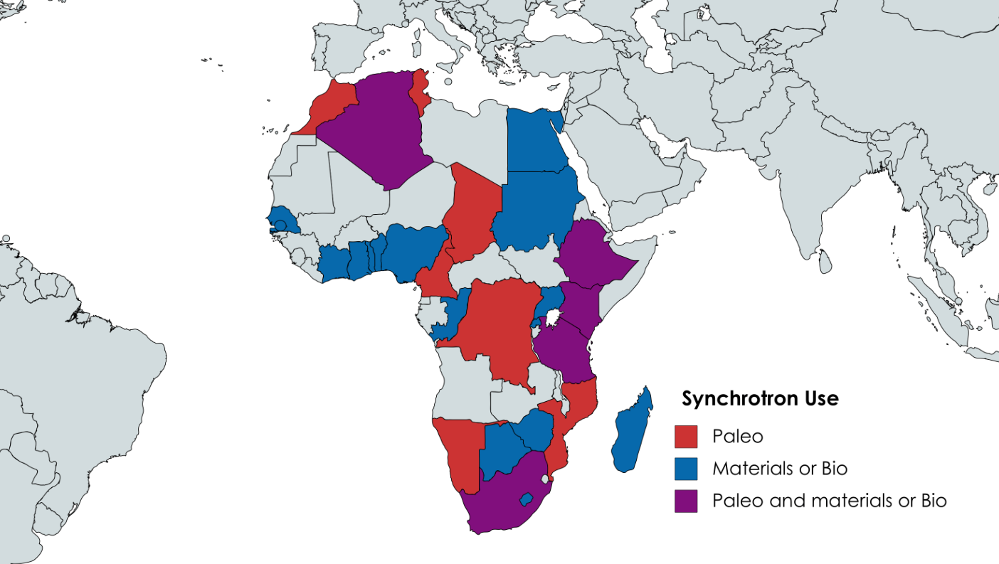
Bottom Up
28/52 > 50%
PhD / Paper / Programme

Slide 7
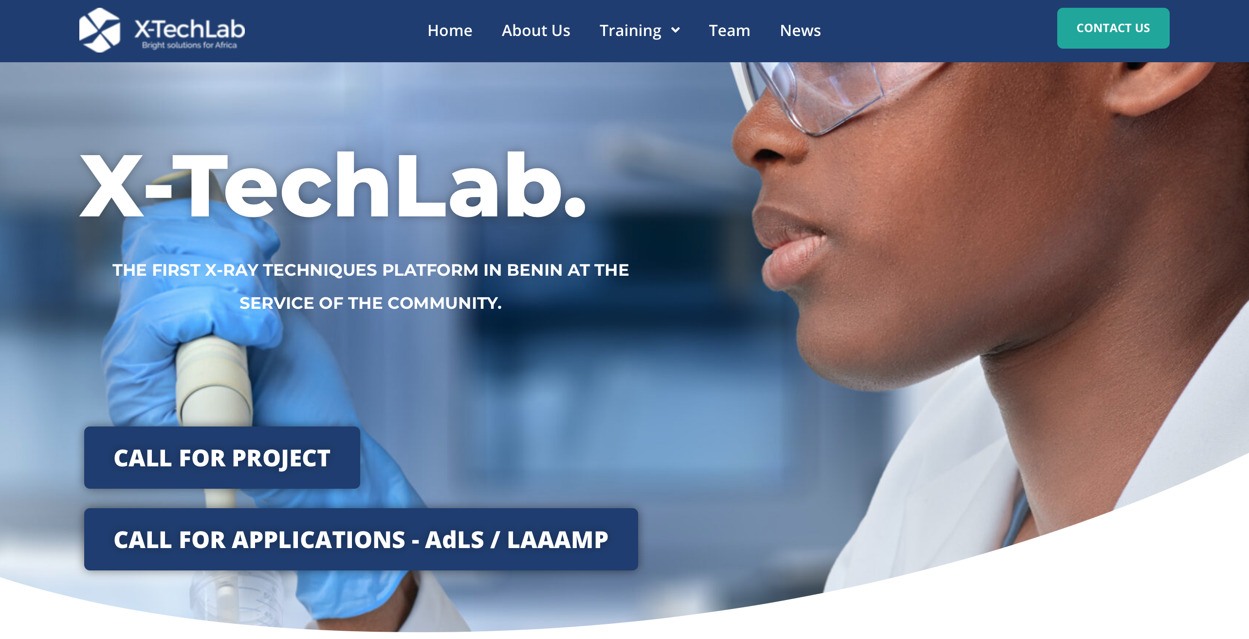
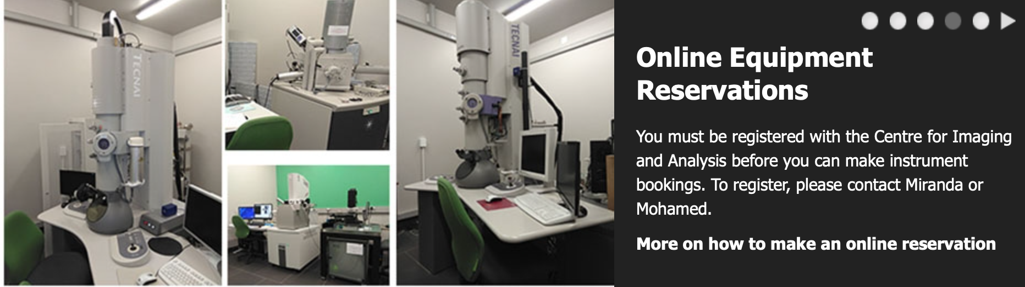



Some Existing Regional Facilities
X-TechLab - Benin
Materials analysis, spectroscopy for many disciplines.
Energy, health, environment, agriculture, materials
Microscopy Centre - SA
Structural biology resource widely used in SADEC region
African Laser Centre
Pan-African NEPAD flagship initiative
ICTP-EAIFR - Rwanda
Condensed matter, Geology, Particle Physics,
Cosmology, Astroparticle physics
Partner with LAAAMP, IUCr – OpenLABS, START, Others ….

Slide 8
Roadmap : AfLS Conference 2015
    http://events.saip.org.za/conferenceDisplay.py/getPic?picId=66&confId=61
Bottom Up
Human Capacity: scientists, engineers, technicians
African scientists access existing LSs
African relationships with existing LSs.
Involvement of industry
Community for the African light source Users
Conferences, Workshops, Outreach, Media
Top Down
Strategic approach to African Governments and (Pan) African orgs.
Conceptual Design Report (CDR)
Inter-African co-operation on Regional feeder infrastructure
African multinational beamlines at existing LSs
Regional / Pan African membership of existing LSs
Technical Design Report (TDR)
Ready soon !!!!
MoU
AUC-ESTI
can help
politically
LoS

Slide 9
African Light Source
Strategic Task Force - African regional infrastructures
Diouma Kobor (Chair)
Gihan Kamel
Simon Connell
Phillip Kurian
Olufunso O. Abosede
Emmanuel Nji
Sourou A. Sidoine Bonou
Lawrence Norris
Tshepo Ntsoane

