Slide 1
ONBOARD
End-of-project Assessment
Innovation Review Board – 27/09/23
Paolo Tedesco, Paul van Uytvinck
Notes:
I am Anna Ferrari Senior fellow at CERN openlab. Today I am going to present you CS4OD but before going into details let me explain to you the context. In 2020 CERN put in place a COVID-19 task force to come up with solutions to face the crisis together with several research communities. We quickly realized that there were many obstacles that prevented us from quickly providing these solutions. One of the most disturbing thing of the COVID19 crisis is that we were all taken by surprise. Why? What were the main obstacles, the main challenges?

Slide 2
Onboard project information
Project catalogue ID: 46
Team:
  Paolo TEDESCO, Staff, IT-PW-IAM, project leader (May 22 - now)
  Paul VAN UYTVINCK, Fellow, IT-PW-IAM, software engineering and development (Sep. 22 - now)
  Anna FERRARI, Fellow, IT-GOV-INN, data scientist/application developer (until Apr. 23)
  Tomas ROUN, Fellow, IT-CA-CTE, software engineering and development, 10% contribution (until Apr. 23)
  Nihal Ezgi YUCETURK, Fellow, IT-PW-IAM, software engineering and development (until Mar. 23)
  Ines PEREIRA DA CRUZ, Fellow, IT-PW-IAM, software engineering and development (until Aug. 22)
  Pedro FERREIRA, Staff, IT-CA-CTE, project leader (until May 22)
  Alexandros IOANNIDIS, Staff, IT-CA-OSR, project leader (until May 22)
Started on 02/21, ended on 09/23 (officially: 01/24)
Funding: special DG funds
Status: ended

Slide 3
Online integrated platform for Open Science
Target users: researchers in a distributed collaboration
Goals:
  Define research projects
  Process data using CERN analysis tools (Zenodo, Swan, Reana)
    Deployment on on-premise/cloud/HPC infrastructure back-ends
  Visualize the results
  Publish the research outcome
Expected impact:
  Allow researchers inside and outside CERN to share and publish their work
  …in compliance with Open Science best practices and FAIR principles
  …through an interface requiring no prior IT knowledge
  …using technologies developed at CERN
Notes:
FAIR = findability, accessibility, interoperability, and reusability

Slide 4
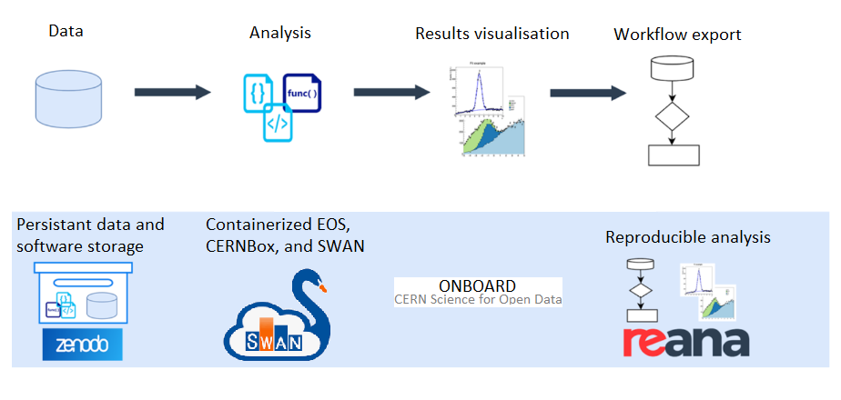
Overview
Proof of concept application
Core integrations
  Zenodo: import and publish resources
  Swan (Sciencebox): storage, notebooks, SSO integration
  Reana: reproducibility
Additional features
  Project structure
  Results visualization
  Metadata definition
  Enforce Open Science principles

Slide 5
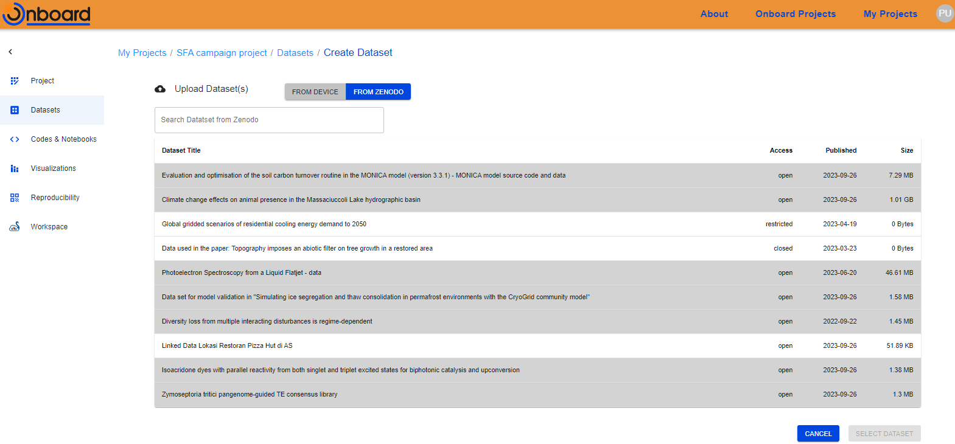
ONBOARD: datasets management
Zenodo integration
Import/publish

Slide 6
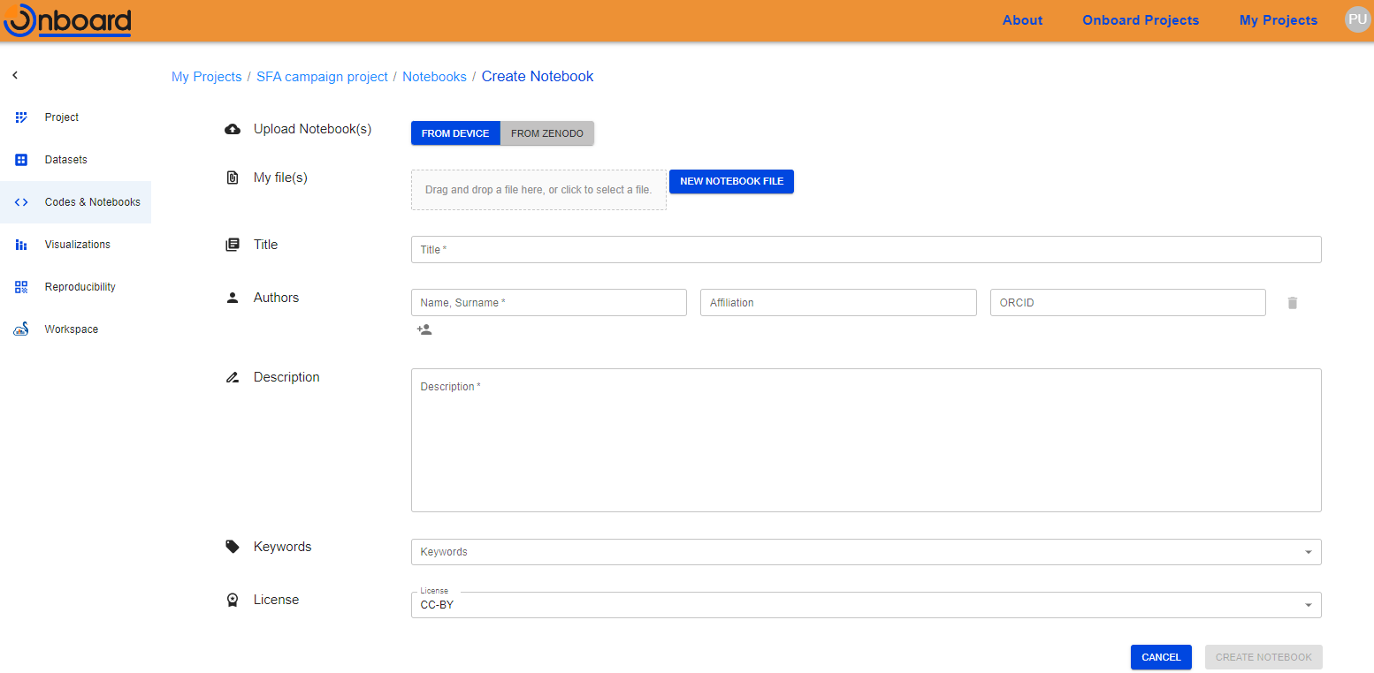
ONBOARD: preconfigured environment
Assist users with notebooks management

Slide 7
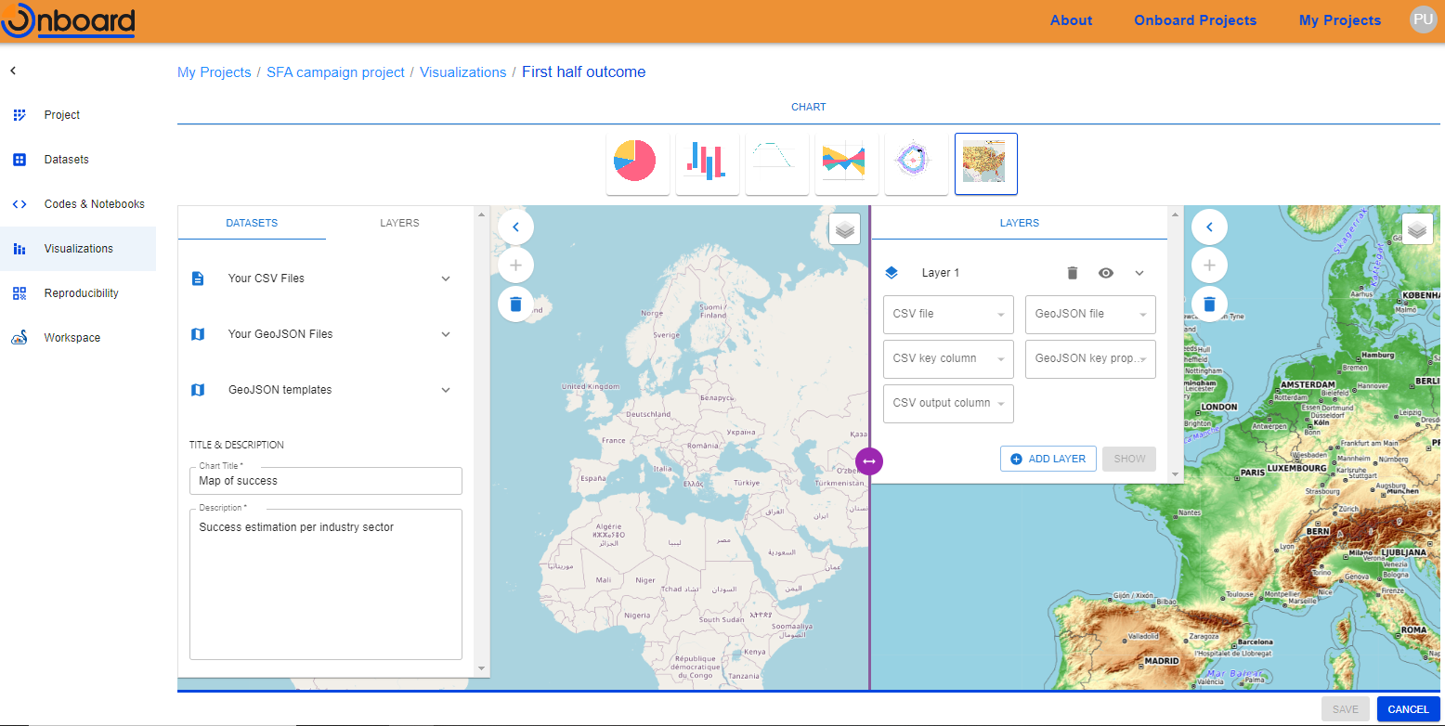
ONBOARD: visualizations

Slide 8
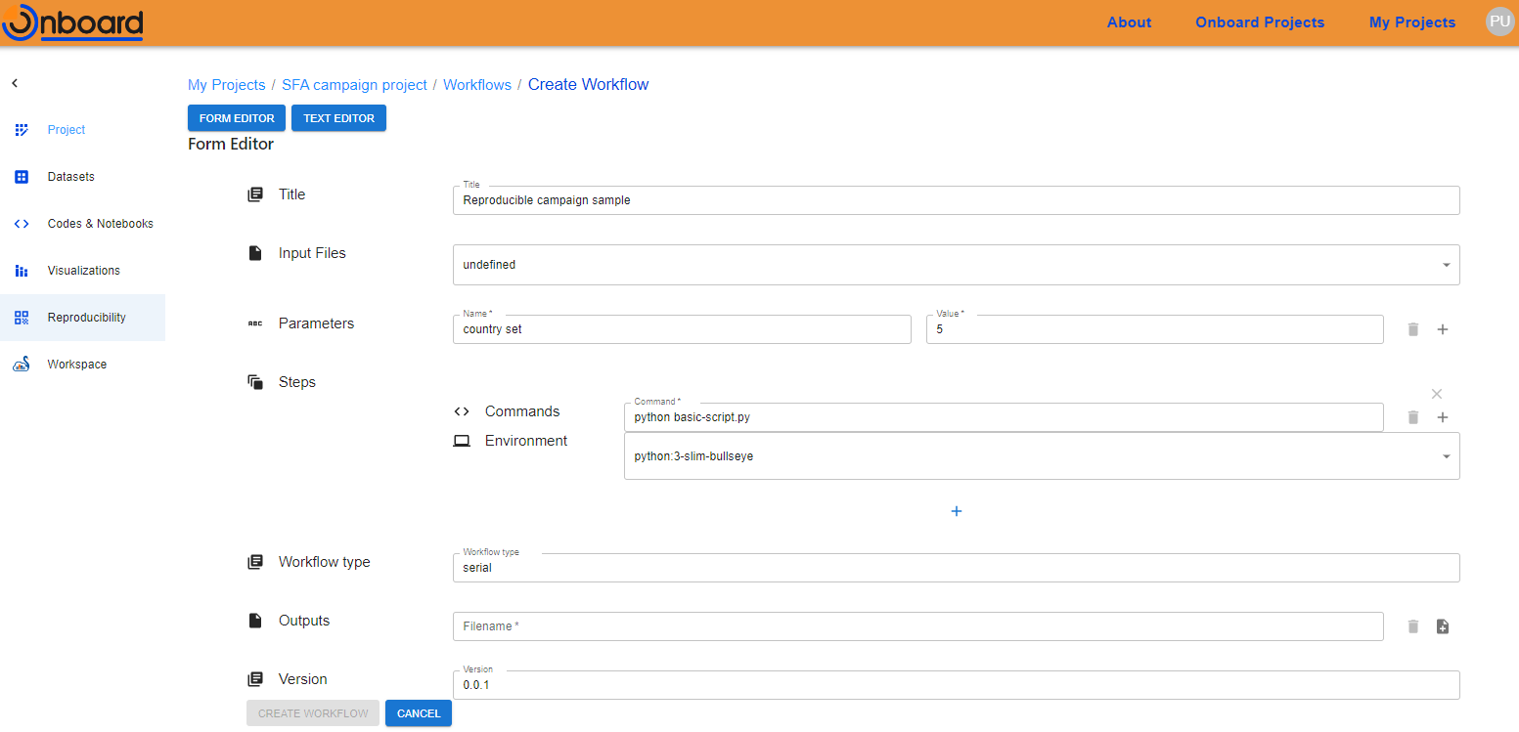
ONBOARD: reproducibility
Reana integration
UI for workflow definition
Reusable React library
  https://gitlab.cern.ch/cs4od/reana-editor
  Base for future developments

Slide 9
Lessons learned

Slide 10
Disclaimer
Onboard's development had a troubled history
Thanks to all the people involved!
  Everyone put forth their best efforts for the project's success
I hope to offer some constructive insights…
…the experience was less than ideal for the people involved

Slide 11
A tool for data scientists
A tool of this kind is better suited to data scientists
  “Data stewardship” will always be needed
Our beta testers would not be able to use such a tool independently
  Researchers have little or no knowledge of programming
Areas for improvement:
  Clearly re-target the tool to data scientists…
  …or foresee a huge effort and work on usability (if possible at all)

Slide 12
Unity in the team
The team was initially structured into two sub-teams
  Makes sense logically
  Not suited for a very small team working on a prototype
Communication happening only through daily standups
  Divergent perspectives on the project
  Lack of shared vision and common goals
Interpersonal conflicts, high turnover
Areas for improvement
  Keep a small team together… if possible, in the same room :)
  Ensure that people can communicate and discuss whenever they need

Slide 13
Team experience
Core responsibilities were primarily delegated to fellows
  Collecting requirements (=> generic working items)
Supervisors working 10-20% on the project
  Unexperienced developers need closer technical guidance
Areas for improvement
  Appropriate amount of supervision
  Some experienced team members (developers, architects)
    Establish best practices
    Speed up professional growth of less experienced members

Slide 14
Clearer objectives
Key architectural decisions missing after 1 year
  Jupyter vs. Swan
Wide scope
  Valid but premature integration ideas
    E.g. storage backends / repository independency
Areas for improvement
  Start from the definition of a minimum viable product
  Choose all the architectural components
  Aim for something compatible with time, resources and experience

Slide 15
Impact and future work

Slide 16
Proof of concept delivered
Showcasing the core concepts of the initial vision
  Manage projects
  Manipulate datasets and notebooks
  Create visualizations
  Guide publication and enforce FAIR principles
Strong interest in such tools from scientific community
  Guidance needed for data analysis

Slide 17
Contributing back
Our goal: simplify Reana workflows definition
Developed a reusable React library
  Streamlines the creation of Reana workflows
  Allows users to edit the Reana YAML workflow definition file
https://gitlab.cern.ch/cs4od/reana-editor
Publish (as software) to the EOSC catalogue

Slide 18
Future developments
A production-ready service would require additional
  Scalability
  Stability
  User-friendliness
Scale of activities and resources beyond the project’s initial scope
CERN has both the skills and the building blocks to deliver such service
  …with appropriate funding and resources

Slide 19
Thanks

