Slide 1
Oracle AI project:
AI Models Registry in the Cloud
11th Innovation Review Board
27/09/2023
Renato Cardoso, Sofia Vallecorsa

Slide 2


Oracle AI at CERN
Team:
  Renato Cardoso (Fellow, 100%)
  Sofia Vallecorsa (Staff, 5%) - PI
Project dates:
  01/04/2022 to 31/03/2024
Funding:
  Oracle (through CERN openlab)
Status:
  Executing

Slide 3



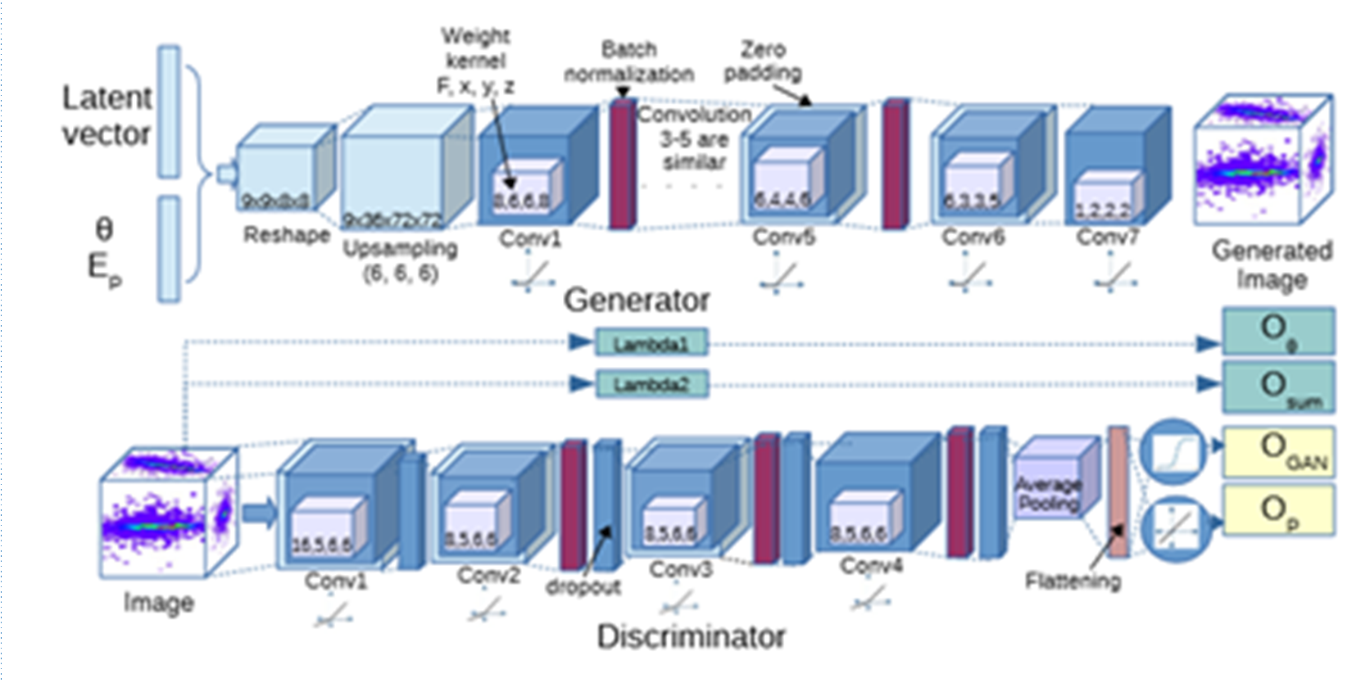




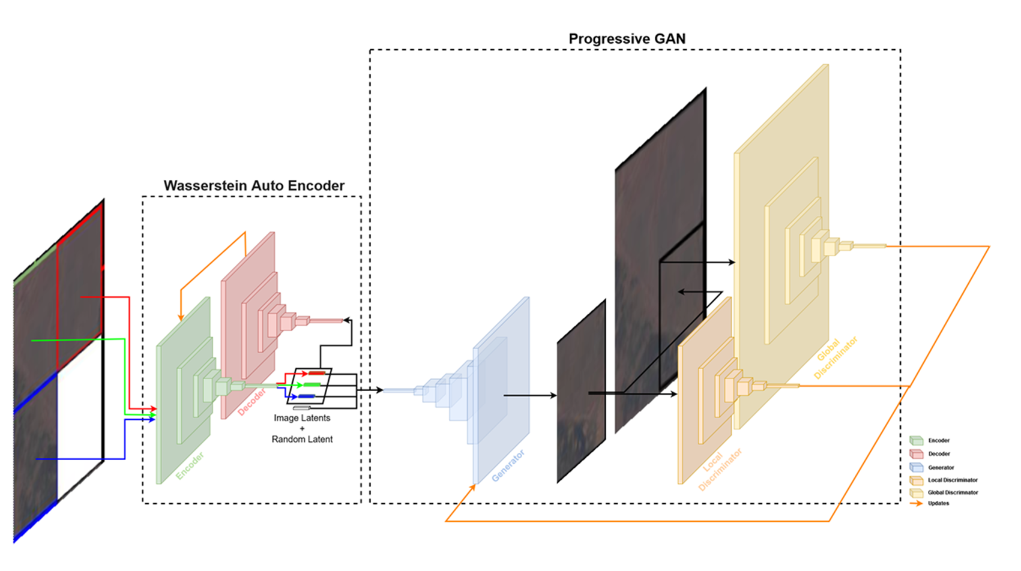

Project Objectives
Demonstrate the possibility to optimise the ML training task for benchmark ML models of different size, complexity and data
Demonstrate the use of a ML model catalogue to speed up R&D and ML model development steps and improve model usability
Evaluate ML training energy footprint and improve efficiency
Test the possibility to large larger models ( toward foundation models) 🡪 on-going
Inspect
User
Download
Data Scientist
Model Catalog
Development of the model
Automate
ML engineer

Slide 4
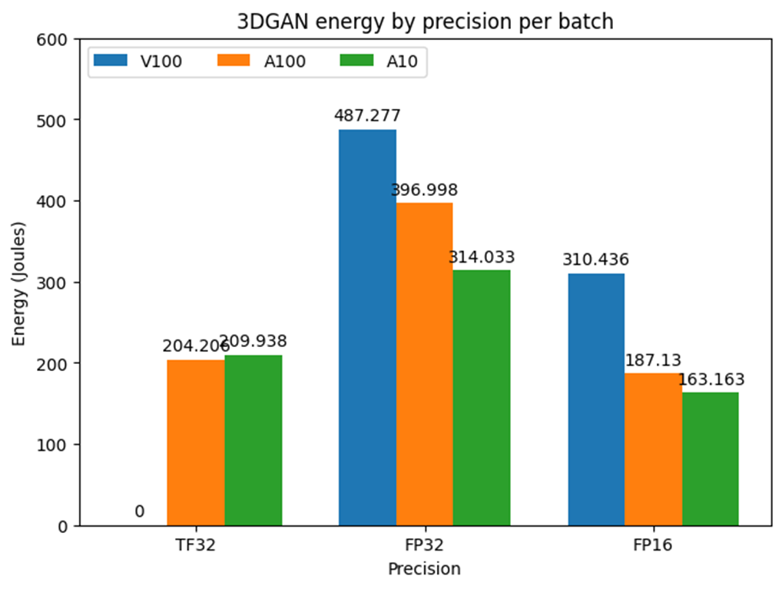
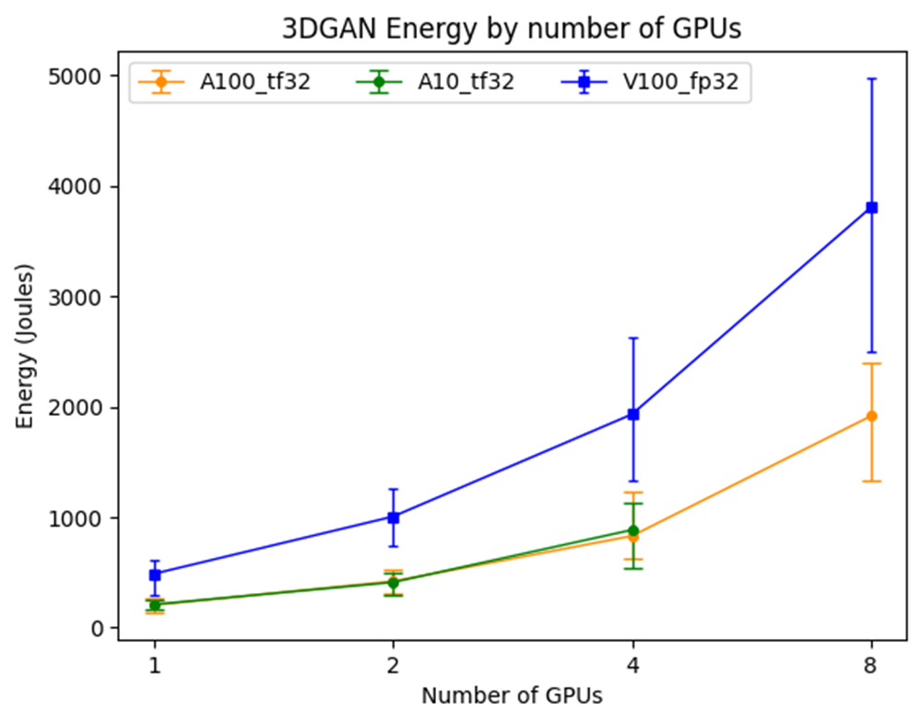
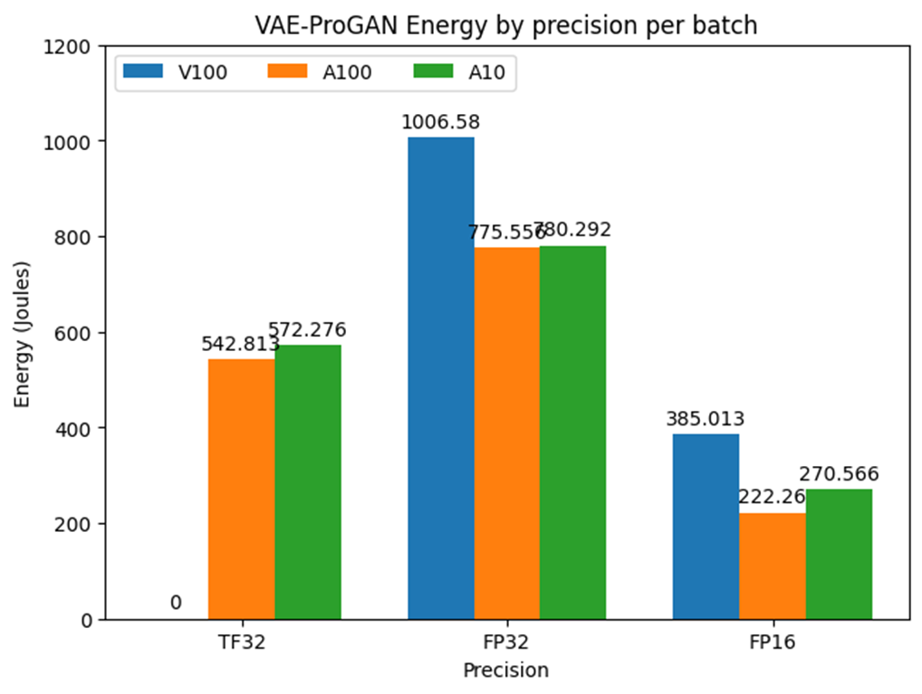
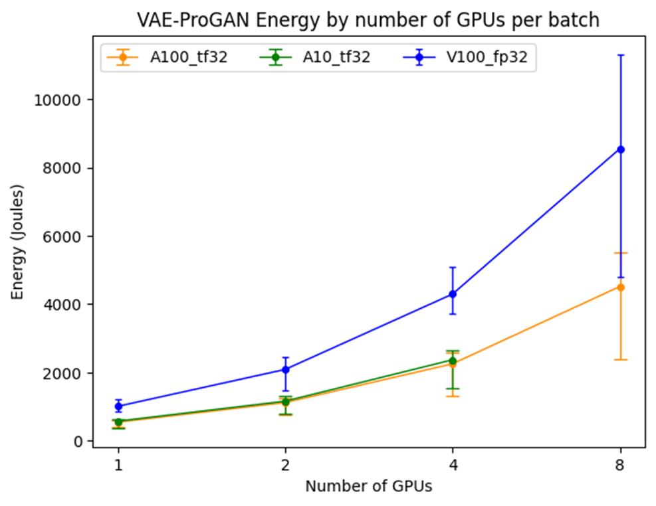
Status
Tested two different deep generative models (for HEP and Earth Observation use cases)
Performed energy consumption analysis
Results presented at CHEP (May 2023) and Oracle World (last week)
Initial implementation and optimisation of new diffusion-based model (example of the latest ML architectures used by the HEP community) 🡪 ongoing

Slide 5
Challenges & Issues
Acquiring access to hardware (GPUs) resources on Oracle Cloud was delayed (several months)
Several features within the Oracle Data Science framework required customization
Next phase (toward foundation models) will require access to larger amount of resources 🡪 this is the main challenge from now to completion
No other major risk are present

Slide 6
Project Benefits and Impact
Evaluate the features and usability of Oracle ML and Data Science offer in the Cloud
Understand the possibility of integrating the Oracle MLaaS infrastructure with CERN infrastructure
Improve ML model training and deployment efficiency toward a future “sustainable AI” approach
Save resources, have faster turnaround and efficient knowledge transfer.
This project contributes to the evaluation of the state of the art and the design of best practices and integration strategies for infrastructure for ML in the context of the on-going CERN IT ML infrastructure initiative

Slide 7
Innovation factors
Input on the benefits and challenges related to using a MLaaS Cloud-based platform are key to the design of efficient ML software-hardware integrated infrastructure at CERN.
Evaluation needs to be done wrt realistic use cases
From a data science perspective this project investigates the issue of AI model generalisation and the steps toward taking a more «foundational approach» .
Introducing AI state-of-the-art trends at CERN
Foundation models are huge O(100B) parameters: we need to understand what is the minimal model size required for HEP problems
The aspect of AI sustainability has been often neglected in the past
It should be factored in already at the initial design stage
It is also naturally fitting the CERN IT dept mandate as resource provider!

Slide 8
Relationships and dependencies to other projects
This project does not exhibit any specific dependency to other projects.
It does however contribute to a broader set of initiatives toward the study of foundation models at CERN

