Slide 2
ODISSEE
Online Data Intensive Solutions for Science in the Exabytes Era
M. Girone, N. Neufeld
IRB, 25 Oct 2023

Slide 3

Disclaimer
This is the first presentation of the ODISSEE project proposal, information to be completed at a later stage, as the proposal gets elaborated by the consortium
  Call: HORIZON-INFRA-2024-TECH-01-01: R&D for the next generation of scientific instrumentation, tools, methods, solutions for RI upgrade
ODISSEE develops on the proposal from DICES HORIZON-INFRA-2022-TECH-01-01
  passed at 12.5 (threshold is 10) but could not be funded. The PO recommended resubmission
Consortium is still being finalized (no technical meetings have happened, yet)
  CERN EP and IT both involved in discussions
Timeline:

Slide 4
INFRA-2024-TECH-01-01: R&D for the next generation of scientific instrumentation, tools, methods, solutions for RI upgrade
Proposal should address all the following aspects:
R&D for new scientific instrumentation, tools and methods for research
infrastructures taking into due account resource efficiency (e.g. energy consumption) and environmental (including climate-related) impacts
their technology validation and prototyping
training of RI staff for the operation and use of these new solutions
the innovative potential for industrial exploitation of the solutions and/or for the benefits of the society
Proposal should contribute to several of the expected outcomes:
Enhanced Scientific Competitiveness of European Research Infrastructures
Development of Innovative Companies
Increase the technological level of industries through the co-development of advanced technologies for research Infrastructures and creation of potential markets
Integration of Research Infrastructures into local, regional and global innovation systems

Slide 5
High-level objectives
Bring together teams supporting four pan-European Research Infrastructures (R.I.) labeled by ESFRI as landmarks or project (CERN HL-LHC, CTA, the SKA and the Einstein Telescope) to prepare for key projects across the physical sciences continuum.
Address digital challenges related to online processing and reduction of extremely large data volumes by developing AI-driven solutions, innovative hardware and software platforms, while focusing on openness and delivering non proprietary solutions based on European technologies.
Striving for sustainability is a built-in requirement for these infrastructures on the cusp of major roll-out and/or upgrades that will challenge the state of the art, or at the design phase.
ODISSEE proposes to use the 3 dimensions of sustainability (social, economic and environmental) as a prism to analyze the specifications and drive the roadmap

Slide 6
Initial thoughts on Technical Work Packages
Address the technology challenges of data processing, reduction and analysis for giant scientific experiments using AI-driven approaches
WP1: Converged enhanced science
  Facilitate the emergence of converged science programs across R.I. (e.g. on dark matter)
WP2: Composable data interfaces
  Incl. data ingestion & distribution across RI
  Implementing data emulators at scale
WP3: Modular HW platform across the continuum
  Based on EU technologies, optimized for cost, space, power, cooling, RAS, development & deployment time
WP4: Energy efficient SW framework
  Co-design of frugal data analytics, energy aware programming models and scalable execution frameworks for HPC + AI
WP5: Optimized infrastructure: Data Centre operations
  Scalable applications, continuous integration, predictive maintenance strategies & power management
Connection to INNOVATION Roadmap objectives:
WP3 and WP4 objectives relate to “Heterogeneous computing architectures and infrastructures” and “environment and green computing”

Slide 7
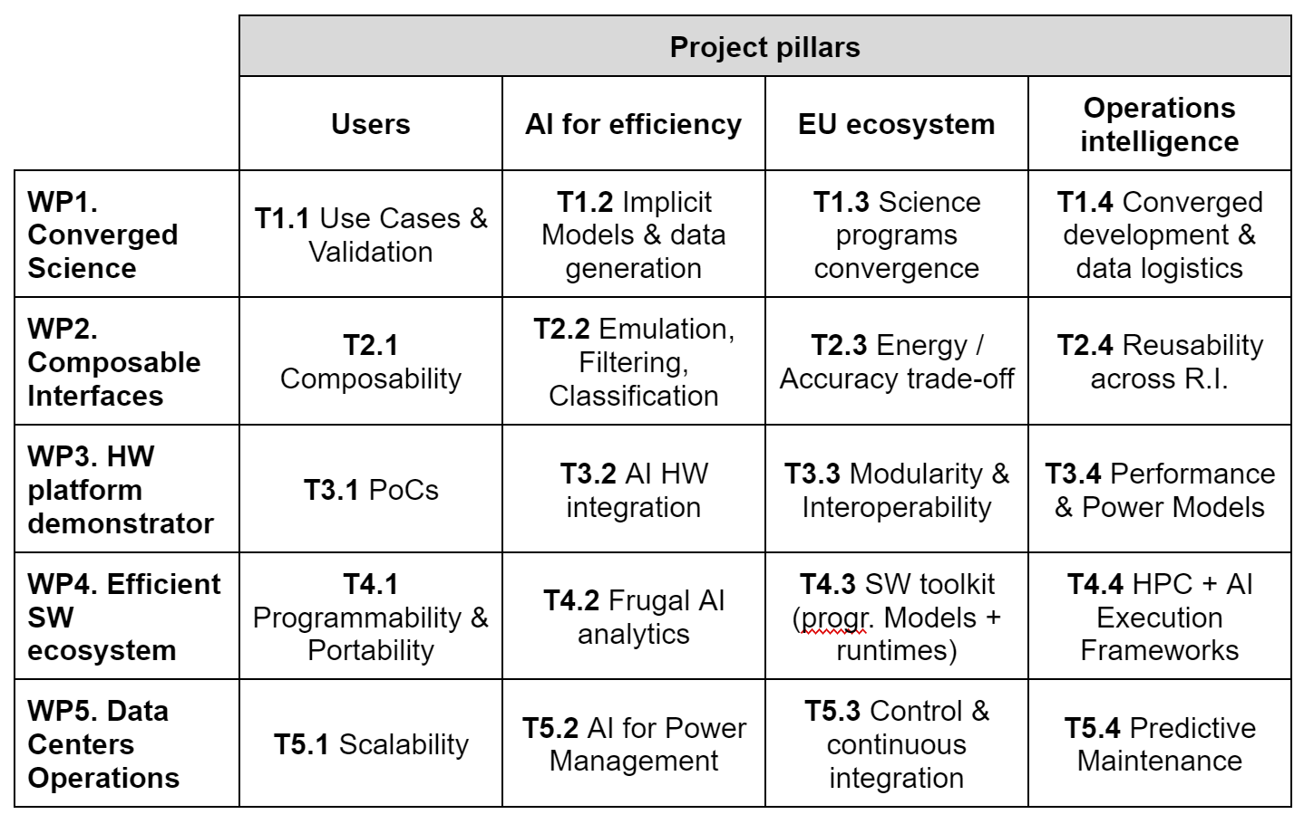
Draft work breakdown structure and initial expression of interest
LHCb/CERN EP LHCb/IN2P3
CERN IT and LHCb
CERN IT
LHCb/CERN EP

Slide 8
Contemplated partnership
European Research Infrastructures (ESFRI) (min. requirement 3)
Physical sciences: SKAO + CERN (LHCb) + Einstein Telescope
CS: SLICES-RI
Industry Engagement:
Hardware: SiPearl + REFLEX CES + Nvidia + TBC: E4 and / or Atos
Software: EAS (+ CS Group and / or Atos for Quantum demo: TBC)
Dissemination & support: Neovia Innovation
Academia / Public Entities Engagement:
CNRS (lead) -- incl. INSU + INS2I + IN2P3
ASTRON
Supercomputing centers:
GENCI (+IDRIS) + TBC: BSC + SURF ?
INRIA
Simula
Others (self-funded):
EPFL + CSCS ?

Slide 9
Next Steps
Coarse grain definition of WP
  The right expertise is available to the project
  The right links have been / are being established
Need to refine use cases definition
  Identify high priority science objectives
  Fine tune technical content
  Request from partners to progress in defining their contributions
Objective for the next two weeks
  Make sure high priorities are well identified: All
  Close on main technical contributions: All
  Close on use cases definition: HEP + A&A
  Start evaluating budget: project PI
Work on external connections
  linkage with R&I projects and platforms
  fine tune bidirectional interactions

Slide 10
Backup slides

Slide 11
WP1: Converged enhanced science
Immediate Objective: Improve sensitivity, resolution & science yield of giant R.I. Implement key science projects across the physics continuum.
Use Cases & Validation
Define key use cases across multiple R.I. (e.g. dark matter project) and identify corpus of validation data for new developments
Implicit Models & Data Generation (propose Data Generation and Reconstruction)
Develop connectionnists approaches for realistic high resolution data generation (e.g. using GANs / generative AI). Building higher level physics objects in real-time.
Science Programs Convergence
Study possible approaches to propose more converge science programs leveraging multiple R.I. a feed point 1 above and 3 below
Converged Developments & Data Logistics
Derive a set of specification on both technology developments & data logistics across multiple R.I.

Slide 12
WP2: Composable Data Interfaces
Immediate Objective: provide solutions supporting both smart data ingestion close to the sensors and scalable data emulators as unique tools for both designing future upgrades and preparing scientific exploitation.
Composability
Specify and co-design features enabling the composability of data interfaces based on smart network controllers and/or dedicated FPGA boards
Emulation, Filtering & Classification
Develop, validate and test IP (SW and/or FW) for smart features based on DNN inference
Energy / Accuracy trade-off
Study the opportunity of trading-off power consumption and accuracy (e.g. through reduced arithmetic precision or leaner modeling)
Reusability across R.I.
Specify & validate dedicated features to maximize reusability across multiple R.I.

Slide 13
WP3: HW Platform Demonstrators
Immediate Objective: Design new HW platform, optimized for cost, space, power, RAS, development and deployment time, and based on EU technology, as a building block of resilient, upgradable and energy efficient infrastructures.
Proofs of Concept
Demonstrate the feasibility and evaluate performance for several use cases of a new compute platform and cooling infrastructures based as much as possible on EU HW
AI HW Integration
Enable new AI hardware integration (e.g. Graphcore IPU) on the modular platform through proper support of physical interfaces and low level software integration.
Modularity & Interoperability
Enable a fully modular platform, including a wide range of compute and I/O technologies, ensuring interoperability between the various components through appropriate support at the node level
Performance & power Models
Provide full support for the building blocks of this modular platform in performance and power models

Slide 14
WP4: Efficient SW Ecosystems
Immediate Objective: Augment the codebase associated to R.I. (operational / exploitation) fostering energy awareness and interoperability at all levels of the stack while enabling reliable operations across this continuum of giant R.I..
Programmability & Portability
Study and validate application portability across a wide range of cyber-infrastructure configurations through enhanced programmability
Frugal AI Analytics
Concentrate on the design and development of new connectionist data analytics methodologies, targeting the core science applications, with the main property of being economical in terms of resources usage and energy consumption
SW Toolkit (programming models & runtimes)
Enable interoperability between programming models (supporting a wide range of compute and I/O technologies) and execution frameworks for fine grained control of the runtime behavior (performance / power / accuracy trade-off)
HPC + AI Execution Frameworks
Assess, at scale, the use of several execution frameworks supporting both HPC and AI workflows, and benchmark core applications from the targeted R.I.

Slide 15
WP5: Data Centre Operations
Immediate Objective: address the principles of data center operations through application scalability, optimized control and continuous integration of emerging technologies, efficient power management of the whole infrastructure and predictive maintenance to address cost of ownership.
Scalability
Assess scalability of core applications from the targeted science infrastructures across a wide range of data center architectures
AI for Power Management
Design, develop and test new methods for power management based on AI (e.g. through reinforcement learning) to build implicit and pragmatic models of the power consumption across the whole infrastructure
Control & Continuous Integration
Develop novel and adaptive queue scheduling and workflow orchestration tools, scalable to large scale distributed memory systems, meeting the requirements of various experimental scenarios..
Predictive Maintenance
New predictive maintenance strategies based on big data analytics

Slide 16
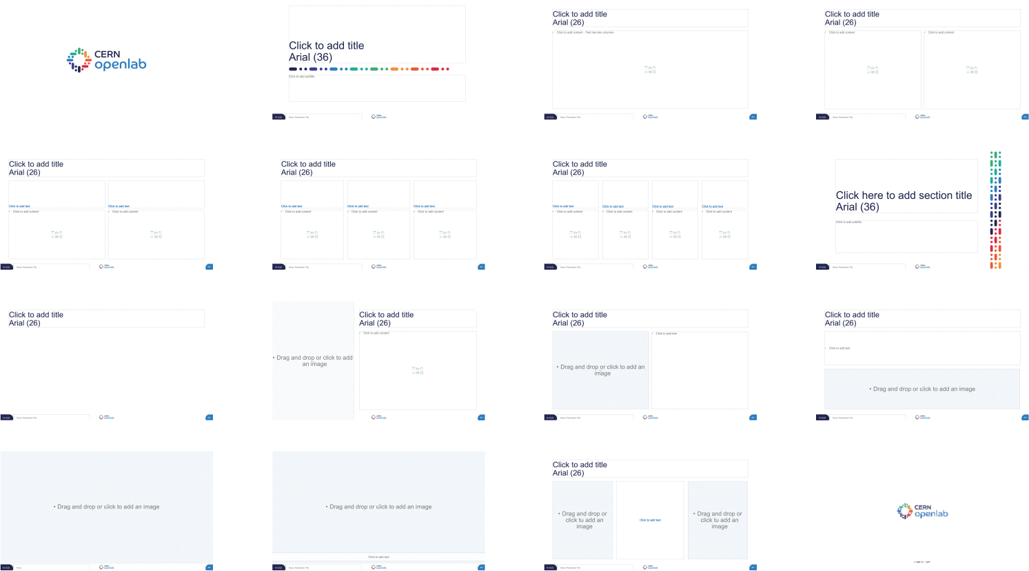
Examples of slide types included in this template

