Slide 1



Lectures 11-12
Instabilities
Professor Emmanuel Tsesmelis
Principal Physicist, CERN
Visiting Professor, University of Oxford
Graduate Accelerator Physics Course
John Adams Institute for Accelerator Science
16 February 2023

Slide 2
Table of Contents
Introduction
Impedance and Wakefields
Types of Instabilities
Landau Damping
Summary

Slide 3
Aims of the Lectures
Provide an overview of the mechanisms that drive instabilities.
Study the beam coupling with the accelerator environment through the concepts of impedance and wakefields.
Identify various types of instabilities in the transverse and longitudinal planes.
Identify single-bunch and multi-bunch instabilities.
Approach
  The deep treatment of instabilities requires a detailed mathematical analysis. In these lectures, a qualitative approach is given and details can be found in the references.

Slide 4
References
P. Bryant, K. Johnsen, Principles of Circular Accelerators and Storage Rings, Cambridge University Press
D. Edwards, M. Syphers, Introduction to the Physics of High Energy Accelerators, Wiley-VCH
M. Miggliorati, Instabilities and Wakefields, JUAS Lectures
G. Romulo, Beam Instabilities, CAS Lectures
H. Wiedemann, Particle Accelerator Physics, Springer
E. Wilson, Introduction to Particle Accelerators,
Oxford University Press
Special thanks to the JAI Lecturers
H. Garcia-Morales
S. Sheehy

Slide 5
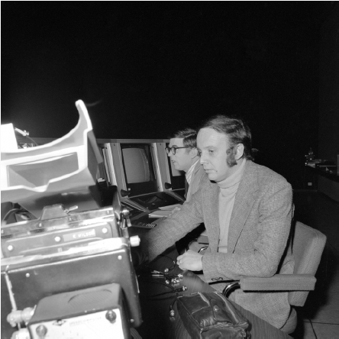
Introduction
So you’ve carefully tuned the machine to produce the best possible performance at the highest intensity and you’ve invited the lab director to the control room to observe, for the first time, the machine working at design intensity. The intensity comes up, the pulse goes up and just when you’re about to get there…there’s a sudden loss of beam. You try again, and it repeats. This is characteristic of an instability.
E. J. N. Wilson, CERN
Ted Wilson in the SPS
control room in 1977

Slide 6
Instabilities in Accelerators
When pushed in terms of performance, accelerators tend to reach an intensity limit.
With analysis, understanding and mitigation, a new limit emerges.
The same pattern can be seen with many high-intensity and high-energy accelerators.
Why does this happen?
  Electromagnetic interactions of the beam with the accelerator environment can affect both individual particles and the collective motion of the whole bunch.
  There are both transverse and longitudinal instabilities.
  There are both single-bunch and multi-bunch instabilities.

Slide 7
Impedance Introduction
We have studied the single particle dynamics (transverse dynamics lectures).
We have seen what happens when the bunches are treated as distribution of self-interacting charges (beam-beam and space charge lectures).
A circulating beam resembles an electric circuit.
Impedance plays an important role in determining the induced voltage on circulating current.
Impedance
  Fourier transform of the electromagnetic waves induced by the passing charged particle beam (wakefield).

Slide 8
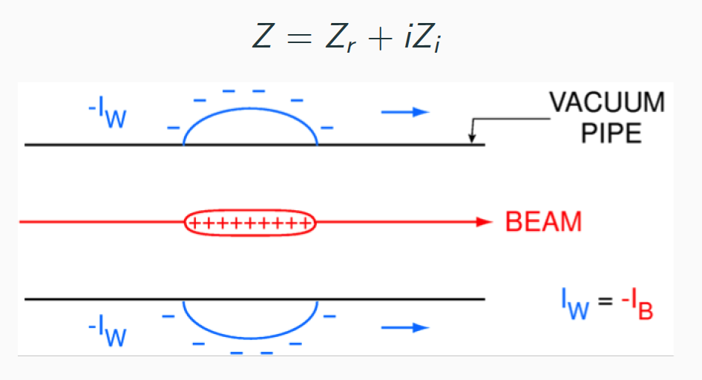
Impedance of a Resistive Wall
There exists a wall current I_{W} due to the circulating beam.
Vacuum pipe is not smooth, so I_{W} sees an impedance.
The induced voltage is V = I_{w} Z = -I_{B}Z, which acts back on the beam.
Instabilities are therefore intensity dependent.

Slide 9
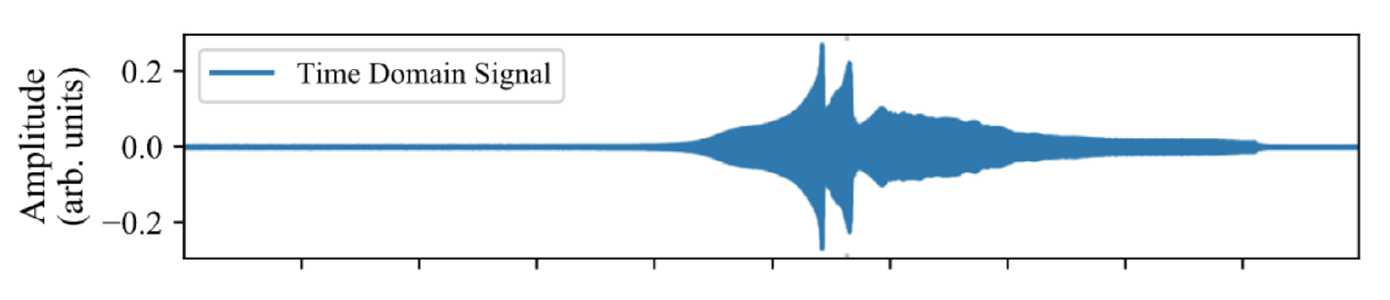
Description of an Instability
From initial small perturbation (i.e. impedance), observe if the perturbation is:
  Increased, thus giving rise to an Instability.
  Decreased, thus Stability.
Example: Perturbation in local line density of charge around a synchrotron.
  If the forces set up by a pattern of perturbation reinforce the shape, it is sure to grow exponentially.
Observables
  Increase of oscillation amplitude.
  Beam losses.
  Intensity losses.

Slide 10
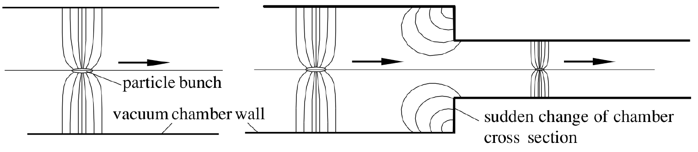
Impedance – Origin/Source
Accelerator components such as resistive wall vacuum chamber, space charge, image charge on vacuum chamber, broad-band impedance due to bellows, vacuum ports, and BPMs, and narrow-band impedance due to high-Q resonance modes in RF cavities, septum and kicker tanks.

Slide 11
Impedance
The particle beam covers a wide frequency spectrum from the kHz regime to the order of the revolution frequency up to many GHz, limited only by bunch length.
The vacuum chamber environment constitutes an impedance which can become significant in the same frequency regime and efficient coupling can occur leading to collective effects.
Strong coupling between RF-cavity and beam.
The ultimate beam intensity is limited by instabilities caused by electromagnetic interaction of the beam current with the environment of the vacuum chamber.

Slide 12
Impedance and Wakefields
Wakefields are created after the interaction of the beam charge with the accelerator environment.
They have the ability to pull or push the charges of the distribution.
Energy losses and gains of a single or collection of particles can cause modifications in the beam dynamics, eventually driving a beam instability.
Transverse wakefields and Longitudinal wakefields

Slide 13

Impedance & Wakefields
In time domain, the interaction is described by wakefields that act on charges.
In frequency domain, vacuum chamber components can be represented as a frequency dependent complex impedance Z(ω).
Impedance os the counterpoint of wakefields in the frequency domain.
The negative sign indicates that the induced voltage leads to an energy loss.
All elements can be seen as accidental cavities. Z depends on their shape, material and frequency under consideration.

Slide 14
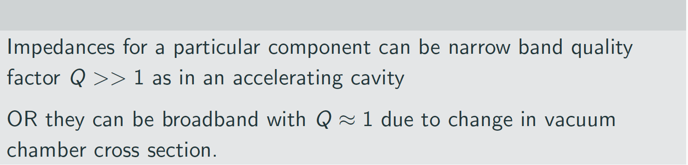
Impedance and Instabilities
In general, impedances, Z, are complex functions and are related to the frequency, ω
Z(ω) = Z(ω)_{real} + iZ(ω)_{imag}
Strong coupling between beam and vacuum chamber if the impedance and particle beam have a significant component at the same frequency.
Impedance depends on each piece of vacuum chamber including cavities, or changes in beam pipe diameter, material, shape etc...

Slide 15
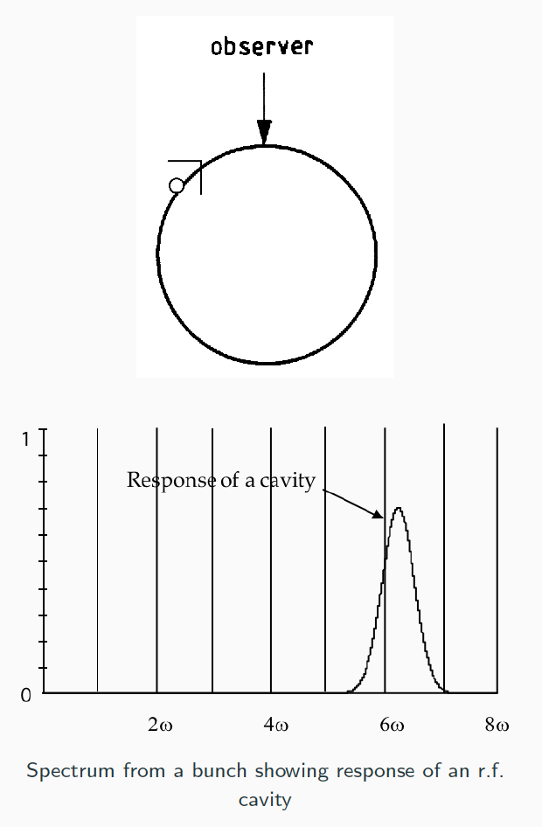
Impedance Driving Terms
Fourier analysis of a circulating delta function bunch of charge passing an observer.
I = Σ I_{n}e^{inω(0)t}
Produces a fundamental at the revolution frequency plus all higher harmonics in equal strength.
Delta function of bunch passing an observer

Slide 16
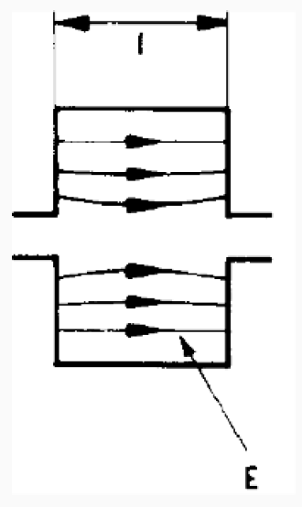

Impedance at a Cavity
The voltage experienced in local enlargement in the beam pipe (which acts like a cavity) has the form:
We can relate force on particles to the Fourier component of the
beam current which excites the force.
The impedance is a complex quantity. V(ω) = - Z(ω) I (ω)
  REAL if voltage and current are in phase
  IMAGINARY if 90 degrees or i between voltage and current.
(Inductive = +, Capacitive = -)
Differs from RF wave by 90 degrees
The resistive part of the impedance can lead to a shift in the betatron oscillation frequency of the particles while the reactive or imaginary part may cause damping or anti-damping.

Slide 17
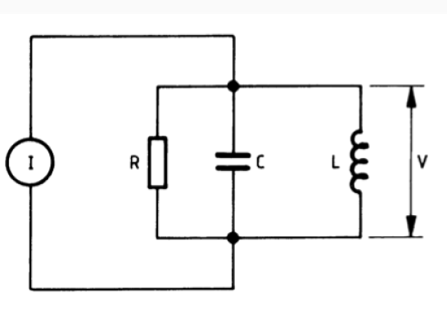
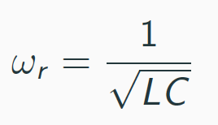

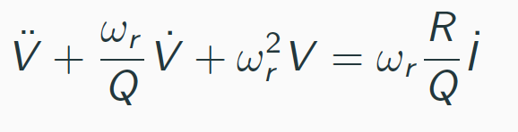
Interlude: RLC Circuit Impedance
A cavity can be modelled as an AC resonant circuit:
where the quality factor
and a differential equation can be written down for voltage and current:
Resonant frequency of cavity

Slide 18
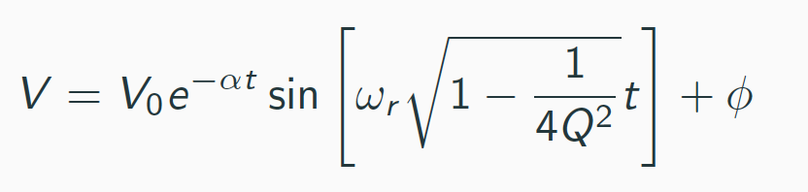
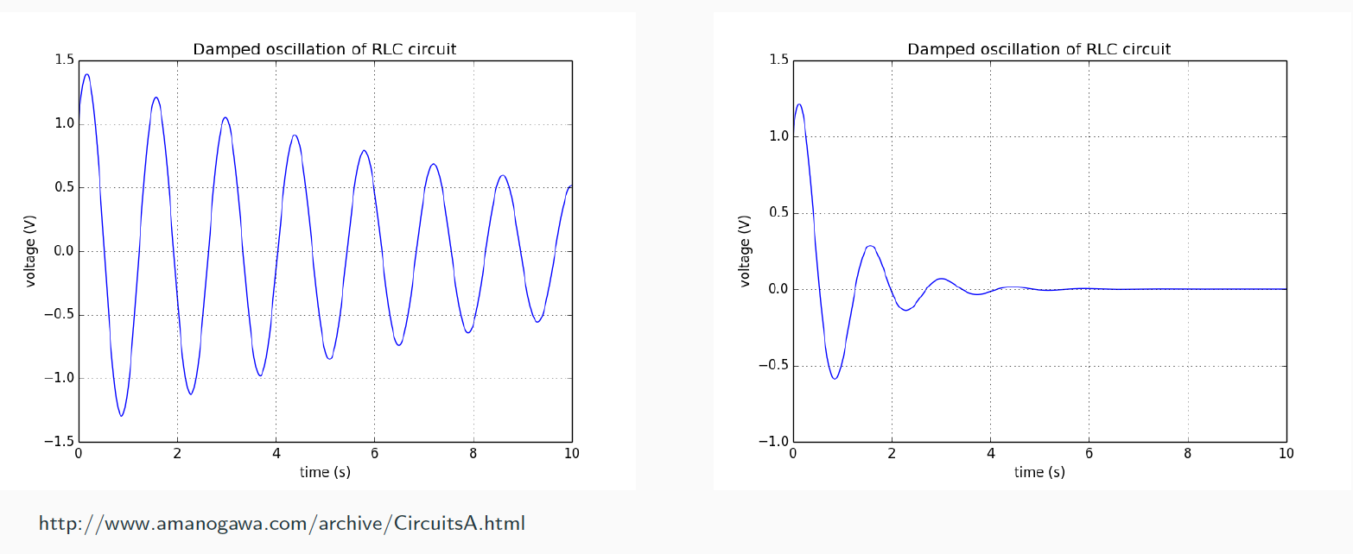
Interlude: RLC Circuit Impedance
The solution is a damped resonant circuit with a damping rate α = ω_{r} / 2Q

Slide 19
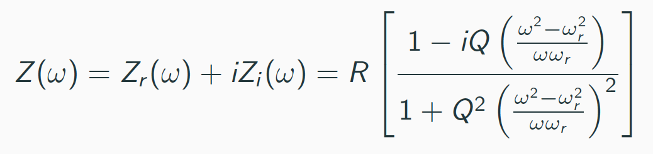
RLC Circuit Impedance
If the current in the circuit is I = I’ e^{iωt} then the impedance seen is
  When the driving frequency ω is below the resonant frequency, the reactive component is inductive or positive.
  When the driving frequency is above the resonant frequency, it becomes capacitive and negative.

Slide 20
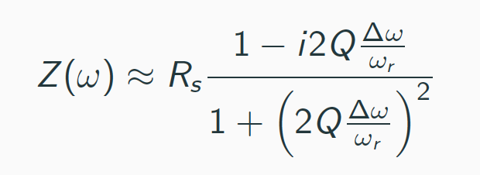
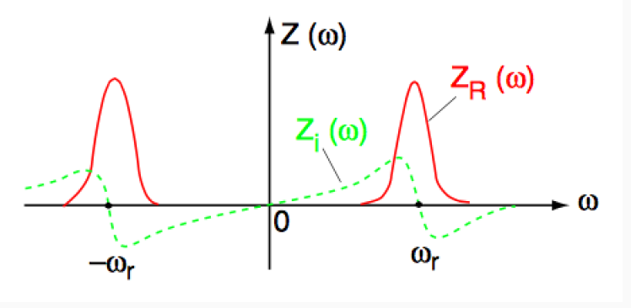
RLC Circuit Impedance
For a high-Q cavity (narrow-band resonator), this can be simplified near the resonance frequency with Δω = ω - ω_{r}, to:

Slide 21
Impedance Effects
For a narrow-band impedance (RF Cavities), the Q factor is high and the damping rate α is low.
  Signal will oscillate for many turns and produce multi-bunch effects.
For a broad-band cavity, Q is low, α is large.
  Τhe fields collapse and they do not affect subsequent bunches.
  Discontinuities in cross section of vacuum chamber (RF Cavities, flanges, kicker magnets, BPMs,...)
  May produce single-bunch effects.

Slide 22
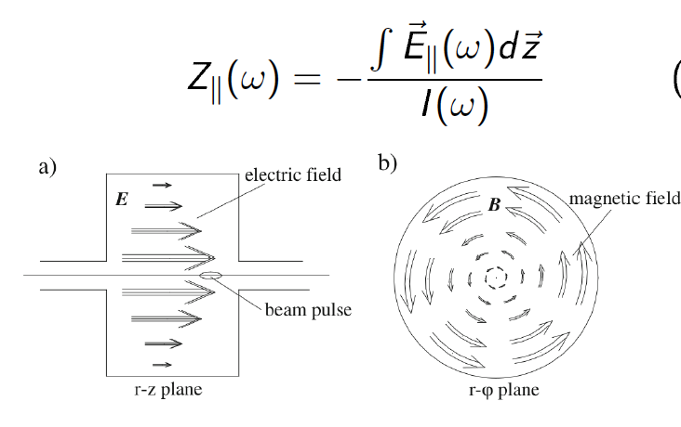
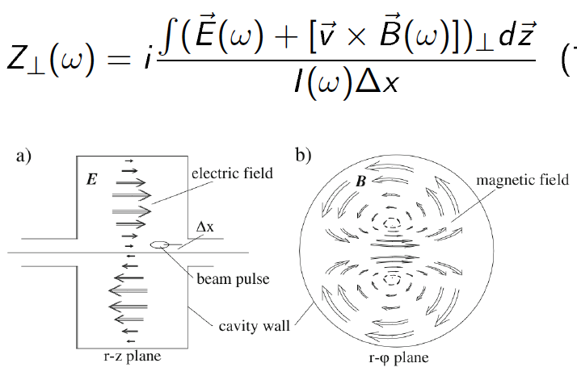
Impedance – Longitudinal vs Transverse
Longitudinal
Transverse
A bunch passing through a structure on axis excites
a longitudinal electrical field and a transverse magnetic field.

Slide 23
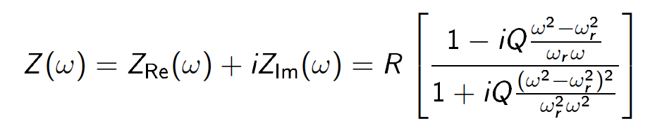
Impedance
In general:
Resistive part (Z_{Re}): Tune-shift
Reactive part (Z_{Im}): Damping or anti-damping
  ω < ω_{r} : Inductive: Z_{Im} > 0.
  ω > ω_{r} : Capacitive: Z_{Im} < 0.

Slide 24
Impedance in the Accelerator Environment
The vacuum chamber of an accelerator is too complicated in geometry to allow an analytical expression for its impedance.
Each section must be treated independently.
Examples of impedances:
  Resistive wall impedance.
  Space-charge impedance.
  Cavity-like impedance.
In earlier machines, the impedance was as much as 20 – 50 Ω, whereas it is < 1 Ω in modern synchrotrons.

Slide 25
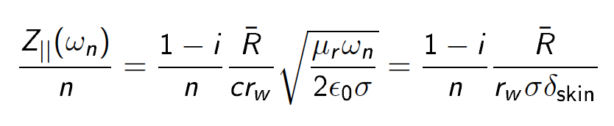
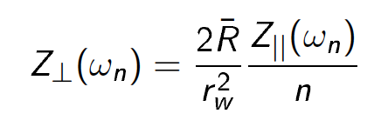
Resistive Wall Impedance
The particle beam induces an image current in the vacuum chamber wall in a thin layer.
Since conductivity is not perfect, resistive losses apply a pull or decelerate field on the particle beam.
The pull is proportional to the beam current:
Important role only for low frequencies.
The transverse resistive wall impedance for a round beam pipe is:

Slide 26
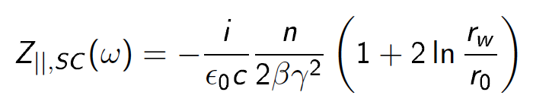
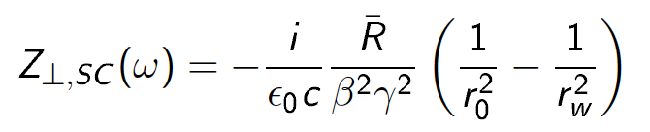
Space-charge Impedance
There is an induced voltage leading to an energy gain or loss due to a collection of charged particles.
Correct for long wavelengths. Purely reactive.
Especially strong for low energy particle beams.

Slide 27
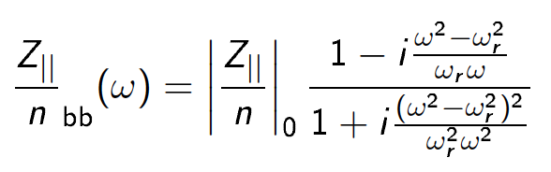
Cavity-like Structure Impedance
Vacuum chamber impedances occur due to sudden changes of cross section.
Collectively described by a cavity-like impedance with quality factor Q = 1.
Broad-band impedance.

Slide 28
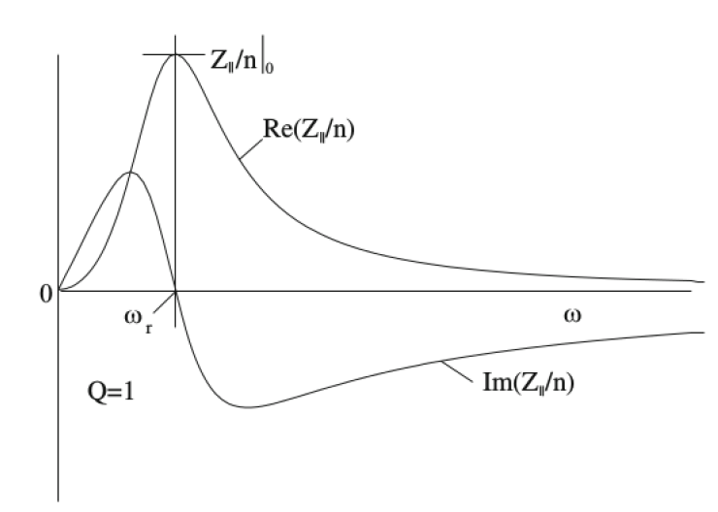
Cavity-like Structure Impedance
At low frequencies the impedance is almost purely reactive and inductive.
At high frequencies it becomes capacitive.
At resonance, it is purely resistive.

Slide 29
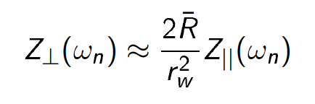
Cavity-like Structure Impedance
Transverse broad-band impedance:

Slide 30
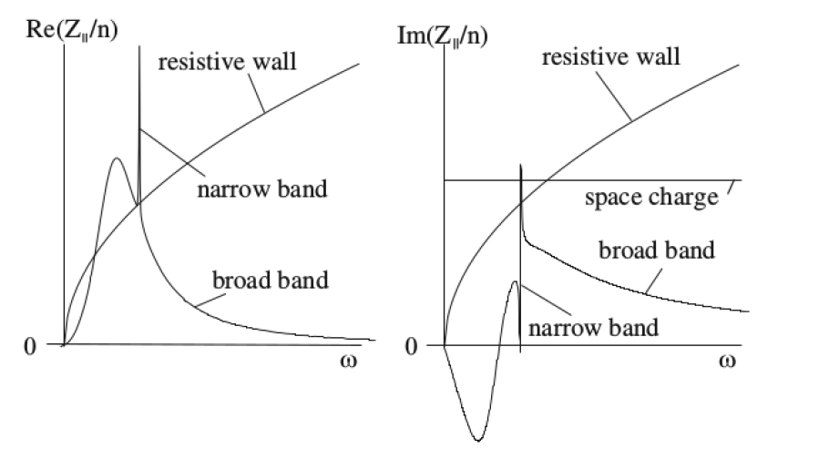
Overall Accelerator Impedance
At low frequencies the reactive and the resistive component of the resistive wall impedance dominates.
Space-charge impedance is independent of frequency.
The narrow-band cavity spectrum includes the high impedances at the fundamental and higher-mode frequencies.

Slide 31
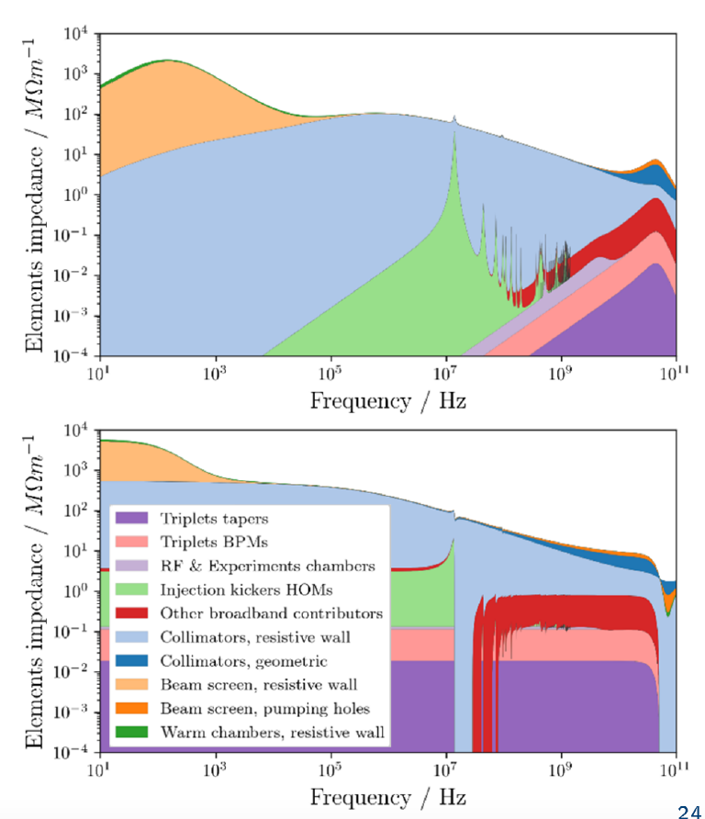
LHC Impedance Model
The impedance model summarises the main impedance contributions from the different elements of the machine.
In the LHC, the main contribution (for high frequencies) is coming from the collimators.
New low-impedance collimators under implementation.

Slide 32
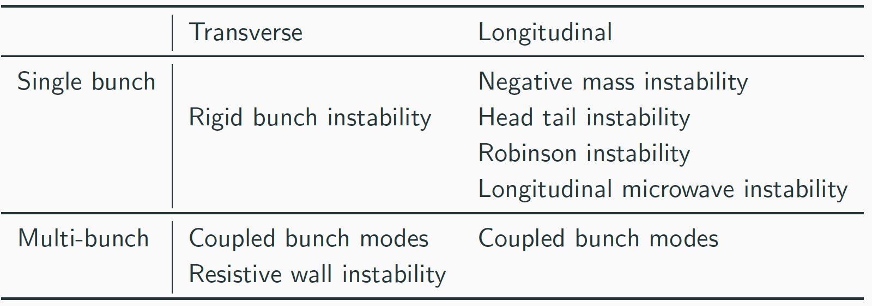
Types of Instabilities
A non-exhaustive list of instabilities

Slide 33
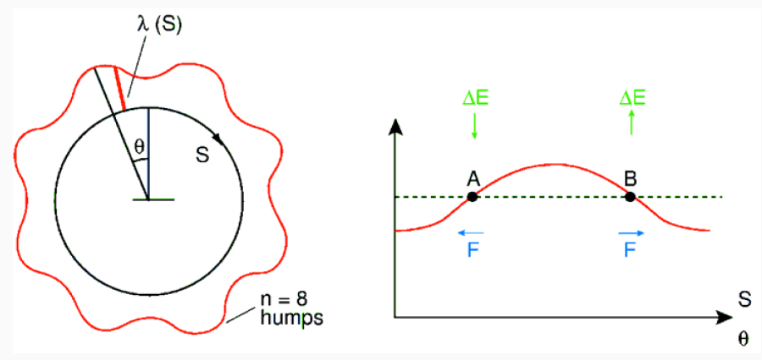
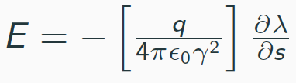
Negative Mass Instability
Imagine a ring with modulation in the line density λ(s) around ring.
What is the result?
  Particle B finds itself with a larger charge density behind it than in front of it, pushing it forward and accelerating.
  Particle A will be decelerated by large charge in front of it.
Field due to space-charge force

Slide 34
Negative Mass Instability
Observed in coasting beams.
So is this stable or unstable? Depends on γ_{t}.
  If γ<γ_{t}: Revolution frequency increases. Repulsive EM field from a ‘lump’ in the distribution causes particles ahead of the ‘lump’ to be accelerated and particles behind to be decelerated. Stabilizing situation and the ‘lump’ smoothes out – STABLE.
  If γ>γ_{t}: Revolution frequency decreases. Particles A and B move toward the ‘lump’ of charge. Instabilty due to ‘negative mass’ – UNSTABLE.

Slide 35
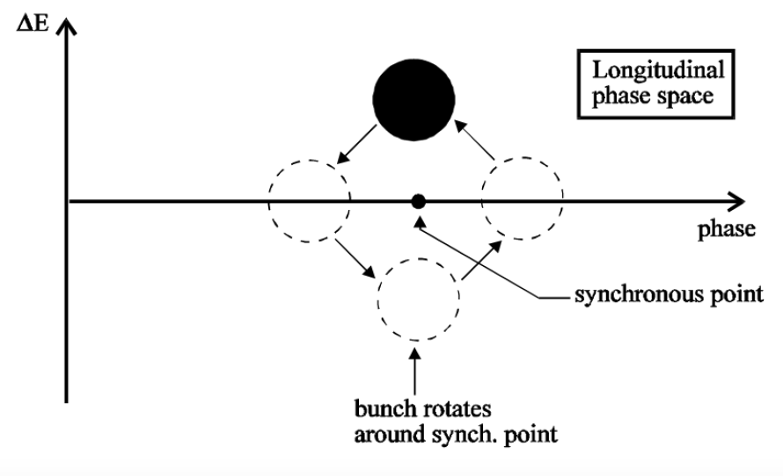
Robinson Instability
Most basic longitudinal instability mechanism that occurs in circular accelerators.
Induced by longitudinal impedance due to RF cavities (ω_{R}).
Dipole mode oscillation. The whole bunch is moving back and forth around the synchronous position.
Above transition, the beam will be unstable if ω_{R} is slightly above hω₀ and stable if slightly below. Below transition, it is the other way around.

Slide 36
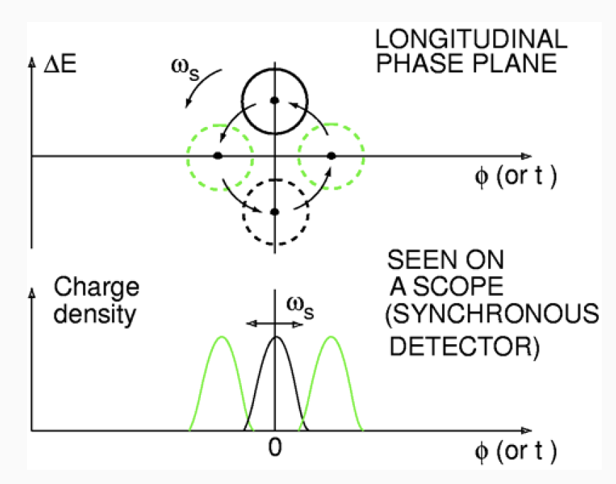
Robinson Instability
Single bunch and resonator over multiple turns.
The single bunch in ‘dipole’ or ‘rigid bunch’ mode rotates in longitudinal phase plane with ω_{s}.
  Phase φ and energy ΔE also vary with ω_{s}.

Slide 37
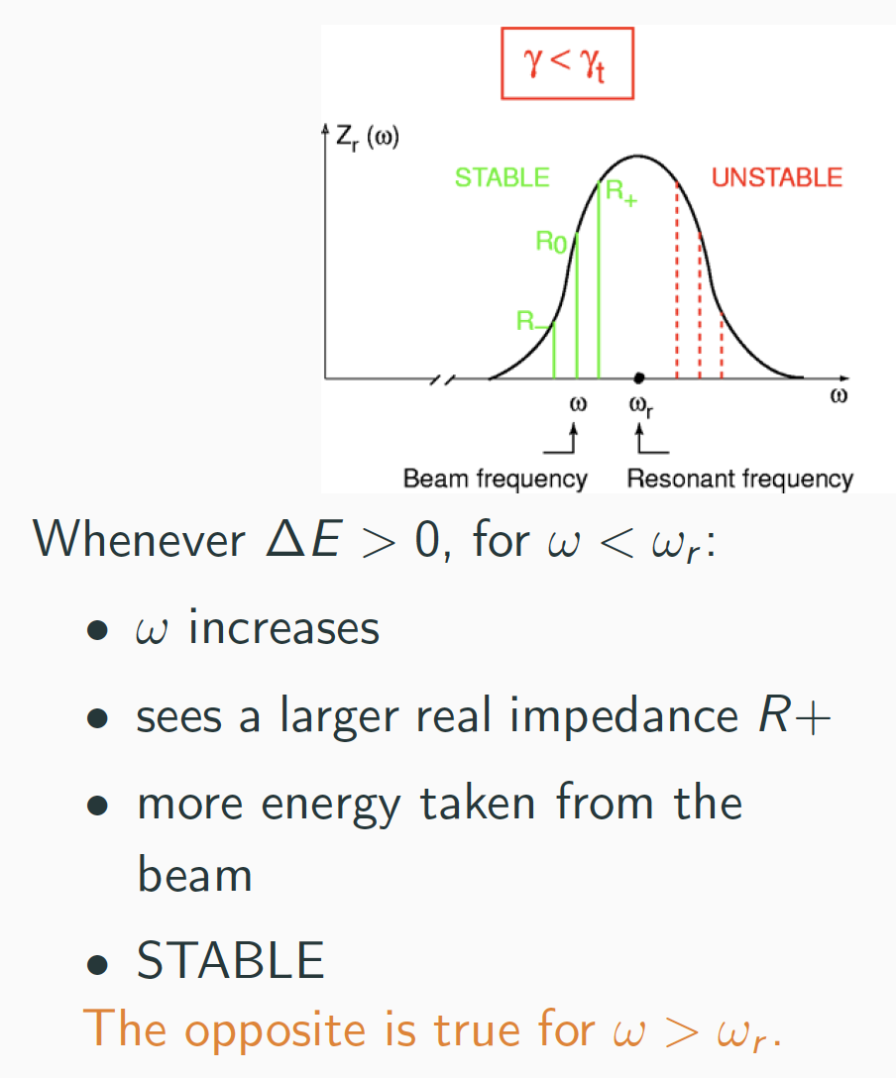
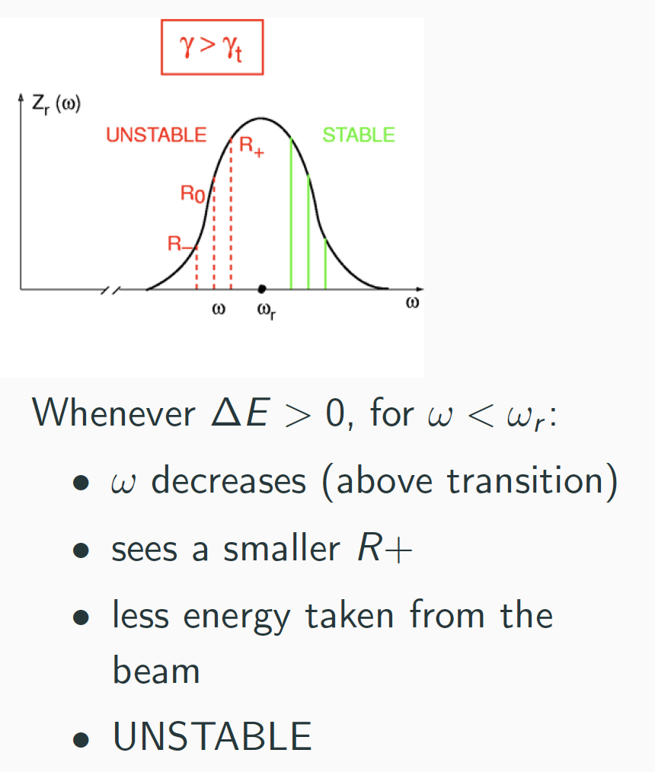
Robinson Instability
The bunch sees a resonator impedance at ω_{r} = ω₀

Slide 38
Robinson Instability
Robinson instabilities were removed just by fine tuning the cavity’s resonant frequency ω_{r} slightly away from the beam frequency ω₀
ω_{r} = nω₀
Nowadays a feedback system on the cavity tune is an efficient way of removing it for increased performance.

Slide 39
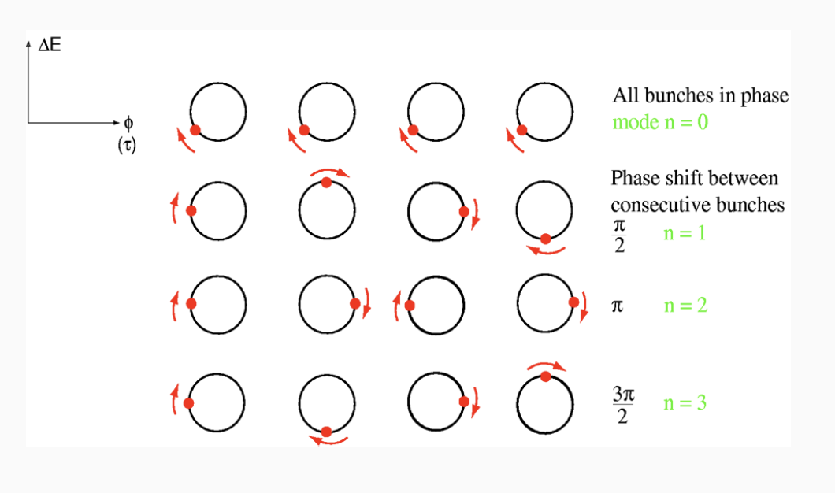
Multi-bunch Coupling Instability
Fields that are induced in the resonator remain long enough to influence subsequent bunches.
Example: For M = 4 bunches, they can couple together in 4 ways.
With 4 possible phase shifts between the four bunches, above transition, n = 1 is UNSTABLE.

Slide 40
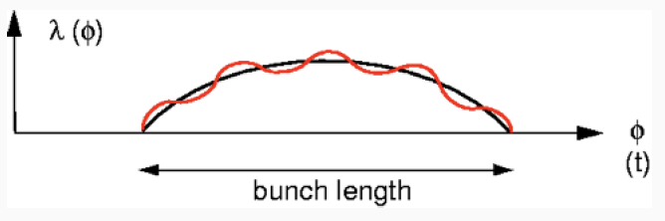
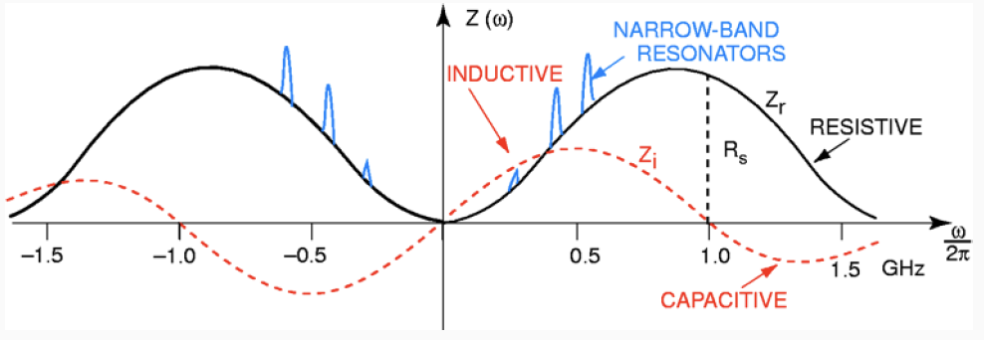
Longitudinal Microwave Instability
This is a single-bunch effect, driven by the broad-band impedance, which is caused by discontinuities in the beam pipe.
Typically results in a high-frequency density modulation superimposed on the bunch shape. Has fast growth rates and also affects leption machines.

Slide 41
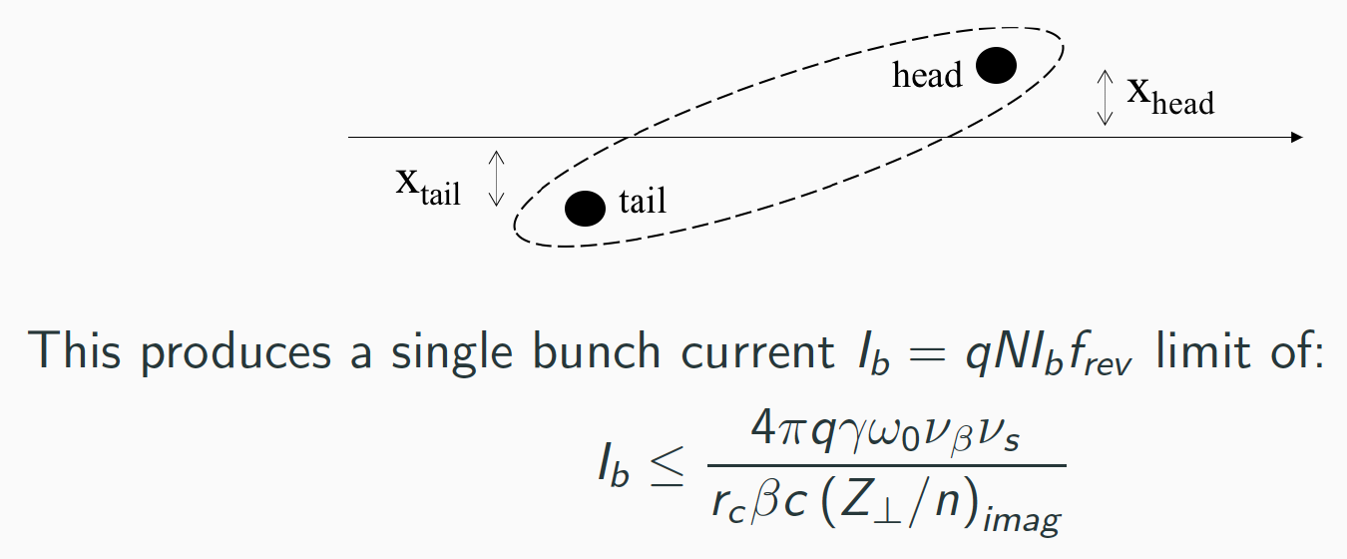
Head – Tail Instability
Single-bunch effect of transverse wakefields generated by head of the bunch on its own tail.
Occurs for broad-based impedances, which act very quickly and decay quickly, so only affects a single bunch.
In linear accelerators, can lead to beam break-up, as they have many cavities.
Represent the head and tail as a two macro-particle model:
Severe limitation on single-bunch currents in storage rings – special care much be taken to minimise transverse impedance of the vacuum chamber.

Slide 42
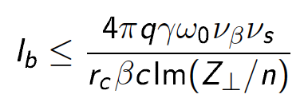
Head – Tail Instability
In a circular proton accelerator:
  No radiation damping.
  Weak transverse wakefields can lead to transverse bunch blow up and beam loss.
  Particles in the head of a bunch oscillate due to synchrotron oscillations.
  There is an intensity I_{b} from which the perturbation from wakefields is strong enough to produce instabilities.
Exceeding this limit leads to an immediate loss of the excess current.
Most severe instability.

Slide 43
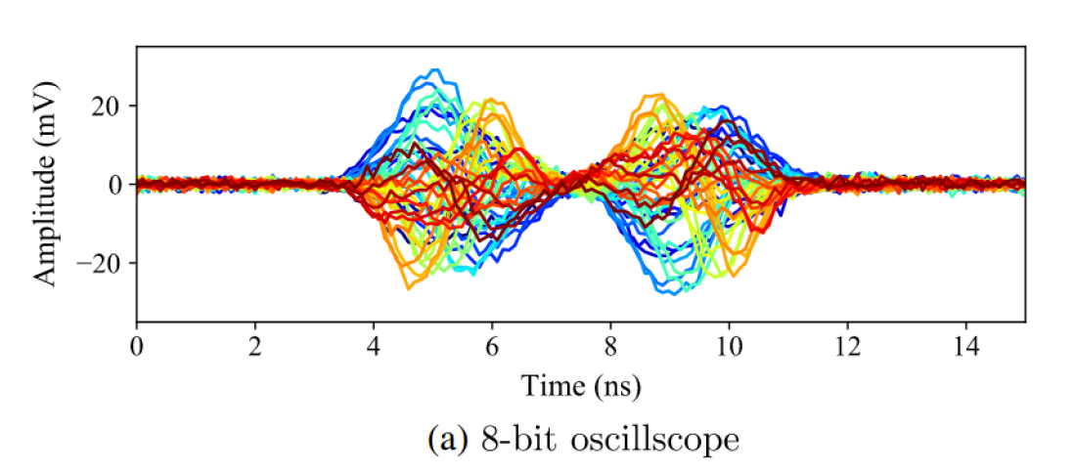
Head – Tail Instability
Head and tail start to oscillate while the centre of the bunch remains unperturbed.

Slide 44
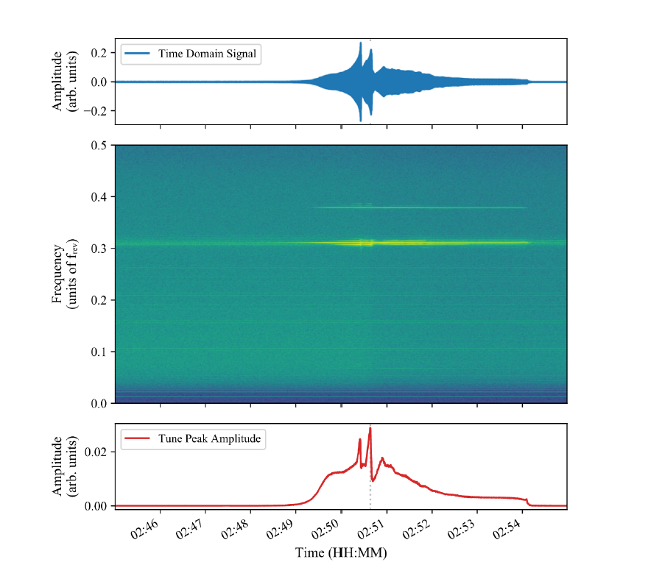
Typical Instability in the LHC

Slide 45
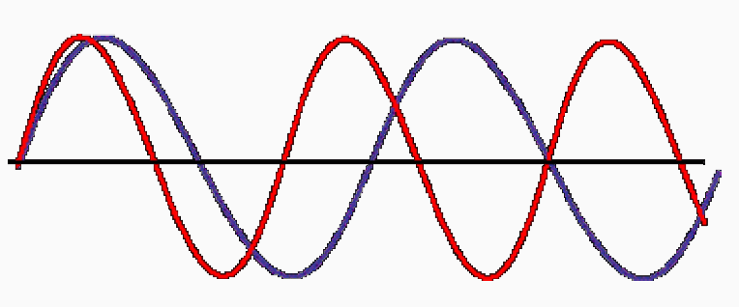
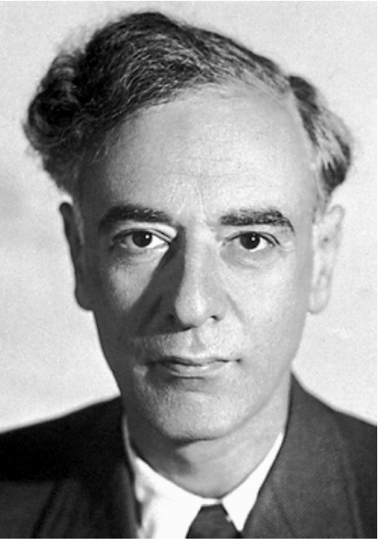
Landau Damping
In real machines, not all particles in the beam have same momentum (frequency).
  Hence have a revolution frequency spread that may be sufficient to stabilise beam.
The coherent motion from an instability therefore de-coheres over time, potentially dampening the instability.
Two oscillators excited together become incoherent and give zero centre of charge motion after a number of turns comparable to the reciprocal of their frequency difference.
Landau damping is the absence of oscillations.
Two particles
of different frequency
move out of step.
Lev. D. Landau

Slide 46
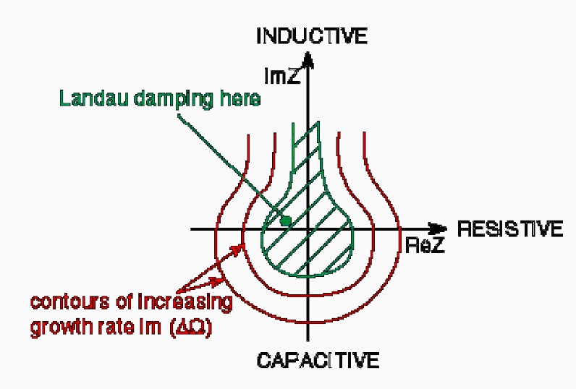
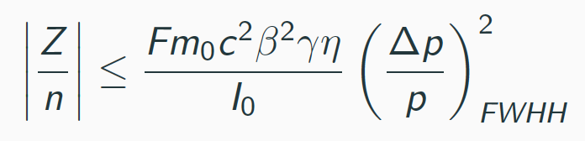
Landau Damping
Landau damping applies not just to longitudinal but also transverse, single-bunch and multi-bunch instabilities.
Along with active feedback systems, it is a powerful way to overcome coherent beam instabilities.
The line defining zero growth rate leads us to a handy approximation for the stability limit of unbunched beams – the ‘Keil-Schnell Stability Criterion’:
Instability diagramme
with damping

Slide 47
General Remarks
Transverse and longitudinal planes treated in basically same way and results are very similar.
Some differences:
  Longitudinal impedance depends predominantly on induced electric fields.
    Z_{long.} Is order of a few Ω.
  Transverse impedance depends on both electric and magnetic fields, with the latter being more important.
    Z_{trans.} Is millions of Ω/m

Slide 48
General Remarks
Impedance of machine varies with frequency.
  Low frequencies – Impedance dominated by skin effect of vacuum chanmber.
  High frequencies – Impedance behaves like broadband resonator (Q = 1), due to numerous small resonators (bellows, cavities, tanks, etc.)
Mitigation factors against coherent instabilities are limited.
  In longitudinal case, design vacuum chamber with low coupling impedance.
  In transverse case, enhance Landau damping by use of sextupoles and octupoles.
  Active feedback system as last resort.

Slide 49
Summary
Impedance is one of the main sources of beam instability.
  Generated by the interaction/coupling between the beam and the accelerator environment.
  Produce wakefields that perturb the beam motion.
Eventually, this perturbation might lead to instabilities.
  Broad-band impedances mainly responsible for single-bunch beam instabilities.
  Narrow-band impedances can cause multi-bunch instabilities but usually do not affect single-bunch intensity limits.
  Both can cause longitudinal and transverse instabilities.
Various ways exist to mitigate instabiities (radiation damping, octupoles etc.)

