Slide 1

Positron generation, capture, damping for FCC-ee
Iryna Chaikovska
Laboratoire de Physique des 2 Infinis Irène Joliot-Curie (IJCLab)
CNRS, Université Paris-Saclay
Many thanks to P. Craievich, M. Schaer, N. Vallis, R. Zennaro (PSI), F. Alharthi, R. Chehab, V. Mytrochenko (IJCLab), A. Grudiev, B. Humann, A. Latina, A. Lechner, H. Pommerenke , Y. Zhao (CERN), A. De Santis (LNF) and all members of the FCC-ee Injector Studies (CHART)

Slide 2
FCC-ee injector complex
Electron-Positron collider
~91 km
Booster ring
Pre-injector: e-/e+ linacs up to 6 (20) GeV, 1.54 GeV Damping Ring
Pre-Booster Ring (SPS or new ring) (6 - 20GeV)
Booster Ring (20 → 45 GeV)
The main 6 GeV linac feeds the positron source. The positrons are produced with 6 GeV e- beam.
electrons
positrons
Pre-Injector
0.5 - 1 km
SPS, ~ 7 km

Slide 3
FCC-ee pre-injector layout (6 GeV option)
More details: talk on linac studies by Simona Bettoni
1.54 to 6 GeV
Linac efficiencies optimized: electron/positron beam with same energy, main and drive electron beam with same final energy
Specifications are fulfilled for the electron bunch (beam dynamics simulations for the e- linac and common linac well advanced)
e+ Linac: several options of the capture section, RF design well advanced 2 GHz, 200 Hz, large iris aperture, beam dynamics on-going.
DR provides the damping of the positron beam and delays extraction to allow single species operation for the common linac.

Slide 4
Injector parameters for the Z-mode
 | Baseline | HE Linac | Unit
Ring for injection | SPS/PBR | BR
Injection energy | 6 | 20 | GeV
Bunch population both species | 3.47 (5.55) | 3.12 (5.0) | 1E10 (nC)
Repetition rate | 200 | 200 | Hz
Number of bunches | 2 | 2
Bunch spacing | 17.5-50 | 17.5-50 | ns
Normalized emittance (x, y) (rms) | 50, 50 | 50, 50 | mm.mrad
Bunch length (rms) | ~1 | ~1 | mm
Energy spread (rms) | <0.1 | <0.1 | %
The bunch by bunch intensity will randomly vary from 0 to 100%, depending on the intensity balance between the collider rings
Electron source: an injector based on a photocathode RF gun can provide electrons for both ring injection and positron production and the laser system can provide the bunch-to-bunch intensity modulation and stability required
Position source: target-converter + capture system + 1.54 GeV linac + DR

Slide 5
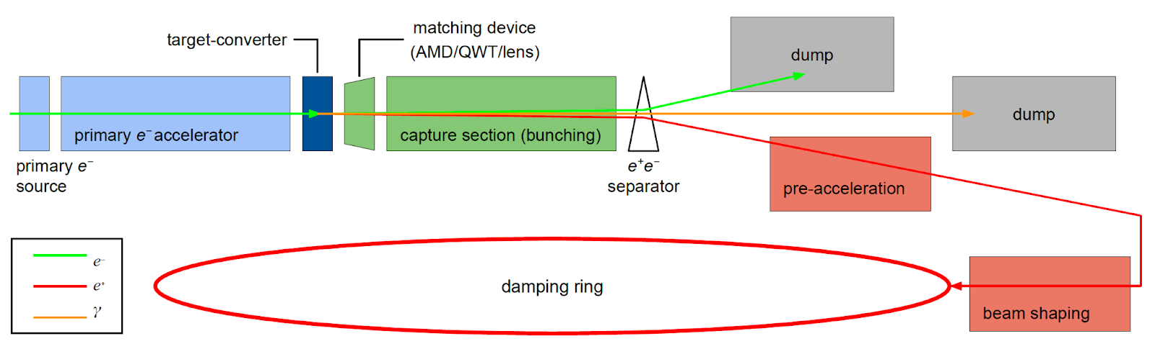

FCC-ee positron source: requirements
Positron source basic scheme
Accepted e⁺ yield is a function of primary beam characteristics + target + capture system + DR acceptance
To estimate the accepted yield:
energy window cut: (1540 ± 58.5) MeV → (±3.8% @ 1.54 GeV)
time window cut: 40° RF (~16.7 mm/c @2 GHz)
The complete filling for Z running => Requirement ~3.5 ⨯ 10¹⁰ e⁺/bunch (5.6 nC)
N_{e-}/bunch ⨯ η^{e+}_{Accepted} ≥ 5.6 nC/bunch ⨯ 2
*A safety margin of 2 is currently applied for the whole studies.
All the studies are focused on the operation scheme: 6 GeV, 2 bunches/pulse, 200 Hz rep. rate, the max e- bunch charge is 5.6 nC ➜ ~ 1.4 ⨯ 10¹³ e⁺/s

Slide 6
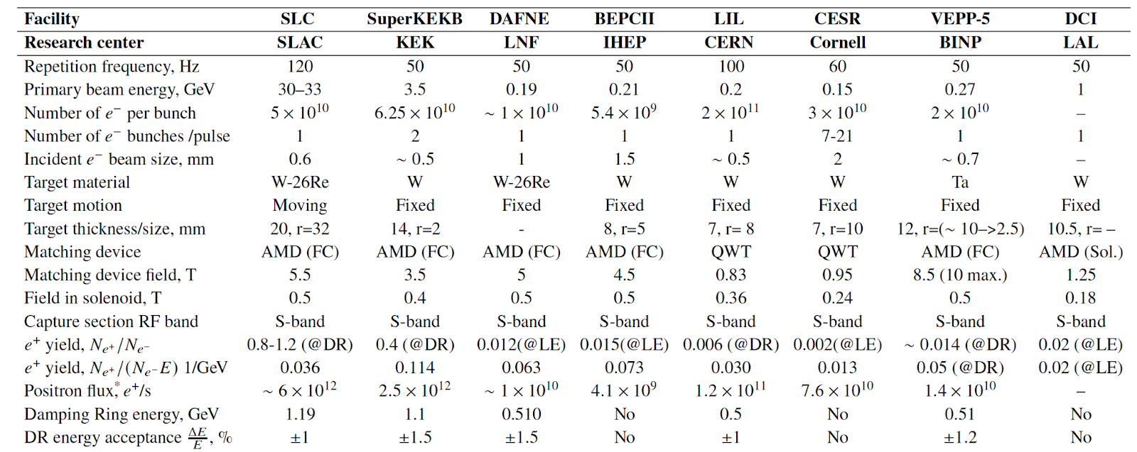
Positron source performances
Demonstrated (a world record for existing accelerators): SLC e+ source ~6e12 e+/s
High intensity
Emittance
Polarization
Reliability and radiation environment
What are the main challenges?

Slide 7
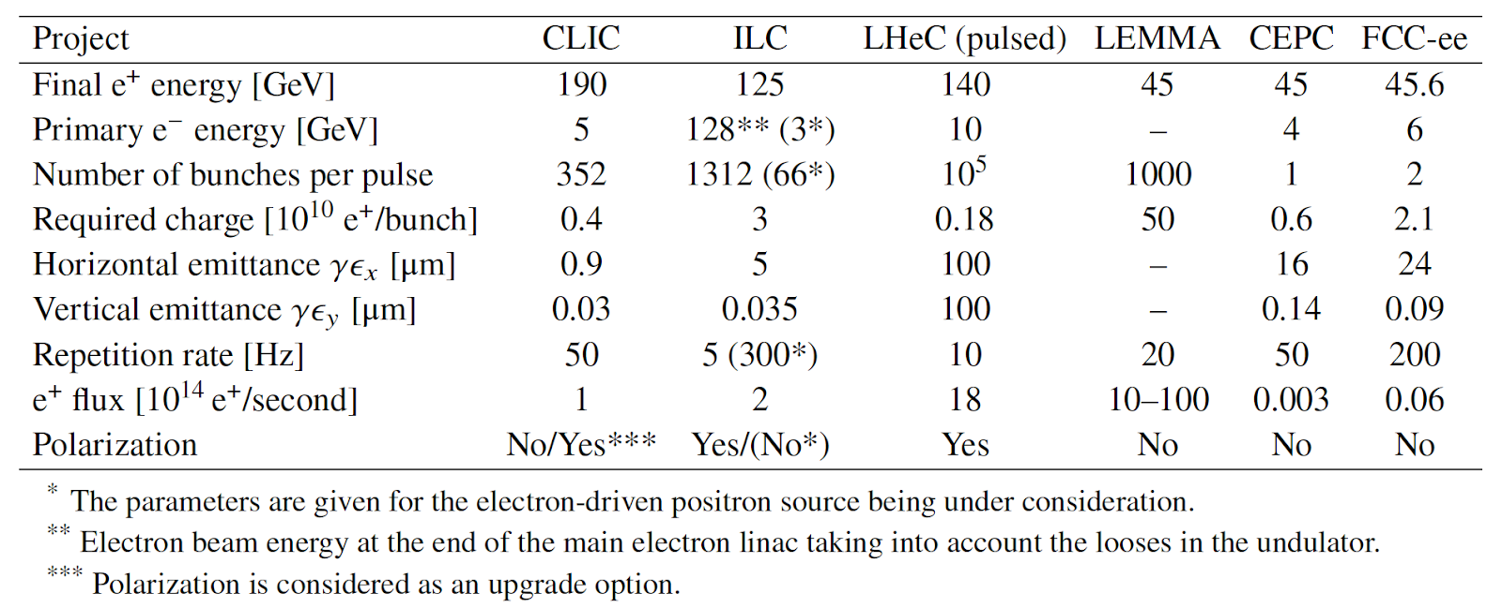
Future collider project challenges
Demonstrated (a world record for existing accelerators): SLC e+ source ~6e12 e+/s
2
1.88
~3.5
100
0.04
~0.1
Linear Collider projects: high request for polarization, requested intensity should be produced in “one shot”.
Circular Collider projects: polarization is under discussion, requirements are relaxed due to stacking and top-up injection

Slide 8
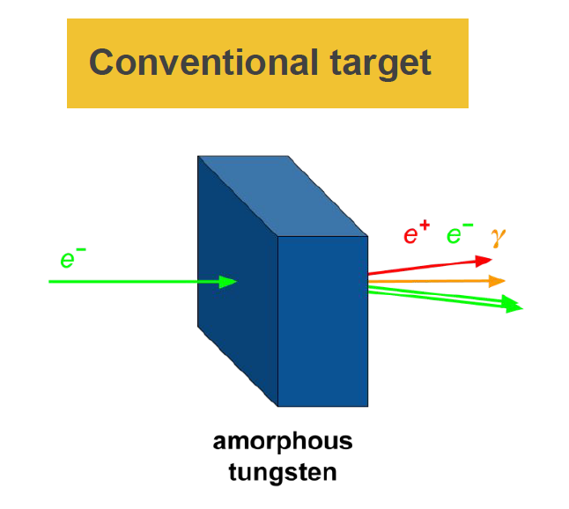
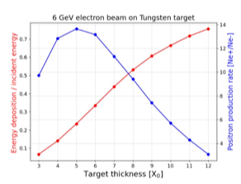
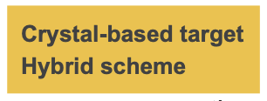
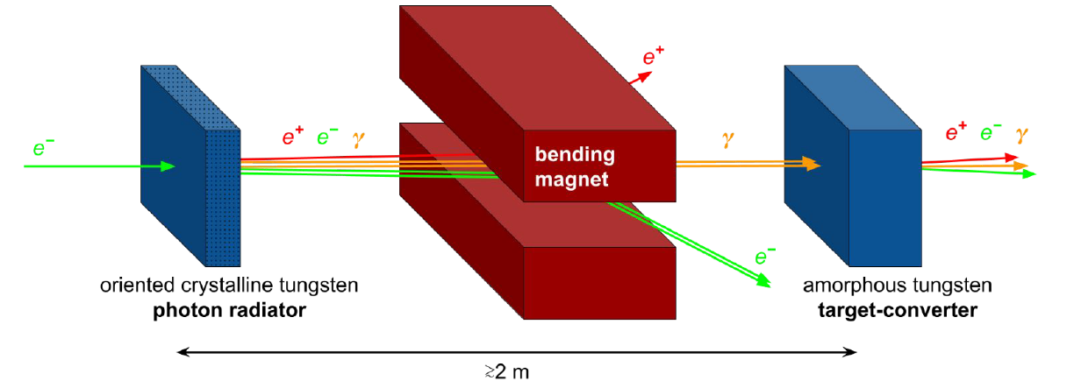
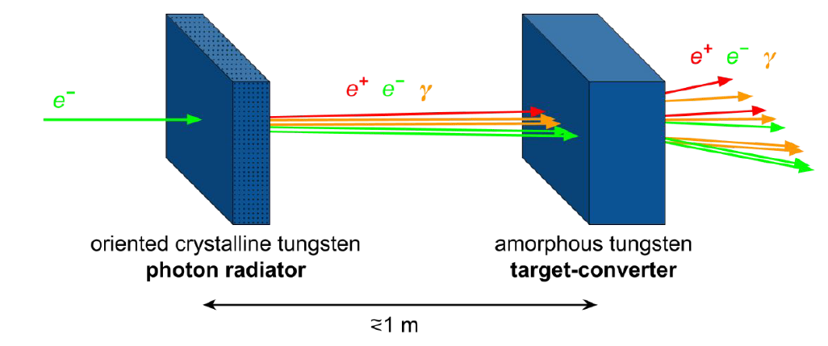
FCC-ee: positron production
Schemes under consideration now
Target thickness | 5 X₀ 17.5 mm
Production rate | ~14 Ne+/Ne-
PEDD* | f(e- beam)
Deposited power | f(e- beam)
Conventional scheme: bremsstrahlung and pair conversion (mainly studied until now)
Hybrid scheme: two-stage process to generate positron beam. Channeling (crystal target) and pair conversion (amorphous target). Benchmark of simulation codes and first simulation/optimization studies => in progress
*According to SLC experience, W₇₄Re₂₆ material has a PEDD limit of 35 J/g (safe value to avoid target failure)
The final choice will be done based on the simulated performances

Slide 9
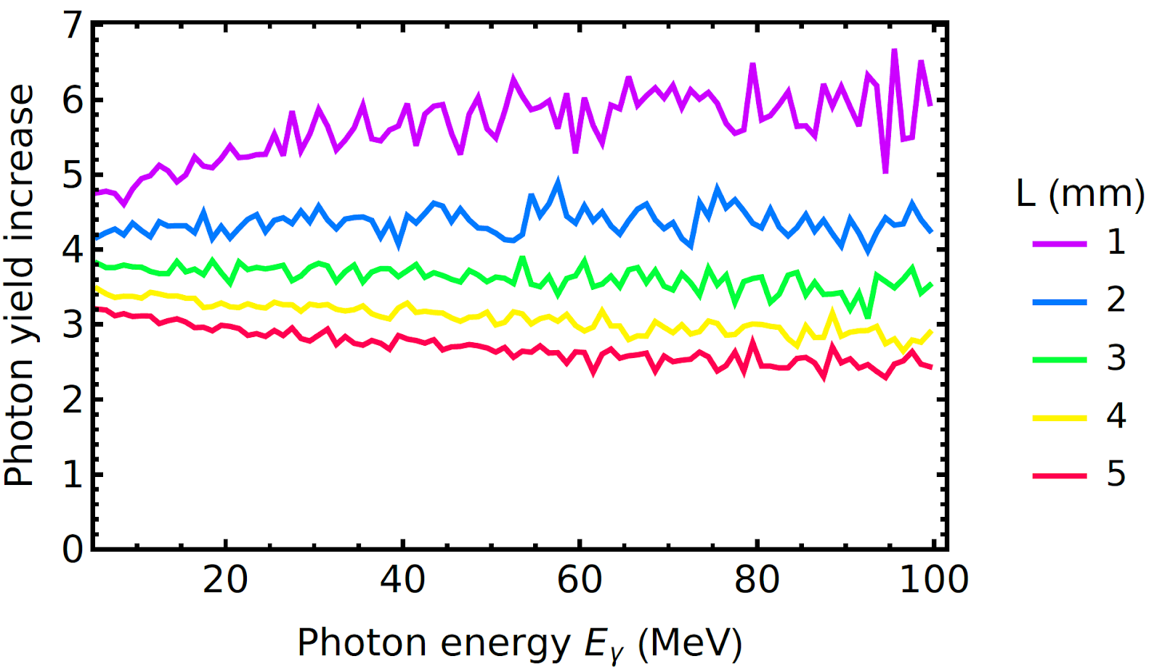
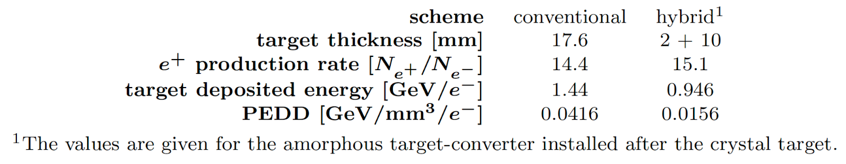
Hybrid scheme: preliminary simulations for the FCC-ee
L. Bandiera et al., Eur. Phys. J. C (2022) 82:699)
e- beam energy = 6 GeV, angular divergence 0.1 mrad and with the r.m.s. transverse beam size of 0.5 mm. W crystal oriented in <111> (θc ≈ 0.6 mrad).
A 2 mm thick crystal has been selected to be used as a radiator for the hybrid positron source.
→ good photon yield, moderate values of photon divergence and energy deposition in the crystal.
Radiation enhancement in the tungsten (W) crystals aligned along <111> axes
Results for the positron production simulations
< 100 MeV : photon yield increase ≈ 4.3
Full spectrum : photon yield increase ≈ 3.7

Slide 10
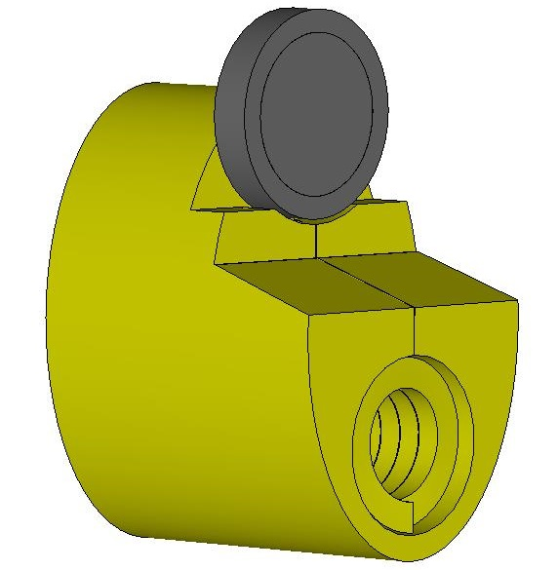
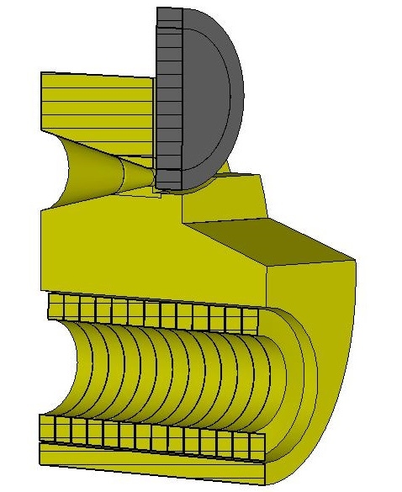
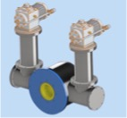
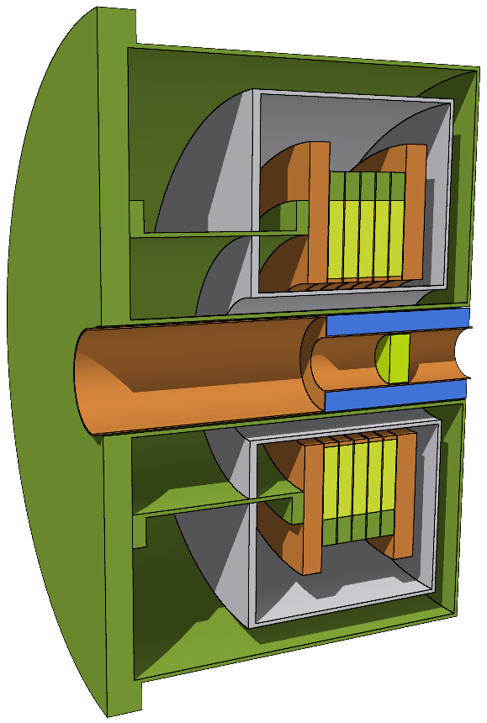
FCC-ee: positron capture system (matching device)
Matching device => a fast phase space rotation to transform the small size and high divergence in big sizes and low divergence beam.
Flux Concentrator (FC)
designed by P. Martyshkin (BINP)
High-Temperature Superconducting (HTS) solenoid designed by J. Kosse, B. Auchmann and M. Duda (PSI)
5 coils ReBCO tape
Compared with HTS solenoid:
Low peak field (5−7 T, ~1.5−3 T at target exit)
Small entrance aperture (Ф = 8−16 mm)
Fixed target position (2−5 mm upstream)
Therefore, lower e+ yield
Compared with FC:
High peak field (~15 T, ~12 T at target exit)
Large aperture (Ф = ~40 mm)
Flexible target position (can be placed inside the bore)
Therefore, higher e+ yield

Slide 11
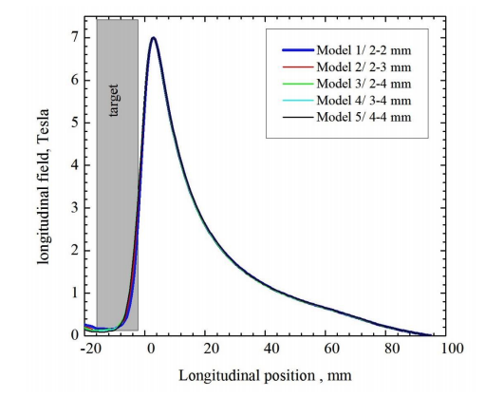
FCC-ee: positron capture system (matching device)
Flux Concentrator (FC)
High-Temperature Superconducting (HTS) solenoid
FC on-axis field, with fixed target position
HTS solenoid field, with optimised target position
Peak of the FC field is at 5 mm from the target => ~40 % drop in capture efficiency

Slide 12
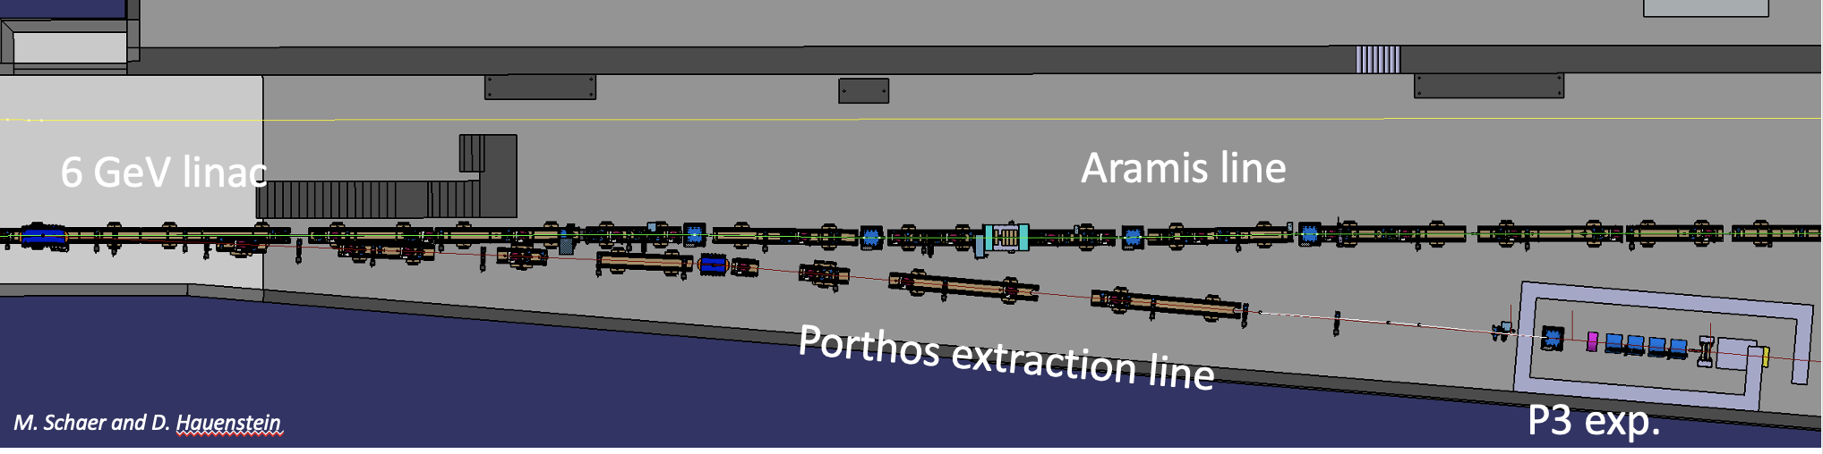
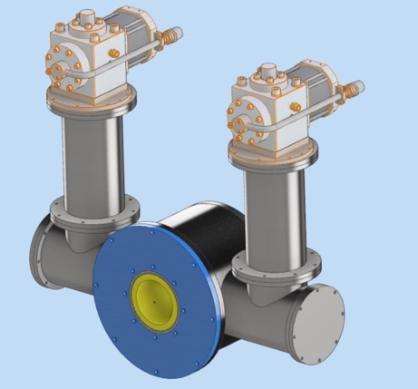
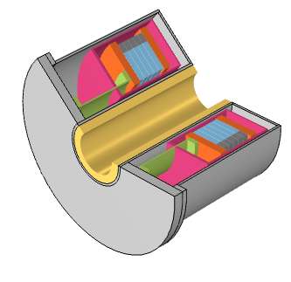
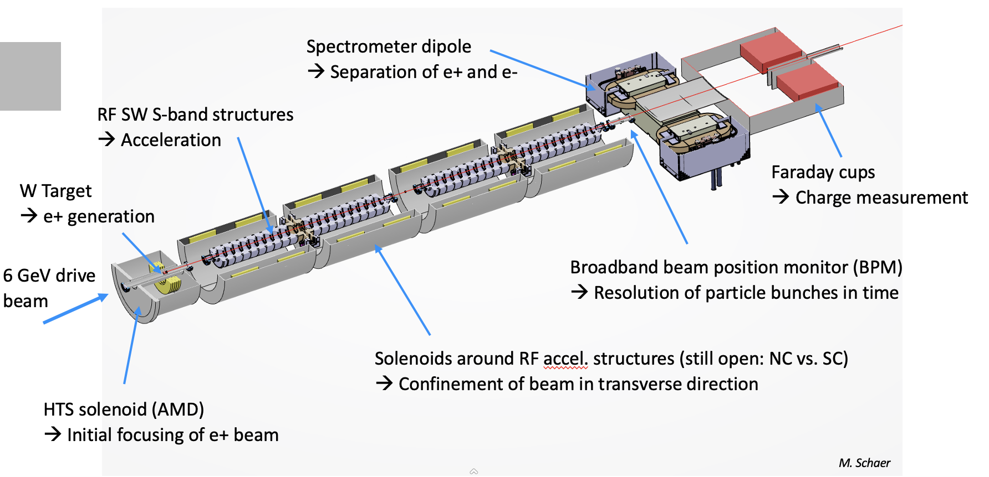
SC-solenoid and PSI Positron Source Experiment at PSI (P³ project )
More details: talk on P³ project by Nicolas Vallis
5 coils ReBCO tape
P³ Layout
HTS solenoid integrated in the cryostat (M. Duda et al.)
Peak magnetic field: 12 T (test up to 18 T)
Positron yield with conventional scheme (simulation vs measurement)
MD: SC Solenoid with HTS technology including mech. and thermal (cryostat) concept
RF structures: large iris aperture
NC versus SC solenoids around the RF structures
Phase 2: hydride scheme with crystal
P. Craievich, M. Schaer, N. Vallis, R. Zennaro et al. (PSI)

Slide 13
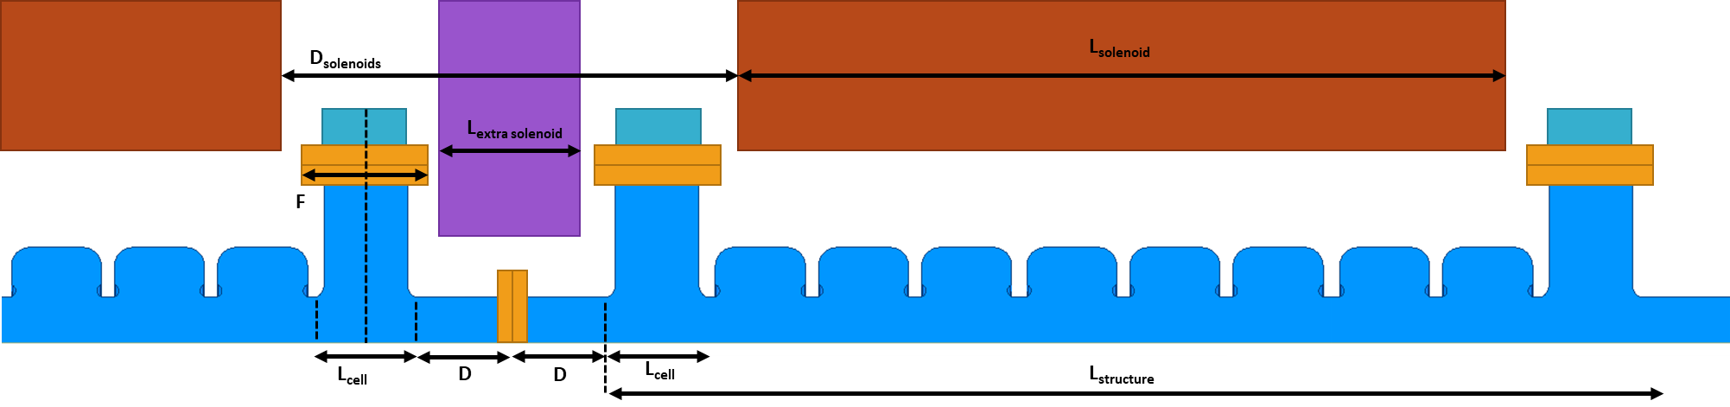
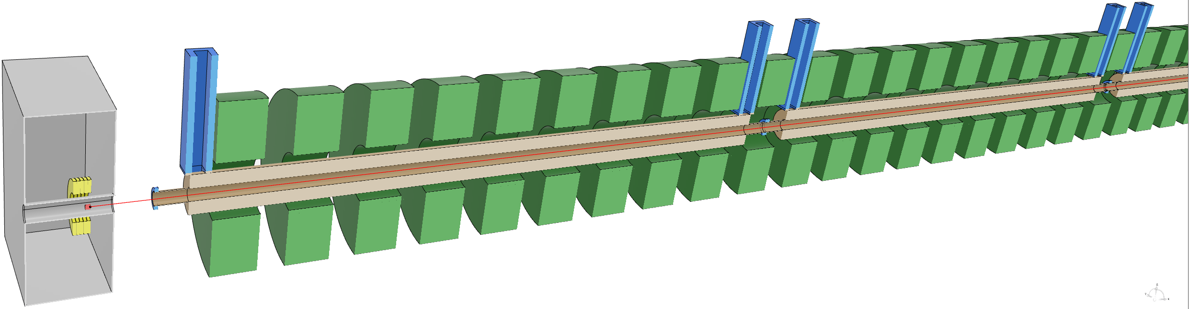
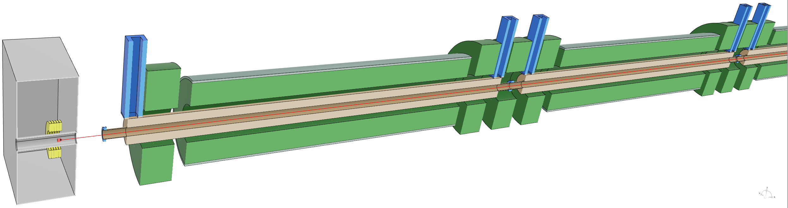
FCC-ee: positron capture system (capture linac)
The capture linac is encapsulated inside a solenoid with the axial magnetic field of ~0.5 T (NC)
(usually with constant solenoid field and recently, more realistic field profiles started to be used)
1.5 m long, ~21 MV/m, TW 2 GHz L-band structures, (Ф = 40 mm)
3 m long ~20 MV/m, TW 2856 MHz S-band structures (Ф = 30 mm),
1.5 m long ~18 MV/m, SW 2998 MHz S-band structures (Ф = 40 mm) -> P³ project
3 meter long ~20 MV, TW 2 GHz large aperture structures (Ф = 60 mm)
 | F3 („baseline“)
Frequency | 2.0 GHz
Constant aperture | 30 mm = 0.2 λ
Phase advance | 9π/10
Length | 3.0 m = 44 cells
Entr., exit iris thickness | 14.3 mm, 20.0 mm
Transverse wake at 17.5 ns | 0.13 V/pC/mm/m
Filling time | 447 ns
Min. group velocity | 1.9 % c
Largest cell radius | 61 mm
SLED coupling | 17
Eff. shunt impedance | 39 MΩ/m
Average gradient | 15 MV/m
E_{max} (instant.) | 58 MV/m
S_{c,max} (instant.) | 329 mW/μm²
Klystron pulse length | 5 µs
Klystron power per structure | 17 MW
F3 structure
Two solenoid designs
H. Pommerenke, A. Grudiev (CERN)
M. Schaer, R. Zennaro (PSI)

Slide 14
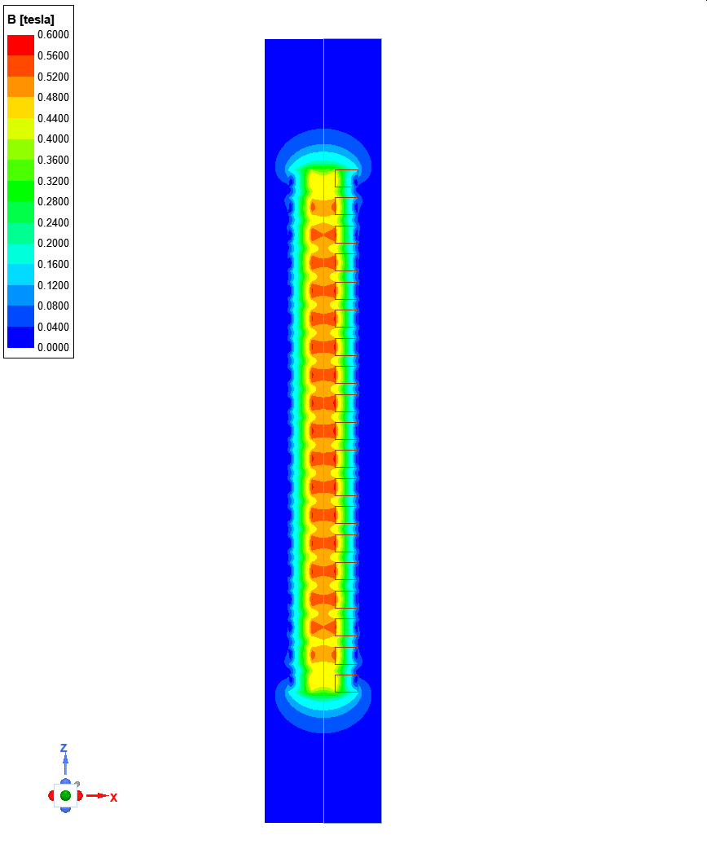
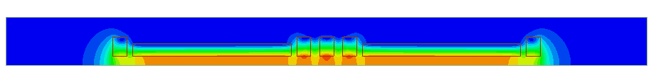
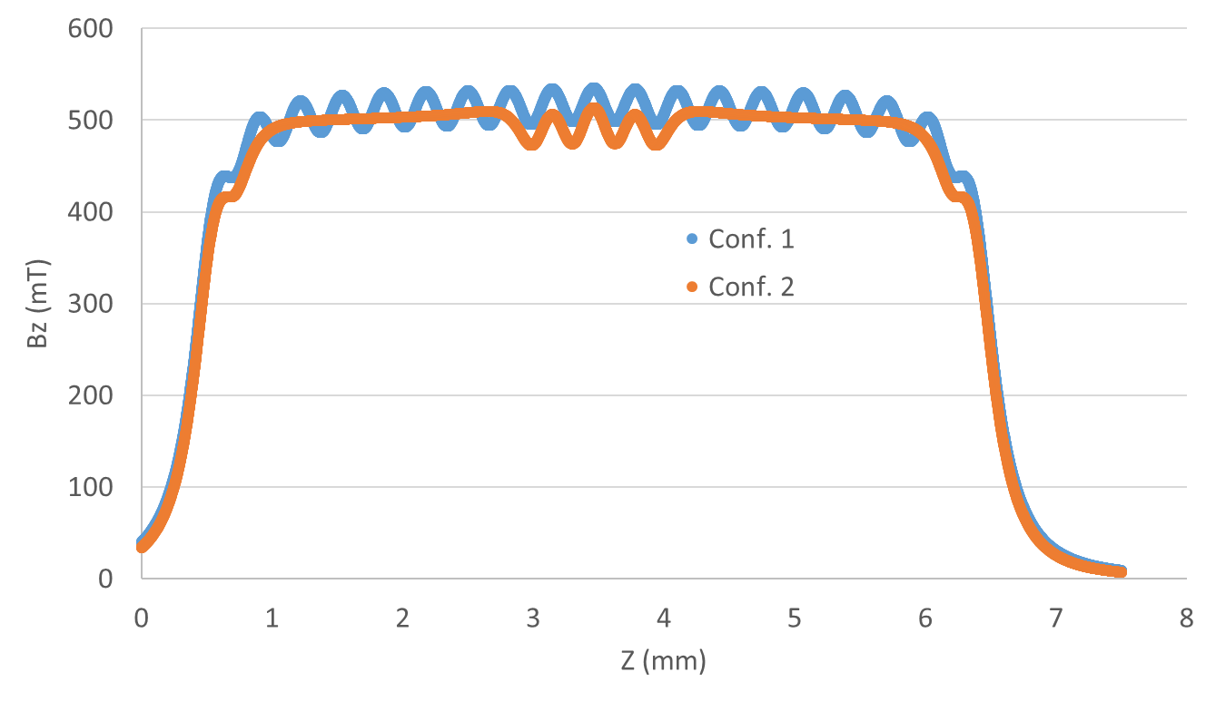
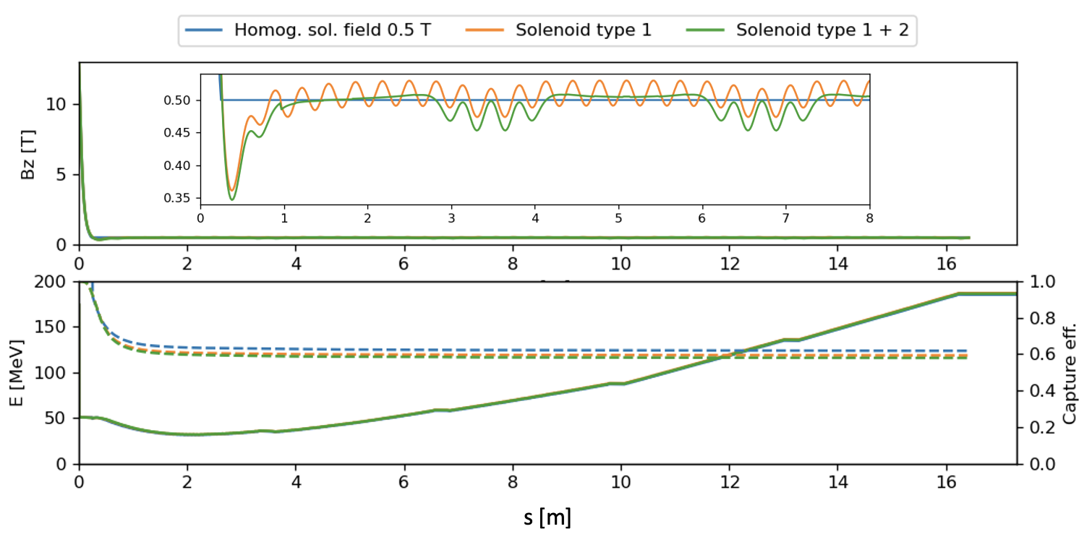
FCC-ee: positron capture section (solenoid around the capture linac)
Maxwell 2D simulation for solenoid over 2 RF structures
Minimal reduction in capture efficiency between homog. channel (0.618) and realistic solenoids (0.593 and 0.579)
M. Schaer, R. Zennaro (PSI)

Slide 15
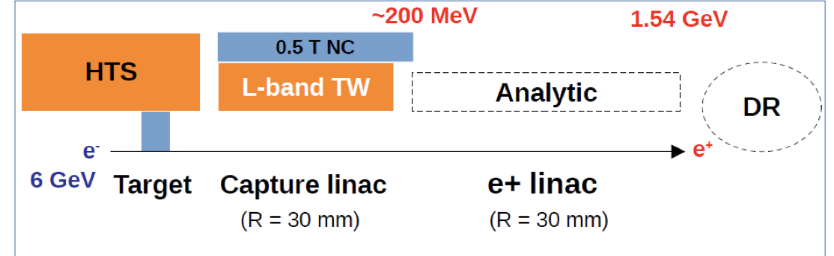
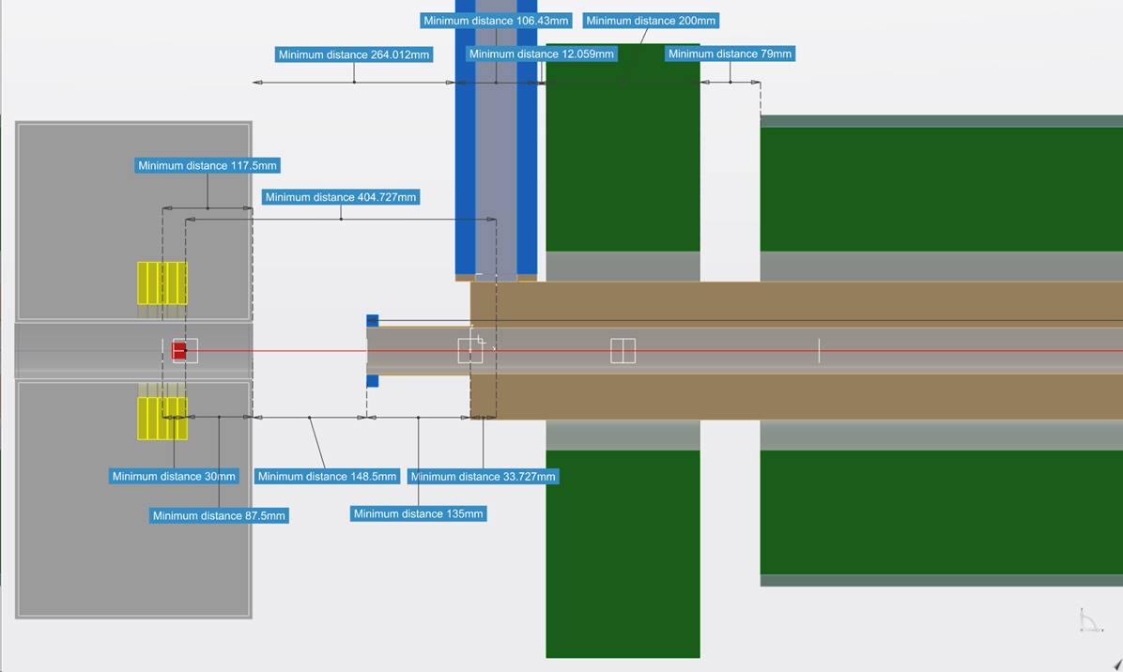
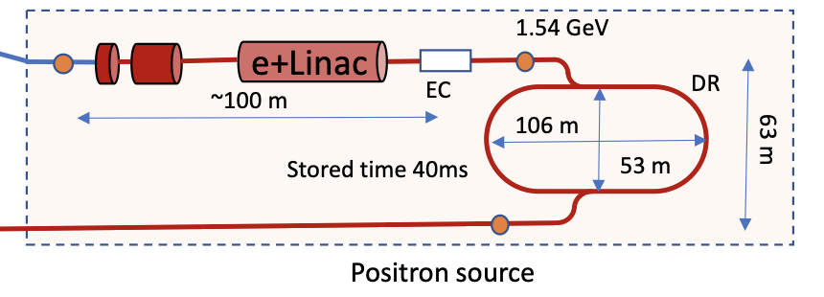
SC-solenoid-based capture system (work in progress)
Scheme under study now
M. Schaer (PSI)
Capture system “-version 0”
Positron production: conventional scheme
Matching Device is based on the SC solenoid (5 HTS coils, 72 mm bore including shielding)
Capture Linac is based on the L-band TW RF structures ( 2 GHz, 3-m long)
NC long solenoid B = 0.5 T (realistic design conf. 2)
The first results (preliminary)
Capture efficiency @ 200 MeV: ~0.6
e+ yield @1.54 GeV: 6.4 Ne+/Ne-
e+ norm. emittance: ~12 mm.rad

Slide 16
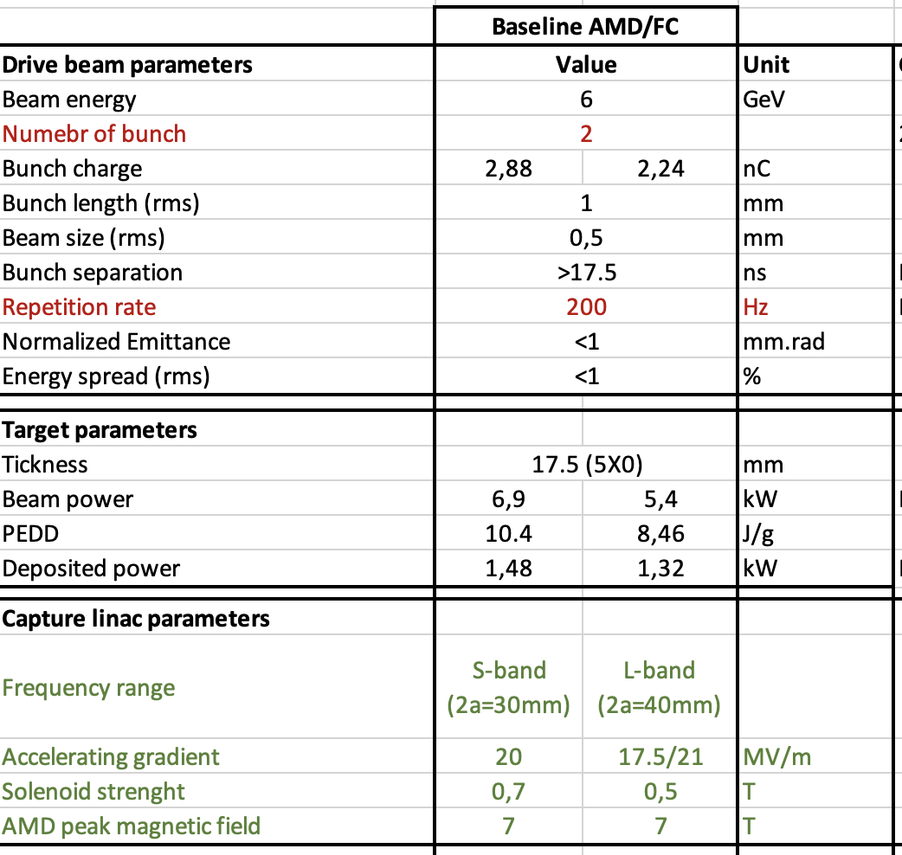
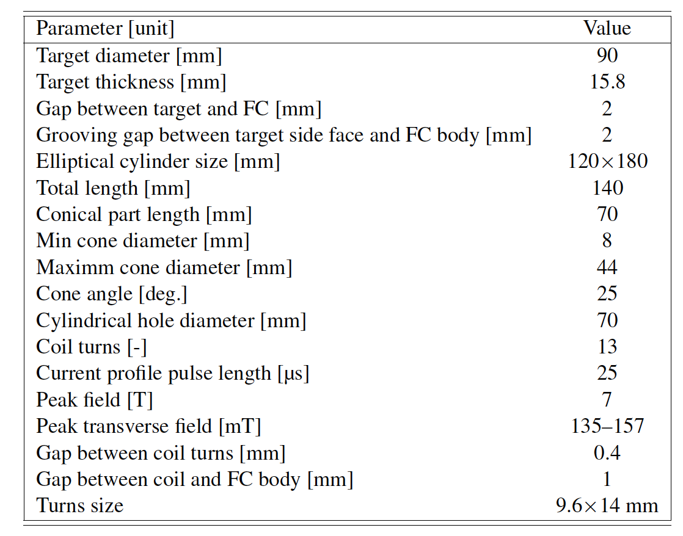
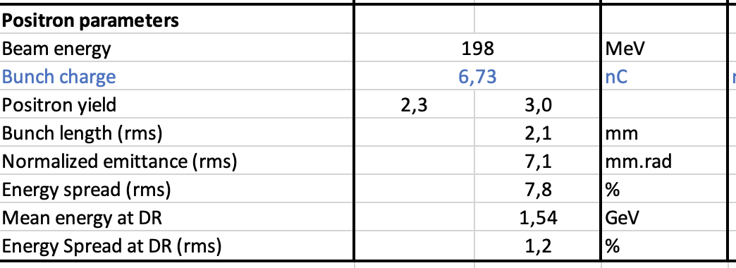
Flux Concentrator-based capture system (CDR baseline)
P. Martyshkin (BINP), Y. Zhao (CERN)
Perform radiation load studies, the first estimation for the target design. First mechanical integration.
Optimize the FC design if needed (rep. rate ?)

Slide 17
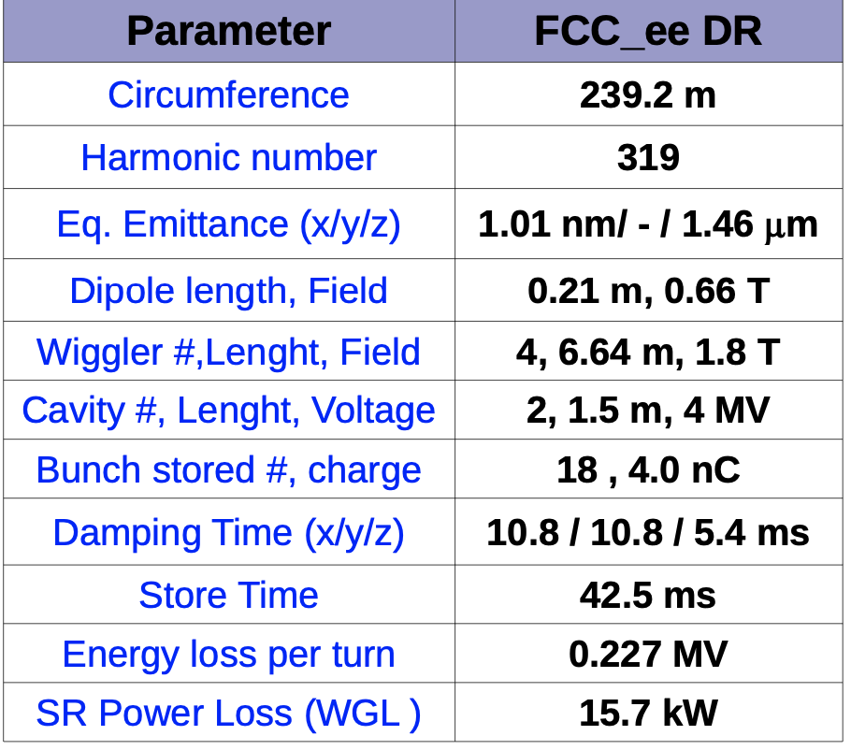
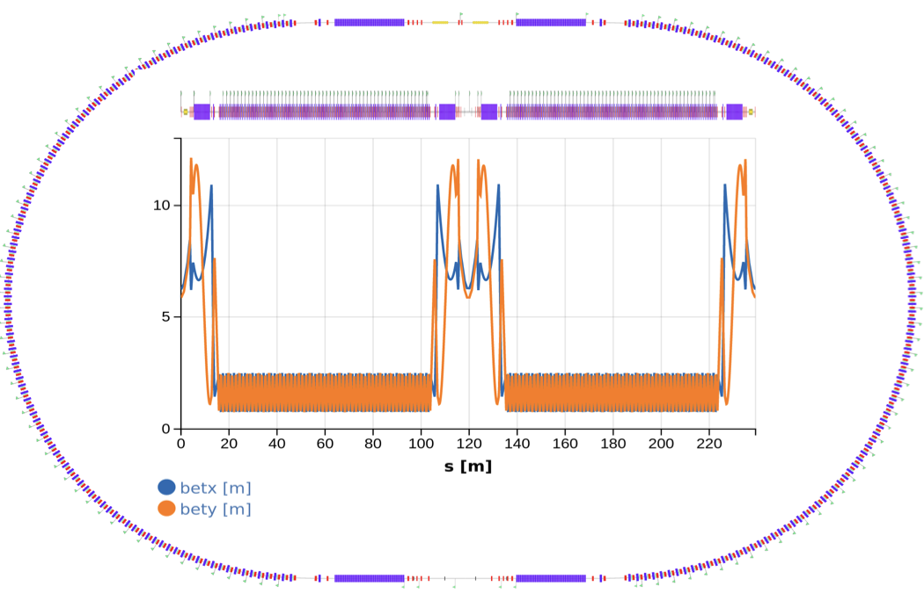
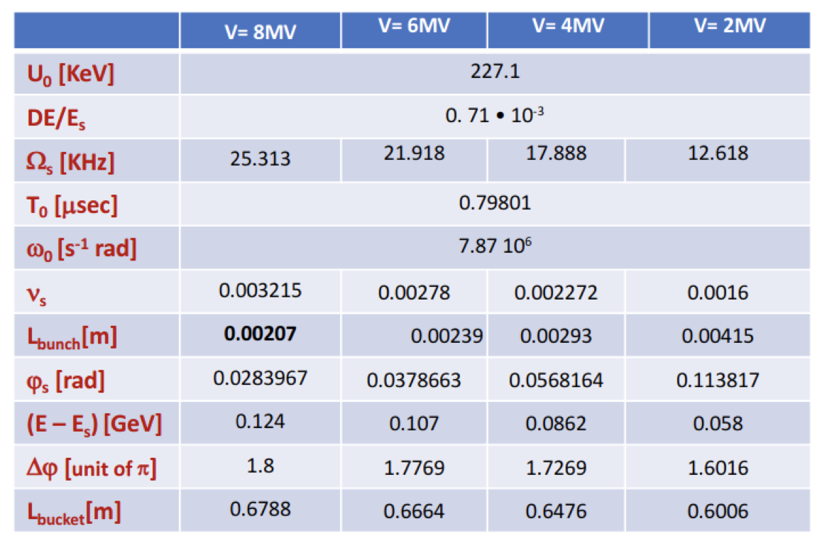
Damping Ring design studies
Studies of the DR dynamical aperture are in progress ➔ start-to-end simulations for the positron source
E = 1.54 GeV
2 wigglers each in straight sections
400 MHz LHC like 2 SC cavities
A. De Santis et al. (LNF)

Slide 18
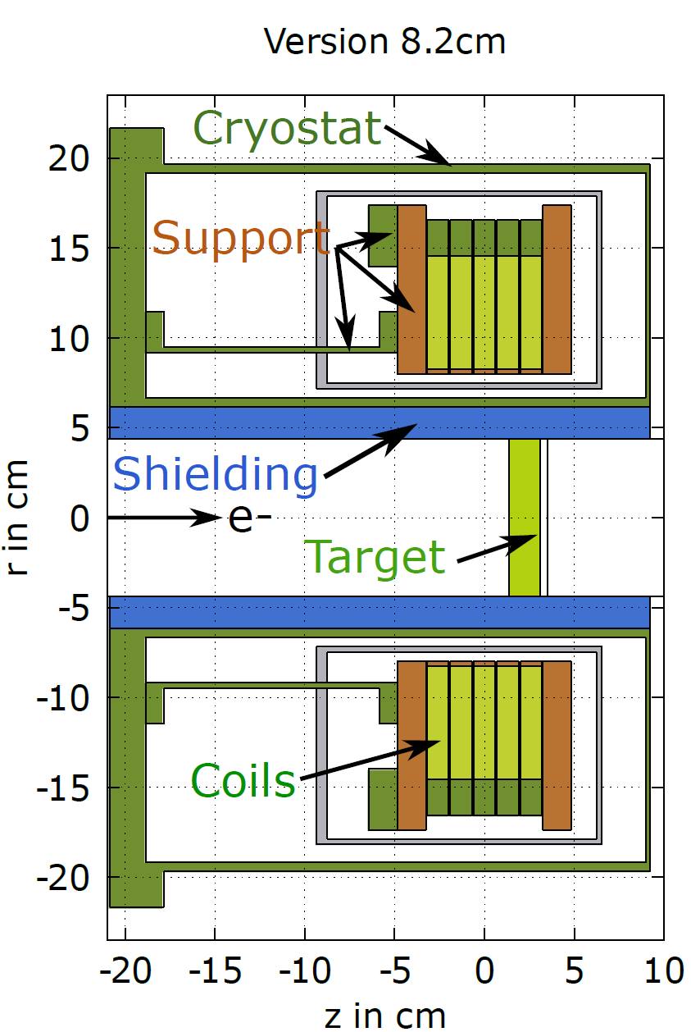
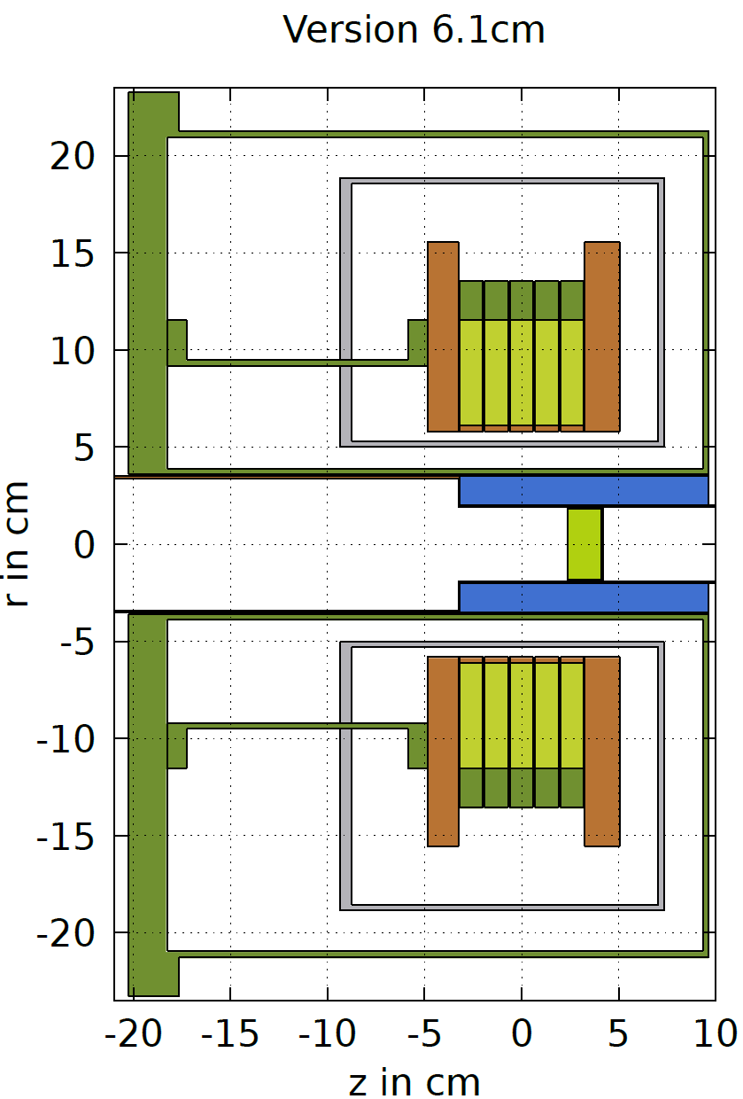
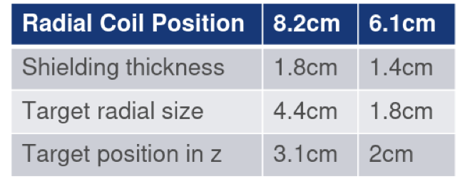
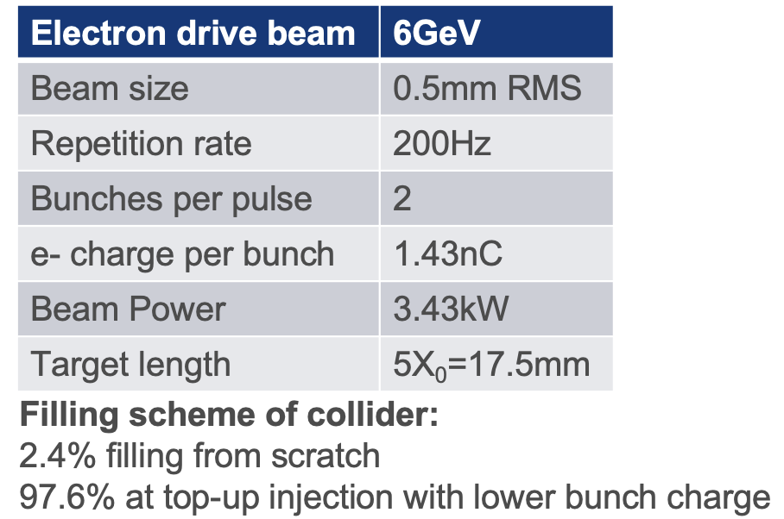
Radiation load studies for SC solenoid-based capture system
Larger vs smaller aperture
B. Humann, A. Lechner (CERN)
In the latest setup, the same cryostat aperture as for P³ experiment (geometry –V6) is assumed
For this option, two different longitudinal target positions are considered, reflecting the optimal position for S-band and L-band linacs
Z operation mode
400 bunches/s*3600s*24h*185 days*0.804 =
= 5.14x10⁹ bunches/year
The FLUKA model to be updated wrt to capture system –version 0

Slide 19
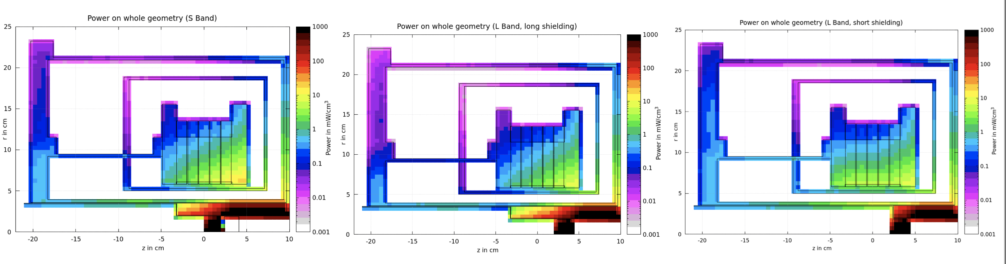
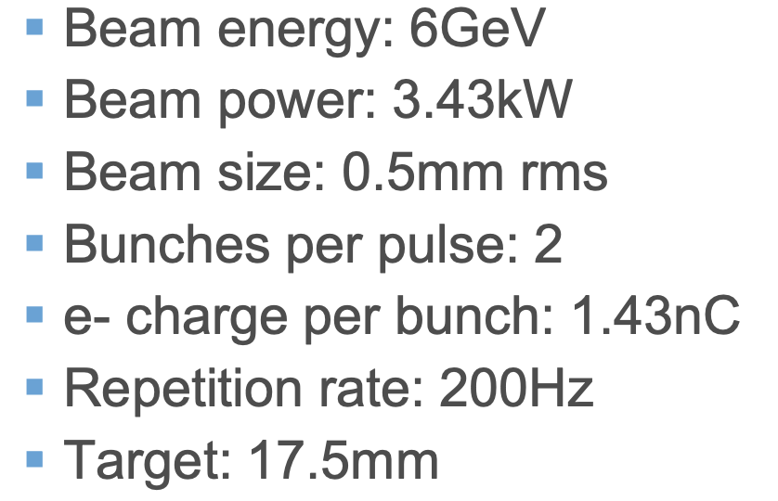
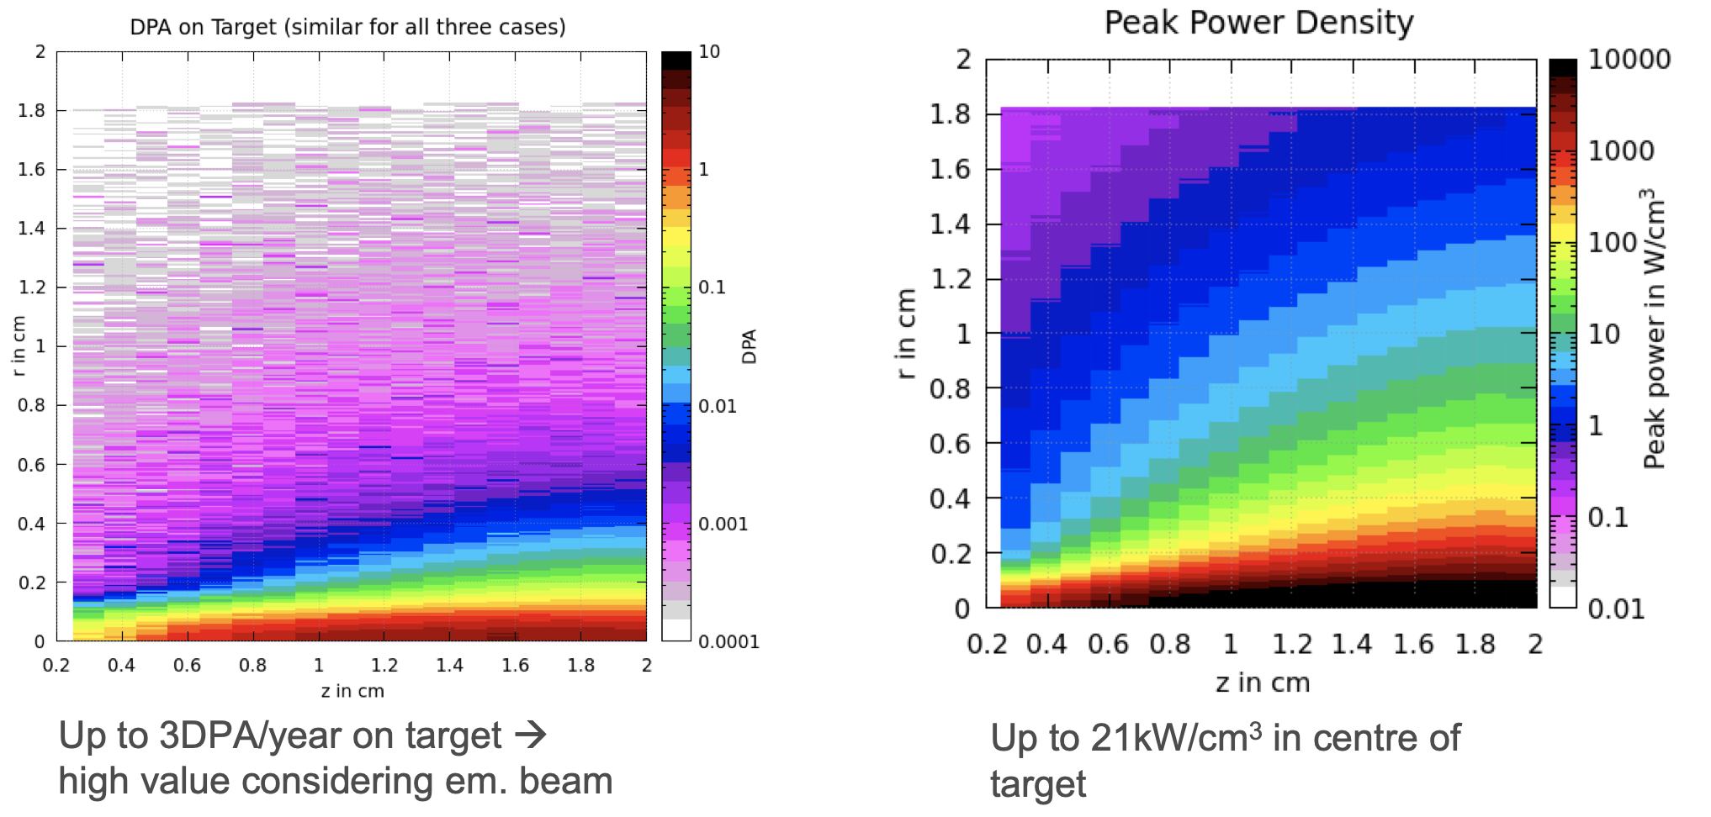
Radiation load studies for SC solenoid-based capture system
B. Humann, A. Lechner (CERN)
For a better estimate of the long-term dose need to establish the source operating conditions for higher collider energies (up to ttbar)!

Slide 20
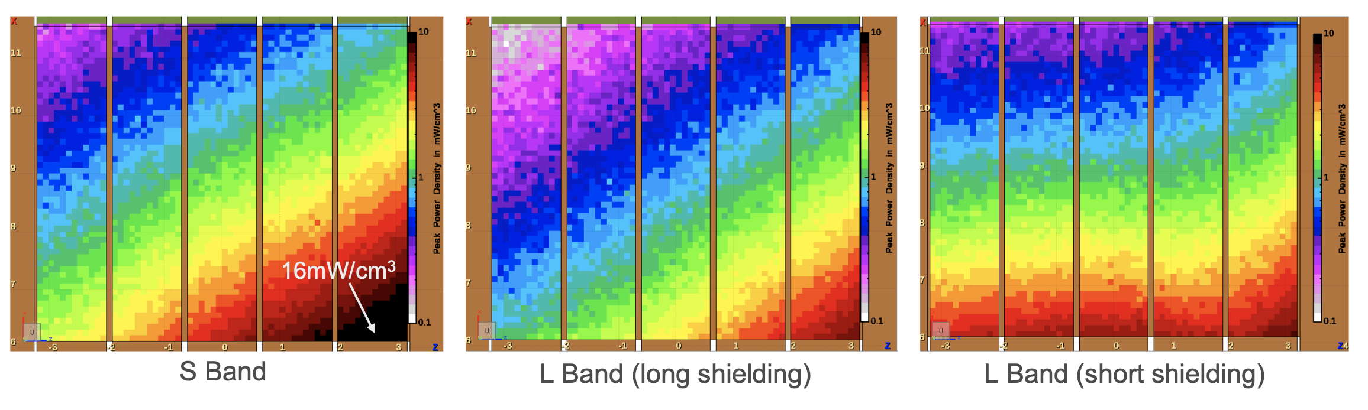
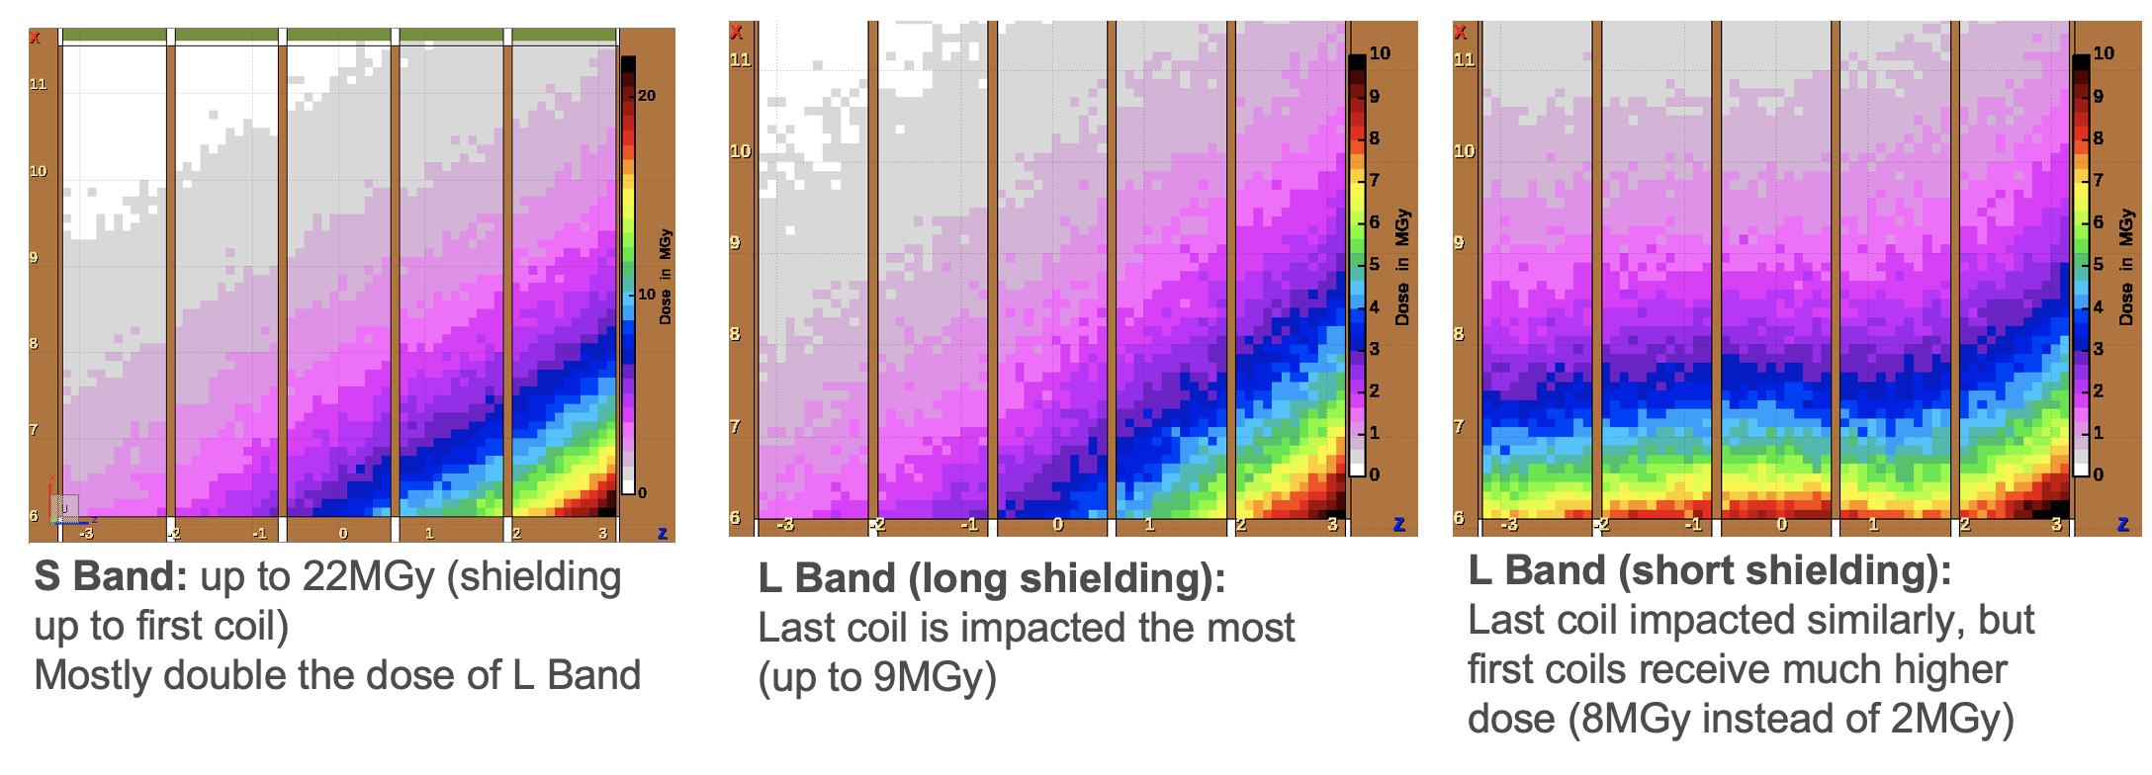
Radiation load studies for SC solenoid-based capture system
B. Humann, A. Lechner (CERN)
Peak Power Density seems OK
Peak Power Density on coils seems to be OK
DPA per year of Z operation on coils: Up to 1E-4 DPA per year => not negligible anymore
Ionizing dose on coils per year of Z operation: S Band: up to 22MGy, L Band (long shielding): up to 9MGy, L Band (short shielding): up to 8MGy => should consider full running time and compare/study wrt HTS limits.
Suggested shielding layout not sufficient ➜ try to make the in-bore shielding slightly thicker without compromising the yield OR/AND make the aperture slightly larger compared to P³
Dose seems to be limiting factor

Slide 21
Summary
In the new version of the FCC-ee pre-injector layout, the positrons are produced by E = 6 GeV, 2 bunches/ pulse at 200 Hz electron beam (cf. CDR injector layout with E = 4.46 GeV).
The studies on the FCC-ee positron source are well advanced : positron production, SC technology feasibility for matching device, capture linac (RF structures and solenoid). So far, no showstoppers found that prevent a SC solenoid matching device, studies ongoing.
e+ linac and DR designs are well-established and advanced. DR dynamic aperture to be optimized. DR filling schemes are under investigation.
Radiation load studies: FLUKA model update (if needed, increase shielding and also the aperture), energy deposition in RF structures (evaluation if mask is needed ).
Design of the target mechanical system in on the way.
A demonstrator for thee FCC-ee positron production and capture will be realized at SwissFEL facility at PSI.
Next deliverables (CHART and FCC FS): inputs for mid study costing exercise in summer 2023, final project cost update and feasibility study report in 2025

Slide 22
BACKUP

Slide 23
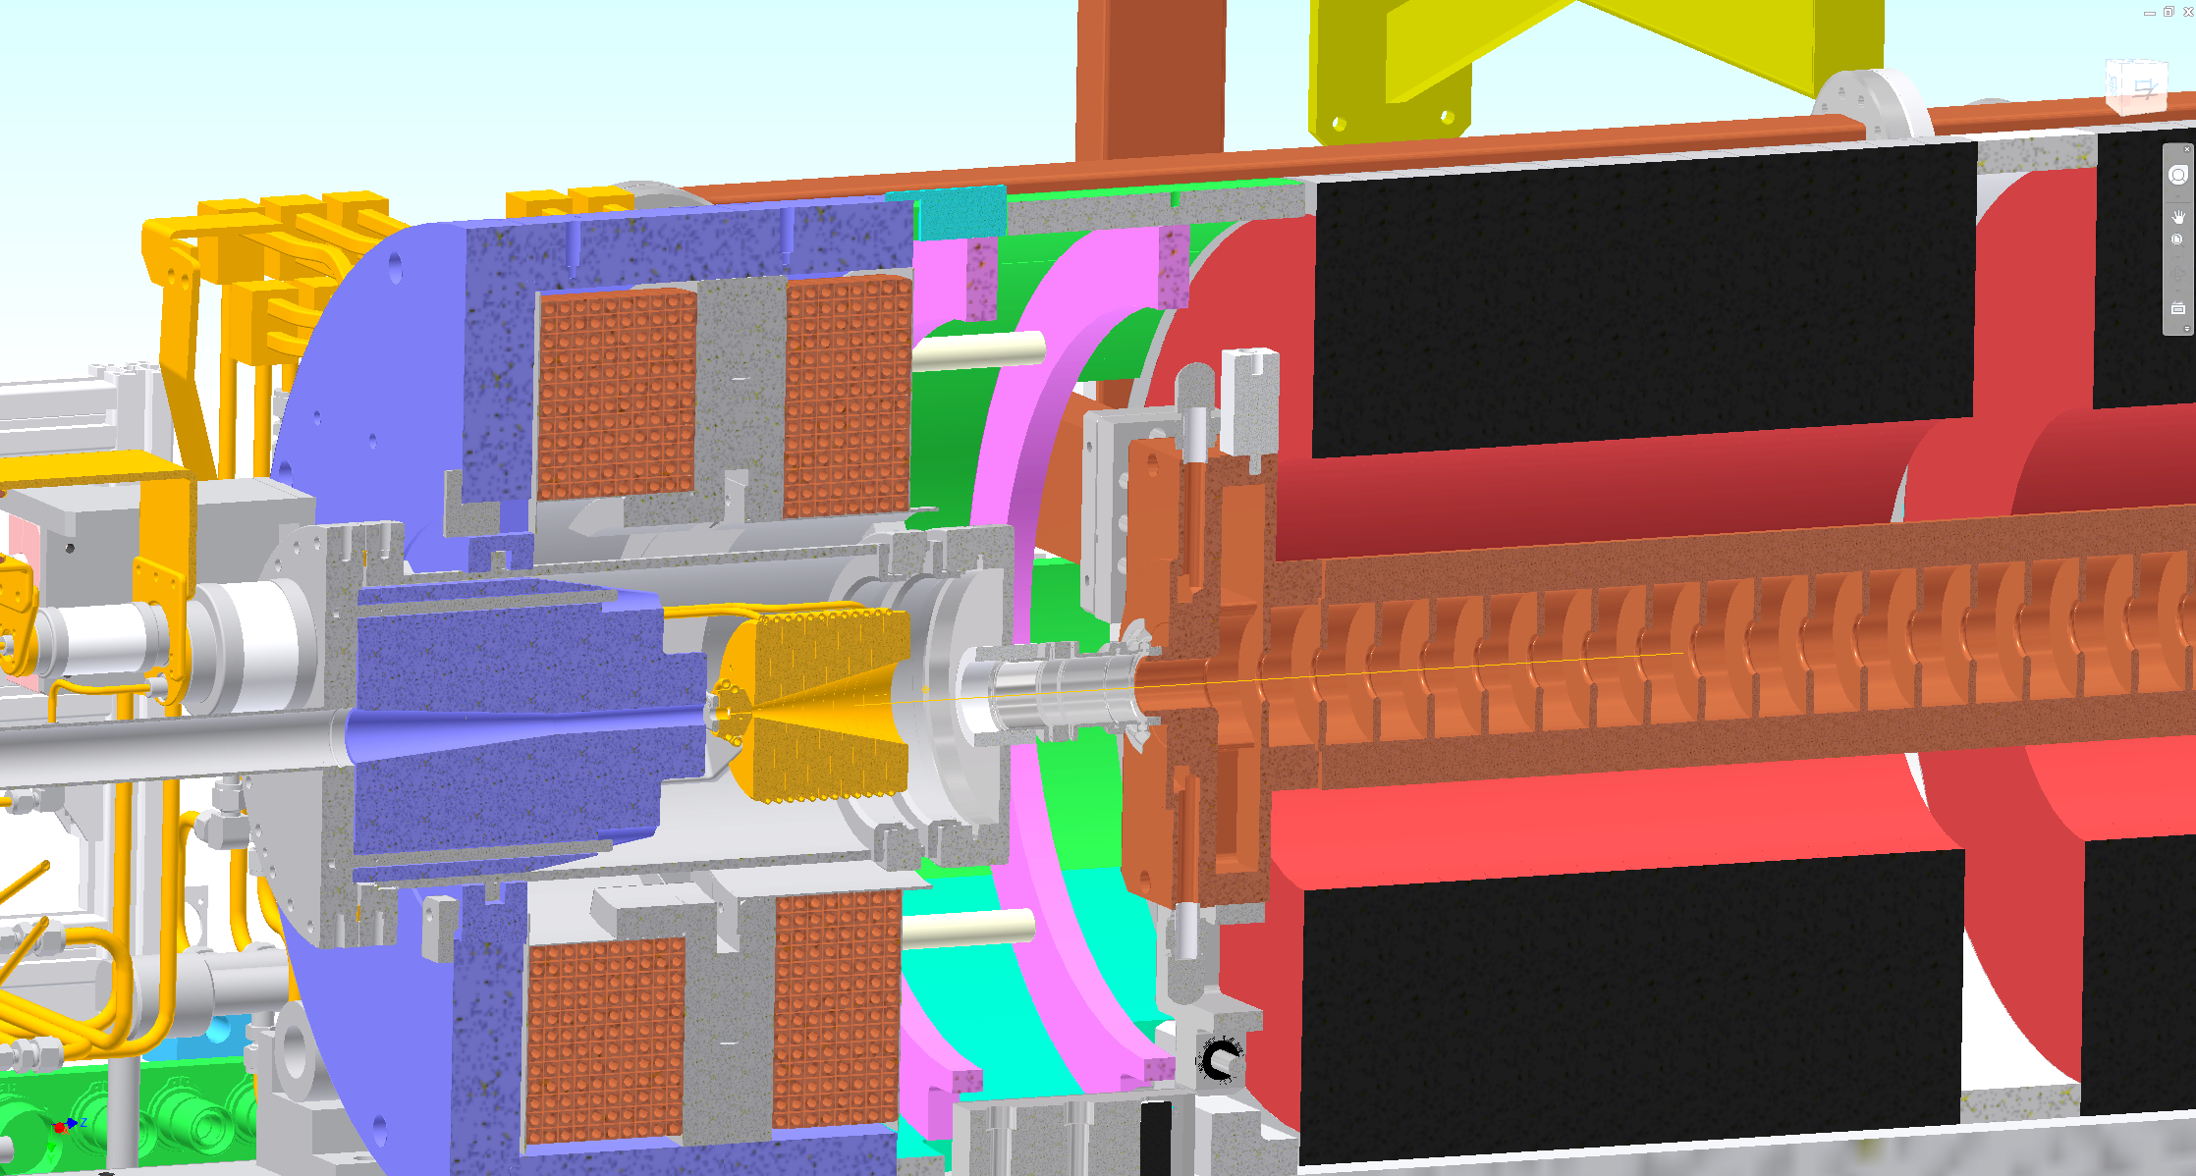
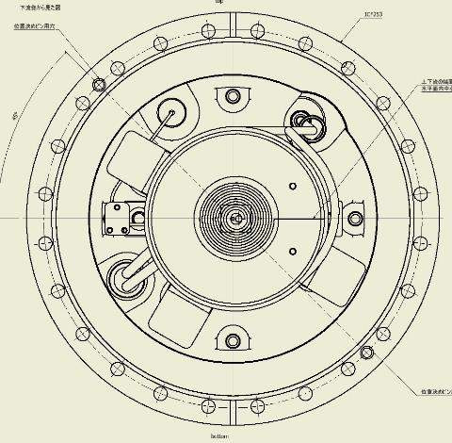
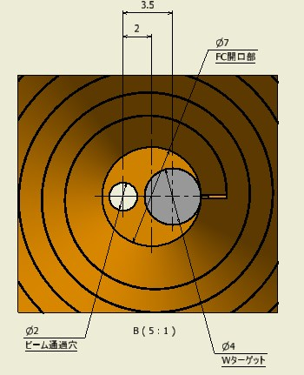
SuperKEKB Positron Source
Courtesy of Y. Enomoto (KEK)
BC (bridge coil)
LAS (large aperture S-band)
W target
FC(flux concentrator) head
solenoid
Target material : W
Target size : Φ4 x 14
Inserted in the pule Cu block
Connected by HIP process
looking from downstream side
hole
W

Slide 24
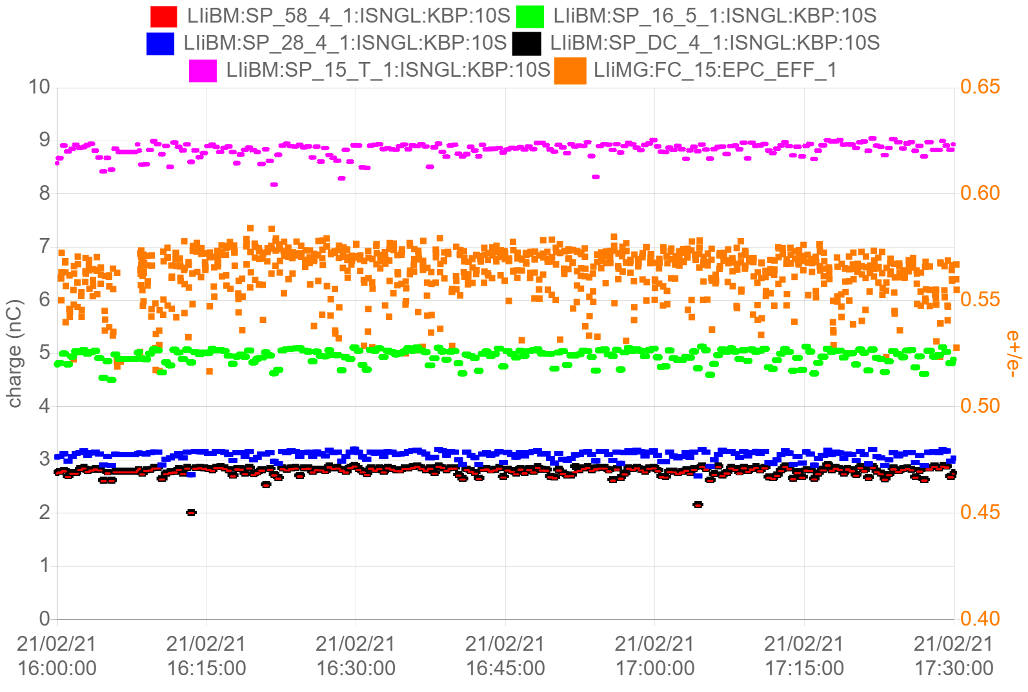
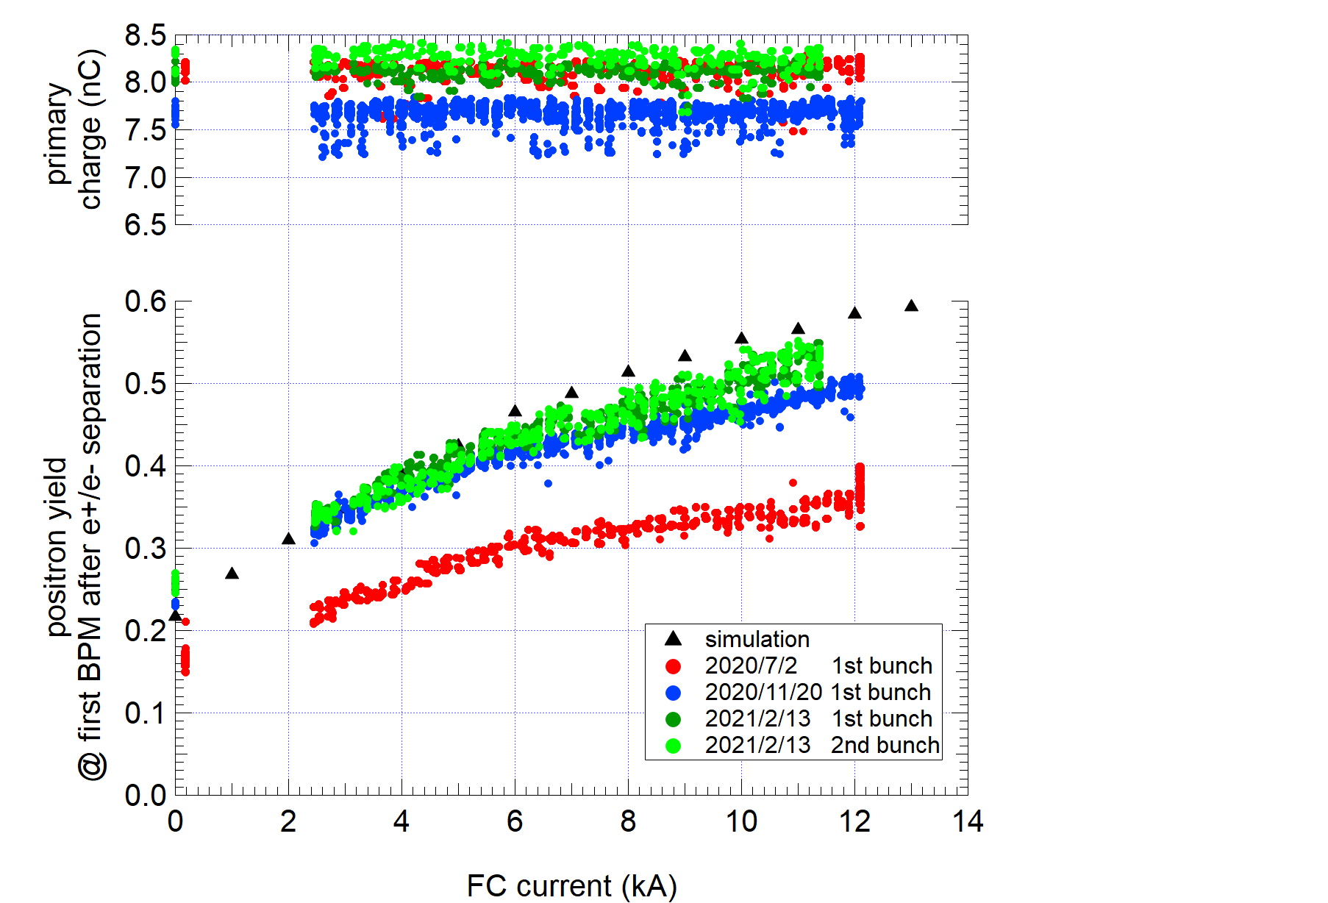
SuperKEKB Positron Source: Latest situation
Design (0.58)
Primary beam
  90% (9 nC / 10 nC)
Positron yield（e+/e-）
  100% (0.58 / 0.58)
transport
  Assuming 5.8 nC (design value) @ first BPM after the target and present transport efficiency, charge @ Linac end is expected to be 3.3 nC.
  There is still room for improvement
Primary electron
e+/e- design
Before DR
First BMP after target
After DR
Linac end
Present
Hardware upgrade
Before upgrade
(To avoid discharge,
FC current was limited very low)
Further beam tuning
 | design | 2020ab | 2020c | 2021a | 2021a (10 nC, 0.58)
Energy (e-) | 3.5 GeV | 3.5 GeV | 3.5 GeV | 3.5 GeV
primary charge (e-) | 10 nC | 8.4 nC | 8 nC | 9 nC
e+/e- | 0.58 | 0.24 | 0.51 | 0.58
e+ @ first BPM after the target | 5.8 nC | 2.0 nC | 4.1 nC | 5.1 nC | 5.8 nC (assume)
e+ @ before DR | - | 1.6 nC | 2.5 nC | 3.2 nC | 4.2 nC
e+ @ after DR | - | 1.4 nC | 2.1 nC | 2.9 nC | 3.3 nC
e+ @ Linac end | 4 nC | 1.4 nC | 2.1 nC | 2.9 nC | 3.3 nC
Courtesy of Y. Enomoto (KEK)

Slide 25
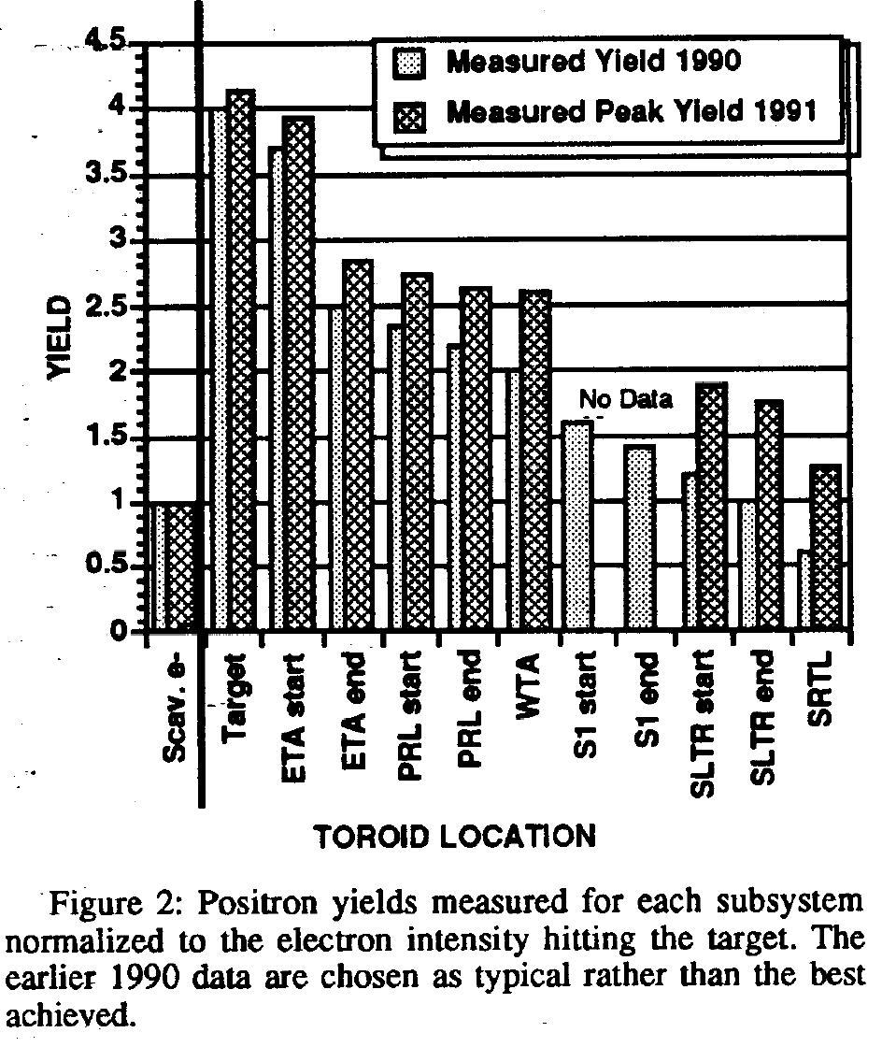

SLC Positron source
P. Krejcik, J. Corbett, S. Ecklund, P. Emma, T. Fieguth, R. Helm, A. Kulikov et al.
Recent improvements in the SLC positron system performance.
SLAC-PUB-5786; CONF-920315-3. SLAC, Menlo Park, CA (United States), 1992.

