Slide 1
Linear Colliders
Lecture 3
Subsystems II
Main Linac (cont.)
  RF system and technology
  Accelerating gradient
Beam / bunch structure
Beam Delivery System
Alignment and Stabilization

Slide 2
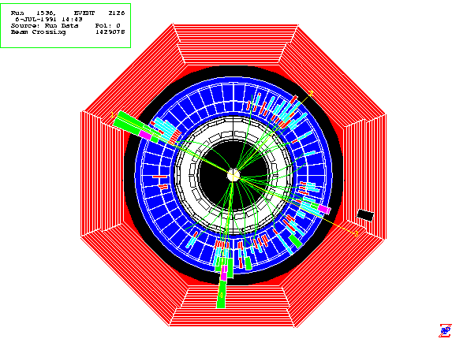
Previous Lecture
Particle production
Damping rings with
wiggler magnets
Bunch compressor
with magnetic chicane
small, short bunches
to be accelerated
w/o emittance blowup
Main linac:
  longitudinal wakefields => energy spread, chromatic effects
  Transverse wakefields, minimized by structure design
Now: Acceleration in the linac
Final Focus
Demagnify and collide beams
Main Linac
Accelerate beam to
IP energy without spoiling DR emittance
Bunch Compressor
Reduce σ_{z} to eliminate hourglass effect at IP
Damping Ring
Reduce transverse phase space (emittance) so smaller transverse IP size achievable
Electron Gun
Deliver stable beam current
Positron Target
Use electrons to pair-produce positrons

Slide 3
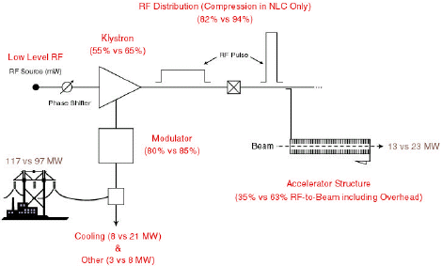
RF systems
Need efficient acceleration in main linac
4 primary components:
  Modulators: convert line AC → pulsed DC for klystrons
  Klystrons: convert DC → RF at given frequency
  RF distribution: transport RF power → accelerating structures
  evtl. RF pulse compression
  Accelerating structures: transfer RF power → beam
Chris Adolphsen

Slide 4
RF systems
Klystron
Modulator
U 150 -500 kV
I 100 -500 A
f 0.2 -20 GHz
P_{ave} < 1.5 MW
P_{peak} < 150 MW
efficiency 40-70%
Energy storage in capacitors
charged up to 20-50 kV (between pulses)
High voltage switching and
voltage transformer
rise time > 300 ns
Or solid state device
=> for power efficient operation
pulse length t_{P} >> 300 ns favourable

Slide 5
Klystrons
narrow-band vacuum-tube amplifier at microwave frequencies (an electron-beam device).
low-power signal at the design frequency excites input cavity
Velocity modulation becomes time modulation in the drift tube
Bunched beam excites output cavity
Collector
Electron Gun
Drift Tube
Input Cavity
Output Cavity

Slide 6
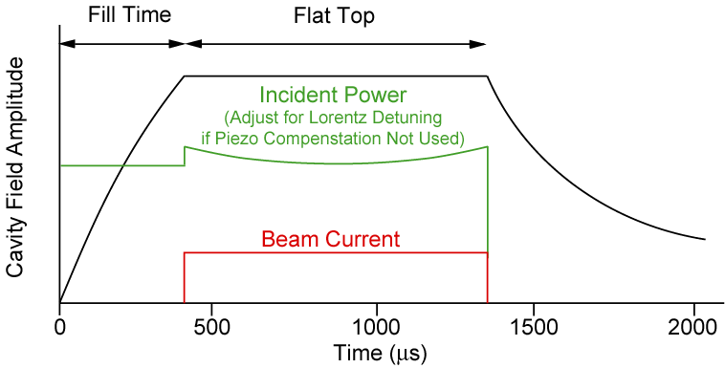
RF efficiency: cavities
SW
Fields established after cavity fill time
Only then the beam pulse can start
Steady state: power to
beam, cavity losses, and (for TW) output coupler
Efficiency:
NC TW cavities have smaller fill time T_{fill}
≈ 1 for SC SW cavities

Slide 7
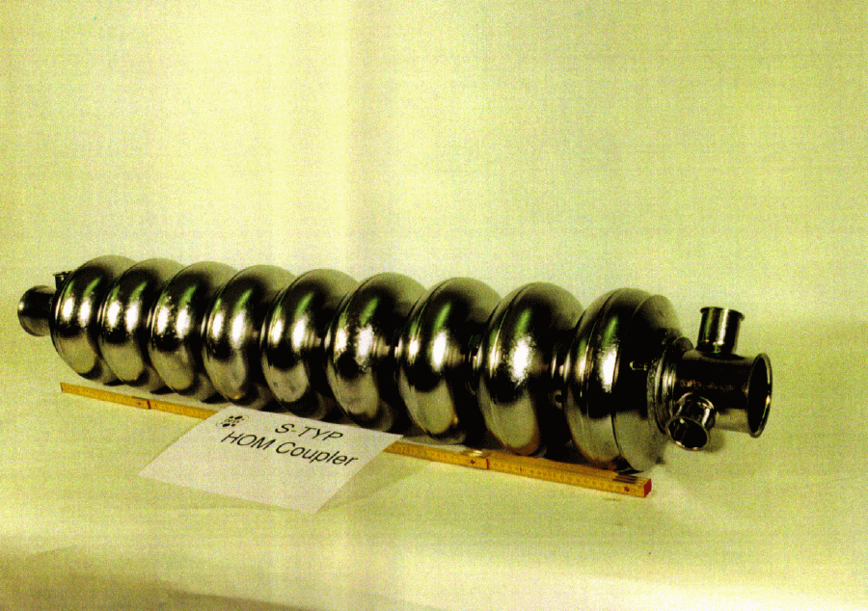
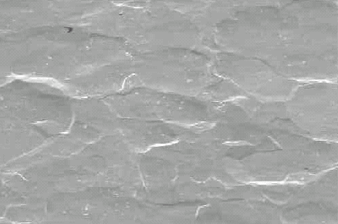
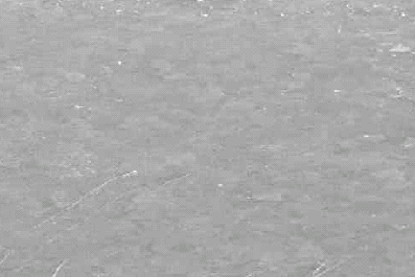
SC Technology
In the past, SC gradient typically 5 MV/m
and expensive cryogenic equipment
TESLA development: new material specs,
new cleaning and fabrication techniques,
new processing techniques
Significant cost reduction
Gradient substantially increased
Electropolishing technique has reached ~35 MV/m in 9-cell cavities
31.5 MV/m ILC
baseline
  limited by critical
  magnetic field H_{crit}
  above which no
  superconductivity exists
=>
Chemical polish
Electropolishing

Slide 8
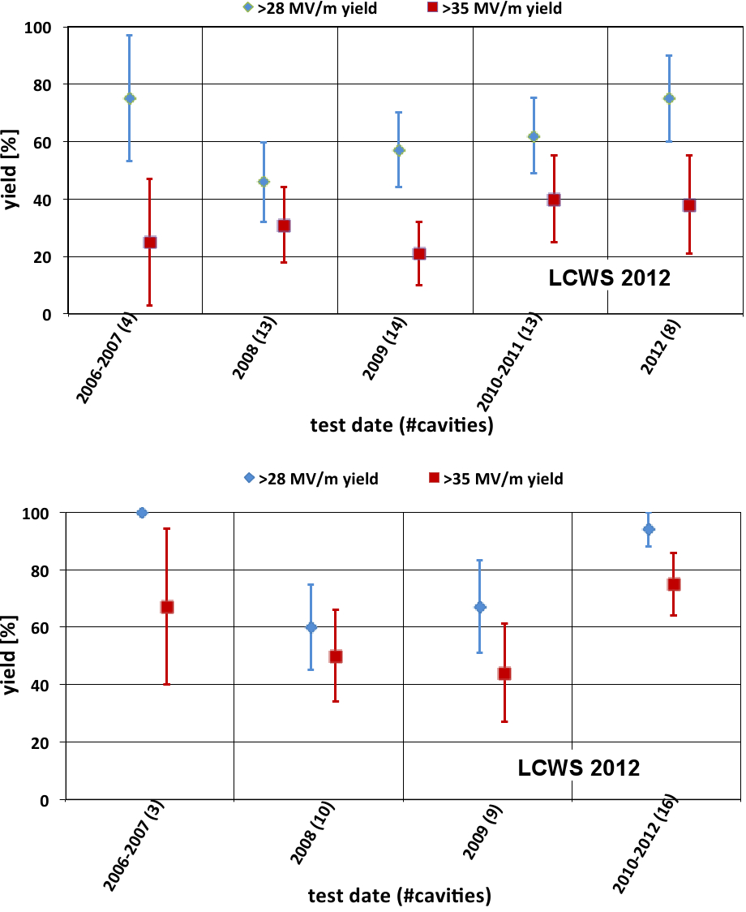
Achieved SC accelerating gradients
Large progress by R&D program to systematically understand and set procedures for the production process
reached goal for a 50% yield at 35 MV/m by the end of 2010
90% yield at 28 MV/m exceeded in 2012
Tests for higher gradient ongoing
  limited certainly below
  50 MV/m (H_{crit})
  X-FEL running with 23.6 MV/m
1st pass
2nd pass

Slide 9
Limitations of Gradient E_{acc}
Surface magnetic field
  SC structures become normal conducting above H_{crit}
  NC: Pulsed surface heating => material fatigue => cracks
Field emission due to surface electric field
  Vacuum arcs - RF break downs
  Break down rate => Operation efficiency
  Local plasma triggered by field emission => Erosion of surface
  Dark current capture
  => Efficiency reduction, activation, detector backgrounds
RF power flow
  RF power flow and/or iris aperture apparently have a strong impact on
  achievable E_{acc} and on surface erosion. Mechanism not fully understood

Slide 10
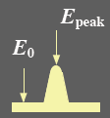
NC Structure conditioning
Material surface has some intrinsic roughness (from machining)
Leads to field enhancement
β field enhancement factor
Need conditioning to reach ultimate gradient
RF power gradually increased with time
RF processing can melt
field emission points
  Surface becomes smoother
  field enhancement reduced
  => higher fields
  less breakdowns
More energy: Molten surface
splatters and generates new
field emission points!
Excessive fields can also damage
the structures
from S.Doebert

Slide 11
Breakdown-rate vs gradient
Strong increase of breakdown rate for higher gradient
C. Adolphsen /SLAC

Slide 12
Breakdown-rate vs pulse length
Higher breakdown rate for longer RF pulses
10
1
10
0
Breakdown rate
10
-1
SLAC 70 MV/m
-2
SLAC 65 MV/m
10
SLAC 60 MV/m
KEK 65 MV/m
-3
exp. fit
10
100
200
300
400
500
600
700
800
900
Pulse length (ns)
Summary: breakdown rate limits pulse length and gradient

Slide 13
Accelerating gradient
Normal conducting cavities have
higher gradient with shorter RF pulse length
Superconducting cavities have
lower gradient
(fundamental limit) with long RF pulse
WARM
SC

Slide 14
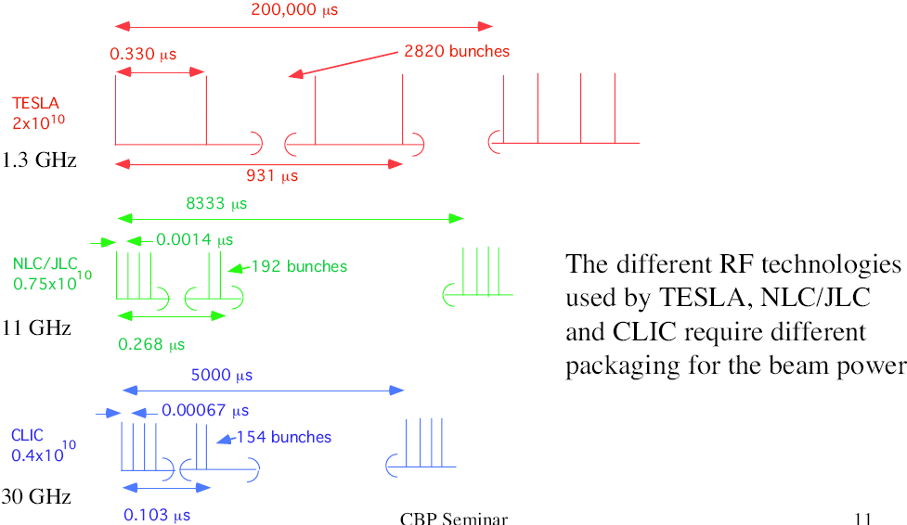
Bunch structure
SC allows long pulse, NC needs short pulse with smaller bunch charge
0.370
2625
ILC
970
ILC
20000
0.0005
312
0.37
12
0.156

Slide 15
Beam Delivery: Final Focus
f₁
f₂ (=L*)
Need large demagnification of the (mainly vertical) beam size
β_{y}* of the order of the bunch length σ_{z} (hour-glass effect)
Need free space around the IP for physics detector
Assume f₂ = 2 m => f₁ ≈ 600 m
Can make shorter design but this roughly sets the length scale

Slide 16
Final Focus: chromaticity
Need strong quadrupole magnets for the final doublet
Typically hundreds of Tesla/m
Get strong chromatic aberations
for a thin-lens of length l:
change in deflection:
change in IP position:
RMS spot size:

Slide 17
Final focus: Chromaticity
Small β* => β_{FD} very large (~ 100 km)
for δ_{rms} ~ 0.3%
Definitely much too large
We need to correct chromatic effects
=> introduce sextupole magnets
Use dispersion D:

Slide 18
Chromaticity correction
Combine quadrupole with sextupole and dispersion
sextup.
quad
x + Dδ
y plane straightforward
x plane more tricky
IP
Second order
dispersion
K_{S}
K_{F}
Quad:
Could require K_{S} = K_{F}/D
=> ½ of second order dispersion left
chromaticity
Sextupole:
Create as much chromaticity as FD upstream
=> second order dispersion corrected

Slide 19
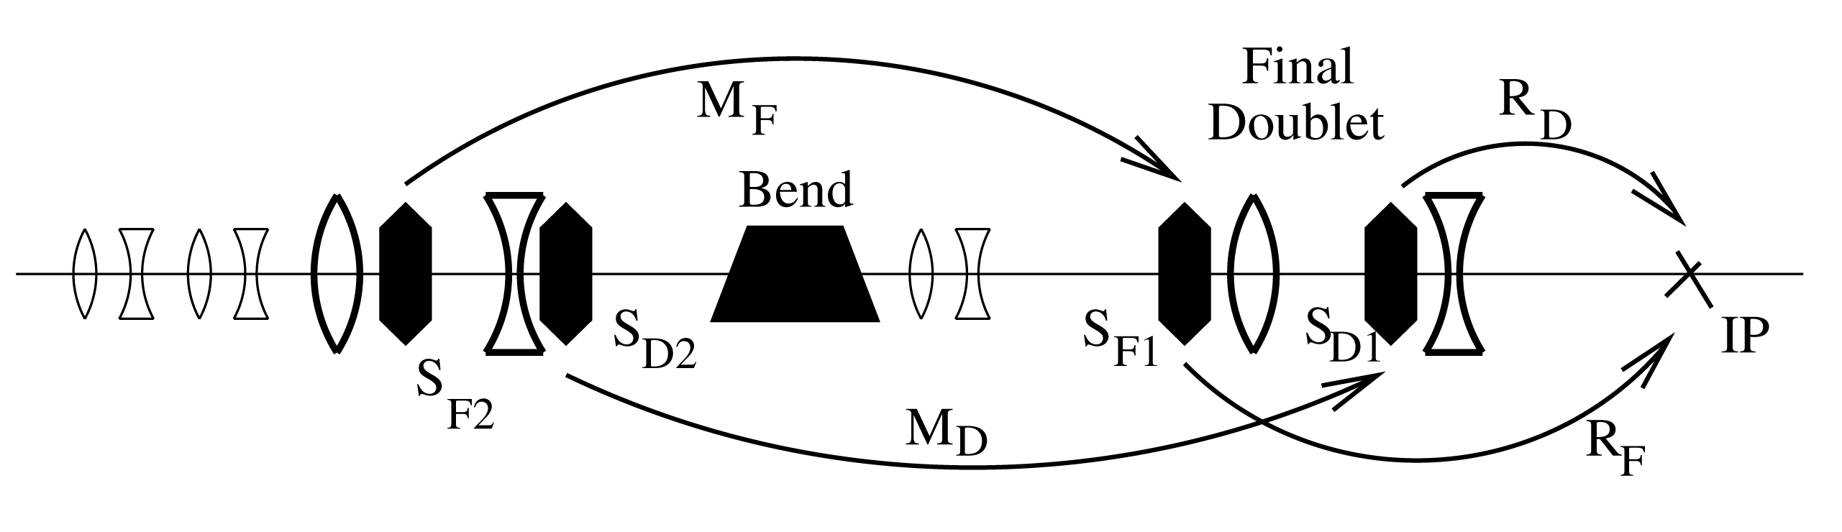
Final Focus: Chromatic Correction
Correction in both planes
Relatively short (few 100 m)
Local chromaticity correction
High bandwidth
(energy acceptance)
FF tested at ATF2 (KEK Japan)
  44 nm achieved (37 nm design)
  scales to 6 nm at ILC (5 nm)
“2001 Report on the Next Linear Collider”, SLAC-R-0571

Slide 20
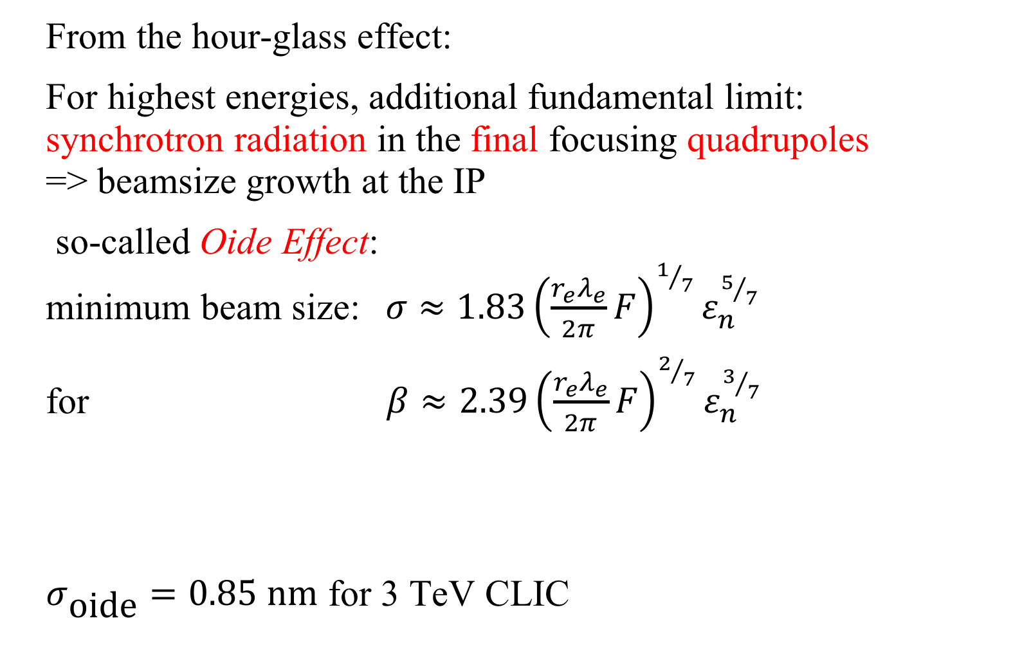
Final focus: fundamental limits
From the hour-glass effect:
For highest energies, additional fundamental limit:
synchrotron radiation in the final focusing quadrupoles
=> beamsize growth at the IP
so-called Oide Effect:
minimum beam size:$σ≈1.83{\left(\frac{r_{e}λ_{e}}{2π}F\right)}^{1/7}ε_{n}^{5/7}$
for $β≈2.39{\left(\frac{r_{e}λ_{e}}{2π}F\right)}^{2/7}ε_{n}^{3/7}$
$σ_{\text{oide}}=0.85 \text{nm}$ for 3 TeV CLIC
λ_{e} is the Compton wavelength of the electron
F is a function of the focusing optics: typically F ~ 7 (minimum value ~0.1)

Slide 21
Stability and Alignment
Tiny emittance beams, nm vertical beam size at collision
Any quadrupole misalignment and jitter will cause orbit oscillations and displacement at the IP
=> Tight component tolerances
  Field quality
  Alignment
Vibration and Ground
Motion issues
Active stabilisation
Feedback systems
Demonstrate Luminosity performance in presence of motion
Some numbers (CLIC):
  Cavity alignment (RMS) 17 µm
  Main Beam quad alignment: 14 µm
  vert. MB quad stability: 1.5 nm @>1 Hz
  hor. MB quad stability: 5 nm @>1 Hz
  Final quadrupole: 0.15 nm @>4 Hz !!!

Slide 22
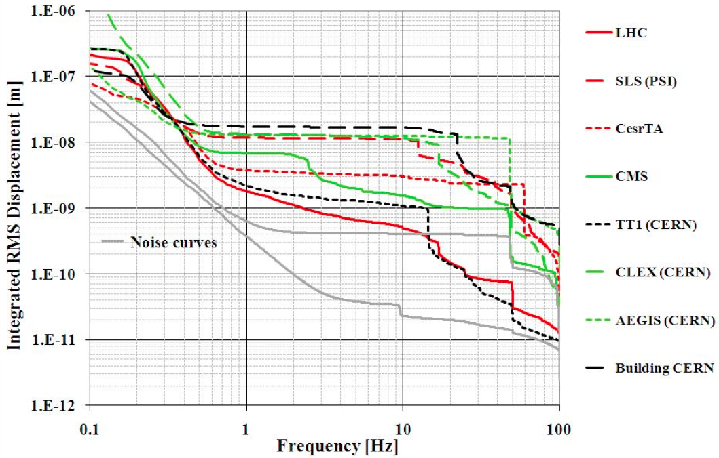
Ground Motion
Site dependent ground motion with decreasing amplitude for higher frequencies

Slide 23
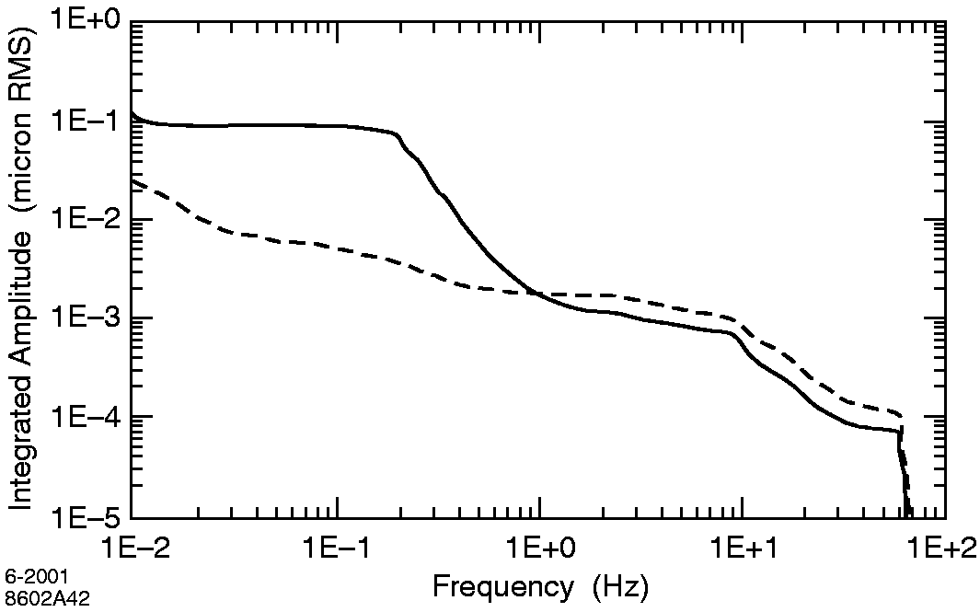
Ground motion: ATL law
Need to consider short and long term stability of the collider
Ground motion model: ATL law
This allows you to simulate
ground motion effects
Relative motion smaller
Long range motion less
disturbing
Absolute motion
Relative motion
over dL=100 m
1nm

Slide 24
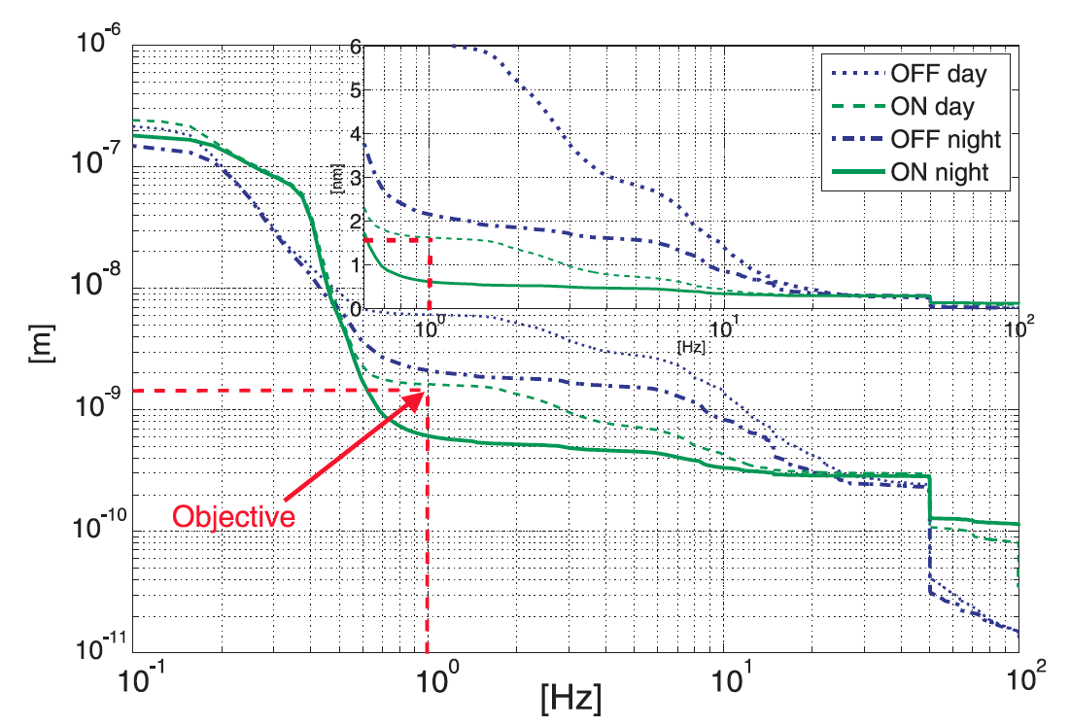
Active stabilization
Test bench reaches required stability of CLIC MB quadrupole

Slide 25
Beam-Beam feedback
Use the strong beam-beam deflection kick for keeping beams in collision
Sub-nm offsets at IP cause well detectable offsets (micron scale) a few meters downstream

Slide 26
Other IP issues
Collimation:
    Beam halo will create background in detector
    Collimation section to eliminate off-energy and off-orbit particle
    Material and wakefield issues
Crossing angle:
    NC small bunch spacing requires crossing angle at IP to avoid parasitic beam-beam deflections
    Luminosity loss (≈10% when θ = σ_{x}/σ_{z} )
Crab cavities
    Introduce additional time dependent transverse kick to improve collision
Spent beam
    Large energy spread after collision
    Design for spent beam line not easy

Slide 27
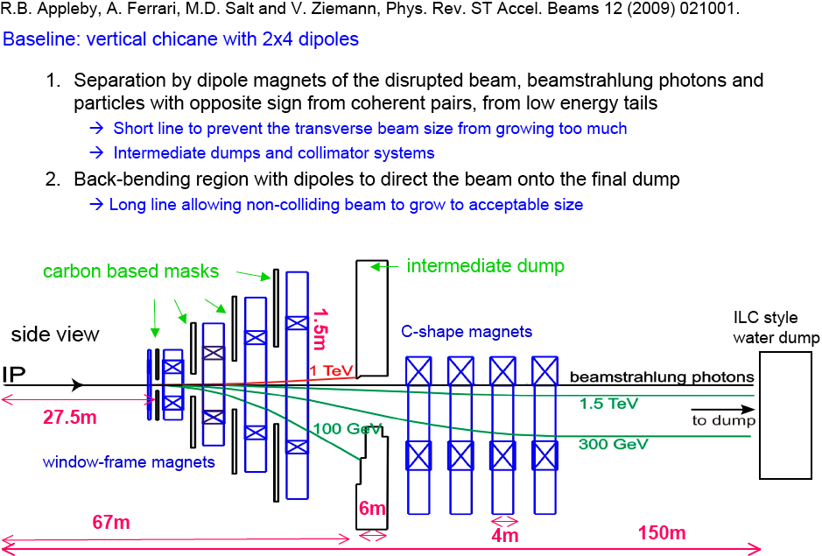
Post-Collision Line (CLIC)

