Slide 1
HL-LHC Project
Introduction, Configuration and Tools
Hector Garcia Gavela
Procurement, Quality and Risk Officer
On behalf of the HL-LHC Project Office
15.12.2022 - Meeting CERN – TRIUMF

Slide 2
Outline
HL-LHC Project Introduction
HL-LHC Quality Plan
MTF / EAM for HL-LHC
Summary

Slide 3
Outline
HL-LHC Project Introduction
HL-LHC Quality Plan
MTF / EAM for HL-LHC
Summary

Slide 4
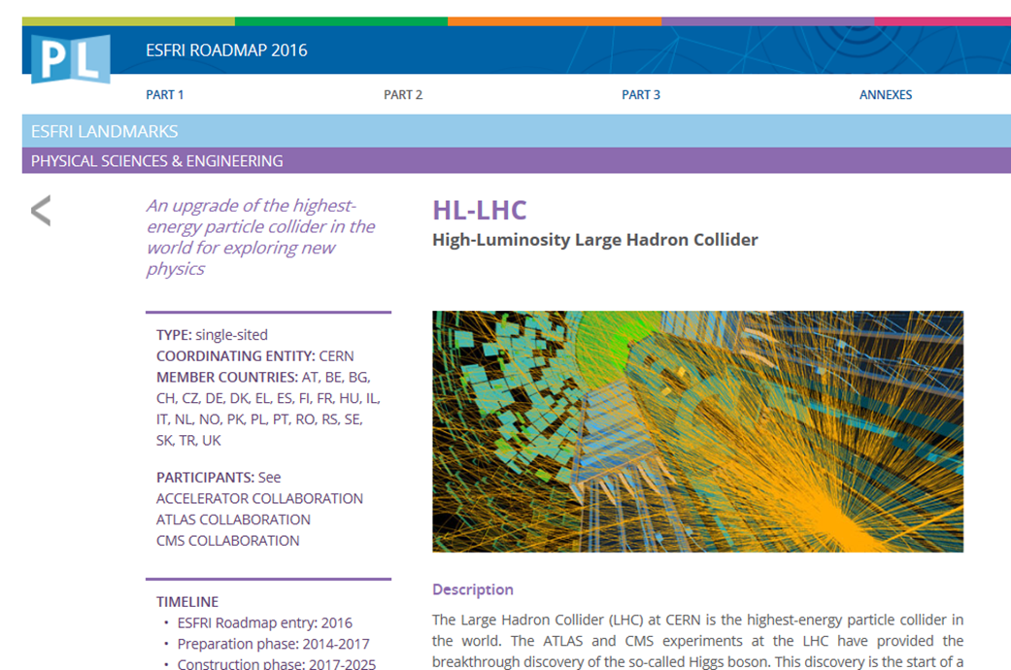

HL-LHC
2010 : High Luminosity LHC Design Study established & application for EU funds
2011: approval and start of the EU co-funded FP7-HiLumi LHC Design Study with 20 Institutions
2013: Approval by EU HEP strategy of HiLumi as main project for the next decade; Kick off meeting in Daresbury of HL-LHC as construction project; P5 subpanel (USA) also put HL-LHC as next main project
2015: 1st C&S Review 1, end of the FP7-Design Study and insertion of the full funding profile in the CERN budget till 2026 (approved formally till 2020);
2015 Oct : end of FP7 design phase issue of first TDR-V0
2016 (June Council): formal approval of the entire HL-LHC project; HL-LHC declared an ESFRI landmark (European Strategy Forum on Research Infrastructures)

Slide 5
Goal of HL-LHC
From EC-FP7 HiLumi LHC Design Study application of 2010
The main objective of HiLumi LHC Design Study is to determine a hardware configuration and a set of beam parameters that will allow the LHC to reach the following targets:
A peak luminosity of L_{peak} = 5×10³⁴ cm⁻²s⁻¹ with levelling, allowing:
An integrated luminosity of 250 fb⁻¹ per year, enabling the goal of L_{int} = 3000 fb⁻¹ twelve years after the upgrade.
This luminosity is more than ten times the luminosity reach of the first 10 years of the LHC lifetime.
Ultimate performance established 2015-2016: with same hardware
and same beam parameters: use of engineering margins:
L_{peak ult} ≅ 7.5 10³⁴ cm⁻²s⁻¹ and Ultimate Integrated L_{int ult} ∼ 4000 fb⁻¹

Slide 6
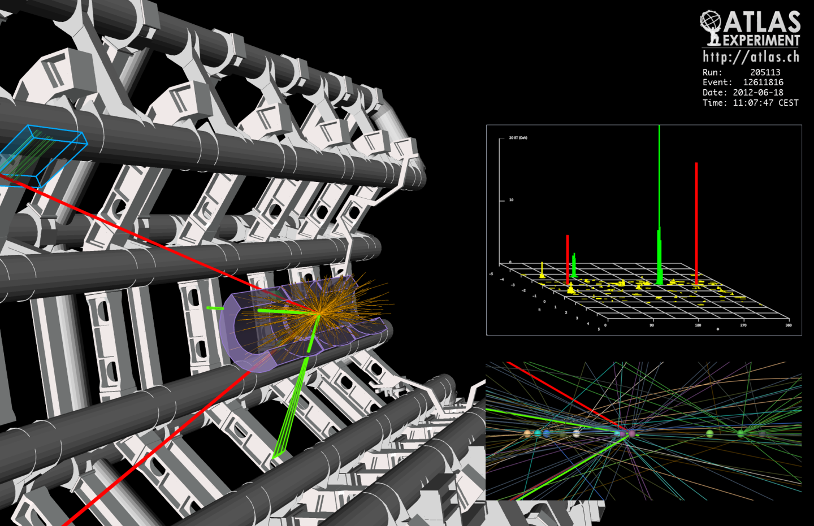
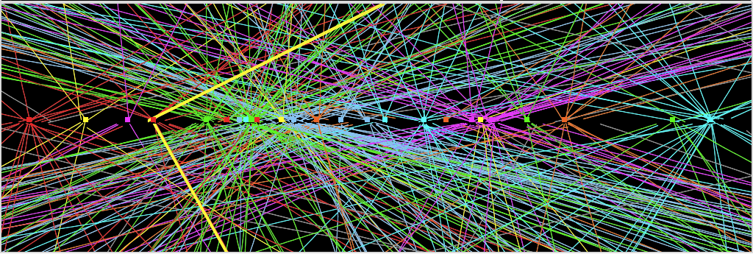
More luminosity
⇒ increased collision rate
Higgs: the needle in the haystack
Picture repeated 40 millions times each second
Z→ μμ
Z→ μμ event from 2012 data with 25 reconstructed vertices

Slide 7
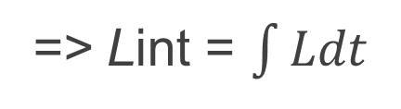
Goal of High Luminosity LHC (HL-LHC) as fixed in November 2010
=> Lint = $\int{Ldt }$
  1) maximize number of bunches n_{b}
  2) maximize bunch intensities
  per beam N₁ and N₂
  3) minimize the beam emittance ε
4) minimize beta function at IP, β*;
5) compensate for ‘F’;
6) Improve machine ‘availability’
2808 bunches; 25ns (7.5 m)
Injector complex
LIU project
  Triplet strength and magnet aperture
Courtesy: L. Rossi
Crab Cavities
minimize number and length
of faults (MTBF and MTTR)

Slide 8
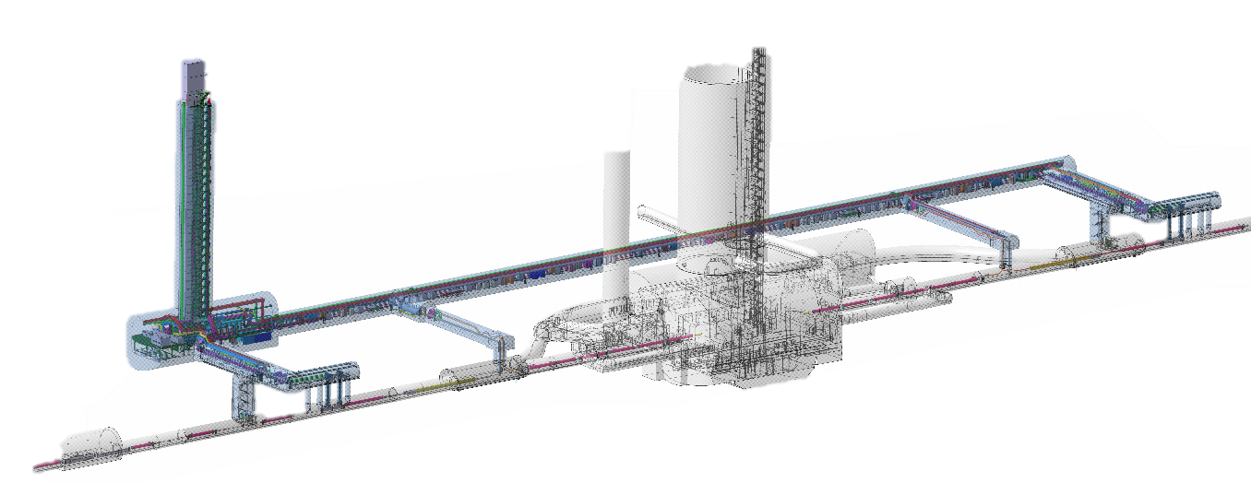
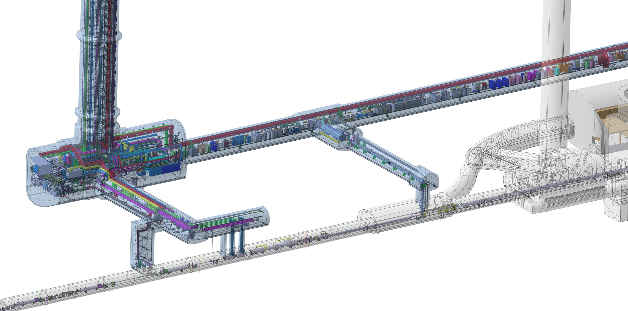
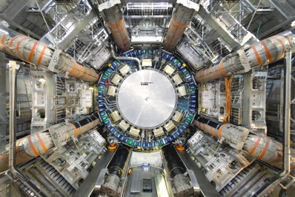
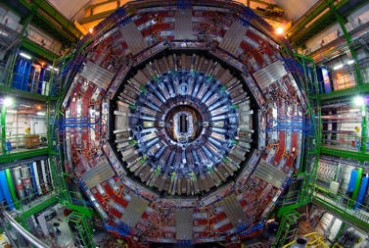
HL-LHC Scope in 1R and 5R
QDS
UR55
Warm Diodes
CLIQ
PIC,BIS
CDBs
OC EE
Valve box
DFHX
D2 OC PCs
DFHM
US57
D2 PC
D1 PC
OC PCs
UW57
PC IT
PCs IT Trims
CDBs
DSHX
D2 OC EE
UL57
Cold box
DSHM
UA57
D1
CP
Q3
Q2B
Q2A
Q1
RF Powering
DFM
DCM
Cooling and Ventilation
DFX
UPR57
Cold Diodes
TAXN
D2
DQHDS
Crab
Cavities
M. Modena and M. Mendes
Q4
Q5
Q6

Slide 9
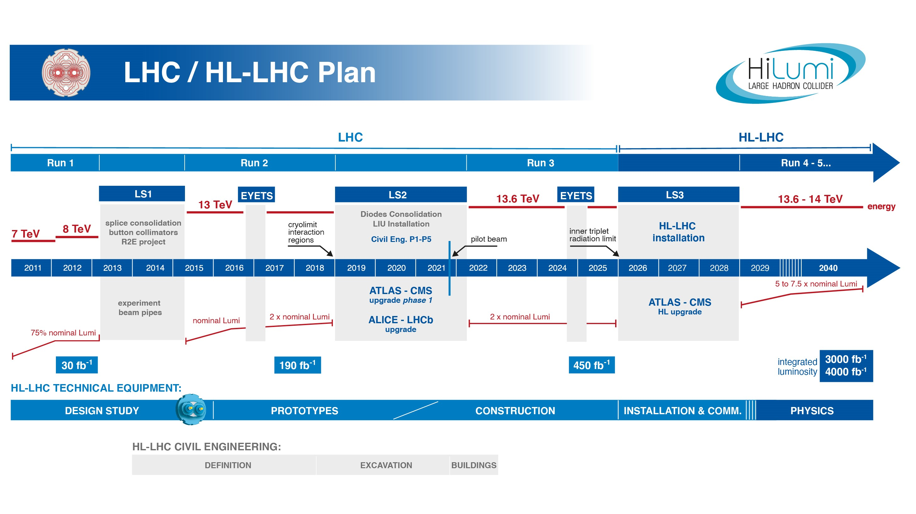
EU funded HiLumi
Design Study
Approval of
HL-LHC Project
We are here
HL-LHC Operation
Run3 operation
Half Way!
6 years since project approval
6 years until end LS3
Transition from Prototype development to
Series production is well underway!

Slide 10
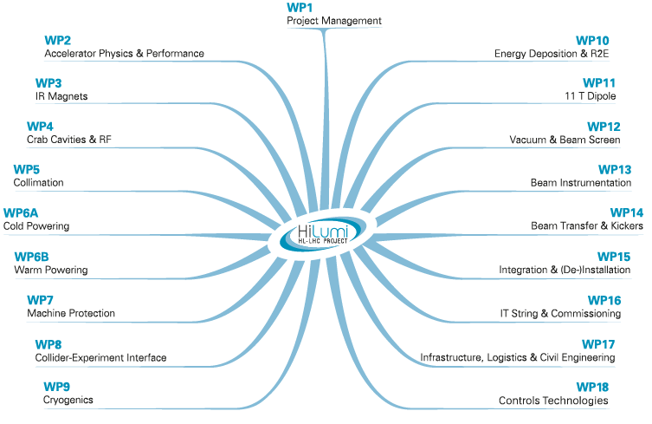
HL-LHC WP Structure
Major upgrade of the iconic LHC machine (mainly but not only at IR1 and IR5)
All core technologies and domains of CERN are well represented within the Project via the different WPs (Project organization different as the Organic Units)

Slide 11
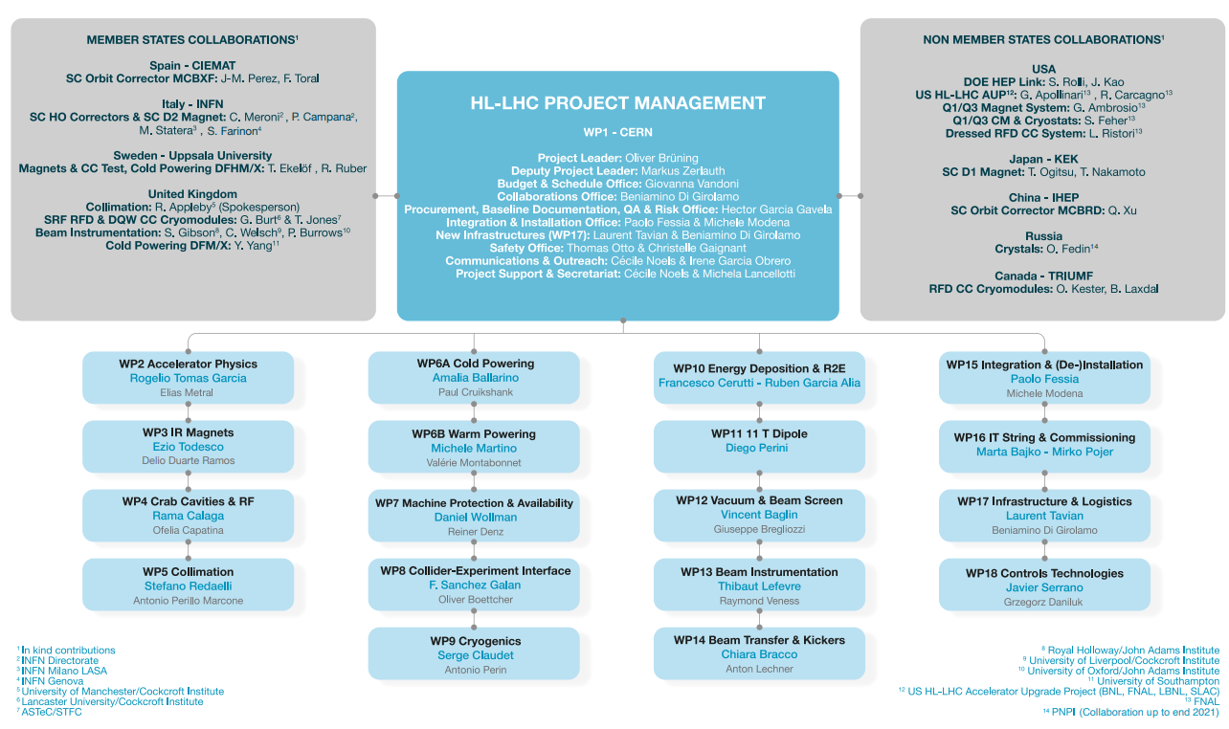
Project Structure

Slide 12
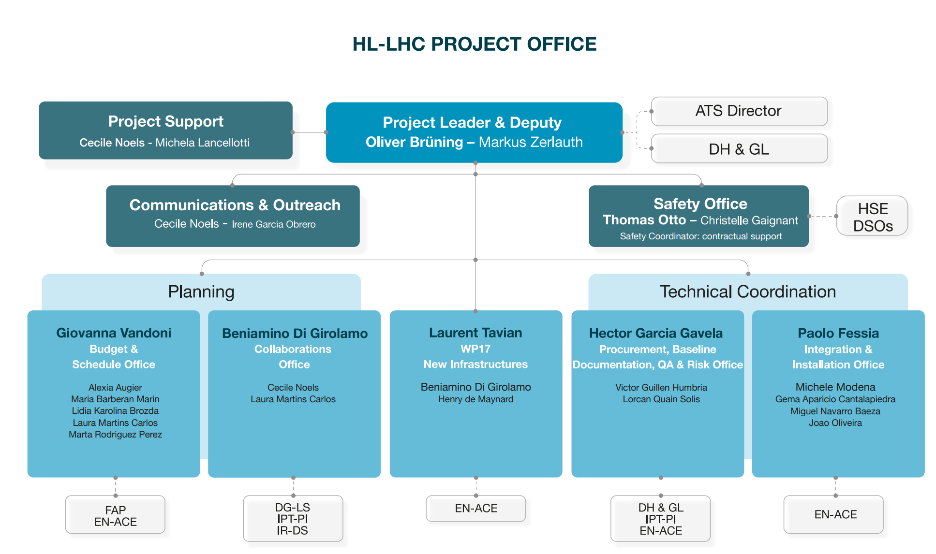
HL-LHC SCE Steering Committee

Slide 13
Outline
HL-LHC Project Introduction
HL-LHC Quality Plan
MTF / EAM for HL-LHC
Summary

Slide 14
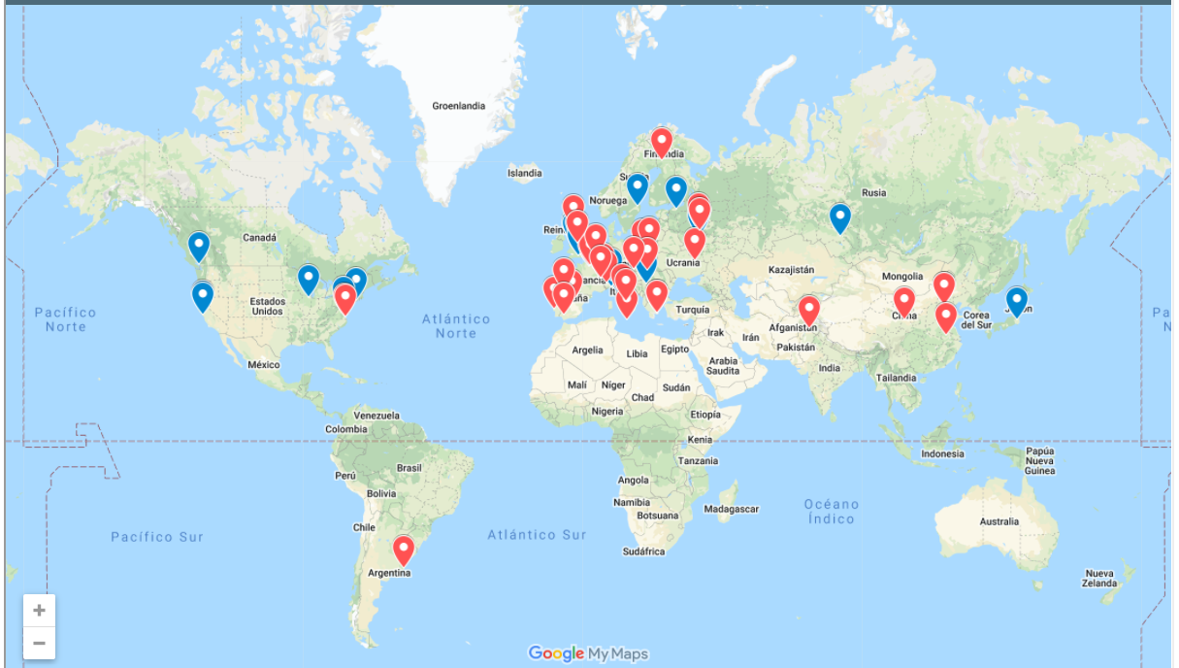
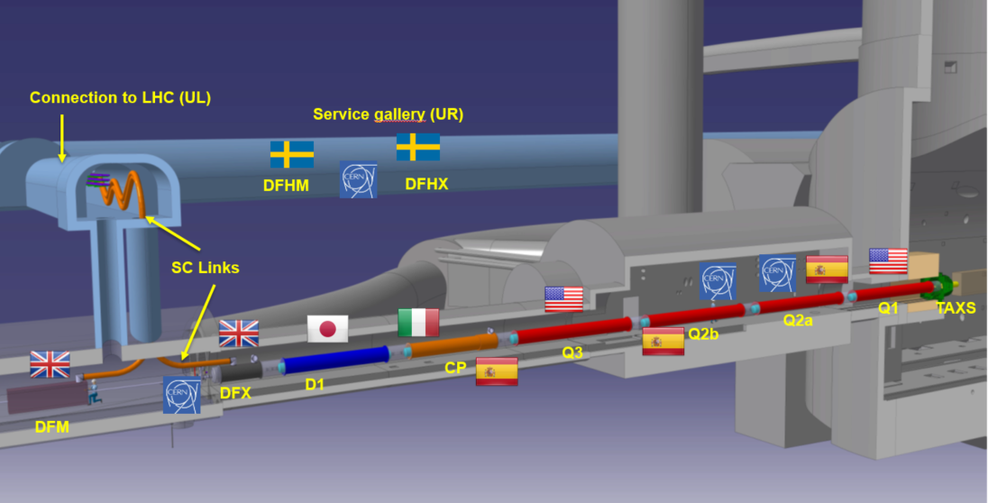
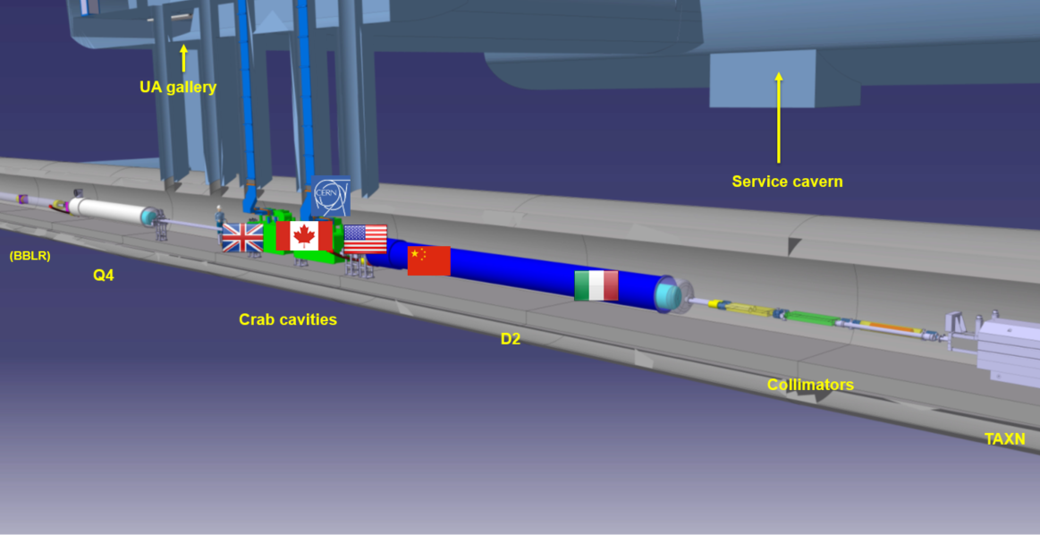

HL-LHC as a truly collaboration project

Slide 15
Pragmatic approach
External contributors are governed by the quality management plans of their home institute, however all HL-LHC deliverables shall be compatible with the HL-LHC Quality plan
Hardware baseline documentation stored in EDMS
Fabrication records in MTF
Project information accessible to all “Hilumiers”
Corporate image when representing the project

Slide 16
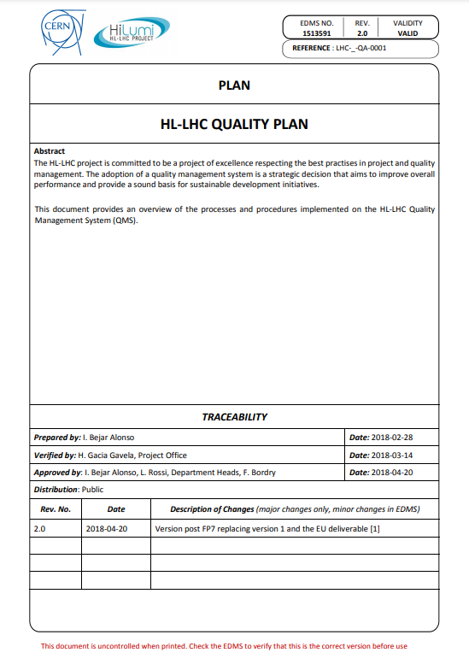
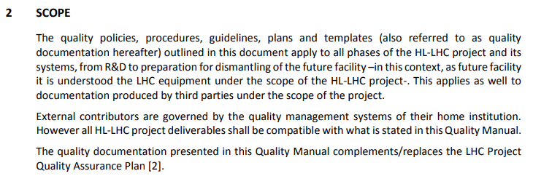
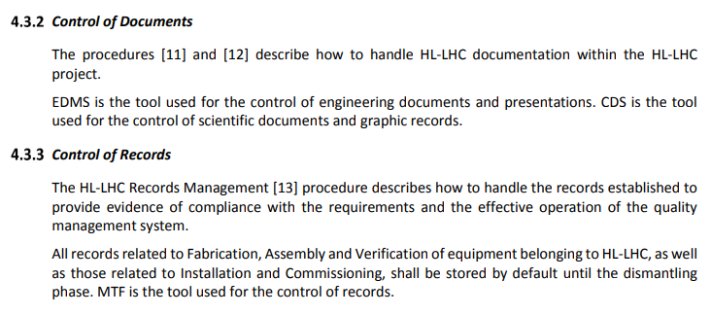
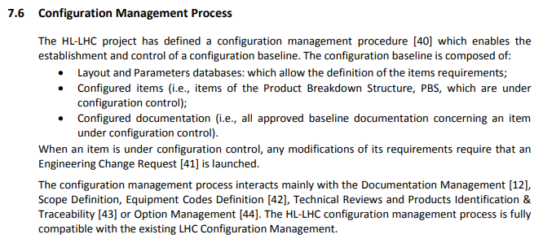
HL-LHC Quality Plan
https://edms.cern.ch/document/1513591/2.0

Slide 17
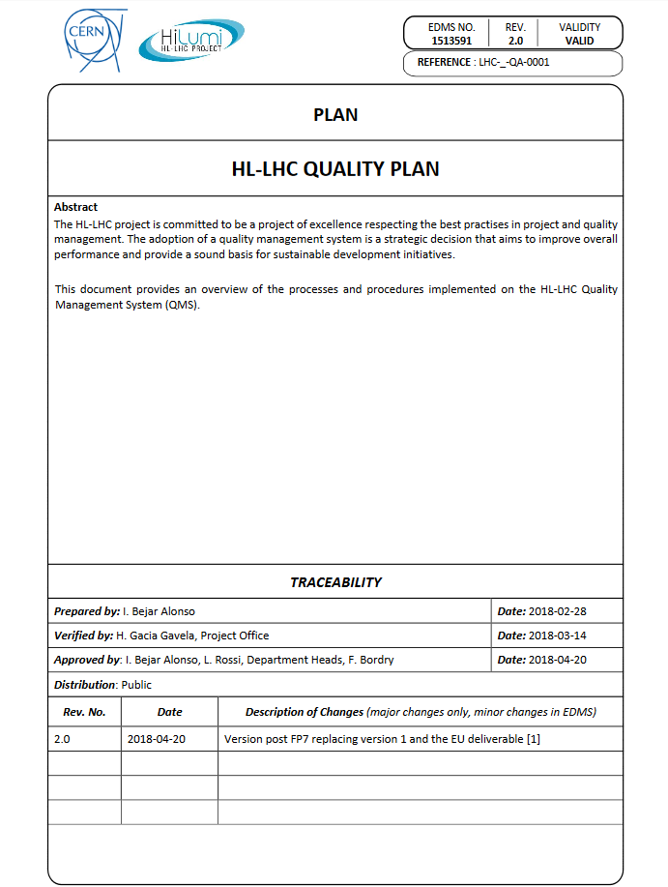
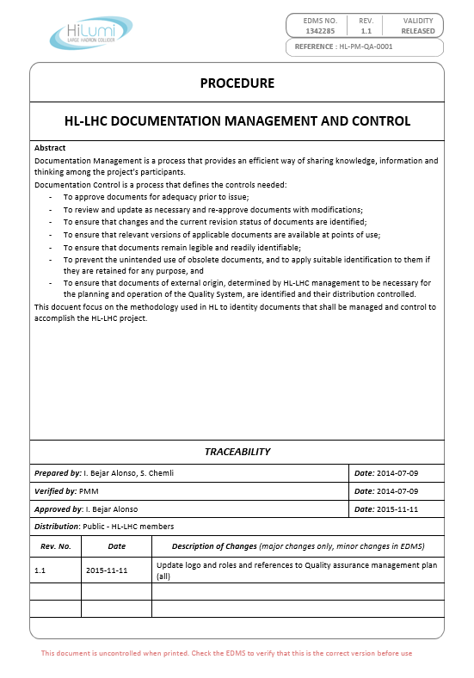
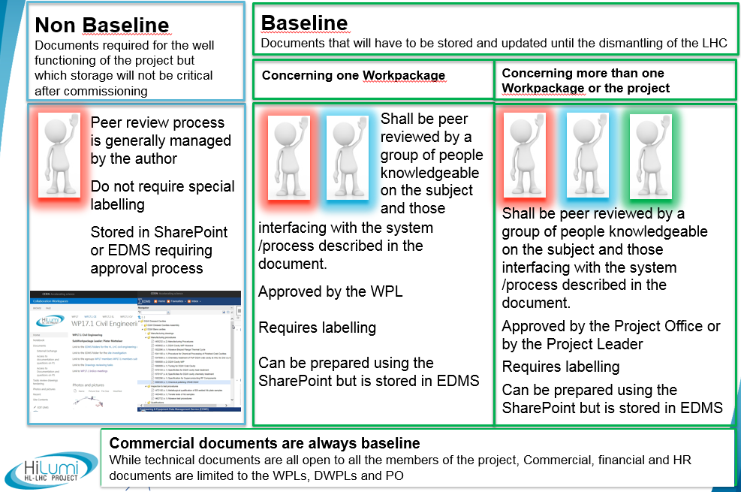
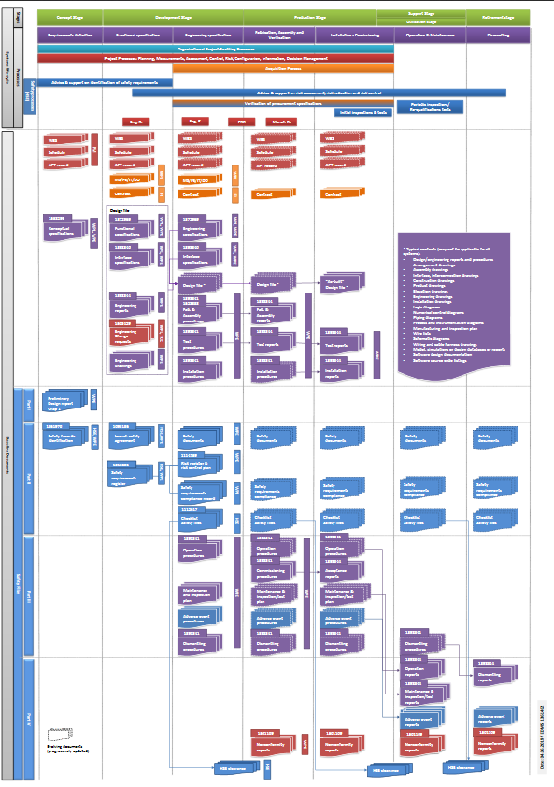







HL-LHC Quality – Some pillars
HL Quality Plan
Doc. Management & Control
It provides the procedures to be used and it explains how quality is managed for HL-LHC
Reference document for the Handling and storing of documentation
EDMS 1513591
EDMS 1342285
On top of the Quality Plan, guidelines, procedures and tools, the most important is the commitment and engagement of the people for these activities
Baseline Documentation
Tools for HL
Baseline documents that need to be issued and stored up to the dismantling of the machine
Tools at CERN to manage the documentation
EDMS 1361462

Slide 18
CERN Tools integrated and supported
SmarTeam/CATIA
Used to extract BOMs and check some assemblies by the QA
CDD
Used for all internal drawings and for drawing control
MTF/EAM
Used for upload and control of external drawings (collaborations and companies) w/ LHC Stamp, by import
Used for assets (equipment or batch) and EDMS documents links
EDMS
Used for items
Used for storage, approval, traceability and management of documentation (engineering, manufacturing, installation,..)
Used thoroughly by the designers that make the 3D and 2D models
Used to access CDD as the drawings are also EDMS documents
Used for equipment production follow-up and their traceability
Used for storage (KIOSK)
Used for Layout links
Used to structure the Project in the different folders following the PBS [Configuration]
Used for manufacturing data storage
Used to access assets linked to an item

Slide 19
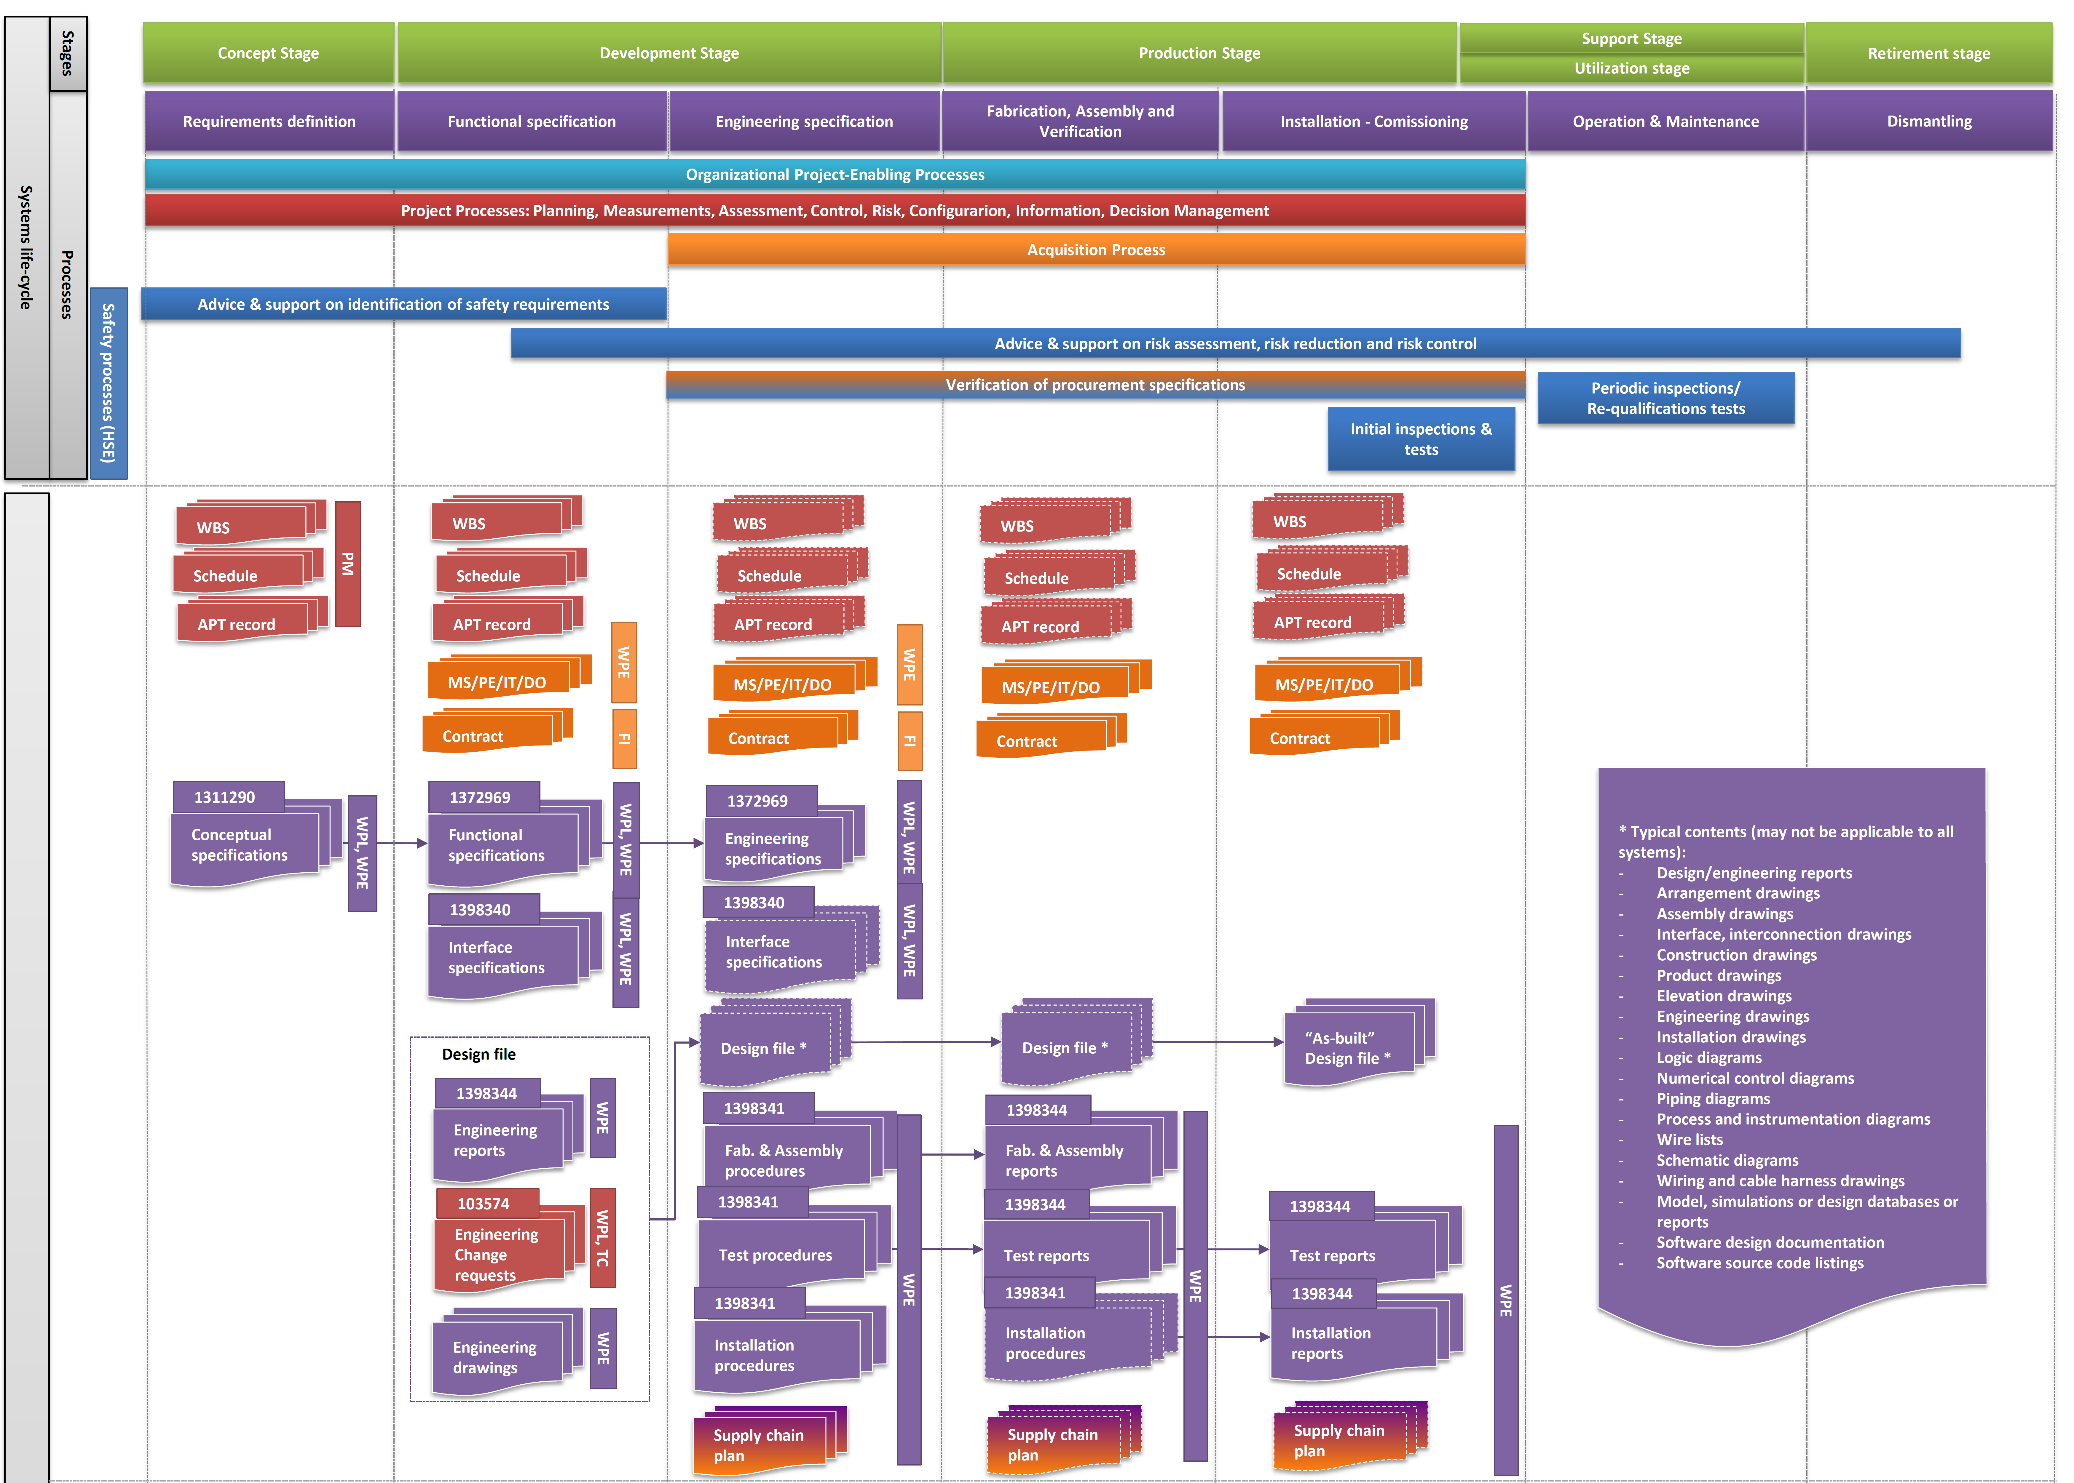
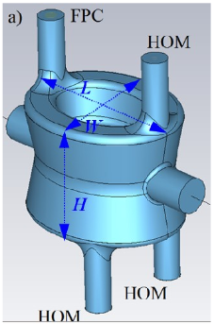
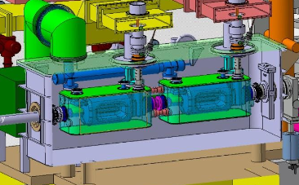
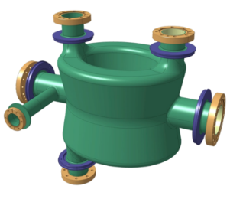
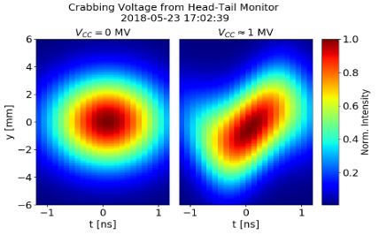
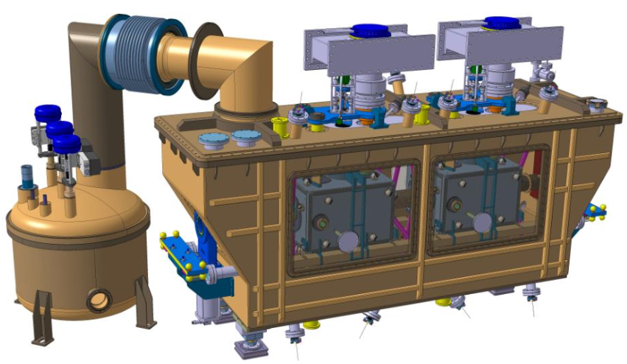
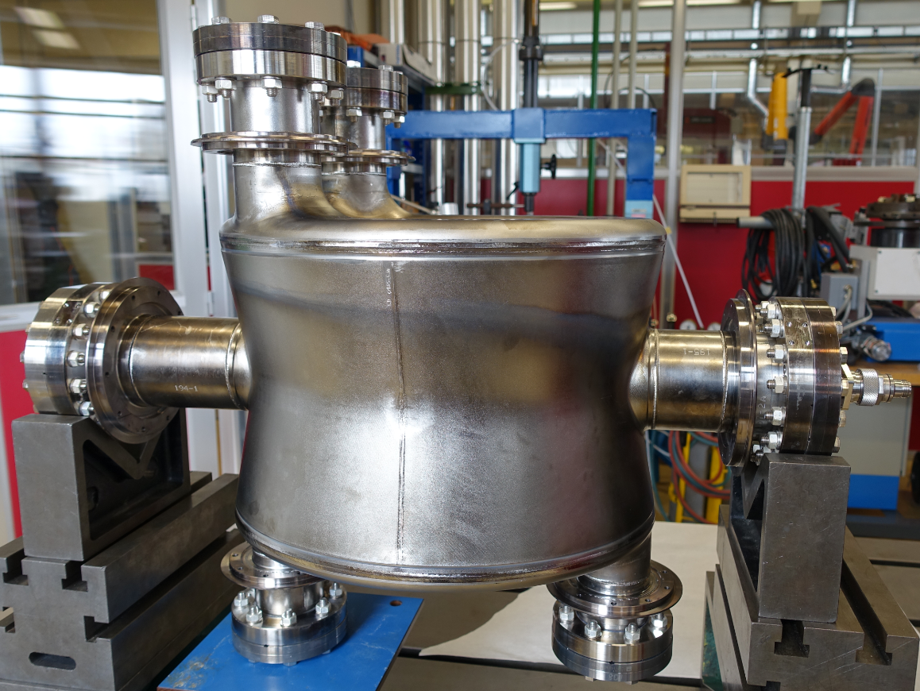
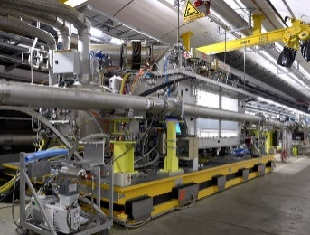
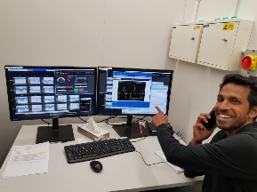
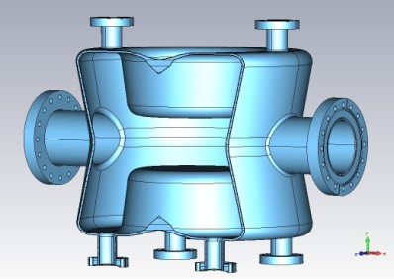
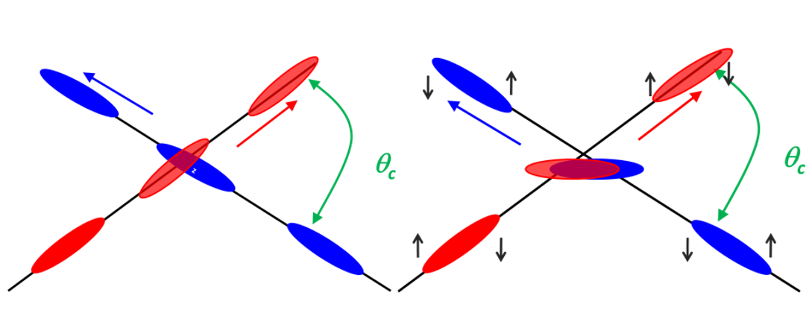
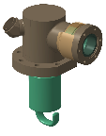
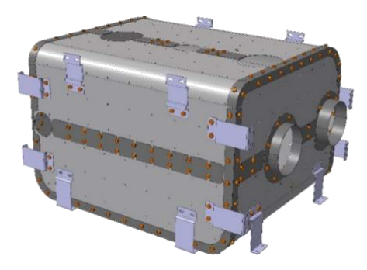
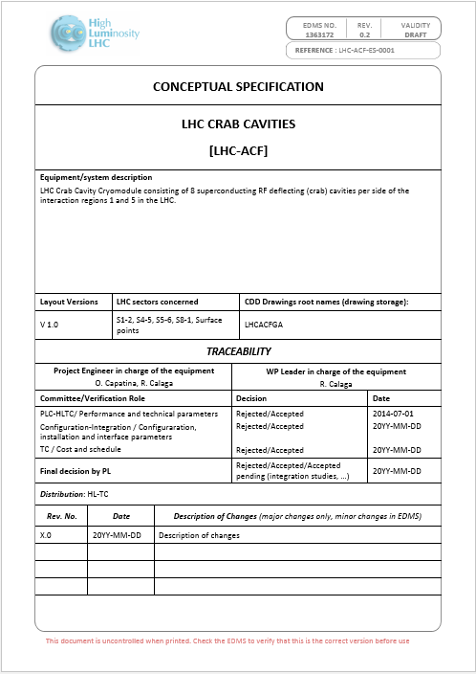
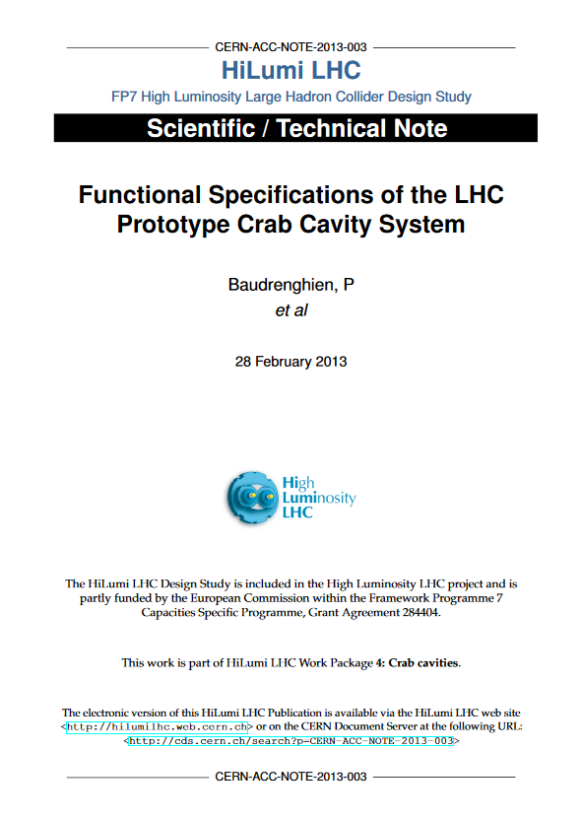
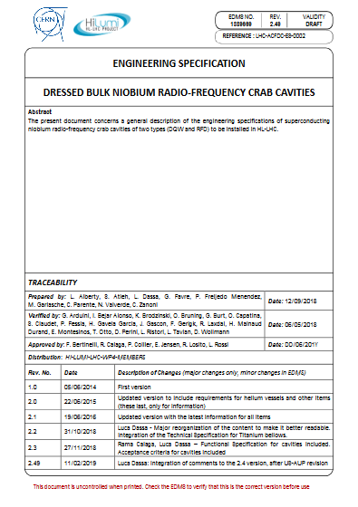
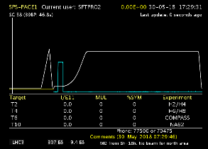
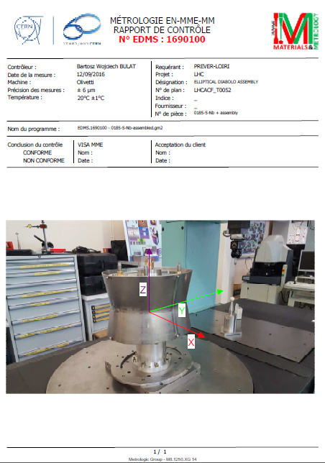
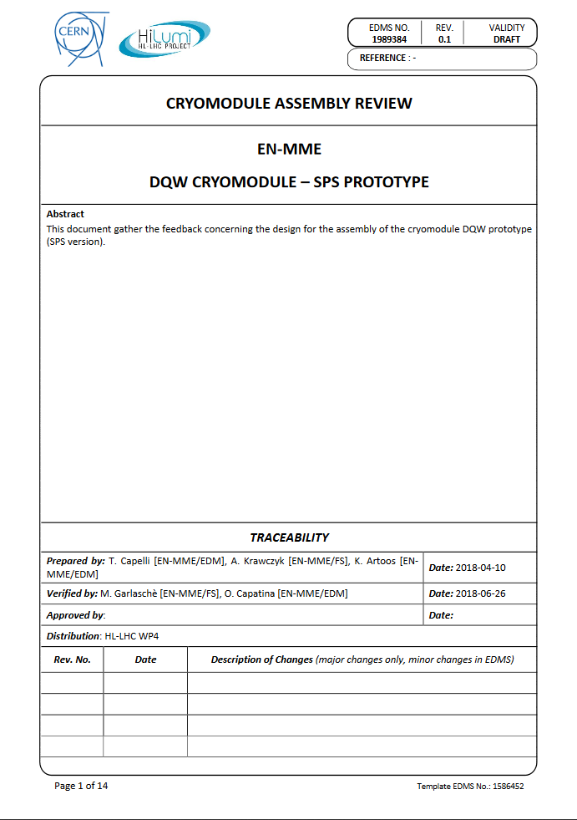
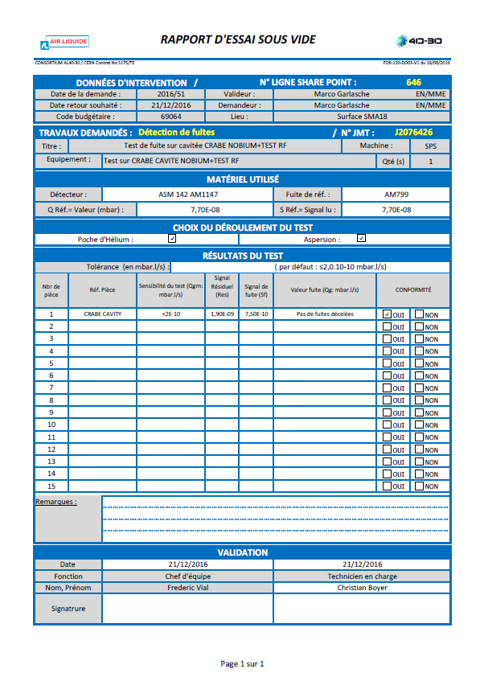
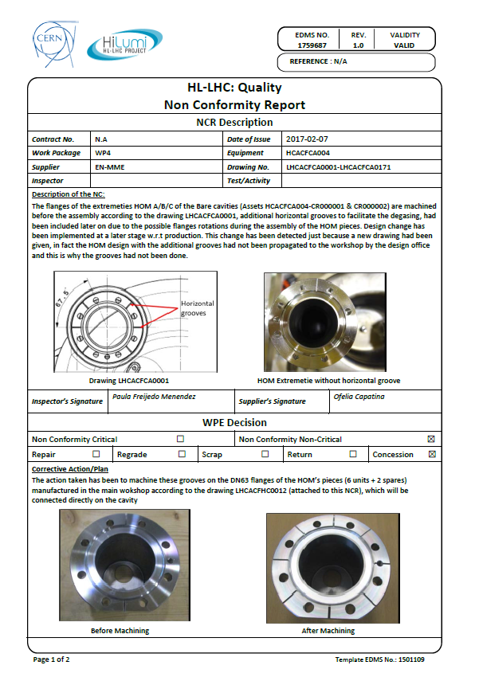
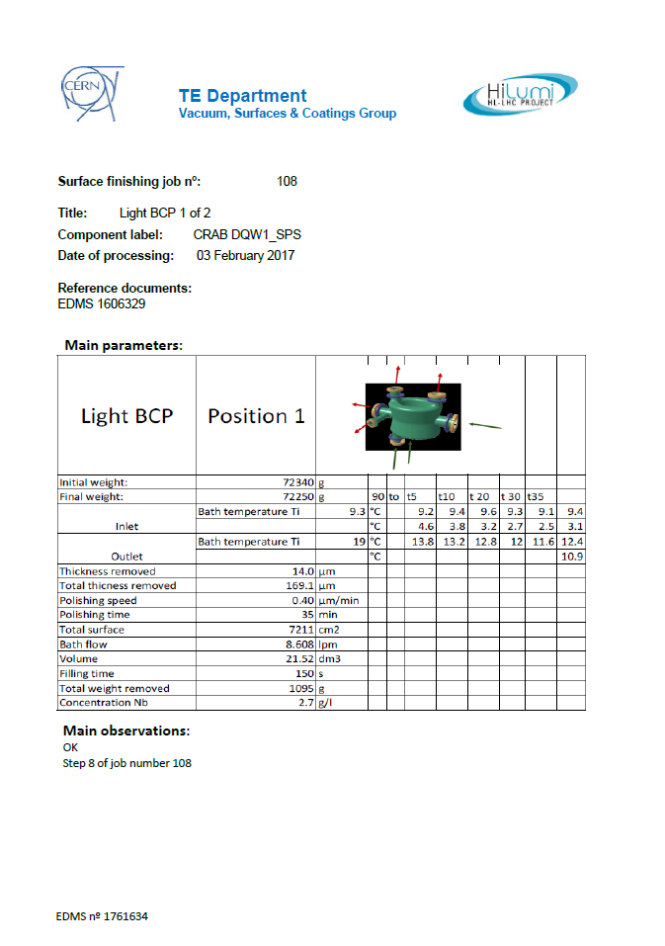
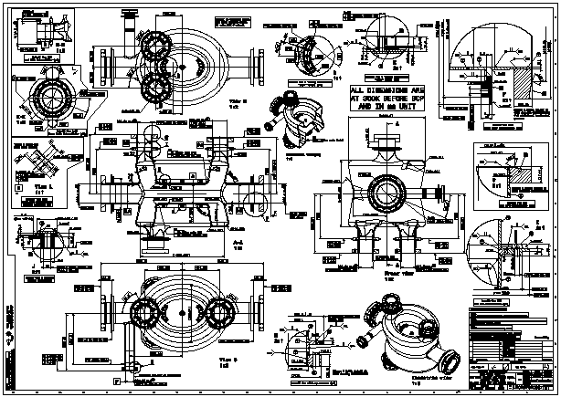
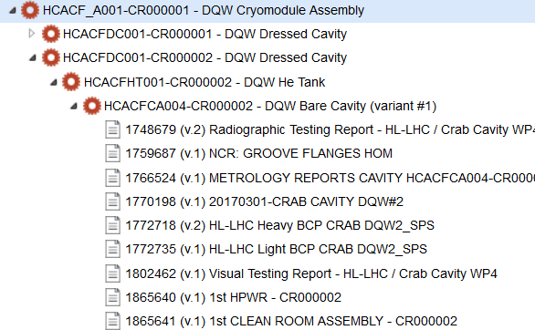
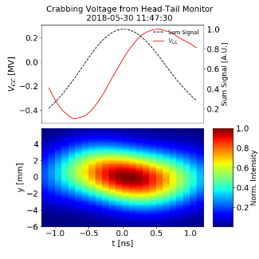
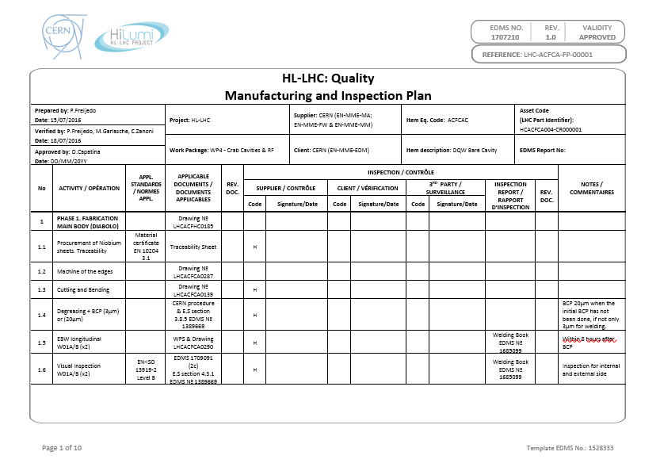
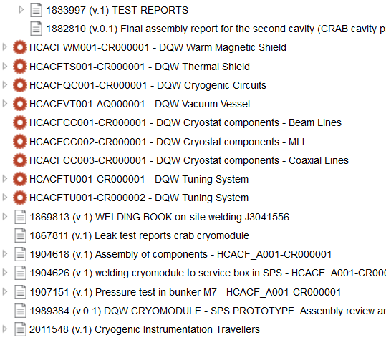
When – The full HL-LHC life-cycle
From Systems Requirements to Technical Solutions & Products

Slide 20
Outline
HL-LHC Project Introduction
HL-LHC Quality Plan
MTF / EAM for HL-LHC
Summary

Slide 21

When – The full HL-LHC life-cycle
End of the HL-LHC Project and take over by Operation

Slide 22
Why do we use MTF/EAM for HL-LHC?
Identification of the equipment - Unique Serial Number for each component (asset) produced
Traceability of components - what is the equipment made of
Production follow-up – Electronic Manufacturing and Inspection Plan (Workflow for production and testing)
Storage of Manufacturing data – Each asset will have its individual manufacturing folder with the QC reporting
Management of Nonconformities
Installation in the machine - What goes where

Slide 23

Identification
MTF / EAM is used to provide an unique identifier to each component manufactured for the Project (according to the granularity agreed with the Technical teams), based on the PBS (Project Breakdown Structure) and the BOM (Bill of Materials) of the equipment
H C A C F _ A 0 0 4 - U K 0 0 0 0 0 1

Slide 24


Traceability of components

Slide 25


Traceability of components
MTF used to build the assembly tree of each equipment (subcomponents assembled to the main component)

Slide 26











From MIP to MTF – Production Follow-up
ITEM
ASSET (S)

Slide 27



Production Follow-up and Storage of Manufacturing Data
ITEM
ASSET (S)

Slide 28


Nonconformities
Nonconformity Report (NCR)
EDMS 1501109
Nonconformity via MTF
A Nonconformity Report is attached to the step in which the deviation was found (Manufacturing Folder) and it is part of the Quality Dossier of the Project
Decision about Non Conformity

Slide 29







What goes where in the machine

Slide 30
Outline
HL-LHC Project Introduction
HL-LHC Quality Plan
MTF / EAM for HL-LHC
Summary

Slide 31
Summary
The HL-LHC Project is the flagship project at CERN for the next years
Since the beginning the existing tools at CERN were adopted to handle the documentation and trace the equipment
(HL-LHC Plan)
The project is now in full Series production. MTF and
EAM are extensively used nowadays (not only at CERN but also by Contractors and Collaborations)
The tools are well adapted to cover our needs: identification, traceability, production follow-up, storage of manufacturing data (Thanks to EN-IM Colleagues for the support to HL-LHC)

Slide 32
Thanks a lot for your attention
Any question?

Slide 33

Why not just keep going with consolidation?
Upgrade!
Performance improving consolidation

Slide 34
Main civil engineering work at Point 1 (ATLAS)
Underground
(Fully completed on 25 Oct’21)
Surface
SF17
SU17
SE17
SHM17
SD17
Buildings | Progress [%] / delivery
SF17 | 100% / delivered
SHM17 | 100% / delivered
SU17 | 100% / delivered
SE17 | 95 % / 26 Sep’22
SD17 | 95 % / 26 Sep’22
Underground | 100% / 26 Sep’22
Fully completed and delivered by Sep’22 (+ ~1 months w/r to the initial contractual date)
Pieter Mattelaer and
Laurent Tavian

Slide 35

Main civil engineering work at Point 5 (CMS)
Underground
(fully completed on 25 Feb’22)
Surface
SF57
SHM57
SE57
SD57
SU57
Buildings | Progress [%] / delivery
SF57 | 100% / delivered
SHM57 | 100% / delivered
SU57 | 100% / delivered
SE57 | 70 % / 01 Dec’22
SD57 | 60 % / 01 Dec’22
Underground | 100% / 01 Dec’22
Fully completed and delivered by Dec’22 (+ ~2 months w/r to the initial contractual date)
Pieter Mattelaer and
Laurent Tavian

Slide 36


Main civil engineering work at Point 5 (CMS)
SF57
SHM57
SU57
SE57
SD57
Pieter Mattelaer and
Laurent Tavian

Slide 37


Main civil engineering work at Point 1 (ATLAS)
UR15
US17

Slide 38

Main civil engineering work at Point 1 (ATLAS)
SD17
SF17
SHM17
SE17
SU17
Pieter Mattelaer and
Laurent Tavian

Slide 39



Main civil engineering work at Point 5 (CMS)
PM57
UR55
US57
Pieter Mattelaer and
Laurent Tavian

Slide 40



Technical infrastructures in the delivered buildings
Sectional doors
Cranes
Cable trays
Lighting
Ventilation system
Primary water system
SHM57
SL172
SF57

Slide 41
How – Defined – Structured – Templates
EDMS #1361462
From system requirements to technical solutions and products
Project management
Acquisition
Technical
Safety

Slide 42

Project Office roles in detail

Slide 43




Manufacturing Inspection Plan - MIP
Manufacturing and Inspection Plan
PROCEDURE: 1563887
TEMPLATE: 1528333

Slide 44

Manufacturing Inspection Plan - MIP
Verification and approval following HL-LHC documentation approval process.
Sequence of required steps to manufacture the equipment (both fabrication and QC activities).
Applicable documentation which supports the related activity such as drawings, procedures, standards, guidelines, acceptance criteria, checklists, etc.
Codification of the activity by the client (see next slide)

Slide 45

Manufacturing Inspection Plan - MIP
The different activities will be categorized by the client during the verification and approval process. The assigned categories shall be respected along the process (N, H, W, R or a combination of those).
We can set these categories on MTF. Since parallel activities are not allowed in the platform, it is not recommended to stop the workflow. Therefore, we can at least indicate the activity code in the name of the activity as per the MIP.

Slide 46




Items / Assets

