Slide 1
QA/QC, processes, procedures and manufacturing documentation
Mike Struik, on behalf of the CMI section

Slide 2
QA/QC in the TE-MSC-CMI section
Current official roles
Group Quality Coordinator (QC) : R. Principe
Quality Correspondent in Section (QS) : M. Struik
QA/QC Officer (WP3) : FSU
QA/QC Officer (WP6a) : S. Hopkins (TE-MSC-SCD)
Storage (WP3 – bld 189) : FSU
Storage (WP3 and WP6a – bld 947) : TEMPORARY (TE-RAS-GLO)
Main reference documents
TE-MSC GROUP Quality Plan, see EDMS Link
HL-QA Quality Plan, see SharePoint Link

Slide 3
QA/QC in the TE-MSC-CMI section
Main activities
Establish and maintain a quality management system based on (juggling between) two existing Quality Plans,
-> Using common sense, good practice, harmonization with what is already done elsewhere, e.g., at TE-MSC-LMF,
Creating “Traceability documentation” based on the “Assembly documentation” (together with the Project Engineers),
Actively help to move towards a paperless electronic MIP solution (together with TE-MSC-TM),
Creating Items, Assets & Batches in EDMS and MTF (with support from HL-QA),
Incoming inspections of components; document verification, identification, storage, logistics,
Documentation of tooling (assembly benches) used in SMI2; User & Maintenance Manuals, Safety Files,
Oversee the implementation of quality control procedures at each stage of production (together with our operators),
Hold regular (two-weeks) QA meetings with SL, QC, QS, QA officer and PE’s when needed (see EDMS Link),
Non-Conformities management and Actions follow up,
Conduct internal quality audits, identify potential sources of errors, and suggest ways to eliminate these errors.

Slide 4
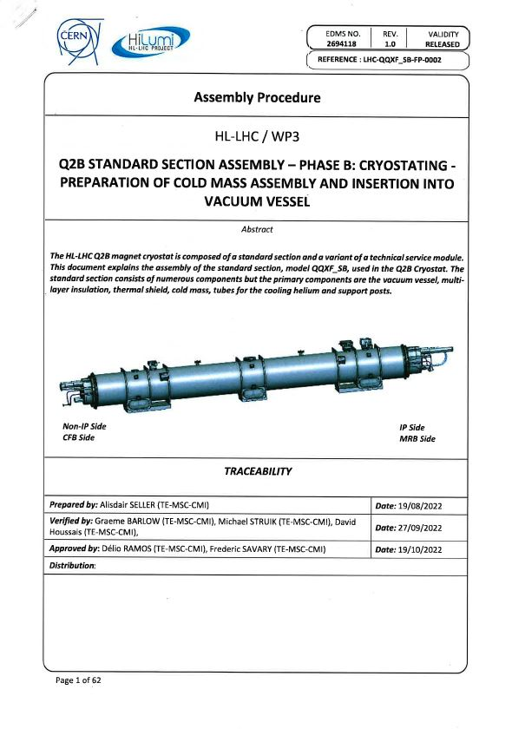
Ongoing Q2b Cryomagnet Assembly example
Assembly Documentation
Assembly procedures
  Drawings (assembly steps)
  Bill of Materials (BOM)
  Sub procedures (often from other sections)
  Manuals / Instructions
  Welding books
All generic info and templates are stored in EDMS under Items

Slide 5
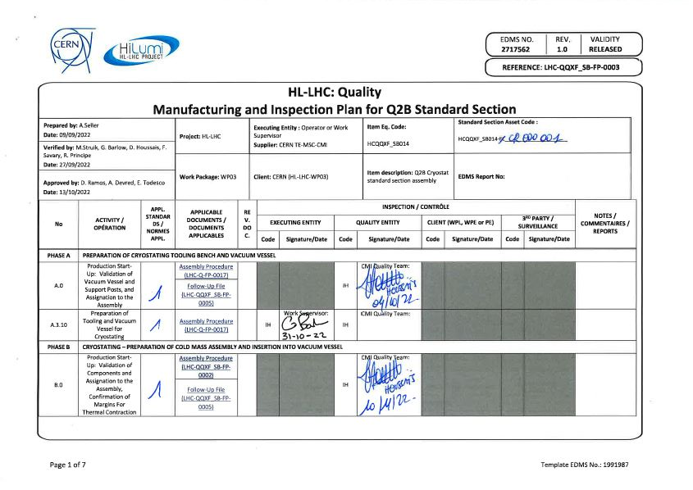
Ongoing Q2b Cryomagnet Assembly example
Traceability Documentation
Manufacturing and Inspection Plan (MIP)
Follow Up File (FUF)
Traceability sheet
Non Conformity Reports (NCRs)
All specific information and data is stored in MTF under Assets
Electronic MIP (eMIP)

Slide 6
QA/QC in the TE-MSC-CMI section
Challenges for 2023
Methodically revise and describe the complete workflow from conception up to final product: design, component procurement, storage, logistics and assembly, with the participation of the engineers/fellows/technicians,
Some EDMS structures still need to be completed (HL-QA is currently overloaded),
Incoming inspections: method to be developed, dedicated space, tools and possibly additional personnel needed,
Completely move to the electronic eMIP system,
Develop QA/QC for the CMI activities outside WP3 and WP6a,
Conduct more internal quality audits.
Estimated QA/QC Resources needed for 2023
First half of 2023 : we can manage as we are,
Second half of 2023: one additional QA/QC officer needed, present in SMI2, for incoming inspections and production.

