Slide 1
HL-LHC
CMI Integrated Resource Plan vs Section Capacities
Yann Leclercq, Sandrine Le Naour, Delio Ramos, Frédéric Savary, Mike Struik, Arnaud Vande Craen
2023-01-17, https://indico.cern.ch/event/1231730/

Slide 2
Outlook
Part I: integrated resource plan vs section capacities
  References and sources of information
  Integrated resource needs
  Methodology “needs vs budget”
  Needs vs budget for WP3
  Needs vs budget for WP6a
Part II: main challenges & solution/mitigation proposals
  Risks & Challenges
  Mitigation proposals

Slide 3
Before we go
It should be clarified that the resource plan object of today’s review does not cover any of the tunnel activities, i.e. those relating to the HL-LHC installation during LS3, from 2026 to 2028, nor the related preparation activities to be carried out on the surface prior to carry out the work in the tunnel.
The resources of the other sections/groups/departments are not discussed here.
The activities other than HL-LHC are included in the analysis.

Slide 4
Part I:
Integrated resource plan vs section capacities

Slide 5
Outlook
Part I: integrated resource plan vs section capacities
  References and sources of information
  Integrated resource needs
  Methodology “needs vs budget”
  Needs vs budget for WP3
  Needs vs budget for WP6a

Slide 6
References and sources of information
WP3 overall detailed schedule dated December 2022, Sarah A. Fleury, EDMS-2645484.
F1 shuffling module planning dated December 2022, cernbox.
Talks on description of the demands, Delio, Yann, Sandrine and Frédéric.
WP3 M4P profile MSC_CMI August 2022, E. Todseco, EDMS-2606898.
Note that the data presented in this document was provided by CMI.
CMI APT 2023-2027.

Slide 7
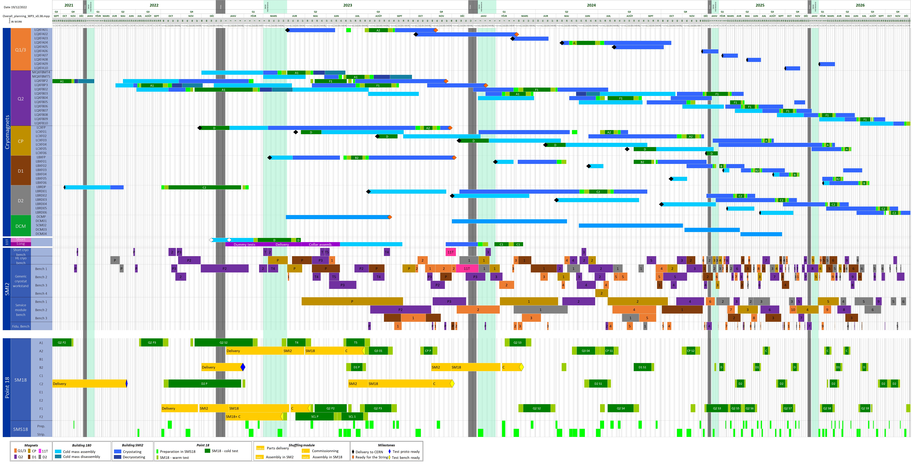
WP3 Detailed Schedule – Dec. 2022 – Sarah A. Fleury
WP3_Detailed_Planning38v4

Slide 8
Outlook
Part I: integrated resource plan vs section capacities
  References and sources of information
  Integrated resource needs
  Methodology “needs vs budget”
  Needs vs budget for WP3
  Needs vs budget for WP6a

Slide 9
Integrated resource needs of the section – 125 FTE•y
Activity | FTE•y
CEA Anticryostats | 1.75
CONS | 2
MP3 & Beam Operation Support | 2
OP | 7.45
WP16 | 0.75
WP6a | 25.5
SM18 reconfiguration | 2.3
WP3 | 83.2
FTE•quarter

Slide 10
Resource needs per category: STAFF – 57.7 FTE•y
Activity | FTE•y
CEA Anticryostat | 0.5
MP3 & Beam Operation Support | 2.0
OP | 4.6
CONS | 1.3
WP16 | 0.7
WP6a | 15.5
SM18 Reconf. | 0.5
WP3 | 32.7
FTE•quarter

Slide 11
Resource needs per category: FSU – 51.1 FTE•y
Activity | FTE•y
CEA Anticryostat | 0.3
OP | 2.9
CONS | 0.7
WP16 | 0.1
WP6a | 2.5
SM18 Reconf. | 1.8
WP3 | 42.9
FTE•quarter

Slide 12
Resource needs per category: FELL – 16.2 FTE•y
Activity | FTE•y
CEA Anticryostat | 1.0
OP | -
CONS | -
WP16 | -
WP6a | 7.6
SM18 Reconf. | -
WP3 | 7.6
FTE•quarter

Slide 13
Outlook
Part I: integrated resource plan vs section capacities
  References and sources of information
  Integrated resource needs
  Methodology “needs vs budget”
  Needs vs budget for WP3
  Needs vs budget for WP6a

Slide 14
Methodology “needs vs budget”
The needs of the section CMI as of today are determined based on what remains to be done from now on (1st of January 2023):
  As part of the scope of work defined by the HL-LHC work packages and other activities (non HL-LHC).
  Taking into account the experience accumulated to date as to the estimation of the manpower needs.
The WP budget is the latest approved description of the needs of the section CMI to carry out the work defined by the HL-LHC work packages (and these needs were determined by the section CMI).
  For WP3, the latest approved description of the needs is given in the document EDMS-2606898.
  For WP6a, the needs of the section to carry out the work have been discussed with and endorsed by
  the WPL.

Slide 15
Outlook
Part I: integrated resource plan vs section capacities
  References and sources of information
  Integrated resource needs
  Methodology “needs vs budget”
  Needs vs budget for WP3
  Needs vs budget for WP6a

Slide 16
WP3 – CMI needs vs WP budget – FSU
FTE•quarter
FSU ramp up
Activity | CMI Needs (FTE•y) | WP3 Budget (FTE•y)
Q1/3,Q2,CP,D1,D2 | 26.25 | 29.10
Logistics | 2.70
QA/QC | 3.75
D2 Interlink | 1.40 | 1.25
Total | 34.10 | 30.35
Balance | - 3.75
4 fitter mechanics
are missing today (FSU10 to FSU13)
Hiring process can take long time
Presently not allowed due to cap imposed to the group
The section supervision capacity is yet insufficient
32.7
Today, we have only 1.6 FSU (FSU3 Nabil and FSU8 Marc), not 4
We need to hire 4 FSUs:
  1 lead fitter mechanic and 1 fitter mechanic to start in Q1
  1 lead fitter mechanic to start in Q2
  1 fitter mechanic to start in Q3
We need to plan proper supervision of these FSUs

Slide 17
WP3 – CMI needs vs WP budget – DCM $λ$-Plates/Plugs
FTE•quarter
Activity | CMI Needs (FTE•y) | WP3 Budget (FTE•y)
FSU | 1.64 | 1.50
FELL / GRAD | 0.33 | 0
The contract of F. Crisci is ending in Q3, August 2024
In Q1 this year, we need 1.5 FSUs and we have only 1 today.
The recruitment needs to be launched for the missing one, FSU14, we are late!
The cable delivery is expected in the next 2-4 weeks

Slide 18
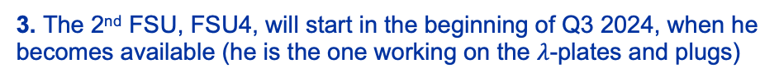
WP3 – CMI needs vs WP budget – DCM assembly
1. The recruitment needs to be launched for FSU14 expected to start in Q1-2023
FTE•quarter
3. The 2nd FSU, FSU4, will start in the beginning of Q3 2024, when he becomes available (he is the one working on the $λ$-plates and plugs)
2. A FSU is here replaced by a staff, the new technician to come on VN155
The contract of F. Crisci is ending in Q3, August 2024

Slide 19
WP3 – CMI needs vs WP budget – DCM assembly
Note that for staff, WP3 did not request manpower estimate, meaning that there is no budget
Activity | CMI Needs (FTE•y) | WP3 Budget (FTE•y)
FSU | 4.16 | 5.00
FELL / GRAD | 0.33 | 0.17
STAFF Tech. | 2.68 | -
STAFF Eng. | 0.89 | -

Slide 20
WP3 – CMI needs vs WP budget – All activities – FSU
Activity | CMI Needs (FTE•y) | WP3 Budget (FTE•y)
Q1/3,Q2,CP,D1,D2 assembly | 26.25 | 29.10
Logistics | 2.70
QA/QC | 3.75
D2 Interlink | 1.40 | 1.25
Anticryostats | 0.67 | 1.00
Q4 | 1.50 + 1.00* | 2.40
Q10 | 1.00* | 0.00
DCM assembly | 4.15 | 5.00
DCM Lambda plates + plugs | 1.65 | 1.50
Total | 44.07 | 40.25
Balance | - 3.82
4 fitter mechanics
are missing today (FSU10 to FSU13)
32.7
1 fitter mechanic
is missing today (FSU14)
* Note that the 1 FTE•y mentioned for Q4 and Q10 (so, 2 in total) will be staff

Slide 21
WP3 – CMI needs – Q1/3,Q2,CP,D1,D2 – STAFF
Note that for staff, WP3 did not request manpower estimate, meaning that there is no budget
Category | FTE•y
Staff Tech. | 9.5
Staff Eng. | 11.3
Addition of a staff technician to reinforce the team, Benjamin, after completion of the AC/SM production and installation
FTE•quarter
This resource profile includes resources like:
  Engineer:
    Workshop Manager
    Work Package Engineer
    Expansion Joint Project Engineer
    QA/QC Responsible Officer
    Magnet coordinator
    Section Leader
  Technician:
    Graeme, then Jeremy (training needed)
    Michel (!! but consolidation !!)
    Benjamin (new recruit)

Slide 22
Outlook
Part I: integrated resource plan vs section capacities
  References and sources of information
  Integrated resource needs
  Methodology “needs vs budget”
  Needs vs budget for WP3
  Needs vs budget for WP6a

Slide 23
Resource needs per activity: WP6a – 22 FTE•y
Category | FTE•y
STAFF | 14.0
FELL / GRAD | 5.6
FSU | 2.5
FTE•quarter
Resource profile agreed with WP6a for the present scope of work

Slide 24
Part II:
Main challenges & solution/mitigation proposals

Slide 25
Outlook
Part II: main challenges & solution/mitigation proposals
  Risks & Challenges
  Mitigation proposals

Slide 26
Risks & Challenges
Hiring of new personnel.
  We are late as to recruitment for WP3 cryostating and WP3 DCM Lambda plates/assembly due to
    Difficulty of finding FSU professionals on the market (last year we could hire only 2 out 15 candidates).
    The cap imposed to the group in terms of Nr FSUs.
It is also difficult to find good professionals for the staff positions (the ongoing VN155 had to be extended).
Training of the newcomers with the very few staff technicians at CMI and having the relevant expertise.
All this in parallel with the learning phase, i.e. first time the equipment is built in most cases.
2023 is most critical year. An important hump is visible in Q3 and there is no way we can flatten it as it concerns critical equipment, e.g. shuffling modules, anti-cryostats, DCM, DFs ...
Supervision of 6 FSUs for WP3 will be challenging.
The risk is obviously to not deliver on time AND to experience numerous non-conformities due to the large number of newcomers (both staff and FSUs) who will have to learn on the job with very limited number of experienced technicians

Slide 27
Outlook
Part II: main challenges & solution/mitigation proposals
  Risks & Challenges
  Mitigation proposals

Slide 28
Mitigation proposals
Hire a designer/draftsman to cover the CAD works (and don’t let them to the staff technicians who have already much to do).
  For this, we could open a job with the design office and have the designer/draftsman working in SMI2.
If deemed appropriate, and necessary, hire TEMP(s) such that we can start ramping up before the arrival of the newcomers FSUs (“but” is it worth the investment and training?).
Open jobs with EN-MME central workshops as needed, again to cover critical needs before the arrival of the newcomers FSUs.
Are there any solutions (people available) in the other sections of the group, or other groups?
As to the supervision of 6 FSUs for WP3, we surely need an additional experienced technician – a professional – to lead part of the crew.

Slide 29
Concluding words
The CMI Section as is today is lacking robustness as to its assembly & construction capacities (SMI2).
We can be confident that it will be the case if we reinforce the team in SMI2 with professionals, staff and FSUs as discussed today.
We need to act quickly. We can phase the hiring of FSUs but the lag between stages cannot be long, and not more than 2 stages.
An additional experienced technician would be an great asset, and a draftsman more than
a “+”.
For completeness, APT will need some adjustments.
Thank you for your attention!

Slide 30
Additional slides

Slide 31
F1 shuffling module planning – Dec. 2022

Slide 32
Integrated resource needs of the section – 125 FTE•y
Category | FTE•y
STAFF | 57.7
FELL / GRAD | 16.2
FSU | 51.1
FTE•quarter

Slide 33
Distribution of personnel Staff / FSU / FELL-GRAD
The balance between staff and FSU is good, globally (this point is rediscussed later).
WP3 and WP6a absorb most of the resources at CMI.
CMI cannot commit on additional activities without adding resources.

Slide 34
Resource needs per activity: WP3 – 78.9 FTE•y
Category | FTE•y
STAFF | 33.9
FELL / GRAD | 6.2
FSU | 38.8
FTE•quarter

Slide 35
Res. needs per activity: SM18 reconfiguration – 2.5 FTE•y
Category | FTE•y
STAFF | 0.7
FELL / GRAD | -
FSU | 1.8
FTE•quarter

Slide 36
Resource needs per activity: WP16 – 0.8 FTE•y
Category | FTE•y
STAFF | 0.7
FELL / GRAD | -
FSU | 0.1
FTE•quarter

Slide 37
Resource needs per activity: OP – 7.5 FTE•y
Category | FTE•y
STAFF | 4.6
FELL / GRAD | -
FSU | 2.9
FTE•quarter

Slide 38
Resource needs per activity: CONS – 2.1 FTE•y
Category | FTE•y
STAFF | 1.4
FELL / GRAD | -
FSU | 0.7
FTE•quarter
FTE•quarter

Slide 39
Res. needs per activity: CEA Anticryostats – 1.8 FTE•y
Category | FTE•y
STAFF | 0.5
FELL / GRAD | 1.0
FSU | 0.3
FTE•quarter
FTE•quarter

Slide 40
WP3 – CMI needs vs WP budget – Q1/3,Q2,CP,D1,D2 – FELL
 | FTE•y
CMI Need | 6.0
More realistically | 5.3
WP3 Budget | 5.6
A gap between a fellow leaving and a replacement arriving later makes this flat profile not possible
FTE•quarter

Slide 41
WP3 – CMI needs vs WP budget – Anti-cryostat
Category | FTE•y
FSU Budget | 1.0
FSU Needs | 1.4
Staff Needs | 1.6
The spare anticryostats will most likely be finished in S1-2024
FTE•quarter
Category | FTE•y
FELL Budget | 1.00
FELL Needs | 0.67
C. Solano Eizaguirre will still be there (extension needed) but paid on another budget code to balance properly the costs with CAE Anticryostats

Slide 42
WP3 – CMI needs vs WP budget – Q4
FTE•quarter
A FSU is here replaced by a staff, the new technician to come on VN 155
Activity | CMI Needs (FTE•y) | WP3 Budget (FTE•y)
FSU | 1.5 | 2.4
FELL / GRAD | 0.4 | 0.4
STAFF Tech. | 1.0 | -

Slide 43
WP3 – CMI needs vs WP budget – Q10 – FSU
FTE•quarter
The request is here fulfilled with a staff, not a FSU

Slide 44
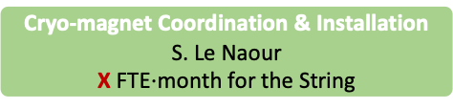
TE-MSC-CMI
CRYOSTATS & MACHINE INTEGRATION
SL: F. Savary
DSL: D. Ramos
QA
M. Struik
QA/QC Officer [FSU1]
Cryo-magnet Coordination & Installation
S. Le Naour
X FTE$⋅$month for the String
Cryostats for
Superconducting Magnets
D. Ramos
Cryostats for
Special Devices
Y. Leclercq
(Anti-) Cryostats for
Magnet Test Stands
F. Savary
Cryo-magnet & Cryostat
Assembly Facility
A. Vande Craen
WP3
WP6a
AOB
PROD
M. Struik (part-time WP3)
A. Seller
B.M. Wong Luis¹
F. Pasdeloup² (WP6a)
M. Struik (part-time WP6a)
A. Jacquemod³
F. Crisci
F. Di Ciocchis⁴
S. Spathopoulos
A. Vande Craen
C. Solano Eizaguirre
G. Barlow (WP3 – Cryo-magnets)
VN Mechanical Technician⁵ (WP3 – DCM)
J.B. Deschamps (WP6a)
M. Šesták (WP6a)
B. Jones⁶ (AC & SM, then WP3 Cryo-magnets)
M. Souchet (OP - CONS)
A. Bastardª (WP3 AC, then OP)
FSU2 (Logistician)
FSU3 (Mechanics – 3D Printing)
FSU4 (Mechanics)
FSU5 (Mechanics) – to be replaced
FSU6 (Mechanics)
FSU7 (Mechanics)
FSU8 (Electromechanics)
FSU9 (Welder)
5 additional FSUs to hire
Bruno’s contract is ending in January 2023. He will be replaced by a QUEST.
Florian is the production engineer to work on WP6a as from 1st January 2023.
André will be retired as from the beginning of March 2023. He is currently on leave.
Franco’s contract is ending in February 2023. He will be replaced by a QUEST.
Mechanical technician to work on WP3 DCM (Replacement A. Jacquemod) – TE-MSC-CMI-2022-155-LD.
Benjamin is the electromechanical technician to work on Anti-Cryostats and Shuffling Modules as from 1st February 23
staff
fellow
tech. fellow
PJAS
FSU
temporary
student

Slide 45
Key numbers
Professional category | Number | Note
Academic engineers/applied physicist | 5 | Including SL. Including a new HL-LHC post for 4 years.
Technical engineer | 2 | A. Jacquemod not counted (retired).
Technician | 6* | Including 1 newcomer on 1st February 23 (HL-LHC post) and another one to come on VN155 (VN published with application deadline postponed to end January). On 1st April 23, J. Mouleyre from CRG will join the section and G. Barlow will go to VSC.
Fellow engineer | 4+2 | 2 will be leaving soon, within 2 months, but recruitment is ongoing to replace them. An extension is needed for 2 of the 4.
Fellow technician (TTE) | 1 | An extension is needed.
FSU | 8 | Was 9 but 1 resigned at the end of 2022. He must be replaced. According to the approved HL-LHC manpower plan, we need to hire this year 5 additional FSUs aiming at a total of 14 FSUs.
* One of the technicians has informed us of his intention to ask anticipated retirement by end 2023. It is a core position.

Slide 46
Many other contributors support our activities!
TE-VSC
  Leak testing by the contractor 4030.
  Major contribution for the design and fabrication of the HL-LHC jacks (till fabrication of prototypes and full qualification prior to start the series production phase).
TE-CRG
  Cryogenic instrumentation.
  Works on equipment owned by the group, e.g. CFBs in the framework of the SM18 upgrade.
TE-RAS
  Space management and storage.
TE-MSC
  The other sections
EN-MME, usually through jobs (all the sections of the group are involved)
  Design Office (note that jobs are not required for engineering & computations, e.g. calculation note for pressure equipment).
  Main Workshop – Fabrication of parts and (sub)-assemblies.
  Main Workshop – Qualified welders to work in SMI2.
  Subcontracting – Parts and (sub)-assemblies.
  Materials, Metrology and NDTs (note that only some works are invoiced).
EN-HE
  Heavy handling in SMI2, and transport.
BE-GM
  Alignment and metrology of our large equipment to be installed in the accelerator, and tooling.
The availability of these numerous stakeholders is critical for the success of our activities
Notes:
Is it now ok with VSC for the vacuum tests?
How does it work with BE-GM, in particular as to the hiring of a fellow?

