Slide 1
A short introduction to the
Worldwide LHC Computing Grid
January 21, 2023

Slide 2

The LHC challenge
~100+ PetaByte / year
  Current total 1.5+ ExaByte
Data analysis requires at least ~1M typical PC processor cores
Scientists in tens of countries worldwide
CERN can provide up to 20-30% of the storage and CPU
We need a GRID !

Slide 3
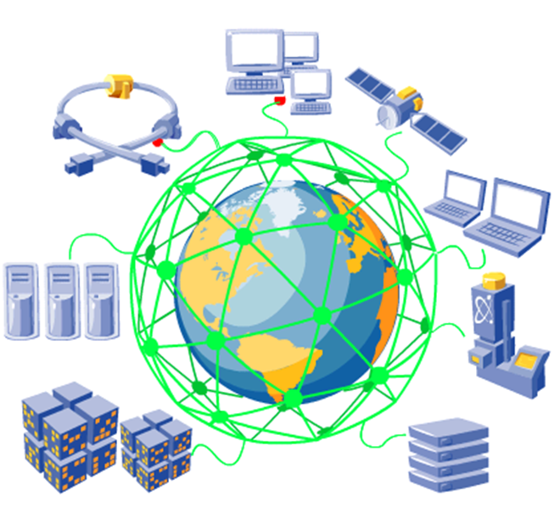
What is a grid?
Relation to WWW?
  Uniform easy access to shared information
Relation to distributed computing?
  Local clusters
  WAN clusters
Relation to distributed file systems?
  NFS, AFS, DFS, …
A grid gives selected user communities uniform access to distributed resources with independent administrations
  Computing, data storage, devices, …

Slide 4
Why is it called grid?
Analogy to power grid
  You do not need to know where your electricity comes from
  Just plug in your devices
You should not need to know where your computing is done
  Just plug into the grid for your computing needs
You should not need to know where your data is stored
  Just plug into the grid for your storage needs

Slide 5
What is cloud computing?
Transparent use of generic computing resources off-site
  Dynamically provisioned
  Metered
Neutral to applications
  Rent-a-center
Computer or data center
Internet
Amazon EC2, S3
Microsoft Azure
Google
IBM
Alibaba
Oracle
…
Site

Slide 6
What is grid computing?
Site
Site
Site
Internet
Site
Site
Site
Site
Site
Site
Site
Site

Slide 7
What is grid computing about?
A grid facilitates collaboration between members of a supported distributed community
  They can form a Virtual Organization within that grid
A grid allows distributed resources to be shared uniformly and securely for common goals
  Computing
  Data storage
A grid can support multiple Virtual Organizations in parallel
  Sites, computer and data centers make selections according to the projects in which they participate
  The quality of service may differ per VO

Slide 8
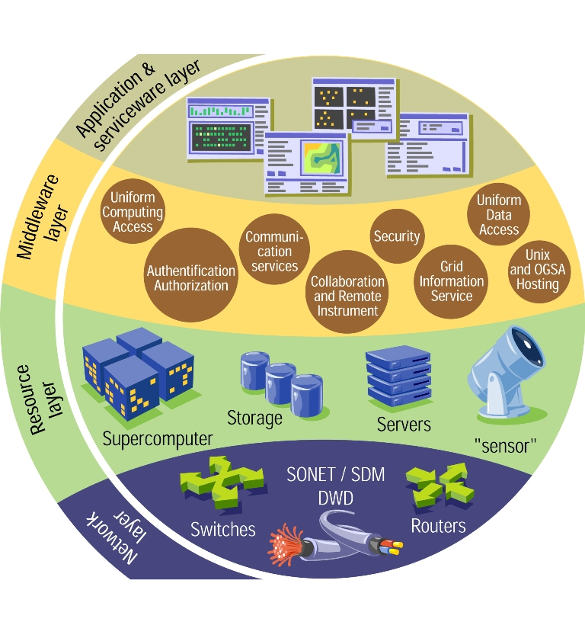
How does a grid work?
Middleware makes multiple computer and data centers look like a single system to the user
  Security
  Information system
  Data management
  Job management
  Monitoring
  Accounting
Not easy!
  Independent sites
  Different systems
  Local policies/priorities
  Other users

Slide 9
Where can we use grids?
Scientific collaborations
  Can also serve in spreading know-how to developing countries
Industry? Commerce?
  Mostly cloud computing
Homes? Schools?
  Internet Service Providers → cloud computing
  Secure data sharing technologies?
    E-learning
    Social media
Government? Hospitals? Other public services?
  Beware of sensitive/private data

Slide 10
Many grids can coexist
EGI – European Grid Infrastructure
  Successor of EGEE – Enabling Grids for E-sciencE ← led by CERN
OSG – Open Science Grid
  USA and beyond
National
  IGI (It), GridPP (UK), DFN (De), France Grilles, …
Regional
  NorduGrid (Nordic countries), BalticGrid (Baltic region),
  SEEGrid (South-East Europe), EUMedGrid (Mediterranean), …
Interregional
  EELA (Europe + Latin America), EUIndiaGrid, EUAsiaGrid, …
WLCG – Worldwide LHC Computing Grid
  Federation of EGI, OSG, Nordic Data Grid Facility, …

Slide 11
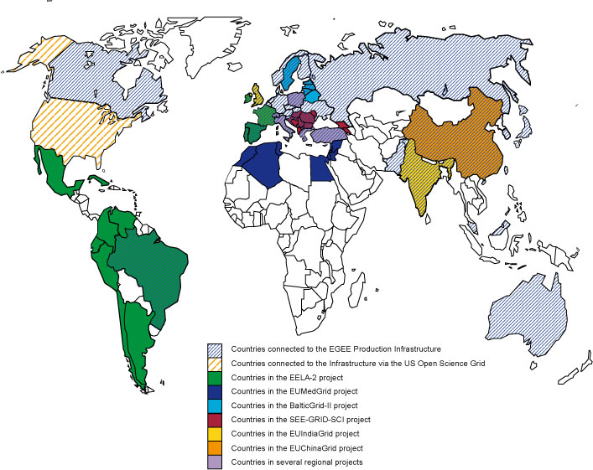

Projects that collaborated with EGEE

Slide 12
Many communities can coexist
High-energy physics
Astrophysics
Fusion
Computational chemistry
Biomed – biological and medical research
  Statistical analysis of anonymized data
  “In silico” discovery of new drugs and vaccines
  …
Earth sciences
UNOSAT – satellite image analysis for the UN
Digital libraries
…

Slide 13
The LHC challenge
~100+ PetaByte / year
  Current total 1.5+ ExaByte
Data analysis requires at least ~1M typical PC processor cores
Scientists in tens of countries worldwide
CERN can provide up to 20-30% of the storage and CPU
70-80% are provided by WLCG partners

Slide 14
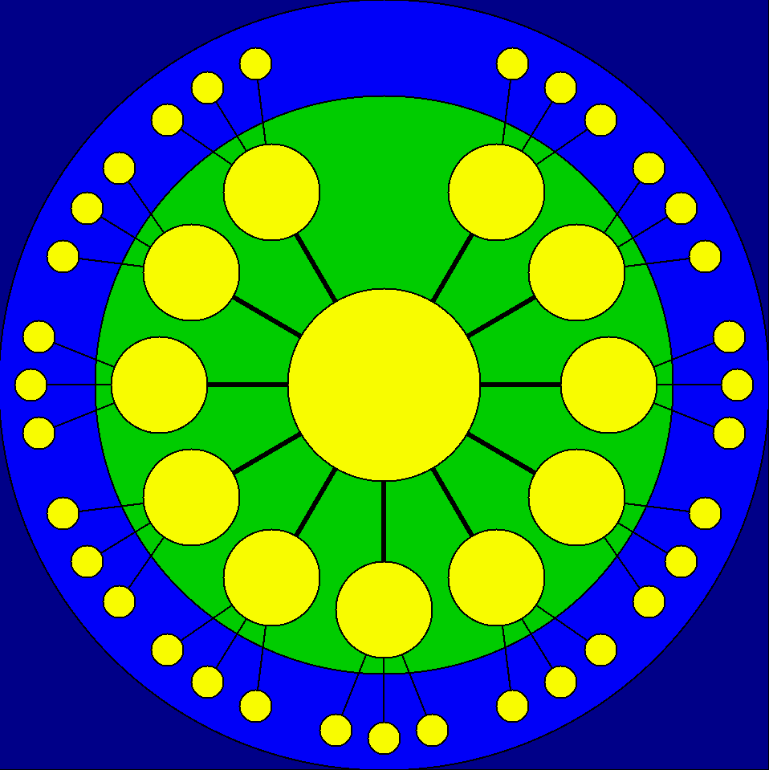
The WLCG answer
160+ computing centers
  30+ countries
Hierarchical and regional organization
15 large centers for long- term data management
  CERN = Tier-0
  14 Tier-1 centers
    South Korea: KISTI
    Russia: JINR, NRC-KI
  Fast network links
60+ federations of 140+ smaller Tier-2 centers
Tens of Tier-3 sites
  Resources outside of WLCG policies
Tier-2
sites
Initial
Tier-1
centers
Canada
TRIUMF
Taipei
ASGC
NL
SARA-
NIKHEF
USA
BNL
UK
RAL
Tier-0
CERN
France
CCIN2P3
Spain
PIC
Italy
CNAF
Nordic
countries
NDGF
USA
FNAL
Germany
KIT

Slide 15
The WLCG evolution
Fast networks allow for direct transfers between:
  Tier-1 sites
    Also providing backup routes since years
  T2 in the same region
  T2 and T2/T1/T0 in different regions
Set of fast network hubs connecting many T2 to many T1 and T0
  LHCONE = LHC Open Network Environment
T1 and T2 sites keep their different responsibilities
Tier-2
sites
Tier-1
centers
Tier-0
CERN

Slide 16
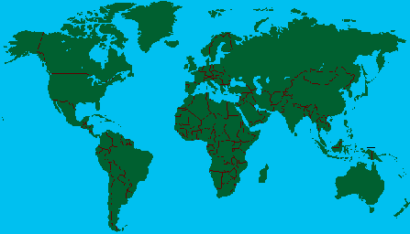
WLCG Tier-1 centers

Slide 17
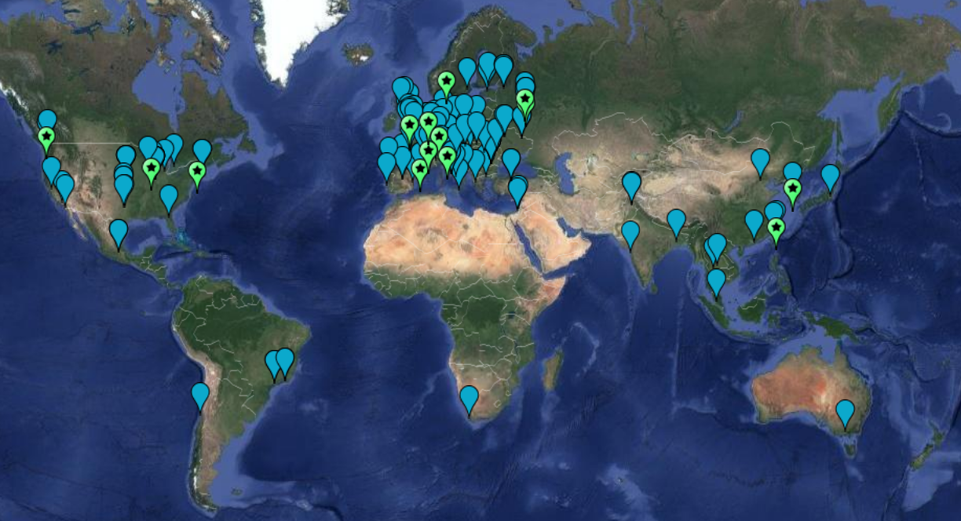
WLCG sites

Slide 18
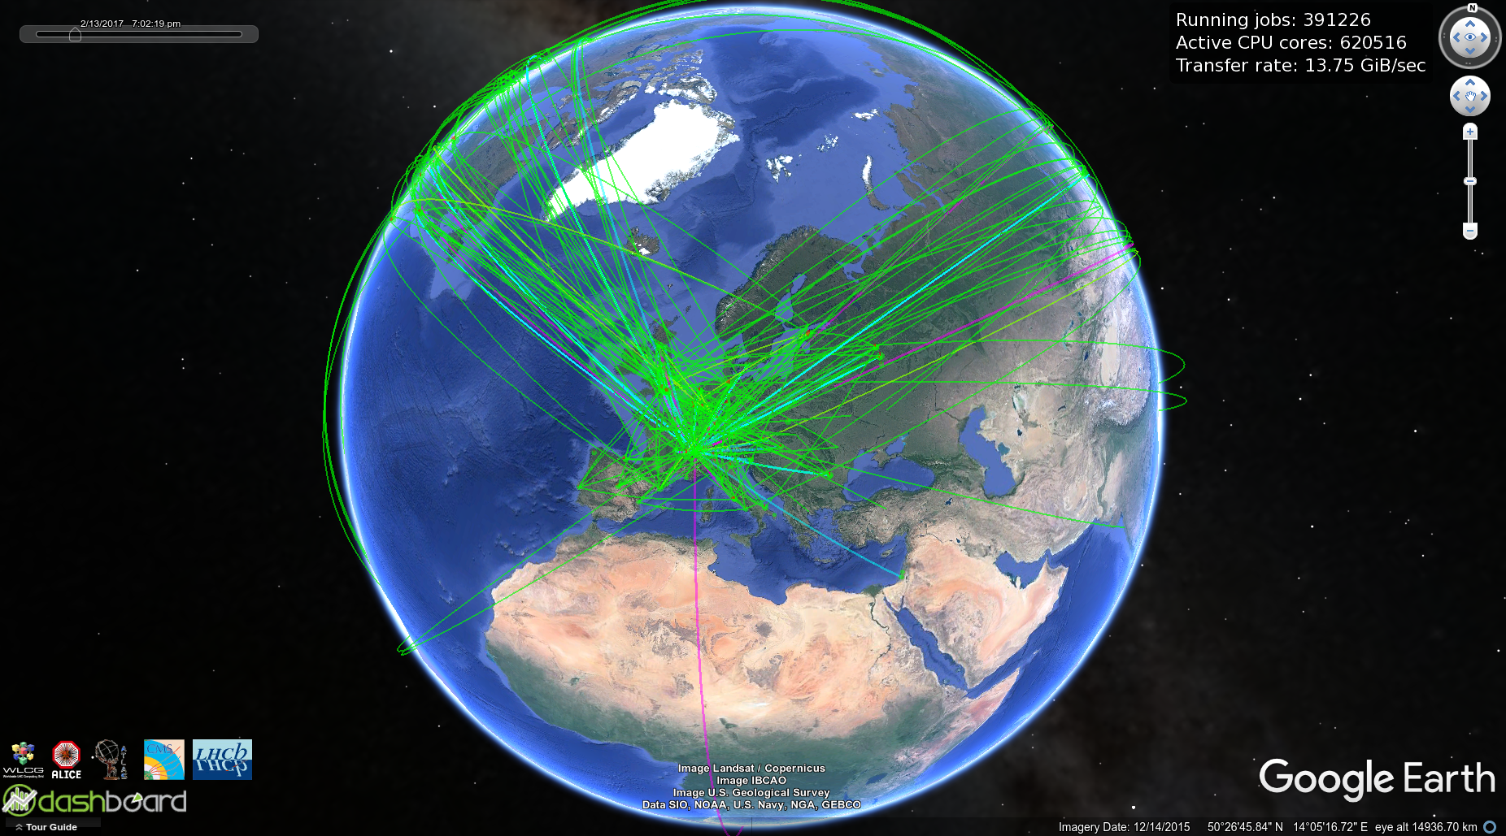
WLCG in action

Slide 19
Conclusions
Grids facilitate collaboration between members of supported distributed communities
Grids allow distributed resources to be shared uniformly and securely for common goals
Grids may have complex infrastructures
Grids are useful for many scientific disciplines and projects
The Worldwide LHC Computing Grid is vital
for the success of the LHC experiments !

Slide 20




More information
wlcg.web.cern.ch
www.egi.eu
www.opensciencegrid.org
www.ndgf.org

