Slide 1
Introduction to I.FAST: goals and structure
Maurizio Vretenar, CERN
Project Coordinator
Period 1 Review, 07.02.2023

Slide 2
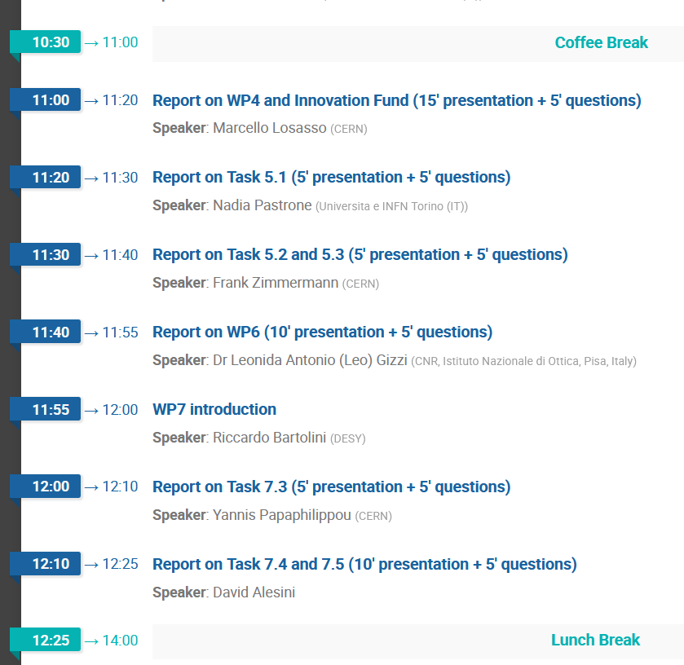
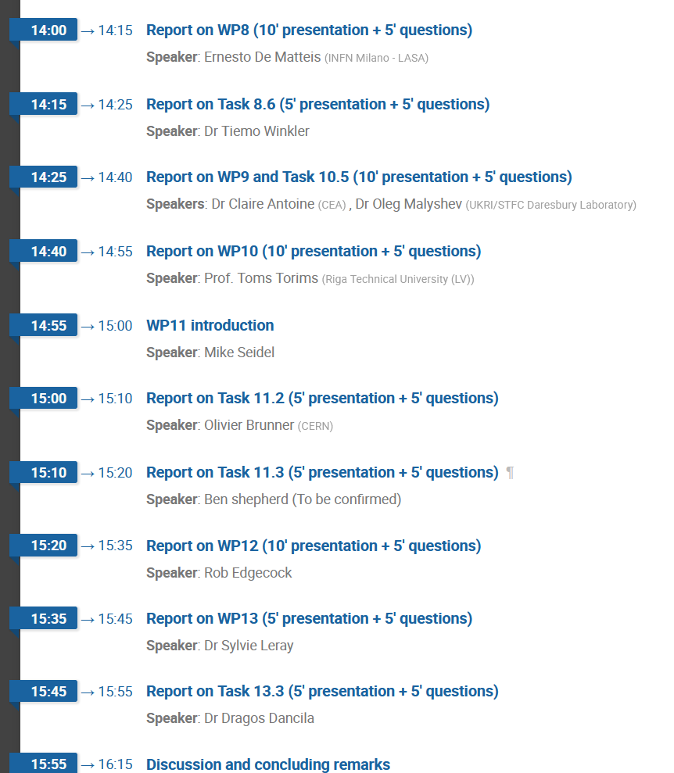
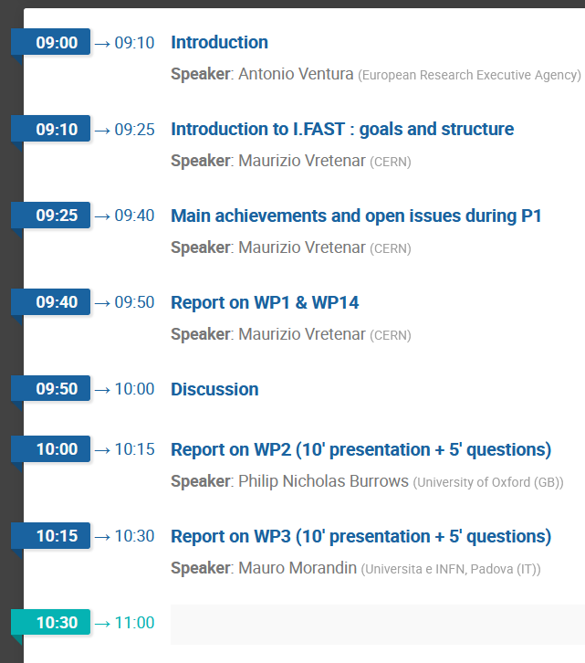
Programme of the Review
To all speakers:
Please respect your time allocation and leave enough time for questions!

Slide 3
Introduction by Project Coordinator
Wider objectives and genesis of I.FAST: to introduce the collection of activities that will be presented into a coherent global picture.
Overview and highlights of Period 1: Milestones and Deliverables, delays, achievements, critical issues.
Report on WP1 and WP13: governance, management, risks, ethics.

Slide 4

I.FAST and Particle Accelerators
Innovation Fostering in Accelerator Science and Technology
An Innovation Pilot, supporting Innovation in Particle Accelerator technologies.
Comes after 4 successful Integrating Activities (CARE, EuCARD, EuCARD2, ARIES) started in 2004.
Particle accelerator community entering the age of open innovation:
Sharing of ideas between scientific institutions and companies, to improve high technology products and to identify new products and markets.
Creation of an innovation ecosystem
(Keywords: community, trust, openness, creativity, connection to industry)

Slide 5

Wider goal and Consortium
Wider goal (from the Commission’s Work Programme):
“Demonstrate the role of Research Infrastructures in the
translation of Open Science into Open Innovation”.
Consortium of 48 beneficiaries
  8 large RI operators,
  12 national research centres,
  12 universities,
  16 industrial partners (1/3, including 11 SMEs)
from 15 European Countries, supported by 12 partner organisations and >20 collaborating institutions, working on 40 R&D Tasks to develop a portfolio of technologies for the next generation of particle accelerators.
Timeline: 4 years, starting 1 May 2021.
Resources: 10 M€ EC contribution, out of a total project cost of about 19 M€ (co-funding principle).

Slide 6
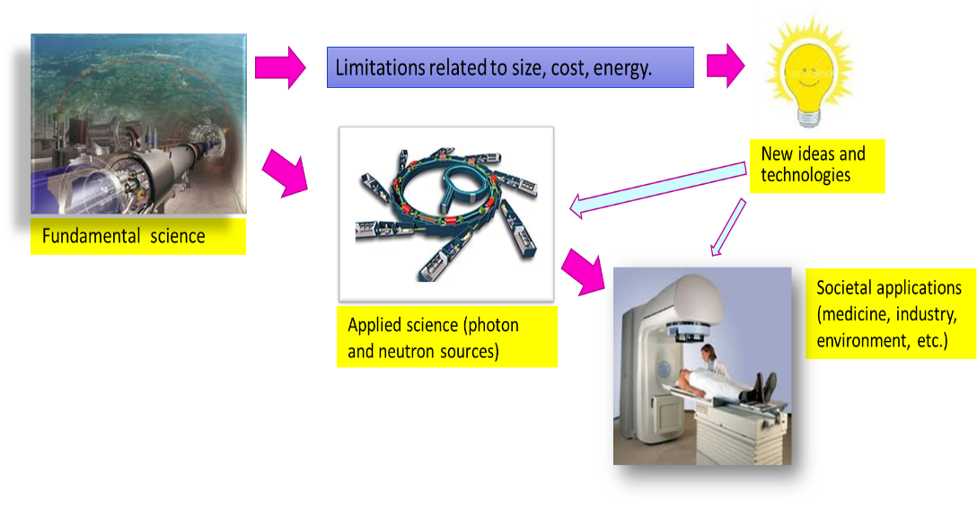
The role of I.FAST in accelerator research
For the entire XX century, fundamental science as driving force for the development of new accelerators, with its continuous quest for higher energies required to discover new particles.
Today, extrapolating present technologies to reach new physics goals may soon bring accelerators towards the limits of sustainability (dimensions, complexity, cost, energy consumption).
In parallel, increasing demands are coming from accelerators for applied science (photon and neutrons) and healthcare, while new societal applications are appearing.
The scientific goal of I.FAST is to support the development of new more sustainable technologies for basic and applied science, promoting at the same time the transfer of these technologies to society and to a wider accelerator market.

Slide 7
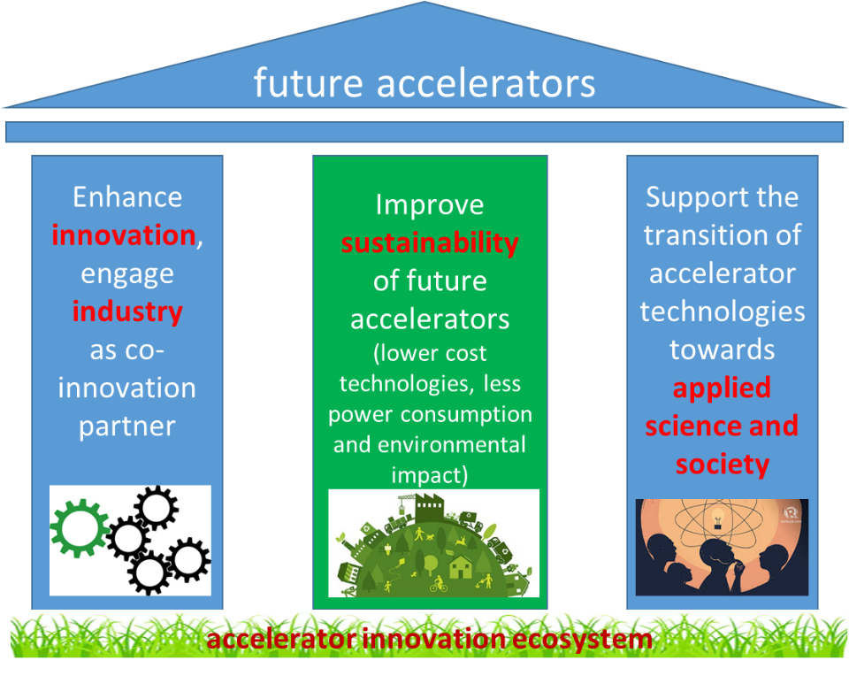
The three I.FAST pillars
These goals correspond to the three I.FAST «pillars», which defined the priorities given in the selection of I.FAST activities following the bottom-up call.
Additional focus areas: training and management of technology infrastructure.
This strategy is coherent with the priorities announced in the 2020 Update of the European Strategy for Particle Physics, and more at large with the priorities of the particle accelerator user communities.
From the EC
From the accelerator community

Slide 8
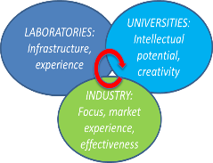
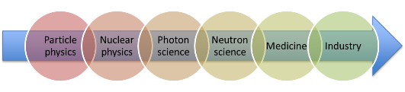
I.FAST Priorities
A project made of “co-innovation” R&D activities with industry, at different Technology Readiness Levels (TRL).
On three priority lines:
  Transversality, exploiting synergies between accelerators for different users: particle and nuclear physics, photon and neutron science, medicine and industry.
  Collaborative schemes involving laboratories, university and industry.
  Priority to long-term R&D topics, beyond the specific needs of approved projects and developments.

Slide 9
Genesis and structure of I.FAST
Bottom-up call in 2019, 101 proposals submitted for:
  Strategies: study groups to define “roadmaps” for specific technologies.
  Prototypes: construction with industry of prototypes at high TRL, with EC contribution ~ 500 k€.
  Developments: development, often with industry, of technologies at lower TRL, with EC contribution ~ 100 k€.
37 proposals selected by a special Committee on the basis of scientific excellence and coherence with the priorities of the accelerator community.
Proposals grouped in 9 “thematic areas” (Work Packages), each made of a strategy with one or more prototypes and developments.
4 “transverse” WPs (Coordination, Training, Industry, Innovation).
1 M€ for a second internal call for proposals in 2023-25.
WP
1 | Coordination, dissemination
2 | Training, communication, outreach
3 | Industry engagement
4 | Managing Innovation, new Materials
5 | New concepts, performance improvements
6 | Novel particle accelerators concepts and technologies
7 | High brightness synchrotron light sources
8 | Innovative superconducting magnets
9 | Innovative superconducting cavities
10 | Advanced accelerator technologies
11 | Sustainable concepts and technologies
12 | Societal applications
13 | Technology Infrastructure
14 | Ethics Requirements
9 thematic areas
Each of the 37 proposals becomes a Task

Slide 10
The I.FAST Structure
The result of this selection process is a large project covering many topics, where Coordinator and WP Coordinators provide the coherence.
In this Review, in some case the WP Coordinator will present all his Tasks, in other cases where technical aspects are prevailing, the activity will be presented by the Task Leader.

Slide 11
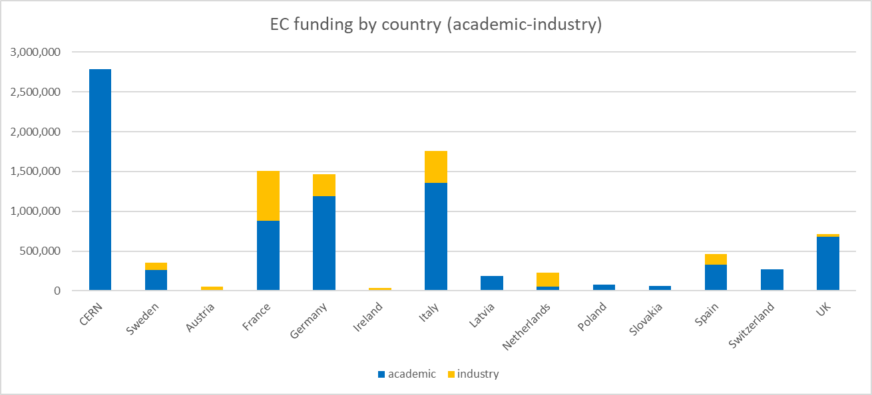
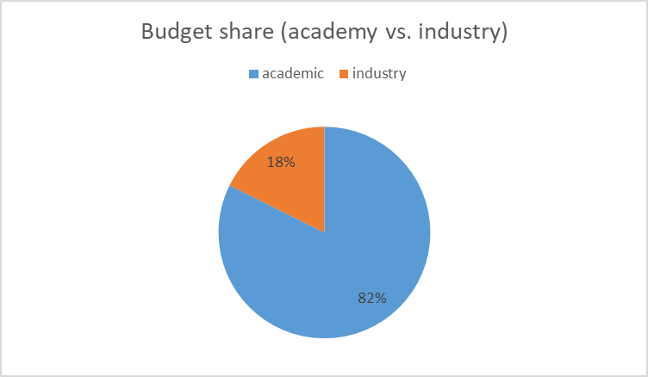
I.FAST Budget
Counting only the R&D WPs (4-13), industry share is 24%
Note: CERN has 1.834 M€ of «coordination» budget (management, communication, KT, Innovation Fund). R&D part (WP 4-13) is only 955 k€.
Overall funding rate 44% (ratio EC contribution / total cost)
22.7 M€ total project cost

Slide 12
Thank you for your attention!

Slide 13
Results, achievements and issues in Period 1
Maurizio Vretenar, CERN
Project Coordinator
Period 1 Review, 07.02.2023

Slide 14
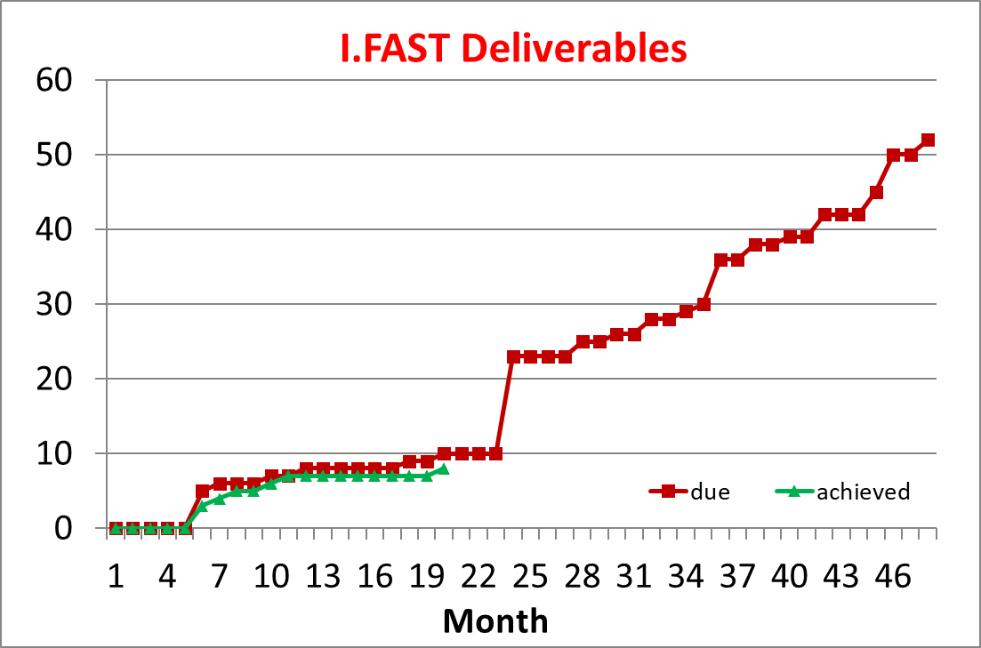
Status of Deliverables
9 Deliverables achieved out of 10.
Only one delayed from M18 to M24 because of a shift of activities from CEA to INFN due to late recruitment at INFN:
D8.3 First Engineering design of HTS demonstrator

Slide 15
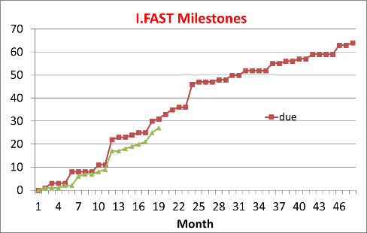
Status of Milestones
27 Milestones reached out of 30.
Three delayed because of minor technical problems or organisational issues with no impact on the Work Plan.
MS46 Performance of Superconductive Cavities made by AM technology by Nb or Cu with Nb thin spattered film on the internal surface, M12 to M30
MS5 ACO workshop, M18 to M24
MS53 Workshop on sustainable materials and lifecycle management for accelerators, M18 to M22

Slide 16
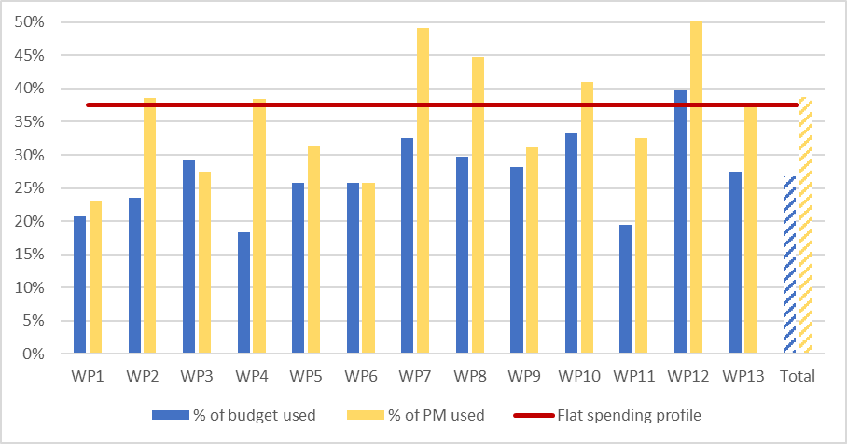
Use of resources – Full costs per WP
Utilisation of personnel and resources for WP1 to WP13 during P1.
The resources cover the full costs incurred by the beneficiaries (EC contribution + matching funds, without overheads) and are shown as percentage of the estimated total man-power and budget for the complete duration of the project.

Slide 17
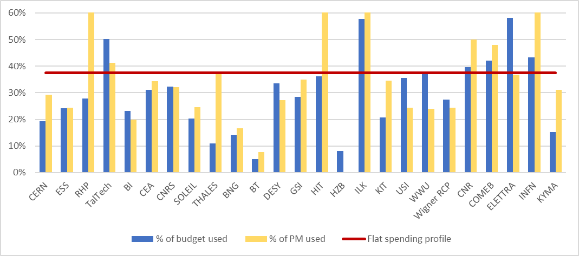
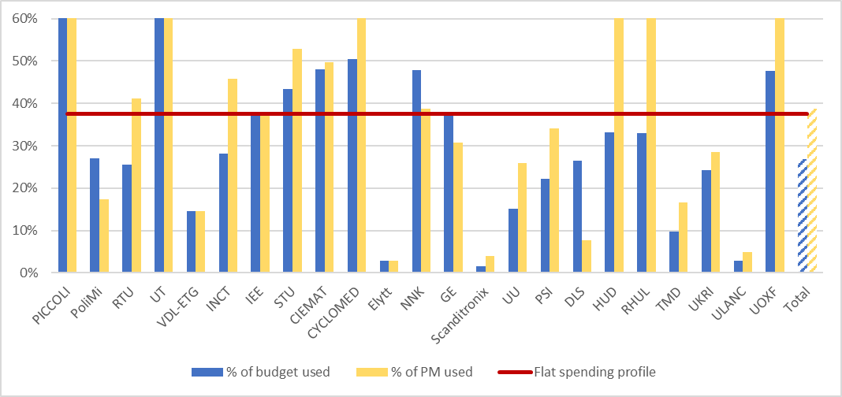
Use of resources – Full costs per Beneficiary
Utilisation of personnel and resources per beneficiary during P1.
The resources cover the full costs incurred by the beneficiaries (EC contribution + matching funds, without overheads) and are shown as percentage of the estimated total man-power and budget for the complete duration of the project.

Slide 18
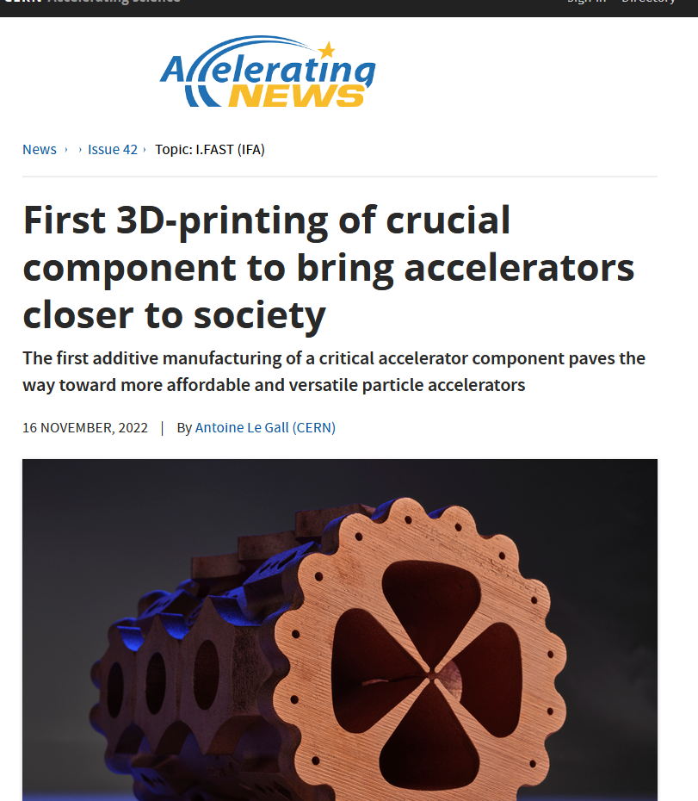
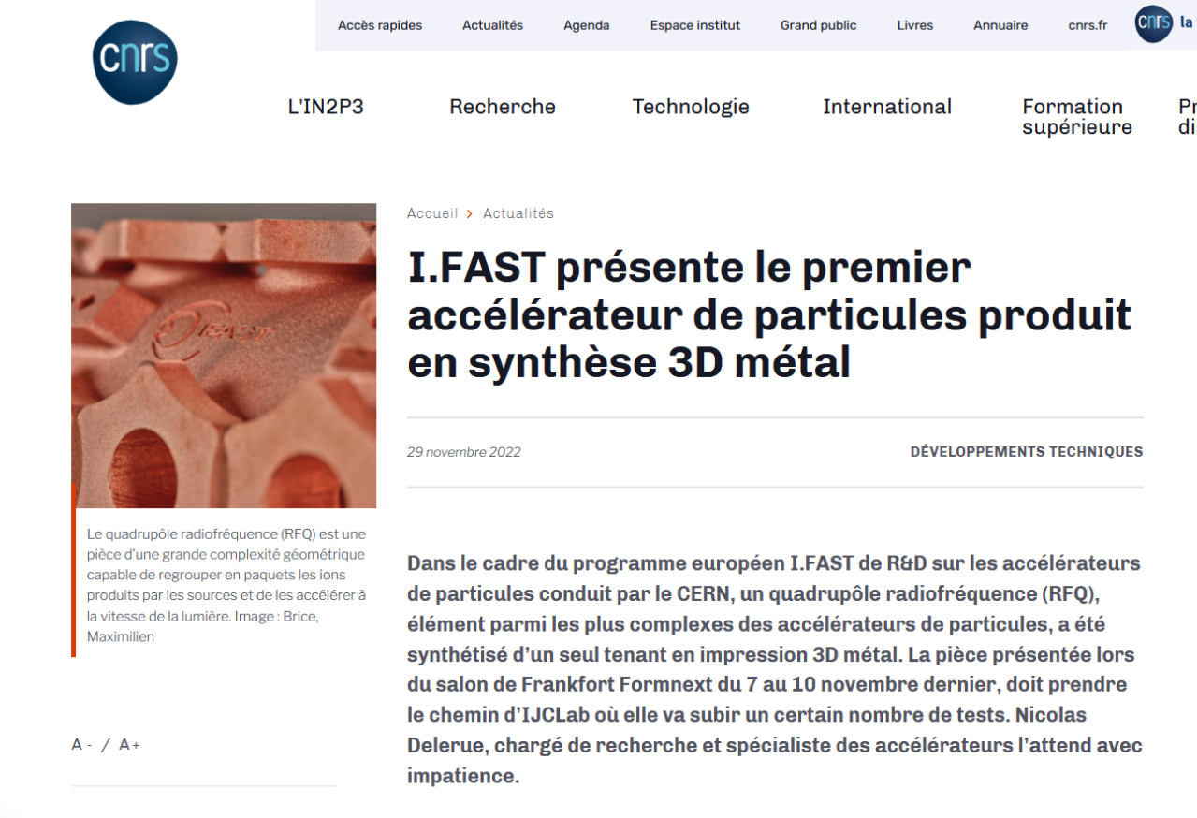
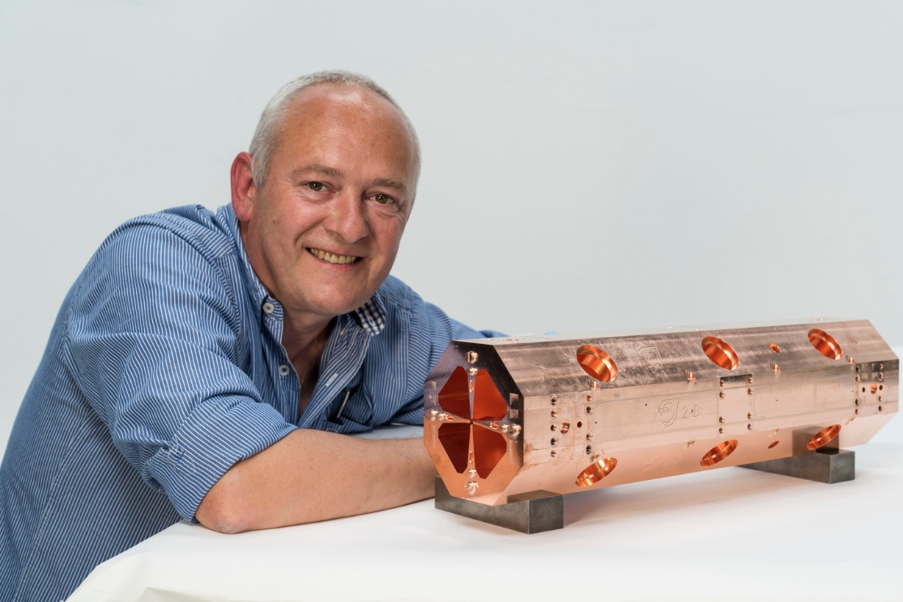
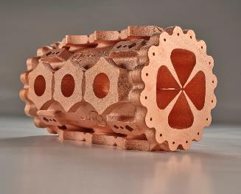
Highlights: Additive-Manufactured RFQ
Task 10.2, Additively-Manufacturing (AM) survey and potential developments.
Aimed at identifying specific needs for AM (3D printing) in accelerators, no prototyping foreseen. At the start of work, the Radio Frequency Quadrupole (RFQ) compact copper linear accelerator for medical and industrial applications was identified as a component that could greatly profit from AM in terms of production time and cost.
The Task has contacted industrial partners, and Trumpf AG has agreed to produce at no cost for the project a full-scale prototype that is being tested by the Task. Trumpf is joining the Consortium as Partner Organisation.
Wide impact: articles, exhibitions, press release, CERN Bulletin, Accelerating News, CNRS newsletter, CORDIS.
The 3D-printed version
The original RFQ, machined and brazed

Slide 19

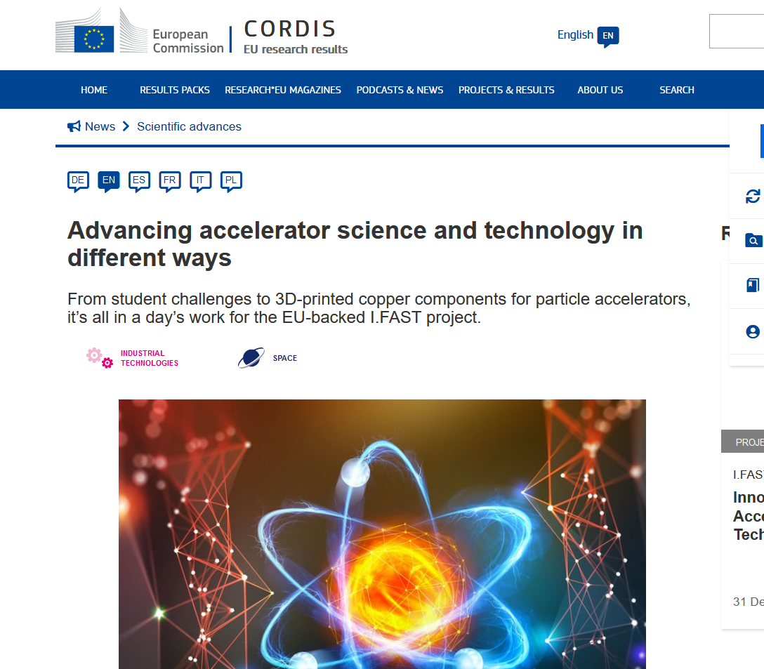
Highlights: Challenge Based Innovation
Task 2.3, Challenge-Based Innovation (CBI) with particle accelerators.
Residential challenge for 24 master students with different backgrounds organised in 4 teams to propose new applications of accelerators for the environment.
Winner: project CYAN for stopping eutrophication (harmful algal bloom) in lakes.
Strong success, projects will be followed-up, articles on CERN Bulletin, Accelerating News and other newsletters, CORDIS. Will be repeated in 2023.

Slide 20
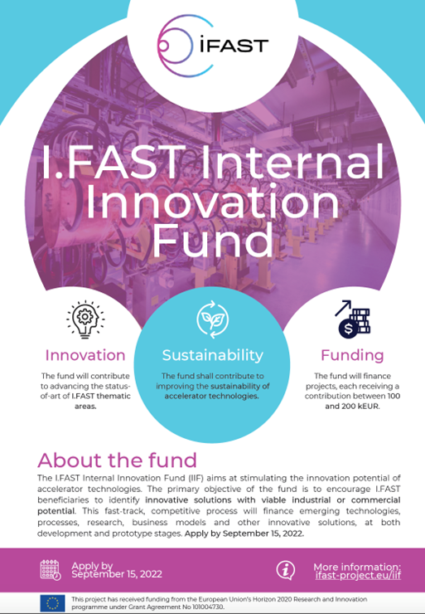
Highlights: the I.FAST Innovation Fund
Task 4.2, Management of the Innovation Fund.
1 M€ funding to an internal competitive call for innovative projects, starting early 2023, for a duration of 2 years. In advance on schedule (awarding at M20 instead of M24)
Funding between 100 and 200 k€ per project;
Consortium: at least one I.FAST beneficiary and one industry;
Initial TRL 3 or higher (from proof-of-concept to laboratory/environment validation);
Project contributes to improving sustainability of particle accelerator technologies;
Project must have potential for industrialisation or commercialisation.
Project must have potential to attract more resources than what deployed by IFAST alone.
18 projects submitted, 8 selected by a 10-member Evaluation Committee:
2 on high-efficiency RF, 2 on superconductivity, 2 on particle sources, 1 on laser plasma acceleration, 1 on additive manufacturing.
Smooth selection procedure and excellent quality of the selected projects!

Slide 21

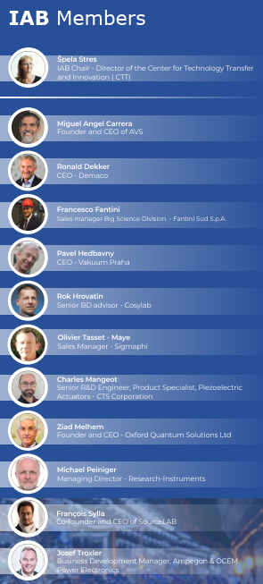

Highlights: Industry participation
Task 3.1 Industry engagement coordination and industrial partnership support
Engagement of industry has been so far excellent:
16 industrial partners,
12 industry members in the I.FAST Industry Advisory Board,
230 registered participants in the 1st I.FAST Accelerator-industry co-innovation workshop, 91 from industry.
Many interesting discussions, resulting in the creation of the “Accelerator Science and Technology Permanent Industry Forum” that will continue after I.FAST. The Terms of reference will be presented and discussed at the next Annual Meeting.
The Coordinator was invited to present the I.FAST industrial strategy at the 2022 International Particle Accelerator Conference (Bangkok, June 2022), at the EPS Forum in Paris, and at the Big Science Business Forum in Granada.

Slide 22

Some problems…
Many minor issues linked with recruitment or loss of critical personnel, remaining Covid impact at the beginning of the Project, minor technical issues, but only one major problem:
The increase of material and energy costs (and related inflation and delays in deliveries) due to the ongoing worldwide crisis.
Strong impact in particular on industry, cost of prototypes to be realised was defined in 2019.
Mitigations: redistribution of work between partners to reduce costs (but increase risks), descoping of some activities (e.g. smaller prototypes), …

Slide 23
Problems: withdrawal of 2 industrial partners
Work Package 8, Tasks 8.4, Construction of a curved CCT magnet demonstrator and Task 8.5, Construction of the HTS CCT demonstrator. They are not yet active, will start after magnet design done in two other Tasks.
Two industrial companies (BNG and Scanditronix) have sent a letter to the Coordinator asking to quit the Project because they “cannot fulfil the milestones to build the requested hardware with the budget available”: “material and energy prices have risen dramatically since the start of the project. We are thus not any more in the position to allocate R&D money for the matching funds into I.FAST.”
Actions:
  Instead of declaring the companies as defaulting partners, the Project is ready to keep them in the collaboration, with 0 or minimum EC contribution, and try to redistribute their work to others.
  Elytt (3rd magnet company in the project) has already agreed to take BNG’s part in Task 8.5.
  We have explored solutions for Task 8.4: internalisation to another I.FAST partner, or another magnet company. Possible descoping and increasing risks (technical and delay).
  A solution has been recently agreed (internalisation to CIEMAT). More details in WP8 talk.
  Implications to be discussed (do we need an Amendment?).

Slide 24
Problems: the Industry training programme
Task 2.4, Industrial Training associated with Knowledge Transfer.
Traineeship programme to support exchanges of personnel between laboratories and industry, by providing grants that could be used for the trainee’s salary, travels and subsistence costs.
The original work plan foresees “training of industrial engineers and technicians at European accelerator development laboratories” – one of the two (industry or laboratory) must be an I.FAST Beneficiary. Original scheme: 10 grants of 8’000 € each.
So far, the scheme had limited success, only 2 successful applications out of 10 positions foreseen.
Analysis of the reasons: companies have limited personnel availabilities to let their young engineers leave for 1 or 2 months.
To solve the issue within the general objectives of the Task, the Project has foreseen to extend the call to transfers in both directions, allowing also young engineers and technicians from accelerator development laboratories to train for 1 or 2 months in an accelerator-related industry.
A call in this sense has been already issued, but before allocating grants we need the support of the Project Officer and possibly of the Reviewer.

Slide 25
Summary of deviations
Section 5 of the Periodic report (Deviations from Annex I) reports a list of delays, all between 3 and 12 months with minor or no impact on the Work Plan.
The only sensitive deviations reported are those mentioned so far:
Modification to scope of Tasks 8.4. and 8.5 to build “combined-function” magnets and not “curved” magnets.
Modification to scope of Task 2.4, to allow Industry Training in both directions.
Modification to Beneficiaries responsible for the deliverables of Tasks 8.4 and 8.5 – details agreed recently, not yet included in the Report.
Integration of the projects awarded with the I.FAST Innovation Fund into the Work Plan (allocation of resources already approved by electronic vote of the Governing Board).

Slide 26
Thank you for your attention!

Slide 27
Report from WP1 and WP14 (Management and Ethics)
Maurizio Vretenar, CERN
Project Coordinator
Period 1 Review, 07.02.2023

Slide 28
WP1 Structure and objectives
Task 1: Project Management, external coordination, sustainability (CERN, RTU): management, Gov. Board, Steering Comm., Annual Meetings, reviews, financial follow-up, reporting, monitoring, strategy for acc. science (with TIARA)
Task 2: Information Flow Management and Cross-coordination (RTU, CERN, GSI): interdisciplinary workshops, information exchange tools.
Task 3: Internal Communication and Dissemination (GSI, CERN, RTU): repositories for documents, organisation of events, publication management.
Task 4: Relations with the other Innovation Pilots (CERN, RTU): coordination.
Goals: smooth functioning of the project, integration of all partners into a wide community covering both academia and industry.

Slide 29
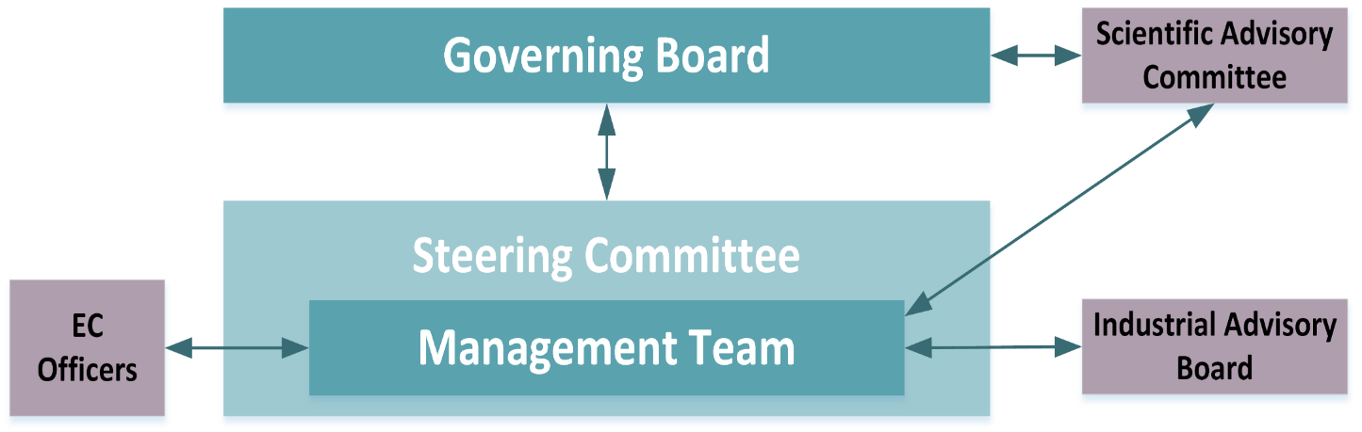
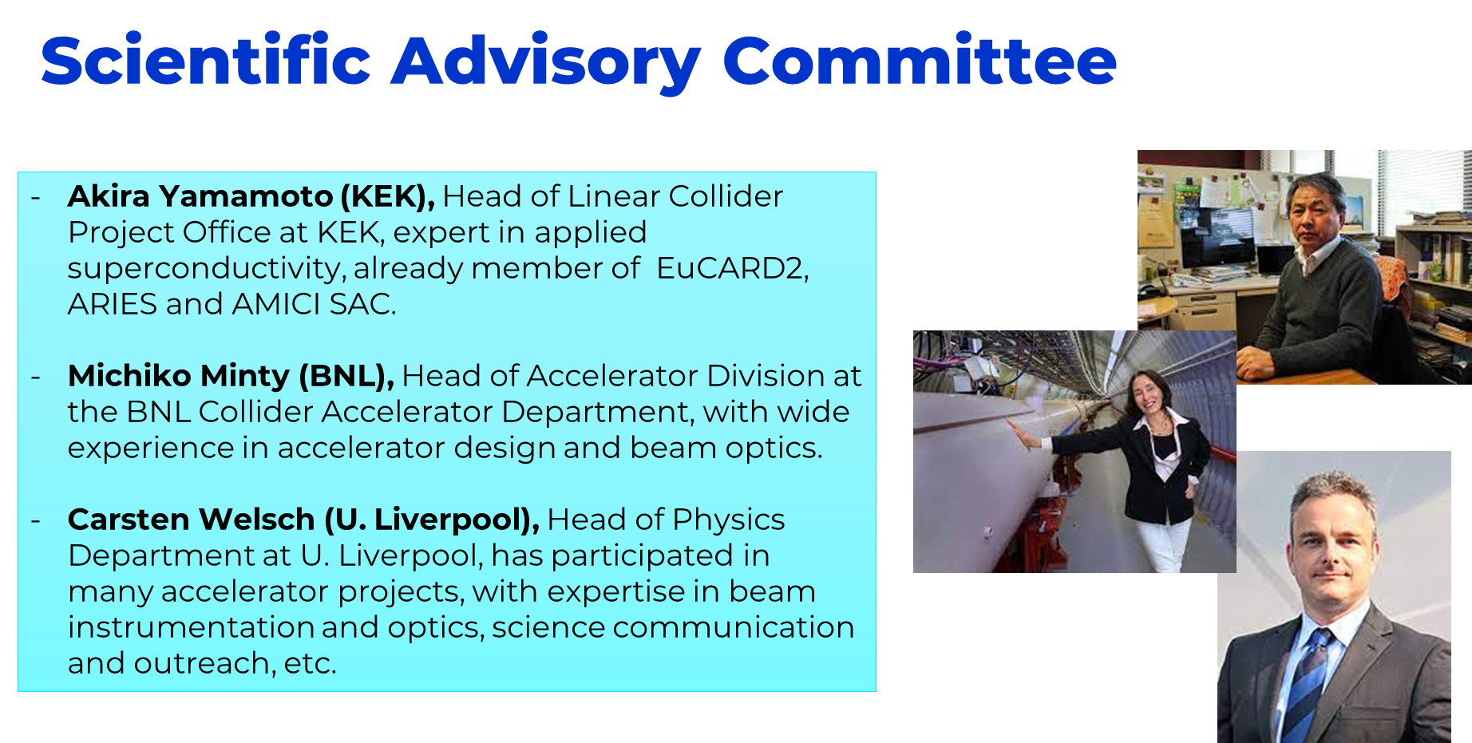
Activities in P1 – management, governance
Establishment of a Consortium Agreement
Set-up of all projects Bodies
All meetings and minutes are registered in Indico: https://indico.cern.ch/category/13033/
So far, 46 events in 20 months.

Slide 30
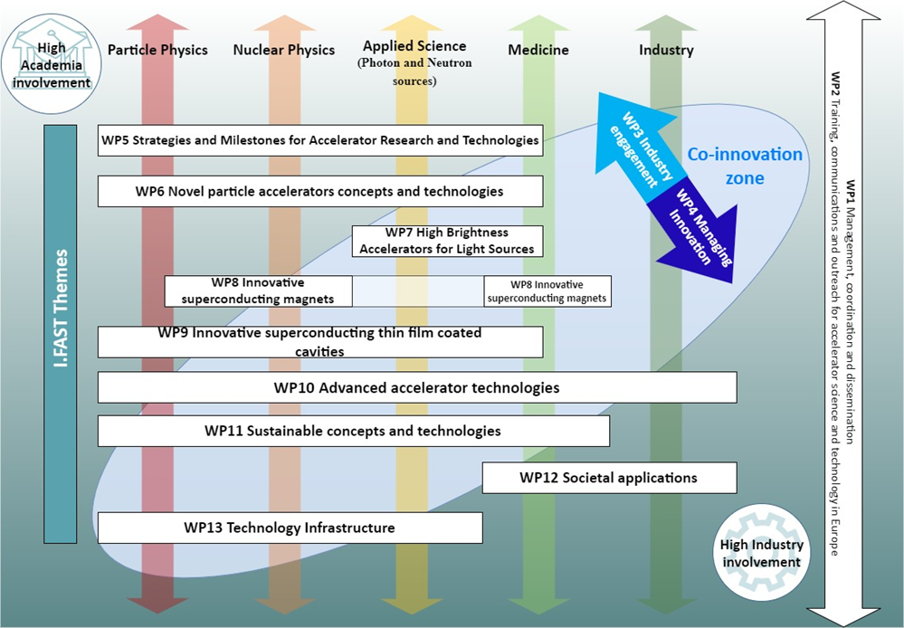
Activities in P1: information flow, dissemination
SharePoint site to exchange information and follow milestones and deliverables: : https://espace.cern.ch/project-IFAST-Intranet
“Transverse” workshops: Additive Manufacturing in Y1, Artificial Intelligence and ML in Y2.
All notes and publications in Zenodo (open access) https://zenodo.org/communities/ifast
Web site for general information https://ifast-project.eu/ .
So far, 69 publications on Zenodo (average of 3.45/month).
9 meetings of the INFRA-INNOV Coordination (I.FAST, AIDAinnova, LEAPSinnova: coordination of industry events, common strategy for proposing future calls.

Slide 31
Deliverables and Milestones P1
In Period 1, WP1 had 2 Milestones and 2 Deliverables:
Milestone MS1: Information Flow management tool installed (planned M3, achieved M5)
Milestone MS2: Dissemination plan (planned M3, achieved M7)
Deliverable D1.1 RI Co-Innovation platform MoU (planned M6, delivered M8)
Deliverable D1.2: Internal communication plan (planned M6, delivered M6)
Relevance of objectives and impact
All objectives are still relevant
The impact of I.FAST is going beyond the boundaries of the project, for example in the definition of the new Work Programmes of Research Infrastructures.

Slide 32
WP14 (Ethics) Deliverables
Deliverable 14.1: Protection Of Personal Data, delivered on M6
DPO appointment, creation of Privacy Notice, etc.
Data protection at I.FAST follows CERN Op. Circ. 11, fully compliant with EU Regulation 2018/1725.
Deliverable 14.2: Environmental Protection Questions, delivered on M7
List of environmental and health hazards for I.FAST compiled after an extensive survey into a risk register, regularly updated. Risk categories: Ionising radiation, Non-ionising radiation, Electrical, Mechanical, Chemical, Flammable gas.

Slide 33
Diversity in I.FAST
Nominated a Diversity Officer (Y. Foka, WP13 Coordinator), web page https://ifast-project.eu/diversity
Diversity in the broadest sense is crucial for creativity and innovation I.FAST: synonym of diversity
  Diversity considerations in the most broad sense regarding:
  nationality/culture, competences/profession, age/generation, gender,
  individual differences such as ethnic origin, belief, sexual orientation or disability
  I.FAST collaborators from different nationalities and cultures, different professions/disciplines, including experienced professionals and young generation, from research institutes, academia, industry.
I.FAST statement on Gender Imbalance:
General observation and acknowledgement of Gender imbalance in STEM
  - with physics and engineering largely below average
  in business/enterprise sector severely under-represented
I.FAST general status on Gender Imbalance
relative to previous Integrating Activity projects
  - larger female researcher’s participation from academic partners
  - very few female researchers present in the 17 industry partners

Slide 34
I.FAST opportunities and Gender Imbalance
I.FAST offers a good opportunity to:
  - understand reasons for disparity
  discuss ways to improve situation
  discuss with industry partners: academia/research/industry attitudes
I.FAST suggests and encourages:
pro-active measures in sourcing and pre-selection recruitment stages
(addressing gender distribution in project teams)
enable women in decision-making positions appointing women in leadership roles
make women contributors visible as speakers: provide role models
encourage outreach events, with participation of women, targeting young scientists including women
encourage participants to ensure working environment that allows work/life integration,
family-friendly policies (e.g. avoid meetings after 17:30)
communicate experiences and best practices in gender policies

Slide 35
Thank you for your attention!

Slide 36
Backup slides

Slide 37
I.FAST Governance and management
Body | Composition | Goal | Meetings
Governing Board | Representatives of all parties | Changes to contract, financial matters | 1 / year
Steering Committee | All WP Coordinators | Scientific decisions on work programme | 2 / year
Enlarged Steering Comm. | WP Coordinators + Task Leaders | Information, feedback on activities | 2 / year
Project Management Team | Coordinator, 2 Deputies, Admin. Manager, Assistant, Comm. officer | Day-to-day follow up of administrative, financial and communication issues | 6 / year
Advisory Bodies | Experts nominated by Gov. Board |  | 1 / year

Slide 38
Integrating Activities for accelerators and the new Innovation Pilot I.FAST
Long tradition of EC support to particle accelerator R&D: four successful Integrating Activities have raised 43 M€ EC funding over 16 years (2.7 M€/yr).
FP6
CARE 01/2004 – 12/2008
5 years, 15.2 M€ EC contribution
EuCARD 04/2009 – 03/2013
4 years, 10.0 M€ EC contribution
Integrating Activities (and Innovation Pilot): Development of cross-boundary subjects, not directly followed by large laboratories, with added value coming from collaboration and sharing of resources.
FP7
Integrating Activities
EuCARD-2 05/2013 – 04/2017
4 years, 8.0 M€ EC contribution
I.FAST is a new step in this progress, including for the first time a large industry representation (1/3 of participants!)
ARIES 05/2017 – 04/2022
5 years, 10.0 M€ EC contribution
H2020
Innovation Pilot
I.FAST 05/2021 – 04/2025
4 years, 10.0 M€ EU contribution

Slide 39
The I.FAST Consortium
Partner organisations
Industrial Partners:
RHP Technologies
Bergoz Instrumentation
Sigmaphi (magnets)
Thales
BNG (magnets)
Barthel HF-Technik
ILK
XILNIX
COMEB
KYMA
VDL-ETG
CYCLOMED
Elytt (magnets)
NNK
GE
Scanditronix
TMD
48 beneficiaries (16 industry, 33%)
20 Partner Organisations
>20 collaborating institutes

Slide 40
Use of resources – EC requested funding
Benef. No. | Under-claiming (<20%) or Over-claiming (>60%) | Justification
3. RHP 41. PSI | PM RHP: 65% PM PSI: 77% Personnel costs PSI: 72% | The Financial Statement includes full costs in effort and personnel costs, which was not foreseen in Annex 2. But only a fraction of the full costs is requested for EU funding on the Financial Statement (Requested EU contribution < Maximum EU contribution)
4. TalTech 5. BI 42. DLS | 19-20% | Slight under-claiming due to slow start of the project (covid and/or slight delays)
9. THALES 19. WWU 44. RHUL | 0% 10% | The use of resources is not linear during the project, and not limited to EU contribution as outlined above. They will claim EU contribution (mostly) as of Reporting Period No. 2.
15. HZB | 6% | Delays due to major maintenance of the HZB cryo plant
47. ULANC | 8% | Delays due to recruitment issues
11. BT 36. Elytt 39. Scand. 45. TMD | 9% 3% 2% 10% | The activities are not linear during the project, and are mostly planned for the 2nd half of the project. NB: Scanditronix will step out of the project and keep only but an observer role.
14. HIT 26. PICCOLI | 90% 111% | The activities are not linear during the project, and are mostly planned for the 1st half of the project.
29. UT | 163% | The use of resources is not linear during the project, and not limited to EU contribution as outlined above. They will not claim EU contribution after Reporting Period No. 1.
Deviations on requested EU contribution compared to flat-spending profile.

Slide 41
Use of resources – EC requested funding
Benef. No. | Higher APC (> 120%) or Lower APC (< 80%) | Justification
3. RHP 4. TalTech 11. BT 14. HIT 26. PICCOLI 35. CYCLOMED 43. HUD | 69% 30% 66% 78% 79% 57% 37% | Less experienced staff are working more than planned, under the supervision of senior researchers/engineers. In addition, senior staff personnel costs are not claimed to the EC for some cases, such as TalTech.
25. KYMA | 79% | More labor hours from staff at the Linked Third Party (LTP) are used than planned, and the LTP has a lower average personnel cost.
31. INCT 33. STU 36. Elytt 39. Scanditronix 40. UU 48. uu | 73% 77% 47% 64% 75% 57% | The use of resources is not linear during the project, and for this first period, they involved more junior staff than initially planned. NB for STU: in addition to this, a valorisation of personnel costs, planned at proposal stage, could not happen due to political situation in Slovakia also connected to global situation in Europe and war in Ukraine. NB for Scanditronix: more senior staff was planned to work later in the project, but as outline above Scanditronix will step out of the project.
5. BI | 129% | Salary increases and incentive plan related to the R&D were not part of the budget estimation
12. DESY 20. Wigner RCP | 159% 204% | The work for I.FAST in P1 was performed by senior scientists NB for WIGNER, this is also due to exchange rate and unforeseen increased personnel costs
Deviations on average personnel cost (€/PM) compared to GA and annexes.

