Slide 1
P1 Report on WP4
Promoting innovation
M.Losasso (CERN)
F.Carra (CERN), L.Notari (La Sapienza), M.Pasquali (L Sapienza), M.Tomut (GSI)
I.FAST Period 1 Review, 07.02.2023

Slide 2
WP4 - Promoting Innovation - objectives
WP4 promotes innovation by structuring and implementing an internal funding (IIF) for financing cutting-edge innovations explored within I-FAST.
The IIF is a competitive call for innovation-oriented projects in collaboration with industry. Performed starting from Y2 of the I.FAST. Its allocated budget allows supporting 5 - 10 projects. WP4 shall manage the fund and monitor the advancement of the funded projects assessing results and properly allocation of resources according to established workplans.
WP4 fosters collaboration within I.FAST and with other EC communities
WP4 is engaged in collaborative R&D projects with industries:
GRAPH&BEAMWIN: a project to develop beam windows for next generation of accelerators, and
  Innovative material industrial developments: a project to identify and manufacture sample of materials with extensive thermophysical characterization

Slide 3
WP4 - Summary of activities in P1
WP4 task 4.1 and 4.2- CERN,CNRS,HUD,INFN -has:
defined the Internal Innovation Fund (IIF), its participation rules, timeline, evaluation procedure and committee, and has advertised and launched the Call for Proposal (CfP)
started the selection among the 18 submitted projects
→ These activities are objects of coming D4.1 (submitted) and D4.2 (in editing, will be submitted end of Feb. : 2M in advance)
WP4 task 4.3 - CERN, GSI,WWM, RHP, UDS- has:
Developed a study to identifying materials able to be used for beam windows in different accelerator applications.
Irradiation tests have been carried out in GSI for selected beam windows samples materials
→ These activities are objects of MS13
WP4 task 4.4 – CERN, NNK,RHP- has:
Defined the technical specification for new Carbon Composite Materials. Produced material samples
Five plates of Molybdenum- Graphite and Chromium-Graphite materials produced and characterized.
→ These activities are objects of MS14

Slide 4
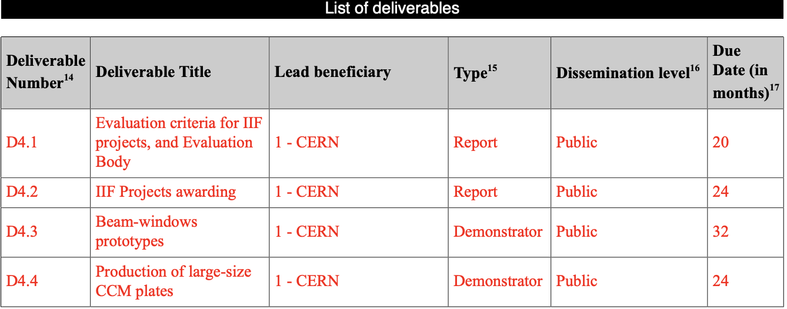
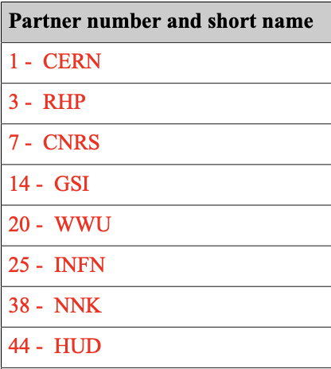
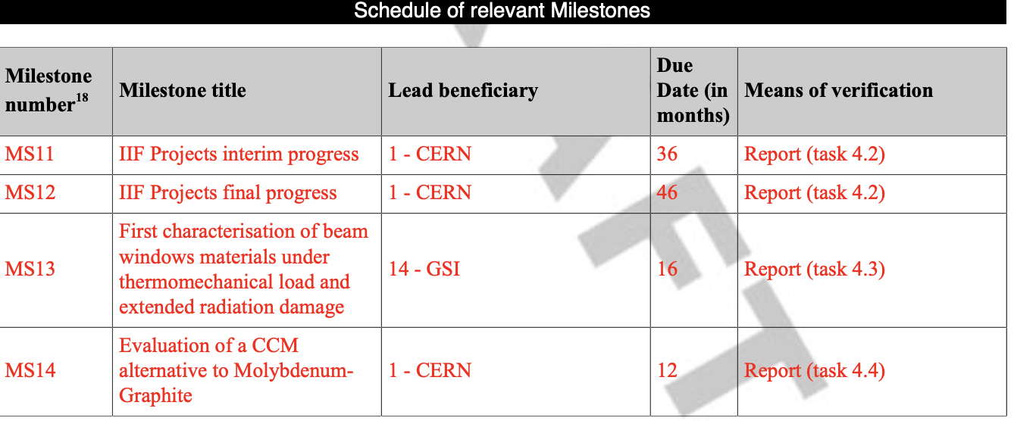
WP4 - structure in 4 Tasks, 4 Deliverables - 4 Milestones
Task
Leader
industry
M.Losasso
submitted
M.Losasso
in editing
M.Tomut, M.Losasso
industry
F.Carra
UDS (Universita’ della Sapienza)
added as collaborating institute after I.FAST start
Industries are partners of I.FAST directly working in Work Plan implementation
achieved
achieved

Slide 5
Task 4.1 / 4.2 Task leader: M.Losasso
Define criteria of selection,
Propose Evaluation Committe
CERN supported by INFN and CNRS
approval
STC, GB approves
Call for Proposal
Set-up, prepare and manage Call for Proposal
Monitoring
WP4 monitors project selected, verifying that money is spent according to scope and used in effective and proper way.
Defined criteria for evaluation of projects for IIF – presented and discussed in Feb and March 2022 STC
Appointment of an evaluation body (EvB) for IIF. Proposal discussed in April STC, approved by GB in May 2022
Launch and Manage the CfP
EvB has scored and proposed to GB projects for award. Projects evaluated from Sept to Dec 2022, proposed for award to Jan. 2023 GB
Beneficiary: CERN, HUD, CNRS, INFN
These activities are objects of submitted
D4.1 and D4.2 (in editing)

Slide 6
IIF: aim and objectives
Based on ARIES acquired experience:
  to promote innovative initiatives of I.FAST community in the phase 2 of project, connecting accelerator community and society at large
  to sponsor fast-tracked, competitive and innovative projects directed towards the 8 thematic I.FAST areas
IIF finances innovative projects: development and/or prototypes, contributing 100 to 200 K€, till the reaching of budget cap (1.2 M€)
Managed in 2 rounds of evaluation, projects to start beginning of 2023
Projects selected in round 1 that will not make to round 2 will be all the same advertised and promoted in IFAST community and in our networks

Slide 7
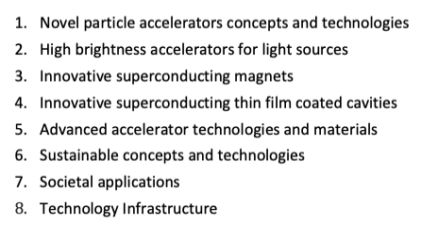
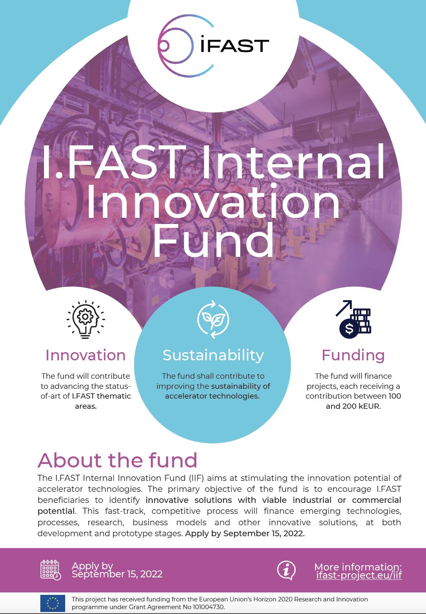
IIF: rules of engagement, timeline, guidelines in web page
Requirements for eligibility
IFAST thematic areas
Participants must include 1 IFAST beneficiary, at least 1 industry
must have potential to attract resources
Must be related to the key Thematic Areas of I.FAST
Proposals must contribute to improve sustainability of future accelerators
The idea or concept must have potential for industrial or commercial application
Almost deployable-ready technologies: technical maturities at least TRL4 (validated in laboratory)
Disclose the call: IFAST AM and Industrial Workshop | May 2, 2022
Deadline for submission of proposals | August 31, 2022
Deadline for first round of evaluation | September 30, 2022
Deadline for second round of evaluations | November 30, 2022.
https://ifast-project.eu/iif
Submission form
Pitch form to present
Timeline
Selection Criteria
Guidelines to CfP

Slide 8
Selection Criteria & EvB
EvB
C. Antoine/ CEA, WP9 Coordinator
G. Bisoffi/ INFN, WP4 member
M. Baylac/ CNRS, WP4 member
A. Faus Golfe/ IAB chair
P. Fork, GSI/ WP5 Coordinator
R. Geometrante/ Kyma SpA (Beneficiary)
Z. Melhem/ Oxford QS Ltd, IAB member
M. Losasso/ CERN, WP Coordinator, EvB chair
M. Morandin/ INFN, WP3 Coordinator
M.Vretenar/ CERN, I.FAST Coordinator
Quality with 3 sub-criteria
  Innovative Aspect of the proposal
  Clarity and Pertinence of the objectives
  state-of-the-art and demonstration of innovation potential
Impact with 3 sub-criteria.
  capacity to create new market opportunities, to reinforce competitiveness and growth of companies or bring other important benefits
  measures to disseminate and exploit the project results, including management of IPR
  How it is addressed sustainability and reduced environmental impact
Implementation with 3 sub-criteria.
  soundness of the concept, credibility of the proposed methodology in terms of meeting specific market needs. Credibility and soundness of the Industrialization /Business Plan.
  Quality and effectiveness of the work plan, including extent to which the resources assigned to work packages are in line with their objectives and deliverables: credibility and soundness of budget plan and schedule and of industries involvement.
  Capability to mobilize additional resources
The use of:
harmonized criteria in EvB
not-for-conflicting process
transparent methodology
Has ensured a fair and effective competition

Slide 9
Task 4.3 GRAPH&BEAM project – M.Tomut, M.Losasso. Beneficiaries: GSI,CERN,WWU, RHP, UDS
Achieved
Milestone/Deliverable Number | Title | Lead beneficiary | Type | Dissemination level | Due Date (in months)
MS13 | First characterization of beam windows material under Thermomechanical load and radiation damages | GSI | Report | Public | 16
D4.3 | Beam windows prototypes | GSI | Demonstrator | Public | 32
D4.3 description
Beam windows are exposed to extreme level of radiation, temperature, thermal stresses, dynamic pressure, and stresses conditions. WP4 tasked to develop beam windows able to sustain high intensity beams, to identify and characterize samples the best available materials in representative radiation environment
To come
Status
L.Notari (La Sapienza University) hired to study materials eligible for application of beam windows, under supervision of M.Pasquali. Beryllium, Titanium and Titanium alloy, Steels, INCONEL 718, Aluminium alloys, and Graphitic materials have been selected. Thesis degree prepared and uploaded in Zenodo.
Figure of Merit for beam windows defined, thermal structural analysis performed, irradiation experiment performed at GSI on material samples procured and manufactured.
Results of the analysis compared with the measurement done during irradiation
Next step: prepare samples of different materials and manufacture/characterize behavior under irradiation

Slide 10
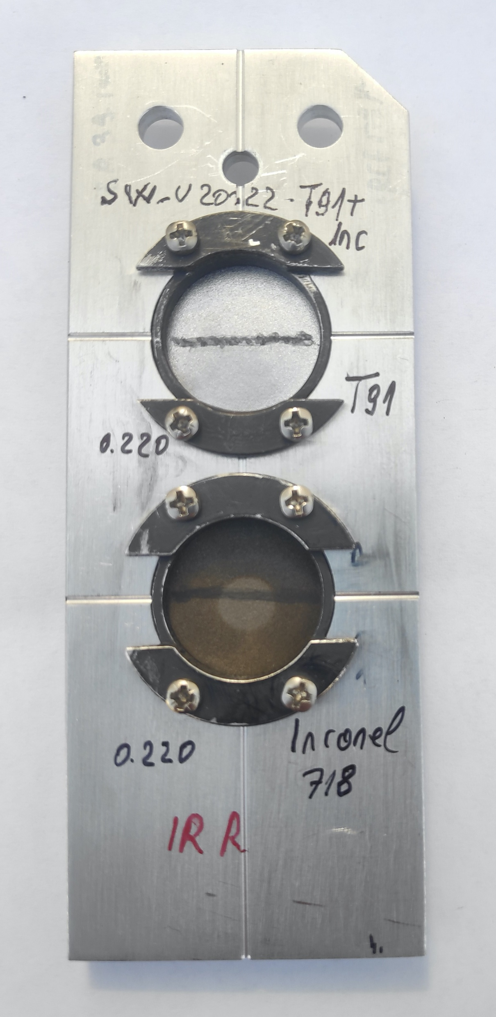
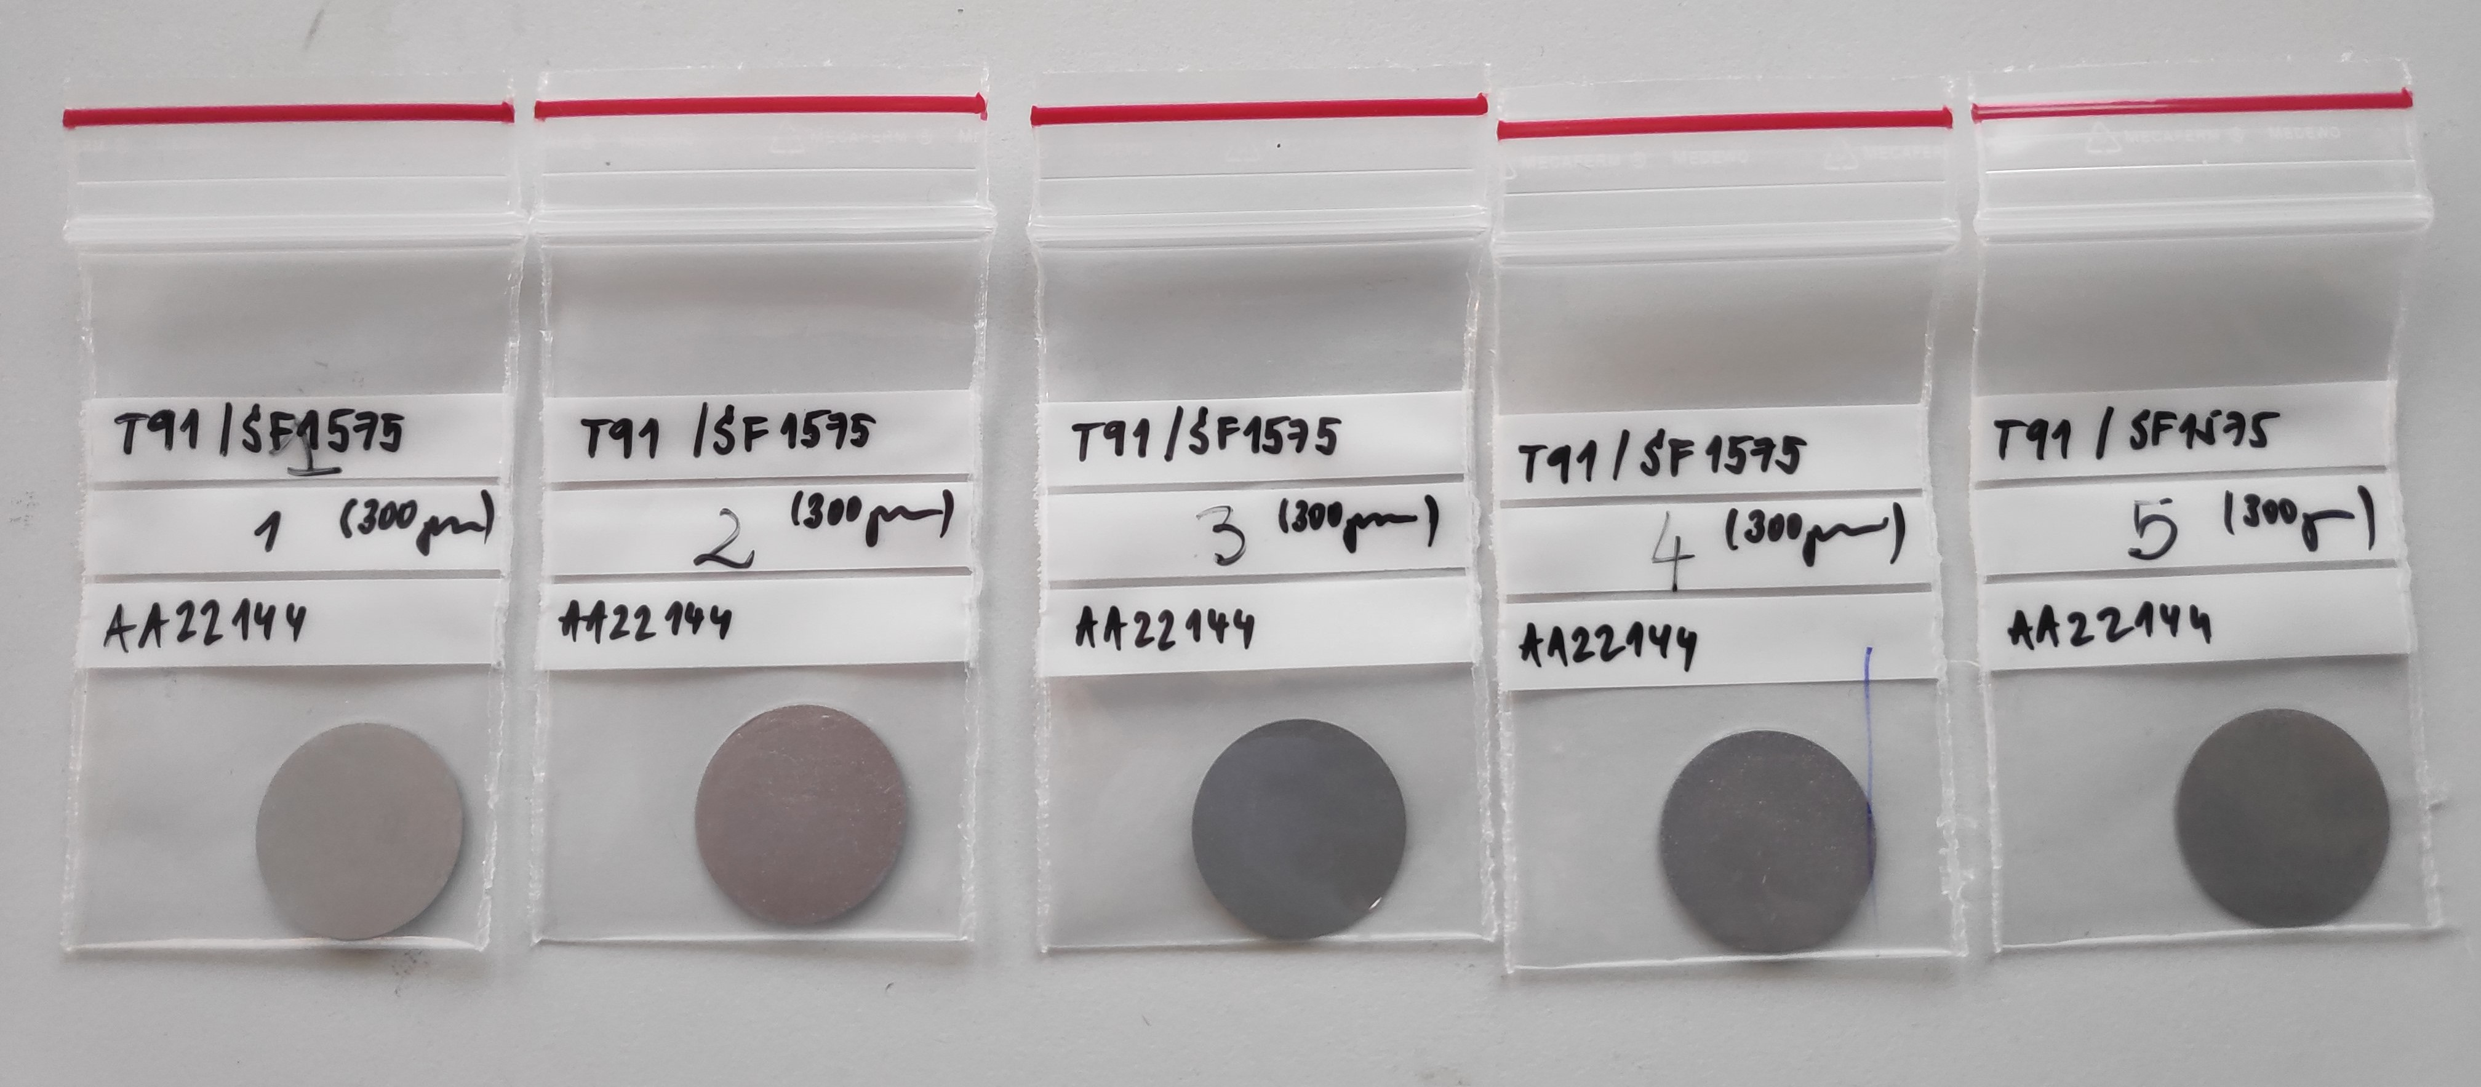
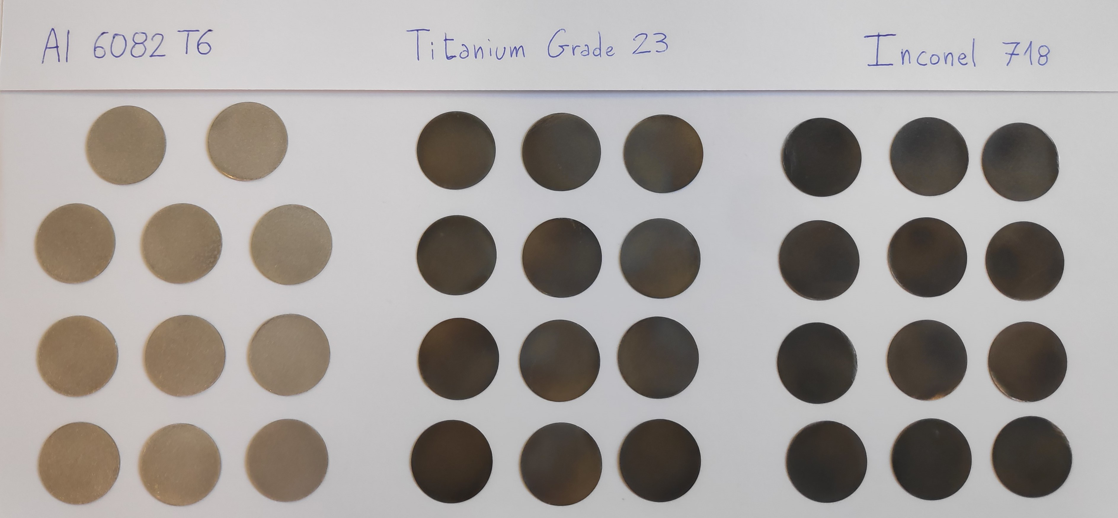
Task 4.3 : U beam irradiation experiments @ GSI - high T-load and transient stress
To better resist radiation and be “transparent” to the beam avoiding scattering effects, materials for beam windows application need to be leak-tight with high mech. strength, low thermal expansion, low atomic number. Thermal load induced by 4.8 MeV/u U beam
M-Branch, UNILAC, GSI – 4.8 MeV/u ²³⁸U
high intensity, short pulses- 5x10⁹ i/cm²s, 100 µs, 1 Hz
Peak temperature per pulse
Materials | Density | Specific Heat | Penetration depth | Peak temperature | Melting temperature | Peak/Melting temperature ratio
 | ρ [g cm-3] | c_{p} [J/kg K] | d_{p} | T_{max} [°C] | T_{melt} [°C] | T_{max} [K]/T_{melt} [K]
Beryllium PF60 | 1.844 | 1925 | 58 | 108.90 | 1273 | 0.2471
Titanium Grade 2 | 4.51 | 540 | 58 | 149.58 | 1665 | 0.2181
Titanium Grade 5 | 4.43 | 526.3 | 58 | 155.35 | 1630 | 0.2252
T91 / P91 | 7.77 | 460 | 58 | 108.29 | 1370 | 0.2321
AISI 316L | 8 | 500 | 58 | 98.89 | 1375 | 0.2257
AISI 316LN | 8 | 500 | 58 | 98.89 | 1375 | 0.2257
AISI 304L | 8 | 500 | 58 | 98.89 | 1425 | 0.2191
INCONEL 718 | 8.19 | 435 | 58 | 108.58 | 1298 | 0.2430
5052-H19 | 2.68 | 880 | 58 | 153.81 | 630 | 0.4727
A5083-O | 2.66 | 901 | 58 | 151.67 | 570 | 0.5039
A6061 T6 | 2.7 | 896 | 58 | 150.45 | 616.85 | 0.4760
SIGRAFINE R6650 (isotropic) | 1.84 | 700 | 58 | 265.01 | 3650 | 0.1372
SIGRABOND C-C 1501 G (anisotropic) | 1.47 | 831 | 58 | 278.34 | 3650 | 0.1406
SIGRABOND C-C 1001 G (anisotropic) | 1.36 | 831 | 58 | 299.23 | 3650 | 0.1459
Silicon Nitride (Si3N4) | 2.81 | 886.5 | 58 | 146.68 | 2441.85 | 0.1546
Silicon Carbide (SiC) | 4.6 | 580 | 58 | 138.28 | 1579.35 | 0.2221
Graphene | 2.27 | 700 | 59 | 215.24 | 3697 | 0.1230
Lorenzo Notari , Master thesis, 2022

Slide 11
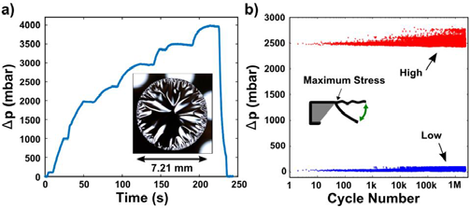
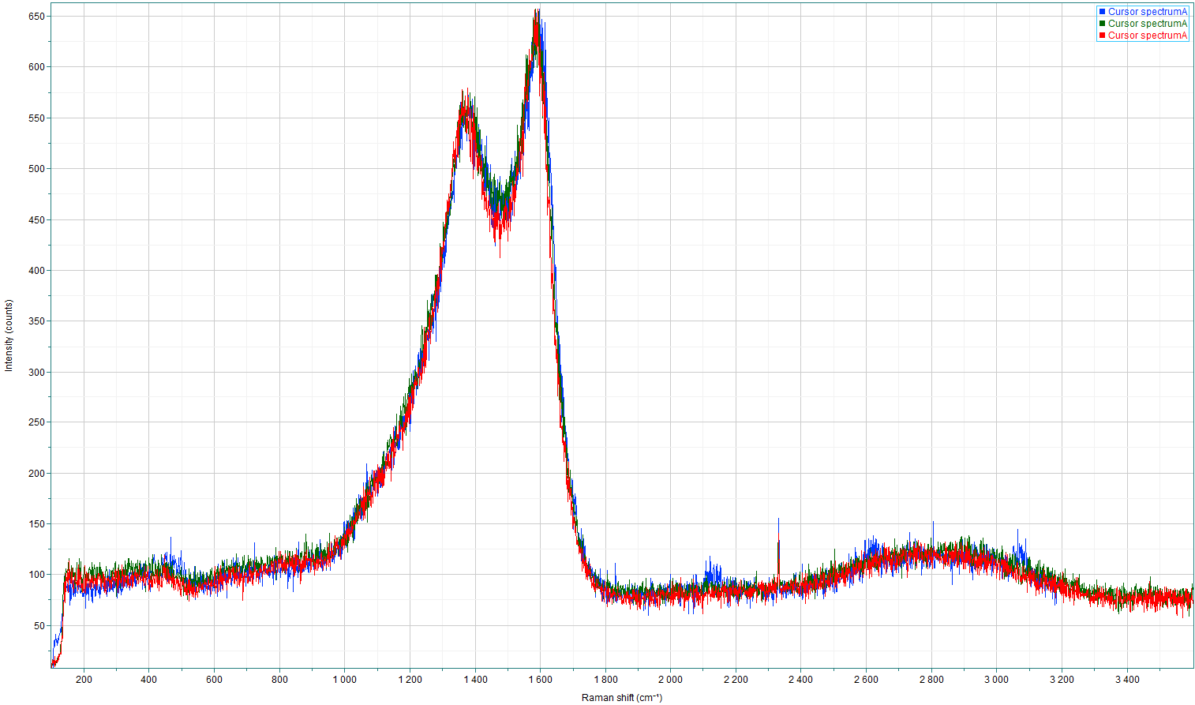
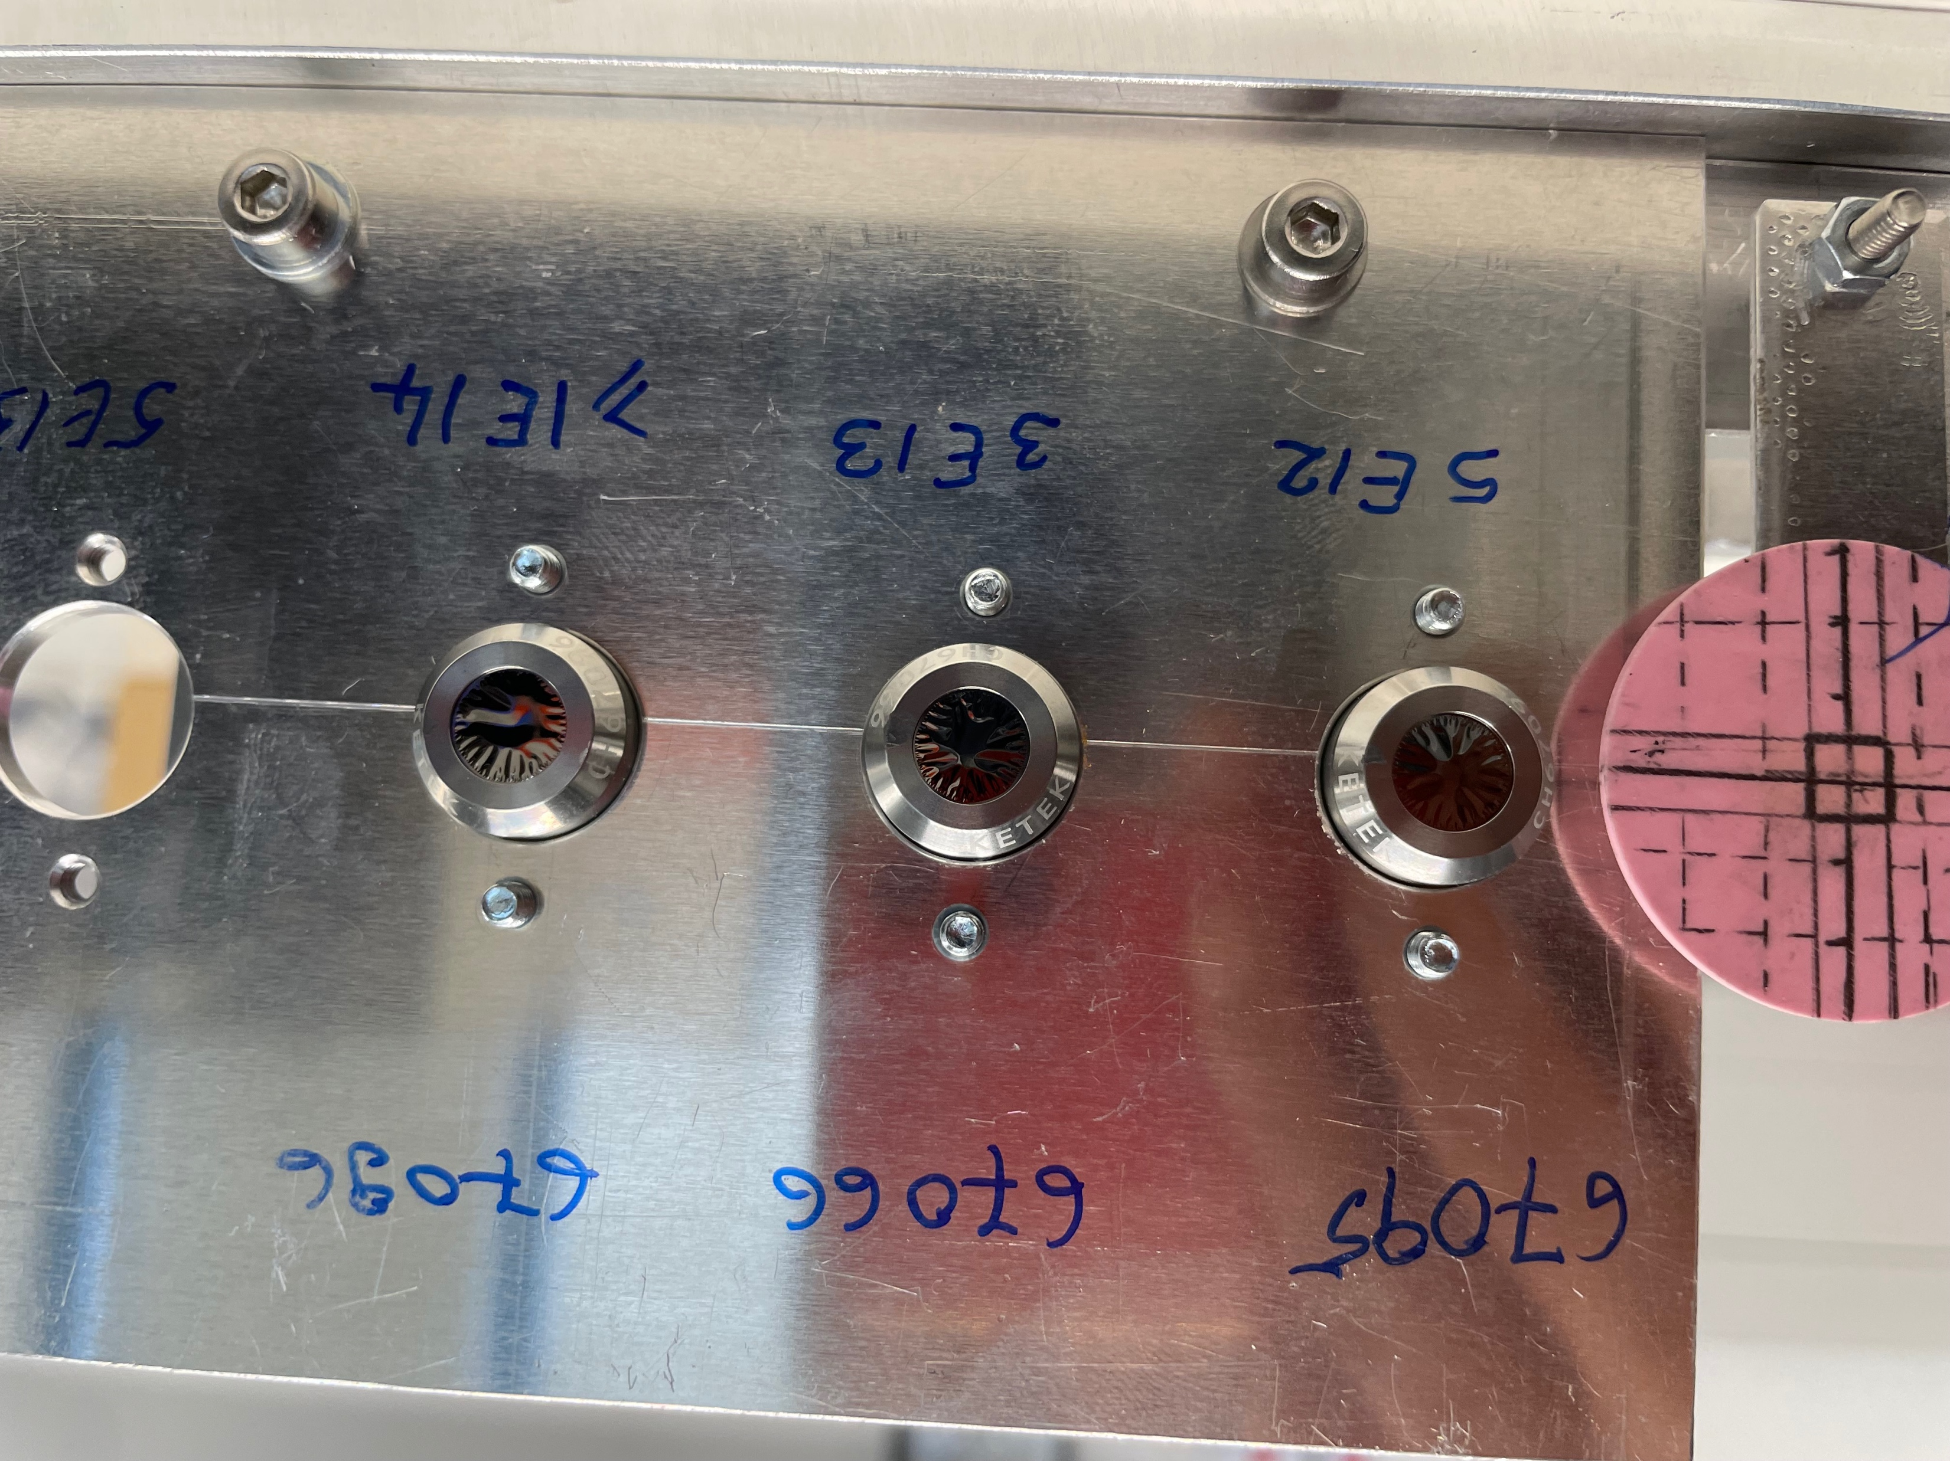
Task 4.3: GRAPH&BEAM project -Post irradiation of graphenic materials and pressure & leak tests on graphenic windows
No significant structural changes and material loss in the irradiated graphenic membranes, within beam spot
Raman spectra of pristine and irradiated graphenic membrane (Au @ GSI, Ne @ RIKEN)
no significant structural changes during irradiation with high dose and intensity beams
Blue- pristine
Green- 4.8 MeV/u ¹⁹⁷Au, GSI
Red- 5.0 MeV/u ²⁰Ne, RIKEN
Blue- pristine
Green- 4.8 MeV/u ¹⁹⁷Au, GSI
Red- 5.0 MeV/u ²⁰Ne, RIKEN
GC window survives with no leak:
Up to 4000 mbar differential pressure
more than 2 million cycles with a differential pressure of at least 2400 mbar per cycle - KETEK

Slide 12
Task 4.4 – innovative materials industrial development /F.Carra
Beneficiaries: CERN, NNK, RHP
Achieved in month 13
Milestone/Deliverable Number | Title | Lead beneficiary | Type | Dissemination level | Due Date (in months)
MS14 | Evaluation of a CCM (carbide-carbon material) alternative to Molybdenum- Graphite | CERN | Report | Public | 16
D4.4 | Production of large-size CCM plates | CERN | Demonstrator | Public | 24
D4.4 description
Carbide-Carbon Materials (CCM) are a family of composites of wide interest for use in HEP facilities and, thanks to their high thermal conductivity and low density, they are of interest in aerospace, nuclear energy production.
Scope: produce two large CCM plates (cross section >400 cm2) in a single sintering cycle at Nanoker (ES)
To come
Status
It was decided to target the 2 plate-in-1cycle production of Chromium-Graphite (CrGr) instead of Molybdenum-Graphite (MoGr)
Reason: CrGr is the composite developed in the MS14, cheaper than MoGr thanks to lower required sintering temperature (lower machine energy consumption, saving consumables such as mould and electrodes) and at the same time, meeting the required tech specifications
Next step: January 2022 sinter of a big size 1plate-in-1cycle of CrGr, if successful, Q1 2023 → 2-in-1 (deliverable!)

Slide 13
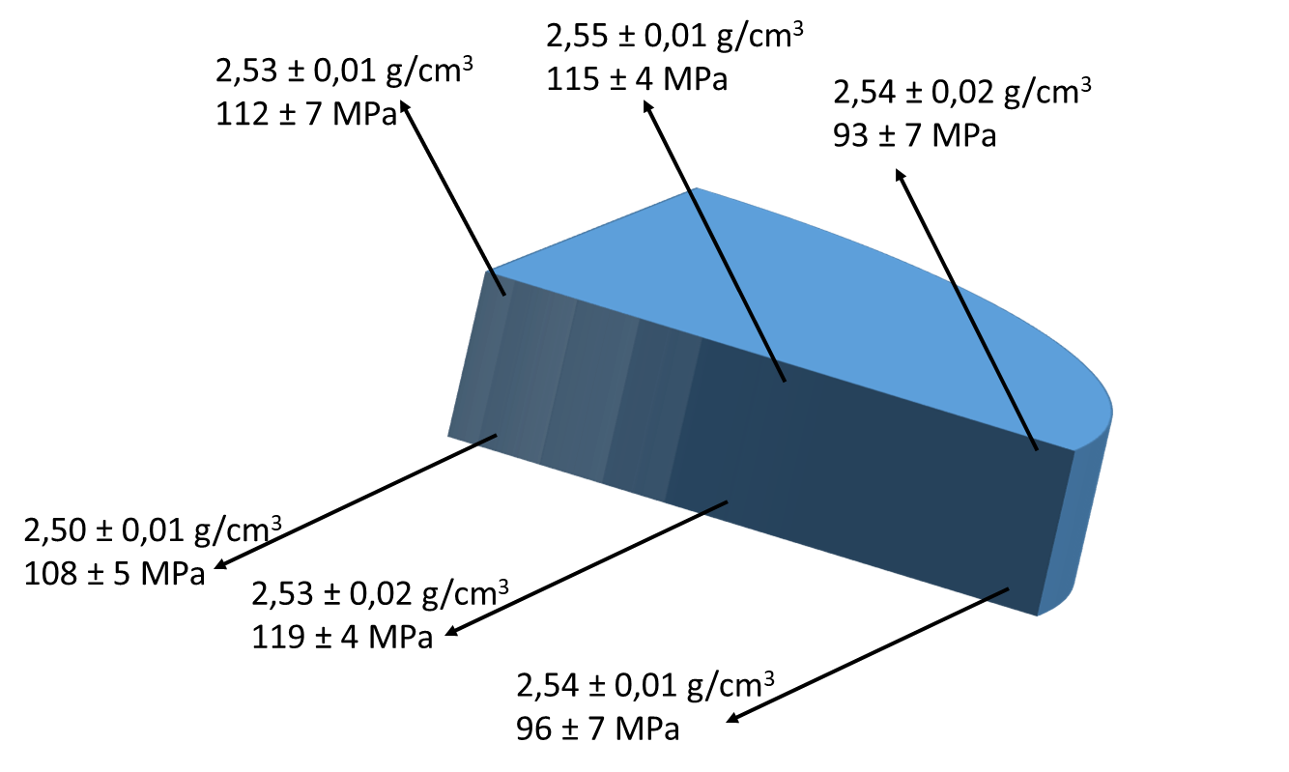
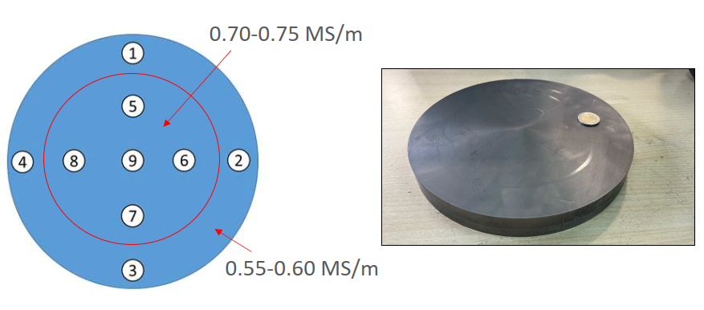
Year 1 Highlights – Molybdenum-Graphite
Molybdenum-Graphite (sintered at 2640°C)
2 plates produced with 230 mm Diameter (2x bigger section than before IFAST)
Disk (230 mm diameter) | Density (g/cm³) | Electrical Conductivity (Mean values on each side) (MS/m)
Plate #1 (p=26 MPa) | 2,53 | 0,6 – 0,63
Plate #2 (p=40 MPa) | 2,60 | 0,65 – 0,68
Specification | 2,3 ÷2,6 | >0,8
Lower electrical conductivity values than in the 170 mm diameter disks
Pre-compaction of the green powder:
Maximum Applied Force Uniaxial Hydraulic Press ~ 900 kN
170 mm Ø → 40 MPa → 2,00 g/cm³
230 mm Ø → 21 MPa → 1,65 g/cm³
Next: increase the metal content, together with the higher sintering pressure

Slide 14
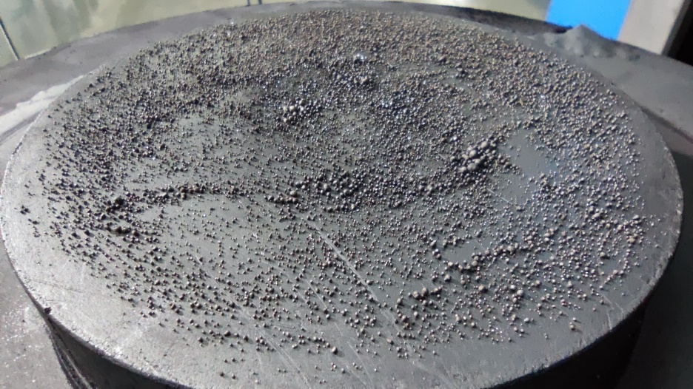
Year 1 Highlights – Chromium-Graphite
Chromium-Graphite (sintered at 2000°C – 1.3x lower T)
Concept proposed by Jorge Guardia within ARIES WP14 & WP17, technically was not demonstrated yet (very poor mechanical properties)
3 plates produced with 170 mm Diameter
Disk (170 mm diameter) | Density (g/cm³) | Electrical Conductivity (MS/m)
Plate #1 | 2,30 | 1,00 – 1,07
Plates #2 & #3 | 2,30 | 0.75/0.81
Specification | 2,3 ÷2,6 | >0,8
Reusable Mold and Parts → Important Cost Reduction
Plate #1 produced in a single plate per cycle, very promising properties, decision for full characterization at CERN
Plates #2 and #3 double-plate per cycle, losing a bit in conductivity → composition and cycle to be optimized

Slide 15
Relevance of objectives and impact
WP4 in P1 has met all the work planned objectives and deadlines, in some case advancing the schedule. For the future, the energy crisis may have an impact on the plan of irradiation campaigns for task 4.3.
Relevance and scope is not changed: WP4 has provided support to innovative projects promising to produce energy savings for accelerators and reduce their environmental impact, while at the same time advancing developments in I.FAST tech areas.
WP4, in collaboration with industries, has investigated new materials for use in application as diverse as nuclear, bio and medical.
WP4, in collaboration with industries, has advanced researches resulting in thesis degree (published in Zenodo). A paper on scientific press is presently in review phase, a new paper will be prepared in the near future.

Slide 16
Thank you for your attention!

