Slide 1
Task 10.5:
Non-evaporable getter (NEG) coating under synchrotron radiation (SR)
Oleg B. Malyshev (UKRI)
Task 10.5 leader
I.FAST Period 1 Review, 09.02.2023

Slide 2
Task 10.5 structure
Partner | Main capability relevant to the project | Future machine
UKRI/STFC/ASTeC beneficiary | NEG deposition and characterisation Pumping property and ESD evaluation Gas dynamics modelling, data analysis, large vacuum system design | UK-XFEL
Diamond LS beneficiary | PSD facility at a SR beamline on Diamond Pumping property and ESD evaluation Large vacuum system design and operation | Diamond-2
Soleil beneficiary | PSD facility at a SR beamline on Soleil Pumping property and ESD evaluation Large vacuum system design and operation | Soleil-2
DESY in-kind contribution | NEG deposition and characterisation Pumping property and ESD evaluation Large vacuum system design and operation | PETRA-IV

Slide 3
WP9 objectives
Building facilities for photon stimulated desorption (PSD) yield measurement on beamlines.
Obtaining and analysing the photon stimulated gas desorption (PSD) experimental data from Non-Evaporable Getter (NEG) coated prototypes under conditions similar to future light sources.
 | Milestone/Deliverable name | Delivery date (in months) | Content
Milestone | First NEG coated sample are installed on SR beamline at DLS and Soleil | 12 | Report - Completed
Deliverable | First PSD data from NEG coating | 36 | Report

Slide 4
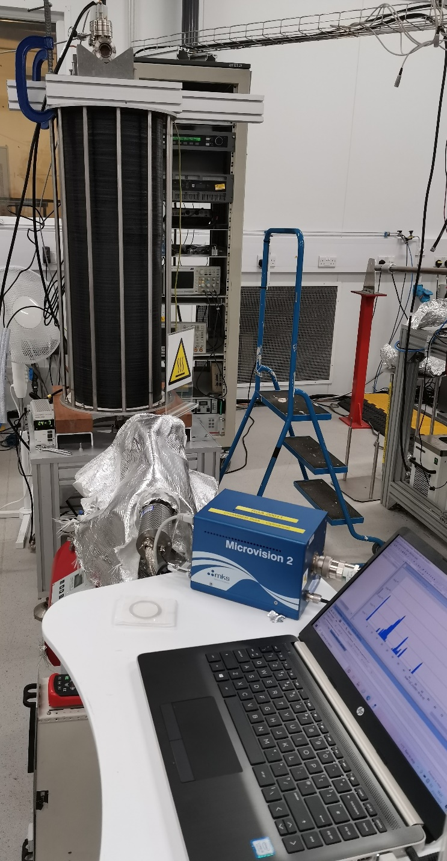
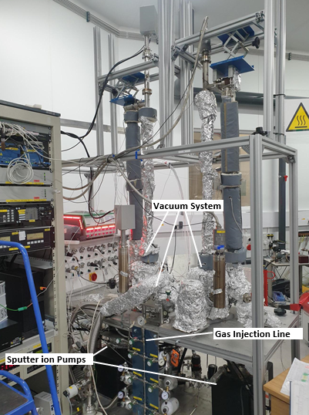
Summary of activities in P1: UKRI
Upgrading the NEG deposition facility
  a new coil to deposit thin films on tubes with
    length of 1 m
    Inner diameter 5-100 mm
    CF16-CF150 flanges.
Upgrading NEG coating evaluation facility
  for 1-m long samples.
Coating 1st PSD sample with NEG

Slide 5
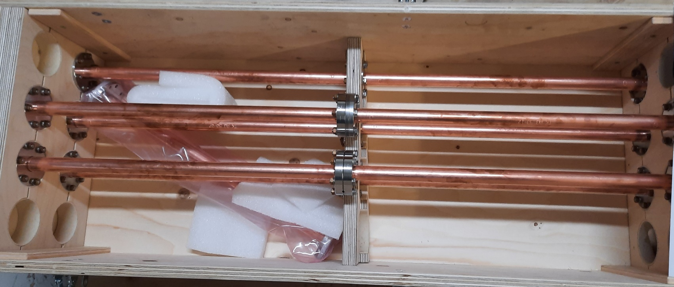
Summary of activities in P1: DESY
It was agreed that a project standard sample for pumping properties evaluation is
  made of OFHC or OFS copper
  ID = 20 mm, L = 500 mm,
  equipped with two CF40 flanges
Progress for P1:
  DESY has provided 11 OFS samples for NEG coating (delivered to UKRI in March 2022)
    3 samples has been used for comparison of cleaning/ etching procedures by thermal outgassing measurements
    samples found to have
      Thermal outgassing was a factor 2-3 higher than a reference sample cleaned at UKRU
      some black coverage identified as silver oxide
    8 samples have been send back to DESY
    the DESY cleaning procedure has been changed to address this issue
Future:
  New 8 samples (expected from DESY) to be coated at UKRI (DL):
    4 samples will be coated with Zr
    4 samples will be coated with Ti-Zr-V
  so identical samples will be tested in 4 labs for comparing (cross-verifying) the results obtained on different facilities
  More samples can be produced in a future.

Slide 6
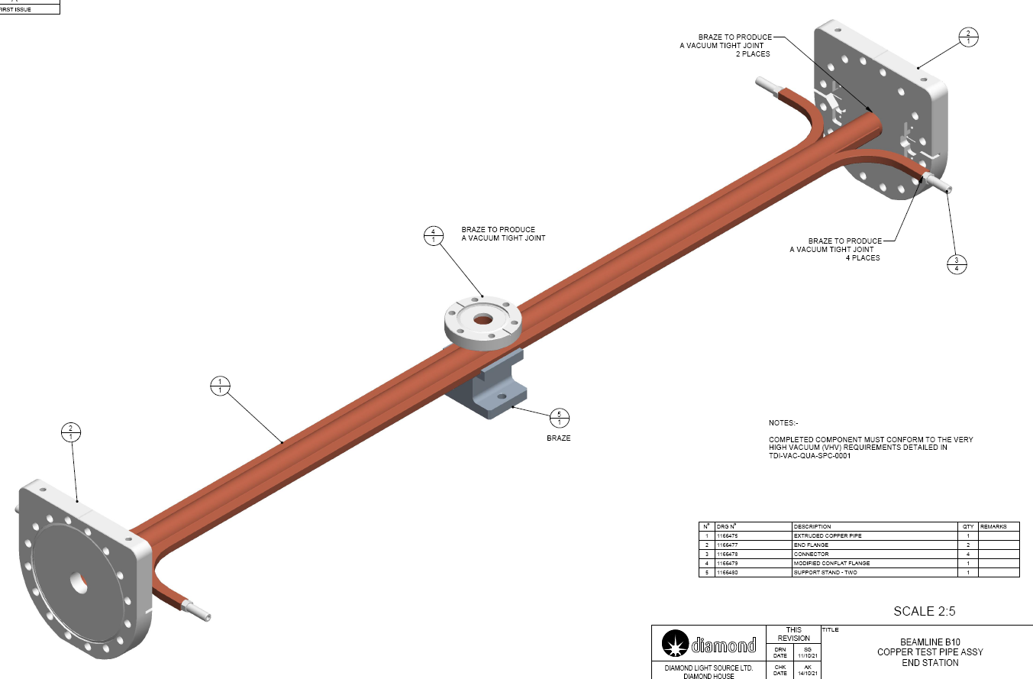
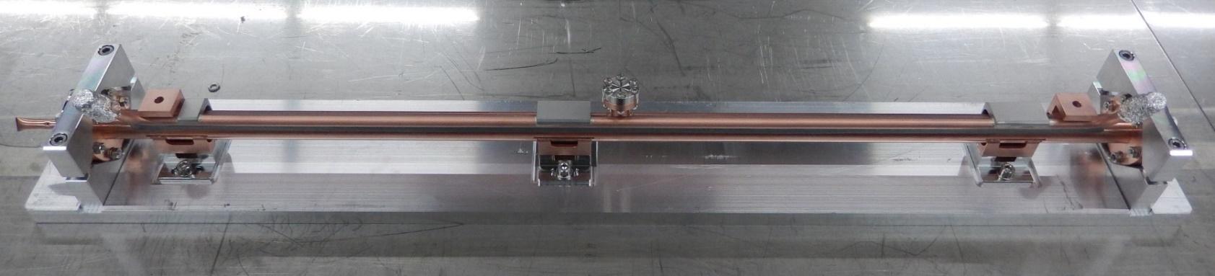
Summary of activities in P1: DLS and Soleil
Measurements of PSD yields will be performed on Synchrotron Radiation (SR) beamlines at DLS and Soleil.
Progress for P1:
  Sample for PSD measurements was jointly designed by Soleil and DLS
  9 samples have been produced from C10700 copper and delivered in October 2022 for coating (6 to UKRI and 3 to DESY).
    delivery delayed by industrial manufacturer SAES REAL
    these samples have been cleaned by a manufacturer
    one sample has been inspected visually and tested on thermal outgassing - satisfactory
Future:
  First two samples will be coated with Zr at UKRI (DL),
    so identical samples will be initially tested in DLS and Soleil for comparing (cross-verifying) the results obtained on different facilities
  More samples will be produced in a future
    Later, samples will be cleaned at DESY following a procedure being developed in an ongoing research

Slide 7
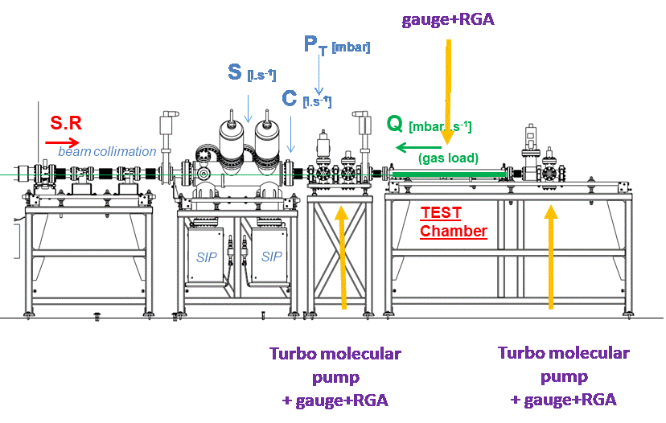
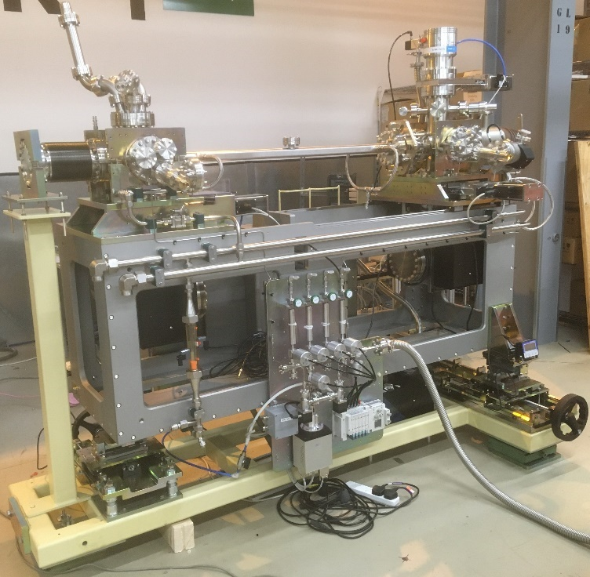
Summary of activities in P1: DLS and Soleil
DLS: dipole front-end (FE10B):
Soleil: dipole front-end
Front-end section: installed November 2020
Experimental end-station:
  post-installation conditioning with an uncoated stainless steel DN40 sample vessel till Feb 2022
  Stainless steel DN40 DLS type sample NEG coated at UKRI (DL) was installed during a DLS shutdown in March 2022 and remain under SR till present
Future:
  Copper sample coated with NEG will be installed during a following DLS shutdowns starting on the 24th March or on the 26th May 2023.
Front-end section: reconditioned during 2020
Experimental end-station:
  currently under operation with samples coated with NEG at SAES getters
Future:
  Copper samples will be NEG coated at UKRI (DL) and installed during a Soleil shutdown in in Feb-March 2023

Slide 8
Deliverables and Milestones P1
One Milestones has been completed,
No Deliverable scheduled for P1
 | Milestone/Deliverable name | Delivery date (in months) | Content
Milestone | First NEG coated sample are installed on SR beamline at DLS and Soleil | 12 | Report - Completed
Deliverable | First PSD data from NEG coating | 36 | Report

Slide 9
Relevance of objectives and impact
1st Objective:
  Building facilities for photon stimulated desorption (PSD) yield measurement on beamlines.
    Completed: two facilities for PSD yield measurement are in operation at DLS and Soleil
2nd Objective:
  Obtaining and analysing the PSD experimental data from NEG coated prototypes under conditions similar to future light sources.
    Work in progress
Relevance: very important data for designing future machines with SR:
  DLS-2, Soleil-2, PETRA-IV, UK-XFEL, etc…
Impact:
  NEG coated vacuum chamber can be activated at low temperature of 150-160°C
  Meeting challenging vacuum specification at UHV or XHV
  Lower cost of vacuum system
    Less number of pumps, thus less controllers and cables
    Smaller size of the pumps, thus lower cost per unit
  The only solution for narrow vacuum chambers

Slide 10
Thank you for your attention!

