Slide 1
Report on WP/Task 11.3:
Permanent Magnet Quadrupoles & Combined Function Magnets for Ultra Low-Emittance Rings
Alex Hinton, STFC
I.FAST Period 1 Review, 07.02.2023

Slide 2
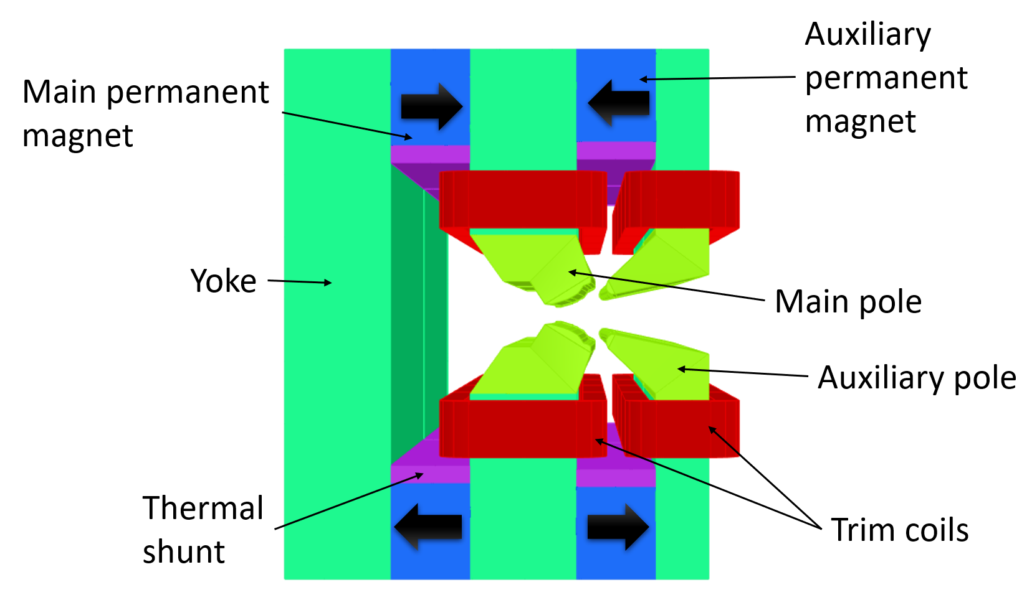
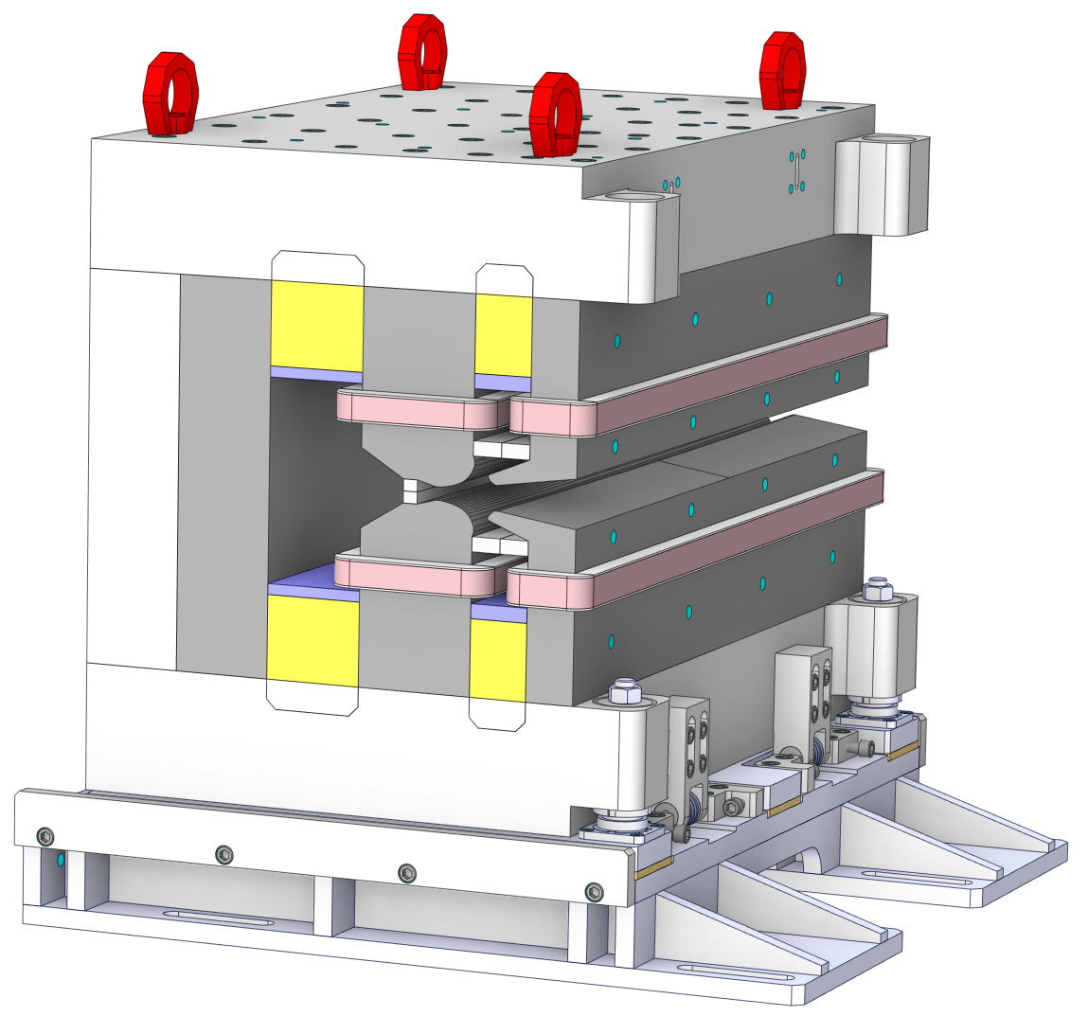
WP/Task structure and objectives
Manufacture and test a prototype permanent magnet (PM) based combined function dipole-quadrupole (DQ) magnet.
Magnetic design aimed at meeting the same parameters as the electromagnetic DQ magnets required for Diamond-II upgrade.
Dipole = 0.7 T, Gradient = 33 T/m
Dipole and gradient fields require independent tuning of ±2.5% using trim coils for commissioning purposes.

Slide 3
Summary of activities in P1
Magnetic design complete by STFC, including:
  Pole shape optimisation
  Setting dimensions of permanent magnet and thermal shunt material
  Machining and alignment tolerance studies
  Trim coil design
  Final magnetic design report completed 28/11/2022
Initial mechanical design complete by Kyma, including:
  Support structure
  Conceptual assembly process and girder design
  Installation process
  Conceptual mechanical design report completed 13/05/2022

Slide 4
Deliverables and Milestones P1
No Deliverables / Milestones scheduled for WP11.3 in Period 1
Final magnetic design and conceptual mechanical design completed in P1
MS56- Magnets constructed and tested - Current planned delivery August 2023
MS56 currently ~3 months behind original schedule due to delays in ordering permanent magnet and thermal shunt material associated with ongoing budget discussions around high material costs
D11.3 -“Prototype adjustable PM quadrupole and combined function magnets” - Current planned delivery end of August 2023

Slide 5
Relevance of objectives and impact
Task 11.3 is still on track to manufacture and test a prototype permanent magnet based combined function magnet with coils for field trimming and tuning.
Nominal power dissipation from trim coils ~ 1W (nominal power consumption of equivalent electromagnet from electrical resistance ~2.56 kW).
Magnetic measurements of constructed prototype will demonstrate if permanent magnets can achieve the same field quality requirements as electromagnets and hence can be used to replace electromagnets in storage rings to reduce the power consumption of facilities.

Slide 6
Thank you for your attention!

