Slide 1
Installation IT String in SM18
S. Le Naour
MSC – 30 June 2022
Many thanks to N. Bourcey, F. Crisci, D. Duarte Ramos, Y. Leclercq, H. Prin, R. Principe for their explanations and patience.

Slide 2
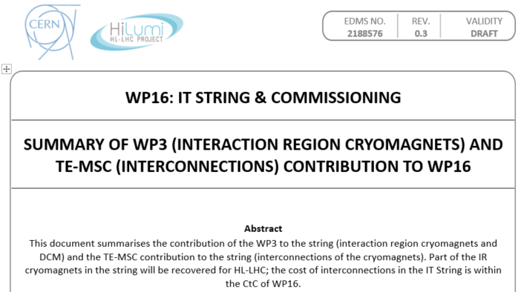
Context
EDMS 2188576
In the frame of the IT string installation in SM18 (WP16), a summary of WP3 and TE-MSC contribution is asked.
In addition of the jacks, anchors and cryo-magnets supply from the WP3, TE-MSC is responsible of the installation and the interconnection of the cryo-magnets and DCM for the string.
Resources payed by WP16
The proposed discussion is to agree on TE-MSC human resources to engage for the string interconnection activities for a given duration.
The material and the personnel will be paid by WP16.
Prior to the installation, tests on simple mock-ups and first version of procedures are prepared and will be under WP3 budget
This discussion does not include the DFX installation nor its connection.

Slide 3
Activities description
A description of the main steps of magnet interconnection for the IT string is given in the following slides.
Many details are still under study!
Main QC steps are also given.
  QC : internal MSC-QC (teams to be defined: LMF-QC or from other section ?)
  QC : support given by TE/VSC, TE/MPE, TE/CRG, EN/MME…
Assumption : local leak tests are done when all lines (cryomagnets, DCM and jumpers) are welded. Helium gaz is provided from the QXL to qualify the helium volume.
D1
CP
Q3
Q2b
Q2a
Q1

Slide 4
Activities description
D1
CP
Q3
Q2b
Q2a
Q1
The initial conditions considered are:
  Plugs on QXL jumpers are removed
  Ground fixations (holes) are ready for installation of jacks, anchors and DCM frame (EN-ACE action with maps given by MSC)
  Motorized jacks are in place.
  Q1 to D1 magnets are in place and anchors are fixed
  Q1 to D1 magnets are aligned
  ELQA tests on each individual magnet are done
  DCM and possibly its frame are not in place.
  DFX can be present (WP6A)

Slide 5
Activity : N lines pulling
N lines pulling
  QC: ElQA test of N lines on the reels
  Cables on reel at DCM position. Installation of winch and pulleys
  Line N1 pulling : 18kA superconducting cables from D1 to Q2a.
  Line N2 pulling : 2kA superconducting cables from D1 to Q2a.
  QC: ElQA test after N lines in position and with/without soldering connection (combined HV and AIV?)
From this step two activities in parallel :
Q1-D1 connection
D1-DCM connection

Slide 6
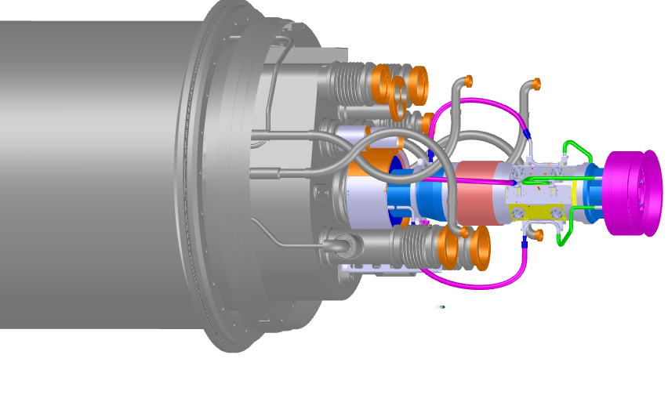
Activity: Q1 to D1connection
D1
CP
Q3
Q2b
Q2a
Q1
Installation of fake BPM/PIM in two interconnections.
No beam line, BPM or PIM are installed for the string.
The proposal is to install a BPM and a PIM (or an envelop of them) in two interconnections to create more realistic conditions for the cryo-lines welding.

Slide 7
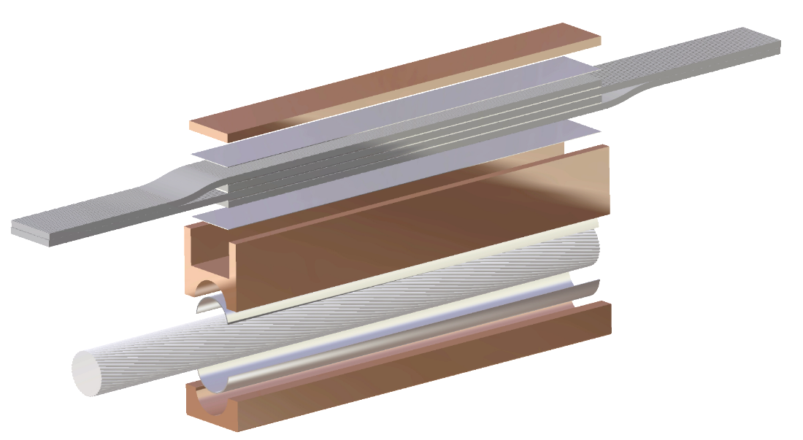
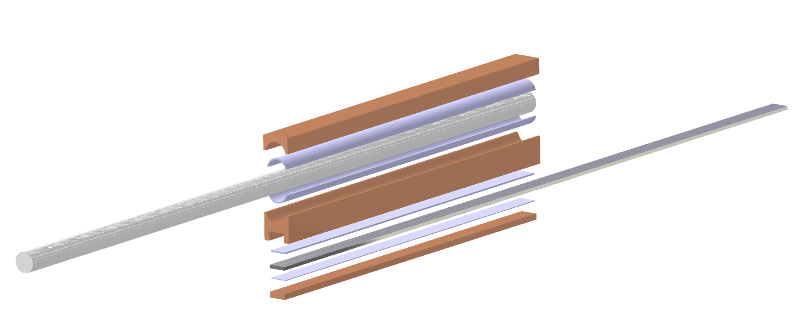
Activity: Q1 to D1connection
D1
CP
Q3
Q2b
Q2a
Q1
Splice connection work
  18kA splice connection
    ̴ 2 / interconnection
    QC (to determine:
      electrical/ visual/ dimension?)
  2kA splice connection
    4 splices in 3 interconnections
    QC (to determine:
      electrical/ visual/ dimension?)
  ElQA (when and how often?)
Magnet leads to 18kA cable join
Corrector lead to 2kA cable join

Slide 8
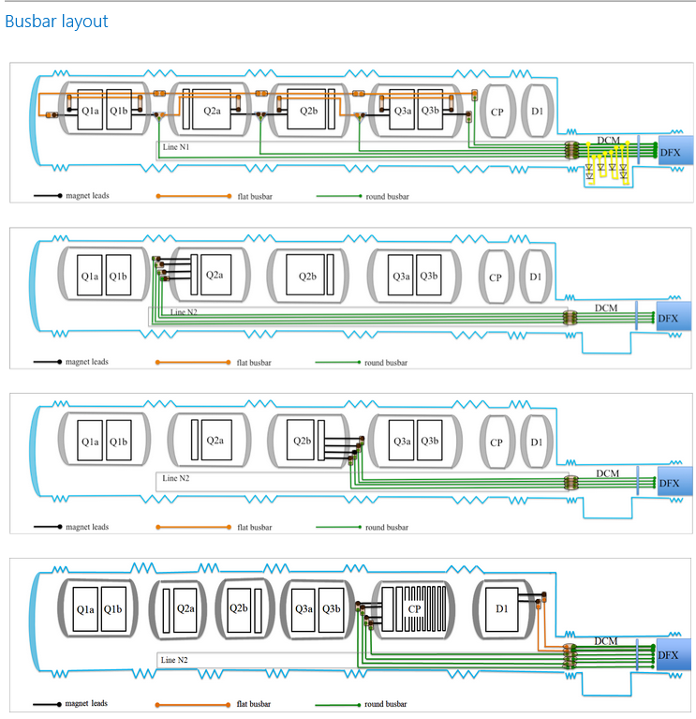
Busbar layout
Line N1
Line N2
Line N2
Line N2

Slide 9
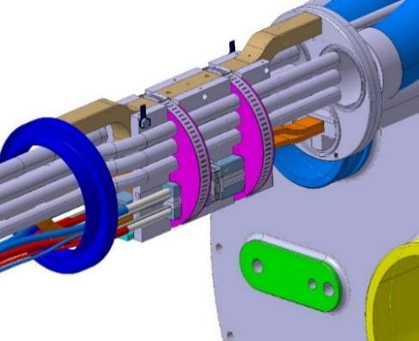
Activity : Q1 to D1connection
  Installation of fixe points
  Eccobond injection
    QC (visual inspection)
  ElQA test before sleeves welding

Slide 10
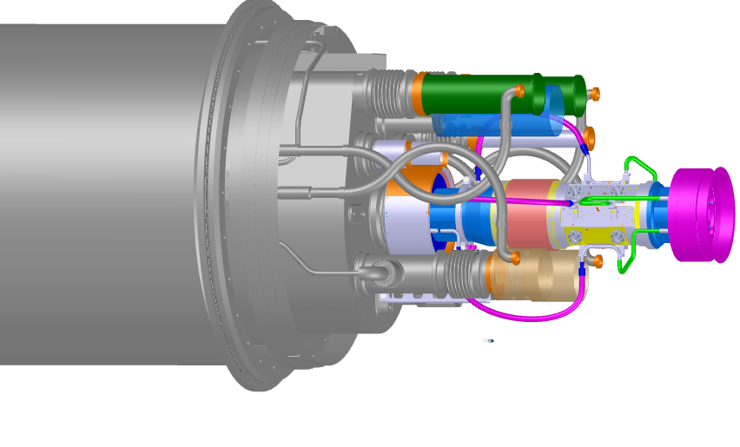
Activity : Q1 to D1connection
Sleeves welding (lip welding)
  QC: Visual inspection
Thermal shield lines welding (butt welding)
  QC: Radiographies and visual inspection
Ready for local leak tests

Slide 11
Activity : Q1 to D1connection
QC : check before closure
Thermal shield, MLI
W closure
Ready for global leak test

Slide 12
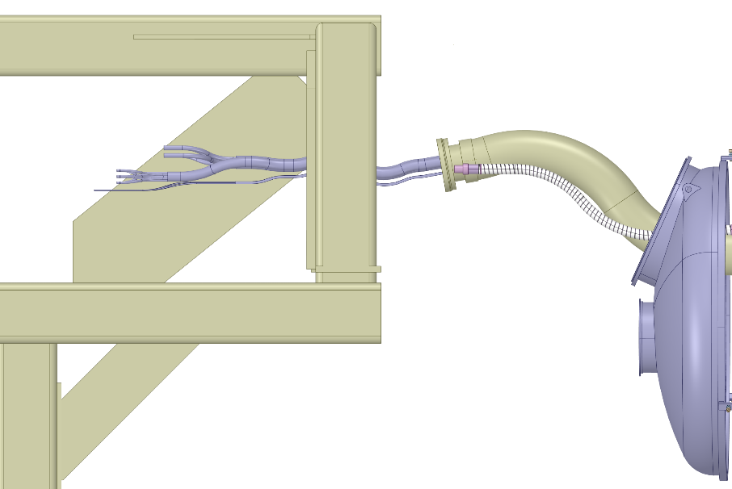
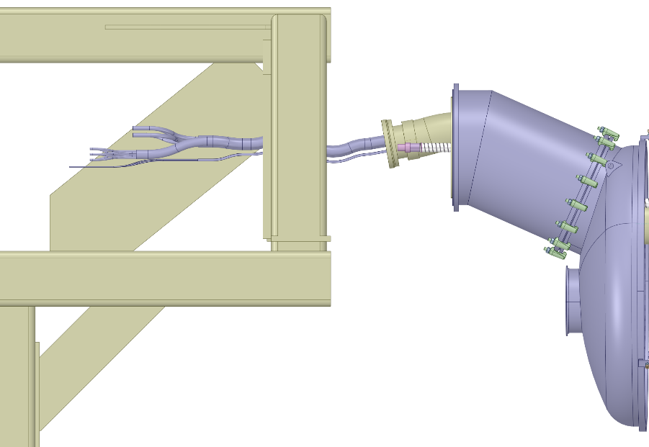
Activity : D1 to DCM connection
Installation of the DCM frame
if not done prior N lines pulling as a support of N lines
Installation of the elbowed vessel between DCM and D1
  With thermal shield, MLI, outer shell… (No welding)
N1, N2 and D1 busbars
E’_{H} lines
(Thermal shield)
D1 end cover

Slide 13
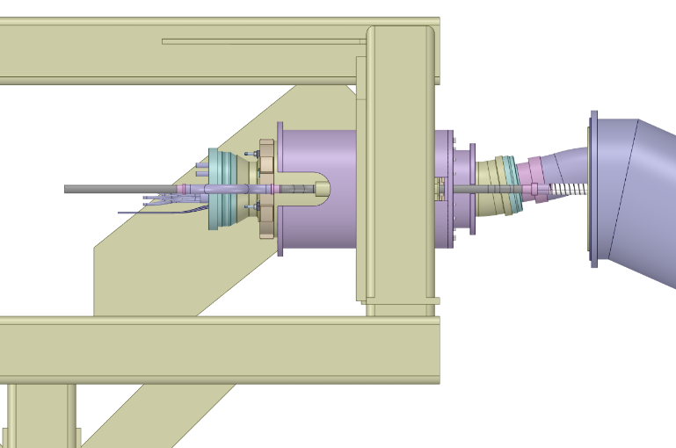
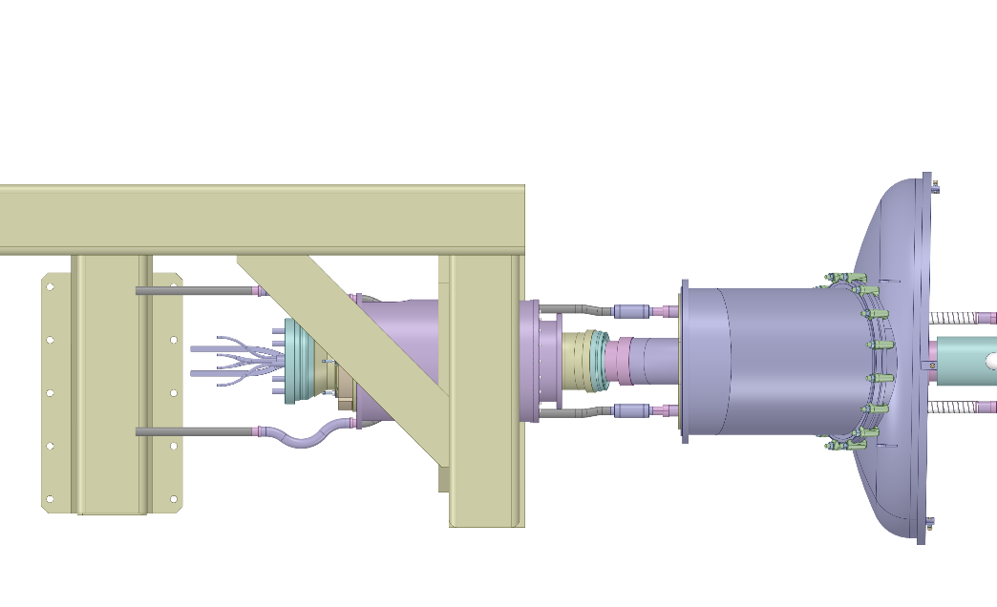
Activity : D1 to DCM connection
Side view D1 inner module
Installation of the inner part of the D1 module
  Positioning of the module
      Tooling and procedure to determine
  Lip welding of the He vessel
      Installation leak test (He bottle)
  Lip welding of the E’_{H} lines
      Installation leak test (He bottle)
  QC holding point
Lip welding of the He vessel
Lip welding of the E’_{H} lines
Top view D1 inner module

Slide 14
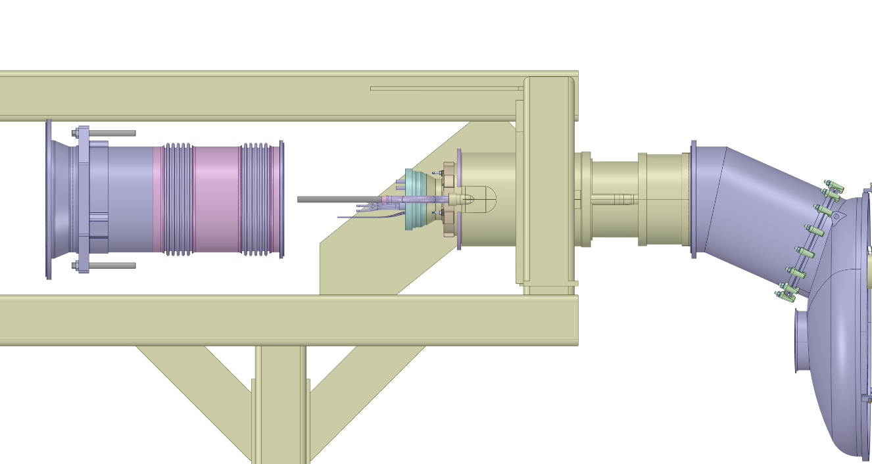
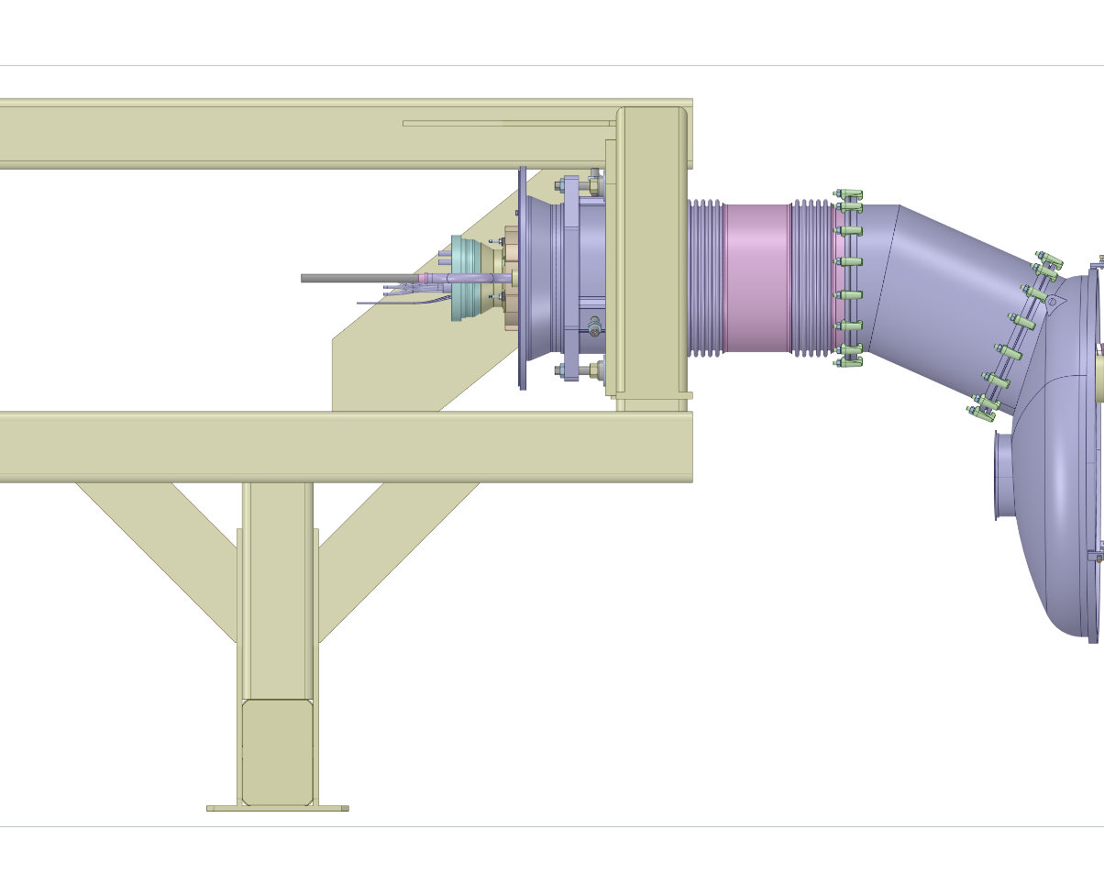
Activity : D1 to DCM connection
Insertion of the vacuum vessel of D1 module
  Thermal shield,
  MLI…
  Correct positioning
  thanks to setting screws
  (criteria to determine)

Slide 15
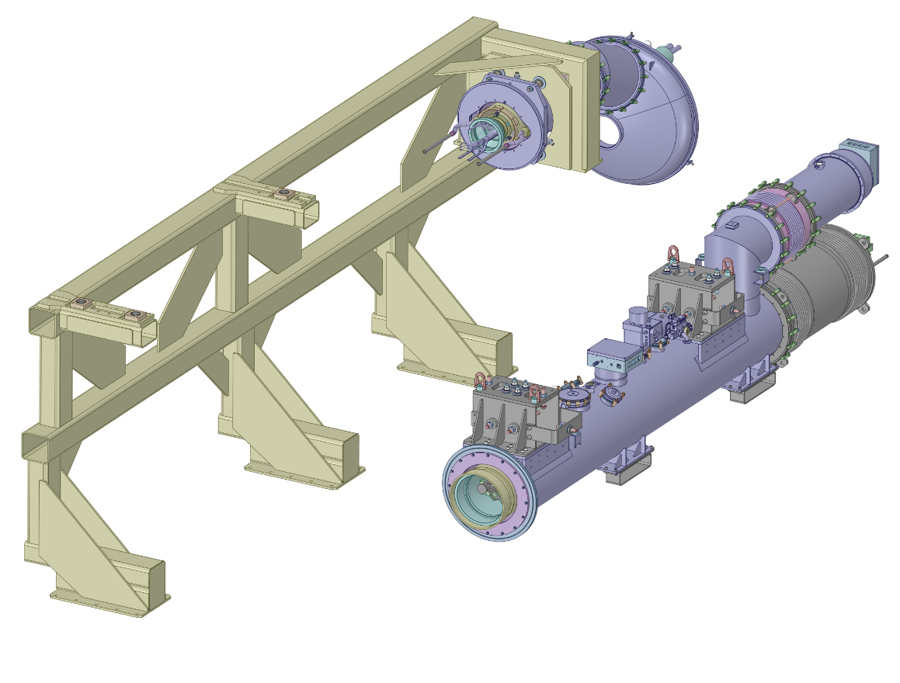
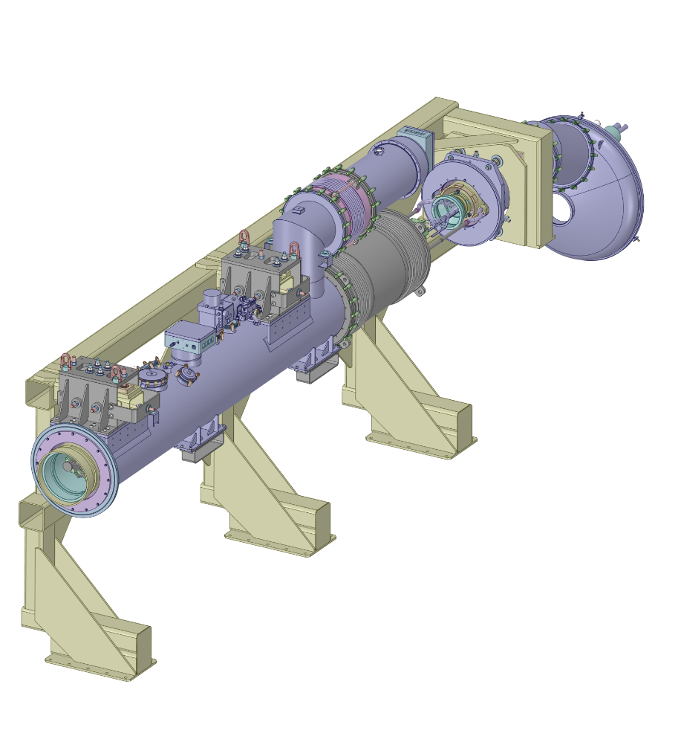
Activity : D1 to DCM connection
DCM installation and alignment
Note: The DCM will be equipped with a DFX module (WP6a) before the installation

Slide 16
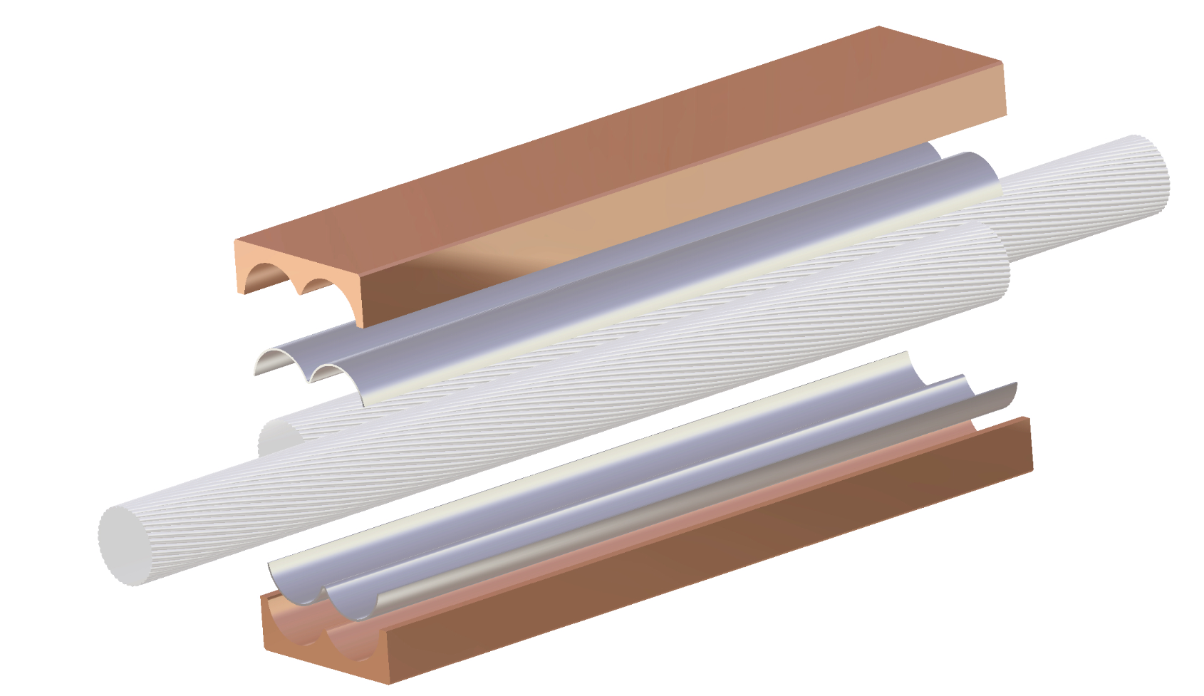
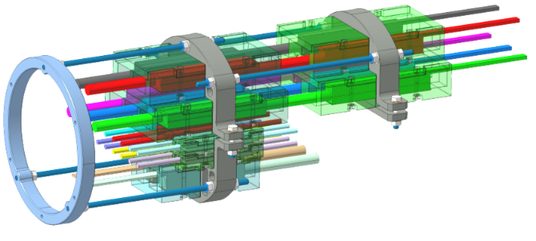
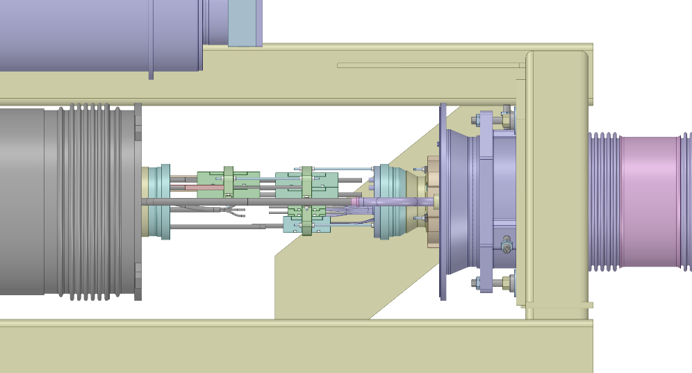
Activity : D1 to DCM connection
Splices connection (NbTi - NbTi) and splices insulation
    12 * 2kA cable splices → QC
    5 * 18kA cable splices → QC
    2 * 13kA cable splices → QC
Insulation boxes installation → QC
Installation of the fixe point → QC
Preliminary concept of splices stack

Slide 17
Busbar layout
WP6a
Line N1
Line N2
Line N2
Line N2

Slide 18
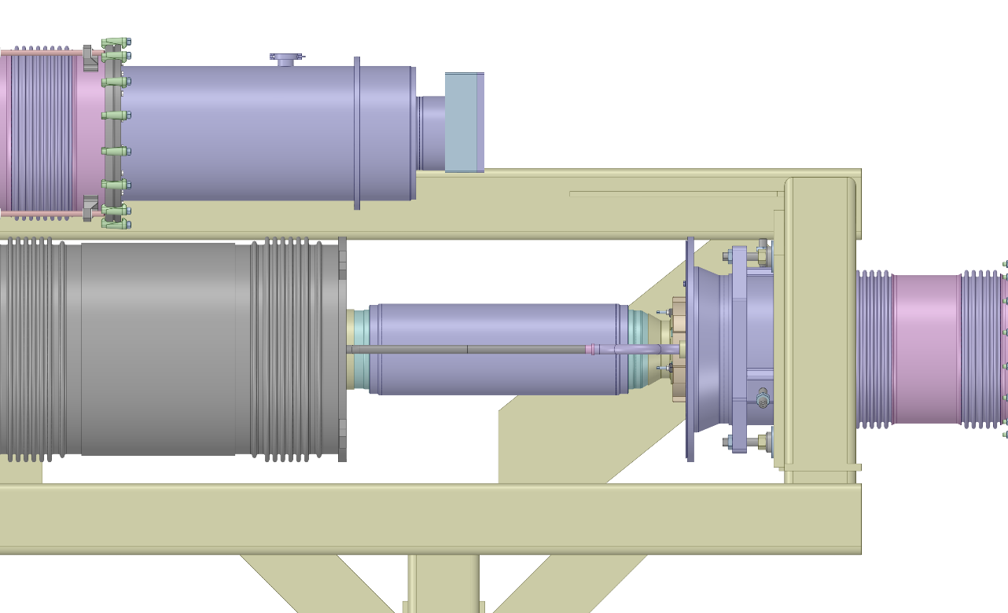
Activity : D1 to DCM connection
Sleeve and E’_{H} lines welding
    Lip weldings of N lines sleeve
    Butt weldings of E’_{H} lines (radiographies)
Ready for local leak tests

Slide 19
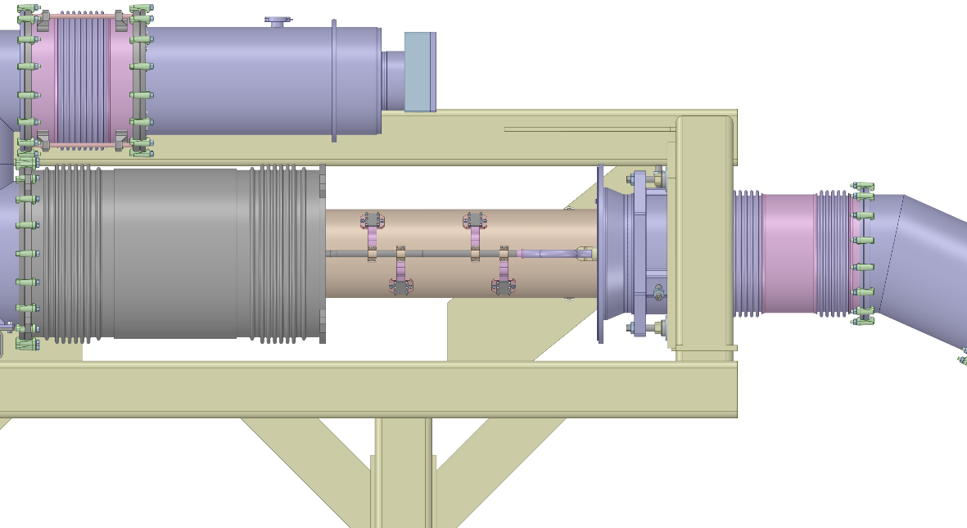
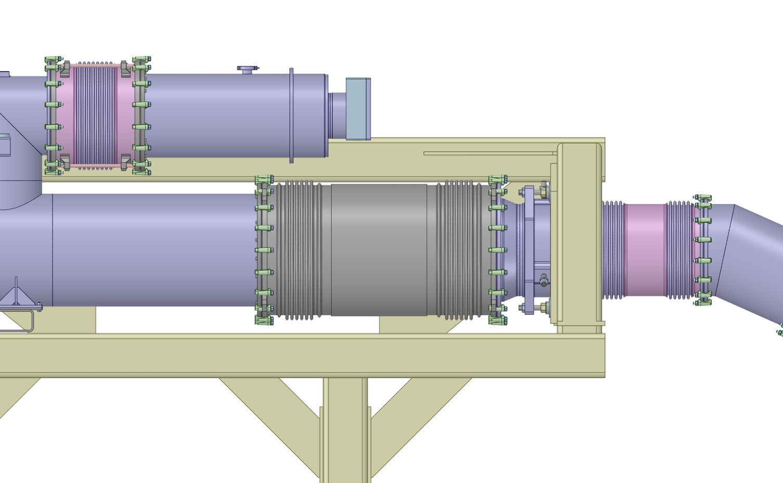
Activity : D1 to DCM connection
QC : check before closure
Thermal shield
Thermal shield connection
  MLI
W closure
Ready for global leak test

Slide 20
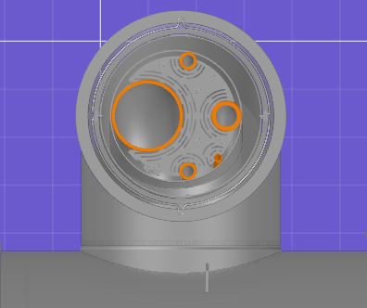
Activity : Jumpers connection
3 Jumpers to weld
Cryo-lines welding (lip & butt welding)
  QC: Radiographies and visual inspection
Ready for local leak tests

Slide 21
Activity : Jumpers connection
Thermal shield welding
W closure
Ready for global leak tests

Slide 22
Planning and Resources
The SM18 IT string will be the first cryo-magnets connection closed to real conditions and will require lots of preparation and documentation prior the installation. Today, we have only a general picture of how to proceed.
Before the IT string installation, teams will practise on simple mock-ups few parts of the assembly and in collaboration with QA/QC team, will prepare first versions of the interconnection procedures.
A significant follow-up is necessary to maintain the know-how and take benefit of the lessons learnt during the IT string installation, to apply them for the HL-LHC project, as the planning for the connection must be optimised (IT string is «only» a fourth of a part of HL-LHC project).
I suggest that strengthened teams for the field coordination and QA/QC are involved, ideally the same people that will be involved for the HL-LHC project in LS3 (three-four years after the string installation).
IT string needs also experimented technicians to improve and optimise the tooling for LS3.

Slide 23
Planning and Resources
IT string is an opportunity to learn and to update the procedures. An effort on the resources and the preparation, will may be slow down magnet production for one or two months but will be a real gain during LS3.
During the IT string connection, the resources estimation is
Main coordinator : 1FTE
Project engineer : 1 FTE ( part time of each project engineer)
Field coordination : 2 FTE (two field coordinators for D1-Q1 section: 0.8 FTE each, 1 field coordinator for D1-DCM section: 0.4 FTE)
QA : 1 FTE (following of procedures)
QC : 0.5 FTE (to determine)
Logistics : 0.5 FTE (transport, machining, …)
Technicians and welders (next slide)

Slide 24
Planning and resources
Technical resources and duration for each activity.
Few activites will be done in parallel if the resources are sufficient.
If external QC takes more than ½ day in the week, extra time must be added.
Learning time is reasonably considered in the given duration, but time for non-conformity repair must be added !
N lines pulling
  2 field coordinators, 3 technicians (2 staff, 1FSU)
  Duration : 1 week
D1 module and DCM installation (without splices connection)
  2 technicians (1staff, 1 FSU)
  Duration : 2 weeks

Slide 25
Planning and resources
Splices connection and fixe points installation
  2 teams of 2 for splices soldering (2 staff, 2 FSU)
  1 person for fixe point and eccobond injection (1 FSU)
  Duration : 3 weeks for D1-Q1 section
  Duration : 2 weeks for DCM-D1 section (and DCM-DFX)
Welding : Jumpers and cryo-lines
  2 experienced welders from MSC
  Duration : 6 weeks (75% time)
Thermal shields and W closure
  4 technicians (2 staff, 2 FSU)
  Duration : 1 week

Slide 26
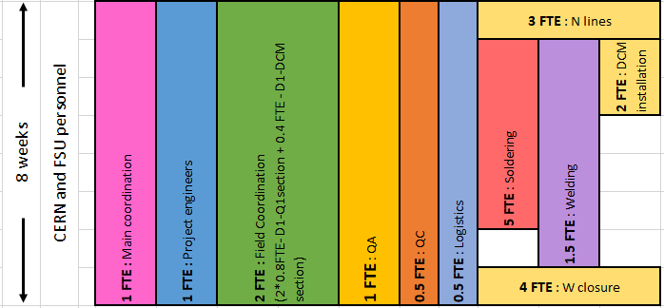
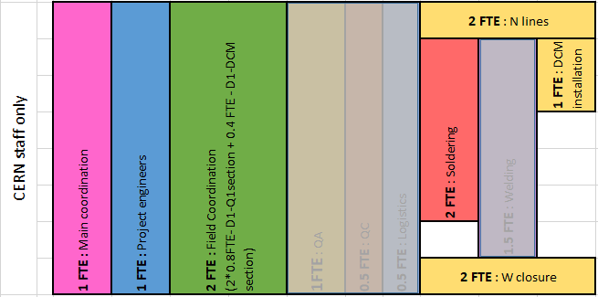
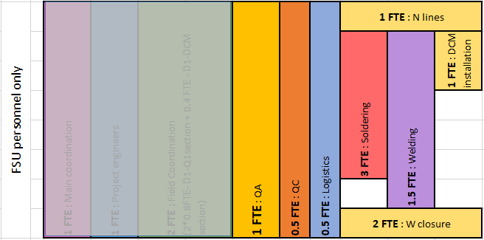
Summary on resources
MSC activities for WP3 only = 8 weeks, but the interconnection work will take longer (Local leak test, FRAS, ….)
CERN staff only
FSU personnel only
6 FTE
5.6 FTE

Slide 27
Top of the iceberg
The interconnection work is only the top of the iceberg. A lot of work, drawings and documentation need to be prepared.
Test on simple mock ups (line N pulling, Splice soldering, …)
  Define the tooling
  Prepare the procedures
  …
Validate the drawings
  Global and detail views
  Kit for interconnection
  …
Define the interface of WP3 with the other WPs
  Interface to the superconducting link (WP6a), defined in EDMS 2429304
  Interface to the cryogenics (WP9), defined in EDMS 2728042
  Interface to protection (WP7), defined in EDMS 2369405
  Interface to FRAS (WP15), defined in EDMS XXXX
  Local/global leak test?
Define the QC procedures
  For LS1 and LS2, the team was independent from LMF section. Still the case?
  Criterias to define and procedures
The progress of the tests on mock up/drawings/procedures are under the sections responsibility and budgeted by WP3
☑

