Slide 1
ATLAS-GTU TAI Workshop
Geometry development for the visualization applications-
Giorgi Mirziashvili
Georgian Technical University (GE)
29.11.2022

Slide 2
Simplification

Slide 3
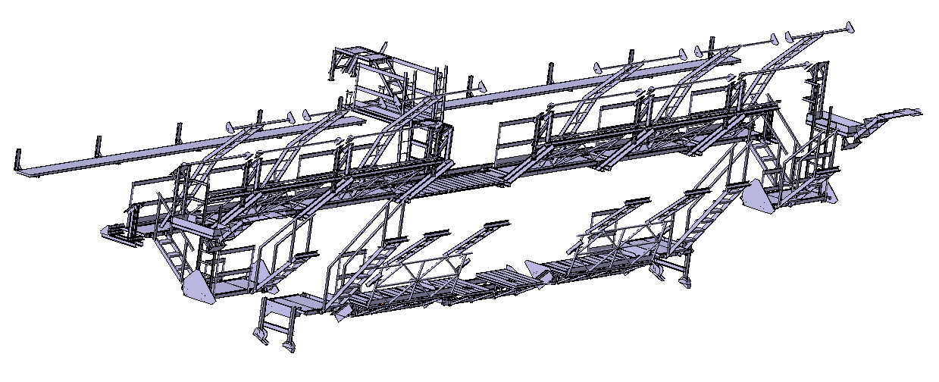
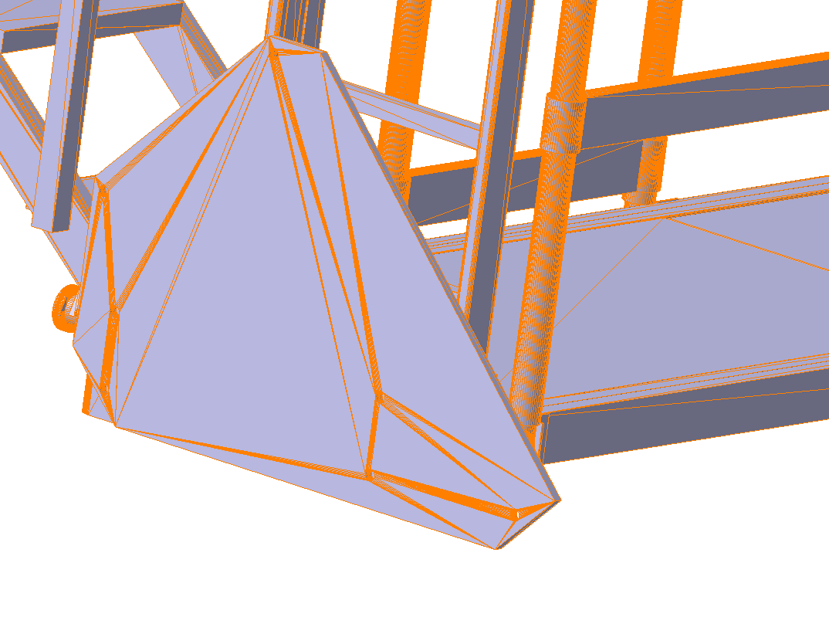
Simplification
To visualize any geometry you need to use polygons
A polygon is a collection of vertices, edges, and faces that define the shape of a polyhedral object in 3D computer graphics and volumetric modeling. The faces are usually triangles, quadrilaterals, or other simple convex polygons.
More polygons load the system more

Slide 4
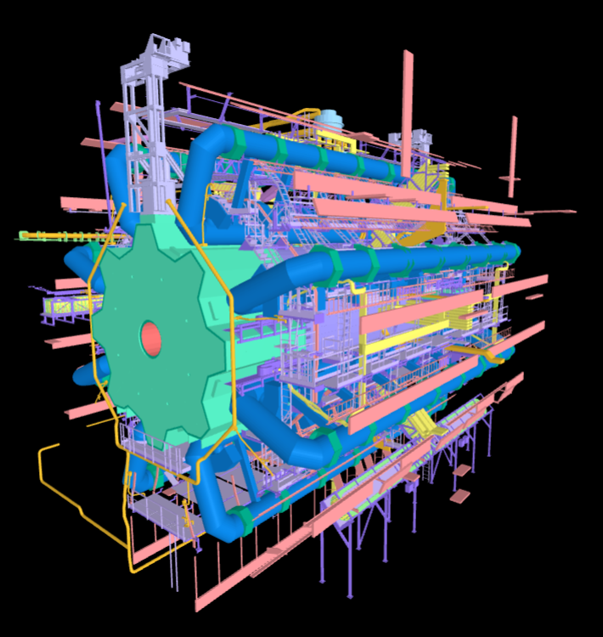
simplification
In order to visualize the components of the atlas detector , we use the geometry simplification

Slide 5
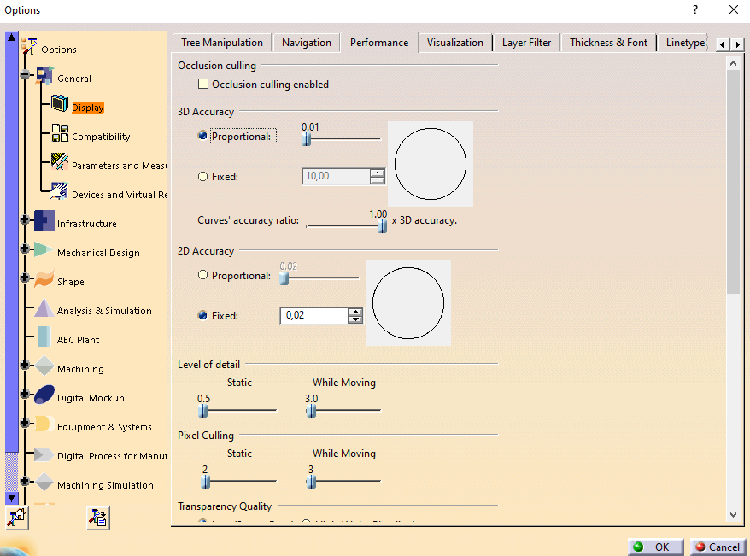
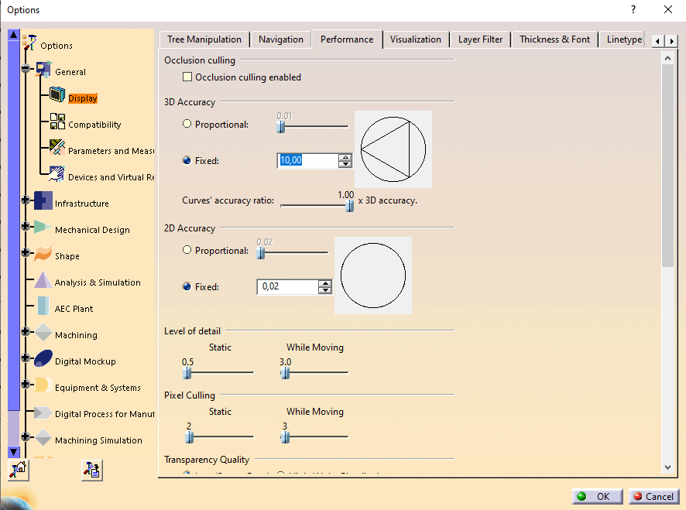
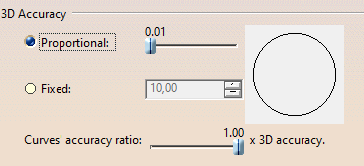
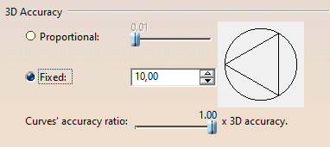
simplification
In order to reduce the load on the system, we first reduce the approximation.
as shown in the figure, we reduce the accuracy of the geometry from 0.1 to 10

Slide 6
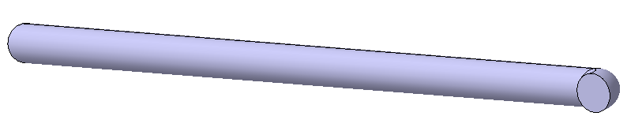
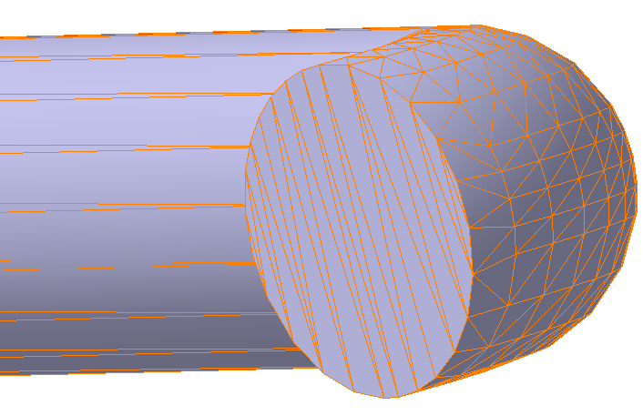
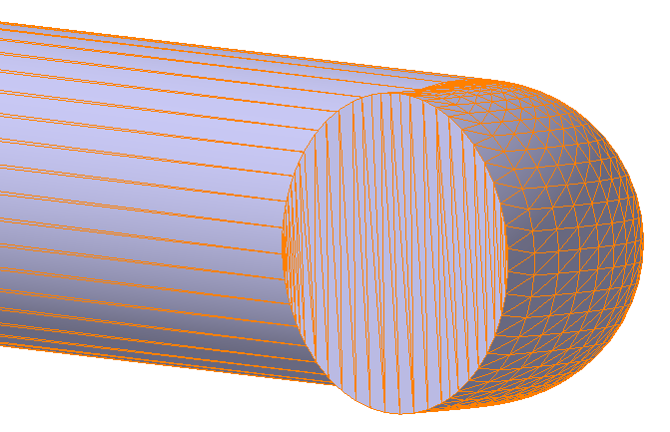
simplification
polygon cannot be round. round objects are replaced by polygonal cuboid, but with a large number of these triangles, which resembles a circle
lowering the accuracy of the geometry gives a difference polygons of about 70.98%
Face: 368
Face: 1268

Slide 7
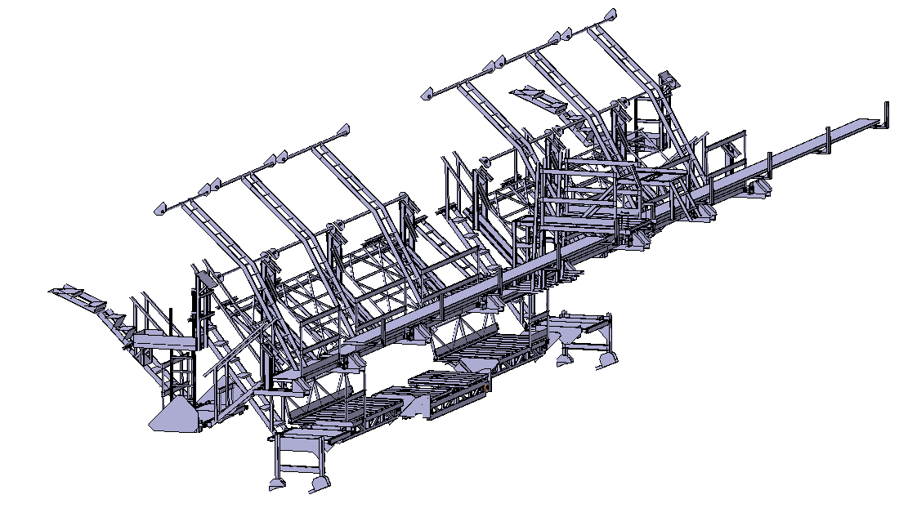
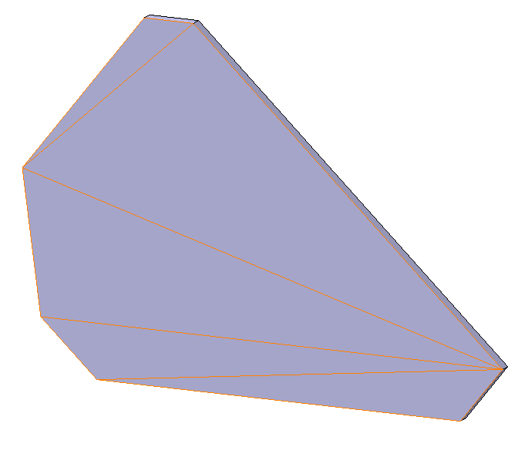
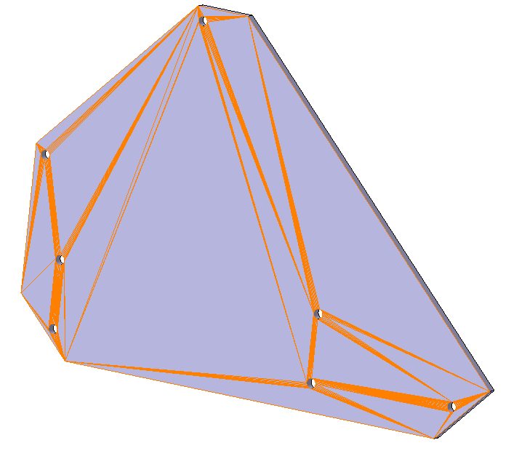
simplification
but reducing the accuracy of the geometry does not always help reduce the load on the system
On the bodies we remove small holes on the geometry
this gives a difference in the number of polygons in some cases up to 98%
Face: 24
Face: 860

Slide 8
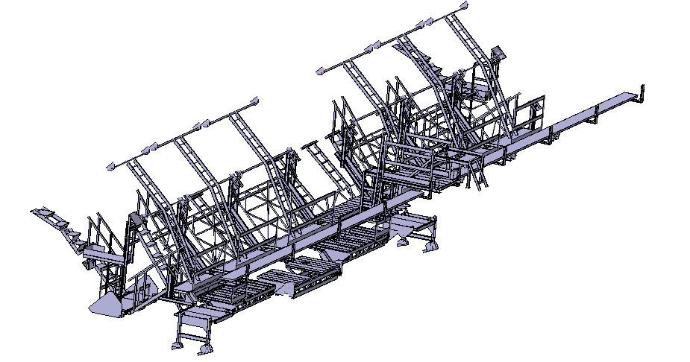
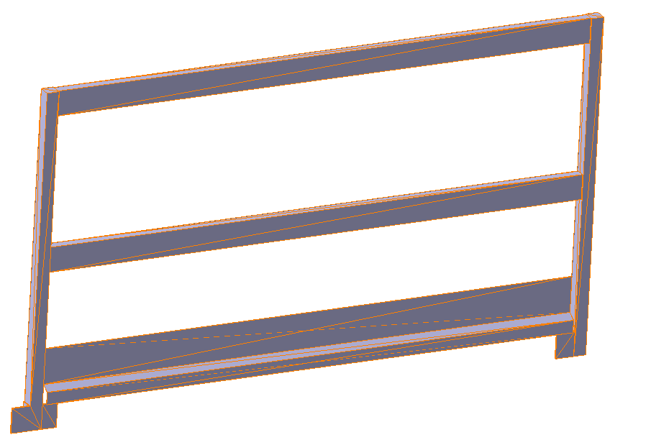
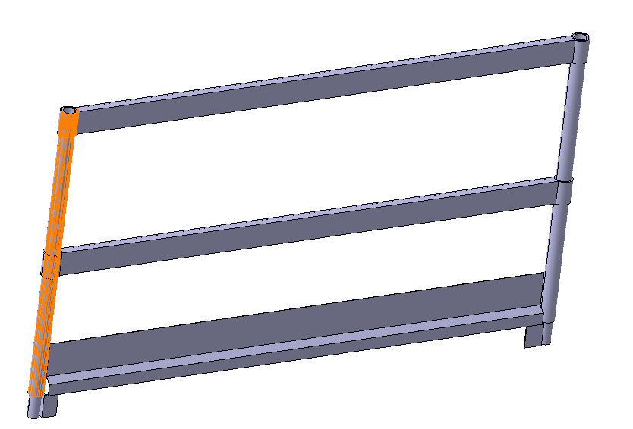
simplification
we also change small circles to polygons and fill empty objects
visually the difference is almost imperceptible. But the difference of polygons is about 95.5%
we simplify this way mainly such geometries as: handrails, stairs, and other small round geometries
Face: 132
Face: 2964

Slide 9
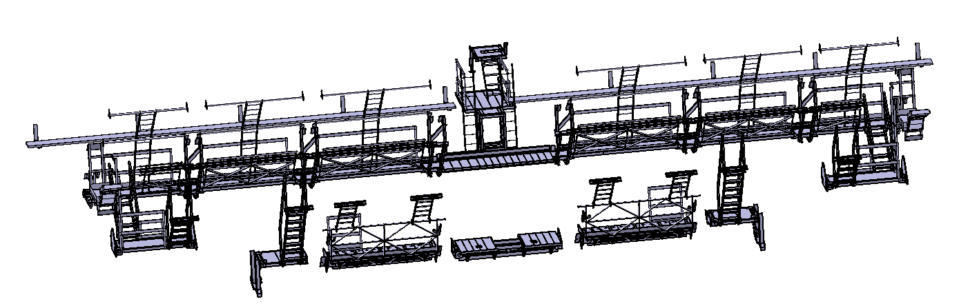
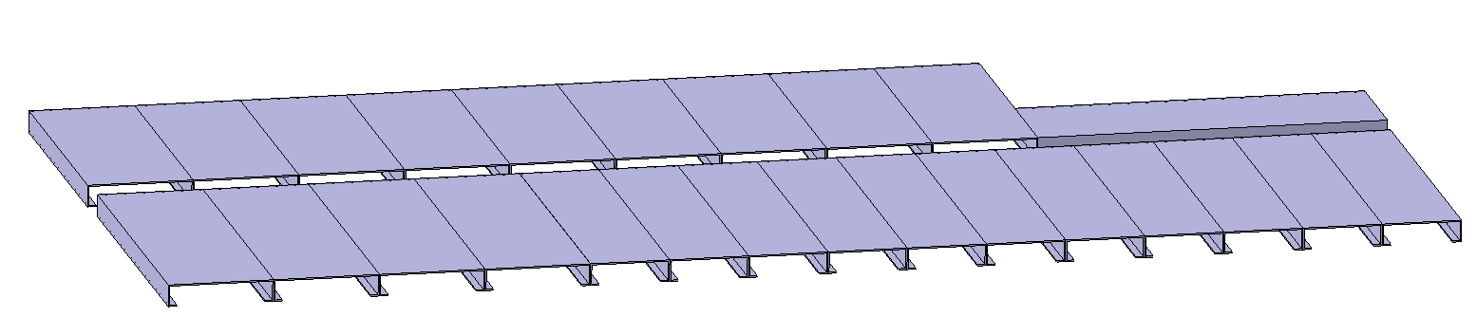
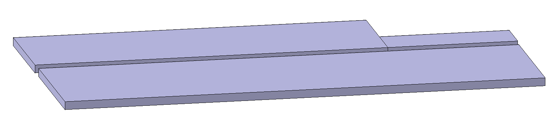
simplification
we also combine several similar objects into one, which also gives difference about 97%
1100
36

Slide 10
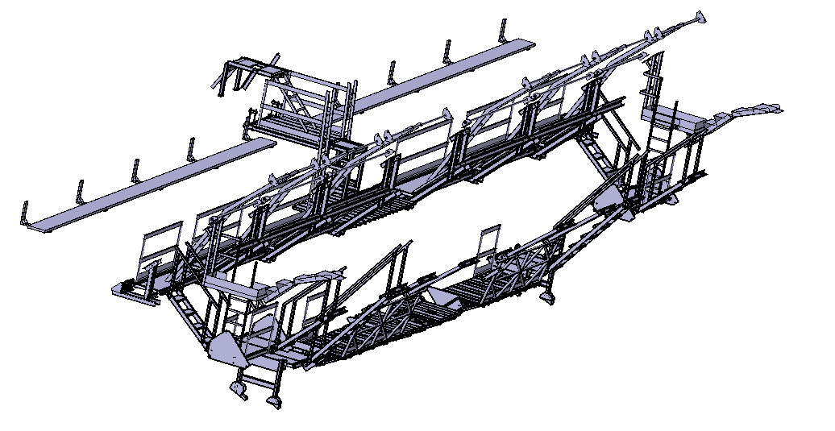
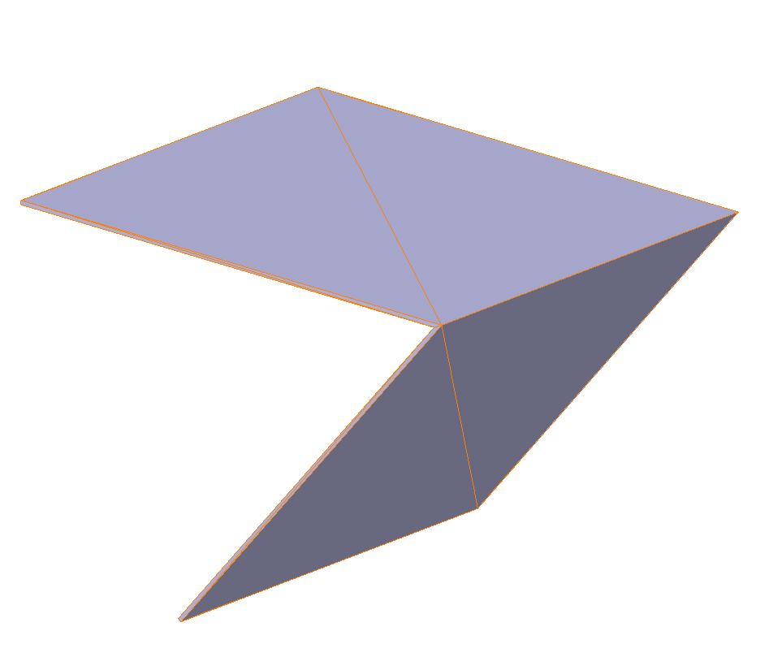
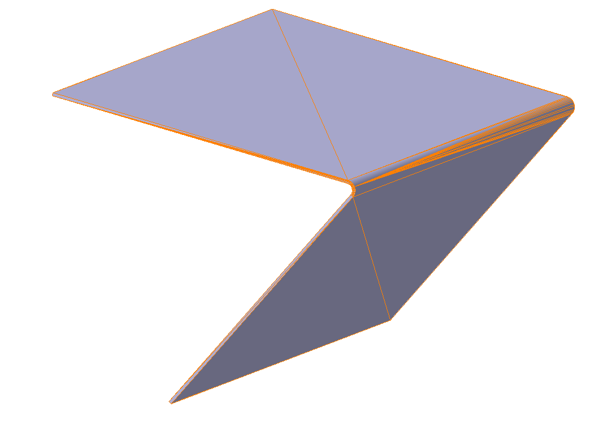
simplification
we also remove small roundings that are barely visible, which also reduces the polygons
Face: 20
Face: 116

Slide 11
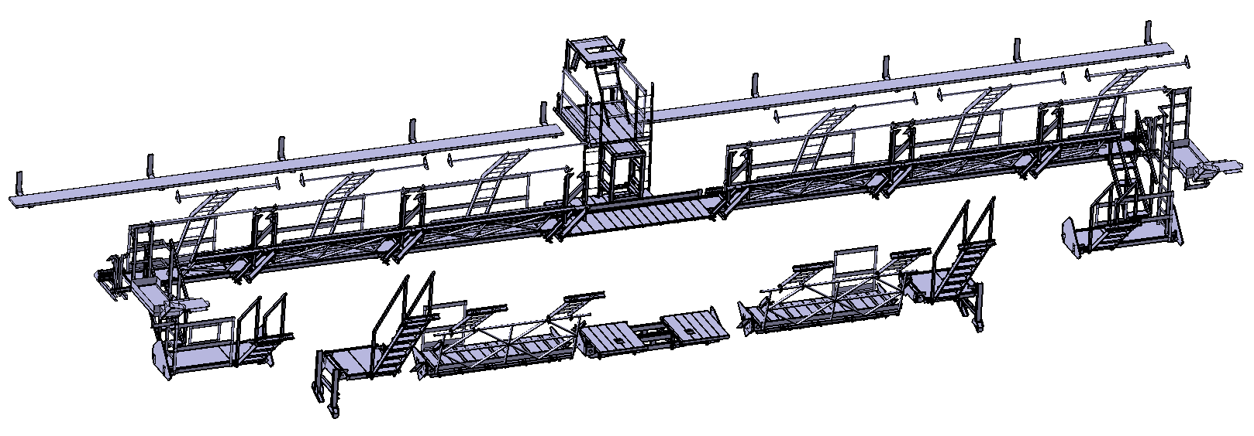
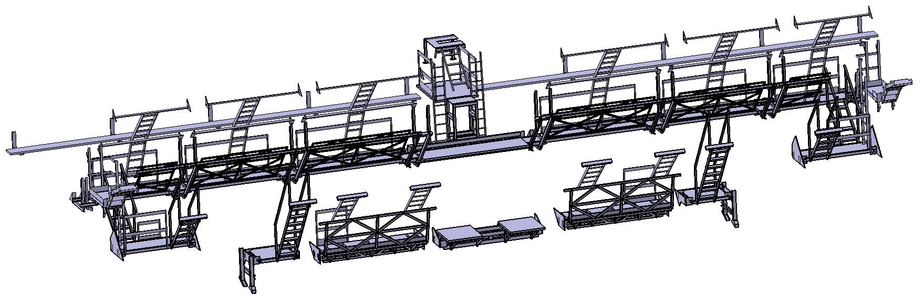
simplification
Detailed
Use the above methods to facilitate the geometry, we get a difference in polygons of about 97%, which significantly affects the system load
But the visual part is almost indistinguishable
Face: 479187
Simplified
Face: 16464

Slide 12
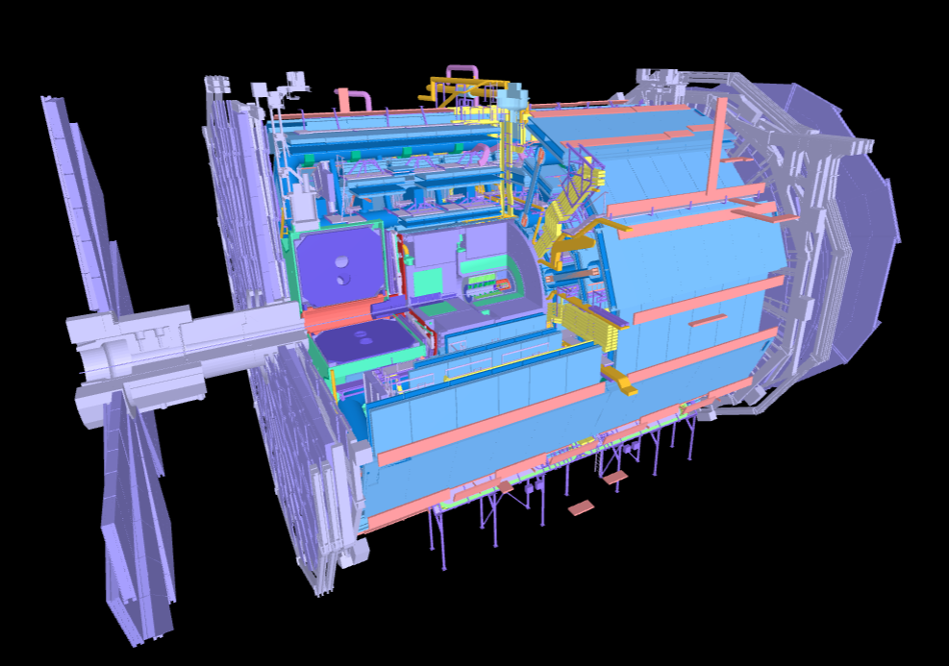
simplification
For today, we have simplified 83 atlas detector geometries that can be seen in Tracer

