Slide 1

TM REVIEW SESSION BEFORE LHC WORKSHOP CHAMONIX
https://indico.cern.ch/event/1232235/
2023 SM18 CRYOGENICS
SCHEDULE – CAPACITY – FLEXIBILITY – LIMITATIONS
2023 JANUARY 18
By Nicolas GUILLOTIN – TE/CRG/ML

Slide 2
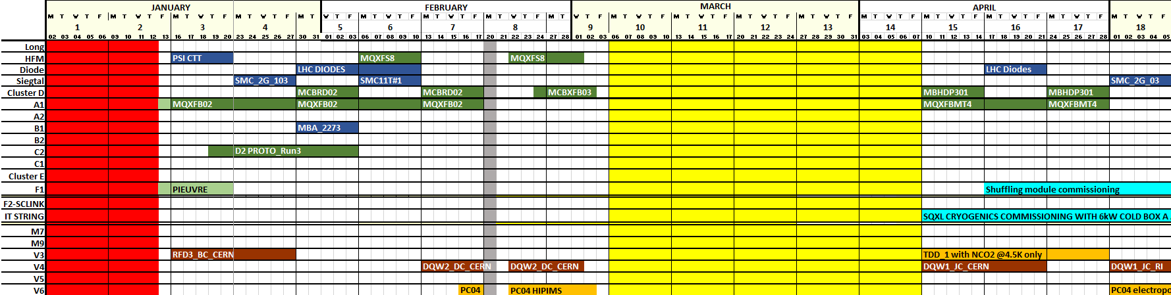
NON HL-LHC MAGNET
2023 - SM18 MAIN REQUESTS
HL-LHC MAGNET
NON HL-LHC CAVITIES & CM
FORECAST WITH SMOOTH COORDINATION
HL-LHC CAVITIES & CM
Maintenance,
Installation & connection of
the 1.9 K equipment for
the IT String infrastructure
Sys. Admin days
EN-CV maintenance
Sys-Admin days with impact on
SM18 cryo equipment until January 9th
EN-EL AUG tests
EN-CV switch to the water bypass with LHC-P18 operation in parallel
Back to SFA-181 water tower on March 13
Restart of cryo infra equipment January 9th
EN-EL Normal Secours tests on January 11th in the morning
Pre-cool down to 80K with CWU can be anticipated on January 11th end afternoon
Reconnection to main dewar with LHe on January 12^{ve}
TM REVIEW SESSION BEFORE LHC WORKSHOP CHAMONIX - Jan. 18th
N. Guillotin
1

Slide 3
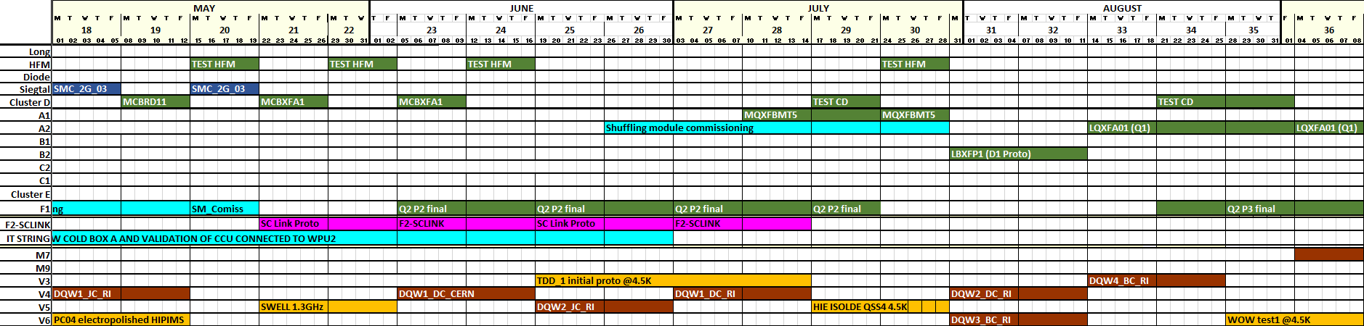
NON HL-LHC MAGNET
2023 - SM18 MAIN REQUESTS
HL-LHC MAGNET
NON HL-LHC CAVITIES & CM
FORECAST WITH SMOOTH COORDINATION
HL-LHC CAVITIES & CM
Several test benches commissioning : A2, F1, F2-SClinK
Dense alternation of Crab RF cavity tests in V3 and V4
Dense alternation of HFM and Cluster_D tests ⇒ high number of quenches and high liquid helium consumption
TM REVIEW SESSION BEFORE LHC WORKSHOP CHAMONIX - Jan. 18th
N. Guillotin
2

Slide 4
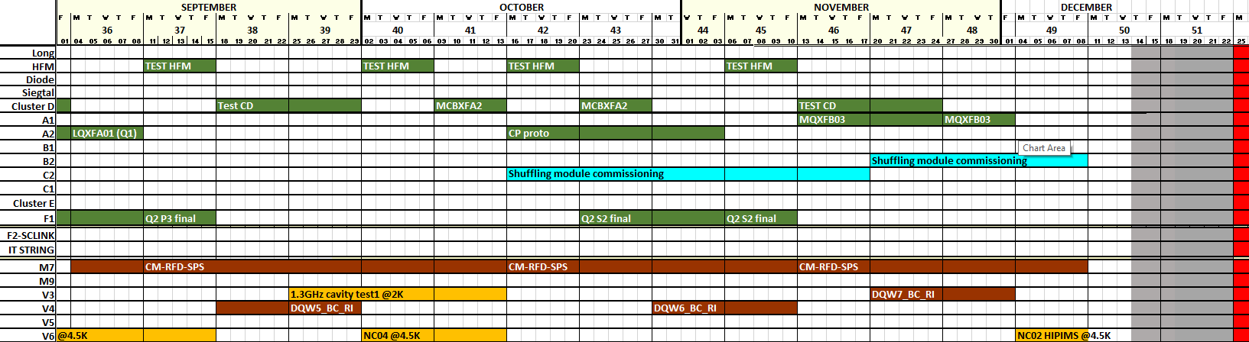
NON HL-LHC MAGNET
HL-LHC MAGNET
2023 - SM18 MAIN REQUESTS
NON HL-LHC CAVITIES & CM
HL-LHC CAVITIES & CM
Several test benches commissioning : M7 (SY-RF), B2, C2 (TE-MSC)
Dense alternation of tests between HFM and Cluster_D :
Cool down can not be performed simultaneously and
Quench recoveries can not be done in parallel
Regular crab RF cavity tests
TM REVIEW SESSION BEFORE LHC WORKSHOP CHAMONIX - Jan. 18th
N. Guillotin
3

Slide 5
g/s
LHE CONSUMPTION 2023
35g/s of pure liquefaction
27g/s of pure liquefaction
MAINTENANCE
TM REVIEW SESSION BEFORE LHC WORKSHOP CHAMONIX - Jan. 18th
N. Guillotin
4

Slide 6
2K PUMPING CONSUMPTION 2023
g/s
FORECAST WITH SMOOTH COORDINATION – NO MARGIN
24 g/s with 2 WPU
@20 mBar
MAINTENANCE
TM REVIEW SESSION BEFORE LHC WORKSHOP CHAMONIX - Jan. 18th
N. Guillotin
5

Slide 7
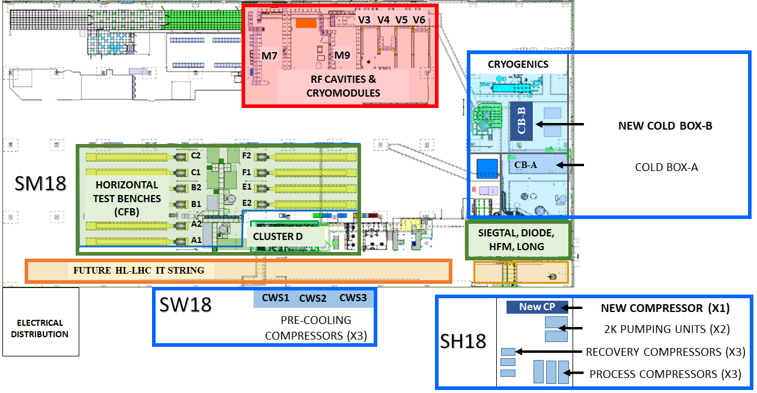
SM18 CRYOGENICS INFRASTRUCTURE
2 bunkers for RF-cryomodules
4 vertical RF-cavity cryostats
Cold Box_B :
Liquefier in operation
10 horizontal magnet
test benches
Cold Box_A :
Back up liquefier
and for IT STRING
6 vertical magnet test benches
2 CWU :
Cold/warm up units,
with 3 Kaesers compressors (CWS)
2 WPU
Warm pumping units,
with very low pressure compressors
Typical performances :
6 g/s @ 10 mbar
12 g/s @ 20 mbar
80g/s for each CWU
120kW @80K for each CWU
CWU are LN2 cooled units
TM REVIEW SESSION BEFORE LHC WORKSHOP CHAMONIX - Jan. 18th
N. Guillotin
6

Slide 8
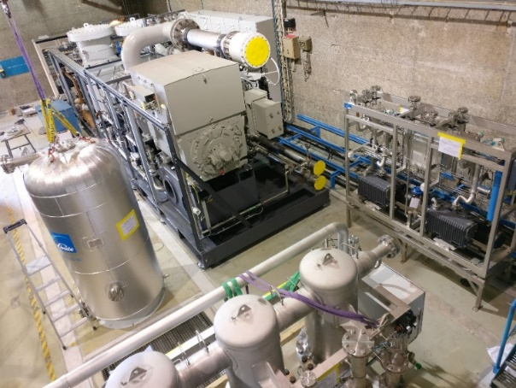
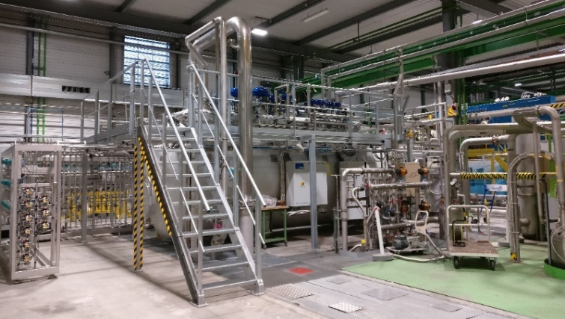
SM18 LIQUID HELIUM DISTRIBUTION infrastructure LAYOUT
2K pumping
units
USERS Supply & Return
Cryo Distribution
Cold BoxES
LHe Supply & Return
CompressorS Station
CCU
HL-LHC IT STRING
Distribution Valve Box
WPU #2
Main
Valve Box
Existing 6 kW
Refrigerator
[CB-A]
Warm Pumping Units
RF Cavities &
Cryomodules
Existing Sulzer process
Compressor Station
WPU #1
New TLs
LHe Delivery
New 35 g/s
Liquefier
[CB-B]
Horizontal Test Benches,
Vertical Test Benches,
F2-SClink
User Supply
Cold Gas Return
New Helium process
Compressor Station
LHe Delivery
Auxiliary Valve Box
+ Purge
+ Balloon
Dewar
25’000L
10’000L
25’000L Dewar reconnection foreseen after the next shutdown
TM REVIEW SESSION BEFORE LHC WORKSHOP CHAMONIX - Jan. 18th
N. Guillotin
7

Slide 9
MONTHLY CRYO AVAILABILITY (%) OVER THE LAST 8 YEARS
25kL-Dewar
Inlet clogging
CP2 blocking & 3.3kV
motor alteration
during Open Days
-18kV Electrical cut-
TU1 filter
clogging
(25 g/s CB)
25kL-Dewar pit’s flooding
Valve box insulation vacuum
MAINTENANCE
MAINTENANCE
MAINTENANCE
MAINTENANCE
COVID’19
MAINTENANCE
MAINTENANCE
2015
2016
2017
2018
2019
2020
2021
2022
Yrly
availability
97.3%
99.4%
99.3%
99.4%
95.8%
96.8%
81.2%
99.9%
TM REVIEW SESSION BEFORE LHC WORKSHOP CHAMONIX - Jan. 18th
N. Guillotin
8

Slide 10
KEY figures for the SM18 CRYO operation with liquid Helium
 | 2020 With 6 kW CB CB-A + 25kL Dewar | 2021 With new liquefier CB-B + 10kL DewAR | 2022 With new liquefier CB-B + 10kL DEWAR
Number of days of CRYO operation at SM18 | 274 days COVID’19 | 262 days 25kL-Dewar pit’s flooding | 310 days
Yearly Average Liquid Helium consumption by the test benches in g/s | 18.0 g/s | 19.8 g/s | 14.1 g/s CryoOK but no tests from wk 11 to wk 15 included
Peak Liquid Helium consumption by the test benches in g/s | 27 g/s | 36 g/s | 37 g/s
Total number of tests | 50 | 52 | 62
HL-LHC project tests | 34 | 27 | 26
TM REVIEW SESSION BEFORE LHC WORKSHOP CHAMONIX - Jan. 18th
N. Guillotin
9

Slide 11
SM18 CRYOPLANT AVAILABILITIES COMPARISON
 | 2020 With 6 kW CB CB-A + 25kL Dewar | 2021 With new liquefier CB-B + 25 or 10kL DewAR | 2022 With new liquefier CB-B + 10kL DEWAR
SM18 CRYOPLANT AVAILABILITY | 96.8 % Lock down period for COVID’19 excluded, Equivalent to 55 days of stop for the tests | 81.2% 99.9 % IF Shutdown period for repair of the main helium liquid storage excluded, Equivalent to 57 days of stop | 99.9%
ROOT CAUSES | major unavailability related to : . FILTER clogging on 1st CB-A turbine . oil coalescer default on compressor side | minor defaults reported : . temporary water cut at the SM18 . under cooling of the CB-B FOLLOWING maladjusted cold gas returns from test benches | MINOR defaults reported : . CWU oil issues . CWS ISSUES . 80K-ADSORBER LEAKS
10
TM REVIEW SESSION BEFORE LHC WORKSHOP CHAMONIX - Jan. 18th
N. Guillotin

Slide 12
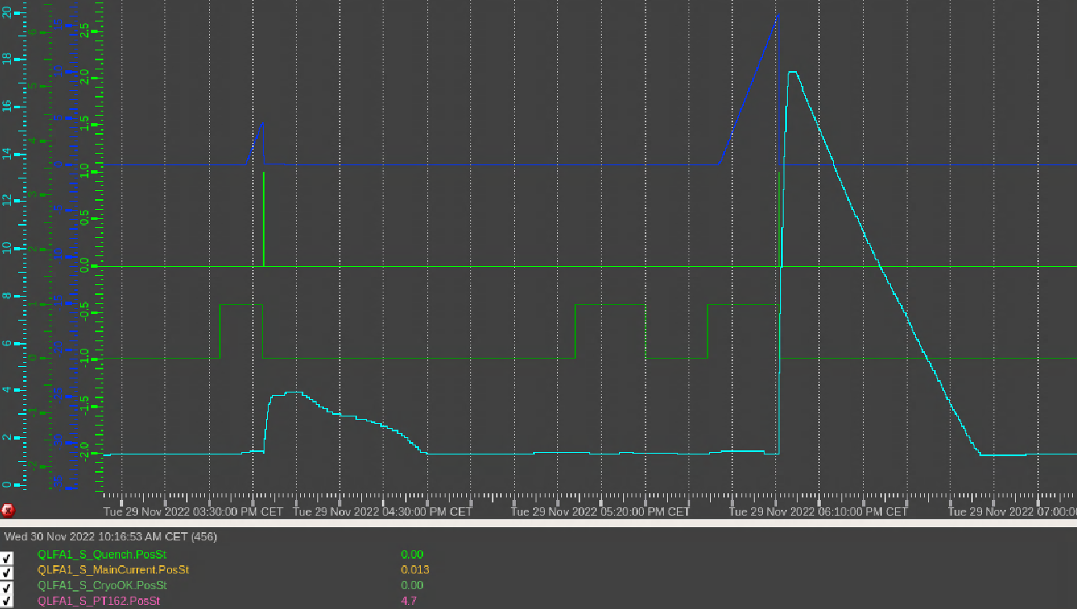
SM18 MAGNET TESTS PARTICULARITIES
About 20 Quenches performed in 2022 on A1 test bench, Nov. 14th to Dec. 15th
Average duration for these quenches recovery ∼2h30
With extrema from ∼ 50 min up to ∼19h for only one of the quenches in 2022
Magnet current
Quench
Recovery duration strongly depends on :
Number of tests performed in parallel and pumping availability
Type of tests and cryostat volumes concerned
Number of quenches in parallel
Peak current value reached
10kL Dewar liquid helium level
CrOK
MAGNETS
Pressure
Average duration for quenches recovery on Cluster_D and HFM is ∼4h, With extrema from ∼ 1h up to ∼10h
High liquid helium volumes for specific cryostats like Cluster_D and HFM (as well as V3 for RF tests)
High heat loads will be experimented on new shuffling modules with electrical heaters to ease electrical current ramp up
RF
Significant heat load for Cryomodule tests on M7
High 1.9K pumping consumption requested for HL-LHC RF cavity tests in 2023 with necessity of very stable values
TM REVIEW SESSION BEFORE LHC WORKSHOP CHAMONIX - Jan. 18th
N. Guillotin
11

Slide 13
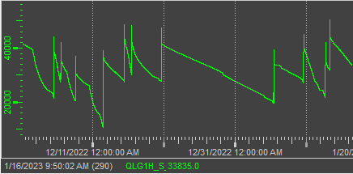
KEY POINTS FOR SM18 OPERATION AND TESTS IN 2023
Dense alternation between HFM and Cluster_D tests in 2nd semester
⇒ Strong LHe and 1.9K pumping consumption with punctual high-level quench recovery.
High LHe consumption expected with new shuffling modules when electrical heaters are activated to ease magnets current ramp-up.
Specific conditions of operation not tested on long periods formerly ⇒ LHe and pumping consumption uncertainty for A2, B2, C2 and F1
Average LHe consumption for the test benches should stand theoretically at ∼75% of the max capacity [slide 4],
Leading to a sufficient margin in terms of coordination and operation
1.9K pumping consumption for the test benches should stand between 80 - 100% in the 2nd semester [slide 5]
⇒ No operational margin
Installation of all or part of the new 1.9K pumping equipment for IT STRING during maintenance period.
CCU commissioning will require a period of 1.9K pumping availability reduction, not taken into account in the current simulations for 2023
Periods with magnets maintained at 80K could be optimized
Magnets cool down to 80K and warm up to 300K with CWU have to be anticipated due to high LN2 consumption, especially during WE
Conclusion :
No showstopper, but new constraint would impact the ideal tests planning as few margin on pumping capacities and LHe after quenches
TM REVIEW SESSION BEFORE LHC WORKSHOP CHAMONIX - Jan. 18th
N. Guillotin
12

