Slide 1



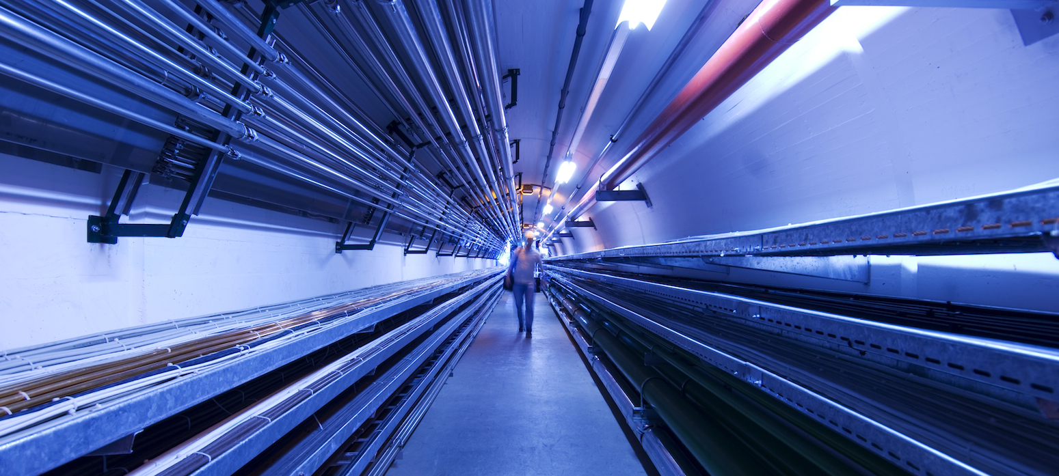
CEA Contribution to WP6 task 6.3
Guillaume Ferrand
CEA Paris-Saclay
Muon collider WP6 meeting
January 12, 2023

Slide 2
6.3: Break-down mitigation studies
Task objectives:
  Find best cavities and RF properties to minimize breakdown due to high accelerating gradients under high magnetic field. (Material, gas, temperature, pulse length,…)

Slide 3
CEA Contribution – Study and simulation
Studying/simulating breakdown models:
  electron tracking under RF + magnetic field,
  different pulse lengths in a pillbox cavity,
  thermal studies.
  scaling laws.

Slide 4
CEA Contribution – Test bench
Study/simulation of a test bench:
  that validates/invalidates the simulations,
  that allows tuning the parameters of the simulations,
  that validates/invalidates the proposed cavity designs (in relation to other tasks of WP6).
Feasibility with CEA klystrons.
Study of a pulse compressor @ 704 MHz.
Estimating costs.

Slide 5
Example of RF breakdown test stand
To build
Already exists
Bunker (radiation and B shielded)
Magnet
(MICE 4T)
Klystrons (f=704 MHz)
6m+4m
Thales 2182A 1.6 MW peak
2.8 MW
magic tee
cavity
CPI VKP7952A 1.2 MW peak
pulse compressor
7m

