Slide 1
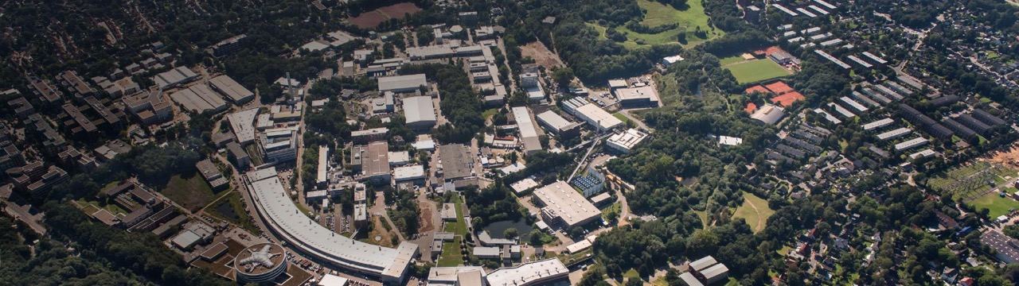


ARES Linac @ SINBAD
A Precision Tool for Accelerator Science, Technology and Application Developments
BTTB workshop 2023
Florian Burkart for the ARES team
with input from R. Assmann, H. Dinter, A. Eichler, S. Jaster-Merz, J. Kaiser, M. Kellermeier,
W. Kuropka, F. Mayet, B. Stacey, O. Stein, T. Vinatier,
Acknowledgements to R. Brinkmann, W. Leemans and the DESY M Technical Groups and FS-LA

Slide 2
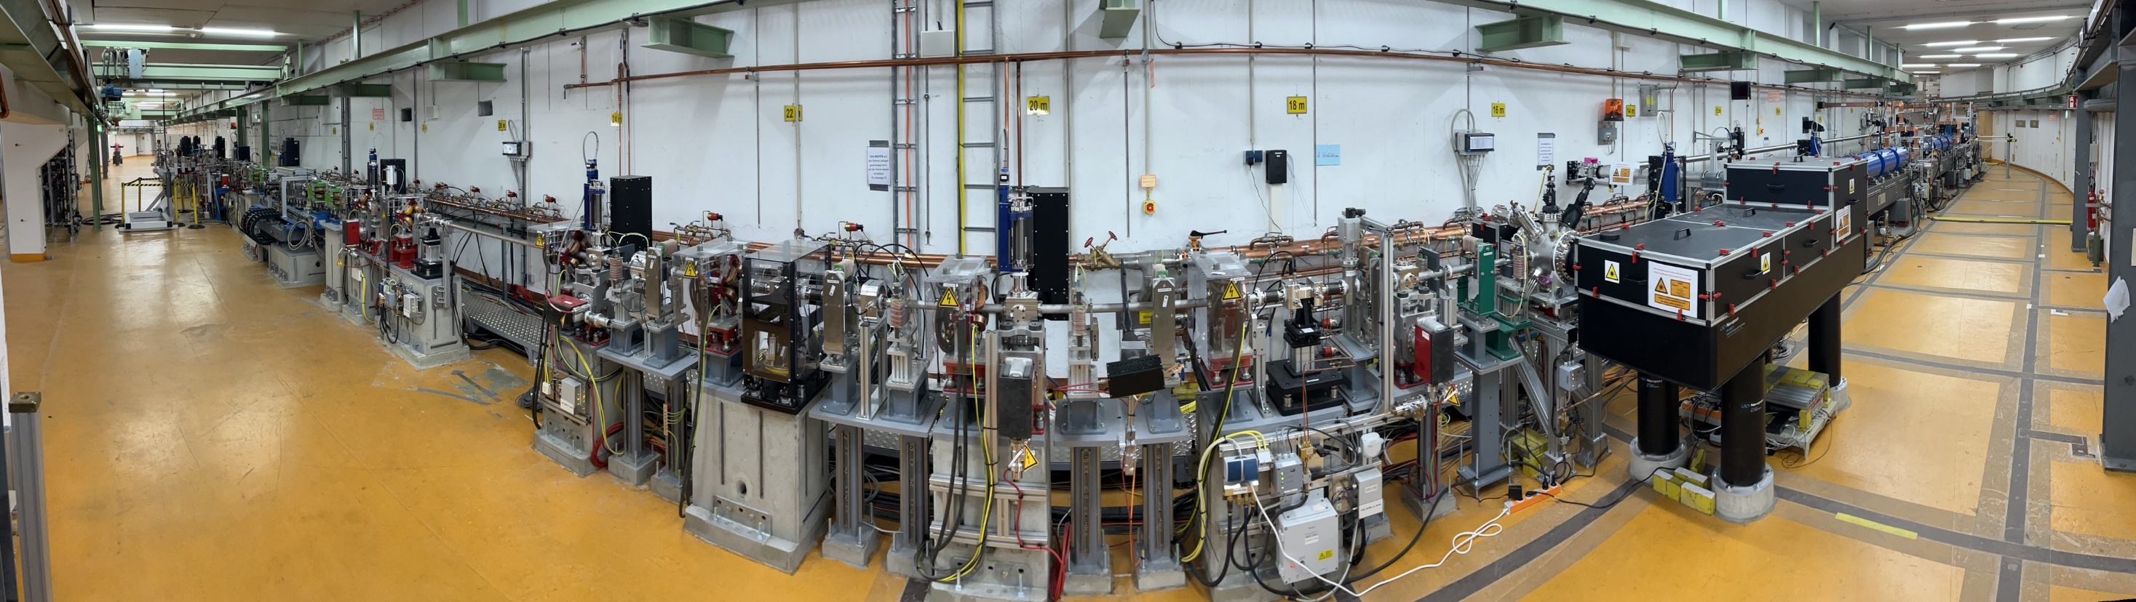
ARES – in a nutshell
In operation since 2020
Normal conducting 160 MeV electron linac for the production of ultra-short electron bunches and diagnostics development
Novel acceleration techniques / beam manipulation testbed (dielectric laser acceleration)
Accelerator components R&D and medical applications (VHEE and diagnostics)

Slide 3
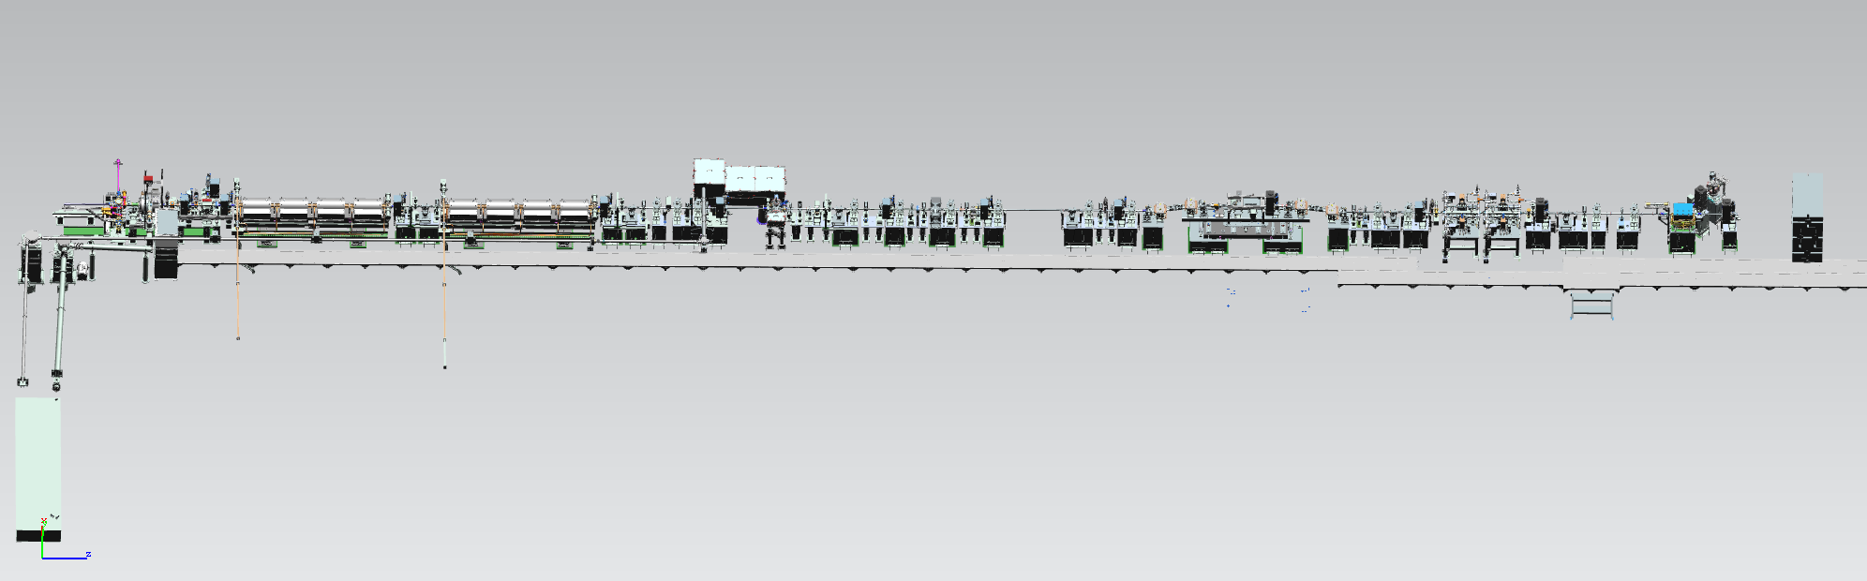
ARES in a nutshell
48 m of conventional accelerator technology
gun
ACC1
ACC2
exp.area 1
exp.area 2&3
bunch compressor
PolariX TDS
PC Laser lab

Slide 4
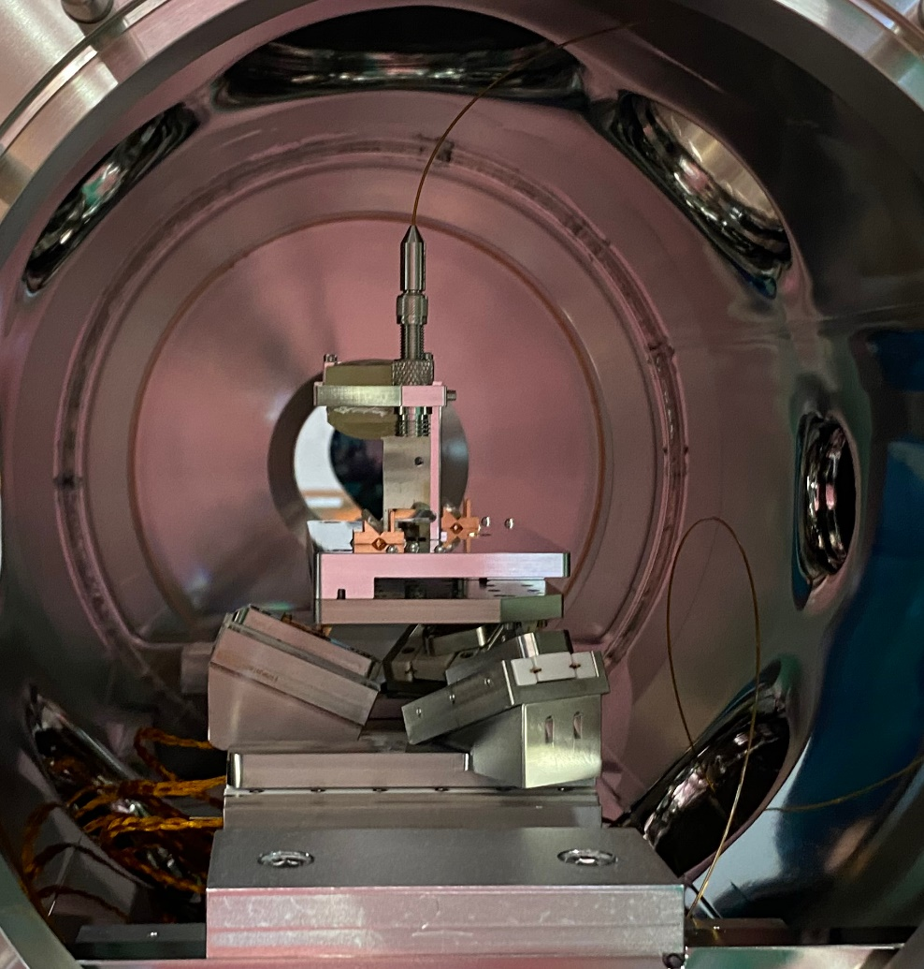
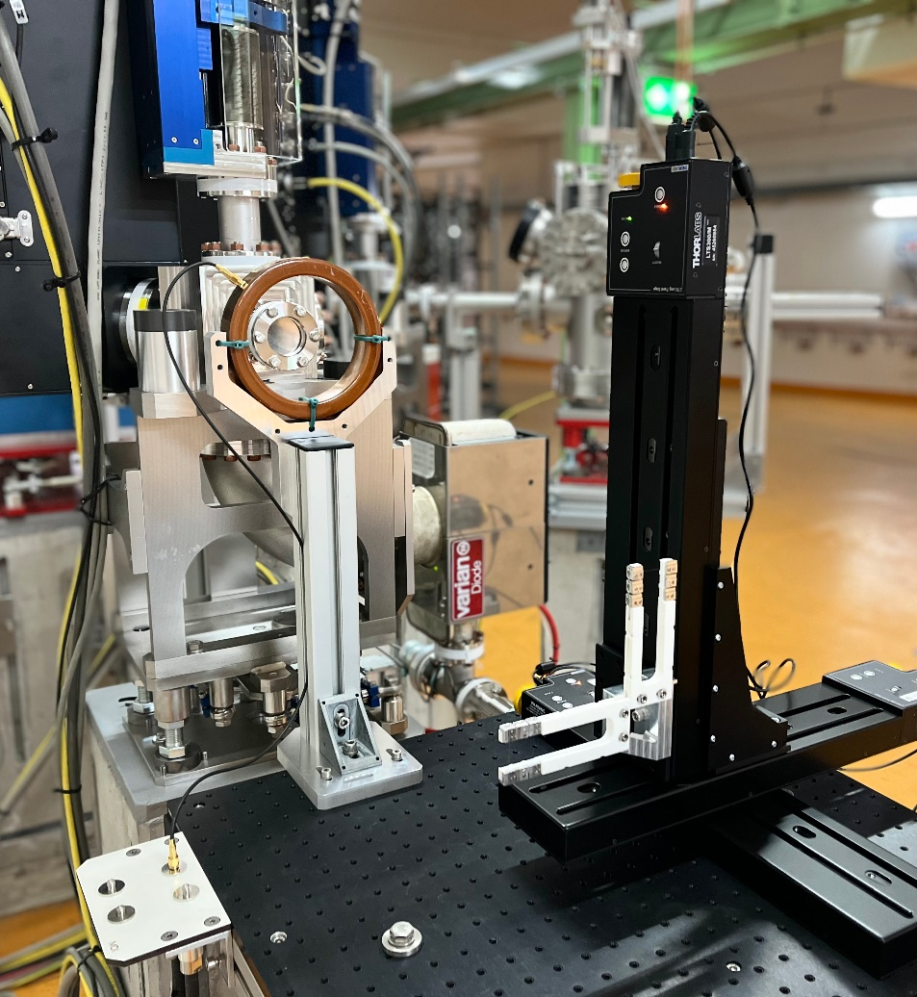
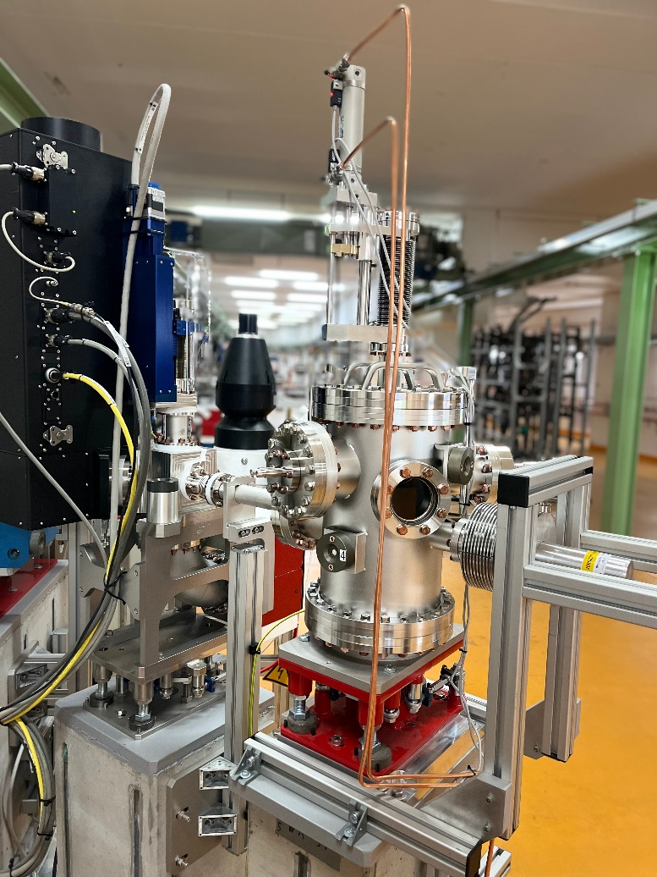
Three experimental areas available for users
Full flexibility
In UHV, highest precision, best beam control.
In air, highest flexibility.
In low pressure vacuum, FH & M detector test stand.

Slide 5
Already close to nominal parameters
waiting for XBand PolariX TDS.
Parameter | Design parameters | Actual commissioning parameters
Energy | 50 – 160 MeV | 20 – 160 MeV
Charge/pulse | 0.5 – 200 pC | 0.001 – 280 pC
Rep. rate | Single pulse @ 50 Hz (*) | 50 Hz
Bunch length | few fs / sub-fs pulse length | 20 fs (resolution limited)
Momentum spread | 10⁻⁴ | 10⁻⁴ (resolution limited)
Normalized transverse emittance | 105 nm (ASTRA) | 102.7 ± 3.8 nm
*arrival time jitter of <10 fs rms

Slide 6
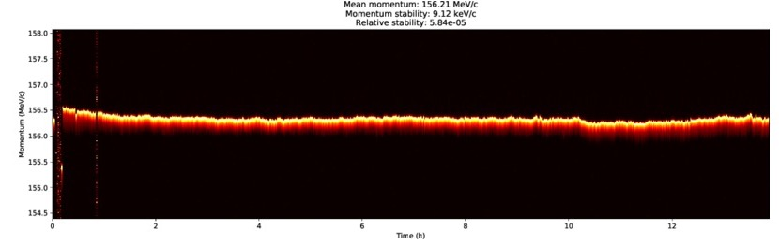
Unprecedented stability at ARES
High precision temperature and modulator stabilization has resulted in excellent stability and reproducibility:
17 μm rms position jitter (5% of σ_{x/y})
5.8e-5 rms relative energy stability over 14 hours (average over 3 days: 2.4e-4) – still room for improvement.

Slide 7
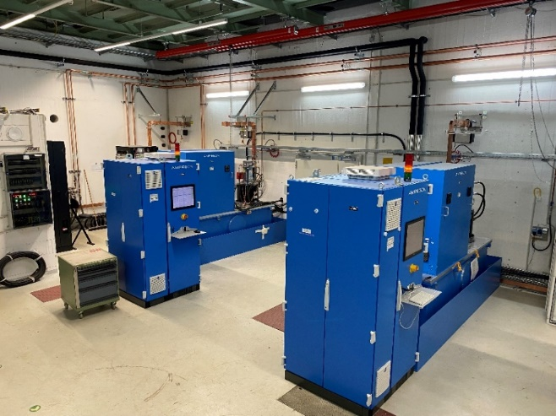
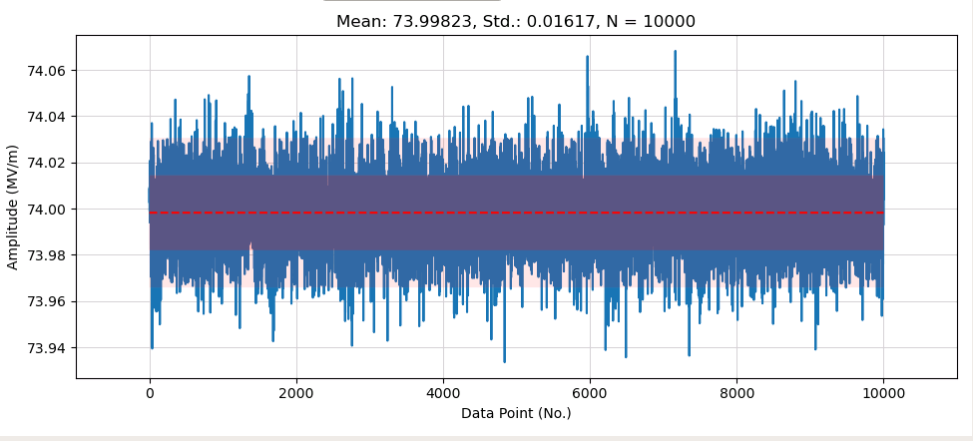
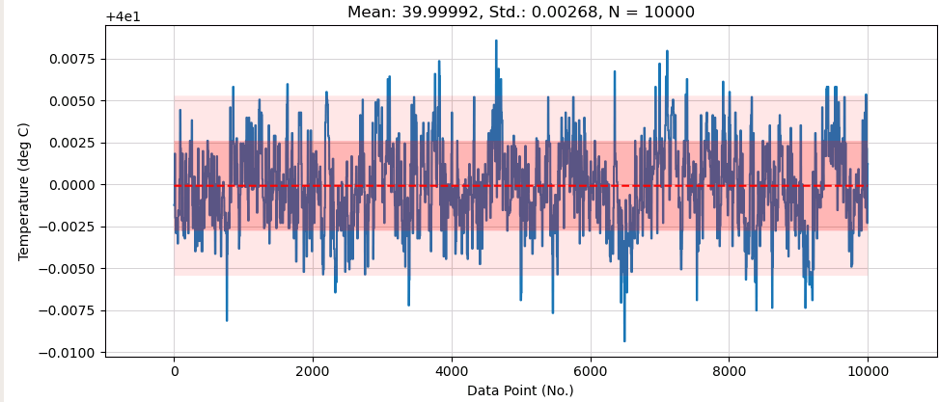
Stable infrastructures (RF power and water cooling)
Excellent engineering
Gun Modulator from Scandinova.
Gun RF power calibrated to gradient. Std: 0.016 MV/m
measured over 2.7 h
Gun precision water cooling, Std: 0.0027 deg C

Slide 8




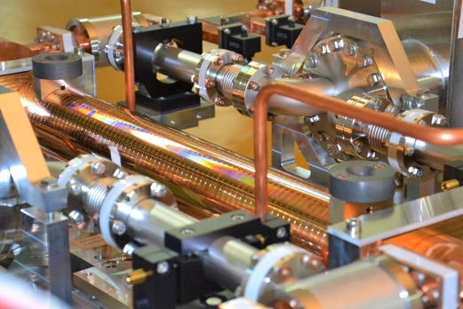
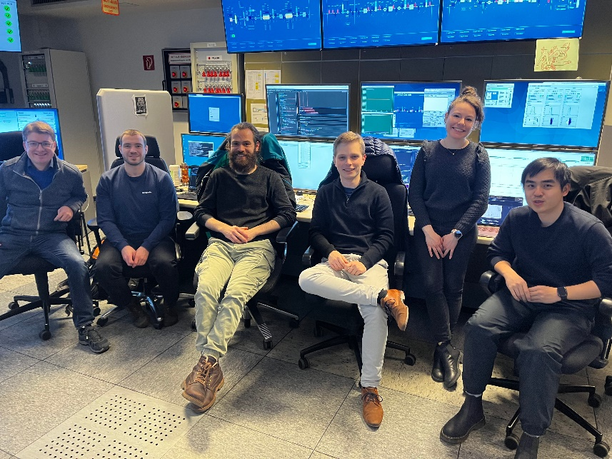



A unique R&D platform
Test components and beam properties with ultra-short, high brightness beams
State of the art beam controls & diagnostics
fs synchronization
Beam tomography studies
Machine learning towards autonomous accelerators
Neural network for emittance analysis
Beam diagnostics in the frame of EIC pathfinder project TWAC …
Kicker magnet tests
Beam position monitors &
Intensity monitors development
Advanced accelerator components R&D
Vacuum windows
High stability infrastructures
Prototyping & 3D printing
Photocathode Laser development
…
PolariX - State of the art beam diagnostics
Autonomous accelerators workshop with collaboration partners from KIT
detector development

Slide 9

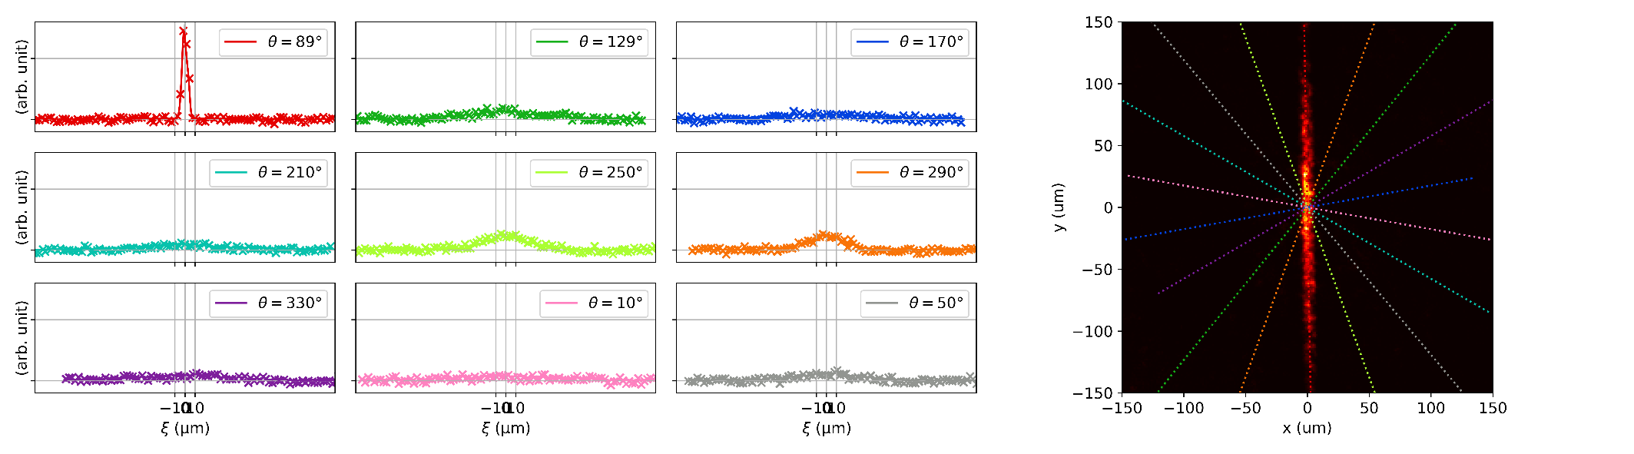
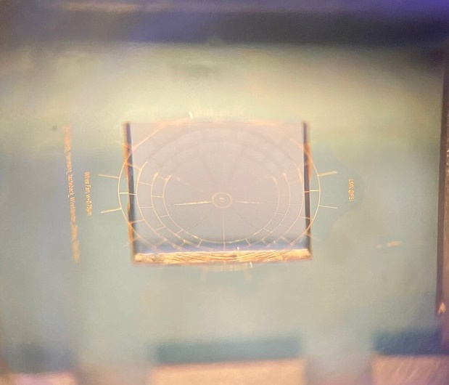
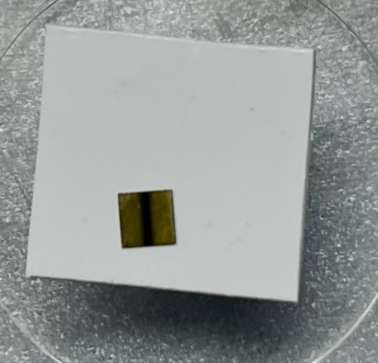
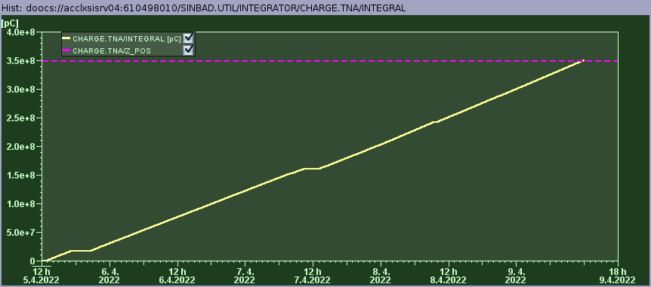

First successful external user experiments
high resolution beam reconstruction and high stability irradiation
In total: 242 h of beam time for externals
Measured beam losses
Reconstructed beam
Micro-wirescanner
1 micron thick gold wires
Around 4 days continuous beamtime to irradiate a 300 mu thick diamond sample with 2E15 e⁻.

Slide 10
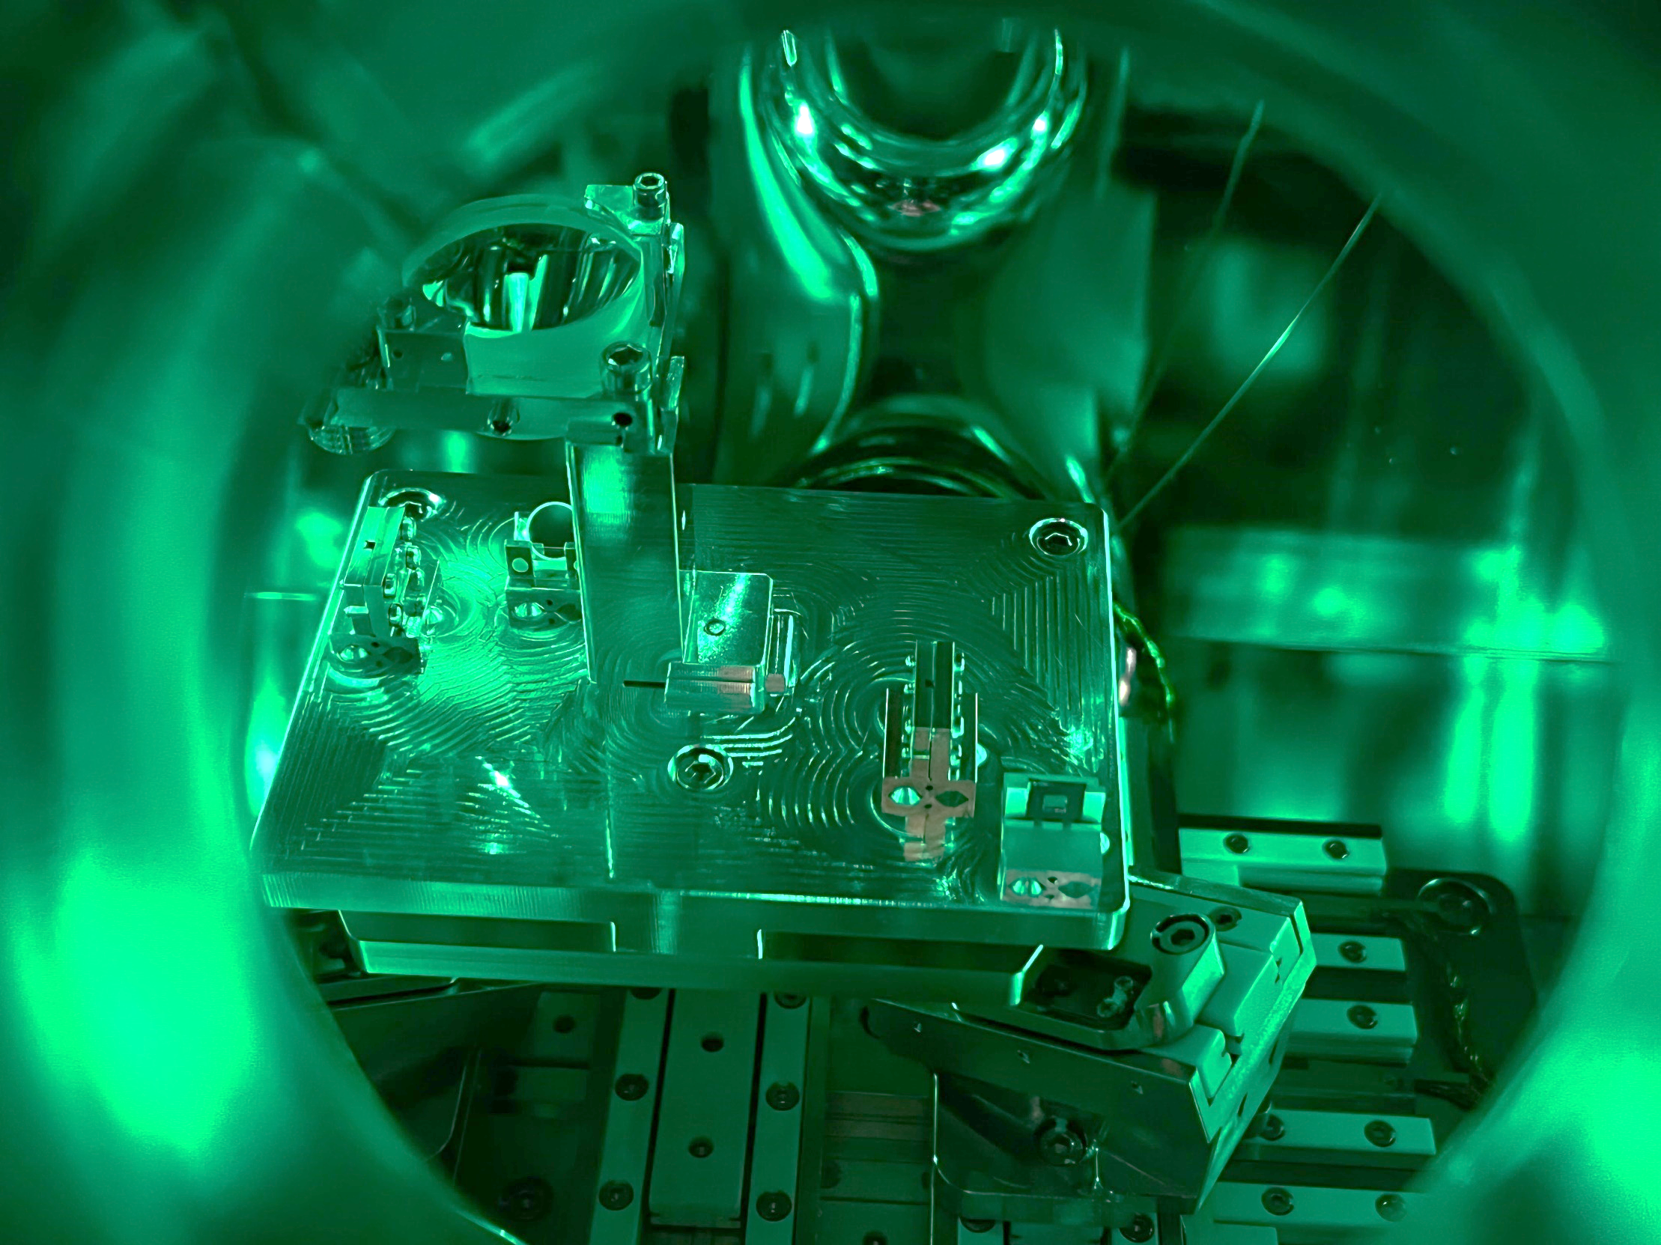
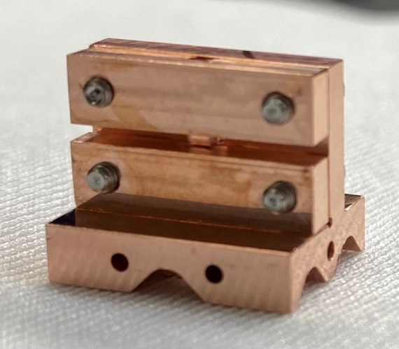
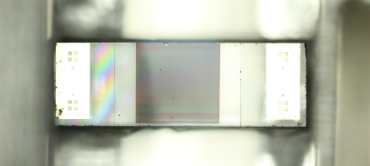


1 mm
3 mm
Novel acceleration techniques
Aperture: 1µm!
Micro-wirescanner

Slide 11

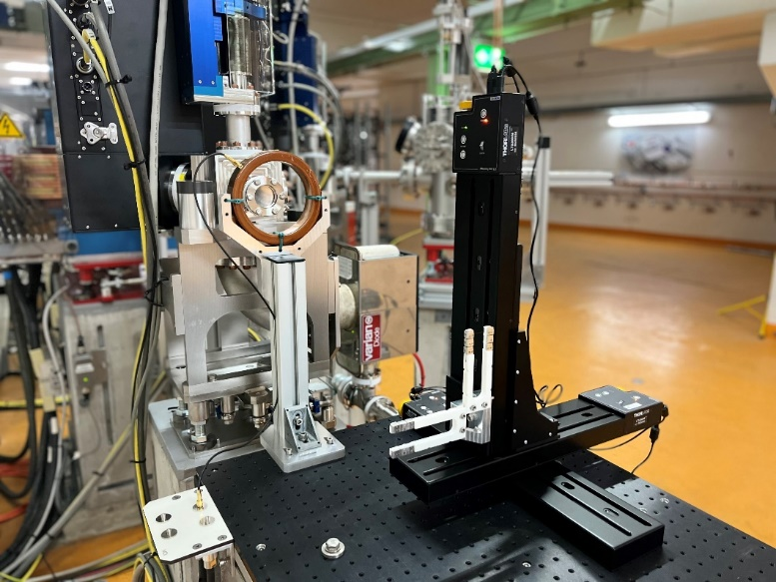
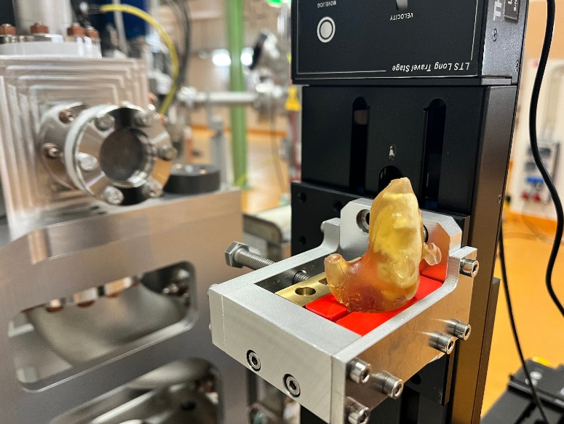



New opportunities – new fields
Started to adapt ARES to the needs of medical research
Up to 160 MeV high precision electron beams for research & development.
  Cutting-edge stability of the electron pulse energy
  Excellent beam control
  Ideally suited for medical applications (very high electron energy treatment)
Setting up collaborations and infrastructure.
Experimental station designed for medical research
Collaboration with UKE Hamburg and University Manchester started to study novel cancer treatment methods (VHEE, FLASH RT)
  Diagnostics (dose measurements) development.
  First benchmarking of simulations.
  Studies on cancer treatments.
Mouse phantom for electron CT studies

Slide 12
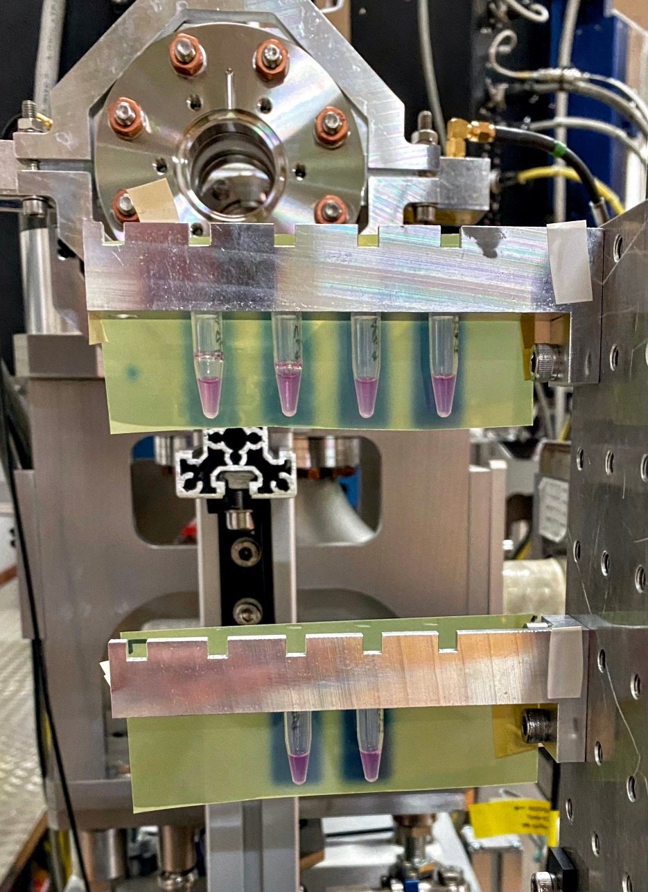
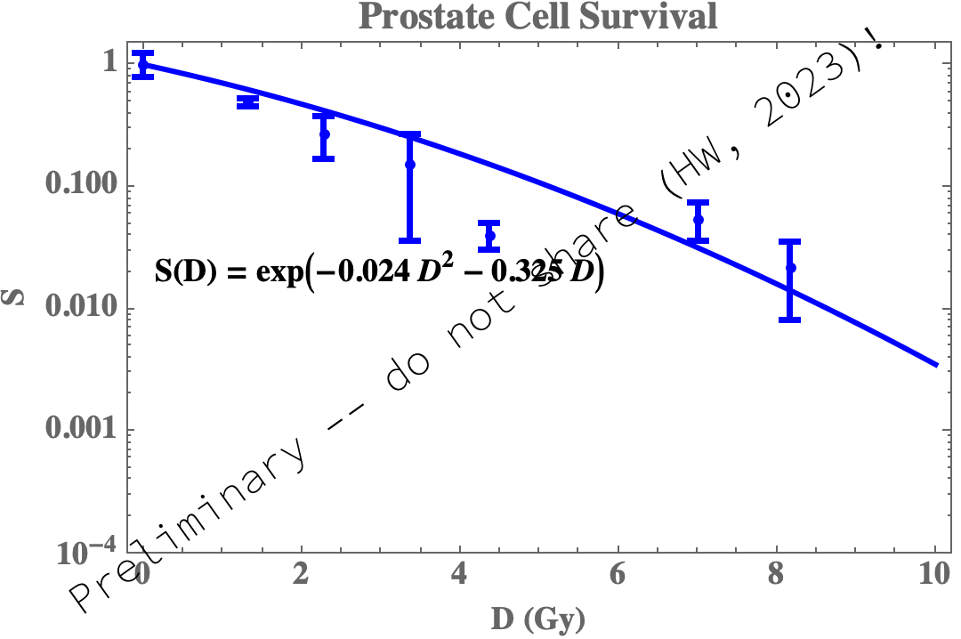
Worldwide first VHEE experiments with living cells!
Prof. Roger Jones, Hannah Wanstall
More experiments scheduled for May.
→ Towards „real“ VHEE experiments with bigger animal phantoms

Slide 13
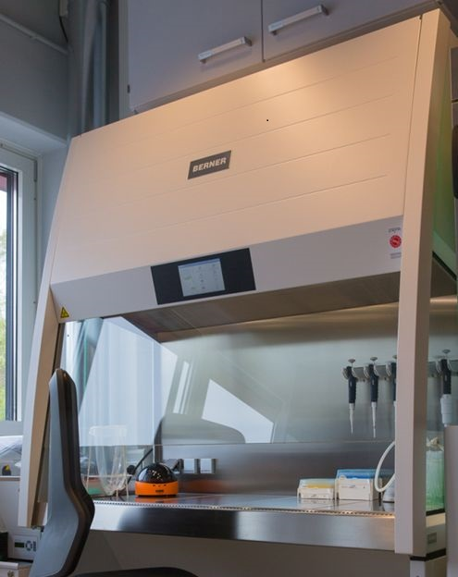
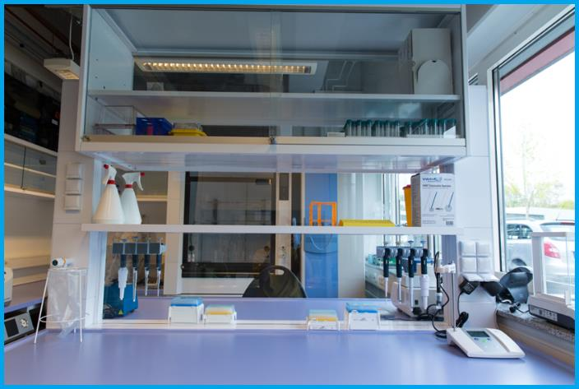
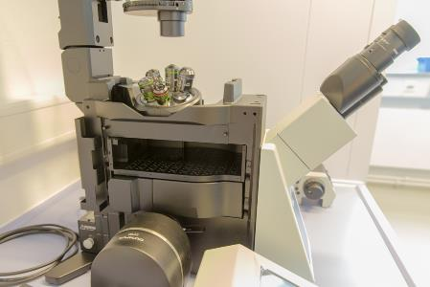
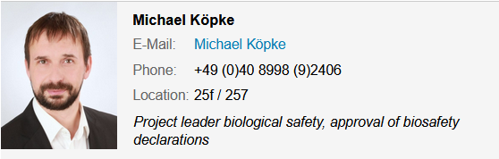
S2 Bio lab next to ARES
photo by courtesy of M. Osterhoff
Used for medical experiments at ARES. 5 min walking distance
inverse fluorescence microscope.
Work place in the Bio-Laboratory.
BSL2 safety workbench equipped with a mini centrifuge, vortexer, vacuum pump,…
Provides all the necessary equipment to cultivate, store, manipulate and analyse biological agents
More info:
https://photon-science.desy.de/facilities/on_site_infrastructure/laboratories_technical_infrastructure_shift_service/biology_laboratory_bsl_2/equipment/%20index_eng.html

Slide 14
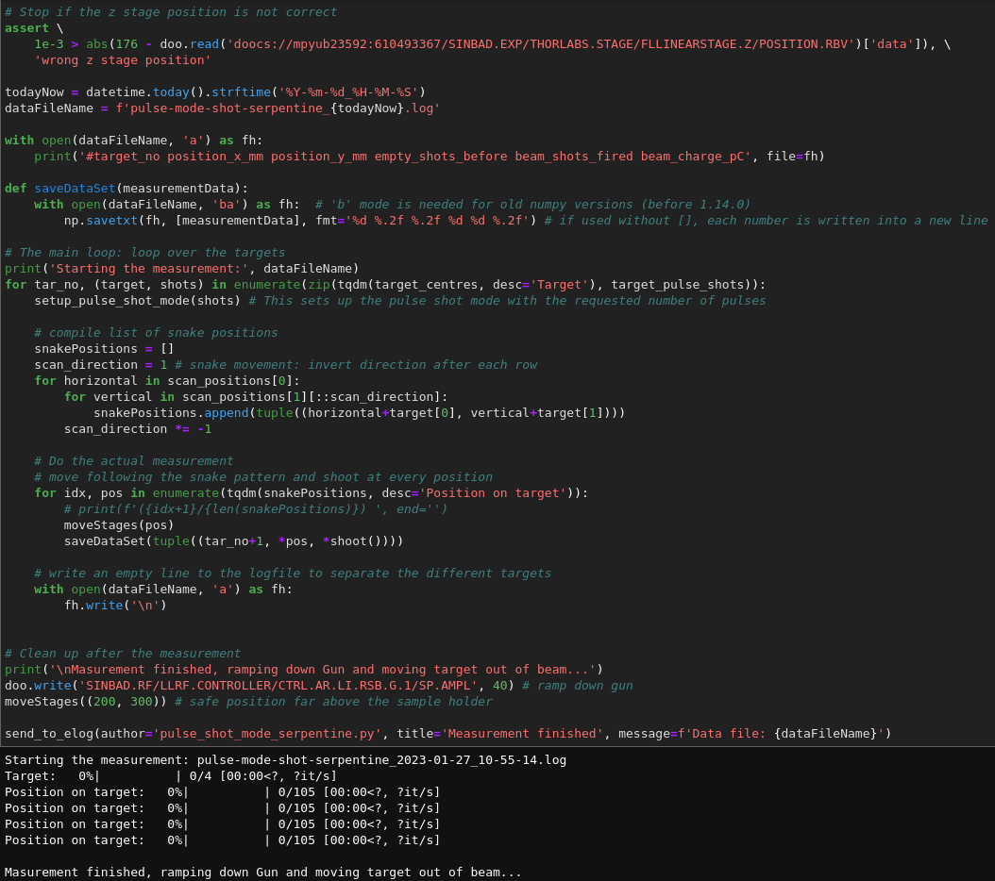
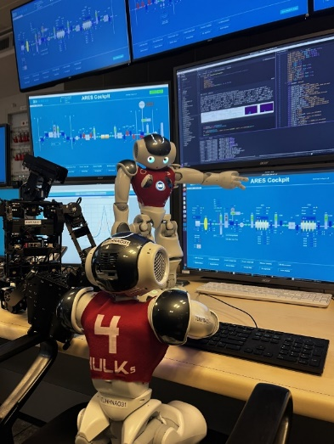
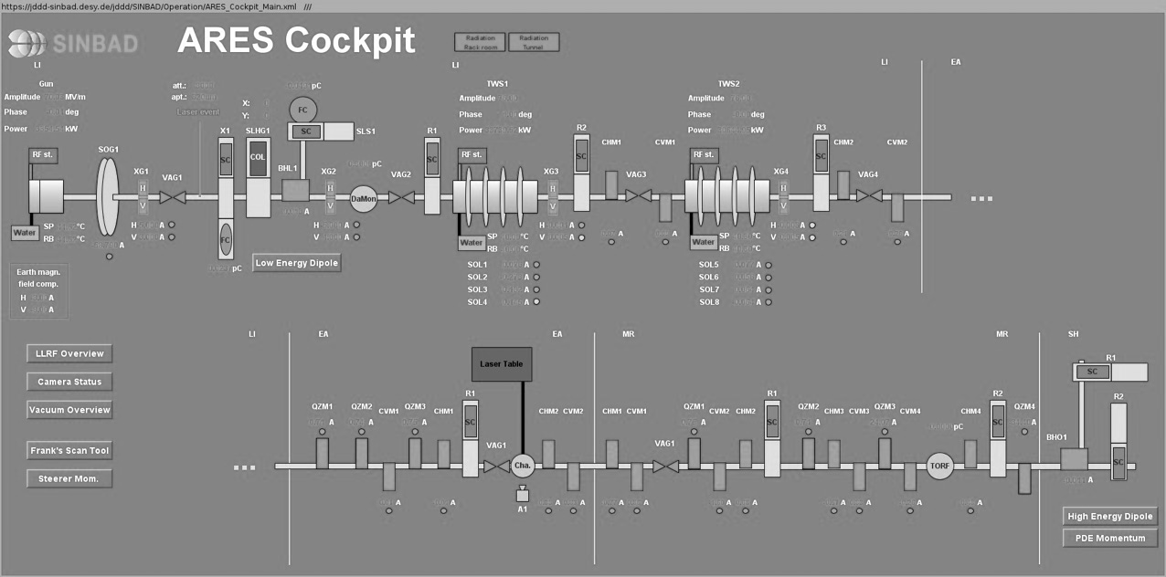
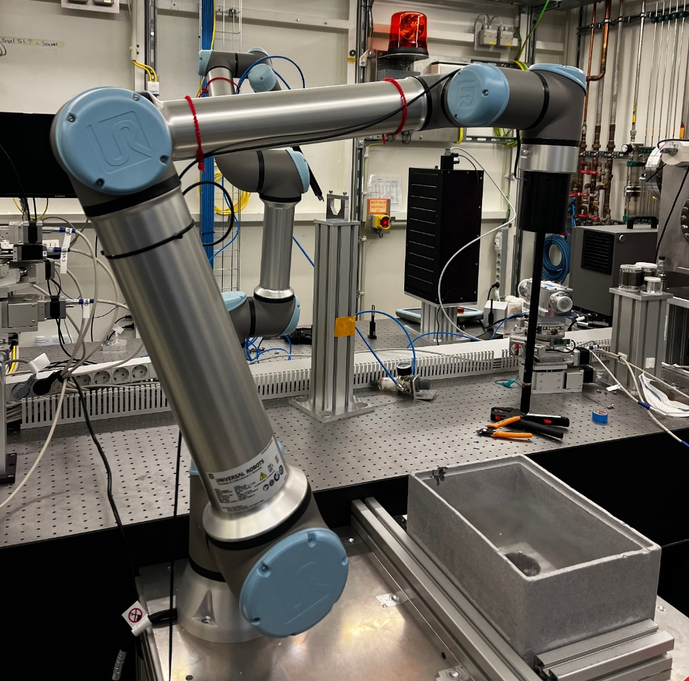
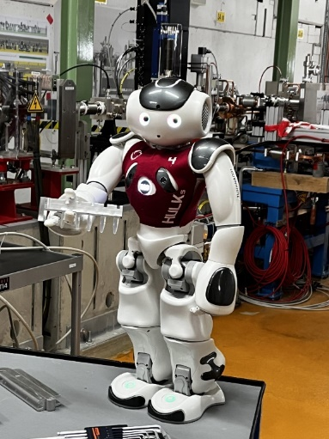
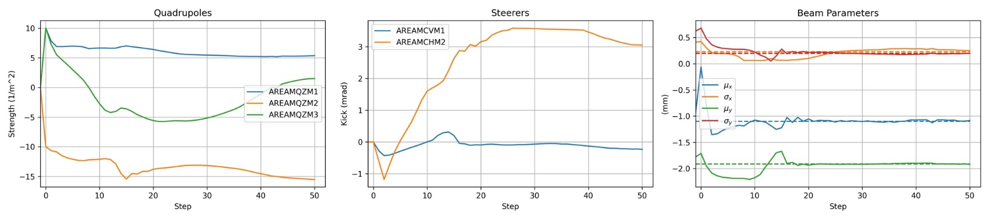
Automation, machine learning, robotics
Ease the user operation & gain efficiency
Movementscripts for irradiation patterns
Visit of the RoboCup team (TU HH).
Robot arm currently located at PETRA III,
Installation at ARES foreseen mid 2023.
Machine learning to improve orbit feedback

Slide 15
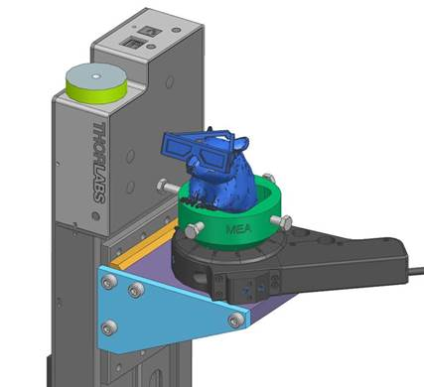
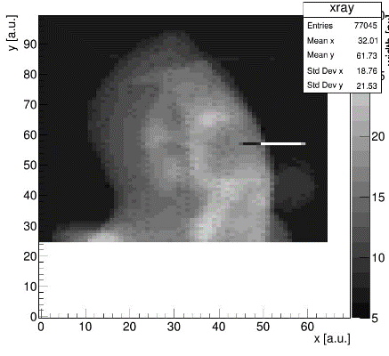
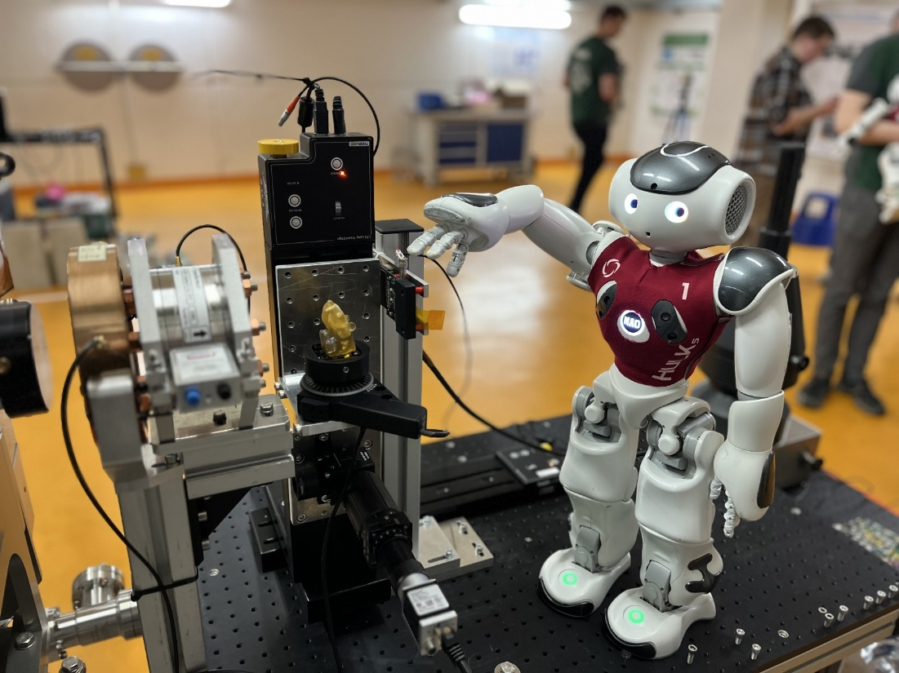
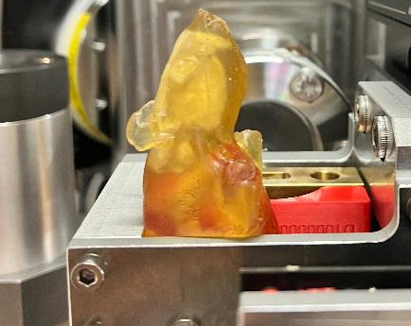
Electron CT experiments
See talk from Simon!
DESY internal collaboration with M-FH-ITT
Simon Spannagel, Paul Schütze (FH)
First proof-of-principle successful
But much more homework to do:
Real tomography
Optimize charge / dose
Optimize resolution
Scan procedure
…
Beam time last week…

Slide 16
Summary and Outlook
ARES is operational and open for internal and external users.
Portfolio from component R&D, diagnostics development over detector tests to medical applications.
Started to adapt ARES to the needs of medical research.
Infrastructure is available and strong support from bio safety and radiation protection.
Worldwide first VHEE experiments with living cells were done!
→ more experiments with water and animal phantoms in preparation.
Regular beam time for users scheduled– users extremely happy!
Hope to see you at ARES!

Slide 17
Thank you!

Slide 18
Florian Burkart
MPY1
florian.burkart@desy.de
+49-40-8998-3039

