Slide 1



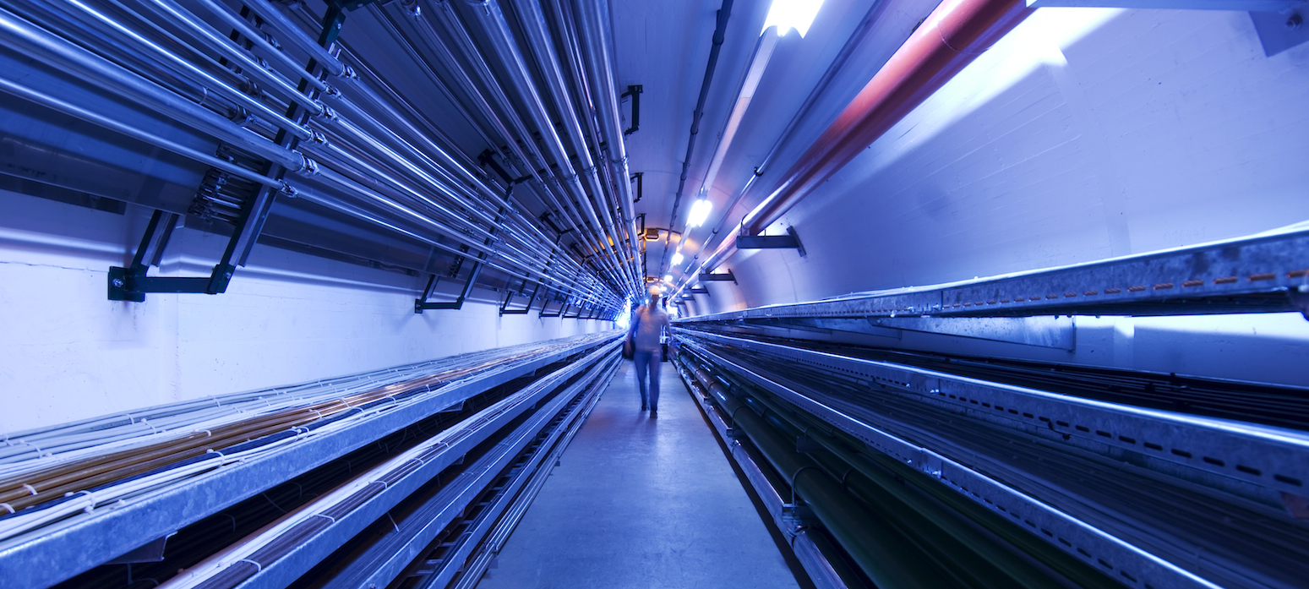
Workplan for RF WP6
Task 3: Break-down mitigation studies
Guillaume Ferrand
CEA Paris-Saclay
RF Package discussions
November 18, 2022

Slide 2
Outline
Problematic of NC RF cavities for the muon cooling complex in high magnetic fields:
  Cavity parameters (f,… ) and magnetic field (MAP study)
  Breakdown issues in magnetic field
  Previous experimental tests of cavity prototypes in high B field: MICE, MUCOOL
Further tests are needed to test new/different BD mitigation solutions:
  Choice of cavity (size, f), max RF power, magnet configuration, max B field, material, gas, temperature, pulse length, …
Claude Marchand / MC collaboration meeting

Slide 3
6.3: Break-down mitigation studies
Task objectives:
  Find best cavities and RF properties to minimize breakdown due to high accelerating gradients under high magnetic field. (Material, gas, temperature, pulse length,…)
  For now, experiments about the effect of magnetic field have mainly been done by Bowring et al. at FNAL.

Slide 4
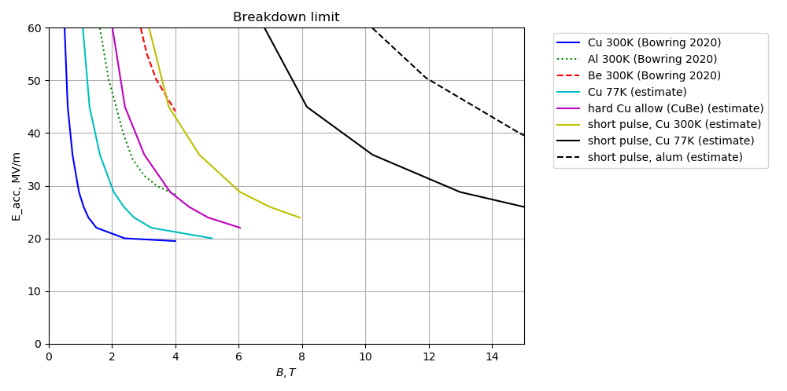
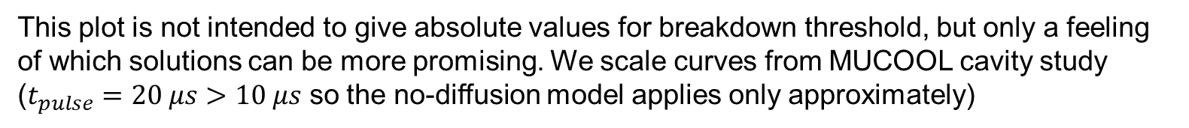
Comparing breakdown mitigation ideas
This plot is not intended to give absolute values for breakdown threshold, but only a feeling of which solutions can be more promising. We scale curves from MUCOOL cavity study ($t_{pulse}=20 μs$ $>10 μs$ so the no-diffusion model applies only approximately)
Scaled from the first 3 curves using the scaling model (slide 6)
Aluminum cavity with a short pulse looks very promising
Benefits of short pulse and aluminum multiply
Claude Marchand / MC collaboration meeting

Slide 5
Proposed methodology – Study and simulation
Studying/simulating breakdown models:
  electron tracking under RF + magnetic field,
  different pulse lengths,
  different materials,
  thermal studies,
  scaling laws,
  Pillbox cavity + other geometries.

Slide 6
Proposed methodology – Experimental data
Different ways: Proposing « simple » experiments in order to check the relevance of the simulations with existing components.
  This could maybe be done with another small funding in parallel to MuCol.
Proposing a « more advanced » test bench with existing components + some additions + shipment.
  This would certainly require to move some components from one laboratory to another one.
Proposing an « ideal » new test bench with dedicated systems.
  This would be the « best » solution, but the most expensive.

Slide 7
Preliminary share of work
CEA: Coordination, RF BD simulation/modeling, pre-study of CEA RF test stand 704 MHz + costing
INFN (Milano, LNL, Napoli, LNS): cavity shape optimization, DC tests of material in magnetic field, pre-study of INFN test stand (missing RF?)
UK (Strathclyde, Lancaster): RF BD simulation/modeling, DC BD studies at Strathclyde, contribute to test stand experiments, BD studies at Lancaster 3 GHz test stand (no magnet yet)

Slide 8
Example of CEA RF BD test stand
To build
Already exists
Bunker (radiation and B shielded)
Magnet
(MICE 4T)
Klystrons (f=704 MHz)
6m+4m
Thales 2182A 1.6 MW peak
2.8 MW
magic tee
cavity
CPI VKP7952A 1.2 MW peak
pulse compressor
7m

Slide 9
Strathclyde Contribution to WP6.3
Contribute to RF breakdown theory models and simulation:
  The effect frequency, duty pattern/pulse duration and magnetic field has on breakdown probability
Contribute to DC breakdown studies at Strathclyde:
  Study the evolution of breakdown
  Influence of pulse duration;
  Surface preparation;
  Choice of materials for “stressed” walls.
Opportunity for collaboration
  Including opportunities for PhD student to assist with experiments using test stands at Saclay, Daresbury and INFN
    Dependent on future research funding for RF activity at
      Saclay,
      Daresbury,
      INFN….

Slide 10
Schedule of 6.3
Name | Type | Dissemination | Delivery date
Preliminary report on breakdown mitigation for cavities for muon cooling cells | Report Milestone | Not public | 24 m
Consolidated report on baseline concepts of the RF systems for the MCC and HEC complexes, including breakdown mitigation studies for MCC cavities | Report Deliverable | Public | 45 m

