Slide 1
Designing, Building and Testing a Multi Wire Proportional Chamber
By Leon Verreijt, Cas van Rossum, Victor Souljé, Sela Hoeijmans, Tijmen de Graaf

Slide 2
Introduction team members
Victor Souljé
Leon Verreijt
Sela Hoeijmans
Tijmen de Graaf
Cas van Rossum
Tim Bouchée (mentor)
Hans van Luijtelaar (mentor)

Slide 3
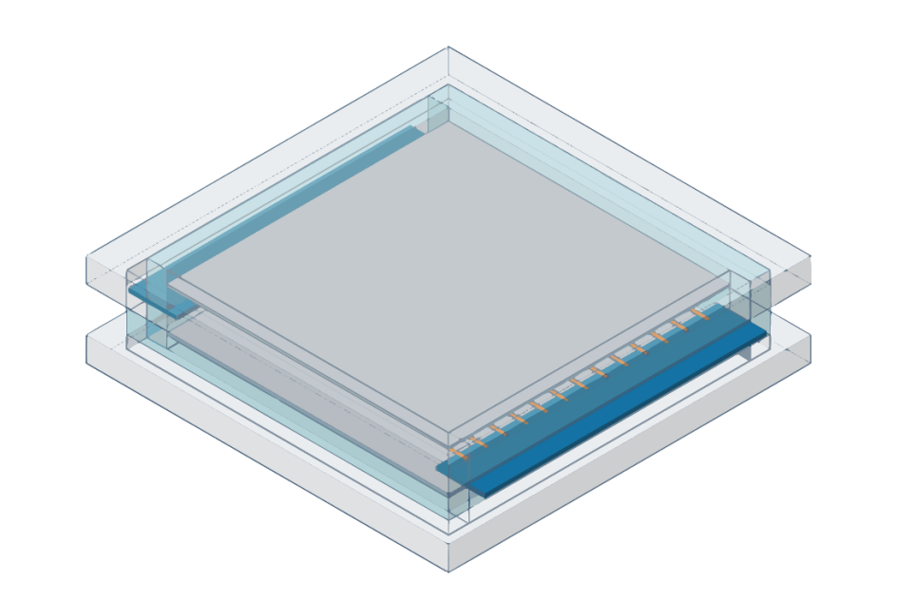
Goal
Designing, building and testing a homemade particle detector.
Why do we find this interesting?
3D model of our first design in Tinkercad

Slide 4
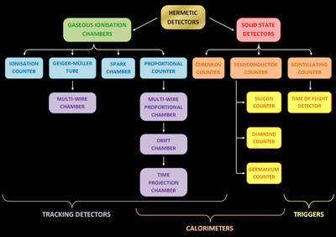
Types of particle detectors
Gaseous ionisation
Construction
Spark & Cloud
The only detectors
that could be
constructed easily at home are Geiger tube, proportional counter, MWPC, spark chamber, and cloud chamber. The MWPC is the best choice as it gives a lot of particle information and can efficiently collect data (which spark chambers and cloud chambers can’t)

Slide 5
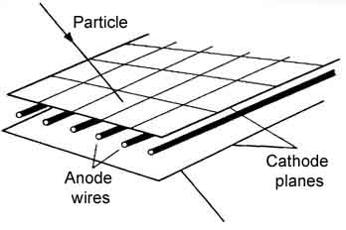
Detector of choice
MWPC because the MWPC is a versatile detector that can be constructed from relatively easy to get materials. It’s also a highly customizable detector and can collect data well (as it can give information about the particle track and energy if used properly)
Explain shortly how the wire chamber is
baslly array of Geiger counters

Slide 6
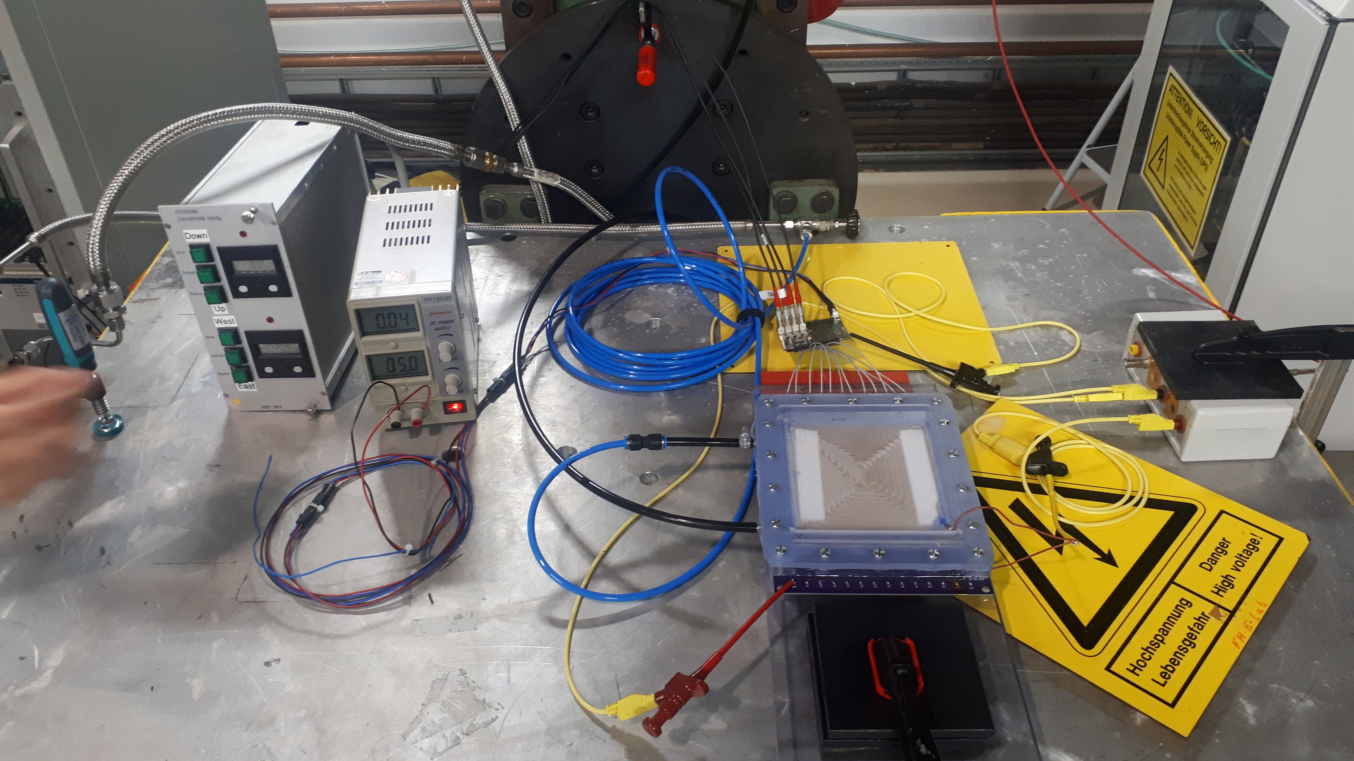
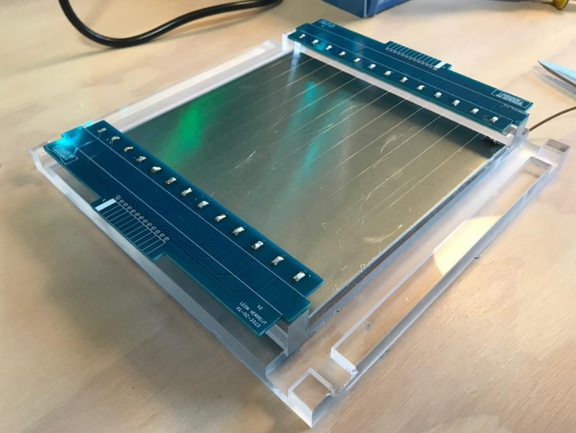
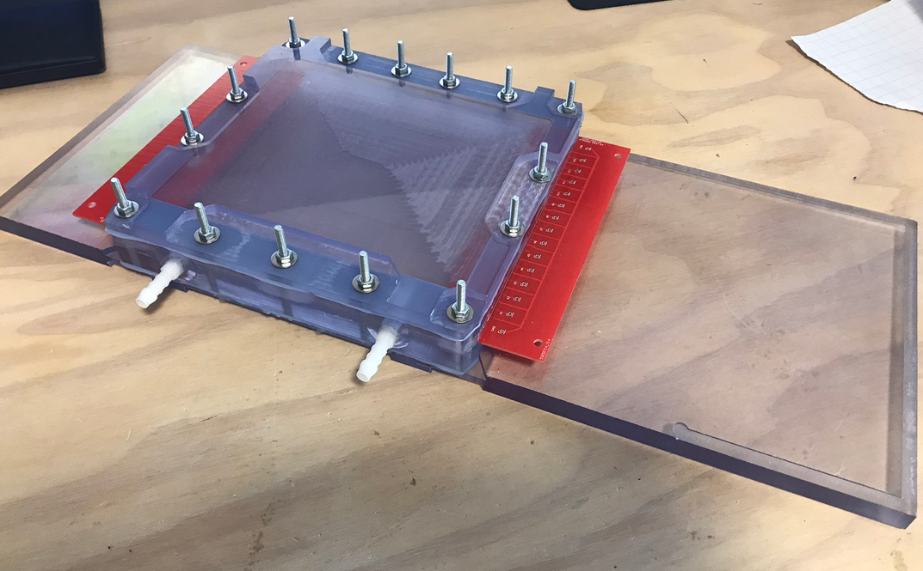
Preparation
Construction of various prototypes
First signals in operational mode
Building the second version
Fourth version
Sixth version in operational mode
Notes:
For the preparation of this experiment we already have build different versions of the detector

Slide 7
Method
Experimental setup
Notes:
Our setup is as the following. First of all, we will place four of our detectors on top of each other, every detector rotated 90 degrees. You will get more explanation

Slide 8
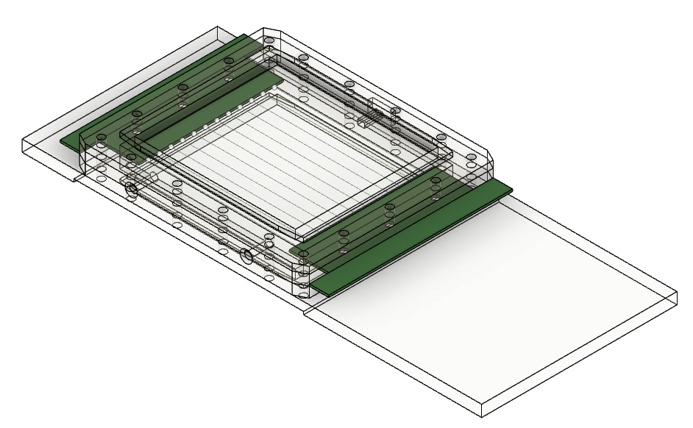
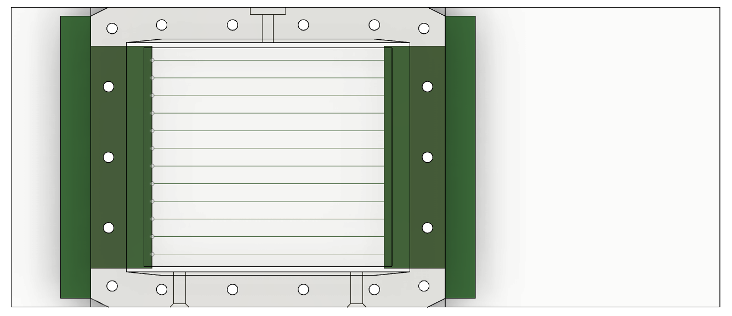
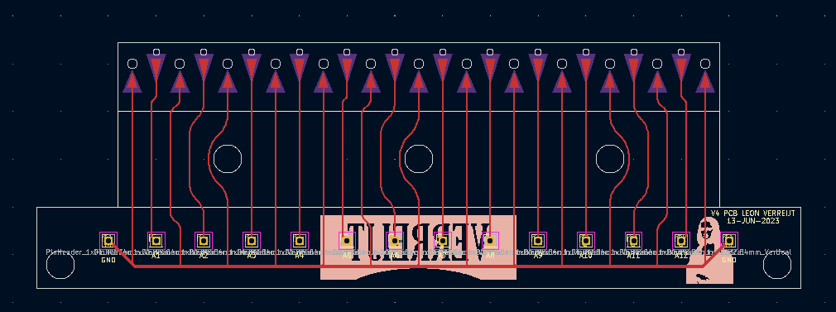
Design
Leon
Key features of the most recent version
Notes:
The detector is made in such a way that it can be opened and closed using a bolted connection and silicone gaskets that we molded. As you can see here, these are the screw holes. Right here you can see some holes for hose fittings and here you can see a small opening closed with a thin plastic foil that can act as an access gate for test radiation to see if there are more signals when the chamber is filled with charged particles. Also, the plates on the bottom are extra long, so here you can put any amplifiers on it for more convenience.

Slide 9
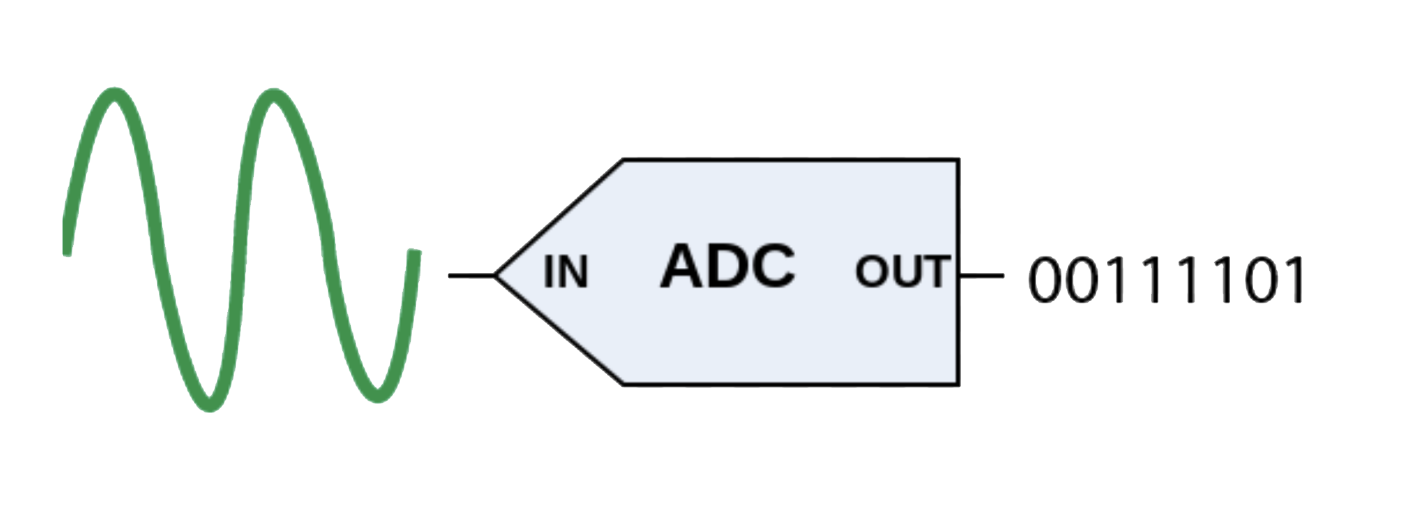
DAQ
Amplification
Conversion
Notes:
Tijmen
- Amplification: When we get an electrical signal through a wire it is very weak. To get a usible signal we need to amplify it.
- Conversion: After we get a strong signal, we need to be able to read the signal. We do this by first converting the signal from an analoge signal to a digital signal using an ADC (analoge digital conversion). This digital signal we can read out with a computer.

Slide 10
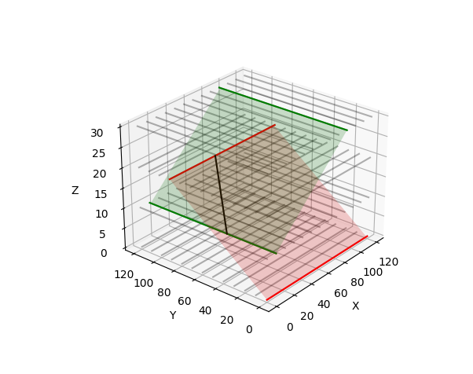
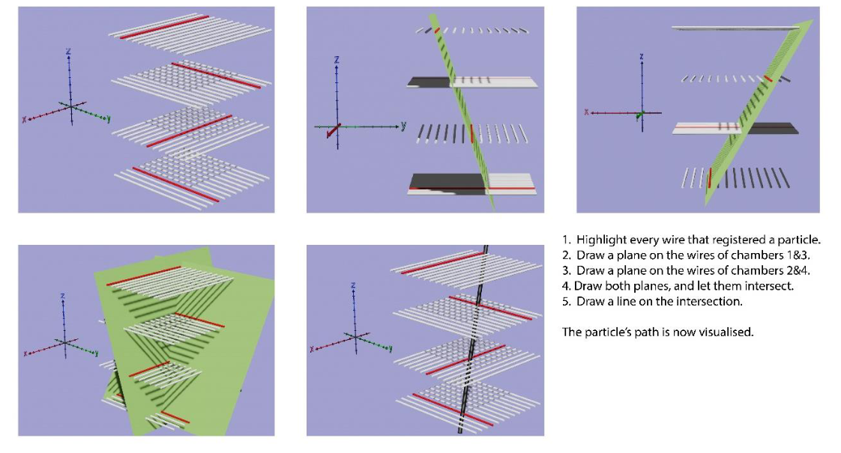
Analysis
Visualisation
Notes:
Tijmen
- Visualisation: When we have a read out with the computer we need to store and use the data. The data gets stored in txt files with the contacted wires. This txt file can be read by a program I have written to visualise the particle path. The program is very simple. It take the txt file input and highlights the wires that have been activated. After that two planes are drawn. One between the x directional wires and one between the y directional wires. The intersection points between the planes is the particle path.

Slide 11


What we hope to get from DESY
Assistance
Facilities
Notes:
Victor

Slide 12
Timetable
Task\Day | 1 | 2 | 3 | 4 | 5 | 6 | 7 | 8 | 9 | 10
T1 | × | ×
T2 | × | × | ×
T3 |  |  | × | ×
T4 |  |  |  | × | × | ×
T5 |  |  |  |  | × | × | ×
T6 |  |  |  |  |  |  |  | × | × | ×
Task 1: Developing reliable amplification circuits
Task 2: Developing a program that will visualize the particles
Task 3: Setting up the detector
Task 4: Reviewing and improving/calibrating our setup
Task 5: Processing data
Notes:
Sela

Slide 13
Community contribution
Social media
Teacher network??
Notes:
Sela

Slide 14
Questions

