Slide 1
Cherenkov detectors

Slide 2
So….what is Cherenkov light?
Electromagnetic shock wave (sonic boom) emitted by charged particles
  This is not an explanation, let’s try again
Light emitted by a charged particle going faster than the local speed of light
  This is not an explanation, let’s try again
“Coherent response of a medium to the passage of a relativistic particle that causes the emission of radiation”
  This is an explanation, are there any catches?
All the above statements are true – but as you get more “precise” it also becomes harder to understand….
Some conditions turn up
  Particle needs to go “fast enough” (explanations on later slide)
  Medium needs to be transparent (if only for practical reasons)

Slide 3
What do we use Cherenkov detectors for?
Detecting particles is not so easy
  Can only detect particles if they leave some kind of trace
  Only a few fundamental processes allow for this: charge deposition, scintillation, transition radiation, Cherenkov light (disclaimer: I may have missed some – but not many)
What are the specific advantages of Cherenkov detectors?
  Light emission is instantaneous
  Light yield is highly deterministic (linear with path length)
  Wide spectrum light source
  Properties of emitted light are dependent on the particle species generating it
    If built well, Cherenkov light is an excellent method of particle identification
Any disadvantages?
  Efficiency relatively low (compared to scintillation or charge deposition)
  Needs transparent medium

Slide 4
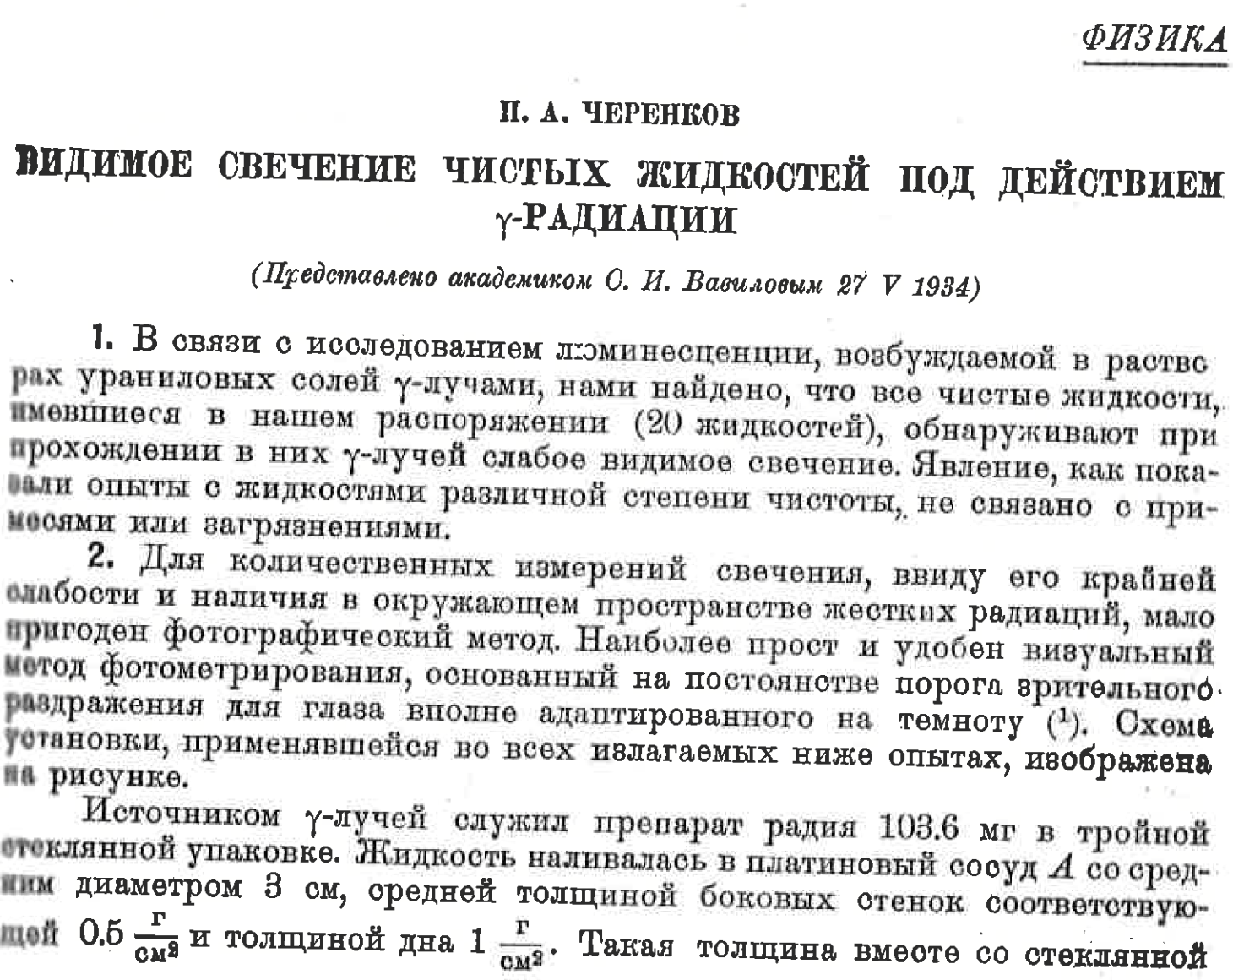
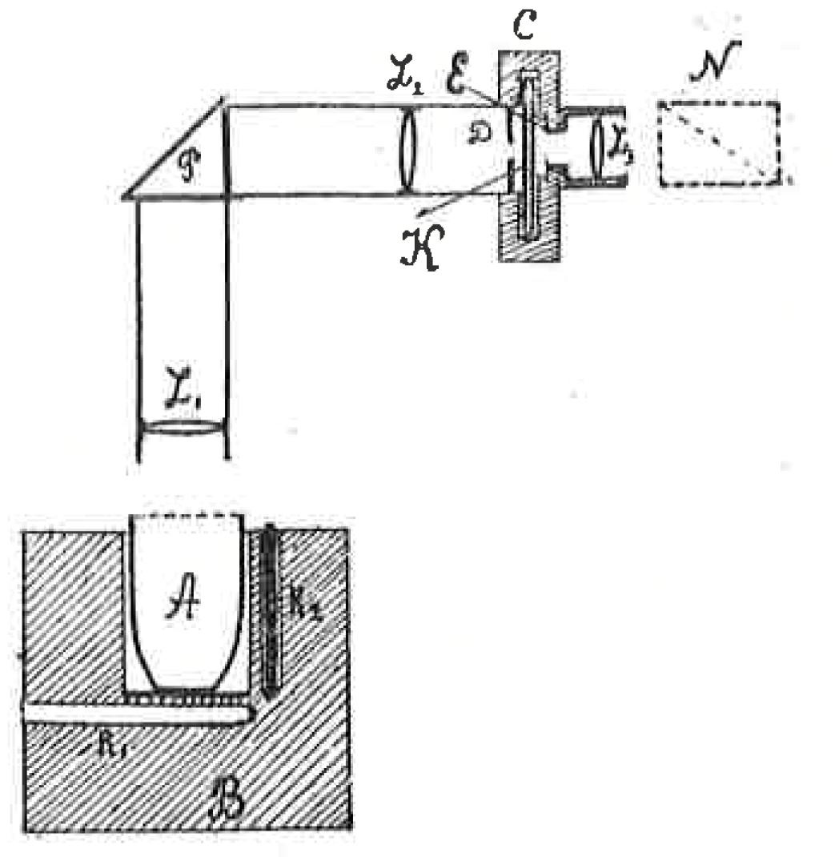
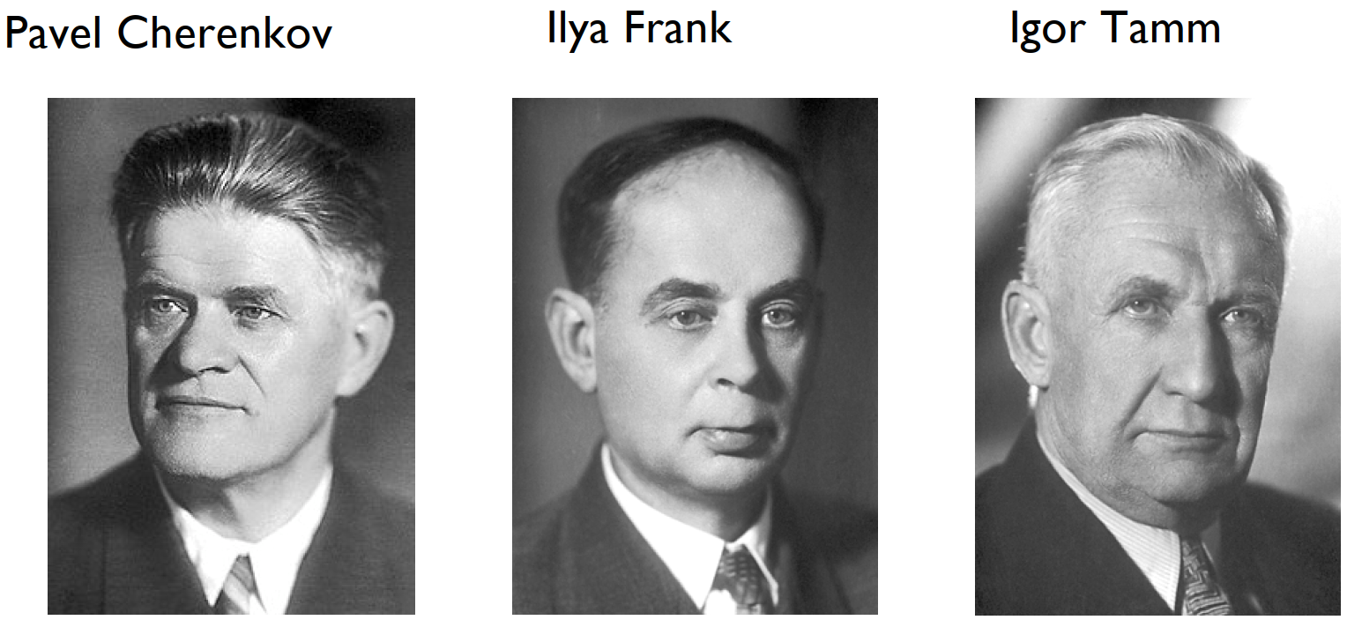
Discovery
Also known as the “Vavilov-Cherenkov” effect
  Cherenkov was a PhD student
  Vavilov was his professor
    Worked also on the interpretation of the effect
Frank and Tamm found the complete theoretical description of the effect
Nobel prize awarded in 1958
  Vavilov was dead at this point
Photographic plate
Silvered mirror
Radioactive
salt in liquid

Slide 5
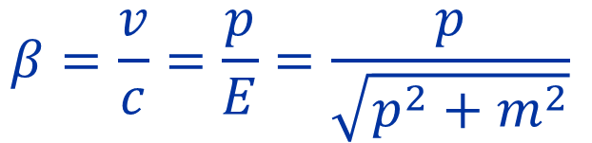



Cherenkov light
$$cos⁡θ_{c}=\frac{1}{nβ}$$
Foundational formula for Cherenkov light
  θ_{c} is the “Cherenkov angle”
  β is the speed of the particle as a fraction of the speed of light in vacuum (c₀ = 299792458 m/s)
    c₀ is the fundamental speed barrier in the universe
    Particles moving at speeds close to c₀ are known as “relativistic” particles
    When you put more energy in a particle, it will come closer to (but never exceed) c₀
  n is the (phase) refractive index of a material
    Probably well known from your optics classes?
    n sets the local speed of light
    This explains why particles can go faster than the local speed of light
$$β=\frac{v}{c}=\frac{p}{E}=\frac{p}{\sqrt{p^{2}+m^{2}}}$$
$$c_{local}=\frac{c_{0}}{n_{g}}$$
$$n_{g}=n_{p}+E\frac{dn_{p}}{dE}$$

Slide 6

Cherenkov light
$$cos⁡θ_{c}=\frac{1}{nβ}$$
Only one angle? What about the other one?
  Let’s call this one φ
  Turns out it is random! Light is emitted in a ring / cone
  at an angle to the particle passing through the medium
Let’s put in some numbers
  n = 1.5 β=1 θ_{c} = 0.841 rad = 48.2 deg
    This is a relativistic particle in water
  n = 1.001 β=1 θ_{c} = 0.0447 rad = 2.56 deg
    This is a relativistic particle in gas
  n = 1.001 β=0.9 θ_{c} cannot be solved for
    Particle does not meet the speed requirement
Important input for detector design!
φ_{c}
θ_{c}
Track

Slide 7
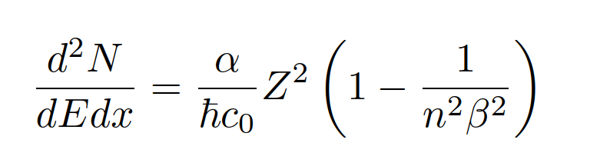
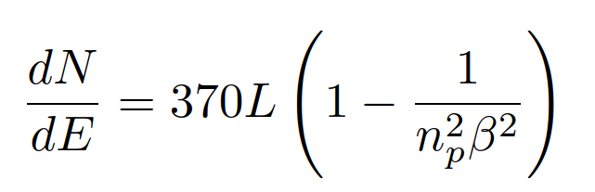
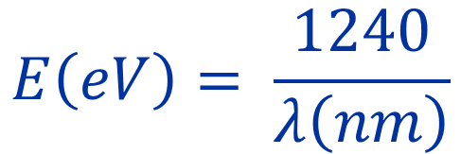
Cherenkov light
Light is a funny thing
  Wave/particle duality – a photon is both a wave and a particle
  The particle is a packet of energy E and has a wavelength λ
    Fundamental unit of energy: electron volt (eV)
    Energy acquired by one electron accelerated by 1 Volt
  These two numbers are linked by a simple proportionality
  For example: Red light 700nm 1.77 eV
  Green light 550nm 2.25 eV
  Blue light 450nm 2.76 eV
  UV light 250nm 4.96 eV
  Note that it also says that there is only light for charged particles
So how much light do we get?
  The Frank-Tamm relation expresses the number of photons emitted per unit energy (spectrum)
$$E\left(eV\right)= \frac{1240}{λ\left(nm\right)}$$

Slide 8

So what’s the use of all of this?
Let’s have a look at how we can use this in reality!

Slide 9


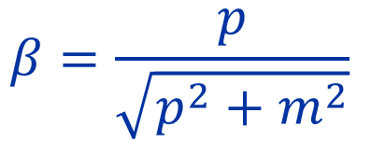
Projecting a Cherenkov angle
$$cos⁡θ_{c}=\frac{1}{nβ}$$
The relativistic factor β is dependent on the particle mass
  Pick a typical momentum for T10 5 GeV/c
  This is then FINALLY what can give us particle ID!
    Different particles give different Cherenkov angles!
Particle identification through two methods
  Ring Image Cherenkov
  Threshold Cherenkov counters
$$β=\frac{p}{\sqrt{p^{2}+m^{2}}}$$
Particle | Mass | Relativistic β
Electron | 0.000511 GeV/c² | 1
Muon | 0.104 GeV/c² | 0.99978
Pion | 0.135 GeV/c² | 0.99964
Kaon | 0.494 GeV/c² | 0.9952
Proton | 0.938 GeV/c² | 0.983

Slide 10
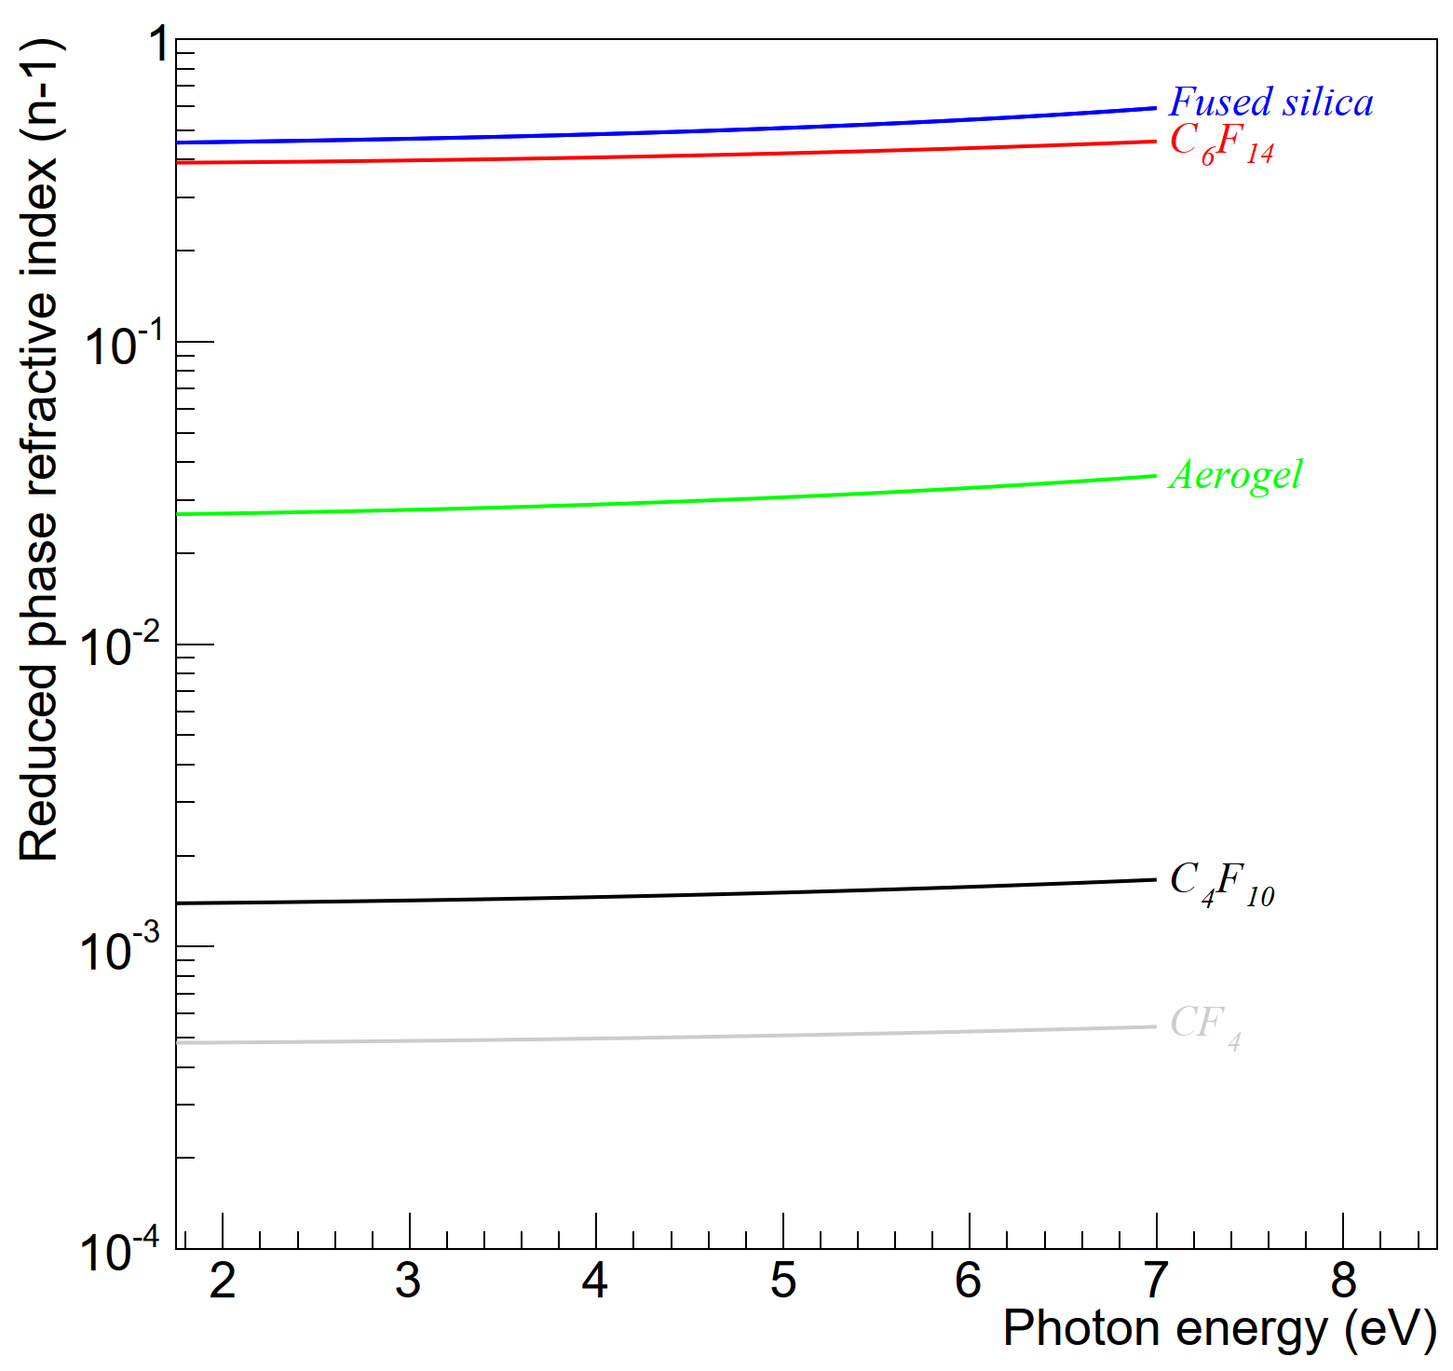

Refractive index is the name of the game
Refractive index is the key to Cherenkov light
  It sets the angle of emission
  It sets the quantity of light you get
Different properties for different media
  Gas 1.000-1.005
  Aerogel 1.01-1.05
  Solid 1.40-1.70
Light yield scales as $\left(1−\frac{1}{n^{2}β^{2}}\right)$
  Some cm of solid can be equivalent to a few meters of gas
  But the behaviour of the emitted Cherenkov light is quite different

Slide 11
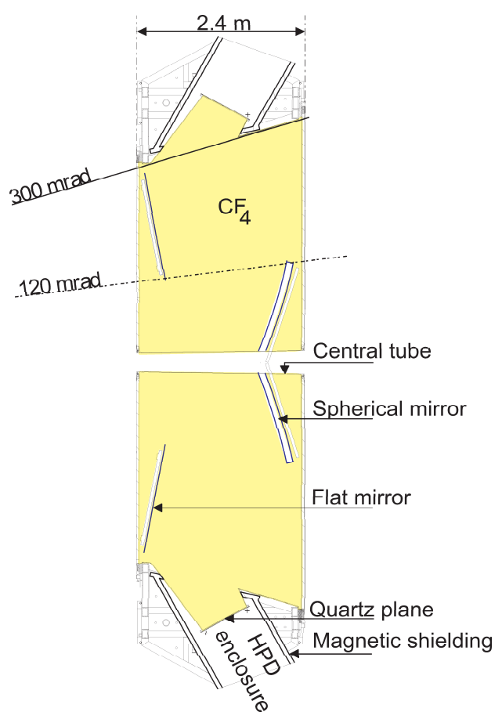
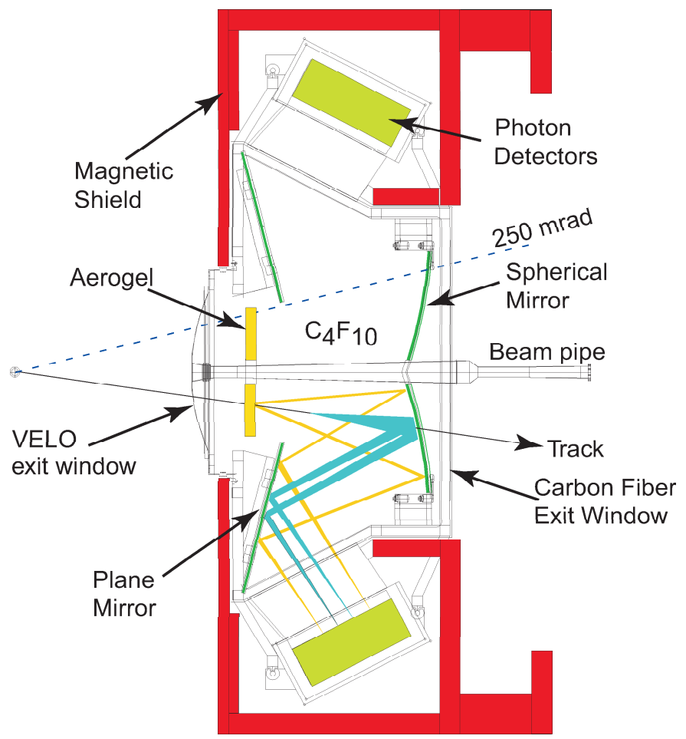
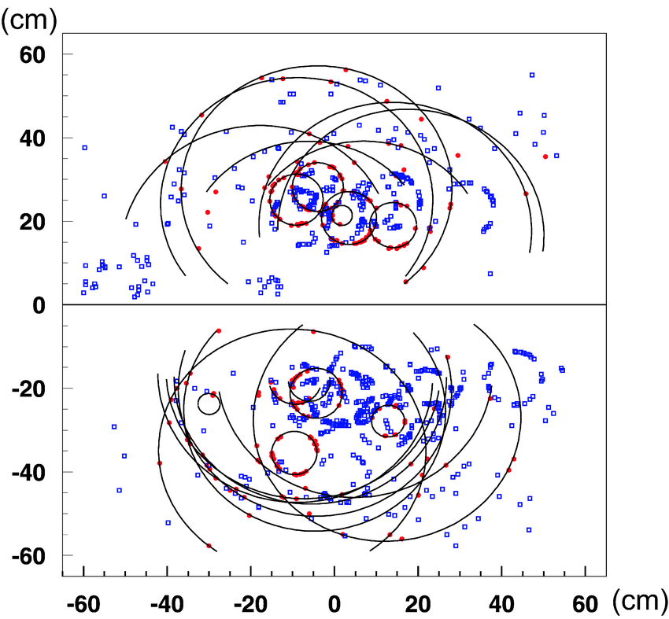
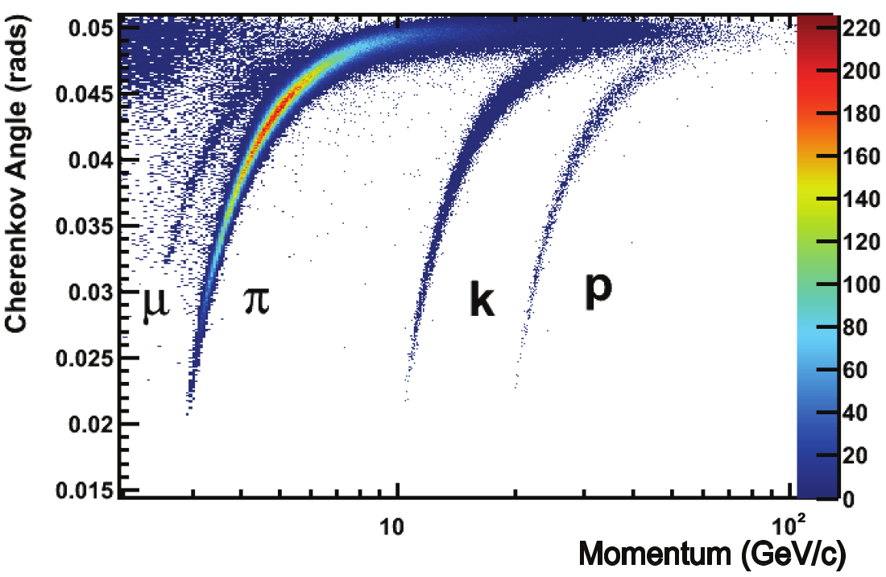
Ring Imaging Cherenkov – RICH
LHCb RICH2
LHCb RICH1
The core idea of the RICH technique is to project the ring forward so that the angle of the photons can be measured
  Use gaseous medium (Č angle ~few degrees)
  Cherenkov angle + momentum = PID
  Gathering enough light takes O(1m) of gas
Example case: LHCb RICH
  LHCb has two RICH detectors
  Filled with two different refractive index gases
  Used for particle identification
    Different from beamline: mix of different momenta so needs external information
LHCb simulation (RICH1)
LHCb RICH1 performance

Slide 12
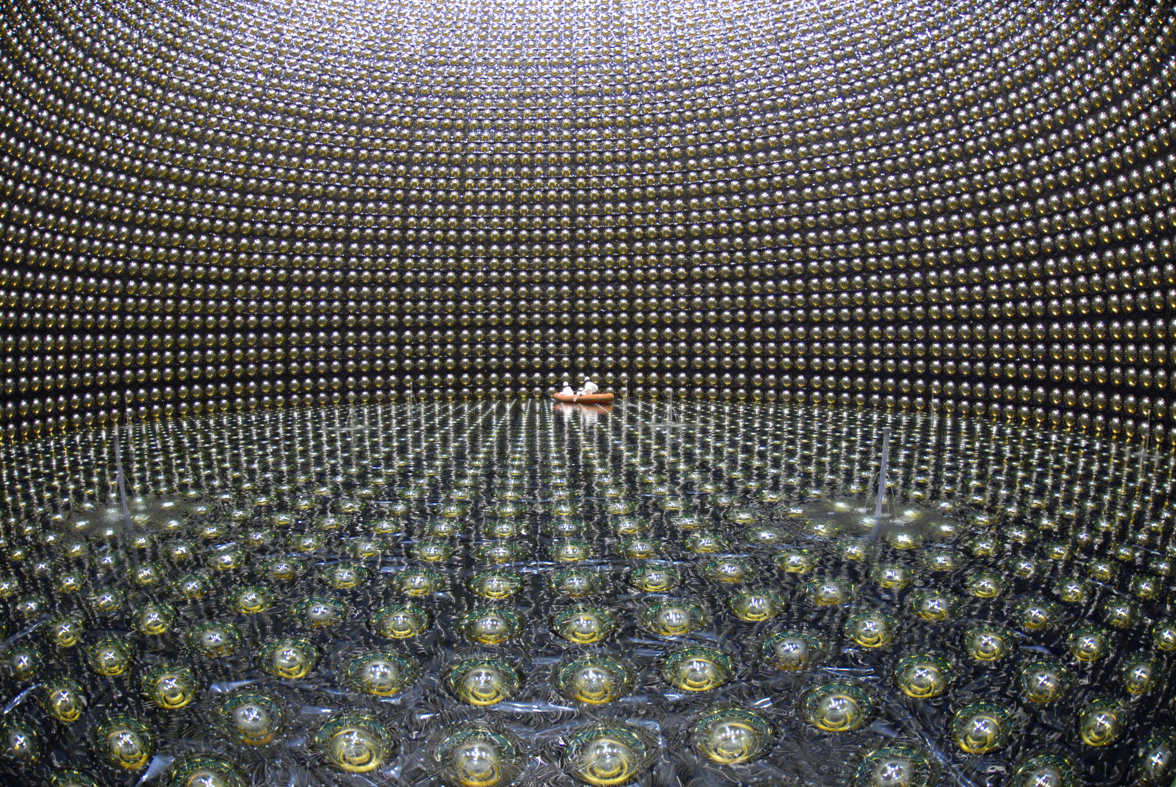
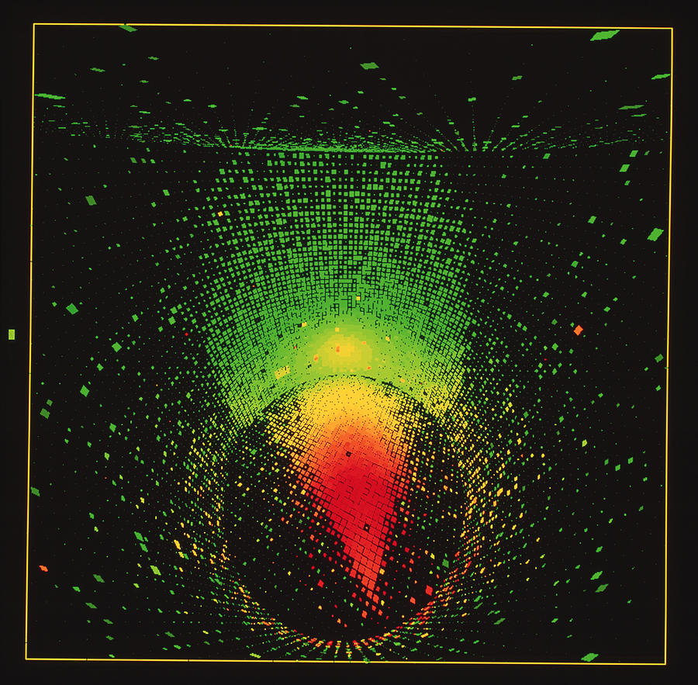
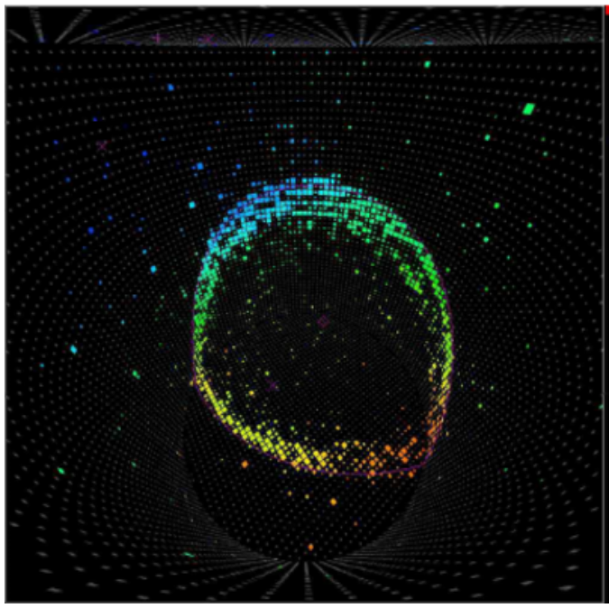
Super Kamiokande
Neutrino detection experiment in Japan
  Giant tank of pure water (41.4m high, 39.3m Ø )
  So, uses liquid medium (Č angle ~45 deg)
  Light detectors around and on top and bottom
Physics with cosmic rays as “beam”
  Radiation from space
  “Disk” event indicates track passing through
  “Ring” event indicates track stopping in tank
  Center and orientation of ring / disk gives point of impact and direction of track
  Different shapes and sizes give more information about event

Slide 13
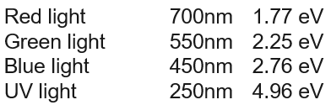
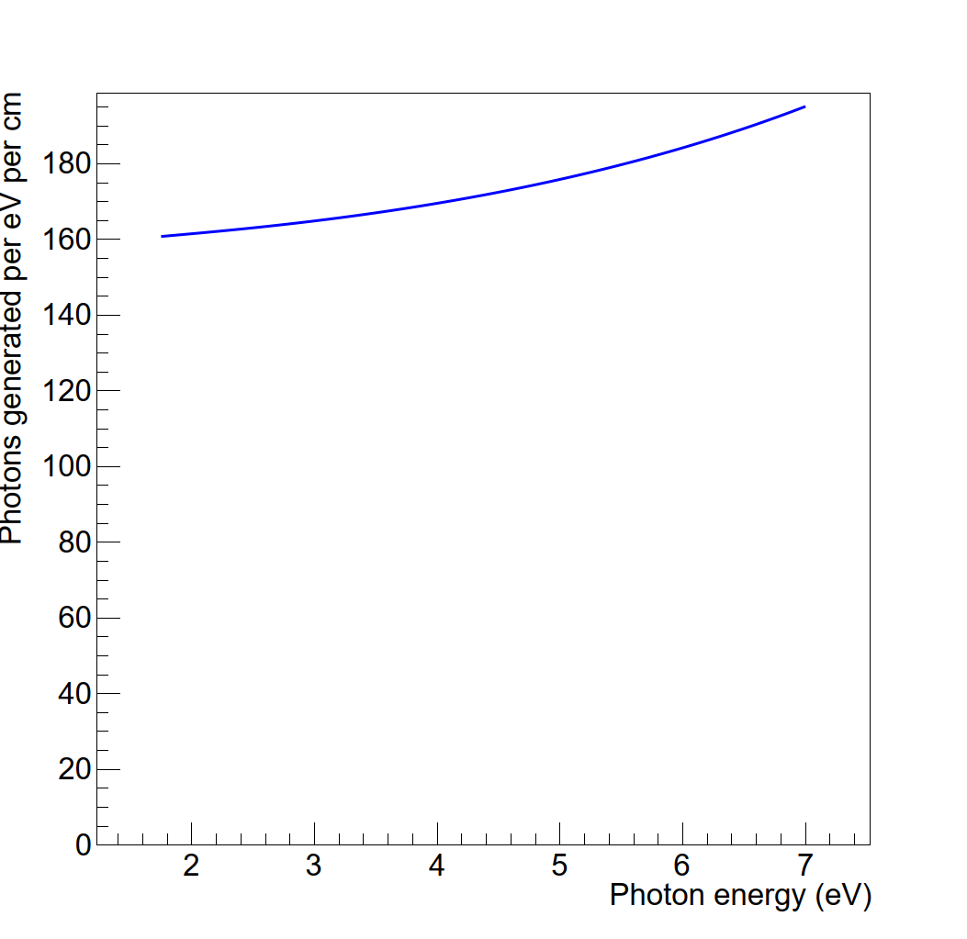
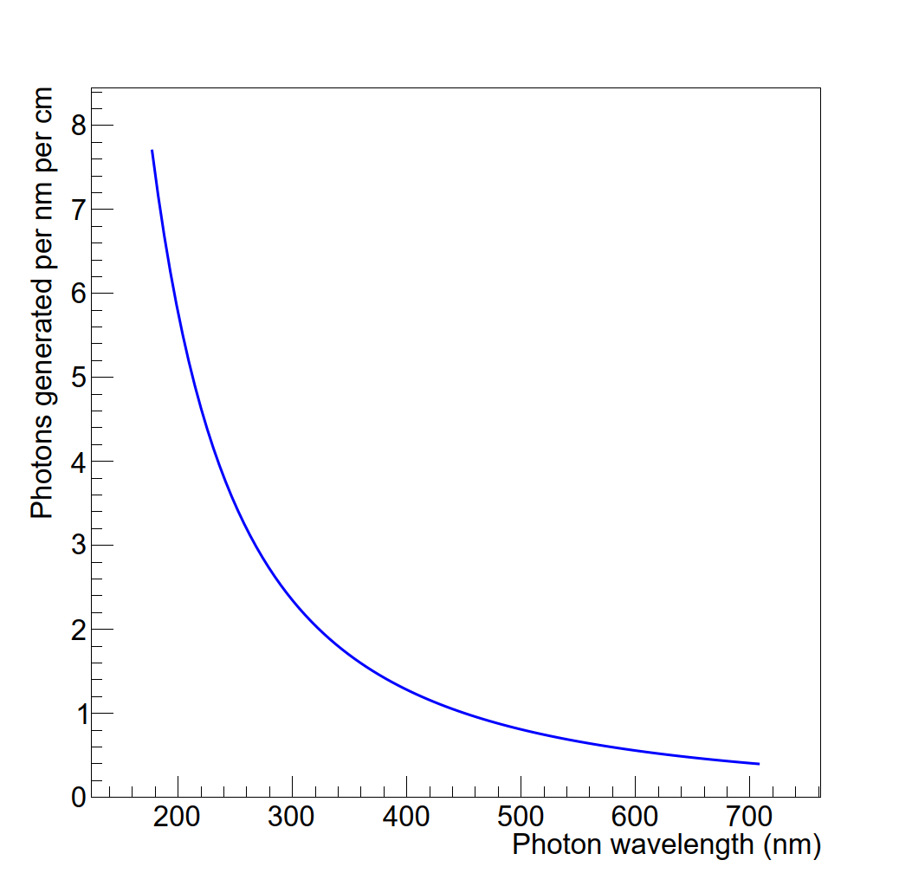
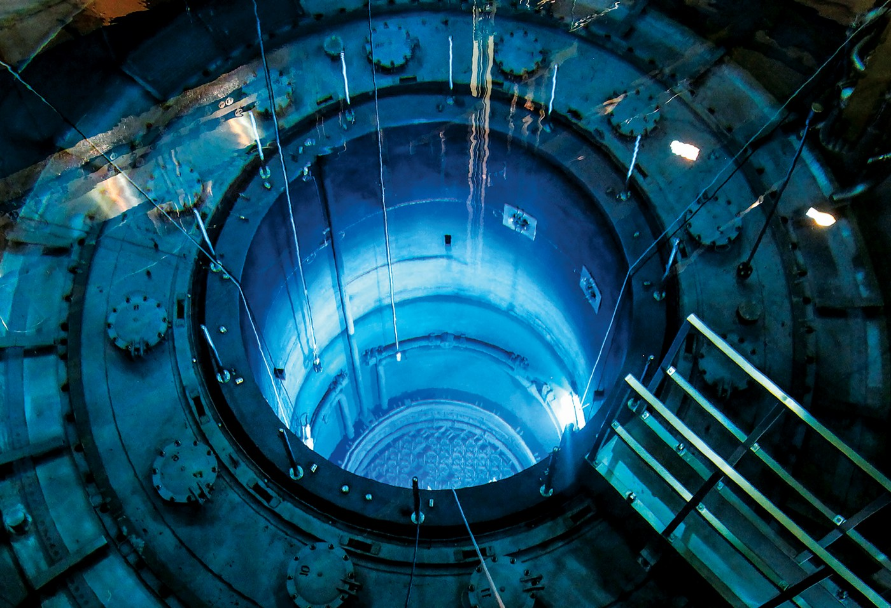
What’s up with the blue glow?
Why does a nuclear reactor glow blue?
  Take the Frank-Tamm relation and plot it for water
  In energy space (eV) and in wavelength space (nm)
Still – where does the blue glow come from?
  After all, a nuclear reactor produces neutrons?

Slide 14
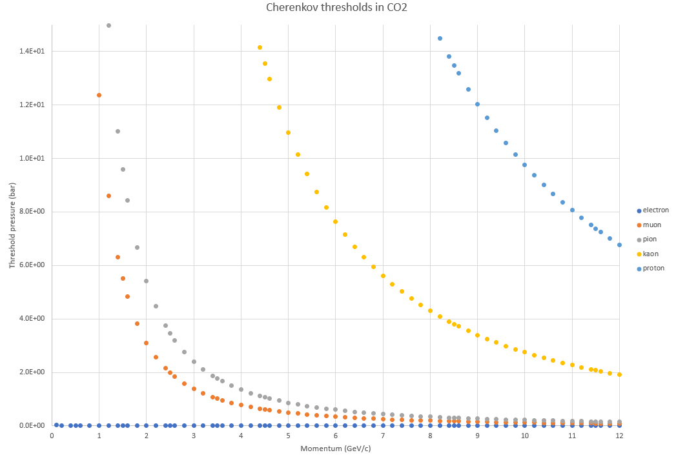
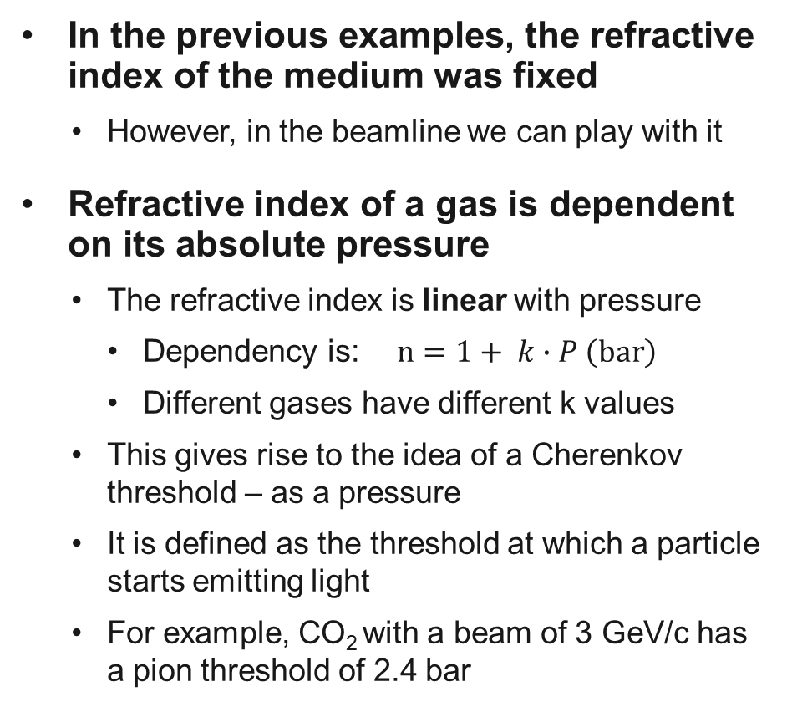
Controlling the refractive index
Gas | k-value
Helium | 3.50 × 10⁻⁵
CO₂ | 4.50 × 10⁻⁴
In the previous examples, the refractive index of the medium was fixed
  However, in the beamline we can play with it
Refractive index of a gas is dependent on its absolute pressure
  The refractive index is linear with pressure
    Dependency is: $n=1+ k∙P \left(bar\right)$
    Different gases have different k values
  This gives rise to the idea of a Cherenkov threshold – as a pressure
  It is defined as the threshold at which a particle starts emitting light
  For example, CO₂ with a beam of 3 GeV/c has a pion threshold of 2.4 bar

Slide 15
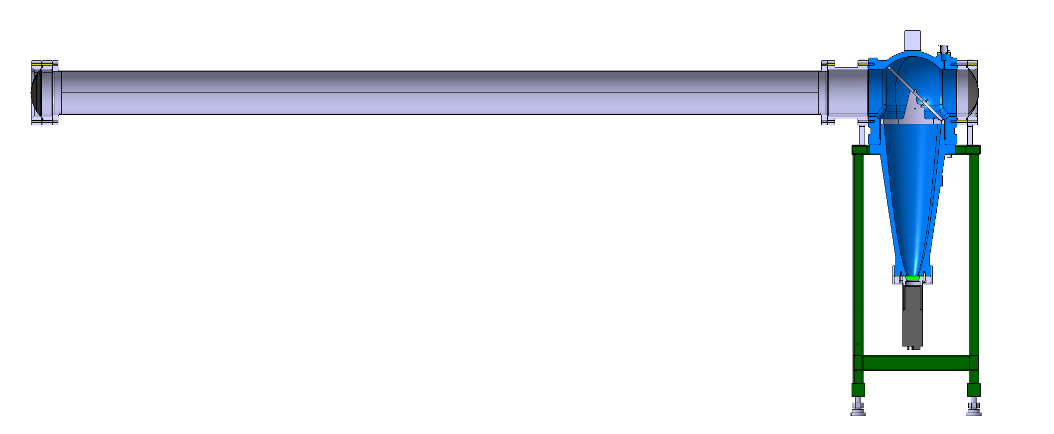
Cherenkov Threshold Counters
Device also known as XCET
  Key beamline equipment for PID
  Both the T9 and T10 beamlines have two
  High pressure (<16 bar, XCET040) and low pressure (<4.2 bar, XCET043)
Combination of signals from two XCETs lets experiments take one species of particles from the beam
  Calculate thresholds for different particles
  Set one just below threshold of desired particle, the other above
  Combine what you need to see in the two detectors
    No signal in detector set below threshold
    Signal in detector set above threshold
This combination gives the users the flexibility to select (tag) a desired particle species

Slide 16

Under pressure
We use a small trick: we use the coincidence of the scintillators
before and after the XCET to normalize the XCET: definition of XCET efficiency!
  Technically, we use the coincidence of the XCET with the trigger divided by the trigger
What do we expect to find when we do a pressure scan?
  Let’s put in an expected beam of 20% of all five particles (e, µ, π, K, p) and label the thresholds
100%
Efficiency
P_{e}
P_{µ}
P_{π}
P_{K}
P_{p}

Slide 17
Under pressure
Add some more reality: remember Drs Frank and Tamm?
  At the threshold pressure, nβ = 1 (this is the definition!)
  So….we get no light at all at the Cherenkov threshold!
  Light yield scales linearly with (P – P_{thr})
100%
Efficiency
P_{e}
P_{µ}
P_{π}
P_{K}
P_{p}

Slide 18
Under pressure
Keeping the momentum stable, and then scanning the pressure should
eventually show all particles
  However, limited in practice by the maximum pressure of the vessel
  For example, for particles at 10 GeV/c shown in table
Reality is not always nice to physicists!
  Cannot see all with one gas
    If threshold is over the maximum – cannot see it!
    If thresholds too close together, cannot see difference!
  We can pick one gas to go up to 16 bar and one to 4.2 bar
  Helium and CO₂ have complementary properties
  We picked for you (for now) CO2 to high pressure and helium
  to low pressure – the detector is still being worked on
Thresholds for 10 GeV/c particles
Particle | Threshold (bar) in helium | Threshold (bar) in CO₂
Electron | 3.73 × 10⁻⁵ | 2.90 × 10⁻⁶
Muon | 1.60 × 10⁰ | 1.24 × 10⁻¹
Pion | 2.78 × 10⁰ | 2.17 × 10⁻¹
Kaon | 3.54 × 10¹ | 2.75 × 10⁰
Proton | 1.25 × 10² | 9.76 x 10⁰

Slide 19
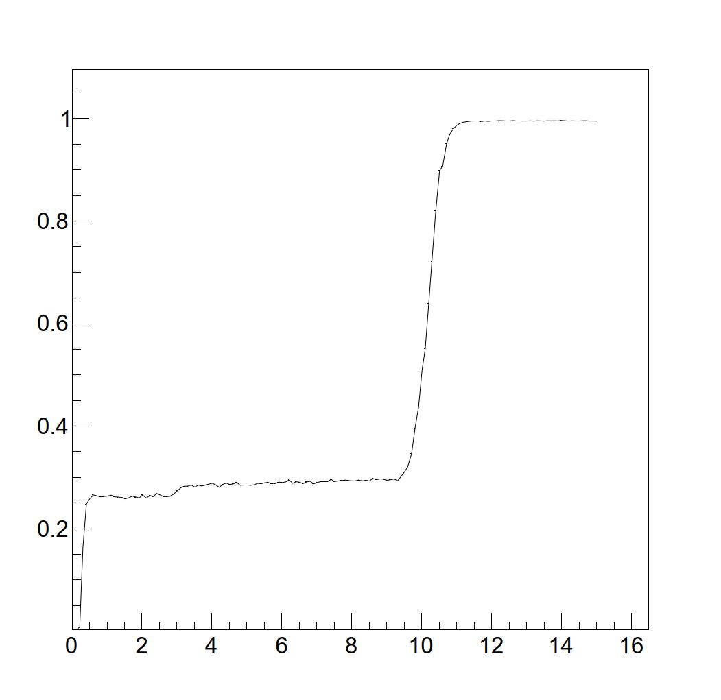
Finally, some actual data!
Let’s interpret the plot!
  Data taken at +10 GeV/c with CO₂
Efficiency
Particle | Threshold (bar) in CO₂
Electron | 2.90 × 10⁻⁶
Muon | 1.24 × 10⁻¹
Pion | 2.17 × 10⁻¹
Kaon | 2.75 × 10⁰
Proton | 9.76 x 10⁰
Pressure (bar)

Slide 20
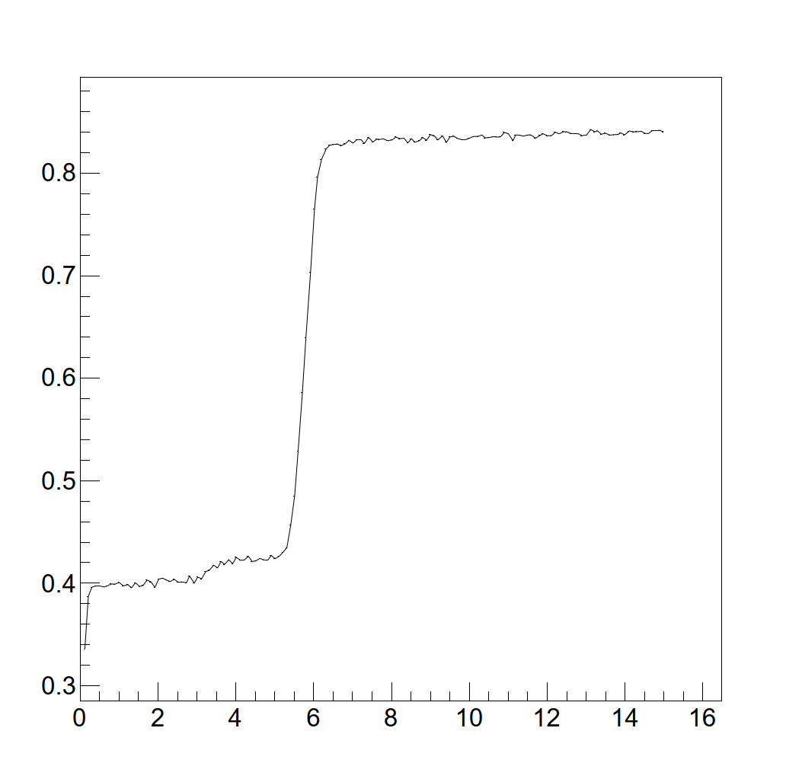
Finally, some actual data!
Let’s interpret the plot!
  Data taken at +2 GeV/c with CO₂
Efficiency
Particle | Threshold (bar) in CO₂
Electron | 7.25 × 10⁻⁵
Muon | 3.10 × 10⁰
Pion | 5.41 × 10⁰
Kaon | 6.78 × 10¹
Proton | 2.32 x 10²
Pressure (bar)

Slide 21
Some further hints for the data analysis
Muons are very strange creatures
  The beam contains a mixture of different momenta of muons (!!!!)
  I expect you to figure out for yourself (and with Berare and Martin, of course!) to figure out what the impact of this is on the Cherenkov scans
Behavior of the low-pressure XCET with helium not yet well understood!
  Discuss as things go on with Berare, Martin and me!
If the threshold pressures are close together, be careful about saying you know!
What is the difference between the negative and the positive beam?
Can we see if the XCET is fully efficient at any point?
  Is it possible that, for example, we miss some 5% of particles always?
  How would we know this?
  If protons are the only particle left we cannot see, can we still estimate their number?

Slide 22
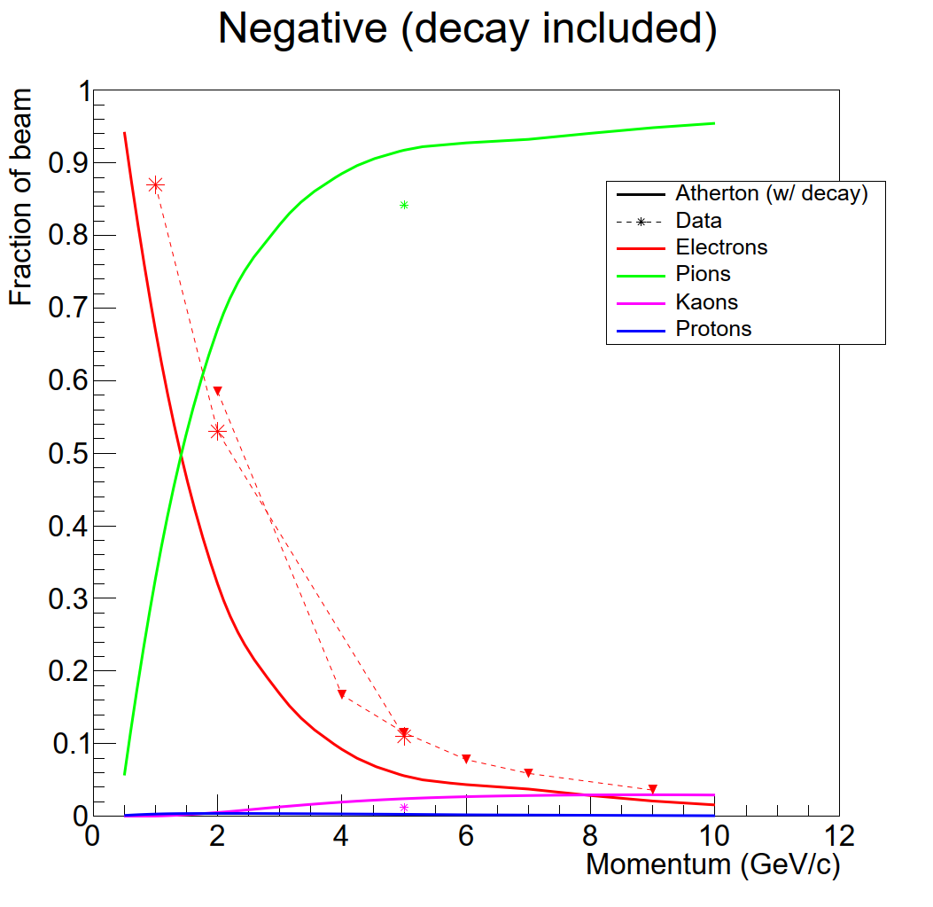
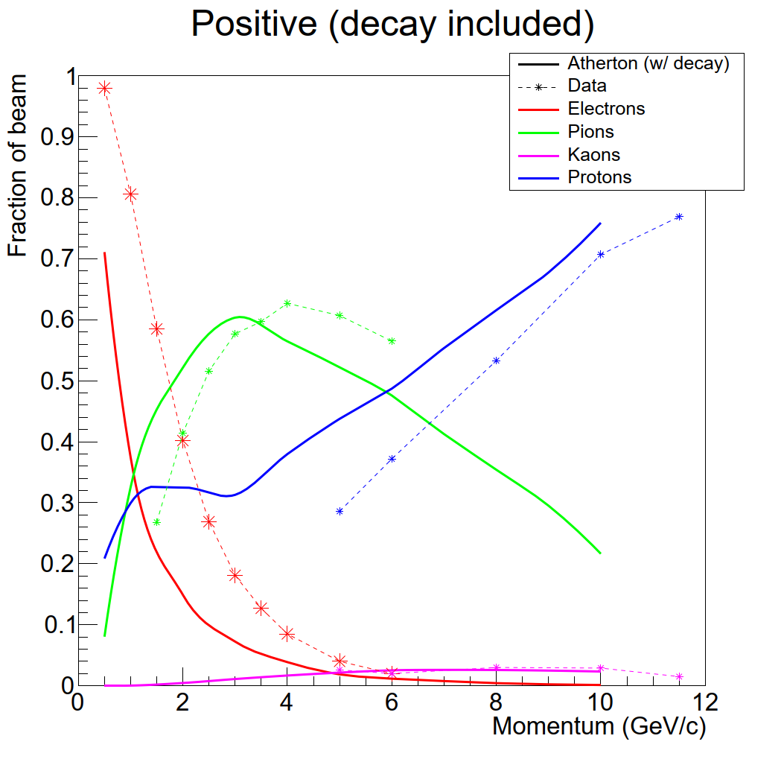
What do we know at the moment?
All preliminary – in other words, not finished, and needs verification
  This is also an open invitation to CHECK these numbers with the available data!

Slide 23
Conclusions
Cherenkov light has many applications – in particular it is excellent for PID
  Used in the secondary beamlines in Cherenkov Threshold counters
The goal (for the Particular Perspective!) is to use *all* techniques to fill the particle identification plot
  XCET counters, calorimeters, time of flight, ….?
We very much look forward to see how much of this plot we can finish!

