Slide 2
Welcome and Introduction
CHIMERA Mini-Workshop: Summary of 2022 Results
R. Alia (BE-STI-BMI) and M. Fraser (SY-ABT-BTP)
19th January 2023
CERN, Geneva, Switzerland

Slide 3
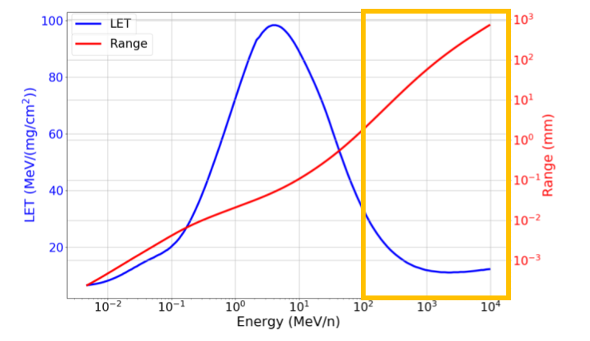
Questions we asked at beginning of 2022…
Can we send beams safely at low energy to CHARM in parallel to EA operation?
Why is the PS slow extraction so non-linear ?
How do we accelerate and extract very, very low intensities ?
How do we ease the CHIMERA overhead for the PS OP team with our requests inc. multiple beam energies and intensities ?
How do we model the optics and transfer different beam energies along the T8 line… in presence of beam intercepting instrumentation, air, etc. ?
How can we measure, control and manipulate the beam profile at CHARM ?
How many ions do with have at CHARM? Can we measure and calibrate the intenisty/flux of low intensity ion beams ?
How do integrate and exchange multiple test setups in CHARM ?
2021
M. Fraser CHIMERA mini-workshop 19th January 2023

Slide 4
Teamwork: CHIMERA Working Group
CHIMERA activies highlight the multifaceted nature of the project with multiphysics and engineering problems being tackled together
We have achieved a lot whilst exploiting existing infrastructure… thanks to all the usual suspects for impressive contributions: presentations to follow!
Transverse Feedback Excitation: thanks to Pablo Arrutia & Thomas Bass (ABT), Gert Kotzian (RF) and Tom Levens (BI) for joining the effort and helping us apply TFB excitation to control the extraction
Slow extraction cycle development: thanks to Marc Delrieux (OP) for driving the effort and creative ideas for simplifying the PS cycles
Beam instrumentation: thanks to the various experts for helping us debug live during MD’s to collect important data using instrumenation design for protons: Inaki, Stephane, Stephen, Joe …
Thanks to PS-OP, RF, STI, Linac3 and LEIR teams, IRRAD and RP for their support
M. Fraser CHIMERA mini-workshop 19th January 2023

Slide 5
Questions at beginning of 2023…
Let’s discuss… !
M. Fraser CHIMERA mini-workshop 19th January 2023

